Slide 1
Time resolution studies for the PANDA barrel DIRC
by Marvin Krebs

Slide 2
Overview
1. Electronics
i) TrBs (Version 2), ToF AddOns
2. Measurements with electronics
i) Procedure
ii) Timing performance of electronics
3. Dispersion; Problem or no problem ?
4. Measurements with photons
i) MCP(s)
ii) Diffuser-/no diffuser- measurements
5. Summary & Outlook

Slide 3
Overview
1. Electronics
i) TrBs (Version 2), ToF AddOns

Slide 4
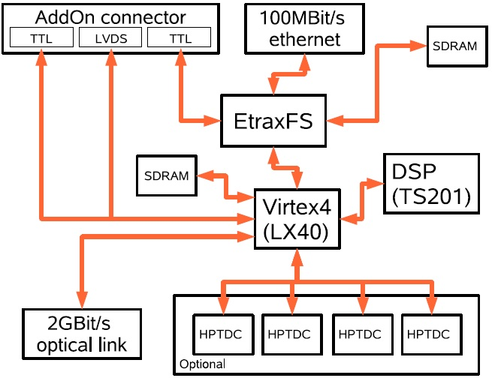
Electronics
Connections for different AddOn boards,

Slide 5
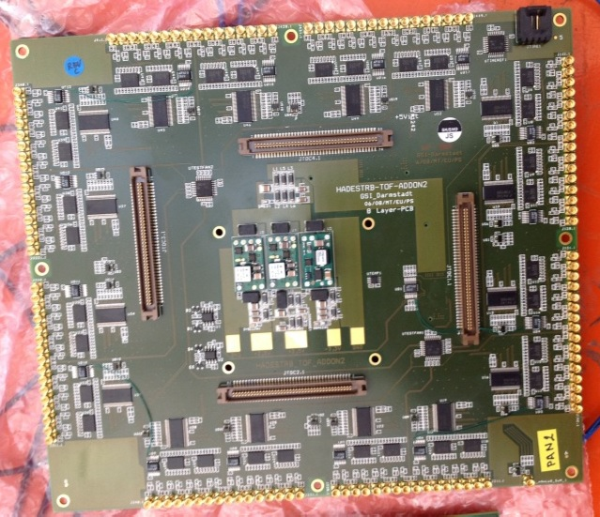
Electronics
ToF AddOn boards:
PAN2
HPTDC connections
Connection to Photodetector or other source

Slide 6
Overview
1. Electronics
i) TrBs (Version 2), ToF AddOns
2. Measurements with electronics
i) Procedure

Slide 7
Measurements with electronics
(
)

Slide 8
Measurements with electronics
Gauss-shaped signal from the function generator
Discr. Thresh.
Leading edge

Slide 9
Measurements with electronics

Slide 10
Measurements with electronics
For time difference method:
-> The time difference between two leading edges on two different channels is plotted here
The sigma of the gauss-fit gives the actual time resolution
02/2011, pocket pulser

Slide 11
Overview
1. Electronics
i) TrBs, ToF AddOns
2. Measurements with electronics
i) Procedure
ii) Results of timing performance of electronics

Slide 12
Measurements with electronics
Board AddOn | TrBv2 02/2011
Properties | Diff. Signals amplitudes; x-axis: Values for the (adjustable) slope of the output signal

Slide 13
Measurements with electronics
02/2011, slope vs. Sigma_M

Slide 14
Measurements with electronics
Board AddOn | TrBv2 PAN2
Properties | Diff. Signals amplitudes; Cablelength fixed; x-axis: Values for the (adjustable) slope of the output signal

Slide 15
Measurements with electronics
PAN2, slope vs. Sigma_M

Slide 16
Overview
1. Electronics
i) TrBs, ToF AddOns
2. Measurements with electronics
i) Procedure
ii) Results of timing performance of electronics
3. Dispersion; problem or no problem ?

Slide 17
Chromatic Dispersion
-> Chromatic Dispersion occurs when a (light)wave passes a medium
-> Causes broadening of the signal
Conductor

Slide 18
Chromatic Dispersion
-> Very small effect for our used cable lengths
=> No problem for the time resolution in our case

Slide 19
Overview
1. Electronics
i) TrBs, ToF AddOns
2. Measurements with electronics
i) Procedure
ii) Results of timing performance of electronics
3. Dispersion, problem or no problem ?
4. Measurements with photons
i) MCP(s)
ii) Diffuser-/no diffuser- measurements

Slide 20
MCP-PMT (schematic view)

Slide 21
MCP-PMT backview

Slide 22
Measurements with MCPs

Slide 23
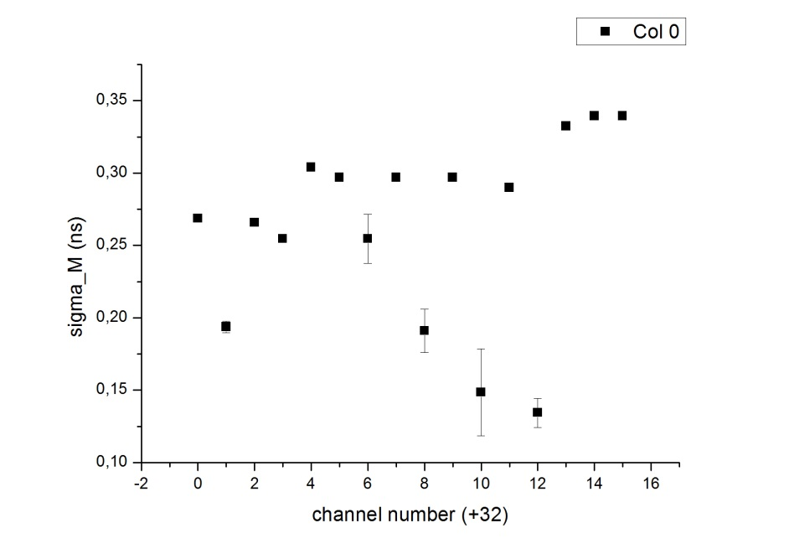
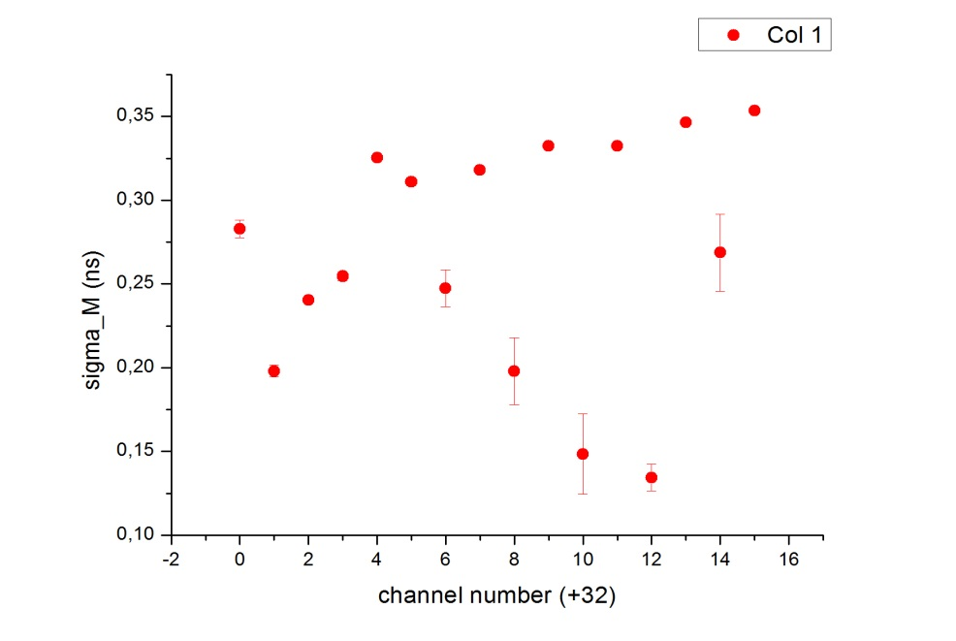
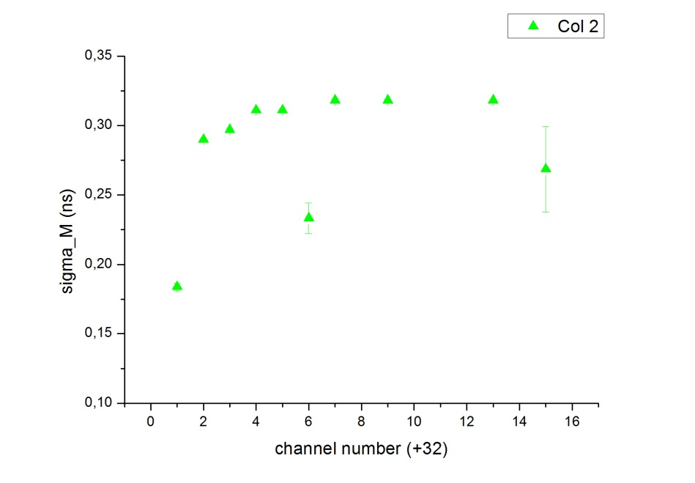
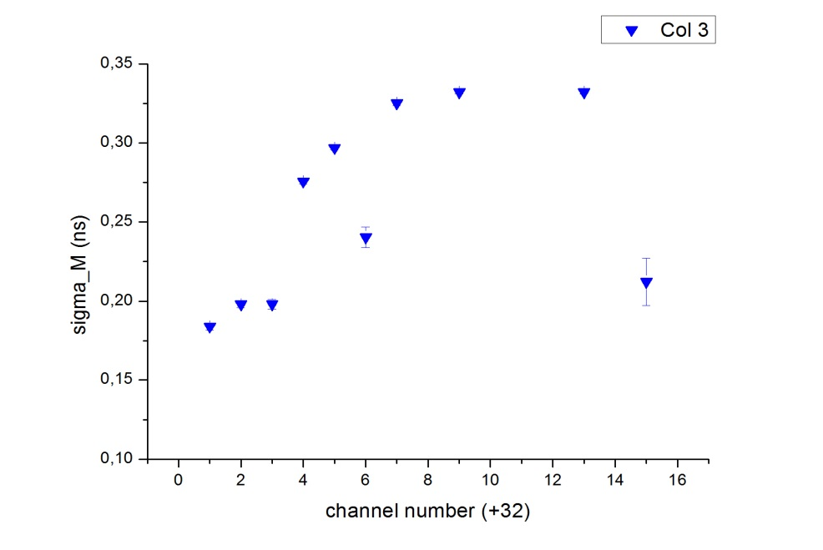
Measurements with MCPs
No diff

Slide 24
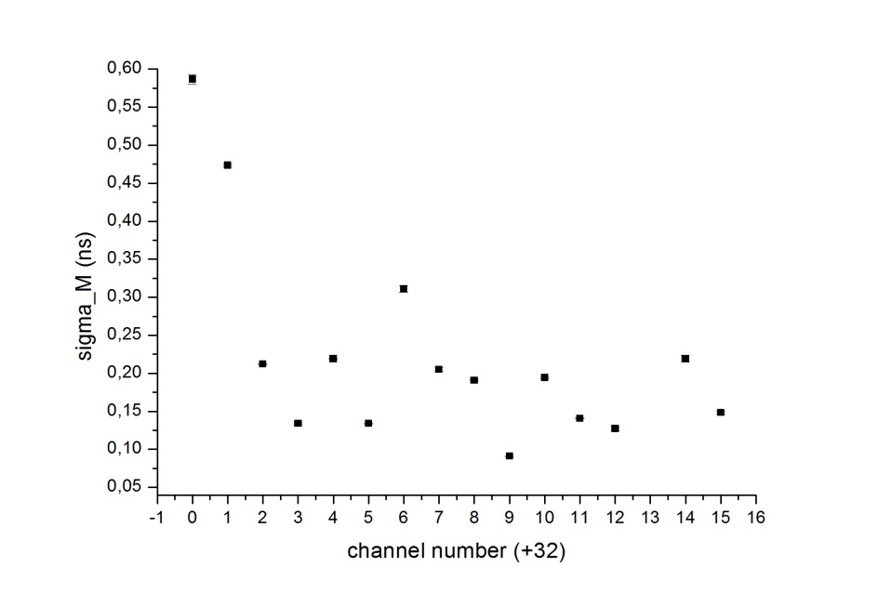
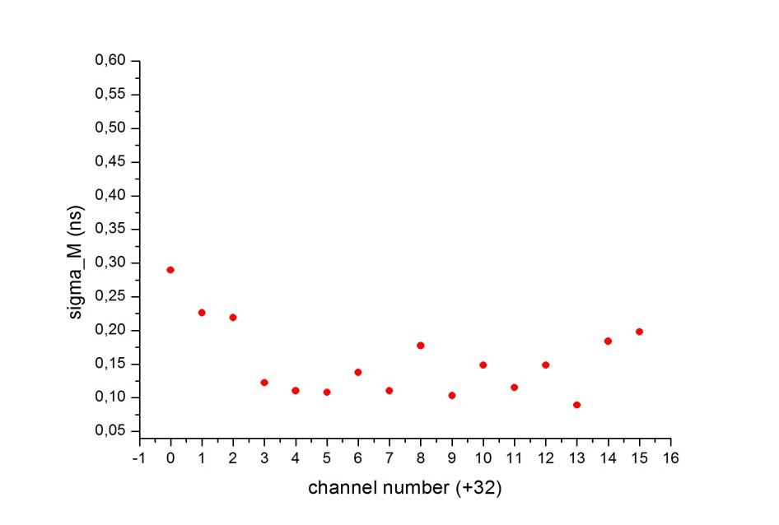
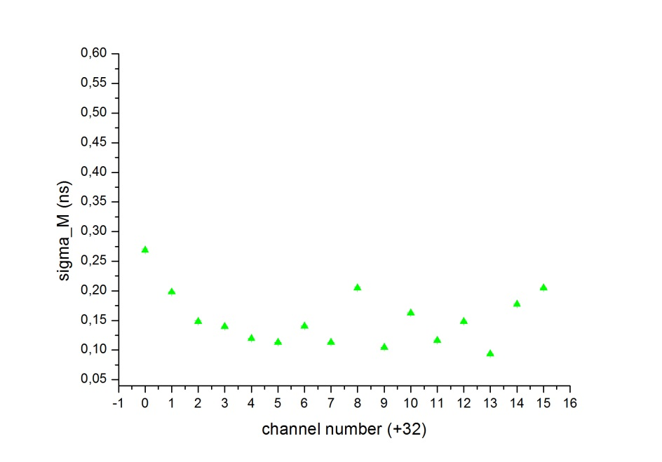
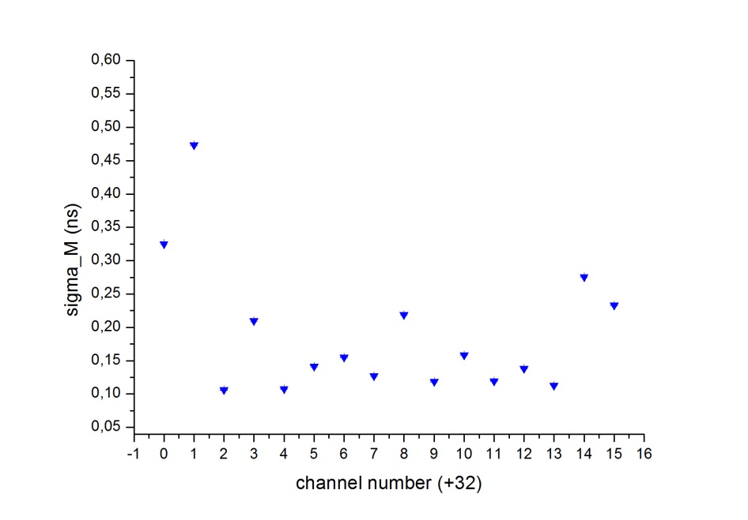
Measurements with MCPs
with diff
col0
col1
col2
col3

Slide 25
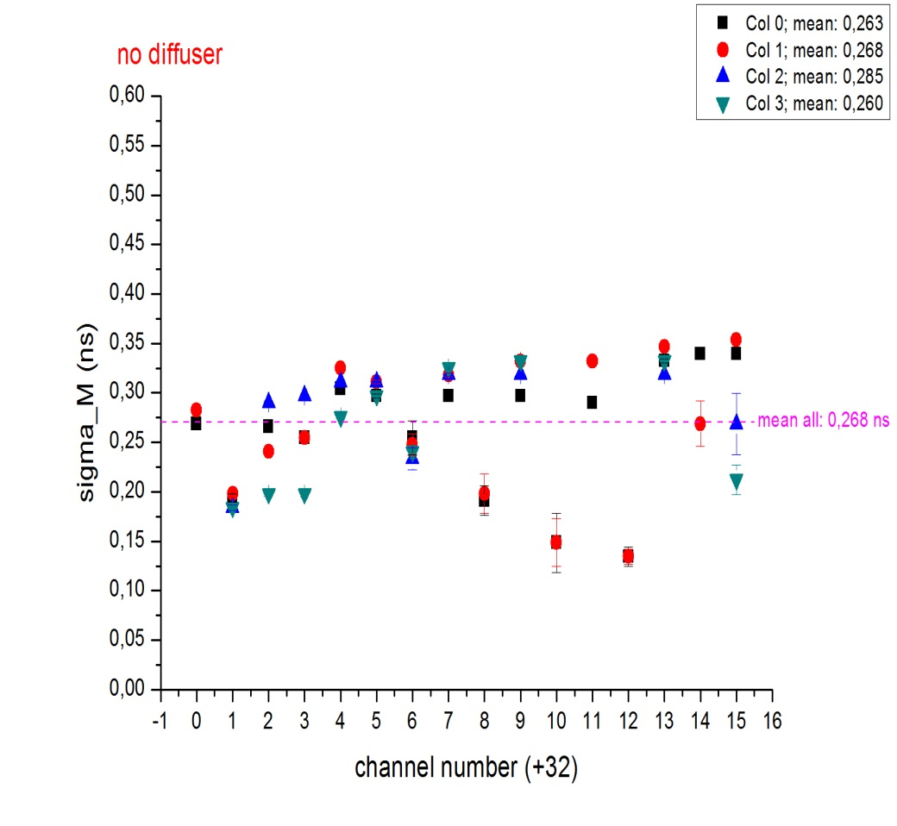
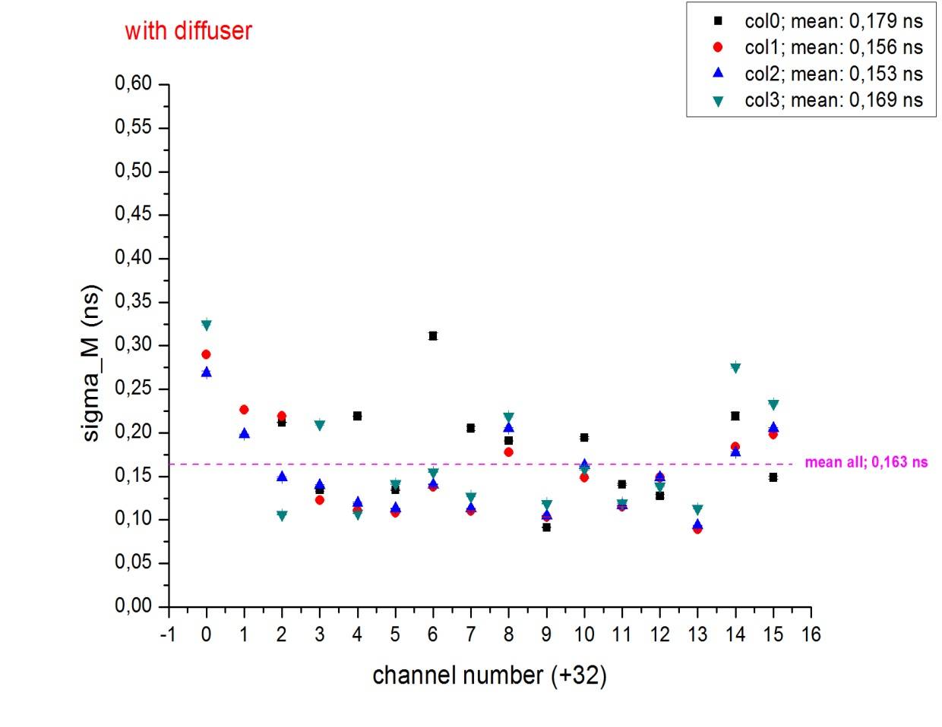
Measurements with MCPs

Slide 26
Overview
1. Electronics
i) TrBs, ToF AddOns
2. Measurements with electronics
i) Procedure
ii) Results of timing performance of electronics
3. Dispersion, problem or no problem ?
4. Measurements with photons
i) MCP(s)
ii) Diffuser-/no diffuser- measurements
5. Summary and Outlook

Slide 27
Summary and Outlook
-> Dispersion does not play any role in our case
-> Higher and steeper signals deliver better resolution (-> valid for 02/2011 and PAN2)
-> Pure electronics measurements gave time resolution of max. 50 ps (02/2011); 40 ps (PAN2)
-> MCP measurements (mean): 150ps<t<250ps (->Best values around 90 ps)
Outlook:
-> TrB version 3 boards are ready to be measured
-> Promise a improvement in time resolution (approx. 15 ps for pulser signals)
-> Resolution with MCPs should be < 100 ps
-> Further studies and analysis of the test beam data CERN 2012 are ongoing

Slide 28
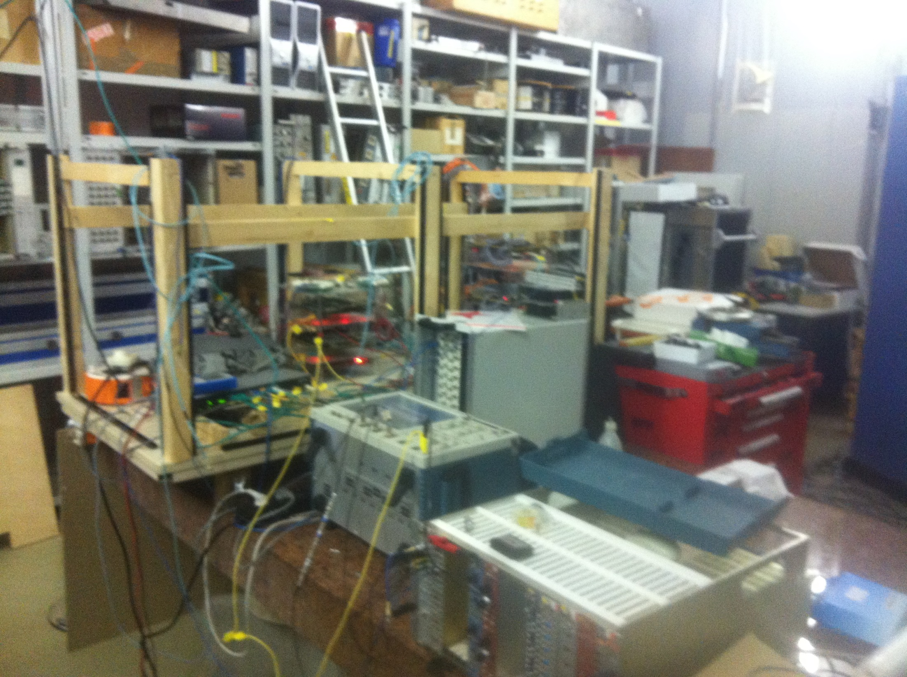
Thanks for your attention!

Slide 29
Backup slides
Sqrt 2 correction:
Measuring (t1-t2), both contain errors, assumption: both errors are equally large dt1=dt2
Error propagation: calculation of the complete error
d(t1-t2)^2= 2*(dt1^2+dt2^2)=2*(dt1^2)
d(t1-t2)=sqrt(2)*(dt1)
d(t1-t2)/sqrt(2)=dt1

Slide 30
HPTDC scheme

Slide 31
Amplifier discriminator

Slide 32
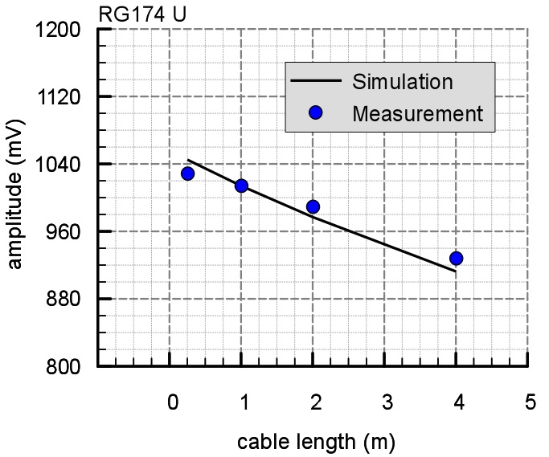
Changes in the amplitude of a fixed output signal by varying the cable length

Slide 33
TrB v2 Scheme

