Slide 1
Reconstructing Radiator Plates for the Barrel DIRC
Marko Zühlsdorf^{1,2}
¹GSI Helmholtzzentrum für Schwerionenforschung GmbH, Darmstadt
²Goethe-Universität Frankfurt

Slide 2
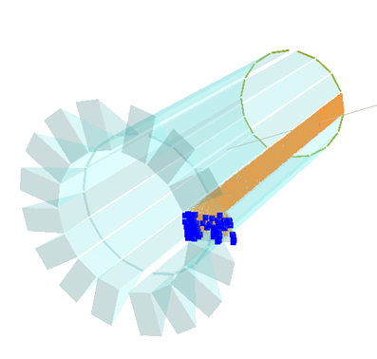
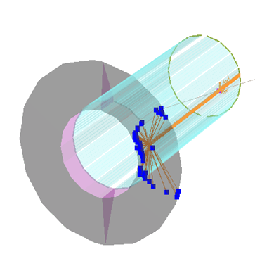
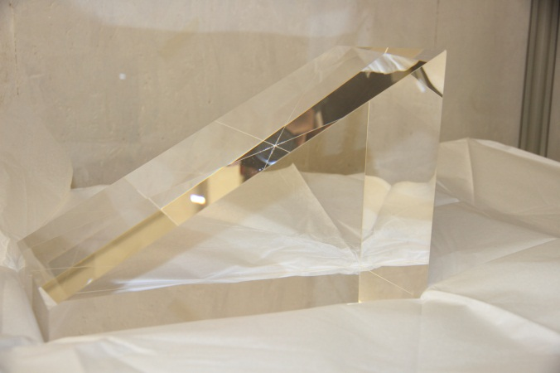
DIRC Design Options
use 1 wide plate Instead of 5 bars per segment
fewer pieces to be polished
requirements for optical quality of side surfaces less severe due to fewer side reflections
significant cost reduction
What about PID performance?
Synthetic fused silica instead of mineral oil as material for expansion volume
one prism per DIRC segment
better optical properties than oil
30 cm

Slide 3
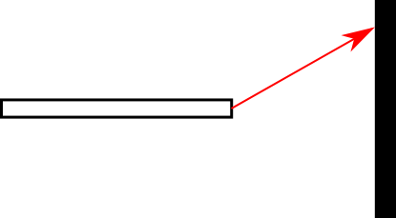
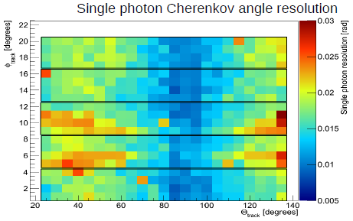
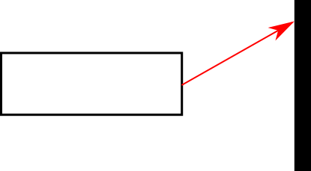
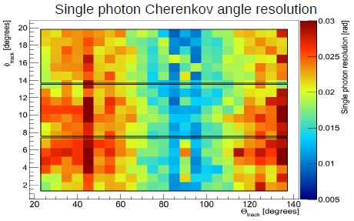
Reconstruction via Look-Up-Table
Maria (PANDA CM, Dec12):
x
radiator
top view
detection plane
z
Reconstruction gets harder with wider radiator as width contribution to θ_{C}-resolution is not negligible anymore

Slide 4
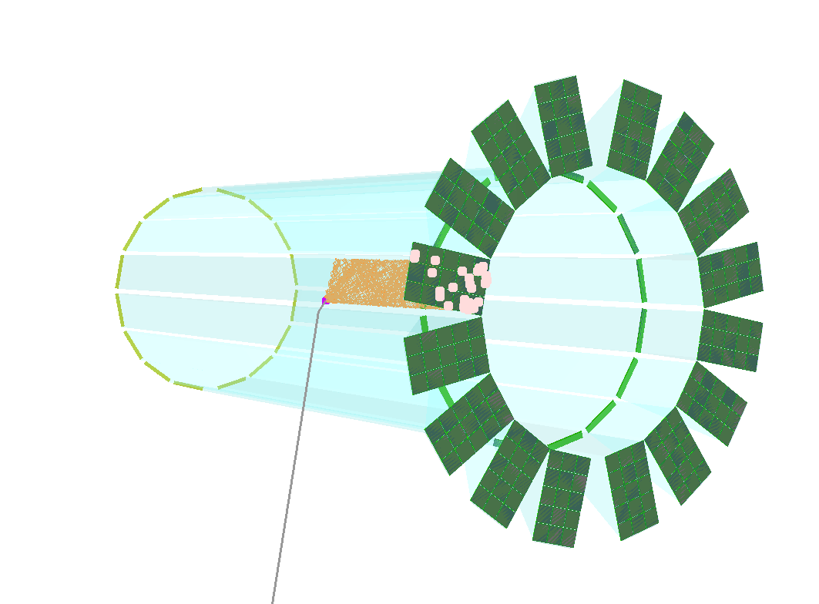
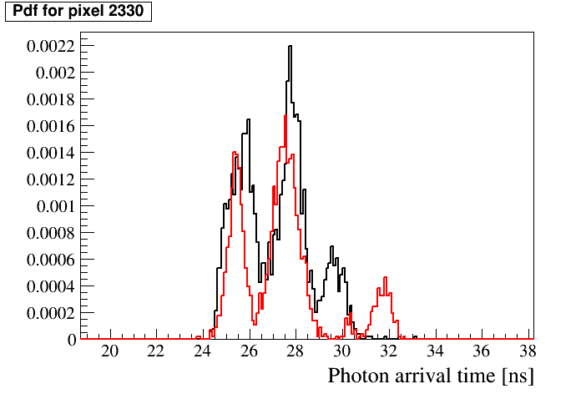
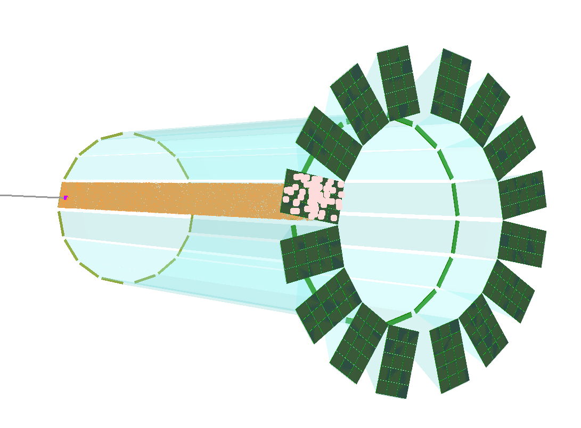
Time-based likelihoods
In 3 dimensions (X,Y,T) hits patterns show differences between particle species
1 GeV/c
π⁺
K⁺
π
K
140° θ
3.5 GeV/c
π⁺
K⁺
Probability Density Functions (pdf) can be created
by shooting ~100,000 particles in Monte Carlo with same event parameters
22° θ

Slide 5
Likelihood ratio test
$$\sum_{j}^{x,y}{\int_{0}^{t_{max}}{\text{pdf}\left(x_{i},y_{i},t_{i},H\right)dt=N_{H} }}$$
$$\ln{L_{H}}=\sum_{i}^{\text{Hits}}{\ln{\frac{\text{pdf}\left(x_{i},y_{i},t_{i},H\right)+B(x_{i},y_{i},t_{i})}{N_{e}}}}+\ln{P_{N_{e}}(\text{Hits})}$$
$$\sum_{j}^{x,y}{\int_{0}^{t_{max}}{B\left(x_{i},y_{i},t_{i}\right)dt=N_{B} }}$$
Take log-likelihood-difference
$\ln{L_{K}}−ln{L_{π}}$:
Separation Power: 4.7σ
$$N_{e}=N_{H}+N_{B}$$
3.5 GeV/c
22°
π-tested
K-tested
$L_{H}$:
pdf:
$B$:
$N_{H}$:
$N_{B}$:
$P_{N_{e}}$:
Likelihood for Hypothesis $H$
PDF for Hypothesis $H$
Background distribution
Expected photon number for Signal
Expected photon number for Bg.
Distribution of expected hits (poissonian)

Slide 6
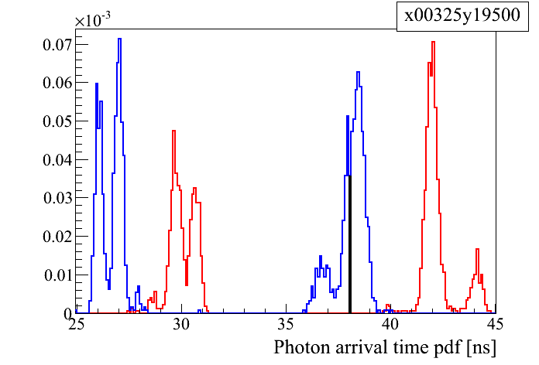
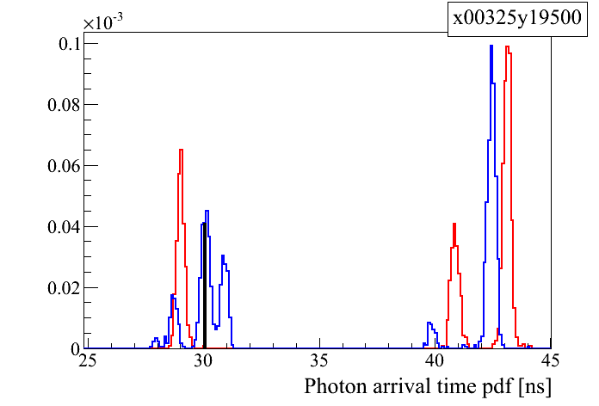
Time based likelihood test: Example
1 GeV/c
3 GeV/c
Blue: Kaon hypothesis
Red: Pion hypothesis
loop over all hits and multiply pdf values
take the likelihood ratio for two competing hypotheses
apply cut value to accept or reject hypothesis

Slide 7
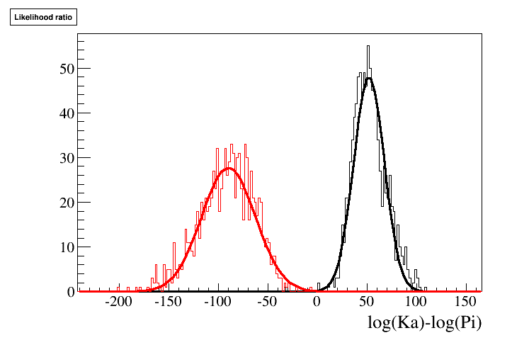
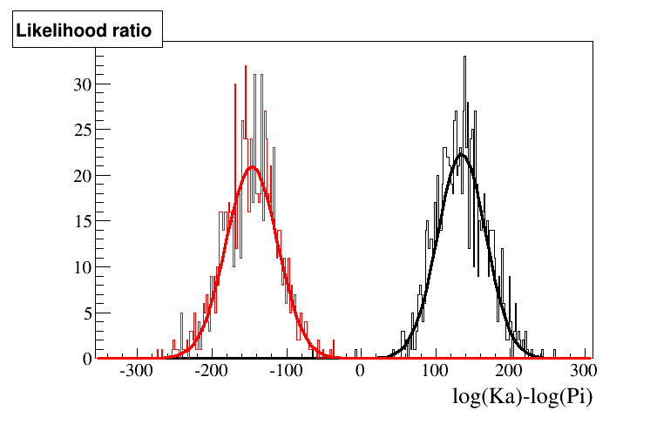
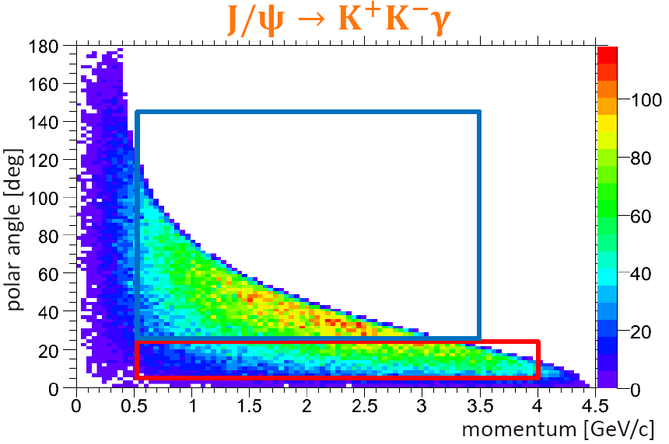
Time based likelihood test
3.5 GeV/c
22°
SP=4.7σ
π-tested
K-tested
1 GeV/c
90°
SP=6.8σ
π-tested
K-tested
1 GeV/c
140°
SP=8.4σ
π-tested
K-tested

Slide 8
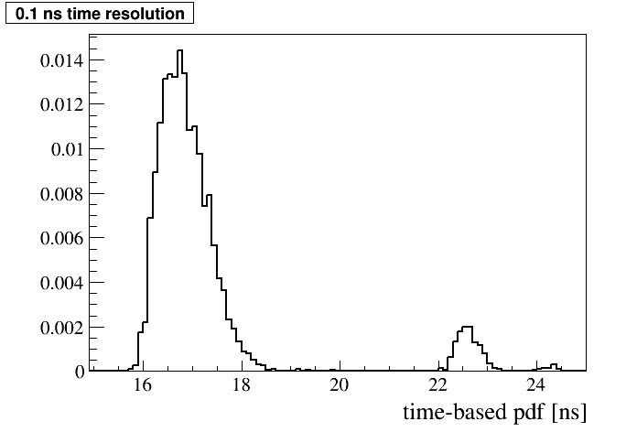
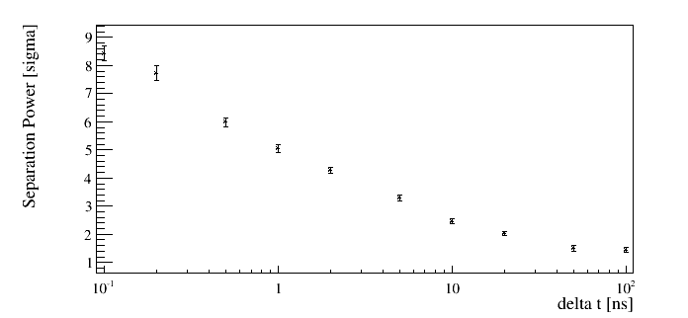
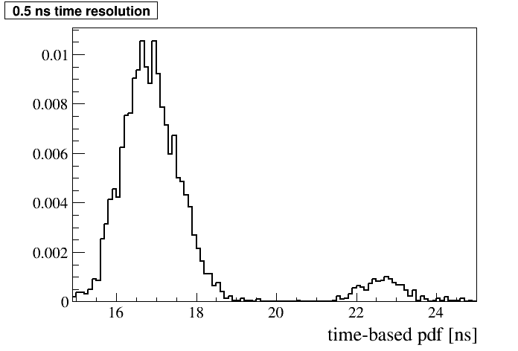
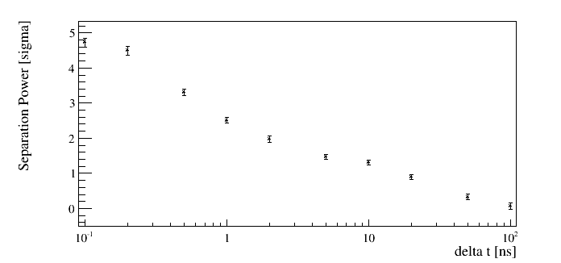
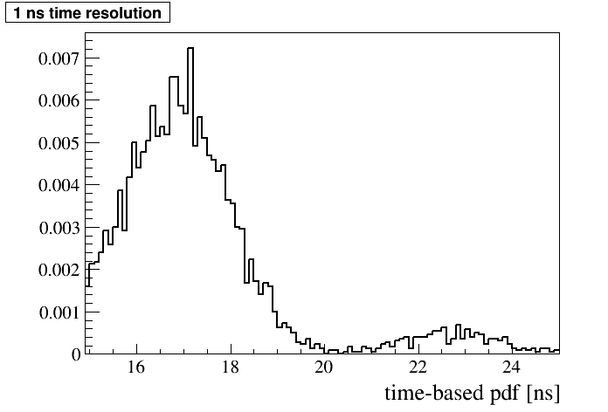
Time based likelihood test
Simulations have been done with 100 ps time resolution.
But what if we don’t have such timing?
100 ps
1 GeV/c
140°
PID seems to be quite robust.
Even with a timing worse than 100 ps results can be expected.
500 ps
3.5 GeV/c
22°
1 ns

Slide 9
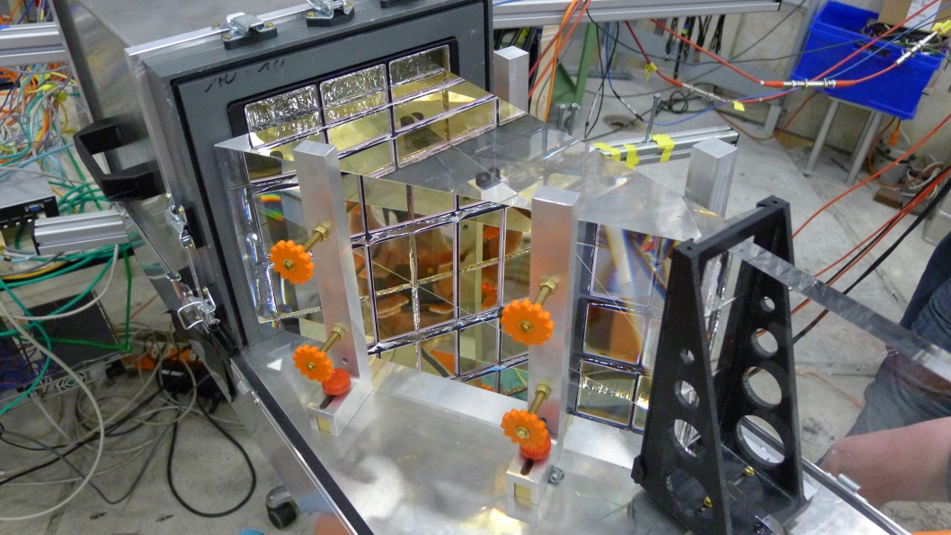
Test Beam Analysis
Greg has told much about the Beam in 2012 but to repeat the essential things:
August 10 – September 3, 2012
Prototype test at CERN PS T9
Tested different design options and varied
many interesting parameters
August 28 – September 1
First plate prototype was tested!
Mainly different lenses were tested with rotating track angle
Few momentum scans without lens

Slide 10
Test Beam Analysis
Data
10 GeV/c hadron rich beam
Simulation
10 GeV/c pions
dead PMT
trigger missing
on TRB
-> no calibration

Slide 11
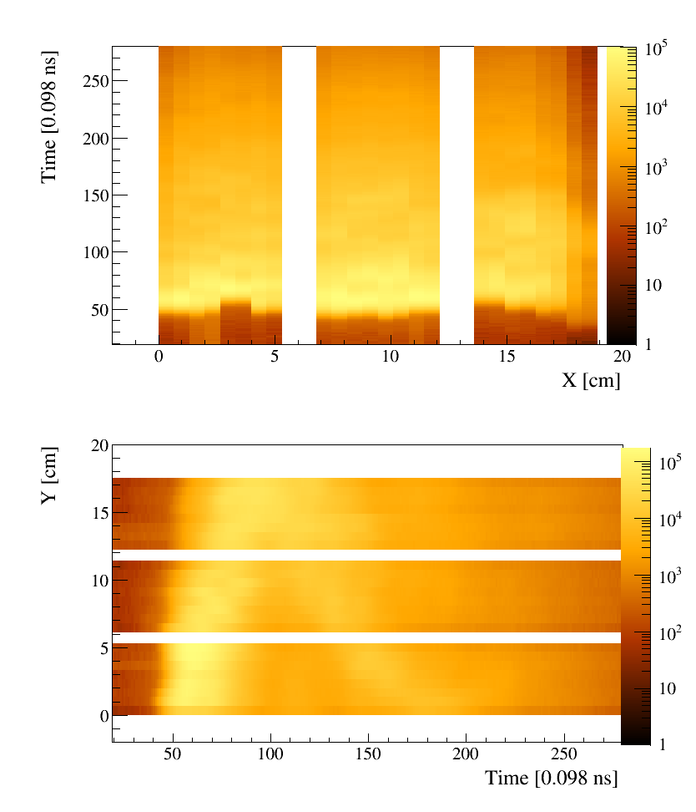
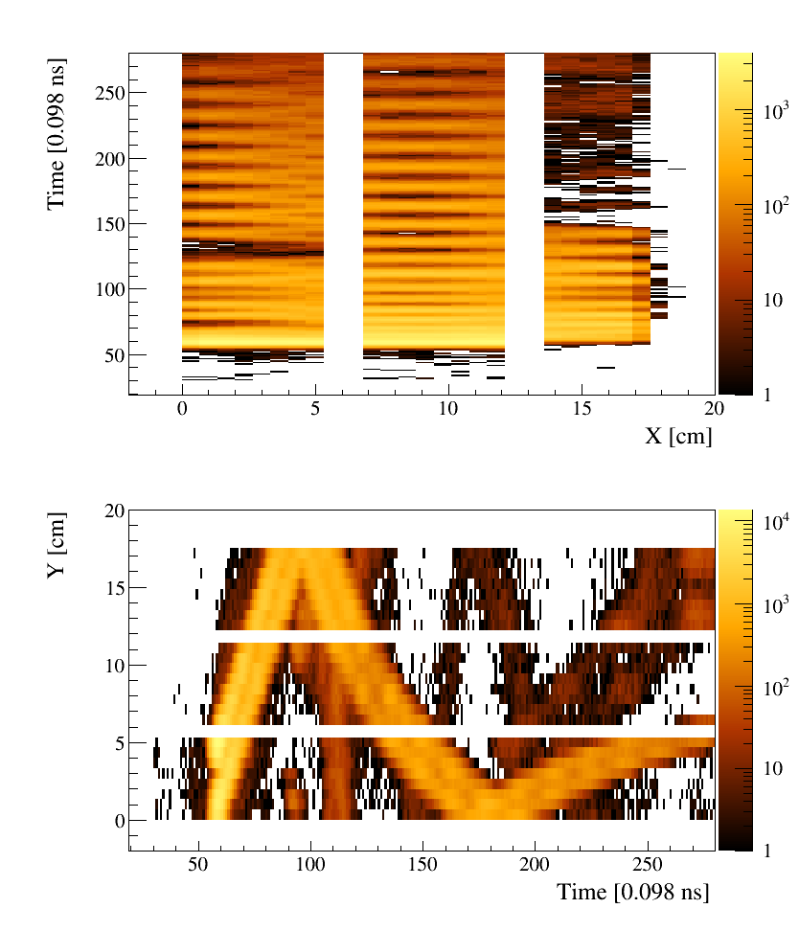
Test Beam Analysis
Data
10 GeV/c hadron rich beam
Simulation
10 GeV/c pions
Further alignment
may be necessary…
Misalignement between
pixels on same PMT

Slide 12
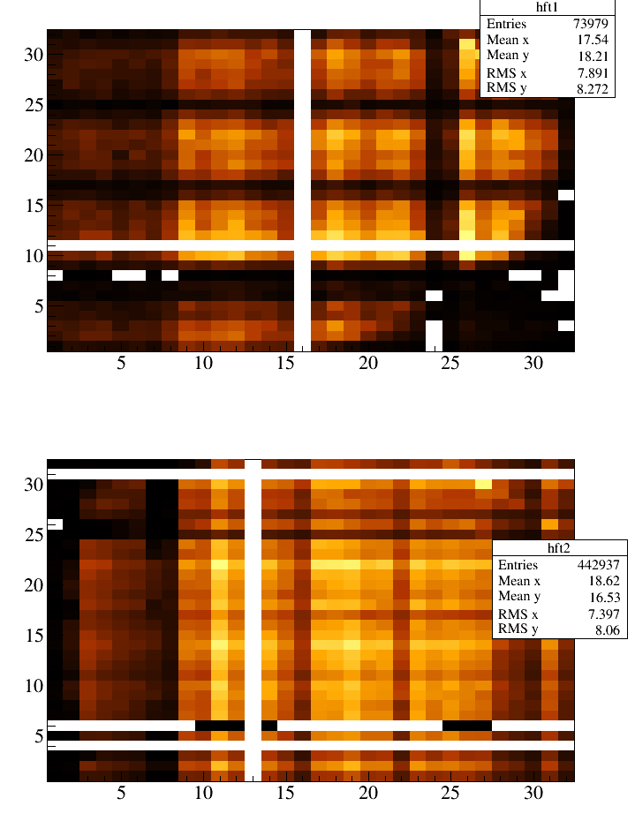
Test Beam Analysis
Hit pattern in x,y,t look similar to Monte Carlo.
With fiber tracker coincidences picture improves but statistic goes down (1% left).
Simulation does not perfectly describe data
Further alignments have to be done
Photon yields do not match:
18.3 hits per event from sim
47 hits per event from data
Fiber Tracker 1
Fiber Tracker 2
Next steps:
Further improve simulation
Use 10 GeV/c runs to calibrate simulation and low momentum runs to perform PID

Slide 13
Summary
A design based on radiator plates instead of narrow bars would significantly reduce the cost of the Barrel DIRC.
A likelihood based approach shows good results for simple geometries for ‘crucial’ phase space points.
Time resolution of 100 ps may not be necessary.
Test beam plate analysis has started and shows promising conformity with simulated hit patterns
Outlook
Beam data needs to be further processed before reconstruction can be applied.
Reco method will be applied to beam data from 2012.
Designs with focusing optics will be tested
An analytical approach to calculate pdfs has to be found as there are too much points in parameter space to be covered by MC.

Slide 14
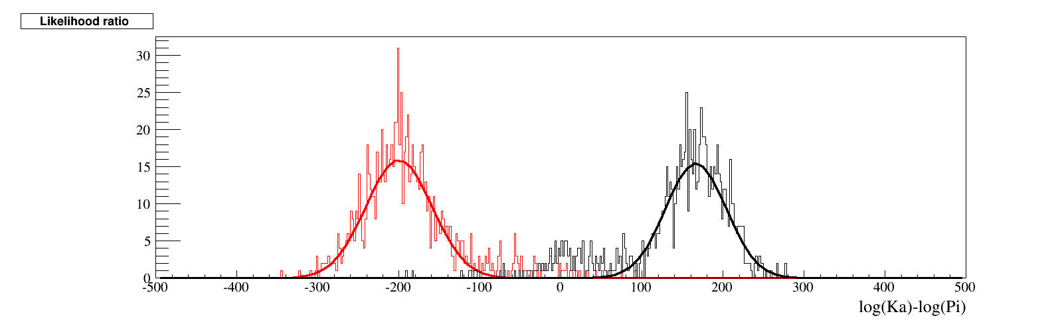
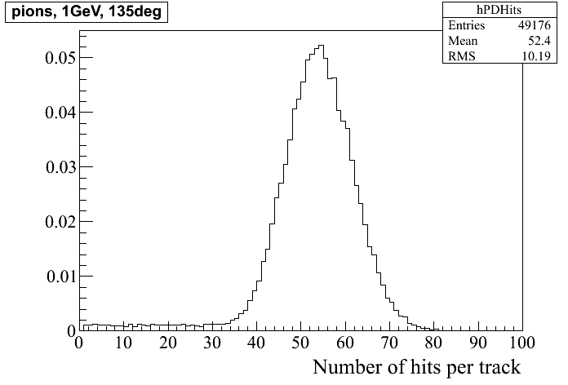
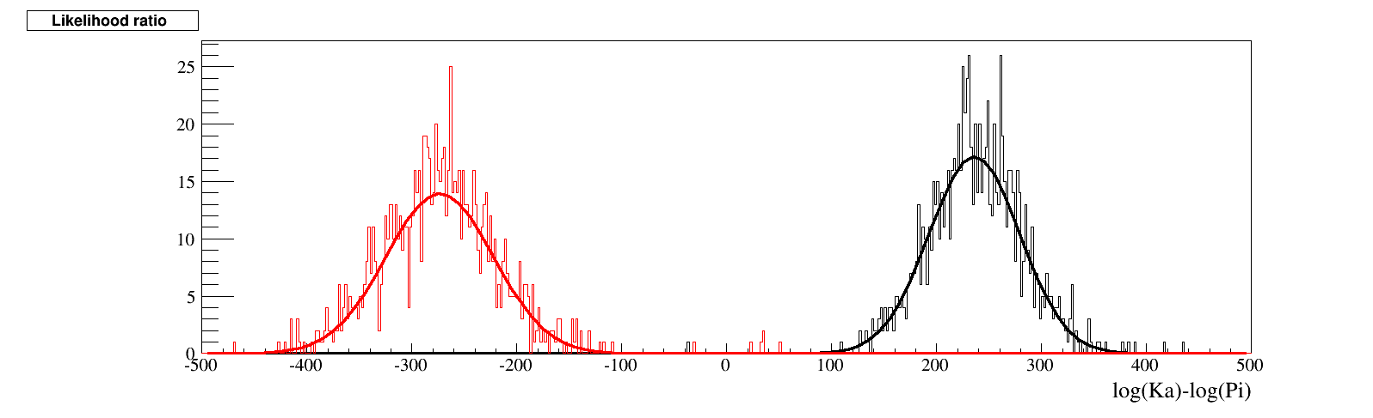
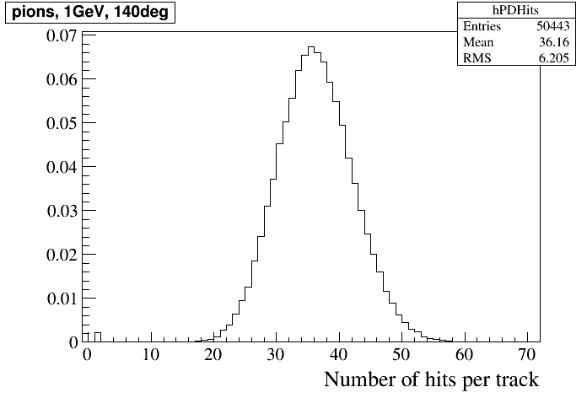
Strange hadronic processes in Geant4
Summer 2013
now

Slide 15
Strange hadronic processes in Geant4

