Slide 1
Results of the July testbeams in Mainz
Christoph Rosner
PANDA Collaboration Meeting, GSI 10.12.2013

Slide 2
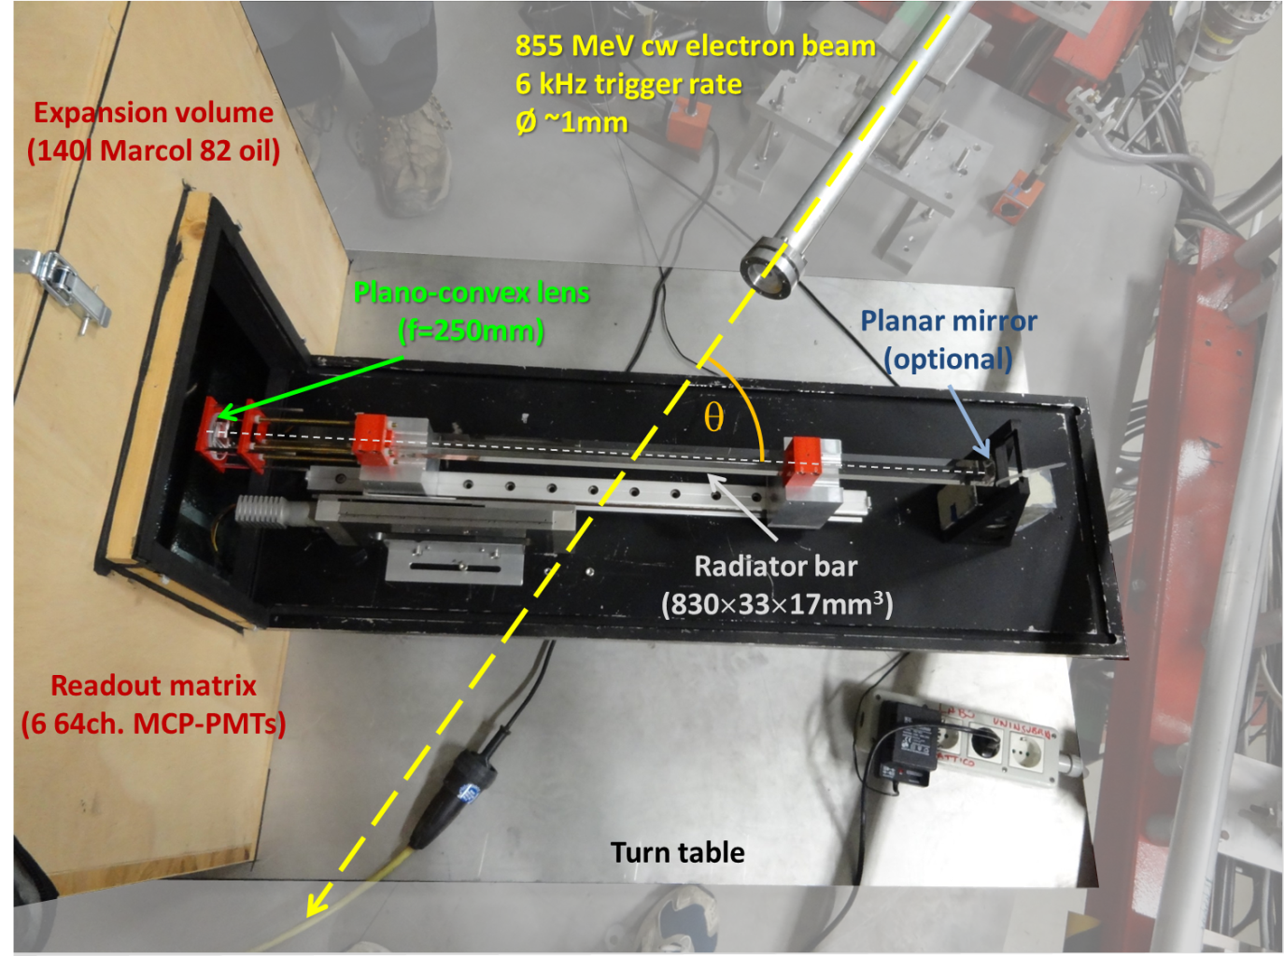
Setup: Prototype
Two testbeams in July 2013, overall
7 days of beam
Place: MAMI B, X1
(e⁻ beam at 855 MeV/c,1 mm
radius, 0.1 mrad divergence)
Prototype already used in last year’s testbeam, consisting of:
17 x 33 x 830 mm quarz radiator bar
Optical lens system
Expansion volume
MCP Readout
Only minor changes to setup between testbeams
(Mirror, MCP Readout)

Slide 3
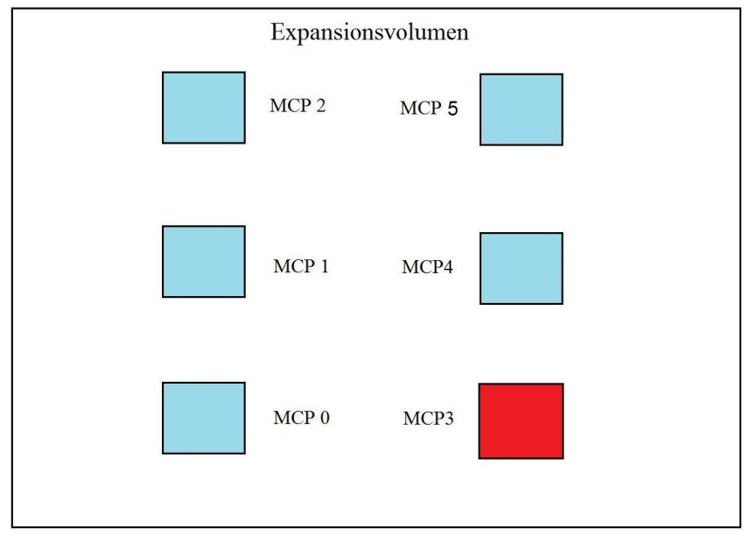
Setup: Readout
Two MCP-Towers:
1. testbeam:
5 MCPs (3 left, 2 right)
4 read out by NINO, 1 by PADIWA
2. testbeam:
6 MCPs (3 left, 3 right)
left tower by NINO, right tower by PADIWA
TRB3 system for data acquisition
Trigger signal provided by coincidence of 2 scintillators
Only second beamtime

Slide 4
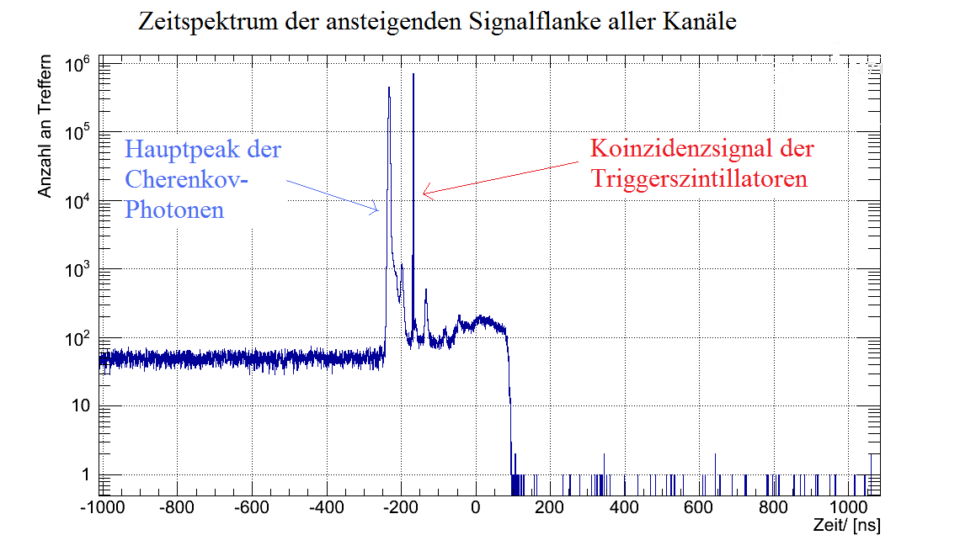
Results: Timespectrum

Slide 5
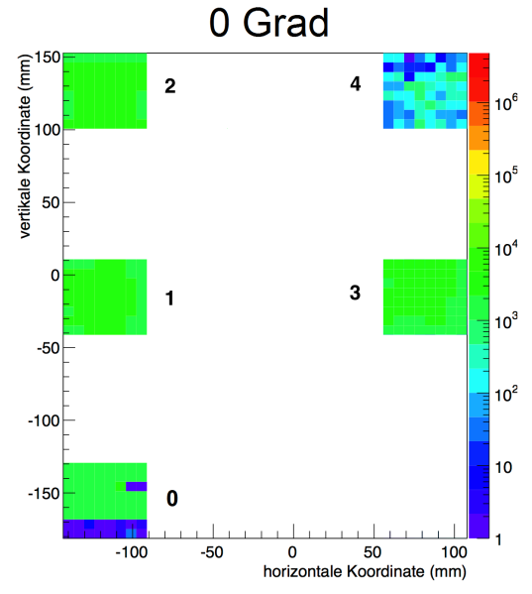
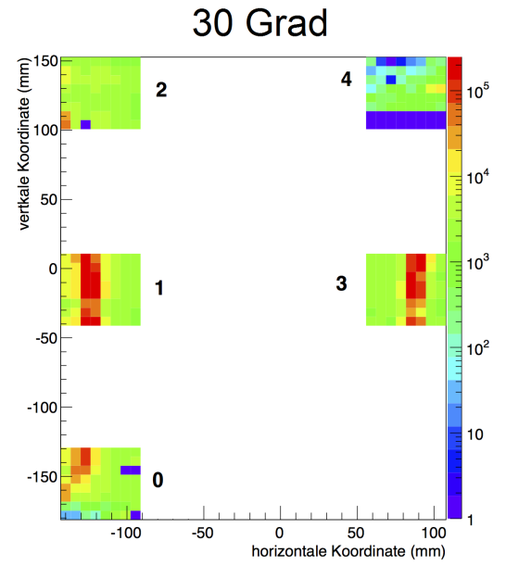
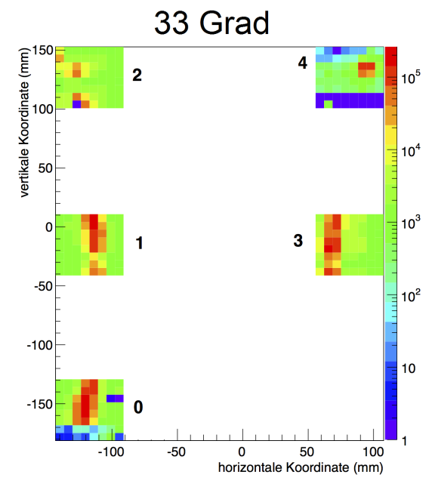
Results: Cherenkov Pattern
Different angles measured during both testbeams (0°, 28°, 30°, 33°)
No pattern for 0 degree as expected from simulation
Pattern moving in the expected direction → Cherenkov photons were obeserved

Slide 6
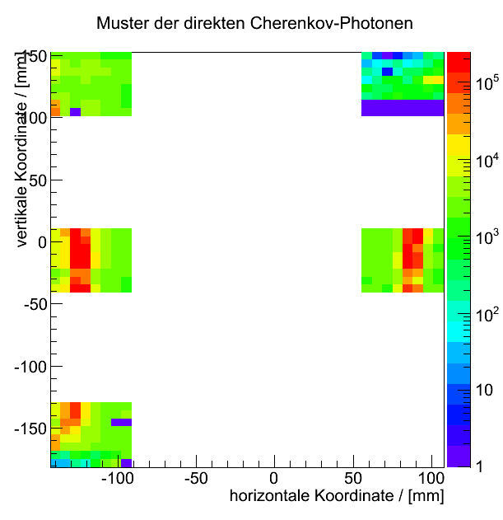
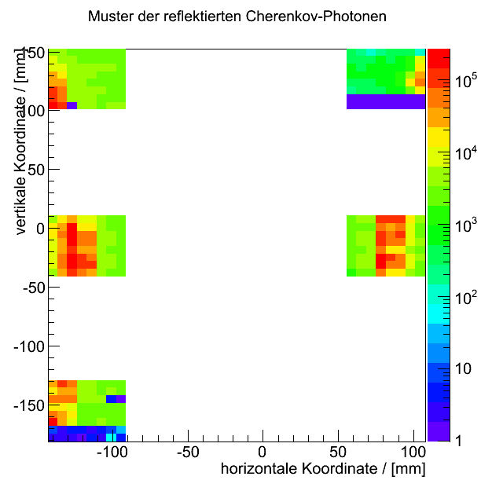
Results: Mirror
Comparison between -30° (reflected light) and 30° (direct light) angles
Pattern at the same position, but much broader for the reflected part
Time difference between reflected and direct light of
4.350 ± 0.003 ns
Good agreement with expectation:
4.164 ns

Slide 7
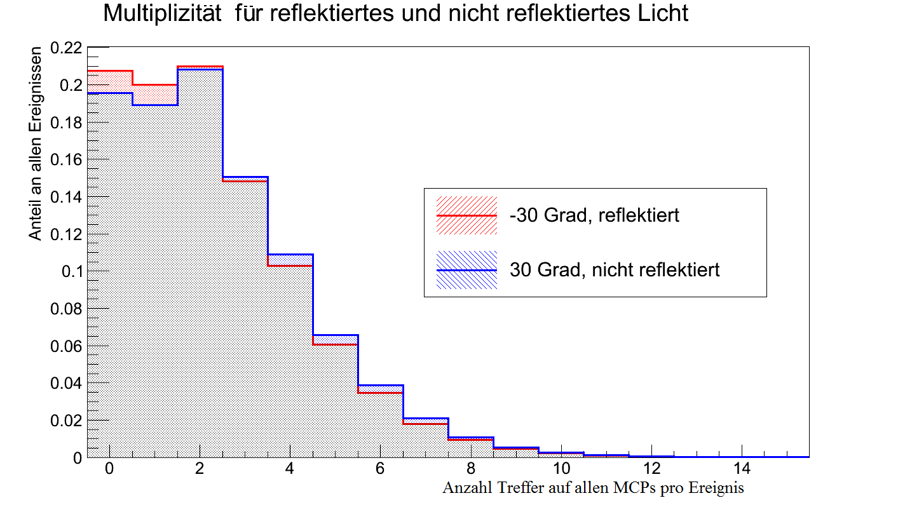
Results: Mirror
Amount of photons lost at the mirror seems to be small
Average amount of photons on all MCPs per event only about 5% smaller for the reflected light

Slide 8
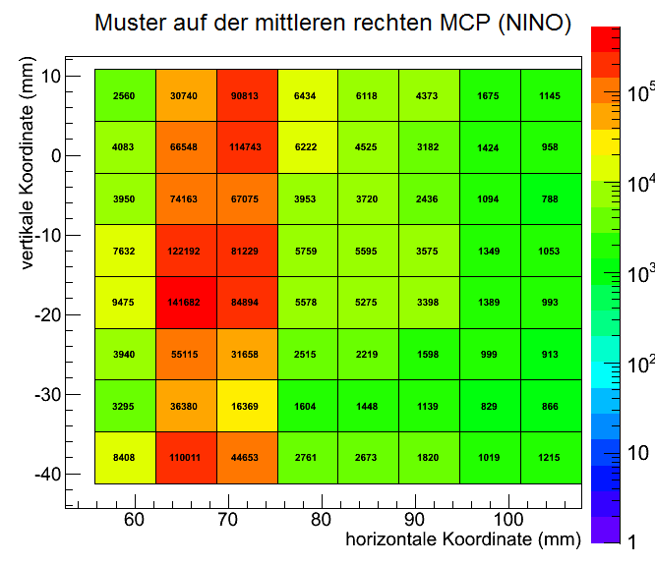
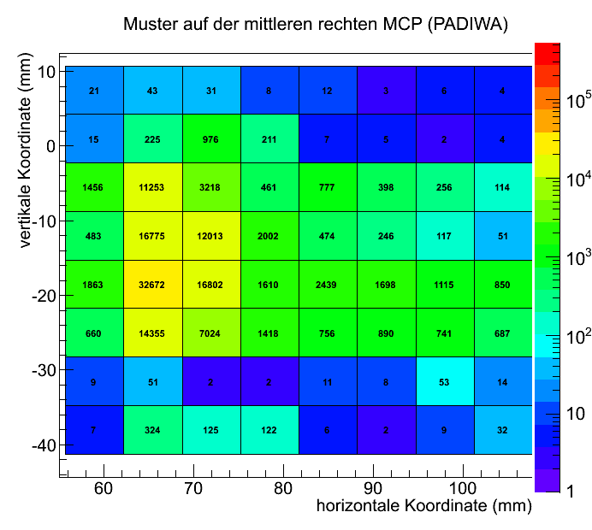
Results: NINO vs. PADIWA
NINO and PADIWA FEE both able to see the pattern
Efficiency of the PADIWA readout much lower
Possible reasons:
PADIWA behaviour not known well enough at beamtime
Not enough amplification on the PADIWA Boards
Signals may be too narrow for PADIWA
Notes:
For best comparison, look at center right MCP after equiping PADIWA, no other changes to setup (patternposition, MCP, hv)

Slide 9
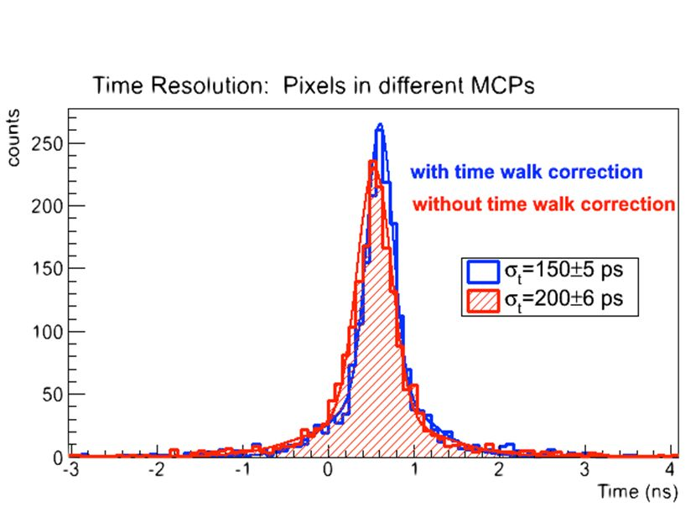
Results: Timing
Time difference of rising edge time of 2 channels on different MCPs
Timewalk correction applied for both channels
2 gauss fits applied: one for the tail (backscattered electrons) and one for the main peak
Sigma₂ divided by gives a pixel time resolution of:
Notes:
Looking at time difference because of uncertainty of the trigger signal (~600 ps)

Slide 10
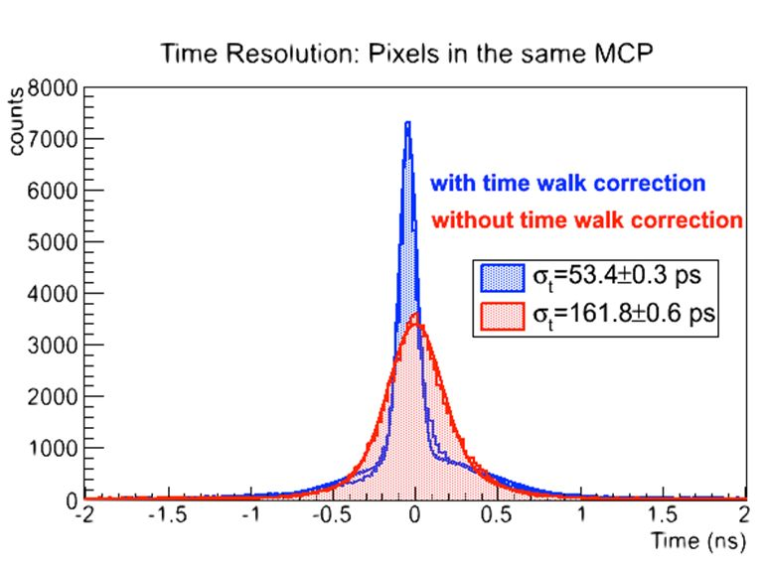
Results: Timing
Looking at time difference of pixels on one MCP to exclude influence of the detector
Dividing by not necessary here
Red: no timewalk correction, blue: timewalk correction aplied
Time resolution of readout chain alone:

Slide 11
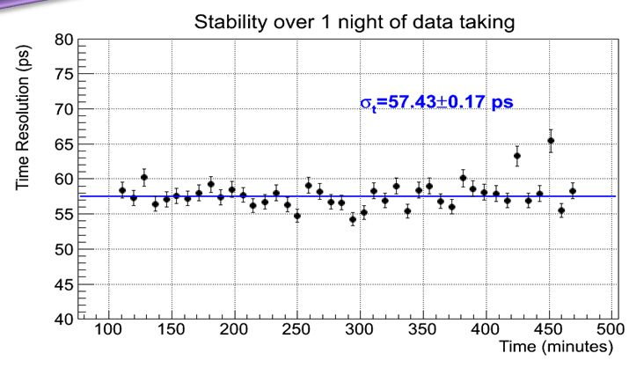
Results: Timing
Calculating time resolution for data taken over one night with steps of 10 minutes
Time resolution obtained remained very stable over the course of the experiment

Slide 12
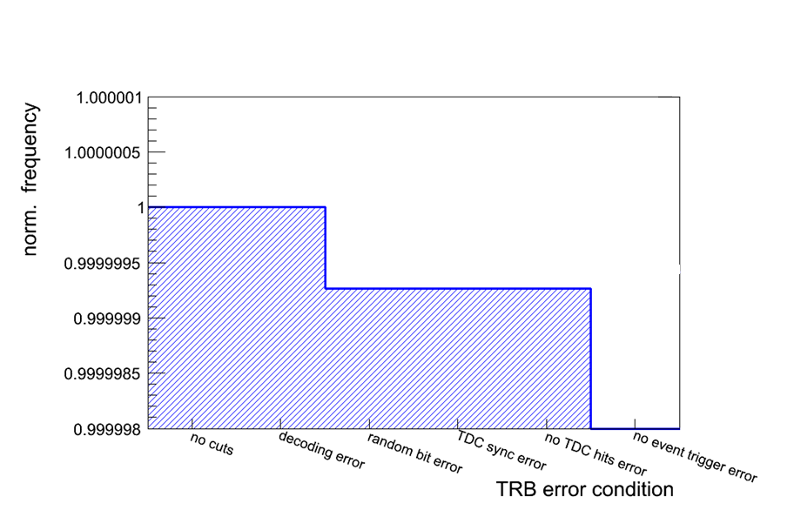
Results: TRB Efficiency
TRB3 Boards showed a high stability and efficiency during the experiement
Less then 1 in a million events lost by TRB
Lost channels affect less than 1% of the events

Slide 13
Summary
Seven days of data taking with DIRC prototype, up to 6 MCPs and the full readout chain
System off FEE and TRB3-Boards proved to be very stable during the whole experiment
Observed Cherenkov Patterns with both NINO and PADIWA FEE
Achieved time resolution for NINO-Boards better than what is needed for PANDA (<100 ps)

Slide 14
Next steps
Over 1 TB of Data taken, further analysis required
PADIWA boards need to be further tested with our laser (black box), possibly with additional preamplifier board
Further development of NINO-Board (32-channel NINO chips)
Looking into the CLARO chip (4 channel chip developed for LHCb RICH)

Slide 15
Thank you

