Slide 1
STT News
Peter Wintz (IKP, FZJ)
PANDA Collaboration Meeting, Dec-2013, FAIR

Slide 2
STT News
Recent STT activities
Workshop summary
Straw production & straw layout
Readout systems
Test system installations
Beam tests 2014
STT timelines
STT pre-series test in 2015/16

Slide 3
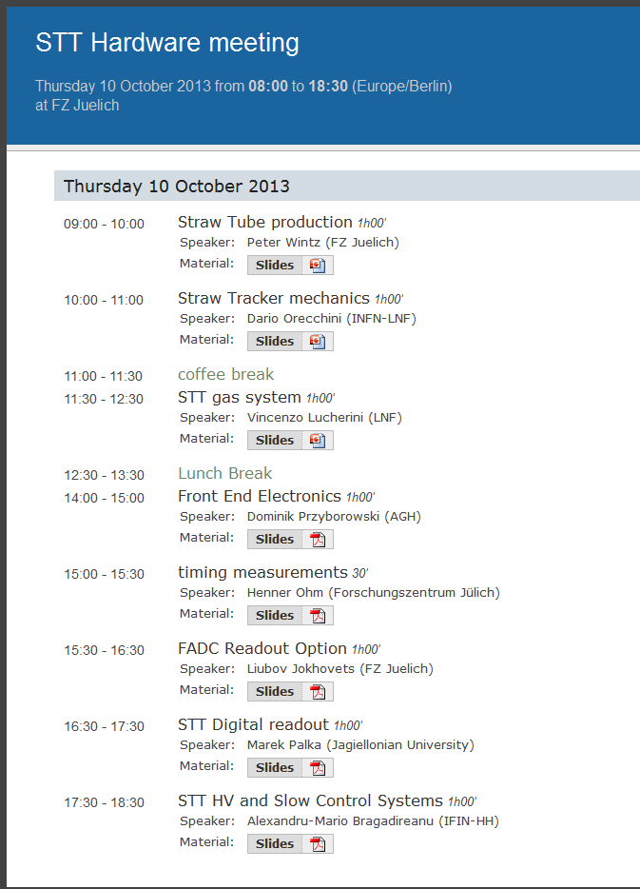
STT Workshop in Oct-2013
STT work packages discussed
Straw and layer-module production (FZJ)
STT general mechanics (LNF)
Gas system (LNF)
Frontend / analog electronics (Krakow, FZJ)
Digital readout (Krakow, FZJ)
Detector control & HV system (IFIN-HH)

Slide 4
Straw Layout in STT
STT straw layout:
New straw pitch: 10.12 mm (~ 10 µm gap)
Straw diameter: ~ 10.05 mm (pressurized)
Mylar film wall: 27µm
Straw layer modules
Determine all straw positions (soon)
Group straws into 4-layer modules, stereo-layer modules
Periphery, mounting elements, ..
Integration in mechanical frame → iteration with Dario
straw pitch

Slide 5
Straw Productions
Straw production
final straw film specification, leakage tests successfull
straw series production started in Oct-2013
complete straw mass production takes 3-4 years, including ~50% spares
Quality checks
leakage and wire tension measurement for each straw
long-term test sample

Slide 6
Electronic Readout Status
Currently in preparation: large-scale systems
ASIC-ToT + TRBv3:
new ASIC chip in design, in production soon
available in (late) Q2/2014, ~ 100chips (×8ch)
FADC based readout
new design amplifiers & cabling, FPGA/FADC architecture
available in Q2/2014

Slide 7
Test System Installations
Permanent STT test systems with DAQ in Juelich
PC network (“strawnet“)
ASIC-TRBv3 readout installed last week by Cracow
3× ASIC-boards, 96 channels
Greg‘s, Jacek‘s talks
Cosmic ray tests as preparation for next beam tests
tuning setups, straw electric coupling, HV distribution
optimise electronic parameters (ASIC shaping)
define default straw operation settings (gas gain)
clean tracking → resolution limits

Slide 8
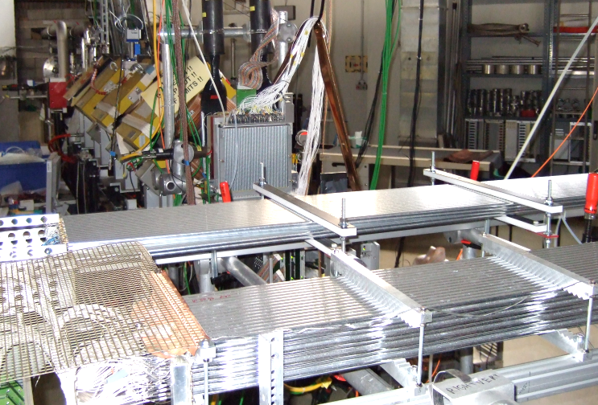
Beam Tests 2014
Beam time requests for 2014 (COSY)
1 week in Jun-2014, protons at 3.0, 0.8, 0.6 GeV/c
1 week in Sep-2014, deuterons at 2.0, 1.3, 1.0 GeV/c
1 week in Nov-2014, protons at 2.0, 1.3, 1.0 GeV/c
dE/dx range ~ 10× mips
aim for prot./deuteron separation
2 straw setups for both readouts
8×24 straws and 8×16 straws
Optional: larger straw setups if
new RO systems available
2 Straw setups, beam coming from the back (Big Karl area @ COSY)

Slide 9
STT Milestones & Roadmap
M3: TDR approval 1.03.2013
M8: Pre-series test accepted 31.03.2016
M9: Final STT construction, acceptance test 31.03.2018
M10: Shipment to FAIR / approval for installation 30.06.2018
M11: Ready for beam 30.09.2018
M12: Commissioning done / ready for operation 20.12.2018
Official timelines transmitted to FAIR

Slide 10
STT Milestones & Roadmap
M3: TDR approval 1.03.2013
M8: Pre-series test accepted 31.03.2016
M9: Final STT construction, acceptance test 31.03.2018
M10: Shipment to FAIR / approval for installation 30.06.2018
M11: Ready for beam 30.09.2018
M12: Commissioning done / ready for operation 20.12.2018
Official timelines correlated with money flow

Slide 11
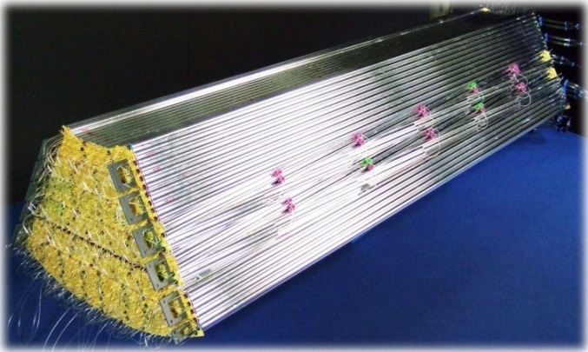
STT Pre-Series Test
One complete STT sector (~ 800 straws)
final design of straw-layer modules
mechanical frame
electronic RO system (800 channels)
supply system & DCS
Assembly and installation in 2015
Beam test at COSY 2015/16
Complete! test
STT hexagon sector
Beam

Slide 12
Pre-Series Test Program
Tracking + dE/dx measurements
position calibration by reconstructed tracks
isochrone + dE/dx calibration methods
scatter target? → fiber, foil, .. in beam
final resolution
Continuous DAQ, (PANDA-DAQ v1?)
high particle rates ~ 1 MHz
online tracking
No magnetic field, straight tracks
STT hexagon sector
Beam

