Slide 1



Electromagnetic Physics session A few remarks to start the discussion
47th PANDA Collaboration Meeting
GSI, 10 December 2013
B. Ramstein, D. Marchand IPN Orsay

Slide 2
Working Group on Electromagnetic Processes
Discuss physics and technical issues specific to Nucleon structure studies using ElectroMagnetic Processes measurements
Short update about on-going activities :
might well be incomplete, please correct !
Information about Horizon2020

Slide 3
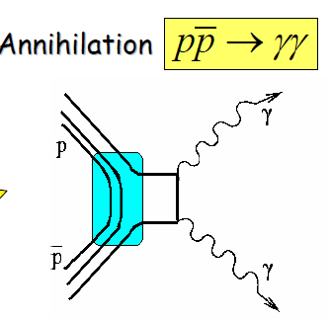
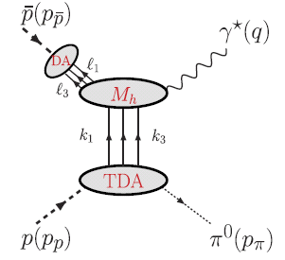
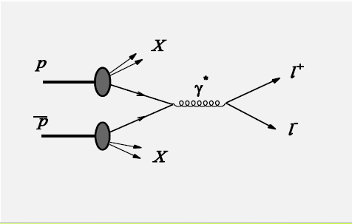
Electromagnetic Processes
Four main topics were studied up to now:
-
pp→J/ψ ⁻π⁰
 |  | γ
-
large p_{t}
-
-
-
pp→ γ γ
pp→e⁺e⁻π⁰ / μ⁺μ⁻ π⁰
pp→μ⁺μ⁻X/e⁺e⁻X
pp→e⁺e⁻ / μ⁺μ⁻
-
-
-
γ*
Fwd/bwd
-
Drell-Yan
p
e⁻
p
γ
p
q²
p
PDF
l⁺
s
Large q²
small t or u
q²>0
p
l⁻
p
q²>0
e⁺
p
p
π⁰
t
Parton Distrib.
Functions
Time Like electro
magnetic Form factors
Generalized Distrib.
Amplitudes
Transition Distrib.
Amplitudes
PDF

Slide 4
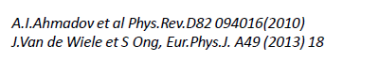
Electromagnetic Time-Like form factors
-
-
pp→e⁺e⁻
Studies with Babar framework
M. Sudol et al. EPJA 44 (2010) 373 Orsay/Mainz
M. Mora-Espi, PhD Mainz 2013
studies with PANDAroot
A. Dbeyssi PhD Orsay 2013 see Alaa’s talk
D. Khaneft on-going PhD work in Mainz
pp→e⁺e⁻ / μ⁺μ⁻
-
e⁻
p
q²>0
p
q²>0
e⁺
Time Like electro
magnetic Form factors
-
Radiative corrections for pp→e⁺e⁻
models
without radiation from hadrons ; PHOTOS event generator
with radiation from hadrons
studies with PHOTOS generator : A. Dbeyssi PhD 2013, Orsay
studies with Van de Wiele’s model: B. Ma, on-going PHD work Orsay
see B. Ma‘s talk
Orsay-Dubna
Orsay
-
pp→ μ⁺μ⁻ I. Zimmermann (HIM Mainz), on-going PHD work Mainz

Slide 5
Generalized Distribution Amplitudes
-
large p_{t}
-
pp→ γ γ
Studies with BABAR framework for pp→ γ γ
and pp→ π⁰ γ (including background rejection)
M. Duerren et al. Giessen
PANDA Physics Performance Report arXiv:0903.3905
Studies with PandaRoot should start soon:
E. Ezelmüller on-going work at Giessen
-
-
γ
p
s
p
Generalized Distrib.
Amplitudes

Slide 6
Transition Distribution Amplitudes
-
pp→e⁺e⁻π⁰ / μ⁺μ⁻ π⁰
-
-
Studies with BABAR framework for pp→e⁺e⁻π⁰
M. Mora-Espi PhD Mainz 2013 and M. Zambrana
Studies with PandaRoot for pp→J/ψ π⁰
B. Ma on-going PhD Orsay
counting rate studies, no detailed background studies yet
-
γ*
Fwd/bwd
p
q²
Large q²
small t or u
p
π⁰
t
-
Transition Distrib.
Amplitudes

Slide 7
Drell-Yan
Simulations for PANDA
Used generators
DUBNA:PYTHIA: A. Skachkova hep-ph/0506139 (Dubna)
A. Bianconi, M. Radici, Phys. Rev. D71, 074014 (2005) (Brescia)
Yields and kinematical criteria to reject lepton pairs
of non Drell-Yan origin A. Skachkova et al. (Dubna)
- Angular asymetries: M. Destefanis, M. Maggiora (Torino)
Detailed study of charged pions rejection neceesary
-
pp→μ⁺μ⁻X/e⁺e⁻X
-
Drell-Yan
p
PDF
l⁺
p
l⁻
Parton Distrib.
Functions
PDF

Slide 8
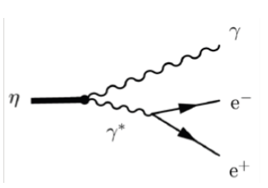
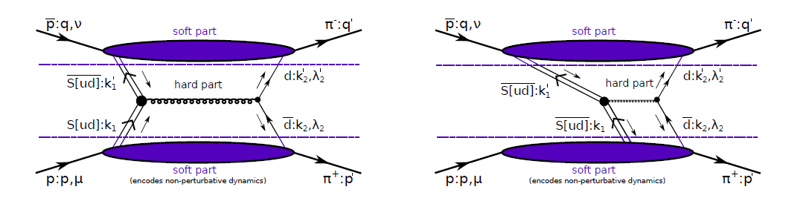
Perspectives for other studies
Meson transition Form Factors: (J. Meschendorp, KVI)
η→γe⁺e⁻, η’→γe⁺e⁻ , ω→π⁰e⁺e⁻, J/ψ→ e⁺e⁻ η_{c, .}η_{c}→ e⁺e⁻ γ …..
Hyperon transition Form Factors: (T. Johansson, K. Schőnning)
Σ⁰→Λe⁺e⁻ see K. Schönning’s talk
To be extended to many mesonic or baryonic transitions ( baryonic resonance Daliz decays,
cf HADES)
-
Double-handbag mechanism: TDA in pp→π⁺π⁻
A.T. Goritschnig et al., arXiv:1311.1908[hep-ph]

Slide 9
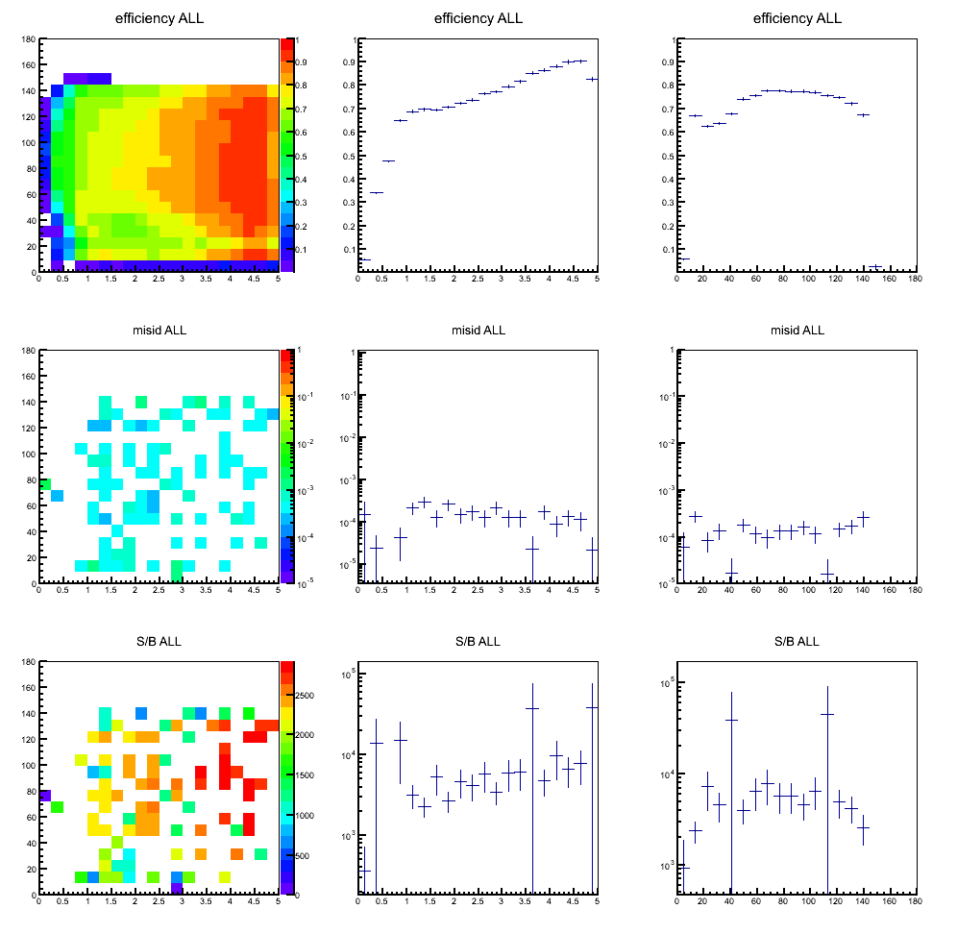
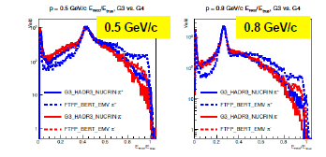
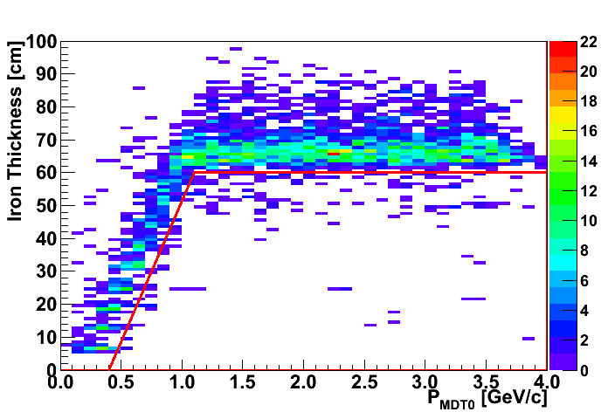
Analysis tool developments for electromagnetic channels
Morceaux choisis (2)
e/π Identification
Response of EMC to charged pions:
dependence on GEANT3/GEANT4 hadronic
models ( E. Atomssa’s talk , computing session )
Bayesian PID method R. Kunne (Orsay)
π⁻ efficiency
π⁻ efficiency
ε< 3 10⁻⁴
e⁻ efficiency
π⁺
π⁻
p (GeV/c)
p (GeV/c)
Electron momentum resolution:
Energy deposit in EMC/ total pion energy
Bremsstrahlung correction using
photon detection in EMC see B. Ma‘s talk
MDT: Hard Cuts
P(μ)=1
Muon tracking:
P(μ)=0
S. Spataro (Torino)

Slide 10
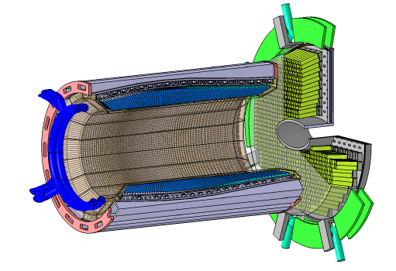
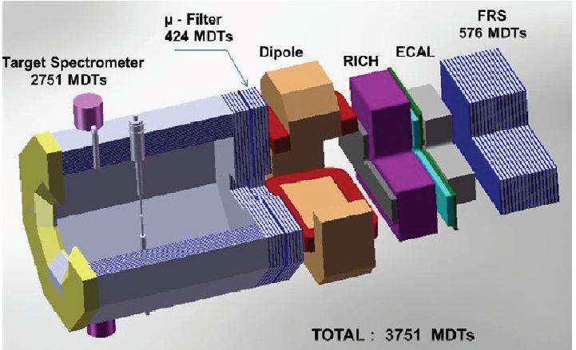
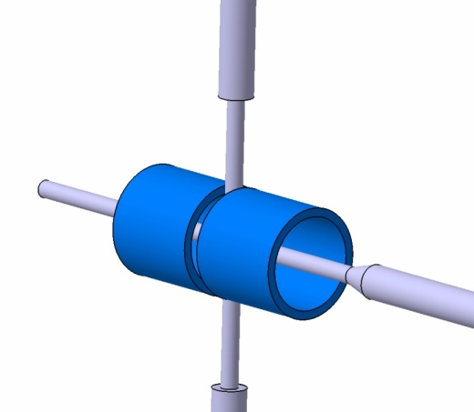
Tecnical developments for electromagnetic channels
R&D on detectors: EMC, muon tracker many labs involved
Filters for electromagnetic channels:
R. Kunne (IPN Orsay) and DAQT-FEE groups
Polarized target studies : B. Froehlich et al. (HIM Mainz)

Slide 11
HORIZON2020
New european framework programme
Proposal for a HadronPhysicsHorizon (HPH) Networking Activity
1 post-doc + money to organize meetings (accomodation and travel expenses)
mainly a follow-up of MESONNET network focused on rare meson decays and meson and baryon transition form factors (with contributions from WASA,HADES,…)
extension to PANDA activities via elastic Time-Like form factors (and possibly meson or baryon transition form factors, …)
guideline: hadronic corrections to g-2 (anomalous magnetic moment)

Slide 12
HPH proposal under construction
Preliminary list of foreseen topics for the new network
1 Hadronic Vacuum Polarization : hadronic cross sections
2 Hadronic Light by Light contribution to a_{μ}
3 Meson transition form factors (Kloe, WASA, BES… ) A.Kupsc (Uppsala)
4 Monte Carlo generators
5 Experimental studies of light meson decays and dynamics of hadronic final states
MAMI, DAPHNE, BEPCII, CEBAF, S. Giovannella (Frascati)
6 tau lepton hadronic decays
7 Model-independent methods for rare decays and transition form factors of light mesons
8 Dalitz decays of baryon resonances (HADES) Piotr Salabura (UJ Cracow) and B. R. (IPN Orsay)
9 Elastic time-like baryon electromagnetic form-factors PANDA B. R. (IPN Orsay), Piotr Salabura (UJ Cracow), Karin Schőnning (Uppsala)
10 non-1−− states in e+e− via 2-photon processes and connection with PANDA studies Johan Messchendorp (KVI)
11 Search for physics beyond SM
12 Hadron physics program for future low energy facilities MESA, IRIDE
13 Two photon contribution to space like FF of nucleons
PANDA activities highly welcome in this network
Please contact us if you plan to involve your institute
Dead line for submitting the proposal: end of march
Needed information before January 10, 2014
Participating institutes, number of EFT, proposed activities

Slide 13
Reminder
Forum: https://forum.gsi.de/
PANDA » PANDA - Physics » PANDA – EMP discussions
Mailing list : PANDA-EMP@WWW-LISTSERV.GSI.DE
Please subscribe , it is easier for information exchange
Thank you

