Slide 1
New ion collisions – LHC accelerator perspective
Low-intensity pilot runs for various ions a la 2025 O-O
High-intensity O-O running with slip-stacked beams
R. Bruce
Acknowledgement: R. Alemany, D. D'Enterria, M. Hostettler, J. Jowett,
E. Sarafoglou, M. Slupecki, N. Triantafyllou

Slide 2
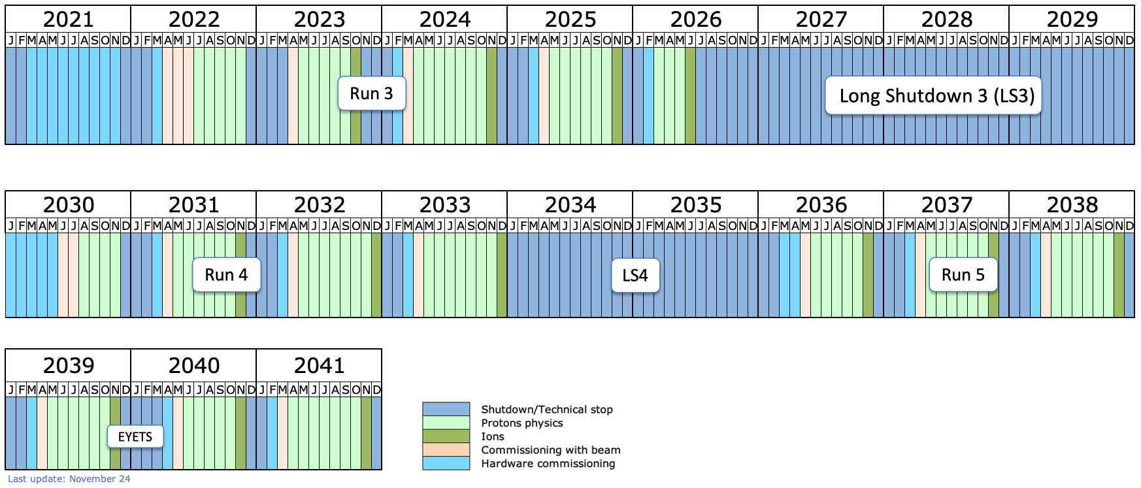
Introduction – LHC ion program
Typically one month of ion operation per year
Run 4: 3 ion periods foreseen
Approved baseline: Pb-Pb or p-Pb with targets in yellow report
  Light ions under study, but presently not part of approved program
  29 days/run* including commissioning
Run 5: 6 ion periods foreseen
  29 days/run*; detailed program not decided
  ALICE3 upgrade
    LOI target is 33 nb⁻¹ of Pb-Pb
    Other ion with A>100 considered if large gain in NN luminosity
*see LHC-PM-ED-0002

Slide 3
Light ions: motivation and background
Potential interest from physics community to collide light ion in the LHC
New ion collisions could be done either as
  Short "pilot runs" with low intensity, similar to O-O and Ne-Ne in 2025
    Shorter commissioning time, less stringent machine protection requirements
    Can be short --> will be less difficult to add in the already packed Run 4 program
  High-intensity runs with slip-stacked trains, similar to Pb-Pb
    Potential for much higher integrated luminosity
    Much longer commissioning required, both in LHC and injectors --> this type of run makes sense only if a longer time period is allocated
Any proposal for light ion operation will have to compete for time with other physics programs: heavy ions (Pb-Pb, p-Pb), pp (?) - competitiveness depends on achievable luminosity
This talk:
  Study integrated luminosity in hypothetical pilot runs for a range of interesting ions
  Study integrated luminosity in a hypothetical high-intensity O-O run
  Respond to request: beam evolution of O beam at LHC injection, for potential Pb-O collisions (requires second source)

Slide 4
Low-intensity pilot runs

Slide 5
LHC simulation principles and method
Step 1
  Simulate beam evolution at LHC injection plateau (intensity, emittance, bunch length)
  Include in particular effects of intrabeam scattering (emittance growth, losses out of the bucket)
  Apply generic intensity transmission through LHC ramp (97%) based on Run 3 experience
Step 2
  Simulate beam evolution in collision (intensity, emittance, bunch length, luminosity, ...)
  Include in particular intrabeam scattering, synchrotron radiation, non-collisional beam losses
Step 3
  Calculate optimal fill time and time-averaged luminosity for given turnaround time
  Calculate daily integrated luminosity, using assumption on machine availability / downtime
References for simulation setup: EPJ Plus paper , NIM paper

Slide 6
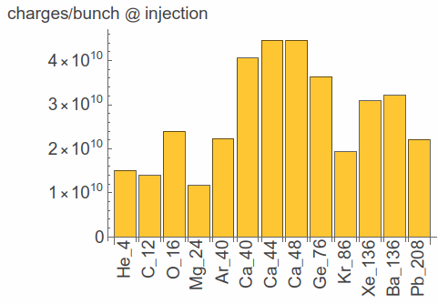
Simulation inputs (1)
Bunch intensities at LHC injection calculated using injector model (R. Alemany, M. Slupecki, E. Sarafoglou)
  Using injector model from NIM paper
  Assumptions: use single bunches as in 2025 OO / NeNe run; no trains
  Injector model tuned using 2025 Pb and O data
  no bunch splitting in LEIR or PS – might be optimistic, given that we had to do PS bunch splitting in the 2025 OO run to reduce ghost charge and avoid problems with LHC BPMs
  In addition to ions computed using injector model, adding O and Pb for reference/comparison using experimentally achieved values at LHC injection
Geometric emittance at injection assumed to be the same as for Pb (not calculated by injector model)

Slide 7
Simulation inputs (2)
Beam optics and crossing angles assumed identical to 2025 O-O run
  β*=0.5m at IP1/2/5, β*=1m at IP8
Max pileup requirements following inputs by LHC experiments
  ATLAS 0.6, ALICE 0.2 , CMS 0.6 , LHCb 1
  Separation levelling applied in cases where peak pileup exceeds requirement
Two beam energy assumptions checked
  Sqrt(sNN)=5.36 TeV, to match Pb-Pb and p-p reference run
  6.8 Z TeV : highest possible beam energy; different sqrt(sNN) for each ion
Bunch charge
  Taking the raw outputs of the injector model, or
  Capped at 2.5E10 charges/bunch to ensure compatibility with LHC beam position monitor electronics and transverse damper – unclear where the limit is and what can be done

Slide 8
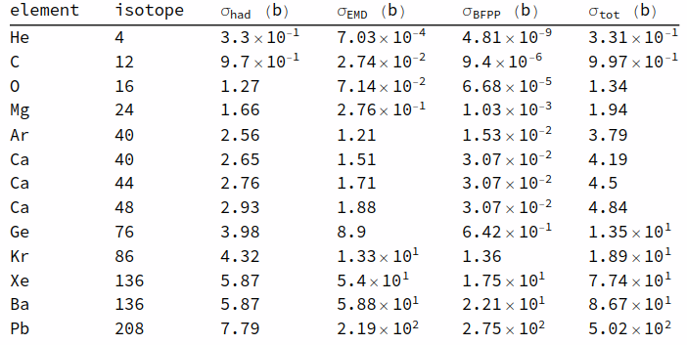
Simulation inputs (3)
Example: cross sections at sqrt(sNN) = 5.36 TeV
Hadronic cross sections
  calculated for most ions by D. D'Enterria using Glauber model
  Where no Glauber calculation is available, used fit in Accelerator handbook (J. Jowett et al.)
Electromagnetic cross sections
  Electromagnetic dissociation:
  using fit in Accelerator handbook
  (J. Jowett et al.)
  Bound-free pair production: using approximations in paper by Aste

Slide 9
Simulation inputs (4)
Filling scheme: same as for O-O with 62 bunches, 40 collisions / experiment
Assume average length of injection plateau of 34 min
  as in 2025 OO run
Assume average turnaround time of 2.4 h
  as achieved in the 2025 OO run
Fill length: keep fills as long as needed to achieve optimal fill time – assume no limitation from transmutation (optimistic?)
  See talk by John in last year's workshop
Assume 70% machine availability
  Note: we were lucky and had ~100% in the 2025 OO run

Slide 10
Errors and uncertainties
Machine availability
  random and unpredictable faults could have a major impact on the collected luminosity
  The shorter the run, the larger the potential impact!
  Even if beam and machine conditions would be known in detail, impossible to give an exact prediction due to availability
Beam parameters
  Most of these ions have never been produced, and in the table, only O, Xe and Pb have been collided in LHC
  Emittance not simulated – assumption on same emittance as Pb
  --> Large uncertainty on beam parameters; would need experimental verification --> could have large impact on luminosity
New regime of bunch charge for LHC operation – unclear where the limitations are for beam position monitors and transverse damper
20-30% mismatch between calculated/simulated and logged OO luminosity - under investigation
Could transmutation impose limits on the fill length or not?
Requirements on min. bunch spacing – if relaxed compared to OO, could review filling scheme
If we commission improved machine configuration for Pb, we could potentially use this to increase performance also for other ions

Slide 11
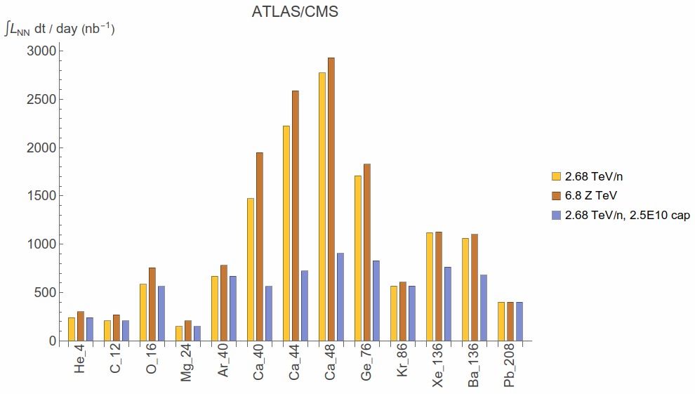
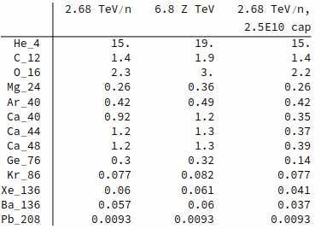
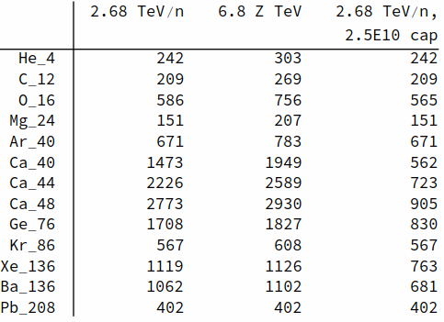
Simulated 1-day integrated luminosity at ATLAS/CMS
With max pileup=0.6, leveling never applied
For O-O, model gives ~40% lower luminosity than achieved in the 2025 run
  Can't count 100% machine availability as in 2025 – assuming here 70%
  Discrepancy between simulated/calculated and logged O-O luminosity
  Emittance more pessimistic in model (not tracked through complex)
Integrated AA luminosity per day (nb⁻¹)
Integrated NN luminosity per day (nb⁻¹)

Slide 12
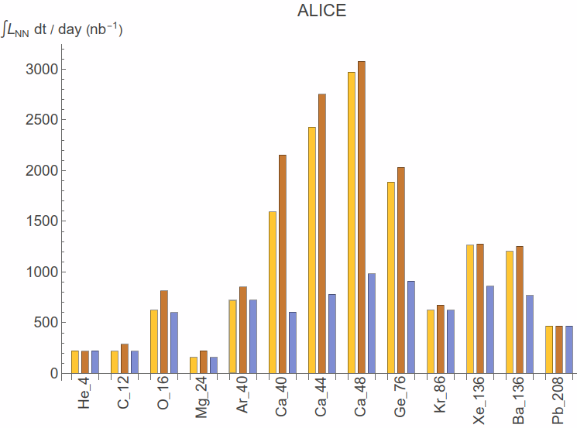
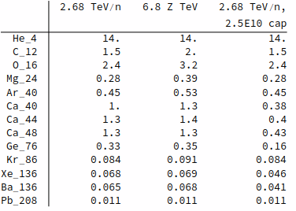
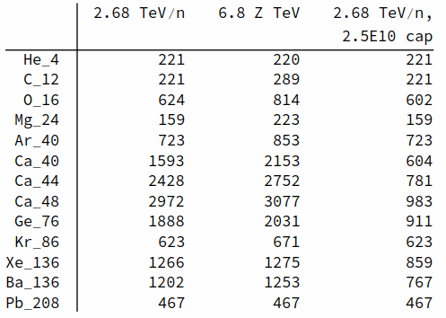
Simulated 1-day integrated luminosity at ALICE
With max pileup=0.2, leveling applied in a few cases (He, Ca)
Max event rate capped at 90 kHz
Integrated AA luminosity per day (nb⁻¹)
Integrated NN luminosity per day (nb⁻¹)

Slide 13
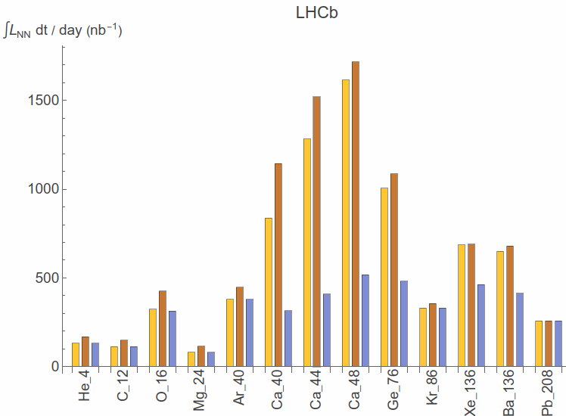
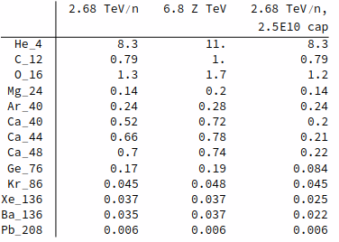
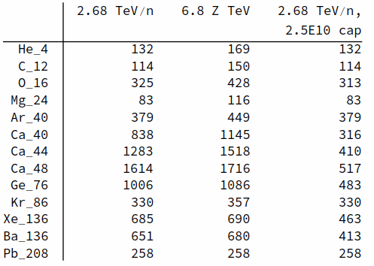
Simulated 1-day integrated luminosity at LHCb
With max pileup=1, leveling never applied
Integrated AA luminosity per day (nb⁻¹)
Integrated NN luminosity per day (nb⁻¹)

Slide 14
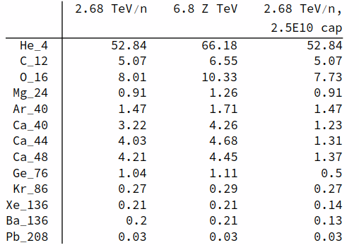
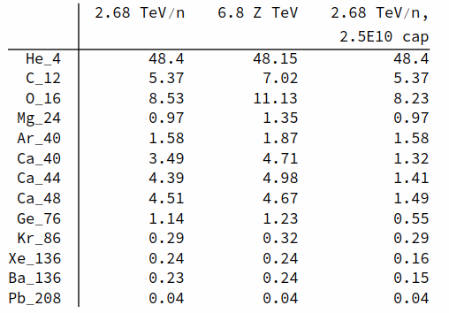
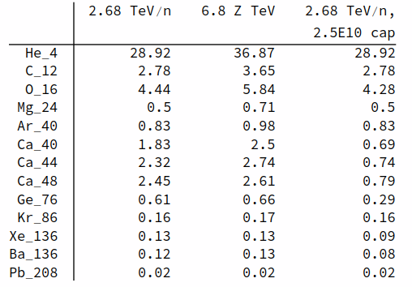
Example calculation: estimated AA integrated luminosity in 5-day run
Assume 5 days assigned, using 1.5 days for commissioning, with some optics commissioned beforehand during pp commissioning --> 3.5 days left for physics
Be aware of errors and uncertainties – see slide 7
Total integrated AA luminosity (nb⁻¹) in 5-day run (3.5 days of physics)
ATLAS/CMS
ALICE
LHCb

Slide 15
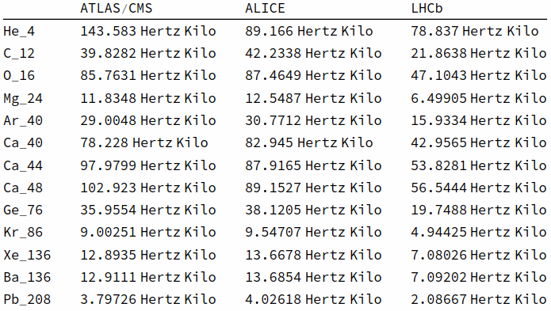
Peak rates
Peak hadronic rates at start of collision for 6.8 Z TeV case (gives highest rates)

Slide 16
Observations
Compared to 2025 O-O run (NN: 925 nb⁻¹/day at CMS)
  Lower daily NN luminosity expected with He, C, Mg
  Highest daily NN luminosity expected with Ge, Ca (winner)
Compared to high-intensity Pb-Pb operation with trains
(NN: 8000 nb⁻¹/day)
  All pilot runs give significantly lower daily NN luminosity
Estimated integrated luminosity to be compared with physics requirements for each ion

Slide 17
High-intensity O-O operation

Slide 18
Motivation and background
Important data sample acquired in the low-intensity 2025 O-O run
Potentially interesting physics case if this data set can be extended by significant factor
Could we run high-intensity O-O with slip-stacked trains, similar to Pb-Pb? What performance could we hope for?

Slide 19
Assumptions for LHC simulation
With high-intensity trains, different O beam production than in 2025 run (additional splitting, longer SPS cycle including slip-stacking)
Parameters of high-intensity O beam estimated in NIM paper
  About 1.6E9 O/bunch in baseline scenario with trains (compare: 2.75E9 O/bunch achieved in 2025 with single bunches)
  Total stored beam energy of ~17 MJ (compare 29 MJ with Pb)
As for pilot runs, simulated luminosity in high-intensity O-O fill used to estimate average daily integrated luminosity. Assumptions:
  6.8 Z TeV beam energy
  Same optics and filling scheme as for Pb-Pb (1032 collisions at IP1/2/5, 557 at IP8)
  No luminosity levelling assumed (optimistic?) - Peak rates of up to 890 kHz, pileup up to 0.08
  Average turnaround time of 3.33 h
  50 % operational efficiency – lower than achieved 2026 with Pb, gives margin for surprises with new ions

Slide 20
Assumptions for estimating integrated luminosity in full run
Need at least the same commissioning time as for Pb
  4 days scheduled for Pb, managed with only 3.5 days in 2026 (but optics not included - commissioned earlier with protons)
  Very likely longer commissioning with new ion. Guess: 4.5 days for O
Assume 3.5 days of intensity rampup and VdM scans, with 1/3 of the daily production compared to full-machine

Slide 21
Errors and uncertainties
Availability: As for all short runs, unpredictable random faults (or their absence) can strongly affect total integrated luminosity
Beam parameters: Slip-stacked O beams never produced – significant uncertainty on beam parameters
Beam losses (to be studied): Any bottlenecks from collimation, collisional beam losses or radiation?
Any performance limit from experimental backgrounds?
Assuming we don't need to shorten fills due to transmutation
  Optimum fill time found to be 12-13 h; assuming this can be used

Slide 22
Simulation result
Result: with full machine, average integrated AA luminosity of
18 nb⁻¹/day, consistent with NIM paper
  NN integrated luminosity: 4600 nb⁻¹/day
Compare 2025 O-O run: AA ~3.6 nb⁻¹/day (CMS example), with ~100% availability (lucky)
  As cross-check, rough scaling to full machine from pilot run: lose factor ½ in bunch intensity for additional splitting – lose factor 4 in luminosity; gain factor 1032/40 in number of collisions; scale to 70% availability (more realistic) --> scaling gives 16 nb⁻¹/day with high intensity

Slide 23
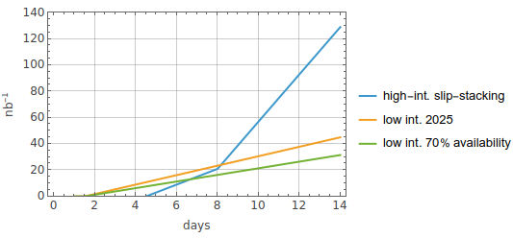
Results: projected integrated O-O luminosity vs time, compared to pilot run
Investment in longer commissioning for high-intensity run starts paying off if total allocated time is above 7-8 days
To accumulate O(100 nb⁻¹), factor ~10 above the 2025 data set, we need about 13 days
Numbers can vary significantly in both directions due to actual machine availability and faults
Integrated AA luminosity

Slide 24
High-intensity O beam evolution at LHC injection

Slide 25
Motivation
Potential interest in Pb-O collisions – possible only if we have a second source
We would need to first do all injections in one ring, then switch the injector complex to the other species, then inject in the other ring
O expected to have better lifetime than Pb – fill O first
Question: how does the O beam degrade at LHC injection? Can it be kept sufficiently long for the injectors to switch to Pb?

Slide 26
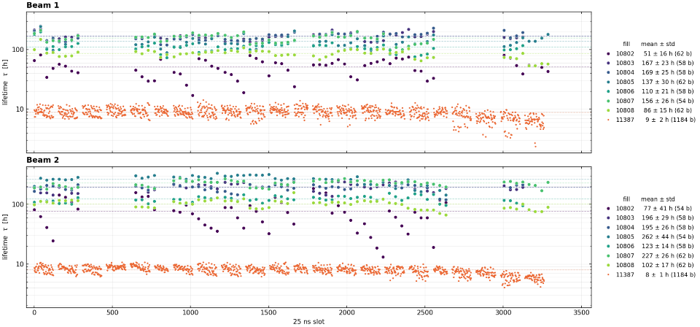
Measured evolution at injection in 2025 O-O run
O - single bunches: lifetime consistently above 50h; average ~150h
Pb trains: average 8-9 h lifetime
M. Hostettler

Slide 27
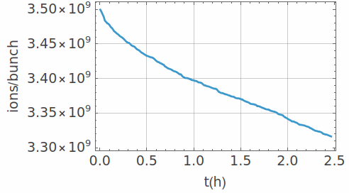
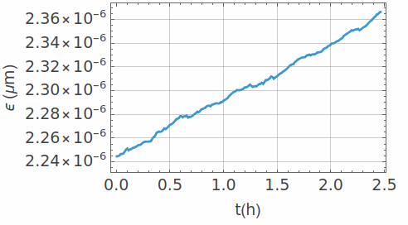
Simulated evolution of slip-stacked O trains
Simulated lifetime of ~44h at LHC injection plateau
Mild emittance blowup of a few percent per hour
Conclusions:
  A mild degradation of beam quality can be expected, not preventing operation.
  No showstopper has been found against injecting O and waiting for injectors to switch to Pb

