Slide 1



Gearing up for GSI/FAIR:
State-of-the-art simulations of dense baryonic matter
Hannah Elfner
September 25th 2026, EMMI Workshop on Light Ion Collisions

Slide 2
  Outline
Heavy-Ion Collisions at Low Beam Energies
Transport Approaches
  Degrees of freedom, potentials
  Equation of state of nuclear matter
  Strings and rope formation -> strangeness
Hybrid Approaches
  Dynamical Initial Conditions
  Phase transition signatures?
  Dileptons and net proton fluctuations
Experimental Status of CBM at FAIR
Hannah Elfner
Light Ion Collisions
09/25/2026

Slide 3
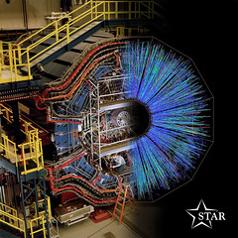
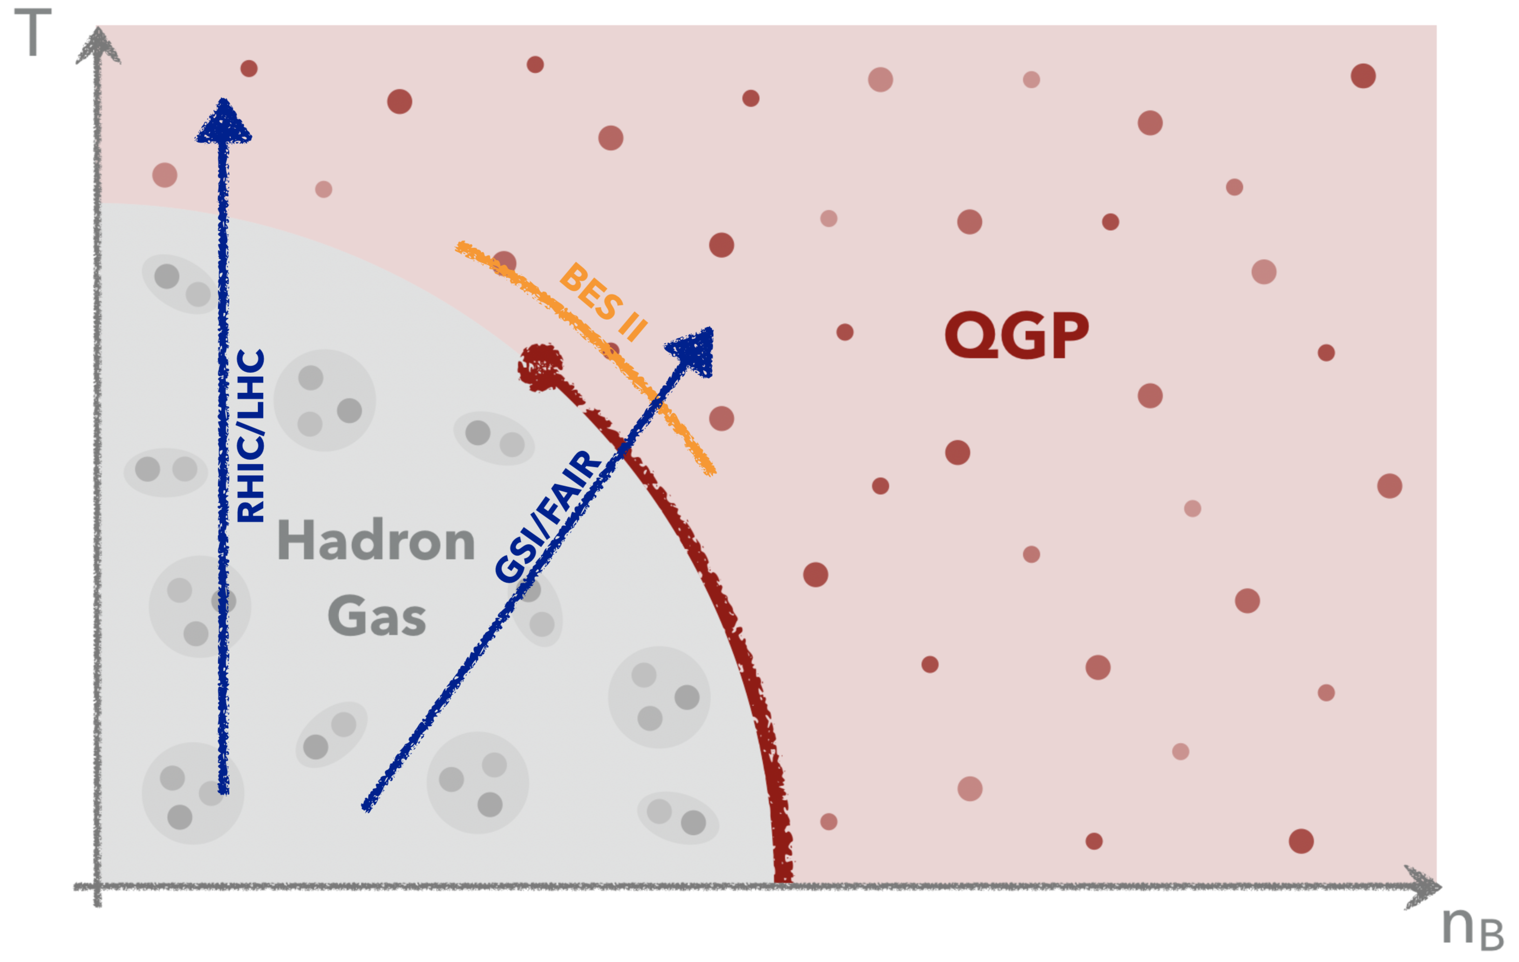
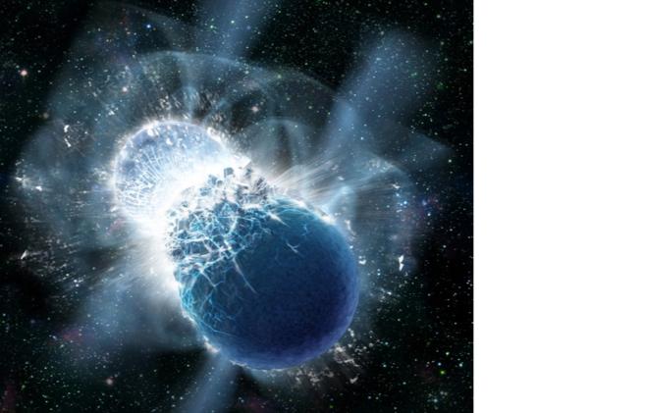
The QCD Phase Diagram
Main goals of heavy-ion research:
  What are the relevant degrees of
  freedom at high densities?
  Phase transition, critical endpoint?
  Properties of neutron star mergers?
STAR experiment at RHIC
Relevant for neutron star mergers as detected by gravitational waves (GW170817)
Dana Berry, SkyWorks Digital, Inc
Hannah Elfner
Light Ion Collisions
09/25/2026

Slide 4
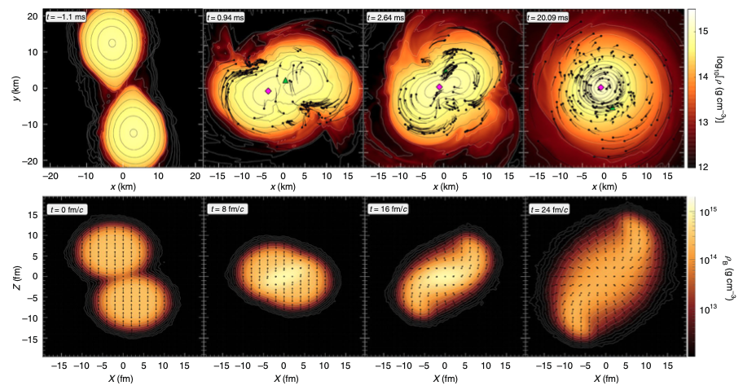
Matter at Extreme Densities
18 orders of magnitude in scales, still similar temperature up to ~80 MeV and densities up to 2-4 times nuclear ground state density
Binary neutron star mergers: First detected events are GW170817, GW19042
Heavy-ion collisions: Ongoing experiments: RHIC-BES, NA61, HADES, FAIR Phase-0
HADES collaboration, Nature Physics 15, 1040-1045 (2019)
Hannah Elfner
Light Ion Collisions
09/25/2026

Slide 5
Dynamical Description
Standard approach at high energies
  Non-equilibrium initial evolution
  Viscous hydrodynamics
  Hadronic rescattering
Status: Two regimes with well-established approaches
Intermediate regime requires appropriate description
Reference to PRC 78, 2016
Low beam energies probe limits of applicability of fluid dynamics as small systems
Standard approach at low beam energies
Hadronic transport approaches
Resonance dynamics
Nuclear potentials
Hannah Elfner
Light Ion Collisions
09/25/2026

Slide 6
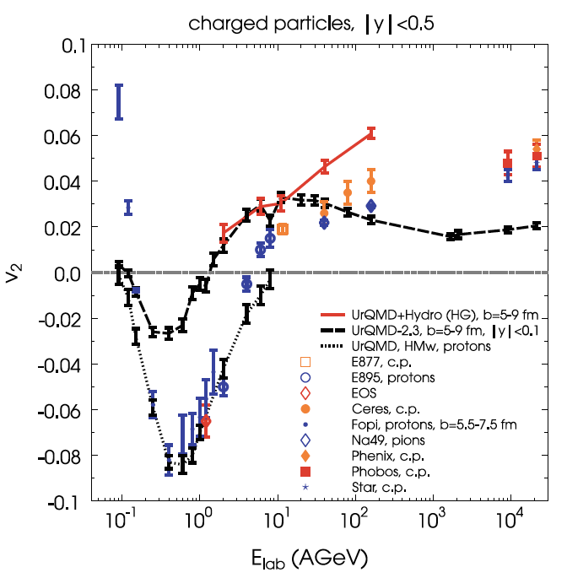
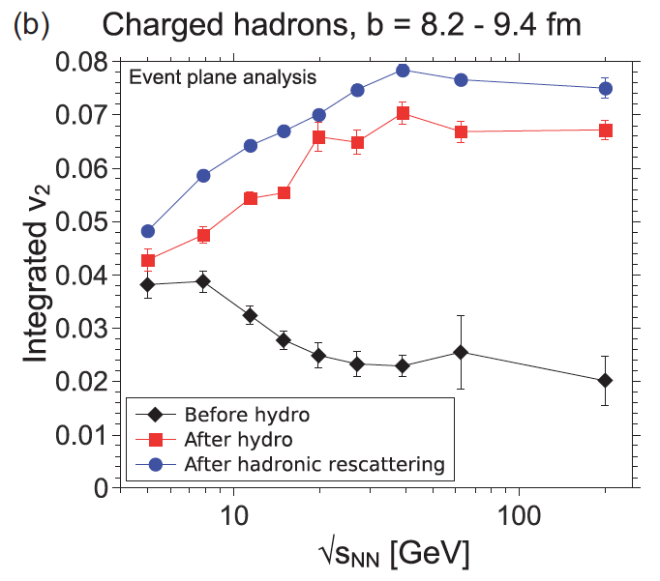
Elliptic Flow Excitation Function
Low energies require mean field potentials
High energies are well described by hybrid approaches
Transition region in between
J. Auvinen and HP, PRC 88, 2013
HP et al, EPJC 62, 2009
Hannah Elfner
Light Ion Collisions
09/25/2026

Slide 7
Transport Approaches

Slide 8
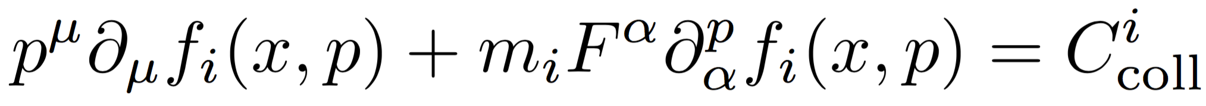
Transport Approaches
Hadronic transport approach (SMASH, UrQMD, GiBUU):
  Includes all mesons and baryons up to ~2 GeV
  Binary interactions: Inelastic collisions through resonance/string excitation and decay
  Boltzmann equation:
  PHQMD includes treatment of light nuclei production and their interactions
Au+Au at EKin = 0.8 AGeV, b=3 fm
J. Weil et al, PRC 94 (2016)
Hannah Elfner
Light Ion Collisions
09/25/2026

Slide 9
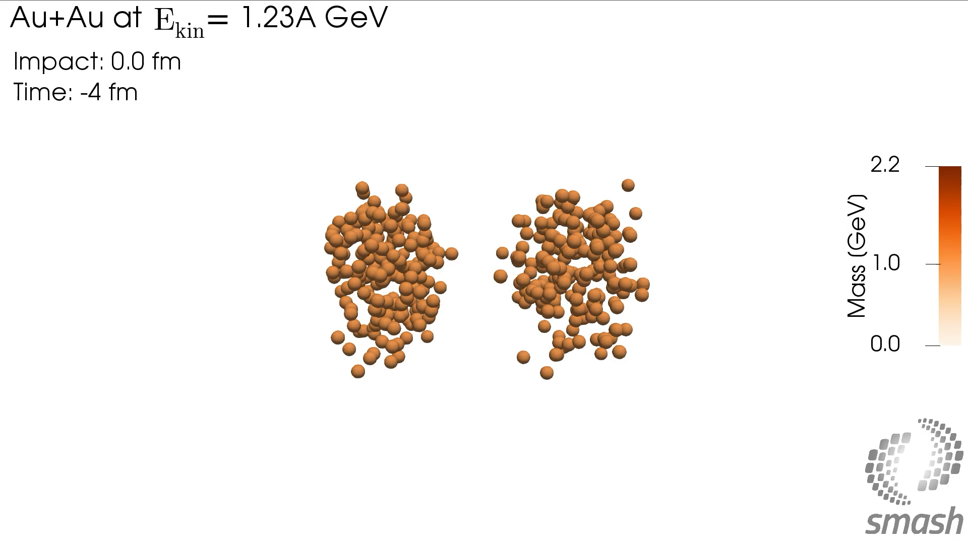
Example for GSI Energy
Reference to PRC 78, 2016
https://cloud.itp.uni-frankfurt.de/s/YJb9zEfzwqXmwgp
Hannah Elfner
Light Ion Collisions
09/25/2026

Slide 10
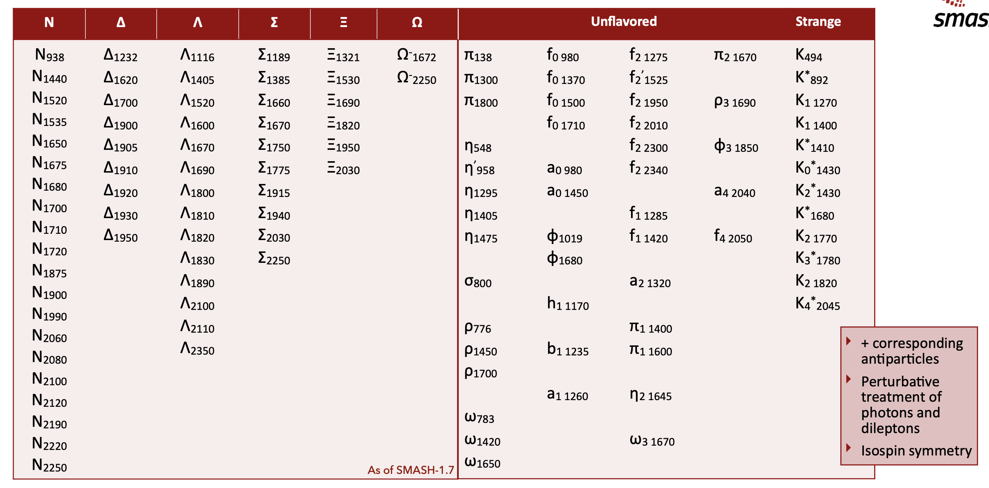
Degrees of Freedom
Blab
Reference to PRC 78, 2016
New jpg from JB
Mesons and baryons according to particle data group
Isospin multiplets and anti-particles are included
Hannah Elfner
Light Ion Collisions
09/25/2026

Slide 11
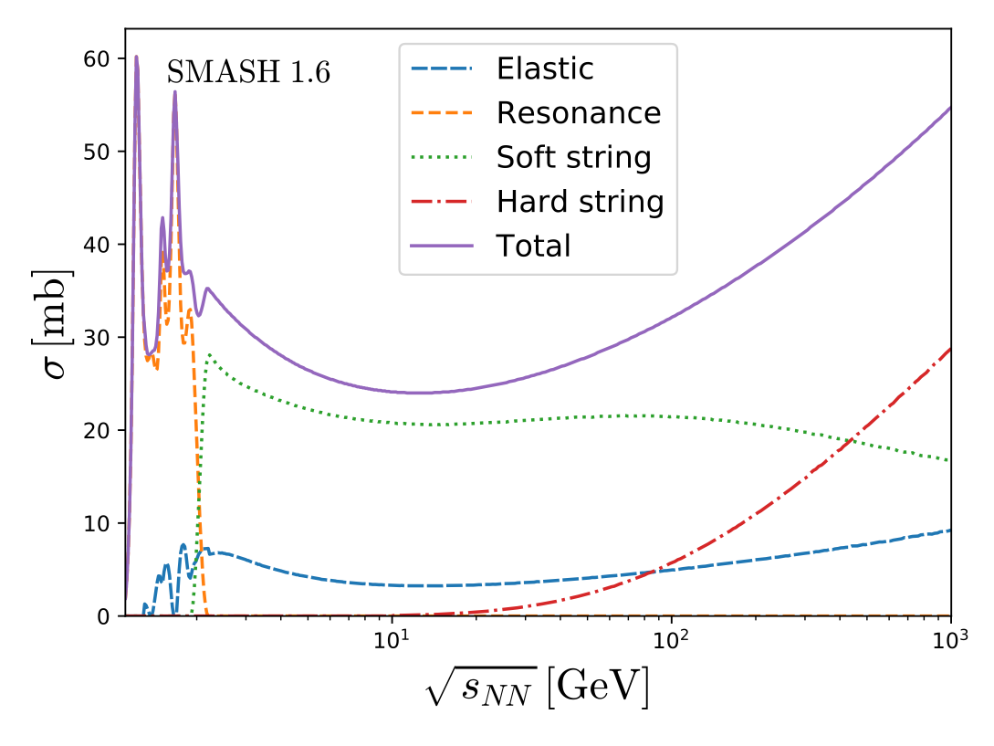
Cross-Sections
High energy cross-section is dominated by string excitation and fragmentation while low energy cross-sections are treated via resonances
Soft strings
  Pythia is only employed for fragmentation
  Single-diffractive, double diffractive and non-diffractive processes
Hard strings
  Fully treated by Pythia
  All species mapped to pions and nucleons
p-π⁻
J. Mohs, S. Ryu and HE, J.Phys.G 47 (2020)
Hannah Elfner
Light Ion Collisions
09/25/2026

Slide 12
Equation of State of Nuclear Matter

Slide 13
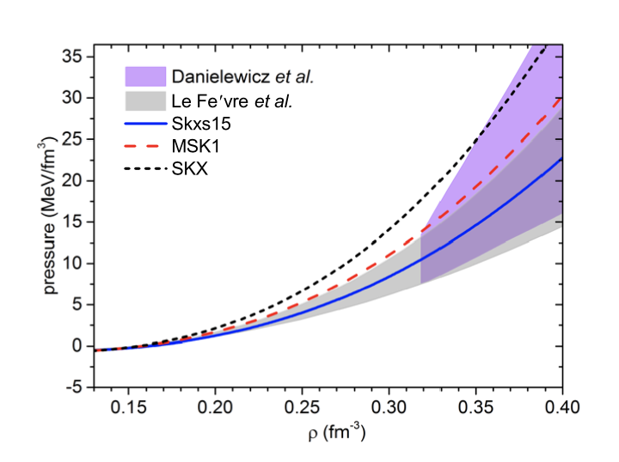
Nuclear Matter Equation of State
‚Danielewicz constraint‘ and newer constraints ->varying mean field parameters to fit flow observables best
Open issues: Results are dependent on details of transport code and in particular mean field properties, e.g. BUU vs QMD, cluster formation, form of the potential…
Y. Wang et al, arXiv:1804.04293
Hombach et al, Eur.Phys.J.A 5 (1999)
Show importance of resonances
TMEP collaboration, e.g. Prog.Part.Nucl.Phys. 125 (2022)
Hannah Elfner
Light Ion Collisions
09/25/2026

Slide 14
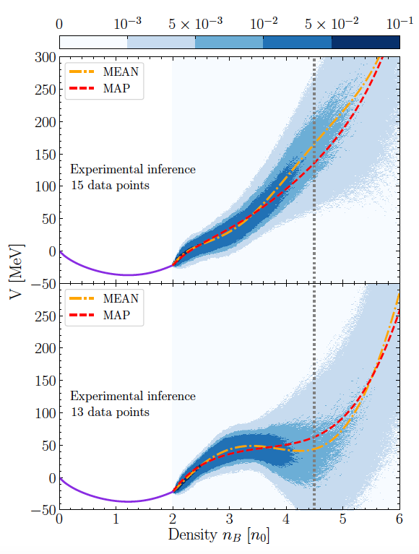
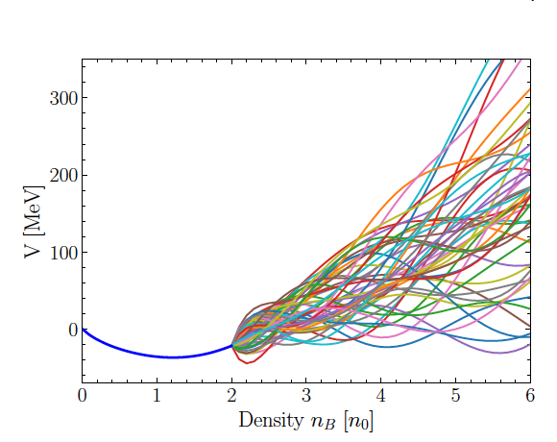
Bayesian Constraints
Chiral mean field in UrQMD allows to vary equation of state -> Bayesian analysis is performed and indicates dependence on which observables are used
Mean transverse mass and elliptic flow from $\sqrt{s_{NN}}$ = 3-9 GeV
M. Omana Kuttan et al., PRL 131, 2023
Hannah Elfner
Light Ion Collisions
09/25/2026

Slide 15
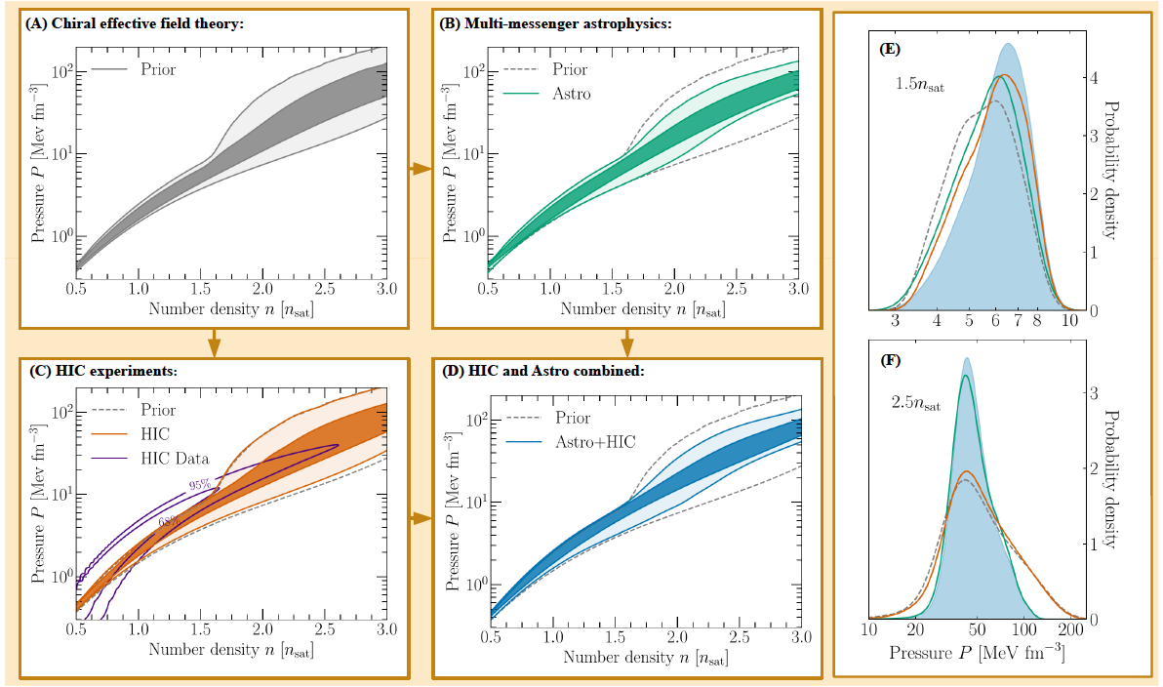
Combing with Astrophysics
Combination of analysis of heavy-ion data and astrophysical constraints
Dependence of results on prior based on chiral effective field theory
S. Huth et al., Nature 606, 2022
Hannah Elfner
Light Ion Collisions
09/25/2026

Slide 16
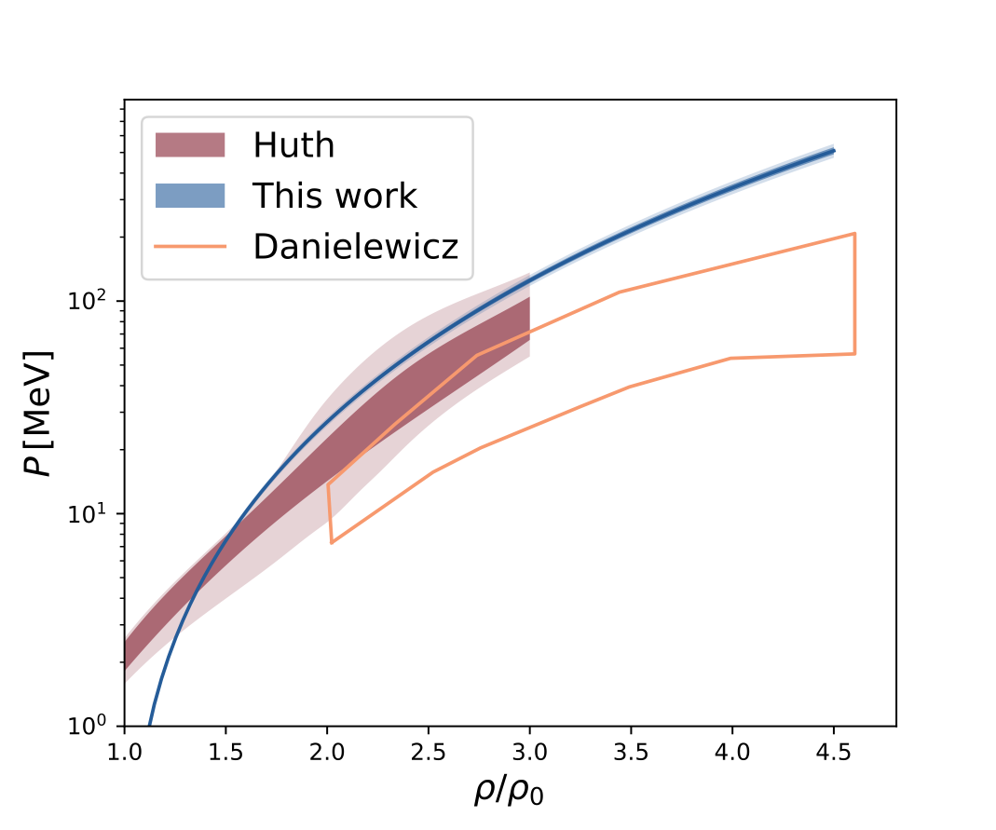
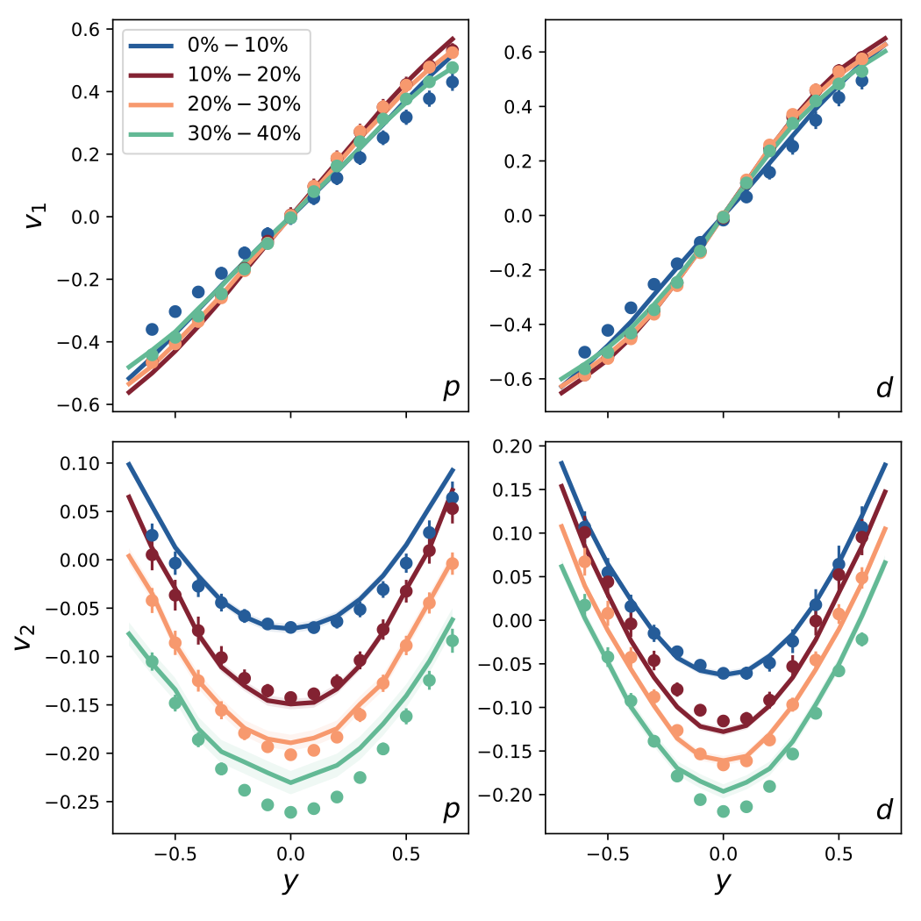
Bayesian Analysis with HADES Data
Comparing the maximum of the posterior distribution to data
Not all data perfectly reproduced but good agreement overall
The pion and kaon yields also agree with HADES measurements
J. Mohs, S. Spies, HE, PRC 112 (2025)
Hannah Elfner
Light Ion Collisions
09/25/2026

Slide 17
Strings and Rope Formation

Slide 18
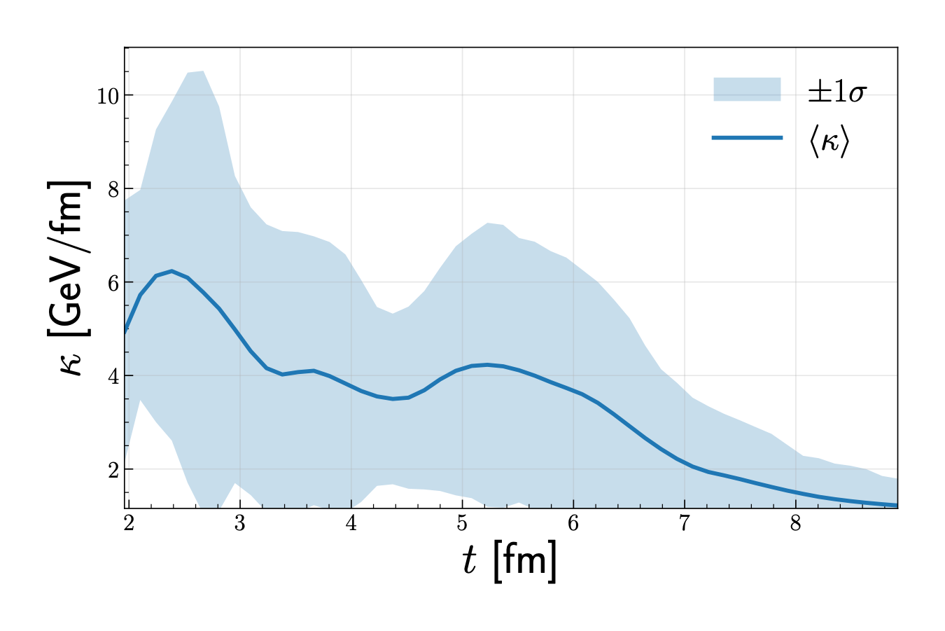
Towards Collectivity
Introducing rope formation in a non-equilibrium transport approach
Does one reach the same level of collectivity as in a hybrid approach?
Idea: Overlapping strings lead to larger string tension following the Angantyr+Ropes approach
Mean string tension over time in a Pb+Pb collision in SMASH at $\sqrt{s_{NN}}$ =17.3 GeV
(default is 1 GeV)
C. Rosenkvist and HE, arXiv:2609.28070
Hannah Elfner
Light Ion Collisions
09/25/2026

Slide 19
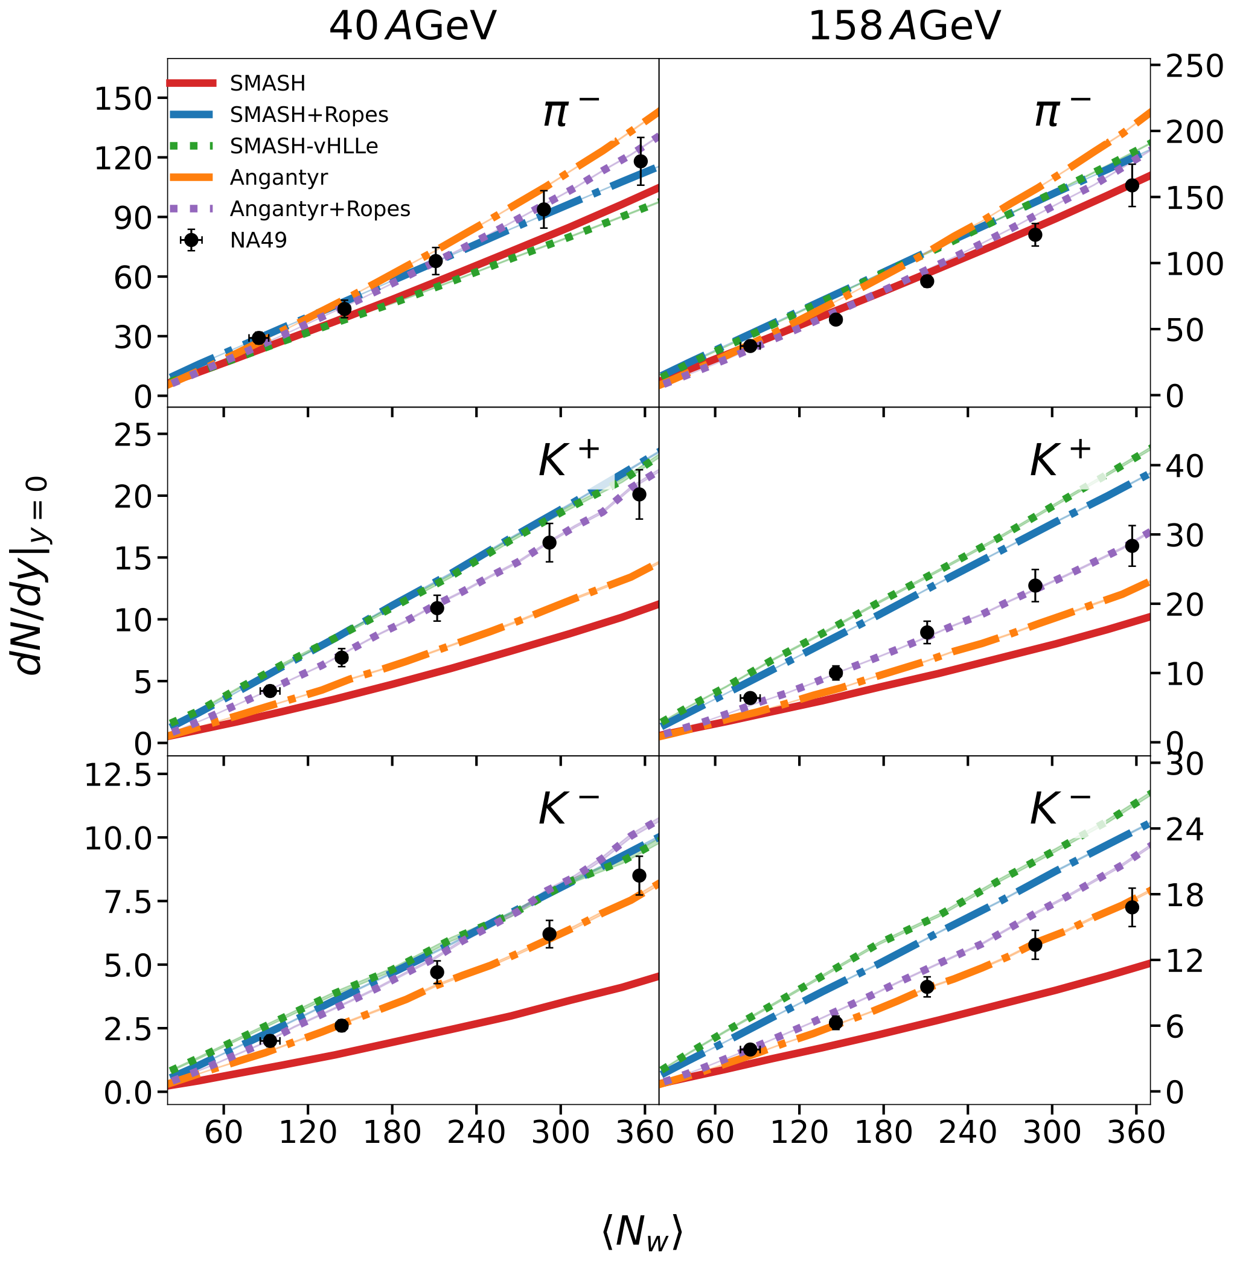
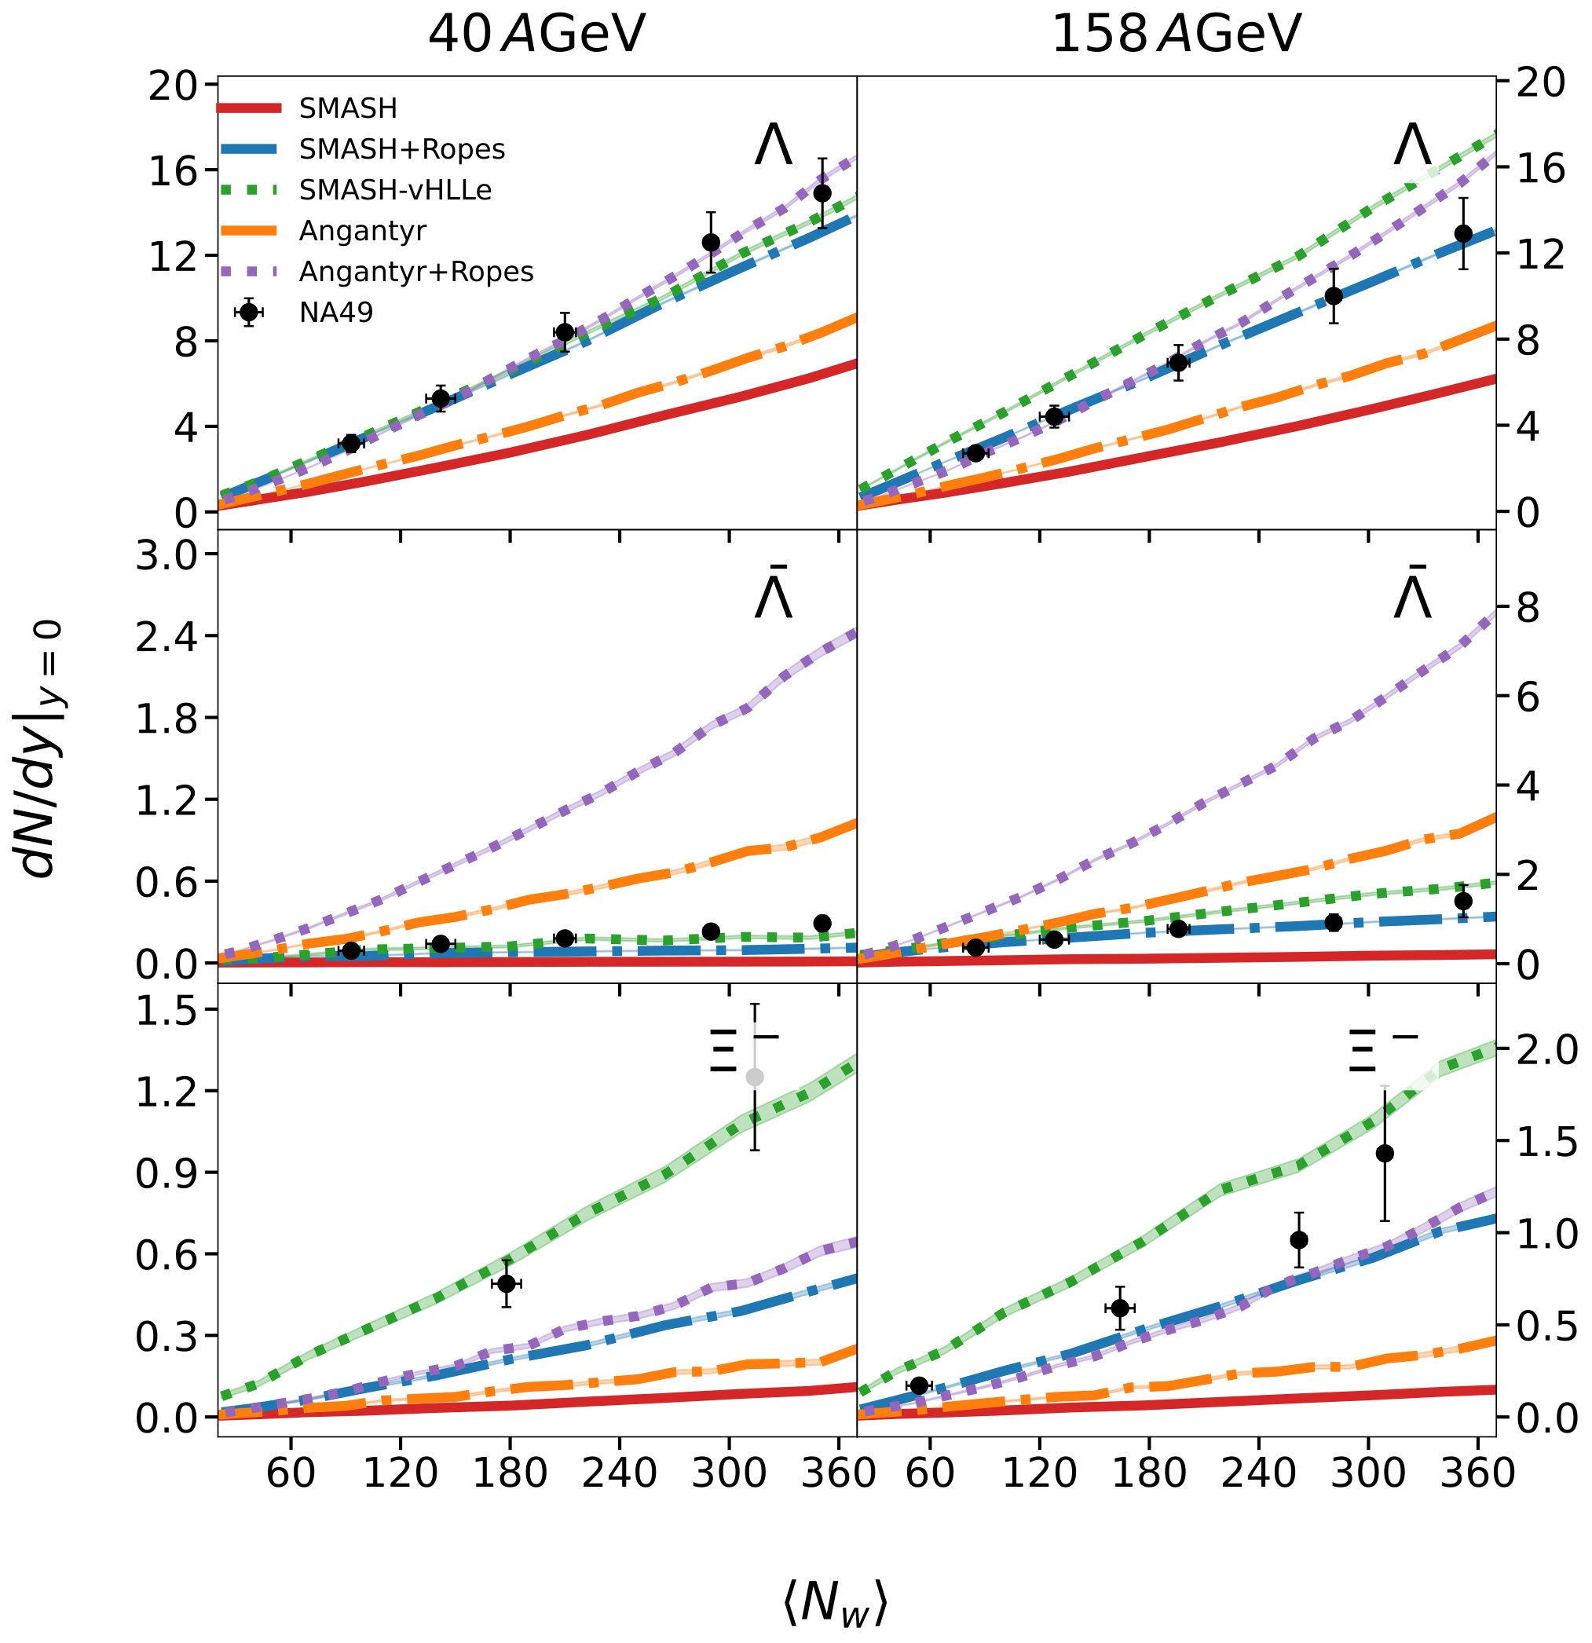
Strangeness Production
Ropes mechanism enhances strangeness production
Ropes lead to similar results as full hybrid approach
C. Rosenkvist and HE, arXiv:2609.28070
Hannah Elfner
Light Ion Collisions
09/25/2026

Slide 20
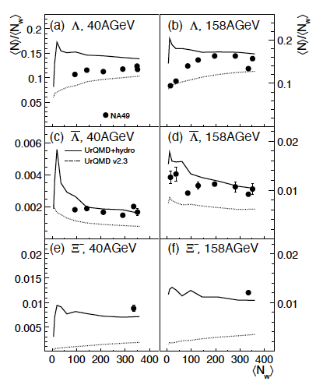
Similar Trends seen before
In particular multi-strange baryons are sensitive to hot and dense stage
Measurements of rare species is one of the goals for CBM at FAIR
Sensitivity to the equation of state is expected
HP et al, PRC 80, 2009
Hannah Elfner
Light Ion Collisions
09/25/2026

Slide 21
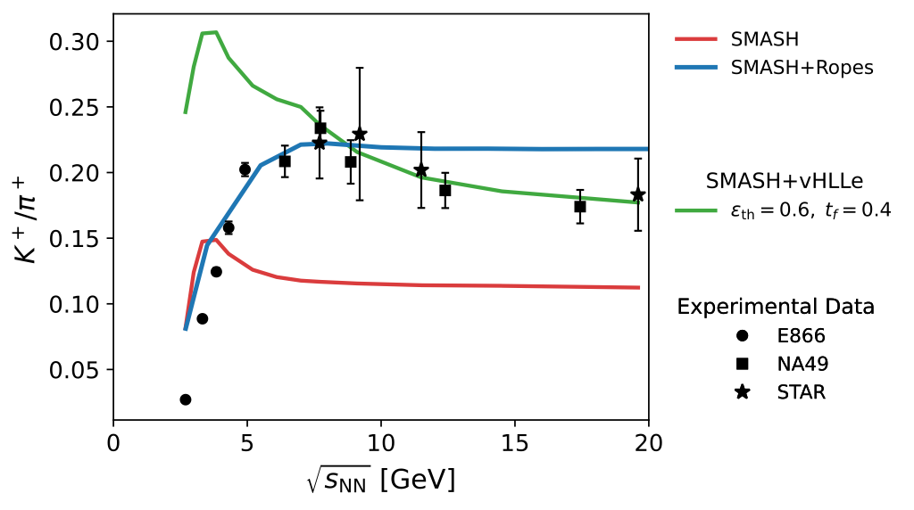
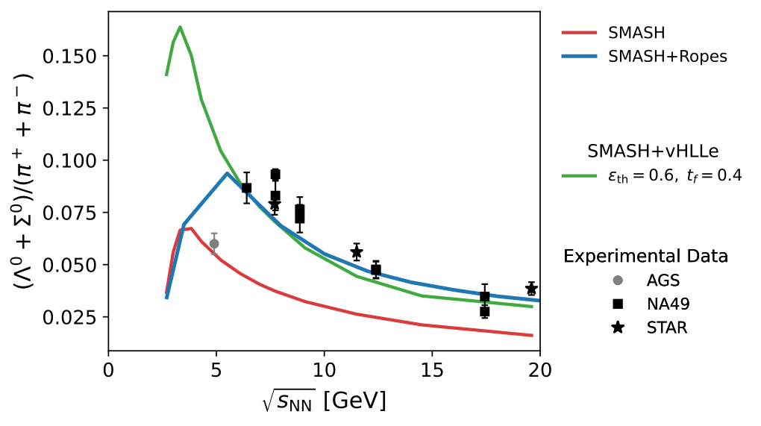
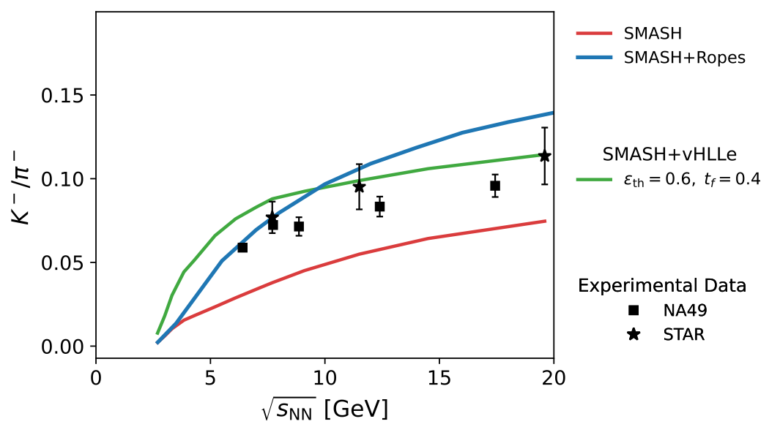
Excitation Function
Rope formation interpolates between pure transport and hybrid approach as a function of beam energy
C. Rosenkvist and HE, arXiv:2609.28070
Hannah Elfner
Light Ion Collisions
09/25/2026

Slide 22
Hybrid Approaches

Slide 23
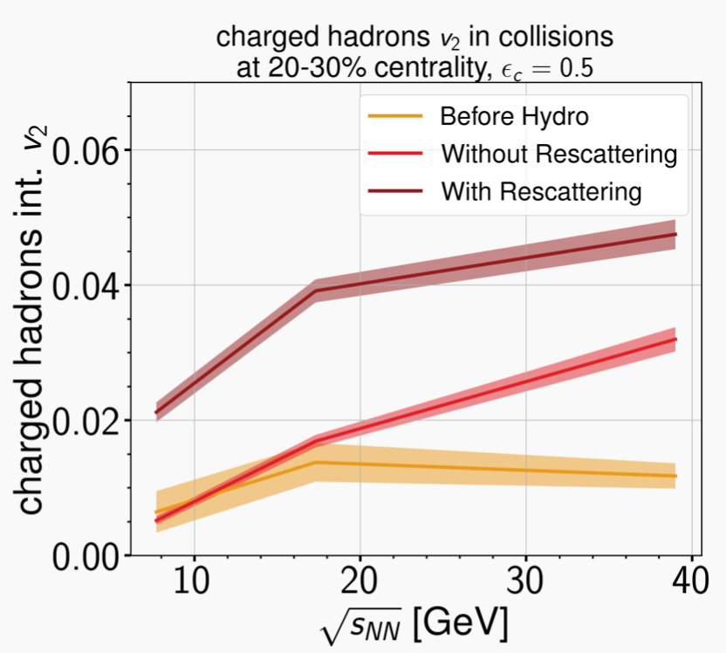
SMASH-vHLLE Hybrid Approach
Modular hybrid approach for intermediate and high energy heavy-ion collisions
Open source and public
Hadronic transport approach
Initial conditions
SMASH
+
3+1 D viscous hydrodynamics
(event-by-event)
Cornelius routine for hypersurface
vHLLE
https://github.com/smash-transport/smash-vhlle-hybrid
+
smash-hadron-sampler
Cooper-Frye sampler
Particlization of fluid elements
+
N. Götz and HE, Phys.Rev.C 106 (2022)
Hadronic transport approach
Evolution of hadronic rescattering
SMASH
A. Schäfer et al., Eur.Phys.J.A 58 (2022)
Huovinen et al.: Eur. Phys. J A 48 (2012)
Karpenko et al.: PRC 91, 064901 (2015)
Karpenko et al.: Comput. Phys. Commun. 185 (2014)
Hannah Elfner
Light Ion Collisions
09/25/2026

Slide 24
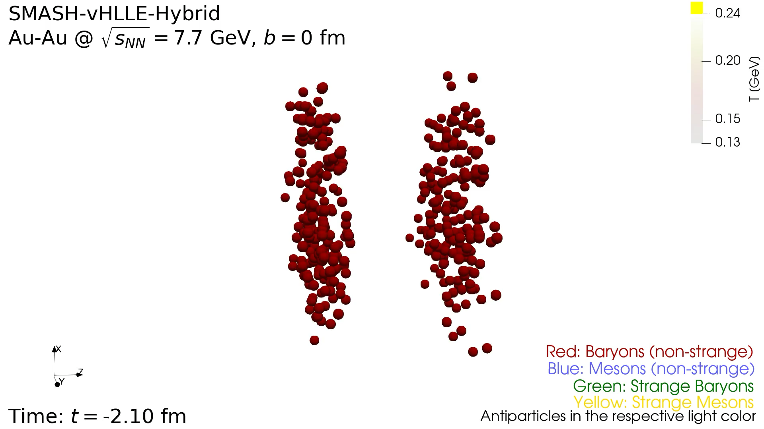
Hybrid Visualization
https://cloud.itp.uni-frankfurt.de/s/8HWkFt8i8yJWbWT
Hannah Elfner
Light Ion Collisions
09/25/2026

Slide 25
Dynamical Fluidization

Slide 26
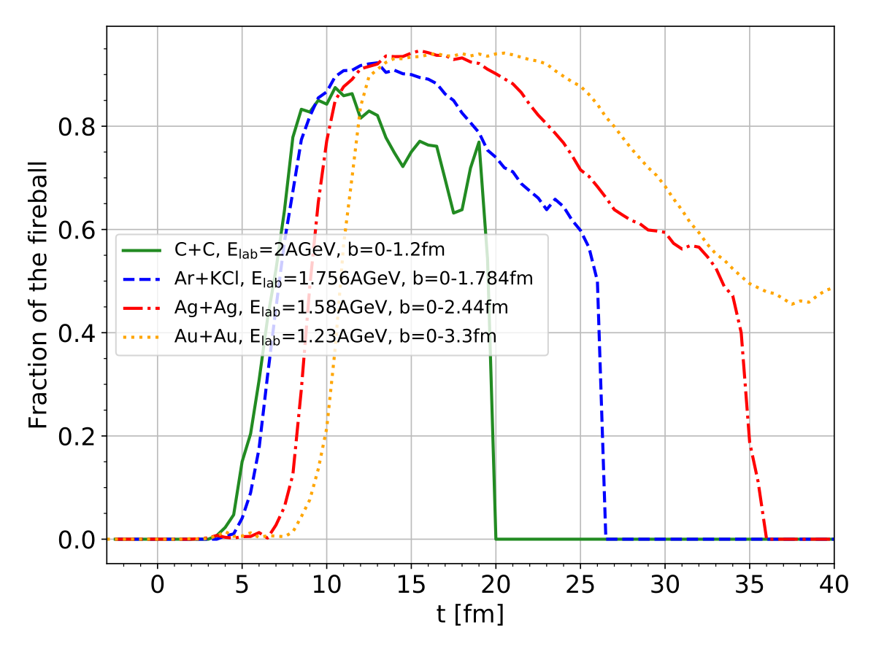
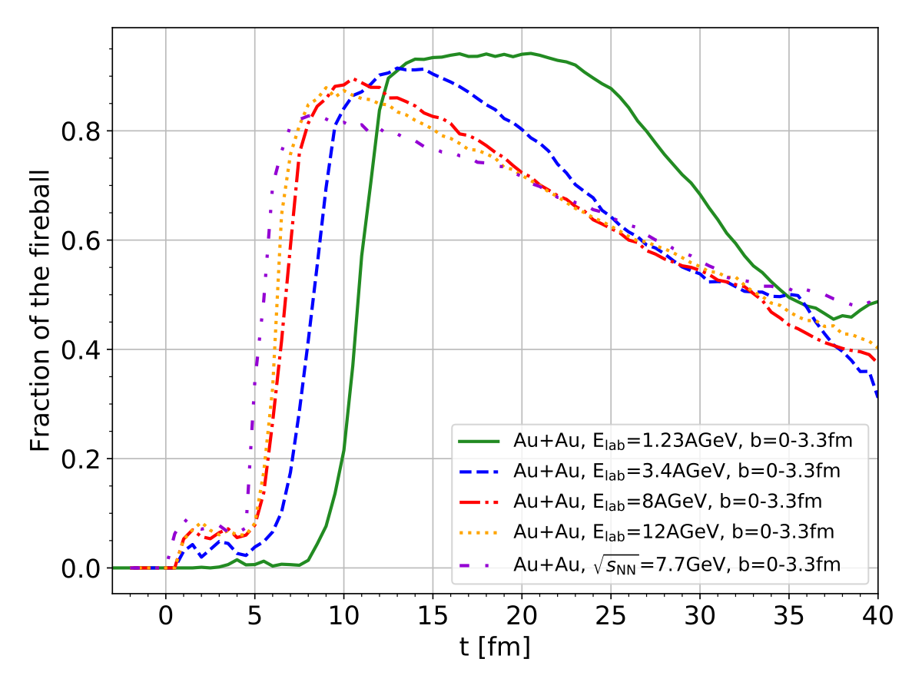
Local Equilibrium
Percentage of fireball close to local equilibrium in different collision systems (left) and in Au+Au collisions at different beam energies (right)
Calculation within coarse-grained SMASH hadronic transport approach by investigating properties of T^{μν}
X, Y < 0.3 and ε > 1 MeV/fm³
G. Inghirami and H. Elfner, EPJC 82 (2022)
Hannah Elfner
Light Ion Collisions
09/25/2026

Slide 27
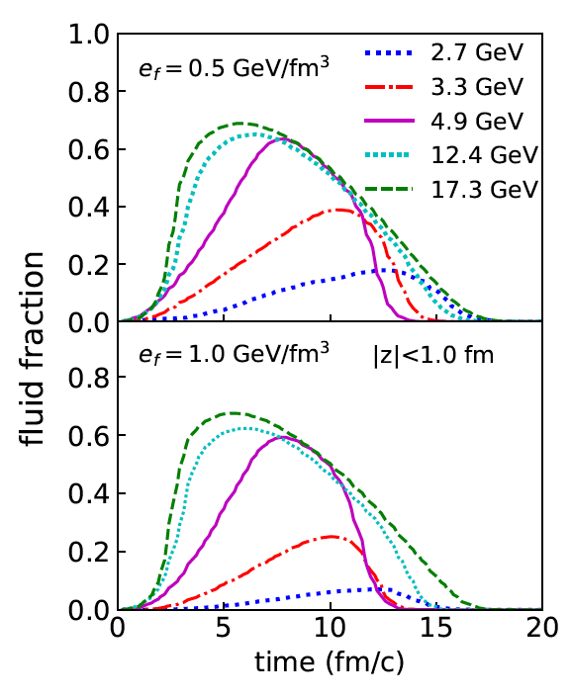
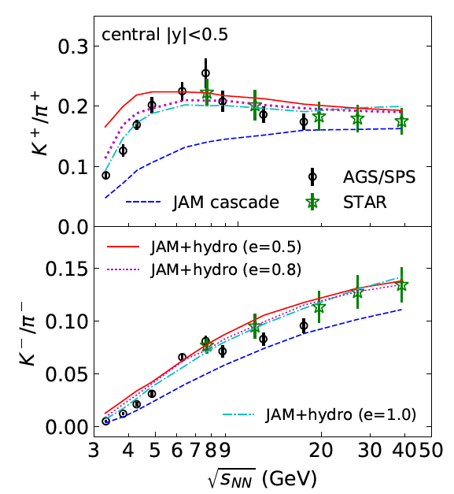
JAM+Fluid Dynamics
Reference to PRC 78, 2016
Energy density based decision of fluid formation
Strangeness production is enhanced
Y. Akamatsu et el, PRC 98, 2018
Hannah Elfner
Light Ion Collisions
09/25/2026

Slide 28
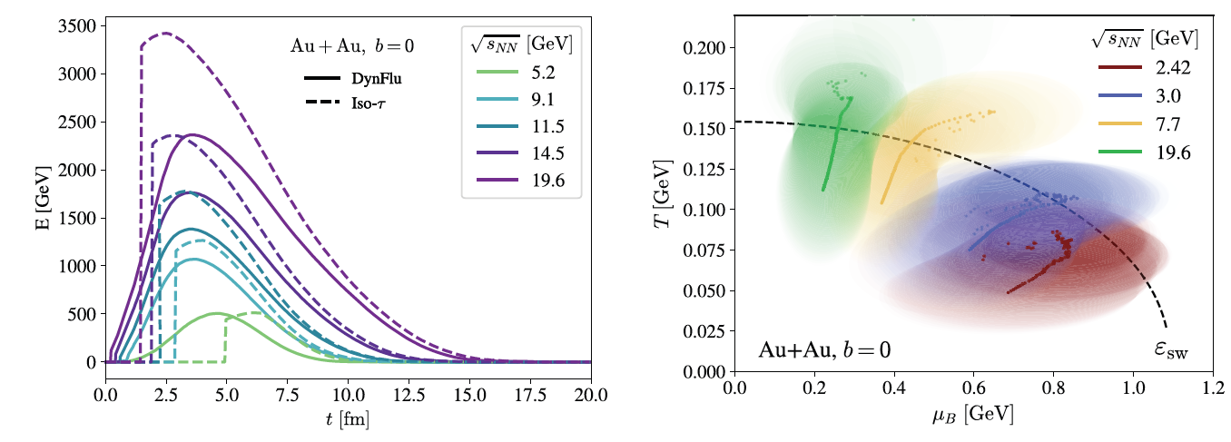
SMASH-vHLLE Hybrid
SMASH particles are converted to fluid when the cells get to high enough energy density
Allows to apply hybrid approach down to ~1 GeV/nucleon
Phase transition can be controlled within hydrodynamics
R. Góes-Hirayama et al, PRC 113, 2026
Hannah Elfner
Light Ion Collisions
09/25/2026

Slide 29
Phase Transition Signatures

Slide 30
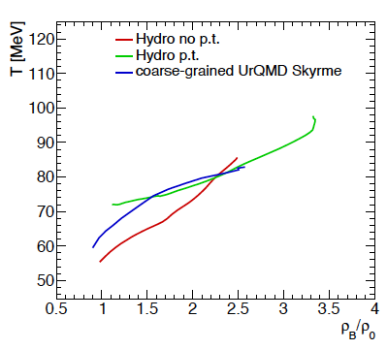
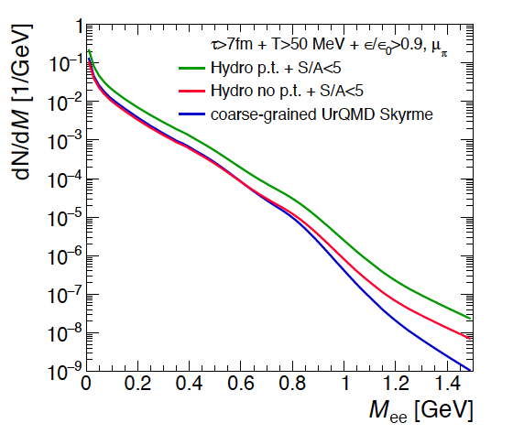
Dilepton Emission
Coarse-grained UrQMD compared to UrQMD hybrid approach with and without first order transition
Dilepton emission is enhanced due to latent heat
F. Seck et al, PRC 106, 2022
Hannah Elfner
Light Ion Collisions
09/25/2026

Slide 31
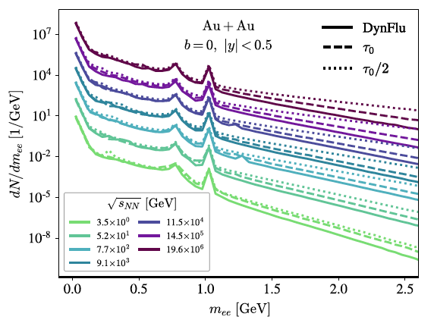
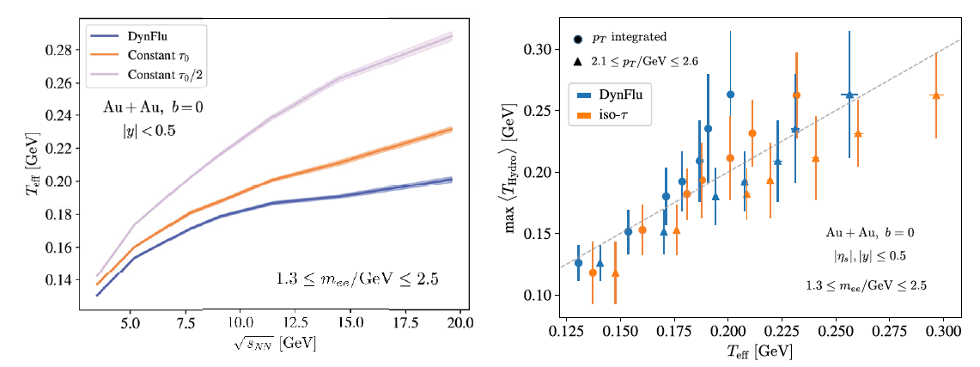
Dileptons as Thermometer
Dilepton production is sensitive to initial conditions
Effective temperature tracks maximum temperature of fireball
R. Góes-Hirayama et al, QM 2025
Hannah Elfner
Light Ion Collisions
09/25/2026

Slide 32
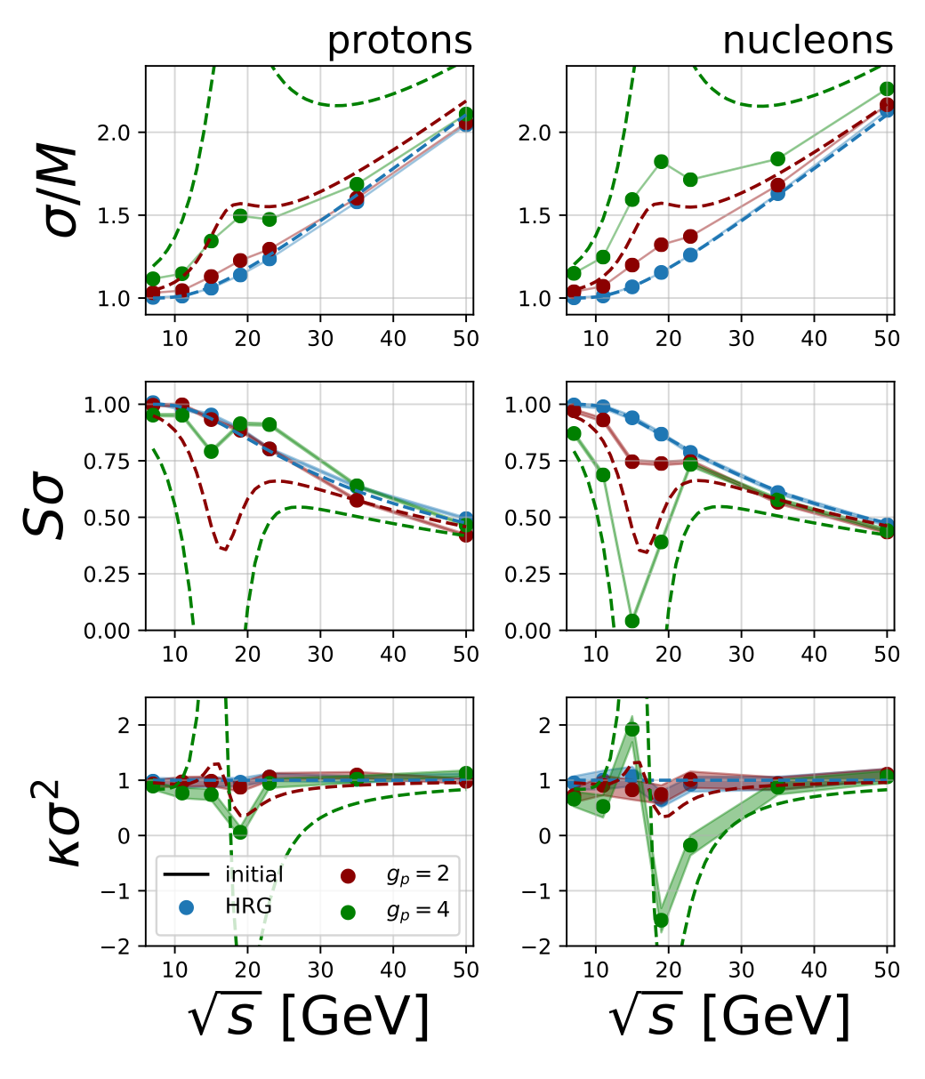
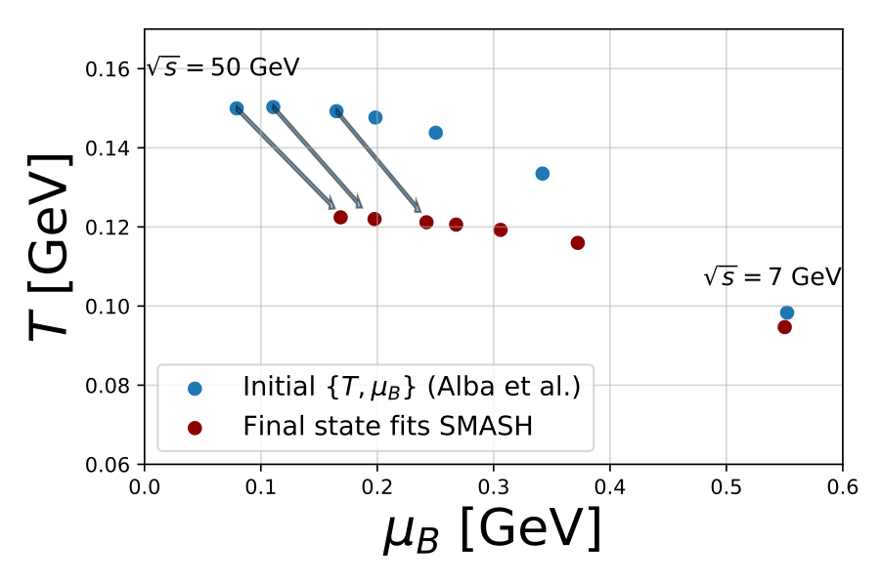
Survival of Critical Fluctuations
J. Hammelmann et al, PRC 110 (2024)
Plugging critical fluctuations in an expanding sphere with full SMASH hadronic dynamics
Signal survives, if coupling strong enough
Hannah Elfner
Light Ion Collisions
09/25/2026

Slide 33
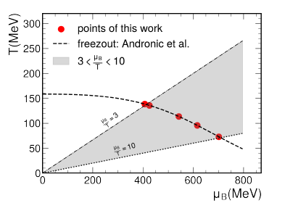
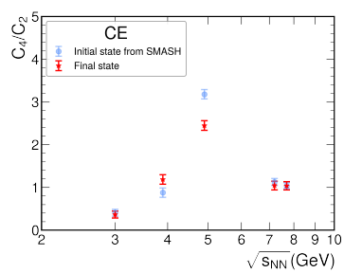
Hadronic Rescattering Effect
FRG input from W.-J. Fu et al, PRD 111 (2015) in SMASH, Q. Lin et al, arXiv:2608.28299
Cumulant ratio as a function of beam energy from FRG calculations
Rescattering reduces height of the peak but leaves structure in place
Hannah Elfner
Light Ion Collisions
09/25/2026

Slide 34
Gearing up for FAIR

Slide 35
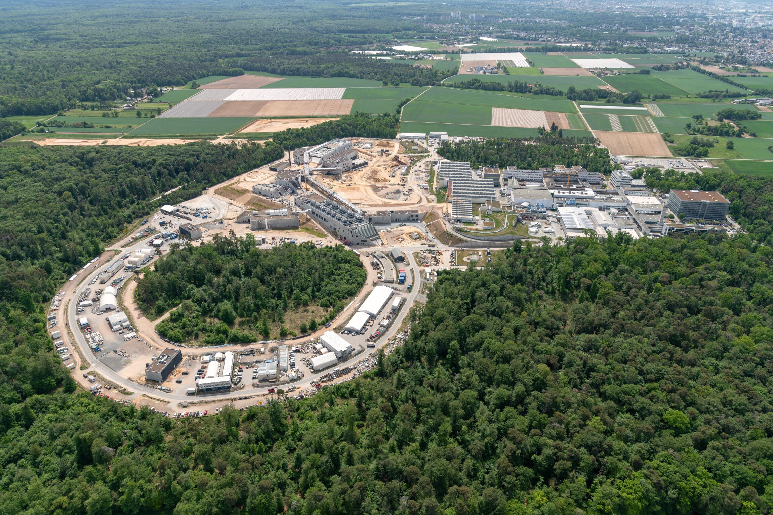


Construction Site FAIR
GSI, D. Fehrenz
SIS-100 tunnel is ready
Many buildings for experiments are ready as well
First beam time with SIS-100 expected in 2028-2030
Hannah Elfner
Light Ion Collisions
09/25/2026

Slide 36
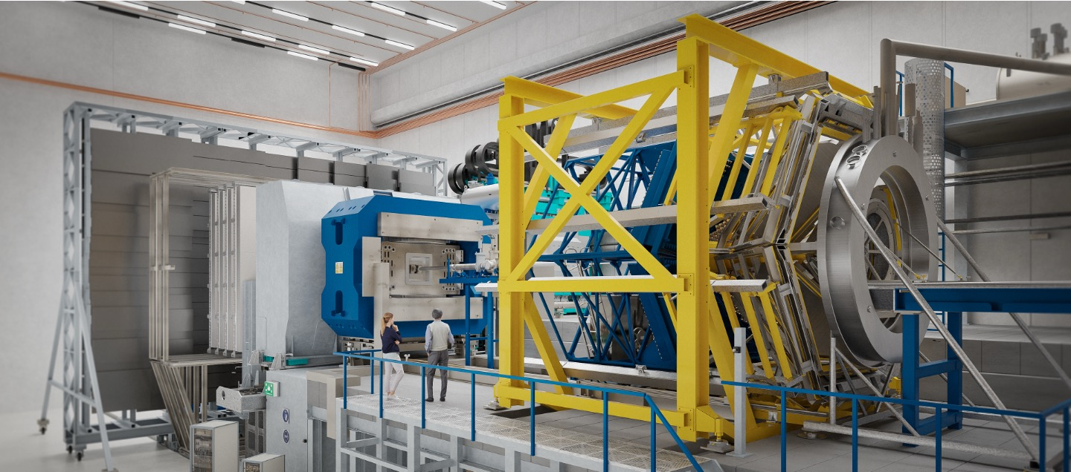
CBM at FAIR
Visualization of CBM at FAIR
Fixed Target Experiment at high densities
Very high luminosity -> rare observables and high statistics
Hannah Elfner
Light Ion Collisions
09/25/2026

Slide 37
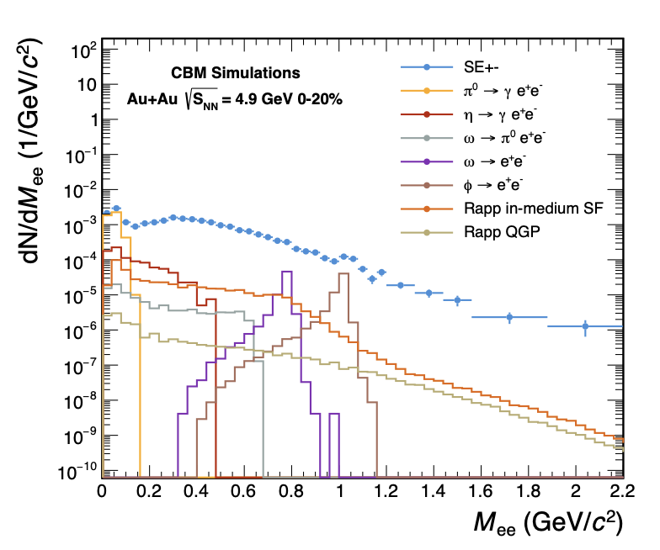
Latest Developments
CBM White paper:
  multi-strange hadron production
  and their flow coefficients,
  high-order net-baryon cumulants
  dileptons
  production of double-strange
  hypernuclei
QCD at FAIR initiative
White paper: Hadron Physics Opportunities at FAIR
  Pion and proton beams to study elementary reaction properties
  From baseline to medium modifications
CBM collaboration, arXiv:2606.16395
J. Messchendorp et al, arXiv:2512.15986
Hannah Elfner
Light Ion Collisions
09/25/2026

Slide 38
Summary
Low beam energies provide access to high baryon densities
Critical endpoint and first order transition to QGP expected in that energy regime
Theoretical models are being developed based on transport or as hybrid approaches
Excitation functions provide interesting information on amount of collectivity
Dileptons and net baryon fluctuations are interesting observables
CBM at FAIR will start data taking within the next years
Theory support is needed to extract full information
Hannah Elfner
Light Ion Collisions
09/25/2026

