Slide 1
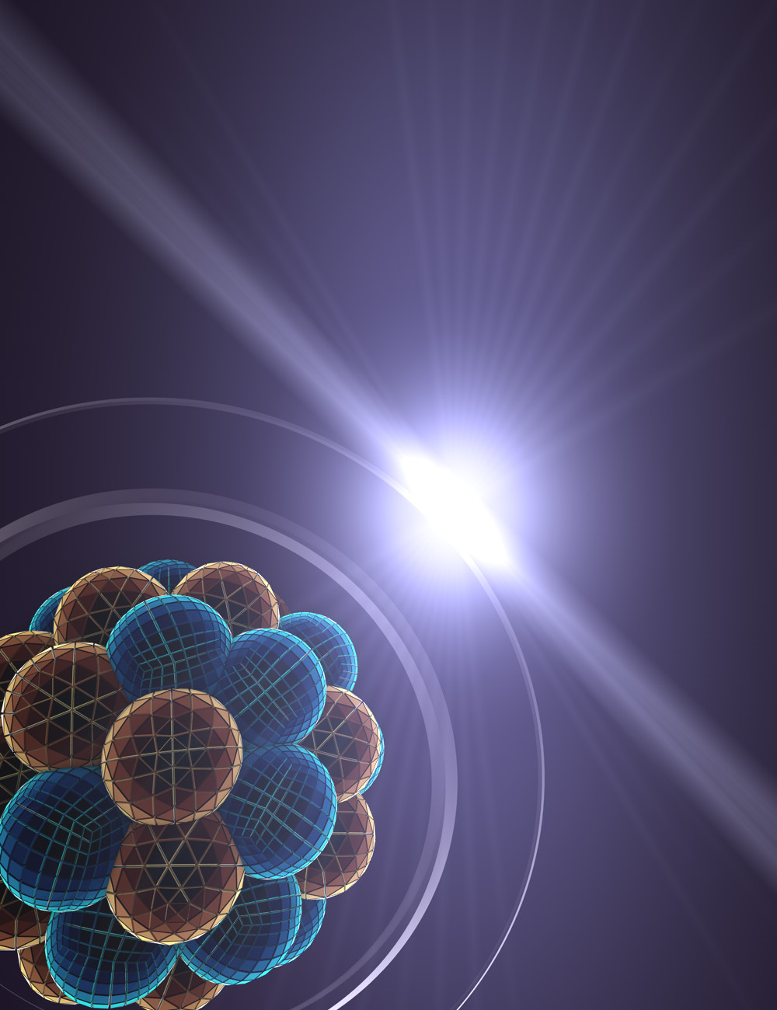
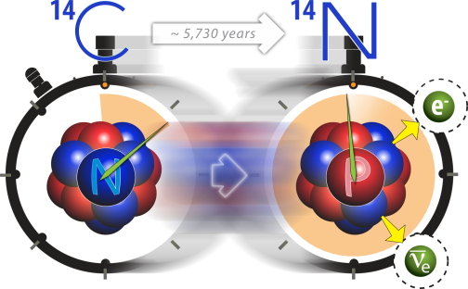
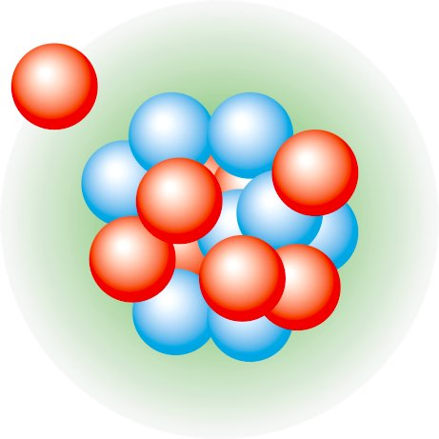




Ab initio nuclear theory: status and roadmap
Gaute Hagen
Oak Ridge National Laboratory
EMMI Workshop: Light-Ion Collisions 2026
Heidelberg, September 21st, 2026

Slide 2
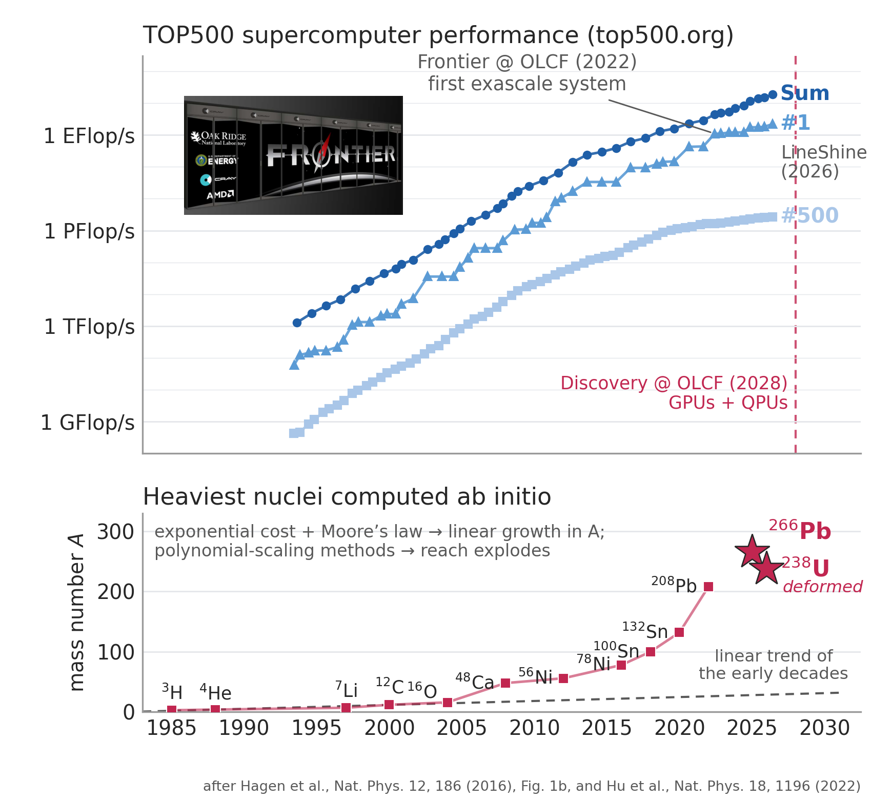
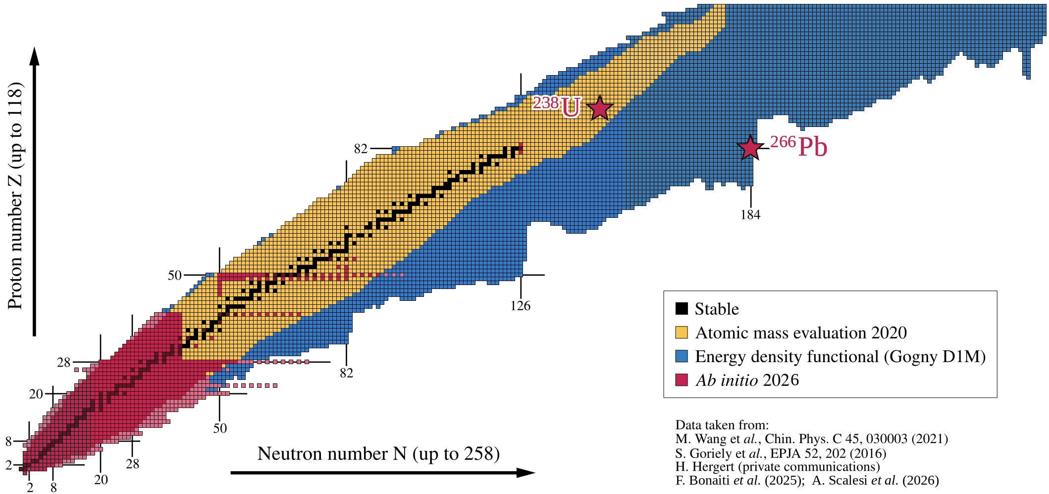
Trend in realistic ab-initio calculations
A lot of progress in recent years because of ideas from EFT and the renormalization group
Computational methods with polynomial cost (coupled clusters 🙂 quantum computing 🤔)
Ever-increasing computer power? Frontier (2022, first exascale) → Discovery @ OLCF (2028: GPUs + QPUs)
2025–26 highlights: ²⁶⁶Pb (N = 184) and deformed ²³⁸U — the heaviest nuclei computed from first principles
Nuclear chart courtesy of B. Bally
Notes:
he bars highlight the years of the first realistic computations of doubly magic nuclei. The height of each bar corresponds to the mass number A divided by the logarithm of the total compute power RTOP500 (in flops s−1) of the pertinent TOP500 list45. This ratio would be approximately constant if progress were solely due to exponentially increasing computing power. However, algorithms which instead scale polynomially in A have greatly increased the reach.

Slide 3
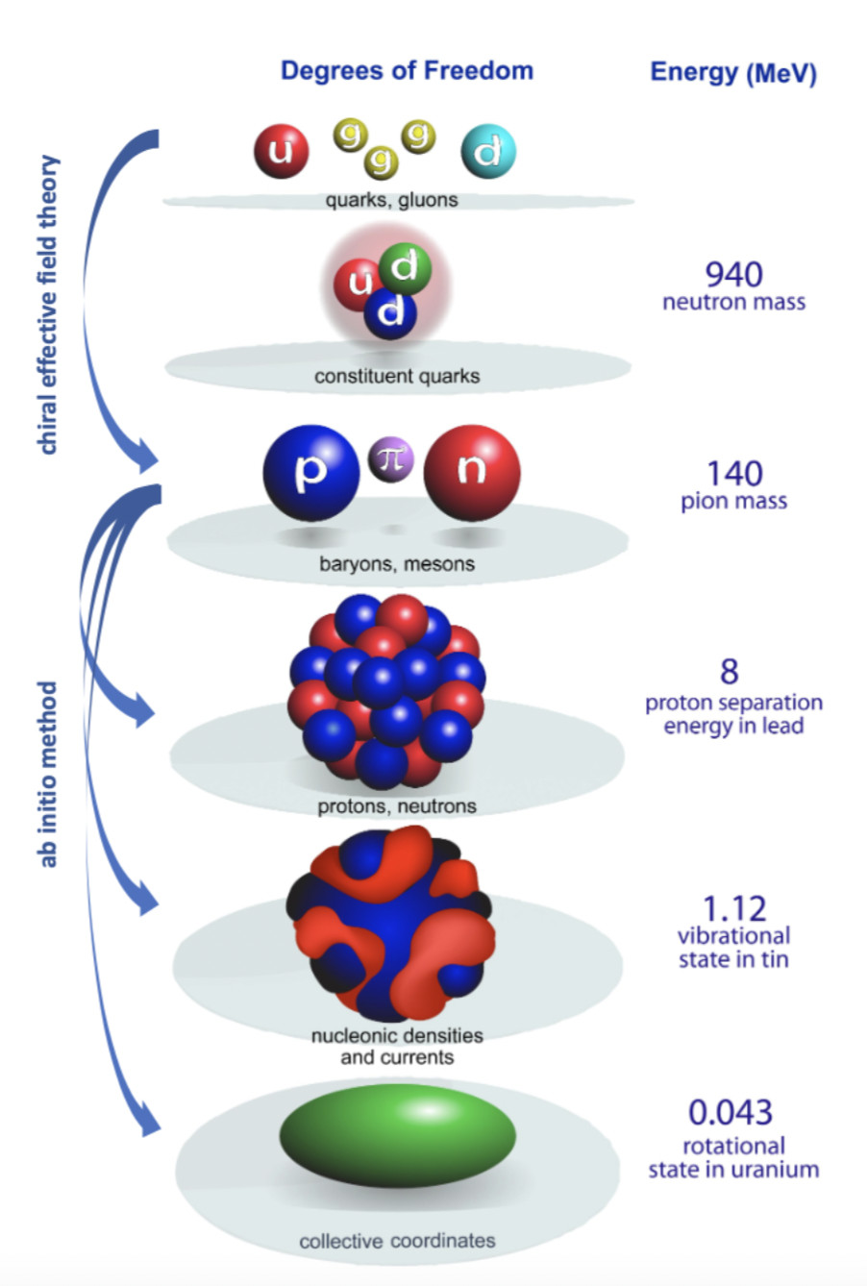
Multiscale physics of nuclei from ab-initio methods
What is ab initio in nuclear theory?
A. Ekström et al, Frontiers (2023)
“we interpret the ab initio method to be a systematically improvable approach for quantitatively describing nuclei using the finest resolution scale possible while maximizing its predictive capabilities”
Nuclei exhibit multiple energy scales ranging from hundreds of MeV in binding energies to fractions of an MeV for low-lying collective excitations.
Describing these different energy scales within a unified ab-initio framework from chiral interactions is a long-standing challenge
Figure adapted from Bertsch, Dean, Nazarewicz, SciDAC review (2007)
Notes:
Ab initio is interpreted differently to different people. Generic expression that benefits a vibrant competitive market place (reflect the creativity and innovation of scientist)
ab initio is unlike Tennessee Whiskey or French Champagne, which are internationally protected labels, but rather like Gruyère cheese, i.e., a generic expression that benefits a “vibrant, competitive marketplace”

Slide 4
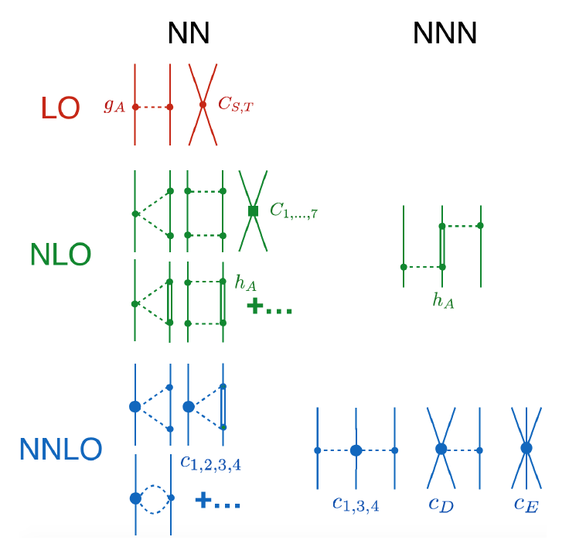
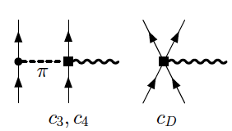
Interactions from chiral effective field theory
Parameters of the model
(16 at NNLO)
Constrained by data & carry uncertainties
Chiral EFT offers consistency between forces and currents
Figure adapted from Bertsch, Dean, Nazarewicz, SciDAC review (2007)

Slide 5
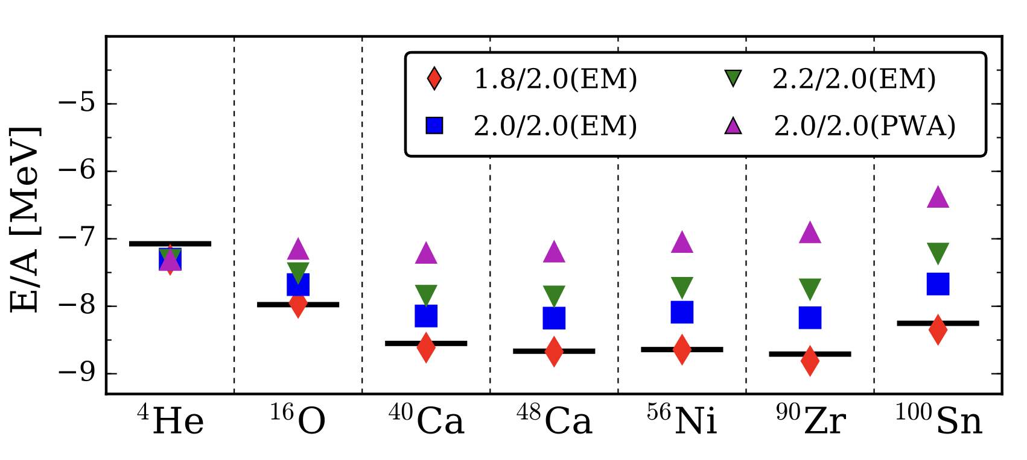
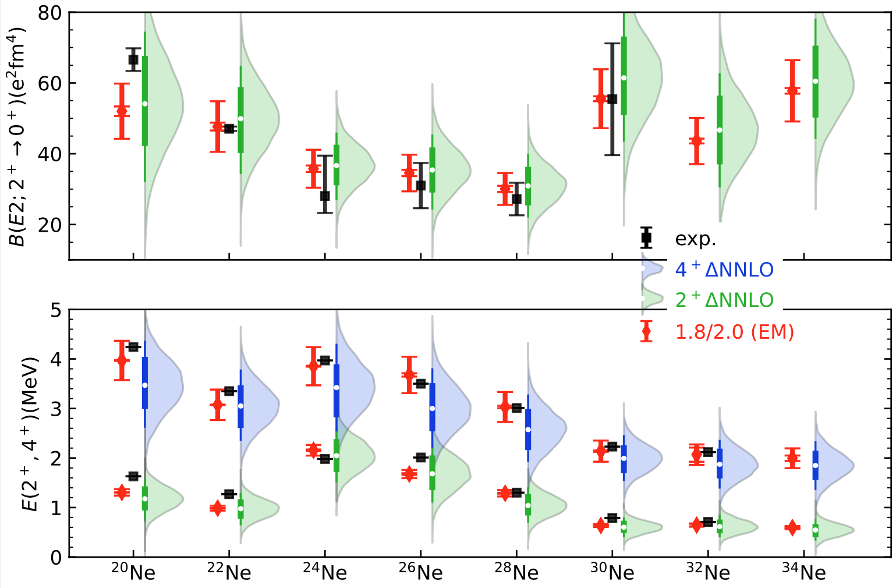
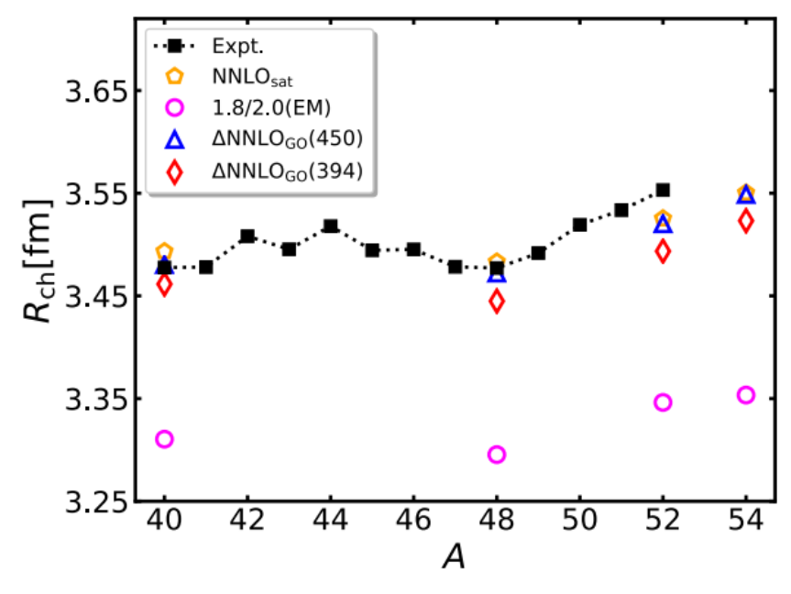
Some interactions work “better” than others
Radii and binding energies are very sensitive to small changes in the interactions – finetuning problem
Good reproduction of excited states and transitions in neon
T. Morris et al, Phys. Rev. Lett. 120, 152503 (2018)
Zhonghao Sun, A. Ekstrom, C. Forssen, G. Hagen. G. R. Jansen, T. Papenbrock, Phys. Rev. X 15, 011028 (2025)
W. G. Jiang, et al., Phys. Rev. C 102, 054301 (2020)
J Simonis, et al., Phys Rev C 96, 014303 (2017)
Notes:
Small energies reflect a large moment of inertia and a strong deformation
Radii are underpredicted and leads to smaller moment of inertia
Pairing reduces moment of inertia (lack of pairing) lucky cancellation

Slide 6
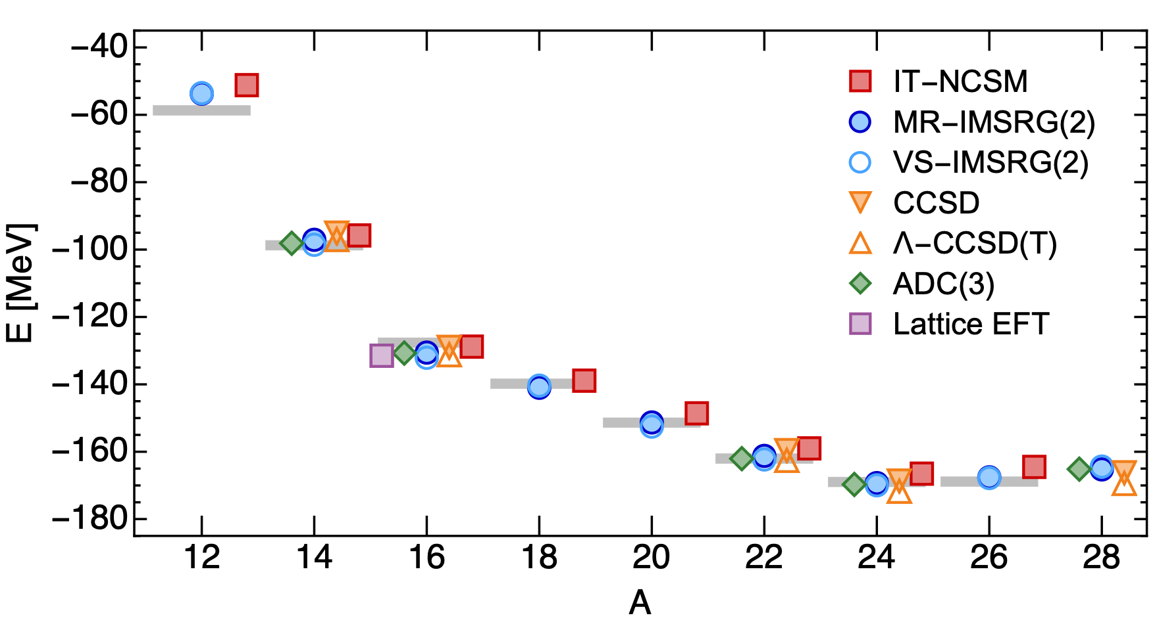
What precision/accuracy can we aim for in ab-initio modeling of nuclei?
Different many-body approaches agree with each for binding energies and radii (challenges exist for transitions, isotope shifts, and deformed shapes)
H. Hergert Front. Phys., (2020)
Notes:
Motivation:
No data exists that can constrain the T=3/2 component of the 3NF in 3- and 4-body systems
Describe nuclear properties at low-energies, we don’t need phase shifts at several hundreds of MeVs
Many-body effects entering at higher orders might be reduced if heavier systems in which those effects are stronger are included in the optimization
Predictive power does not go together with large extrapolations

Slide 7
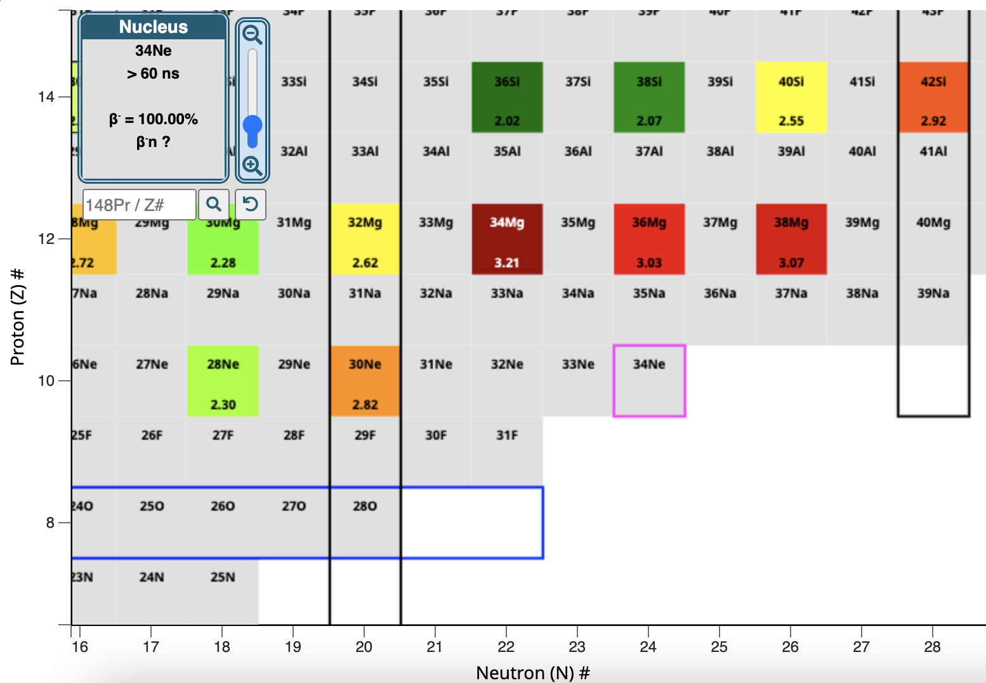
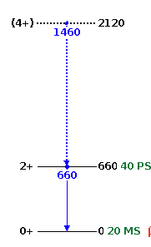
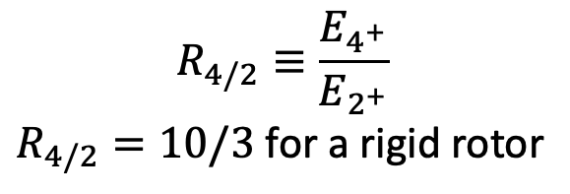
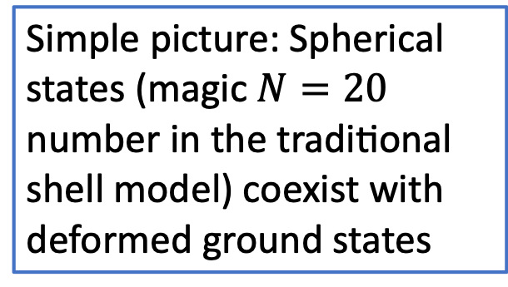
Neutron-rich nuclei beyond N = 20 are deformed
$$R_{4/2}≡\frac{E_{4^{+}}}{E_{2^{+}}}$$
$R_{4/2}=10/3$ for a rigid rotor
?
?
Simple picture: Spherical states (magic $N=20$ number in the traditional shell model) coexist with deformed ground states
³⁴Mg
(BE: 257MeV)
Poves & Retamosa (1987); Warburton, Becker, and Brown (1990); …

Slide 8
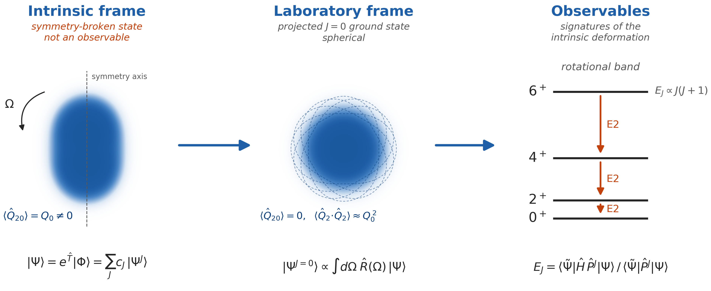
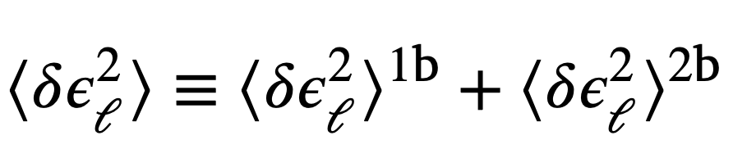
What do we mean by a deformed nucleus?
There is no timescale associated with symmetry projection
One can not take an instantaneous snapshot of the intrinsic shape
T. Duguet et al, Phys. Rev. Lett. 135, 182301 (2025)
S. Bofos et al, Phys. Lett. B 879, 140649 (2026)

Slide 9
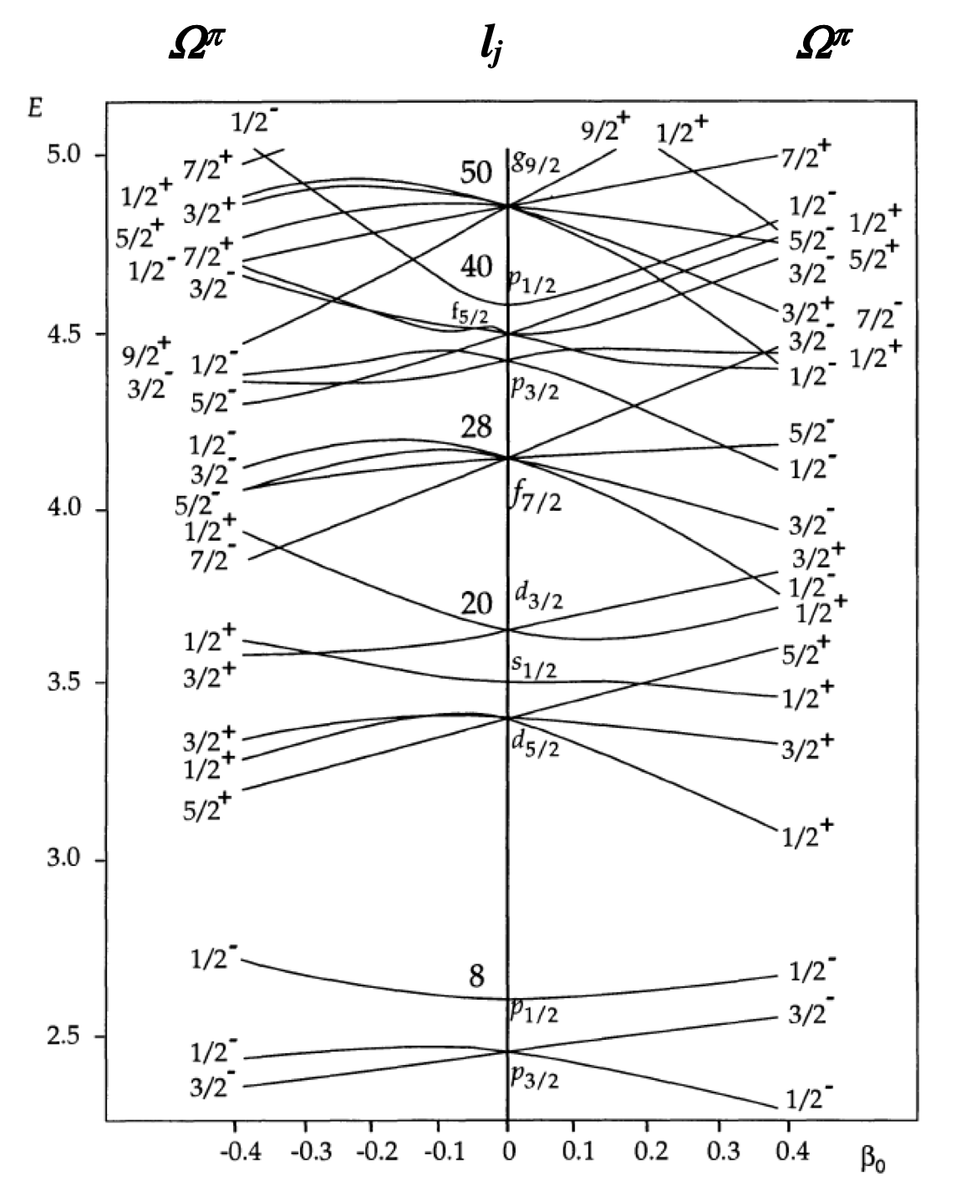
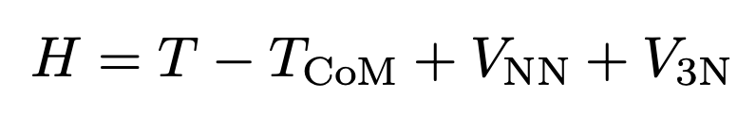
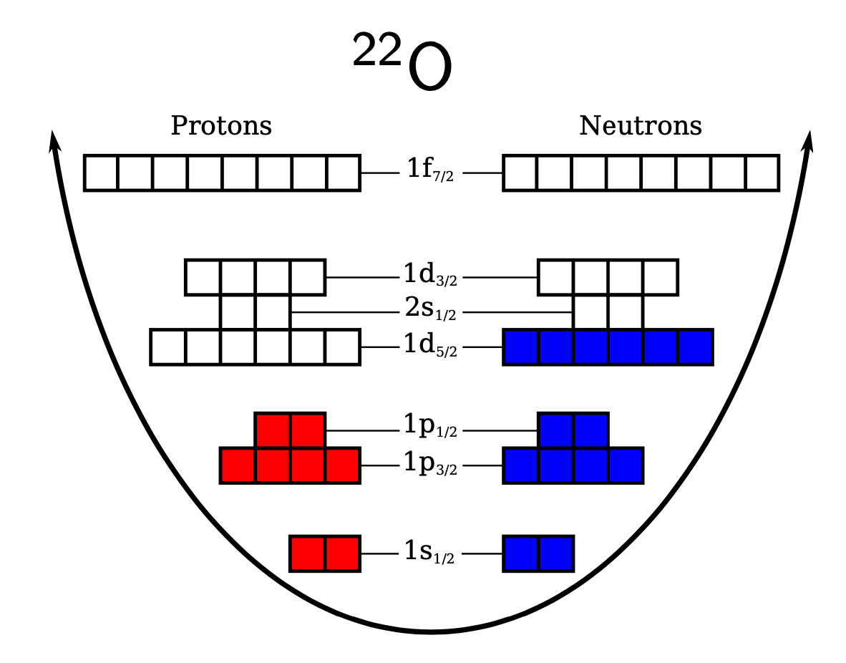
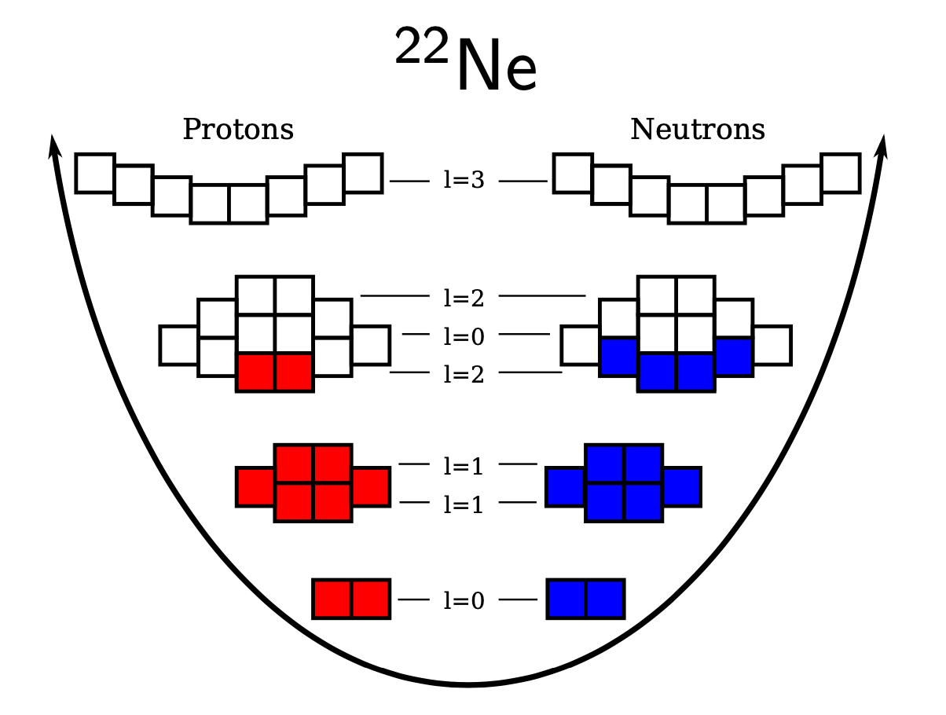

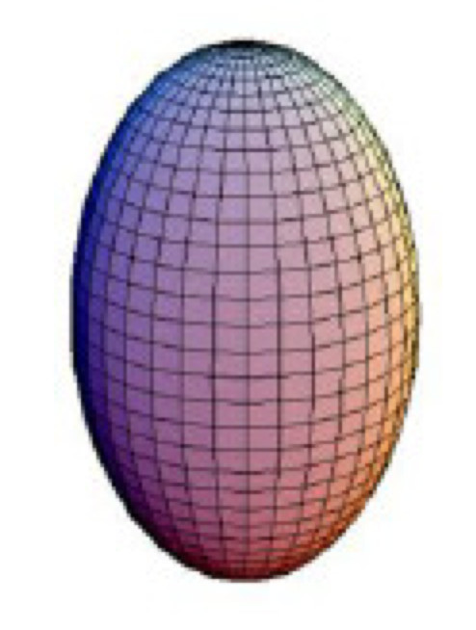
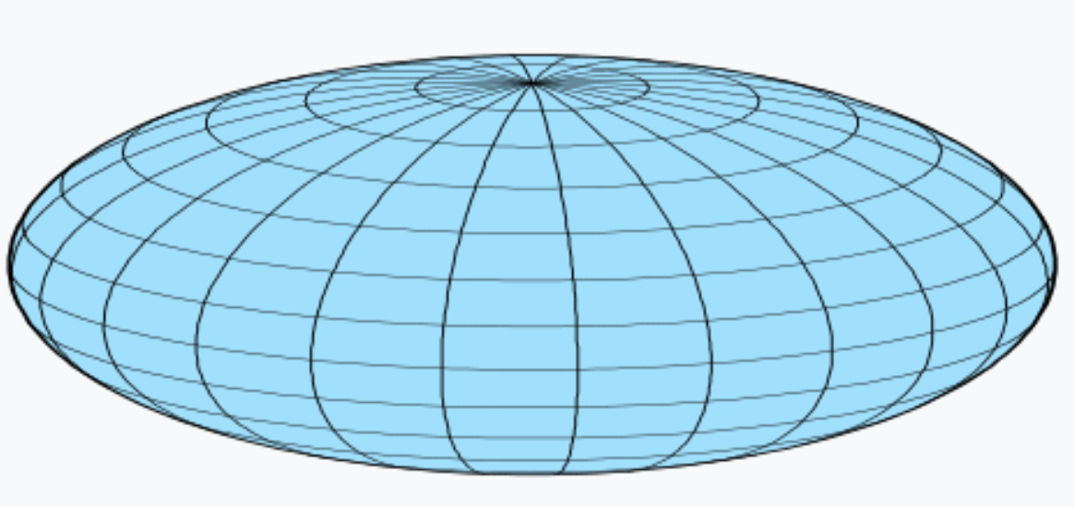
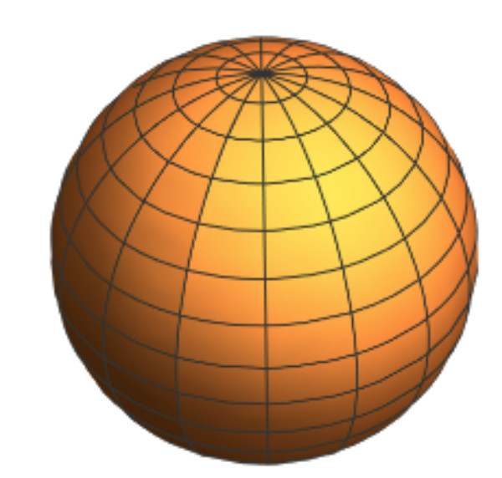
Coupled-cluster computations of deformed nuclei
Compute Hartree-Fock reference state:
Informs us about emergent breaking of symmetries
Spherical
Deformed
Wave-operator (includes many-body correlations)

Slide 10
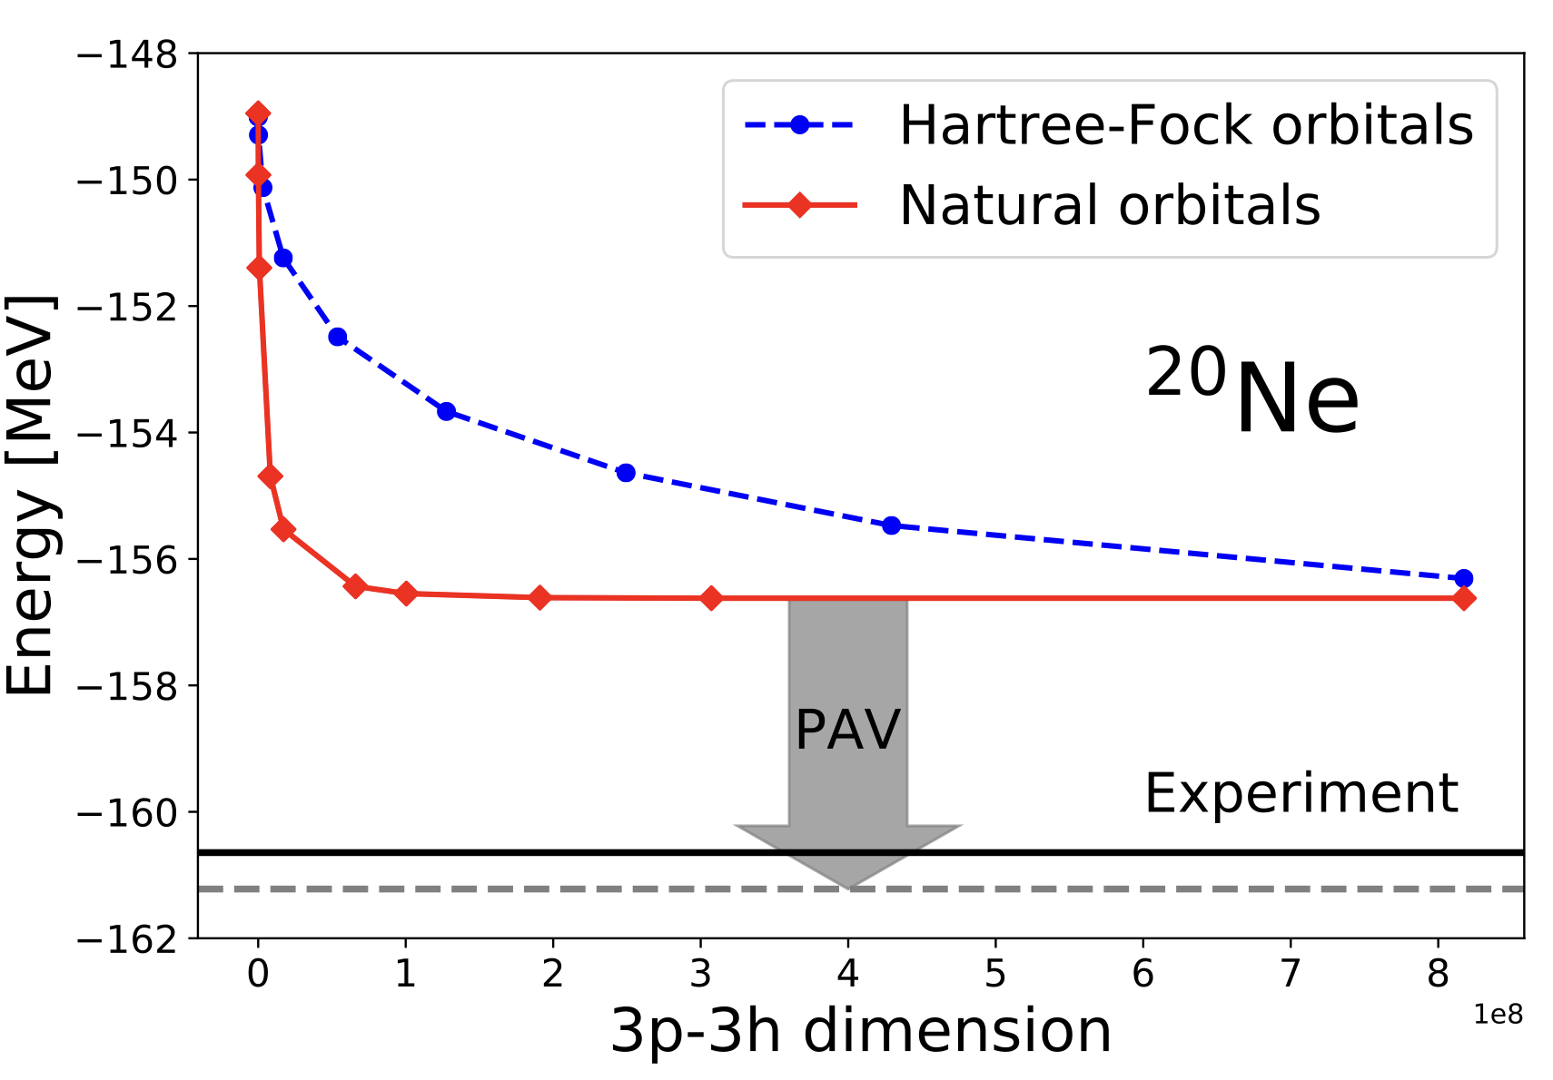
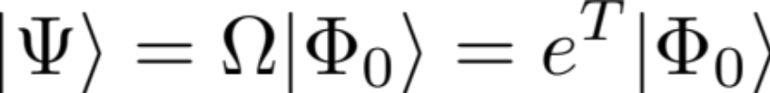

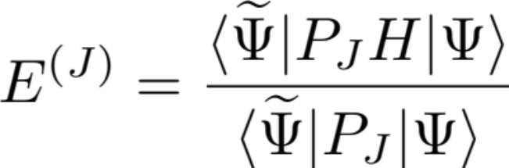
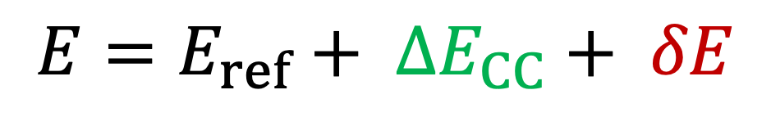
Coupled-cluster computations of deformed nuclei
Include short-range correlations via coupled-cluster theory
  Large contribution to total energy
  Cost increases polynomial with mass
Include long-range correlations via symmetry projections
  Small contribution to total energy
  Relevant for rotational bands and transition matrix elements
S. J. Novario, et al PRC 102, 051303 (2020)
Total energy:
$$E=E_{ref}+ ∆E_{CC}+ δE$$
Notes:
Norm kernel: overlap of rotated and initial states
Hamiltonian kernel: Hamiltonian matrix element between rotated and initial states

Slide 11
Collectivity in neon isotopes
Small energies reflect a large moment of inertia and a strong deformation
Radii are underpredicted and leads to smaller moment of inertia
Could it be that pairing effects are lacking?
Ensemble of delta-full interactions from recent study of ²⁸O
Y. Kondo et al.,
Nature 620, 965–970 (2023)
Zhonghao Sun, A. Ekstrom, C. Forssen, G. Hagen. G. R. Jansen, T. Papenbrock, Phys. Rev. X 15, 011028 (2025)

Slide 12
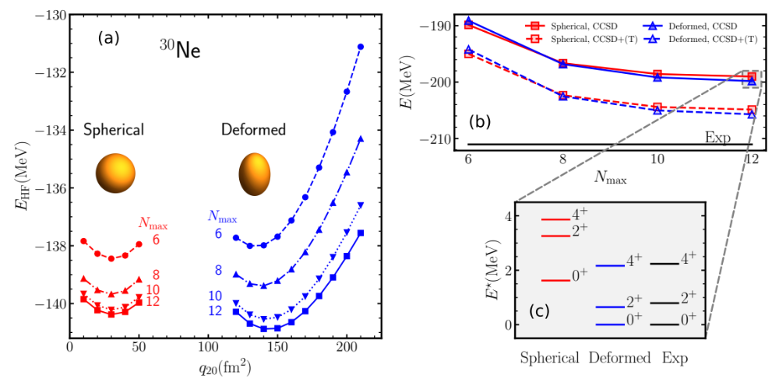
Shape co-existence in ³⁰Ne
Zhonghao Sun, A. Ekstrom, C. Forssen, G. Hagen. G. R. Jansen, T. Papenbrock, Phys. Rev. X 15, 011028 (2025)
Notes:
signatures of the N = 20 magic number can be seen in our calculations and lead to shape coexistence

Slide 13
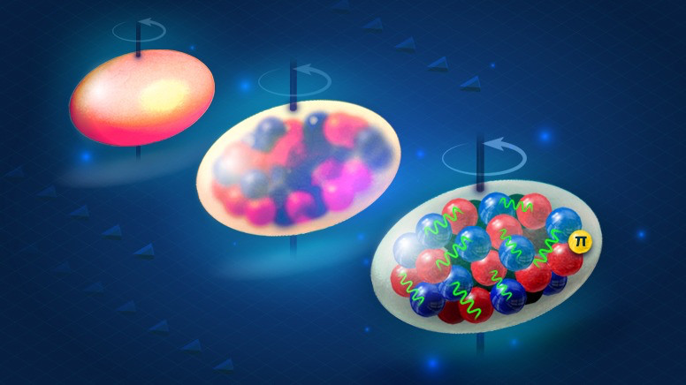
What drives deformation in nuclei?
50’s: surface vibrations of a liquid drop (Bohr/Mottelson)
60’s: competition between pairing and quadrupole interactions from HFB calculations in two shells (Baranger/Kumar)
70’s: isoscalar neutron-proton interactions dominate over isovector pairing from shell model (Federman/Pittel, Dufour/Zuker)
How do the individual LECs impact deformation?
Nuclear deformation viewed at different resolution scales
Credit: Güneş Özcan/ORNL, U.S. Dept. of Energy

Slide 14
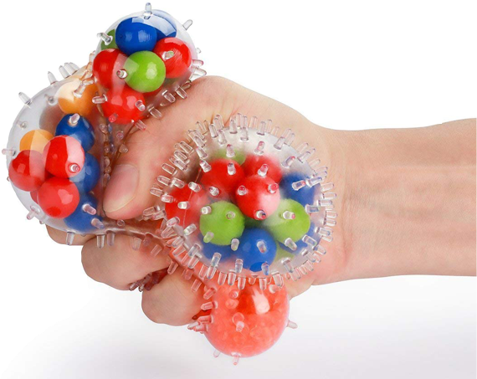
Global sensitivity analysis
Sensitivity analysis addresses the question ‘How much does each model parameter contribute to the uncertainty in the prediction?’
Global methods deal with the uncertainties of the outputs due to input variations over the whole domain.
Computational bottleneck
A global sensitivity analyses of properties of atomic nuclei typically would require more than one million model evaluations
Sensitivity analysis of the radius and binding energy of ¹⁶O
Andreas Ekström, Gaute Hagen PRL 123, 252501 (2019)

Slide 15
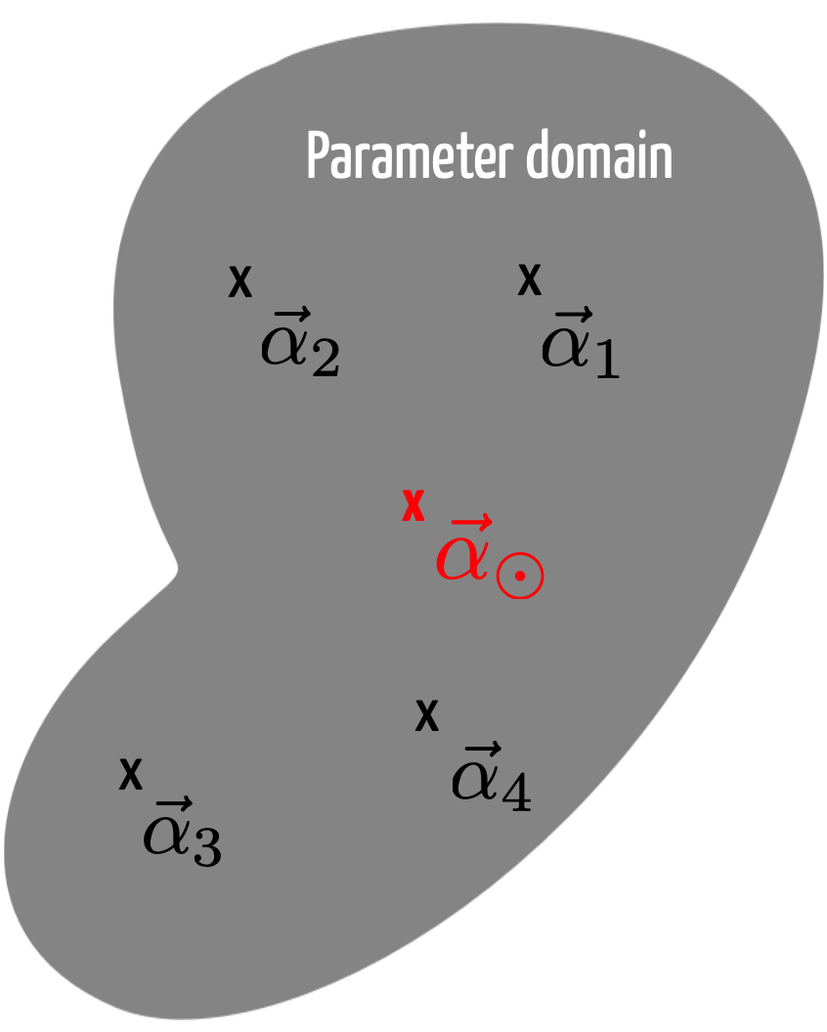
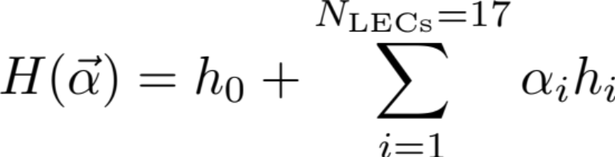
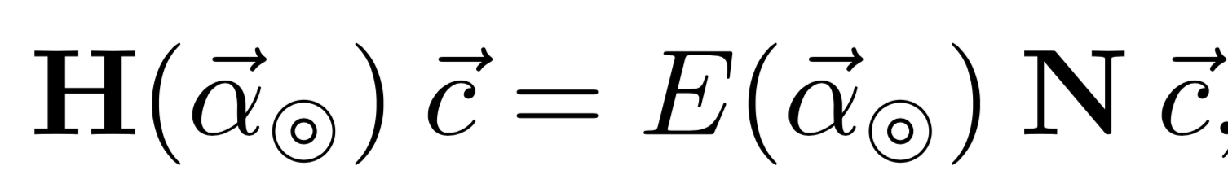
Reduced order model for deformed states
Zhonghao Sun, A. Ekstrom, C. Forssen, G. Hagen. G. R. Jansen, T. Papenbrock arXiv:2404.00058 (2024)
Eigenvector continuation method [Frame D. et al., Phys. Rev. Lett. 121, 032501 (2018), A. Ekström, G. Hagen PRL 123, 252501 (2019), S. König et al Phys. Lett. B 810 (2020) 135814]
Write the Hamiltonian in a linearized form
Select “training points” (snap-shots) where we solve the exact problem
Project a target Hamiltonian onto sub-space of training vectors and diagonalize the generalized eigenvalue problem
Latin Hypercube Sampling

Slide 16
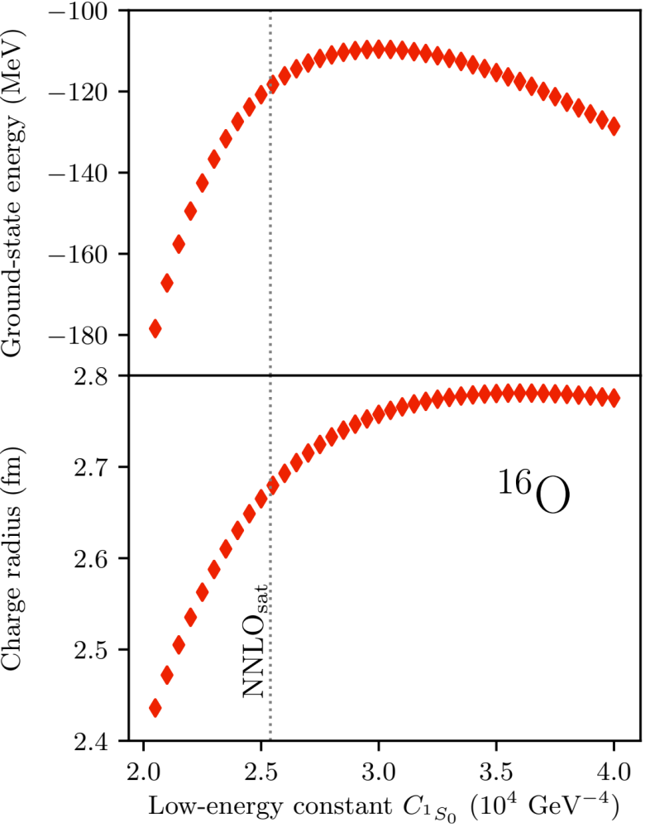

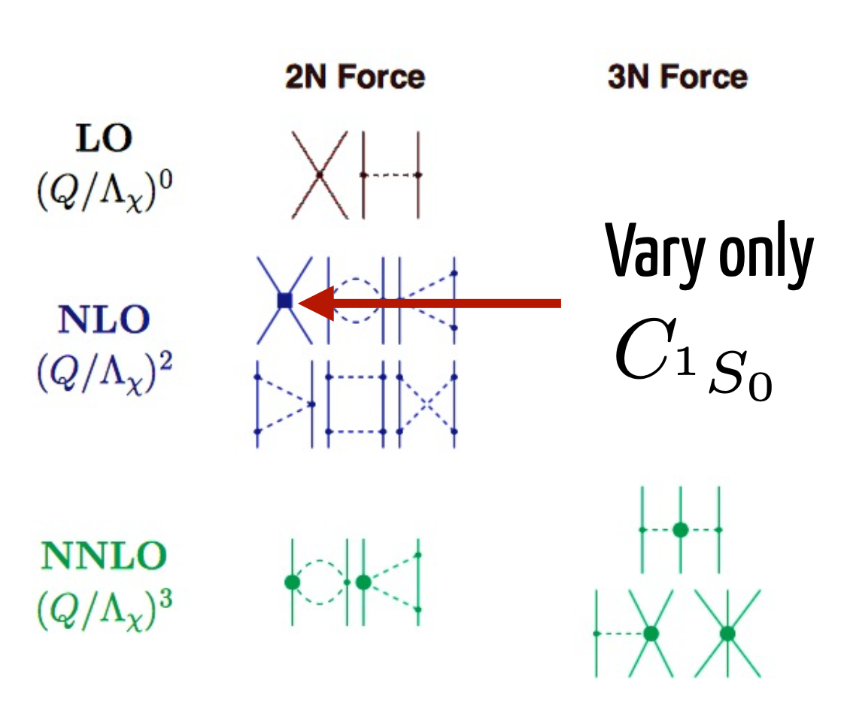
Emulating ab-initio coupled-cluster calculations
Andreas Ekström, Gaute Hagen PRL 123, 252501 (2019)
Exact coupled cluster calculations at the singles and doubles level

Slide 17
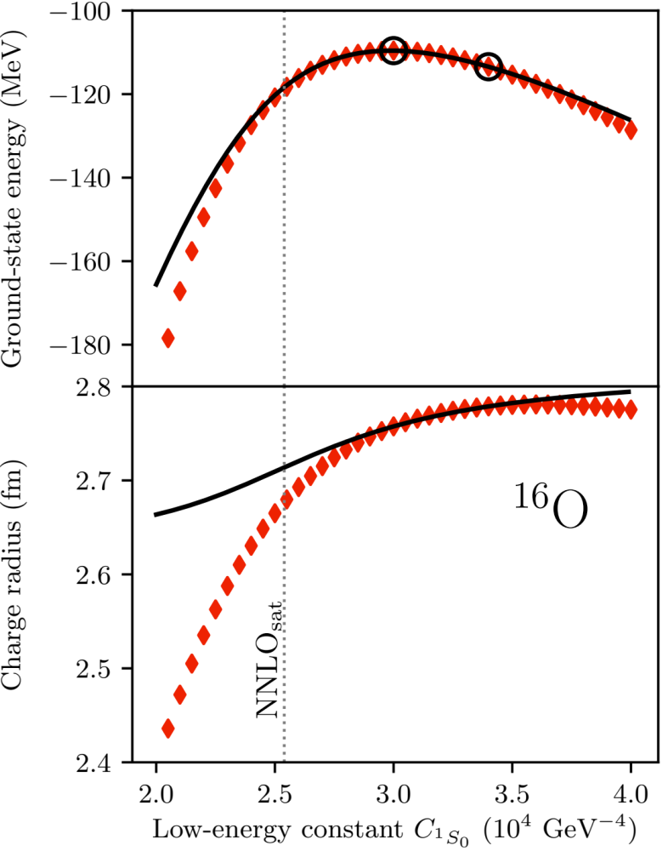
Emulating ab-initio coupled-cluster calculations
Andreas Ekström, Gaute Hagen PRL 123, 252501 (2019)
Exact coupled cluster calculations at the singles and doubles level

Slide 18
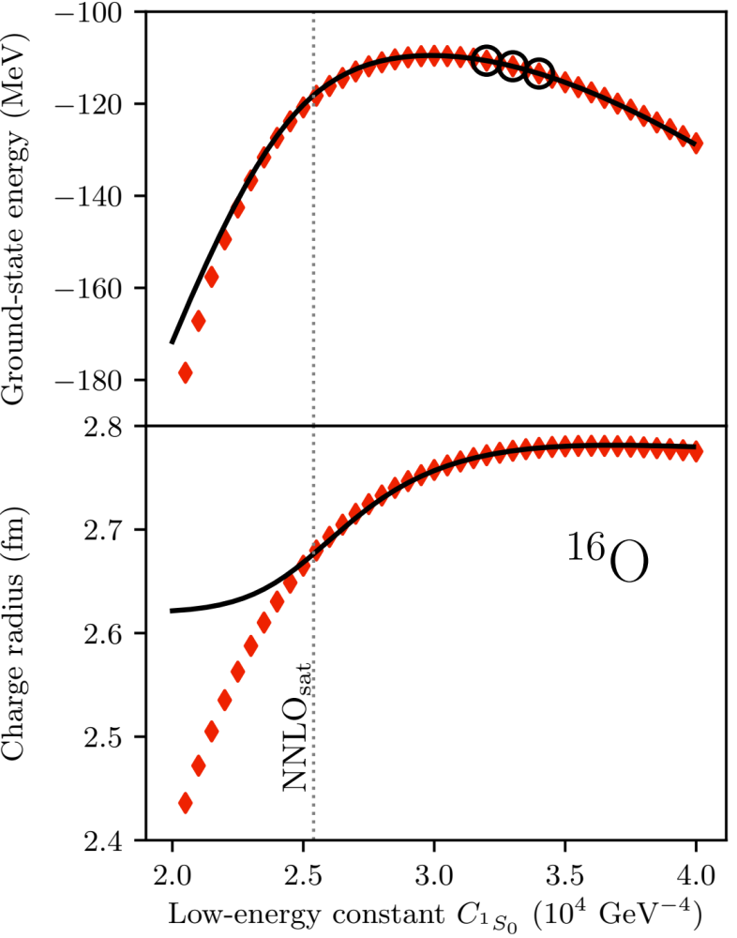
Emulating ab-initio coupled-cluster calculations
Andreas Ekström, Gaute Hagen PRL 123, 252501 (2019)
Exact coupled cluster calculations at the singles and doubles level

Slide 19
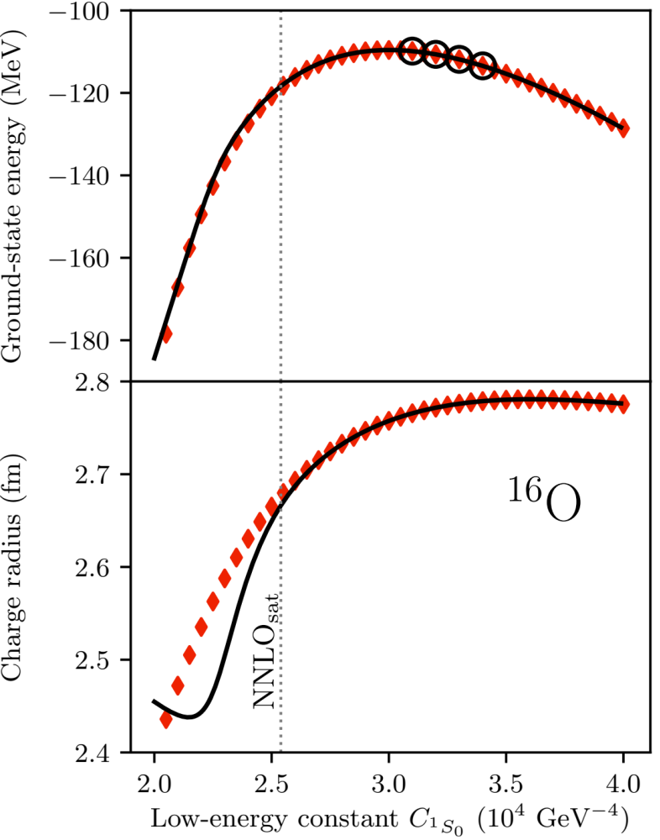
Emulating ab-initio coupled-cluster calculations
Andreas Ekström, Gaute Hagen PRL 123, 252501 (2019)
Exact coupled cluster calculations at the singles and doubles level

Slide 20
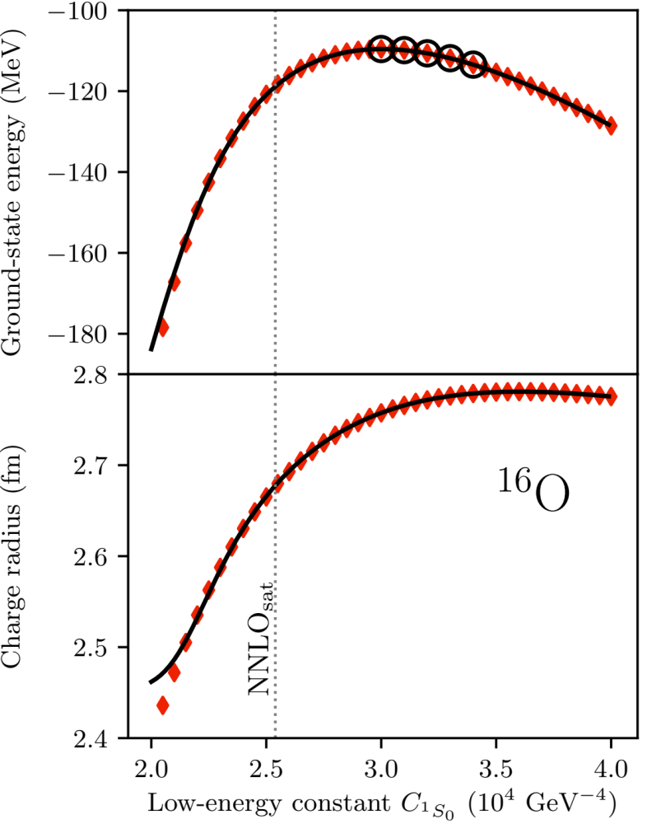
Emulating ab-initio coupled-cluster calculations
Andreas Ekström, Gaute Hagen PRL 123, 252501 (2019)
Exact coupled cluster calculations at the singles and doubles level

Slide 21
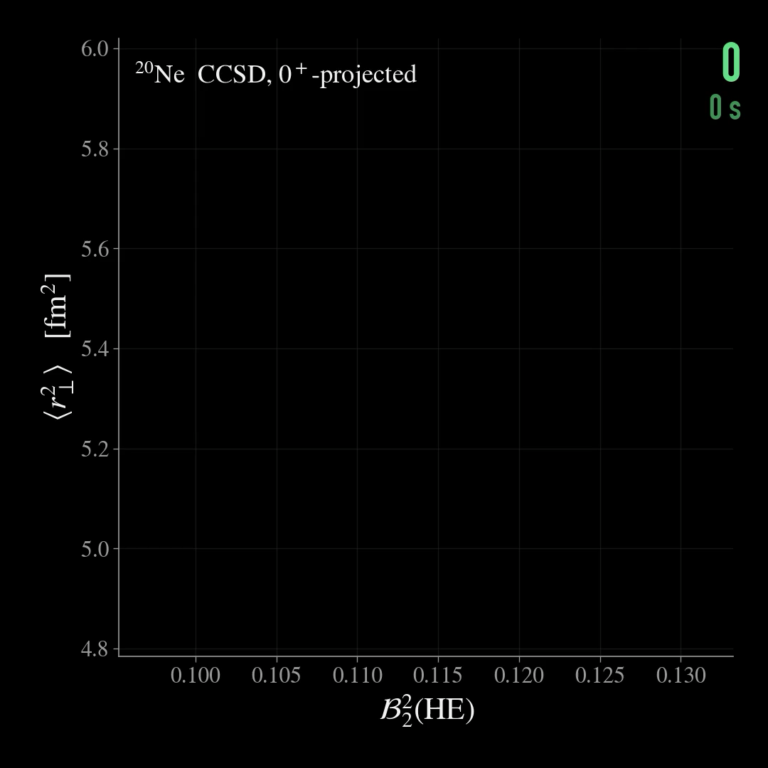
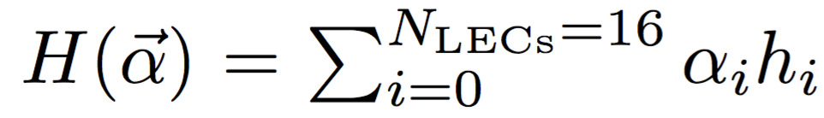
Computing nuclei at lightning speed
(~1 min: ~10⁵ 0⁺ projected calculations of ²⁰Ne)
Realtime speed of emulated transverse radius and shape parameter for different values of interaction parameters in ²⁰Ne
Accuracy: 1%
Speedup: 20 years of single node computations can be replaced by a one hour run on a laptop
Andreas Ekström, Gaute Hagen PRL 123, 252501 (2019)
Notes:
space-filling latin hypercube design
Select 64 and 128 sub-space vectors in the 16 dimensional space of LECs using a space-filling latin hypercube design

Slide 22
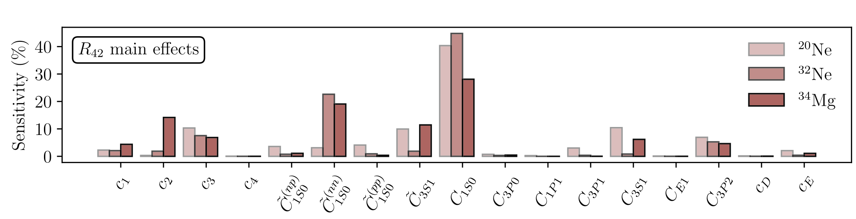
Linking deformation to nuclear forces
More than 50% of the deformation is driven by the S-wave contact part of the interaction
Adding short-range repulsion increase deformation presumably by reducing pairing
Increasing the pion-nucleon coupling strength also increases deformation, presumably by adding attraction in higher partial waves
~10⁶ samples
Notes:
The first order sensitivity apportions the total variance in the model output to an individual model parameter αi. The higher-order indices, e.g. Sij, apportion the variance in the model output to the combination of parameters αi and αj

Slide 23

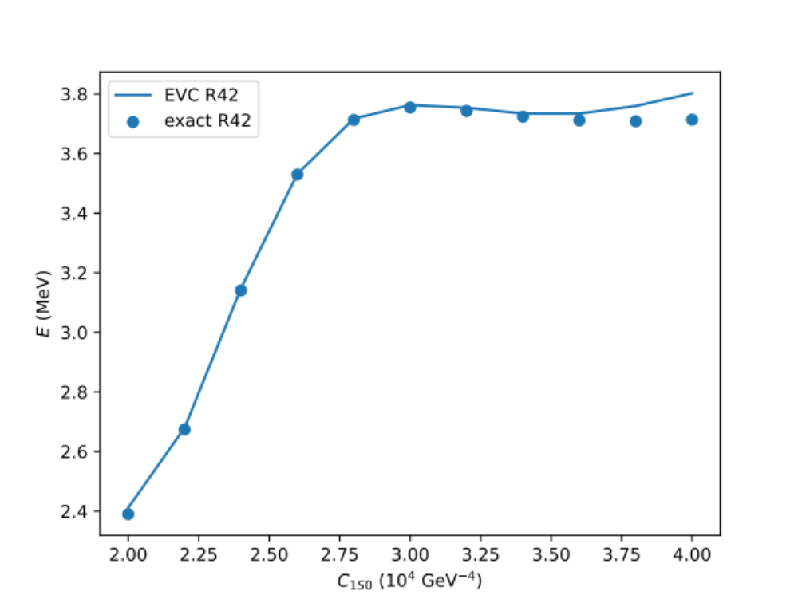
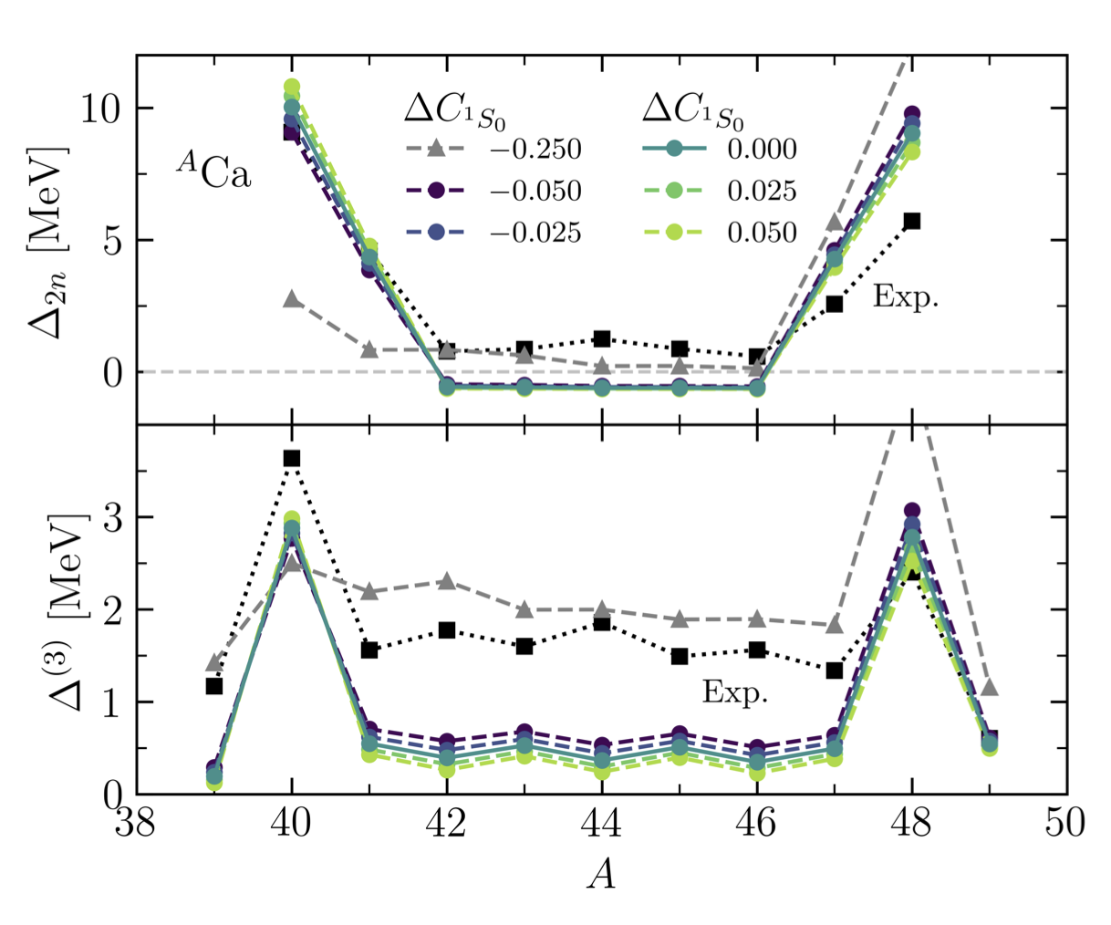


Linking deformation to nuclear forces
Varying only one parameter
Rigid rotor
Two neutron shell gap and three point mass difference in calcium isotopes
A. Scalesi, et al Phys. Rev. C 113, L051303 (2026)
Decreasing the s-wave contact strength leads to increased pairing and reduced deformation
Notes:
The first order sensitivity apportions the total variance in the model output to an individual model parameter αi. The higher-order indices, e.g. Sij, apportion the variance in the model output to the combination of parameters αi and αj

Slide 24
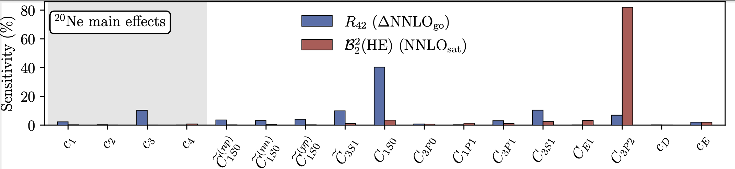
Linking deformation to nuclear forces
ℬ₂²(HE) is the deformation the collision sees: ⟨δε₂²⟩ ≈ 1/A + (3/4π)·ℬ₂²(HE), and ℬ₂²(HE) = β₂₀² for a rigid rotor.
It is essentially the two-body part of the Kumar quadrupole invariant ⟨Q₂·Q₂⟩, i.e. a sum rule for the total E2 strength rather than a single transition
R₄₂ and ℬ₂² respond to different LECs: C_{1S0} carries 40% of R₄₂ but 4% of ℬ₂²; C_{3P2} carries 7% of R₄₂ but 82% of ℬ₂²
The P-wave contacts carry the two-body spin–orbit force, ³P₂ strongest. Spin–orbit sets the sd-shell ordering and so the quadrupole strength; pairing (¹S₀) sets the level spacings that R₄₂ measures
Andreas Ekström, Thomas Duguet, Giuliano Giacalone, GH, Takayuki Miyagi, and Alexander Tichai, in preparation
Notes:
The first order sensitivity apportions the total variance in the model output to an individual model parameter αi. The higher-order indices, e.g. Sij, apportion the variance in the model output to the combination of parameters αi and αj

Slide 25
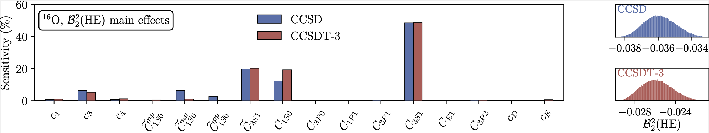
Linking deformation to nuclear forces
In contrast to 20Ne the sensitivity of ℬ₂²(HE) in 16O is dominated by the 3S1 partial wave
The sensitivity analysis is robust with respect to many-body truncations in the coupled-cluster wave-function
Andreas Ekström, Thomas Duguet, Giuliano Giacalone, GH, Takayuki Miyagi, and Alexander Tichai, in preparation
Notes:
The first order sensitivity apportions the total variance in the model output to an individual model parameter αi. The higher-order indices, e.g. Sij, apportion the variance in the model output to the combination of parameters αi and αj

Slide 26
Summary
Breaking and restoring symmetries
  Exploits separation of scale between collective and specific UV physics
  Conceptually simple & computationally affordable
  Shape coexistence in ³⁰Ne and ³²Mg
  Much improved B(E2) values with no effective charges in ^{3x}Ne, ^{3x}Mg
  Connected deformation to microscopic forces
  Shape parameter in ²⁰Ne probe ³P₂ — complementary to R₄₂
  Challenges: many-body UQ, beyond quadrupole shape parameters, deformed heavy mass nuclei…

Slide 27
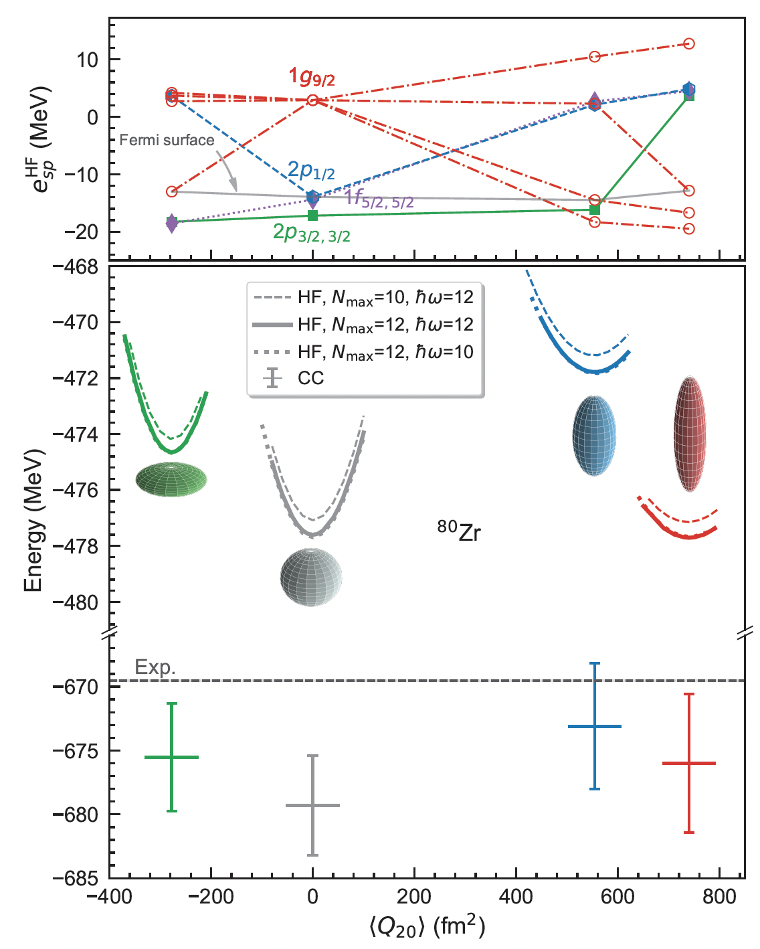
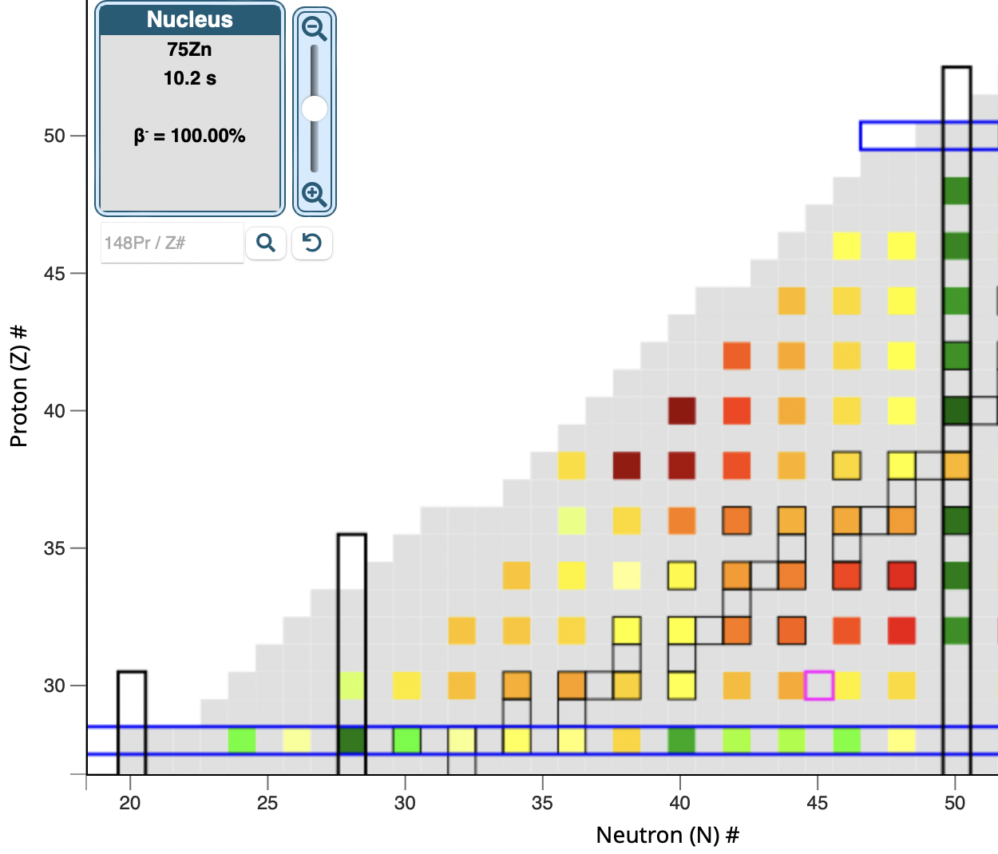

Strongly deformed nuclei around ⁸⁰Zr
Tomás R. Rodríguez, J. Luis Egido,
Phys. Lett. B 705 255 (2011)
N = Z
Baishan Hu, Zhonghao Sun, G. Hagen, T. Papenbrock. Phys. Rev. C 110, L011302 (2024)

Slide 28



Strongly deformed nuclei around ⁸⁰Zr
Spectrum prefers larger prolate shape
$B(E2)$ prefers prolate band
1.8/2.0(EM)
Baishan Hu, Zhonghao Sun, G. Hagen, T. Papenbrock. Phys. Rev. C 110, L011302 (2024)

Slide 29




Shape co-existence in ⁷⁸Ni?
R. Taniuchi, et al, Nature 569, 53 (2019)
T Otsuka and Y Tsunoda J. Phys. G 43 024009 (2016)
Deformed band?
Where is the band head?

Slide 30

Shape co-existence in ⁷⁸Ni?
VS-DMRG: A. Tichai, et al, PLB 855, 138841 (2024), MCSM: R. Taniuchi, et al, Nature 569, 53 (2019), LSSM: F. Nowacki, et al, PRL 117, 272501 (2016)
B. Hu et al Phys. Lett. B 858, 139010 (2024)

