Slide 1
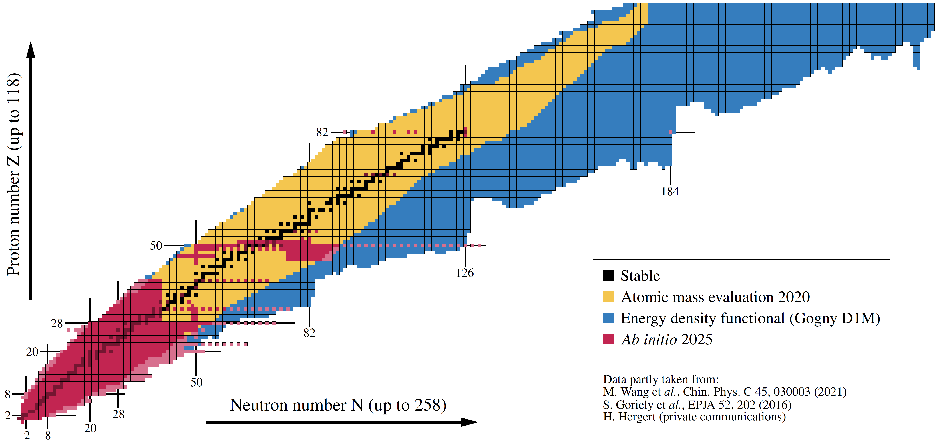
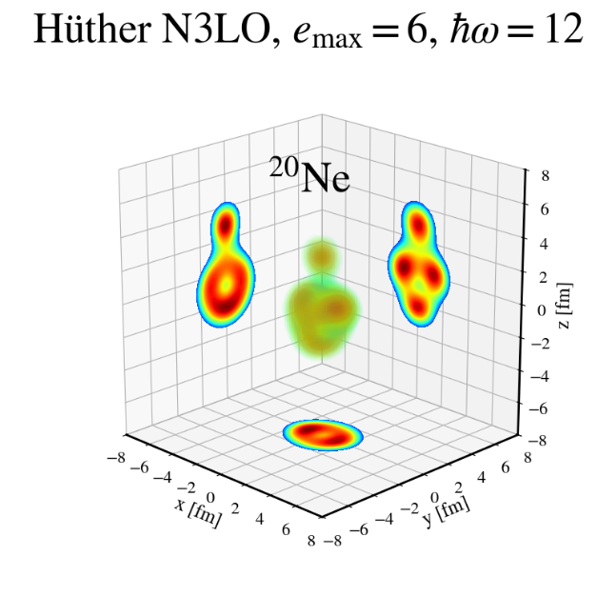
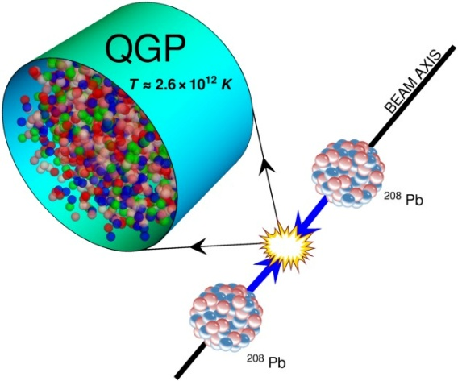
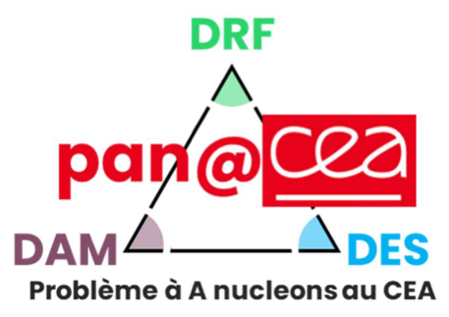

Imaging many-body correlations in nuclei
via symmetric ultra-central ion-ion collisions
Ab initio nuclear theory
Covered today
Formalization of the connection
Ab initio anatomy of 2-nucleon correlations
Not covered today
Review of past phenomenological studies
versus
Ultra-relativistic ion-ion collisions
Figure: B. Bally
EMMI Workshop: Light-ion collisions 2026
Sept. 21-25, Heidelberg
Thomas DUGUET
DPhN, CEA-Saclay, France

Slide 2










Collaborators on ab initio nuclear structure vs HIC
J.-P. Blaizot
G. Blanchon
S. Bofos
J.-P. Ebran
T. Demartini
M. Dupuis
M. Frosini
F. Gelis
L. Heitz
A. Porro
S. Sainato
V. Somà
P. Tamagno
E. Thiriont–Bernolle
L. Zurek
G. Hagen
H. Hergert
C. Ding
Y. Li
J. Yao
M. Aytekin
B. Bally
R. Roth
A. Tichai
U. Vernik
P. Demol
A. Scalesi
S. Jeon
G. Giacalone
P. Navratil

Slide 3
Contents
⦿ Introduction
⦿ Imaging (two-body) correlations in nuclei via ultra-relativistic ion-ion collisions
⦿ Azimuthal hadronic flow versus classical rigid rotor model
⦿ Azimuthal hadronic flow versus a fully quantal description of nuclei
⦿ Anatomy of two-body correlations based on ab initio nuclear structure calculations
⦿ Conclusions and perspectives

Slide 4
Contents
⦿ Introduction
⦿ Imaging (two-body) correlations in nuclei via ultra-relativistic ion-ion collisions
⦿ Azimuthal hadronic flow versus classical rigid rotor model
⦿ Azimuthal hadronic flow versus a fully quantal description of nuclei
⦿ Anatomy of two-body correlations based on ab initio nuclear structure calculations
⦿ Conclusions and perspectives

Slide 5
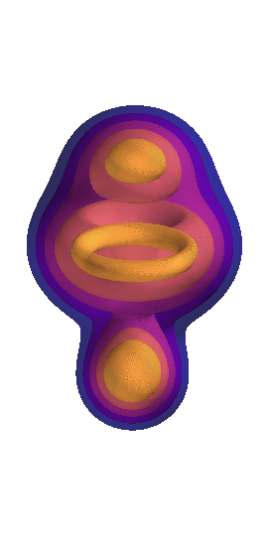
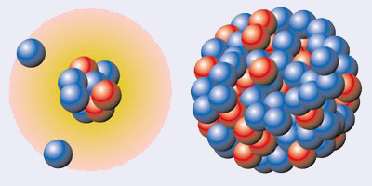
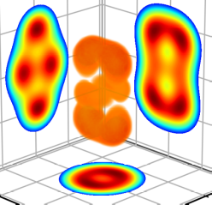
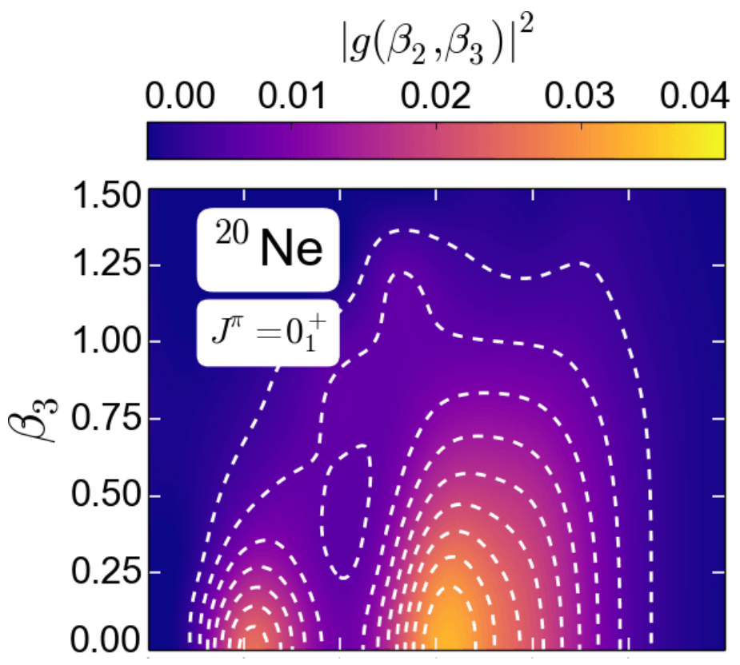
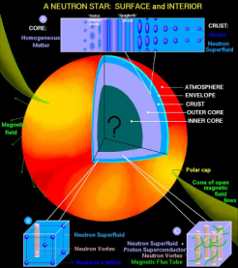
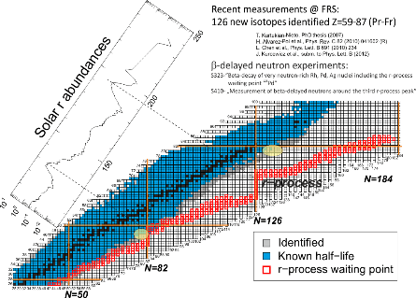
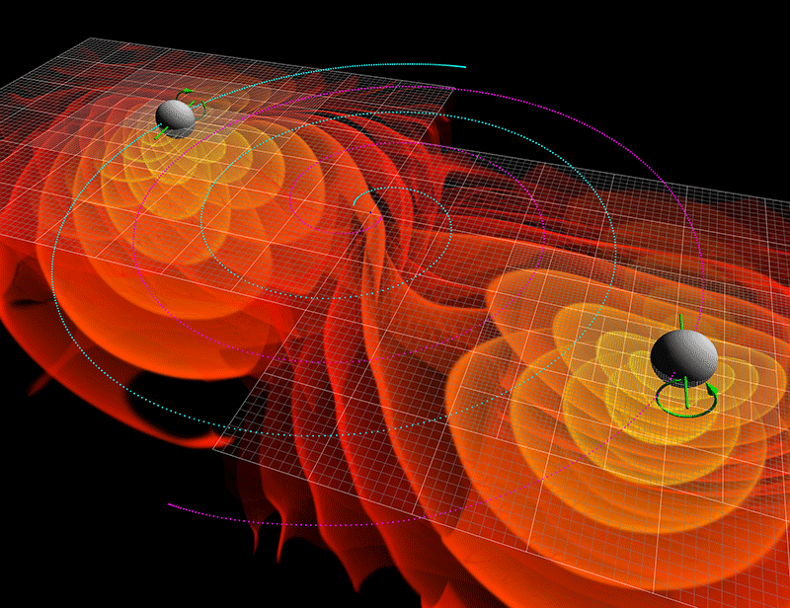
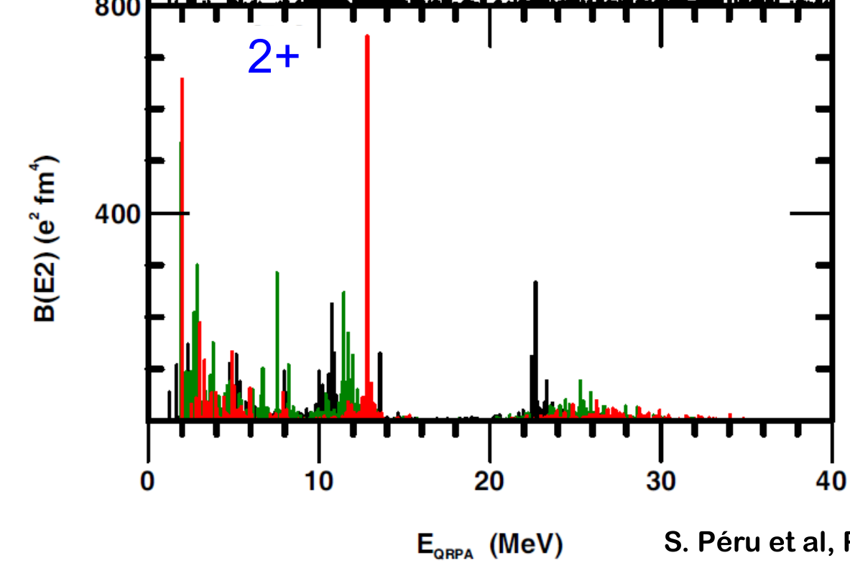
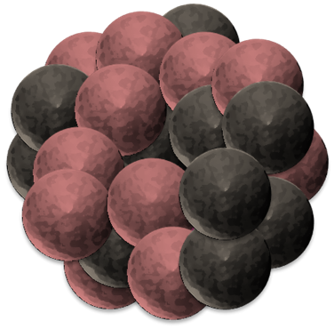
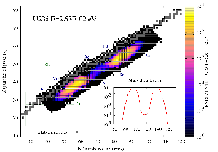
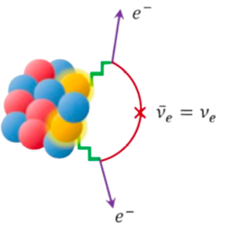
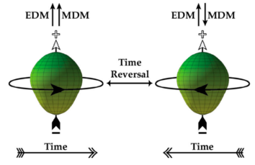

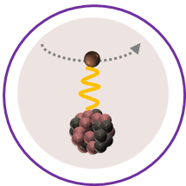
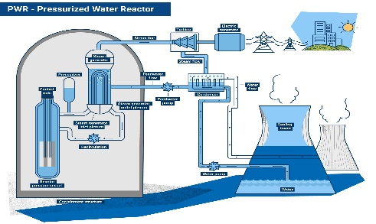
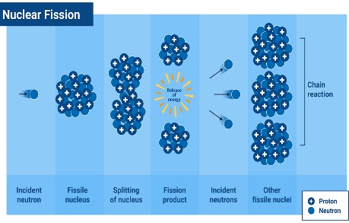
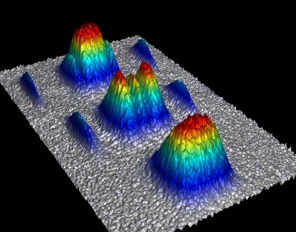
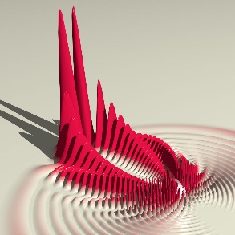
The atomic nucleus as a 4-components quantum mesoscopic system
An extremely rich and diverse phenomenology
Exotic nuclei
Neutron skin, halo, soft mode, clustering…
Bound (&resonant) state of Z protons and N neutrons
Ground-state
masses, radii, density distributions …
“Ab initio” (= In medias res) long-term endeavor
Can nuclear systems be convincingly described
From structure-less nucleons and their interactions: right balance of reductionism vs emergence?
Rooted into QCD in a systematically improvable way: sound connection via EFT(s)?
Systematically: complete phenomenology up to (super) heavy nuclei?
Accurately enough: relevant to experimental investigations/applications?
Astrophysics
Neutron star, supernovae, nucleo-synthesis…
Excitation spectra
energies, transition probabilities, response function to electroweak probes, …
Standard model of particle physics
0ν2β, unitarity of CKM matrix, PT
Ab Initio
theory
Decay modes
lifetime, yields, …
Practical benefit = work in progress… yet to be proven
Nuclear observables can be
Described consistently
With (small enough) uncertainties
Extrapolated in a controlled fashion
Reactions
cross sections, …
Nuclear data applications
Nuclear energy, nuclear defense…
Mesoscopic many-body systems
Molecules, atoms, cold atom gases…

Slide 6
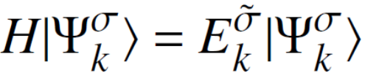


Ab initio theoretical scheme
In this talk “Ab initio” theoretical scheme
=
Chiral effective field theory (χEFT) based on Weinberg Power Counting (WPC)
Exponential curse with A
Systematic expansion of H
Full solution | Ψ_{k} >
Limited to A ~ 16
Talk by E. Epelbaum on wednesday

Slide 7



Ab initio theoretical scheme
In this talk “Ab initio” theoretical scheme
=
Chiral effective field theory (χEFT) based on Weinberg Power Counting (WPC)
Exponential → Polynomial cost
Systematic expansion of H
Systematic expansion of | Ψ_{k} >
Quantum
rotor&vibrator
Non-collective correlations
State-of-the-art truncation: <1% error
Double expansion systematically improvable towards well-defined limit
Talk by G. Hagen on wednesday
H
| Ψ_{k} >
Uncertainties evaluation
Chiral EFT truncation
LECs adjustement
Rank reduction of V^{3N}
Basis truncation
Expansion truncation
Talk by E. Epelbaum on wednesday
Talk by A. Ekstrom on wednesday

Slide 8
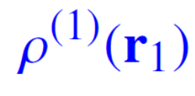
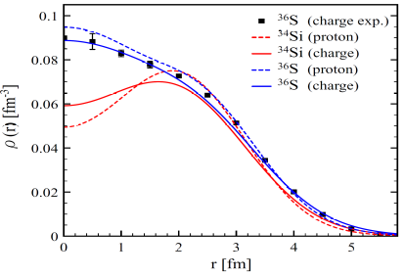
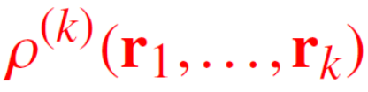
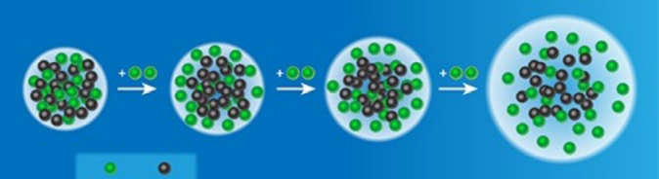
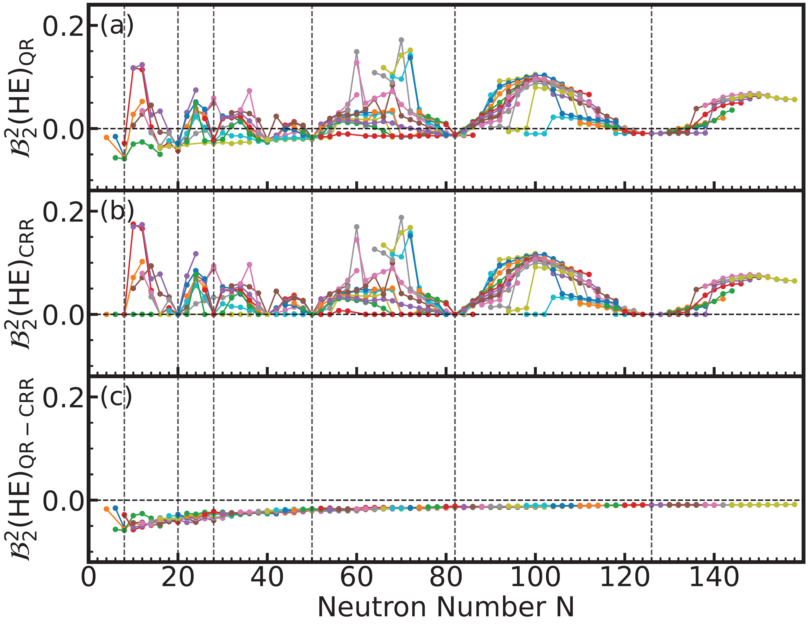

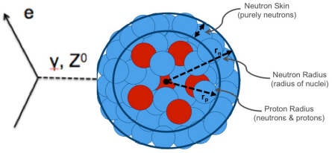
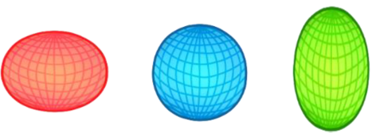
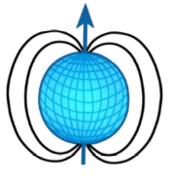
How are nucleons self organized in nuclear ground states?
Dominated by one-body density
Charge density
Nuclear clustering
Leave fingeprint into k-body density (k>1)
e⁻ scattering (unstable nuclei!)
Cluster radioactivity
Transfer/knockout reactions
Relativistic ion-ion collisions
How nucleons
self organize
inside the
atomic nucleus?
Charge radius
Angular correlations
e⁻ scattering
Laser spectroscopy
Neutron skin
EM moments(J≠0)
Coulomb excitation
Relativistic ion-ion collisions
Laser spectroscopy
Magnetic resonance spectroscopy
π-violating e⁻ scattering
Relativistic ion-ion collisions

Slide 9
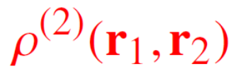

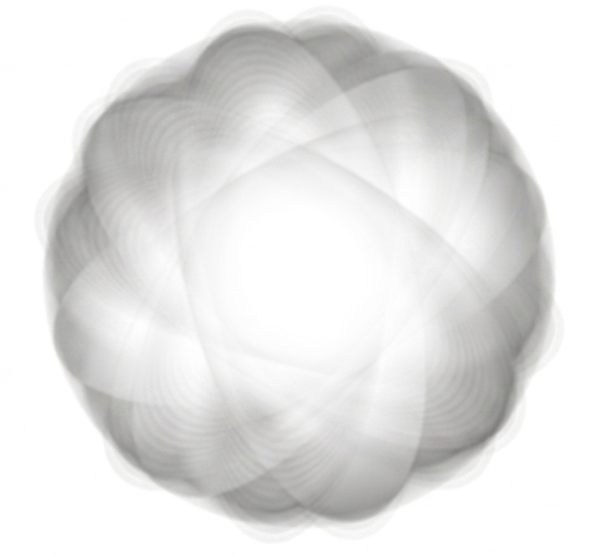
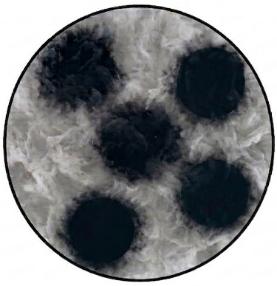
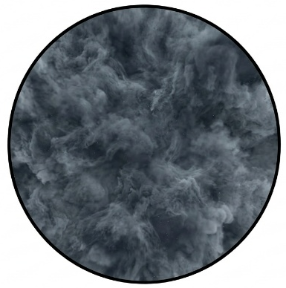
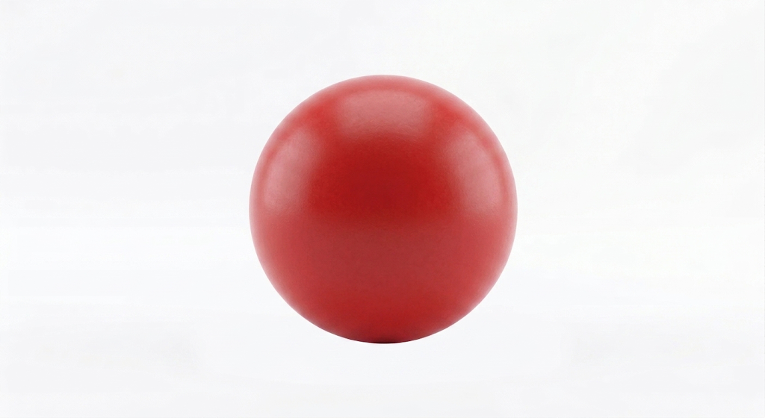
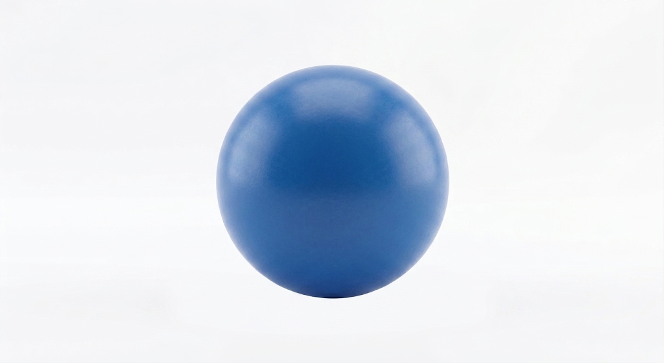
How are nucleons self organized in nuclear ground states?
Dominated by one-body density
Charge density
Nuclear clustering
Leave fingeprint into two-body density
e⁻ scattering (unstable nuclei!)
Cluster radioactivity
Transfer/knockout reactions
Relativistic ion-ion collisions
J=0 state
Angular correlations
Coulomb excitation
Relativistic ion-ion collisions
The one-body density distribution is spherically symmetric
The two-body density distribution encodes angular correlations
α-clustering relies on the 4-body density distribution

Slide 10

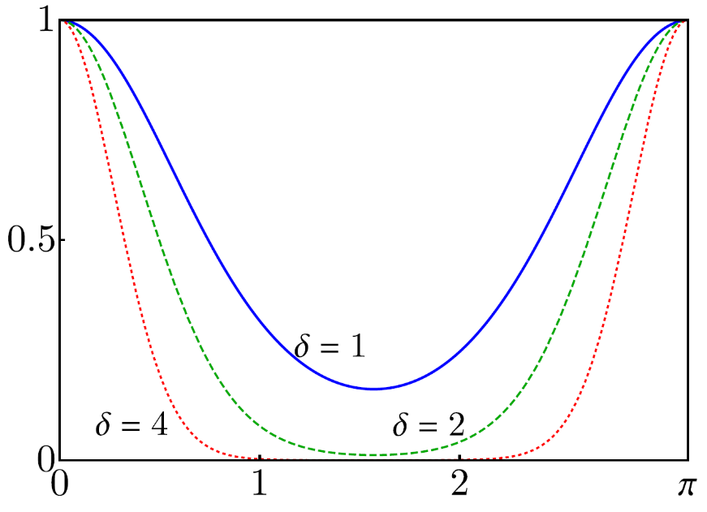
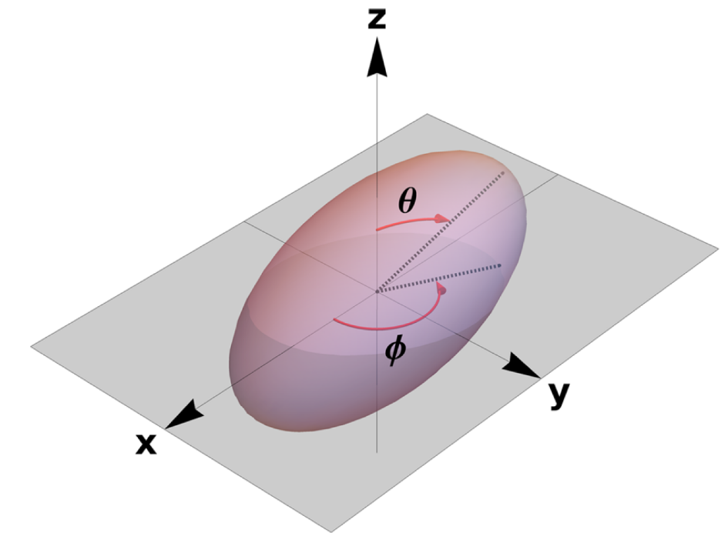
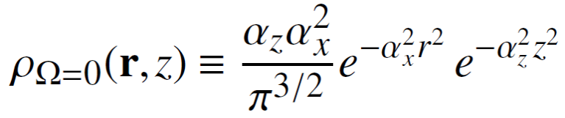

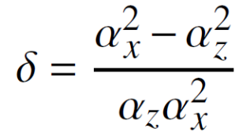

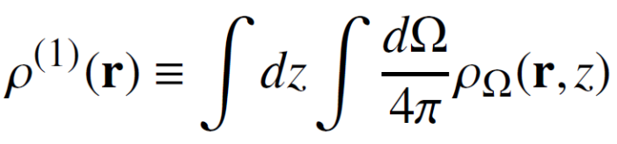
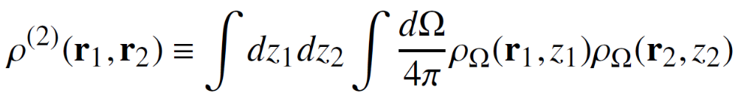


Intrinsic deformation, rotation and two-body correlations
►Intrinsic deformation = powerful notion to manipulate with care to avoid improper statements
►For an excellent historical review
History of the concept of nuclear shape
D. Verney, Eur. Phys. J. A (2025) 61
In “The intersection of low-energy nuclear structure and high-energy nuclear collisions” Eds. T. Duguet, G. Giacalone, V. Somà, Y. Zhou
Efficient Proxy
(i.e. Occam's razor)
►In a nutshell
The J=0 ground state of even-even nuclei is never deformed: the 1-body local density distribution is spherical
Symmetry breaking (e.g. rotational) cannot be realized in a finite system
Its character is only emergent
►Manifests in the way the system excites with specific subset of states displaying remarkable patterns = rotational bands
►Specific angular patterns in the J=0 ground-state k-body density with k > 1, e.g. 2-body density
►Axial quadrupole classical rigid rotor (CR) model
Tranverse plane
Blaizot, Giacalone, EPJA (2025)
Nucleonic position
1-body axially deformed intrinsic density
= orientation of deformed body
= deformation parameter
Characteristic of deformed nuclei
1- and 2-body laboratory density in transverse plane
= spherical
Proportional to intrinsic deformation
Azimuthal modulation
►Can such patterns due to intrinsic deformation and other angular correlations be quantitatively probed experimentally?

Slide 11
Contents
⦿ Introduction
⦿ Imaging (two-body) correlations in nuclei via ultra-relativistic ion-ion collisions
⦿ Azimuthal hadronic flow versus classical rigid rotor model
⦿ Azimuthal hadronic flow versus a fully quantal description of nuclei
⦿ Anatomy of two-body correlations based on ab initio nuclear structure calculations
⦿ Conclusions and perspectives

Slide 12
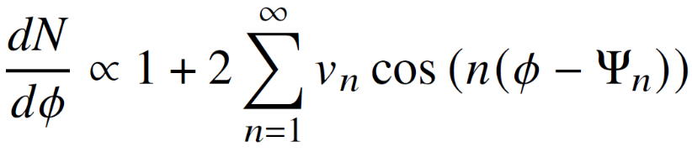
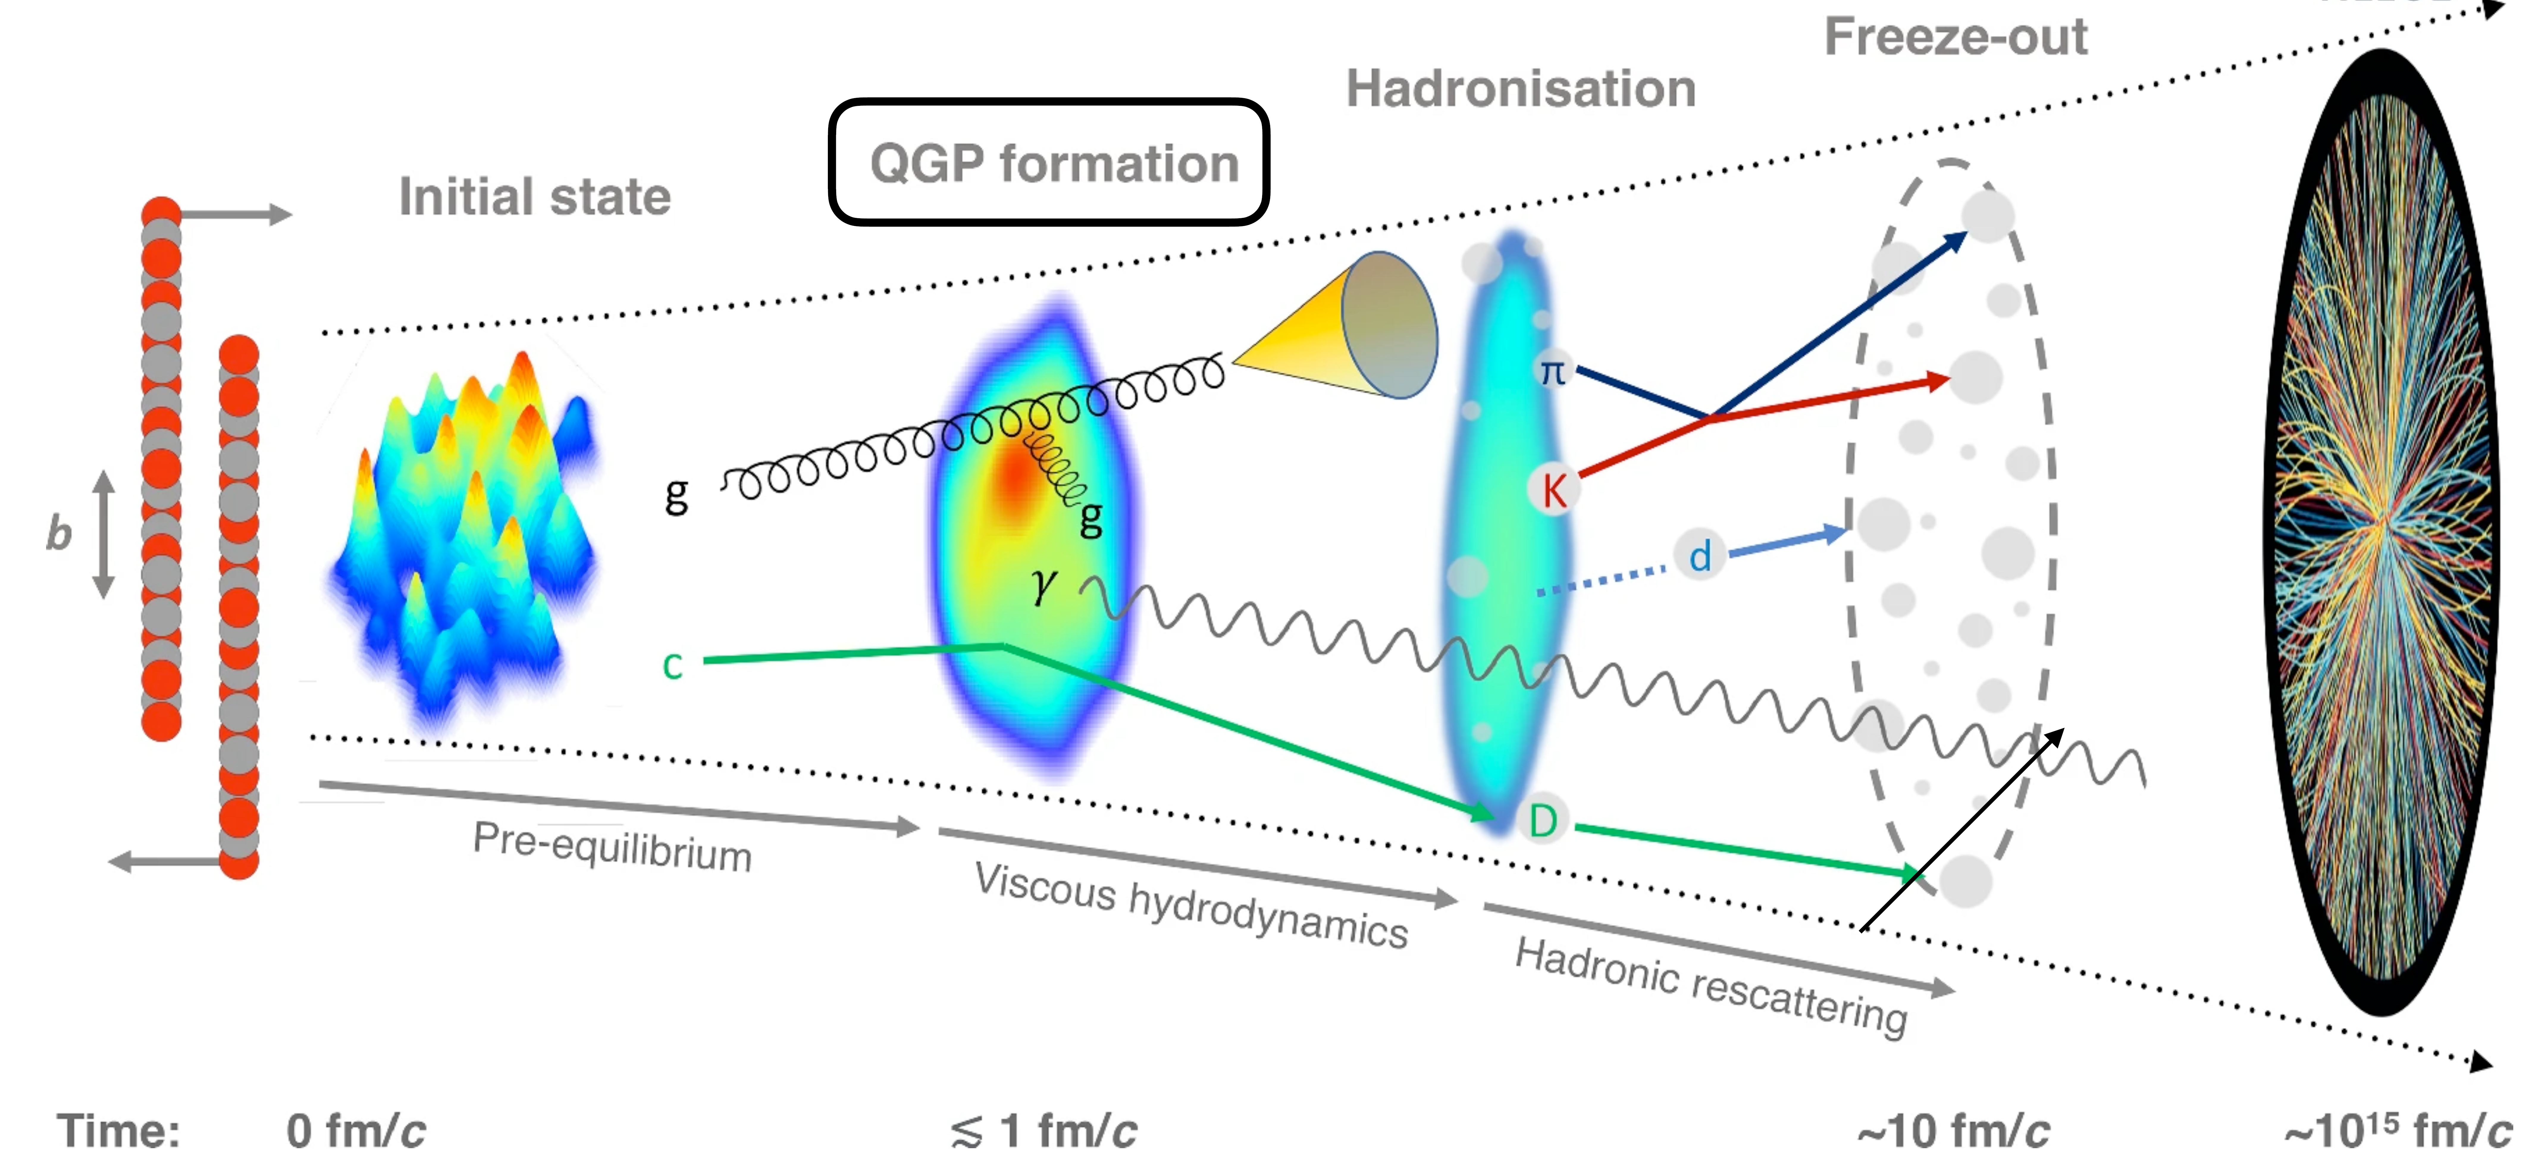
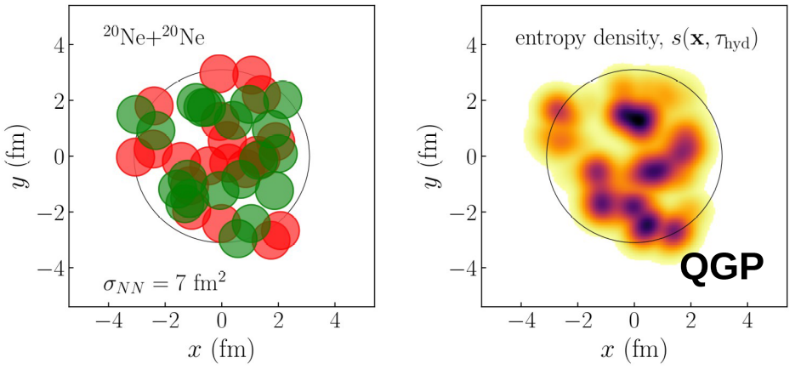
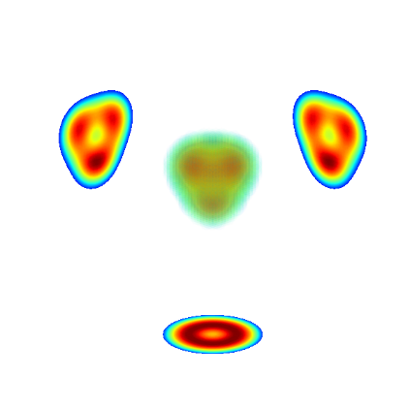
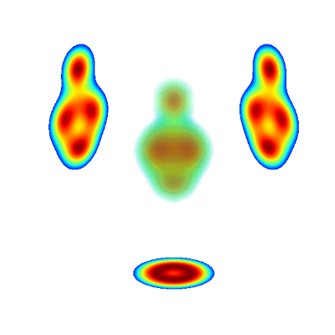
Modern flow paradigm and nuclear structure
        Propagates memory of initial geometry
Anisotropy of hadronic flow
        Nuclear structure drives initial state geometry
        <v₂²> = elliptic flow variance
        →Quadrupolar eccentricity variance
        <v₃²> = triangular flow variance
        →Octupolar eccentricity variance
        Ultra-central
        ion-ion
        collision
        Angular correlations among nucleons
        →Initially analyzed via classical rotor (CR)
        < 10⁻²⁴s = snapshot of nucleons position in g.s…
        ²³⁸U (β₂₀, β₂₂, β_{30,} β₄₀) deformation
        Reconstructing the initial state
        … but fluctuates on an event-by-event basis
STAR collab., Nature (2024)
        = Imaging of a quantum system requires taking very many snapshots!
STAR collab., arXiv:2506.17785
        1) Nucleons position → large-scale structure of the energy density of initial QGP
Ryssens et al., PRL (2023)
        The shape of gold
Bally, Giacalone, Bender, EPJA (2023)
¹⁶O
²⁰Ne
        QGP in light systems: ²⁰Ne vs ¹⁶O
Giacalone et. al, PRL (2025)
        Based on ab initio NLEFT&PGCM calculations
        Motivated 1-day ²⁰Ne-²⁰Ne collisions @LHC
        Exp data consistent with predictions
vs
        2) Hydrodynamic evolution propagates large-scale structure to final state
        ²⁰⁸Pb and ⁴⁸Ca neutron skins
Gardim et al, PRC (2012,2015)
Giacalone, Nijs, van der Schee, PRL (2023)
Liu et al., PRC (2024)
        3) <v_{n}²>_{events} = image fluctuations of nucleons positioning at the time of the collision
Zhang et al., arXiv:2510.07816

Slide 13
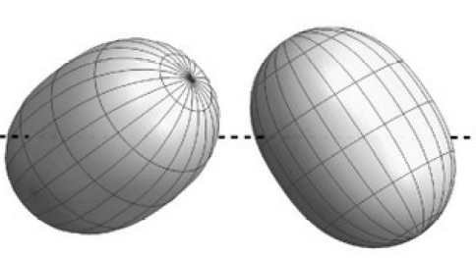
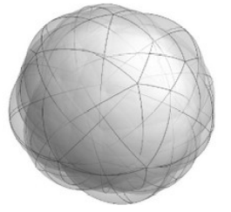
Spatial imaging of k-body correlations in nuclei
Classical rotor (CR) has underlined the way nuclei are (mostly) seen in HIC applications
1) Nucleus seen as a pure deformed rigid body rotating classically
2) Time scale used to « justify » a snapshot-frozen orientation picture in each event
3) Average over events includes an averaging over orientations of deformed bodies
Ultra-relativistic ion-ion collisions are of course performed with quantal nuclei
1) Angular momentum projection has no time-scale associated to it
2) Nuclei colliding are (J=0) spherical and there is no resolution of the intrinsic frame
3) Nuclei contain correlations among nucleons beyond the classical rigid rotor picture
2) Deformation is a proxy to imprint specific angular correlations into 2-body (and higher-body) density
3) Different mechanisms induce correlations among nucleons: -Fermion statistics
-Rotational and vibrational motions
-Non-collective motions
Needs:
Generic quantum mechanical foundation of multi-particle correlations in relativistic ion-ion collisions
Ab initio calculations including correlations step by step to quantify their respective impact on flow observables
Questions of interest to be addressed (non exhaustive list)
1) To which (quantitative) extent is the pure classical picture valid?
2) What is the impact of vibrational fluctuations within a quantum rotor+vibrator (QR+V) approximation?
3) Do non-collective (i.e. dynamical) correlations on top display a marked angular character?
4) Can we hope to separate the different sources of angular correlations (at fixed resolution scale)?
5) Can the intrinsic deformation of a CR mapped onto the effective deformation of a full quantum description?
6) Is there a specificity/advantage of HIC over low-energy probes?
7) What features of the strong interactions are probed?
8) Are their specific physics problems that this imaging can contribute to solve?

Slide 14
Contents
⦿ Introduction
⦿ Imaging (two-body) correlations in nuclei via ultra-relativistic ion-ion collisions
⦿ Azimuthal hadronic flow versus classical rigid rotor model
⦿ Azimuthal hadronic flow versus a fully quantal description of nuclei
⦿ Anatomy of two-body correlations based on ab initio nuclear structure calculations
⦿ Conclusions and perspectives

Slide 15
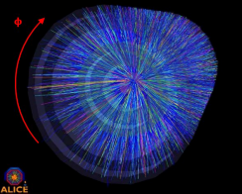



















Azimuthal flow versus quantum correlations in nuclei
End-to-end framework (ultra-central symmetric collisions here)
Azimuthal flow
Gardim et al., PRC (2015)
Energy density
Duguet et al., PRL (2025)
Nuclear ground state
2-particle observable
Hydrodynamic
Initial state model
1
2
Eccentricity
Squared eccentricity operator
One-body part of squared eccentricity operator
Normalized eccentricity variance
=0 for 0⁺ states
1) Linear approximation
Blaizot, Broniowski, Ollitrault, PLB (2014)
Two-body part of squared eccentricity operator
2) T_{R}ENTo ansatz
with
Eccentricity variance = ground-state expectation value of one- and two-body local operators
Two-particle observable Var(V_{l}) is induced by up to two-body correlations to leading order
Deformed surface of the intrinsic one-body density distribution
►Classical axial rigid rotor model
with
“Independent sources” (finite number of them)
Non-trivial contribution
“Squared” effective deformation
2-body part of E_{l}⁽¹⁾ E_{l}⁽¹⁾ only!
Nothing to do with deformation/correlations

Slide 16
Contents
⦿ Introduction
⦿ Imaging (two-body) correlations in nuclei via ultra-relativistic ion-ion collisions
⦿ Azimuthal hadronic flow versus classical rigid rotor model
⦿ Azimuthal hadronic flow versus a fully quantal description of nuclei
⦿ Anatomy of two-body correlations based on ab initio nuclear structure calculations
⦿ Conclusions and perspectives

Slide 17







Ab initio anatomy of quadrupole two-body correlations
Ab initio method = PGCM-based MR-IMSRG
Ding et al., arXiv:2608.22699
QRV+DC
Dynamical correlations
Quantum vibrator
Quantum rotor
QRV
QR
CR
J=0 proj.
Intr. def. β₂₀
$$β_{20}^{2}$$
Sum over different β₂₀
QRV+DC
QRV
QR
The QR β₂₀ and V rigidity are modified by non-dynamical correlations → s dependent!
EM1.8/2.0 χEFT nuclear Hamiltonian
Kebeler et al., PRC (2011)

Slide 18

Ab initio anatomy of quadrupole two-body correlations
Ab initio method = PGCM-based MR-IMSRG
Ding et al., arXiv:2608.22699
QRV+DC
Dynamical correlations
Quantum vibrator
Quantum rotor
QRV
QR
CR
J=0 proj.
Intr. def. β₂₀
$$β_{20}^{2}$$
Sum over different β₂₀
QRV+DC
QRV
QR
The QR β₂₀ and V rigidity are modified by non-dynamical correlations → s dependent!
EM1.8/2.0 χEFT nuclear Hamiltonian
Kebeler et al., PRC (2011)
Ding et al., arXiv:2608.22699
Effective vs intrinsic « squared » quadrupole deformation
►Classical rotor: B₂²(HE) ~ QR β₂₀²(s=0)
►Pauli: universal reduction of B₂²(HE) (no impact on B₃²(HE))
Pauli

Slide 19
Ab initio anatomy of quadrupole two-body correlations
Ab initio method = PGCM-based MR-IMSRG
Ding et al., arXiv:2608.22699
QRV+DC
Dynamical correlations
Quantum vibrator
Quantum rotor
QRV
QR
CR
J=0 proj.
Intr. def. β₂₀
$$β_{20}^{2}$$
Sum over different β₂₀
QRV+DC
QRV
QR
The QR β₂₀ and V rigidity are modified by non-dynamical correlations → s dependent!
EM1.8/2.0 χEFT nuclear Hamiltonian
Kebeler et al., PRC (2011)
Quantum Rotor
Ding et al., arXiv:2608.22699
Quadrupole correlations and effective vs intrinsic deformation
►Classical rotor: B₂²(HE)~ QR β₂₀(s=0)
►Pauli: universal reduction of B₂²(HE)
Classical Rigid Rotor
Pauli
Bofos et al., arXiv:2605.28813
MR-EDF calculations
Quantum effects
Full J=0 projection vs needle approx
Fermions statistics (Pauli)
1) < 0
2) Ind. of β₂₀
3) with A
Still -15% in ²³⁸U and -0.01 in ²⁰⁸Pb
Bofos et al., arXiv:2605.28813

Slide 20
Ab initio anatomy of quadrupole two-body correlations
Ab initio method = PGCM-based MR-IMSRG
Ding et al., arXiv:2608.22699
QRV+DC
Dynamical correlations
Quantum vibrator
Quantum rotor
QRV
QR
CR
J=0 proj.
Intr. def. β₂₀
$$β_{20}^{2}$$
Sum over different β₂₀
QRV+DC
QRV
QR
The QR β₂₀ and V rigidity are modified by non-dynamical correlations → s dependent!
EM1.8/2.0 χEFT nuclear Hamiltonian
Kebeler et al., PRC (2011)
Ding et al., arXiv:2608.22699
Quadrupole correlations and effective vs intrinsic deformation
►Classical rotor: B₂²(HE) ~ QR β₂₀(s=0)
►Pauli: universal reduction of B₂²(HE) (no impact on B₃²(HE))
►Vibration: increase here but effect depend on PES topology
→Triaxiality omitted = increase in ¹⁶O underestimated
►Dynamical correlations: unexpected significant impact
→Decrease B₂²(HE) in ²⁰Ne via decrease of β₂₀
→Increase B₂²(HE) in ¹⁶O at fixed β₂₀ =0
►Conclusion: B₂²(HE) ~ QR β₂₀(s=∞) in presence of DC!
→Justify use of effective theory based on CR for <v₂²>
→Extend to heavier nuclei, nuclei with clustering, halos…
-42%
Pauli
Vibration
DC
+40%
Higher-order cumulants to differentiate correlations (i.e. beyond effective CR)
Hagino, Kitazawa, PRC (2025) ; Liu et al., PLB (2026)
Anatomy of full 2-body (and more…) correlations in nuclei at hand

Slide 21

Ab initio anatomy of quadrupole two-body correlations
Ab initio method = PGCM-based MR-IMSRG
Ding et al., arXiv:2608.22699
QRV+DC
Dynamical correlations
Quantum vibrator
Quantum rotor
QRV
QR
CR
J=0 proj.
Intr. def. β₂₀
Giacalone, priv. comm.
$$β_{20}^{2}$$
Sum over different β₂₀
~x(1.01)²
QRV+DC
QRV
QR
The QR β₂₀ and V rigidity are modified by non-dynamical correlations → s dependent!
EM1.8/2.0 χEFT nuclear Hamiltonian
Kebeler et al., PRC (2011)
Ratio of elliptic flow in ²⁰Ne and ¹⁶O
►Measured at LHC in 2025 = 1.2
→Ratio suppresses exp. and theor. uncertainties
►Ab initio anatomy of two-body correlations
→CR overestimates exp.
→QR enhances overestimation
→Shape fluctuations further enhances overestimation
→Dynamical correlations lower ratio down to 1.5
→Difference to NLEFT (1.36) → ΔH + triaxiality in ¹⁶O(?)
►NLEFT vs data (+13%): δH + end-to-end framework corr.
→Correction to linearization needed in light nuclei
→Short-range QCD corrections (e.g. nucleon’s size)
Ding et al., unpublished
Blaizot, Giacalone, Lovato, arXiv:2512.18926
Giacalone, EPJA (2023); Giacalone, Duguet, unpublished

Slide 22
Contents
⦿ Introduction
⦿ Imaging (two-body) correlations in nuclei via ultra-relativistic ion-ion collisions
⦿ Azimuthal hadronic flow versus classical rigid rotor model
⦿ Azimuthal hadronic flow versus a fully quantal description of nuclei
⦿ Anatomy of two-body correlations based on ab initio nuclear structure calculations
⦿ Conclusions and perspectives

Slide 23
Summary
Imaging particle correlations in quantum many-body systems via k-body correlation functions at reach
►Imaging of microscopic cold atom gases in optical trap via high-resolution fluorescence (mm)
►Imaging of nuclear ground states via hadronic flow in relativistic ion-ion collisions (fm)
First steps based on simplistic nuclear models have demonstrated the power of the approach
►Deformation within CRR picture strongly impacts azimuthal flow in ultra-central collisions
►Several successful empirical studies leading to the ²⁰Ne-²⁰Ne/¹⁶O-¹⁶O runs
The field has now entered the well-founded and quantitative era
►Quantum mechanical foundation of multi-particle correlations via ion-ion collisions
►Allow to quantify the angular character of all types of many-body correlations in nuclei
State-of-the-art ab initio many-body calculations
►Unexpected importance of quadrupolar correlations induced by Pauli’s exclusion principle
►Importance of shape fluctuations
►Unexpected importance of quadrupolar non-dynamical correlations (to be further quantified)
►Unexpected compensation of correlations in both intrinsically spherical and deformed nuclei

Slide 24
Outlook
Extraction of effective deformation from experimental data
►Quantitative demonstration (still based on CR only) made recently for triaxial ¹²⁹Xe
►To be redone based on fully correlated nuclei
►More challenging in light nuclei = to be investigated
Extend present study based on full-scale triaxial PGCM calculations of ¹²C, ¹⁶O, ^{20,22}Ne
►Current axial PGCM not sufficient
►Triaxial octupole is key for clustering (e.g. Hoyle state and ¹⁶O g.s.)
Extend anatomy of two-body correlations up to heavy intrinsically deformed nuclei
►It is becoming possible to perform ab initio calculations up to the actinides
Interaction sensitivity analysis
►Quantify sensitivity of Cov(E_{l}⁽¹⁾) to χEFT interaction operators (LECs) at N^{ν}LO
►Correlates with other observables believed to be sensitive to such correlations
Multi-particle correlations
►Cov(E_{l}⁽²⁾ ,r_{perp}²) is sensitive to triaxiality in leading order
►Higher-order cumulant (skewness and kurtosis) to differentiate correlations of different natures
►Operator formulation + systematic triaxial PHFB and PGCM calculations
Multi-particle correlations via relativistic ion-ion collisions based on an end-to-end controlled EFT
►Provides systematic sub-leading QCD shorter-range corrections
►Control scheme and scale dependence of the extracted physics
Giacalone et al., arXiv:2606.03993
Bally, Heitz et al., in progress
Scalesi, Duguet, Somà, 2608.28091
Ekstrom et al., in progress
Talk by A. Ekstrom on wednesday
Mehrabpour, Giacalone, Luzum, arXiv:2604.00619
Bofos et al., in progress
Barata, Giacalone, arXiv:2609.18754; Duguet, Gelis, Giacalone, in progress

