Slide 1
Usage of the SciTil for first T0
PANDA Collaboration Meeting 9.12.2013
| Tobias Stockmanns

Slide 2
Type of Simulation Done
Can we use the data from the SciTil detector as a starting T0 information?
What type of simulation done:
Only MC simulation not looking into digitization
Looking at time-of-flight of tracks hitting SciTil detector
DPM generator used with 1.5 / 6 / 15 GeV/c beam momentum (magnetic field not adapted)
1000 events simulated

Slide 3
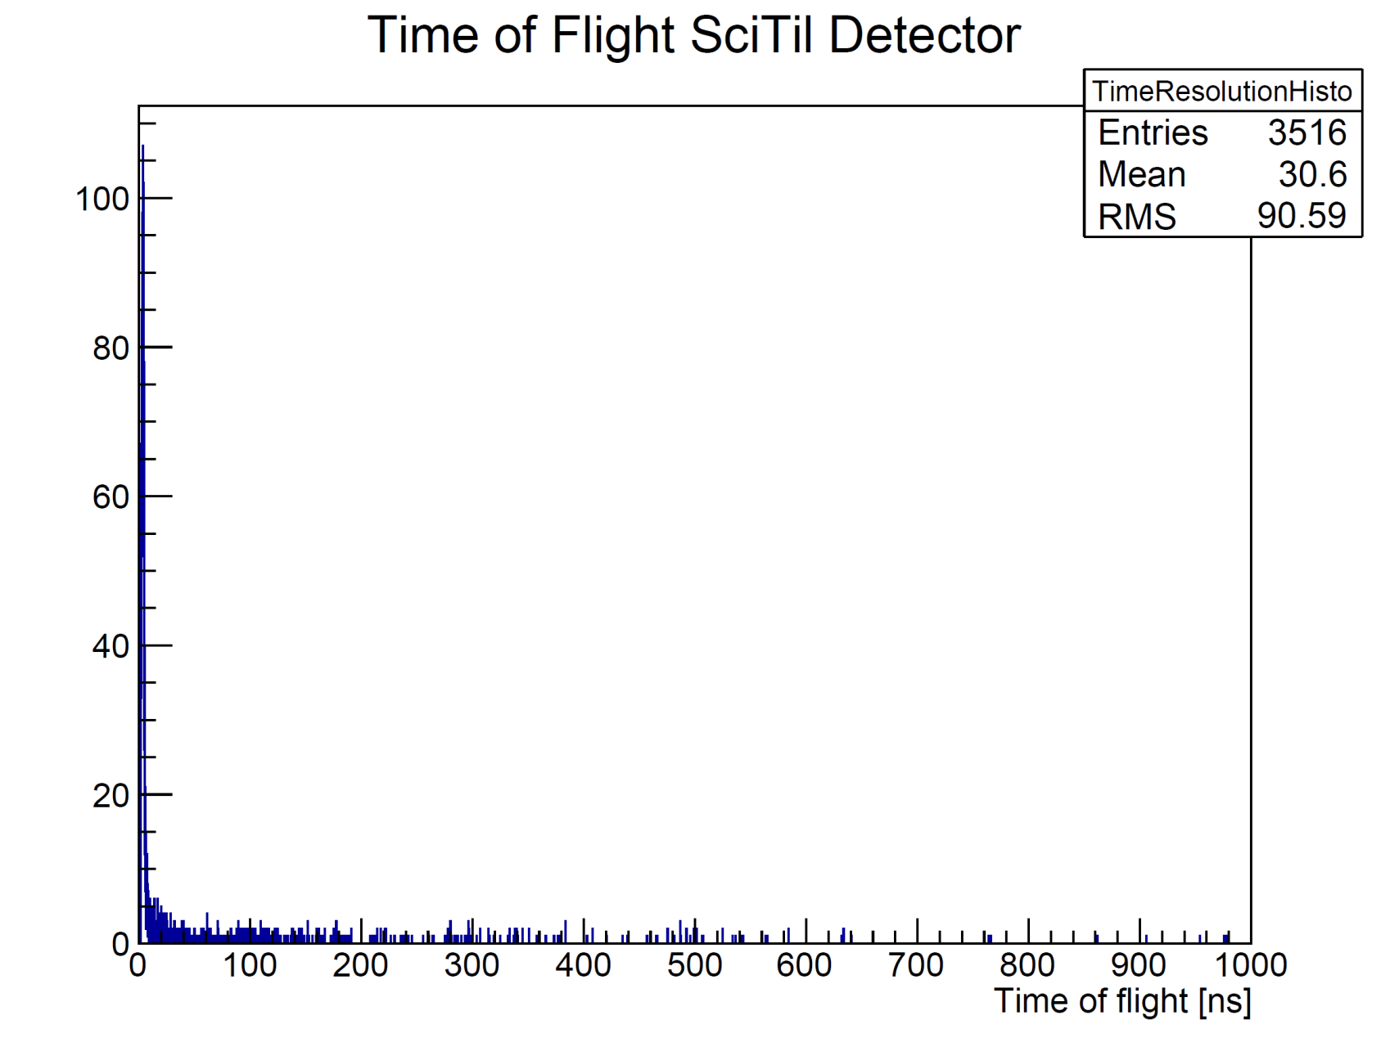
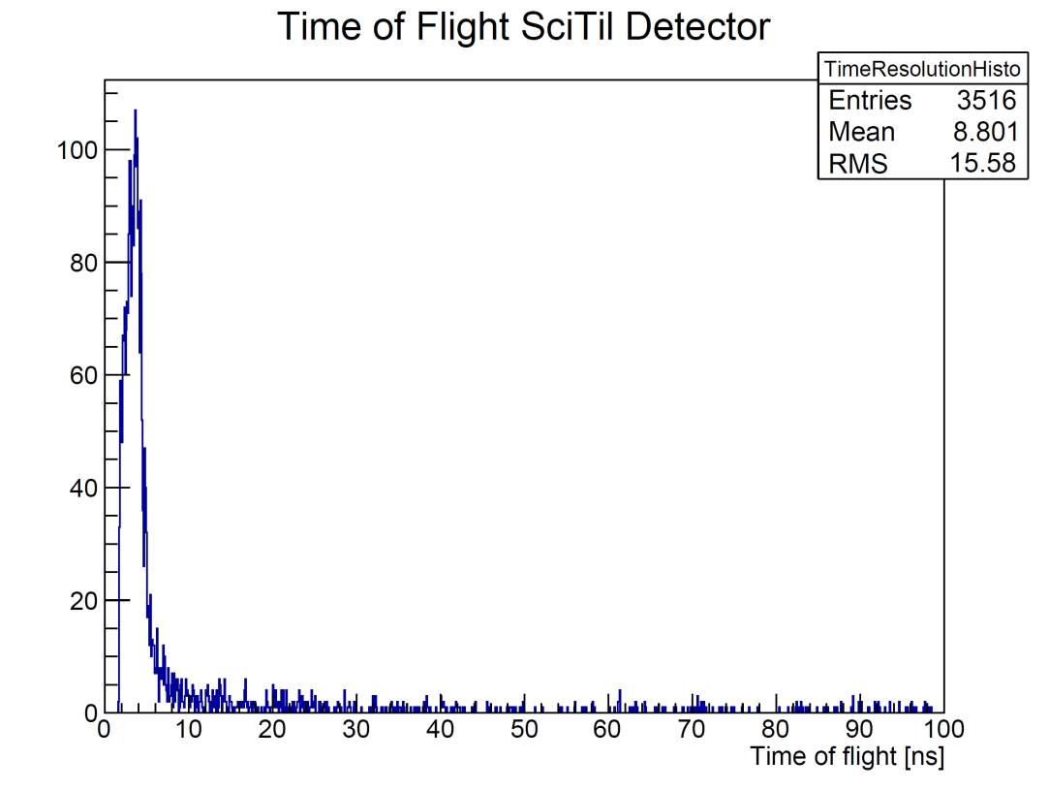
15 GeV/c all hits

Slide 4
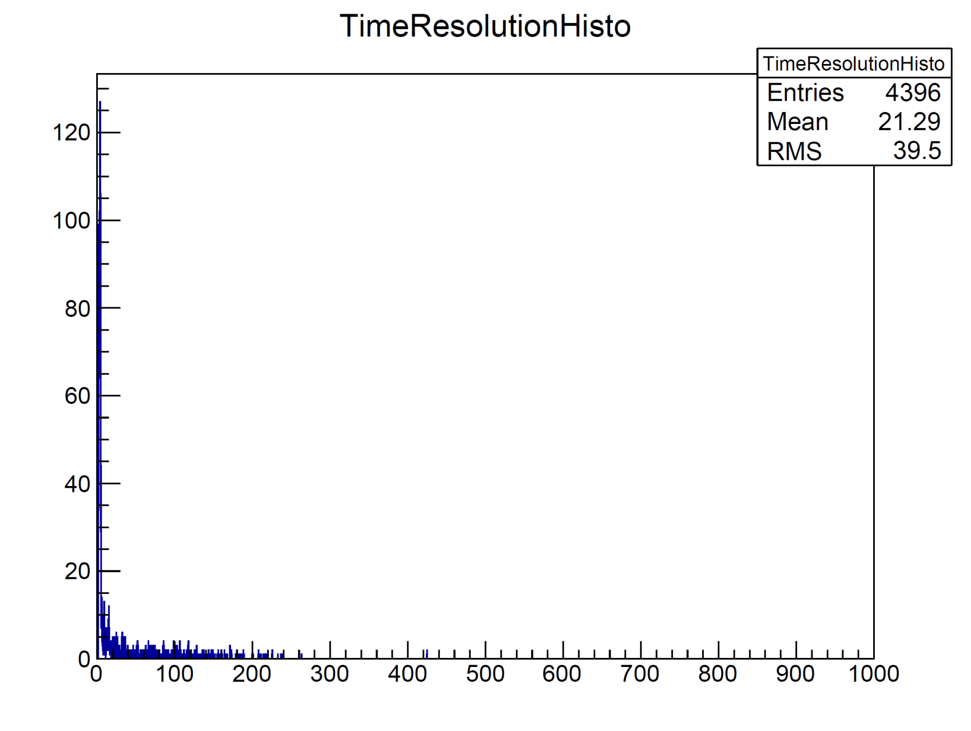
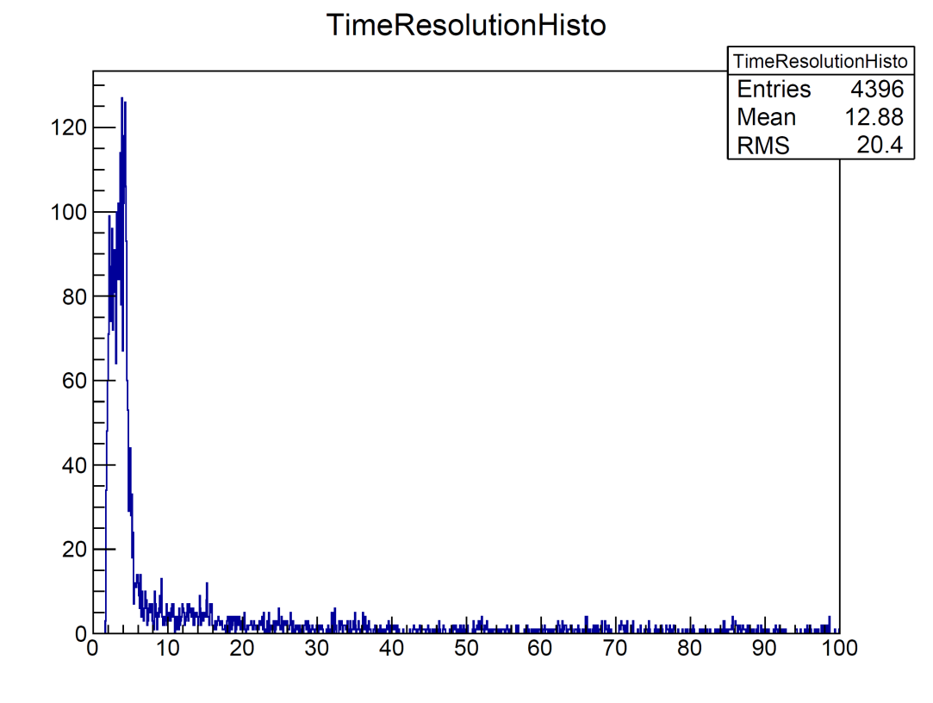
15 GeV/c no elastic scattering

Slide 5
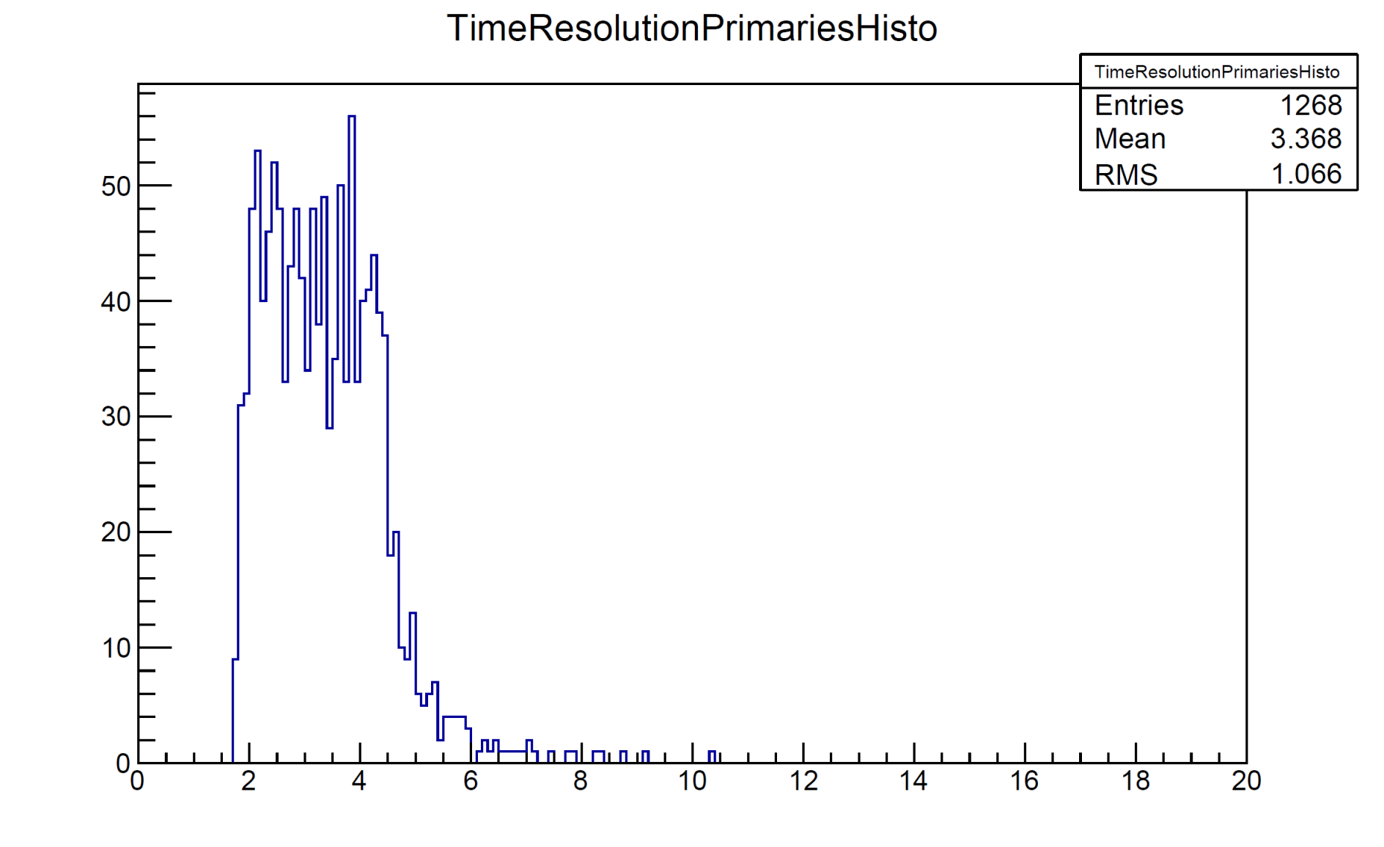
15 GeV/c primaries only

Slide 6
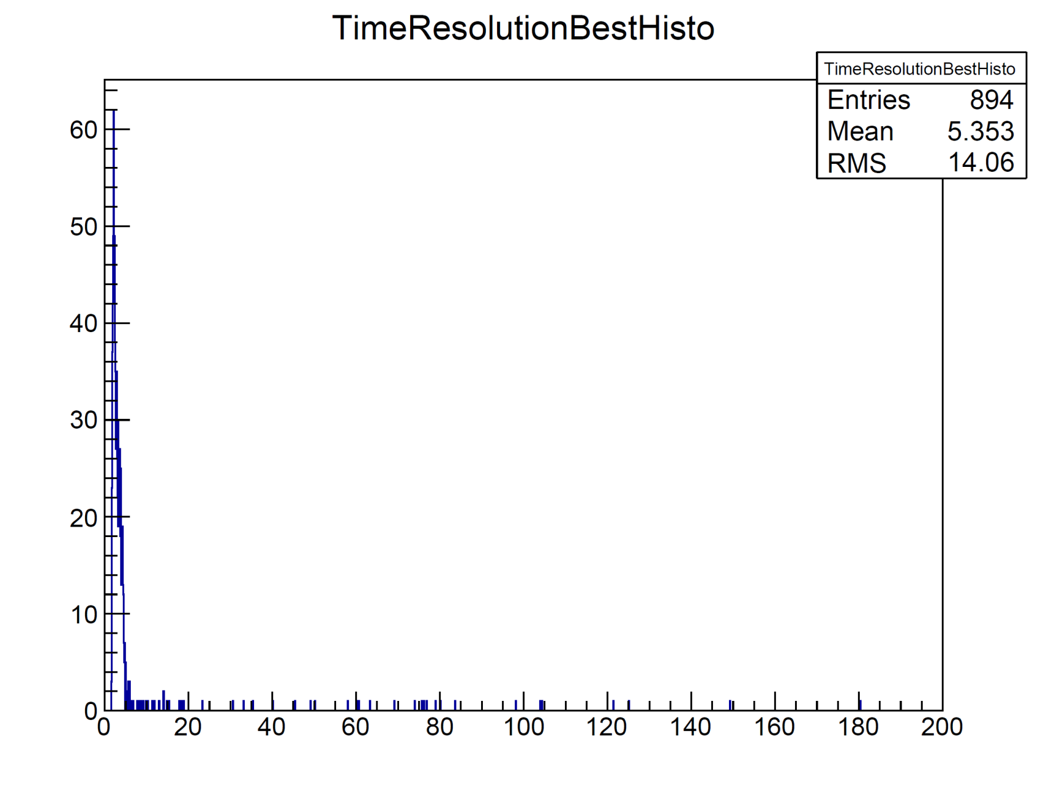
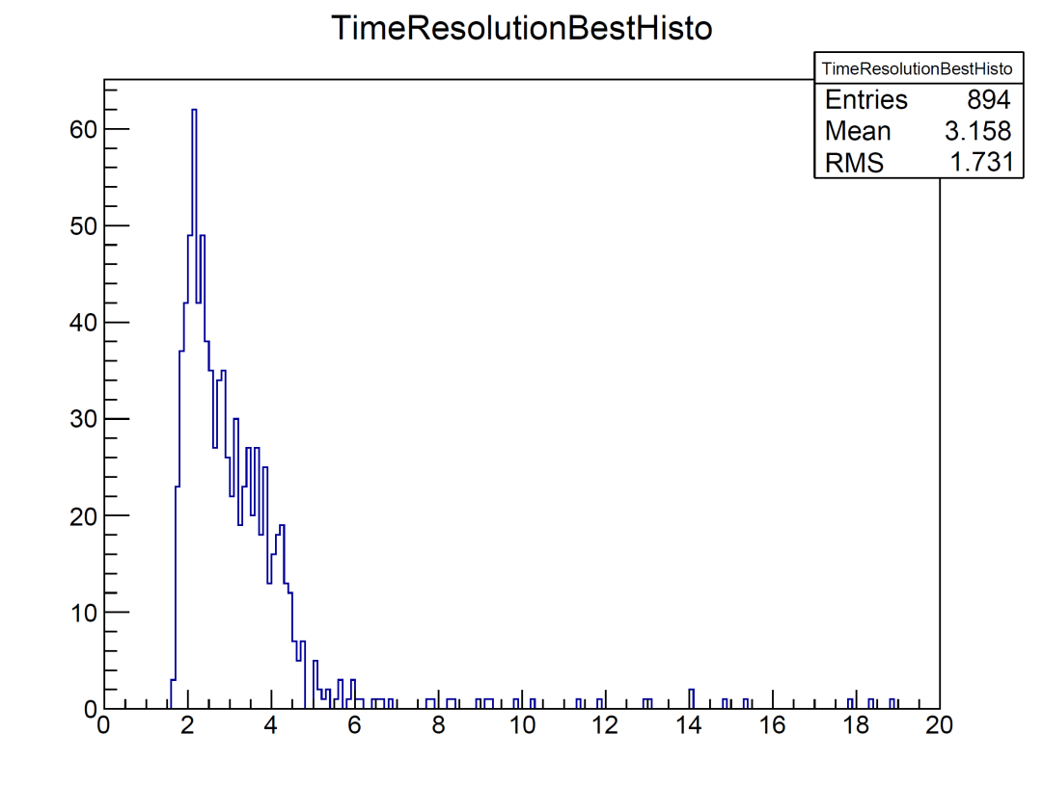
15 GeV/c fastest track in event

Slide 7
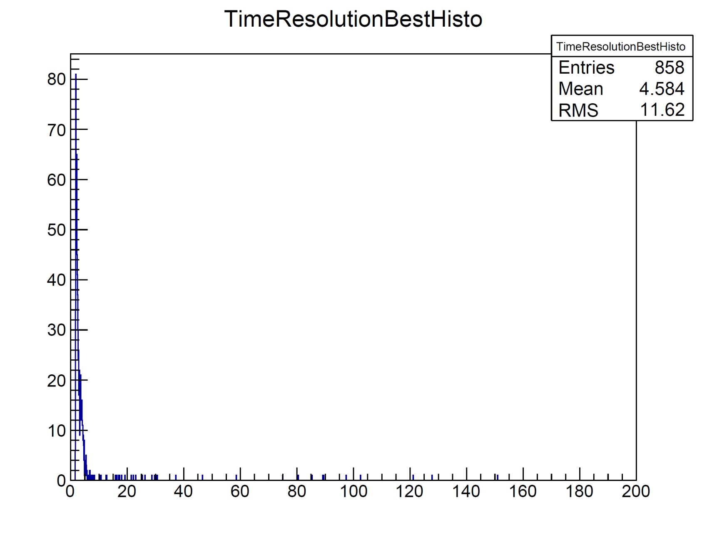
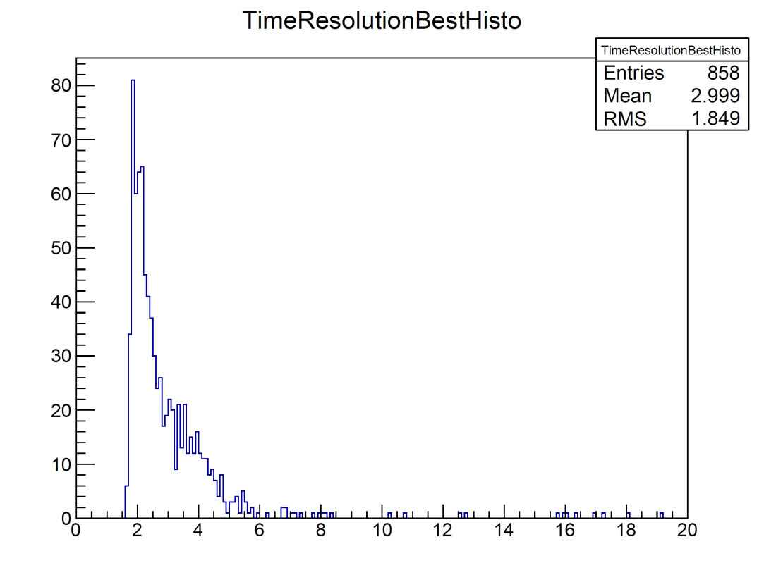
6 GeV/c fastest track per event

Slide 8
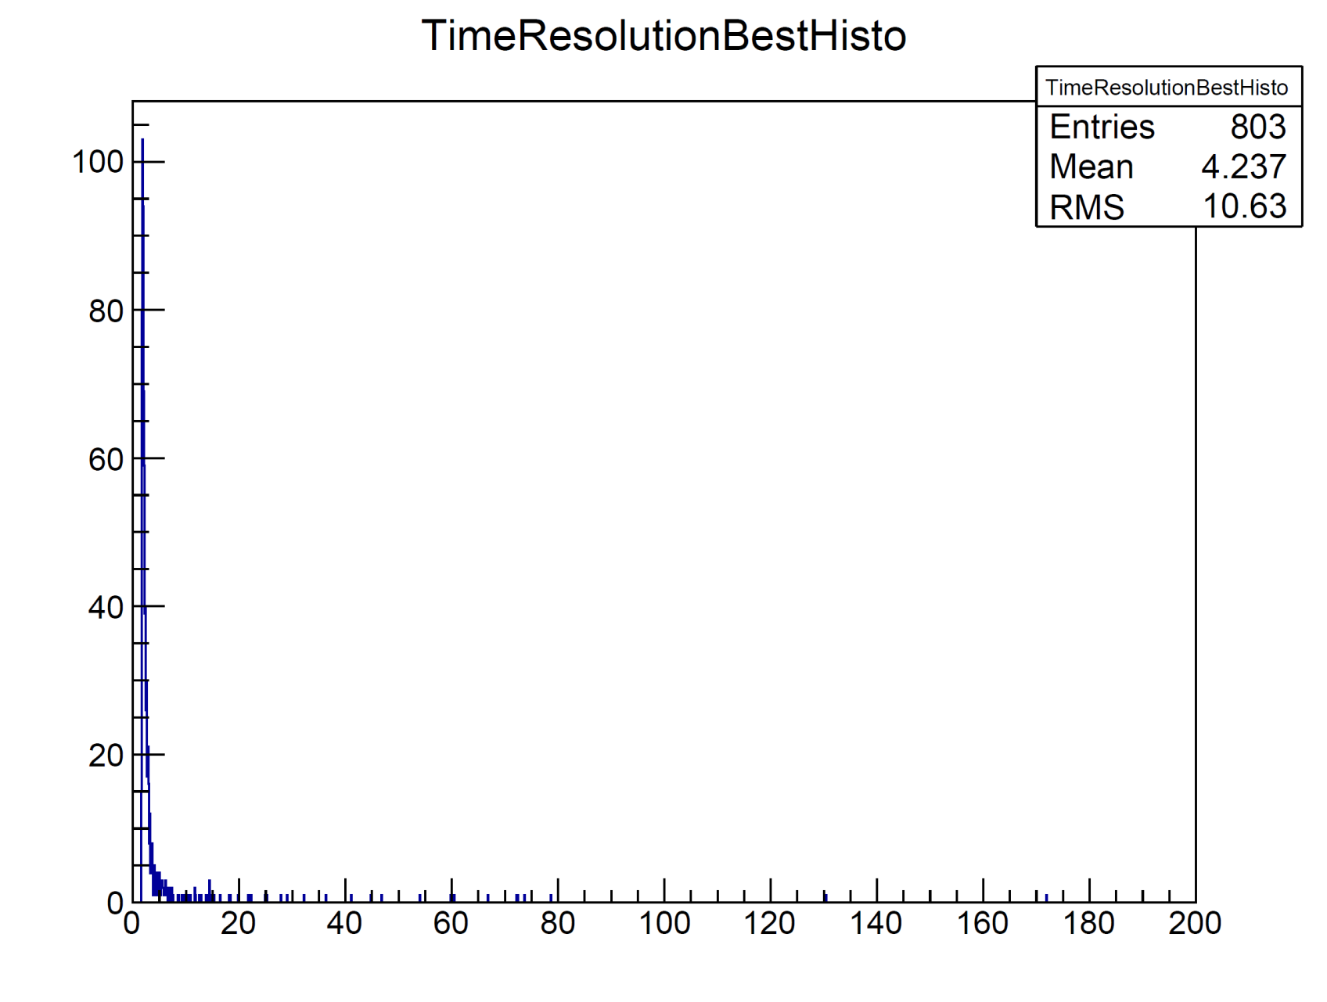
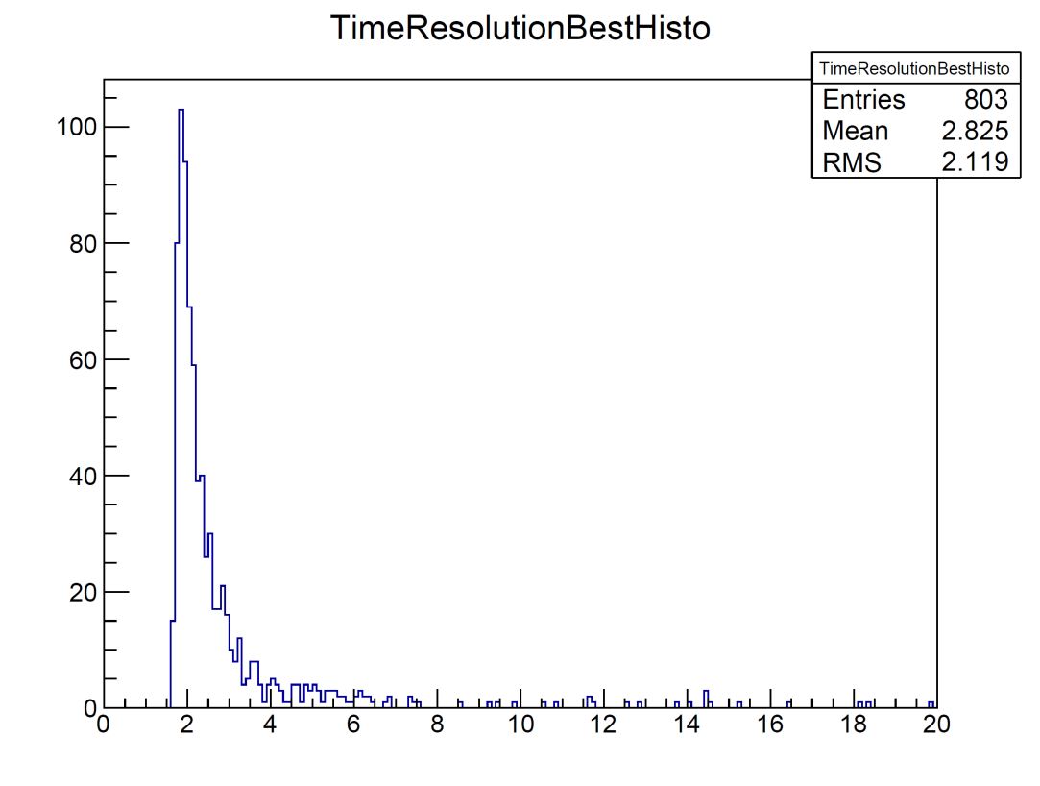
1.5 GeV/c fastest track per event

Slide 9
Summary
Complex time spectrum from SciTil detector because of long time-of-flight of secondaries up to 1 µs
For primaries the time-of-flight varies from 2 ns up to 10 ns
If one takes the time-of-flight of the fastest particle hitting the SciTil per track the distribution goes up to ~ 150 ns for rare cases
In total 10% - 20% of events do not leave a hit in the barrel SciTil detector

