Slide 1
Ergebnisse pre-MAC und Planung MAC (RA)
Steering Meeting
11 Mai 2026
Ralph Aßmann
Head Accelerator
Operations & Development

Slide 2
Path to Recovery
Strong and Immediate Reaction of the Technical Level
Fire incident
5 Feb 2026
Major damage to UNILAC accelerator & building, multi-year interruption of operation for GSI and FAIR injection → Technical report on the fire incident collects all info and data.

Slide 3
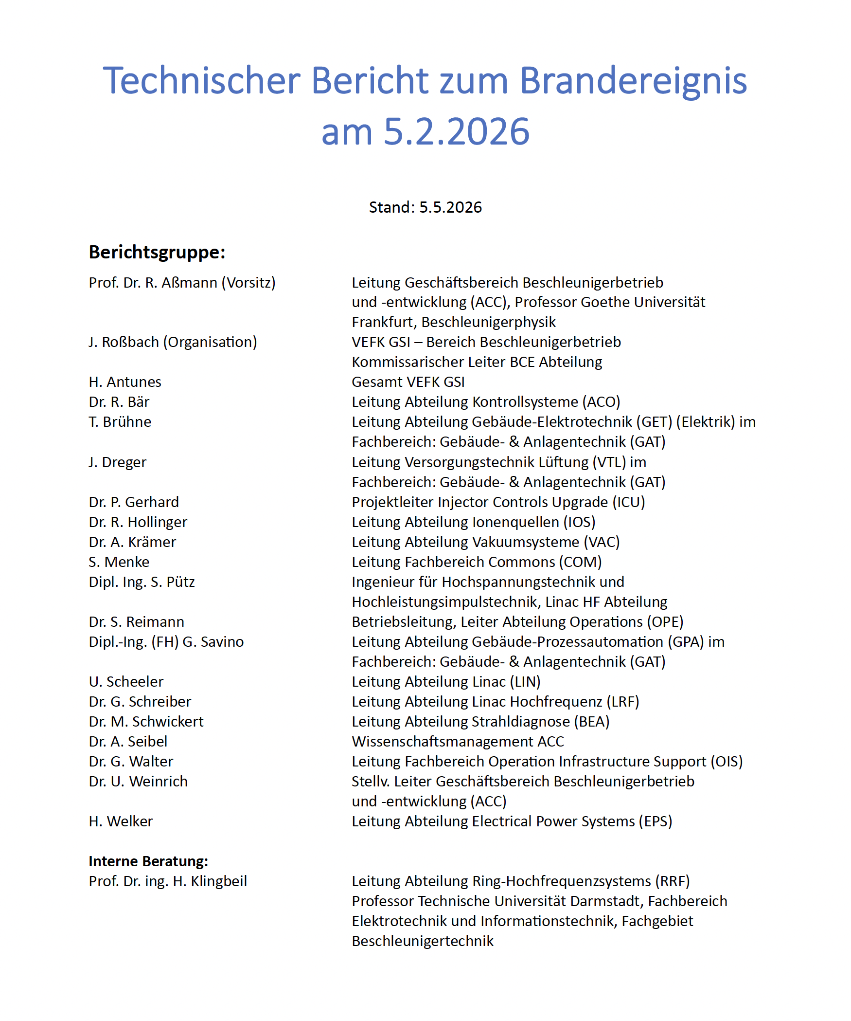
Technical Report Fire Incident 5.2.2026
49 page report + 365 page annex
Impressive effort by all technical departments in ACC, Commons, GAT, …
Many thanks!

Slide 4
Path to Recovery
Strong and Immediate Reaction of the Technical Level
Fire incident
5 Feb 2026
Major damage to UNILAC accelerator & building, multi-year interruption of operation for GSI and FAIR injection → Technical report on the fire incident collects all info and data.
Task Force
“UNILAC and FAIR Injector”
12 Feb – 16 Apr 2026
Discussion of multiple conceptual solutions, initial prioritization, performance estimates for scientific evaluation, definition of a focused concept between accelerator and science → Project plan.

Slide 5
Task force “UNILAC and FAIR Injector”
Scope: Review all technical accelerator options available to us
Invited: Z. Andelkovic, R. Aßmann (Chair), R. Baer, A. Blazevic, O. Boine-Frankenheim,
M. Galonska, R. Gebel, O. Geithner, P. Gerhard, L. Groening, M. Heilmann, F. Herfurth,
C. Hessler, R. Hollinger, S. Litvinov, C. Kleffner, H. Klingbeil, A. Kraemer, G. Loisch,
F. Maimone, S. Menke, S. Mickat, C. Muehle, P. Niedermayer, D. Ondreka, V. Plyusnin,
H. Podlech, M. Miski-Oglu, S. Reimann, E. Rosi, G. Schreiber, A. Seibel, A. Schnase,
M. Schwickert, B. Schlitt, P. Spiller, J. Stadlmann, N. Stallkamp, Y. Valdau, M. Vossberg,
H. Vormann, U. Weinrich, H. Welker, N. Winters, C. Zhang, …
Meetings: 12 – 16 – 19 – 24 – 26 Feb
2 – 5 – 18 – 26 Mar – 16 Apr
Thanks to participants and to U. Weinrich and P. Niedermayer

Slide 6
Outcome of the Accelerator Task Force on one slide
Fastest and most efficient UNILAC restoration as the highest priority
  As quickly and efficiently as possible implies with new RF of Alvarez2.0 but with old, current accelerator structures (new Alvarez2.0 structures not installed for time being*)
  This results in future UNILAC short-pulse operation (1% duty factor with 10 Hz) and the need of HELIAC for Super Heavy Elements research and materials research
Interim solutions for heavy-ion operation are possible
  25 options considered, 13 of which were prepared for scientific evaluation (from GSI in-house to industrial solutions to new scientific linacs)
  Evaluation Accelerator & Science prioritized two GSI in-house options for FAIR commissioning in 2027(reversed HITRAP ‘de’→’ac’celerator in TK) and science in 2028 (HLI’ with energy booster in EH or elsewhere)
  Plan B of the technical sector: Tandetron (not pursued in project for the time being)
*However, the production sequence for Alvarez2.0 will be optimized for the fastest possible installation (if necessary): A1 as soon as possible

Slide 7
Technical Roadmap Document October 2025
(part of list that shows RF components)
after the 05 Feb 2026 fire superseded by the project plan

Slide 8
Path to Recovery
Strong and Immediate Reaction of the Technical Level
Fire incident
5 Feb 2026
Major damage to UNILAC accelerator & building, multi-year interruption of operation for GSI and FAIR injection → Technical report on the fire incident collects all info and data.
Task Force
“UNILAC and FAIR Injector”
12 Feb – 16 Apr 2026
Discussion of multiple conceptual solutions, initial prioritization, performance estimates for scientific evaluation, definition of a focused concept between accelerator and science → Project plan.
Restoration Project (ACC)
14 Apr 2026 until ∼ 2031
Budget ACC: 159.7 M€ (full)
= 94.5 M€ (I,II) + 65.2 M€ (III,IV,V)
plus 64.35 M€ (building/techn. infras.)
Ask for budget approval 11 June
Detailed feasibility studies, technical design, optimized solutions, layouts and specifications, procurement, implementation, commissioning, project execution: budget, milestones, resources
Interim solution(s) for FAIR commissioning and science by 2027 and 2028
UNILAC restoration for full FAIR science until Q1/2031

Slide 9
Project Plan
Package | Spending | Construct./Techn. Infrastructure | Accelerator (ACC) | Wissenschaft
1 | Immediate Actions | 9.35 M€ | 2.4 M€
 | HITRAP for FAIR Commissioning | included in ACC | 3.8 M€ | -
 | HLI’ for Science | included in ACC | 5.3 M€
2 | Restoration UNILAC operation | 33 M€ | 83.4 M€ | 5.9 M€
3 | Improvement operational reliability, elimination of central risks for FAIR injection + CRYRING | 22 M€ | 38.5 M€
4 | Improvement operational reliability, elimination of central risks for GSI science | - | 11.3 M€
5 | Rest of technical roadmap (increase intensity) | - | 18.8 M€
Total |  | 64.35 M€ | 163.5 M€ | 5.9 M€
143.2 M€

Slide 10
Project Organization
TGF, GF
Overall Project Lead
R. Aßmann
Dep.: U. Weinrich
Project processes and documentation
R. Hess
Dep.: A. Seibel
Steering Committee
R. Bär, O. Boine-Frankenheim,
R. Gebel, L. Groening, R. Hollinger,
A. Krämer, B. Lommel, S. Menke,
H. Podlech, T. Radon, S. Reimann,
J. Rossbach, M. Schwickert,
D. Severin, H. Simon, P. Spiller,
G. Stephan, G. Walter, H. Welker…
Technical Coordinator
M. Vossberg
Dep.: S. Mickat
Activity coordination: M. Klich
Schedule, cost and risk planning
E. Rosi, Dep.: N. Winters
Bau / GAT Projekte in KGF
UNILAC Restoration
U. Scheeler
Dep: N. Stallkamp
HITRAP in TK
Z. Andelkovic
Dep: F. Herfurth
HLI-type Linac
G. Loisch / H. Vormann
Dep: M. Miski-Oglu
Construction/TI VR/TU
U. Fabig / A. Giesler
Dep: M. Martin-Pelaez
SIS-18 Injection
J. Stadlmann
Dep: D. Ondreka
Safety and RP
T. Radon
Dep: Philipp Kewes
LINAC Controls
P. Gerhard
Dep: J. Pforr
Deinventory
B. Benz
Dep: M. Martin-Pelaez
LINAC RF
B. Schlitt / C. Herr
Dep: G. Schreiber
LINAC Diagnostics
B. Walasek-Höhne
Dep: A. Reiter
Project Procurement
G. Harks
Dep: M. Spatar
VAC
xxx
Dep: A. Krämer
TRI
D. Acker
Dep: M. Bevcic
EPS
C. Hunkel
Dep: H. Welker
NCM
C. Mühle
Dep: xxx
DMU
A. Seidel
Dep: xxx
Kick-off 14 Apr 2026

Slide 11
Integrated Planning
Courtesy PMO

Slide 12
Planning UNILAC Restoration Projects 1 – 3
UNILAC fully back
in operation
→ full FAIR Science
HITRAP in TK
→ FAIR commissioning
HLI’ in EH with energy booster
→ FAIR commissioning and
Operation for Science
Courtesy PMO

Slide 13
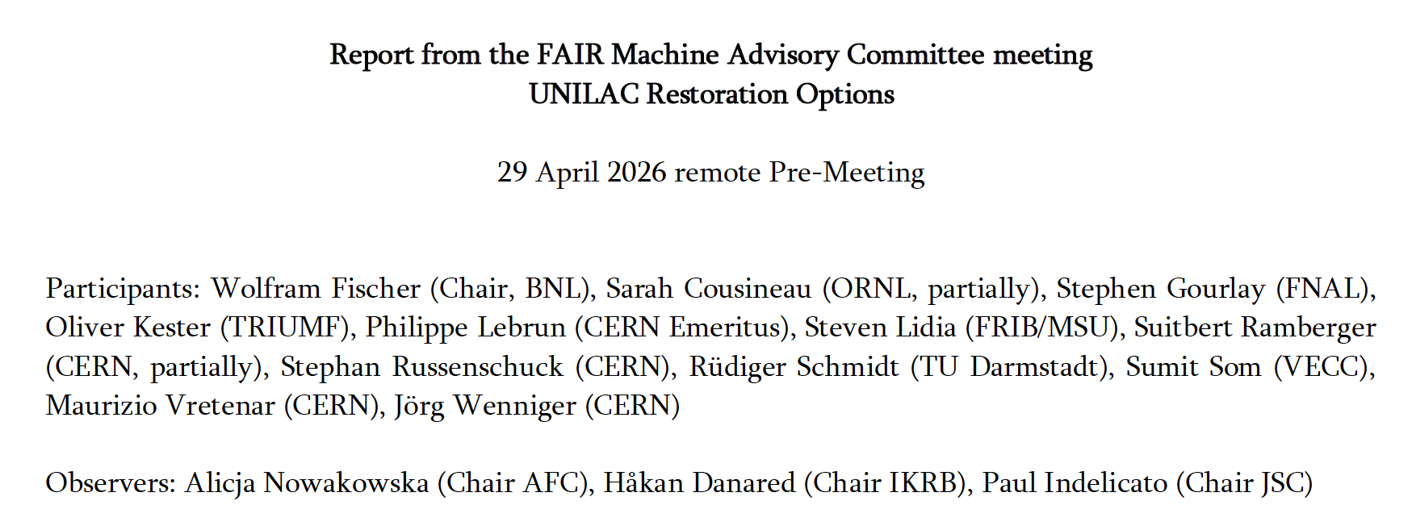
Pre-MAC Report

Slide 14
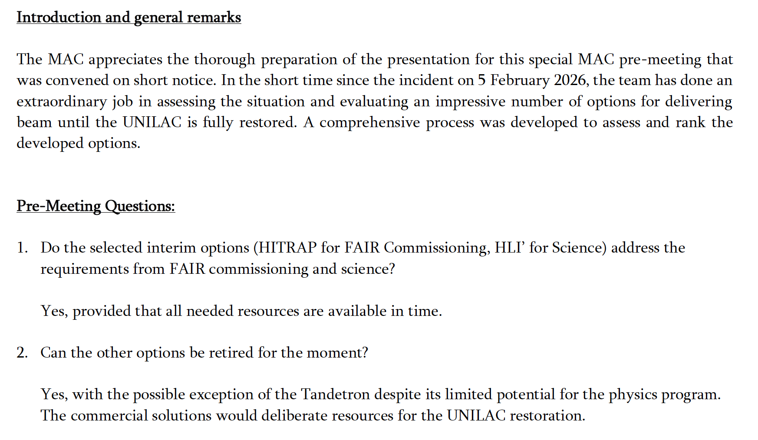
Pre-MAC Report

Slide 15
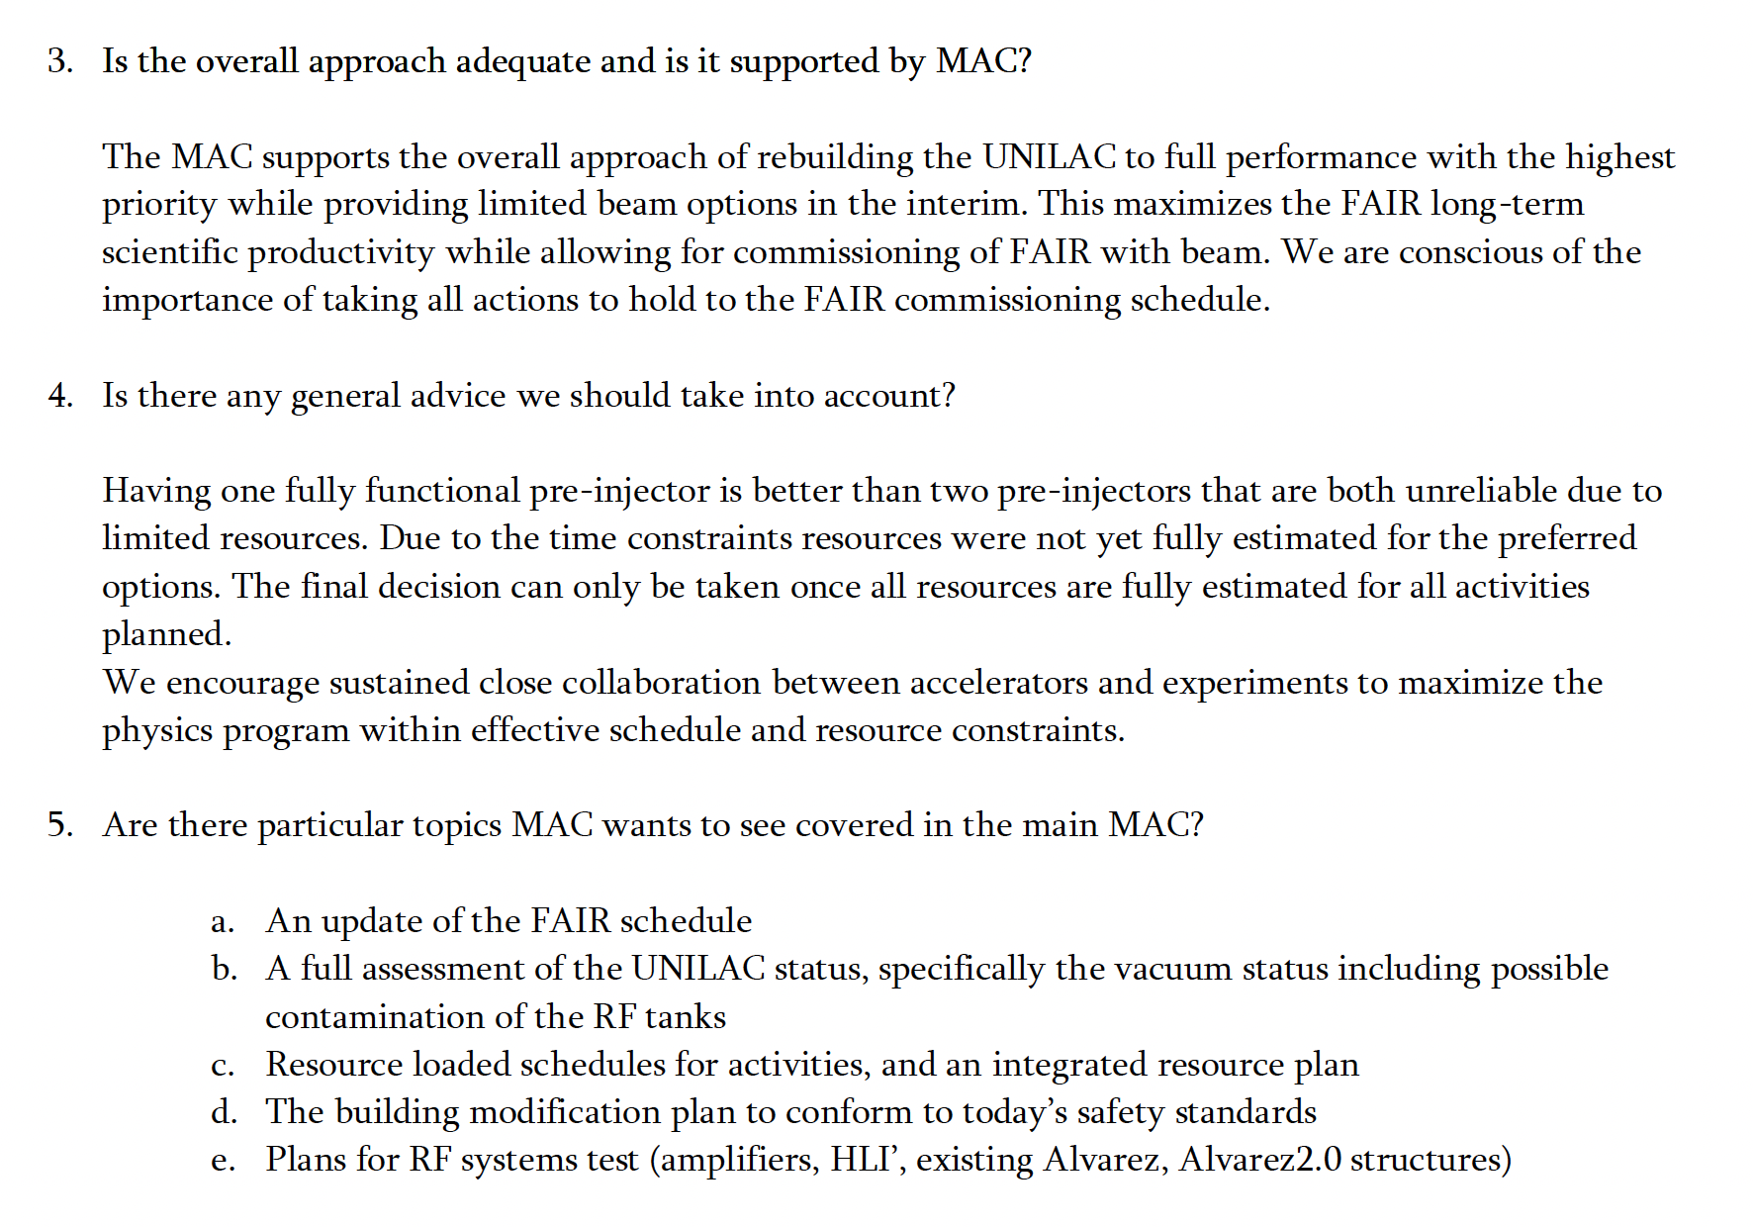
Pre-MAC Report

Slide 16
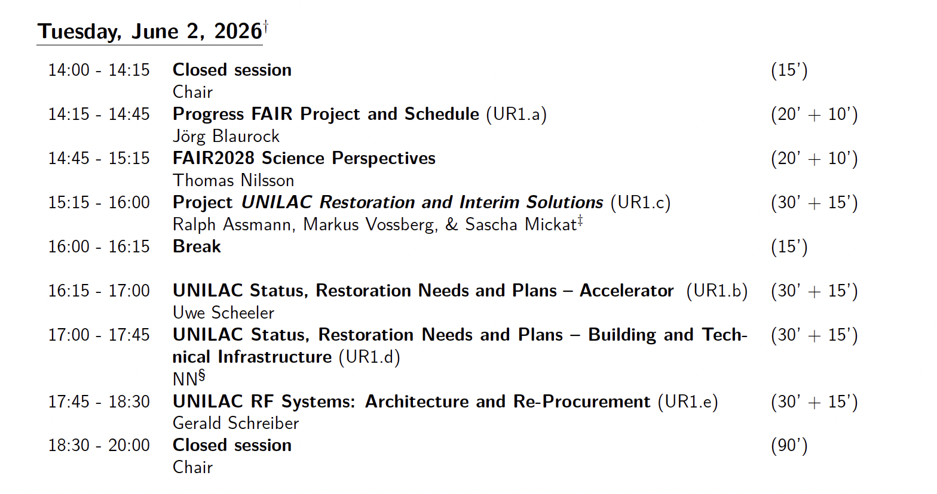
Agenda MAC

Slide 17
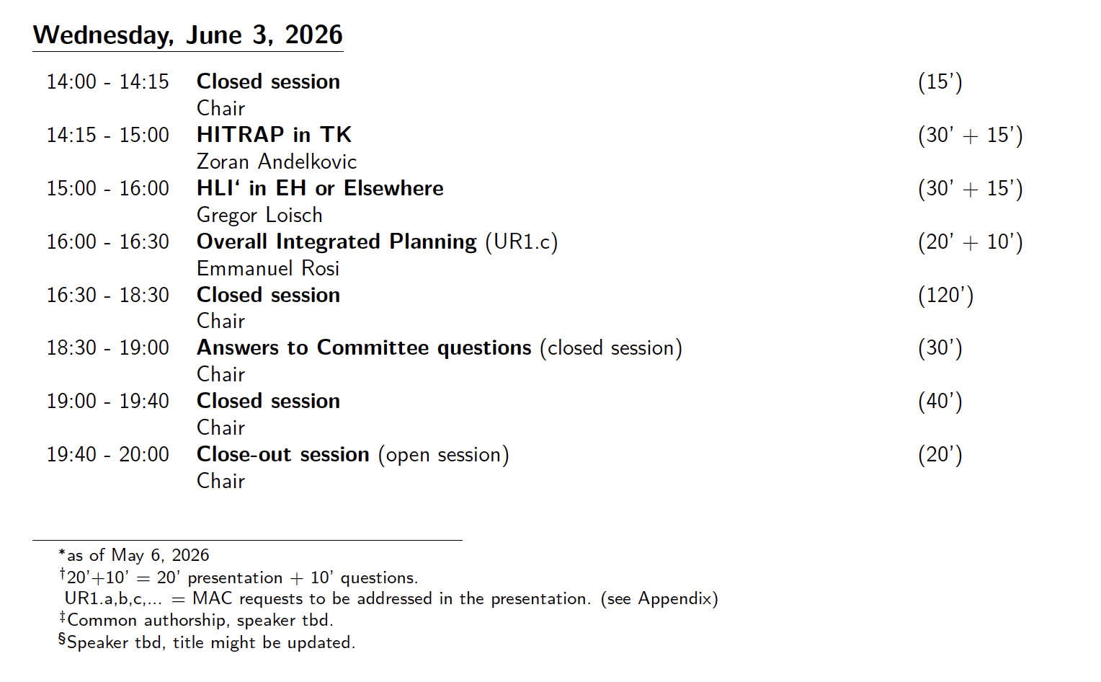
Agenda MAC

Slide 18
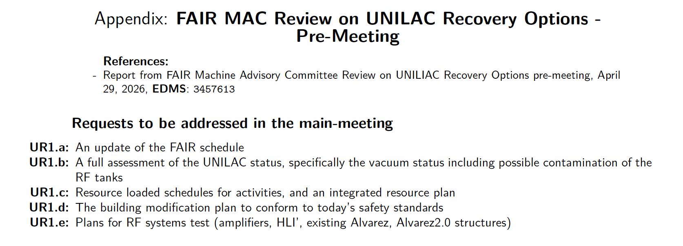
Agenda MAC

Slide 19
Thank you for your attention

Slide 20
Additional Slides

Slide 21
Machine Meeting → Overall project meeting
Every 2 weeks
Chair: R. Assmann
Steering Meeting Monthly
Chair: R. Assmann
Layout and Specifications
Weekly
Chair: M. Vosberg
Shutdown Meeting → Technical Measures / Installations
Weekly
Chair: M. Vosberg
Planning meeting
(Schedule and Resources)
Every 2 weeks
Chair: E. Rosi
Project meetings on projects
Chair: respective sub-PL
Meeting Structure

