Slide 1
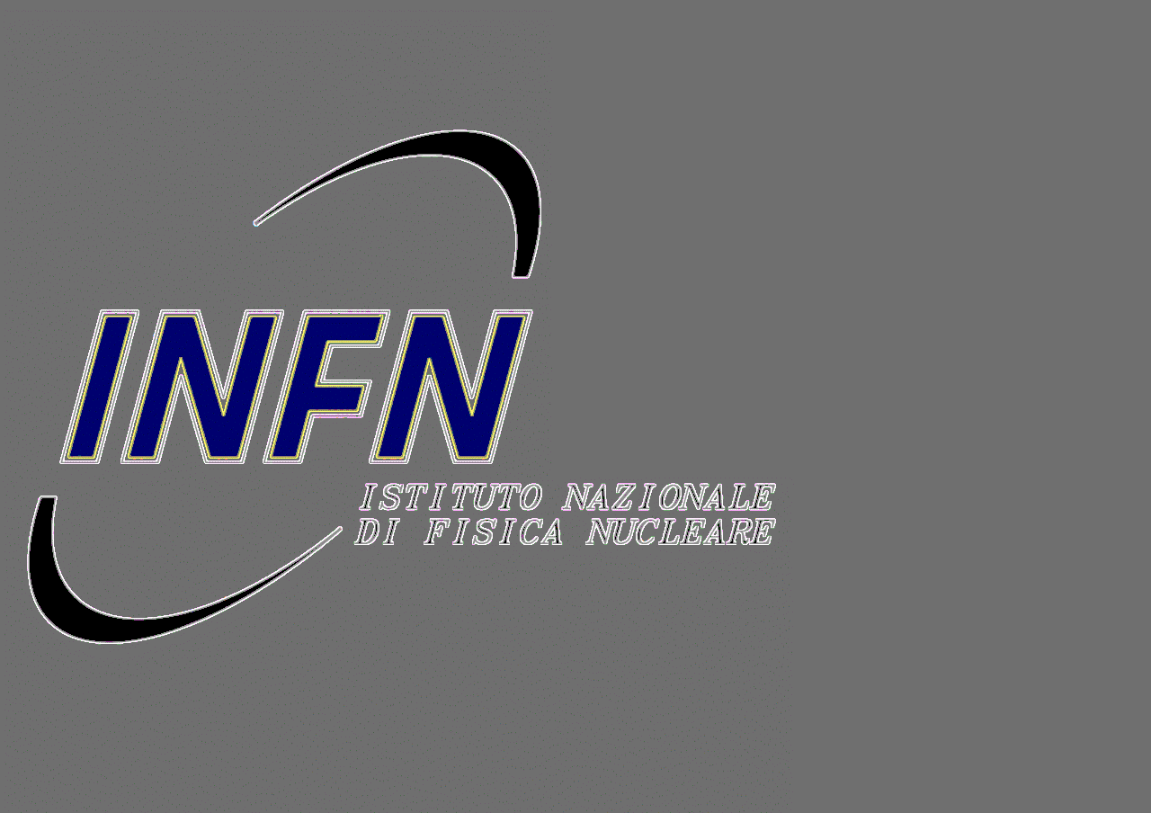
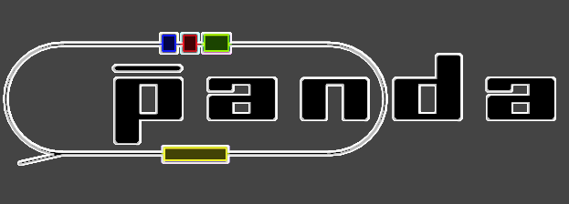
CROSS-PIPE & MVD
Interaction MVD-pixel disks & cross pipe
MVD assembly problem
G.Giraudo
GSI-Mechanics Workshop 9-Dec-2013

Slide 2
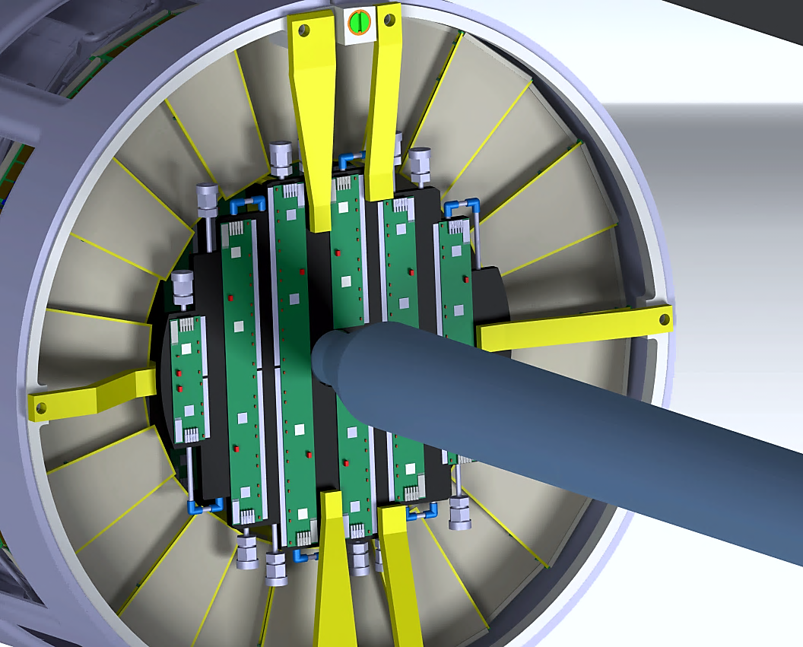
MVD forward disks sector – existing design
Cross pipe (welded structure)
  Manufacturing tolerances
  Assembly constraints
  Final position (unknown)
  MVD Disks (machined structure)
    Manufacturing tolerances: fixed
    Assembly sequence and final
    position defined
0.8 mm clearance
G.Giraudo
GSI-Mechanics Workshop 9-Dec-2013

Slide 3
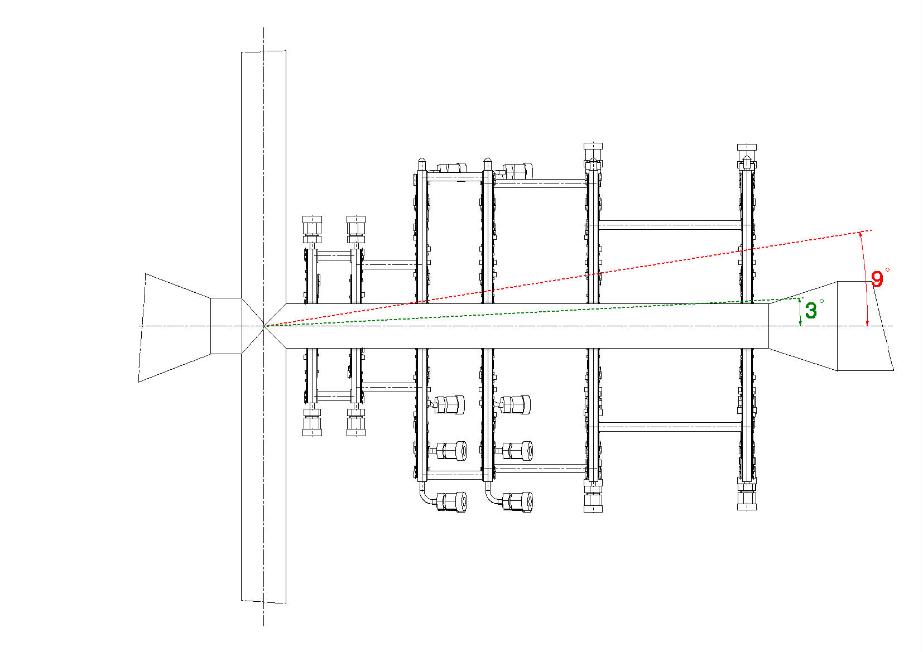
SOLUTIONS (?)
Increase of the disks inner radius (sensors arrangement changed)
Reduce of the cross pipe radius
Fix the cross-pipe tolerances and tune the pixel-disks machining
(sensors arrangement?)
MVD forward pixel disks sector – existing design
G.Giraudo
GSI-Mechanics Workshop 9-Dec-2013

Slide 4
MVD internal assembly problem:
  big quantity of services
  strip disks supporting structure
    strip disks position inside the MVD frame
Proposed Solution:
  forward shift of the pixel disk 6
  new arrangement of the pixel/strip disk 6
Effects:
  forward shift of the connecting cone of the cross-pipe
or
  increase of the inner radius of the pixel disk 6
G.Giraudo
GSI-Mechanics Workshop 9-Dec-2013

Slide 5
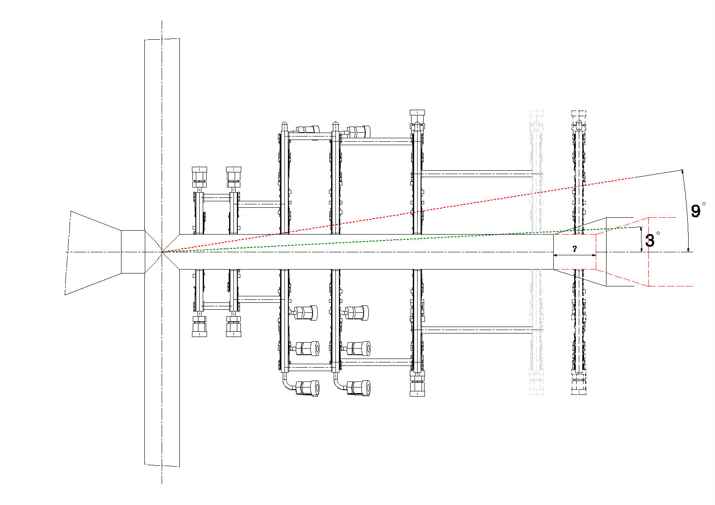
forward shift of the connecting
cone of the cross-pipe
Actual design
Proposed design
G.Giraudo
GSI-Mechanics Workshop 9-Dec-2013

Slide 6
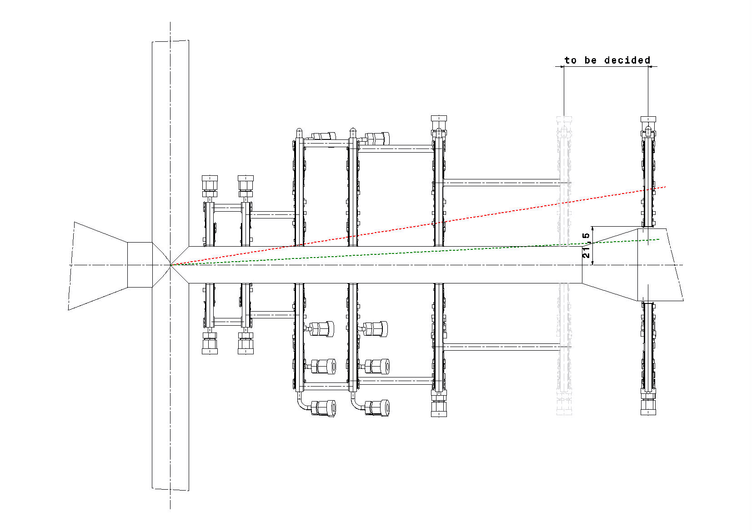
increase of the inner radius of the pixel disk 6 to 21.5 mm (or more)
Pixel disk 6 inner radius to 21.5 mm ➔ forward shift > 40 mm
G.Giraudo
GSI-Mechanics Workshop 9-Dec-2013

Slide 7
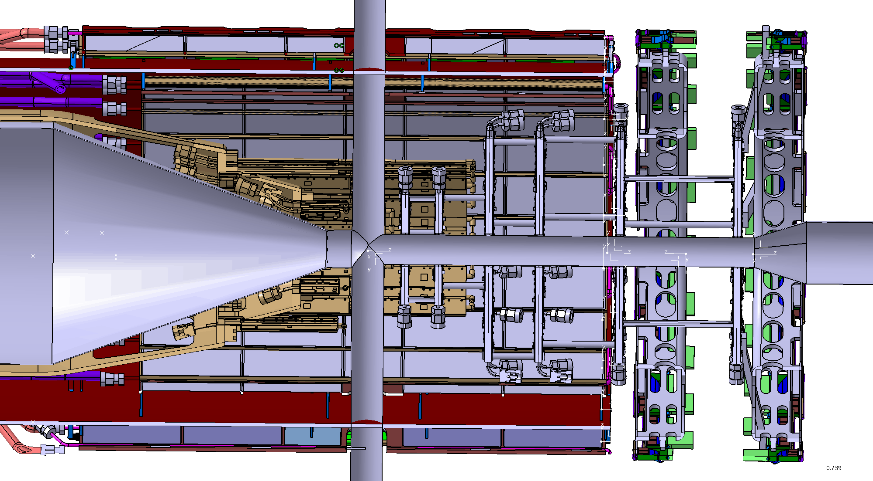
current pixel-disk arrangement with strip-disks in two sectors
Pixel-disks
New MVD’s frame design
Strip-disks
G.Giraudo
GSI-Mechanics Workshop 9-Dec-2013

Slide 8
Summary
Possible interference between cross-pipe & MVD
  Gain space between inner radius of the pixel disks
  and outer radius of the cross pipe
    Increase of the disks inner radius (sensors arrangement changed)
    Reduce of the cross pipe radius
  Fix the cross-pipe tolerances and tune the pixel-disks machining
MVD internal assembly problem
  Strip disks structure changes
    Cross pipe changes
    New supporting structure/New disks arrangement & new MVD frame design

