Slide 1
Multidifferential analysis of dielectron spectra in ag+ag collisions At 1.23a gev
Master‘s Thesis Proposal

Slide 2
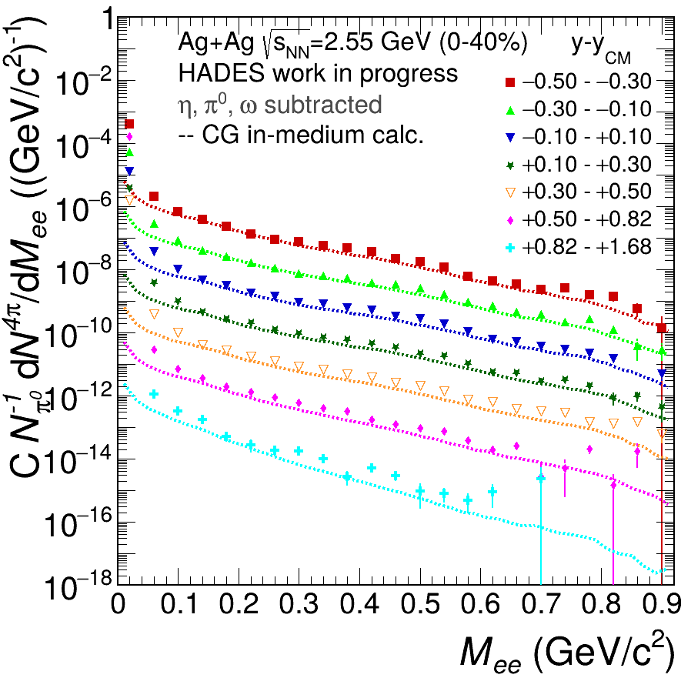
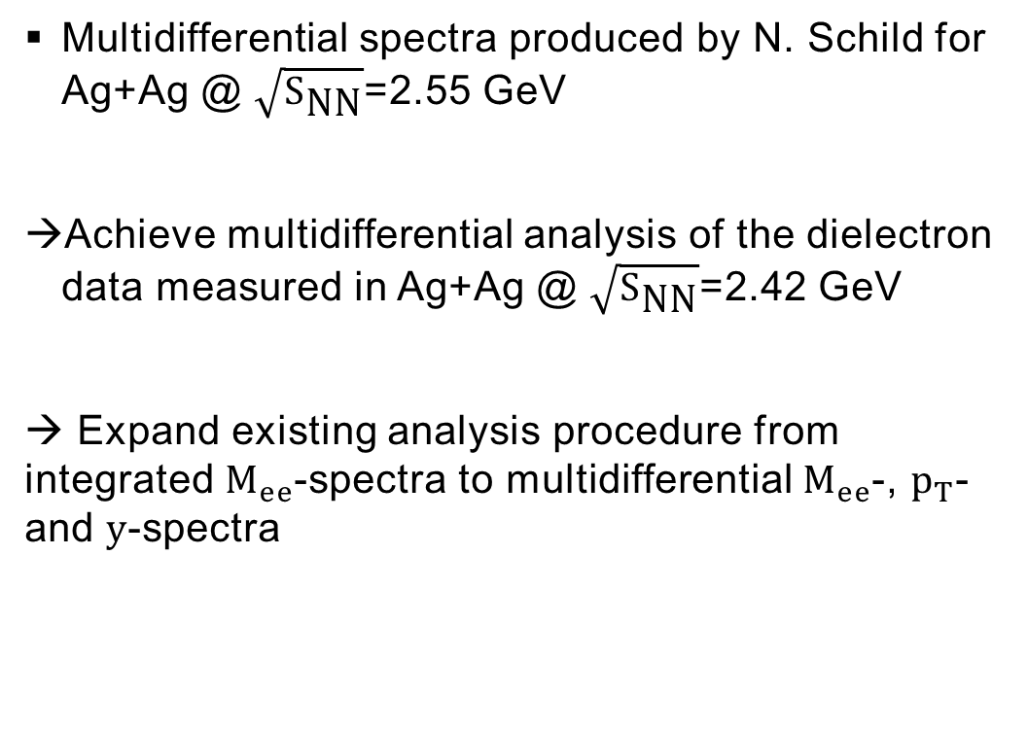
Motivation and Goals
Multidifferential spectra produced by N. Schild for Ag+Ag @ $\sqrt{S_{\text{NN}}}$=2.55 GeV
Achieve multidifferential analysis of the dielectron data measured in Ag+Ag @ $\sqrt{S_{\text{NN}}}$=2.42 GeV
→ Expand existing analysis procedure from integrated $M_{ee}$-spectra to multidifferential $M_{ee}$-, $p_{T}$- and $y$-spectra
N. Schild, PhD Thesis

Slide 3
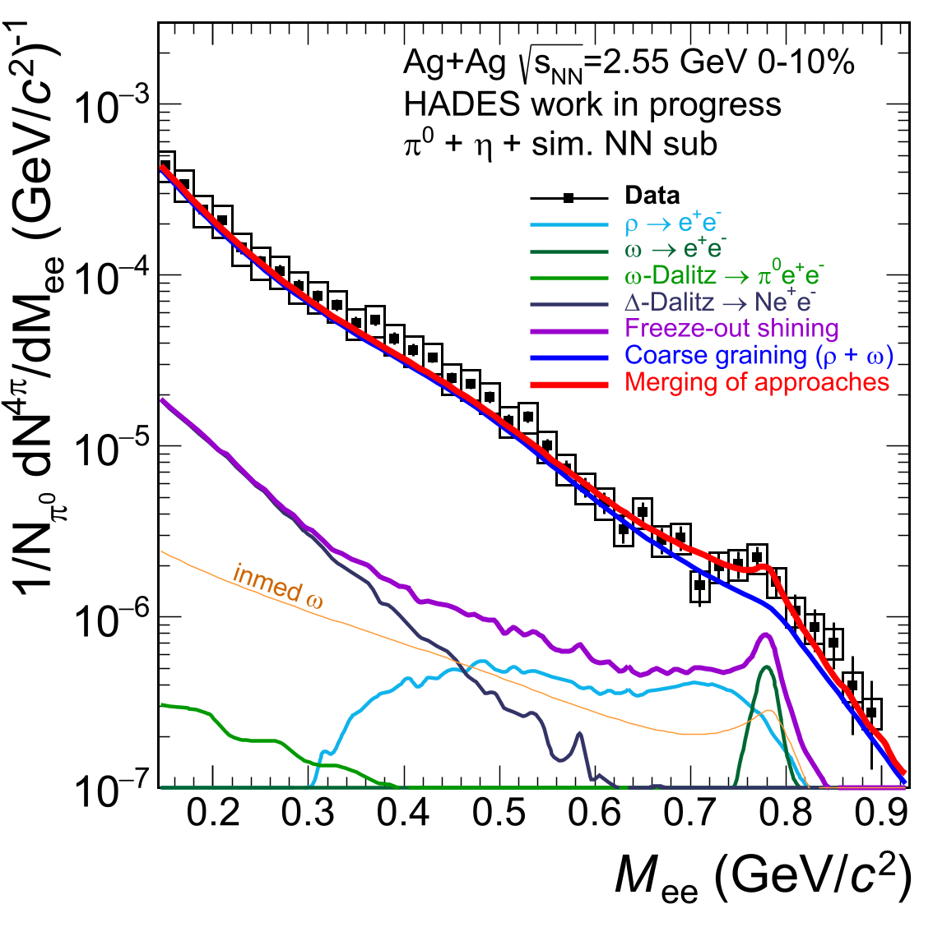

Motivation and Goals
Use multidifferential Ag+Ag @ $\sqrt{S_{\text{NN}}}$=2.42 GeV dielectron spectra to compare to merged model calculations established by J. Vogel in her master‘s thesis
Merged model approach:
Combination of shining model and coarse-grained UrQMD to investigate the thermalised medium
Master‘s Thesis J. Vogel

Slide 4
Particle Identification
Difficulties of using dilelectrons as probes:
  Rare
  Charged hadrons contaminate the data
  Conversion pairs
A multitude of cuts is applied to the data for particle identification and filtering
Event selection
Lepton track candidate
100 MeV/c < momentum < 1200 MeV/c
Velocity cut
RichQa cut & Ring radius cut
Conversion cut
Opening angle ring cut
cut

Slide 5
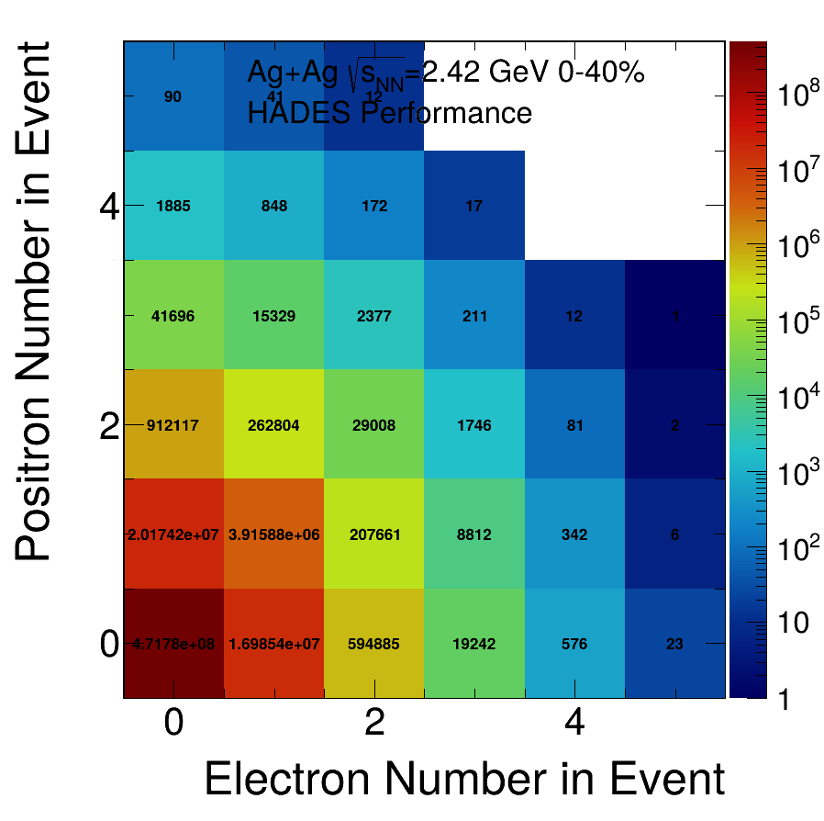
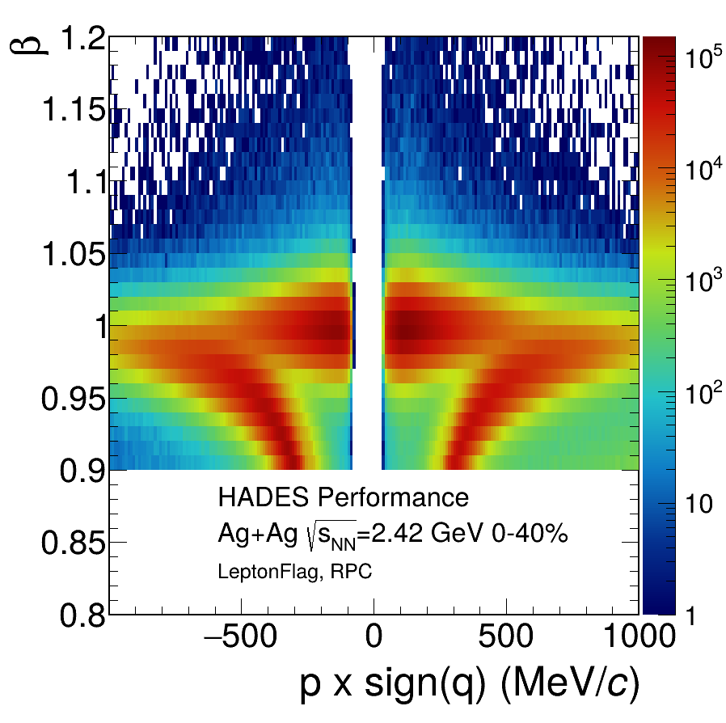
Particle Identification
Dileptons are very rare probes
We require a good quality particle identification
REPLACE STILL
“ “
“ “

Slide 6
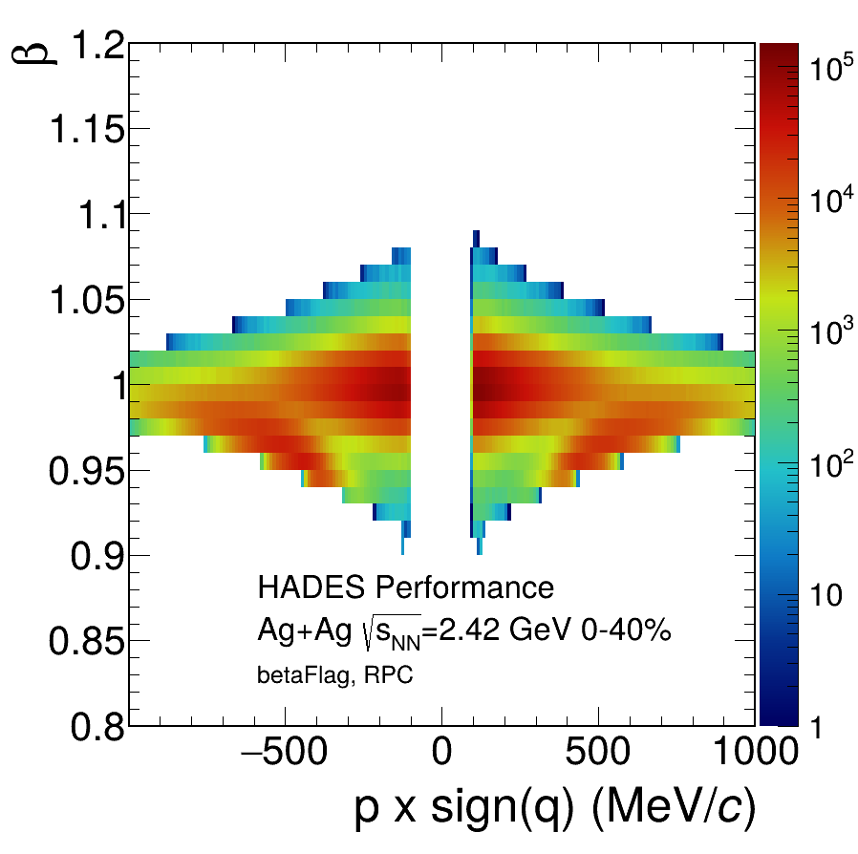
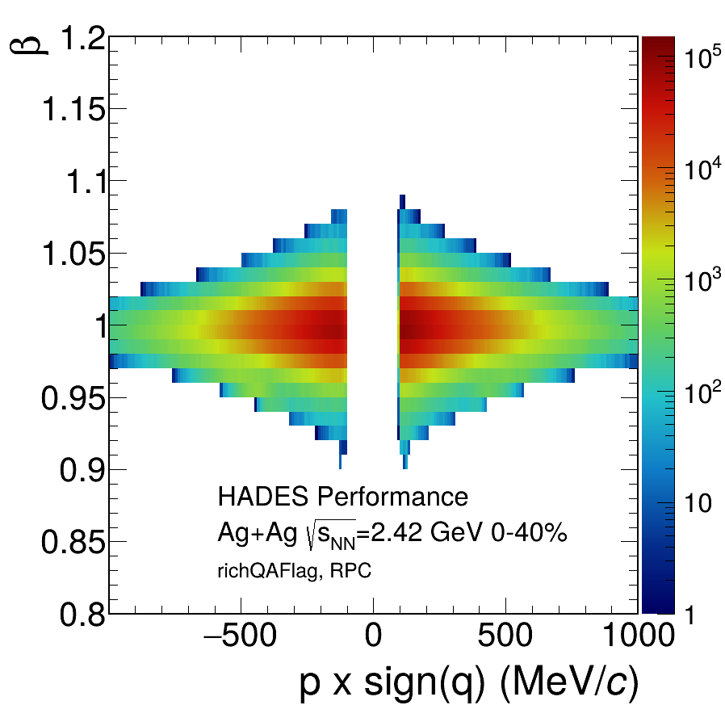
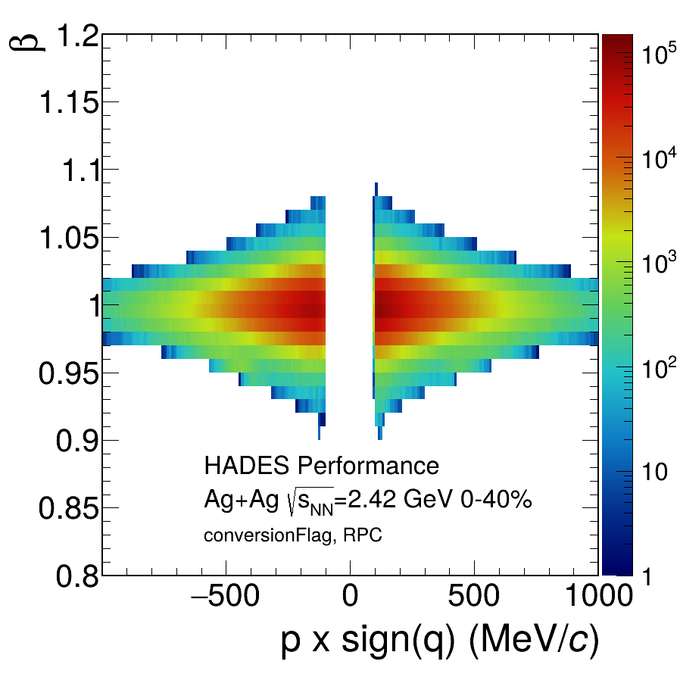
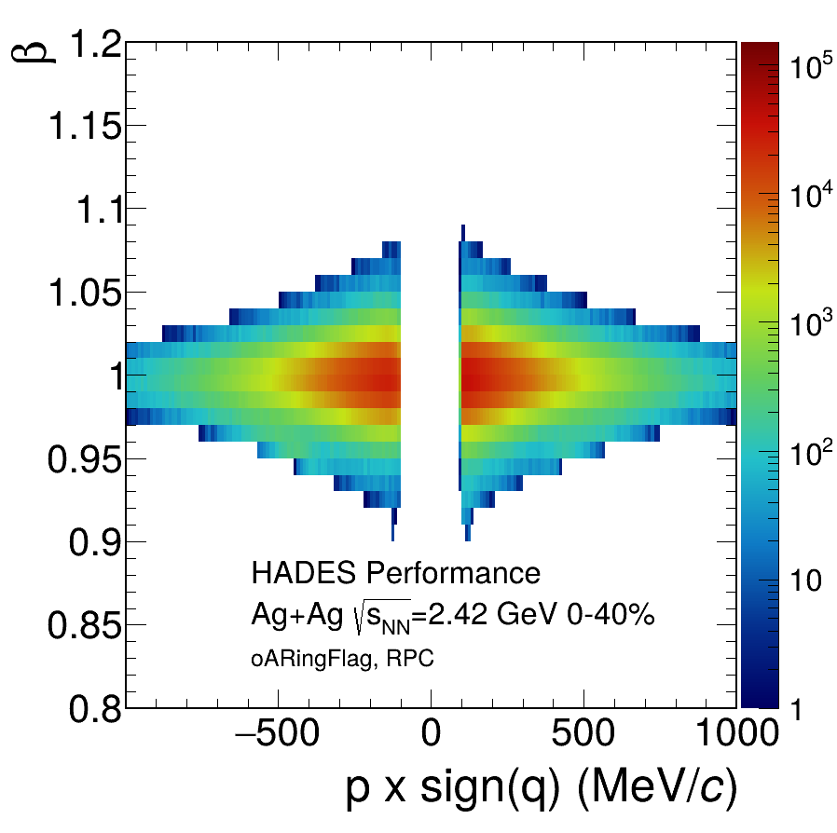
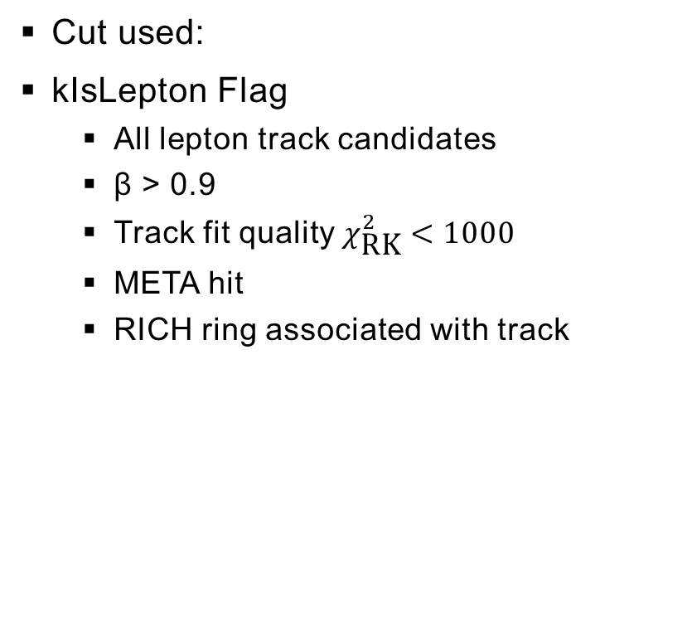
Particle Identification
Cut used:
kIsLepton Flag
  All lepton track candidates
  β > 0.9
  Track fit quality $χ_{\text{RK}}^{2}<1000$
  META hit
  RICH ring associated with track
6

Slide 7
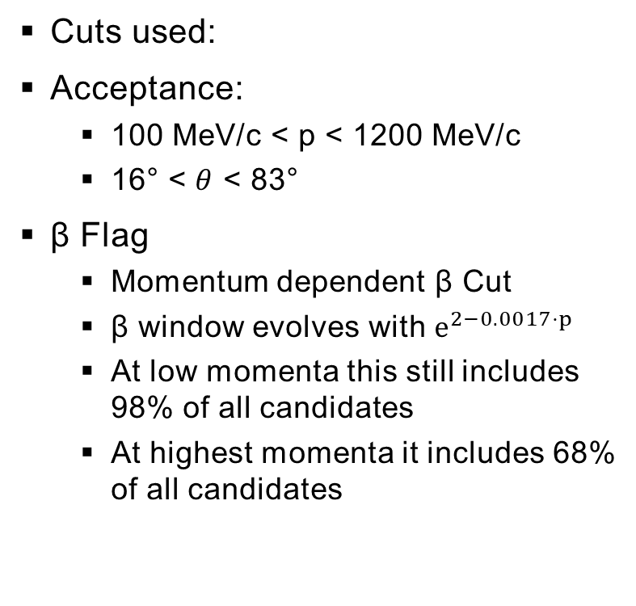
Particle Identification
Cuts used:
Acceptance:
  100 MeV/c < p < 1200 MeV/c
  16° < $θ$ < 83°
β Flag
  Momentum dependent β Cut
  β window evolves with $e^{2−0.0017⋅p}$
  At low momenta this still includes 98% of all candidates
  At highest momenta it includes 68% of all candidates
7

Slide 8
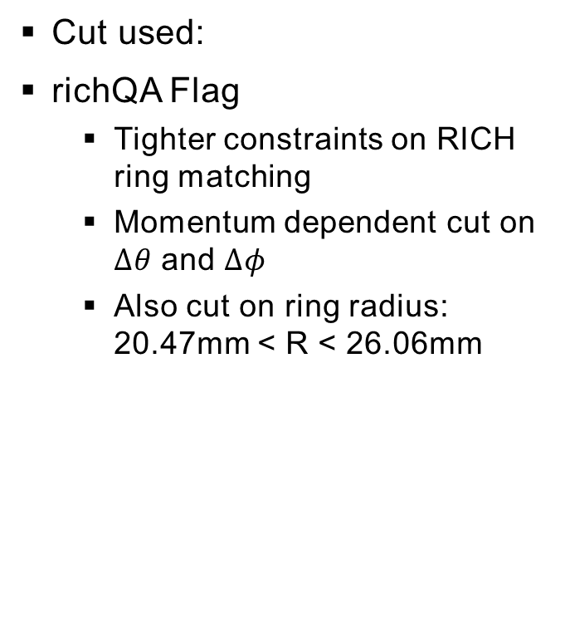
Particle Identification
Cut used:
richQA Flag
  Tighter constraints on RICH ring matching
  Momentum dependent cut on $Δθ$ and $Δφ$
  Also cut on ring radius:
  20.47mm < R < 26.06mm
8

Slide 9
Conversion rejection
Cuts used:
Conversion rejection
  Candidates with unusually many or unusually placed RICH hits are excluded
  The could correspond to double ring → conversion in RICH
oARing Flag
  Take angle between ring center of given candidate and another in same event
  If angle < 9°: reject candidate
9
Notes:
Jan Otto

Slide 10
Conversion rejection
Cuts used:
Conversion rejection
  Candidates with unusually many or unusually placed RICH hits are excluded
  The could correspond to double ring → conversion in RICH
oARing Flag
  Take angle between ring center of given candidate and another in same event
  If angle < 9°: reject candidate
10
Notes:
Jan Otto

Slide 11
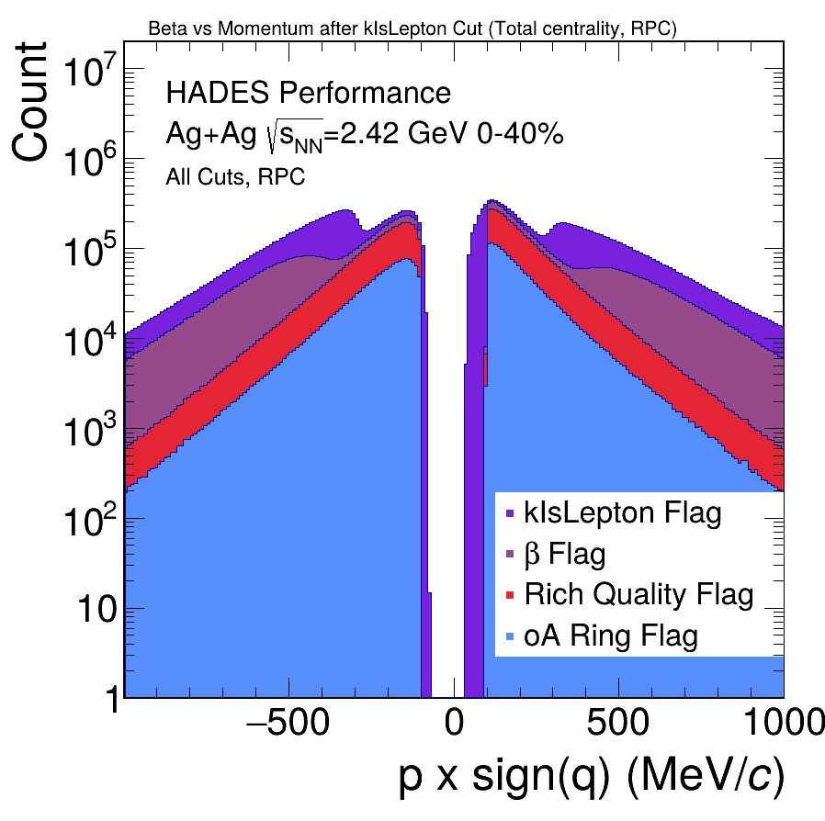
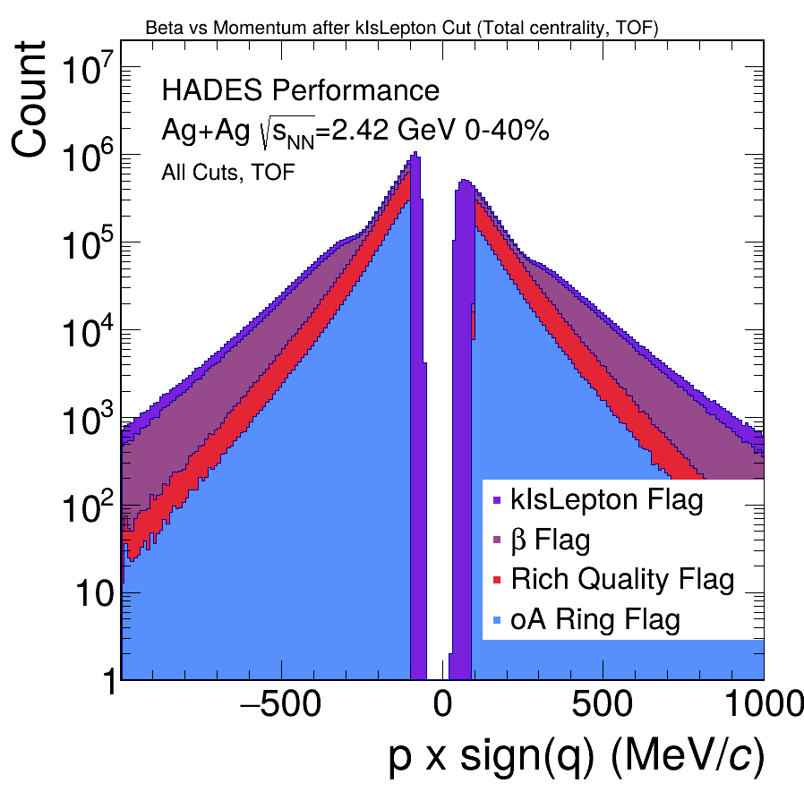
Particle Identification

Slide 12
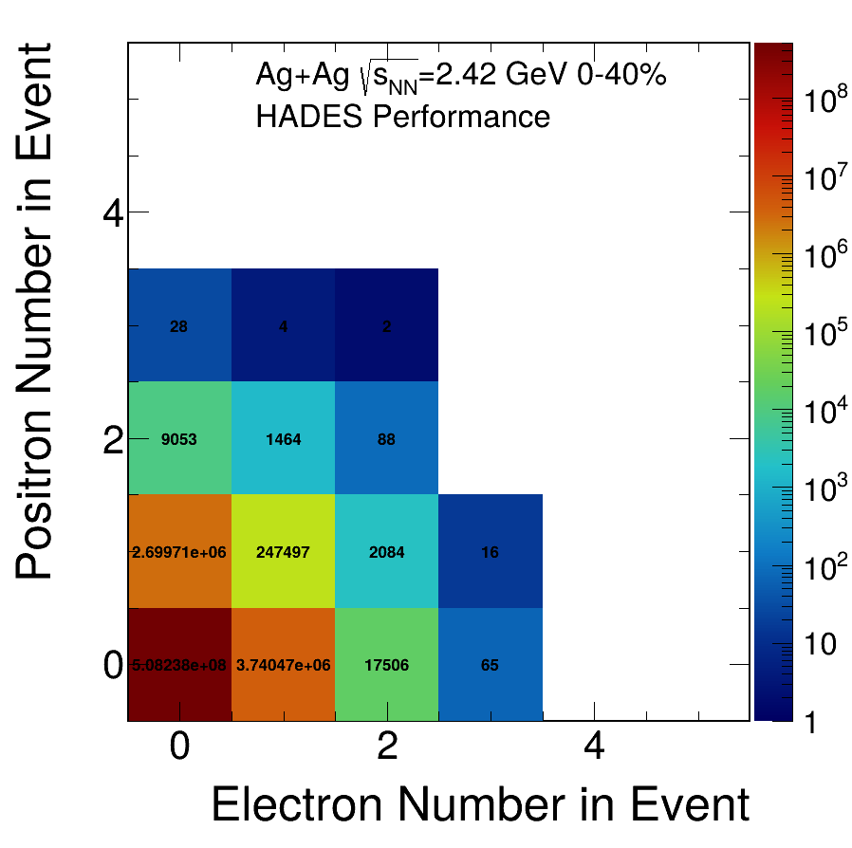
Particle Identification
→ Significant reduction in hadron contamination

Slide 13
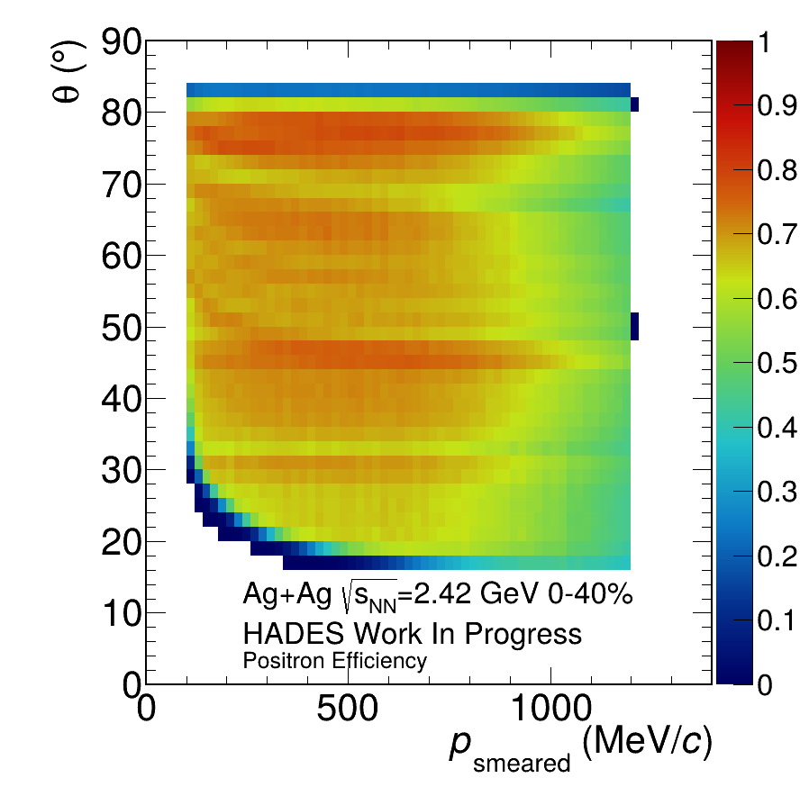
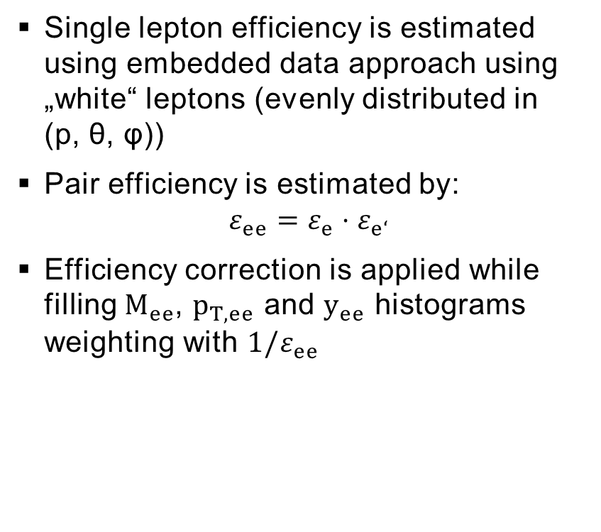
Efficiency Corrections
Single lepton efficiency is estimated using embedded data approach using „white“ leptons (evenly distributed in
(p, θ, φ))
Pair efficiency is estimated by:
$$ε_{ee}=ε_{e}⋅ε_{e‘}$$
Efficiency correction is applied while filling $M_{ee}$, $p_{T, ee}$ and $y_{ee}$ histograms weighting with ${1/ε}_{ee}$
Notes:
Embedded data with white leptons

Slide 14
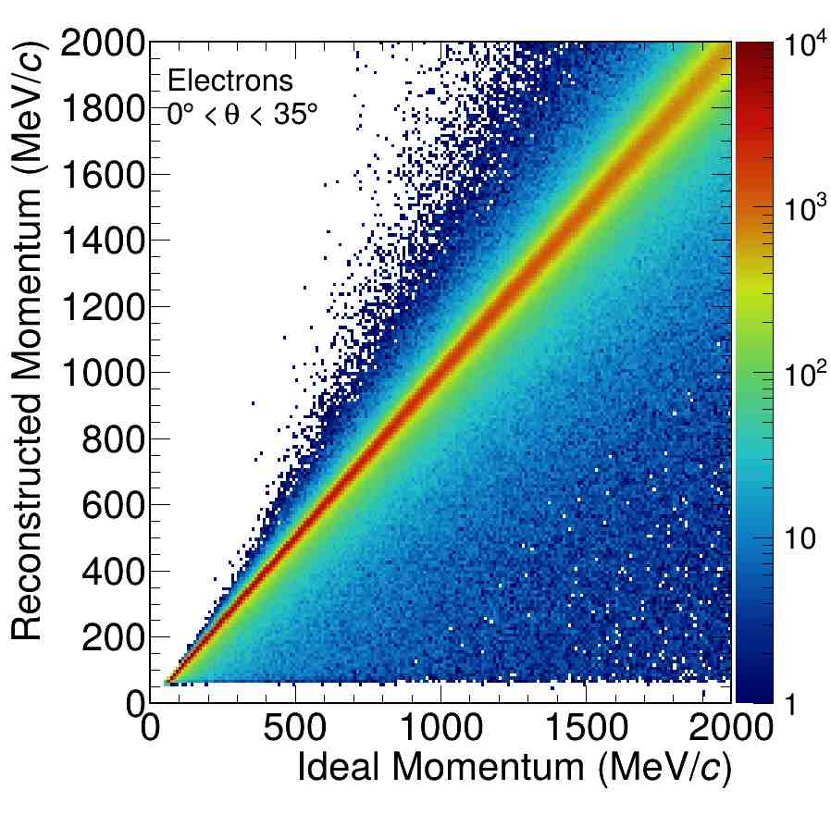
Momentum smearing
Kine particle momenta are „smeared“ using one of four matrices depending on θ-angle
  0°-35°
  35°-55°
  55°-70°
  70°-90°
In the following analysis, efficiency matrices with smeared momenta where used
Notes:
Momentum smearing with matrices in different theta reanges

Slide 15
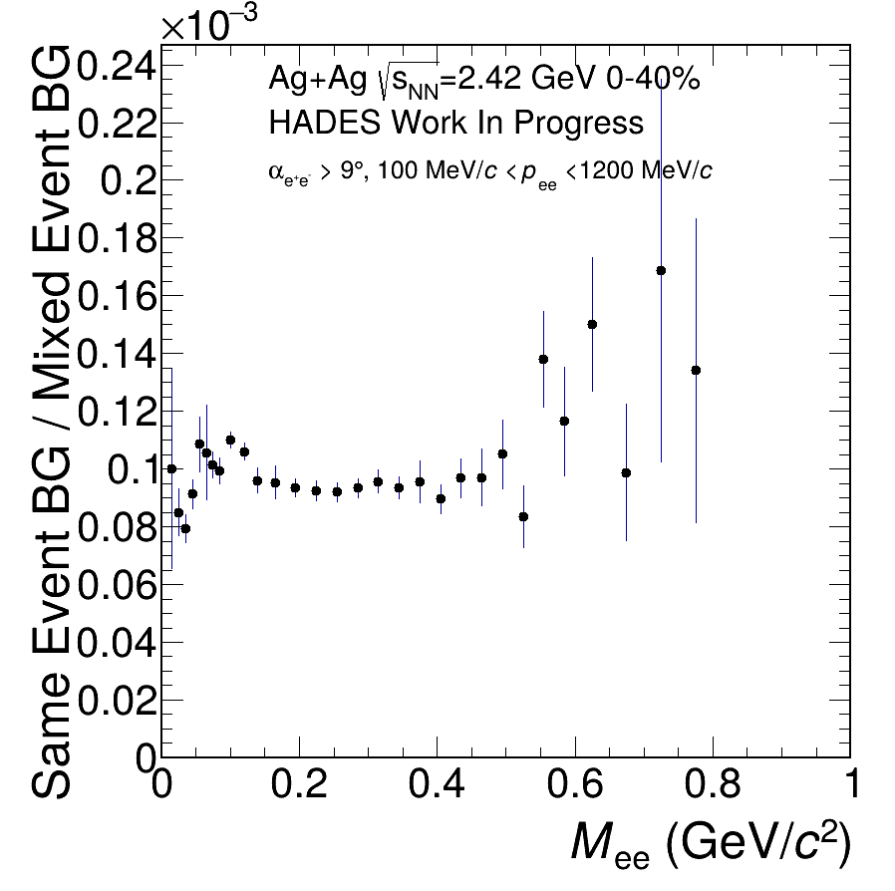
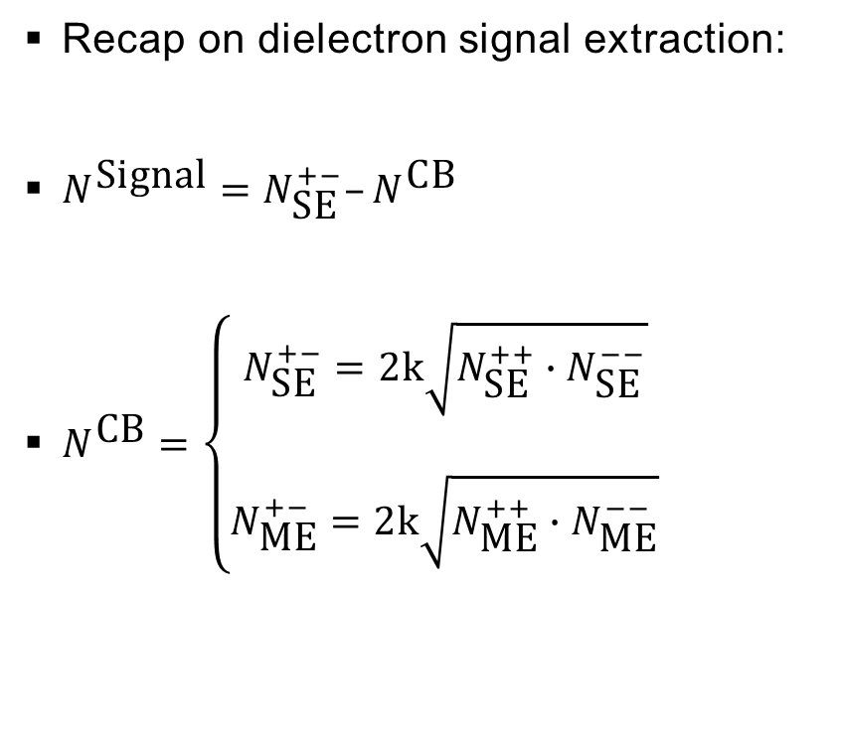
CB estimation
Recap on dielectron signal extraction:
$N^{\text{Signal}}=N_{\text{SE}}^{+−}–N^{\text{CB}}$
$N^{\text{CB}}=\left\{\begin{aligned}N_{\text{SE}}^{+−}=2k\sqrt{N_{\text{SE}}^{++}∙N_{\text{SE}}^{−−}} \\ \\ N_{\text{ME}}^{+−}=2k\sqrt{N_{\text{ME}}^{++}∙N_{\text{ME}}^{−−}}\end{aligned}\right.$

Slide 16


CB estimation
Recap on dielectron signal extraction:
Use Interval I to extract a mixed event scaling factor
Scaling =
I
$$\sum_{I}{N_{\text{SE}}^{\text{CB}}}$$
$$\sum_{I}{N_{\text{M}\text{E}}^{\text{CB}}}$$
Notes:
0.15-0.34

Slide 17
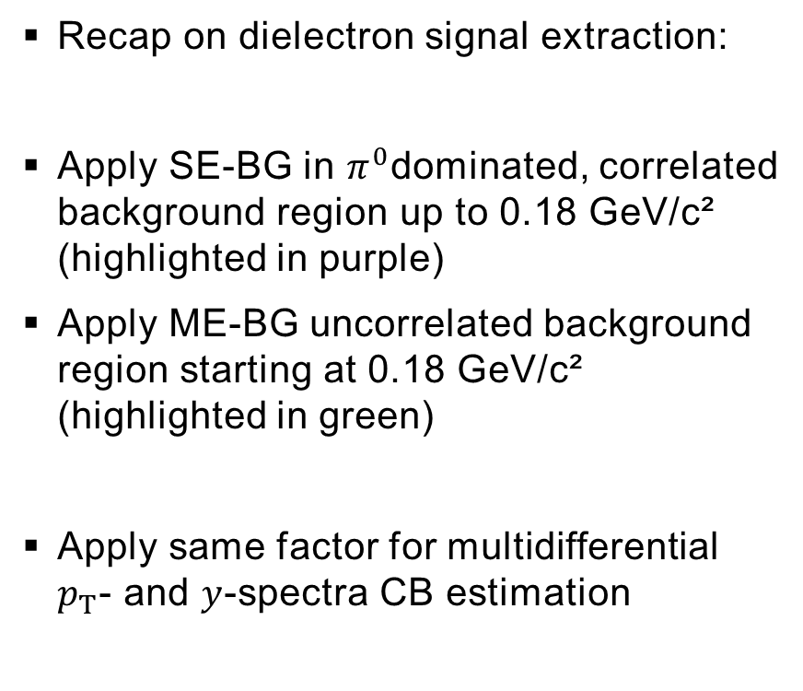
CB estimation
Recap on dielectron signal extraction:
Apply SE-BG in $π^{0}$dominated, correlated background region up to 0.18 GeV/c² (highlighted in purple)
Apply ME-BG uncorrelated background region starting at 0.18 GeV/c² (highlighted in green)
Apply same factor for multidifferential $p_{T}$- and $y$-spectra CB estimation
SE
ME

Slide 18
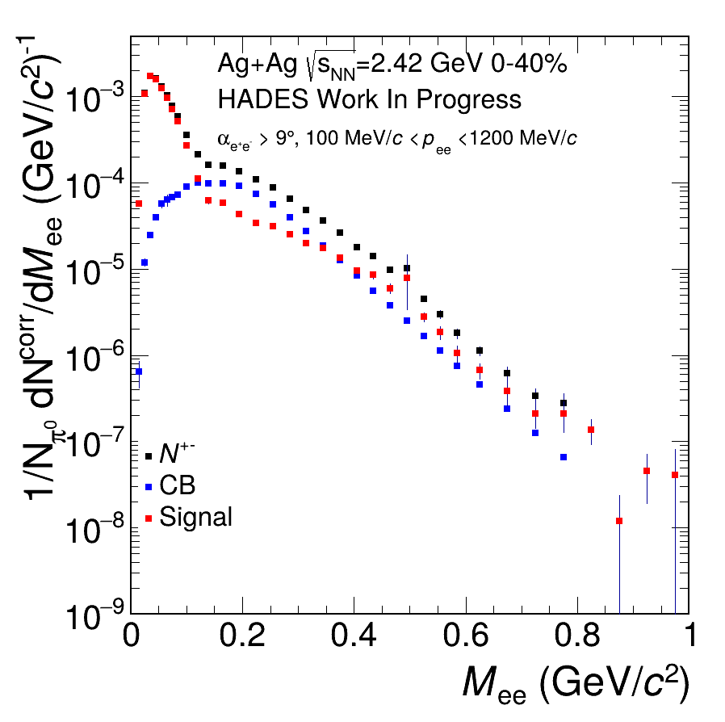
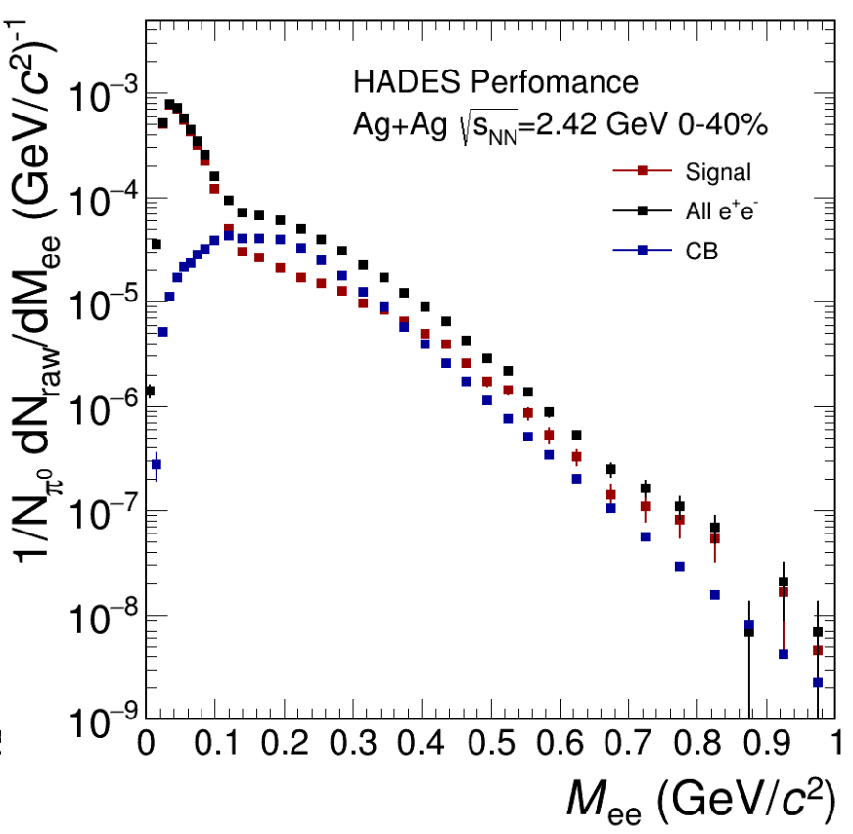
Dielectron signal extraction
N. Schild, PhD Thesis
Notes:
First endavour:
Reproduce niklas phd results for 2.42 gev
Sucessfully done

Slide 19
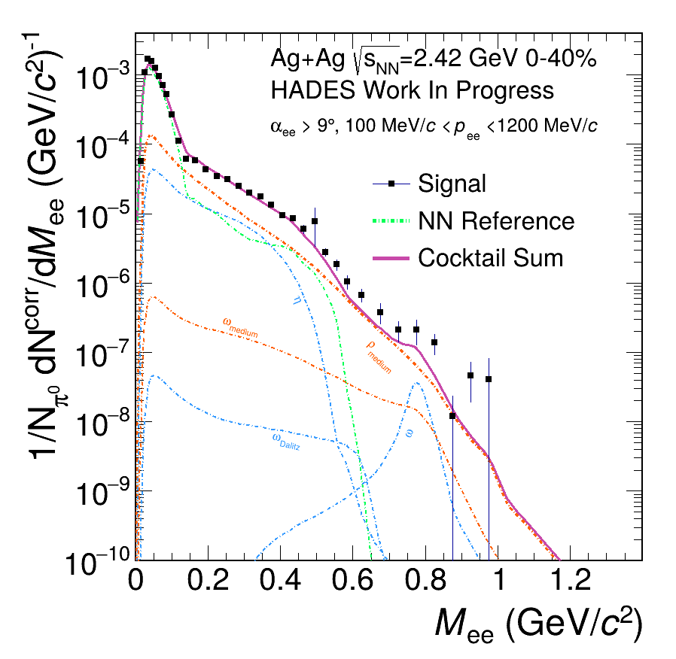
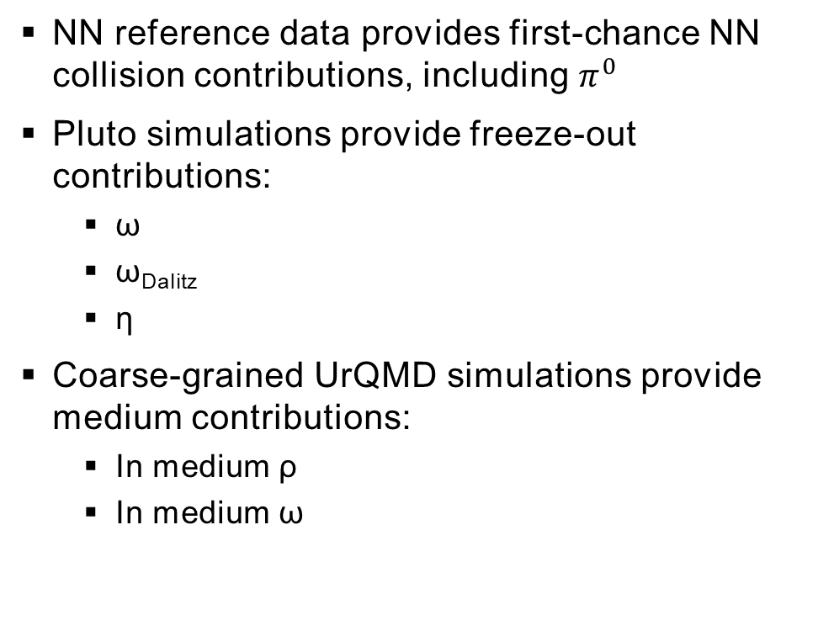
Comparison to simulation
NN reference data provides first-chance NN collision contributions, including $π^{0}$
Pluto simulations provide freeze-out contributions:
  ω
  ω_{Dalitz}
  η
Coarse-grained UrQMD simulations provide medium contributions:
  In medium ρ
  In medium ω

Slide 20
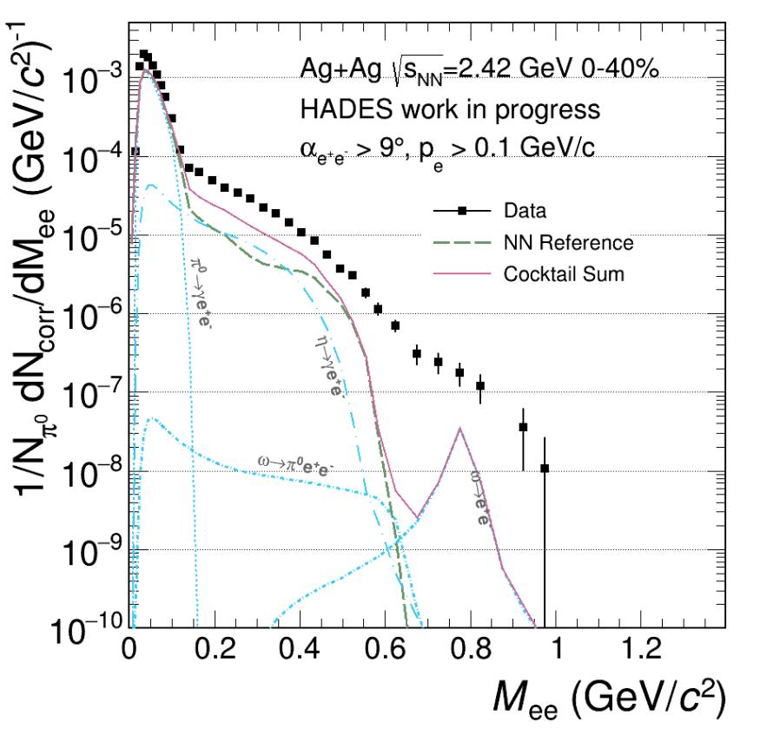
Comparison to simulation
N. Schild, PhD Thesis

Slide 21
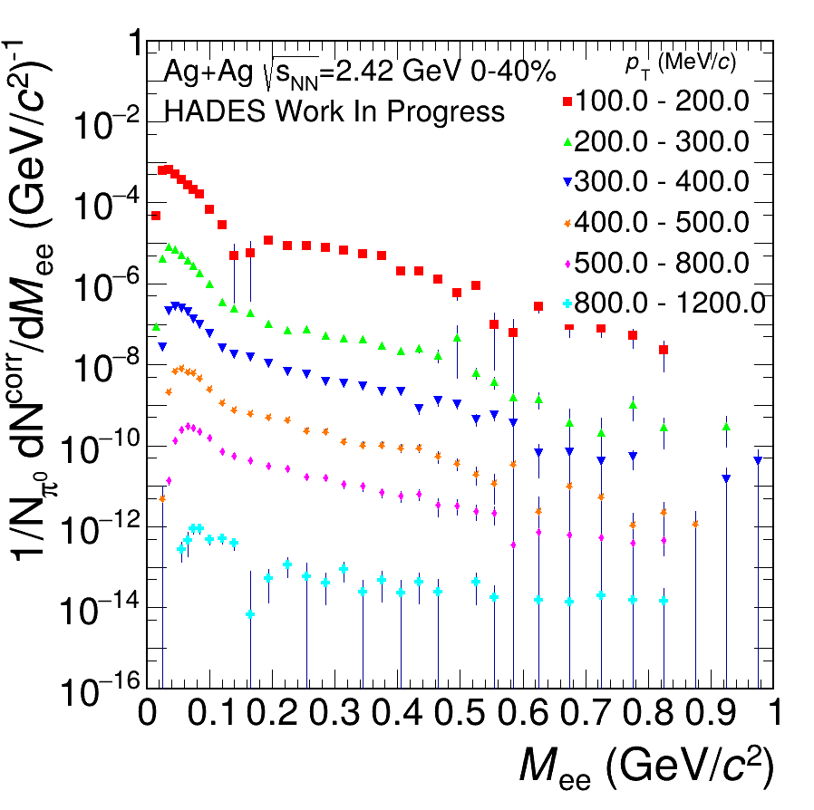

TransVerse Momentum
Multidifferential $M_{ee}$-spectra for varying $p_{T}$
Each scaled by an additional factor of ${10}^{−1}$ to keep visually distinct
Notes:
Statistik ist da

Slide 22
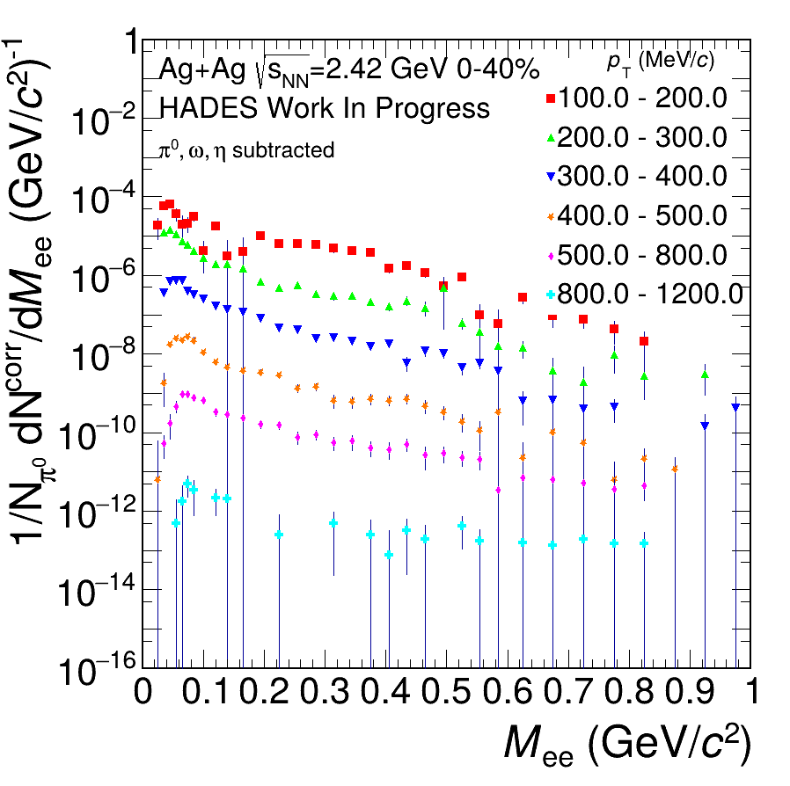

TransVerse Momentum
Multidifferential $M_{ee}$-spectra for varying $p_{T}$
$π^{0}$-, $ω$-, and $η$-contributions subtracted
Each scaled by an additional factor of ${10}^{−1}$ to keep visually distinct
Notes:
WIP

Slide 23
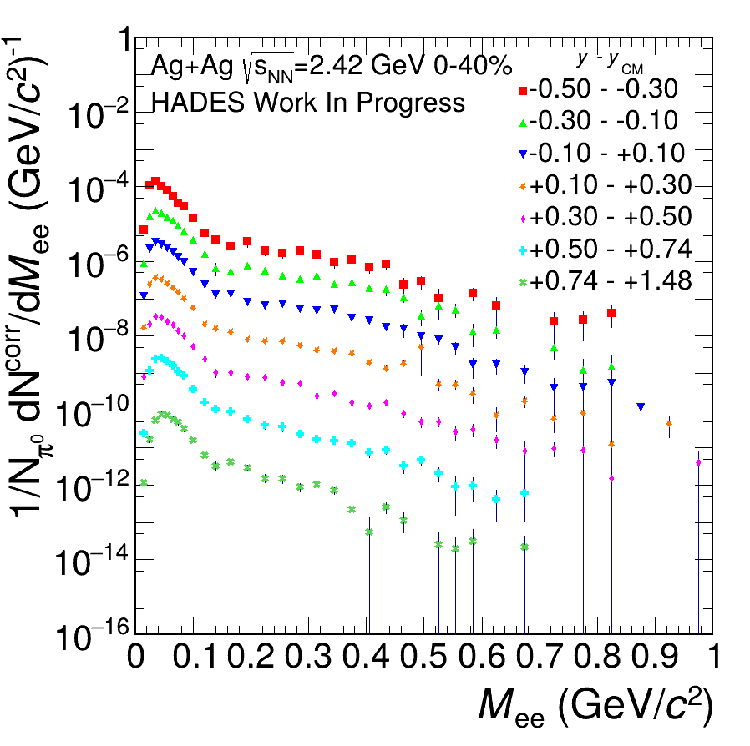

Rapidity
Multidifferential $M_{ee}$-spectra for varying $y$
Each scaled by an additional factor of ${10}^{−1}$ to keep visually distinct

Slide 24
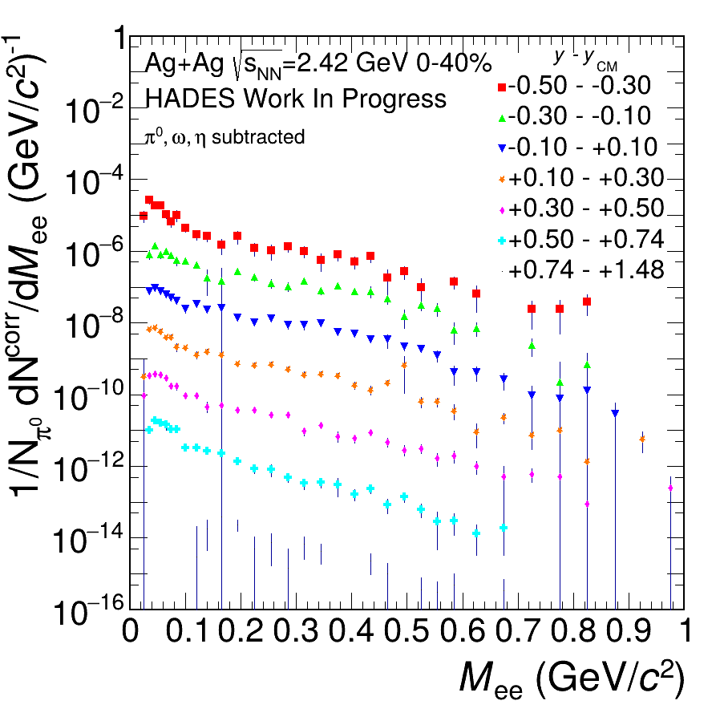

Rapidity
Multidifferential $M_{ee}$-spectra for varying $y$
$π^{0}$-, $ω$-, and $η$-contributions subtracted
Each scaled by an additional factor of $5^{−2}$ to keep visually distinct

Slide 25
Multidifferential Spectra

Slide 26
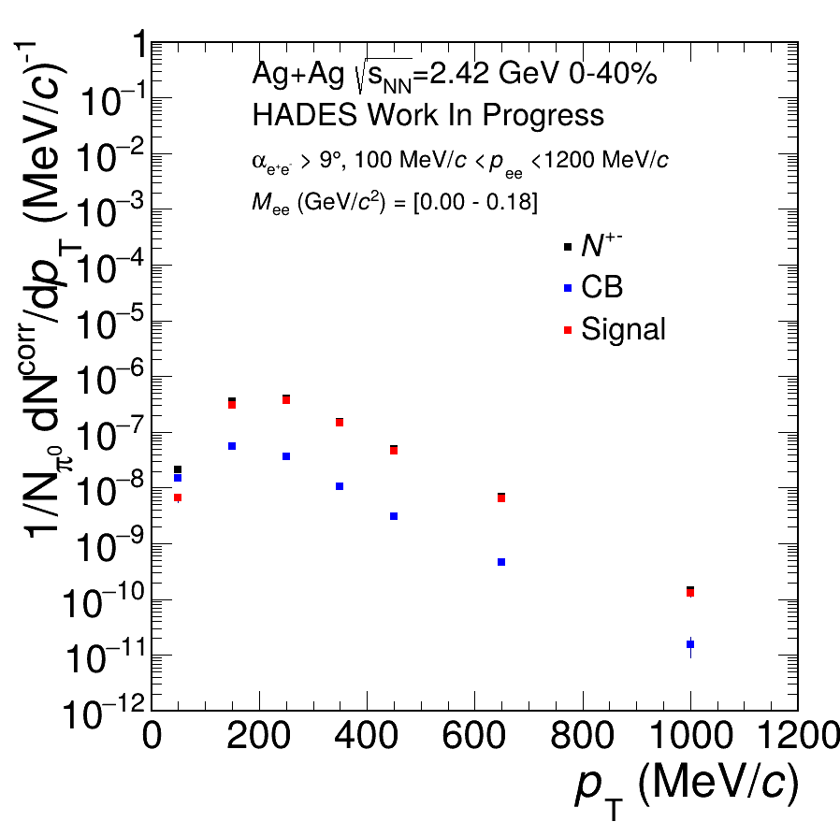
TransVerse Momentum
Notes:
Signal 2 bg vgl mit masse sig2bg

Slide 27
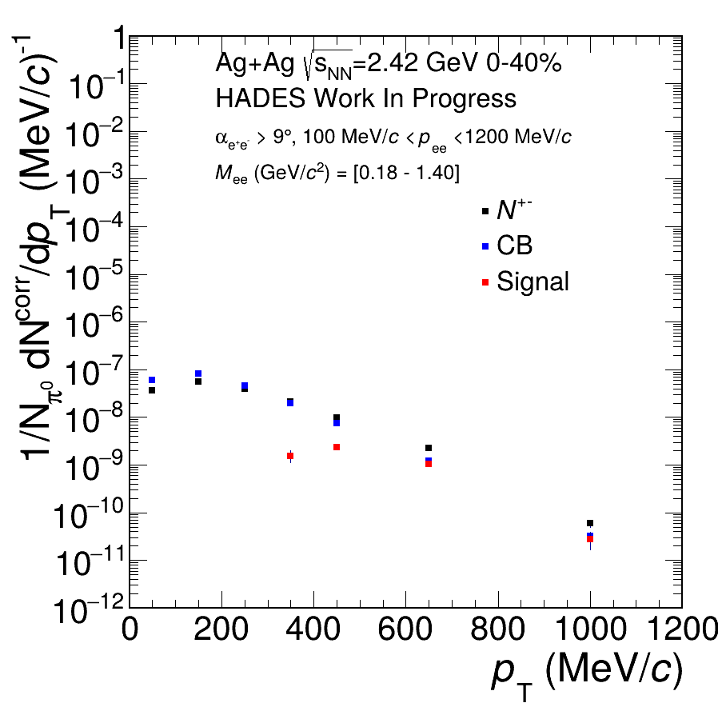
TransVerse Momentum

Slide 28
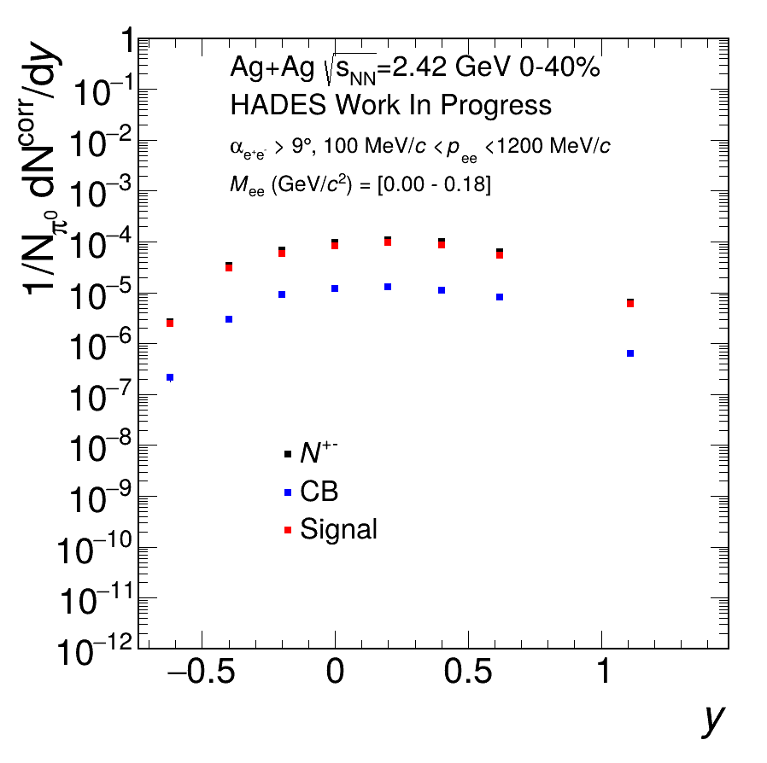
Rapidity

Slide 29
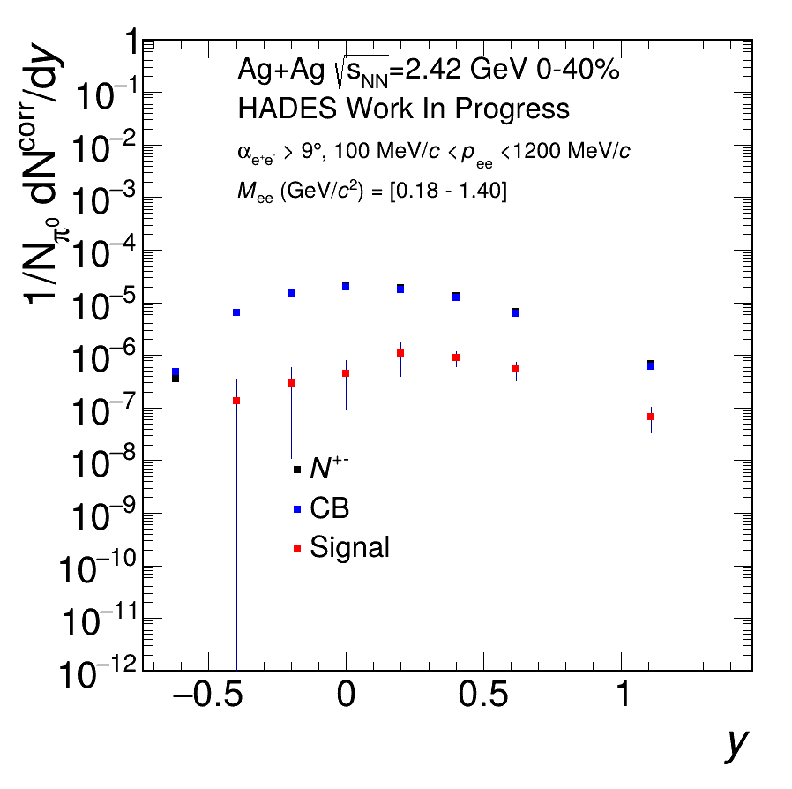
Rapidity

Slide 30
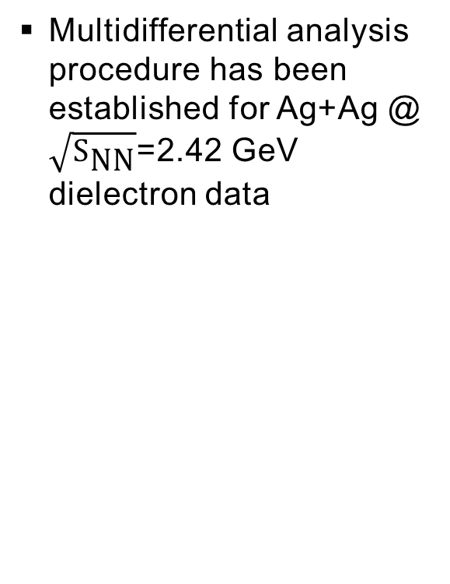
Summary
Multidifferential analysis procedure has been established for Ag+Ag @ $\sqrt{S_{\text{NN}}}$=2.42 GeV dielectron data

Slide 31
Summary
Multidifferential analysis procedure has been established for Ag+Ag @ $\sqrt{S_{\text{NN}}}$=2.42 GeV dielectron data

Slide 32
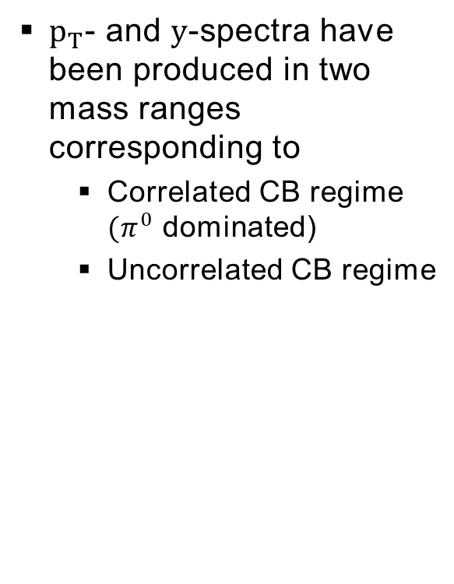
Summary
$p_{T}$- and $y$-spectra have been produced in two mass ranges corresponding to
  Correlated CB regime $(π^{0}$ dominated)
  Uncorrelated CB regime

Slide 33
Summary
$p_{T}$- and $y$-spectra have been produced in two mass ranges corresponding to
  Correlated CB regime $(π^{0}$ dominated)
  Uncorrelated CB regime

Slide 34
Outlook
Finalize multidifferential analysis procedure by
  Trying out different binnings
  Evaluating systematic uncertainties
  Make results comparable to simulations
N. Schild

Slide 35
Outlook
Extract necessary multidifferential excess yield spectra
Compare to merged model calculations presented in J. Vogels work
Master‘s Thesis J. Vogel

Slide 36
THANK YOU!

Slide 37
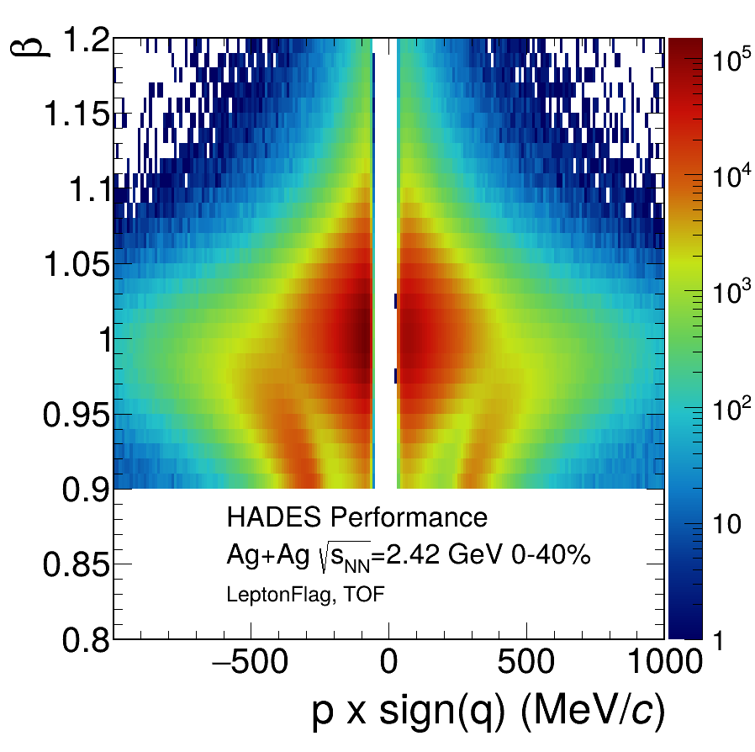
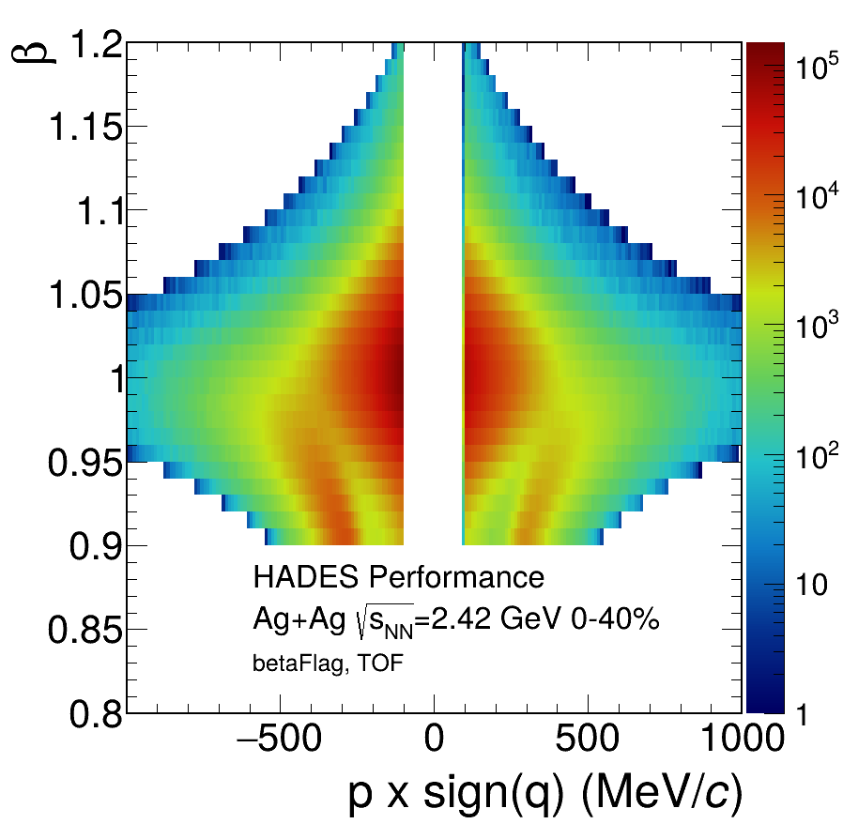
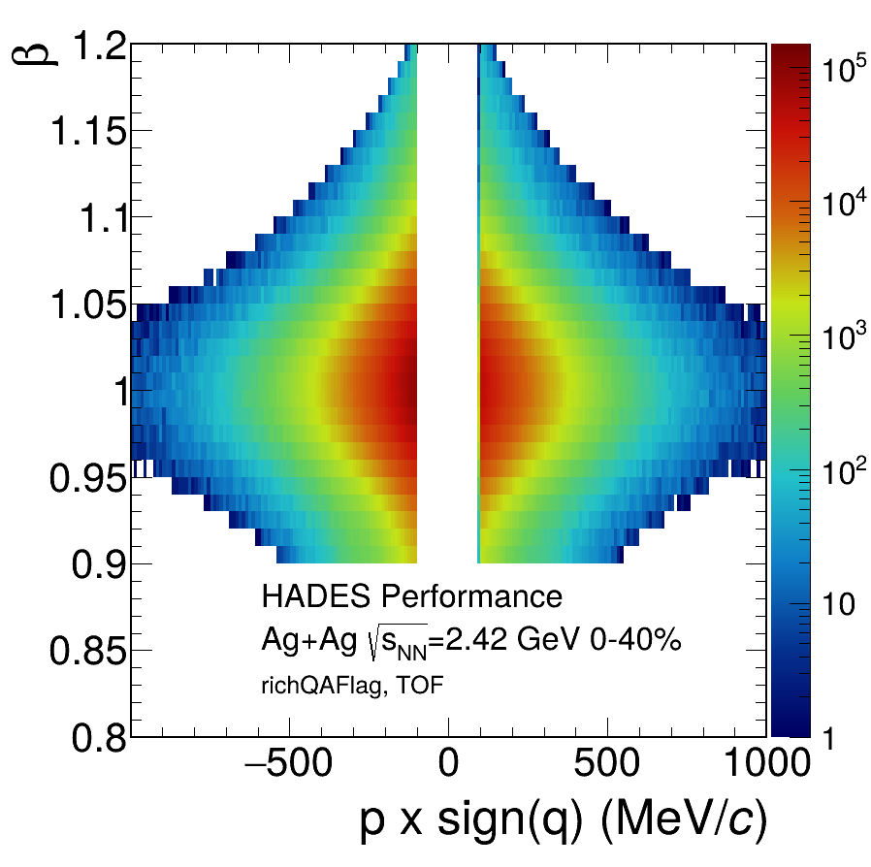
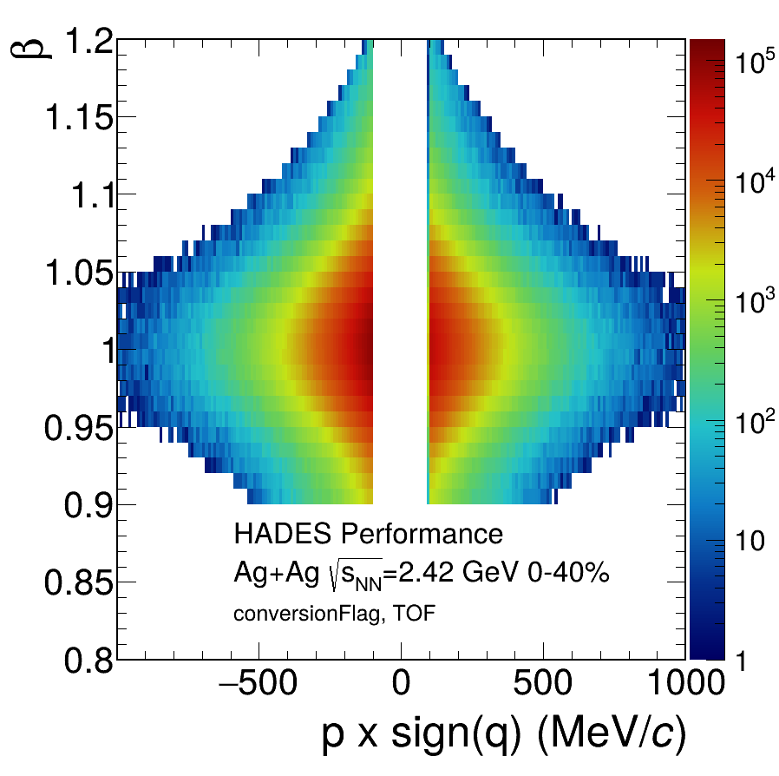
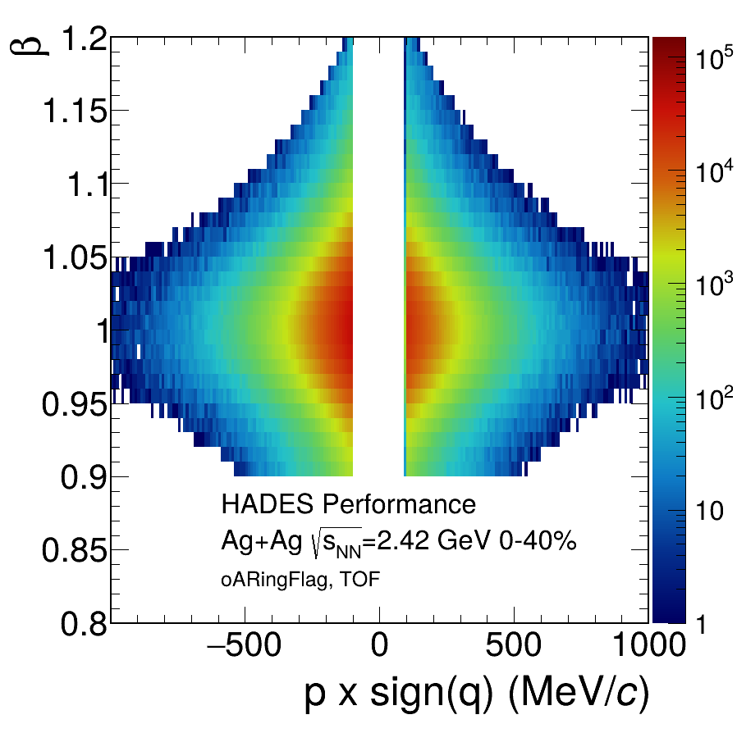
Additional: Performance

Slide 38
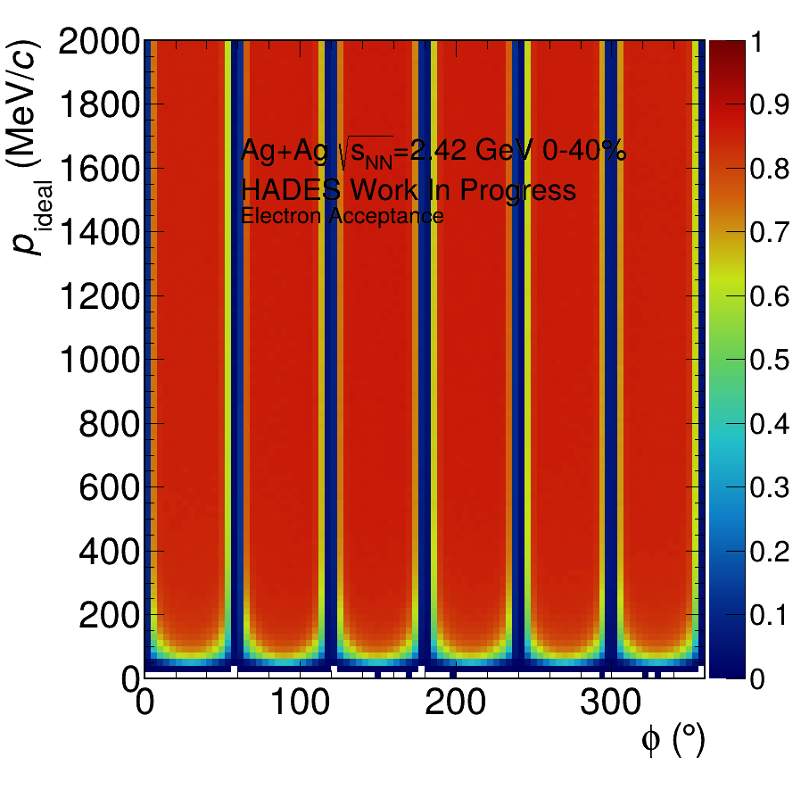
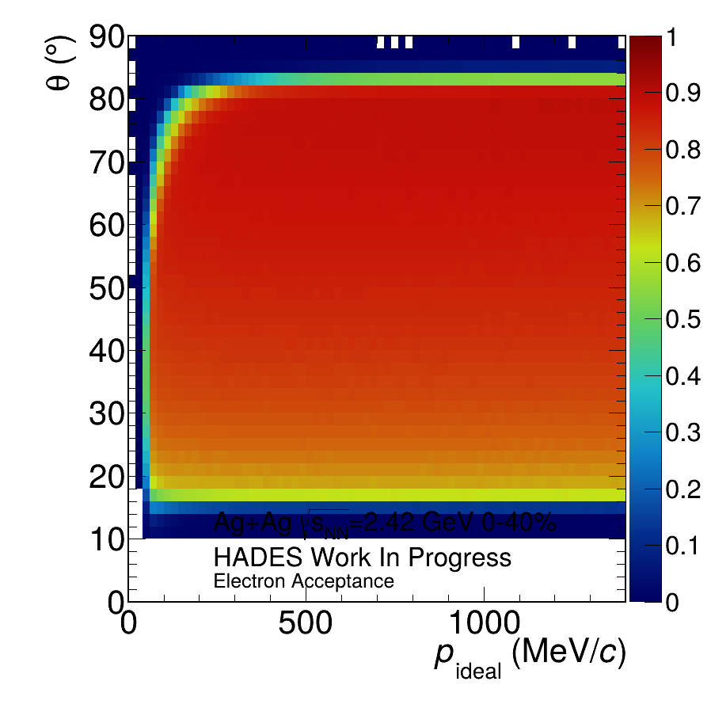



Additional: positron Acceptence

Slide 39





Additional: positron Acceptence

Slide 40






Additional: electron Efficiency

Slide 41





Additional: positron Efficiency

Slide 42





Additional: Invariant Mass

Slide 43


Additional: Invariant Mass
Notes:
Log scale sig2bg

Slide 44




Additional: Invariant Mass

Slide 45




Additional: Invariant Mass

Slide 46




Additional: Invariant Mass

Slide 47





Additional: Transverse Momentum

Slide 48





Additional: Transverse Momentum

Slide 49





Additional: Rapidity

Slide 50





Additional: Rapidity

Slide 51

Additional: Rapidity
N. Schild

Slide 52


Using Dileptons to probe hot and dense matter
Dileptons do not interact via the strong force
Dileptons are produced at every stage of heavy ion collisions:
  First chance NN collisions:
  Δ Dalitz decay and Bremsstrahlung
  Hot and dense fireball:
  ρ,ϕ and ω Vector mesons are produced
  Freeze out:
  and η dominate
ρ-meson decays inside the fireball because of decay width of 1.3 fm/c being smaller than that of the fireball of about 15 fm/c
Dileptons can be used to:
  Acquire lifetime or volume of the fireball
  Study collectivity (flow)
  Study in medium modifications and connect to chiral symmetry restoration

Slide 53
Using Dileptons to probe hot and dense matter
Dileptons are emitted during every stage of the collision
After creation they no longer interact with the medium
Good probes for studying:
  Fireball temperature, expansion, volume, etc.
  Characteristics of the hot and dense medium

Slide 54
Outlook
Play around with binnings for multidifferential analysis procedure
Evaluate systematic uncertainties
N. Schild

