Slide 1


Open charm and charmonium production: results from the NA60 experiment
E. Scomparin (INFN – Torino, Italy), NA60 collaboration
HICforFAIR Workshop:
Heavy flavor physics with
Introduction, experimental set-up
Charmonium suppression in p-A and In-In collisions
(results, lessons from the learning process)
Studying the Intermediate Mass Region (IMR)
“Preliminary” results on the A-dependence of the open charm yield
(from the dimuon mass spectrum)
Conclusions

Slide 2
SPS experiments
Long and glorious history, dating back to 1986
Third generation experiments: NA60, NA61
NA61
NA60
2003
3
2000
NA49
NA57
strangeness,
hadron spectra
NA45
(Ceres)
NA50
Pb
exotics
photons
NA52
WA97
NA44
WA98
2
1994
muons
WA94
NA34/3
(Helios-3)
strangeness
S
NA35
NA36
WA85
NA34(Helios-2)
NA38
WA80
1
1986
HADRONS
LEPTONS, PHOTONS
strangeness,
hadron spectra
muons
multistrange
electrons

Slide 3
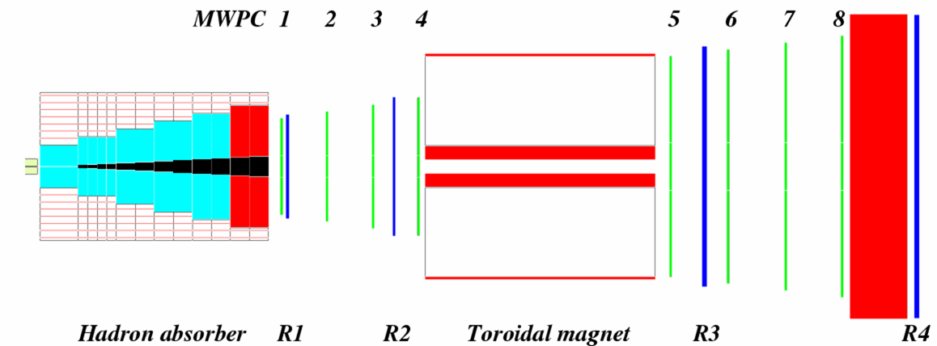
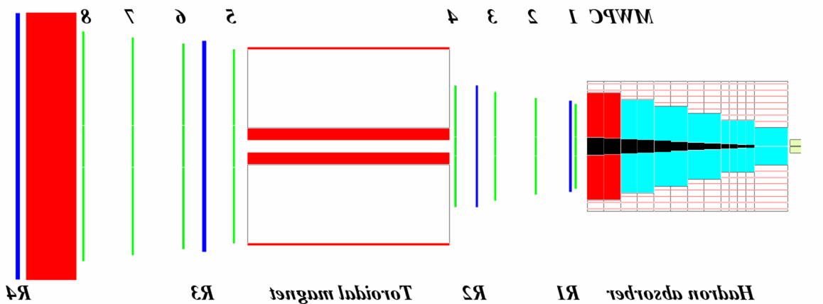
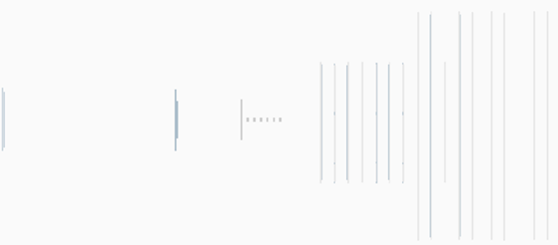
The NA60 experiment
NA60, the third generation experiment studying dimuon
production at the CERN SPS
Muon trigger
and tracking
2.5 T dipole magnet
NA10/38/50 spectrometer
beam tracker
vertex tracker
magnetic field
Iron wall
targets
ZDC
hadron absorber
Matching in coordinate
and momentum space
Muon
Other
or
Data samples
In-In collisions at 158 GeV/nucleon
p-A collisions at 158 and 400 GeV
  9 nuclear targets, Al-U-W-Cu-In-Be1-Be2-Be3-Pb
  (mixed A-order to limit possible z-dependent systematics)

Slide 4
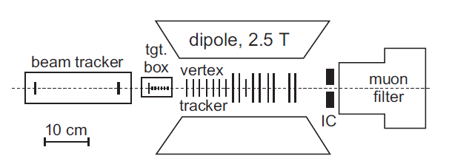
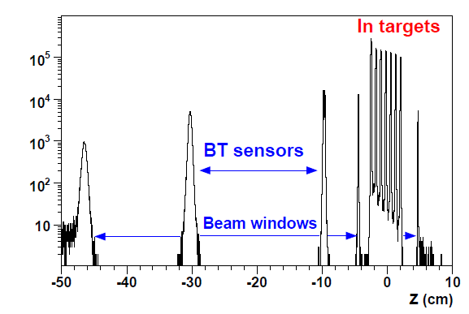
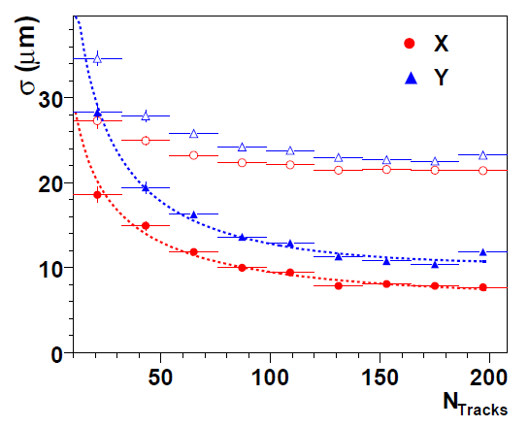
Performances
Vertex tracker
  16 pixel planes
  ALICE1LHCb readout
  chips
  Pixel size: 50 × 425 μm²
  10 MHz clock
Vertex resolution
~10 μm (X), ~15 μm (Y)
z-coordinate of the reconstructed vertices
7 In targets 1.5 mm thick, 8 mm spacing

Slide 5
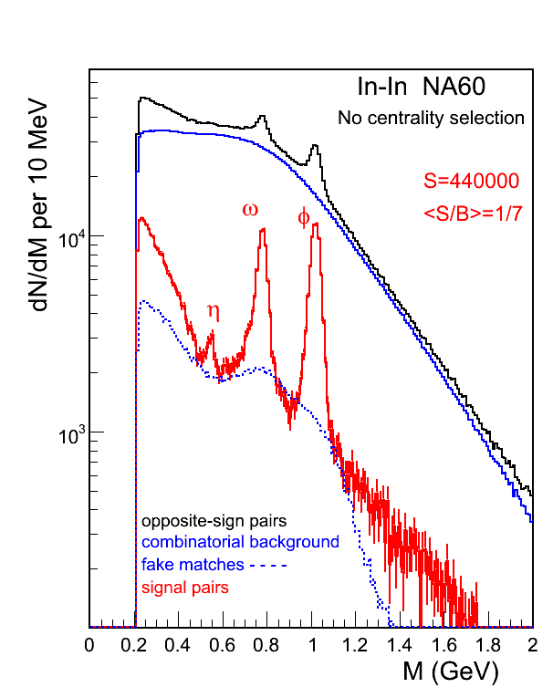
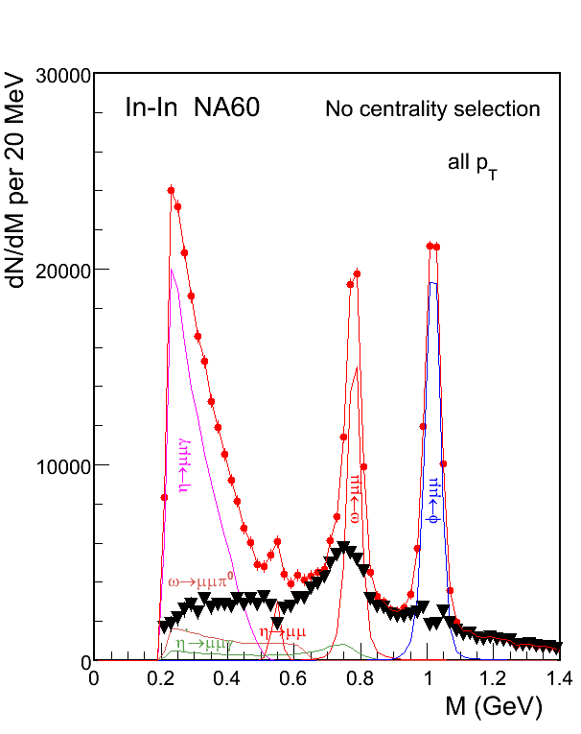
A glimpse of low-mass results
20 MeV mass resolution at the ω
Excess all along the spectrum
NO ρ-mass shift

Slide 6
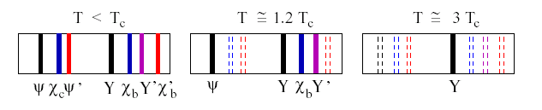
Charmonia suppression: pA, AA
Study of charmonium production/suppression in pA/AA collisions
THE hard probe at SPS energy
AA collisions
Color screening and charmonium suppression
> 25 year long history
pA collisions
Production models (CSM, NRQCD, CEM, ....)
Reference for understanding dissociation in a hot medium
Initial/final state nuclear effects (shadowing, dissociation,...)

Slide 7
J/ψ analysis: match vs no-match
2 event selections have been used for J/ψ analysis
1)
No matching required
Extrapolation of muon tracks must lie in the target region
Higher statistics
Poor vertex resolution (~1 cm)
2)
Matching between muon tracks and vertex spectrometer tracks
Dimuon vertex in the most upstream interaction vertex
(MC correction to account for centrality bias due to fragment reinteraction)
Better control of systematics
Good vertex resolution (~200 μm)
Lose 40% of the statistics
After quality cuts → N_{J/ψ} ~ 45000 (1), 29000 (2)
2 analyses
a) Use selection 1 and normalize to Drell-Yan
b) Use selection 2 and normalize to calculated J/ψ nuclear absorption

Slide 8
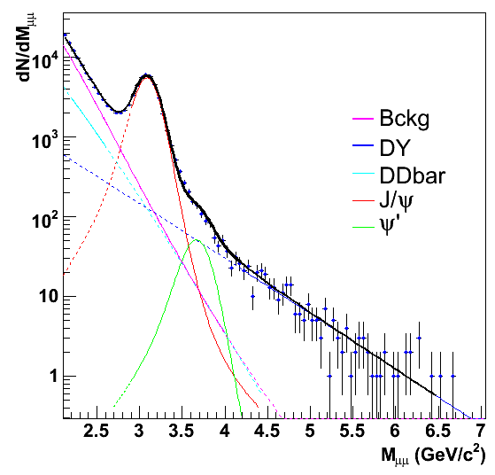
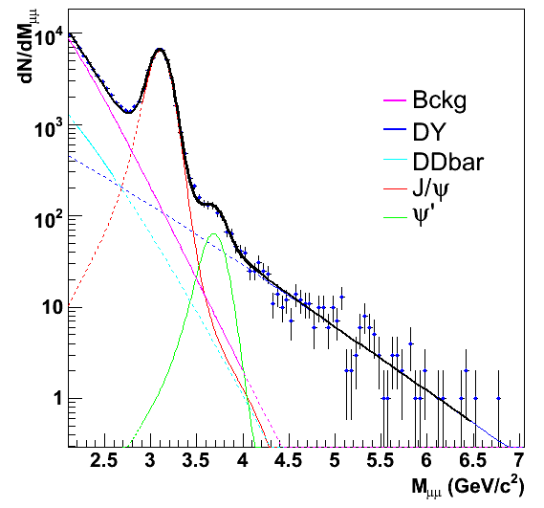
J/ψ / DY analysis
Set A (lower ACM current)
Set B (higher ACM current)
Combinatorial background (π, K decays) from event mixing method (negligible)
Multi-step fit:
a) DY (M>4.2 GeV), b) IMR (2.2<M<2.5 GeV), c) charmonia (2.9<M<4.2 GeV)
Mass shape of signal processes from MC (PYTHIA+GRV94LO pdf)
Results from set A and B statistically compatible → use their average in the following
Stability of the J/ψ / DY ratio:
  Change of input distributions in MC calculation → 0.3% (cosϑ), 1% (rapidity)
  Tuning of quality cut for muon spectrometer tracks → < 3%

Slide 9
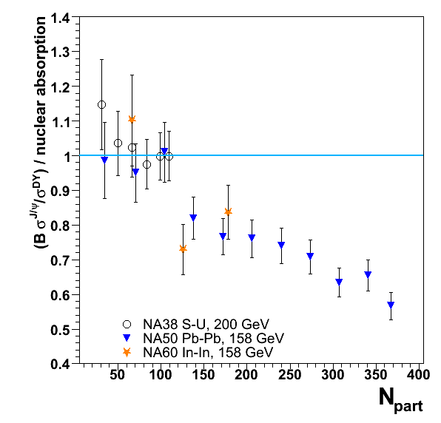
J/ψ / DY vs. centrality (analysis a)
3 centrality bins, defined through E_{ZDC}
Anomalous suppression present in Indium-Indium
Qualitative agreement with
NA50 results plotted as a
function of N_{part}
Data points have been normalized
to an expected yield which takes
into account CNM effects,
parameterized through
deduced from p-A NA50 data
at 400 and 450 GeV
σ^{J/ψ}_{abs} = 4.18 ± 0.35 mb
B. Alessandro et al., Eur. Phys. J. C39(2005) 335
WARNING: hypothesis on √s-independence of CNM effects
NOT TESTED at that time

Slide 10
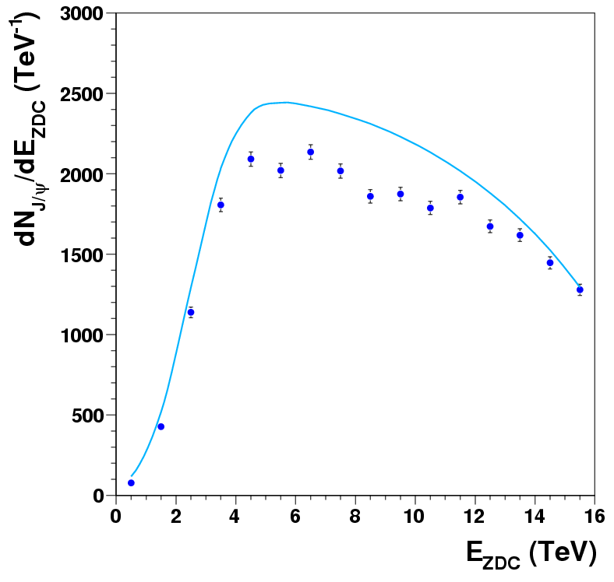
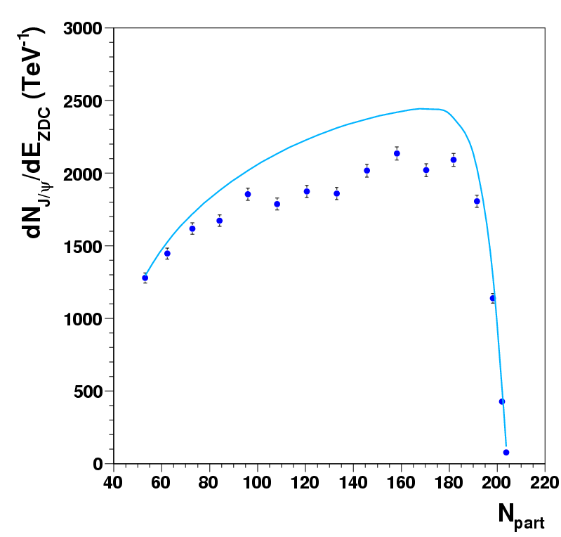
J/ψ yield vs nuclear absorption (analysis b)
Compare data to the expected J/ψ centrality distribution, calculated
assuming CNM effects (parameterized through σ_{abs} =4.18 mb) as the
only suppression source (see later)
Nuclear
absorption
require the ratio measured/expected, integrated over centrality, to be equal to the same quantity from the (J/ψ)/DY analysis (0.87 ± 0.05)
Normalization of the
CNM reference

Slide 11
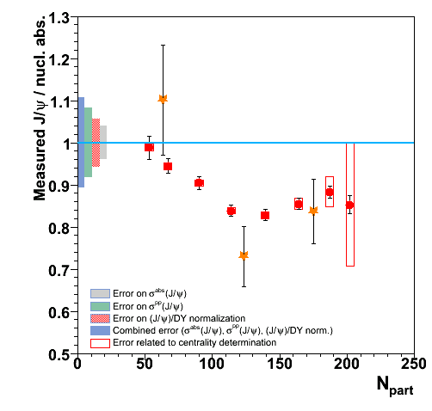
Results and systematic errors
Small statistical errors
Careful study of systematic
errors is needed
Sources
Uncertainty on parameters which
enter CNM calculation
(σ^{abs}(J/ψ) and σ^{pp}(J/ψ))
Uncertainty on relative
normalization between data
and CNM reference
Uncertainty on centrality
determination (affects relative
position of data and abs. curve)
  Glauber model parameters
  E_{ZDC} to N_{part}
~10% error centrality indep.→ does not affect shape of the distribution
WARNING: result depends on hypothesis of √s-independence of CNM effects

Slide 12
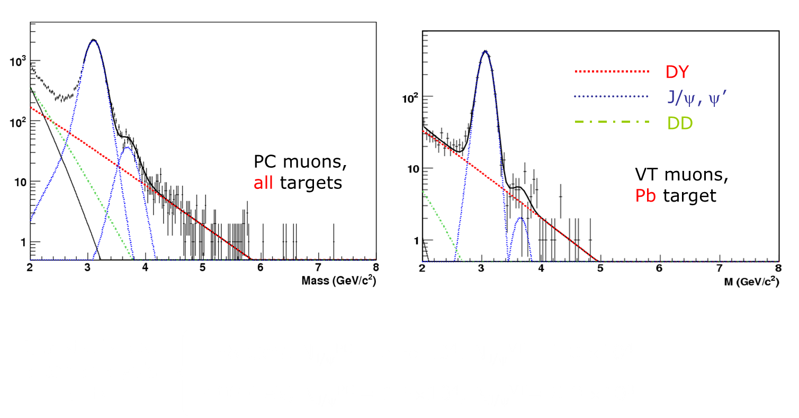
Moving to pA collisions
Absence of pA data collected at the same energy of In-In (Pb-Pb) data
considered as a serious issue → obtained 3 days of primary SPS proton
beam at 158 GeV in 2004

Slide 13
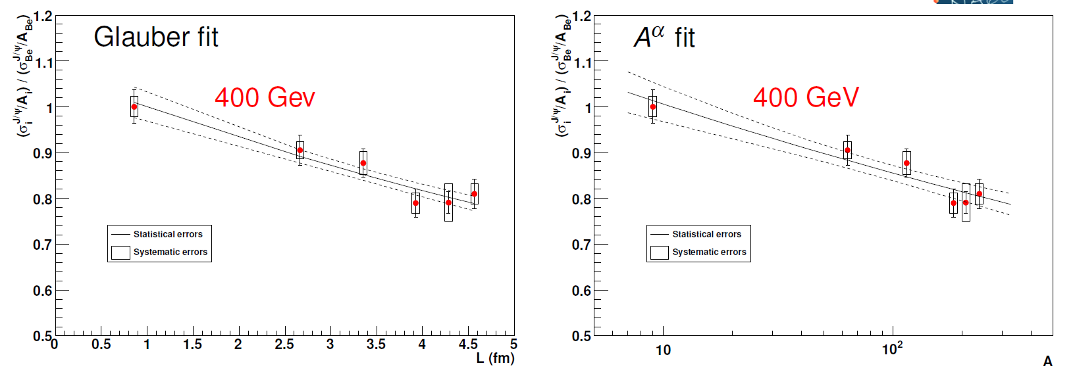
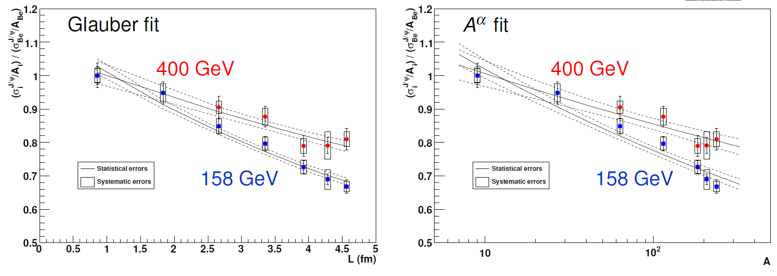
√s-dependence of CNM effects at SPS
Using the Glauber model, we get
σ_{abs} ^{J/ψ} (400 GeV)= 4.3 ± 0.8 (stat) ± 0.6 (syst) mb
σ_{abs} ^{J/ψ} (158 GeV)= 7.6 ± 0.7 (stat) ± 0.6 (syst) mb
Using σ _{J/ψ} = σ₀ ⋅ A^{α}, we get
α (400 GeV) = 0.927 ± 0.013 (stat) ± 0.009 (syst)
α (158 GeV) = 0.882 ± 0.009 (stat) ± 0.008 (syst)
(effective values, shadowing not corrected for)

Slide 14
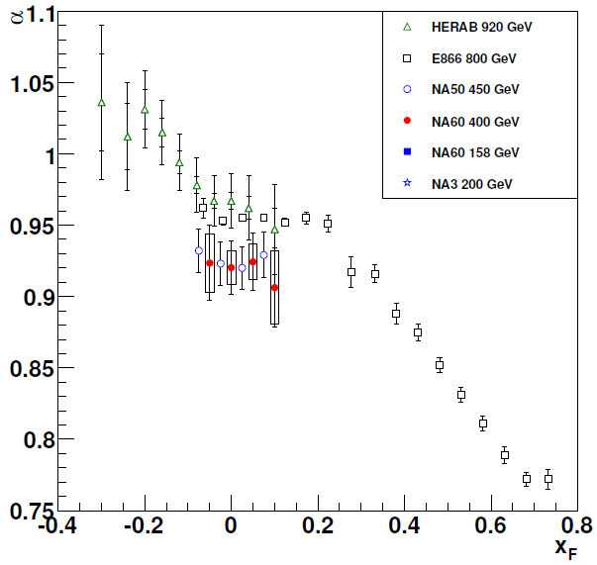
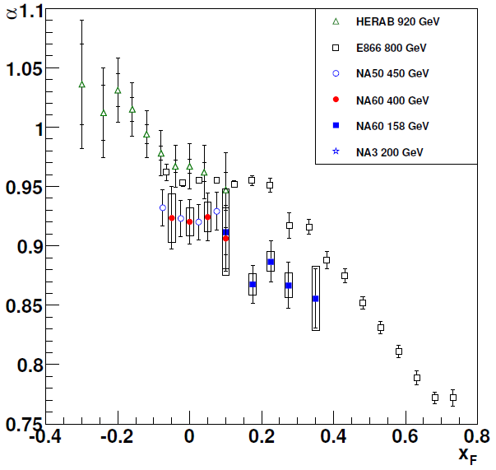
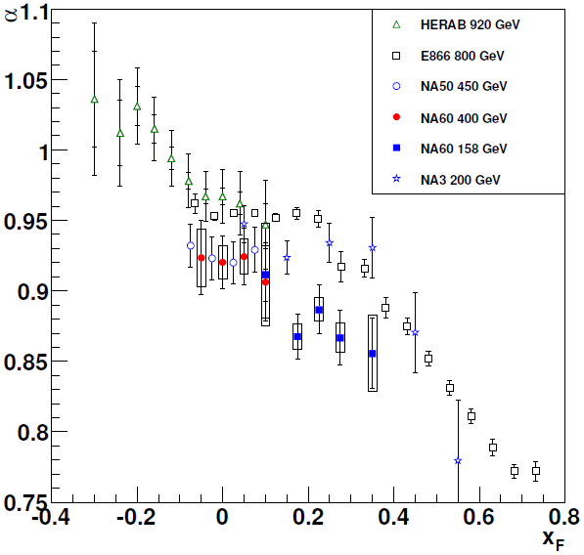
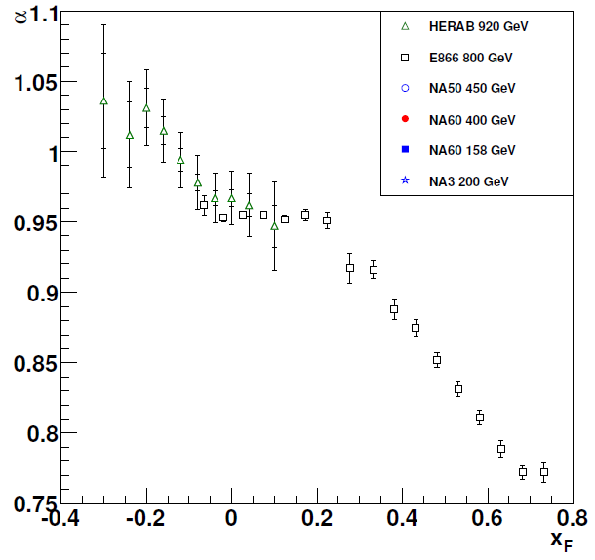
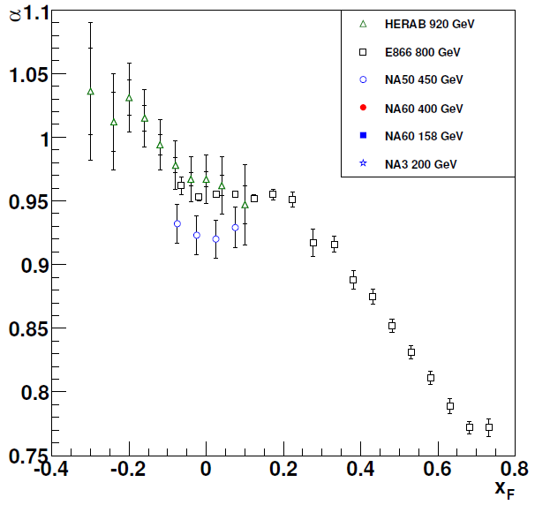
Comparisons with other experiment: x_{F}
Results on α vs x_{F} from HERA-B, NA50, E866, NA3
(removed α bias from use of p-p)
In the region close to x_{F} = 0,
stronger deviation of α from 1
when decreasing √s
NA60
  400 GeV: very good agreement with NA50
  158 GeV: smaller α
  Disagreement with NA3
  200 GeV results
Systematics of fixed-target data still difficult to interpret
→room for improvement on theory and experiment side

Slide 15
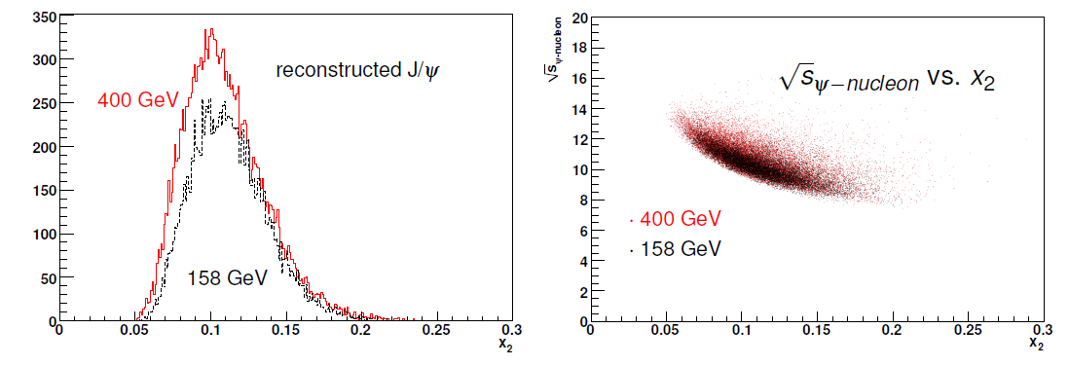
Studying nuclear effects vs x₂
The x₂ acceptance of the NA60
spectrometer is ~ energy independent
x₂ is strongly correlated
with √s_{ψN} → expect same
absorption at fixed x₂
Shadowing effects (2→1 approach) scale with x₂
If parton shadowing and final state absorption were the only two relevant mechanisms
→ α should not depend on √s at fixed x₂

Slide 16
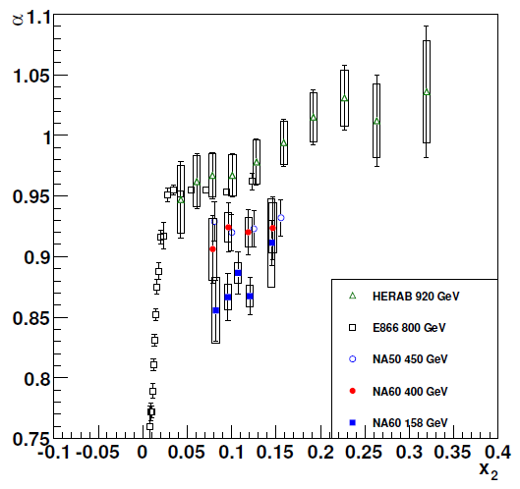
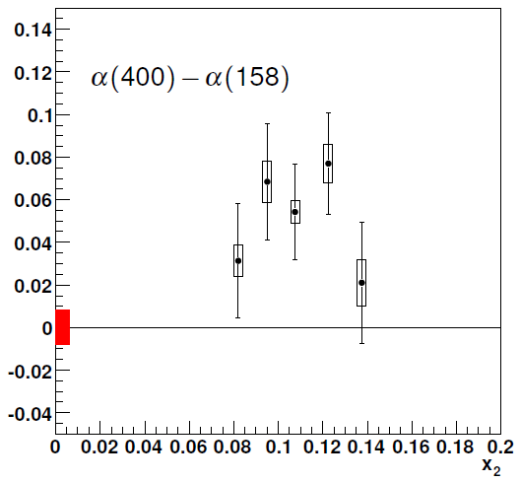
x₂-dependence of α_{J/ψ}
NA60 can measure
Δα = α(400) - α(158)
within the same experiment
→ common systematics cancel
→ reduced systematics on Δα
Clearly effects different from shadowing and final state
absorption are present

Slide 17
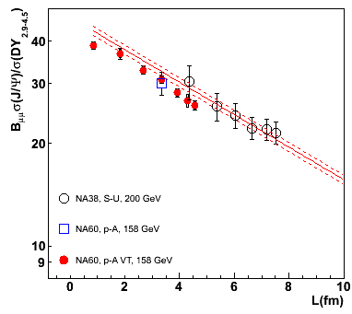
Reference for AA data
CNM effects, evaluated in pA, can be extrapolated to AA, assuming a
scaling with the L variable and taking into account that:
σ_{abs}^{J/ψ} shows a dependence
on energy/kinematics
reference obtained from 158 GeV pA data (same energy/kinematics as the AA data)
in AA collisions, shadowing affects both projectile and target
proj. and target antishadowing taken into account in the reference determination
Use as reference:
slope determined only from pA@158GeV
σ_{abs} ^{J/ψ} (158 GeV) = 7.6 ± 0.7 ± 0.6 mb
normalization to σ_{J/ψ}^{pp} determined from
pA@158 GeV (J/ψ/DY point) and (to
reduce the overall error) SU@200GeV
SU has been included in the fit, since it has a slope similar to pA at 158 GeV
advantage: small error on normalization (3%)
drawback: hypothesis that SU is “normal”‏
Notes:
Nuclear effects scale with L…Se uso solo pA PC point: 8% error. Con SU 3%. Differenza slopes 0.3 sigma

Slide 18
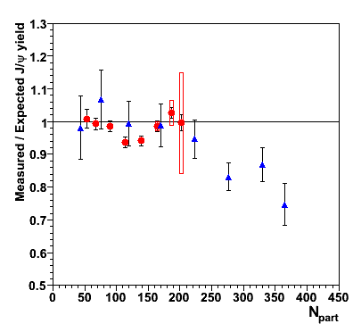
Anomalous suppression
In-In 158 GeV (NA60)
Pb-Pb 158 GeV (NA50)
Using the previously defined reference:
Central Pb-Pb:
→ still anomalously
suppressed
In-In:
almost no anomalous
suppression
B. Alessandro et al., EPJC39 (2005) 335
R. Arnaldi et al., Nucl. Phys. A830 (2009) 345
R.Arnaldi, P. Cortese, E. Scomparin Phys. Rev. C 81 (2009), 014903
Notes:
Ratio measured over expected

Slide 19
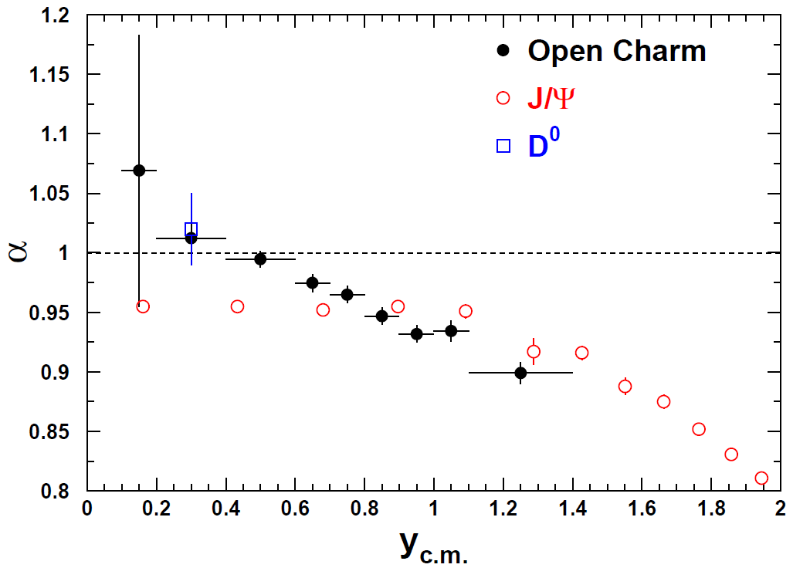
Open charm production in p-A collisions
Open charm shares initial state effects with charmonium
  → a measurement of open charm in p-A collisions may help
  in understanding J/ψ suppression
Recent results from SELEX and E866 suggest rather strong
nuclear effects on open charm
E866/NuSea Preliminary
A. Blanco et al. (SELEX), EPJC64(2009) 637
M. Leitch (E866), workshop on “Heavy Quarkonia
Production in Heavy-Ion Collisions”, ECT* 2009

Slide 20
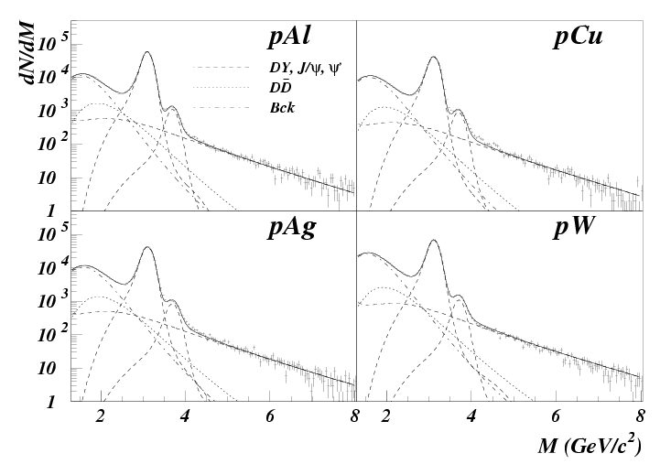
Open charm dimuons in p-A: NA60
NA50 tried to evaluate DD production studying the IMR in pA
→Large background levels (S/B ~0.05 at m_{μμ} = 1.5 GeV/c²)
NA50 had to impose
a constant DD/DY vs A
(i.e. α_{DD}= α_{DY} ~1 )
M.C. Abreu et al., EPJC14(2000) 443
NA60 is much better placed, thanks to the muon matching
→ S/B is ~60 times more favourable

Slide 21
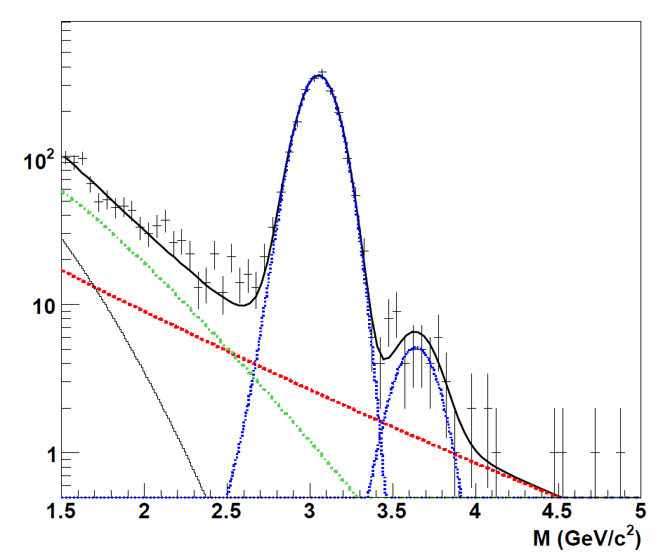
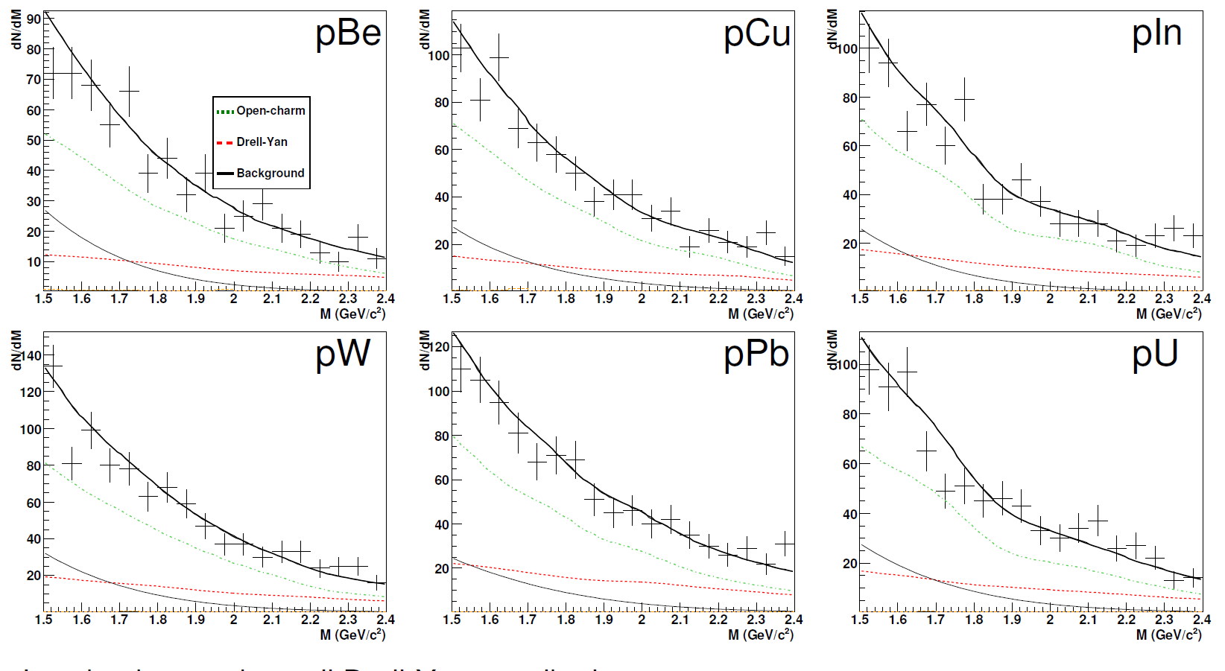
Fit to the mass spectra
400 GeV: larger open
charm signal
p-U 400 GeV
Not possible to directly
measure the D decay
length in p-A
Simultaneous semi-muonic decays of DD pairs are the dominant source in the invariant mass region m<m_{J/ψ}
High-mass DY statistics is low
  →Drell-Yan cannot be directly constrained by the fit
Use the ratios ψ/DY from NA50 (EPJC 48 (2006)) 329 to fix DY
Background evaluated with event mixing technique, remaining
muon pairs come from open-charm decay

Slide 22
Open charm signal(s) in the mass spectra
Low background, small Drell-Yan contribution
Open charm is the dominant source of dimuons in the IMR

Slide 23
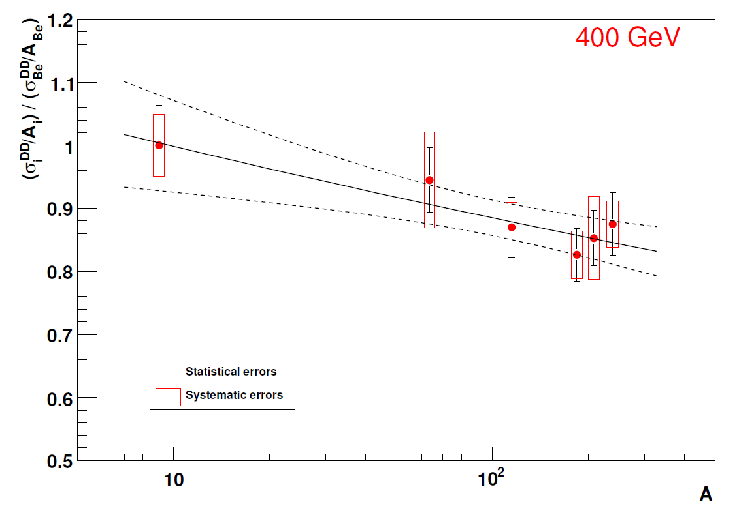
Nuclear dependence of open charm
χ²/ndf = 0.4(stat.), 0.2 (tot.)
α_{DD} (400 GeV) = 0.948 ± 0.022 (stat) ± 0.018 (syst)
Systematic errors include uncertainties on: target thickness, reconstruction efficiencies, fit inputs (ψ/DY measured by NA50), background subtraction. They include also the effect of applying different fitting approaches and quality cuts

Slide 24
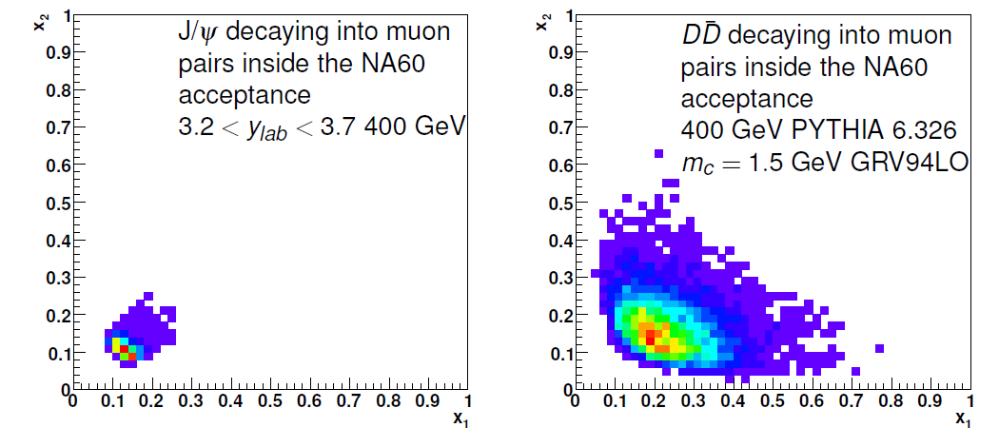
Influence of shadowing
To properly compare J/ψ with open-charm one has to take
into account possible differences in shadowing effects due to
the different x₂ coverage
Calculate the expected α (pure shadowing) for J/ψ and DD pairs decaying into muons in the NA60 acceptance at 400 GeV

Slide 25
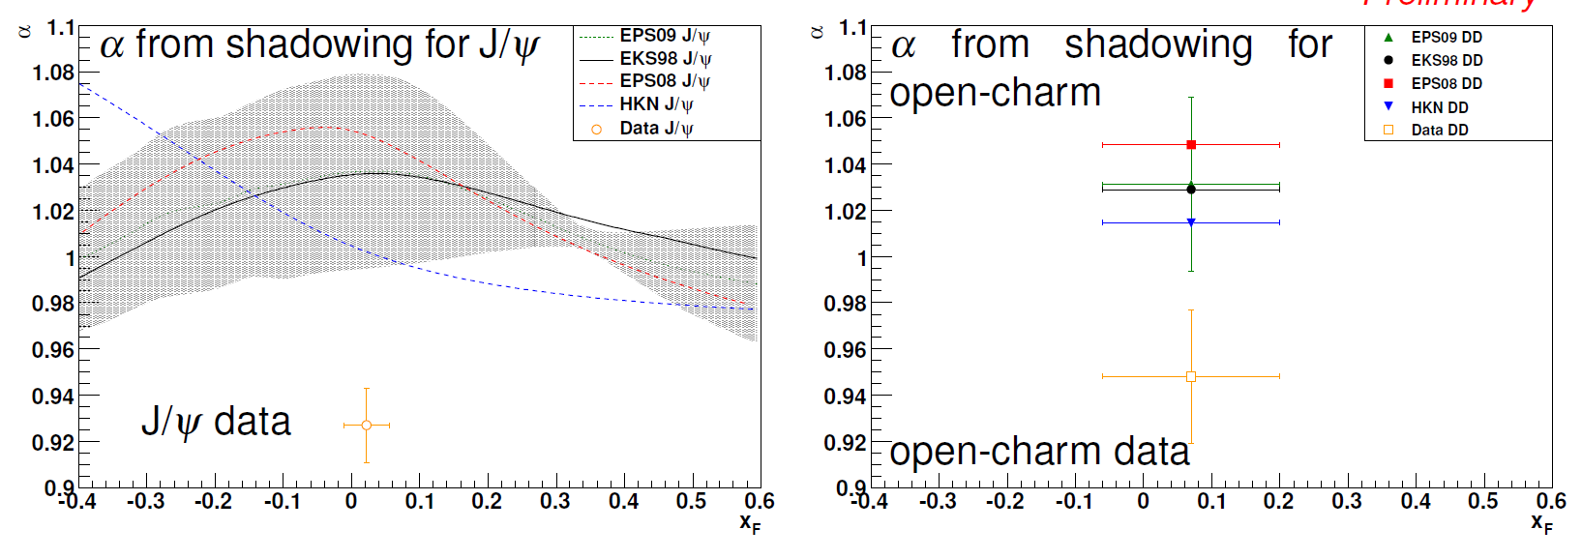
Nuclear dependence,
J/ψ vs open charm
Shadowing effects quite similar for J/ψ and open-charm
Shadowing is not the origin of the measured α < 1 for open-charm
  Anti-shadowing region
Experimentally we observe similar α for J/ψ and open-charm

Slide 26
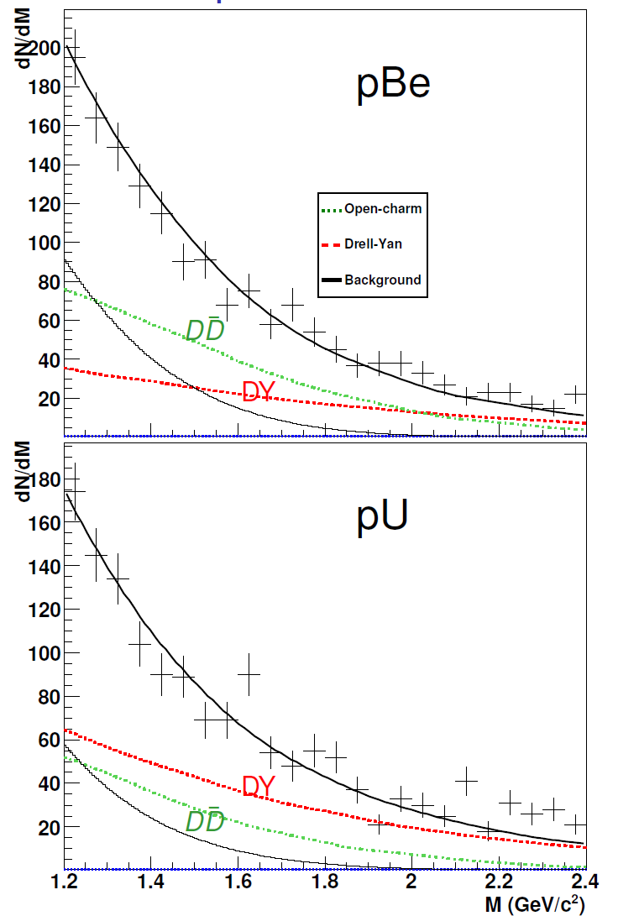
Outlook: open charm at 158 GeV
Possible presence of a strong nuclear dependence
  → to be further investigated
Open-charm signal lower than at 400 GeV, need careful check of systematics
  DY subtraction
    constrained by NA50 measurement at 158 GeV (EPJC 49 (2007) 559)
    direct fit on data
  Background subtraction

Slide 27
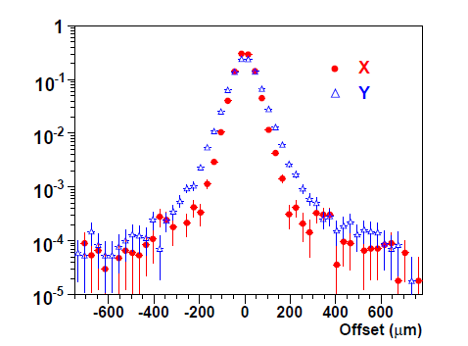
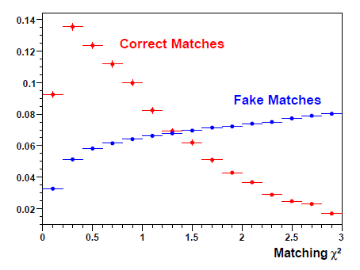
In-In IMR: offset resolution, matching
Offset distribution for matched muons
from prompt decays (J/ψ, φ) directly
gives offset resolution
→ 37 μm (x), 45 μm (y)
Matching χ² distribution (coordinate
+ momentum) for single muons
→Working point χ²<3 (χ²<1.5)

Slide 28
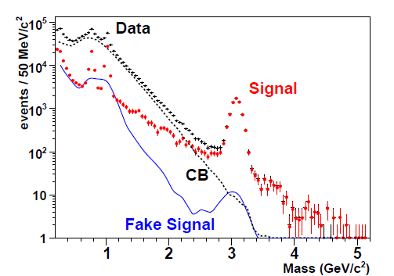
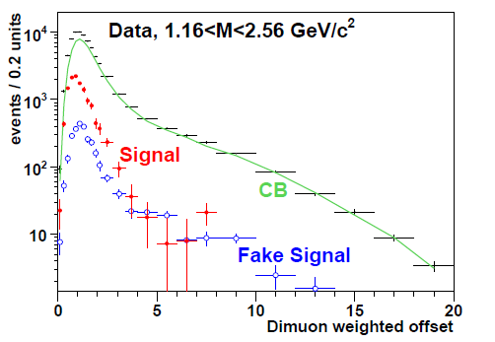


Mass and offset distributions
Here matching χ²<1.5 adopted
Define weighted offset for muons (to remove momentum-dependence) as
V⁻¹: inverse error matrix for uncertainties
of the vertex fit and muon kinematics fit
For dimuons

Slide 29
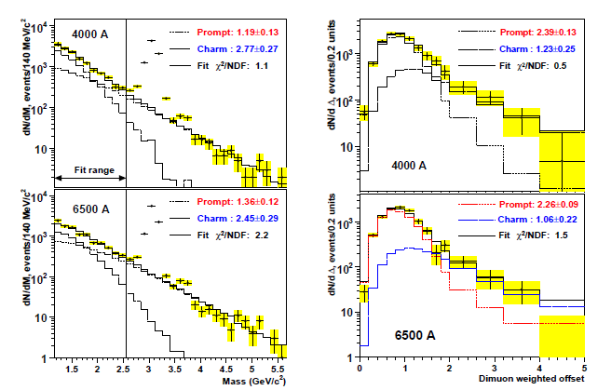
In-In data in the IMR
Superposition of Drell-Yan, open charm + unknown contribution
It has an invariant mass compatible with charm ….
… but the offset distributions show it is not !

Slide 30
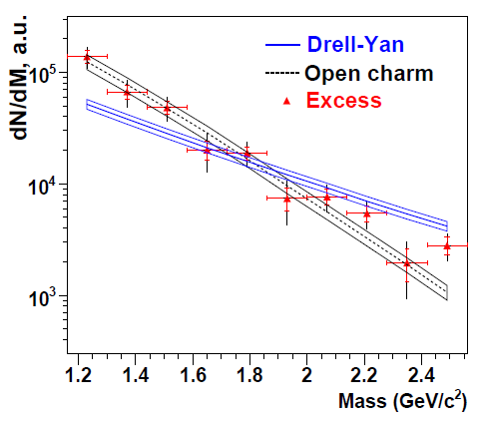
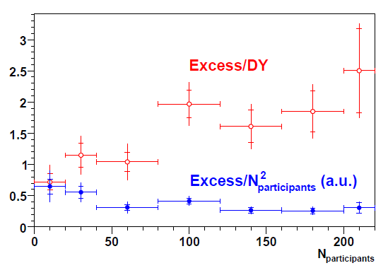
Open charm and other physics
Open charm contribution compatible with collision scaling
_{cc} = 9.4 μb/nucleon ± 14% (stat.) ± 15% (syst.)
Accounting for extrapolation model adds ~20% syst. Uncertainty
Mass distribution of the excess compatible with that of open charm
(but it is NOT open charm, since it it prompt!)
Dependence on N_{part} between linear and quadratic in N_{part}

Slide 31
Conclusions
NA60 performed detailed studies of charmonium suppression in In-In collisions at 158 A GeV and in p-A collisions at 158 and 400 GeV
  Cold nuclear matter effects stronger when decreasing √s
  Lack of x₂ scaling for J/ψ nuclear dependence
→ shadowing + nuclear absorption scenario is ruled out
  Anomalous J/ψ suppression (beyond CNM effects) at SPS significant only for Pb-Pb, beyond N_{part}~200-250
Measurement of nuclear dependence of open-charm
production at 400 GeV
  Contrary to the expectation from shadowing an open-charm suppression is observed (1.7 σ effect)
  α values similar for open-charm and J/ψ
Measurement of open charm production in In-In collisions
  Presence of a prompt excess contribution
  Open charm compatible with collision scaling (within unc.)

Slide 32
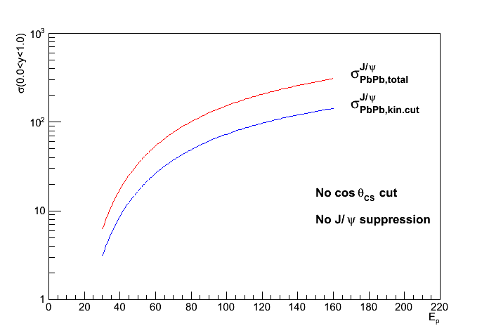
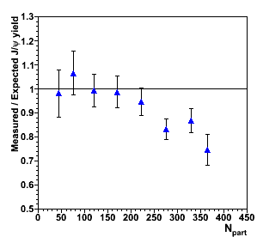
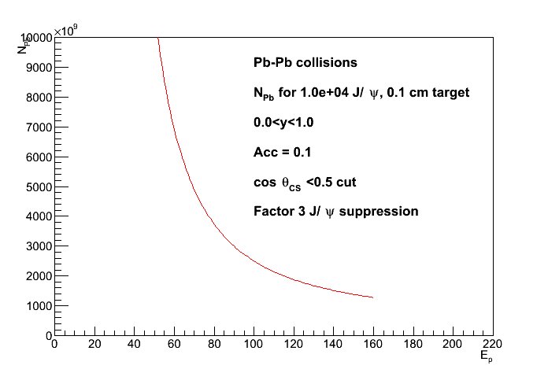
Future SPS charmonium measurements ?
  Identify thresholds for charmonium
  suppression via SPS energy scan
  Detailed study of χ_{c} by detecting
  the decay photon
  Studies for a NA60-like set-up
Decreasing energy
Feasible in a few weeks
at typical SPS beam intensities
Scan feasible (luminosity) down to
50-60 GeV incident Pb energy

Slide 33
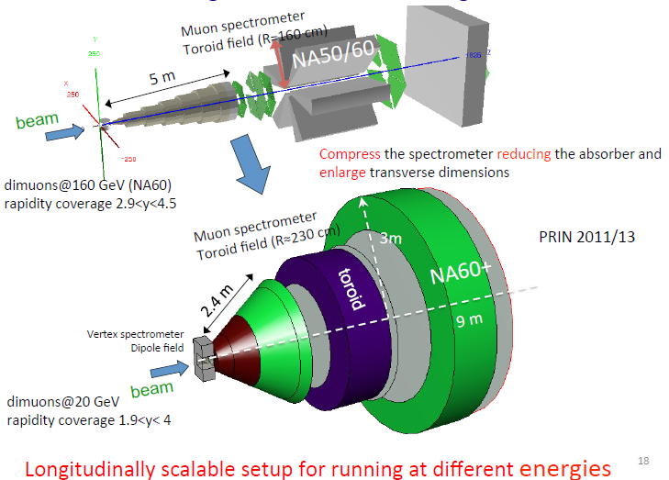
Feasibility studies

Slide 34
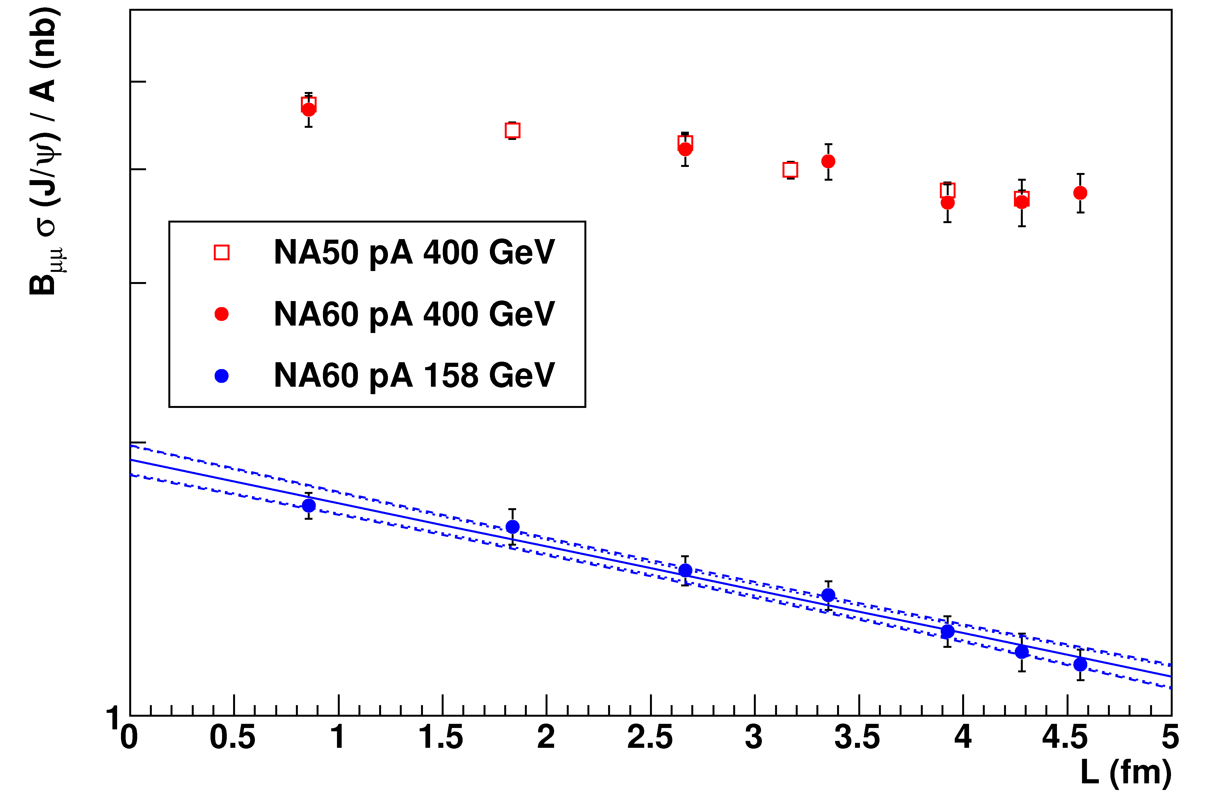
New result: J/ψ cross section in pA
J/ψ production cross sections for pA data
Systematic error on (absolute) luminosity estimation quite high
Relative luminosity estimate between 158 and 400 GeV
much better known (~2-3% systematic error)
Normalize NA60 400 GeV cross section ratios to NA50 results
158 GeV cross sections constrained by the relative normalization
Notes:
Banda blu-> errore su sigma e normalizzazione (1 sigma)

Slide 35
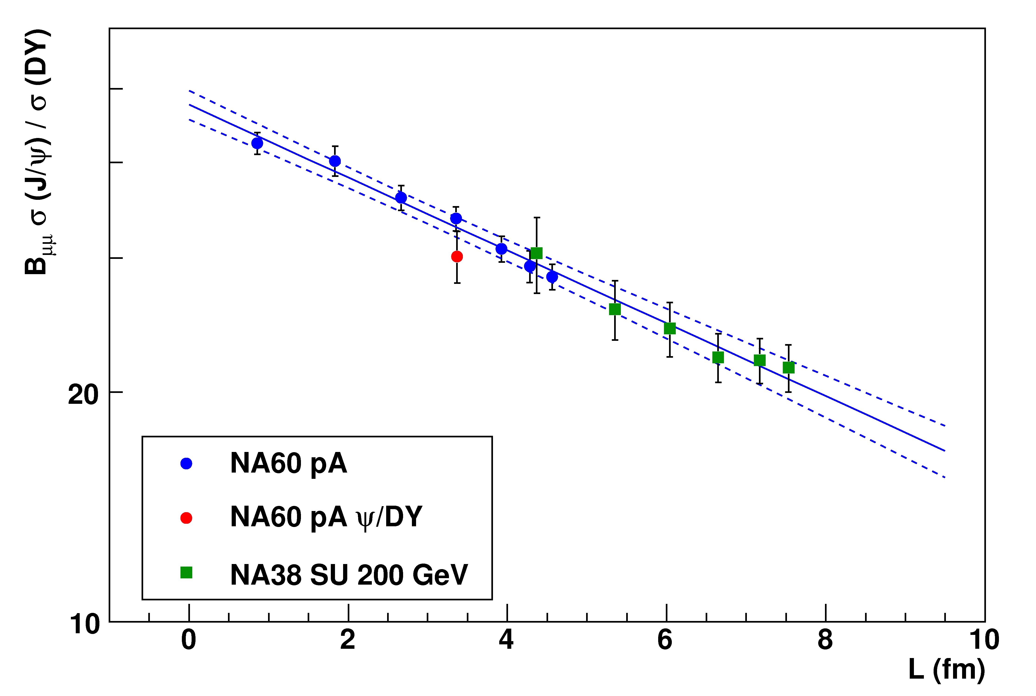
New reference using J/ψ cross sections
Alternative approach for the normalization of the pA
reference curve based on the pA J/ψ absolute cross section
To fully profit from this approach, a measurement of the
absolute J/ψ cross section in In-In would be needed. For the
moment…
J/ψ/DY values are obtained rescaling the DY cross section
measured at 450 GeV by NA50 (not enough statistics at 158 GeV)
Main advantage: no assumption on SU, since it is not used
anymore in the fit
Preliminary
No practical consequence on anomalous J/Ψ suppression
difference with previous CNM reference ~1% well within errors

Slide 36
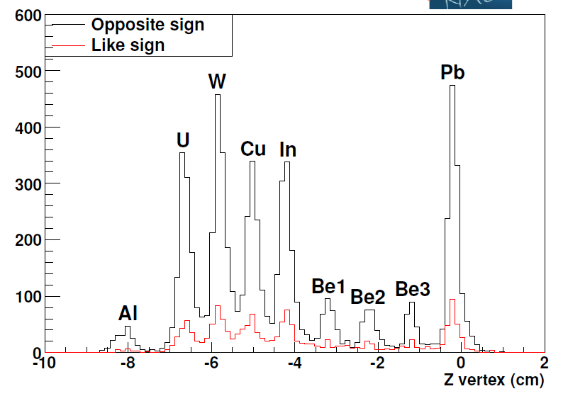

Target ID in the IMR
1.5<m<2.4 GeV/c²
Low background in the IMR (matching)
Good resolution on the longitudinal position of the vertex in the IMR → good target assignment
Cross target contamination (0.5- 9%) has been corrected for

