Slide 1
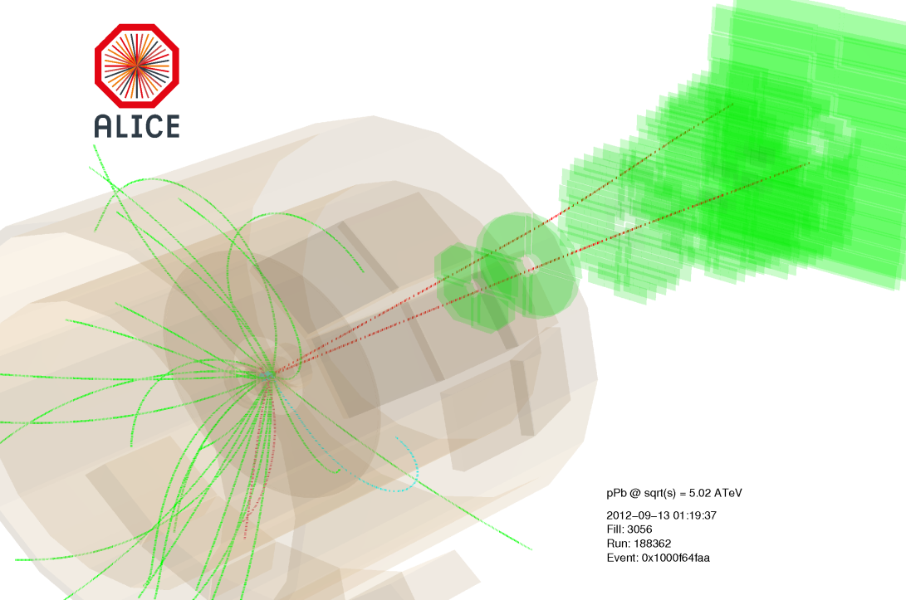
Charmonium in ALICE
Roberta Arnaldi
INFN Torino
for the ALICE Collaboration
HICforFAIR Workshop:
Heavy flavor physics with CBM
Frankfurt am Main, 26-28 May 2014

Slide 2
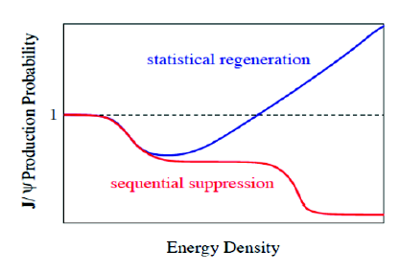
From suppression…to (re)combination
From suppression to recombination in 1 slide!
Differences in the binding energies of the quarkonium states lead to a sequential melting of the states with increasing temperature
(Digal,Petrecki,Satz PRD 64(2001) 0940150)
→ thermometer of the initial QGP temperature
T_{c}
T_{c}
T_{c}
T_{c}
ψ(2S)
ψ(2S)
ψ(2S)
ψ(2S)
J/ψ
χ_{c}
J/ψ
J/ψ
ϒ(1S)
ϒ(1S)
ϒ(1S)
T~3T_{c}
T~T_{c}
T<T_{c}
T>>T_{c}
Increasing the energy of the collision the cc pair multiplicity increases
In most central AA collisions | SPS 20 GeV | RHIC 200GeV | LHC 2.76TeV
N_{ccbar}/event | ~0.2 | ~10 | ~75
An enhancement via (re)combination of cc pairs producing quarkonia can take place at hadronization or during QGP stage
P. Braun-Muzinger and J. Stachel, Phys. Lett. B490(2000) 196, R. Thews et al, Phys.ReV.C63:054905(2001)

Slide 3
How do we measure medium effects?
Nuclear modification factor R_{AA}:
compare quarkonium yield in AA with the pp one, scaled by the nuclear overlap factor T_{AA} (from Glauber model)
If yield scales with the number of binary collisions
→ R_{AA} = 1
Cold Nuclear Matter effects (CNM):
Nuclear parton shadowing
Parton energy loss
$c\overline{c}$ in medium break-up
If there are medium effects
→ R_{AA} ≠ 1
Hot Medium effects:
quarkonium suppression
enhancement due to recombination
knowledge of CNM effects fundamental to disentangle genuine QGP induced modification in AA!

Slide 4
Quarkonium in heavy-ion collisions
A-A
Quarkonium as a probe of the hot medium created in the collision (QGP)
Suppression vs regeneration
p-A
Investigation of cold nuclear matter effects (shadowing, energy loss…)
Crucial tool to disentangle genuine QGP effect is AA collisions
p-p
Reference process to understand behaviour in pA, AA collisions
Useful to investigate production mechanisms (NRQCD, CEM models...)
pp @ √s= 2.76, 7 and 8TeV
Pb-Pb @ √s_{NN}= 2.76TeV
p-Pb @ √s_{NN}= 5.02TeV
ALICE has measured J/ψ and ψ(2S) in the following systems:

Slide 5
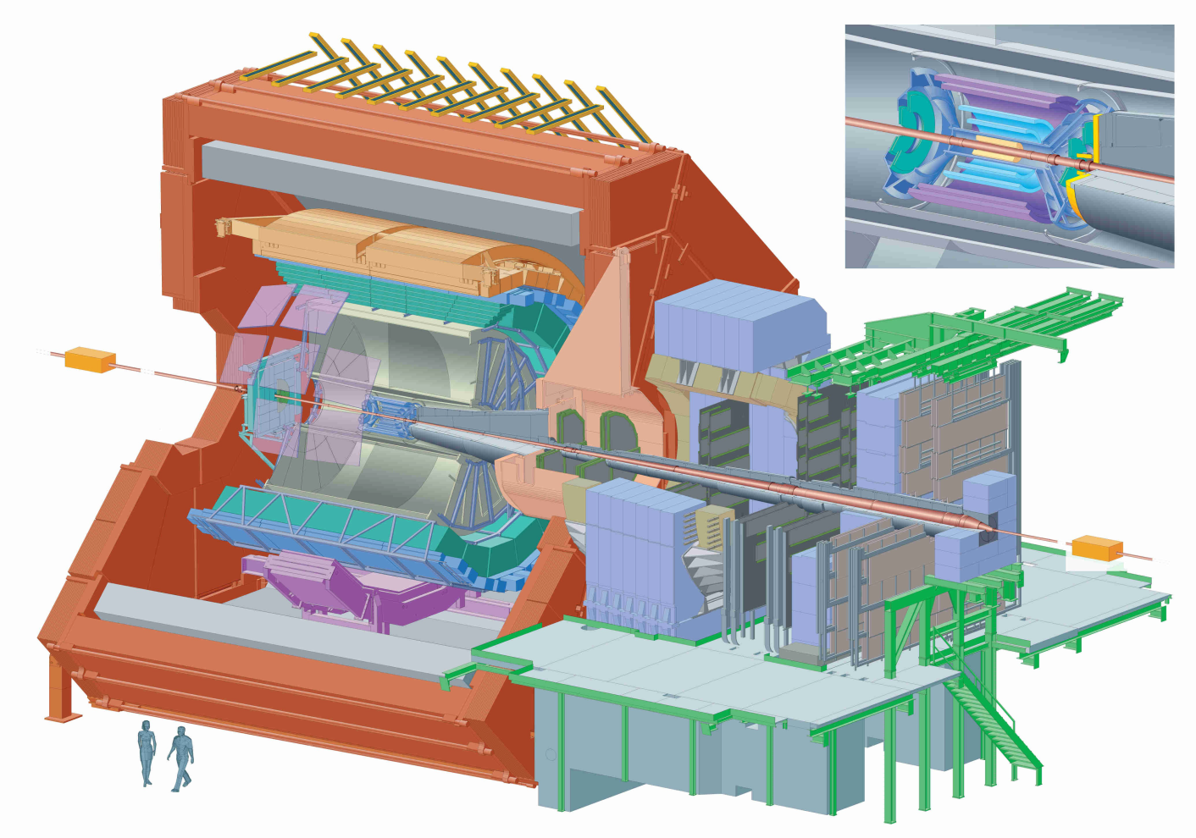
Charmonium in ALICE
Quarkonium in ALICE can be measured in two ways:
Central Barrel J/ψ →e⁺e⁻
(|y_{LAB}|<0.9)
Electrons tracked using ITS and TPC
Particle identification: TPC, TOF, TRD
Forward muon arm J/ψ →μ⁺μ⁻
(2.5<y_{LAB}<4)
Muons identified and tracked in the muon spectrometer
Acceptance coverage in both y regions down to zero p_{T}
ALICE measures inclusive J/ψ at mid and forward-y and prompt J/ψ at mid-y
µ⁺
e⁺
e⁻
µ⁻

Slide 6
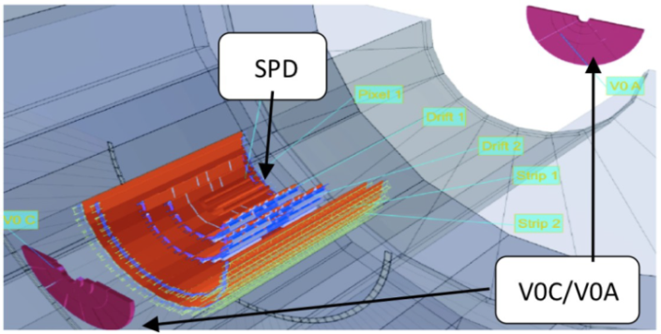
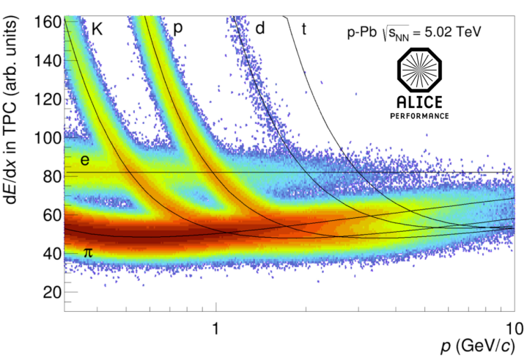
Event and track selection
Event and track selection details are specific to the various analyses, but general features are:
Event selection:
Rejection of beam gas and EM interactions (VZERO and ZDC)
SPD for vertex determination
Electron track selection:
|η_{e}|<(0.8)0.9, p_{T}>(0.85)1GeV/c (for pPb and PbPb)
Rejection of tracks from photon conversion
VZERO
Trigger:
Electron analysis: MB trigger
Muon analysis: dimuon trigger, i.e. coincidence of MB with two μ⁺, μ⁻ tracks in the Muon Spectrometer trigger chambers
Muon track selection:
Muon tracking-trigger matching
-4<η_{μ}<‐2.5, 2.5<y^{μμ}_{LAB}<4
17.6<R_{abs}<89 cm (R_{abs}= track radial position at the absorber end)
Event activity:
VZERO classes for PbPb
ZDC (ZN) energy classes for pPb analysis
Notes:
Electron pT cut to remove combinatorial background. Eta cut to ensure good tracking

Slide 7
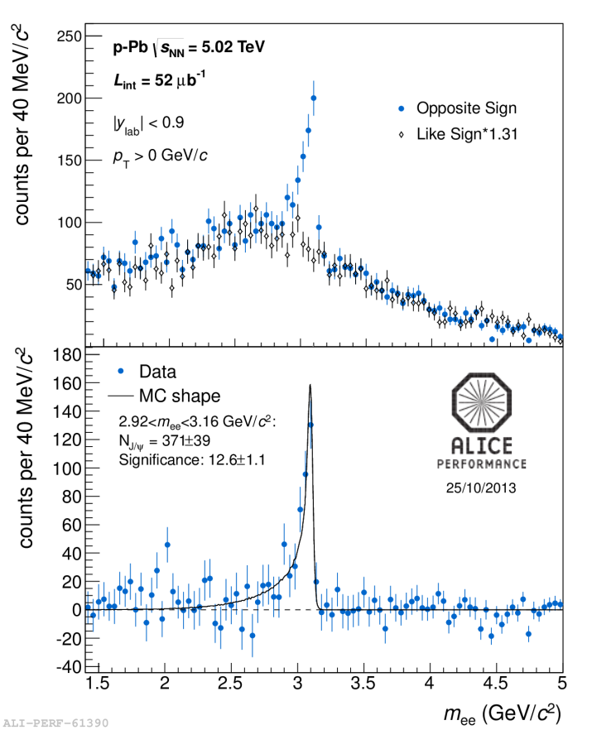
J/ψ and ψ(2S) signals
Dimuon analysis:
Dielectron analysis:
Charmonium yields extracted fitting the opposite sign dimuon invariant mass spectrum
Signal: extended Crystal Ball function or pseudo-Gaussian phenomenological shapes
Background: variable width Gaussian or combinations of exponential x polynomial functions. Pb-Pb: background evaluated
via mixed-event technique
Charmonium yields extracted with a counting technique, after subtraction of the combinatorial background (via like-sign, mixed events or fitting)
Notes:
Fitting come metodo altern per pA, like-sign pp, mixed+fitting. Counting +MC correction per la parte non inclusa

Slide 8
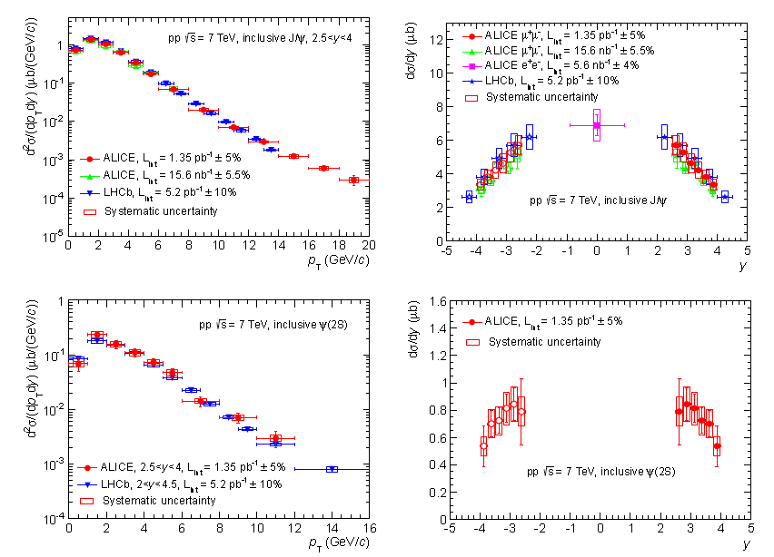
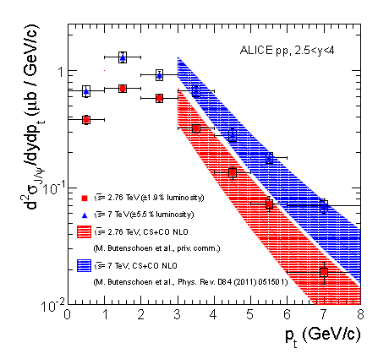
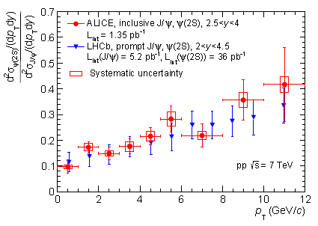
J/ψ and ψ(2S) in pp
ALICE studied J/ψ and ψ(2S) both at forward and at mid-y
Interesting results to investigate production models
pp data used also as reference for pPb and PbPb results
ALICE, arXiv:1403.3648

Slide 9
J/ψ nuclear modification factor
The J/ψ production in p-Pb or Pb-Pb, with respect to binary scaled pp yield, is quantified with the nuclear modification factor
(nuclear overlap T_{pA} (T_{AA}) from Glauber model)
R_{AA}:
pp reference at √s = 2.76TeV
R_{pA}:
pp reference at √s = 5.02TeV
No measurements available
→ interpolation procedure adopted
J/ψ→μ⁺μ⁻
J/ψ→μ⁺μ⁻
Use ALICE pp data at √s = 2.76TeV
√s-interpolation: performed bin-by-bin in y or p_{T}, using ALICE pp results at √s=2.76 and 7TeV
y-extrapolation (due to p-Pb y-shift, the p-Pb and pp y_{cms} ranges do not coincide)
ALICE, Phys. Lett. B718, 295 (2012)
J/ψ→e⁺e⁻
Use interpolation of measured inclusive J/ψ cross sections
J/ψ→e⁺e⁻
Phenix, Phys. Rev. D85, 092004 (2012)
CDF, Phys. Rev. D71, 032001 (2005)
ALICE, Phys. Lett. B718, 295&692 (2012)
√s-interpolation: performed using PHENIX, CDF and ALICE results at y=0
p_{T} dependence: phenomenological scaling (arXiv:1103.2394)

Slide 10
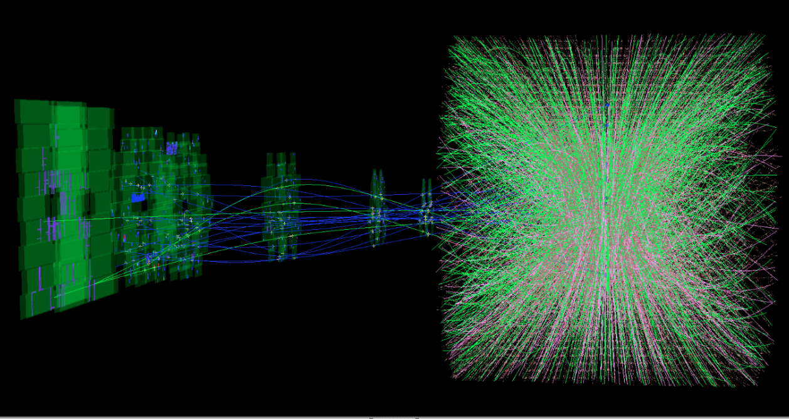
Charmonium in Pb-Pb collisions

Slide 11
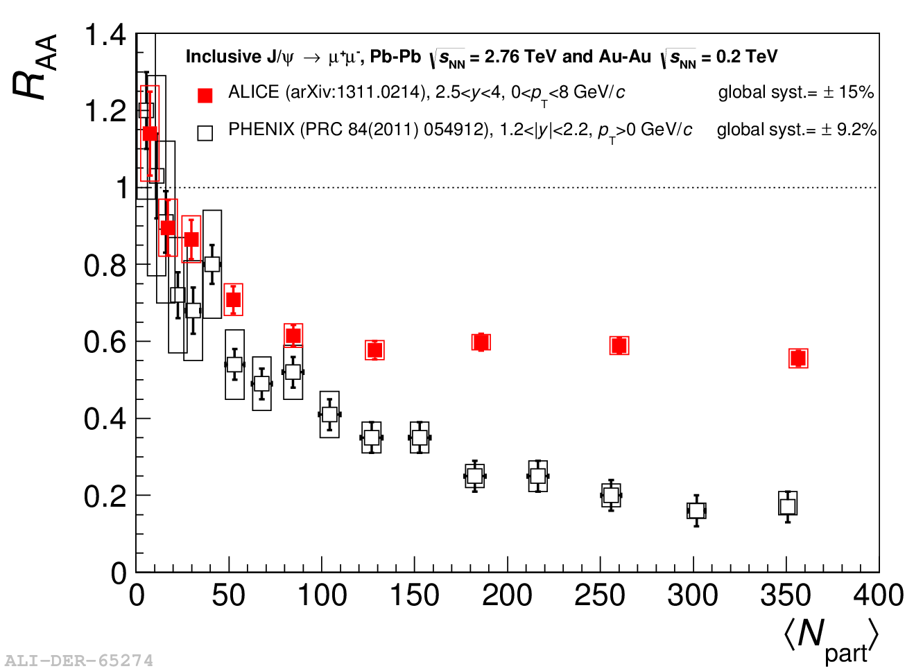
J/ψ R_{AA} vs centrality
ALICE 2.5<y_{J/ψ}<4
PHENIX 1.2<|y_{J/ψ}|<2.2
ALICE |y_{J/ψ}|<0.8
PHENIX |y_{J/ψ}|<0.35
ALICE Coll. arXiv:1311.0214
ALICE results:
Clear J/ψ suppression with almost no centrality dependence above N_{part}~100
Less J/ψ suppression at mid-rapidity wrt forward y for central events
Comparison with PHENIX: ALICE results show weaker centrality dependence and smaller suppression for central events
Is this the expected signature for (re)combination ?

Slide 12
J/ψ R_{AA} vs centrality
Comparison to theory calculations:
Models including a large fraction (> 50% in central collisions) of J/ψ produced from (re)combination or models with all J/ψ produced at hadronization provide a reasonable description of ALICE results

Slide 13
J/ψ R_{AA} vs p_{T}
J/ψ production via (re)combination should be more important at low transverse momentum
p_{T} region accessible by ALICE
Different suppression for low and high p_{T} J/ψ
→ smaller R_{AA} for high p_{T} J/ψ in both rapidity ranges
Striking difference between the PHENIX and ALICE patterns, in particular at low p_{T}

Slide 14
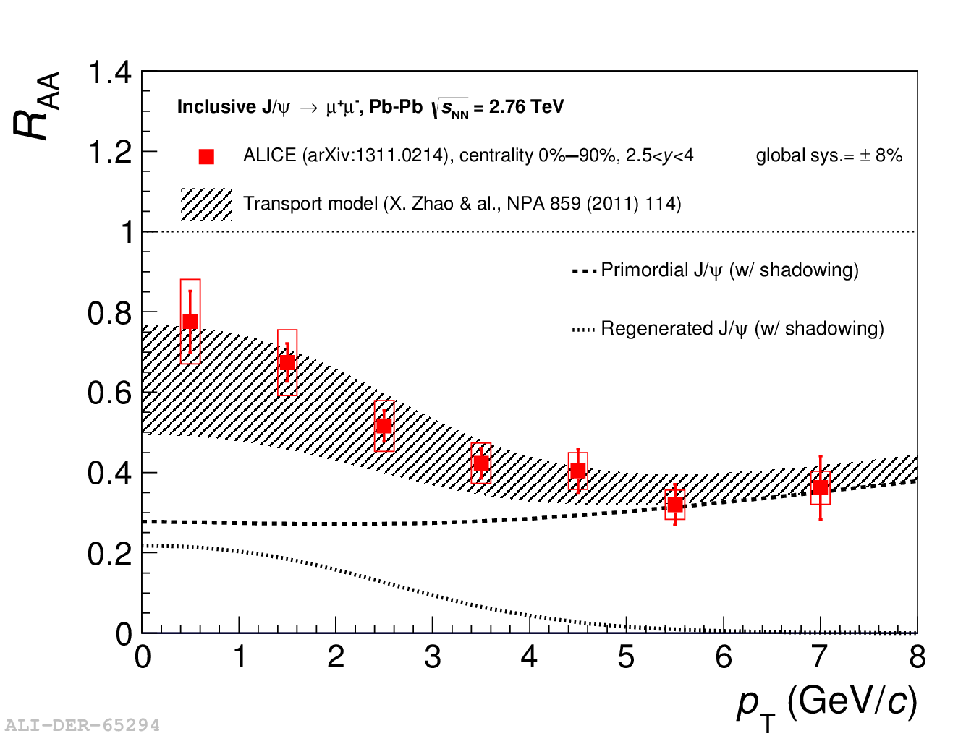
J/ψ R_{AA} vs p_{T}
J/ψ production via (re)combination should be more important at low transverse momentum
p_{T} region accessible by ALICE
Models with a large regeneration component (at low p_{T}) are in fair agreement with the data
Multi-differential studies show that the difference low vs high p_{T} suppression is even more important for central collisions
Notes:
dsigma_cc/dy: stat hadr= 0.3-0.4 mb, transport Rapp= 0.5-0.75, Zhuang= 0.65-0.8 mb

Slide 15
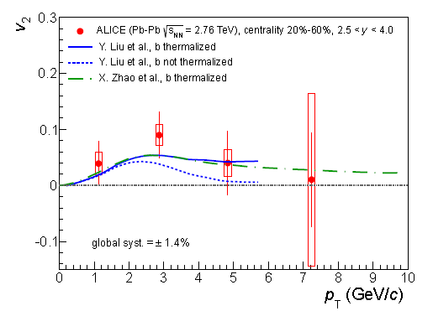
J/ψ v₂
The contribution of J/ψ from (re)combination should lead to a significant elliptic flow signal at LHC energy
First hint for J/ψ flow in heavy-ion collisions (ALICE, forward y, semi-central collisions), contrary to v₂~0 observed at RHIC!
ALICE, Phys. Rev. Lett. 111, 162301 (2013)
Significance up to 3σ for chosen kinematic/centrality selections
Qualitative agreement with transport models including regeneration

Slide 16
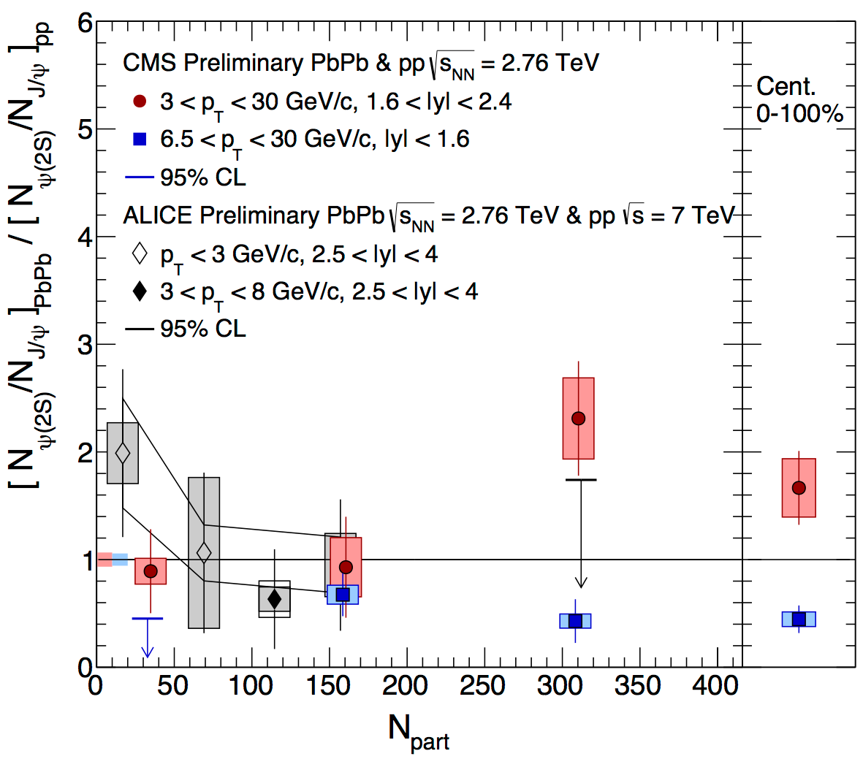
ψ(2S)→μ⁺μ⁻ production in Pb-Pb
The ψ(2S) yield is compared to the J/ψ one in Pb-Pb and in pp
Reference: pp data @√s=7TeV (small √s- and y-dependence from [ψ(2S)/J/ψ]_{pp} results by CDF, LHCb and CMS taken into account in the syst. uncertainty). (Error on the reference is shown as dashed line)
Main systematic uncertainties (some sources cancel out in the double ratio) are the signal extraction and the choice of the MC inputs for acc. calculation
Large statistics and systematic errors prevent a firm conclusion on the ψ(2S) trend vs centrality
Improved agreement between ALICE and CMS data (new pp CMS reference)

Slide 17
Charmonium in p-Pb collisions

Slide 18
ALICE p-Pb collisions
Beam energy: √s_{NN} = 5.02 TeV
Energy asymmetry of the LHC beams (E_{p} = 4 TeV, E_{Pb}= 1.58 A⋅TeV)
→ rapidity shift Δy= 0.465 in the proton direction
Beam configurations:
Data collected with two beam configurations: p-Pb and Pb-p
p
Pb
Pb
p
Muon analysis
2.03<y_{CMS}<3.53
-4.46<y_{CMS}<-2.96
p
Electron analysis
Pb
-1.37<y_{CMS}<0.43

Slide 19
J/ψ R_{pPb} vs rapidity
J/ψ behaviour strongly rapidity dependent:
Strong J/ψ suppression at forward and mid-y
No suppression in the backward region
Uncertainties:
Lines: statistical
Boxes: uncorrelated
Filled boxes: partially correl.
Box around 1: global
Comparison with theoretical predictions shows fair agreement with:
shadowing EPS09 NLO calculations (R. Vogt, Ferreiro et al.)
models including coherent parton energy loss contribution (F. Arleo et al)
Negligible role played by cc break-up, as expected (Ferreiro et al.)
CGC model (Q²_{S0,A} = 0.7-1.2 GeV/c², H. Fujii et al) underestimates the data

Slide 20
J/ψ R_{pPb} vs p_{T}
backward-y
mid-y
forward-y
The p_{T} dependence of J/ψ R_{pPb} has been studied in the three y ranges
backward-y: negligible p_{T} dependence, R_{pA} compatible with unity
mid-y: small p_{T} dependence, R_{pA} compatible with unity for p_{T}>3GeV/c
forward-y: strong R_{pA} increase with p_{T}
Comparison with theory:
Data consistent with pure shadowing calculations and with coherent energy loss models (overestimating J/ψ suppression at low p_{T}, forward-y)
CGC calculation overestimate suppression at forward-y

Slide 21
J/ψ Q_{pPb} vs event activity
NEW
Q_{pA} is a nuclear modification factor with a possible influence due to potential bias in the event activity estimator, not related to nuclear effects
At forward-y, strong J/ψ Q_{pA} decrease from low to high event activity
At backward-y, Q_{pA} consistent with unity, with a feeble event activity dependence

Slide 22
J/ψ Q_{pPb} vs p_{T} and event activity
5-10% event activity
80-100% event activity
NEW
Q_{pA} shows a strong dependence on event activity, y and p_{T}
Low event activity classes: similar backward and forward-y behaviour, consistent with no modification, with a negligible p_{T} dependence
High event activity classes: p_{T}-dependent Q_{pA} behaviour.
Difference between forward and backward-y is larger for increasing event activity class

Slide 23
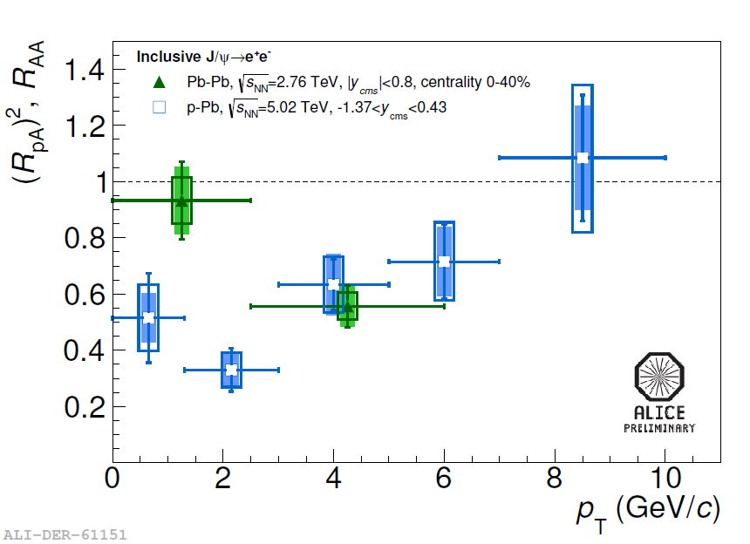
Role of CNM effects
Hypothesis:
2→1 kinematics for J/ψ production
CNM effects factorize in p-A and are dominated by shadowing
pA
AA
Sizeable p_{T} dependent suppression still visible → CNM effects not enough to explain AA data at high p_{T}
Notes:
PbPb: 2.1 · 10⁻⁵<x < 9.2 ·10⁻⁵, 1.4 ·10⁻² < x < 6.1 ·10⁻²
pPb: 1.8·10⁻⁵ < x < 8.1·10⁻⁵

Slide 24
Role of CNM effects
Hypothesis:
2→1 kinematics for J/ψ production
CNM effects factorize in p-A and are dominated by shadowing
pA
AA
Sizeable p_{T} dependent suppression still visible → CNM effects not enough to explain AA data at high p_{T}
From enhancement to suppression increasing p_{T}→ hint for recombination?
Notes:
PbPb: 2.1 · 10⁻⁵<x < 9.2 ·10⁻⁵, 1.4 ·10⁻² < x < 6.1 ·10⁻²
pPb: 1.8·10⁻⁵ < x < 8.1·10⁻⁵

Slide 25
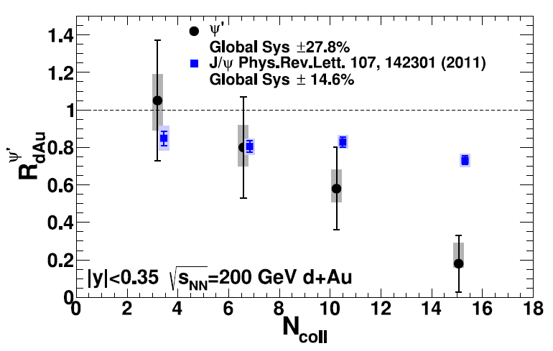
ψ(2S) production in p-Pb collisions
Being a more weakly bound state than the J/ψ, the ψ(2S) is another interesting probe to investigate charmonium behaviour in the medium
J/ψ and ψ(2S) significantly affected by cold nuclear matter (CNM) effects as shadowing, energy loss and cc break-up
Low energies: J/ψ and ψ(2S) behaviour in p-A collisions interpreted in terms of charmonia crossing and formation time
mid-y: ψ(2S) more suppressed than J/ψ:
→ formation time<crossing time (fully formed resonance traversing the nucleus)
forward-y: similar J/ψ and ψ(2S) suppression
→ formation time>crossing time
PHENIX Collab., PRL 111 (2013) 202301
High-energy: PHENIX has observed a ψ(2S) suppression stronger than the J/ψ one, in mid-y d-Au collisions
→ unexpected because, at RHIC, crossing time should be shorter than charmonium formation time
Notes:
Jpsi binding en: 0.64 GeV
Psi(2S) binding en: 0.05 GeV

Slide 26
ψ(2S)/J/ψ
A strong decrease of the ψ(2S) production in p-Pb, relative to J/ψ, is observed with respect to the pp measurement (2.5<y_{cms}<4, √s=7TeV)
arXiv:1405.3796
Warning: different √s and slightly different y range between p-Pb and pp
Compared to pp, the ψ(2S) is more suppressed than the J/ψ to a 2.0σ level at forward-y and 3.2σ at backward-y

Slide 27
ψ(2S)/J/ψ
A strong decrease of the ψ(2S) production in p-Pb, relative to J/ψ, is observed with respect to the pp measurement (2.5<y_{cms}<4, √s=7TeV)
arXiv:1405.3796
The double ratio allows a direct comparison of the J/ψ and ψ(2S) production yields between experiments
Similar effect seen by PHENIX in d-Au collisions, at mid-y, at √s_{NN}=200 GeV
Line: statistical uncertainty
Shaded box: partially correl. syst. unc.
Open box: uncorrelated syst. uncertainty
[ψ(2S)/J/ψ]_{pp} variation between (√s=7TeV, 2.5<y<4) and (√s=5.02TeV, 2.03<y<3.53 or -4.46<y<-2.96) evaluated using CDF and LHCb data (amounts to 8% included in the systematic uncertainty)

Slide 28
ψ(2S) R_{pPb} vs y_{cms}
The ψ(2S) suppression with respect to binary scaled pp yield can be quantified with the nuclear modification factor
(again, used √s=7TeV pp ratio including an 8% systematic uncertainty related to the different kinematics)
ψ(2S) suppression is stronger than the J/ψ one and reaches a factor ~2 wrt pp
arXiv:1405.3796
Same initial state CNM effects (shadowing and coherent energy loss) expected for both J/ψ and ψ(2S)
Theoretical predictions in disagreement with ψ(2S) result
Other mechanisms needed to explain ψ(2S) behaviour?

Slide 29
ψ(2S) R_{pPb} vs y_{cms}
The ψ(2S) suppression with respect to binary scaled pp yield can be quantified with the nuclear modification factor
Can the stronger suppression of the weakly bound ψ(2S) be due to break-up of the fully formed resonance in CNM?
possible if formation time
(τ_{f} ~0.05-0.15fm/c) <crossing time (τ_{c})
arXiv:1405.3796
forward-y:
τ_{c}~10⁻⁴ fm/c
backward-y:
τ_{c}~7⋅10⁻² fm/c
D. McGlinchey, A. Frawley and R.Vogt, PRC 87,054910 (2013)
break-up effects excluded at forward-y
at backward-y, since τ_{f} ~τ_{c} , break-up in CNM can hardly explain the very strong difference between J/ψ and ψ(2S) suppressions
Final state effects related to the (hadronic) medium created in the p-Pb collisions?
Notes:
Gia’ in pA dove non c’e’ break-up ci sono effetti div
ersi per Jpsi e PsiP
Final state effects, as the resonance break-up with interactions with cold nuclear matter could lead to this effect, but the short crossing-times for the cc pair, especially at forward-y, make the explanation unlikely
Tau_c correspond to pt~0

Slide 30
[ψ(2S)/J/ψ]_{pPb} / [ψ(2S)/J/ψ]_{pp} vs p_{T}
The sizeable ψ(2S) statistics in p-Pb collisions allows the differential study of ψ(2S) production vs p_{T}
Different p_{T} correspond to different crossing times, with τ_{c} decreasing with increasing p_{T}
NEW
backward-y: τ_{c}~0.07 (p_{T}=0)
and ~0.03 fm/c (p_{T}=8 GeV/c)
if ψ(2S) breaks-up in CNM, the effect should be more important at backward-y and low p_{T}
arXiv:1405.3796
No clear p_{T} dependence is observed at y<0, within uncertainties
Notes:
E= mT coshy
at backward-y and low p_{T}, a larger fraction of cc pairs may evolve into a ψ(2S) in the medium, being suppressed because of the ψ(2S) weak binding energy
hint that final state break-up in CNM may not play a major role

Slide 31
[ψ(2S)/J/ψ]_{pPb} / [ψ(2S)/J/ψ]_{pp} vs event activity
The p-Pb ψ(2S)/J/ψ ratio, normalized to the pp one, is studied also as a function of the event activity
NEW
At backward rapidity, ψ(2S) suppression, relative to J/ψ, increases with event activity
Notes:
Legare lo spessore ai tempi
Slopes Ap:-0.16+-0.07, pA: -0.02+-0.08

Slide 32
J/ψ and ψ(2S) Q_{pPb} vs event activity
J/ψ and ψ(2S) Q_{pA} are compared vs event activity
NEW
forward-y: J/ψ and ψ(2S) show a similar decreasing pattern vs event activity
backward-y: the J/ψ and ψ(2S) behaviour is different, with the ψ(2S) significantly more suppressed for largest event activity classes
→ Another hint for ψ(2S) suppression in the (hadronic) medium?
Notes:
Guardare con glauber di quanto varia L

Slide 33
Conclusions
J/ψ and ψ(2S) production have been measured in Pb-Pb at √s_{NN}= 2.76 TeV and p-Pb collisions at √s_{NN}= 5.02TeV
Pb-Pb:
J/ψ suppression significantly different with respect to low energy collisions results → clear indication for recombination effects at LHC
p-Pb:
ψ(2S) significantly more suppressed than the J/ψ both at forward and backward rapidity
J/ψ behaviour in fair agreement with models based on shadowing and coherent energy loss
initial state nuclear effects (shadowing, energy loss) alone cannot account for the modification of the ψ(2S) yields
final state effects as the cc pair interaction with the hadronic medium created in p-Pb collisions should be considered

Slide 34
Backup slides
Backup slides

Slide 35
Electron analysis: event and tracks selection
Event and track selection details are specific to the various collision systems analyses, but general features are:
Event selection:
Rejection of beam gas and EM interactions (VZERO and ZDC)
SPD used for vertex determination
VZERO
Electron track selection:
-0.9<η_{e}<0.9, p_{T}>1GeV/C (for pA analysis)
Rejection of tracks from photon conversion
TPC electron identification
Trigger:
MB trigger (coincidence of signals in VZERO detectors)

Slide 36
J/ψ and ψ(2S) →μ⁺μ⁻ signals
Charmonium yields extracted fitting the opposite sign dimuon invariant mass spectrum with a superposition of signal and background shapes:
Signal:
shapes described by an
extended Crystal Ball function or other pseudo-Gaussian phenomenological shapes
Background:
several functions tested, as a variable width Gaussian or combinations of exponential x polynomial functions.
For Pb-Pb studies, background is also subtracted through a mixed-event technique
Results obtained with the different techniques are combined to extract <N_{J/ψ}> and to evaluate systematic uncertainties
Depending on the system, signal is extracted in y, p_{T} or event activity bins

Slide 37
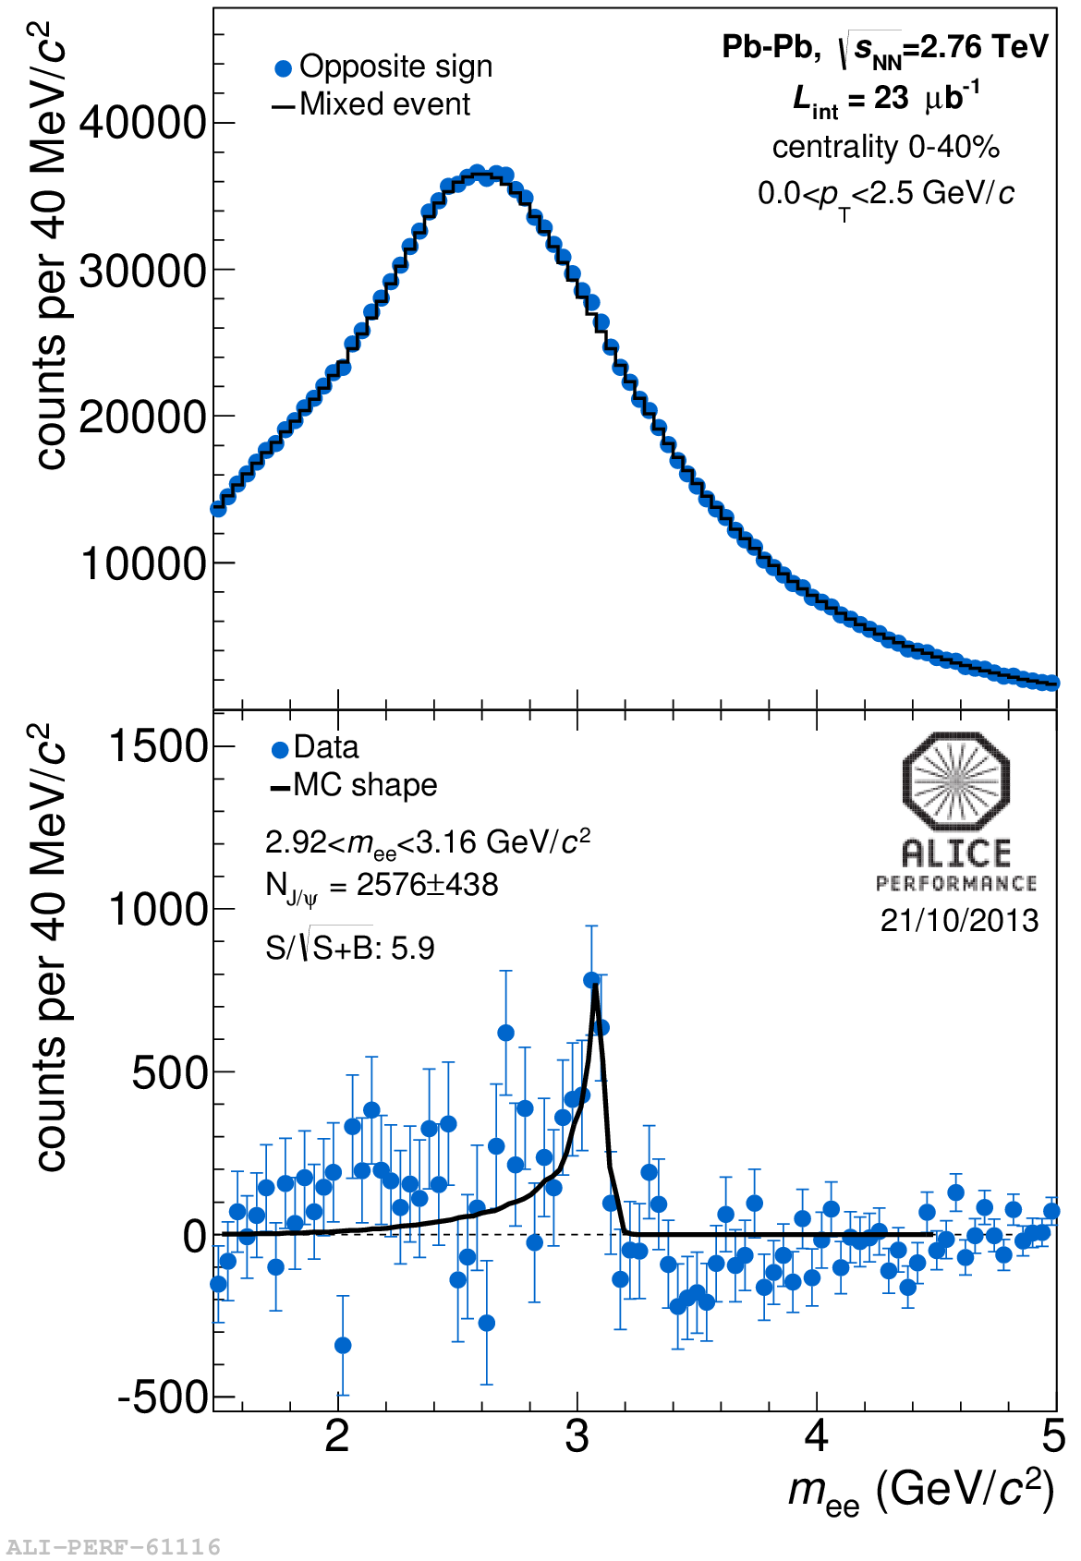
J/ψ →e⁺e⁻ signal
Charmonium yields extracted with a counting technique, after subtracting the combinatorial background to the opposite sign dielectron invariant mass spectrum
Signal:
shapes described by MC
Background:
For Pb-Pb studies background is subtracted through an event mixing technique.
For pA analysis, background from normalized like-sign pair distributions or polynomial parametrizations
Depending on the system, signal is extracted in y, p_{T} and event activity bins

Slide 38
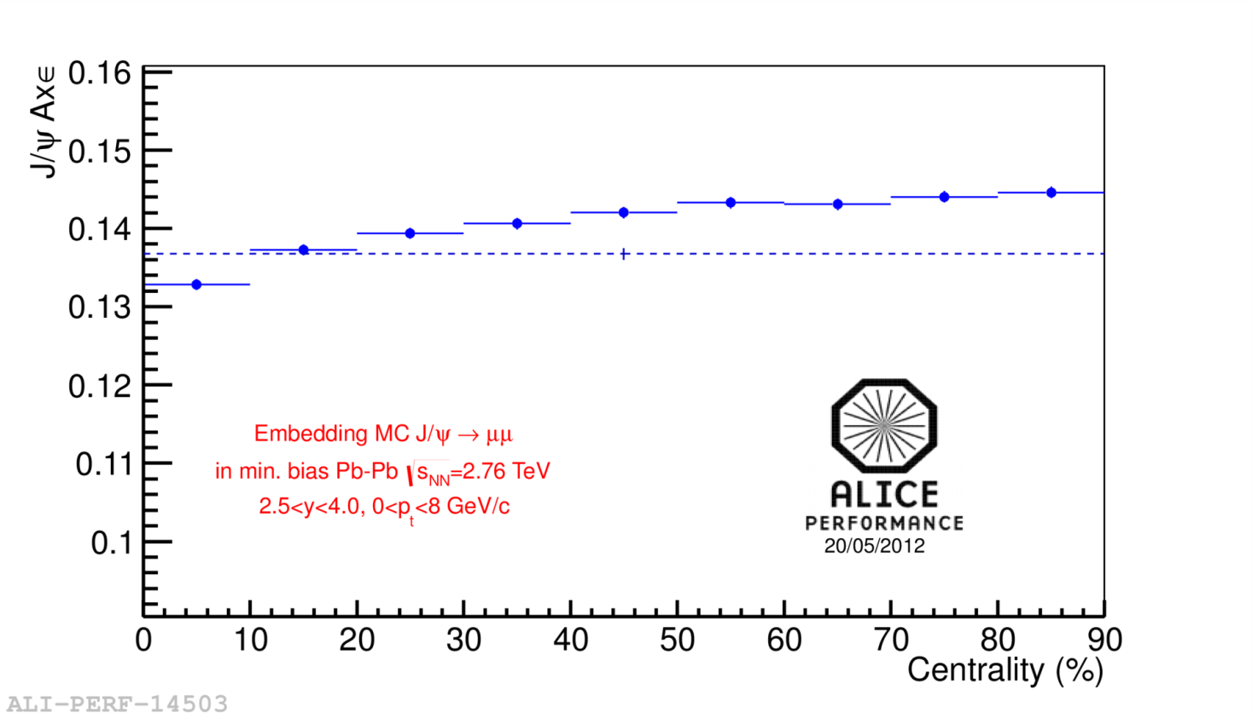
J/ψ acceptance x efficiency in PbPb
Acceptance x efficiency computed embedding MC J/ψ’s into real events
Weak centrality dependence of the J/ψ efficiency (decreasing from 14.5% to 13.3% from peripheral to central collisions)

Slide 39
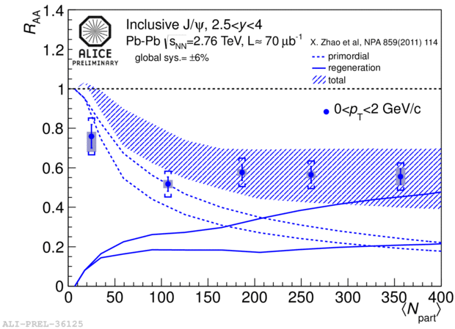
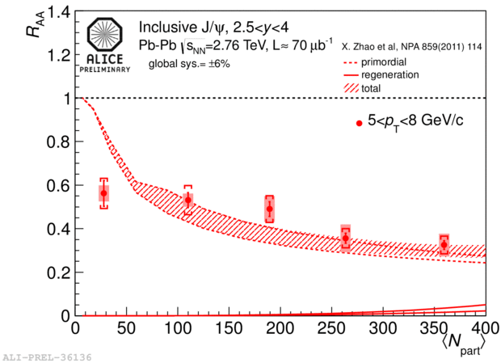
J/ψ R_{AA} vs centrality in p_{T} bins
J/ψ production via (re)combination should be important at low p_{T}
Comparison of the R_{AA} centrality dependence of low (0<p_{T}<2 GeV/c) and high (5<p_{T}<8 GeV/c) p_{T} J/ψ
0<p_{T}<2 GeV/c
primordial
Different suppression for low and high p_{T} J/ψ
Smaller R_{AA} for high p_{T} J/ψ
recombination
5<p_{T}<8 GeV/c
In central collisions, these models (X. Zhao et al, Y.P. Liu et al, E. Ferreiro) predict ~50% of low p_{T} J/ψ to be produced via (re)combination, while at high p_{T} the contribution is negligible
primordial
recombination

Slide 40
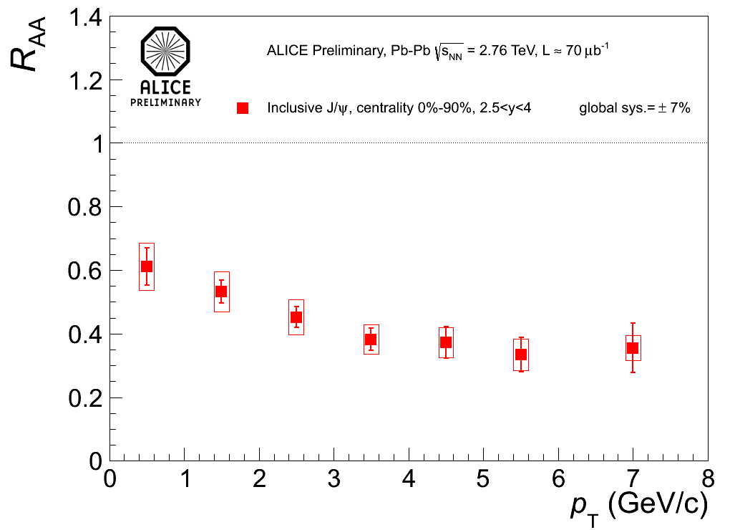
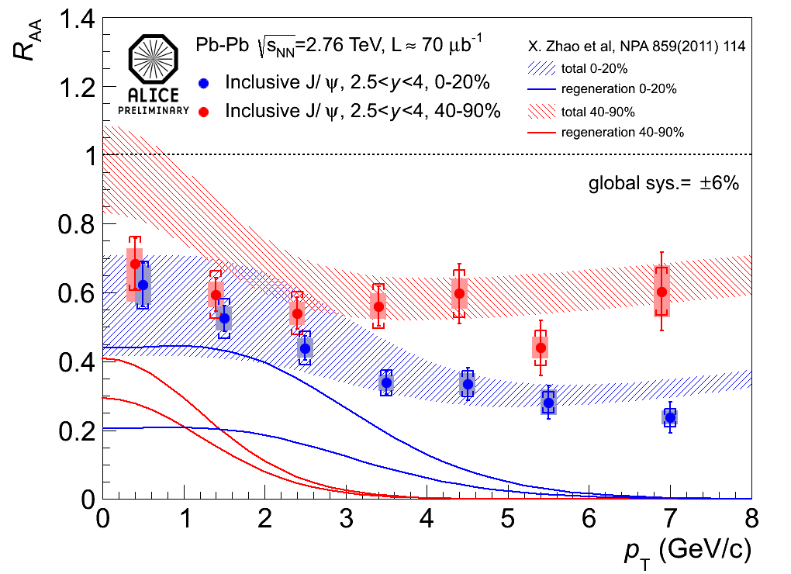
J/ψ R_{AA} vs p_{T} in centrality bins
As an alternative view, R_{AA} is shown as a function of the J/ψ p_{T} for various centrality bins
0-90%
0-20% vs 40-90%
Suppression is stronger for high p_{T} J/ψ (R_{AA}~0.6 at low p_{T} and ~0.35 at high p_{T})
Splitting in centrality bins we observe that the difference low vs high p_{T} suppression is more important for central collisions
Fair agreement between data and models including a large contribution from (re)combination (~50% in central and ~30% in peripheral collisions)

Slide 41
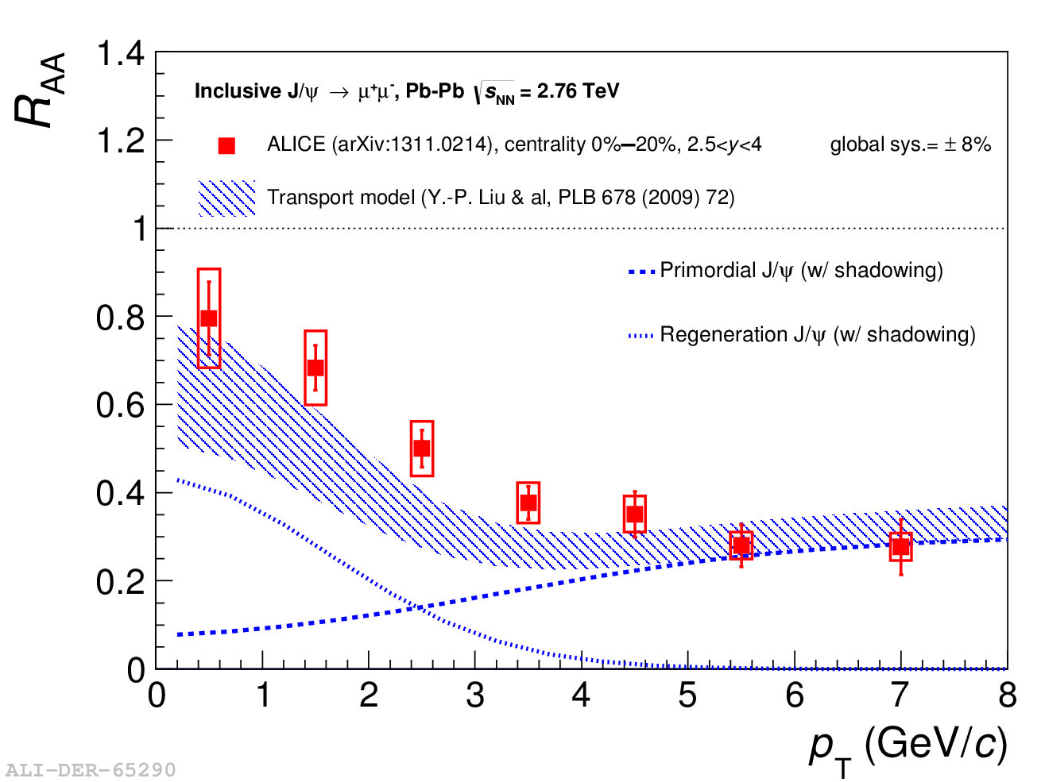
Forward J/ψ R_{AA} vs p_{T}
J/ψ production via (re)combination should be more important at low transverse momentum
p_{T} region accessible by ALICE
Models with a large regeneration component (at low p_{T}) are in fair agreement with the data

Slide 42
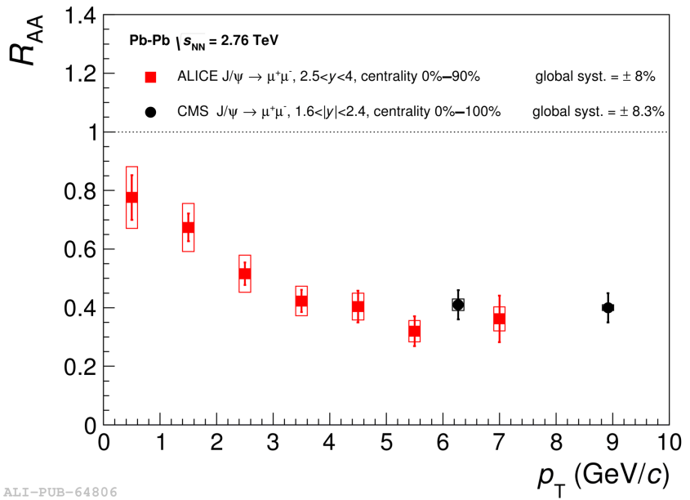
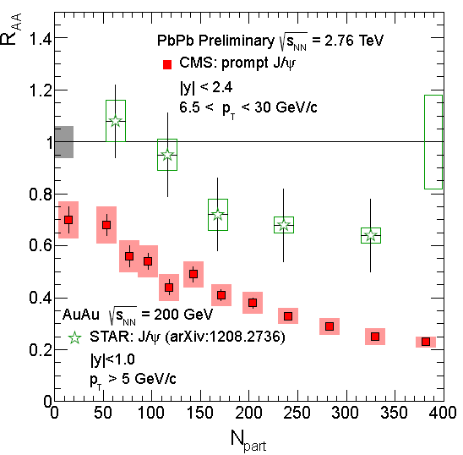
CMS high-p_{T} J/ψ
The high p_{T} region can be investigated by CMS!
Good agreement with ALICE (at high p_{T}) in spite of the different rapidity range
High p_{T}: stronger J/ψ suppression at LHC wrt to RHIC (re-combination should not play a role)

Slide 43
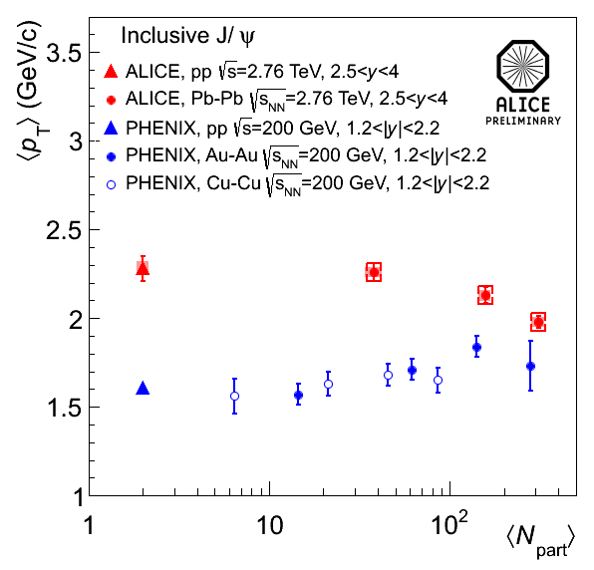
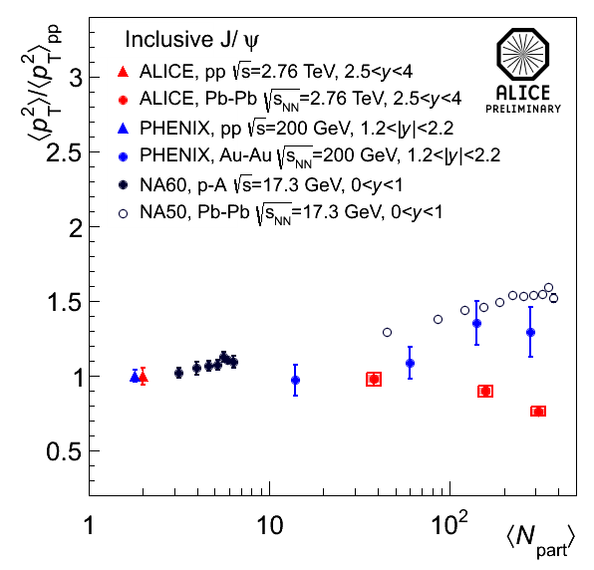
J/ψ <p_{T}> and <p_{T}²>
The J/ψ <p_{T}> and <p_{T}²> show a decreasing trend as a function of centrality, confirming the observation that low p_{T} J/ψ are less suppressed in central collisions
The trend is different wrt the one measured at lower energies, where an increase of the <p_{T}> and <p_{T}²> with centrality was observed

Slide 44
J/ψ R_{AA} vs rapidity

Slide 45
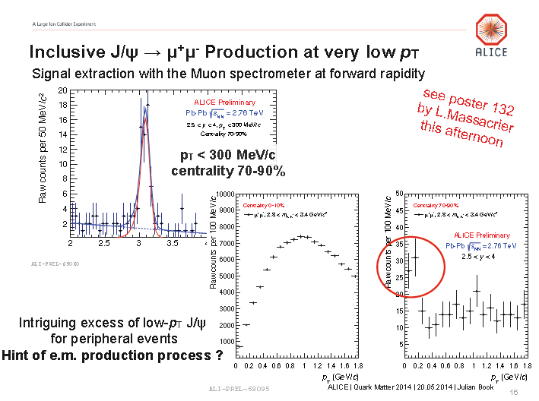
J/ψ production at very low p_{T}

Slide 46
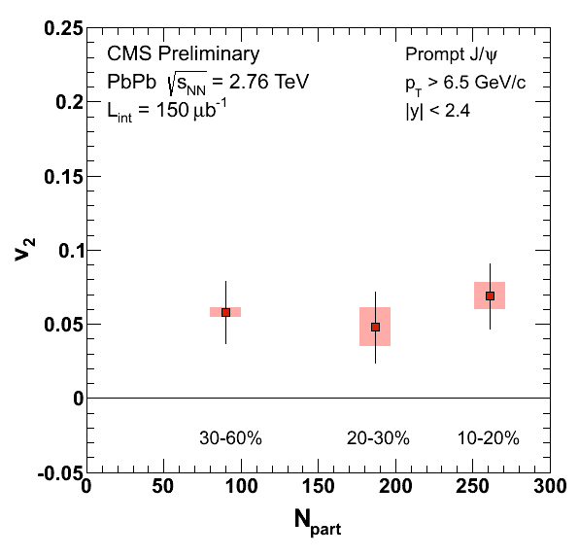
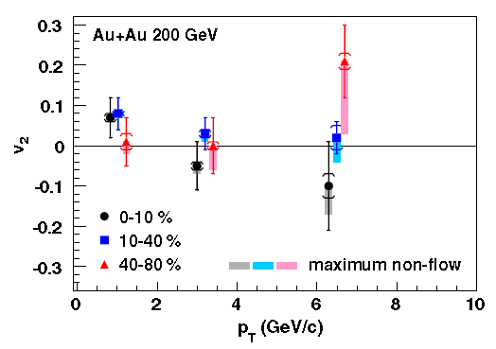
J/ψ flow
J/ψ flow
The contribution of J/ψ from (re)combination should lead to a significant elliptic flow signal at LHC energy
ALICE PRL111, 162301 (2013)
D.Moon, HP2013
STAR
Hint for J/ψ flow in heavy-ion collisions (LHC), contrary to v₂~0 observed at RHIC!
ALICE: qualitative agreement with transport models including regeneration
CMS: path-length dependence of energy loss?
STAR, PRL 052301(2013)
Notes:
6.5 < pT < 30 GeV/c: v2 = 0.054 ± 0.013 ± 0.006 with a 3.8􀐜
significance

Slide 47
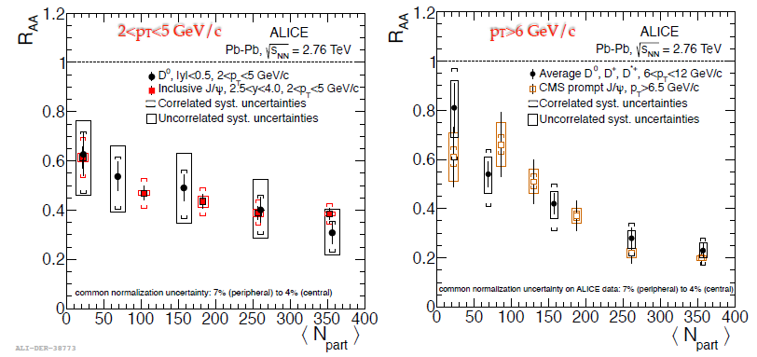
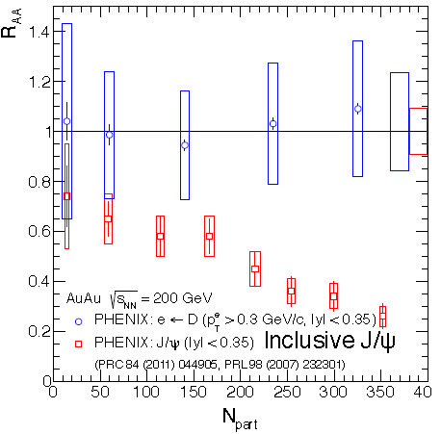
J/ψ vs D in AA collisions
J/ψ vs D in AA collisions
Open charm should be a very good reference to study J/ψ suppression (a‘ la Satz)
Interesting comparison between ALICE
and CMS J/ψ compared to D
Caveat:
complicate to compare J/ψ and D R_{AA} at LHC because of restricted kinematic regions.
Low p_{T} D not accessible for the moment
Different trend observed at low p_{T} at RHIC.
At high p_{T} trend is similar to the LHC one

Slide 48
J/ψ vs D in AA collisions
J/ψ vs D in AA collisions
Open charm should be a very good reference to study J/ψ suppression (a‘ la Satz)
Interesting comparison between ALICE
and CMS J/ψ compared to D
Caveat:
complicate to compare J/ψ and D R_{AA} at LHC because of restricted kinematic regions.
Low p_{T} D not accessible for the moment
Different trend observed at low p_{T} at RHIC.
At high p_{T} trend is similar to the LHC one

Slide 49
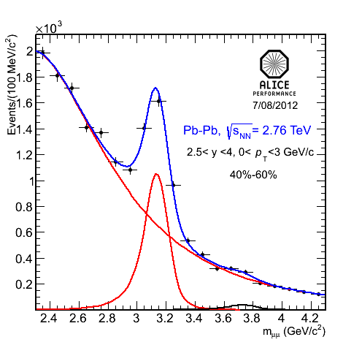
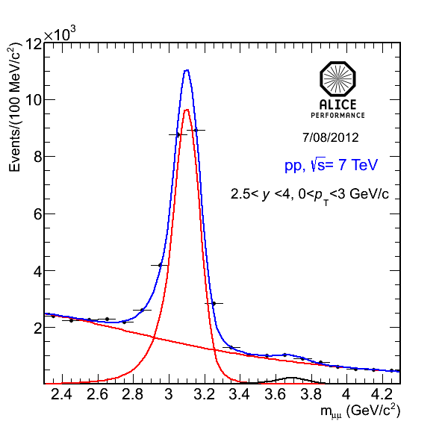
ψ(2S) production in Pb-Pb
The ψ(2S) yield is compared to the J/ψ one in Pb-Pb and in pp
Charmonia yields are extracted fitting the invariant mass spectrum in two p_{T} bins: 0<p_{T}<3 and 3<p_{T}<8 GeV/c and, for Pb-Pb, also as a function of centrality
Pb-Pb@√s_{NN}=2.76TeV
pp@√s=7TeV
Pb-Pb: S/B (at 3 σ around the ψ(2S)) varies between 0.01 and 0.3 from central to peripheral collisions

Slide 50
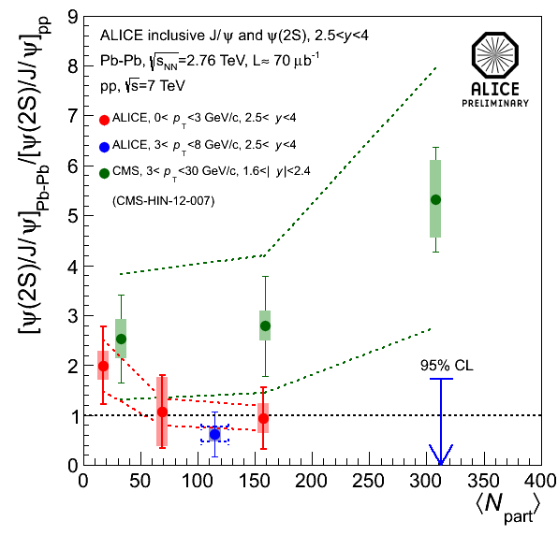
[ψ(2S)/J/ψ]_{PbPb} / [ψ(2S)/J/ψ]_{pp}
Reference: pp data @√s=7TeV (small √s- and y-dependence from [ψ(2S)/J/ψ]_{pp} results by CDF, LHCb and CMS taken into account in the syst. uncertainty). (Error on the reference is shown as dashed line)
Main systematic uncertainties (some sources cancel out in the double ratio) are the signal extraction and the choice of the MC inputs for acc. calculation
Large statistics and systematic errors prevent a firm conclusion on the ψ(2S) enhancement or suppression versus centrality
ALICE result, in central collisions, does not show a large ψ(2S) enhancement

Slide 51
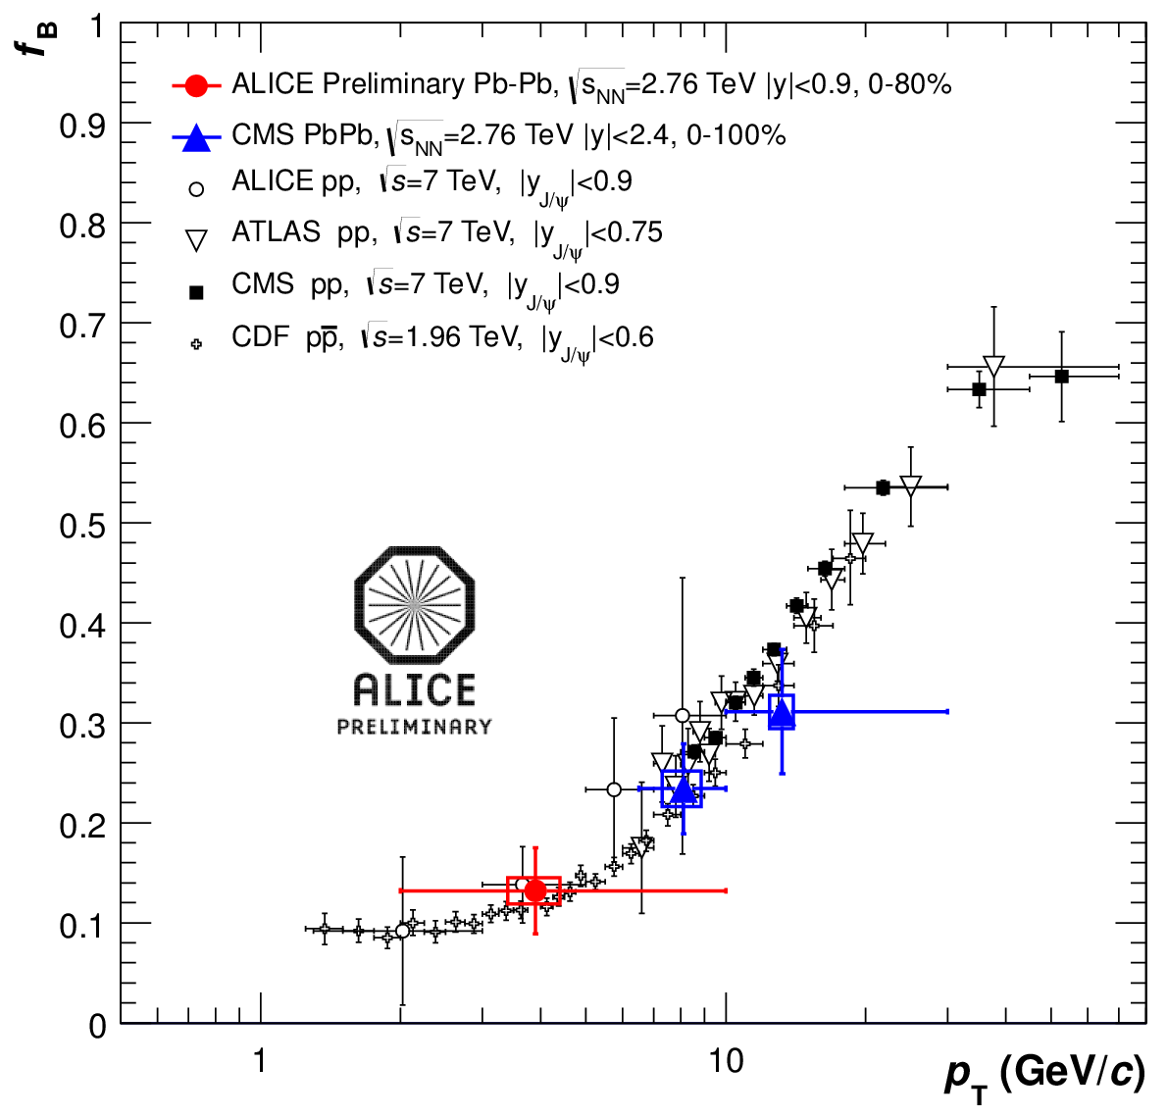
J/ψ →e⁺e⁻ prompt-non prompt separation
Feasible via secondary vertex identification, exploting ITS capabilities
Fraction of b-hadron decays evaluated down to p_{T}= 2GeV/c

Slide 52
J/ψ R_{FB}

Slide 53
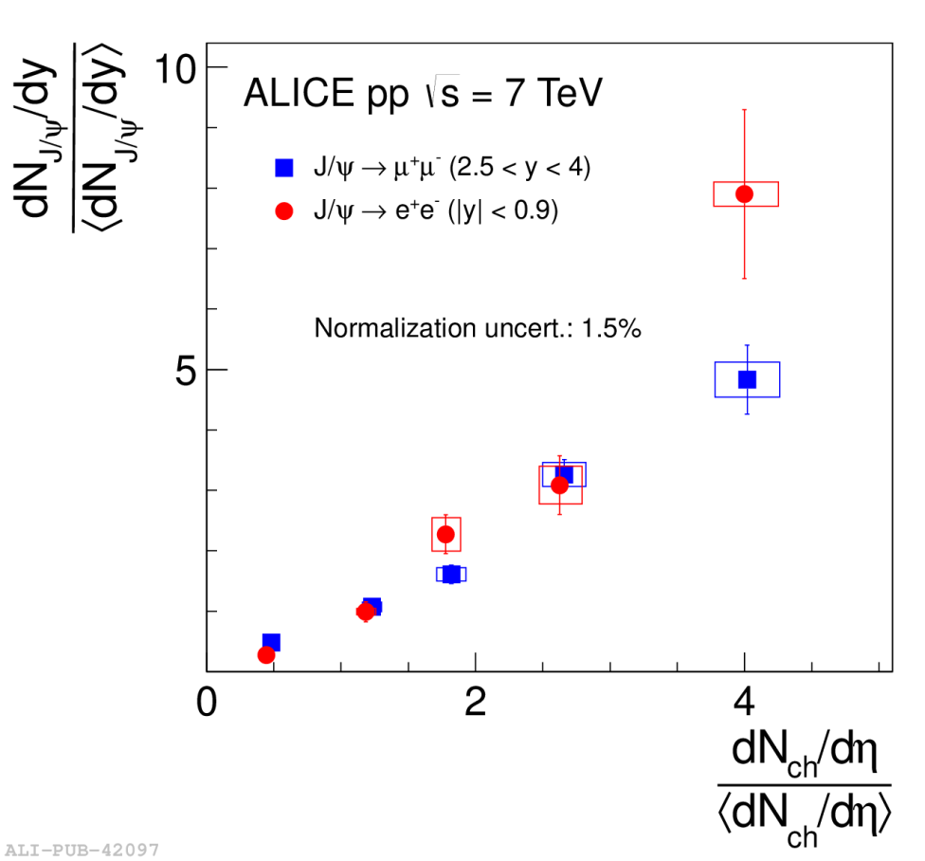
J/ψ relative yield vs mid-y relative multipl.
ALICE, Phys. Lett. B (2012) 165-175
Strong increase of relative J/ψ yields at forward and backward-y with relative multiplicity
Similar behaviour found in pp collisions at backward-y, deviations at forward-y

Slide 54
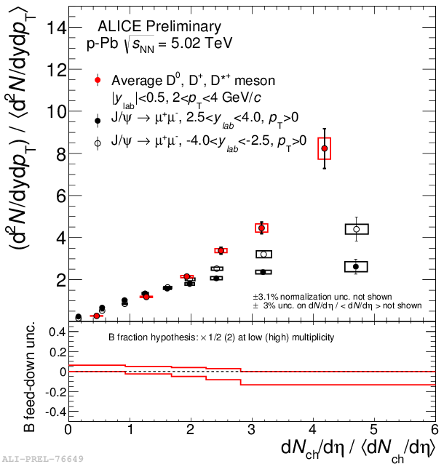
J/ψ relative yield vs mid-y relative multipl.
Strong increase of relative J/ψ yields at forward and backward-y with relative multiplicity
Similar behaviour found in pp collisions at forward-y, deviations at backward-y
D meson relative yield, at mid-y, shows also a strong increase

Slide 55
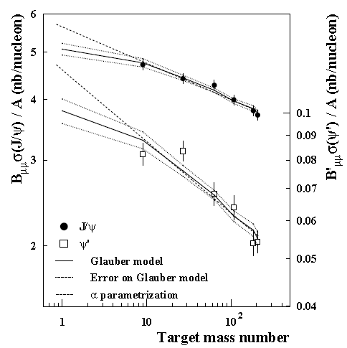
ψ(2S)
Being a more weakly bound state than the J/ψ, the ψ(2S) is an interesting probe to investigate charmonium behaviour in the medium
Stronger ψ(2S) suppression, with respect to J/ψ, observed in Pb-Pb
collisions at SPS → sequential suppression?
→ J/ψ and ψ(2S) also significantly affected by cold nuclear matter (CNM) effects as
J/ψ
shadowing and energy loss
should not depend on final charmonium quantum numbers
cc break-up
important at low energy since the resonance may be formed in the medium
ψ(2S)
pA
Stronger ψ(2S) suppression already in p-A collisions at SPS
NA50 Collab., Eur. Phys. J. C48 (2006) 329
Notes:
Devo dire che ho un cc che evolve…???

Slide 56
ψ(2S)
Being a more weakly bound state than the J/ψ, the ψ(2S) is an interesting probe to investigate charmonium behaviour in the medium
Similar observation made by E866 and HERA-B in pA collisions
E866 Collab., PRL 84 (2000) 3256
mid-y: ψ(2S) suppression stronger than J/ψ one, interpreted in terms of pair break-up
→ charmonium formation time (~0.1fm/c) < crossing time
→ fully formed resonances traversing the nucleus!
α
forward-y: suppression
becomes identical
→ formation time > crossing time
→ dominated by energy loss
x_{F}
Notes:
Devo dire che ho un cc che evolve…???

Slide 57
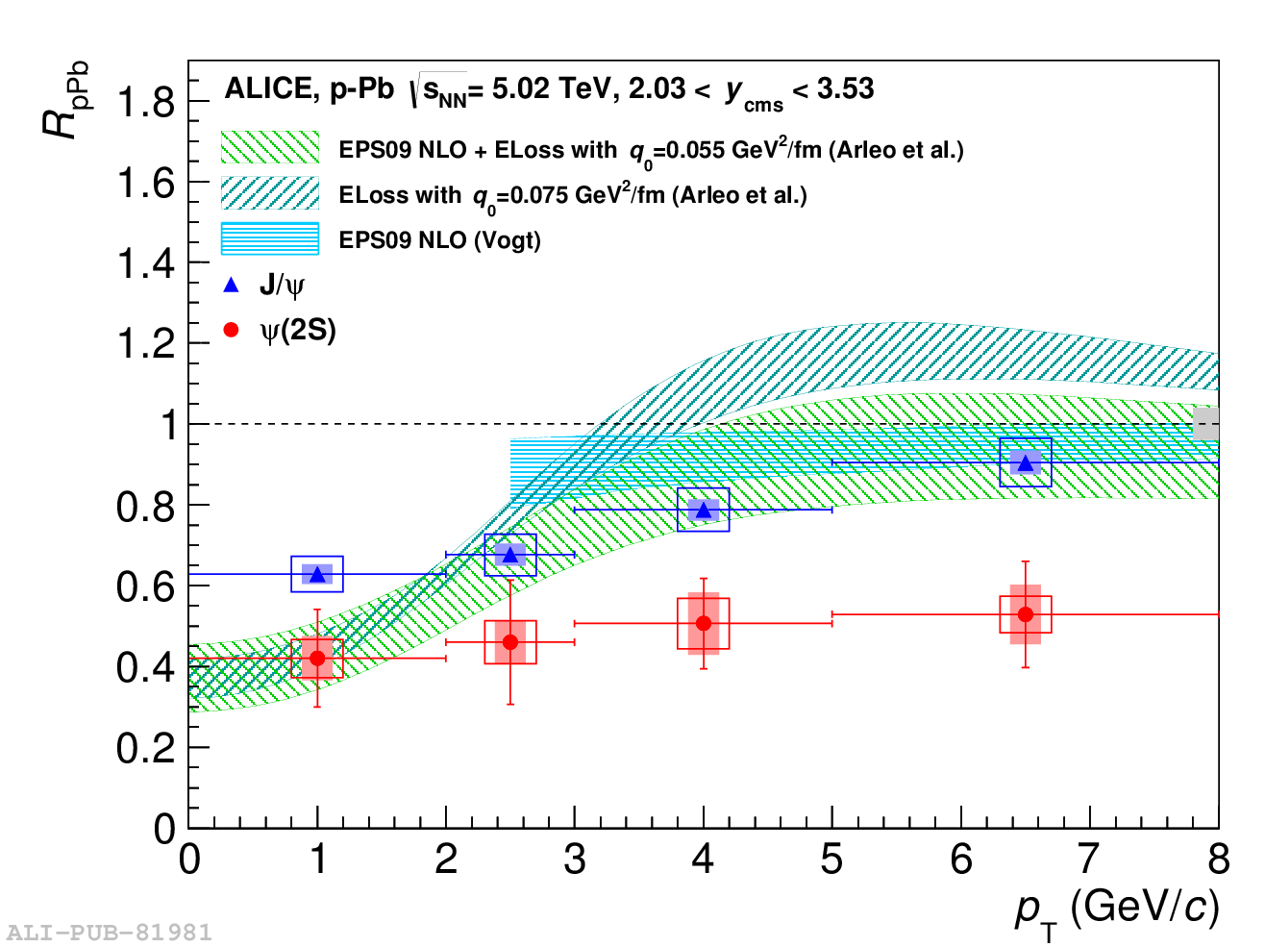
ψ(2S) R_{pPb} vs p_{T}
The p_{T}-dependence of the R_{pPb} is also investigated
NEW
arXiv:1405.3796
arXiv:1405.3796
As already observed for the p_{T}-integrated results, ψ(2S) is more suppressed than the J/ψ
Theoretical models are in fair agreement with the J/ψ, but clearly overestimate the ψ(2S) results

Slide 58
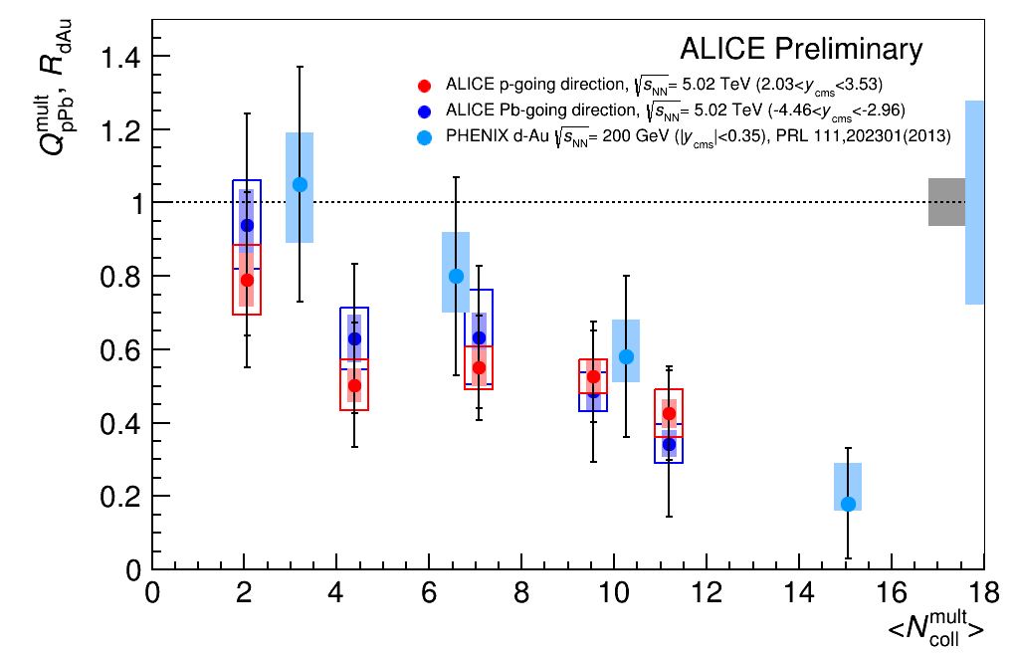
ψ(2S) Q_{pPb} vs event activity
The ψ(2S) Q_{pA} is evaluated as a function of the event activity
NEW
Q_{pA} ≠ R_{pA} due to potential bias from the centrality estimator, which are not related to nuclear effects
with
Rather similar ψ(2S) increasing suppression with N_{coll} for both ALICE and PHENIX results

Slide 59
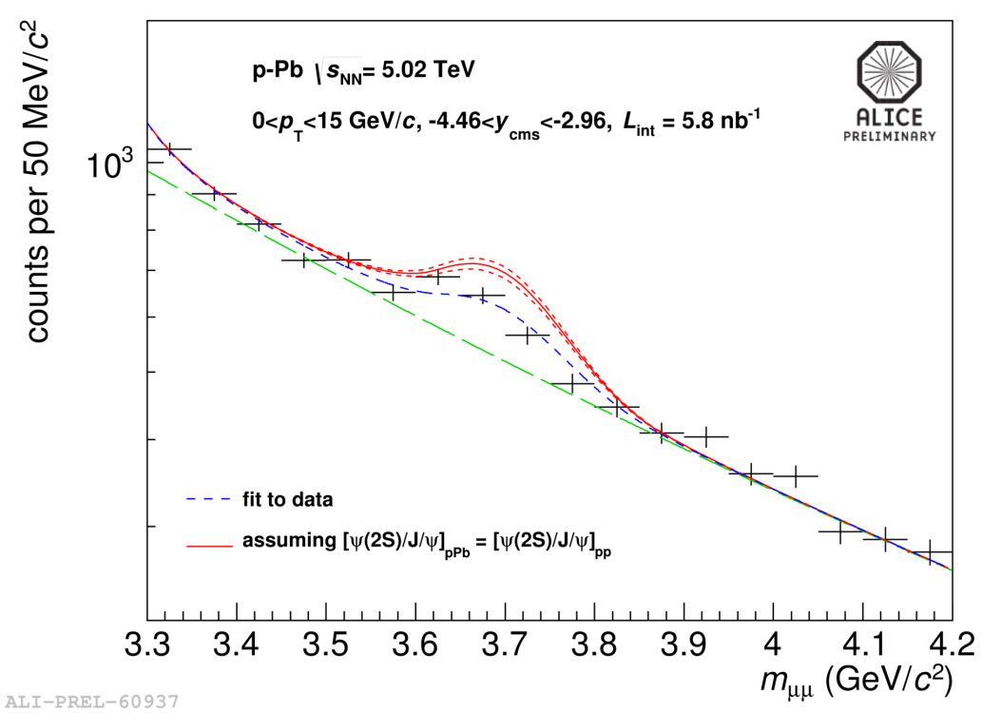
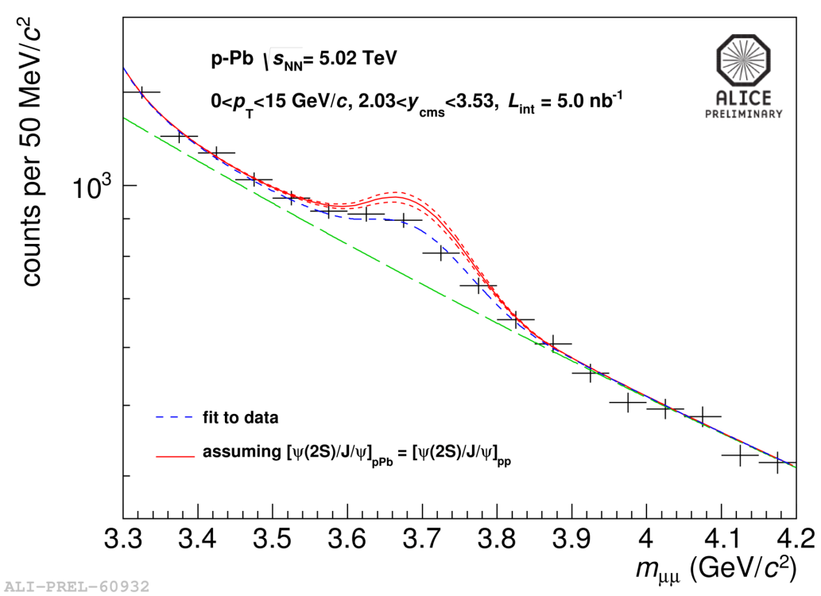
ψ(2S)/J/ψ vs rapidity
A strong decrease of the ψ(2S) production in p-Pb, relative to J/ψ, is observed with respect to the pp measurement (2.5<y_{cms}<4, √s=7TeV)
Pb-going direction
p-going direction
59
ALICE Coll., arXiv:1403.3648
B. Paul’s poster
Notes:
Several uncertainties cancel or are reduced when studying the ratio

Slide 60
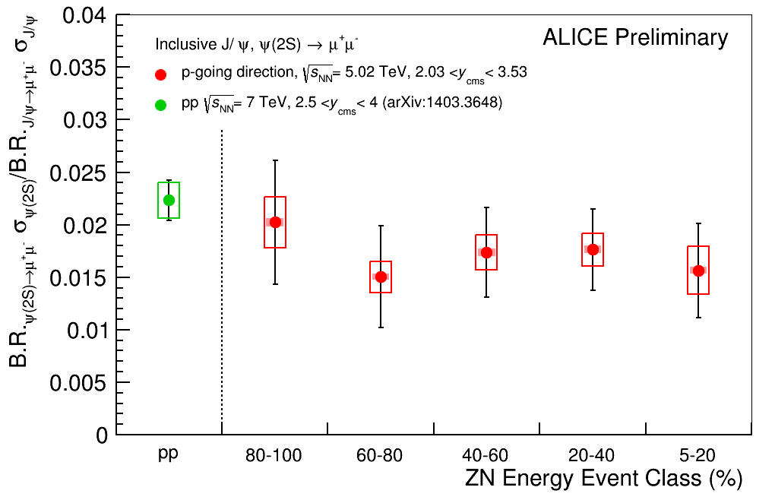
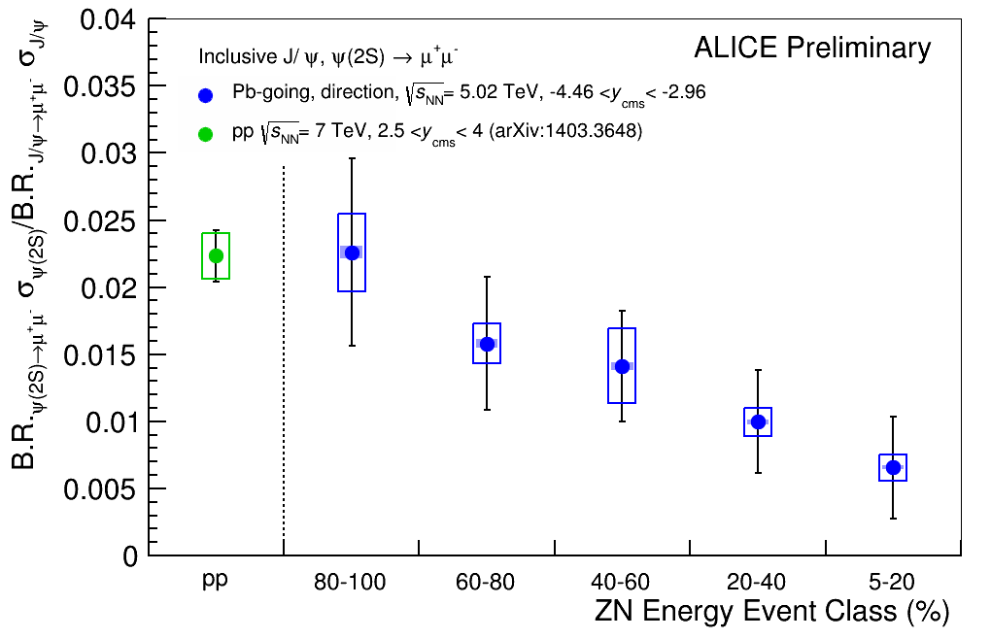
ψ(2S)/J/ψ vs event activity

Slide 61
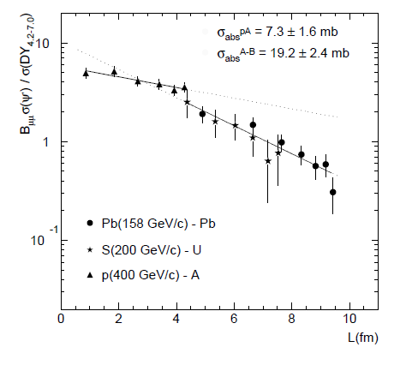
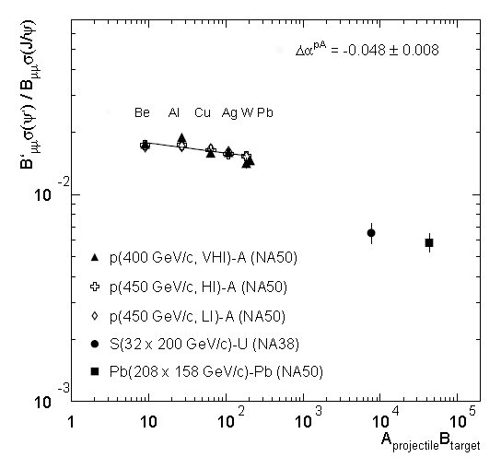
ψ(2S) production in PbPb collisions at SPS
NA50 Collab., Eur. Phys. J. C49 (2007) 559

Slide 62
ψ(2S) Q_{pPb} vs event activity
The ψ(2S) Q_{pA} is evaluated as a function of the event activity
NEW
Clear ψ(2S) suppression, increasing with event activity, both in p-Pb and Pb-p collisions
Rather similar ψ(2S) suppression at both forward and backward rapidities
Notes:
Dire che QpA e’ diverso da RpA quando siamo in bins di centralita’. QpA is a nuclear modification factor with a potential bias…

Slide 63
A×ε and systematic uncertainties
Acceptance x efficiency
computed with a pure signal MC simulation assuming unpolarized ψ(2S) production
<Acc x eff>_{pPb} ~ 0.270 ± 0.014
<Acc x eff>_{Pbp} ~ 0.184 ± 0.013
Systematic uncertainties
Global uncertainties
T_{pA} (Glauber) | 3.4%
σ_{pp}^{J/ψ} | 7.5%
ψ(2S) / J/ψ |_{pp} | 7.5%
list of all systematic sources related to ψ(2S) analyses (sources may depend on the specific ψ(2S) result under study)
Uncorrelated uncertainties
 | p-Pb | Pb-p
J/ψ signal extr. | 2% | 2%
J/ψ MC input | 1.5% | 1.5%
ψ(2S) signal extr. | 8-14% | 9-20%
ψ(2S) MC input | 1.5% | 2.5%
T_{pA} | 3.6(1.5-9.5%) | 3.6(1.5-9.5%)
Normalization | 1% | 1%
Partially Correlated uncertainties
 | p-Pb | Pb-p
Pile-up | 2% | 2%
Muon trigger | 2.8% | 3.2%
Muon tracking | 4% | 6%
Muon matching | 1% | 1%
pp kinematic range cor. | 8% | 8%

