Slide 1
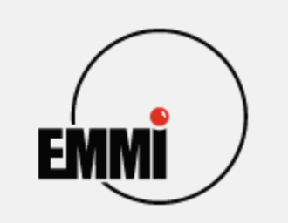
EMMI Rapid Reaction Task Force (RRTF)
Impact of Vector Mesons on the studies of the 3D structure of the nucleon
Unlike standard conferences or workshops, an RRTF is a small, specialized working group with specific blueprint:
Targeted Objective: It is convened "rapidly" when an urgent scientific question arises.
Restricted Participation: Attendance is by invitation only. It brings together a limited number of experts who are directly working on the specific problem.
Working Format: Instead of a long schedule of standard presentations, RRTFs prioritize active collaboration. They feature brief introductory talks followed by extensive round-table discussions and debates.
The Deliverable: The ultimate goal is to produce a concrete output. Within a few months of the meeting, the group publishes a Final RRTF Report or a joint scientific paper that outlines the consensus, resolves the discrepancy, or sets the roadmap for future research.
In short, an EMMI-supported RRTF is essentially a ”think tank" locking a small group of experts in a room for a few days to crack a critical, time-sensitive scientific puzzle.
Fully exploiting vector meson production to map the nucleon's 3D structure requires: a) complex theoretical frameworks that are still highly debated, b) establish systematic ways to analyise the data via multi-differential cross-section and polarization measurements, c) develop robust Monte Carlo simulation frameworks and advanced phenomenological tools for global data extraction, such as neural-network-based fitting and modern amplitude analysis packages.

Slide 2
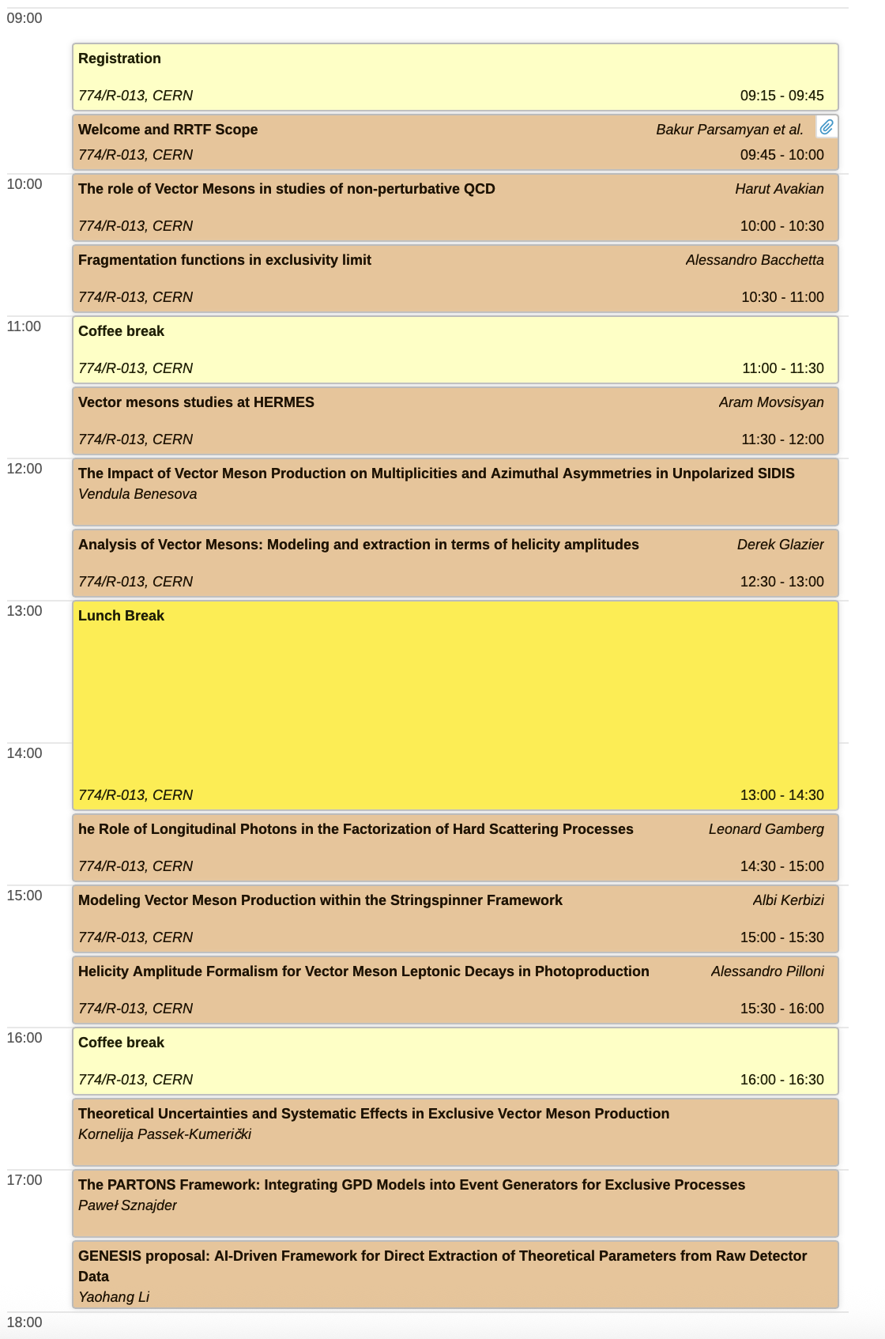
Program
  500 "Glass-box" (CERN
  500 "Glass-box" (CERN
An Open Symposium to set the stage
18:30 Cocktail reception – 500 “Glass Box” CERN

Slide 3
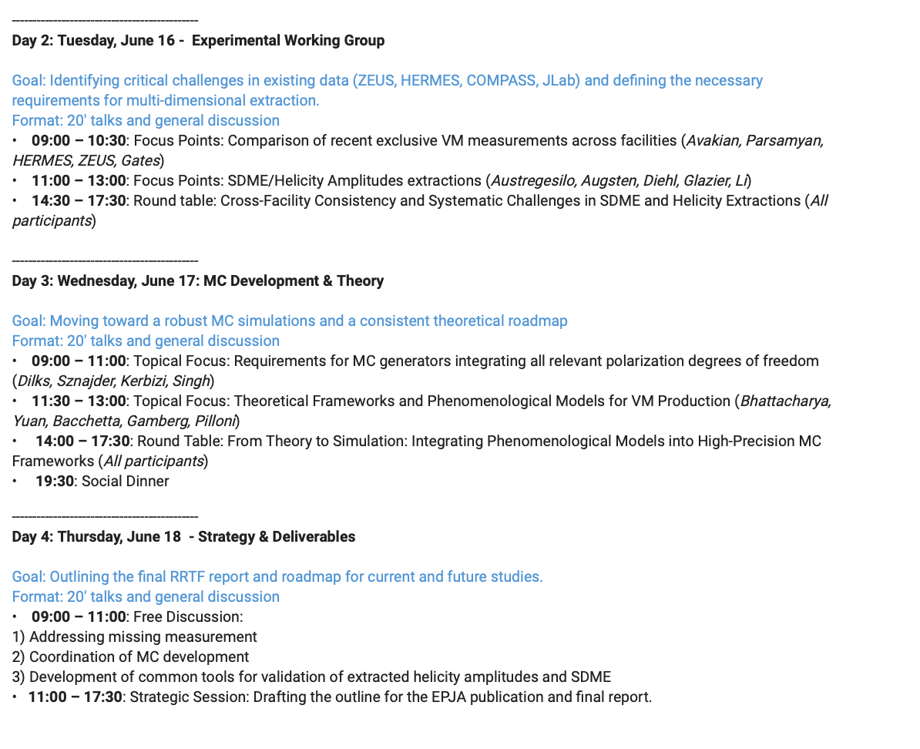
Backup

