Slide 1

AI-Driven Framework for Direct Extraction of Theoretical Parameters from Detector Data
Yaohang Li
Department of Computer Science
Old Dominion University
yaohang@cs.odu.edu
6/15/2026 @ The EMMI Rapid Reaction Task Force: Impact of Vector Mesons on the Studies of the 3D Structure of the Nucleon

Slide 2
Agenda
The Inverse Problem
Generative AI for Inverse Problem
Model-Independent Framework
  Reconstruct Scattering Amplitudes from Pion-Pion Scattering
  Sampling Problem
    QCF Parameterization
  Unfolding Detector Effects
Model-Dependent Framework
  Extraction of Compton Form factors
  Extracting TMDs from SIDIS Data
  Out-of-Domain Problem and An Active Learning Solution
Conclusion

Slide 3
Extracting Physics Properties from Observed Events

Slide 4
The Inverse Problem
The Forward Problem (Normal Problem)
  Use the model parameters to calculate the observables
The Inverse Problem
  Use the results of actual observables to infer the values of the parameters characterizing the system
Challenges
  Ill-posedness
    Different values of the model parameters may be consistent with the observables
  Curse of Dimensionality
    Need to explore a huge, high-dimensional parameter space

Slide 5
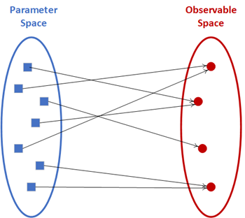
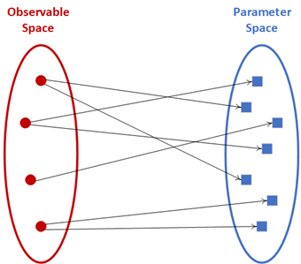



Ill-posedness of Inverse Problems
Forward Mapper
Backward Mapper
well-posed
ill-posed

Slide 6
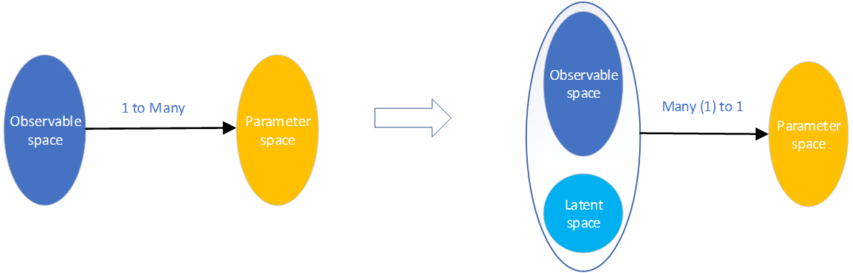
Fundamental Idea
Variational Autoencoder Inverse Mapper
Inverse Problem
VAIM
ill-posed
well-posed

Slide 7
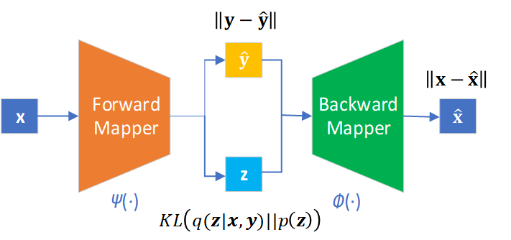
Variational Autoencoder Inverse Mapper Architecture
Variational Autoencoder Inverse Mapper
Predicted Observables
Parameters
Reconstructed Parameters
Latent Variables
Almaeen et al., IJCNN, 2021.

Slide 8
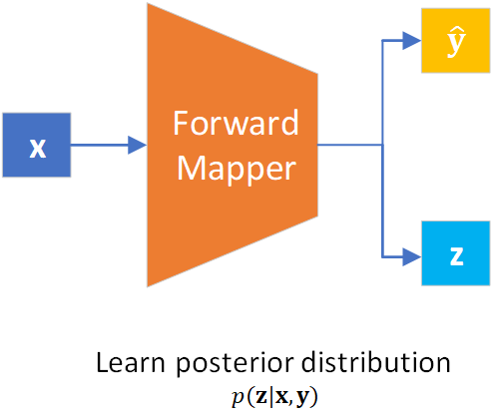
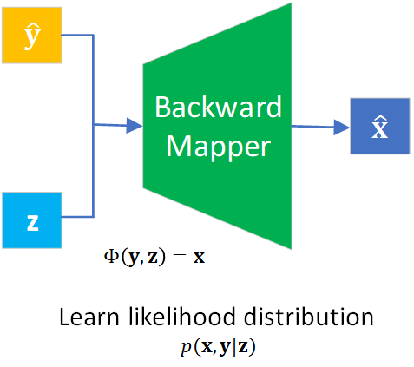

Forward Mapper and Backward Mapper
Almaeen et al., IJCNN, 2021.

Slide 9
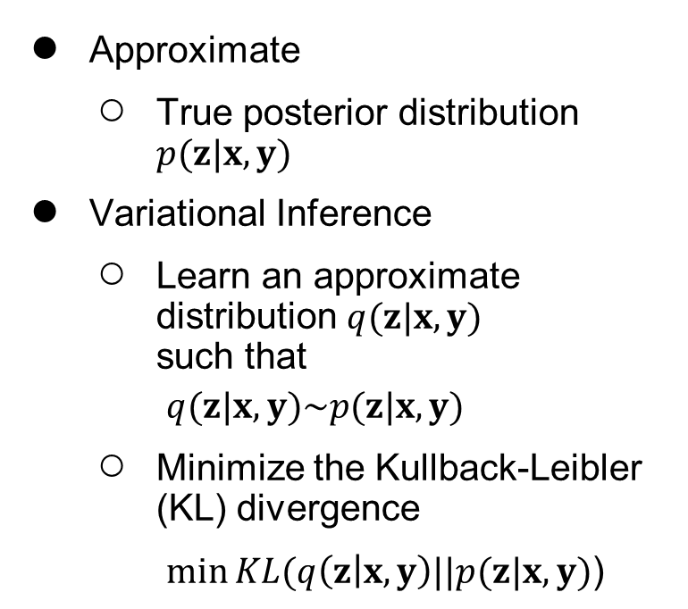
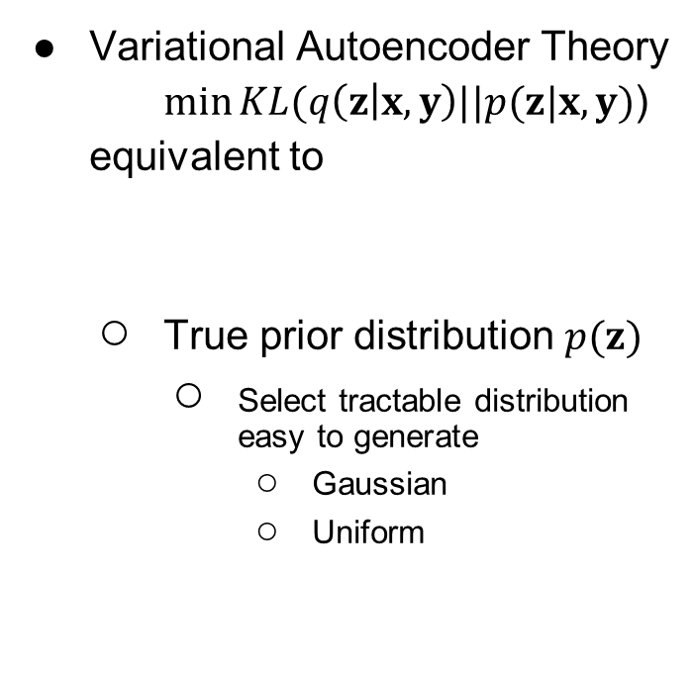
Math behind Variational Autoencoder Inverse Mapper
Approximate
True posterior distribution $p(z|x,y)$
Variational Inference
Learn an approximate distribution $q(z|x, y)$ such that
$q(z|x, y)\sim p(z|x, y)$
Minimize the Kullback-Leibler (KL) divergence
$\min{KL(q\left(z | x, y\right)||p(z|x, y)\text{)}}$
Variational Autoencoder Theory
$\min{KL(q\left(z | x, y\right)||p(z|x, y)\text{)}}$
equivalent to
True prior distribution $p(z)$
  Select tractable distribution easy to generate
  Gaussian
  Uniform
Almaeen et al., IJCNN, 2021.

Slide 10
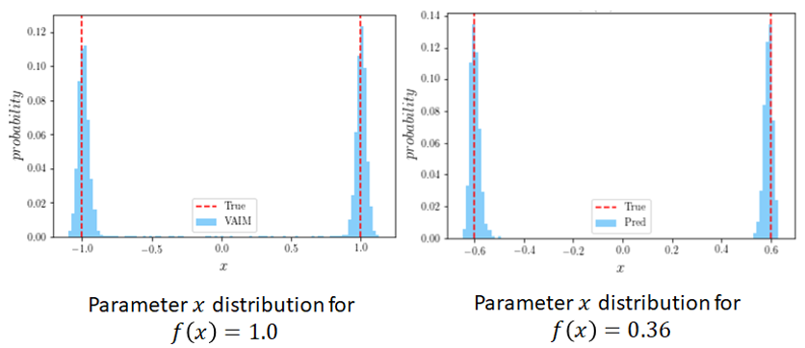
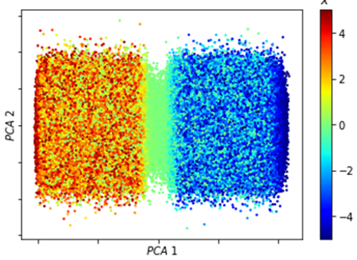
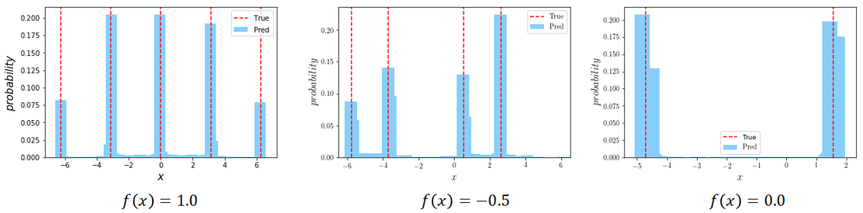
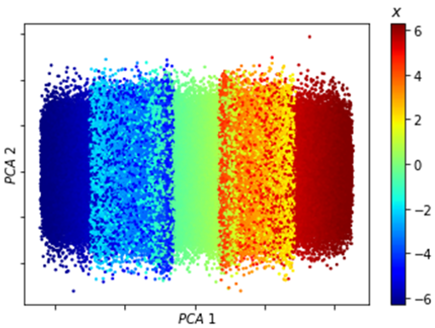
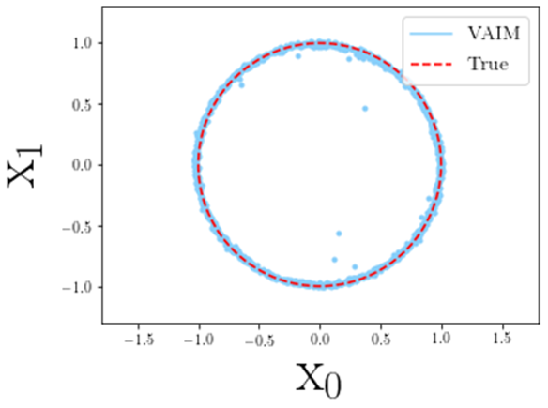
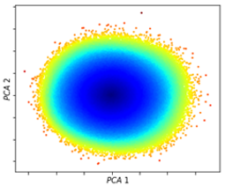
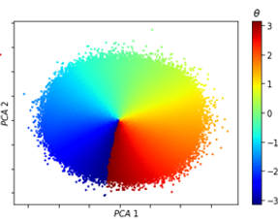
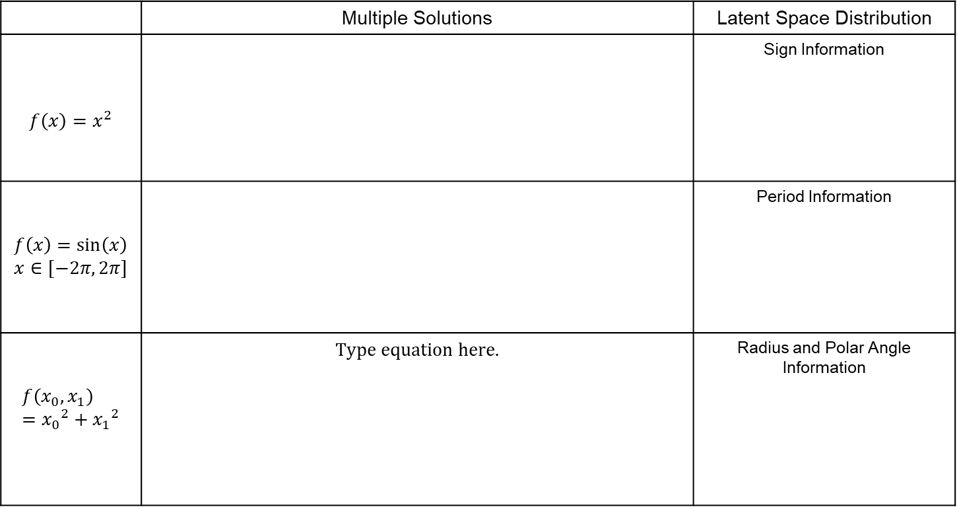

VAIM on Toy Inverse Problems
Almaeen et al., IJCNN, 2021.
 | Multiple Solutions | Latent Space Distribution
$$f\left(x\right)=x^{2}$$ |  | Sign Information
$$f\left(x\right)=\sin\left(x\right)$$ $$x∈[−2π, 2π]$$ |  | Period Information
$$f\left(x_{0}, x_{1}\right)={x_{0}}^{2}+{x_{1}}^{2}$$ |  | Radius and Polar Angle Information
$$f\left(x_{0}, x_{1}\right)=1.0$$

Slide 11
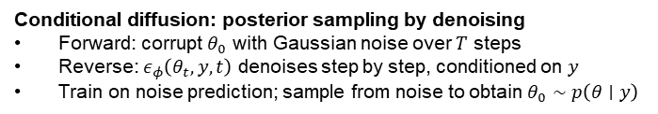
Generative AI for Inverse Problem
Generative Adversarial Networks (GANs)
Variational Autoencoder (VAE)
Normalizing Flow (NF)
Diffusion Models (DM)
Conditional diffusion: posterior sampling by denoising
Forward: corrupt $θ_{0}$ with Gaussian noise over $T$ steps
Reverse: $ε_{φ}\left(θ_{t}, y, t\right)$ denoises step by step, conditioned on $y$
Train on noise prediction; sample from noise to obtain $θ_{0}∼p\left(θ∣y\right)$

Slide 12
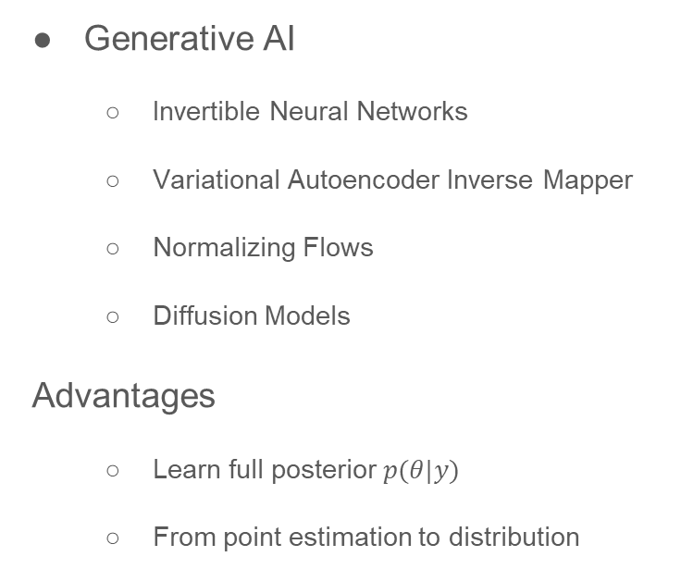
Machine Learning for Inverse Problems
Classical Methods
  Regularization (L2, Sparsity)
  Bayesian Inference
  Optimization-based inversion
Limitations:
  Rely on strong priors
  Application-specific tuning
Generative AI
  Invertible Neural Networks
  Variational Autoencoder Inverse Mapper
  Normalizing Flows
  Diffusion Models
Advantages
  Learn full posterior $p(θ|y)$
  From point estimation to distribution

Slide 13
Agenda
The Inverse Problem
Generative AI for Inverse Problem
Model-Independent Framework
  Reconstruct Scattering Amplitudes from Pion-Pion Scattering
  Sampling Problem
    QCF Parameterization
  Unfolding Detector Effects
Model-Dependent Framework
  Extraction of Compton Form factors
  Extracting TMDs from SIDIS Data
  Out-of-Domain Problem and An Active Learning Solution
Conclusion

Slide 14
A Model-Independent Framework
A GAN-based Workflow

Slide 15
Agenda
The Inverse Problem
Generative AI for Inverse Problem
Model-Independent Framework
  Reconstruct Scattering Amplitudes from Pion-Pion Scattering
  Sampling Problem
    QCF Parameterization
  Unfolding Detector Effects
Model-Dependent Framework
  Extraction of Compton Form factors
  Extracting TMDs from SIDIS Data
  Out-of-Domain Problem and An Active Learning Solution
Conclusion

Slide 16
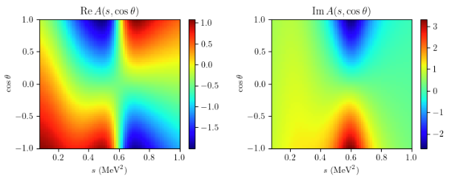
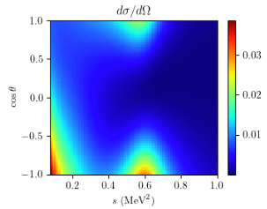
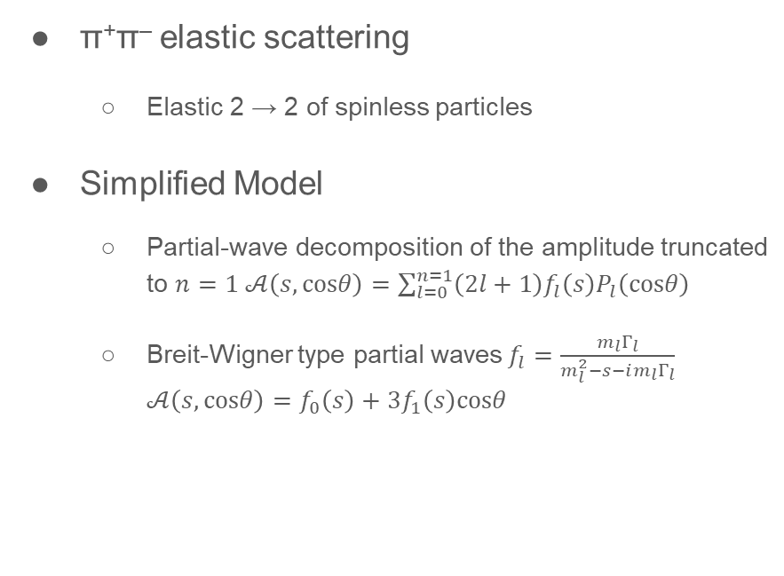

Reconstruct Scattering Amplitudes from Pion-Pion Scattering
π⁺π– elastic scattering
  Elastic 2 → 2 of spinless particles
Simplified Model
  Partial-wave decomposition of the amplitude truncated to $n=1$ $𝒜\left(s, cosθ\right)=\sum_{l=0}^{n=1}{\left(2l+1\right)f_{l}\left(s\right)P_{l}\left(cosθ\right)}$
  Breit-Wigner type partial waves$f_{l}=\frac{m_{l}Γ_{l}}{m_{l}^{2}−s−im_{l}Γ_{l}}$ $𝒜\left(s, cosθ\right)=f_{0}\left(s\right)+3f_{1}\left(s\right)cosθ$
Collaboration with Gloria Montaña, Adam Szczepaniakj, Marco Battaglieri, Alessandro Pilloni, Jitao Xu, Derek Glazier, and others in AIDAPT Collaboration
  Differential cross section
  $${\left.\frac{dσ}{dΩ}\right|}_{data}\frac{dσ}{dΩ}=\frac{1}{64π^{2}}\frac{1}{s}{\left|𝒜\left(s, cosθ\right)\right|}^{2}$$

Slide 17
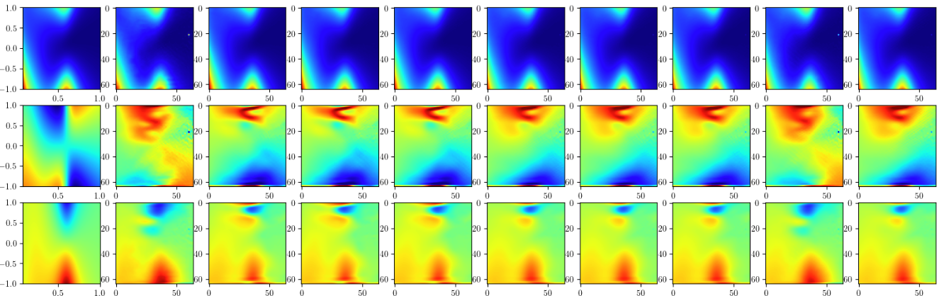
GAN Framework
Preliminary Results
Samples
Truth
1
2
3
4
5
6
7
8
9

Slide 18
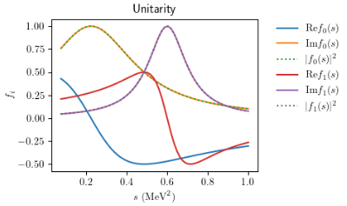

GAN Framework with Physics Constraints
Unitarity Constraint
  Comparing the modulus squared of the integral of the scattering amplitude over angular variables to the imaginary part
Phase Shift Constraint
  The positive derivative of the phase shift
$$ℒ=ℒ_{GAN}+ℒ_{Unitarity}+ℒ_{Phase Shift}$$

Slide 19
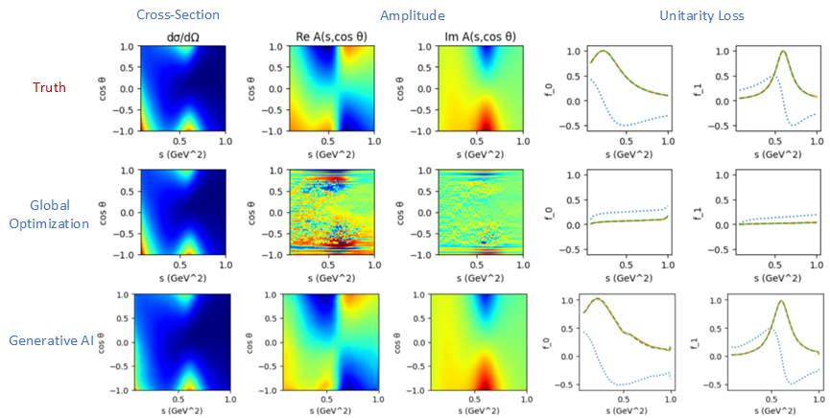
Results (With Unitary Constraints)

Slide 20
Agenda
The Inverse Problem
Generative AI for Inverse Problem
Model-Independent Framework
  Reconstruct Scattering Amplitudes from Pion-Pion Scattering
  Sampling Problem
    QCF Parameterization
  Unfolding Detector Effects
Model-Dependent Framework
  Extraction of Compton Form factors
  Extracting TMDs from SIDIS Data
  Out-of-Domain Problem and An Active Learning Solution
Conclusion

Slide 21
The Issue of Sampling

Slide 22
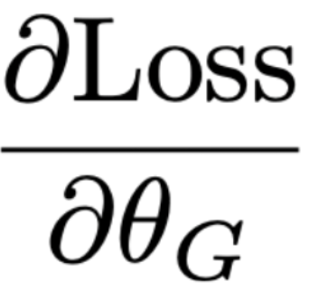
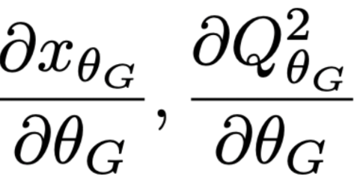
A Critical Obstacle in Backpropagation: Gradient over Sampling
Gradient?

Slide 23
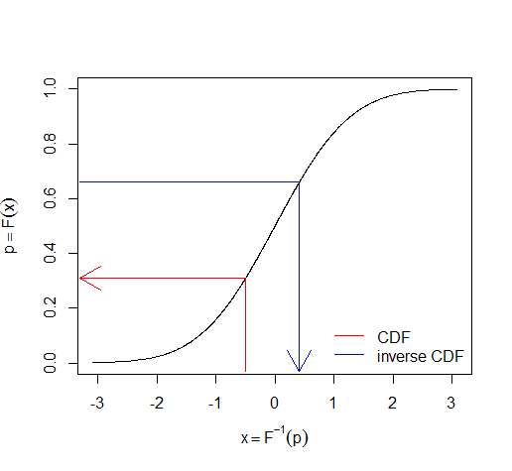
Problems of Classical Sampling Algorithms
Inverse CDF
  Can provide meaningful gradient
  Only works in 1D
Markov Chain Monte Carlo (Gaussian proposal function)
  Random walk
  Can work in higher dimensionality
  No useful gradient

Slide 24
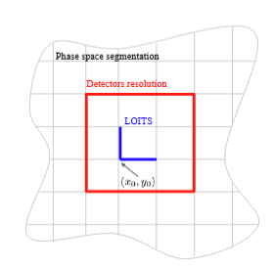
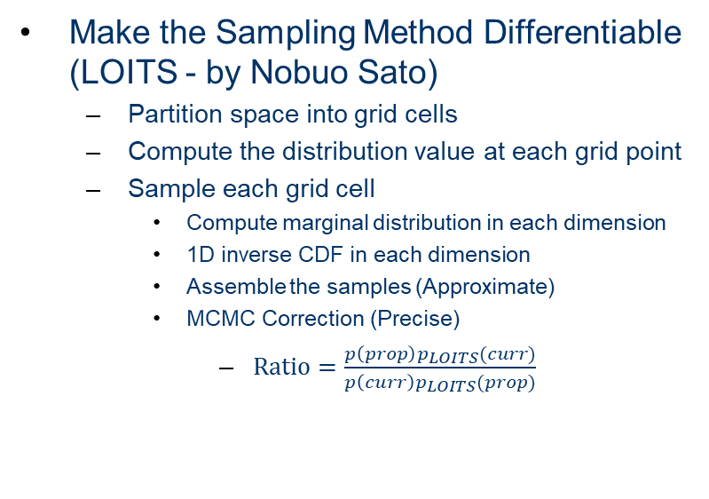
Two Possible Solutions
Build a Surrogate Model
  Neural Network
  Approximate the sampling process
  Differentiable
  Easy to incorporate in the event-based analysis workflow
Make the Sampling Method Differentiable (LOITS - by Nobuo Sato)
  Partition space into grid cells
  Compute the distribution value at each grid point
  Sample each grid cell
    Compute marginal distribution in each dimension
    1D inverse CDF in each dimension
    Assemble the samples (Approximate)
    MCMC Correction (Precise)
      $Ratio=\frac{p\left(prop\right)p_{LOITS}(curr)}{p\left(curr\right)p_{LOITS}(prop)}$
Alghamdi et al., ITCAI, 2025.
Braga et al., arXiv:2507.15768, 2025.

Slide 25
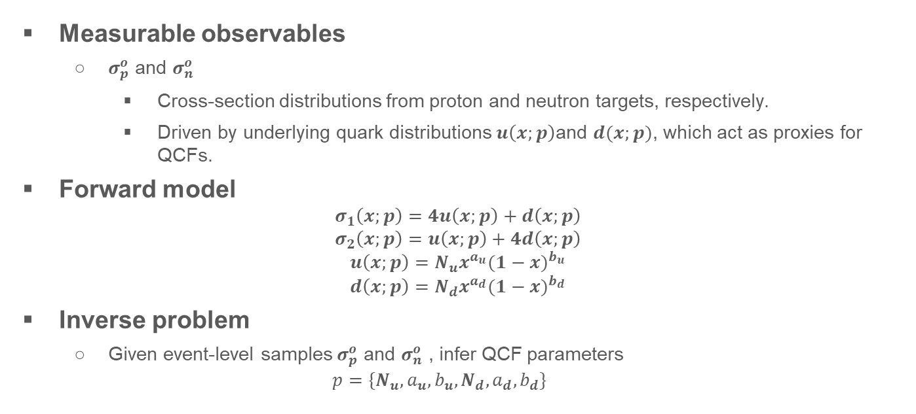
QCF Proxy Model
Measurable observables
  $σ_{p}^{o}$ and $σ_{n}^{o}$
    Cross-section distributions from proton and neutron targets, respectively.
    Driven by underlying quark distributions $u\left(x;p\right)$and $d(x;p)$, which act as proxies for QCFs.
Forward model
$$σ_{1}\left(x;p\right)=4u\left(x;p\right)+d\left(x;p\right)$$
$$σ_{2}\left(x;p\right)=u\left(x;p\right)+4d\left(x;p\right)$$
$${u\left(x;p\right)=N}_{u}x^{a_{u}}{(1−x)}^{b_{u}}$$
$${d\left(x;p\right)=N}_{d}x^{a_{d}}{(1−x)}^{b_{d}}$$
Inverse problem
  Given event-level samples $σ_{p}^{o}$ and $σ_{n}^{o}$ , infer QCF parameters
  $$p=\{N_{u},a_{u},b_{u},N_{d},a_{d},b_{d}\}$$
Alghamdi et al., ITCAI, 2025.

Slide 26
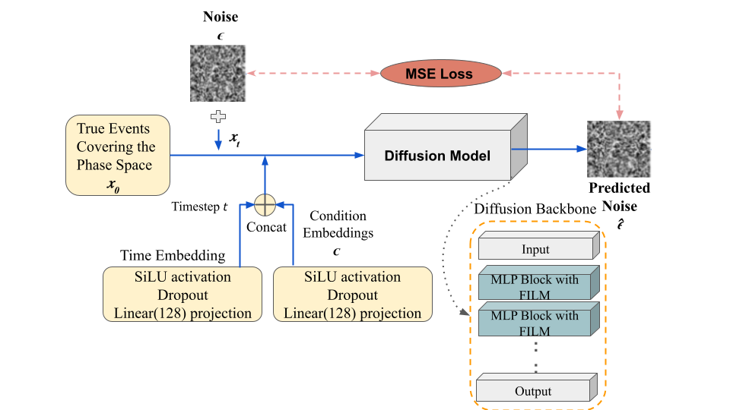
Surrogate for Sampling
Conditional Diffusion Model
  Denoising Network
    6 MLP blocks (256 hidden units)
    FiLM (Feature-wise Linear Modulation) conditioning
  Noise schedule
    T = 1,000 steps
    β_{min} = 10⁻⁴
    β_{max} = 0.02
  Training
    MSE loss between predicted and true noise
    Trained on 20M parameter-event pairs
Alghamdi et al., ITCAI, 2025.

Slide 27
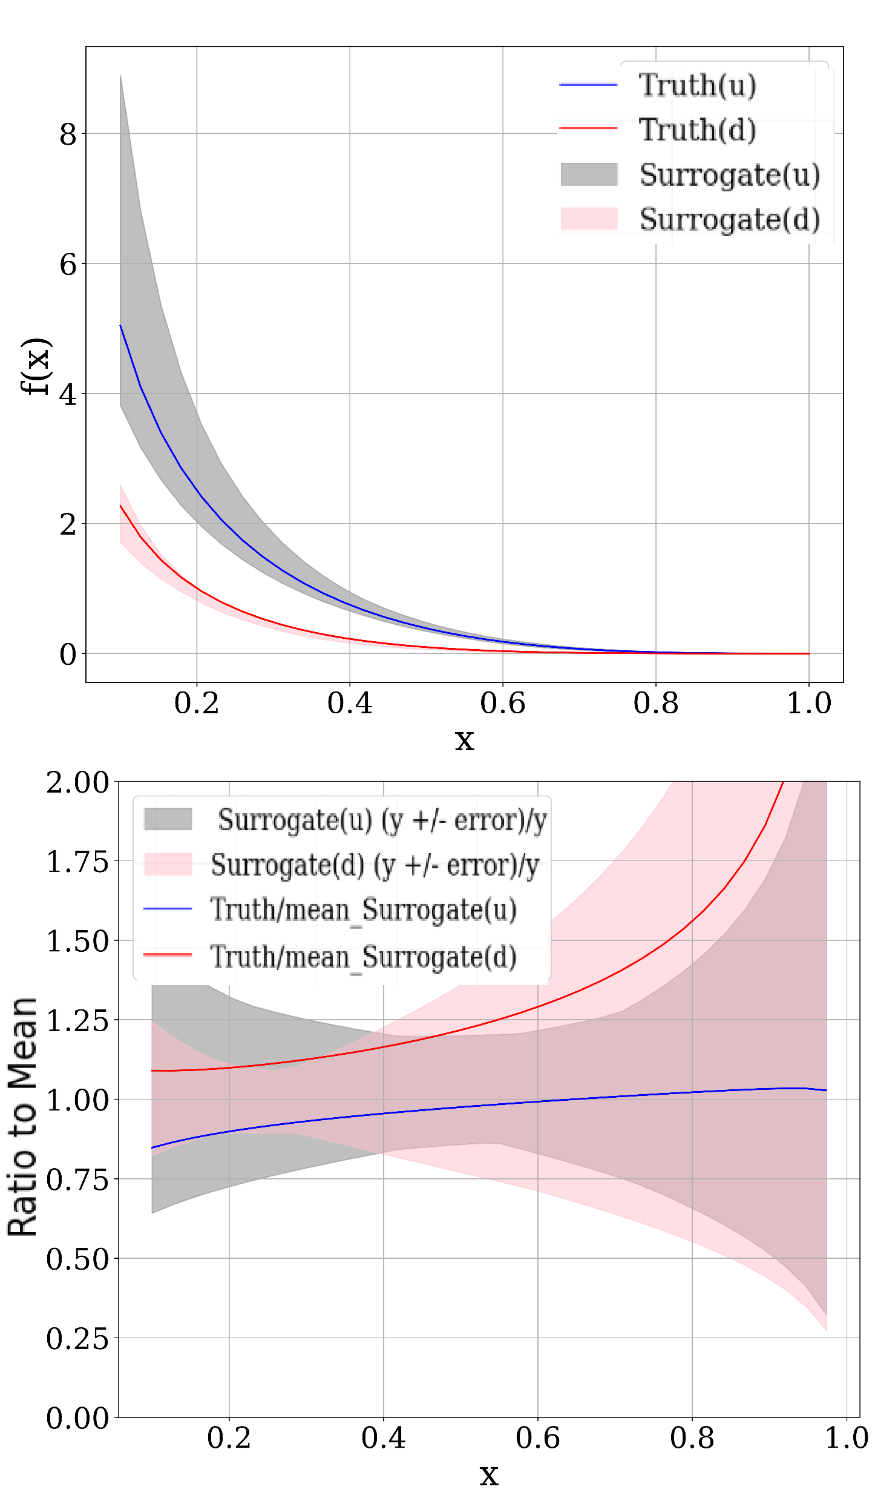
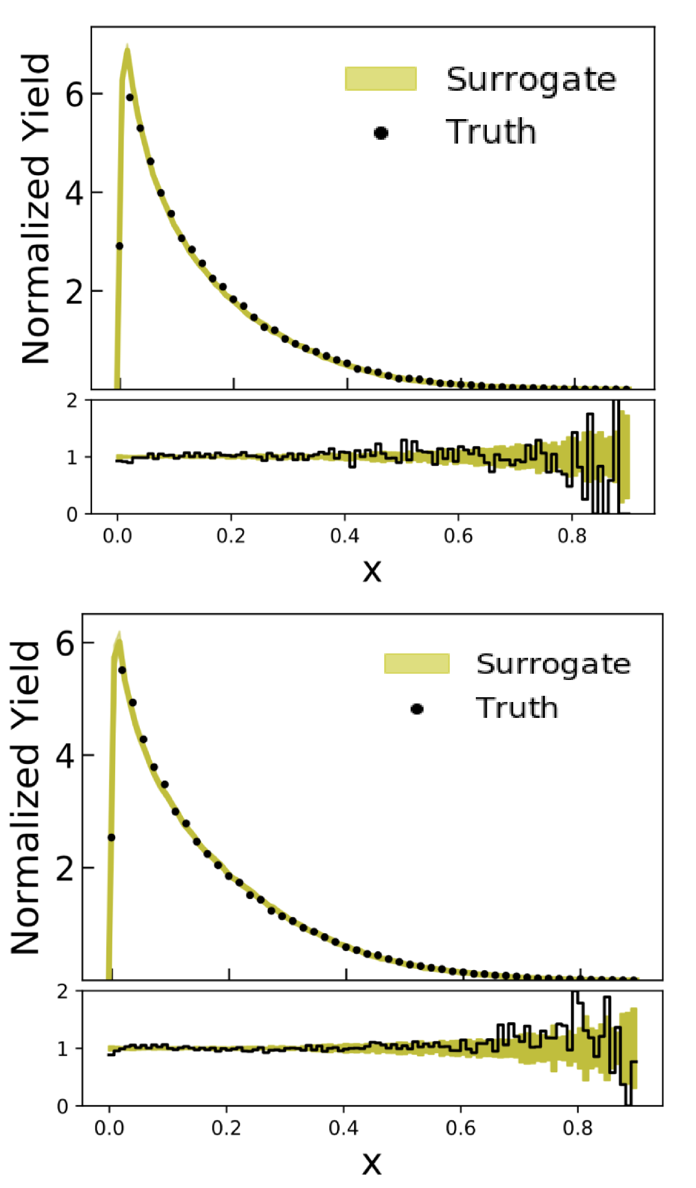
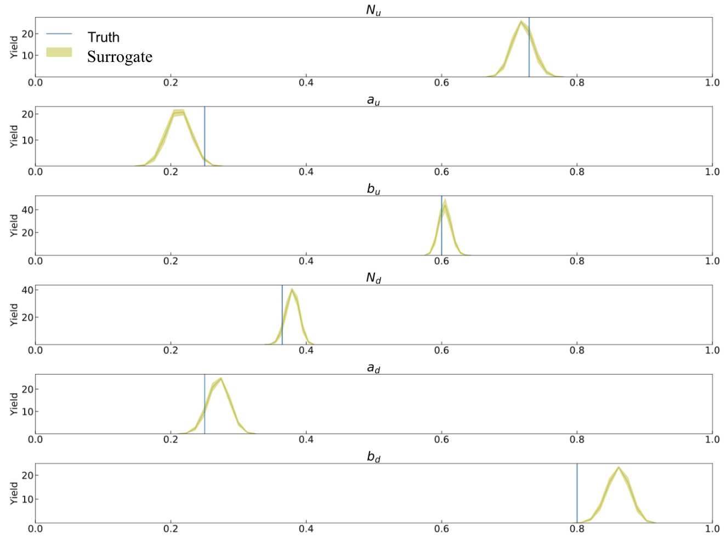
QCF Inference
Reconstructed QCF
Reconstructed Cross-section
QCF Parameters Inference
Alghamdi et al., ITCAI, 2025.

Slide 28
Agenda
The Inverse Problem
Generative AI for Inverse Problem
Model-Independent Framework
  Reconstruct Scattering Amplitudes from Pion-Pion Scattering
  Sampling Problem
    QCF Parameterization
  Unfolding Detector Effects
Model-Dependent Framework
  Extraction of Compton Form factors
  Extracting TMDs from SIDIS Data
  Out-of-Domain Problem and An Active Learning Solution
Conclusion

Slide 29
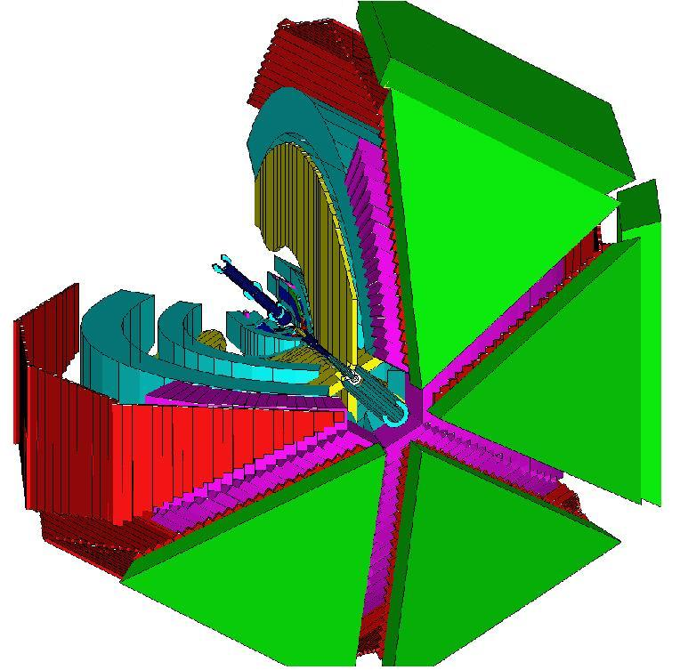
Unfolding Detector Effects
Smearing
  Finite resolution of the detector
  Distortion of measured distribution
Acceptance
  Detector’s inability to cover the full space
  Lost sections of detected distributions
Inefficiency
  Detector’s failure to register certain particles
  Missing data

Slide 30
Unfolding Detector Effects
Image credit to Marco Battaglieri

Slide 31
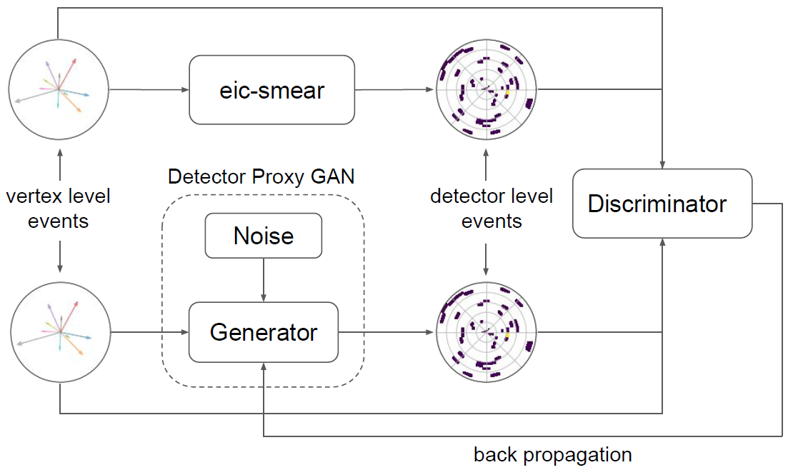
Detector Surrogate
Detector Proxy GAN
  Conditional GAN
  Training samples
    From guessed vertex-level samples and corresponding detector-level samples using a detector simulator
Alanazi et al., Phys. Rev. D 106, 096002, 2022

Slide 32
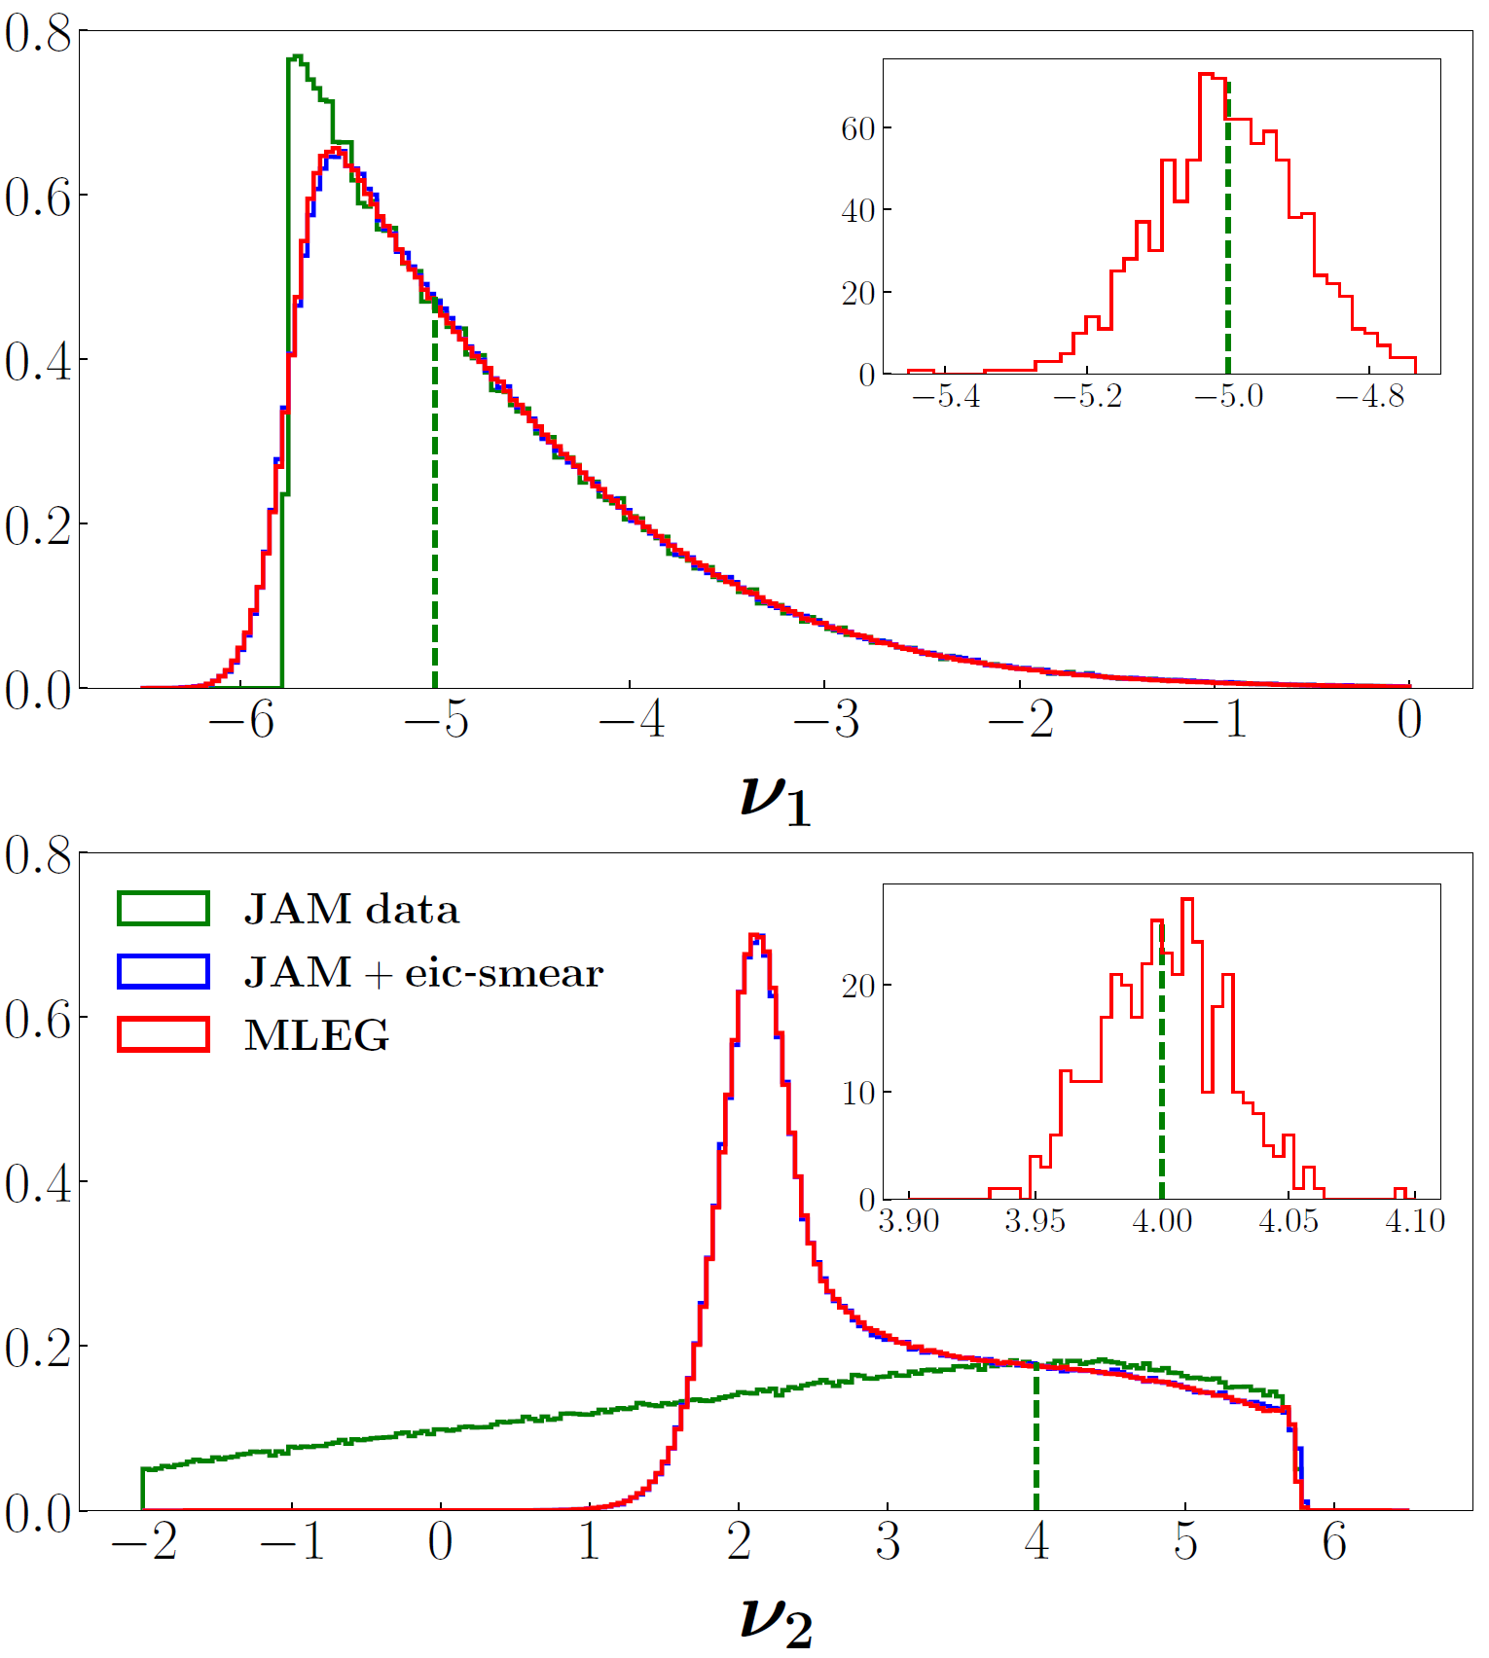
Detector Surrogate for Electron-Proton Scattering
Detector Surrogate
  Conditional GAN Architecture
  Translate vertex-level events to detector level events
  Trained by detector parametrization provided by the eic-smear.
Vertex-level events
  JAM global QCD analysis
Detector-level events
  Simulated by EIC-smear
  Vertex- and detector-level distributions for ν1 and ν2, where significant distortions are observed
Comparison of training features at the vertex level (generated, green histograms) and detector level (smeared, blue histograms) with the MLEG generated synthetic data (red histograms). The insets illustrate the local smearing effect at the points indicated by the green vertical dashed lines.
Alanazi et al., Phys. Rev. D 106, 096002, 2022

Slide 33
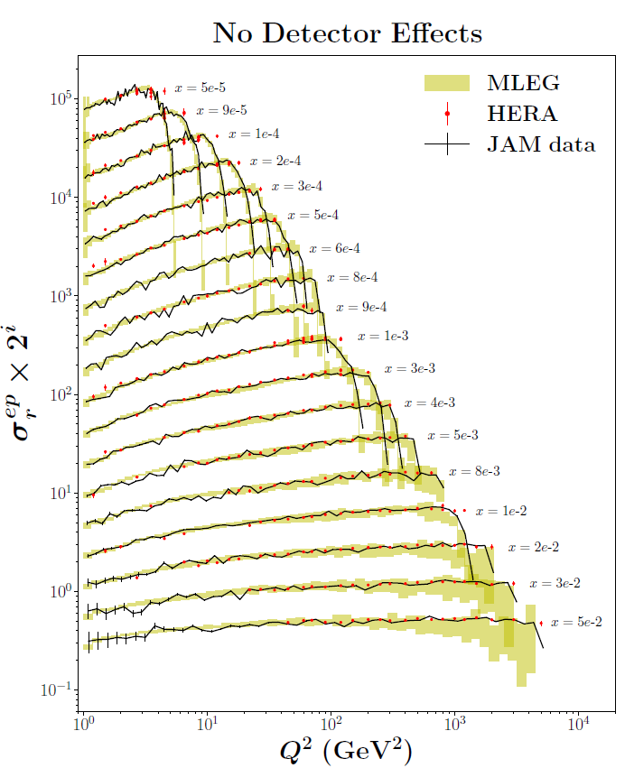
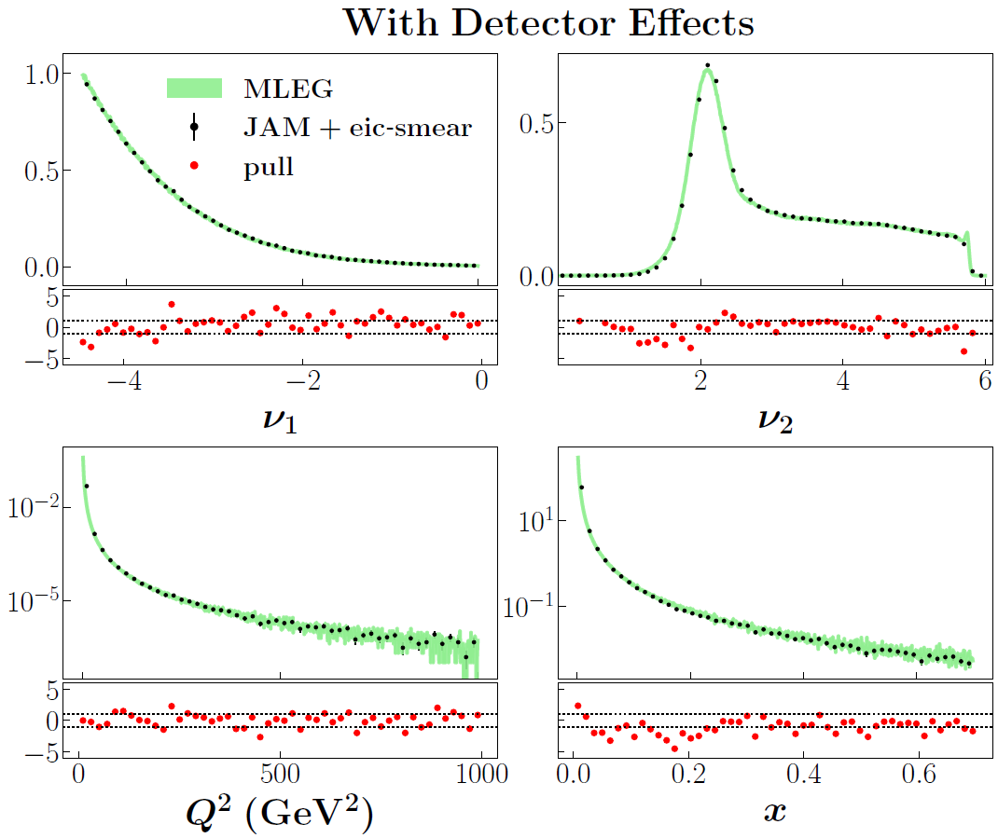
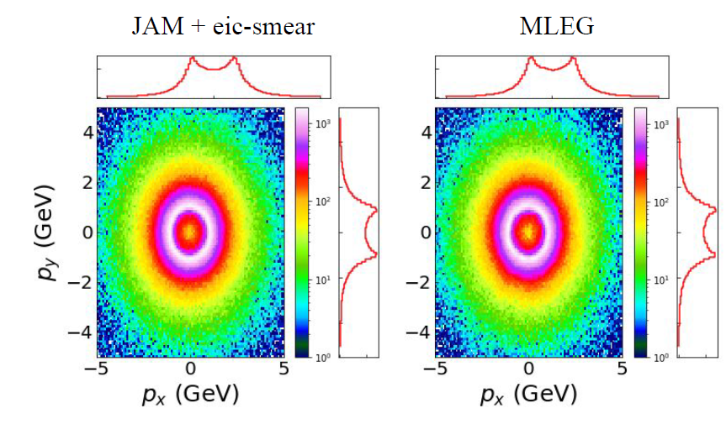
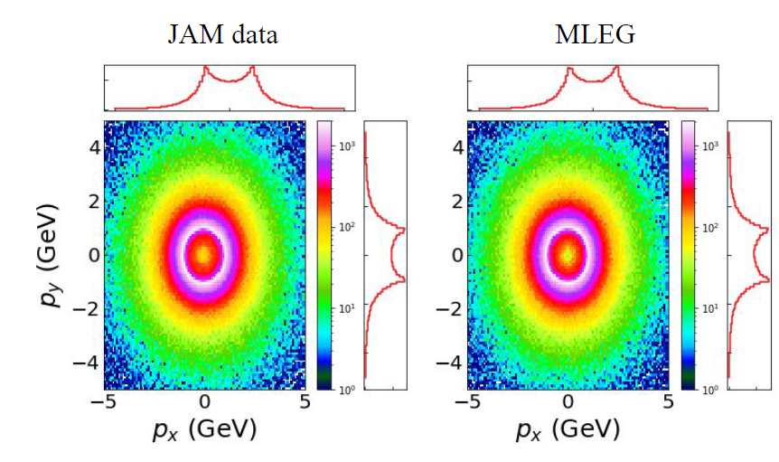
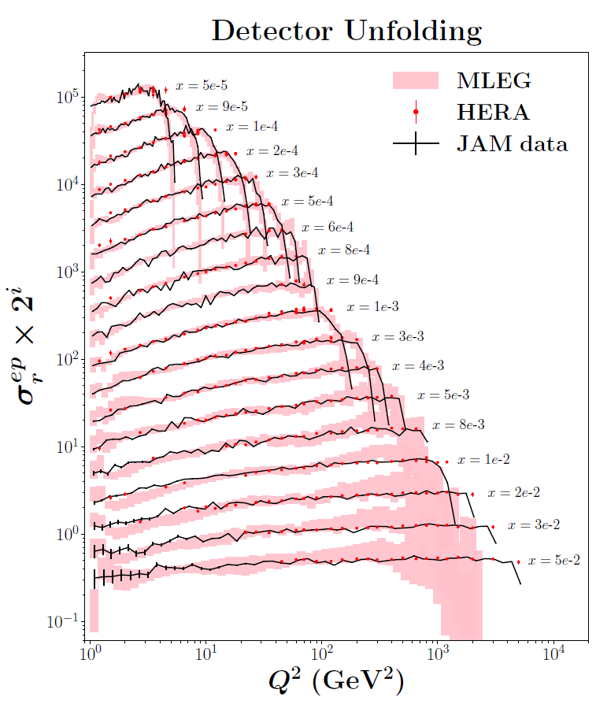
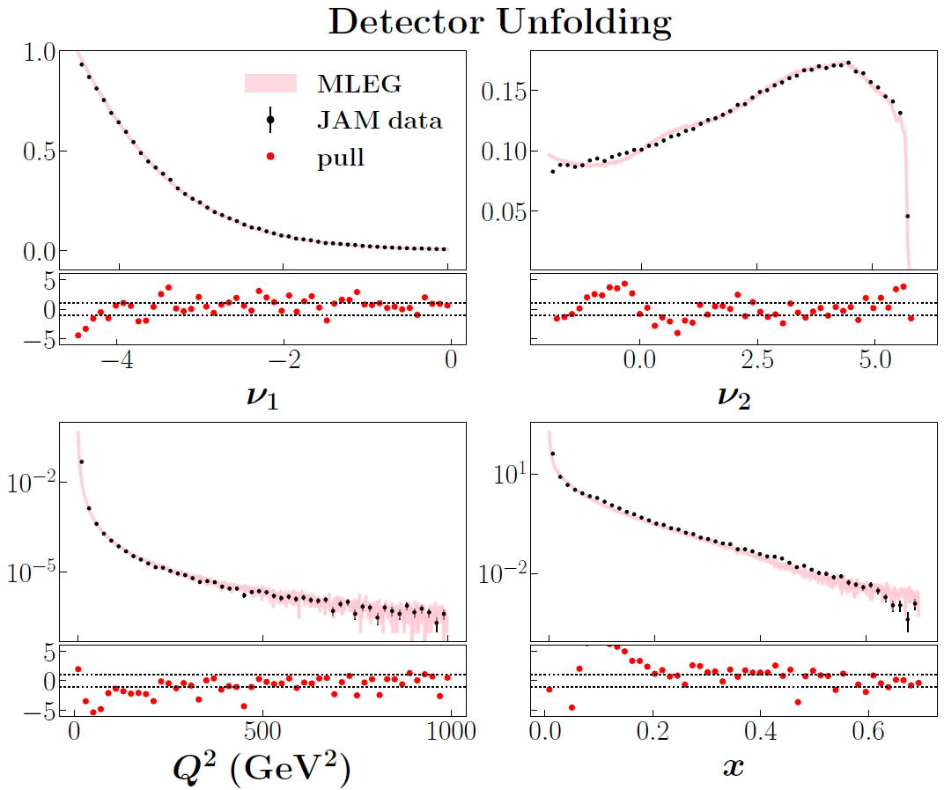
Unfolding Results
HERA
Alanazi et al., Phys. Rev. D 106, 096002, 2022

Slide 34
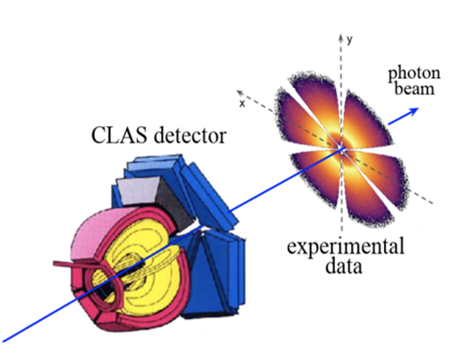
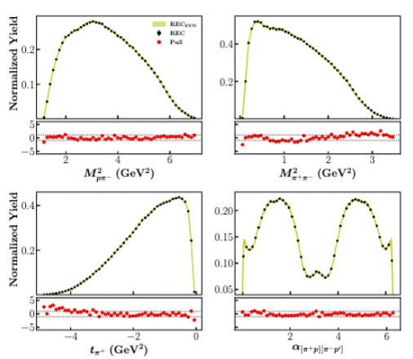
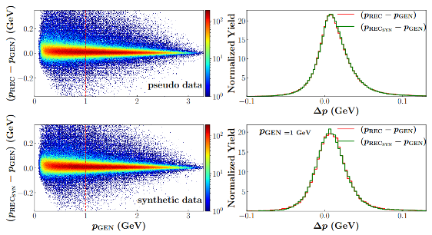
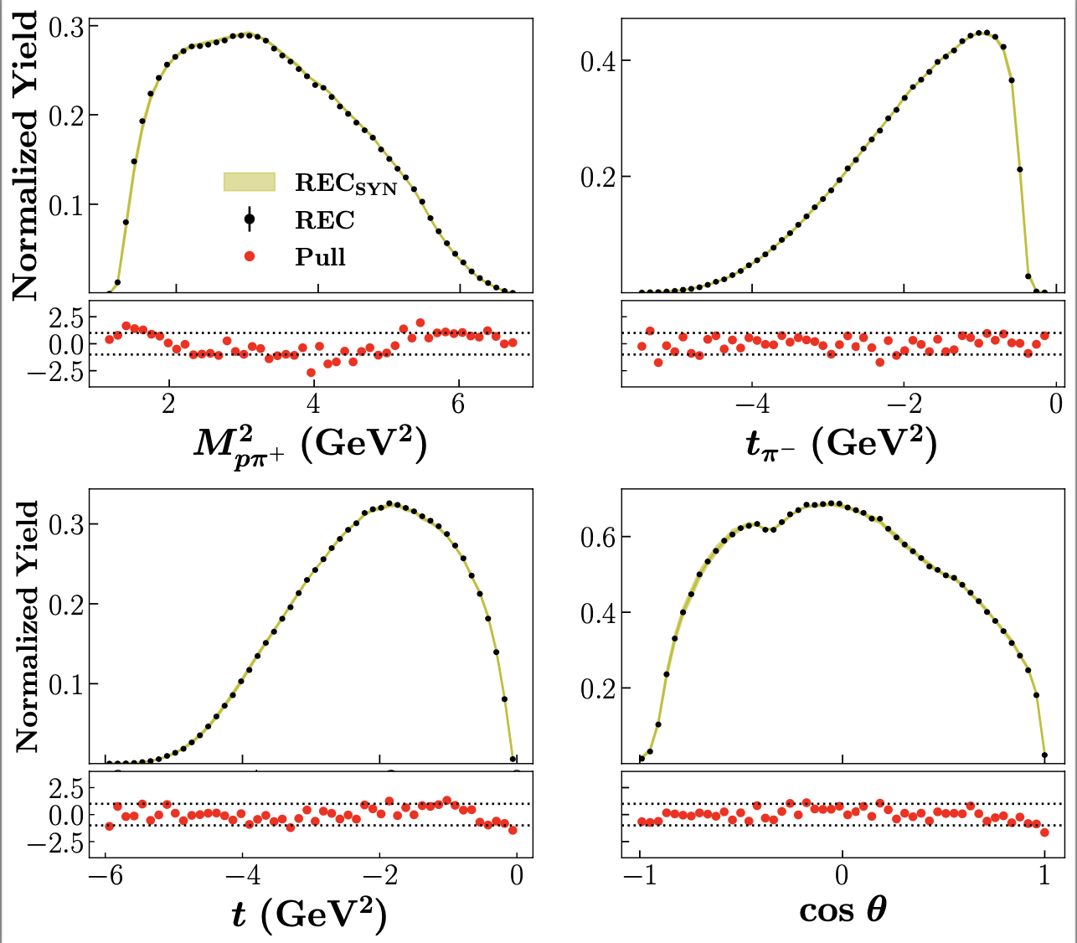
Detector Effect for CLAS Exclusive 2π photoproduction
Detector Simulation GAN (DS-GAN): Simulate the smearing detector effects
MC-Phase Space Events
Vertex-level
DS-GAN
Detector-level
MC REC events vs DS-GAN synthetic events
CLAS Resolution
Derived Variables (not used in training)
Alghamdi et al., Phys. Rev. D 108, 094030, 2023

Slide 35
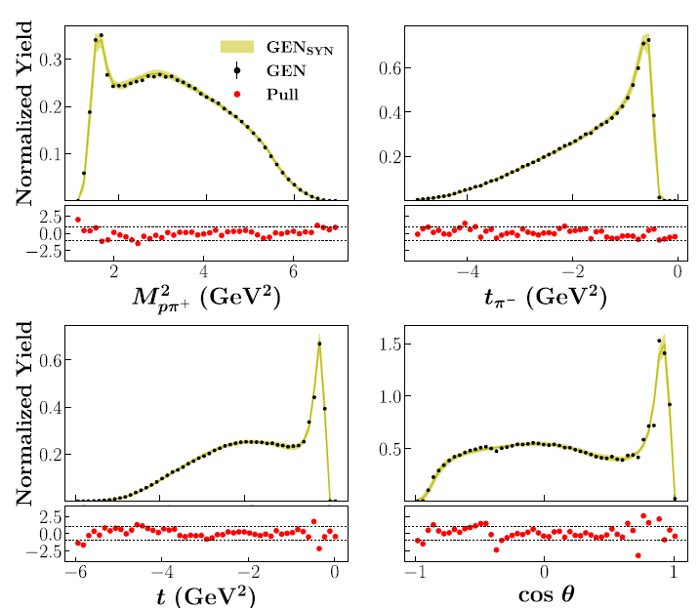
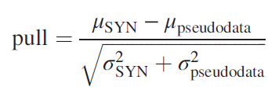



Unfolding Detector Effect for CLAS Exclusive 2π photoproduction
Derived Variables
Unfolding GAN (UNF-GAN): Reconstruct the vertex-level events.
    MC-Realistic Events
Vertex-level
UNF-GAN
Detector-level
CM Frame
RE-MC GEN
events
UNF-GAN SYN
events
2D Pull
Alghamdi et al., Phys. Rev. D 108, 094030, 2023
Lab Frame

Slide 36







GAN Architecture for Acceptance Unfolding
Key Feature: a custom, physics-informed penalty term in the generator loss
  Penalize discrepancies between generated and true unmeasured topology event distributions.
Entire Phase Space
Unmeasured topology
Entire Phase Space
Alghamdi et al., ITCAI, 2024
Measured topology

Slide 37




Generative AI for Multiple Topologies
Build a single ML model to generate in the full phase space
  Combine vertex-level data from different experiments
  Extend as much as possible the measured phase space
  Minimize model dependency
Vittorini et al., GANs towards data smearing and acceptance corrections, in preparation

Slide 38
Agenda
The Inverse Problem
Generative AI for Inverse Problem
Model-Independent Framework
  Reconstruct Scattering Amplitudes from Pion-Pion Scattering
  Sampling Problem
    QCF Parameterization
  Unfolding Detector Effects
Model-Dependent Framework
  Extraction of Compton Form factors
  Extracting TMDs from SIDIS Data
  Out-of-Domain Problem and An Active Learning Solution
Conclusion

Slide 39
A Model-Dependent Framework (End-to-End)

Slide 40


DM for Amplitude Reconstruction
Cross-Section
Truth
Reconstructed
π⁺π– elastic scattering
  Elastic 2 → 2 of spinless particles
Simplified Model
  Partial-wave decomposition of the amplitude truncated to $n=1$ $𝒜\left(s, cosθ\right)=\sum_{l=0}^{n=1}{\left(2l+1\right)f_{l}\left(s\right)P_{l}\left(cosθ\right)}$
  Breit-Wigner type partial waves$f_{l}=\frac{m_{l}Γ_{l}}{m_{l}^{2}−s−im_{l}Γ_{l}}$
  $𝒜\left(s, cosθ\right)=f_{0}\left(s\right)+3f_{1}\left(s\right)cosθ$

Slide 41





Extraction of Compton Form factors
Generalized Parton Distributions (GPDs)
  Multi-dimensional descriptions of proton structure
Deeply virtual exclusive scattering processes
  Golden channel for the extraction of information on partonic 3D dynamics in the nucleon
Compton Form Factors (CFFs)
  2D Slices of GPDs
  Measured in DVCS
  Contain potentially new information on hadronic structure
Extraction of 8 CFFs from a single polarization observable
  An inverse problem of extracting 8 unknowns from a single equation: $Re\left(H\right),Im\left(H\right),Re\left(\tilde{H}\right),Im\left(\tilde{H}\right),Re\left(E\right),Im\left(E\right),Re\left(\tilde{E}\right),Im\left(\tilde{E}\right)$
  Quantification of information extracted from experiments
Training Data:
  Kinematics values
  Generate uniformly distributed CFFs
    $ReH∈\left[−4, 4\right]$
    $ReE∈\left[−4, 4\right]$
    $Re\tilde{H}∈\left[−10, 10\right]$
    $Re\tilde{E}∈\left[−10, 30\right]$
    $ImH∈\left[−1, 5\right]$
    $ImE∈\left[−1, 5\right]$
    $Im\tilde{H}∈\left[−1, 20\right]$
    $Im\tilde{E}∈\left[−10, 30\right]$
Almaeen et al., EPJC, 2025

Slide 42


Prediction of CFFs
Predicted CFFs from VAIM-CFF
  X_{Bj} = 0.343
  t = -0.172 GeV²
  Q² = 1.820 GeV²
Latent Space Analysis
Almaeen et al., EPJC, 2025

Slide 43

Training C-VAIM on Different Cross-section Formulations
Two Cross-section Formulations
  FemtoNet (UVA)
  BKM (Belitksy, Kirchner, Mueller)
Kinematics
  X_{Bj} = 0.35
  t = 0.172
  Q² = 1.9 GeV²
  Eb = 5.75 GeV
Almaeen et al., EPJC, 2025

Slide 44


Extracting TMDs from SIDIS Data
Infer Transverse Momentum Dependent (TMD) PDFs from experimental data
Input: SIDIS events: $(x, Q^{2}, z, q_{T}, φ)$
Challenge: Inverse problem through a complex physics pipeline
  High dimensional
  Nonlinear transformations
  Limited experimental statistics
Conditional Diffusion for TMD Inference
  Learn $p\left(\text{TMD}∣\text{events}\right)$
  Generates full posterior distribution
Event-to-TMD Pipeline
  Diffusion backbone:
    2D U-Net on TMD images (20×30 grid)
  Conditioning:
    PointNet-style encoder for variable-size event sets
    Transformer → fixed embedding
  Integration:
    Event embedding injected into diffusion steps
J. Xu et al., PAI, 2026

Slide 45



Results
Performance vs Number of Events
$N_{ev}=1,000$:
  Captures shape, high uncertainty
$N_{ev}=10,000$:
  Accurate reconstruction, reduced variance
$N_{ev}=100,000$:
  Near-perfect recovery, very low uncertainty
Uncertainty scales as $∼1/\sqrt{N_{ev}}$
J. Xu et al., PAI, 2026

Slide 46


A Hidden Problem
Out-of-domain Inference
  Training
    Assumption: known parameter domain $Θ_{0}$ ​
  Reality
    True parameters $θ^{∗}$ may be outside of training range ${θ^{∗}∉Θ}_{0}$
  Consequence
    Confident but wrong predictions in diffusion model-based inference
    No built-in warning signals
Active-learning Solution
  Detect Model Failure → Expand domain → Retrain
    Generative AI
      For posterior sampling
    Active learning
      For domain refinement
  Learn correct parameter region even with incomplete priors

Slide 47


Active Learning Loop
Step 3: Uncertainty-triggered domain update. If ${Tr(Σ}_{\tilde{θ}})>τ$, expand domain
$$Θ_{k+1}=Expand(Θ_{k}, \tilde{θ})$$
Generate synthetic samples
$$D_{k+1}=\left\{\left(θ_{j}, ℱ\left(θ_{j}\right)\right):θ_{j}∈Θ_{k+1}\right\}$$
Fine-tune the diffusion model on the augmented dataset $D_{k+1}$.
Step 4: Iteration. Repeat steps 2-3 until ${Tr(Σ}_{\tilde{θ}})≤τ$
The posterior has contracted to a well-supported region containing $θ^{∗}$.
Step 1: Initial guess. Select an initial parameter domain $Θ_{0}$ based on physical guess and generate a dataset on the initial training region
$$D_{0}=\left\{\left(θ_{i}, ℱ\left(θ_{i}\right)\right):θ_{i}∈Θ_{0}\right\}$$
Train the diffusion model on $D_{0}$
Step 2: Inference on target data. Given the control observable $y^{∗}$, perform reverse diffusion to obtain inferred parameter samples
$$\tilde{θ}∼p_{φ}(\tilde{θ}|y^{∗})$$
Compute $Σ_{\tilde{θ}}$

Slide 48



QCF Parameterization
$$In domain predictions$$
Measurable observables
  $σ_{p}^{o}$ and $σ_{n}^{o}$
    Cross-section distributions from proton and neutron targets, respectively.
    Driven by underlying quark distributions $u\left(x;p\right)$and $d(x;p)$, which act as proxies for QCFs.
Forward model
$$σ_{1}\left(x;p\right)=4u\left(x;p\right)+d\left(x;p\right)$$
$$σ_{2}\left(x;p\right)=u\left(x;p\right)+4d\left(x;p\right)$$
$${u\left(x;p\right)=N}_{u}x^{a_{u}}{(1−x)}^{b_{u}}$$
$${d\left(x;p\right)=N}_{d}x^{a_{d}}{(1−x)}^{b_{d}}$$
Inverse problem
  Given event-level samples $σ_{p}^{o}$ and $σ_{n}^{o}$ , infer QCF parameters
  $$p=\{N_{u},a_{u},b_{u},N_{d},a_{d},b_{d}\}$$
J. Xu et al., IJCAI, 2026

Slide 49




Incomplete Prior for QCF Parameterization
$$\text{O}\text{ut}\text{−}\text{of}\text{−}\text{domain} Inferences$$
$$After Active Learning$$
J. Xu et al., IJCAI, 2026

Slide 50

Genesis Proposal: AI-Enabled Inference of Helicity Amplitudes and Spin-Density Matrix Elements in Vector-Meson Production

Slide 51
Summary
Generative AI for Inverse Problem
Model-Independent Framework
  Does not rely on a particular physics model
  Gradient problem
  Detector response unfolding
Model-Dependent Framework
  Need some assumption of a physics model
    Parameterization
  Out-of-Domain Problem
    Active Learning

Slide 52
References
M. Almaeen, Y. Alanazi, N. Sato, W. Melnitchouk, M. P. Kuchera, Y. Li., “Variational Autoencoder Inverse Mapper: An End-to-End Deep Learning Framework for Inverse Problems.” Proceedings of International Joint Conference on Neural Networks (IJCNN2021), 2021.
M. Almaeen, T. Alghamdi, B. Kriesten, D. Adams, Y. Li, H. W. Lin, S. Liuti, “VAIM - CFF: A variational autoencoder inverse mapper solution to Compton form factor extraction from deeply virtual exclusive reactions,” The European Physical Journal C, 85(5): 499, 2025.
T. Alghamdi, J. Xu, N. Ramachandra, N. Sato, Y. Li, “Towards an event-level analysis in hadronic physics using generative AI-based surrogates,” Proceedings of IEEE International Conference on Tools with Artificial Intelligence (ICTAI2025), 2025.
J. Xu, N. Sato, Y. Li, “Active Diffusion-Based Inference for Ill-Posed Inverse Problems under Incomplete Priors,” International Joint Conference on Artificial Intelligence (IJCAI2026), accepted, 2026.
J. Xu, K. Braga, C. Cocuzza, D. Lersch, N. Sato, Y. Li, “Learning Transverse Momentum Distributions fromRaw Scattering Events via Conditional Diffusion,” Proceedings of Conference on Physics and AI (PAI2026), 2026.
K. Braga, M. Diefenthaler, S. Goldenberg, D. Lersch, Y. Li, J. Qiu, K. Rajput, F. Ringer, N. Sato, M. Schram, “Toward an event-level analysis of hadron structure using differential programming,” arXiv:2507.15768, 2025.
T. Alghamdi, Y. Alanazi, M. Battaglieri, Ł. Bibrzycki, A. V. Golda, A. N. Hiller-Blin, E. L. Isupov, Y. Li, L. Marsicano, W. Melnitchouk, V. I. Mokeev, G. Montaña, A. Pilloni, N. Sato, A. P. Szczepaniak, T. Vittorini, “Toward a generative modeling analysis of CLAS exclusive photoproduction,” Physical Review D, 108(9): 094030, 2023.
Y. Alanazi, P. Ambrozewicz, M. Battaglieri, A. N. Hiller-Blin, M. P. Kuchera, Y. Li, T. Liu, R. E. McClellan, W. Melnitchouk, E. Pritchard, M. Robertson, N. Sato, R. Strauss, L. Velasco, “Machine learning-based event generator for electron-proton scattering,” Physical Review D, 106(9): 096002, 2022.

Slide 53





Acknowledgements
DOE SciDAC Program
DOE Research on Artificial Intelligence and Machine Learning Applied to Nuclear Science and Technology Program
Center for Nuclear Femtography (CNF)
A(I)DAPT Collaboration
EXCLAIM Collaboration
QuantOm Collaboration

