Slide 1

The role of Vector Mesons in studies of non-perturbative QCD
Harut Avakian (JLab)
CERN, June 15-19, 2026
Why rho matters?
Description of VMs: Transverse and Longitudinal x-sections
  SDMEs vs Helicity Structure Functions (HSFs)
  Relevance of a detailed MC
Extraction of amplitudes
Validation procedure
Summary

Slide 2
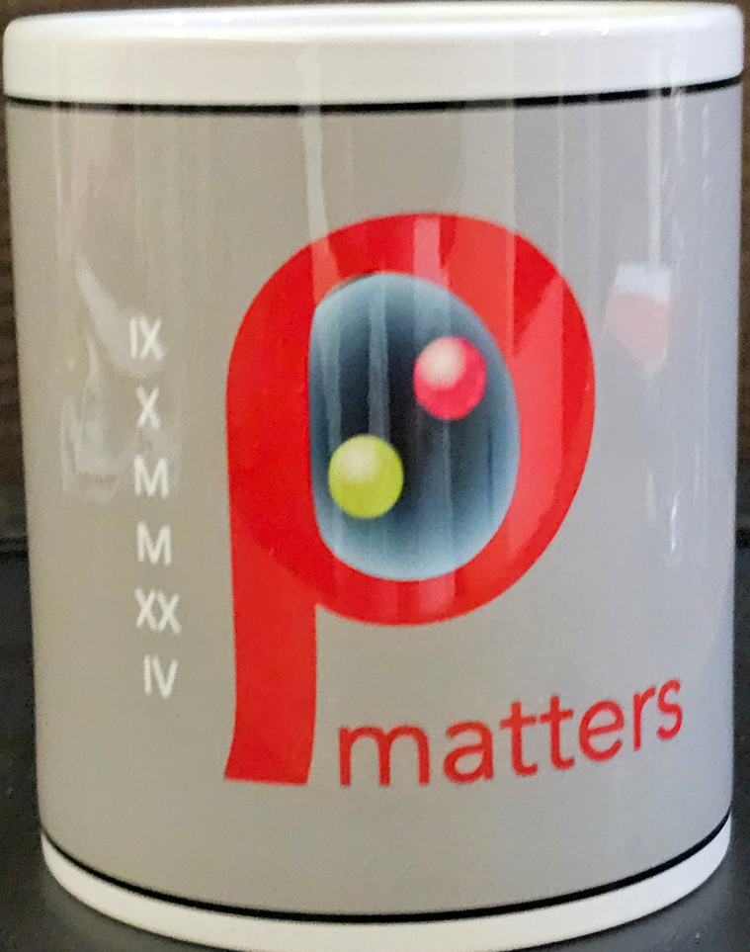
CPHI-2024 Summary
Set a focus group to study exclusive VMs (JLab/HERMES/COMPASS/EIC)
Organize a dedicated workshop
“Exclusive Vector mesons and SIDIS”
Set a CPHI prize for theoretical description of exclusive vector meson observables (SSA/DSA)
Propose EMMI Rapid Reaction Task Force meeting on rho

Slide 3
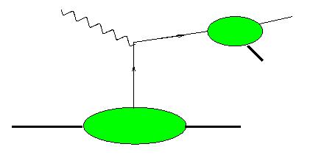
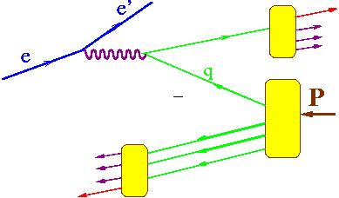
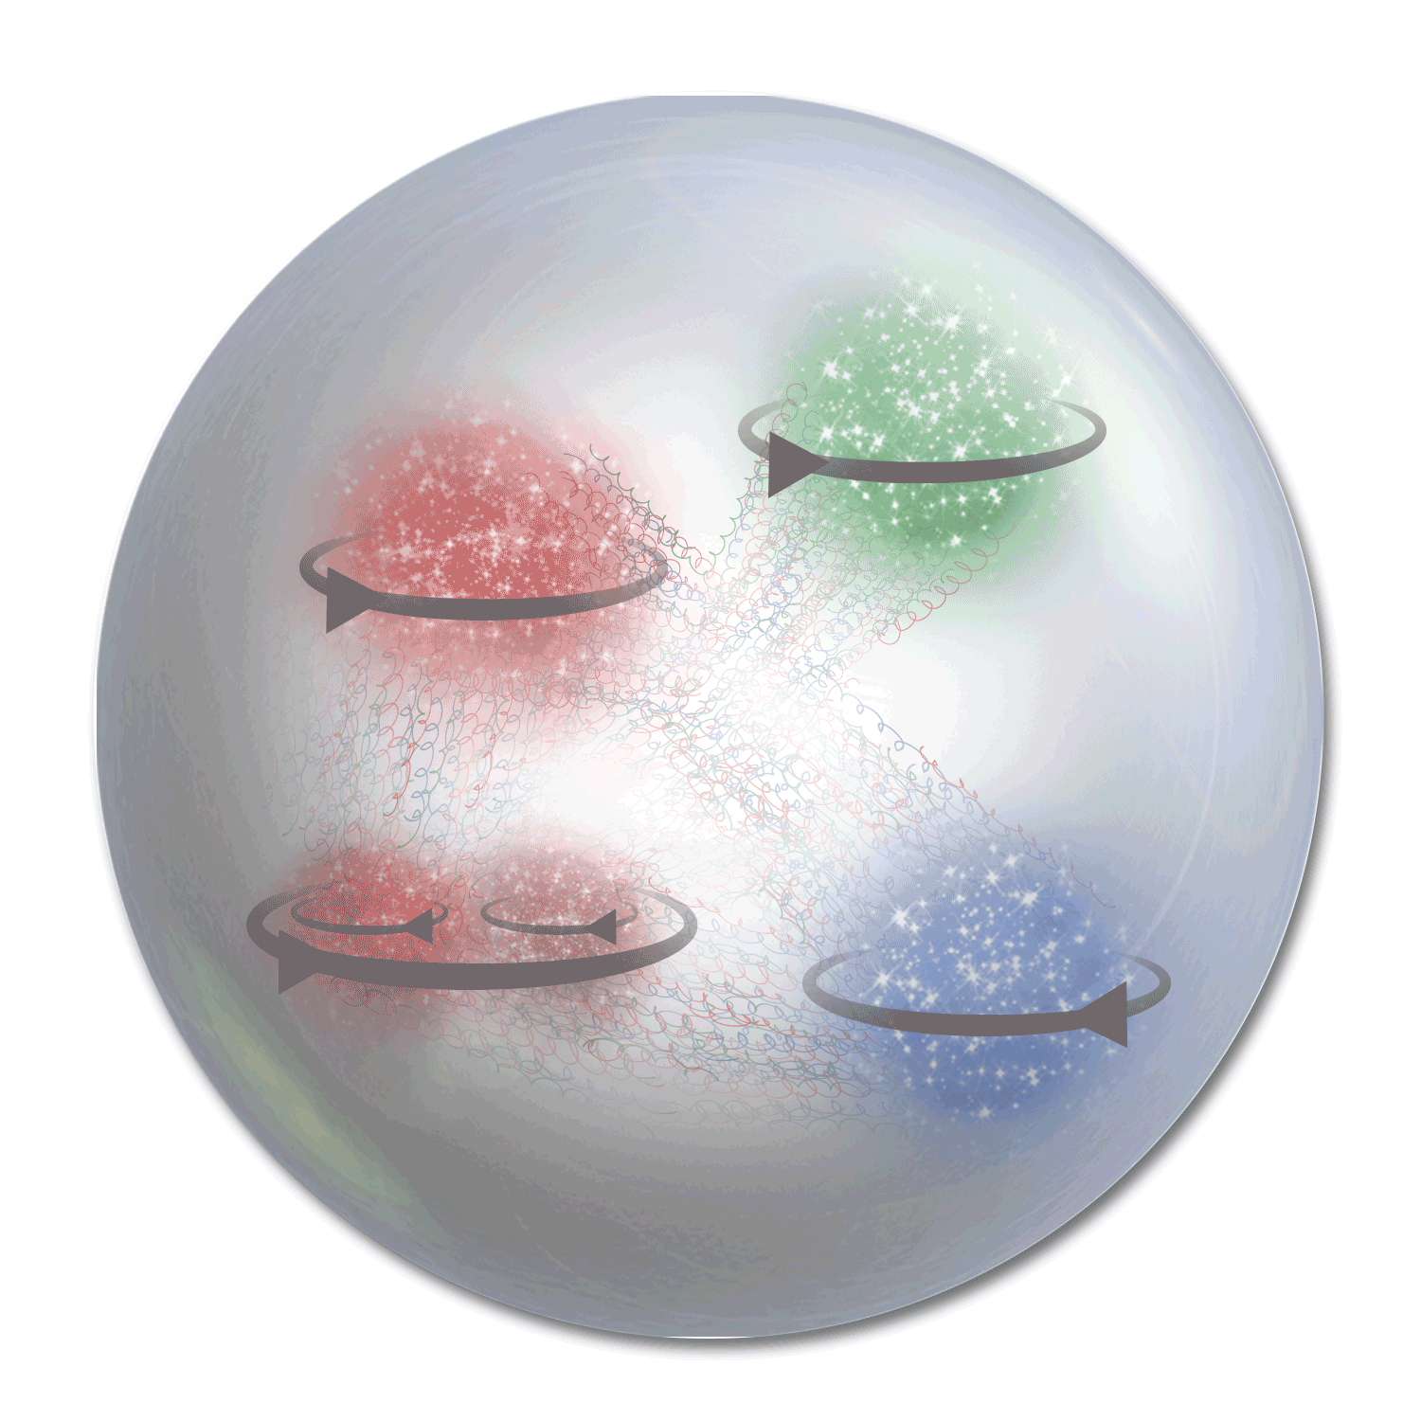
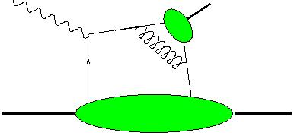
3D PDFs: Electroproduction of hadrons
Study
SIDIS
γ∗_{Τ}
h
Current Fragmentation Region (CFR)
x,Q²,z,P_{T},φ,φ_{S}
~1/Q⁴
TMD-FF
x_{F}>0
N
Flavor and polarization dependence of transverse momentum distributions
X
h
TMD-PDF
HEP
γ∗_{L}
DA
π,ρ,Κ.
x,Q²,t,φ,φ_{S} +φ,θ
~1/Q⁶
h
N
N,Δ,Λ,..
Flavor and polarization dependence of transverse space distributions
GPD
x_{F}<0
Target Fragmentation Region (TFR)
Phenomenology tends to ignore contributions from longitudinal photons to SIDIS and transverse photons to HEP→ practically no attempts to understand sin and cosine modulations in cross sections!!!
Different non-perturbative objects may be relevant with several independent variables involved
Cross contributions make studies based on a given set of assumptions challenging

Slide 4


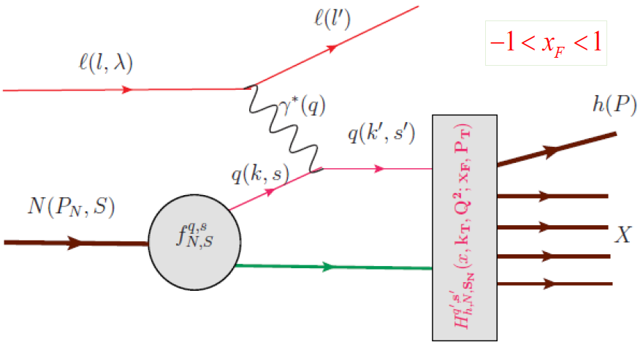


One-photon exchange cross sections for eh→e’hX
The only difference with exclusive production is the
probability to produce π+
Hadronization function describes the probability to produce a hadron for a given leftover configuration with spin and flavor content
Additional 1/Q² appears after replacement of z with t
Event generators such as PYTHIA (based on string fragmentation) are for years describing semi-inclusive production of hadrons in the full energy range of experiments and also exclusive limit (extension to polarization critical!!!)
Notes:
lN\rightarrow l^\prime \omegaX

Slide 5
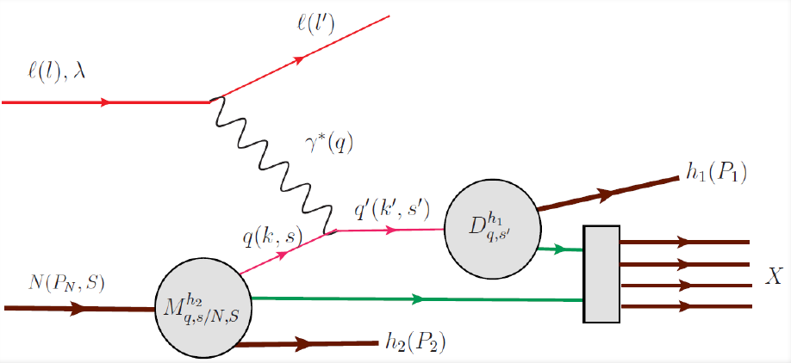
One-photon exchange cross sections for eh→e’hX
0 for low P_{T}s
Hadronization function
SIDIS phenomenology
probability to produce π+
…........
TMD Fragmentation Function
TMD PDF
Fragmentation function
…........
missing in SIDIS
most significant
increases at higher energies
experiment
What type of exclusive processes should we cut out from experiment to have an adequate comparison with theory which doesn’t have longitudinal photon contributions?
Notes:
lN\rightarrow l^\prime \omegaX

Slide 6
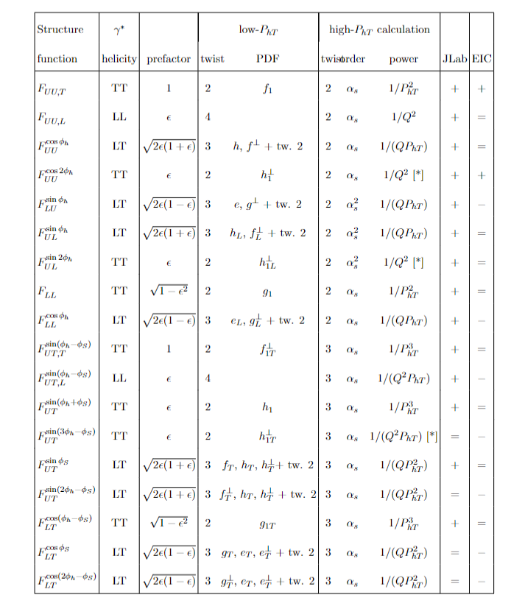

Tranverse & Longitudinal photons
Bacchetta-0611265
Important features to notice
No L in Double Spin 0 moment
Some critical observables (cross sections, sin(φ−φ_{S}) containl contributions from TT/LL and can’t be separated easily
Several TT terms, may provide info on T-amplitudes
P_{hT} and k_{T} critical for understanding of transverse x-sections
Need a similar table for exclusive Helicity Structure Functions!!!

Slide 7
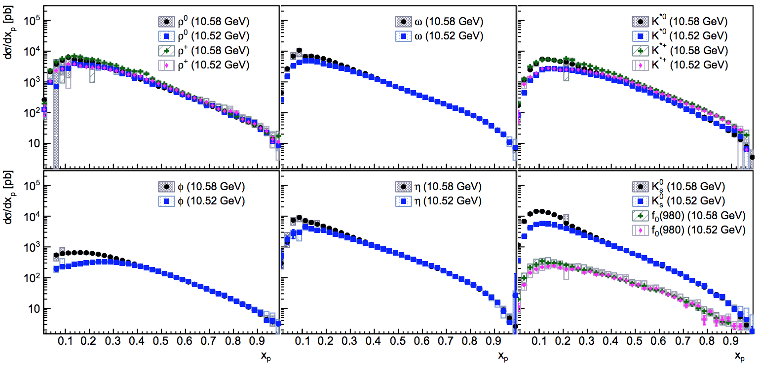





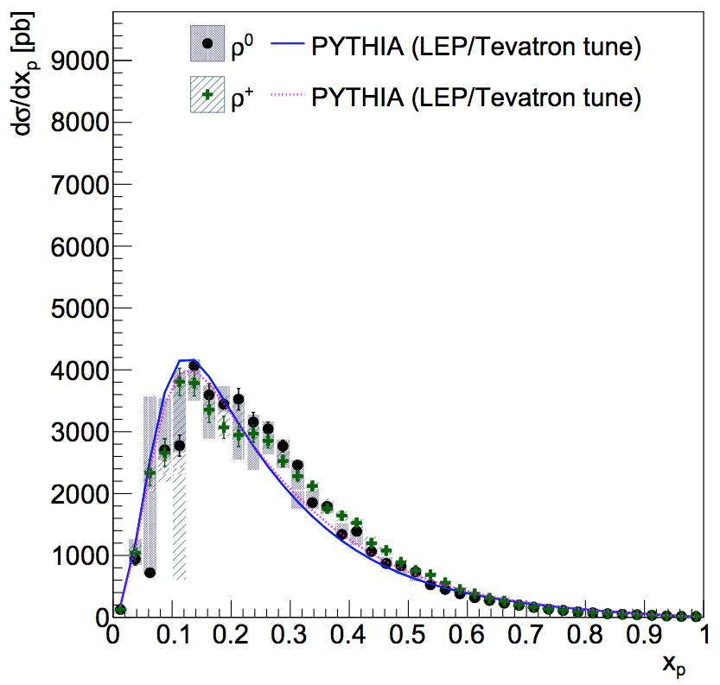
cross sections in the z→limit from e+e-
2411.12216
what is the z^{α} (1-z) ^{β}
hadron momentum in e+e- CM
Belle: production cross sections as a function of x_{p}
Possible contribution from γ∗_{Τ}
Is the γ∗_{Τ} contribution from ρ0 ρ+ comparable?
slightly more rho+!

Slide 8
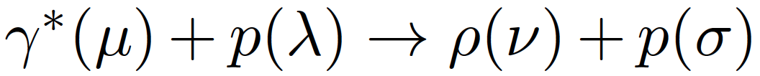
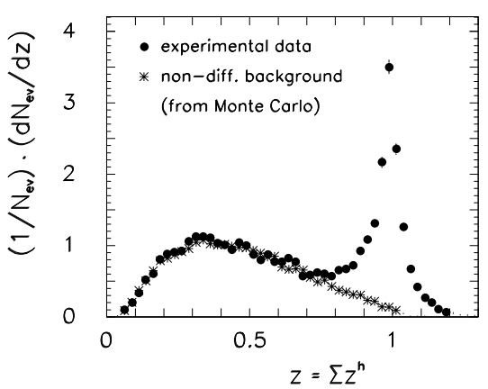
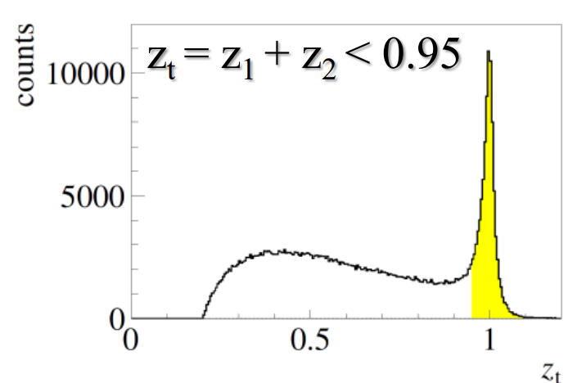
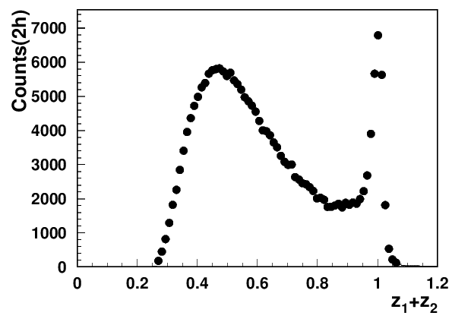

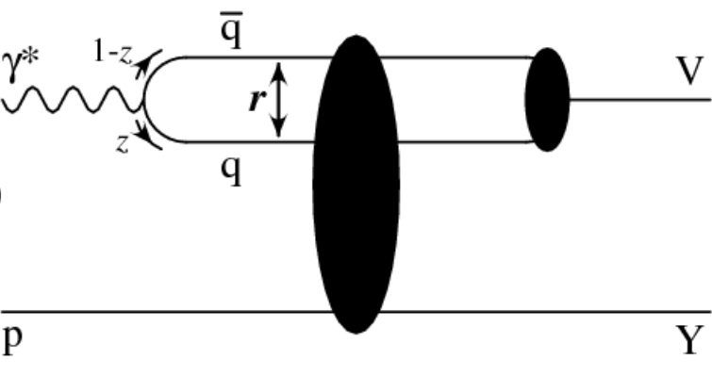
Exclusive VMs (ρ⁰, ω,φ, J/Ψ,…)
E665 Eμ = 470 GeV
COMPASS Eμ = 160 GeV
CLAS12 E=10.6 GeB
→ helicities
Q²=2 GeV²
x=0.2
γ∗_{L}
Estimated ~20% contributions from rho to charged pion SIDIS, consistent with ~10% of diffractive DIS in inclusive DIS
→seem to have no major impact in π+π0
indication: most longitudinally polarized ρ⁰
For GPD based interpretation need experimental separation of contributions
Studies of exclusive processes require high resolution and multidimensional measurements !!!

Slide 9
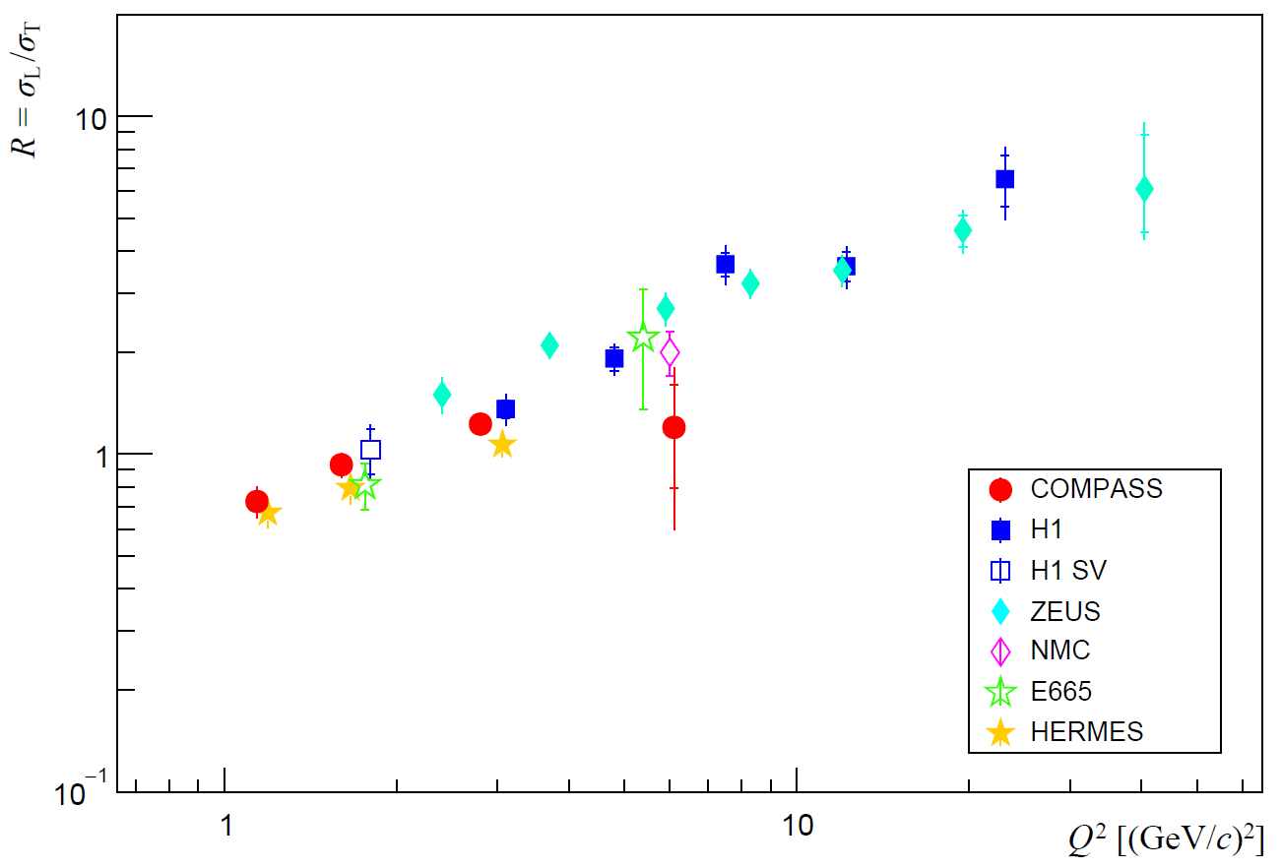

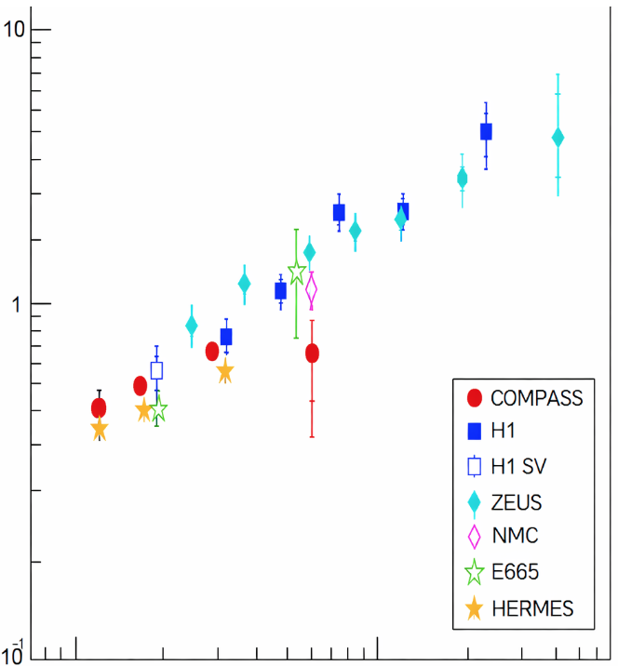
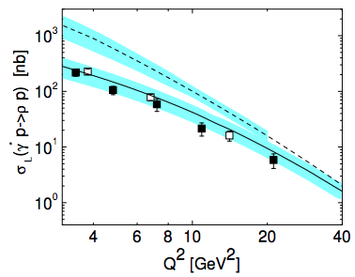
Separating Longitudinal photon contributions
“The greatest enemy of knowledge is not ignorance, it is the illusion of knowledge.”
D.J. Boorstin
1/Q⁶ theory misses ~70-80% at low Q²
~1/Q⁴
L/T separation Assuming SCHC
The ZEUS measurements, followed by others, indicated that the longitudinal photon contributions (diffractive rho) drop as ~1/Q⁴ → dramatically underestimate JLab ρ⁰s
To be checked both, extraction of σ_{L} cross-section and evaluation of σ_{L}/σ_{T}

Slide 10
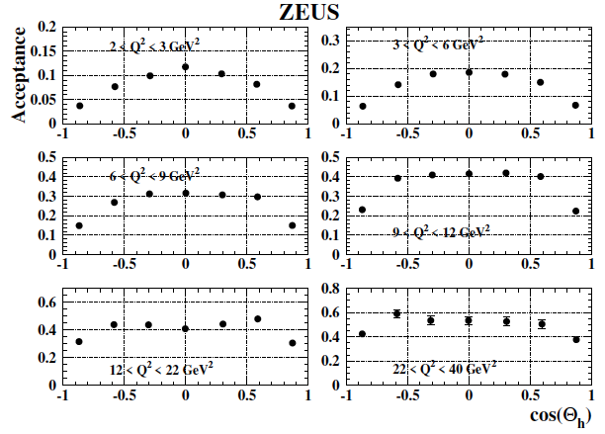
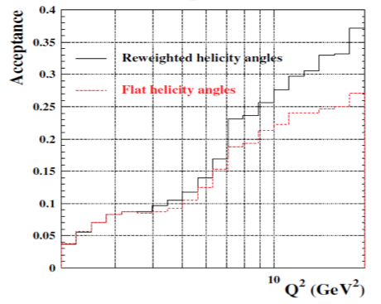
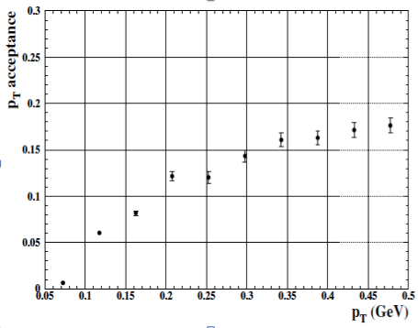
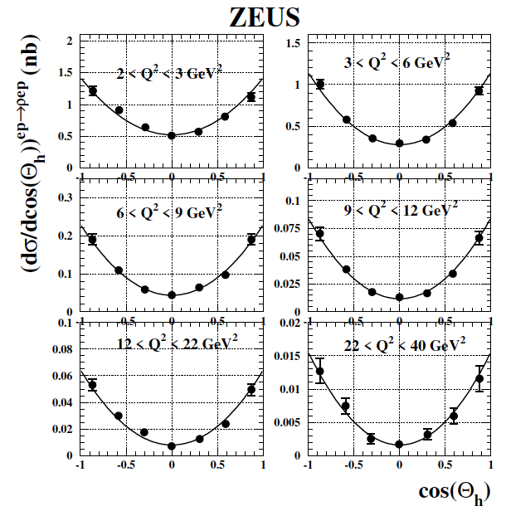
Acceptances from ZEUS
ZEUS rho (0708.1478)
→C. Dilks
tiny acceptances at low Q² and small t/p_{T}
A single bin in cosθ>0.6, where most of the longitudinal VMs appear
7-bins with acceptance at |cosθ|>0.8 reducing ~2 times (integrated over t?)

Slide 11
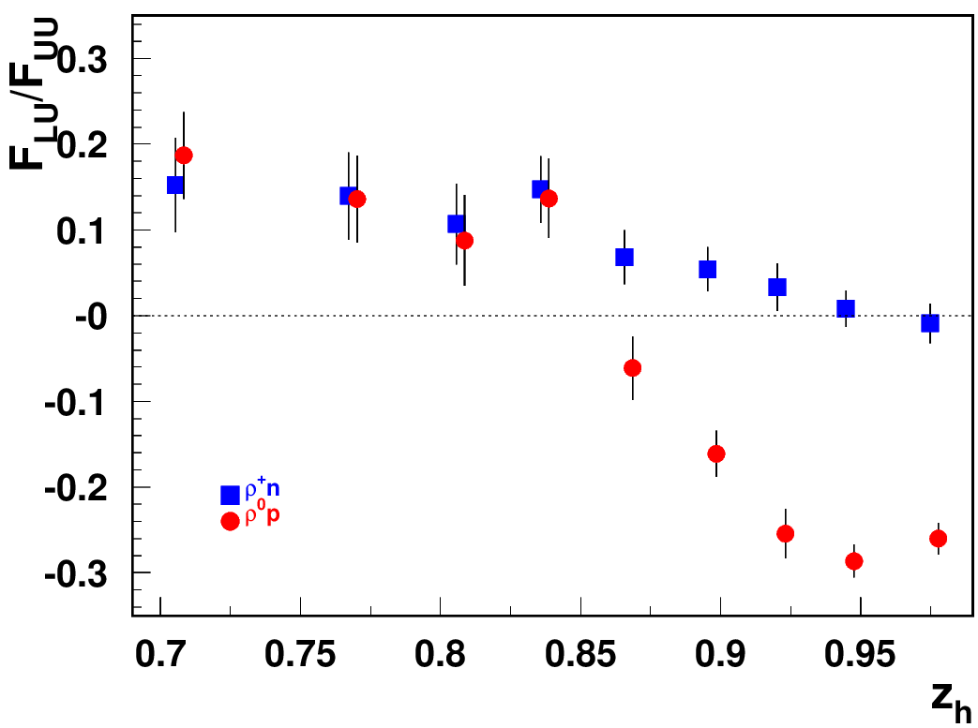
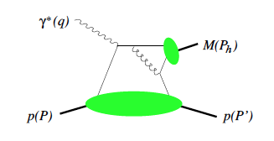
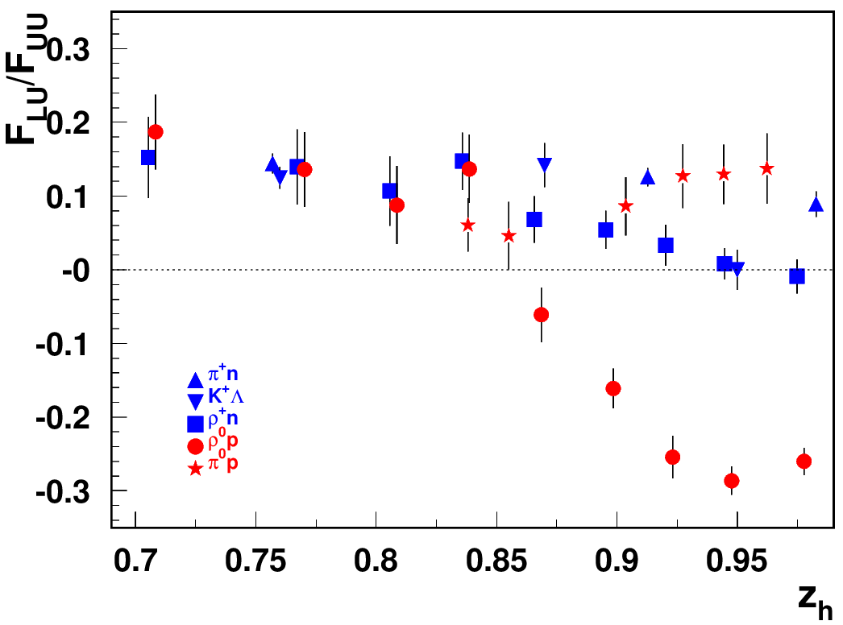
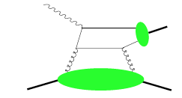

L/T photons producing T/L VMs
G.Matousek (Duke) & N.Trotta (UCONN)
Beam SSA for exclusive states
ρ⁰_{T}
ρ⁰_{L}
Indication of different dynamical mechanism for ρ⁰
For modeling some intuition is needed on what are the relative contributions from T and L photons in different channels?
L/T separation and proper measurements of Q²-dependences of all observables are critical for interpretation of different contributions
Realistic modeling is critical for understanding of the 7D acceptances!!!

Slide 12


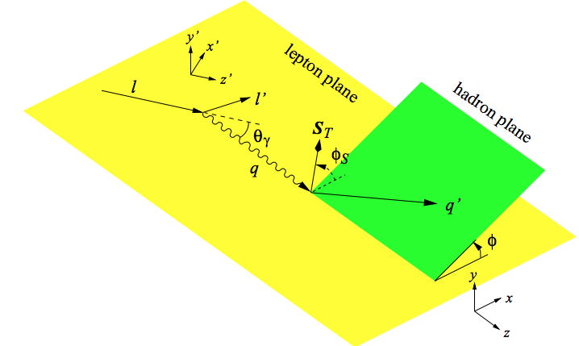
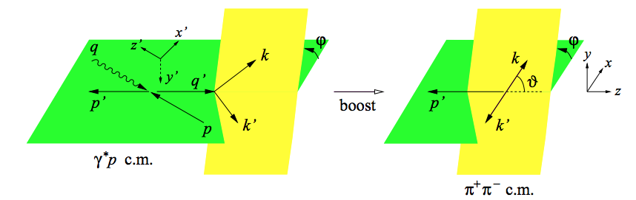
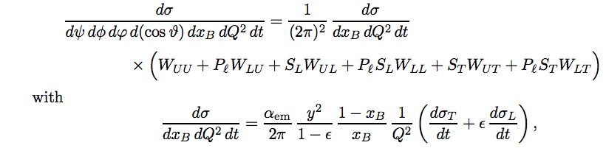
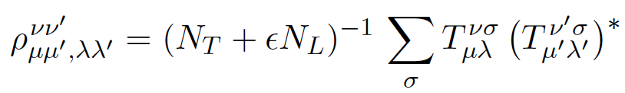
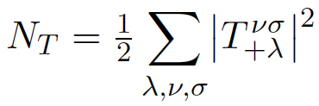
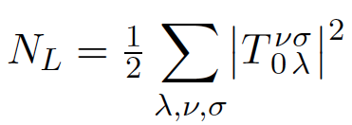
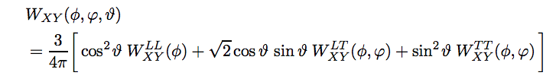
Structure functions case of VMs decaying to h+h-
Diehl: 0704.1565
helicity amplitudes describing depend on x,Q²,t
helicities
More angles involved
spin density matrix
beam and target polarizations
All W_{XY} depend on Q²,x_{B},t,φ,θ,ϕ
longitudinal rho
transverse rho
interference between longitudinal and transverse ρ

Slide 13

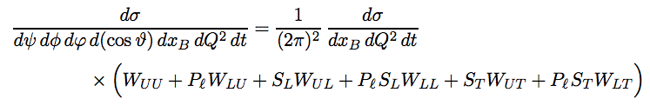
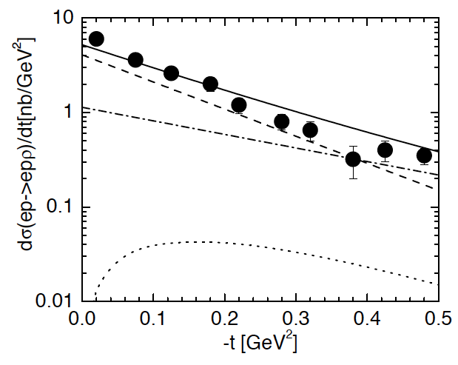
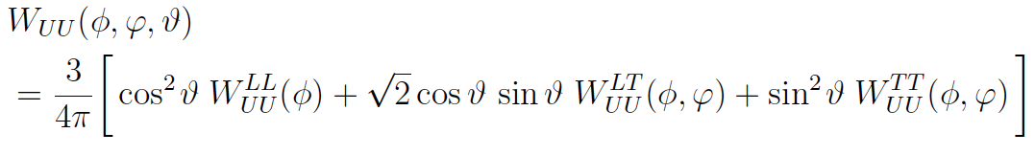

Structure functions for VMs: integrated case
Diehl: 0704.1565
helicities
The GPD based description is applicable for certain helicity amplitudes
GK:0501242
unpolarized part involves several dynamical contributions
longitudinal rho
transverse rho
L→L
T→T
SDME (mixes L and T with different x,Q²,t-dependences)
T→L
longitudinal photon (L) with 0 helicity producing longitudinal ρ_{L}
transverse photon (T) with + helicity producing longitudinal ρ_{L}
Looking for L→L physics
t-dependences very different
focus on low t large Q² Extrapolation to t=0 not trivial!
(keep normalization)

Slide 14
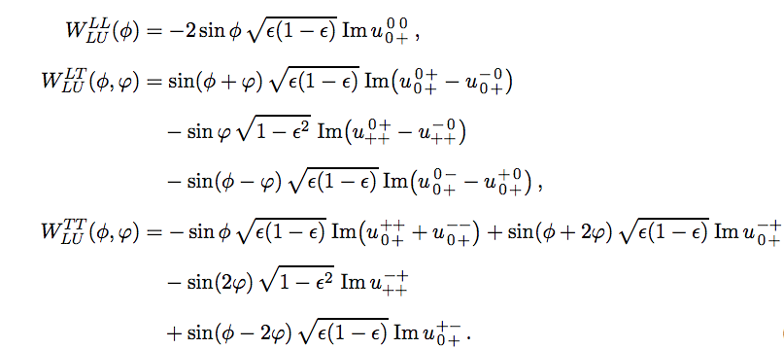
Structure functions: case of VMs
Diehl: 0704.1565
More angles involved
beam SSA involves several dynamical contributions
After integration over
two terms survive
interference of transverse and longitudinal ρ from transverse photons
Detector has acceptances in angles, and integration should account that to be interpretable by theory

Slide 15






SDMEs: different combinations in experiment
Diehl: 0704.1565
sinusoidal modulations(~0 at COMPASS)
Valuable source of info on longitudinal photon!!!
Interference of γ_{T}*→ρ_{L} and γ_{L}*→ρ_{L}
cosine modulations(huge at COMPASS)
(>0 at COMPASS/HERMES)
Interference of γ_{T}*→ρ_{T} and γ_{L}*→ρ_{T}
(~0 at COMPASS/HERMES)

Slide 16
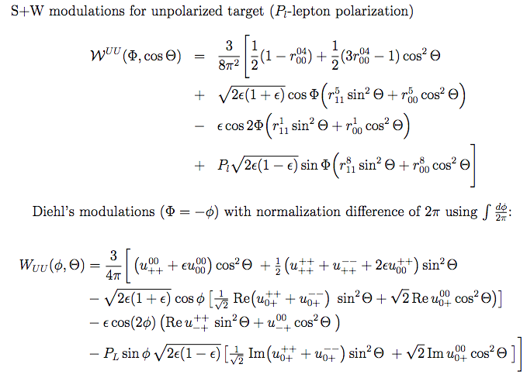


S+W vs Diehl in VM production in MC
L/T photon interference to produce Longitudinal ρ
In Diehl’s formalism, connection between modulations and polarization more clear
→We effectively extract Cahn and B&M effects for different polarizations of VM!!!

Slide 17

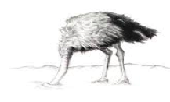





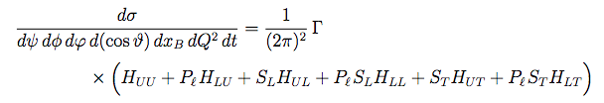




Modeling of VM production in MC: Modified Diehl’s formalism
Standard SDME approach
Ex. cross section of L→L in terms of SDMEs will be
Moving the UNKNOWN σ_{Total} makes modeling challenging and confusion in cross contributions
Modified approach with Helicity Structure Functions (HSFs) H_{XY}

Slide 18

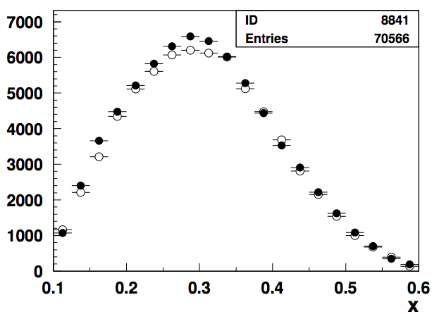
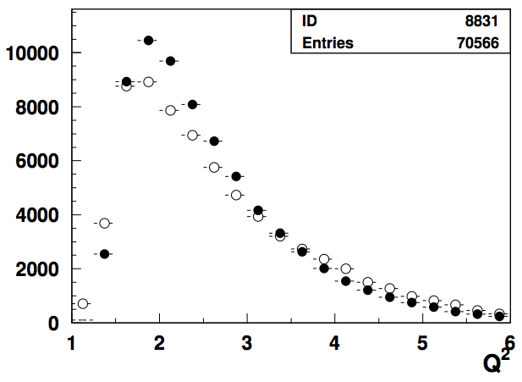
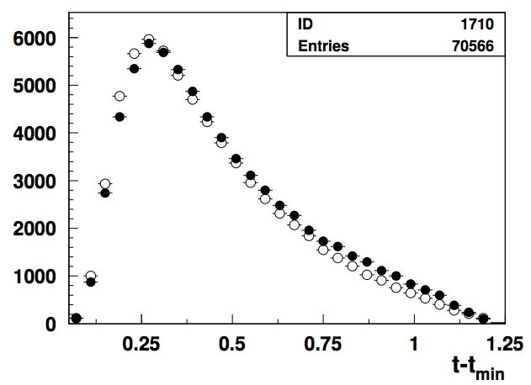

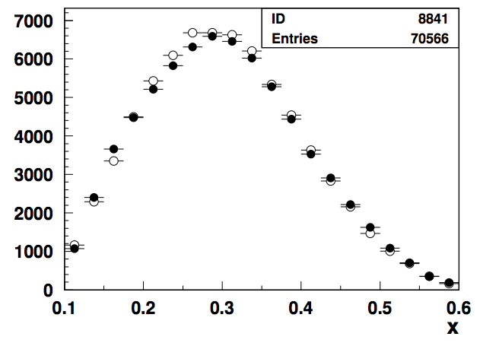

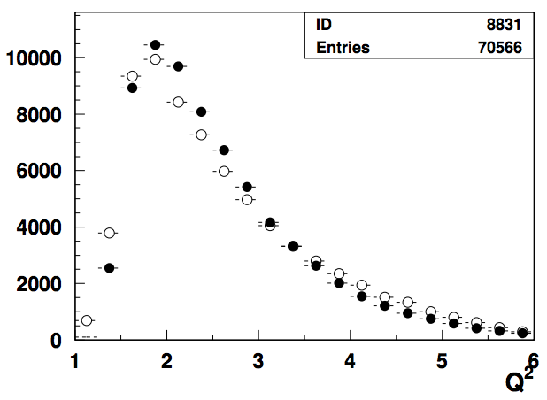
Comparing the MC with CLAS12 data (ep→e’p’ρ)
use the rho-generator-gemc-reconstruction chain to compare with CLAS12 10.6 GeV data vs 2 MC models
filled circles RGA
open circles MC
With proton detected and exclusivity cuts applied no major background left
Good agreement for distributions on relevant variables
10359 has additional terms in
from interference of transverse and longitudinal rho produced by transverse photons

Slide 19
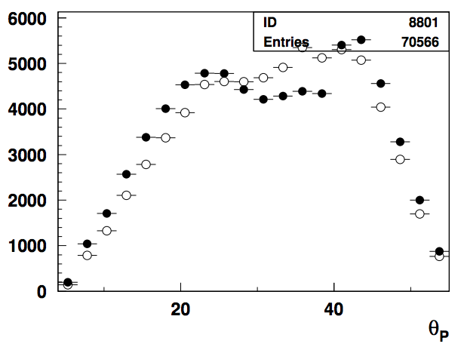
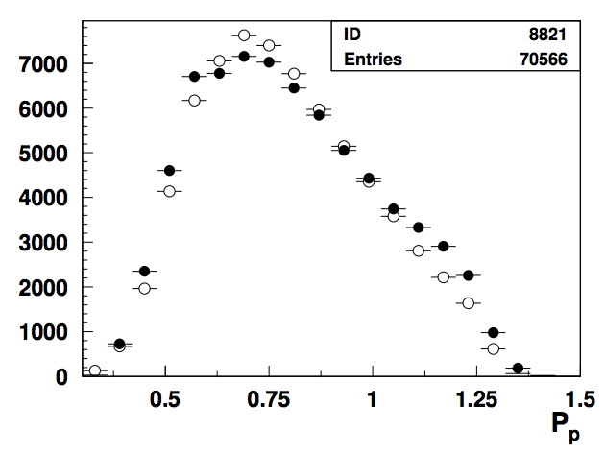
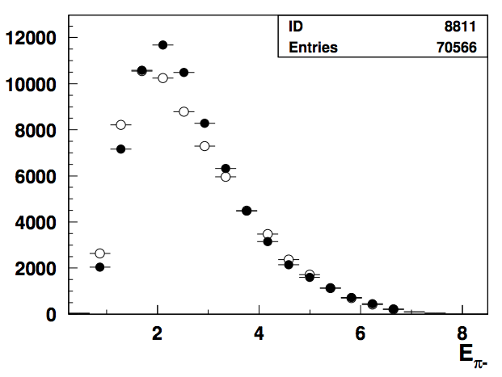
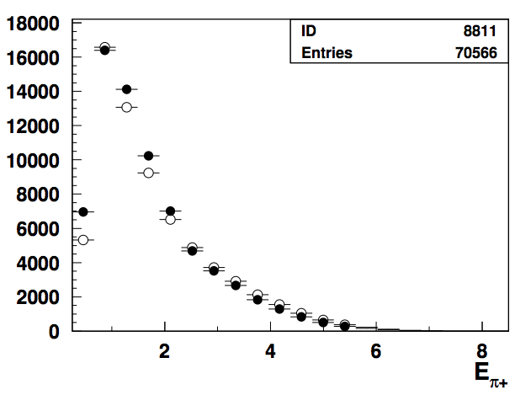
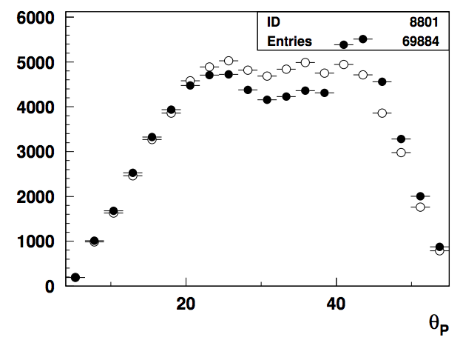



Comparing the MC(gemc) with CLAS12 data
After a preliminary tune and testing use the rho-generator-gemc-coatjava chain to compare with RGA inbending Fall18 for 2 versions different only for 1 amplitude
filled circles RGA
open circles MC

Slide 20



Comparing the MC with CLAS12 data
CLAS12 10.6 data set vs MC
Relative contributions from longitudinal and transverse described well with Longitudinal rhos dominating ~5-6 times for Q²~1.5

Slide 21






Comparing the MC versions with CLAS12 data
use the rho-generator-gemc-coatjava chain to compare with RGA inbending Fall18
filled circles RGA
open circles MC
SSA dependence described vs some variables, require proper integration over others
-dependence of the beam SSA likely comes from interference of L/T ρ⁰s

Slide 22




Comparing the MC v4 with CLAS12 data
Generated
Reconstruction efficiencies

Slide 23



Comparing acceptances for MC model inputs
Acceptance difference for 2 MCs using the rho-generator-gemc-coatjava chain to compare with RGA inbending Fall18
Only difference is additional terms
from interference of transverse and longitudinal rho produced by transverse photons
in HERMES/COMPASS ~ +10% 0-within errors
While overall distributions over relevant variables look similar, the acceptances integrated over wide bins may be very different

Slide 24


ε-dependence for electroproduction experiments
CLAS12 already collected data on proton for 6.4,6.5,7.5.8.5.10.2,10.6 GeV
Combining SDME measurements (may need “event base” analysis) at CLAS12 and HERMES/COMPASS will be important for model independent separation of longitudinal part

Slide 25



Alternative measurements with epX
F. Benmokhtar
Longitudinal rho disappears in epX at large t
Inclusive proton measurements provide access to exclusive VMs, for cross sections integrated over decay variables (θ and φ )
Different backgrounds and systematics and will require good resolutions to separate different contributions

Slide 26
SUMMARY
Development of realistic MC is absolutely critical for measurements of exclusive VMs and, longitudinal rhos, in particular, with polarized beams and targets, which are crucial for proper interpretation of the measurements of 3D structure, including GPD and TMD based formalisms
  Studies of exclusive rho, indicate several strong dynamical contributions from different interference terms, including longitudinal photon contributions
  Measurements of rho, are classical demonstration of how critical multidimensional measurements with high precision could be, including the acceptance in 7D
  CLAS12 has significant advantage compared to higher energy experiments in resolution and statistics, required for proper separation of exclusive VMs from semi-exclusive VMs, and separation of rhos from transverse and longitudinal photons
  Target and beam SSAs and DSA can help to separate diffractive rho from other exclusive and semi-exclusive processes, and extract kinematic dependences of helicity amplitudes
  The diffractive VM contributions, violate the factorized picture of SIDIS based on the dominance of the leading twist contributions, and detailed understanding of exclusive rho contributions in the multi-D space will be critical to address the challenges of SIDIS
A program for AI-enabled Inference of helicity amplitudes with validation in development
  Develop MC, produce large samples for cross section studies, extract helicity amplitudes/SDMEs from RGK (6.5,7.5,8.5)/RGA(10.6)/RGC(LPol)/RGB(D) data sets
  Most critical: sort out Q²-dependences of relevant amplitudes/HSFs
  Combine efforts of CLAS+GLUEX+COMPASS communities (ex. generator development) in understanding the diffractive ρ,φ, J/Ψ.. and sort out the impact on OAM, TMD-PDFs, ….

Slide 27
support slides

Slide 28

Measurements of exclusive rho at ZEUS
Around rho0 mass the longitudinal photon contribution is maximized, can we claim that rho production dominates the longitudinal photon production?
The low MX is dominated by rho0s
At low MX the ratio ~1/Q² with week dependence on W and x

Slide 29






Impact of acceptances in cos θ
ZEUS rho (0708.1478)
1/Q⁶ theory misses ~70-80% at low Q²
CLAS6 0803.3537
ep→e’p’φ
Proper acceptance account requires fine multidimensional binning, high statistics
ZEUS 7-bins with acceptance at |cosθ|>0.8 reducing ~2 times (integrated over t?)
Situation even worse for electroproduction of φ-mesons

Slide 30



Structure functions case of VMs
Diehl: 0704.1565
More angles involved
helicities
cross section could be presented in terms of combinations of helicity amplitudes
unpol
long.pol
In the forward limit of small t
To measure any observables in bins of x,Q²,t integrated over the photon (μ) and VM (ν) polarizations (cross sections and spin asymmetries) one has to integrate in the multidimensional space the experimental observables corrected for acceptance in

Slide 31





CLAS12 Experiments involved: Exclusive rhos
Exclusivity condition defined by the missing Energy:
CLAS12 (width <0.1GeV)
HERMES(width ~0.6GeV)
COMPASS(width ~2GeV)
~20% of data
hep-ex/0004023
dominated by transverse photons
what are cosθ distributions of those?
Guarantying the “exclusivity” requires good resolutions (gets worse at higher energies)
Subtraction procedure relays on normalization, based on exclusive limit of LUND-MC
All distributions have tails, indicating the RC may not be negligible
Extraction of SDMEs, will require validation in the multi-D space (significant samples)

Slide 32





COMPASS/HERMES Measurements
HERMES
COMPASS
transverse part independent on t’
transverse part decreasing with t’
The normalized SDMEs (ratio to σ_{Total}) seem to be independent on kinematics
While average values seem to be consistent, the t-dependences of transverse dominated contributions inconsistent

Slide 33

Bin-size effects in SDME extraction
B. Singh

Slide 34
L/T photons producing T/L VMs
G.Matousek (Duke) & N.Trotta (UCONN)
Beam SSA for exclusive states
ρ⁰_{T}
ρ⁰_{L}
Indication of different dynamical mechanism for ρ⁰
L/T separation Assuming SCHC→ SSA of rho should be 0←clearly violated
To separate L and T-photon contributions detailed measurements are needed for L/T interference observables, which are practically impossible at higher energies!!!

Slide 35






Exclusive π+π−: missing mass dependence
forward protons
forward rhos
ρs dominate both exclusive dihadron samples, contributing differently depending on z
SSA can be used as a tool to check dominance of different dynamical contributions

Slide 36


SSA: ρ⁰ A_{LU}
Large cosines correspond to higher fractions of longitudinal rho from unpolarized target runs (RGA) and polarized target runs (RGC)
CLAS12
X=0.3
CLAS24
CLAS12 PRELIMINARY
EIC 5x41
EIC 18x275
Some modulations (ex. SSAs and DSAs) suppressed at large x kinematically at higher energies
due to ε→1
SSA is very significant and has cosine shape, likely indicating significant contributions from longitudinal ρ0s

Slide 37





From electron ehX cross sections to exclusive γ*p→hp
SIDIS eN→e’hX
hep-ph/0611265
replace with structure functions in helicity basis
Go to exclusive limit replacing P_{T} with t M_{X}=M_{p} →

Slide 38
Interconnections of SIDIS and HEP
Connecting cross sections in terms of helicity amplitudes and structure functions
Exclusive limit, and connections between variables used in SIDIS and HEP
Exclusive pi0s and possible connection with interpretation using fragmentation functions defining the global probability for given type of quark to produce a given type of hadron
z-dependences of fragmentation functions at z→1as possible source of information on transverse photon contributions

Slide 39

Question addressed to ZEUS

Slide 40








Connecting M_{X}, t, P_{T} and z
ep→e’π⁰X (M_{X}=M_{P}, t=(γ*-p_{π0})²)
exclusive limit M_{X}=M_{P}

Slide 41





Correlated slopes in P_{T} and t
ep→e’π⁰X (M_{X}=M_{P}, t=(γ*-p_{π0})²)
From exclusive note (I.Korover et al)

Slide 42






DDIS and rho from ZEUS
SATRAP→ep→e’pX
RHOP→ep→e’pr
SANG→ep→e’NX
Is the M_X invariant mass of the hadronic system X (γ*p → XN) with M_N<2.3 GeV?, Why the peak at 0.9?
why 0.05, interval will have <50% of events?

Slide 43



DDIS and rho from ZEUS
No major dependence on W for low M_X?
SATRAP→ep→e’pX
RHOP→ep→e’pr
SANG→ep→e’NX

Slide 44


DDIS and rho from ZEUS
No major dependence on W for low M_X?

Slide 45




DDIS and rho from ZEUS
ZEUS diffraction 1/Q⁶ at low M_X
Q² from Claude
W ≈ 45 GeV
What are the other ~70-80% contributions to DDIS in the low MX bin, at low Q², in particular?
wrong M_{X}(3.1)

Slide 46


rho from ZEUS
is this indicating that rho0 is more dominated by longitudinal photons than any other processes (prodicing pions)?
sigma_L/sigma_T ~Q^2? What is epsilon?
What is sigma_T Q^2-dependence

Slide 47
Precision measurements in SIDIS and HEP
Some requirements in precision multidimensional measurements in hadron production in SIDIS and HEP, needed for proper interpretations in terms of 3D partonic distributions (TMDs and GPDs)
SIDIS interpretation in terms of TMDs requires detailed understanding of exclusive VM contributions
Measurements of VM observables, require detailed understanding of multidimensional acceptances, also for integrated x-sections
Detailed MC describing VMs is critical, also for AI-enabled inference of helicity amplitudes
Validation of claims on separating different dynamical contributions through measurements of target and beam spin asymmetries important advantage of JLab
Combination of different beam energies, good resolutions, high statistics, makes JLab a unique place for VM studies

Slide 48







From electron cross sections to γ*p→hX
hep-ph/0611265
helicity structure functions
hep-ph/0503023

Slide 49

Exclusive ρ0s: impact on SIDIS multiplicities
0.18<x<0.22
0.5<z0.7
Q²=2 GeV²
total eπ+X
Estimated ~20% contributions from exclusive ρ0, mainly show up at low P_{T} in SIDIS, messing up extracted P_{T}-dependences
The “diffractive” rho will bias extractions of TMDs, unless properly subtracted in multidimensional space of SIDIS measurements.
Notes:
Lorenz invariant amplitudes

Slide 50


Exclusive ρ0s: impact on SIDIS SSAs
“ρ-free” SIDIS
0.1<P_{T}<0.3, 0.4<z<0.6
Can change the pion SSAs, in particular at small P_{T}
The same sign and size of π+ and π- SSA indicates the rho0 may be significant, subtraction will require detailed MC studies, which require proper SDMEs
While VM contributions are ~20% in multiplicities in SSA they can be >100%
Detection of the target proton allows to clean up the SIDIS sample from exclusive rho contributions

Slide 51


Exclusive ρ0s: impact on double spin asymmetries (NH₃ target)
A.Bongallino (theory bands for e’π⁺X)
CLAS12 Preliminary
NH3: ep→e’πX
π+
π⁰
π⁻
DSA suppressed for exclusive rho as
longitudinal photon cross section is P-odd
→ contribution appears only in the SSA, a P-odd observable, and does not appear in DSA
DSA of charged pions affected by the rho introducing dilution in measured DSAs (will affect all kinds of extractions of helicity PDFs in SIDIS and DIS ), in particular at small x

Slide 52
L/T photons producing T/L VMs
G.Matousek (Duke) & N.Trotta (UCONN)
Beam SSA for exclusive states
ρ⁰_{T}
ρ⁰_{L}
CLAS12
x=0.3
CLAS24
L/T separation Assuming SCHC→ SSA of rho should be 0←clearly violated
To separate L and T-photon contributions detailed measurements are needed for L/T interference observables, → practically impossible at higher energies and large x!!!
EIC 5x41
EIC 18x275

Slide 53
Impact of acceptances in cos θ
ZEUS rho (0708.1478)
1/Q⁶ theory misses ~70-80% at low Q²
CLAS6 0803.3537
ep→e’p’φ
Proper acceptance account requires fine multidimensional binning, high statistics
ZEUS 7-bins with acceptance at |cosθ|>0.8 reducing ~2 times (integrated over t?)
Situation even worse for electroproduction of φ-mesons

Slide 54
Experiments: Defining Exclusive rhos
Exclusivity condition defined by the missing Energy:
CLAS12 (width <0.1GeV)
HERMES(width ~0.6GeV)
COMPASS(width ~2GeV)
~20% of data
hep-ex/0004023
dominated by transverse photons
what are cosθ distributions of those?
Guarantying the “exclusivity” requires good resolutions (gets worse at higher energies)
Subtraction procedure relays on normalization, based on exclusive limit of LUND-MC
All distributions have tails, indicating the RC may not be negligible
Extraction of SDMEs, will require validation in the multi-D space (significant samples)

Slide 55








SDMEs from photoproduction
JLab/GlueX, S. Adhikari et al: https://arxiv.org/pdf/2305.09047
vanish after φ-integration
vanish after φ-integration
vanish after φ-integration
The SDMEs for transverse photons with sin²θ (to transverse rho?) at Q²>0 seem to be smaller (detailed comparison vs Q²).

Slide 56

Genesis: Unifying Physics from Quarks to Cosmos

Slide 57



Cuts on Invariant/Missing masses
bin 0.275<x<0.325,0.05<-t<0.35 (RGA 10.2 GeV)
With tight exclusivity cuts background is minor
Wide rho peak makes problematic proper background subtraction
ep→e’p’ρ
LUND-MC
Solid line correspond to reconstructed set, using generated values in LUND-MC
Points correspond to reconstructed values
→Width is wider than resolution effects
With proton detected and exclusivity cuts applied no major background left

Slide 58



Cuts on Invariant/Missing masses
bin 0.235<x<0.265 (RGA 2019, 10.2 GeV)
Qualitative agreement between MC and Data in a given bin in 0.235<x<0.265

Slide 59


MC sensitivity for a given x-bin
0.34<x<0.36 (solid lines 1/Q^6, exp(-4.25t)
1/Q^(2N) solid N=3,
dashed 2.2,2.8,3.2,3.5
exp(-Bt) solid B=4.25, dashed 4.0 and 4.5
Extraction of parameters B and N (Q^{2N}_{L} and Q^{2N}_{T}, B_{L} and B_{T} ) require proper integration in the multidimensional phase space!!!
Implementing in the MC predictions from GK for B_{L} and B_{T}

Slide 60

Measuring exclusive VMs: ZEUS and H1
ZEUS rho (0708.1478)
<100K events
hep-ex/9602007
Proper acceptance account requires fine multidimensional binning, high statistics
7-bins with acceptance at |cosθ|>0.8 reducing ~2 times (integrated over t?)

Slide 61

Acceptances in cos\theta
ZEUS rho (0708.1478)
in 80% cases one of the pions has <20% of the total momentum
CLAS6 0803.3537
Proper acceptance account requires fine multidimensional binning, high statistics
7-bins with acceptance at |cosθ|>0.8 reducing ~2 times (integrated over t?)
Situation much worse for electroproduction of φ-mesons

Slide 62


More plots from ZEUS
ZEUS rho (0708.1478)
The acceptance low at low P_{T}, (low t?) and Q², increasing with Q² (agreement with LT theory also improving at large Q²).

Slide 63










Measured x-section: DDIS vs DIS
M_{X} in DDIS →mass of the particle[s] in the current fragmentation
~1/Q²?
ZEUS
Week increase with W in photoproduction
Strong increase in electroproduction (longitudinal rho?)
Eur. Phys. J. C 6, 43{66 (1999)
Electromagnetic radiative effects were corrected (less than 10% and independent of W).
For η_{max} < 1.5 the contribution from nondiffractive scattering is expected to be negligible
No dependence of DDIS/DIS on W, decrease with Q² indicating the VMs can be the main contributor
At lowest M_{X} seem to be ~1/Q², at higher M_{X} there seem to be no Q²-dependence

Slide 64

Exclusive rhos and SDMEs from COMPASS
corr. with r₁₀⁵ (Hermes) no corr (COMPASS)
corr. with r₁₋₁⁸ (Hermes) no corr (COMPASS)

Slide 65


Understanding exclusive rhos and SDME validations
corr. with r₁₋₁⁵ , r₁₋₁⁶ ,r₀₀⁵ (Hermes, COMPASS)
corr. with r₁₋₁⁸ ,r₀₀⁸ (Hermes, COMPASS)

Slide 66
Exclusive π+π−: missing mass dependence
forward protons
forward rhos
ρs dominate both exclusive dihadron samples, contributing differently depending on z
SSA can be used as a tool to check dominance of different dynamical contributions

Slide 67





Comparing the v1 MC with RGA data
Transverse ρ dominated

Slide 68

Model dependence of the acceptance
no bck
no bck
Four versions of MC (v1-v4) with reasonable description of all kinematic dependences, carry different physics content, very different L/T parts
Acceptance indeed is a very strong function of the angle and even small variations change the acceptance for 20-30% for wide bins in Q²,x_{B},t,φ,θ,ϕ

Slide 69





Measurements of rho: E665
https://inspirehep.net/files/58cfd687d71fffa160843650967cdd61
Z.Phys.C 74 (1997) 237-261

Slide 70




Measurements of rho: E665
https://inspirehep.net/files/58cfd687d71fffa160843650967cdd61
Z.Phys.C 74 (1997) 237-261

Slide 71





SDMEs from photoproduction
JLab/GlueX, S. Adhikari et al, Phys.Rev.C 108 (2023), 055204: ArXiv:2305.09047
-t~0.2
GlueX preliminary
-t~0.8
While at small t (dominant part of the statistics) the transverse rhos dominate, at large t the contribution from transverse photons going to longitudinal rho becomes more significant

Slide 72




VM contributions
Yuri Kovchegov
in 80% cases one of the pions has <20% of the total momentum
Asymmetric decays of longitudinal rho lead to much smaller acceptance
Similar but inverted distributions for e+e- decays

Slide 73


VM contributions
Yuri Kovchegov
in 80% cases one of the pions has <20% of the total momentum
CLAS12
Asymmetric decays of longitudinal rho lead to much smaller acceptance, more than order of magnitude

Slide 74

Using e+e- to estimate vector mesons
The invariant mass of dihadrons is contaminated by other vector mesons, with shape not changing significantly with hadronization fraction to spin-1 vs spin-0 mesons
decays of π and η are kinematically separeated from ω and ρ⁰
π⁰→ γe+e- →1.10⁻²
η→ γe+e- →7.10⁻³
ρ→ e+e- →4.72+/−0.05 10⁻⁵
ω→ e+e- →7.36+/−0.15 10⁻⁵
φ→ e+e- →2.97+/−0.15 10⁻⁴
π⁰
η
ω
ρ
Vector meson per electron can be independently estimated from ep→e’e+e-X
Significant fraction of VM may affect DY studies.

Slide 75





supporting plots
cuts
RGC-Fall and RGA inbending 10.6 consistent

Slide 76

Тяжело в учении
--легко в бою
the more you sweat in times of peace the less you bleed in war
Monte Carlo simulation is crucial for understanding of systematics of all steps and assumptions used in extraction of complex 3D nucleon structure

Slide 77



More plots from ZEUS
hep-ex/9808020
Wide bins in t, what is the minimum energy of pi+/pi- detected?:
What is the resolution in t ?
What is the fraction of events for t<0.1 ?
What is the acceptance in cos\theta for low Q^2 bin for lowest t?
What is the total statistics of rho H1+ ZEUS, anyway to do 4D (x,Q^2,t,theta) analysis?

Slide 78

VM contributions
Yuri Kovchegov
in 80% cases one of the pions has <20% of the total momentum
CLAS12
Asymmetric decays of longitudinal rho lead to much smaller acceptance, more than order of magnitude

Slide 79











Exclusive dihadrons from CLAS12
all exclusive ρ
Q²=2 GeV²
Q²=3 GeV²
Q²=4 GeV²
x=0.2
longitudinal ρ
Q²=2 GeV²
Q²=3 GeV²
Q²=4 GeV²
Q²=5 GeV²
GK: arXiv:0708.3569
x=0.3
Q²=2 GeV²
Q²=3 GeV²
Q²=4 GeV²
Q²=5 GeV²
x=0.4
at lower x need higher z
The exclusive rho contributions in SIDIS (multiplicity) drop with Q² (~1/Q²)
At large z=z₁+z₂ the transverse photon contributions to ρ_{L} suppressed
Notes:
Lorenz invariant amplitudes

Slide 80



SIDIS as THE theory describes it
Probability to produce 1 or 2 hadrons in single photon exchange
can be measured from e+e-
h
can be measured from DY
X
+Radiative Corrections
hard part
Factorization allowing description using distribution functions (TMD-PDF) and fragmentation functions (TMD FF)
X→ multiplicity of unobserved hadrons LARGE, and x-section doesn’t depend on X (independent fragmentation)
Leading twist dominates,
p┴
P_{hT} = p┴ +z k┴
Conclusions in case of apparent disagreement:
factorization is broken?
unaccounted terms may contribute (assumptions are not good in certain kinematics,…)
“much bigger/smaller” defined in comparison with experiment
Data has it all!!! Dealing with unaccounted terms:
Theory accounts for them (ex. VMs)
Experiment measures and excludes them!!! (ex.VMs)

Slide 81



Studies of ρ⁰ impact with longitudinally polarized NH₃ target
CLAS12 Preliminary
Need clear separation of hydrogen from NH₃
and diffractive exclusive ρ0s from exclusive π+π−
DSA is P-even, SSA is P-odd
longitudinal photon cross section is P-odd
→ contribution appears only in the SSA, a P-odd observable, and does not appear in DSA
ep->e’p’ρ⁰
With x10 less statistics than RGC, RGH can provide a significant measurement of ρ0 SSAs
Beam SSA (RGC summer)

Slide 82


Exclusive ρ contributions to π: P_{T}-dependence
COMPASS→“Positive trend”
“ρ-free” SIDIS
0.1<P_{T}<0.3, 0.4<z<0.6
π− and π+ show similar behavior
COMPASS→“Positive trend” also reproduced when additional proton in TFR detected (red)
The same sign and size of π+ and π- SSA indicates the rho0 may not be properly subtracted(require detailed MC studies, which require proper SDMEs)
While VM contributions are ~20% in multiplicities in SSA they can be >100%
Detection of the target proton introduces much smaller bias on the inclusive charged pion SSA, than the exclusive rho contributions

Slide 83




Experiments (ZEUS)
https://arxiv.org/pdf/0708.1478v2
what about fixed x?

Slide 84








Experiments (EMC, NMC)

Slide 85

Response from theory

Slide 86




A_{LL} studies of exclusive ρ⁰ : HERMES
A_{1ρ}=0.23 ± 0.14±0.02
1D plots can be really misleading need multi-D
For a proper extraction of multiplicities and spin-azimuthal modulations of exclusive ρs, clean separation is needed for ρ⁰, and longitudinally polarized ρ⁰ signal, in particular
At low P_{T}, where the background is smaller, the asymmetry indeed tend to be negative
Accounting of ρ⁰ will change the phenomenology of helicity distributions

Slide 87
Excluding the “diffractive” rho from SIDIS
Depending on how we exclude the exclusive rho we can have several versions of experimental samples of inclusive hadrons, each with their own bias:
1) Standard SIDIS (eN→ehX, h=π,K,..) within the full accessible kinematics, corrected for acceptance and RC, measured in the multidimensional space
  →eπX biased with respect to theory by presence of contributions from diffractive rho, contributing to ~20% of counts, in low P_{T}, with contributions to SSA ~10 times higher
2) Standard SIDIS (eN→eπX) within the full accessible kinematics, corrected for acceptance and RC, measured in the multidimensional space, with subtracted in multi-D bins for rho0 contributions (“rho-subtracted SIDIS”)
  →requires measurements of pions from diffractive rho in multidimensional space, means detailed studies of SDMEs of rhos, requiring good precisions and huge statistics, develop MC (ex. HEPGEN) also for all polarization observables, extensive validation needed, little known RC
SIDIS subsamples (eN→epπX, eN→eππX) within the full accessible kinematics, allowing clear eliminiation of rho0 contributions using cuts on missing masses of epX or eππX
(“rho-free SIDIS”)
  →biased by the presence of additional hadron in TFR (epX) or CFR (eppX), may need a new phenomenology
  requires measurements of dependence on M_{X} to understand the bias,
  Theory should be able to evaluate the bias from the presence of an additional hadron

Slide 88

SDMEs vs helicity amplitudes

Slide 89



Studies of ρ⁰ impact with longitudinally polarized NH₃ target
Separating exclusive dihadrons
CLAS12 Preliminary
calculated
θ
measured
cut on Δθ <1º beetween measured and calculated π−
ep->e’p’π⁺π⁻
Require the angle of negative pions is within a degree from calculated from e’,p,π+ assuming exclusive e’,p,π+π- event.
Measurements of A_{LL} for ρ⁰ indicate very small values (with ~10-20% bck, likely negative ~ -2-10% ), and can be one of the reasons for higher A_{LL} with protons with a M_{X} cuts above 1.35 GeV (excluding exclusive ρ⁰ )
Request to theory→ evaluate the impact on g₁(x,k_{T}) with all A_{LL}s increasing 10-20%
Need clear separation of hydrogen from NH₃
and diffractive exclusive ρ0s from exclusive π+π−

Slide 90







RGC: SSA in b2b hadron production
Using the sample ep→e’pπ+X
A. Kotzinian et al, arXiv:1107.2292
N/q
2 theory frameworks currently available to study b2b processes
Formalism based of fracture functions (Anselmino, Barone, Kotzinian
Semi-exclusive processes, involving GPDs on proton side (TFR) and TMDs on pion side (CFR) Yuan and Guo

Slide 91


b2b protons and pions
bin2
ep->e’pπ+X Counts and asymmetries
Constant term corresponds to A_{LL}

Slide 92






RGC SSA in b2b : PT-dependence
Using the sample ep→e’pπ+X
Target SSA extracted using fits to AUL(f) in bins of P_{T}pP_{T}π+
2 methods consistent

Slide 93




CLAS12 Studies: Data vs MC
Using PEPSI (LUND) generator
Filled symbols data
Open symbols MC
Kinematic distributions, z,x_{F},P_{T}-distributions of protons, and widths are in good agreement with LEPTO
TFR may be a valuable source for studies of widths in hadronization
Expect significantly better separation of TFR and CFR at JLab24
Notes:
One more slide showing perfect agreement between data and experiment for inclusive protons, which are predominantly produced in the target fragmentation region.

Slide 94











SIDIS cross section: separating F_{UU,L}
Semi-Inclusive:
ratio of longitudinal and transverse photon flux
Hall-C E12-06-104
E12-23-014
Hall-B E12-16-010C
Separation of contributions from longitudinal and transverse photons critical for interpretation
EIC18x275
Wide ε-coverage needed!!!
EIC5x41
CLAS12
JLab24/HERMES
ep→e’πX
JLAB12
x=0.3
ep→e’π⁺π⁻X
At higher energies longitudinal photon contributions kinematically enhanced (at EIC 5 times bigger at Q²~10 )
JLab studies critical for EIC data interpretation
R=F_{UU,L}/F_{UU,T} depend on the process,
need for all relevant ones, in all kinematics!

Slide 95







VM contributions
A. Kerbizi (Trieste U.)
CLAS22
Counts
All pions
Gaussian width
Decay pions
Direct pions/VMs
Strong dilution of SSAs(3-5 for pions 2-3 for Kaons) due to VM decays
Significant differences in pions vs Kaons from VMs(JLab can measure also K*, and their SSAs)
Understanding VMs is critical for interpretation even for unpolarized data

Slide 96








Exclusive rho: impact on π+ A_{UL} SSAs
All pions
significant>0
significant<0
pions from rho0 decays
significant
mixed
not
significant>0
φ
At large z the impact of rho may be significant, even if rho itself may not have significant SSA

Slide 97





VM contributions:3D space
Use a single Gaussian fit
all π+
ρ⁰-decay π+
Understanding VMs is critical for interpretation, extraction of P_{T}-widths, following extraction of k_{T}-widths (tails stay the same)
Similar situation with Kaons and K*

Slide 98



Philosophers about knowledge
Certainty without understanding blocks progress.
“Nothing is so firmly believed as what we know least” (Montaigne)
“Doubt is not a pleasant condition, but certainty is absurd” (Voltaire)
“The trouble with the world is that the stupid are cocksure and the intelligent are full of doubt.” (Russell)

Slide 99


