Slide 1




Open Science at UAM: Trends and Achievements
Rafaella Lenoir Improta
OPEN SCIENCE OFFICER
VICE-RECTORATE FOR RESEARCH POLICY
"Open Science at UAM: Trends and Achievements". NAPMIX Training Workshop 2026, Madrid, 19 May 2026
Notes:
Hello everyone,
I’m Rafaella Lenoir Improta, Open Science Officer at the Vice‑Rectorate for Research Policy.
My role is to help translate Open Science principles into everyday research practice across the university - through governance, services, and training.
As this workshop focuses on integrating metadata into Research Data Management workflows - in line with FAIR principles - my contribution offers an institutional perspective, showing how UAM supports the conditions needed to make these practices sustainable in everyday research.
Today, I will provide a practical overview of how Open Science is being implemented at UAM, with a particular focus on the institutional structures, infrastructures, and services that support Research Data Management and FAIR principles, and how you can benefit from them.
My key message is simple: Open Science is not an extra burden; it is a way of doing research that improves visibility, reuse, and trust, while supporting good research practices.

Slide 2


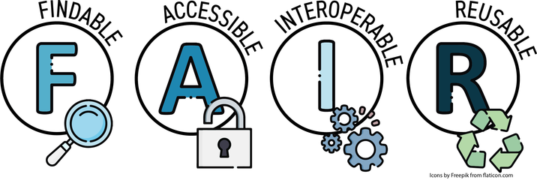
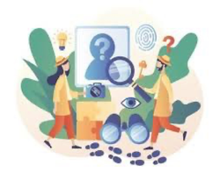
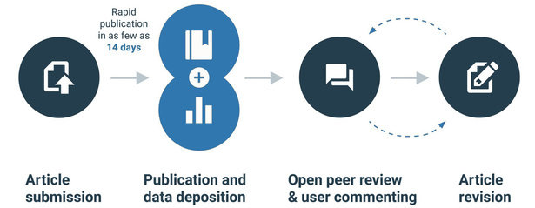

Open Science Pillars
FAIR DATA, PROTOCOLS AND METHODOLOGIES
OPEN PLATFORMS
OPEN ACCESS
CITIZEN SCIENCE AND CITIZEN ENGAGEMENT IN SCIENCE
NEW RESEARCH ASSESSMENT MODELS
OPEN PEER REVIEW
"Open Science at UAM: Trends and Achievements". NAPMIX Training Workshop 2026, Madrid, 19 May 2026
Notes:
But, before entering into details on the practical actions at UAM, I want to introduce the Open Science pillars that frame UAM actions.
First, Open Access: making research outputs openly accessible, which improves visibility, dissemination and knowledge transfer. For many researchers, this is the first entry point into Open Science
Second, FAIR data- FAIR is about making data and methods findable, accessible, interoperable and reusable, so results can be verified, reproduced, reused, and extended.
It’s also about reducing friction: ensuring that data can be understood by someone outside your lab.
If I understood correctly, this is exactly the challenge NAPMIX is tackling: integrating a metadata schema into Research Data Management workflows and strengthening interoperability with existing infrastructures, so that FAIRness is built into the process rather than added at the end.
Third, open platforms, including open educational resources — providing open access to infrastructures and supporting long‑term sustainability and availability
Fourth, open peer review, which strengthens rigour and transparency and increases accountability in evaluation
Fifth, citizen science and citizen engagement: involving society across the research cycle, co‑creating knowledge around societal challenges.
And finally, new research assessment models. This matters because incentives shape behaviour. If we want researchers to invest time in good RDM, high‑quality metadata, and data sharing, those contributions need to be recognised.
But to make these pillars real, we need coordination— so let me show you UAM’s governance structure

Slide 3
Open Science at UAM: Institutional Positioning
Open Science Technical Committee (since 2022)
Team Composition
Leading
Vice-Rectorate for Research Policy
Assistant Vice-Rector for the Internal Research Plan
Open Science Officer at the Vice-Rectorate for Research Policy
Research Unit
University Library
Publishing Service
Doctoral School
Ethics Committee
Teaching Innovation Unit
Vice-Rectorate for Internationalisation
Science Communication Unit
Academic staff representatives
Vice-Rectorate for Research Policy
"Open Science at UAM: Trends and Achievements". NAPMIX Training Workshop 2026, Madrid, 19 May 2026
Notes:
Open Science at UAM is supported by an institutional structure
Since 2022, we have an Open Science Technical Committee that brings together the key parts of the university that shape research practice:
the Vice‑Rectorate for Research Policy, the Research Unit, the Library, the Publishing Service, the Doctoral School, the Ethics Committee, the Teaching Innovation Unit, the Internationalisation Vice-Rectorate, the science communication unit, and academic staff representatives. The purpose is coordination: aligning policies, services, training, and support to make Open Science practical and consistent across disciplines.
Why is this important for an event like NAPMIX? Because implementing FAIR in a lab is not only a technical problem. It requires institutional coordination: clear guidance, stable services, and consistent expectations across disciplines.
One of the easiest entry points for the university community is a website — let me show you what you can find in our Open Science webpage.

Slide 4
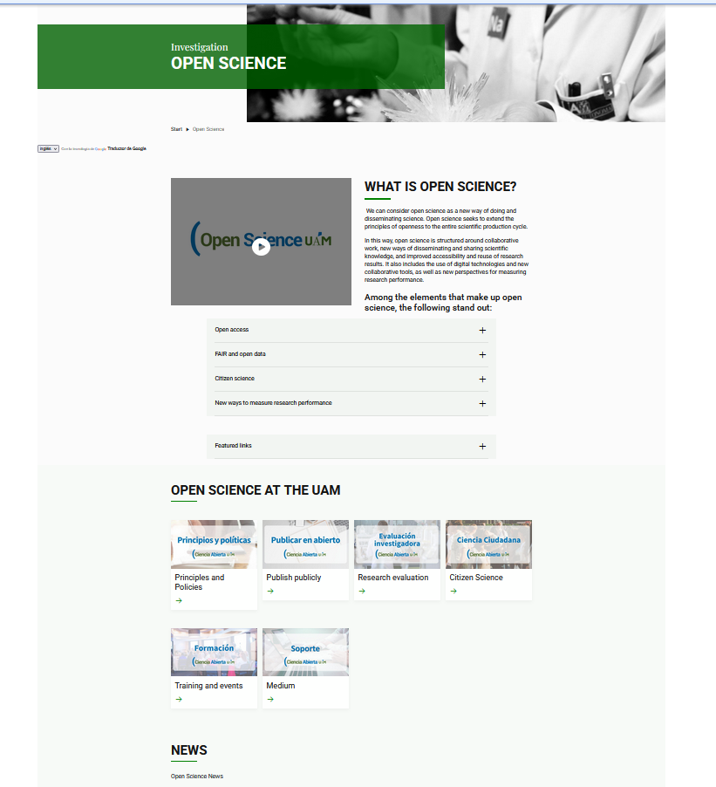
Open Science webpage
  Introduction of Open Science and its pillars
  Resources offered and actions being taken by UAM
  News on events, publications, etc.
"Open Science at UAM: Trends and Achievements". NAPMIX Training Workshop 2026, Madrid, 19 May 2026
Notes:
So, the UAM OS webpage is designed as a practical hub: an introduction to Open Science and its pillars, a structured overview of resources offered and action being taken by UAM, and updates on news, events, publications, and activities.
If you’re new to Open Science, this is the best place to start; if you’re already working with Open Access or research data, it helps you find the relevant services.
Now, beyond information, Open Science depends on concrete infrastructures — especially those managed by the Library, in your case, in this workshop.

Slide 5
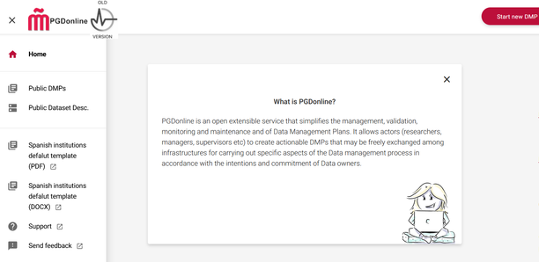
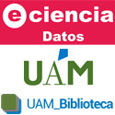
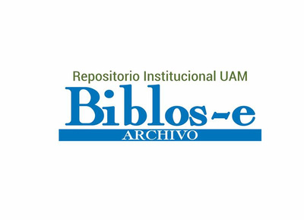
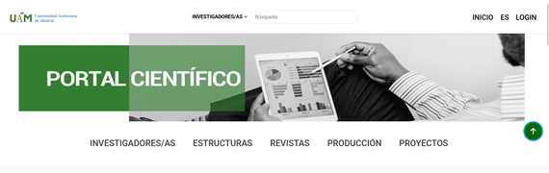
Library-managed infrastructure and services
Biblos-e Archivo: Institutional repository for scientific publications
Research Portal: CRIS UAM Scientific Information System
PGDonline:
Tool for the development of Data Management Plans
e-cienciaDatos:
Research data repository
"Open Science at UAM: Trends and Achievements". NAPMIX Training Workshop 2026, Madrid, 19 May 2026
Notes:
This is where Open Science becomes tangible. UAM’s Library manages key infrastructures and services that support Open Science in practice.
Biblos‑e Archivo is the institutional repository for scientific publications — a core route for making outputs accessible.
The Research Portal, which organises and surfaces research information.
It is not shown on this slide, but the Library is in the final stages of developing the Educational Resources Portal, which will bring together the University's openly available educational resources produced by UAM academics.”
PGDonline is a tool that supports the preparation of Data Management Plans.
And e‑cienciaDatos is the research data repository
But services only help if people know how to use them — so training is the next piece.

Slide 6
OS Courses offered by the UAM
Introduction Open Science
Research Data Management
Publishing in Open Access
Open Science short learning resources for Academics (coming soon)
CIVIS Microcredentials – transversal skills for Phd candidates – OS module
Customised training sessions upon request
Research Data Management Days (2ⁿᵈ EDITION – NOVEMBER 2026)
"Open Science at UAM: Trends and Achievements". NAPMIX Training Workshop 2026, Madrid, 19 May 2026
Notes:
Let me now briefly turn to training.
We currently offer a range of courses on Open Science for early-career researchers — including PhD candidates and postdoctoral researchers — as well as for academic staff.
In addition to this, the Library provides targeted training on key aspects such as research data management and Open Access publishing.
Beyond individual courses, we are also involved in broader initiatives — for example, the CIVIS micro-credentials on Open Science, which promote these skills as transversal competences for early-career researchers.
At the same time, we are developing bite-sized learning resources on specific Open Science topics for academics.
We also offer customised training sessions upon request. This allows researchers and teams to receive support tailored to their specific needs — for instance, when preparing a proposal, developing a Data Management Plan, or managing research datasets.
In parallel, we are organising the Research Data Management Days. And, while I have the opportunity, I would like to mention that the second edition will take place at the end of November.
[Transition]
But training is only one part of the picture. Open Science also has important implications for how research is evaluated — and this is where research assessment reform and CoARA come in.

Slide 7
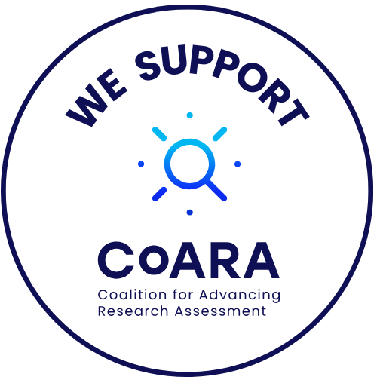
Research Assessment Reform - CoARA
CoARA
  UAM signatory (November 2022)
  CoARA Action Plan (2024–2027)
  CoARA Working Group at UAM
  Member of the Spanish National Chapter
LERAR Project (CoARA Boost project)
  Laboratory of Engagement with Research Assessment Reform in the CIVIS Alliance
  Aim: To promote CoARA within CIVIS and identify best practices in research assessment, building a collaborative network across the Alliance.
"Open Science at UAM: Trends and Achievements". NAPMIX Training Workshop 2026, Madrid, 19 May 2026
Notes:
UAM is a CoARA signatory since November 2022. We have a CoARA Action Plan, and we have established a CoARA Working Group at UAM. We also participate in the Spanish National Chapter.
In addition, the LERAR project — a CoARA Boost funded project — works within the CIVIS Alliance to promote CoARA, identify good practices in research assessment, and build a collaborative network across the Alliance .
So why is this relevant for metadata, Research Data Management and FAIR integration? Because assessment drives what gets prioritised. If careful data stewardship, high‑quality metadata, code, and sharing of reusable datasets are treated as ‘nice to have’, they remain optional and uneven. If they are recognised as part of research quality and contribution, they become embedded in the research culture.
Why does this matter to you, as a researchers in general? Because assessment shapes behaviour: what gets rewarded gets repeated. If we want openness, quality, and societal relevance, assessment needs to recognise a broader range of contributions and impacts.

Slide 8
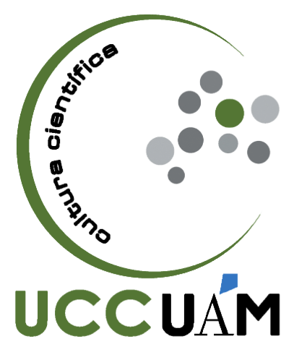
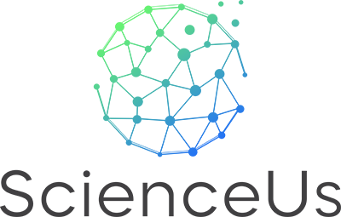
Citizen Science and
Citizen Engagement in Science
ScienceUs Project
Science Communication Unit
  Communicates UAM’s scientific activity
  Promotes public engagement and scientific culture
  Training and research in Science Communication
Objective:
Build an EU‑wide network of interconnected citizen science projects
Key actions
Provide funding and support services to five high‑potential Citizen Science initiatives
ScienceUs Academy
  Strengthen communication, dissemination and knowledge transfer
  Support research data management and DMP development
Notes:
Finally, citizen science and citizen engagement remind us why openness matters: it connects research to societal needs and can strengthen trust in science.
In many fields, citizen involvement can improve data coverage and relevance — and it also raises practical questions about data quality, documentation, ethics, and reuse.
One example that illustrates this is the Horizon Europe project ScienceUs, where we coordinate a consortium of eight research institutions. The aim of the project is to build a network of interconnected citizen science initiatives across Europe, providing funding and support services to 5 high‑potential Citizen Science initiatives
One key aspect we are developing with the 5 projects selected is data management and Data Management Plans. This is essential to ensure that citizen science outputs are trustworthy, reusable, and aligned with FAIR principles — just like the results of any other research project.
At the institutional level, UAM also has dedicated structures such as the Science Communication Unit, which plays a key role in connecting research with society by promoting public engagement and supporting science communication.
Overall, this reflects a core dimension of Open Science: making research more collaborative, inclusive, and closely connected to society.
The broader message here is that Open Science isn’t only about openness for scientists; it’s also about making research more relevant, more trustworthy, and more connected to the world it aims to serve.
To conclude, I would just like to highlight that at UAM, Open Science is supported by structures, tools, and training — and those are here to support you to put Open Science into practice.

Slide 9
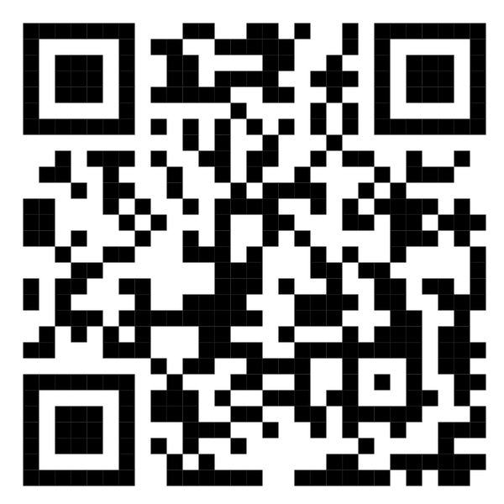
Thank you for your attention
For more information
Rafaella Lenoir Improta
Open Science Officer – UAM
rafaella.lenoir@uam.es
"Open Science at UAM: Trends and Achievements". NAPMIX Training Workshop 2026, Madrid, 19 May 2026
Notes:
Thank you for your attention.

