Slide 2
Controls: Software Interlock System
and Fixed Displays
J. Wenninger, R. Bär
17.04.2026

Slide 3
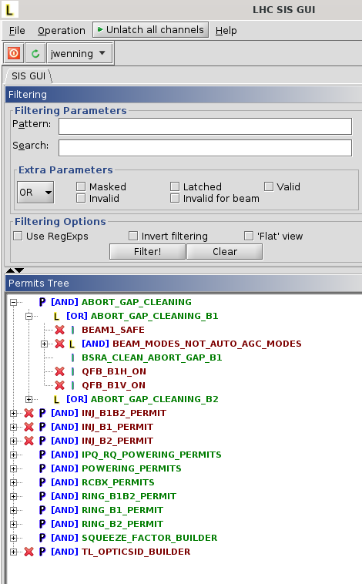
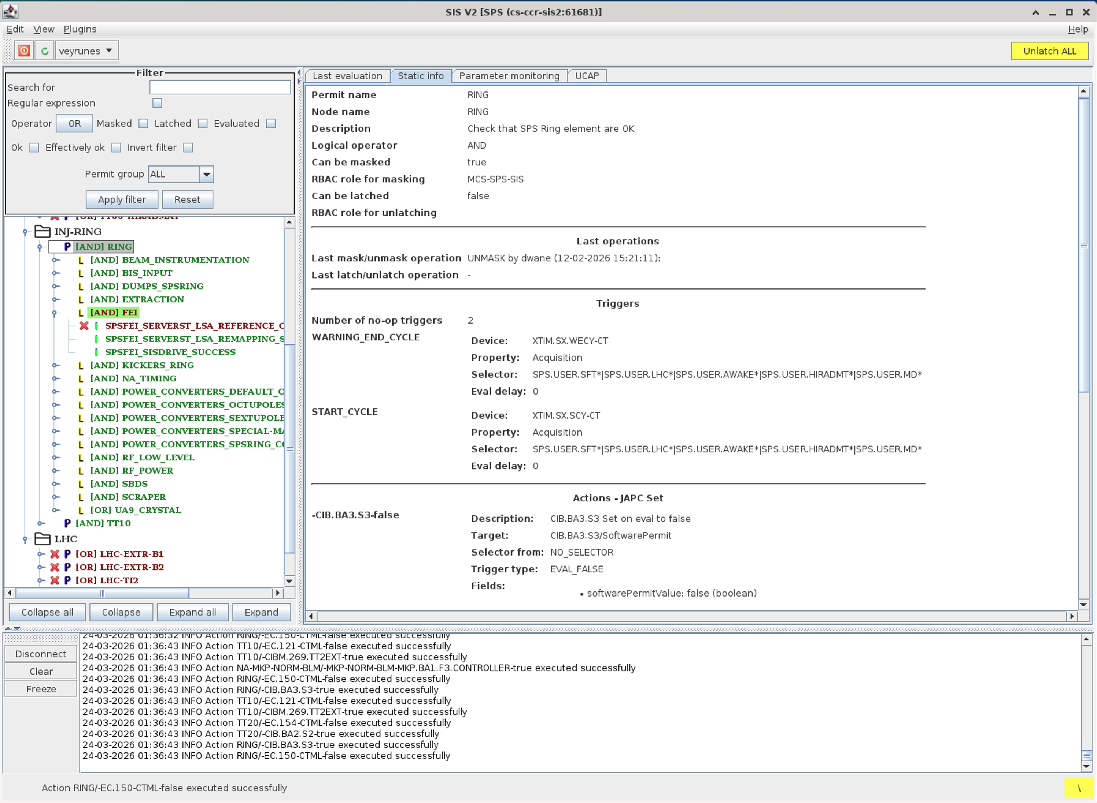
Software Interlock System V2
CERN is currently migrating to V2 of its Software Interlock System (SIS).
V1 in production at CERN for 20 years.
SIS is a JAVA-based framework that based on standard controls elements that are also in production at GSI/FAIR.
SIS is used for interlocking, alarms, vocal warnings and automated actions.
User-configurable (at CERN: by operation group).
SIS would integrate well into the GSI/FAIR environment.
A CERN SPS operation operator who is very experienced in SIS is willing to build a first SIS configuration for FAIR.
CERN contacts: E. Veyrunes,
J. Wenninger, J.B. de Martel

Slide 4
Software Interlock System V2
SIS → SWIS
Complements GSI/FAIR machine protection system, Integrates well in FAIR Beam Interlock System and controls environment
Adds higher complexity interlock handling per instance/machine and automated actions (yet missing functions)
High potential for early commissioning phases and SFRS+ beam commissioning
SWIS prototype planned for Q3/2026 @CRYRING
Prototype runs @GSI (DEV)
Short term: min. add. CERN effort to properly get started:
exposing artifact repositories for dependencies
Slight adaptions of site specifics (selector)
Long term goal: collaboration on SW base w/ contribution in both directions

Slide 5
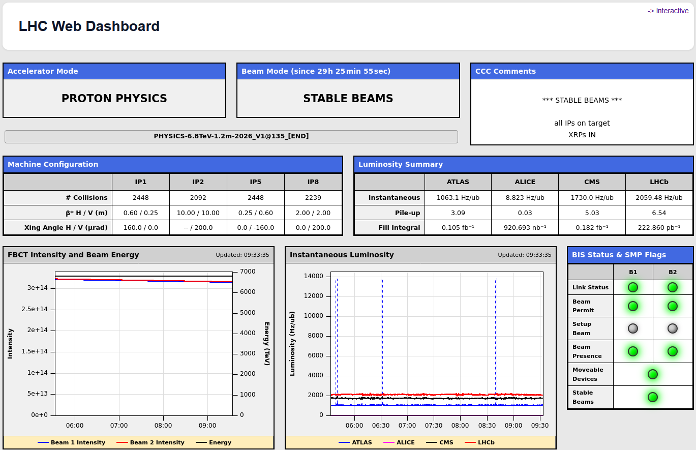
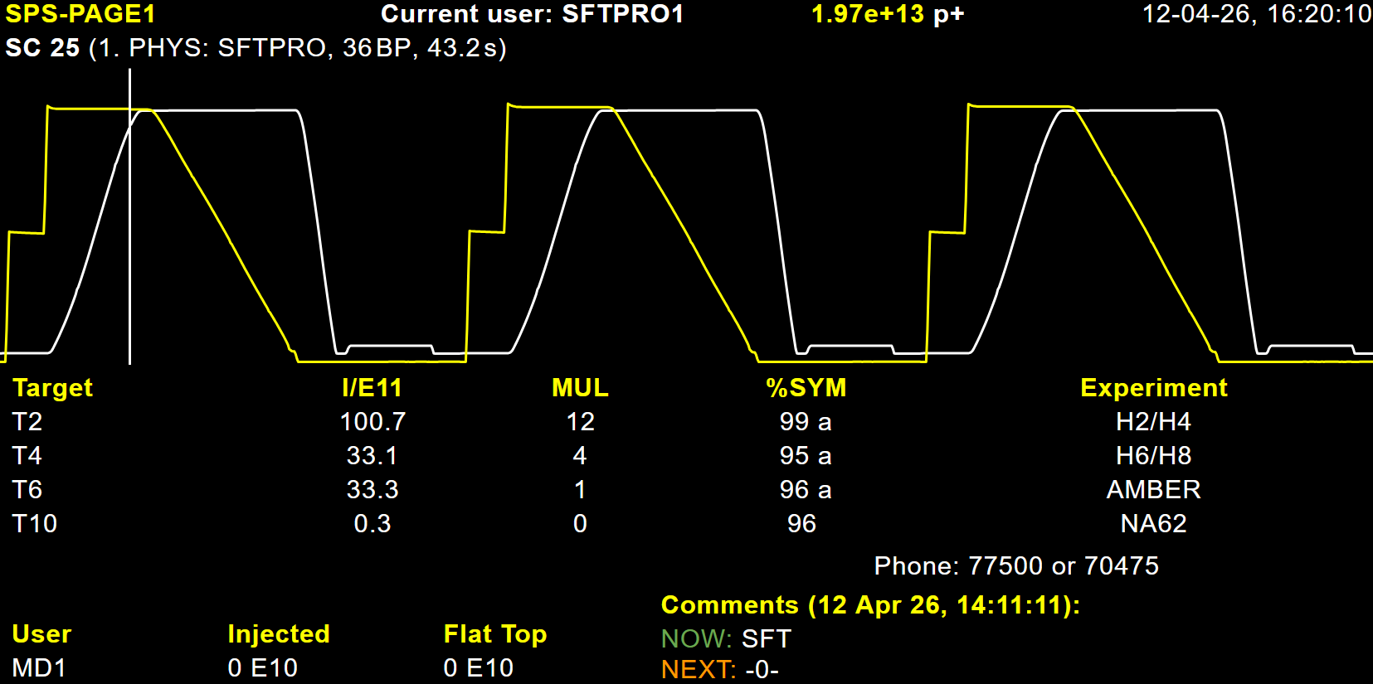
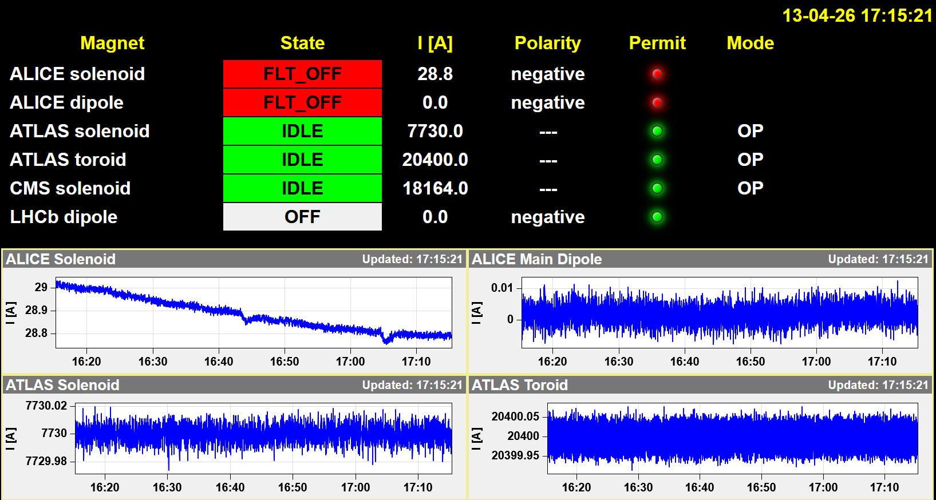
WEB fixed display
The CERN operation group has developped a light-weight fixed-display / dashboard system that is now used to replace older JAVA-based fixed-displays.
Static or dynamic (zoom),
For WEB browsers, but also very good rendering also on smartphones (including zoom).
There is interest by the GSI controls group to perform a technical evaluation of this FD system.
The CERN OP group is willing to support the evaluation process, possibly with a demo use case.
CERN contact: M. Hostettler

