Slide 1
Accelerator Operation and Development: Status and Perspectives
GSI – CERN Collaboration Meeting
20 - 21 Apr 2026
Prof. Dr. Ralph Aßmann
Head Accelerator Operations & Development

Slide 2
Acknowledging the long collaboration from the business area ACC
In addition to the great collaboration on FAIR there are long historical ties between GSI and CERN since the 1970’s:
Linear accelerators
Stochastic beam cooling
Controls
Diagnostics
Beam Cancer therapy
…
Last December we signed several new collaboration amendments:
Beam commissioning
Diagnostics
Controls
Much appreciated! I think these are and will be very important topics!

Slide 3
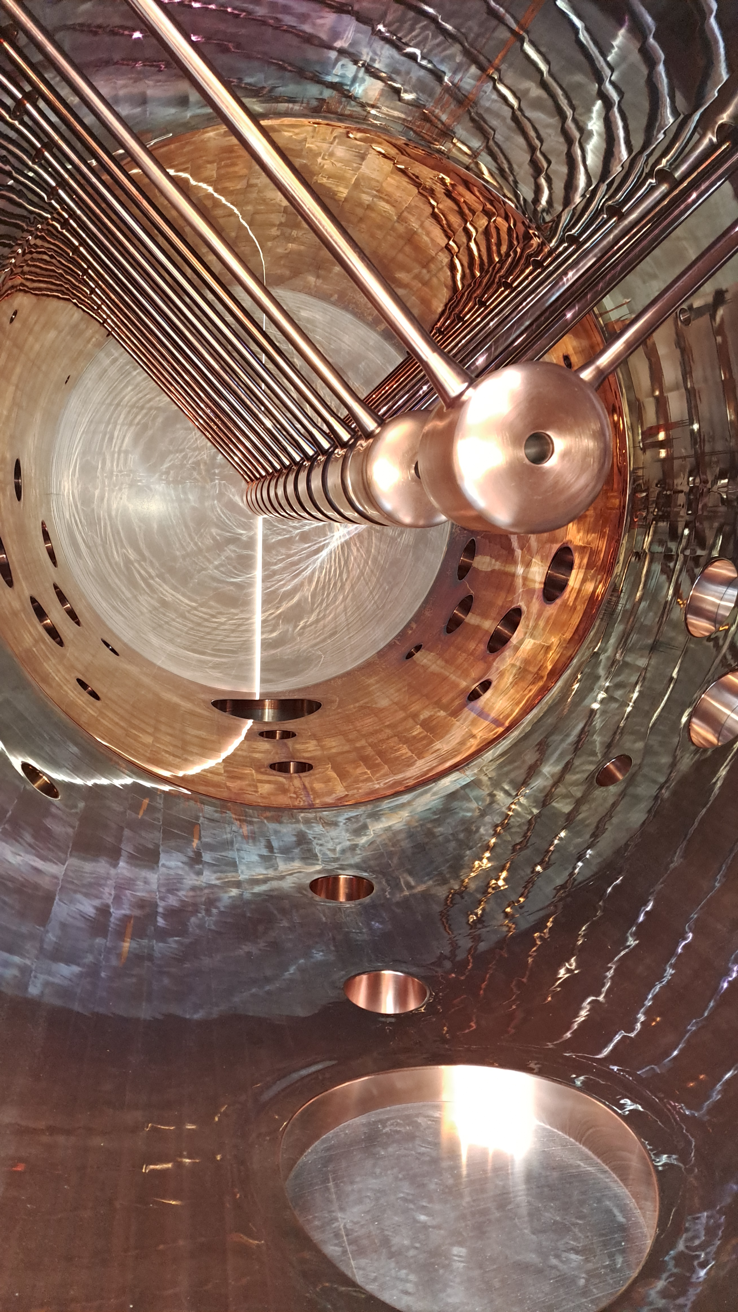
Not to forget: Collaboration in Accelerator Construction also for GSI
We are rebuilding the Alvarez part of the linac, the so-called post-stripper, PSU project, since several years.
We are copper-plating the big tanks in our GSI Galvanic workshop.
For the drift-tubes we profit from a contract with CERN.
And things work very well… MANY thanks!
One issue: Is a prolongation of the contract for Mrs. Roupioz to beyond end August 2027 possible on basis of our collaboration contract? The present contract has zero margin for even slight delays.

Slide 4
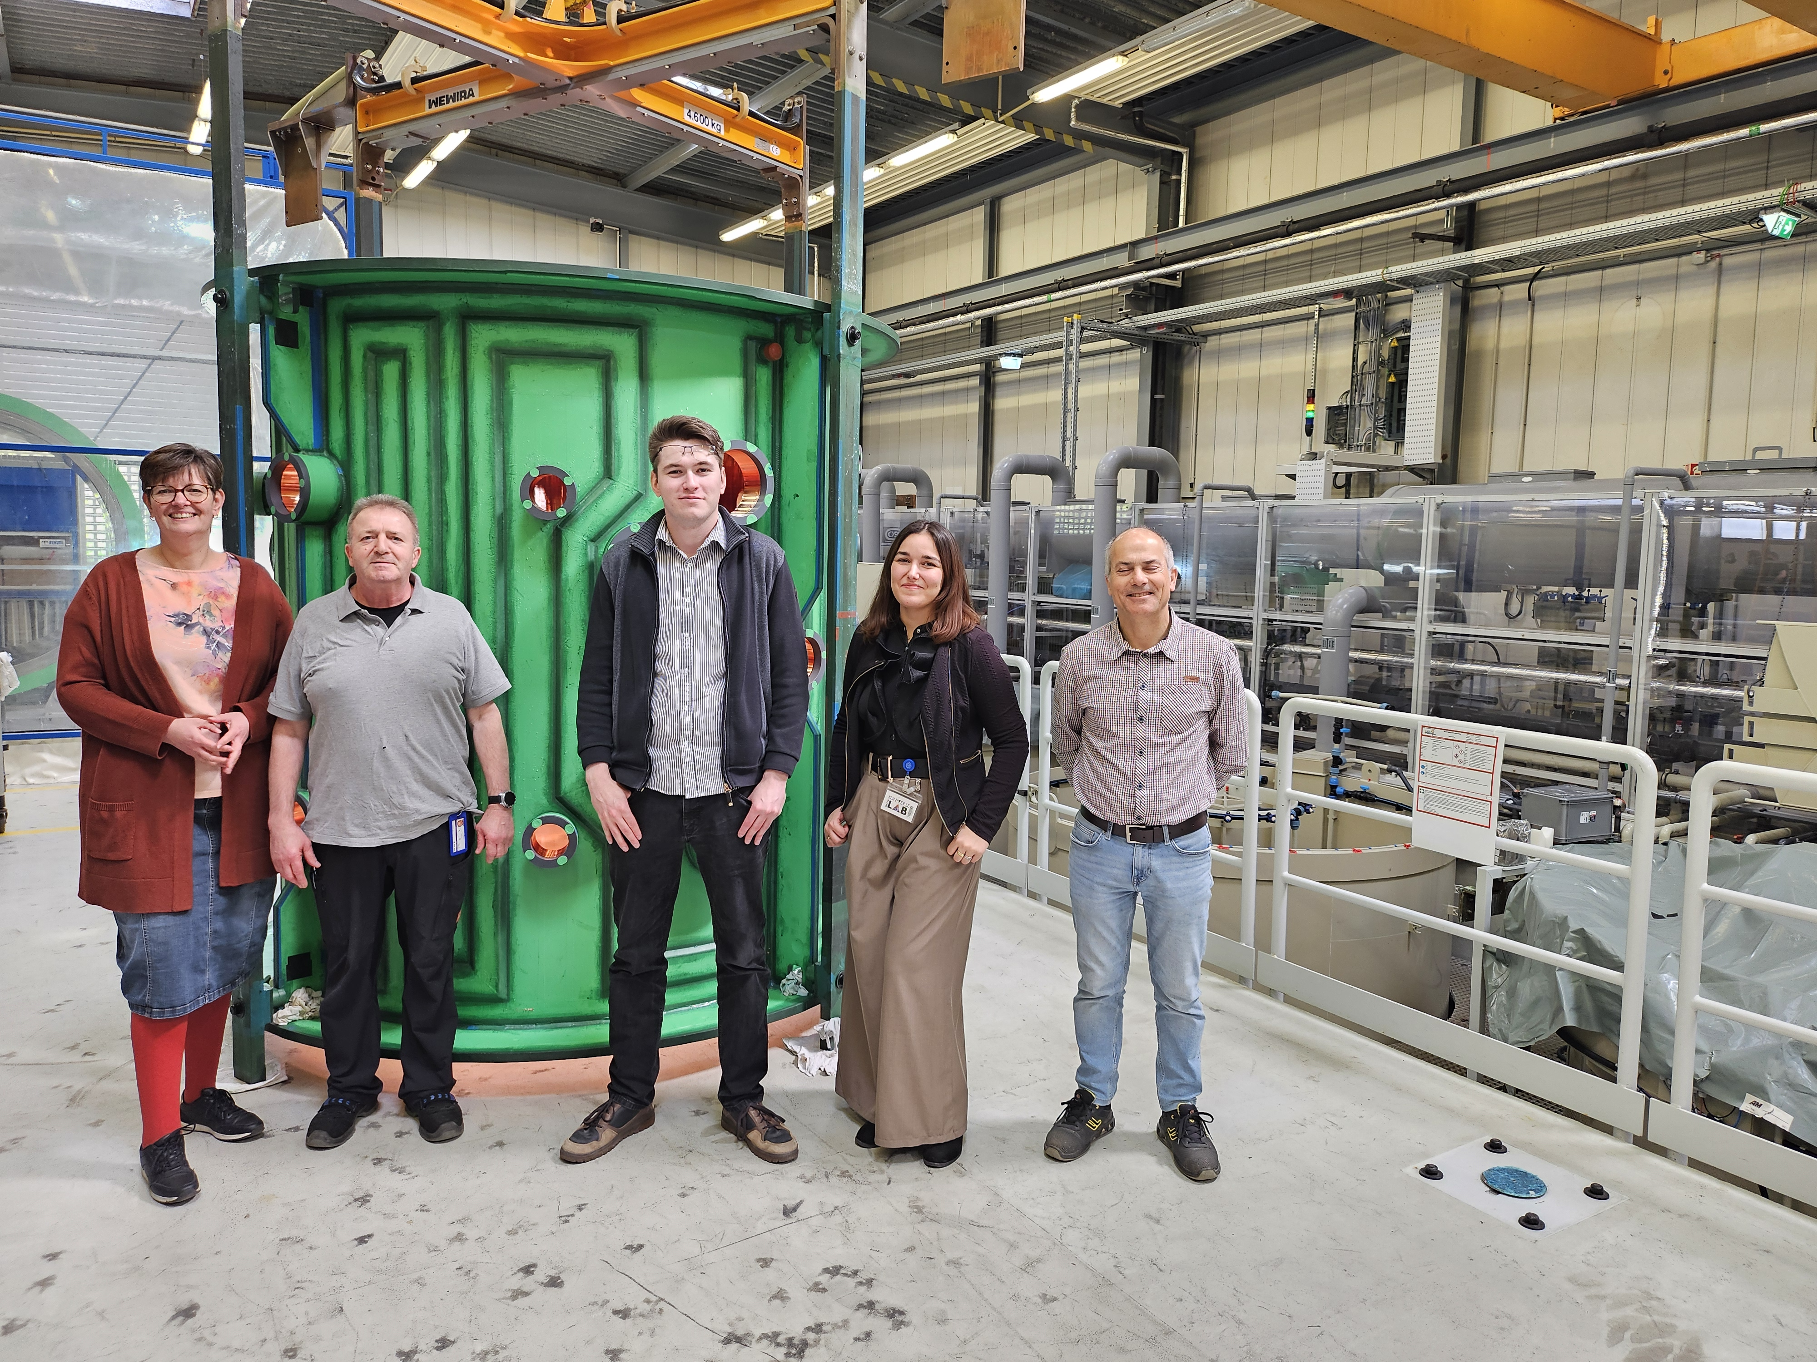
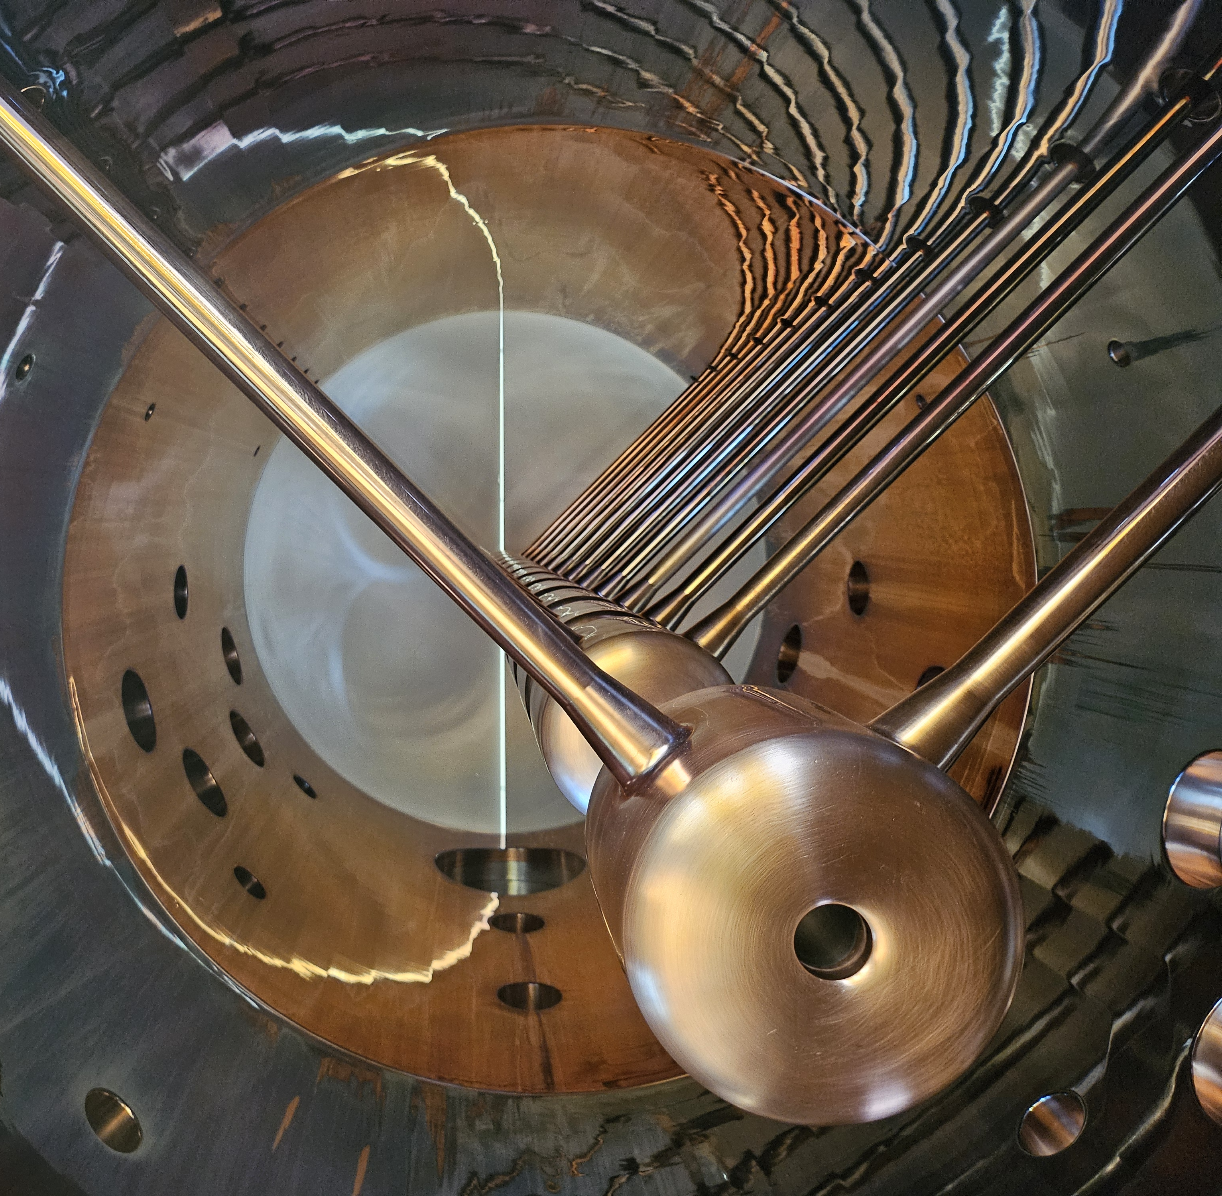
Visit of CERN Colleagues in our Galvanic Workshop this Wednesday
Copper-plating of one of the big Alvarez tanks

Slide 5
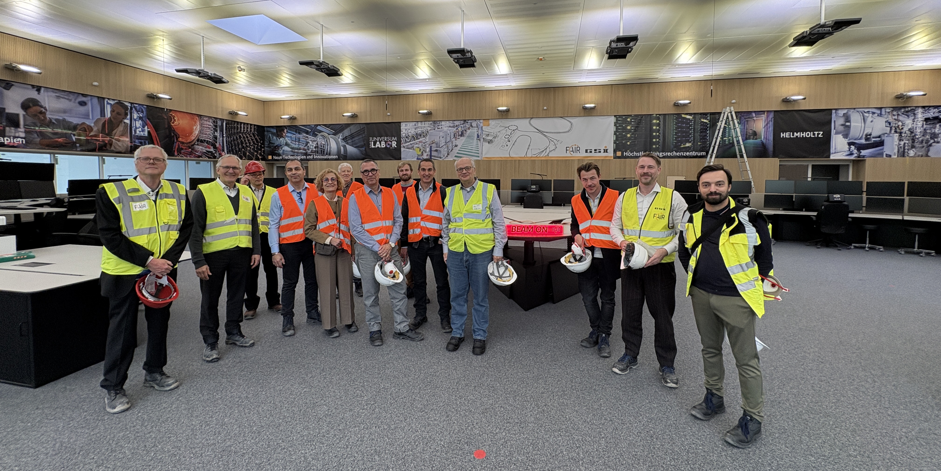
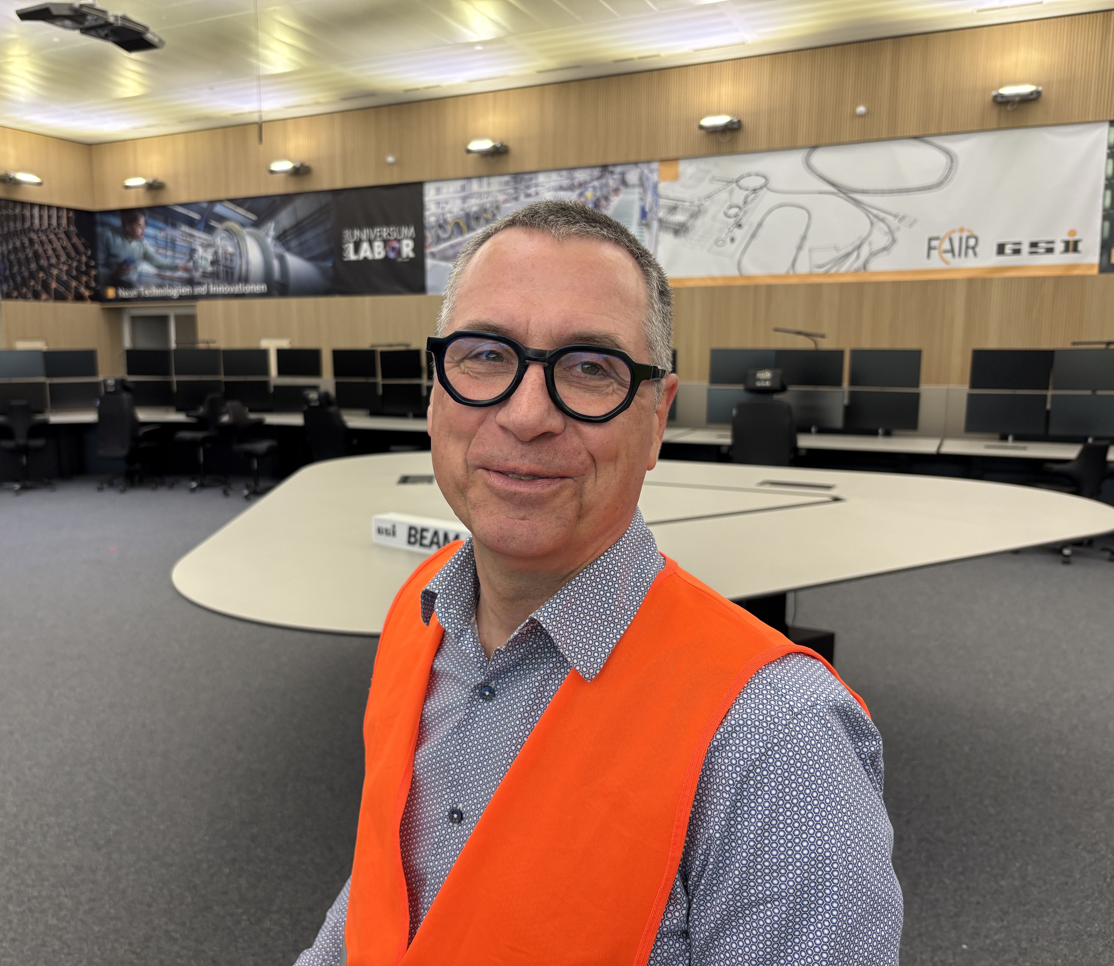
Visit to FAIR Control Center 16 Apr 2026

Slide 6
Content
Original Plan Accelerator Operations
Fire Incident on 5 Feb 2026
Damage and Consequences
Accelerator Task Force on Required Actions and Options
Perspectives: UNILAC Restoration → Project 1
Perspectives: Interim Option(s) → Projects 2 and 3
Restoration Project
Conclusion

Slide 7


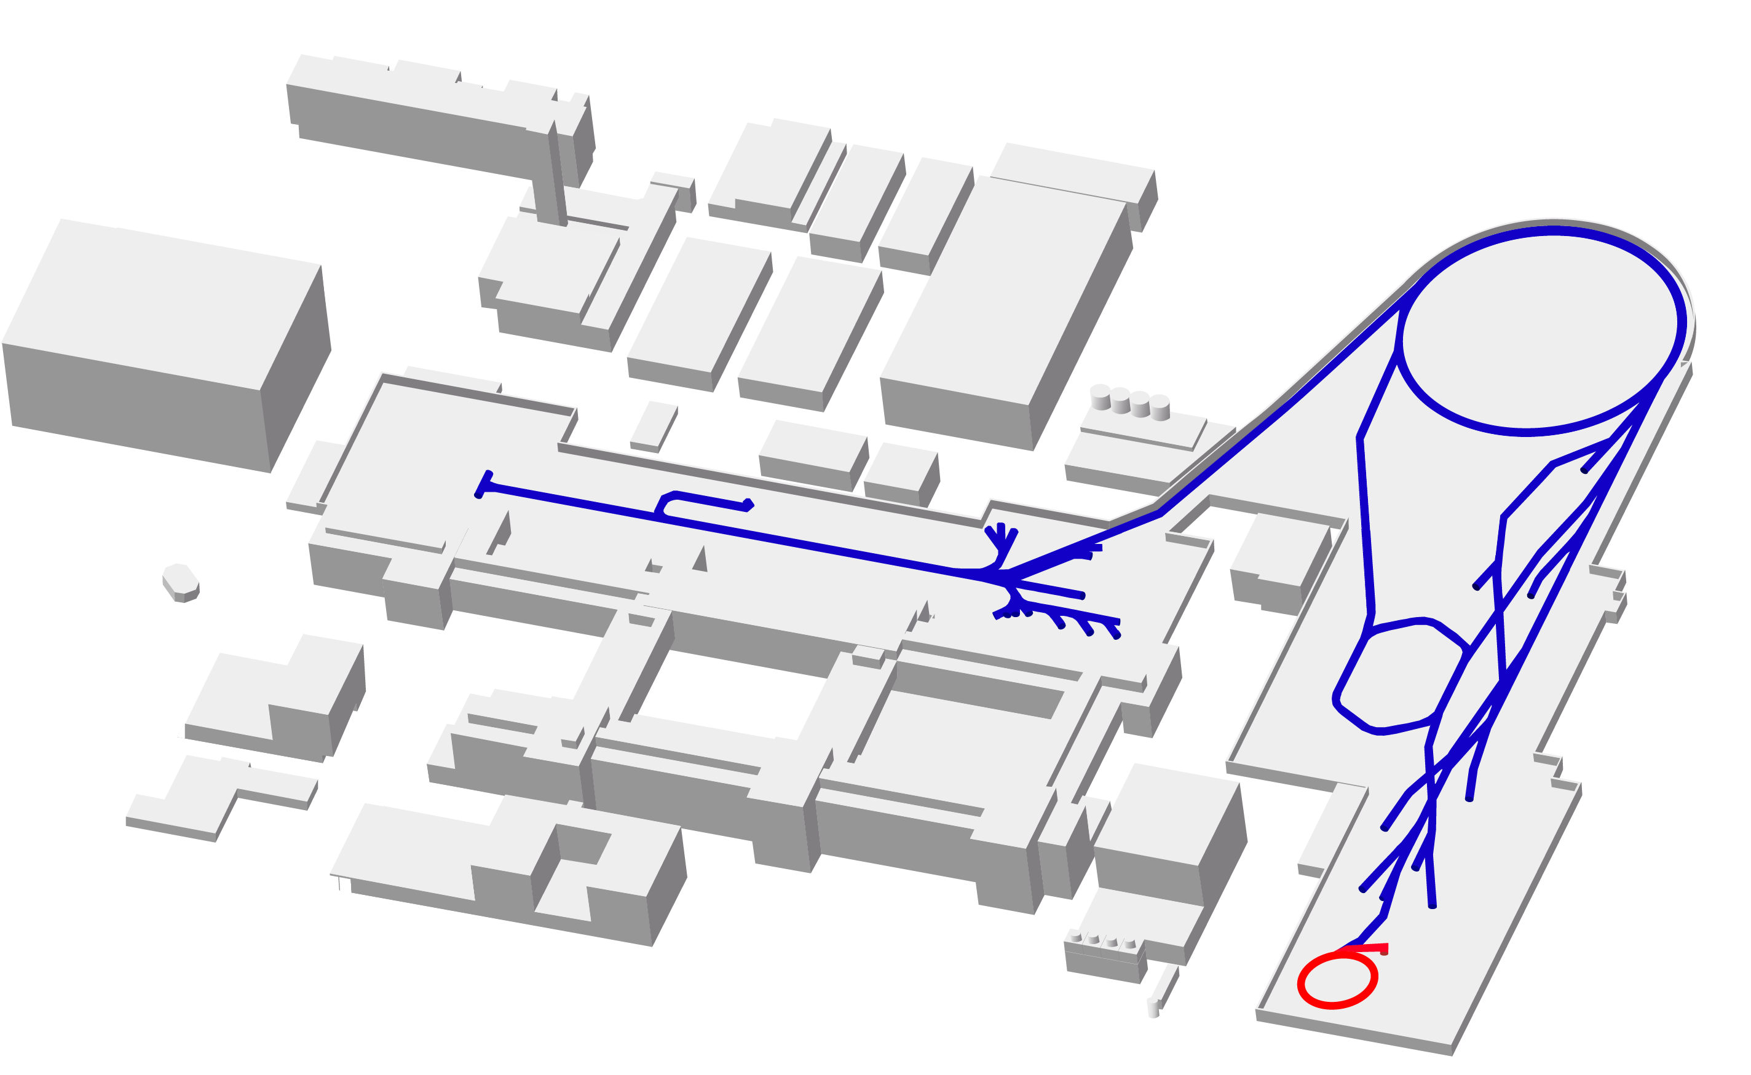

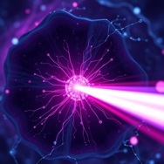


FAIR/GSI Plan End 2028
100 m
Synchrotron ring
SIS-18 (1990)
FAIR Synchrotronring
SIS-100 (2028)
Ion sources
(1991 &1999)
Linear trap
HITRAP (2025)
Transfer
HEST
Linear accelerator
UNILAC (1975)
Storage ring
ESR (1990)
FAIR Super
Fragment Separator
SFRS (2027)
Storage ring
CRYRING (2021)
Heavy ion research
Heavy ion tumor irradiation

Slide 8
Supported by a Detailed Technical Roadmap Prepared 2024 – 2025, presented to supervisory body November 2025 to be adapted after the 05 Feb 2026 fire
D
Decision point
Ongoing: UNILAC upgrade projects including Alvarez 2.0 project
Ongoing: Long-term R&D for frontier ion accel. (→ German hub nuclear physics)
Work effort on automatic procedures, ML, AI for machine operation
 | Consolidation program: components with high failure rates, better availability
 | Design critical systems/components… …for FAIR injection & performance
 | Start to end simulation team for performance checks, upgrade decisions
 | HELIAC project (to be approved and funded)
 |  |  |  |  | Installation HELIAC
 |  |  |  |  |  |  | Installation Alvarez 2.0
 |  |  |  |  |  |  | Improvement program: Upgrade injector complex
Beam time | …from FCC
 |  | FAIR beam comm.
 |  |  |  | FAIR beam operation (full) |  |  | HELIAC as FAIR injector |  | FAIR operation (full)
Ongoing, in funding plan |  |  | Project plan proposed |  |  | New efforts, resources not assigned yet
with Universities F, Da, Mainz, …
D
D
with Universities F, Da, Mainz, …
with Univ. F, Da, Mainz, …
D
with HI Mainz

Slide 9
Technical Roadmap Document October 2025 to be adapted after the 05 Feb 2026 fire
39,5 M€ invest, 2026 – 2034
Prioritised technical measures for GSI facilities:
50% UNILAC
30% SIS-18+HEST
20% ESR/CRYRING/HITRAP
Obsolescence: 80 % of total
UNILAC RF: 35 % of total
Report includes:
Motivation
Prioritisation criteria
POF recommendations
MAC Review of technical roadmap
Risk register
Budget plan
FAIR injector
72 pages

Slide 10
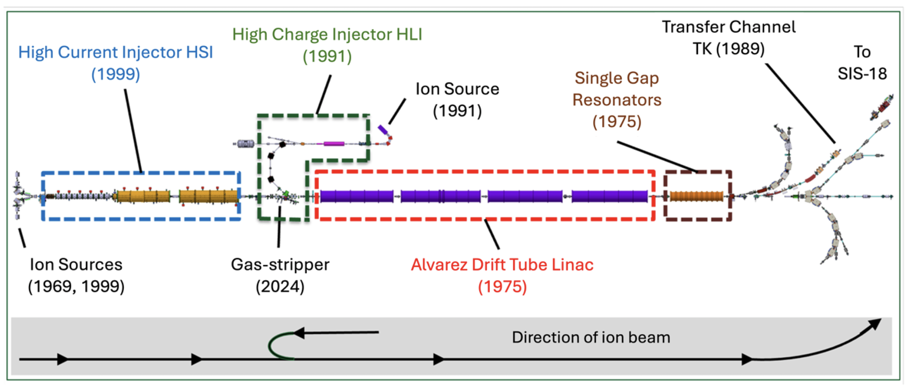
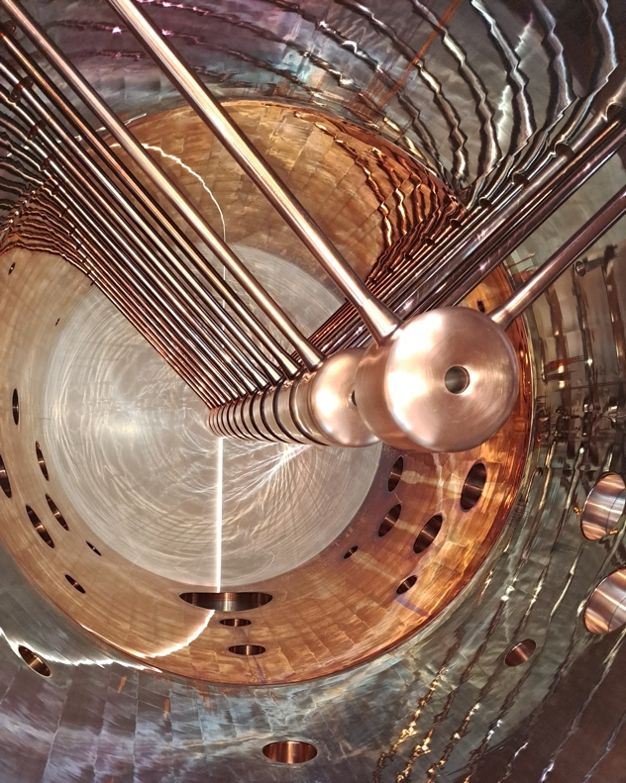
The UNILAC Linear Accelerator Technical roadmap invests: Linac RF, power supplies, HSI, spares, …
→ Alvarez2.0 linac in construction (PSU)

Slide 11
Technical Roadmap Document October 2025
(part of list that shows RF components) to be adapted after the 05 Feb 2026 fire

Slide 12
Content
Original Plan Accelerator Operations
Fire Incident on 5 Feb 2026
Damage and Consequences
Accelerator Task Force on Required Actions and Options
Perspectives: UNILAC Restoration → Project 1
Perspectives: Interim Option(s) → Projects 2 and 3
Restoration Project
Conclusion

Slide 13
Notes on the fire incident of 5 Feb 2026 From the accelerator point of view
January 2026: preparing controls wet run (with beam): readiness of all accelerators to operate from new FCC control room with the new control system.
On 5 Feb preparations for controls wet run (with beam) ongoing, interrupted by a short circuit that started a fire. From available info:
Short circuit in 1 MW anode voltage supply A2. One of several such (big) devices in RF gallery.
Device had been regularly maintained, serviced, cleaned and documented*. Controls modernized. Device in reliable operation in previous years, few weeks before and also night before (25% of maximum power).
Due to high age, device was in risk register and in October 2025 technical roadmap for replacement until 2030.
Preliminary conclusions from available data/observations:
Short circuit likely in input circuit of A2: cause still unknown.
Based on logging and main control room report we presently exclude incorrect settings, incorrect operation, manipulation or sabotage.
Incident rapidly developed heavy smoke, preventing access to the device for two technical teams trying to intervene 15 minutes after short circuit. Fire then spread along RF gallery.
*Not a single personal injury in 51 years of operation in the UNILAC RF gallery. Also, nobody hurt in fire incident.

Slide 14
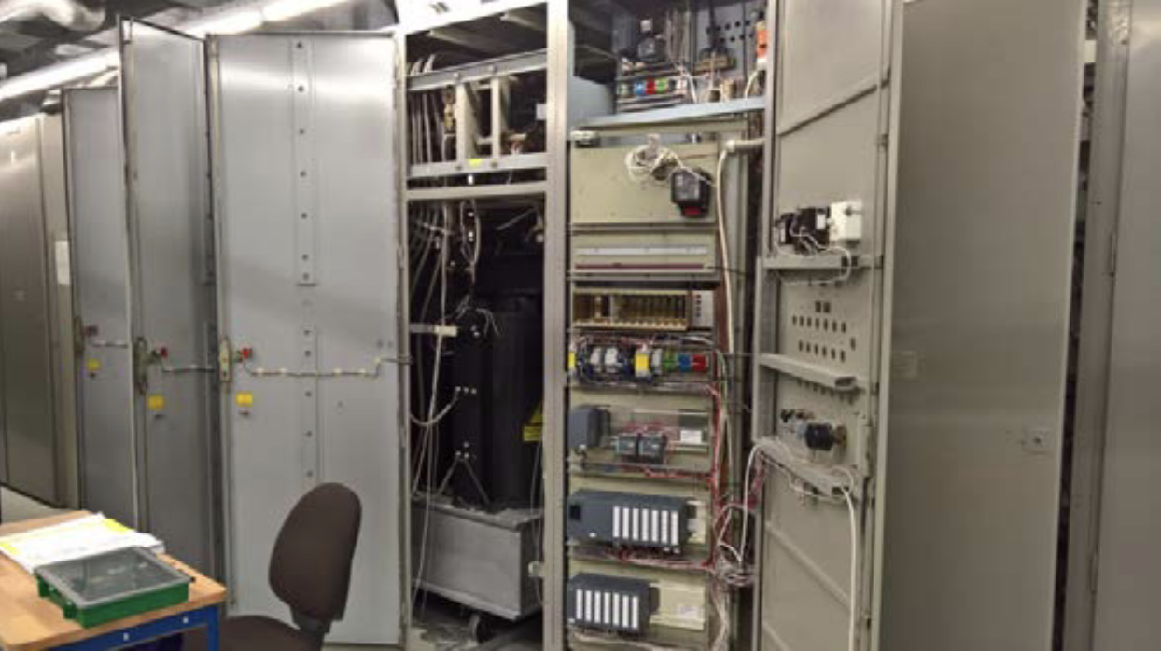
The Alvarez Power Supply Unit A2
System: Air-cooled anode voltage power supply
System history: from 1974/75: capacitors, coils, starting resistors, cabling, … controls had been modernized
Input: 20 kV AC
Output: 18 kV DC (24 kV max, not used)
Principle: classical transformer/rectifier
Tube protection: ignitron crowbar
Capacitor bank: ∼ 880 μF
Stored energy: up to 250 kJ @ 24 kV
Dimensions: 8,8 m x 2,1 m x 2,75 m (L x W x H)
Status 5 Feb: operating at < 25% of maximum power, no change in setting since 21:00 of previous evening
Electrical analysis: short circuit, time: 5.2.2026 6:03:08 a.m., 224 ms cut-off time, 40 MJ

Slide 15
Content
Original Plan Accelerator Operations
Fire Incident on 5 Feb 2026
Damage and Consequences
Accelerator Task Force on Required Actions and Options
Perspectives: UNILAC Restoration → Project 1
Perspectives: Interim Option(s) → Projects 2 and 3
Restoration Project
Conclusion

Slide 16
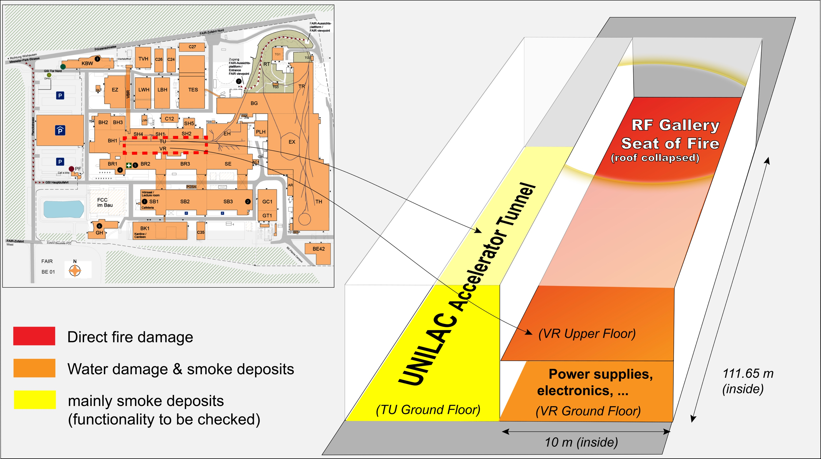
Fire in RF Gallery of UNILAC Linear Accelerator → Damage and Consequences

Slide 17
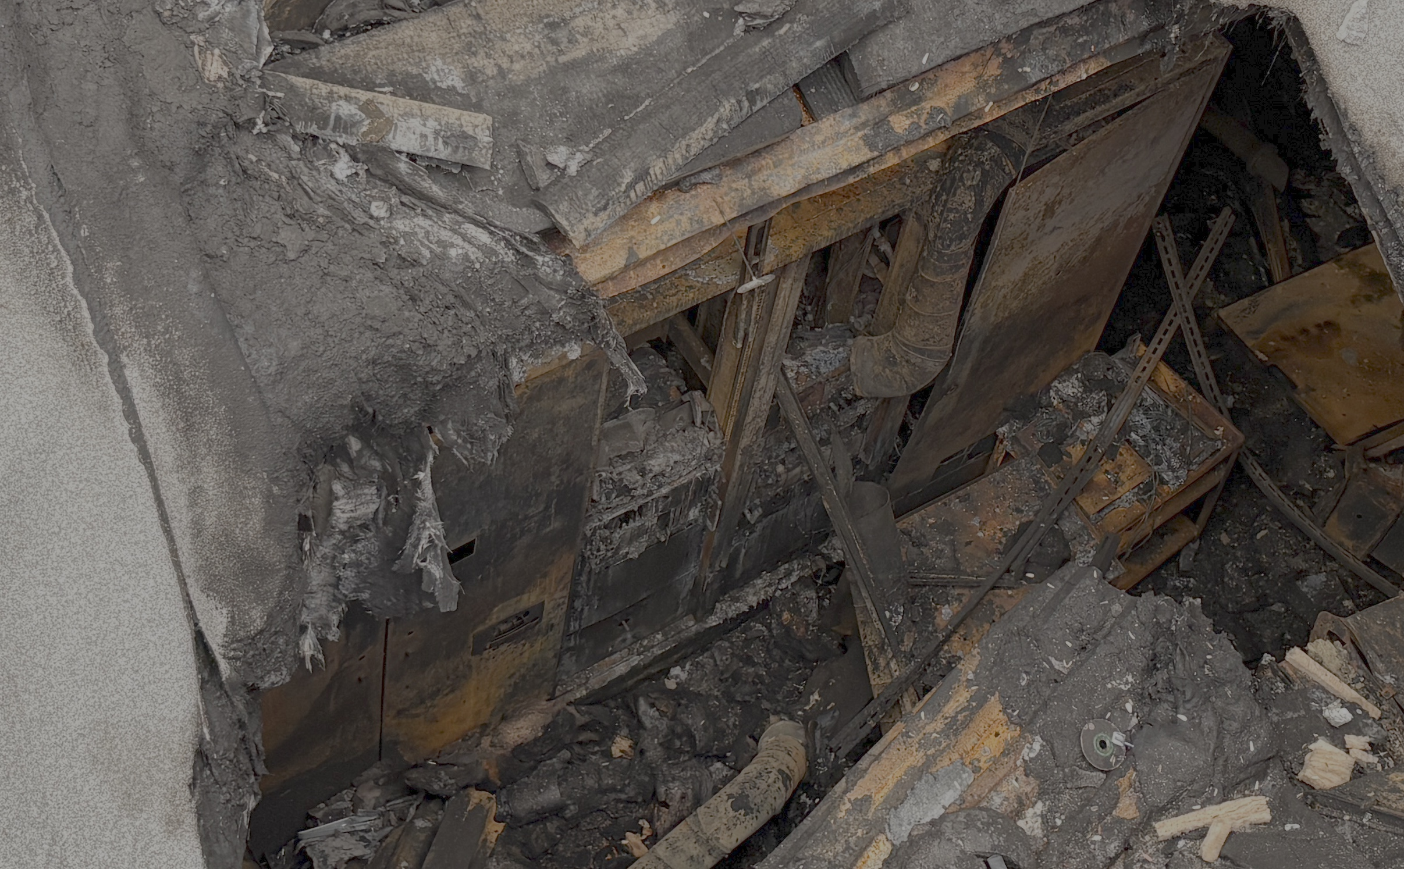
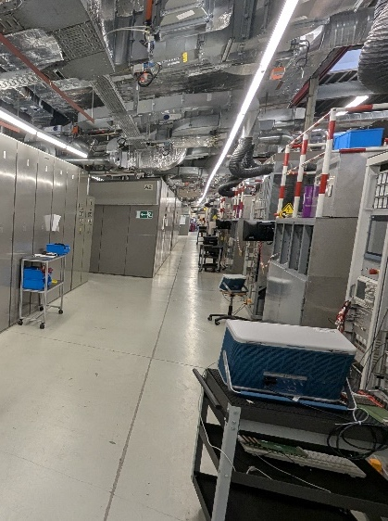
Fire in RF Gallery of UNILAC Linear Accelerator All RF equipment in gallery assumed lost → Procurement

Slide 18
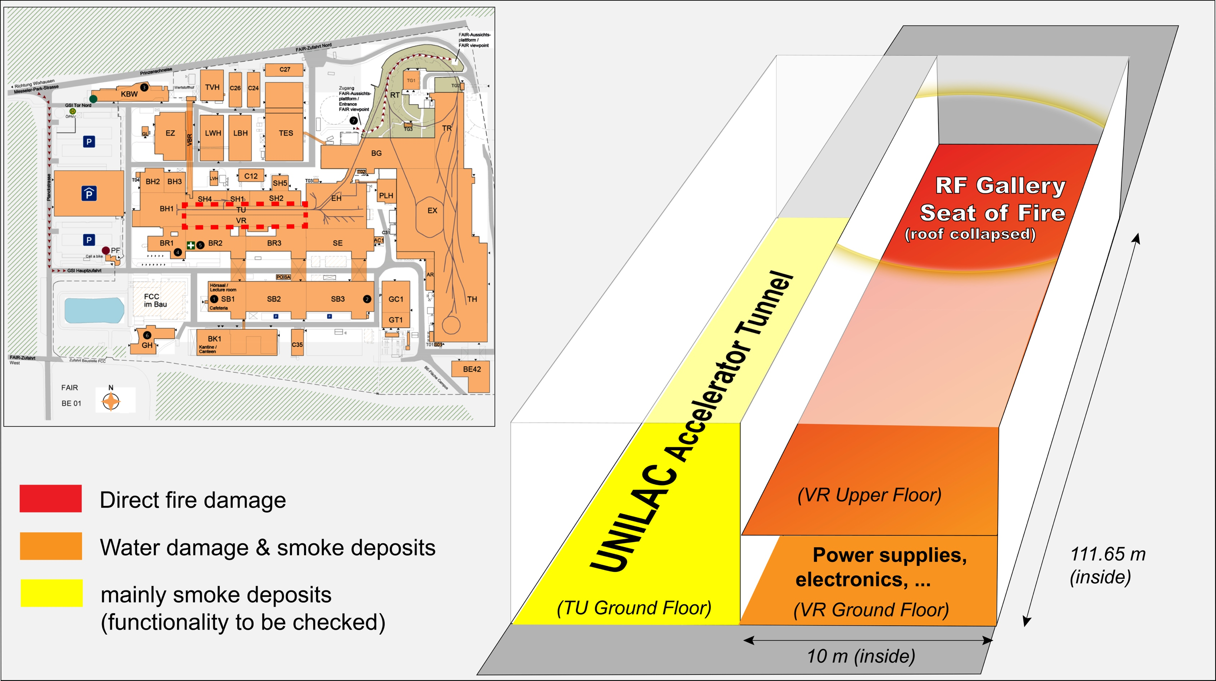
Fire in RF Gallery of UNILAC Linear Accelerator Equipment in VR ground floor → status being checked
Electrical systems (to be checked):
360 power supplies (partially OK)
Vacuum (to be checked):
> 1.253 devices or racks
Beam diagnostic electronics systems:
Destroyed: 20
For repair: 1
Unknown: 14
Controls systems:
Repair requires 2.7 M€ & 24 months

Slide 19
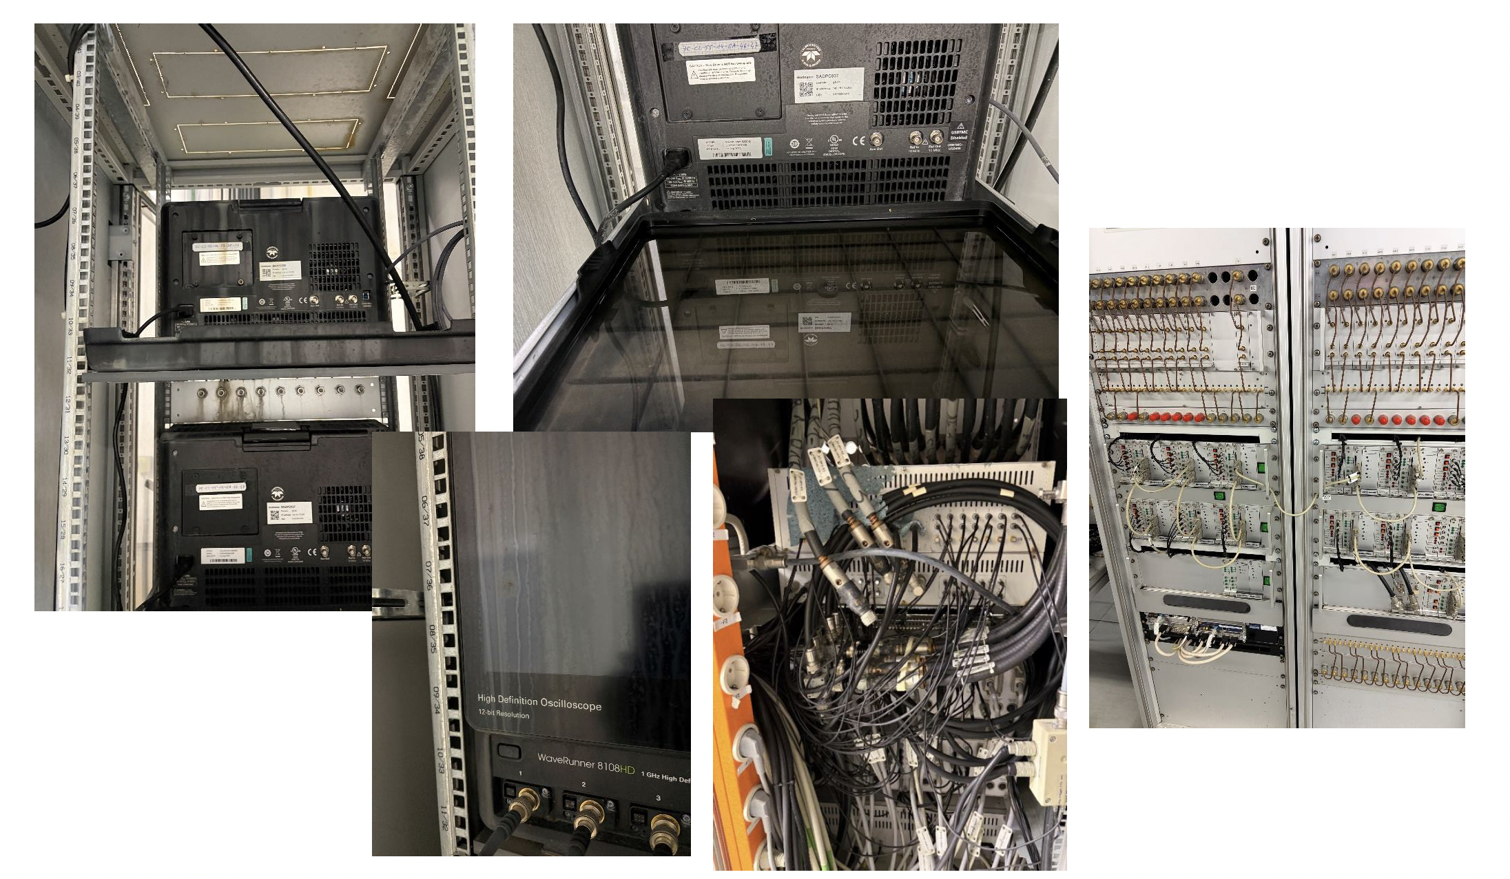
M. Schwickert

Slide 20
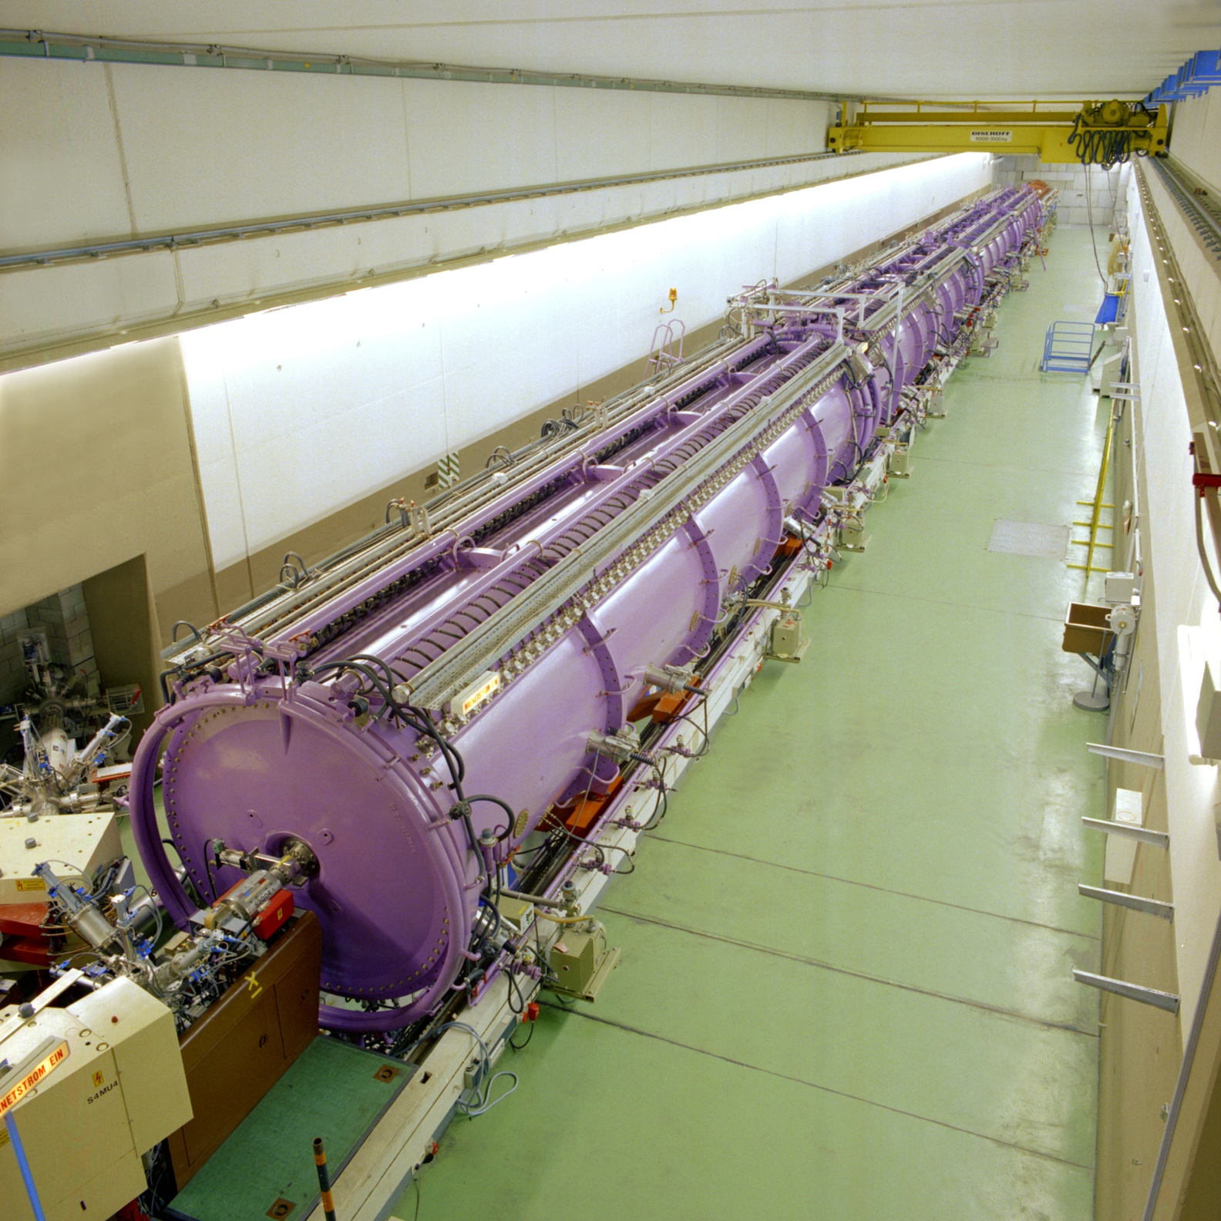
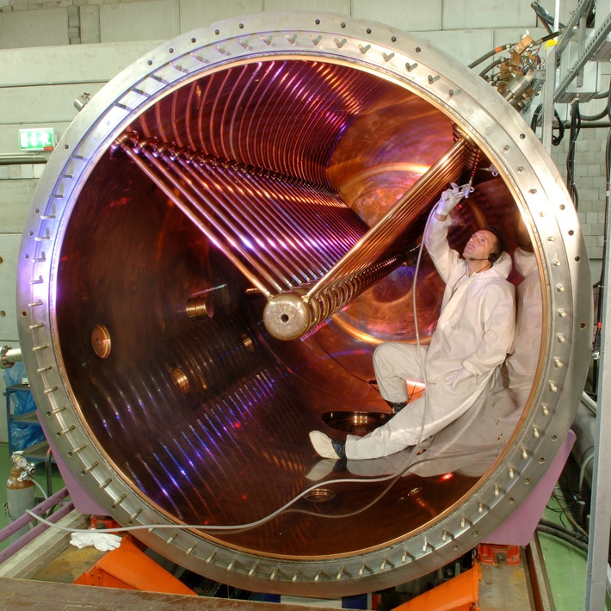
Fire in RF Gallery of UNILAC Linear Accelerator Accelerator to be checked for vacuum + RF performance

Slide 21
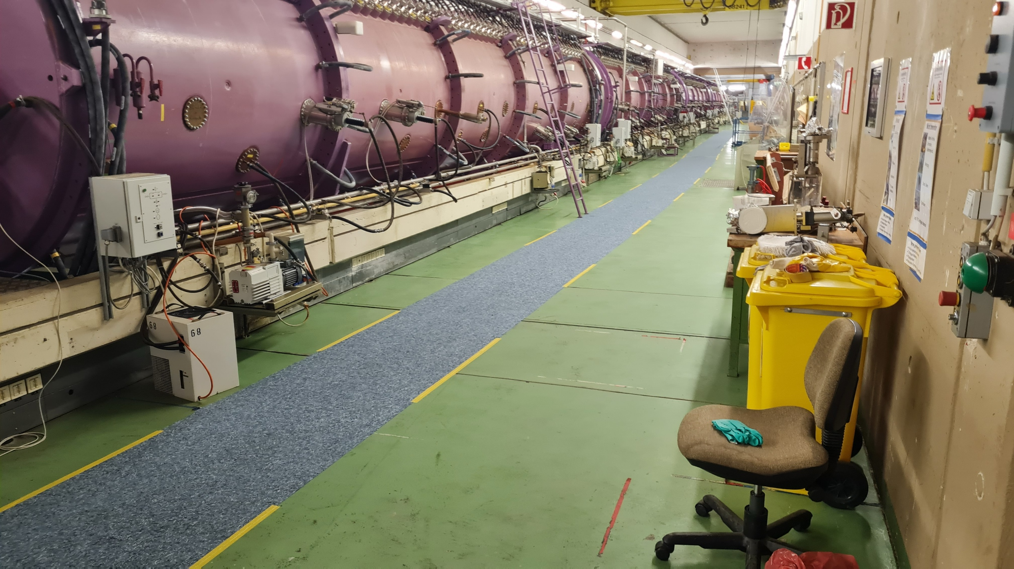
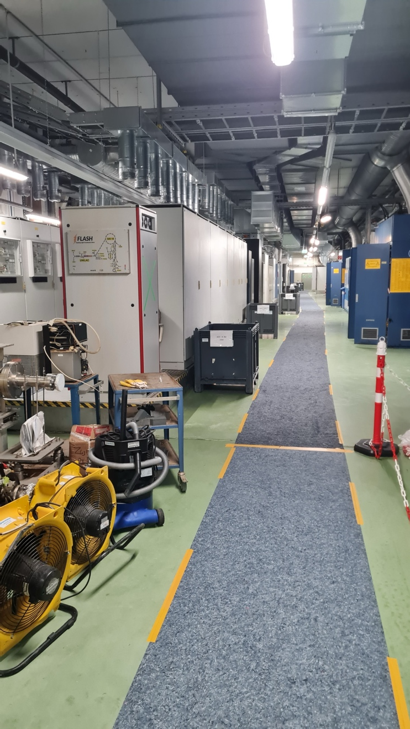
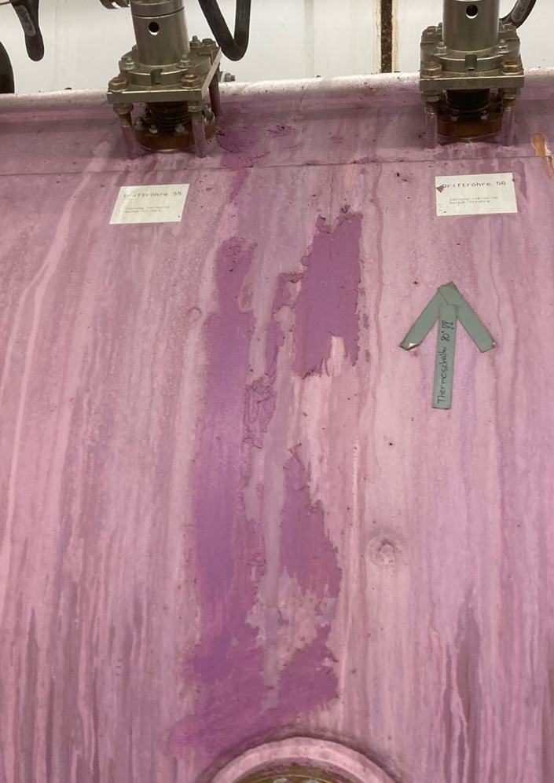
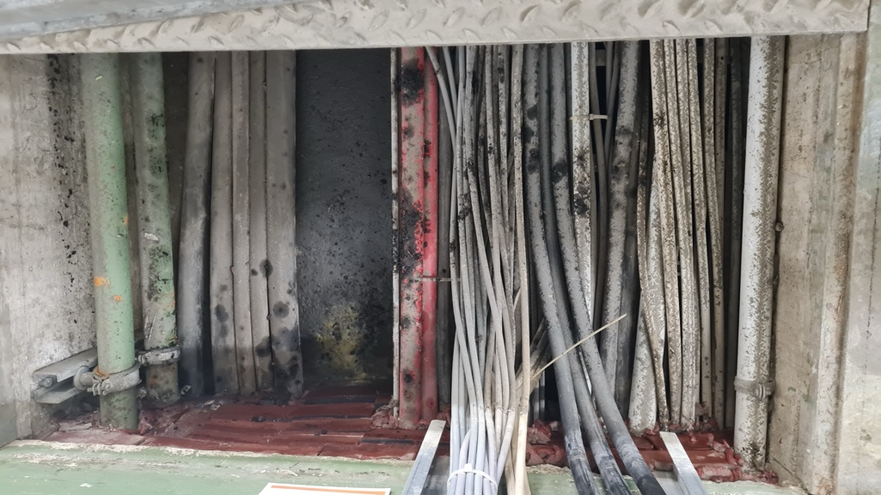
Damage Assessment UNILAC
Task Force 18.3.2026
H. Vormann
Alvarez A3
Floor channel
VR -- HLI-Basement
VR East

Slide 22
Old Plan End 2028
100 m
Synchrotron ring
SIS-18 (1990)
FAIR Synchrotronring
SIS-100 (2028)
Ion sources
(1991 &1999)
Linear trap
HITRAP (2025)
Transfer
HEST
Linear accelerator
UNILAC (1975)
Storage ring
ESR (1990)
FAIR Super
Fragment Separator
SFRS (2027)
Storage ring
CRYRING (2021)
Heavy ion research
Heavy ion tumor irradiation

Slide 23
FAIR/GSI Status 2026
100 m
Synchrotron ring
SIS-18 (1990)
FAIR Synchrotronring
SIS-100 (2028)
Ion sources
(1991 &1999)
Linear trap
HITRAP (2025)
X
Transfer
HEST
Linear accelerator
UNILAC (1975)
Storage ring
ESR (1990)
FAIR Super
Fragment Separator
SFRS (2027)
Storage ring
CRYRING (2021)
Heavy ion research
Heavy ion tumor irradiation

Slide 24
Content
Original Plan Accelerator Operations
Fire Incident on 5 Feb 2026
Damage and Consequences
Accelerator Task Force on Required Actions and Options
Perspectives: UNILAC Restoration → Project 1
Perspectives: Interim Option(s) → Projects 2 and 3
Restoration Project
Conclusion

Slide 25
Workflow
Fire incident
5 Feb 2026
Major damage to UNILAC accelerator & building, multi-year interruption of operation for GSI and FAIR injection
Task Force “UNILAC and FAIR Injector”
12 Feb – 16 Apr 2026
Discussion of multiple conceptual solutions, initial prioritization, performance estimates for scientific evaluation, definition of a focused concept between accelerator and science

Slide 26
Task force “UNILAC and FAIR Injector”
Scope: Review all technical accelerator options available to us
Invited: Z. Andelkovic, R. Aßmann (Chair), R. Baer, A. Blazevic, O. Boine-Frankenheim, M. Galonska, R. Gebel, O. Geithner, P. Gerhard, L. Groening, M. Heilmann, F. Herfurth, C. Hessler, R. Hollinger, S. Litvinov, C. Kleffner, H. Klingbeil, A. Kraemer, G. Loisch, F. Maimone, S. Menke, S. Mickat, C. Muehle, P. Niedermayer, D. Ondreka, V. Plyusnin, H. Podlech, M. Miski-Oglu, S. Reimann, E. Rosi, G. Schreiber, A. Seibel, A. Schnase, M. Schwickert, B. Schlitt, P. Spiller, J. Stadlmann, N. Stallkamp, Y. Valdau, M. Vossberg, H. Vormann, U. Weinrich, H. Welker, N. Winters, C. Zhang, …
Meetings: 12 – 16 – 19 – 24 – 26 Feb 2 – 5 – 18 – 26 Mar – 16 Apr
Thanks to participants and to U. Weinrich and P. Niedermayer

Slide 27
Outcome of the Accelerator Task Force on one slide
Fastest and most efficient UNILAC restoration as the highest priority
As quickly and efficiently as possible implies with new RF of Alvarez2.0 but with old, current accelerator structures (new Alvarez2.0 structures not installed for time being*)
This results in future UNILAC short-pulse operation (1% duty factor with 10 Hz) and the need of HELIAC for Super Heavy Elements research and materials research
Interim solutions for heavy-ion operation are possible
24 options considered, 10 of which were prepared for scientific evaluation (from GSI in-house to industrial solutions to new scientific linacs)
Evaluation Accelerator & Science prioritized two GSI in-house options for FAIR commissioning in 2027(reversed HITRAP ‘de’→’ac’celerator in TK) and science in 2028 (HLI’ with energy booster in EH or elsewhere)
Plan B of the technical sector: Tandetron (not pursued in project for the time being)
*However, the production sequence for Alvarez2.0 will be optimized for the fastest possible installation (if necessary): A1 as soon as possible

Slide 28
A very complex challenge for GSI under extreme time pressure
In-house solutions multiply the in-house workload in parallel with FAIR work:
Existing: New Alvarez2.0 Linac for UNILAC
Existing: CW Demonstrator → SIBAF project. Plan for HELIAC.
NEW: Fastest, efficient UNILAC restoration
NEW: Reversed HITRAP ‘de’→’ac’celerator in TK
NEW: HLI’ with energy booster in EH or elsewhere
NEW: Restoration VR building + technical infrastructure (in Bau/GAT)
Projects must be coordinated in detail and must remain coordinated
Projects access the same resources and competences
Need for an overall project in which sub-projects are coordinated

Slide 29
Content
Original Plan Accelerator Operations
Fire Incident on 5 Feb 2026
Damage and Consequences
Accelerator Task Force on Required Actions and Options
Perspectives: UNILAC Restoration → Project 1
Perspectives: Interim Option(s) → Projects 2 and 3
Restoration Project
Conclusion

Slide 30
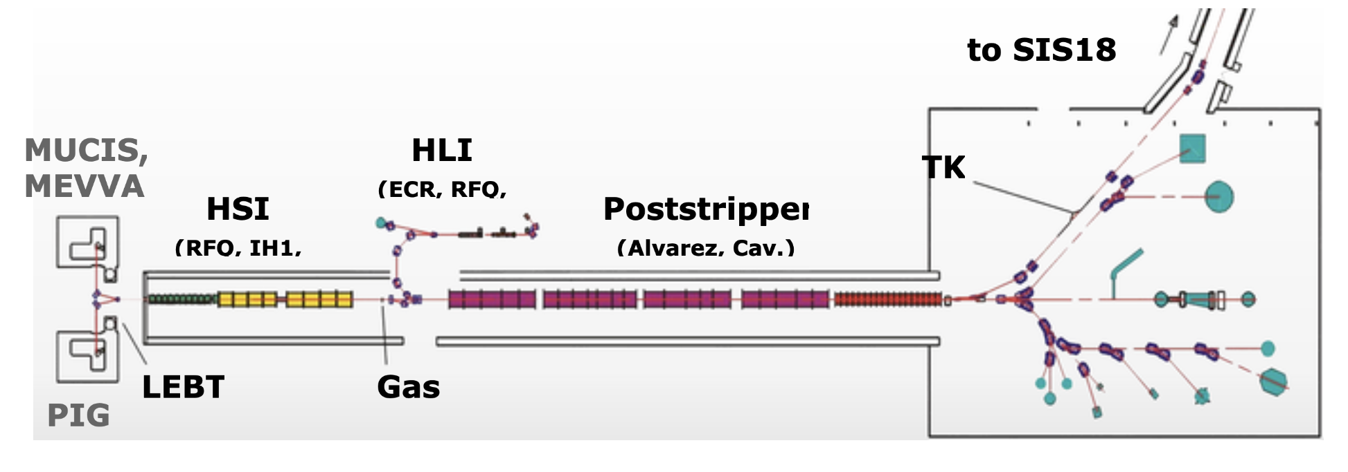
UNILAC Perspectives: Status
X
X
X
X
X
X
X
X
X
High Current Injector HSI → FAIR science, including U, but 36 MHz RF will come in few years
High Charge Injector HLI → Low A/z, but lower power 108 MHz available in mid-2027

Slide 31
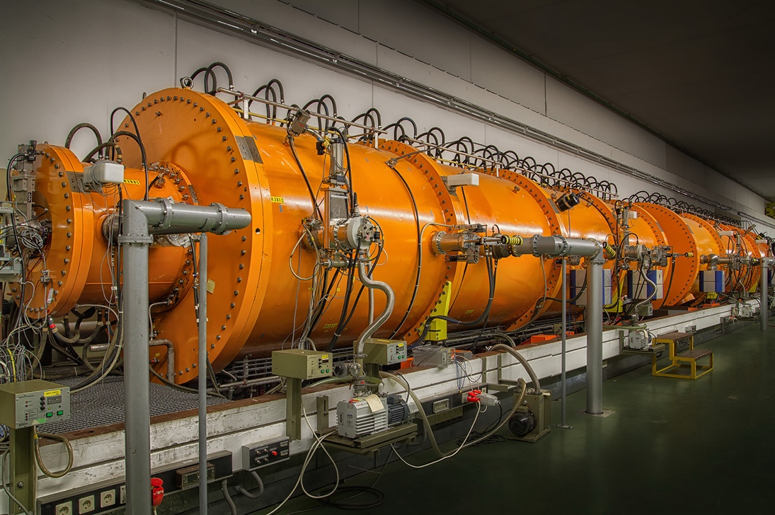
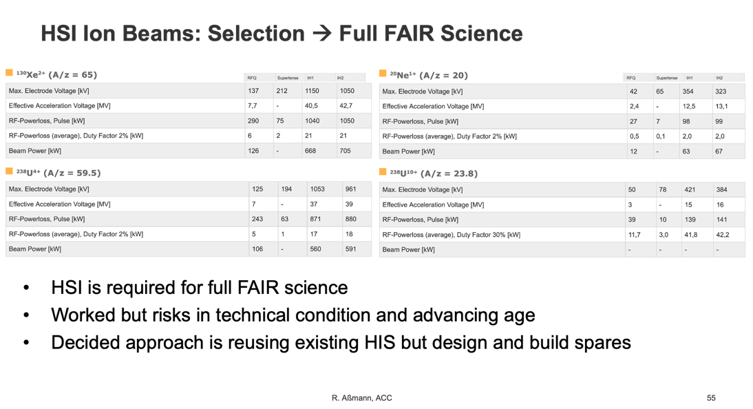
UNILAC Restoration → Project 1
The first priority is to secure and to restore the UNILAC:
No delays allowed, only way to offer full FAIR science. Mainly low conceptual and technical design risks due to preparatory work for the new Alvarez2.0 in UNILAC (2017 decision, ongoing project). New RF partially designed and prototyped. Other RF devices profit from work with companies for technical roadmap. Risk lies in procurement times, in technical condition of HSI high-current injector and UNILAC after fire incident.
Vacuum performance tested very soon now, safe condition to be established (cooling water circulation, vacuum or protective atmosphere).
Other challenges in UNILAC beam instrumentation, controls, …
New UNILAC has short-pulse and 10 Hz operation → need for parallel construction of the HELIAC for SHE and material research.

Slide 32
Project 1: Step-Wise UNILAC Restoration
Fastest path to UNILAC operation:
use existing, established UNILAC RF structures with new RF (and cables!?). Alvarez2.0 installation will not be advanced.
However, risks of major delays if we find issues late. E.g. in case of damage to Alvarez RF structures we will install Alvarez2.0 RF structures.
Cannot wait for full completion of RF gallery before we start re-equipping and start testing the UNILAC functionality.
Therefore agreed with Bau/GAT that we will aim at stepwise approach:
finish one section of RF gallery, such that we can install RF
test the A1 RF structure with full power.
Goal: HLI and A1 of UNILAC back in operation by end 2028 or beginning 2029. With or without beam to be decided → required “Baufreiheit”

Slide 33
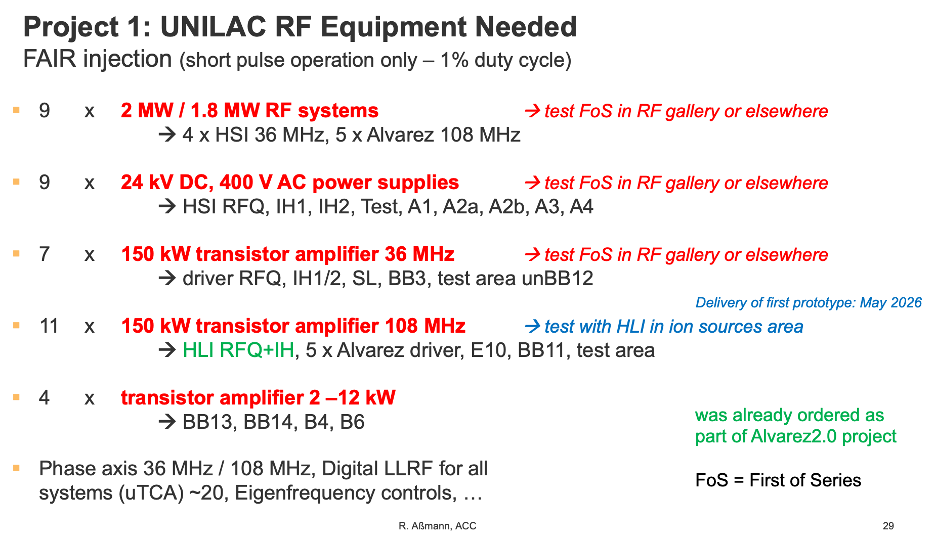
Project 1: Step-Wise UNILAC Restoration
Fastest path to UNILAC operation:
use existing, established UNILAC RF structures with new RF (and cables!?). Alvarez2.0 installation will not be advanced.
However, risks of major delays if we find issues late. E.g. in case of damage to Alvarez RF structures we will install Alvarez2.0 RF structures.
Cannot wait for full completion of RF gallery before we start re-equipping and start testing the UNILAC functionality.
Therefore agreed with Bau/GAT that we will aim at stepwise approach:
finish one section of RF gallery, such that we can install RF
test the A1 RF structure with full power.
Goal: HLI and A1 of UNILAC back in operation by end 2028 or beginning 2029. With or without beam to be decided → required “Baufreiheit”
See reserve slides

Slide 34
UNILAC Perspectives: Goal End 2028 Sufficient RF (108 MHz) to equip HLI and A1
X
X
X
X
X
X
X
X
X
High Current Injector HSI → FAIR science, including U, but 36 MHz RF will come in few years
High Charge Injector HLI → Low A/z, but lower power 108 MHz available in mid-2027

Slide 35
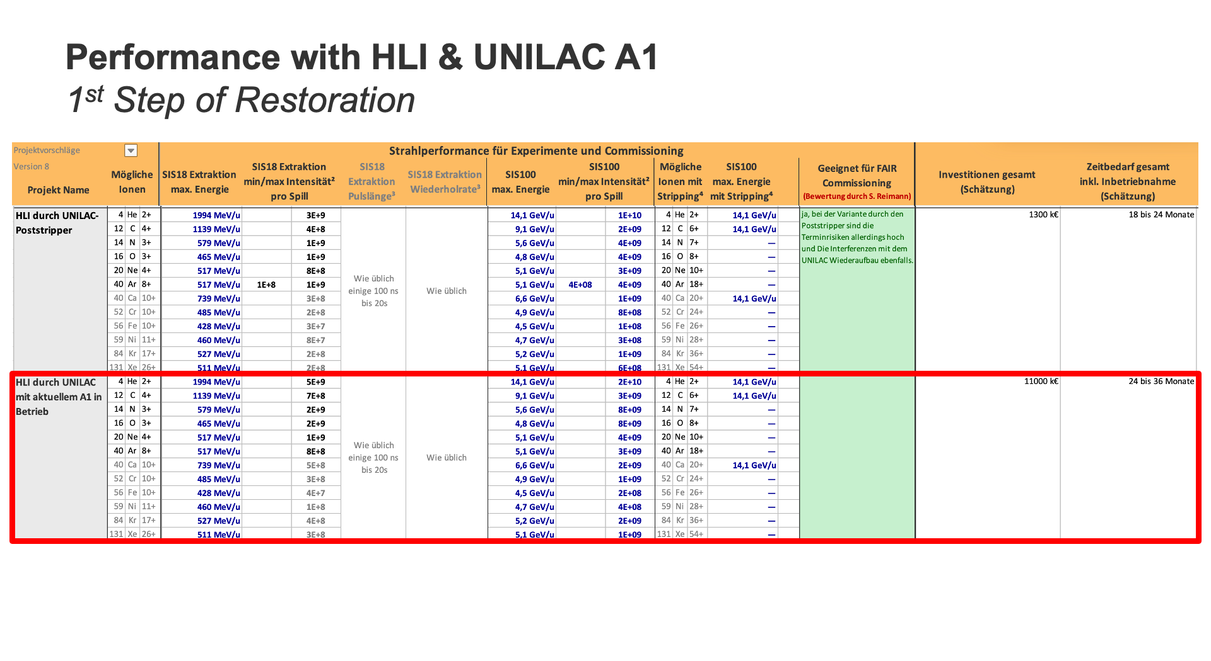
UNILAC Perspectives: Goal End 2028 Sufficient RF (108 MHz) to equip HLI and A1
X
X
X
X
X
X
X
X
X
High Current Injector HSI → FAIR science, including U, but 36 MHz RF will come in few years
High Charge Injector HLI → Low A/z, but lower power 108 MHz available in mid-2027
See reserve slides for performance estimates

Slide 36
Content
Original Plan Accelerator Operations
Fire Incident on 5 Feb 2026
Damage and Consequences
Accelerator Task Force on Required Actions and Options
Perspectives: UNILAC Restoration → Project 1
Perspectives: Interim Option(s) → Projects 2 and 3
Restoration Project
Conclusion

Slide 37
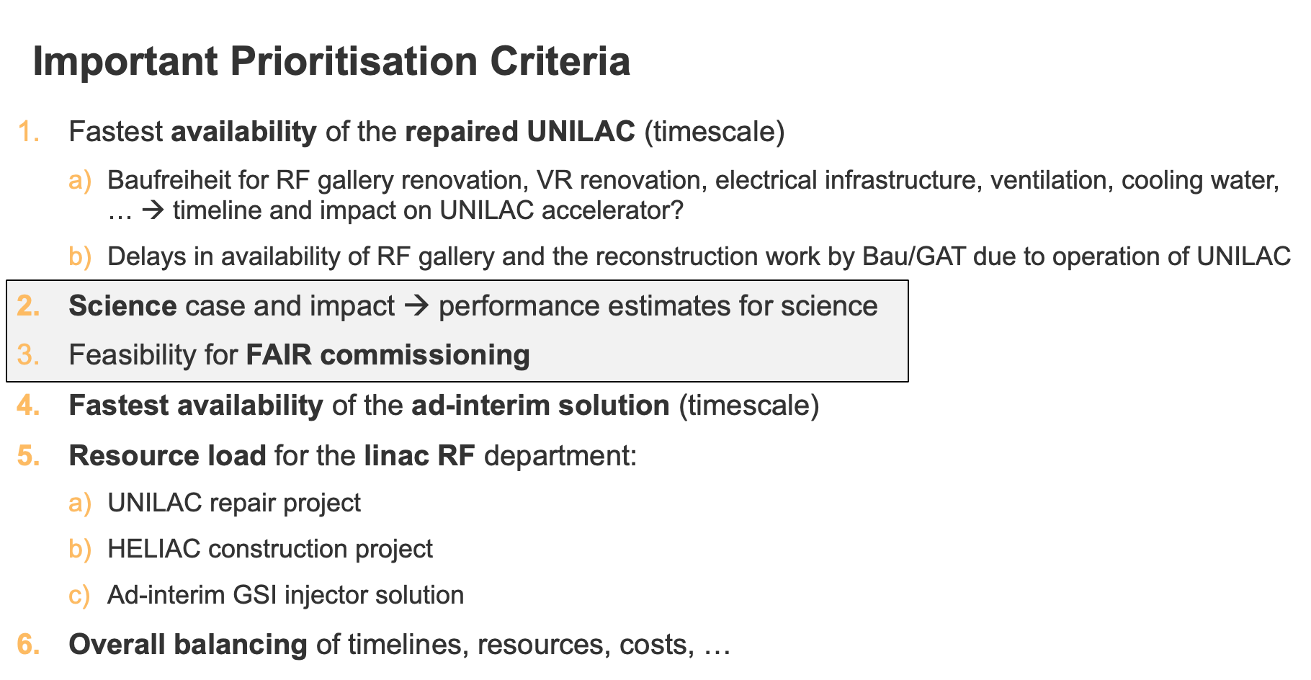
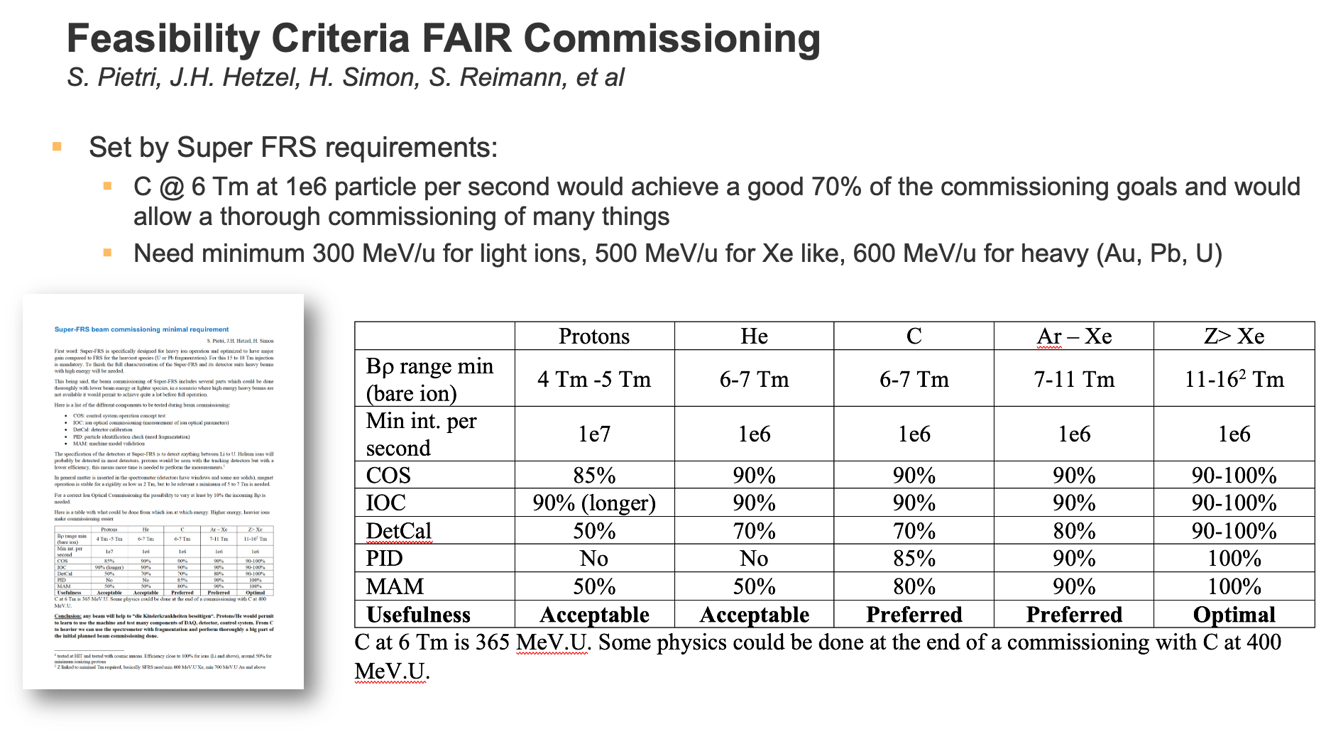
Interim Option(s)
Interim injection of medium-Z, low energy ions into SIS-18 with a 1-2 year time scale (if possible) → FAIR beam commissioning and science
In total 24 interim injector options considered.
Duration, cost & performance after SIS-18 as well as after SIS-100 estimated
Large EXCEL file with performance estimates for each option provided to science
Evaluation Accelerator & Science prioritized two GSI in-house options for FAIR commissioning in 2027(reversed HITRAP decelerator in TK) and science in 2028 (HLI’ with energy booster in EH or elsewhere)
Plan B of the technical sector: Tandetron (not pursued in project for the time being)

Slide 38
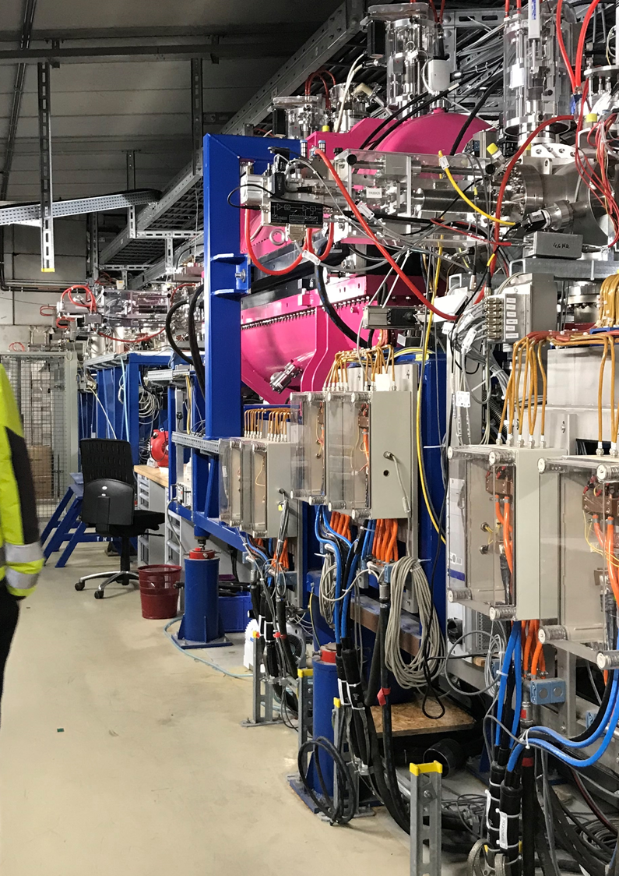
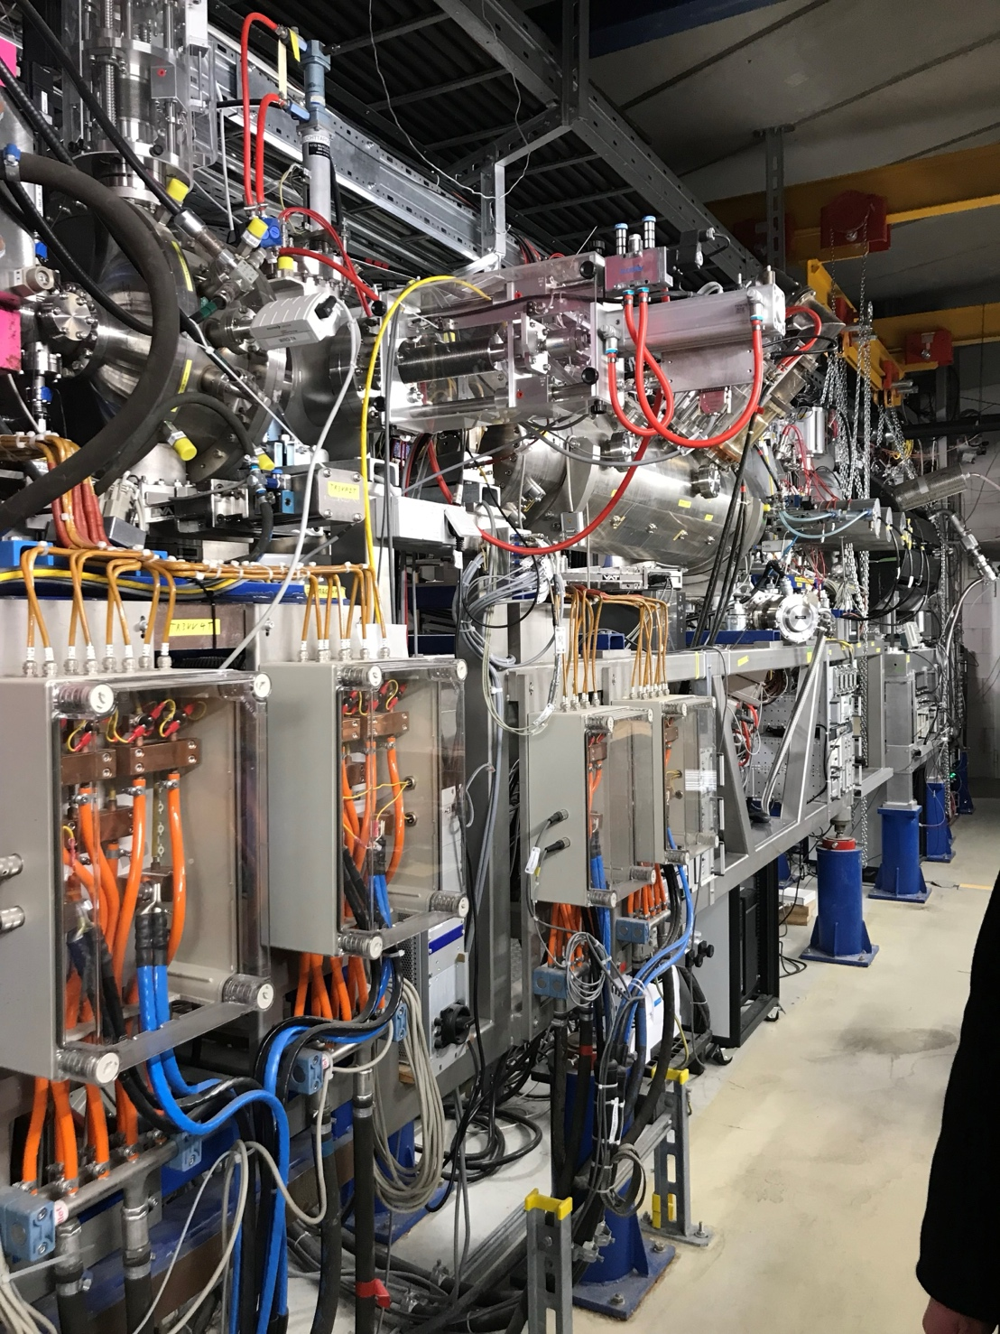
Project 2: Reversed HITRAP in the TK
Short-term temporary setup for FAIR Commissioning: Inverted HITRAP in TK.
The advantage is that we have all parts, including RF, in the institute (except minor parts). Therefore, quick implementation. Significant conceptual and technical risks, due to high age of the RF system, lack of spare parts, performance of the inverted decelerator and SIS-18 injection with low energy.
Goal: Beam for FAIR comm. in 2027
Current Location HITRAP in EX
1st structure and 2nd structure
Overall length about 10 m + source

Slide 39
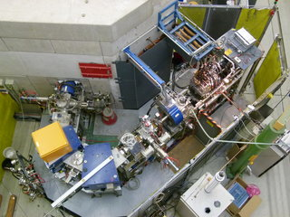
Project 3: HLI-like heavy ion accelerator in EH (or elsewhere)
Setup for FAIR science: HLI-like heavy ion accelerator in EH (or elsewhere) possibly with energy booster:
Prefer “new” HLI’ from parts, instead of moving the existing HLI (remains an option). Necessary RF was ordered for other purposes and should be operational at GSI by mid-2027.
Energy booster with cryo module 1 of HELIAC or a new RT 216 MHz RF structure – (installed as upgrade?)
By-pass transfer line from existing HLI through STF halls also looked at. Significant conceptual and technical risks, due to high age of the high-charge injector HLI, unclear condition of the HLI, partial storage without a protective atmosphere (RFQ at HIM), necessary modification or relocation of the equipment, lack of spare parts and SIS-18 injection with low energy.
Goal: Beam for science in 2028

Slide 40
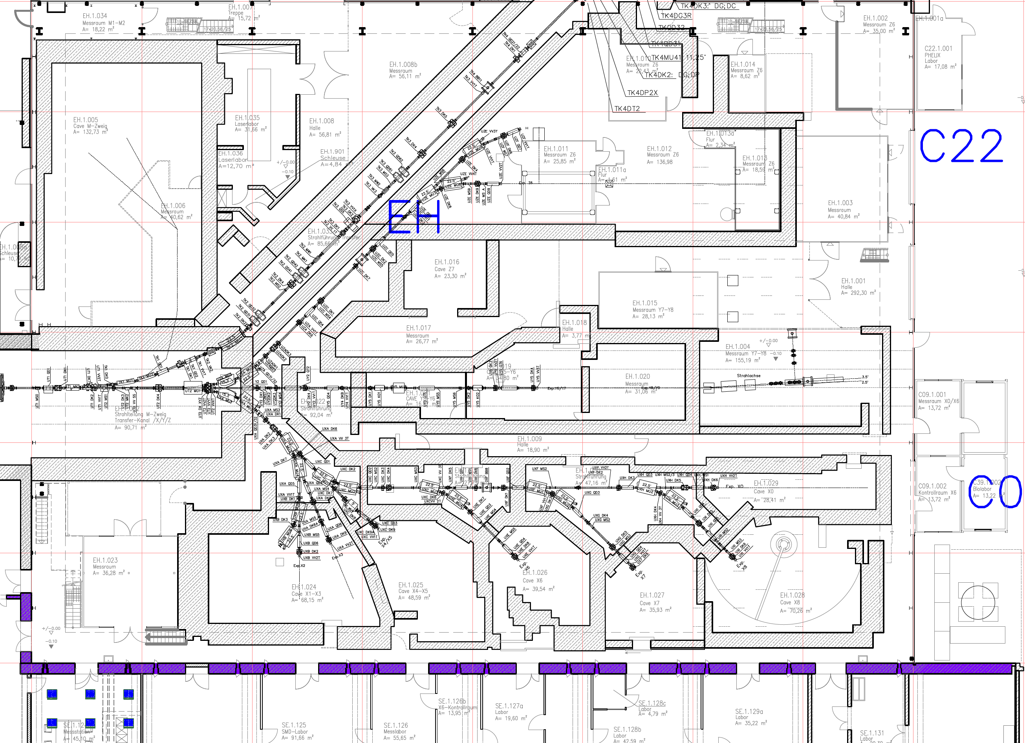


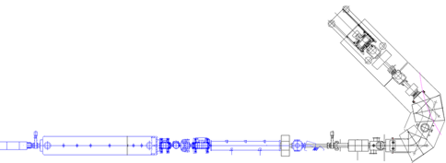

EH Overview incl. Rough Scalings
~30m
~17.5m
~7m
HELIAC
~13m
HLI
~10m
HITRAP

Slide 41
FAIR/GSI Options
for injection into SIS-18 – locations
100 m
Synchrotron ring
SIS-18 (1990)
FAIR Synchrotronring
SIS-100 (2028)
HITRAP
3
HSI
X
2
UNILAC
HLI type setup in EH/TK evtl. mit CM1…
FAIR Super
Fragment Separator
SFRS (2027)
CRYRING

Slide 42
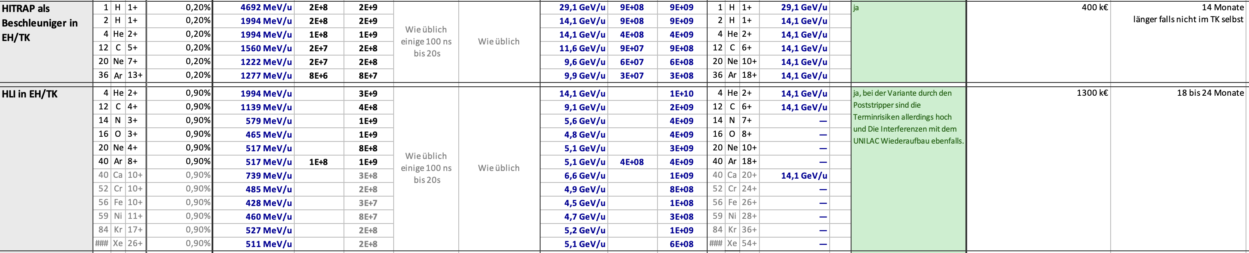
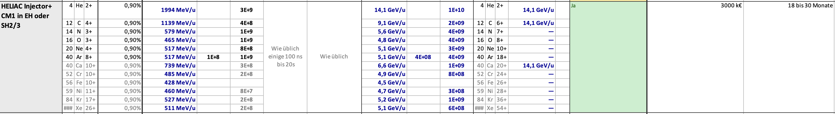
Conceptual Performance Estimates for Interim Solutions
FAIR Commissioning and FAIR Science
FAIR Commissioning
Science
Science
See disclaimer!

Slide 43
Content
Original Plan Accelerator Operations
Fire Incident on 5 Feb 2026
Damage and Consequences
Accelerator Task Force on Required Actions and Options
Perspectives: UNILAC Restoration → Project 1
Perspectives: Interim Option(s) → Projects 2 and 3
Restoration Project
Conclusion

Slide 44
Workflow
Fire incident
5 Feb 2026
Major damage to UNILAC accelerator & building, multi-year interruption of operation for GSI and FAIR injection
Task Force “UNILAC and FAIR Injector”
12 Feb – 16 Apr 2026
Discussion of multiple conceptual solutions, initial prioritization, performance estimates for scientific evaluation, definition of a focused concept between accelerator and science
Restoration Project
14 Apr 2026 until ∼ 2031
Detailed feasibility studies, technical design, optimized solutions, layouts and specifications, procurement, implementation, commissioning
Interim solution(s) for FAIR commissioning and science by 2027 and 2028
UNILAC restoration for full FAIR science as soon as possible

Slide 45
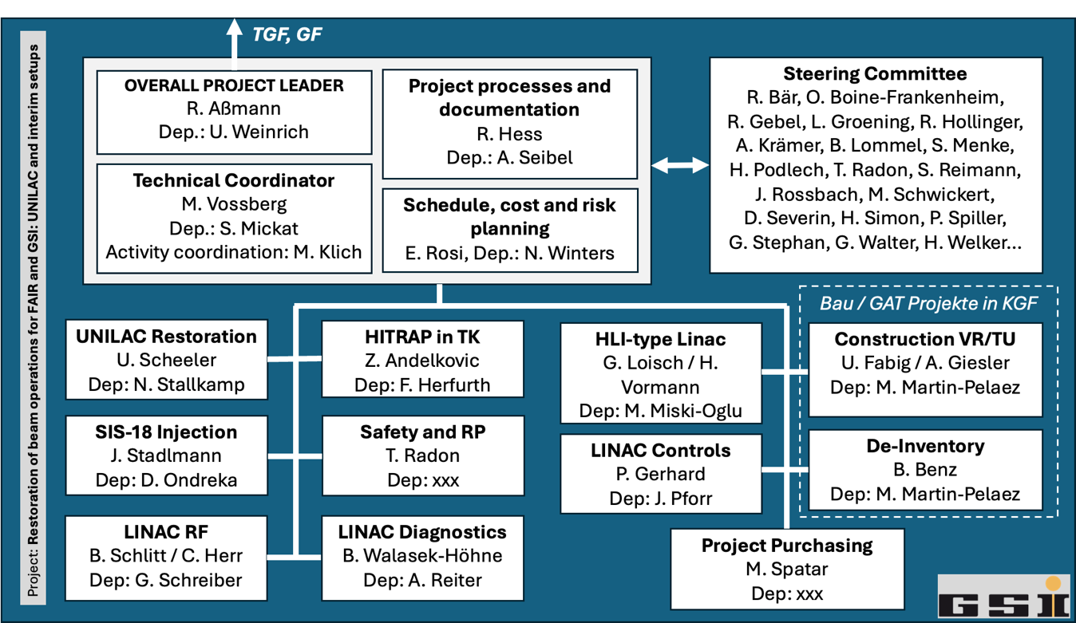
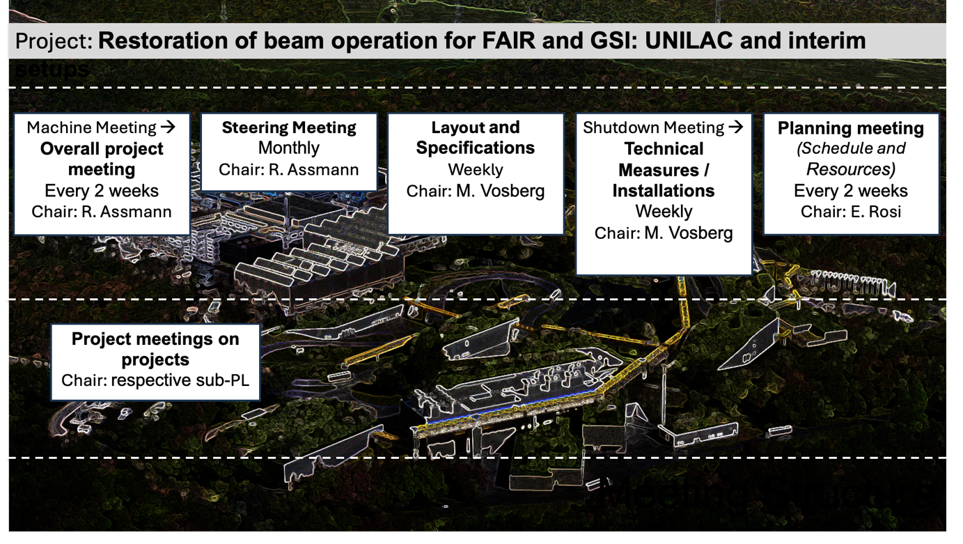
Project Organization
Technical task force: Conceptual study and work.
Project organization: Technical design phase and implementation, including cost and schedule.
Coord. projects, ensures overarching consistency.
Project started, bringing capabilities focused on goals:
Highest priority: Beam operation UNILAC with HSI within 4-5 years
Interim beam from HITRAP in TK for FAIR commissioning in 2027
Interim, HLI type beam from EH through TK for interim science in 2028
Preparation SIS-18 ion beam injection and acceleration for beams
For all above: building and GAT work and plans, safety, TVS, …

Slide 46
TGF, GF
Steering Committee
R. Bär, O. Boine-Frankenheim,
R. Gebel, L. Groening, R. Hollinger,
A. Krämer, B. Lommel, S. Menke, H. Podlech, T. Radon, S. Reimann,
J. Rossbach, M. Schwickert, D. Severin, H. Simon, P. Spiller, G. Stephan, G. Walter, H. Welker…
OVERALL PROJECT LEADER
R. Aßmann
Dep.: U. Weinrich
Project processes and documentation
R. Hess
Dep.: A. Seibel
Technical Coordinator
M. Vossberg
Dep.: S. Mickat
Activity coordination: M. Klich
Schedule, cost and risk planning E. Rosi, Dep.: N. Winters
Bau / GAT Projekte in KGF
Project: Restoration of beam operations for FAIR and GSI: UNILAC and interim setups
UNILAC Restoration
U. Scheeler
Dep: N. Stallkamp
HITRAP in TK
Z. Andelkovic
Dep: F. Herfurth
HLI-type Linac
G. Loisch / H. Vormann
Dep: M. Miski-Oglu
Construction VR/TU
U. Fabig / A. Giesler
Dep: M. Martin-Pelaez
SIS-18 Injection
J. Stadlmann
Dep: D. Ondreka
Safety and RP
T. Radon
Dep: P. Kewes
LINAC Controls
P. Gerhard
Dep: J. Pforr
De-Inventory
B. Benz
Dep: M. Martin-Pelaez
LINAC RF
B. Schlitt / C. Herr
Dep: G. Schreiber
LINAC Diagnostics
B. Walasek-Höhne
Dep: A. Reiter
Project Purchasing
M. Spatar
Dep: xxx

Slide 47
Content
Original Plan Accelerator Operations
Fire Incident on 5 Feb 2026
Damage and Consequences
Accelerator Task Force on Required Actions and Options
Perspectives: UNILAC Restoration → Project 1
Perspectives: Interim Option(s) → Projects 2 and 3
Restoration Project
Conclusion

Slide 48
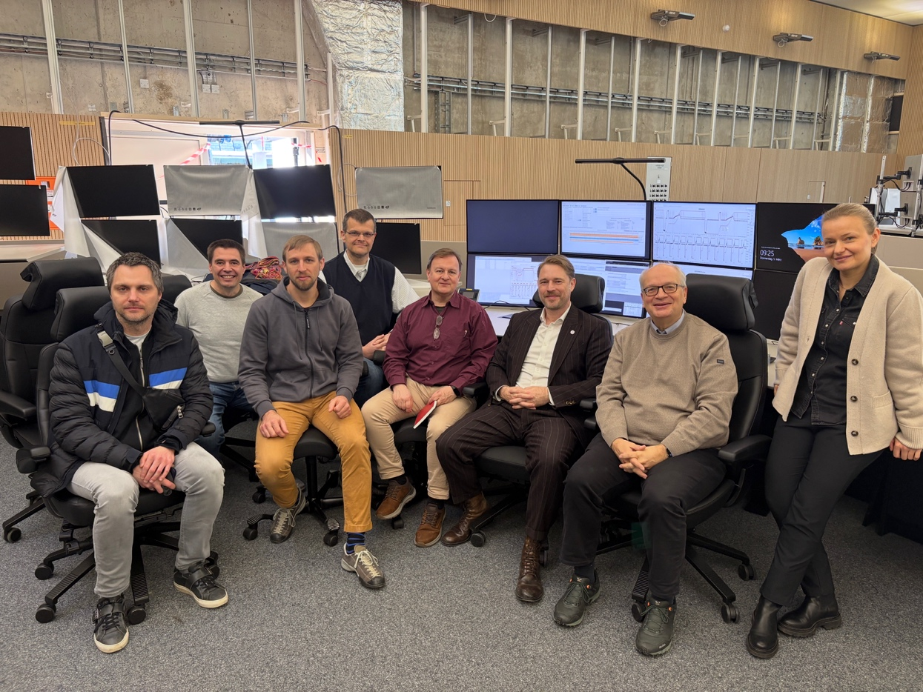
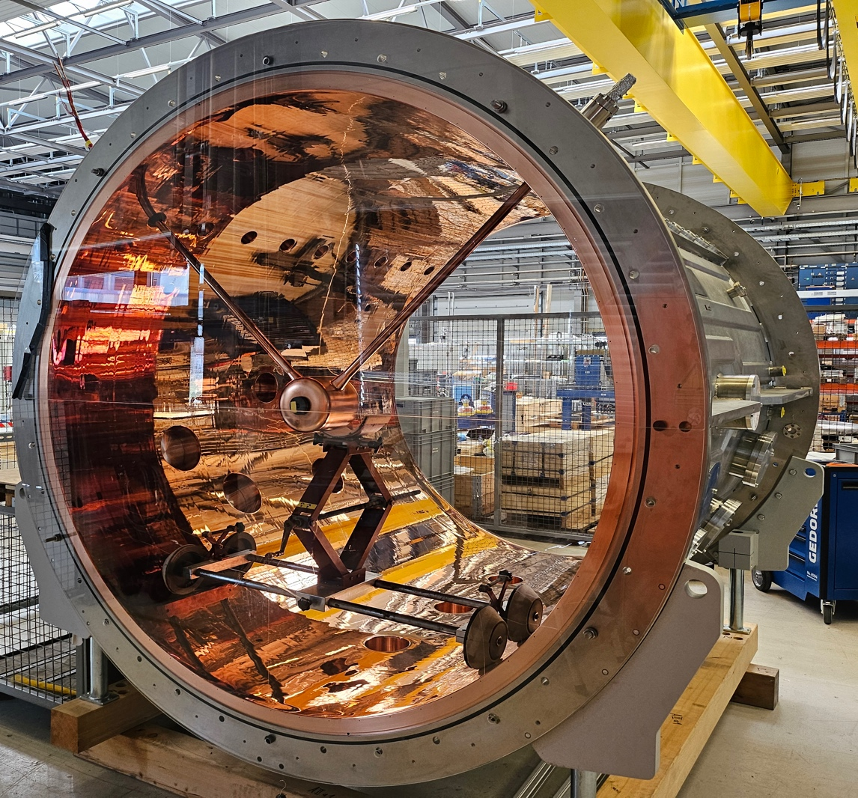
Conclusion
Open Digitizer during CRYRING standalone beam OP in FCC.
We are working hard to restore beam operation as quickly as possible, including interim options → MAC review 2/3 June 2026.
Advice but also help from CERN will/would be great!
Restoration and technical roadmap are interlinked: Now we rebuild part of what was on the technical roadmap.
Very important from my perspective: Not only repair/rebuild what was destroyed. Other weaknesses listed in our roadmap.
Therefore we promote an integrated view: Rebuild, repair and address risks (other single point of failures) for FAIR injection and FAIR science at the same time.
Then: improve FAIR performance and de-risk GSI science through measures listed in technical roadmap.

Slide 49
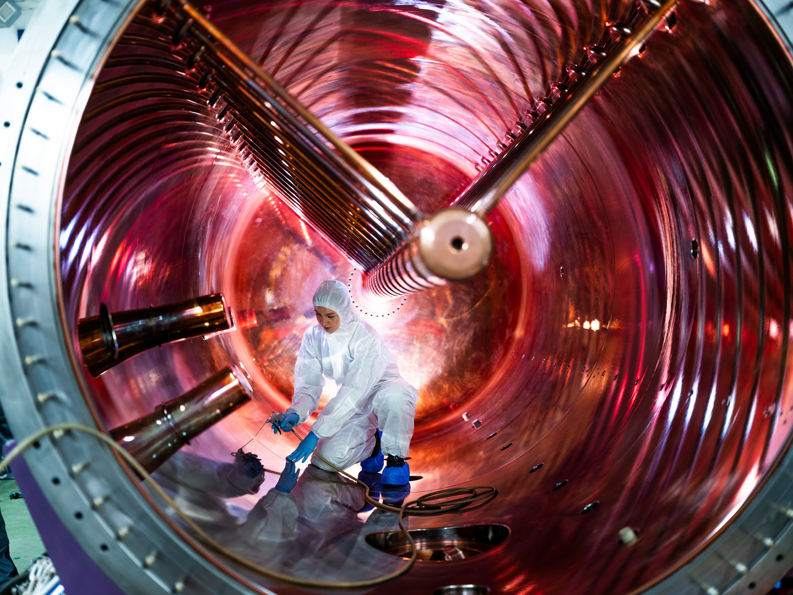

If we do it right: The Good in the Bad
We will end up with a modern UNILAC & RF system, that was anyway required, with new diagnostics, …
At the same time we will modernize or have spares in critical components that could otherwise be the next single-point-of-failure.
We will prepare fast installation of Alvarez2.0 as much as possible and save time later
We will push HELIAC construction as much as possible for continuation of the SHE and materials R&D program
Then the future is bright:
1) Modern UNILAC with lower failure rates, faster repairs, improved operational safety → better availability = more time for science
2) HELIAC as second linac for GSI/FAIR science

Slide 50
Thank you for your attention

