Slide 1
Field measurements and simulations for a hybrid twin (avatar) of the Super-FRS magnets
H. Müller, S. Russenschuck

Slide 2
Motivation
Up to Now
Avatar (hybrid twin) approach
Simulations for magnet design
(„perfect magnet“)
Refine simulations (data driven modelling)
include and weigh uncertainties in
numerical simulations
magnet production
magnetic measurements
for each magnet
Manufacturing of magnets
(with manufacturing errors)
Include environmental effects like
cross-talk
beam tube
magneto-mechanical effects
powering
Magnetic measurements
(deviations from „perfect“ magnet)
Reconstruction of local field distribution
Model of Super-FRS string
Qualification
yes/no use in Super-FRS
uncertainties/deviations remain
Benefit for beam optics simulation and machine optimization
(as easier tuning of the machine)

Slide 3
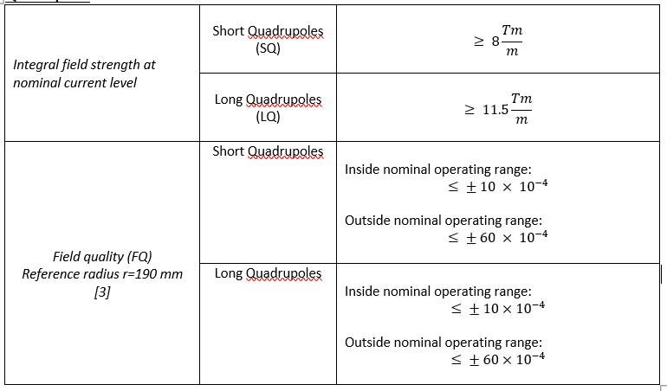
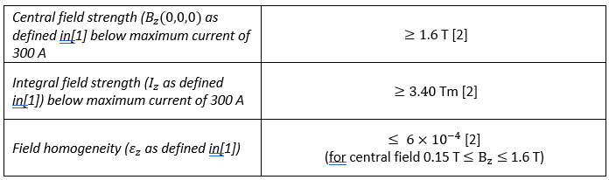
Super-FRS: Specifications
Quadrupoles
Dipole
Note: Field quality requirements depend on the position of the magnet in Super-FRS
Specification defines most stringent values

Slide 4
Design: Simulations from manufacturers
To check if the design meets requirements
Based on ideal material parameters (BH-curves)
Perfect magnets (no manufacturing errors)
Tolerance analysis only for some selected cases (at best)
Inevitable „model-order reduction“; not all details considered in the FEM model

Slide 5
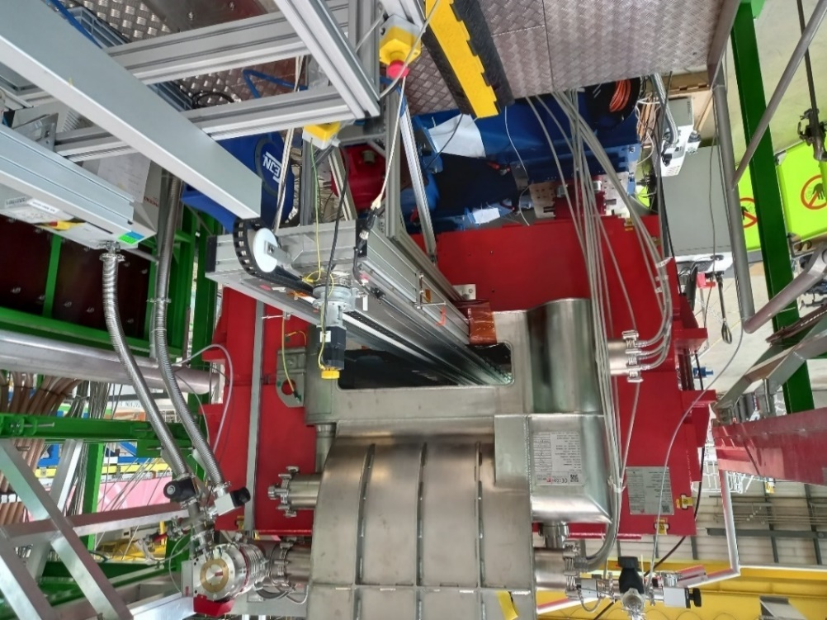
Magnet Qualification (dipole as example)
Measurement program
Polarity check
Central nominal field "search"
Central field loadline
Fringe field loadline
PCB coil calibration
Gaussmeter/polarimeter
NMR
NMR
Hall probe
TF
Translating Fluxmeter (TF)
Integral field loadline + homogeneity at midplane
Integral homogeneity in the GFR
PCB coil calibration
TF
TF
TF
Verification of specifications

Slide 6
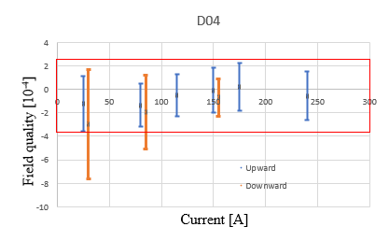
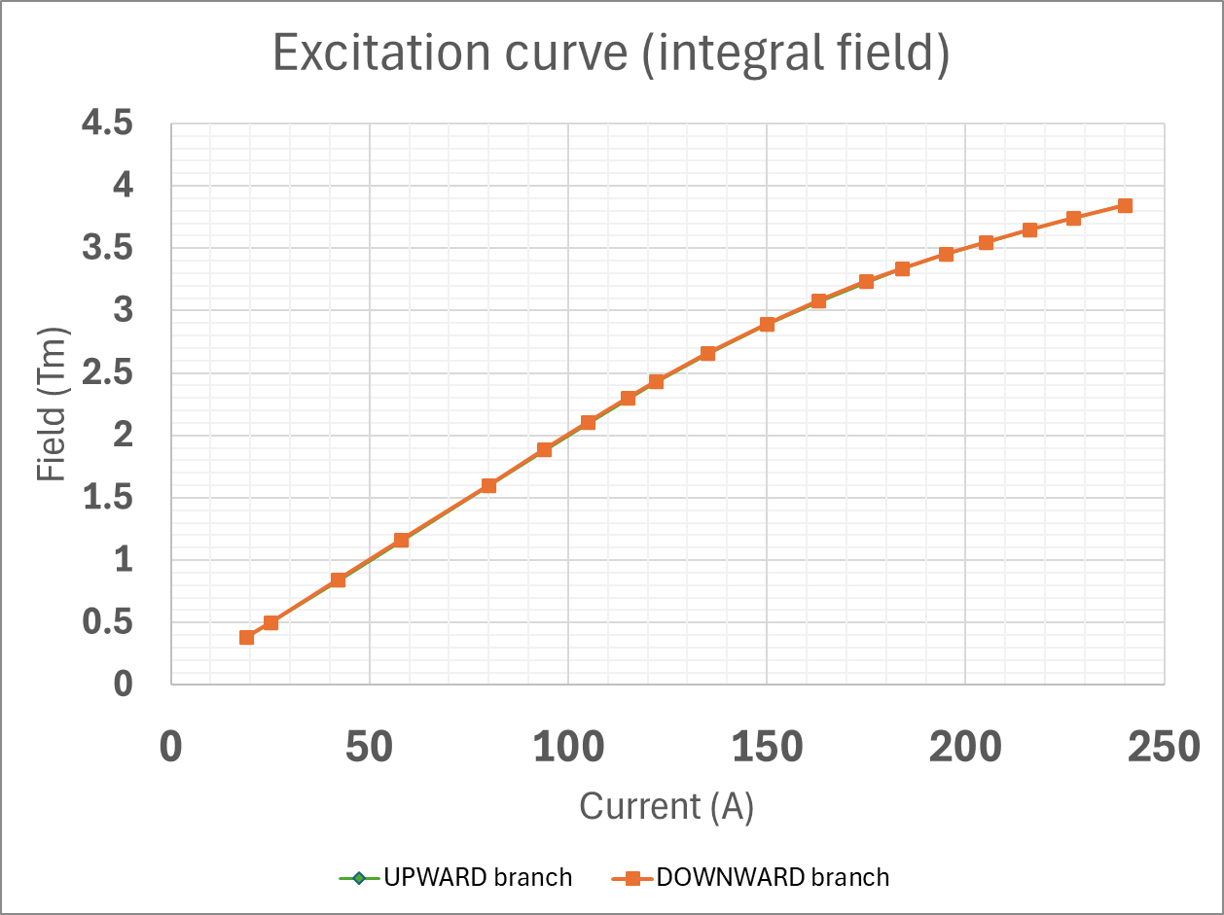
Magnet Qualification (dipole as example)
Field quality
check by
Super-FRS beam optics
approval: yes/no
deviations from simulations
Load Line
Not check of specification
but necessary for magnet operation
measurements of many current levels needed
Standard procedure sufficient to decide on use of magnet in Super-FRS

Slide 7
Uncertainties
Magnetic measurements
Random capture and read-out noise
Systematic errors from voltage dividers, calibration, integrator drift, or stray fields
Approximation errors from the projection of measurement data onto Fourier polynomials
Inadequate knowledge of the effects of environmental conditions
Ignorance (unrecognized systematic uncertainties), e.g., hysteresis in sensor response
Magnet construction
Random manufacturing tolerances
Systematic errors from assembly processes
Inadequate knowledge of the geometrical parameters
Ignorance (unrecognized systematic uncertainties), e.g., material parameters and environmental/operational effects (cross-talk, power converter settings)
Simulations:
Random machine rounding errors
Systematic errors from uncertainties in (superconducting) material data
Approximation errors from FEM discretization
Inadequate knowledge of dynamic effects (hysteresis, eddy currents)
Ignorance (unrecognized systematic uncertainties), e.g., magnetostriction

Slide 8
Uncertainties (dipole as example)
Due to hystersis effects not considered initially? Wrong material parameters? Integrator drift?
Field quality out of specification for
downward hysteresis branch at low currents

Slide 9
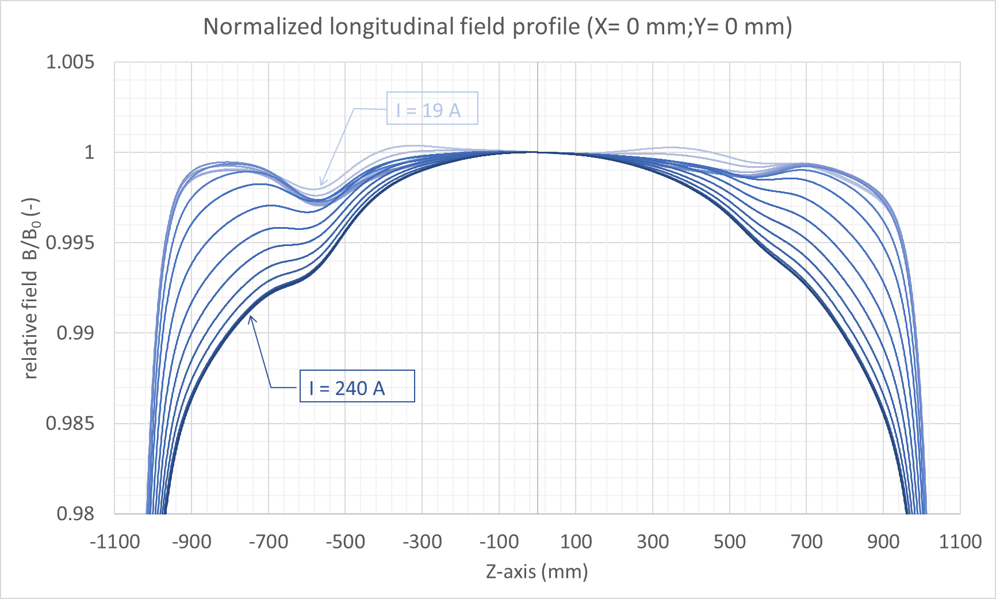
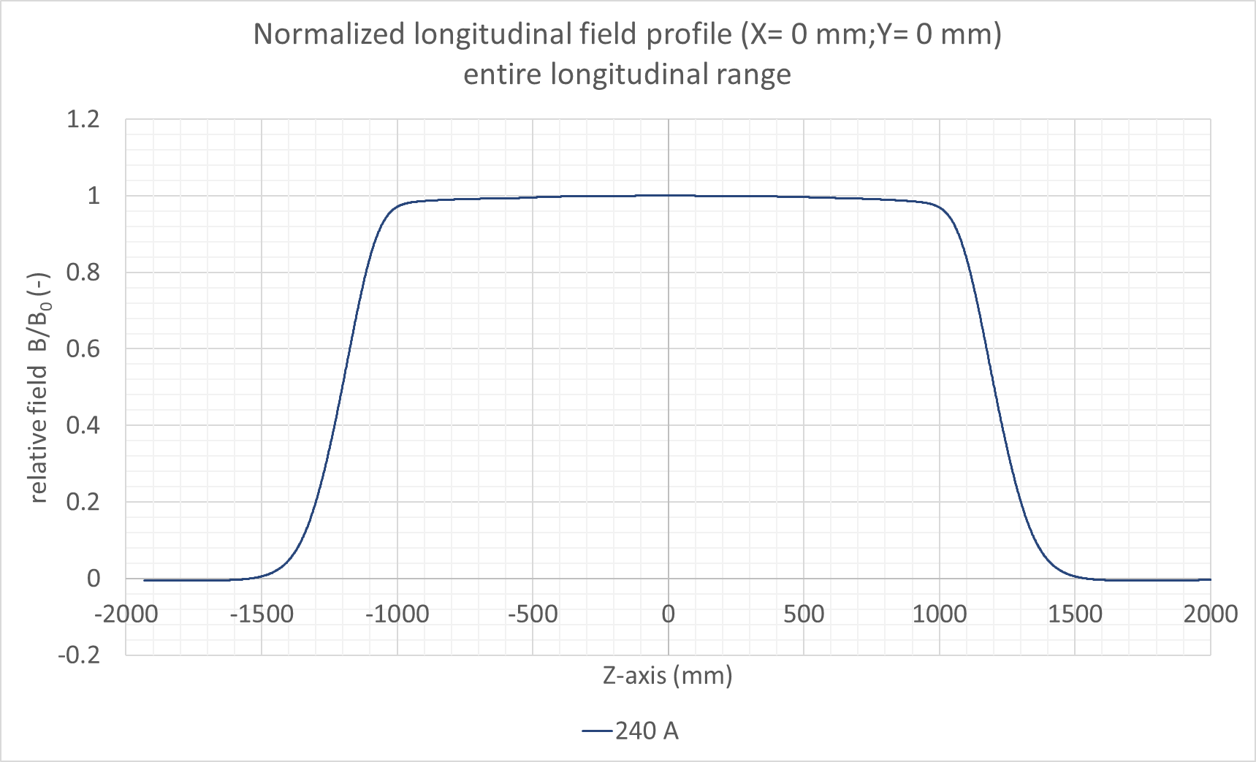
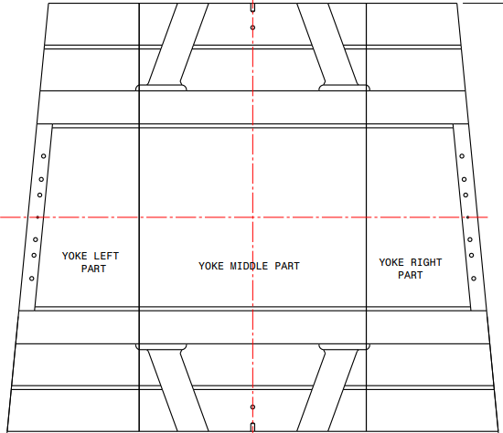
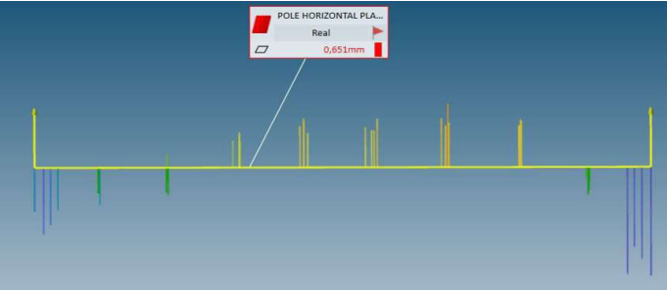
Uncertainties (dipole as example)
Local defects in
magnetic field
Due to semi-yoke
manufacturing in
three parts

Slide 10
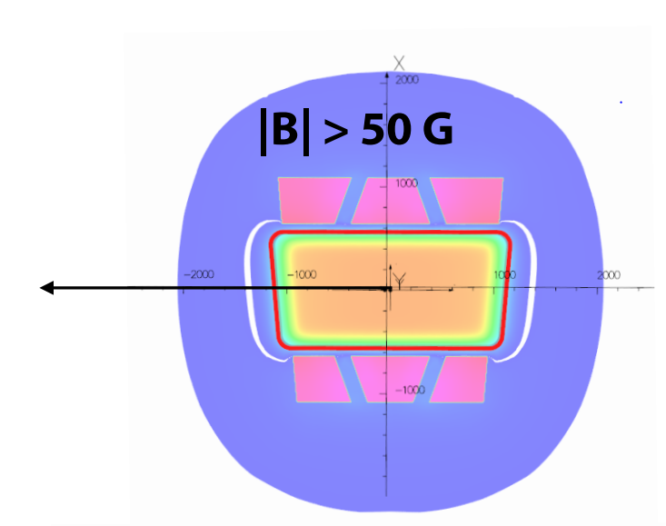
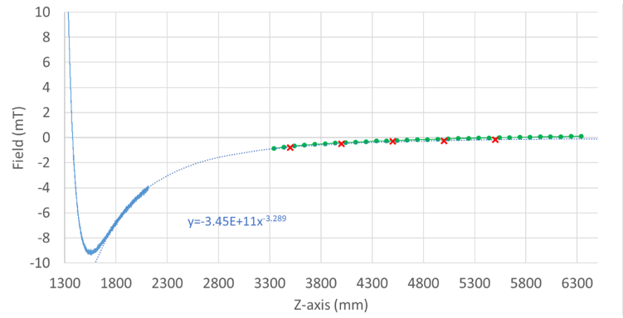
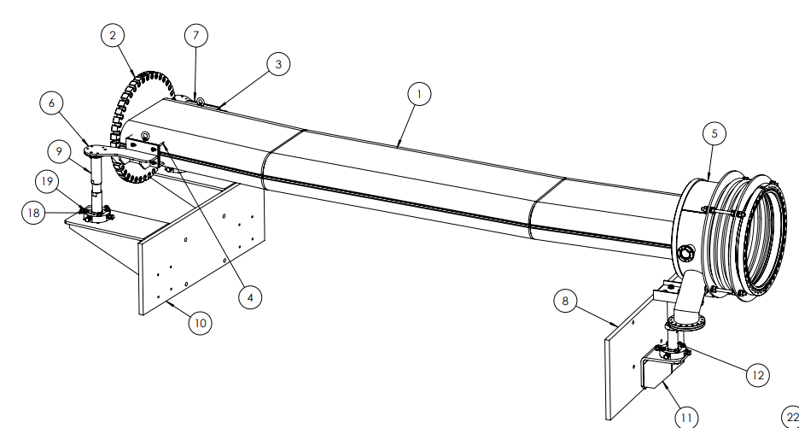
Uncertainties (dipole as example)
Fringe field and cross talk
Proximity effect on fringe fields of neighboring magnets
cannot be measured with
current test facility set-up
Beam pipe
Influence of beam pipe, especially the welding seams
has not (yet) been measured

Slide 11
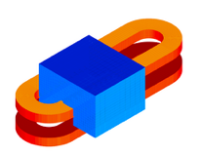
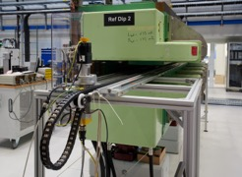
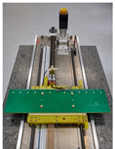
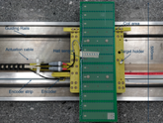


Bringing together Simulations and Magnetic Measurements
Numerical model (design)
Physical object (magnet)
Manufacturing tolerances/
errors
Modelling errors
Magnetic flux density in the magnet bore
Capture noise
Field transducer
Numerical errors
Magnetic flux
density in Ω
Read-out noise
Raw signal (voltages)
Approximation
errors
Prediction
Calibration
Processed data (fluxes)
Approximation
$$X$$
$$\tilde{X}$$
Simulated ????? Measured

Slide 12



Generalized Field Description
Physical object (magnet)
Physical state variables
Boundary sources: single and double-layer
potentials, or harmonic coefficients on trivial domains
Magnetic flux density in the magnet bore
Observation
function
Field transducer
Prediction
Magnetic flux density in
trivial domain Ω
Expected voltages in transducer, including uncertainty
Raw signal (voltages)
Quantity of interest
Comparable quantity
Processed data (fluxes)
Error
metric
$$X$$
$$\tilde{X}$$
Inverse field problem

Slide 13
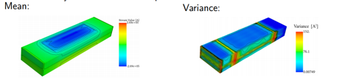

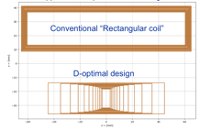

Field Mapping with the Moving Fluxmeter (Established: Liebsch, Fleig)
Physical object (magnet)
Prior
Magnetic flux density parameterized by stream
function on 3D domain boundary
Magnetic flux density in the magnet bore
Prediction
Observation
function
Field transducer
Field Distribution
Raw signal (voltages)
Quantity of interest
Comparable quantity
Processed data (fluxes)
Bayesian
Inference
$$X$$
$$\tilde{X}$$
Inverse field problem (ill-conditioned)

Slide 14
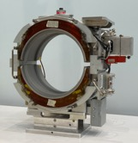
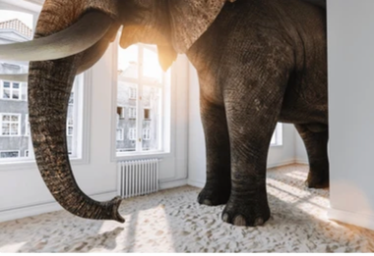

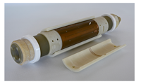

Ignorance (Unrecognized Phenomena)
Physical object (magnet)
Physical state variables
Boundary sources: single and double-layer
potentials, or harmonic coefficients on trivial domains
Observation
function
Magnetic flux density in the magnet bore
Prediction
Magnetic flux density in
trivial domain Ω
Expected voltages in transducer, including uncertainty
Field transducer
Comparable quantity
Inadequate knowledge and ignorance
Quantity of interest
Raw signal (voltages)
Processed data (fluxes)
Error
metric
$$X$$
$$\tilde{X}$$

Slide 15

String of Magnets and Real-Time Machine Control
Physical object (magnet)
Physical state variables
Boundary sources: single and double-layer
potentials, or harmonic coefficients on trivial domains
Proximity
effects
Prediction
Observation
function
Magnetic flux density in the magnet bore
Magnetic flux density in
trivial domain Ω
Expected voltages in transducer, including uncertainty
Power converter
control
Field transducer
Manufacturing
errors and features
Quantity of interest
Comparable quantity
Field-dependent
mechanical
deformations
Hysteresis
Raw signal (voltages)
Time-trans.
effects
Processed data (fluxes)
$$X$$
ΔX
$$\tilde{X}$$
Monitoring and
Machine Learning (GBT)
First-principle (Newton)
Data model (Kepler)

Slide 16


Avatar
Monitoring and
Machine Learning (GPT)
First-principle (Newton)
Data model (Kepler)
$$X$$
ΔX
$$\tilde{X}$$
Supervised
(physics-informed)
Unsupervised
Design of experiment
Global/local field relation
Sensitivity analysis
Maxwellification
Interpolation of
states (powering cycles)
Empirical fits for:
Rate-dependent dynamic effects and hysteresis
Machine model
Notes:
Generative pre-trained transformers

Slide 17
Avatar
Benefits:
Identify reasons for the observed deviations of the nominal beam parameters
Help in the setting and tuning of the machine
Simulate magnet behavior at unmeasured current levels
Reduce magnetic measurements to a lower number of excitation currents
Effort:
Set-up of the Avatar model (not time or schedule sensitive)
Additional magnetic measurements required (must be done now)

Slide 18
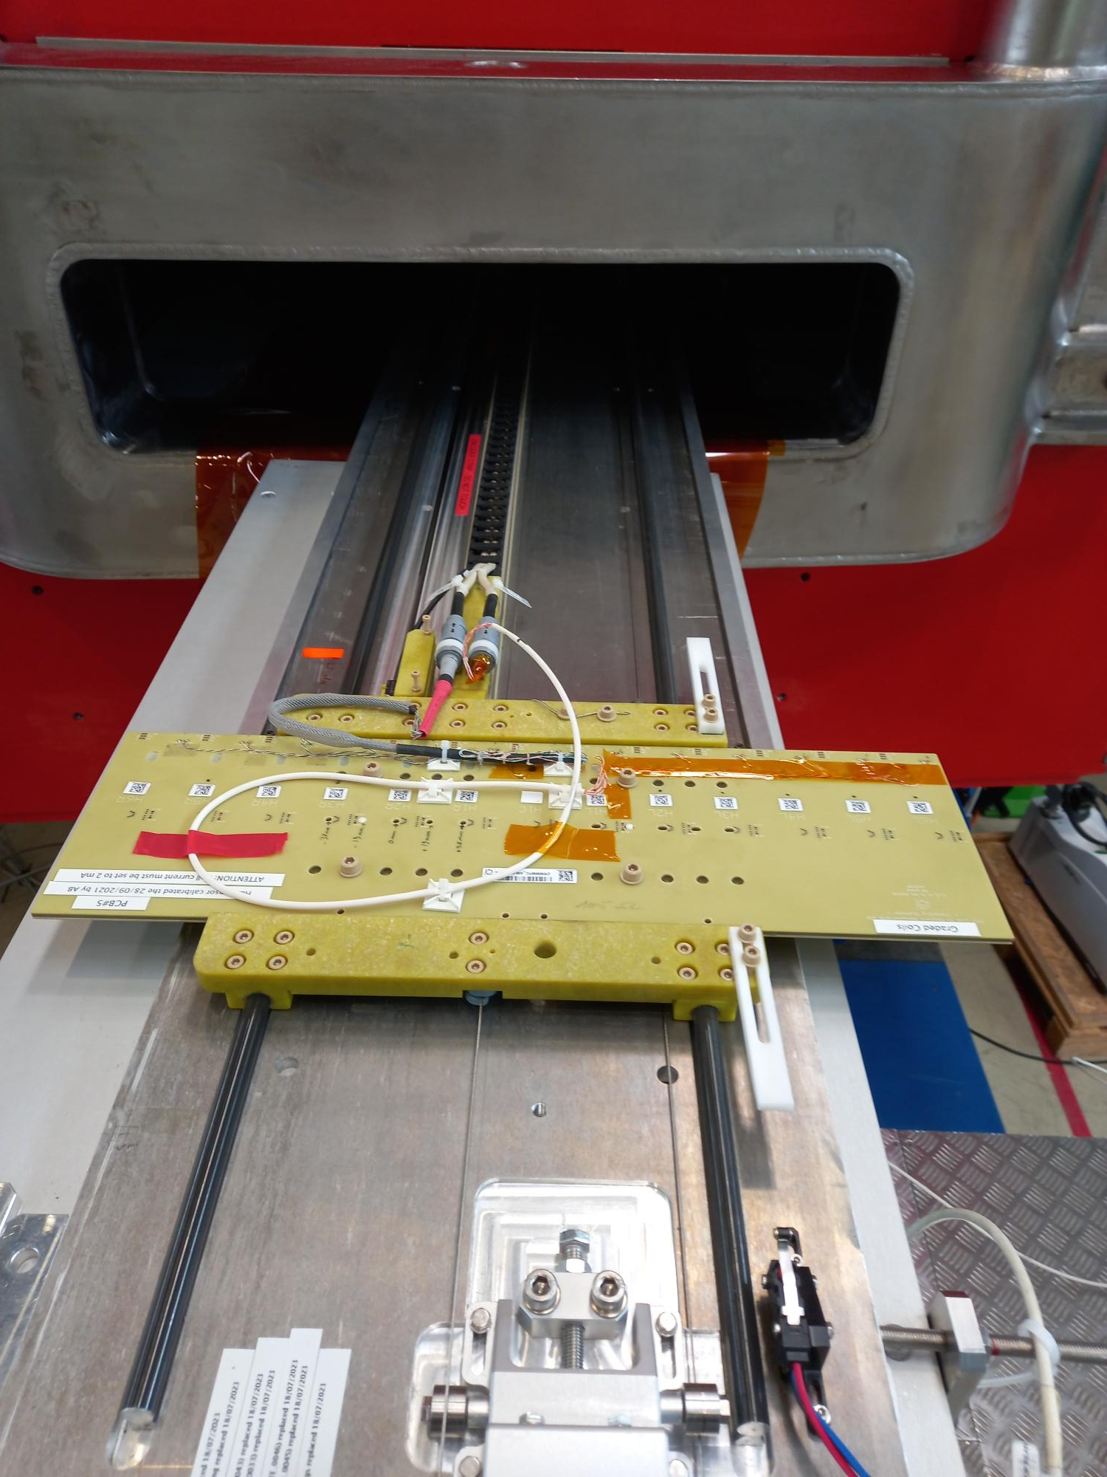
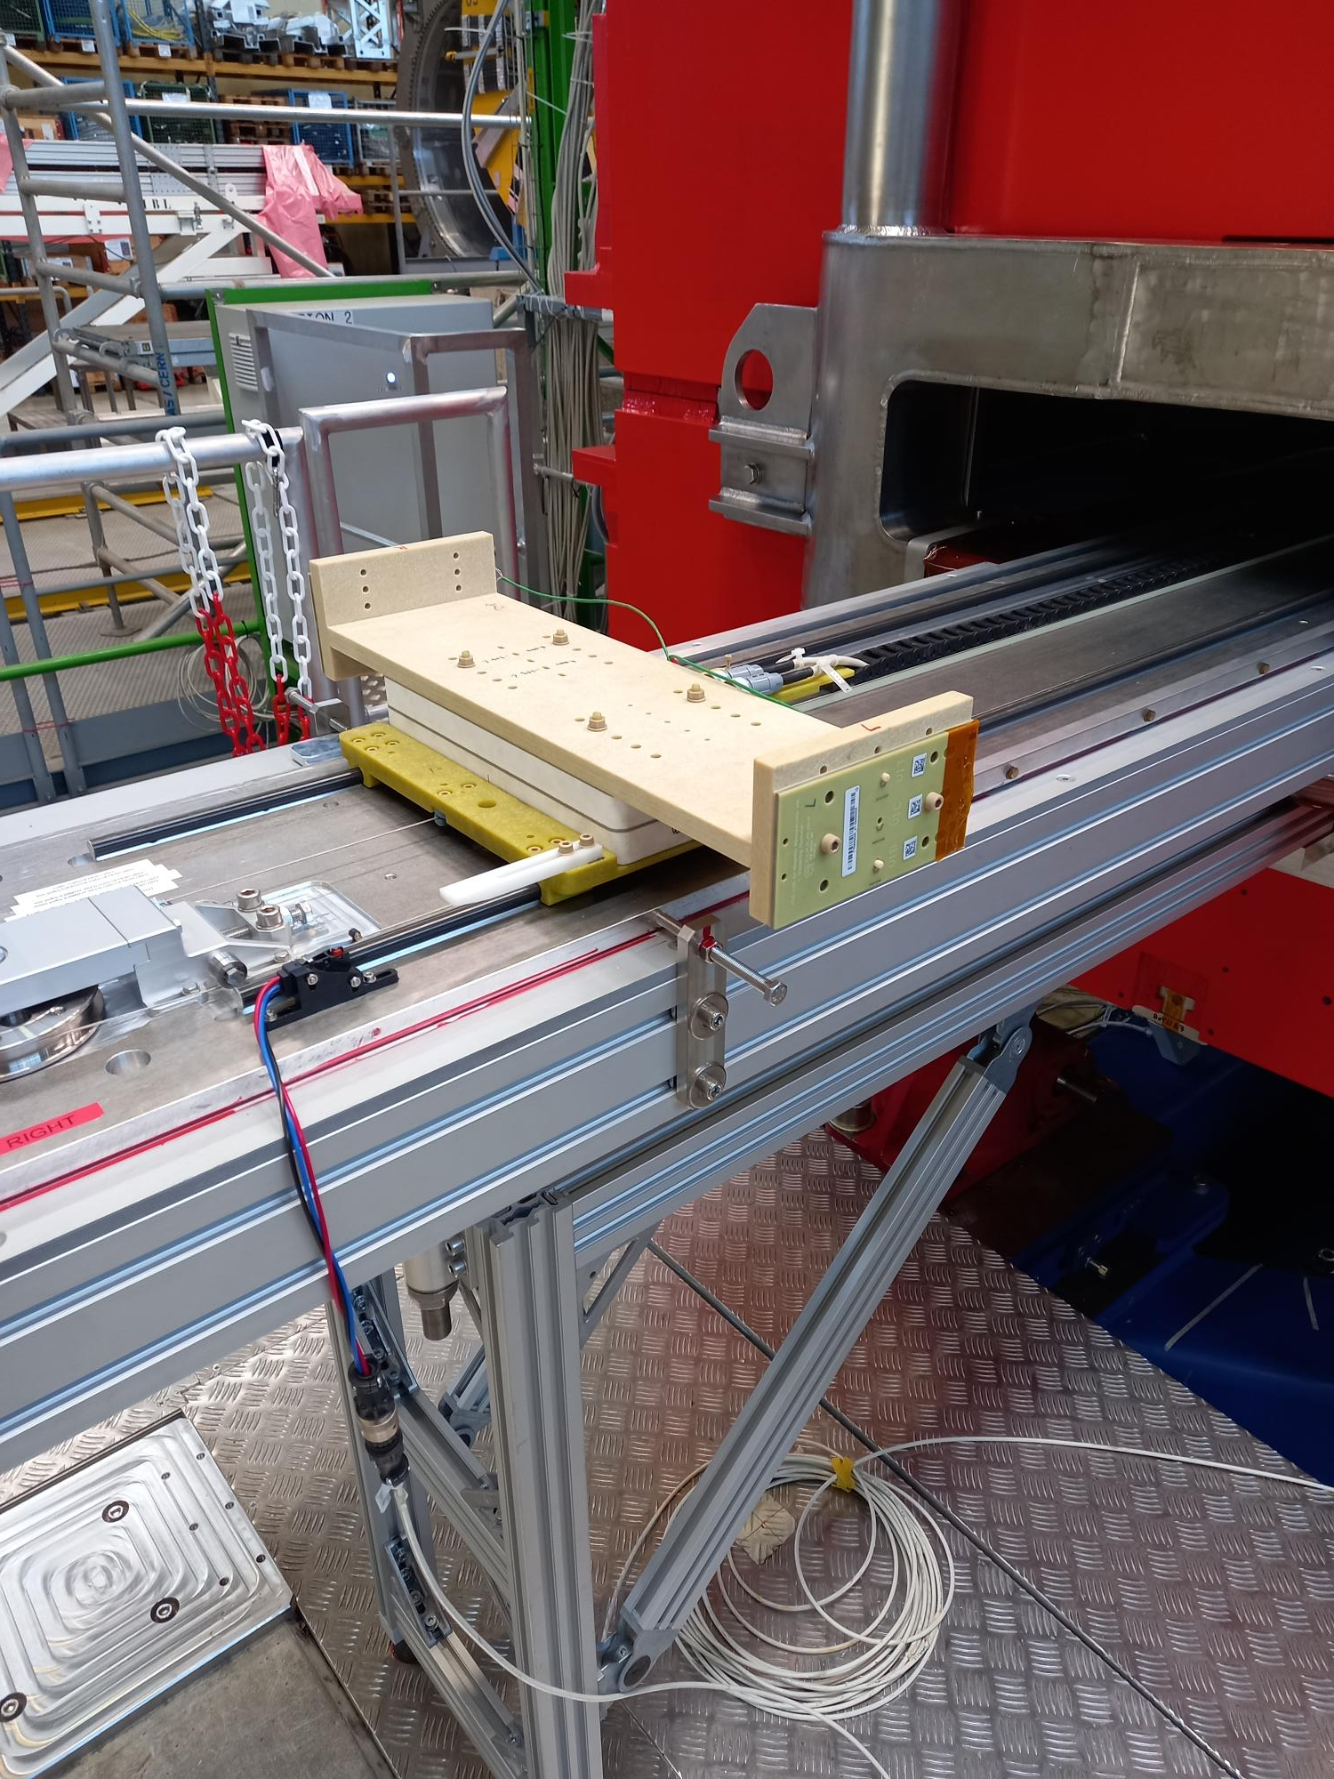
Box measurements with the moving fluxmeter
Required: Local field distribution
Can be calculated from field measurements on the closed surface of a box (normal components of the magnetic flux density on the boundary of a trivial domain)
Can be measured for horizontal and vertical fields
with existing equipment at CERN (longitudinal resolution <= 1 mm)
2-3 days additional measurement time needed

Slide 19
Proposal for collaboration
Scope
GSI deploys 1 PhD student, who is working on the Avatar topic (official supervisor: Oliver Boine-Frankenheim)
CERN provides the post-processing software for the generalized field description as developed in the framework of a previous PhD.
CERN provides best-effort support for the above-mentioned PhD student
Project responsible from CERN-side: Carlo Petrone
Expenses accruing for this project will be paid from the FAIR/GSI budget code.
Necessary magnetic measurement time for the Avatar will be granted by GSI

