Slide 1
CERN-GSI Collaboration Steering Board Meeting
Super-FRS Magnet Testing
Status and upgrade of the CERN test facility
https://indico.gsi.de/event/24515/
https://indico.gsi.de/event/24515/
17 April 2026
G. Riddone on behalf of the CERN team

Slide 2
Content
KR3912/TE – Collaboration agreements and amendment
CERN contributions
Status and upgrade of the main systems of the test facility
  Transport/Logistics
  Mechanical activities
  Cryogenic system, including major overhauling
  Powering and EDAQ
  Dedicated development and support
EAM tool development for the test follow-up and schedule Gantt Chart
Conclusions

Slide 3
KR3912
Short reminder of the agreement and CERN contributions

Slide 4
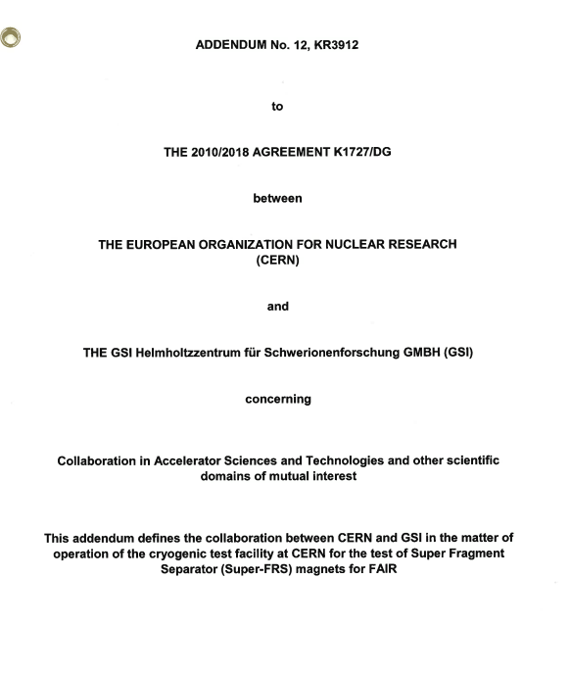
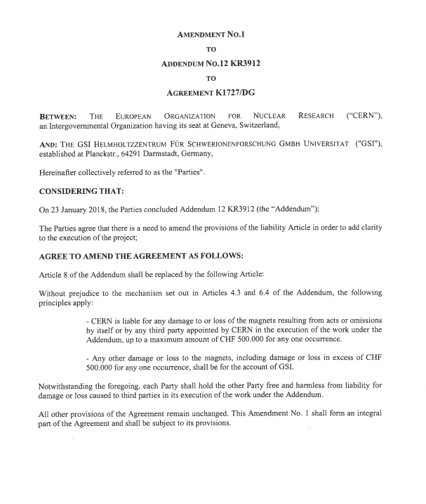
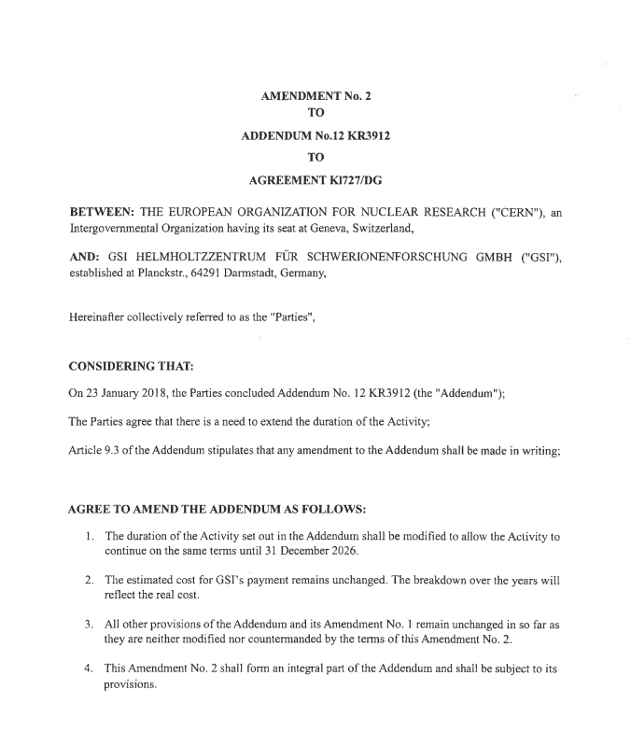
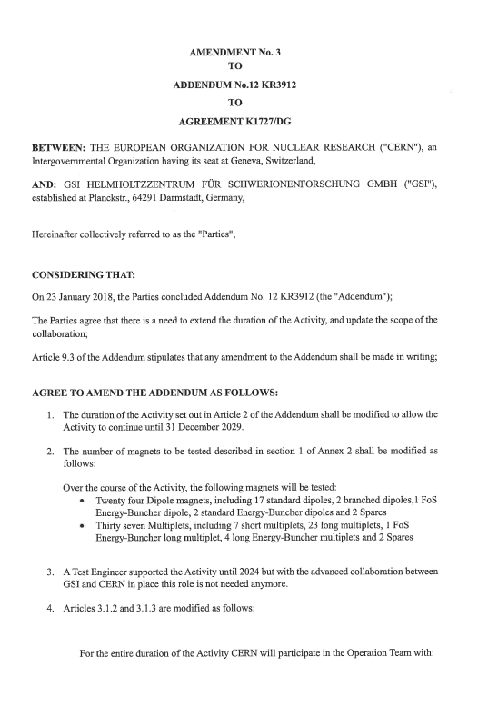
KR3912 Addendum to K1727
Test facility at CERN for the tests of Super Fragment Separator (Super-FRS) magnets for FAIR
Amendment 1
Amendment 2
Amendment 3
Signed in 2022, clarification on insurance liability and responsibility
Signed in Jan 2018 for 5.5 years
Signed in July 2023, end set to Dec 2026
Signed in May 2025, end set to Dec 2029, change of scope and new organization

Slide 5
Amendment 3 – Focus on CERN contribution
Magnets to be tested:
24 dipoles (17 standard, 2 branched, 1 FoS)
37 multiples (7 short, 23 long, 5 EB and 2 spares
CERN is contributing with:
  Project leader
  Logistics coordinator (0.2 FTE)
  CERN will support with planning, sequencer tool and QA activities (0.3 FTE)
  CERN will support the activity with best-effort service from its equipment groups (cryogenics, survey, power converters, energy extraction, quench protection, data acquisition and controls; estimated total of 0.6 FTE)
  CERN will support the Joint Expert Task forces for the magnet suppliers of FAIR with best-effort service from its equipment groups (cryogenics, survey, power converters, energy extraction, quench protection, data acquisition and controls; estimated total of 0.3 FTE)
  Industrial support: 2 FTE
Upgrade of the Test Facility (e.g. multibench parallel powering)
1.4 FTE

Slide 6
Recall of CERN contribution
Activity | Description | Group
Logistics and handling | Procedures and administrative documents Handling operations with crane | TE-DPS ( EN-HE
Mechanical activities | Preparation of the magnets for the tests and before shipping Welding activities on jumper connection, endoscopic inspections | CERN industrial support EN-MME
Cryogenic activities | Cryogenic system, including several upgrade and related operation | TE-CRG
Leak-tightness validation | Tests of inner circuits and outer envelope Pumping system and operation | AL4030
Powering and Magnet protection Software update support | Specification and hardware procurement for parallel powering Supply of power converters Supply of quench detection and energy extraction systems | TE-MSC SY-EPC TE-MPE / BE-ICS / BE-CEM
Magnet alignment | Fiducialisation (position of magnet wrto outer targets) | BE-GM
Magnetic measurement | Support for measurements | TE-MSC
Test follow-up and planning | Development and maintenance of the tracking tool Daily planning tool: development and maintenance | EN-ICE TE-DPS
Quality assurance | For CERN documents, creation and maintenance of the EDMS structure | TE-DPS
Task forces | Active participation for brazing/welding aspects, mechanical calculation and dedicated mechanical and thermal tests | Several groups within TE, EN departments
Taking into account the upgrades over the last nine months, CERN’s contribution, involving several groups within the ATS sector, has substantially exceeded the contractual obligations

Slide 7
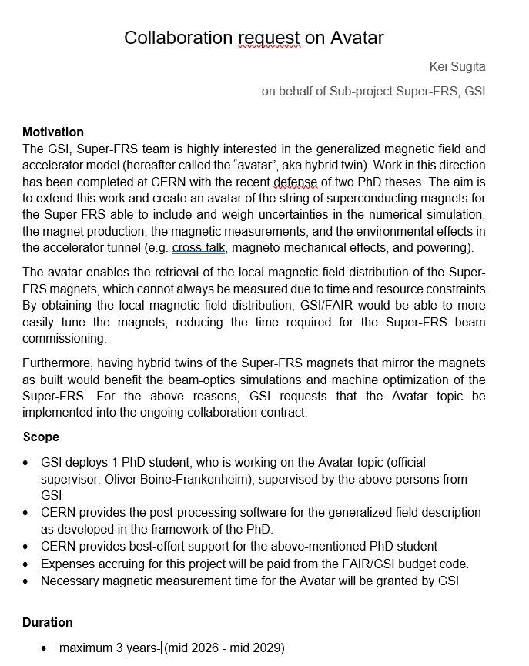
Amendment 4 – To be prepared
The new amendment will include the collaboration on Avatar and the change in CERN contribution,
  namely on:
  industrial support: from 2 to 3 FTE
  AL4030 for leak-tightness test: from 0.3 to 0.5 FTE from 2026
as well as revenue update (below the status as per today)
Draft, see Presentation by Hans and Stephane

Slide 8
Test facility, including main upgrade in 2025/2026
Logistics and Transport
Cryogenic system, including shut-down and SCADA application
Mechanical activities
Powering system including EDAQ
Dedicated development and support

Slide 9
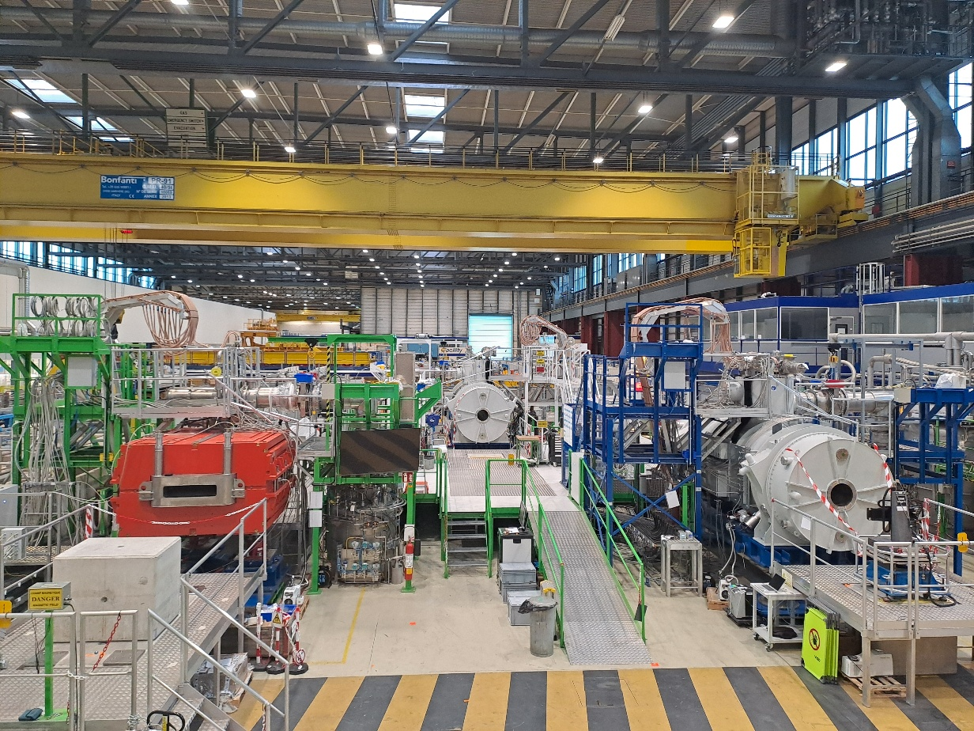
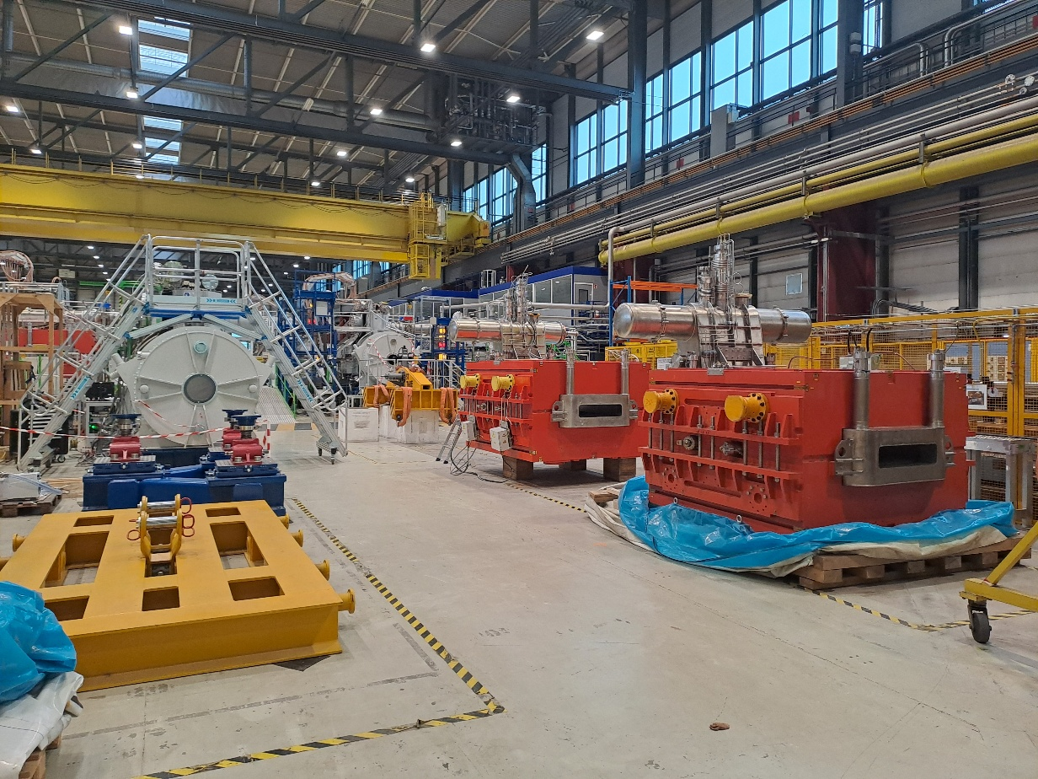
B180: test benches and preparation area
2
3
1
Long Multiplet
Dipole
Long Multiplet
Dipole
Dipole
Long Multiplet
Preparation area (PA)
3 Test Benches
Preparation Area
From magnet connection to the jumper magnet to the completion of all tests, including e.g. leak tightness tests cooldown/warmup, powering and training
The PA can accommodate up to 5 magnets: delivery (preparation to the Test bench), shipping and storage

Slide 10
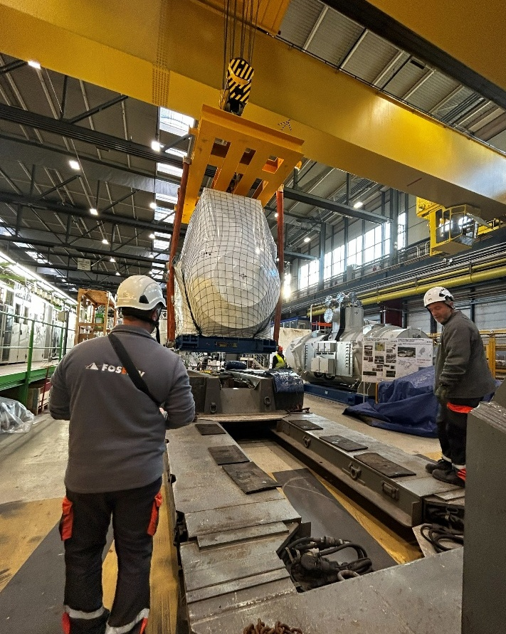
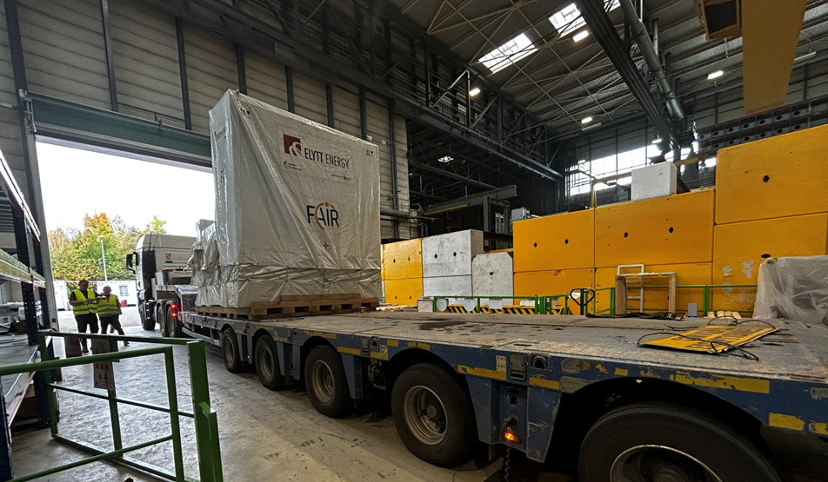
Transport and logistics: a collective effort
Transport is a key activity.
EN-HE together with its subcontractor, ensures seamless end-to-end operational coordination at CERN.
D02 Delivery – octobre 2025
SM04 Shipping – november 2025
Clear chain of command with well-defined roles and responsibilities
Proactive approach with structured problem analysis and effective resolution
Rapid response to constraints and evolving scheduling demands

Slide 11
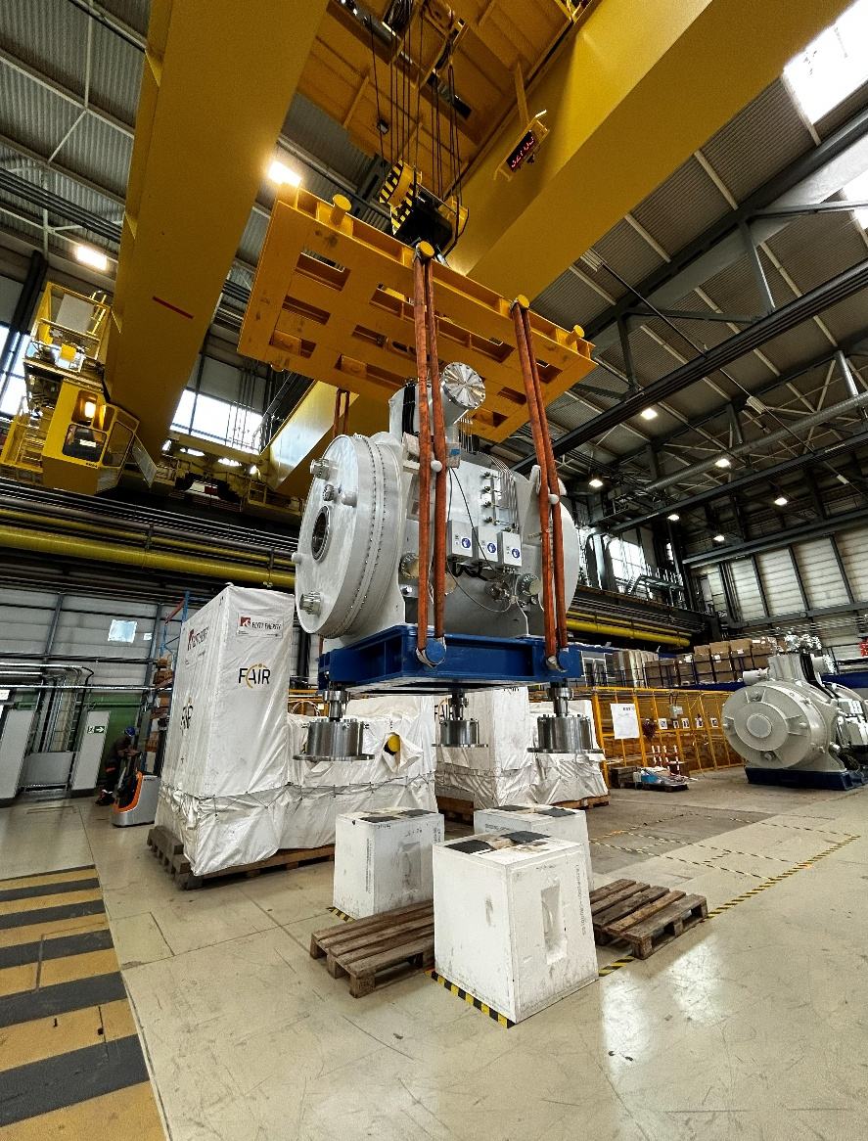
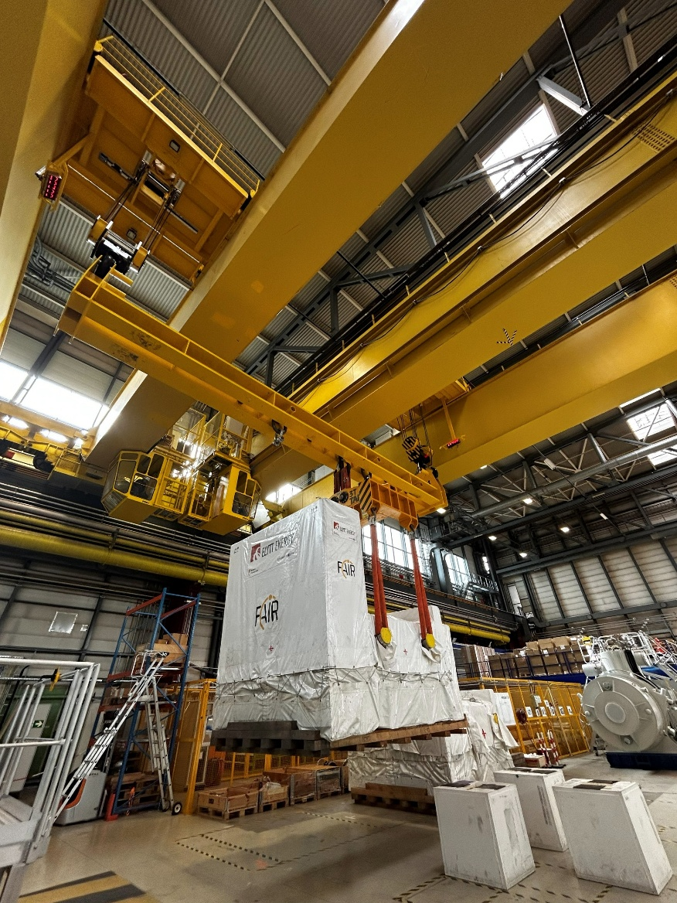
Handling lifting configurations
A variety of magnets, each with specific handling requirements, also requires close coordination with all B180 users
SM / Dipoles < 60 T
Handling with one overhead crane (60 T capacity)
LM / Dipoles > 60 T
Handling with coupled overhead cranes (60 T + 40 T capacity)
SM06 handling on blocks with 1 overhead crane
D02 handling on blocks with coupled overhead cranes

Slide 12
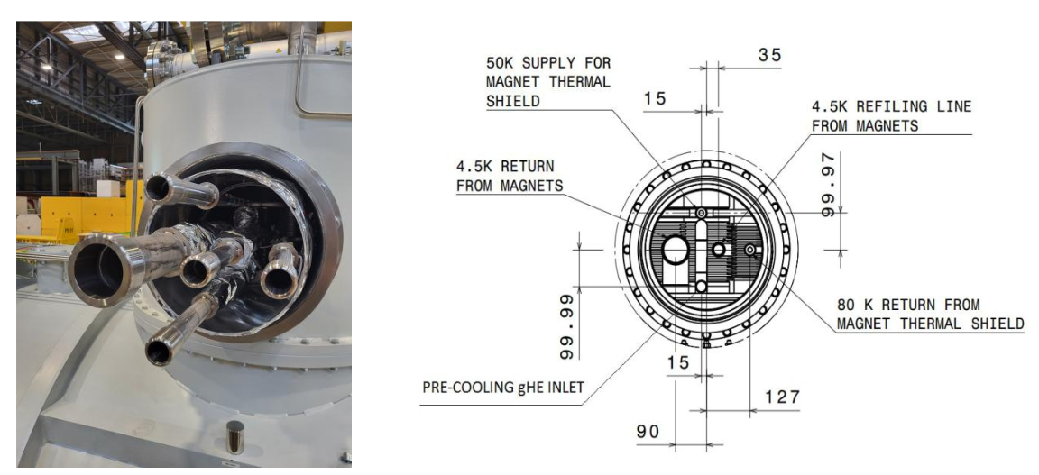
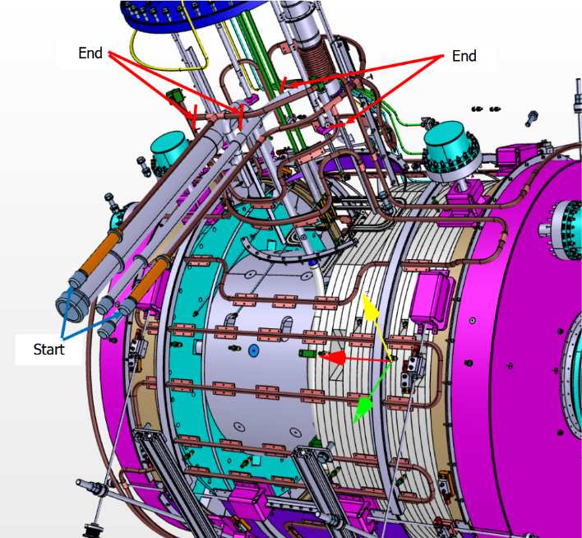
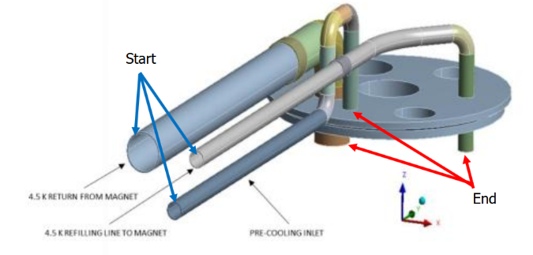
Quality control: endoscopic inspection
  As mentioned at the GSI-CERN steering board in 2025, it is essential to ensure the cleanliness of the cryoline, as metallic particles could cause serious damage to the valve seats. Visual inspections are therefore performed prior to connection.
  Visual inspections using video-endoscope Mentor visual IQ
  Frequency : 1 magnet out of 4
  Inspection reports registered in EDMS
Scope of the inspection:
  The 5th cryogenic lines
  The vessel at the end of 4.5 K return
  and refiling lines from magnet

Slide 13
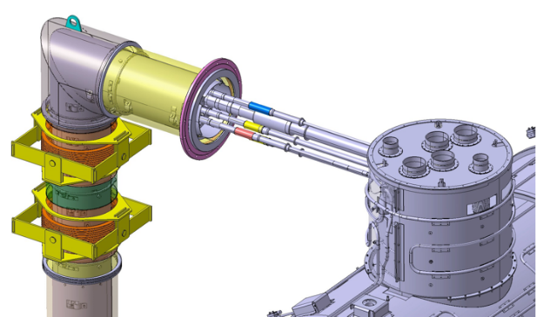
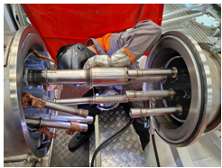
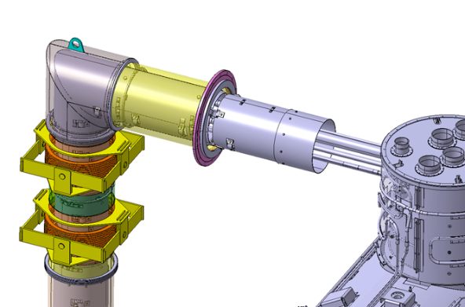
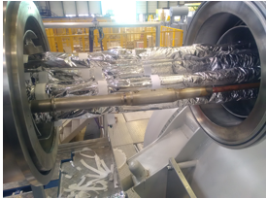
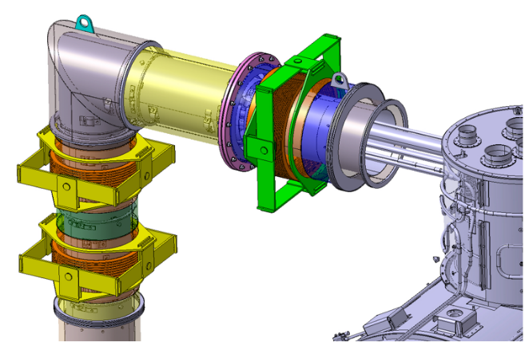
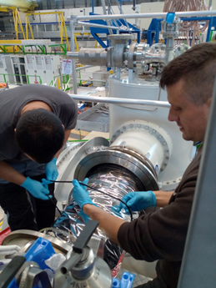
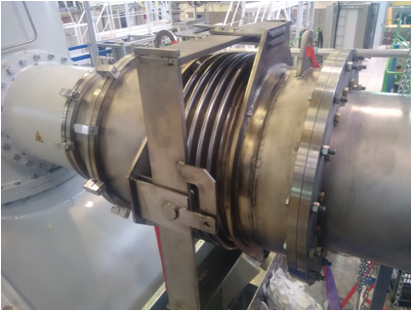
Jumper (de-)connection
CERN availability for jumper (de-)connections, including required analyses such as tomography and dimensional control, according to the GSI test schedule.
1. Mechanical interconnection and leaktightness validation
Check the internal cleanless and insert the filter
Set up the sleeves and weld the internal lines
Perform leak test of the related sleeves
Install the MLI and aluminum thermal screen
Install the second layer of MLI over the
thermal screen
Clean the gasket faces and close
the jumper
2. Magnet de-connection

Slide 14
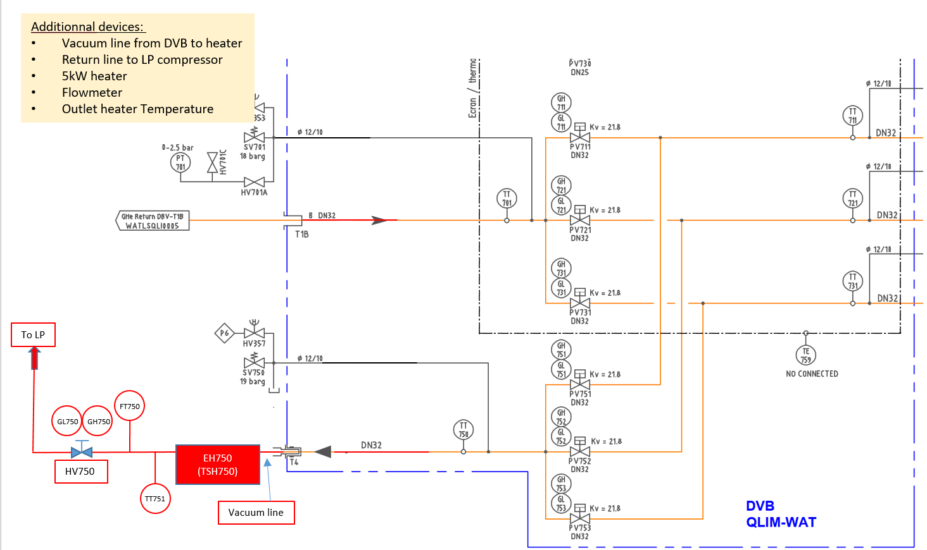
Cryogenic system – Upgrade
Objective
Ensure that a quench occurring on a single test bench does not induce pressure disturbances in the other test benches.
Consolidation
Heater replacement by a 15 KW (> 10 g/s) (available)
PV751/752/753 (ON/OFF) (Kv= 21,8) replacement by CV751/752/753 (Controlled Valve) (Kv~10) to control maximum flow/outlet
temperature to LP Compressor Station (valves do not change, only valve positioner replacement).
Upgrade FT750 to 10 g/s (ordered)
➔ Successfully implemented during the cryo shut-down in June 2026

Slide 15
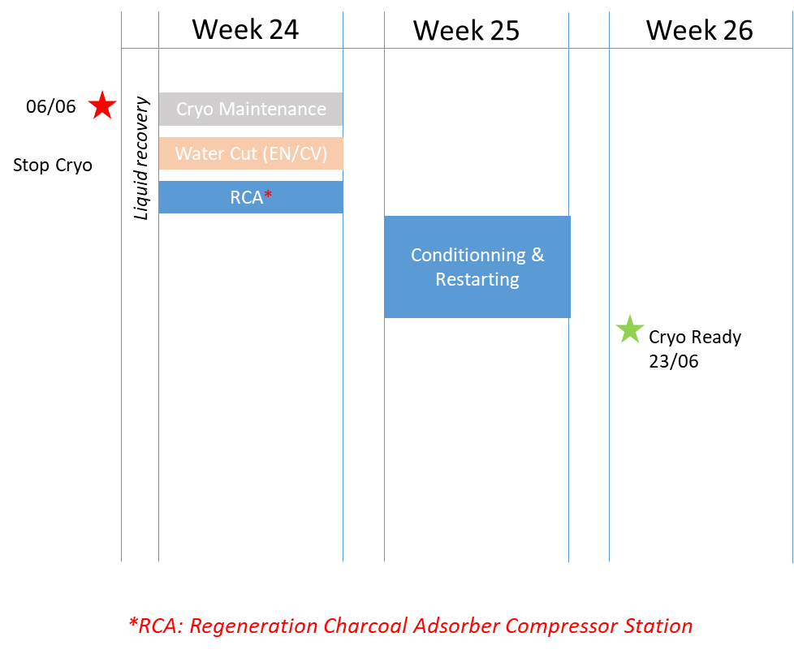
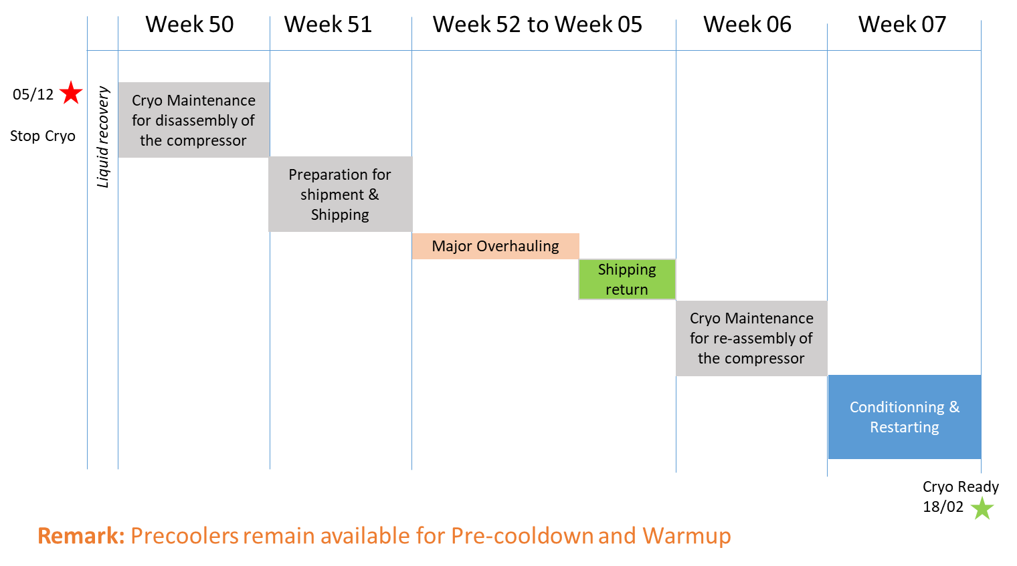
Cryo shut-down (mid and end-of-the year)
Yearly maintenance (2025)
Major overhauling of main compressor 4.5 K (2025-2026)

Slide 16
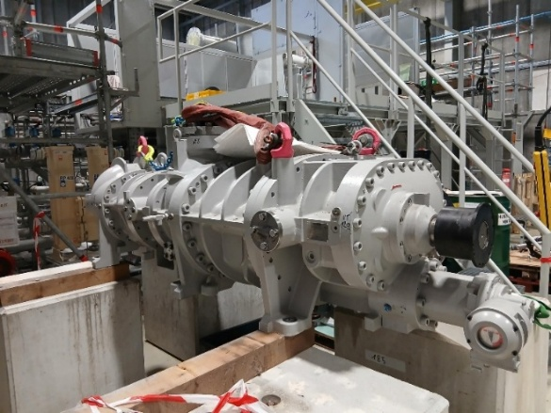
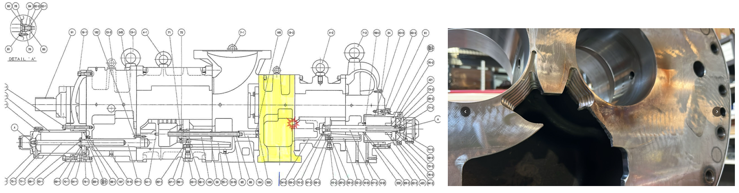
Major overhauling of main compressor 4.5 K
The compressor was fully disassembled for inspection.
Overall, the compressor components were found to be in good condition, with no signs of abnormal wear on the majority of the parts. The journal bearings could be reused after polishing and dimensional checks.
The high-stage bearing head was found damaged: its discharge port broken on one side.
CERN, in agreement with the manufacturer, decided to proceed with the major overhauling while keeping the damaged bearing head, as the delivery time for a replacement part was estimated at 4 to 6 months.
The defect was probably already present during the last operating phase and did not affect the compression capability but was probably causing higher absorbed power and reduced compression efficiency. CERN has requested a formal quotation for a new bearing head, which has not yet been received.

Slide 17
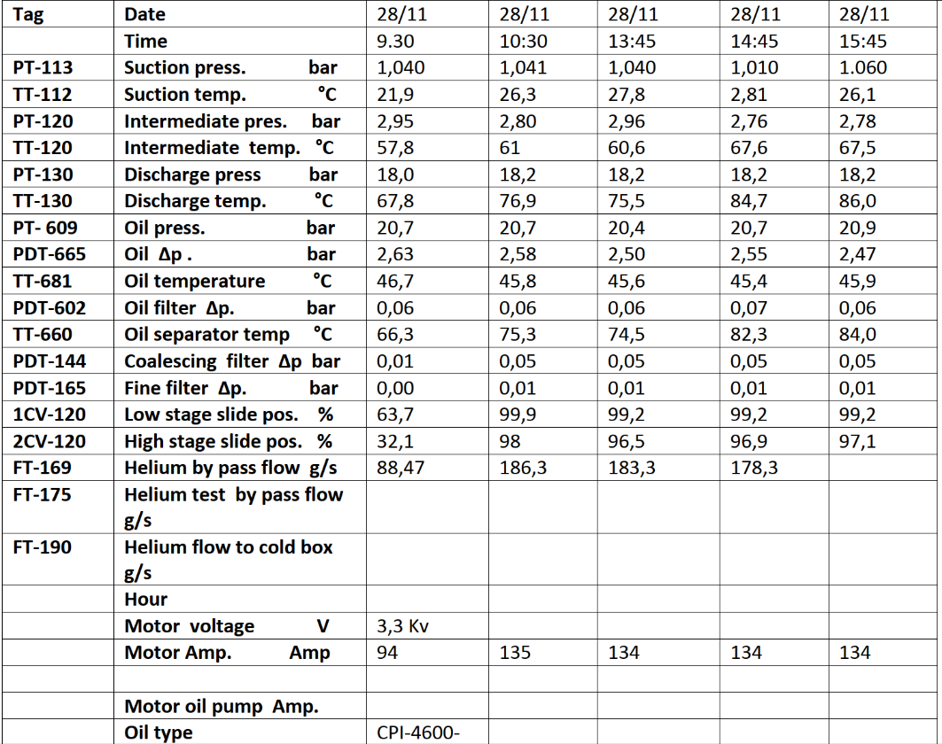
Major overhauling of main compressor 4.5 K
Before Major Overhaul (29/11/25)
After Major Overhaul (05/02/26)
29/11/25
05/02/26
11:00
18:00
1,02
1,03
27,9
27,8
2,86
3,02
65
66
16,5
17,5
Difference due
to the adjustment
of the oil pump
(solved)
82,7
83,3
18,75
18,9
2,27
1,41
48,5
48,8
0,05
0,08
79,5
83,3
0,3
0,29
0,016
0,015
100
100
96,6
96,8
182
188
132
137
Performance comparison
Compressor performance values remained consistent before and after the major overhaul, despite the observed damage.

Slide 18
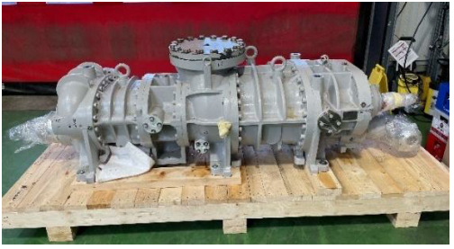
Main compressor at 4.5 K: critical spare parts
CERN cryogenic group recommendation is to purchase critical spare parts for main compressor station:
  Motivation: extension of the collaboration agreement with GSI till 2029, and internal break inside compressor detected during major overhaul.
  Estimated budget:
    Compressor: request for quotation transmitted to Mayekawa, based on recent ATS-CONS purchase, estimation of the compressor to 280 kCHF, lead time 12 months
    HV motor, based on recent purchase of similar motors, estimation to 120 kCHF, lead time 9 months
To be reminded that compressor station breakdown could lead to 12-month MTTR, impacting the FAIR magnet test program.
To be agreed how this could be funded

Slide 19
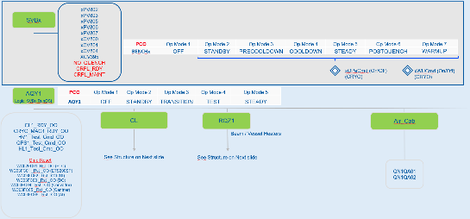
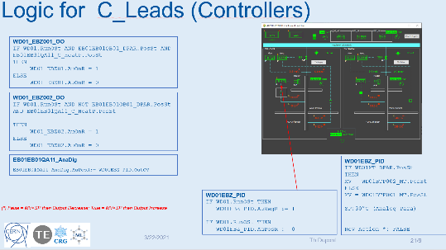
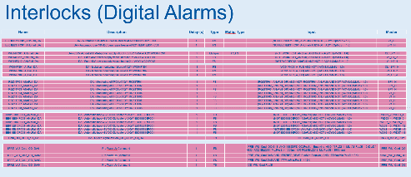
Cryo-process upgrade
Link to EDMS
Implementation
Identify the main objects and Interlocks of current Process (TE-CRG)
Create the new structure (TE-CRG /GSI)
Define the process and necessary interlocks
(TE-CRG / GSI)
Write the new process file (TE-CRG)
Programming and upgrading of the synoptics
(TE-CRG)
Tests and commissionning (TE-CRG / GSI)
Objective
Streamline and automate the existing process, including the already implemented evaporation automation
Review and optimize interlocks, ensuring proper filtering and validation
Automate GSI objects in alignment with the defined operational modes
Design and implement a new process that is efficient, scalable, and easily adaptable for final GSI operations
Completed
In Progress
Not Start
01/26
02/26
03/26
04/26
05/26
1
2
3
4
5
06/26
Time line

Slide 20
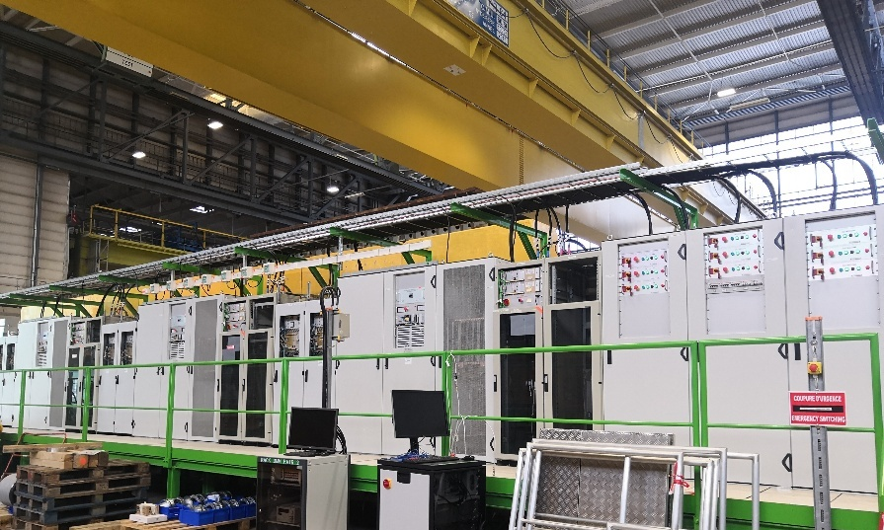
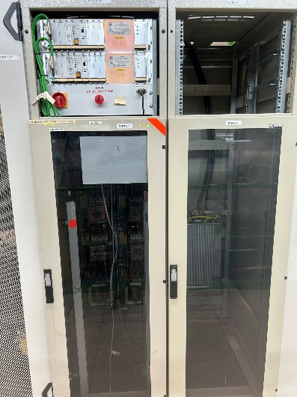
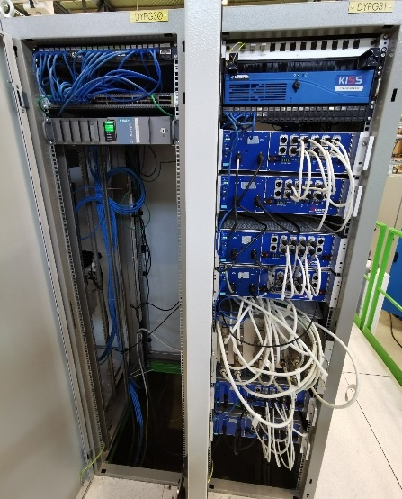
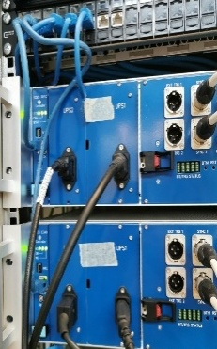
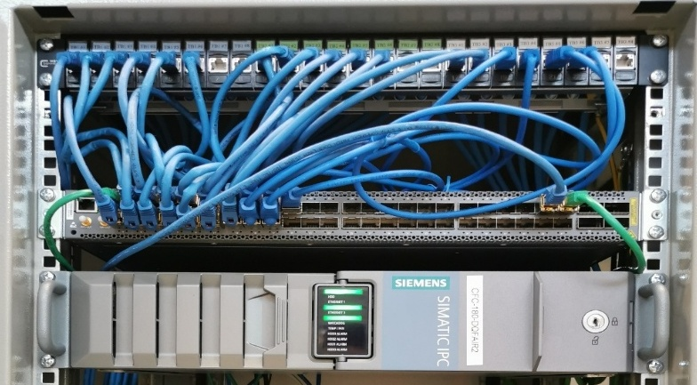
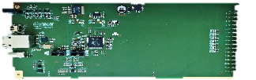
Magnet Protection and Instrumentation
Power convertor racks and Energy Extraction (EE)
Infrastructure overview:
  Each testbench has 6 Quench Detection Systems (QDS) with double redundancy.
  Each powering cluster for an RM circuit is equipped with 2 Energy Extraction (EE) devices.
EE: the systems of an RM powering cluster are controlled independently.
QDS: protects up to 3 superconducting magnets with independent settings (1 RM and 2 RC circuits)
  Up to 9 simultaneous powering (2 types of PC: RM and RC)
EDAQ IT Infrastructure - New
Ethernet Patch Panel
Quench Detection System uQDS crates
EDAQ UQDS - New
Ethernet Switch
Front-End Computer

Slide 21
QDS and Multi-bench parallel powering
EDAQ (Ethernet-enabled Data Acquisition) infrastructure - Improved the Ethernet network so that it is possible to monitor systems remotely and fix issues faster.
  FEC installation by BE-CEM team.
  Installation of Ethernet cables and patch panels by Super-FRS team.
  Installation and configuration of Ethernet switch by TE-MPE team.
  UQDS upgrade – hardware installation and firmware development by TE-MPE team.
Instrumentation: termination patch panel for terminating unused instrumentation connections - Improved Operational Efficiency and QDS safety
  Design and installation by Super-FRS team. Details in the EDMS 3319629 document.
SCADA applications - Deployed control and monitoring software and improved how data is accessed
  Deployment of low level FESA SCADA and expert applications by TE-MPE team.
  Deployment of adapted WinCC OA operational SCADA by BE-ICS team
  Adaptations to data retrieval applications (PM and NXCALS) by BE-CEM team.
Multi-bench parallel powering - commissioning procedures – New procedure for the complete and autonomous commissioning by TE-MPE team (Details in the EDMS 3393438 document).

Slide 22
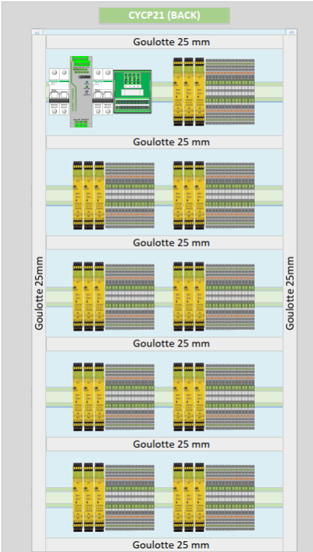
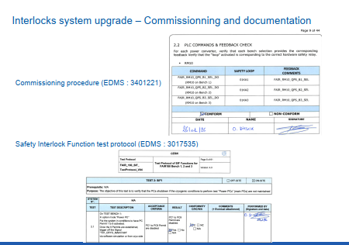
Interlocks’ system upgrade
New QPS commutation design layout
The interlocks and QPS protection commutator system have been redesigned to power several test benches
SW: Functional Safety Report (risk analysis) and corresponding logic program review in collaboration with BE-ICS (EDMS 2016209)
Safety Interlock Function
test protocol (EDMS 3017535)
System fully commissioned:
procedure (EDMS 3401221)
Review in Jan 2026 :
Recommendations
all implemented (see link)

Slide 23
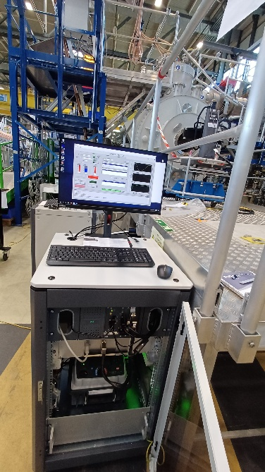
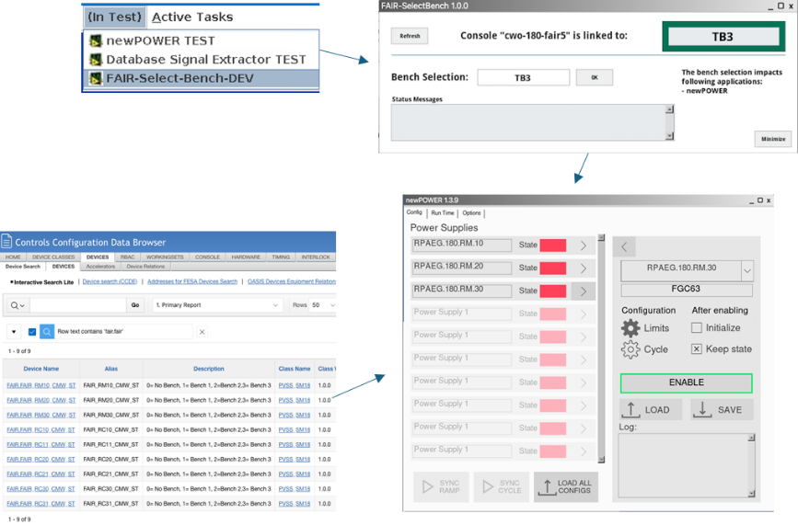
Developments and Support in 2025-2026
Done
  Support for Virtual Machines (VM): PC used for analysis (Q1-2025) - New Windows 11 VM created to replace the old Win10 (VM are associated with the FAIR Linux consoles)
  New High Voltage mobile racks for GSI (Q1-2025) and for B180 (Q3-2025)
  Study for a solution to control the 9 power supplies in // on the 3 Test Benches (Q4-2025)
  PXISSM05 (CPU of the DMM meas. system 2) upgraded to Win10-LTSC (Q4-2025)
  PXISSM06 (CPU of the DMM meas. system 1) upgraded to Win10-LTSC (Q1-2026)
  PXI-HVT-FAIR2 (CPU of the HV meas. system 2) upgraded to Win10-LTSC (Q1-2026)
  DVP and deployment of the Select-Bench tool (Q1-2026)
Still to be done
  PXI-HVT-FAIR1 to be upgraded to Win10-LTSC

Slide 24
EAM-Infor and Schedule Gant chart follow-up

Slide 25
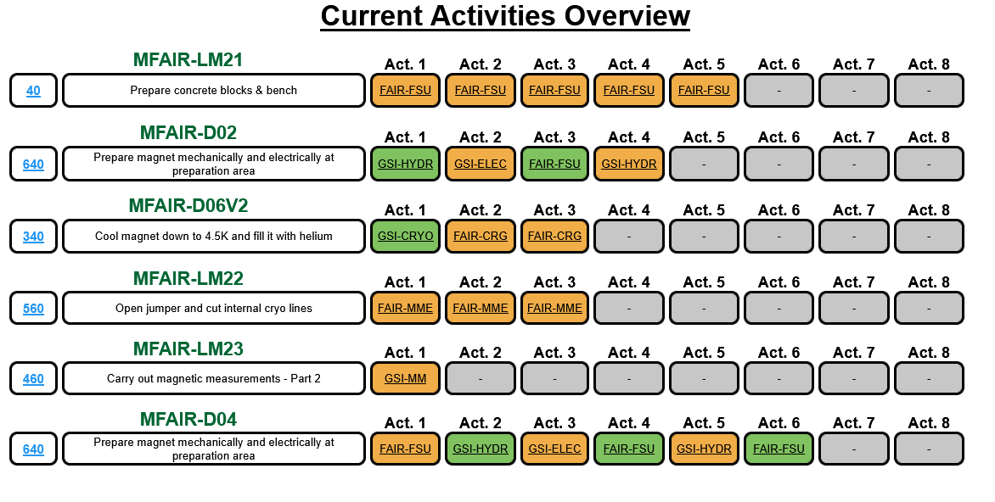
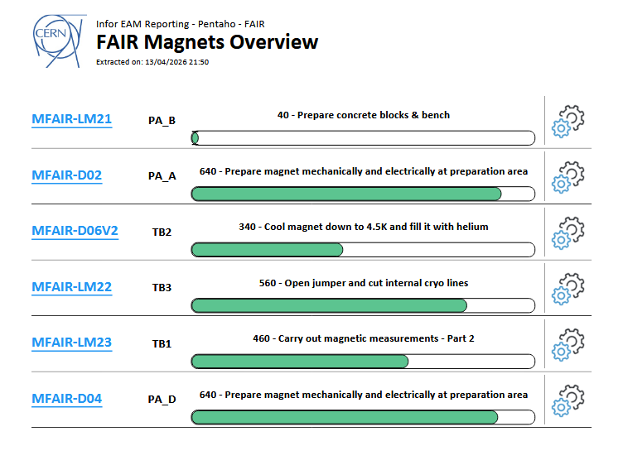
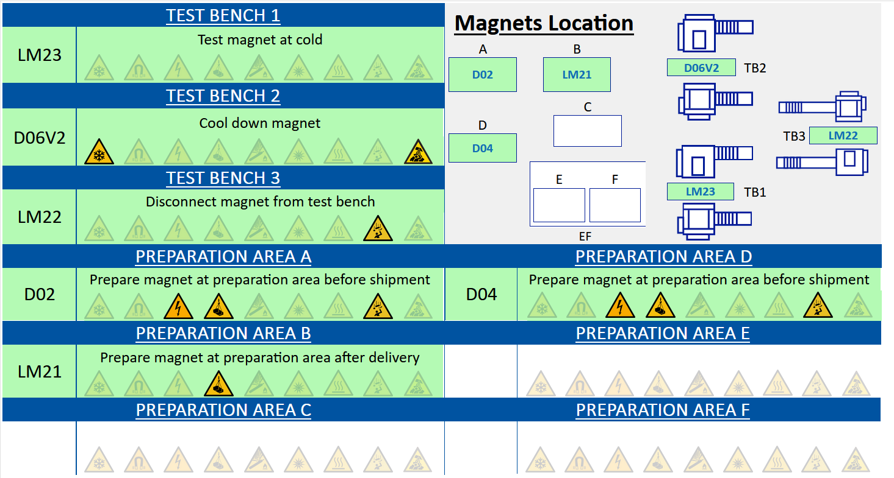
EAM*-Kiosk development
Ongoing support for test progress tracking with EAM-Kiosk and regular test sequence updates
Magnets under tests or under preparation
*Entreprise Asset management

Slide 26
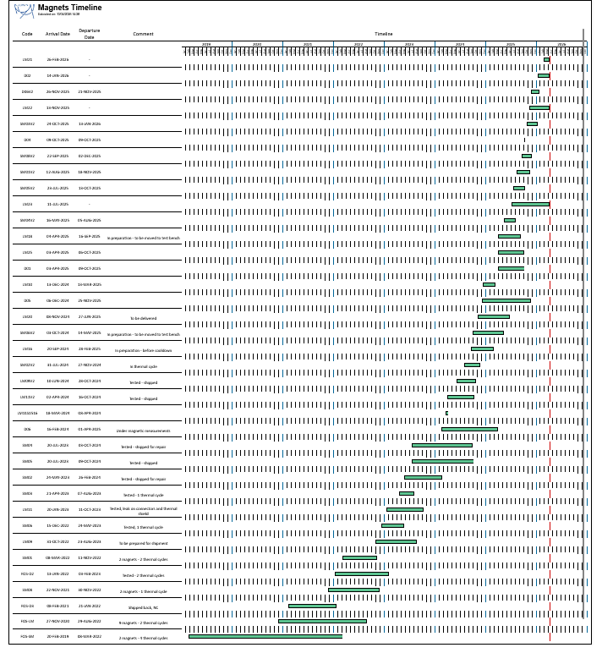
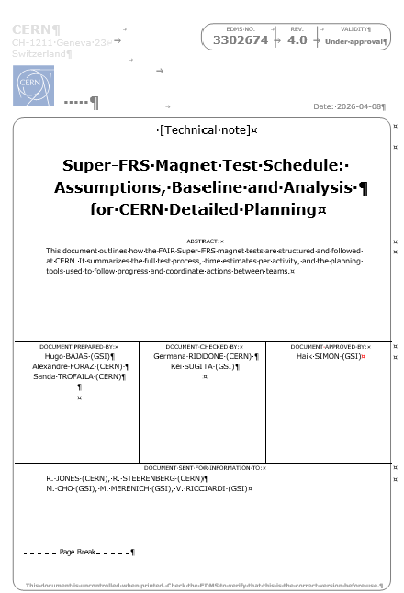
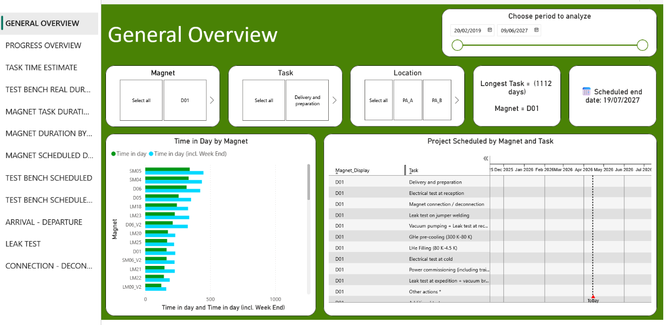
2019
2026
New test sequence to complete the ES program implemented and Gantt Chart updated accordingly
Still 14 magnets to be tested and 4 ongoing
End of the Magnet tests on the test benches: July-2027
EDMS: 3302674
36 Magnet tests from 2019 to present, highlighting visible learning and improved test duration
Link to analysis in power BI (access on request)

Slide 27
Conclusions
The CERN test facility is fully operational and meets Super-FRS testing requirements.
Major upgrades in cryogenics, powering, and control systems have significantly improved reliability and flexibility.
Multi-bench parallel powering and enhanced protection systems (QDS, interlocks) have been successfully implemented, representing a key achievement that will contribute to reducing overall test duration
Logistics, mechanical operations, and quality control are well-established and efficiently coordinated.
The 4.5 K compressor overhaul was successful but revealed damage, highlighting the need for critical spare parts procurement (funding to be agreed).
Advanced EDAQ, SCADA, and software tools improve safety, monitoring, data quality, and operational autonomy.
The tests are progressing well and are expected to conclude the ES magnets by Q3 2027; however, reaching the final milestone will require operational flexibility to address any non-conformities.
Strong and effective CERN–GSI collaboration, with increasing autonomy of the Super-FRS team.
Amendment 4 (in preparation) will extend the collaboration scope (AVATAR) and increase CERN contributions, notably industrial support.

Slide 28
3rd Workshop on Super-FRS magnet modules
From production and testing to commissioning – enabling early science of FAIR
Magnetic measurements on dipoles are currently performed in series due to the availability of only one magnetic measurement (MM) device (fluxmeter). An additional MM device will enable parallel testing and reduce test duration.
Organise a review with TE-MPE, including A. Siemko, to discuss quench analysis and the optimisation of the current ramp to reduce peak amplitudes. The large volume of available data underscores the need for a structured analysis framework.
Impedance spectroscopy: borrow measurement equipment at CERN (mobile equipment may be available in SM18; coordinate with M. Buzio).
SCADA and cryo process: make sure the CERN development and learning from the B180 magnets tests is transferred to the GSI control team.

Slide 29
I would like to thank the GSI colleagues for the pleasant and fruitful collaborations.
Thanks for your attention

Slide 30
Additional slides

Slide 31
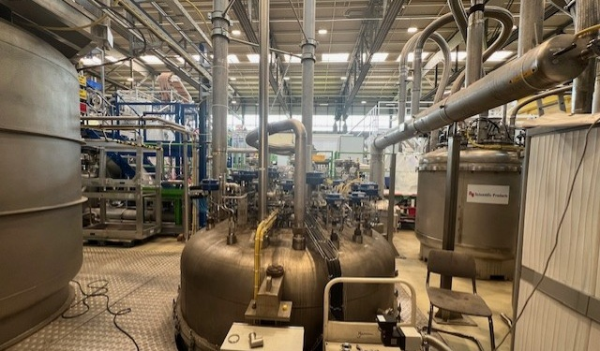
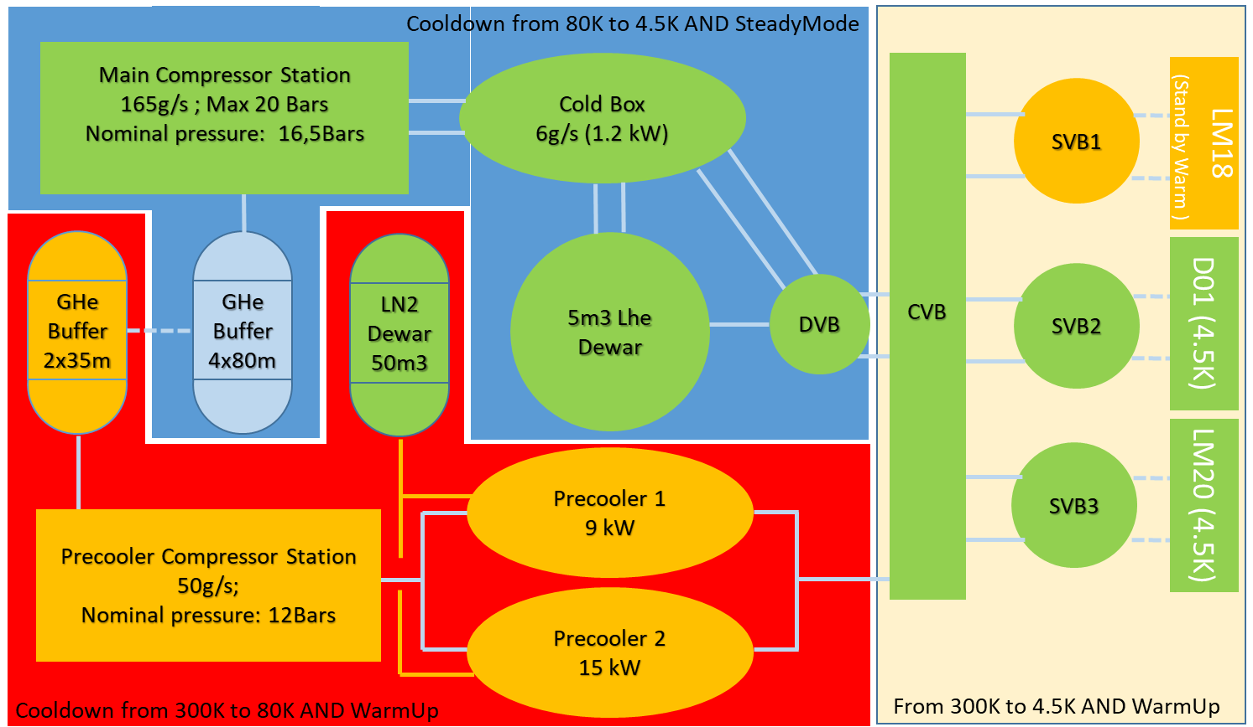
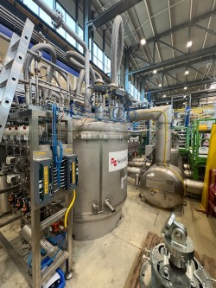
Cryogenic system
DVB
CWU
CVB
Example: 2 magnets at 4.5 K and one in warmup stand-by

Slide 32
Test schedule for ES magnets

