Slide 1

Status Magnet Production and Further Collaboration Steps
Haik Simon
GSI, April 17th, 2026

Slide 2
Collaboration Topics
Collaboration status
Sc multiplets
production and testing status
Sc dipoles
production and testing status
Sc magnets and local cryogenics
delivery after testing w.r.t. installation schedule
Summary and Outlook

Slide 3

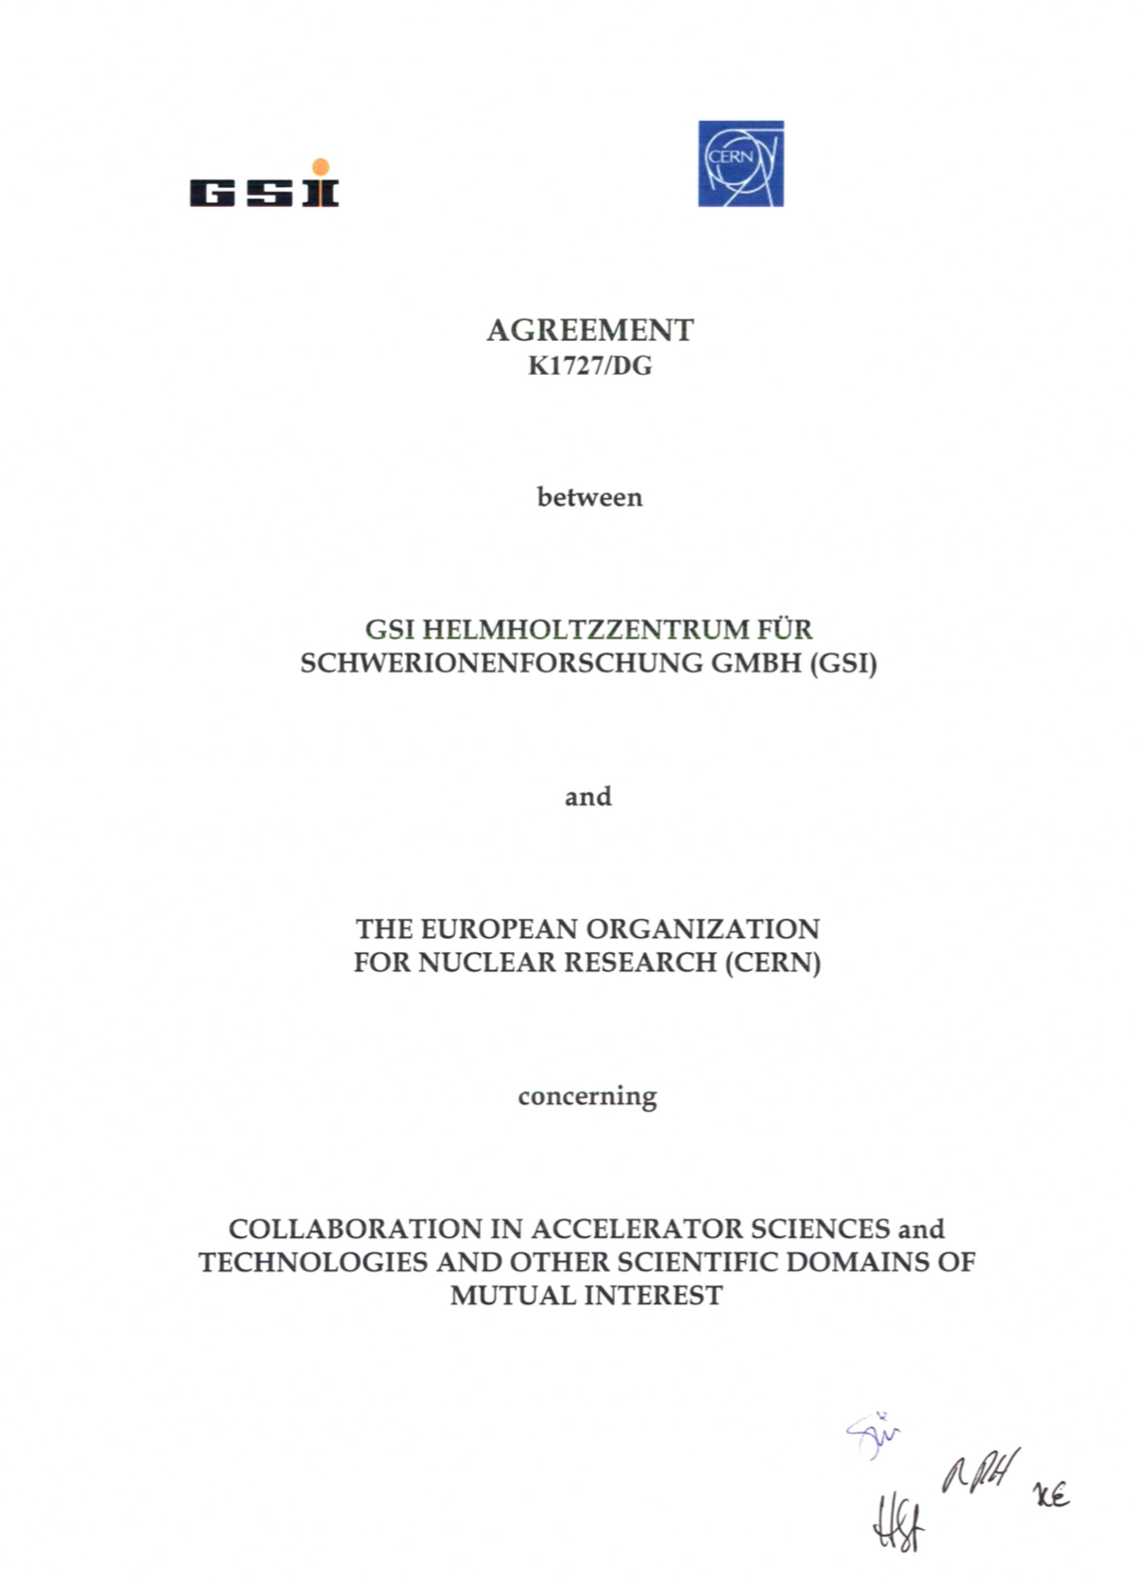

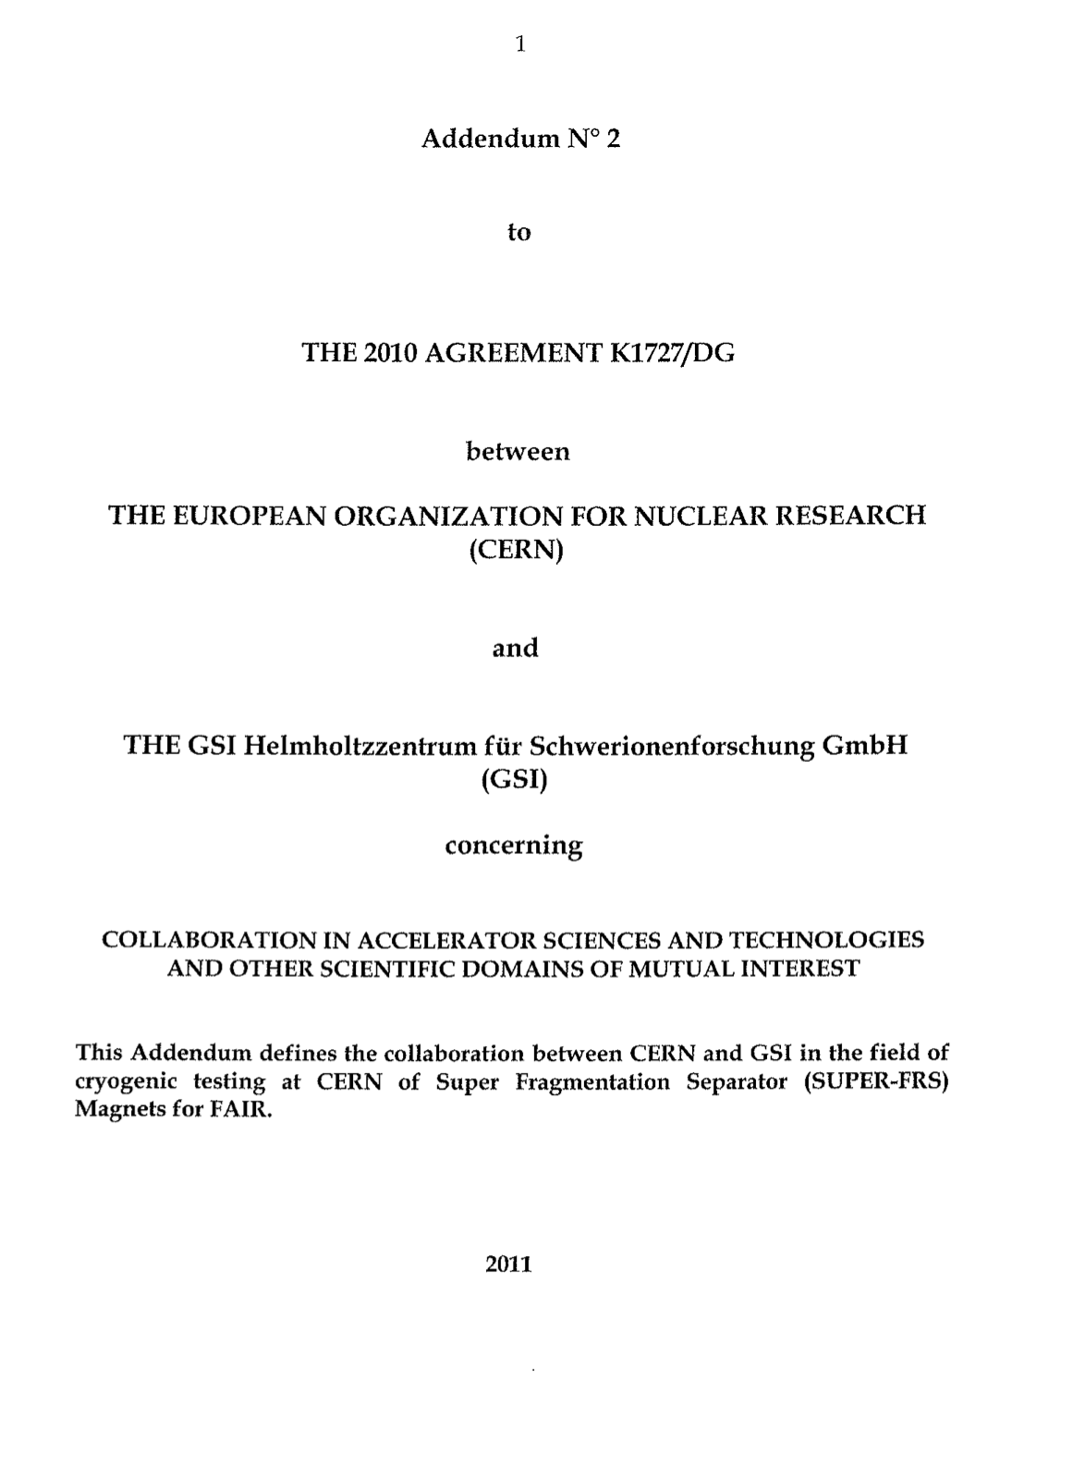

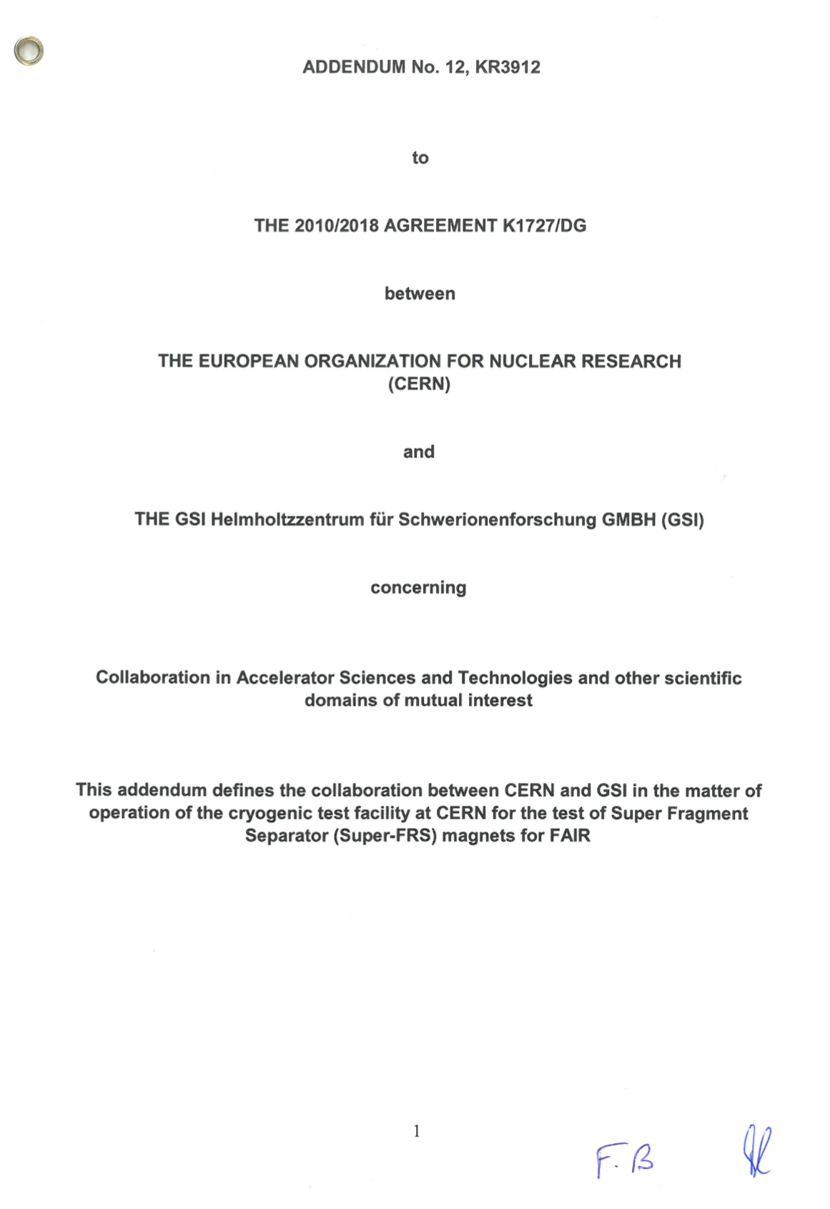
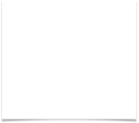
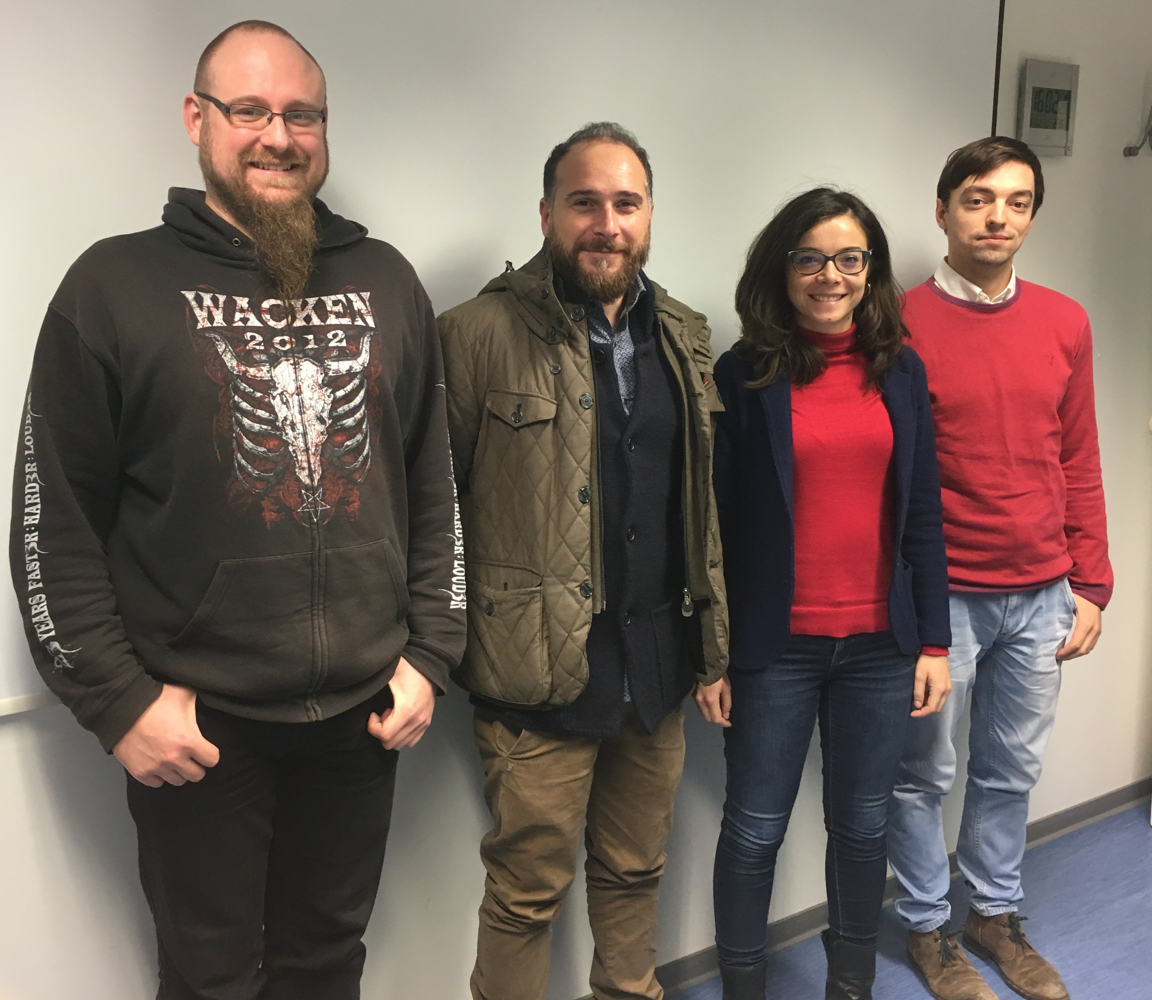
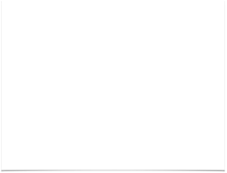
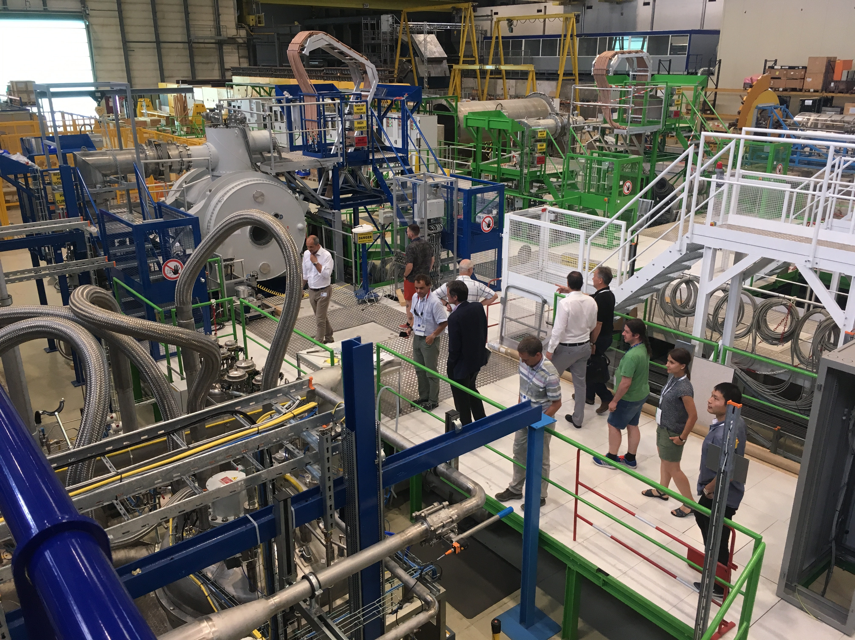
History of the project
2010
CERN-GSI Agreement K1727/DG:
General agreement on collaboration in accelerator science and technologies
On 14/04/2010, GSI and CERN signed the Agreement K1727/DG establishing an operational framework for collaboration in accelerator sciences and technologies, and other scientific domains of mutual interest
2011
2012
Addendum No.2:
Cryogenic testing of S-FRS Magnets at CERN
2013
2014
Addendum No.4:
Procurement of pre-cooler, QPS, Survey tools
2015
2016
Addendum No.5:
Floor, control room
“CERN maintains the facility operational,
GSI executes the testing.”
with some exceptions:
welding, crane operation, cryo operation, fiducialization, …
2017
2018
Addendum No.12 KR3912:
Testing operation phase
2019
GSI testing team deployed, first magnet received, commissioning of the facility started
“Kick-off meeting” at CERN
2020
2021
2022
Amendment No.1 to Addendum No.12: update “Liability”
2023
Amendment No.2 to Addendum No.12:
extension to end of 2026
2024
Amendment No.3 to Addendum No.12: extension to end of 2029, redefine scope of magnets to be tested, update resource assignment, options for work outside of regular working hours, parallel powering
2025
Workshop at CERN
K. Sugita

Slide 4
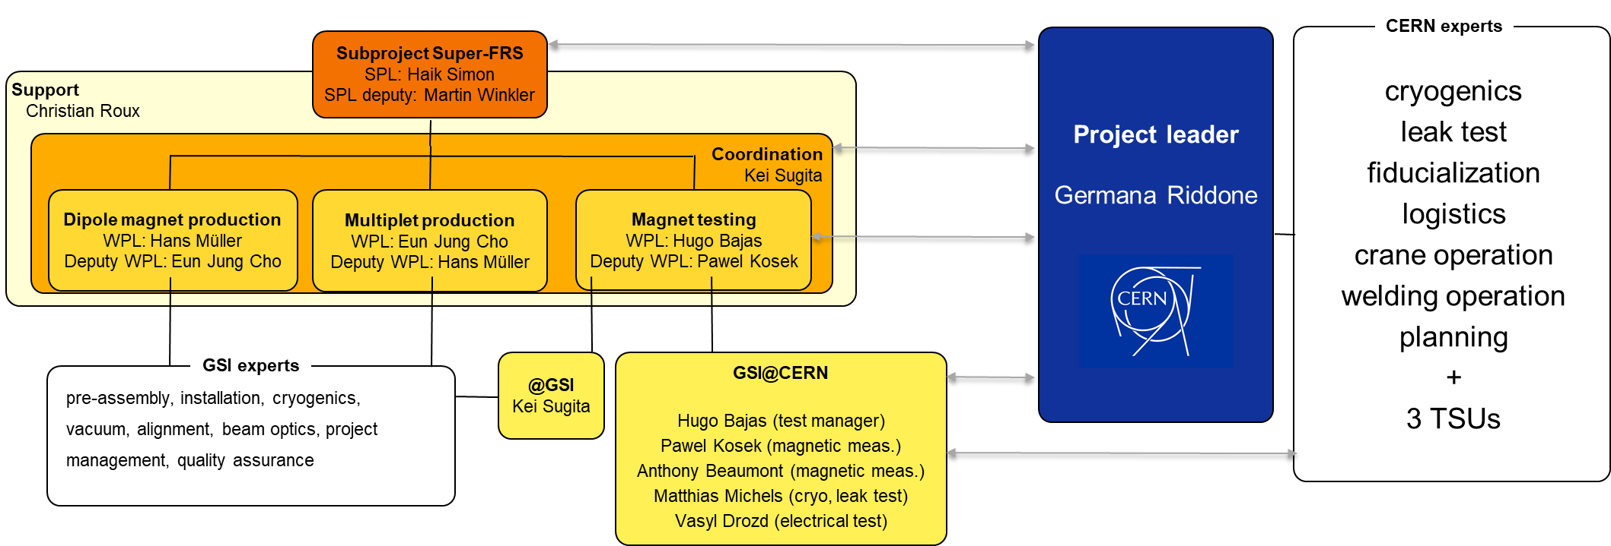
Collaboration Structure
K. Sugita

Slide 5
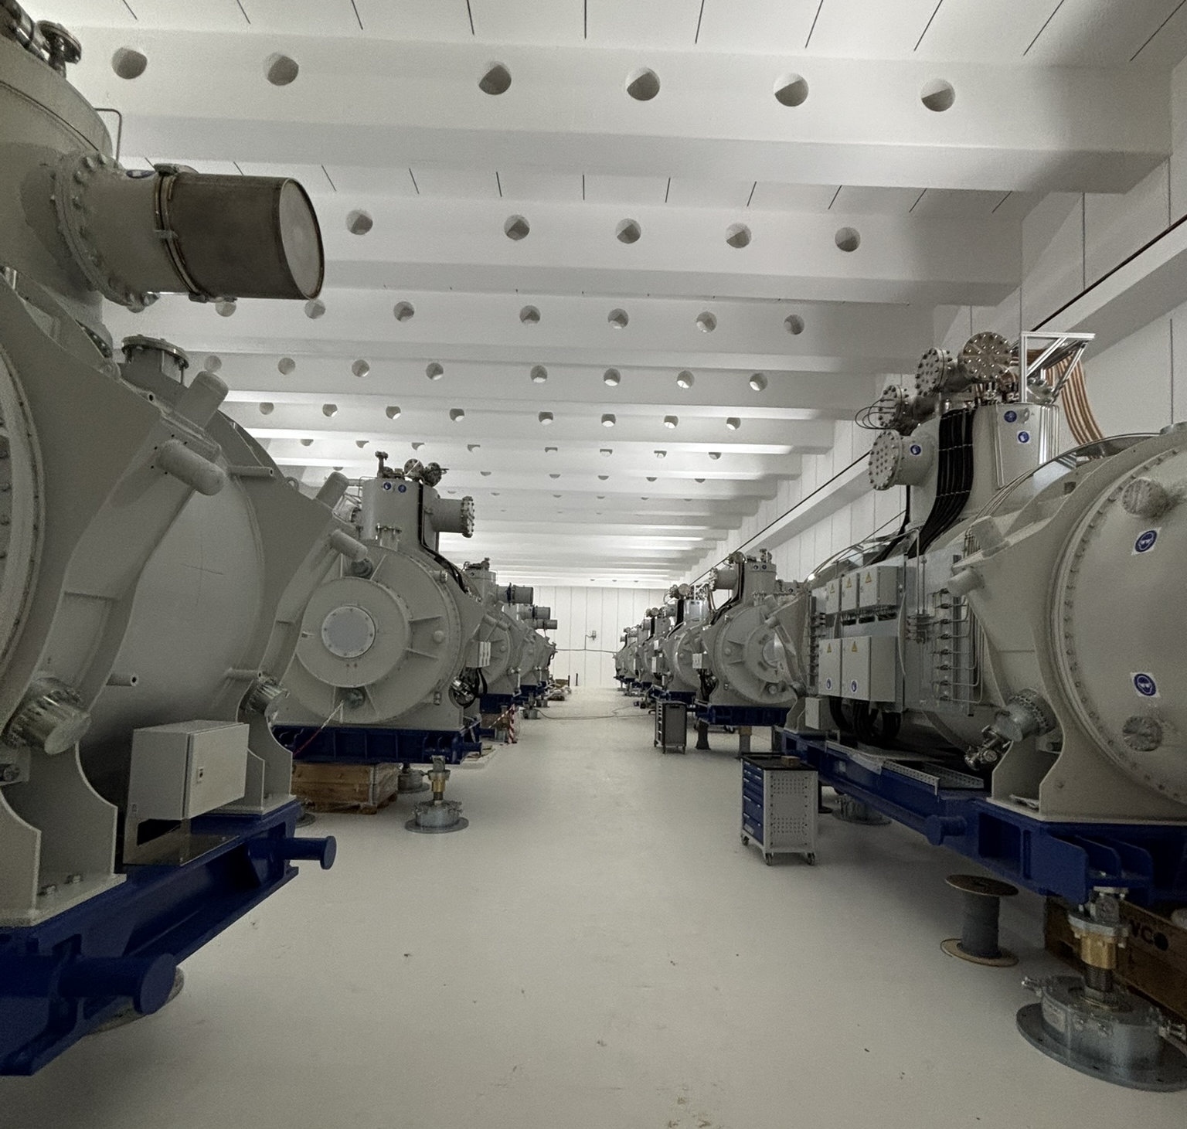
Sc multiplets (for ES: 7 short and 13 long)
Procurement sc multiplets: a short history
20(/32) sc multiplets for ES. GSI in-kind.
GSI contract signed: July 2015 (ASG, IT)
FAT FoS short multiplet: January 2019
FAT FoS long multiplet: September 2020
Manufacturing status for ES in July 2023 (first round): 92%
→ Technical issue (leakage at cold)
Task Force GSI-CERN-ASG
technical solution for thermal shield implemented
no leakage since first repaired LM (Apr-24)
repair (all multiplets)
Since April 2024: regular monitoring of external qualified supervisor at ASG premises
sc multiplets at FAIR March 2026
multiplets at FAIR campus
12/11/2024 CERN
Current status: all sc multiplets for ES produced and Factory Acceptance Test successfully done
see next slides

Slide 6
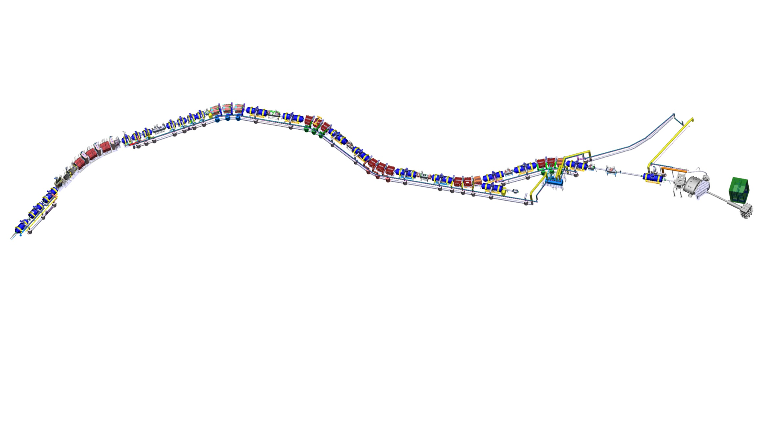
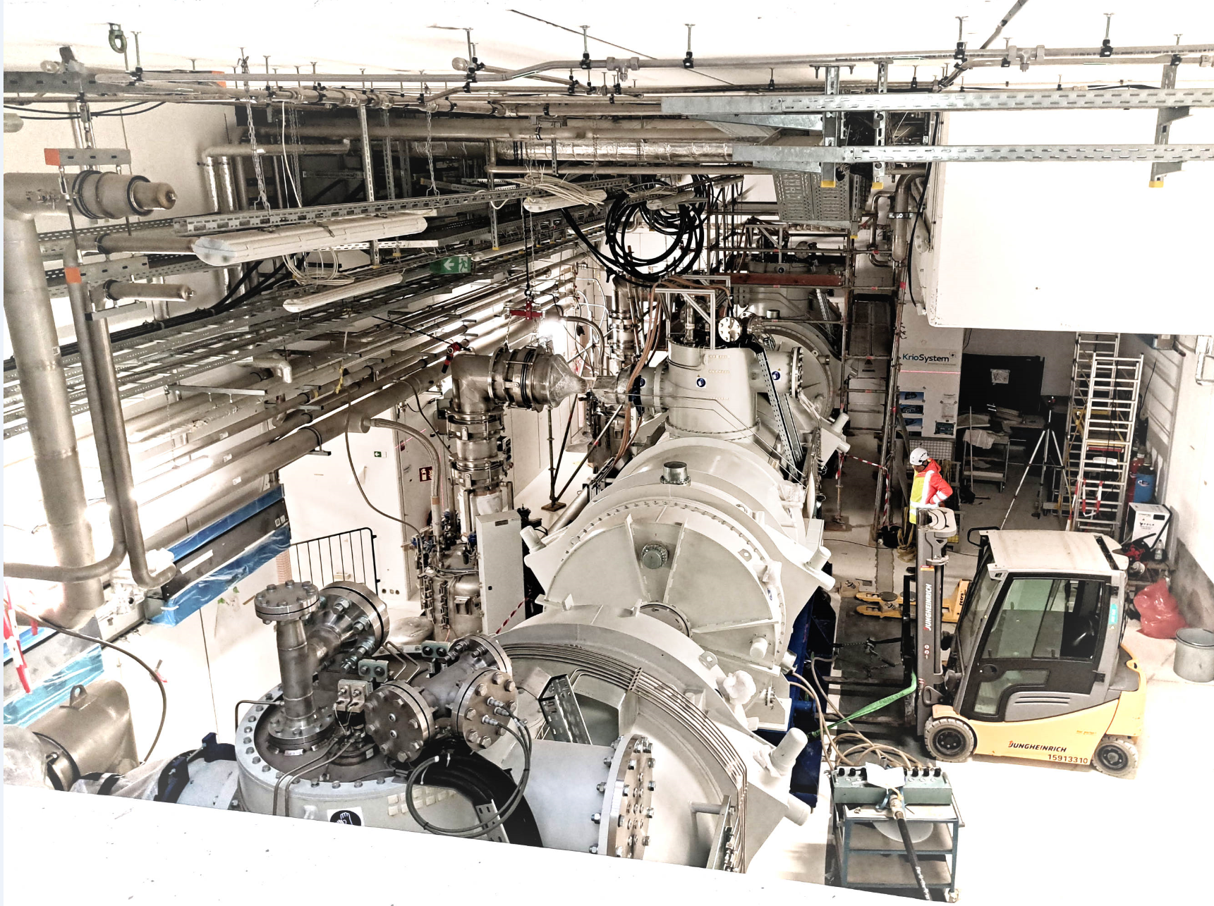

Sc multiplets for Early Science (ES)
CERN test done
SM03
SM05
SM02
SM04
SM08
shielded target area
SM06
SM01
LM16
CERN test ongoing
LM10
LM18
LM11
LM09
at CERN, next on the bench
LM20
LM21
at ASG, FAT done
LM22
LM23
LM25
LM13
LM15
LM29
Section installed and pressure & vacuum tested 19.12.25

Slide 7
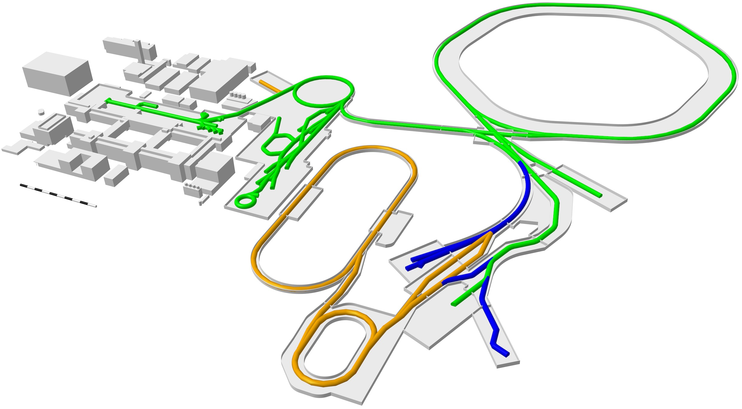
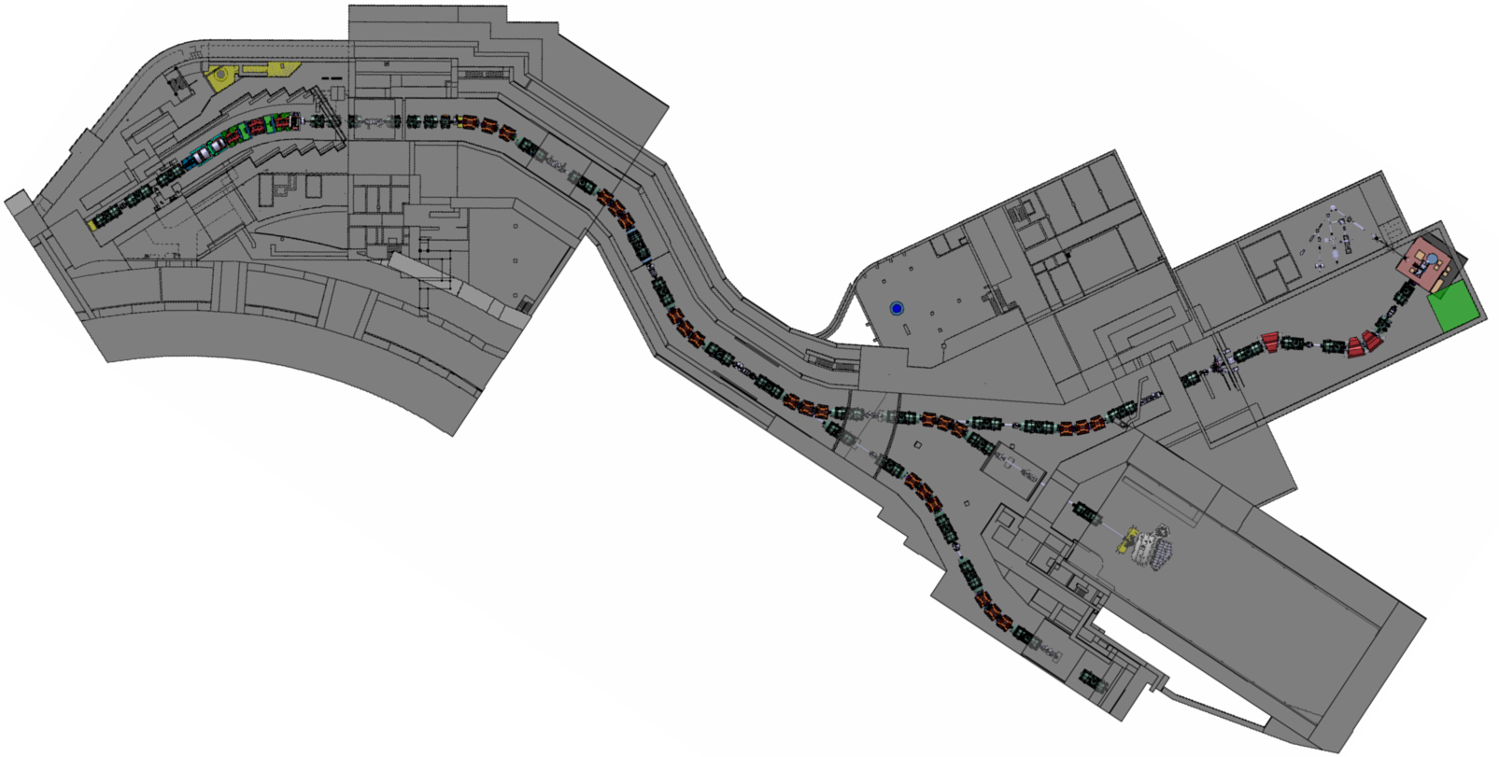
FAIR 2028 and beyond Low Energy Branch (LEB), Energy Buncher, and Ring Branch (MSV)
Low Energy Branch with Energy Buncher
Ring Branch
High Energy (Early Science)
According to current planning the Low Energy Branch is the next NUSTAR facility to come (FS+++)

Slide 8
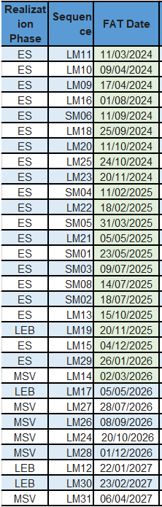
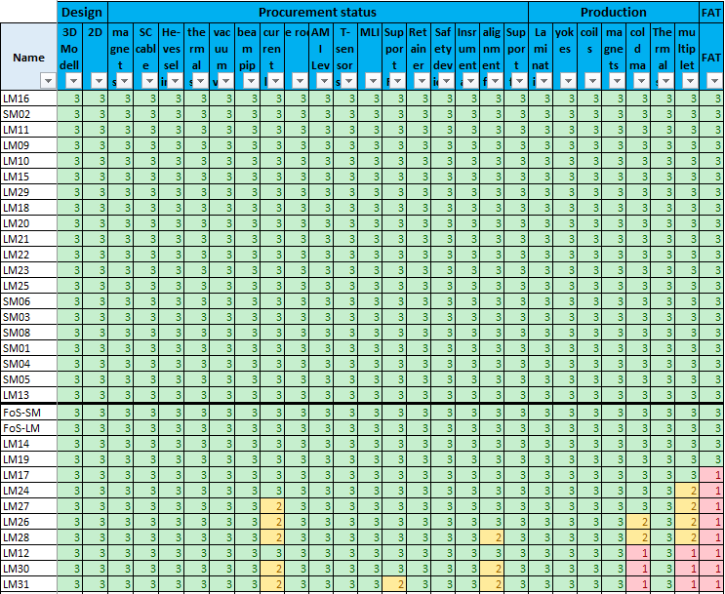
SC multiplet production (ASG Italy, all ES magnets done)

Slide 9
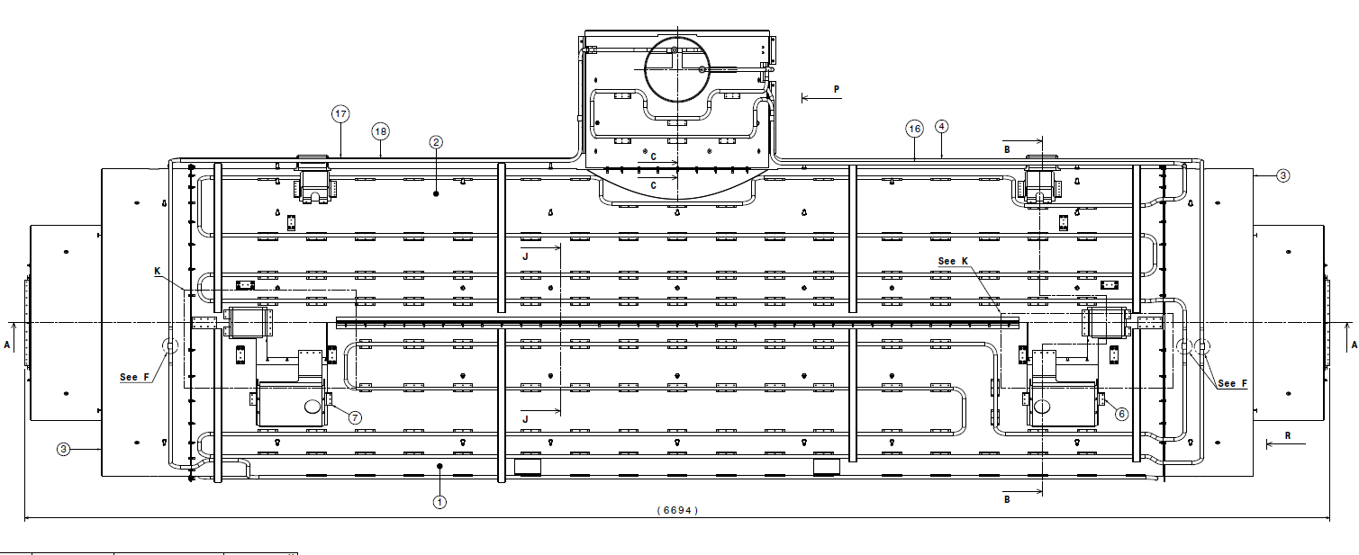
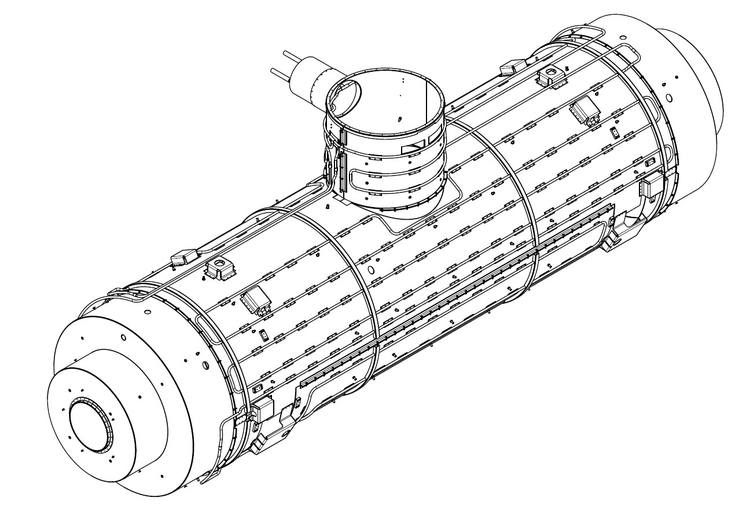
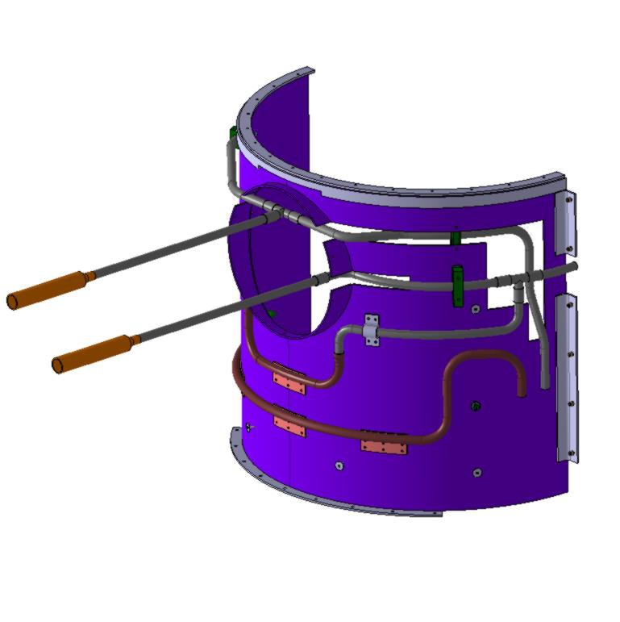
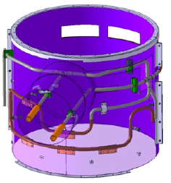
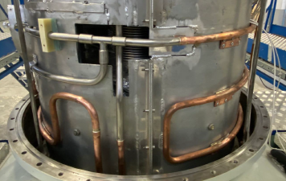
Technical issues already resolved
GSI-CERN-ASG task force
3
1
2
6
5
4
Source: ASG 06-09-23
Wherever possible brazed copper pipes have been replaced.
2) Remaining pipe brazing is strictly quality controlled.
9
Notes:
Space expert Jonathan McDowell says on ISS 2023 leaks, if you have three such leaks, you have a problem: "One doesn't matter, two are a coincidence, three are systematic."

Slide 10
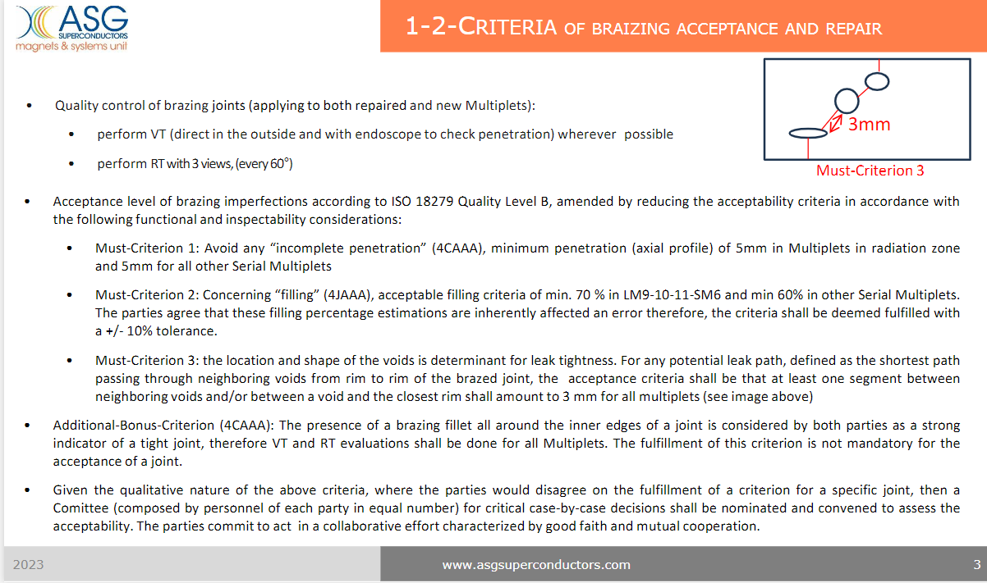
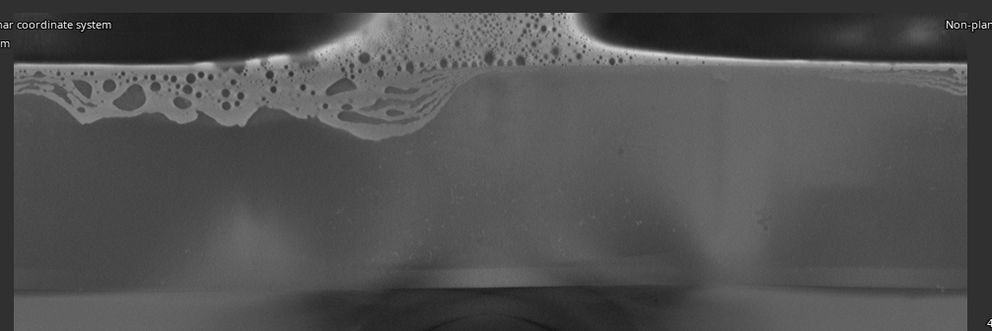
Quality Criteria and X-Ray proc.
GSI-CERN-ASG task force
Specific brazing quality agreed upon in late 2023 between GSI and ASG, following the recommendation of the task force. The Must-Criteria shown below reflect the DIN/EN 18279 from Level C to Level D:
outer edge (ring)
incomplete
penetration
inner edge (ring)
Notes:
THESE are massive reductions against level B
With the tolerance of -10%, the 2nd must Criterion 2 reduces to level D for LM9-10-11-SM06 and below in all other modules.
Must Criterion 3 isn‘t defined in the standard for good reason. It is a massive Q-reduction.

Slide 11
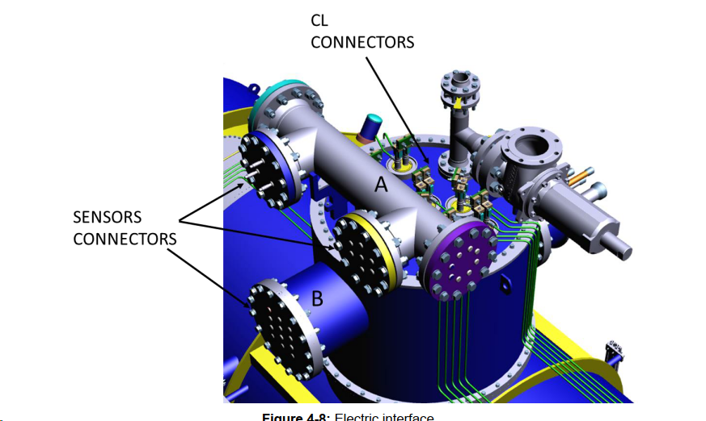
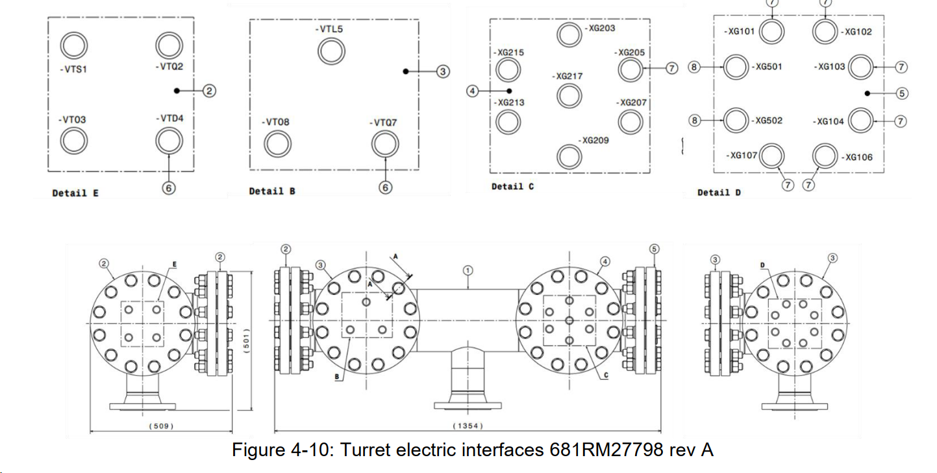
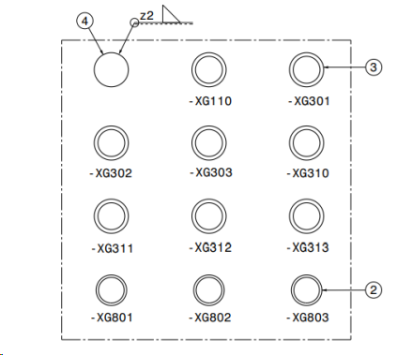
Technical Issue, solution found via
GSI-CERN-ASG task force
A leak rate of feedthroughs increases after exposure to high pressures.
Quality issue at supplier
At ASG, around 20 % failure rate during incoming inspection (leak test at 22 bars for 96 hours).
At SAT, leaks found at incoming and specially after thermal cycle
Acceptance criteria at FAT : a global leak rate < 5 x 10⁻⁵ mbar l/s
To proceed cool down at CERN : a local leak rate < 1 x 10⁻⁴ mbar l/s
Lemo Feed-throughs
under vacuum
Lemo Feed-throughs under pressure:
Voltage taps, CERNOX sensors, level sensors

Slide 12
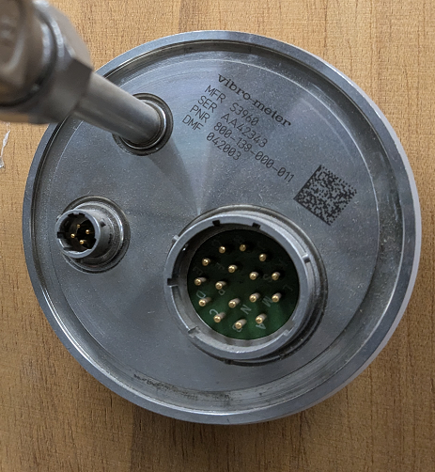
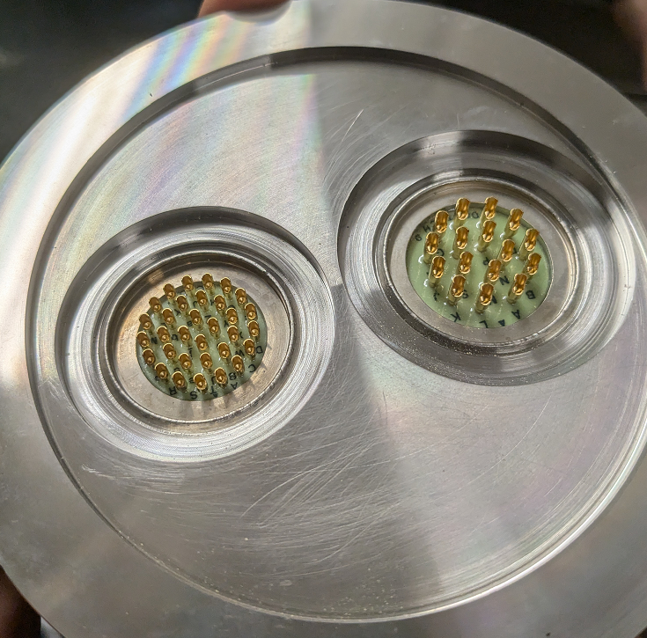
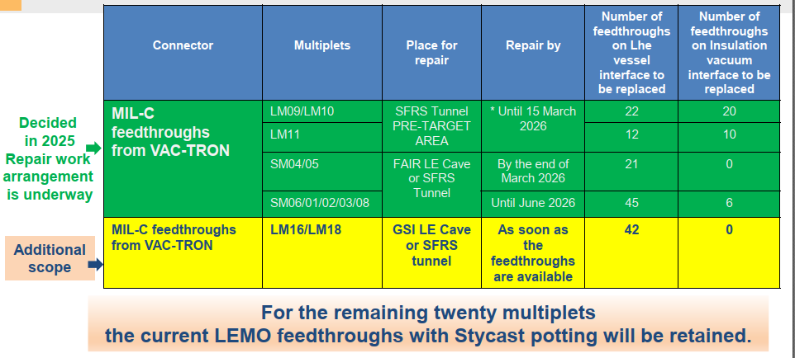
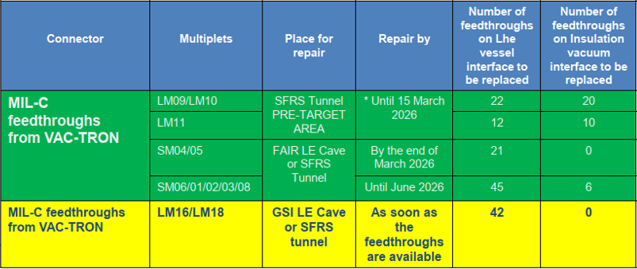
Ongoing Repairs at FAIR
Decision for LEMO Repair, February 2026

Slide 13
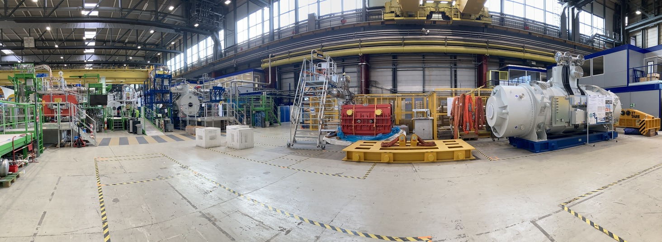
Sc standard dipoles for ES: 3 D2 (11°), 10 D3 (9.75°)
Procurement sc dipoles: a short history
CERN Bât.180 12/2025
21 superconducting standard dipoles (13 for early science)
FAIR contract: January 2018 (Elytt Energy, ES)
Procurement status for ES (d.d: Nov. 2023) advanced; coil casing by Vacree (China) and WME (Italy)
Planned installation: Nov 2025 – Oct 2026
Dipole
Multiplet
Multiplet
Multiplet
Dipole
FoS D3 (9.75°)
FAT: ▪ Dec-2020
@CERN: ▪ Feb-2021
on test bench ▪ May-2021
- dust cleaned
- big leak detected at cold on thermal shield
SAT aborted ▪ Nov-2021
2022: leaks detected in several magnets in production at Elytt
May 2022: all production going beyond thermal shield assembly was stopped by manufacturer
June-December 2022: extensive R&D to resolve leak issue
Beginning 2023: work on cryostats resumed using new brazing machine
2023: further non-conformities detected
mid-2023: task force GSI-CERN-Elytt activated
Sep-2023: resignation of key engineer at Elytt
end 2023: mitigation NC established:
dust: cleaning of pipes; endoscopic inspection by FAT
07/2024 chamfer: development of new (2nd) fixation for series dipoles
11/2024 Implementation of X-ray brazing checks
FoS D2 (11°)
FAT: ▪ Oct-2021
@CERN: ▪ Jan-2022
on bench: ▪ Feb-2022
- dust cleaned
- leak detected at cold on thermal shield
- chamfer movement detected after 1st thermal cycle
- leak detected in cryostat after 2nd thermal cycle
end SAT (magn. field OK; leakage NOK) ▪ Jan-2023

Slide 14
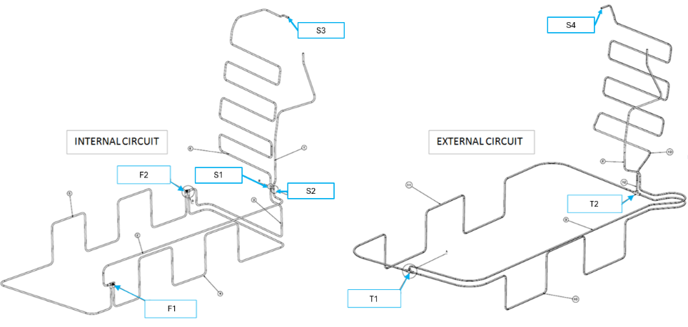
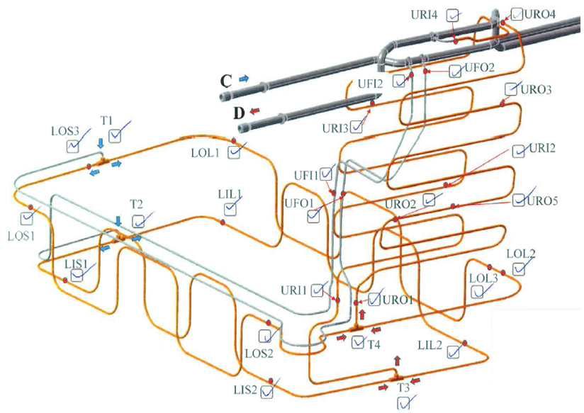
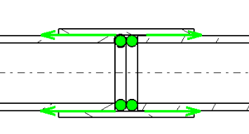
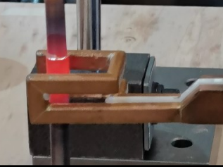
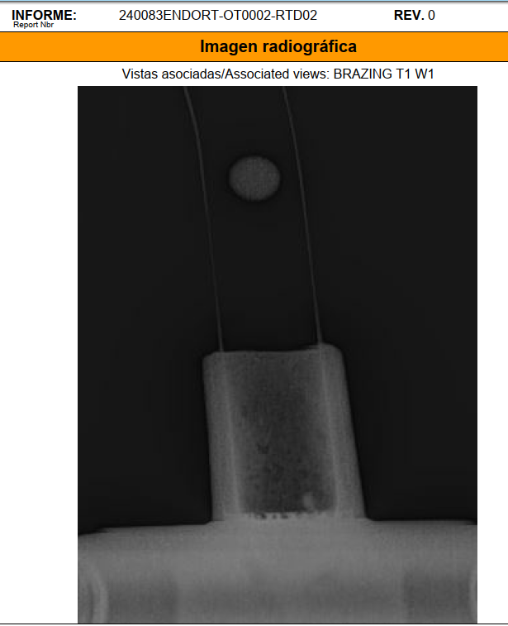
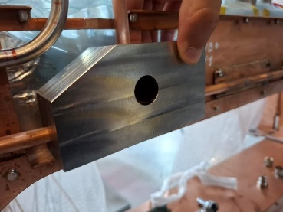
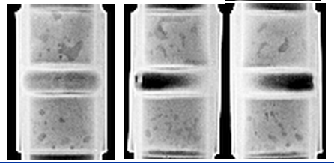
Sc dipoles technical issue - solved
Thermal shield brazing joints
GSI-CERN-Elytt task force
Old Design:
6 m Cu pipes → about 20 brazing joints
New Design:
7 m Cu pipes → only 8 joints
2 F- and 2 T-joints in coil casing area
4 straight joints in chimney area
OLD
NEW
New brazing method:
Using filler material rings
Inductive brazing
Additional intermediate test:
Local leak test of pressurized pipe with chamber on each brazing
X-ray inspection of each joint
Chamber for T-joint testing
CERN-X-ray on Elytt sample

Slide 15
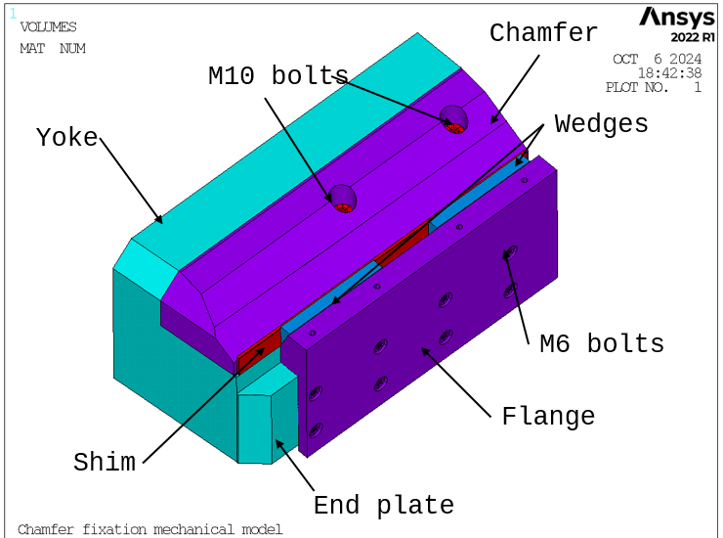
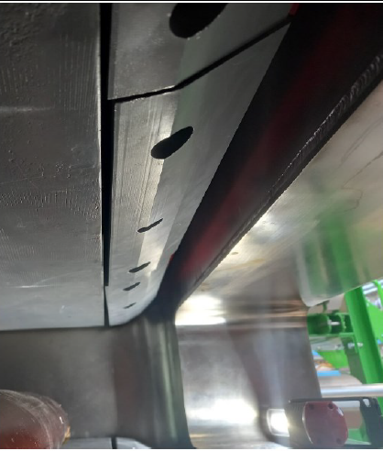
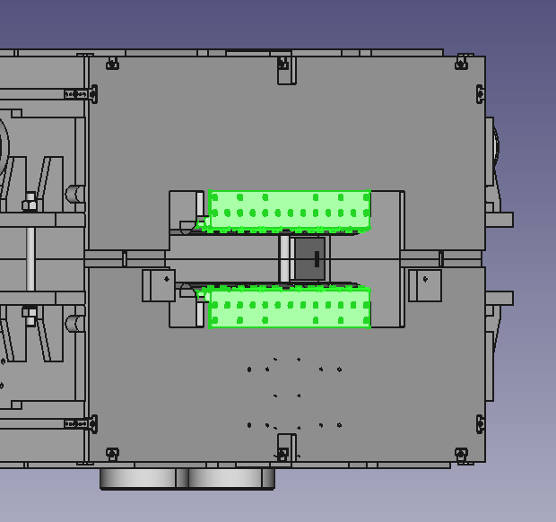
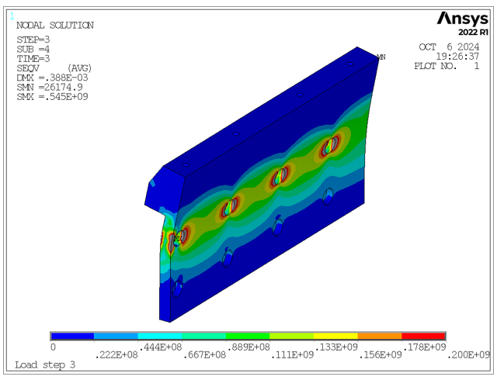
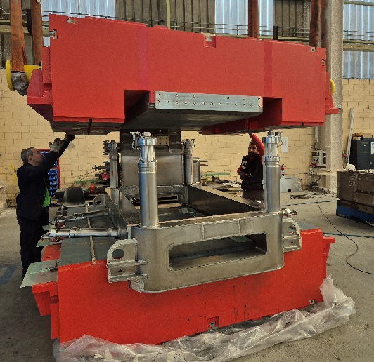
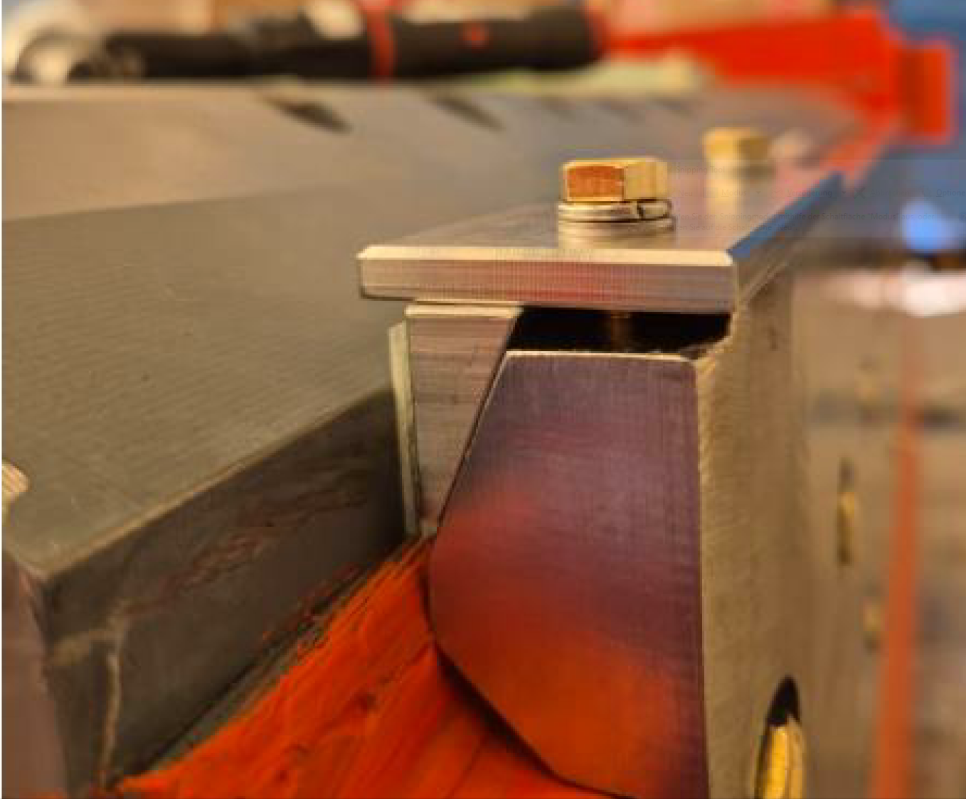
Sc dipoles technical issue - solved
Chamfer movements
GSI-CERN-Elytt task force
caused by bending of screws and delamination in yoke due to high magnetic forces (40 kN) acting on chamfers
Solution:
External fixation with retainer screwed on end plate
Status (31.10.24):
Retainers for 2 magnets ready
Status (07.11.24)
Integration at Elytt

Slide 16
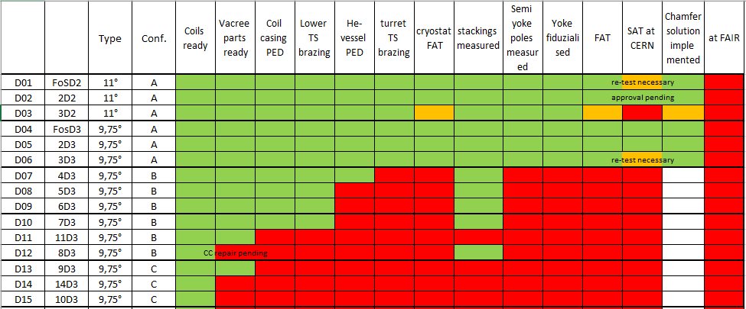
Sc dipoles for Early Science Current status
CERN test done
shielded target area
D01
D02
D03
CERN test ongoing
11°
D04
at CERN, next on the bench
D05
D06
9.75°
at Elytt, FAT done
D07
D08
in construction
D09
D10
D11
Production dashboard
D12
D13
D14
D15
9.75°
9.75°
14/04/2026

Slide 17
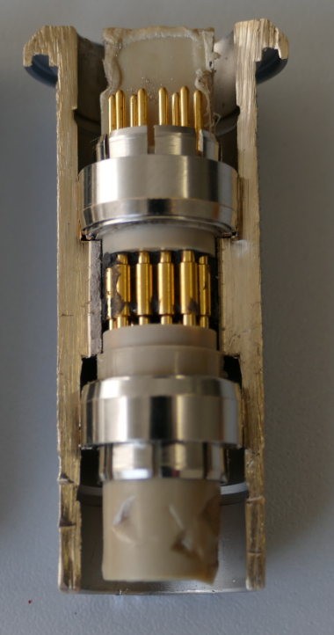
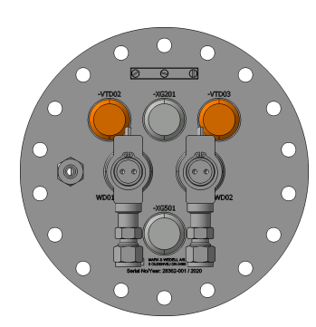
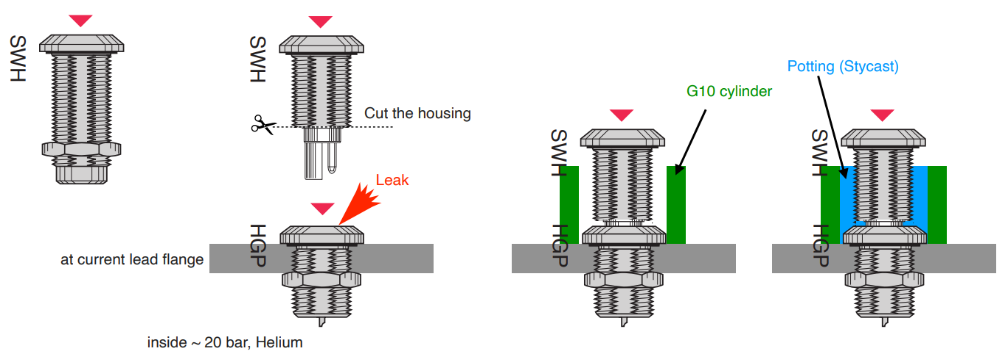
Remaining technical issue
Lemo Feed-Throughs
GSI-CERN-Elytt task force
Lemo Feed-throughs under pressure:
All mounted on current lead flange already by Marc & Wedell
T90 temperature sensors
Voltage Taps
He-Level sensors
Leak test on magnets at CERN
D01 (FoS D2): Leaks detected (1e-4 mbarl/s) at 12 bar on three connectors D06 (3rd D3): no leaks detected at 1.3 bar
Tests and Repair strategy with input from GSI-CERN task force

Slide 18
Sc magnets delivery to CERN overall schedule
Delivery to CERN
CERN test done
CERN test ongoing
04.26
magnet already at CERN
05.26
magnet produced
SM03
SM05
D01
SM02
SM04
SM08
shielded target area
SM06
SM01
D02
D03
magnet in production
LM16
LM10
LM18
D04
LM11
LM09
D05
D06
06.26
LM20
07.26
LM21
10.26
D07
11.26
01.27
03.27
D08
01.27
07.26
02.27
04.27
D09
10.26
LM22
LM23
D10
D11
05.26
D12
LM25
LM13
D13
D14
D15
LM15
LM29
Data date: April 2026

Slide 19
Comparative view: up: sc magnets delivery to FAIR down: local cryogenic branches, installation completed
magnet already at FAIR
magnet’s delivery to FAIR (data date: 10/04/2026)
09.26
SM06
SM02
SM03
SM01
SM04
SM05
SM08
08.26
05.26
LM16
LM18
05.26
05.26
D03
06.26
D02
D01
D04
09.26
D05
LM20
LM21
04.27
D06
10.26
06.27
11.26
05.27
11.26
12.26
05.27
05.26
03.27
05.26
01.27
05.27
P2
D07
03.27
D15
LM15
shielded target area
D14
D08
LM23
D13
LM29
LM22
P1
11.26
M1
D09
LM25
LM13
D10
D11
10.26
D12
LM10
07.26
LM09
M2
H
G
LM11
12.26
M3
01.27
02.27
T
done
02.27
T: Inox, Kriosystem
P: Inox, Kriosystem
DD: Mar-26
M: Cryo Diffusion
DD: Mar-26
H: Cryoworld
DD: Mar-26
G: Cryoworld
DD: Mar-26
Local cryogenics benches: installation completed

Slide 20
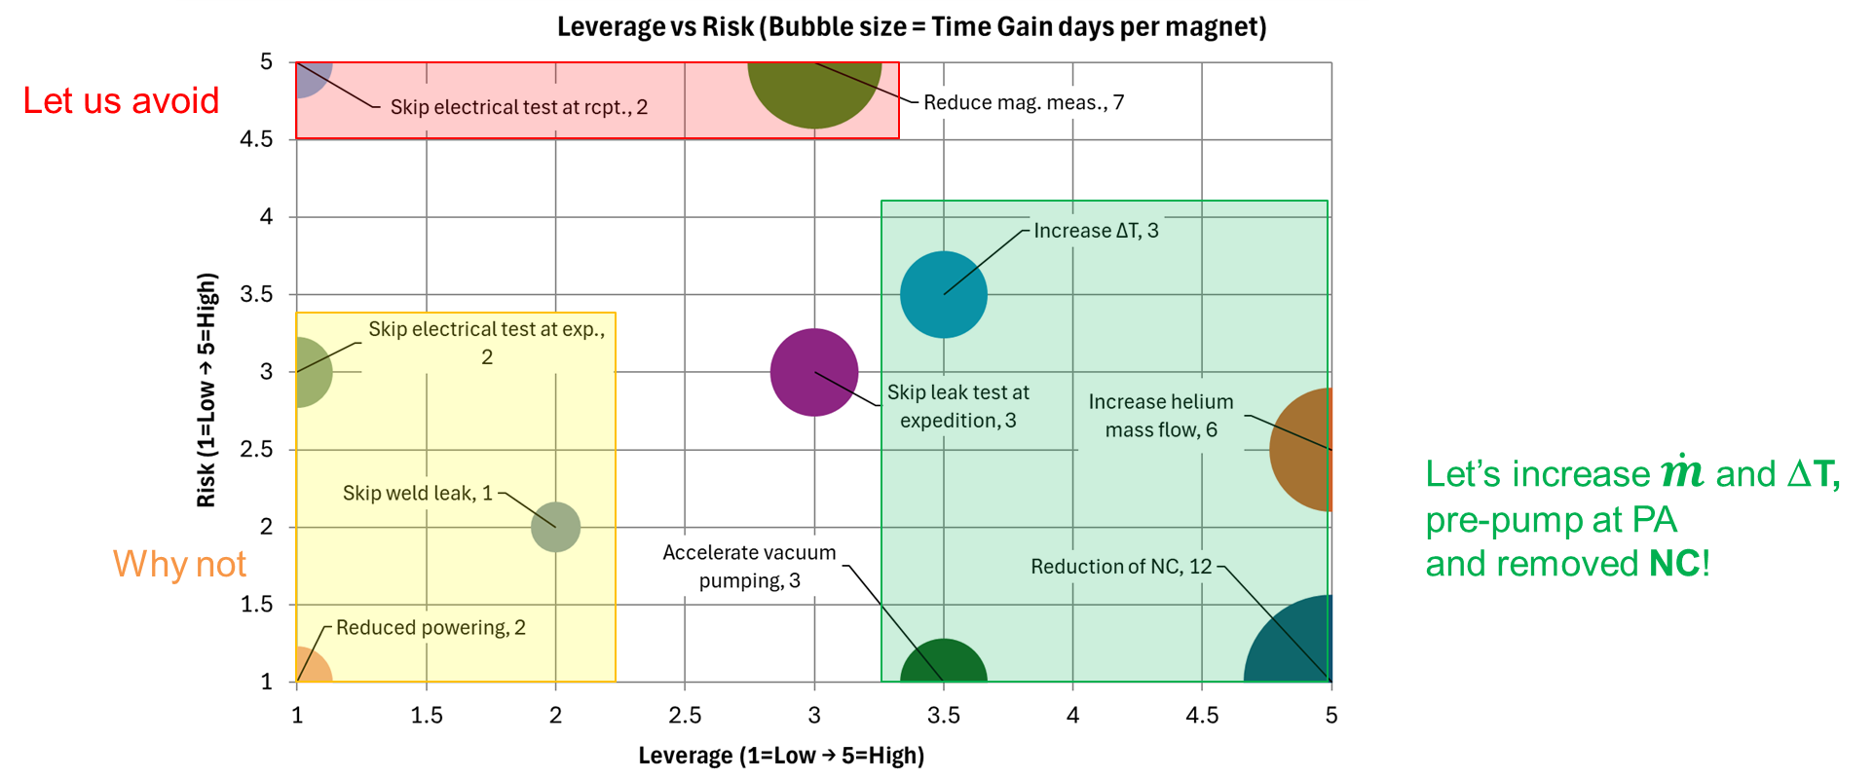
Test at CERN: speed-up possibilities
Time driver identification
Some possible time savers associated to risk estimates have been identified.
H. Bajas Workshop 15/04/2026
Recently new identified time savers:
eDAQ gives us the quench file on the spot. Shorter commissioning (0.5h/quench, 1 day).
Automatic evaporation allows to run over night and reach 10 K much sooner (1-2 days gain).
Over-heating (T > T_{dew point}) allows to break vacuum right after the leak test (more stat needed, but 1-2 days gain).
Additional:
under development: additional devices for dipole magnetic measurements (test up to 3 dipoles in parallel)
Continuous adaptation and optimization of testing plan (improved criteria in work)
Preparation of Magnet Avatar measurements (remaining dipoles)

Slide 21
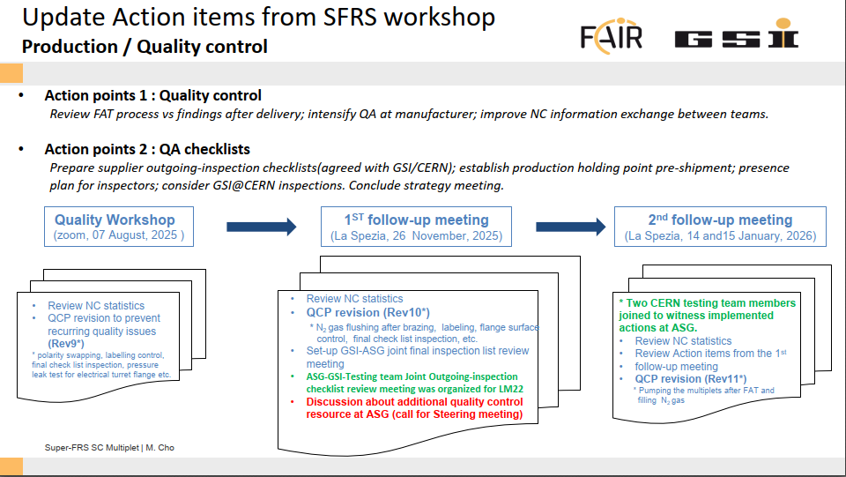
Successful Implementation of Quality Measures (ASG)
3rd visit 17 March 2026, ASG
Follow up at first (FAT acc. LM13)
Melanie Cho, 17/02/2026

Slide 22
Summary
Very successful collaboration !
Major technical and quality improvements thanks to CERN-GSI-FAIR-industry task forces
Expediting team solved several major production issues but still hindering problems are in process to be solved
Expediting and technical advisors in place to stabilize Elytt delivery schedule
Sc dipole production currently in critical path for testing schedule and Early Science scope
Upgrade of CERN testing facility (talk by Germana Riddone) and ramp-up of testing team (GSI and TSU) result in a resilient testing response
Next steps:
Early Science scope / First Science+++ scenario: Branched Dipoles / Low Energy Branch
Prepare Operation – measure Avatar relevant data for magnets (remaining dipoles) ➔
avatar/digital twin of spectrometer (talk by H. Müller) Thanks to the Team !

