Slide 1
CERN Overview
Oliver Brüning
Director Accelerators and Technology Sector
CERN-GSI Collaboration Steering Board Meeting, April 17, 2026

Slide 2
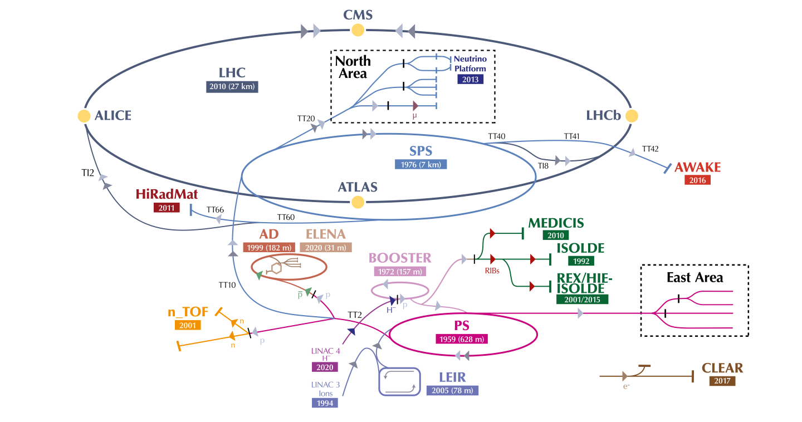
CERN Accelerator Complex
LHC : 2x(0.45 – 7) TeV
SPS : 26 – 450 GeV
[RF Power]
PS : 2 - 26 GeV
[RF and powering]
PSB : 0.16 -2 GeV
Linac 4: 0-160 MeV H⁻
17 April 2026

Slide 3
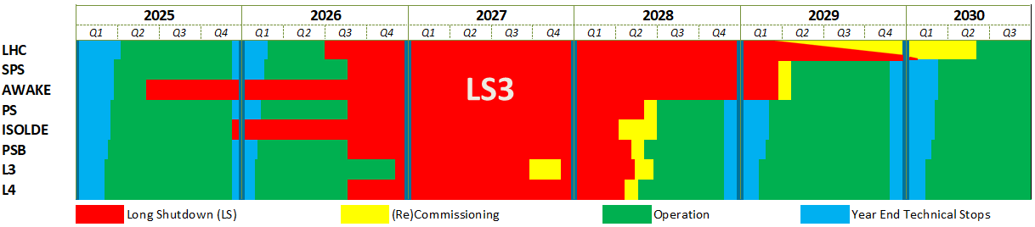
Long Shutdown 3 is coming
We are here: Operation of the accelerator complex is back after the Year End Technical Stop [YETS]
LS3 start
AWAKE: 02.06.2025
ISOLDE: 08.12.2025
LHC: 29.06.2026
Injectors: 31.08.2026
L3: 30.11.2026
Inj. Operation restart
L4 : May 2028
PSB : May 2028
PS : July 2028 (*)
SPS : April 2029 (*)
(*) To be optimised
LHC restart
1st sectors cooldown : Early 2029
Final HW Com (P1&5) : January 2030
Caverns closure : Mid May 2030
Beam vac valves op : End May 2030
O. Brüning | Accelerator Complex Status
17 April 2026
Notes:
Challenges for this mandate

Slide 4
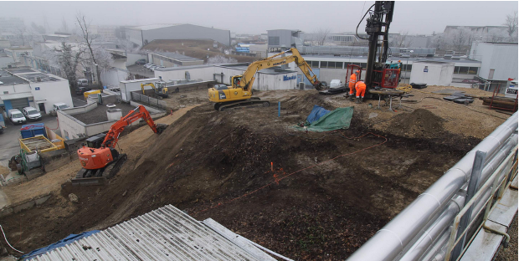
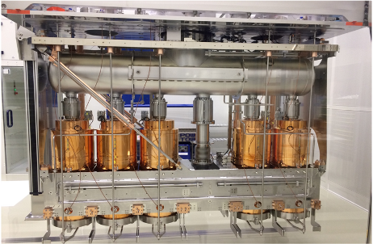
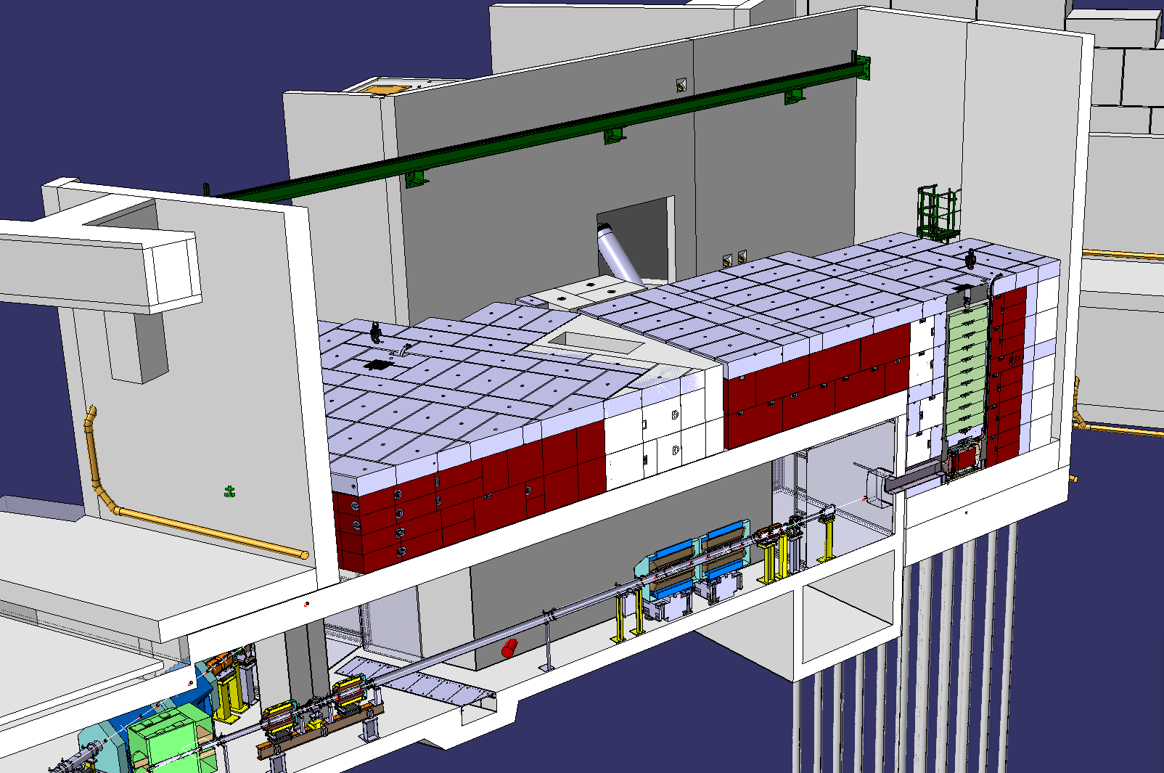
ISOLDE Facility Status
The Long Shutdown 3 (LS3) at the ISOLDE facility started at the end of 2025 to accommodate the two-year consolidation work needed for the replacement of the beam dumps.
Layout of the building that will host the new ISOLDE beam dumps
On-going excavation work around the SOLDE beam dumps
HIE-ISOLDE cryomodule and quarter-wave resonators to be transported to SM18 for refurbishment in April 2026
17 April 2026

Slide 5
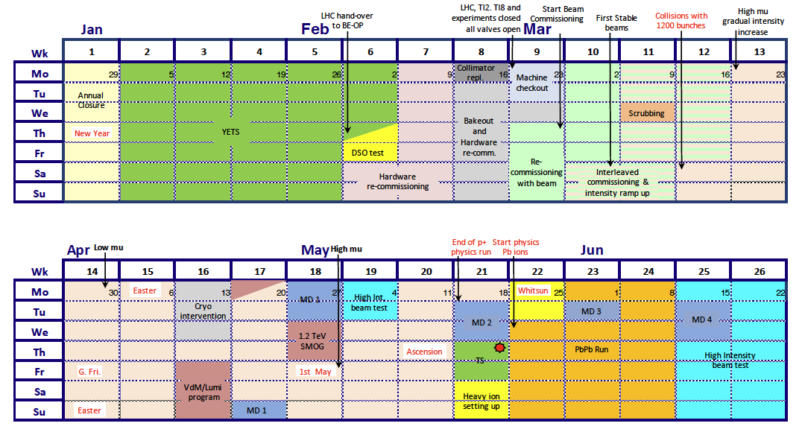
LHC 2026 Schedule
Highly compressed startup
Only 10.7 weeks beam-to-beam YETS
< 2 weeks for powering tests.
9 days of beam commissioning.
Anticipation of 2-days High Intensity
6 operation days lost (COLL & Compressor)
Diverse Program:
  Intensity ramp up and high-μ run
  Low-μ run
  VDM
  LHCb “1 TeV” run
  MDs
  High intensity tests
  Pb ion run
17 April 2026

Slide 6
Injector Complex back in Operation
[ISOLDE is already in Long Shutdown 3]
Machine | Period | Availability
Linac 4 | 22/01 9h – 13/04 9h | 99.1%
PSB | 27/01 9h – 13/04 9h | 98.8%
PS | 02/02 9h – 13/04 9h | 95.7%
AD/ELENA | 27/02 9h – 13/04 9h | 95%
SPS | 02/03 9h – 13/04 9h | 87.6%
17 April 2026

Slide 7
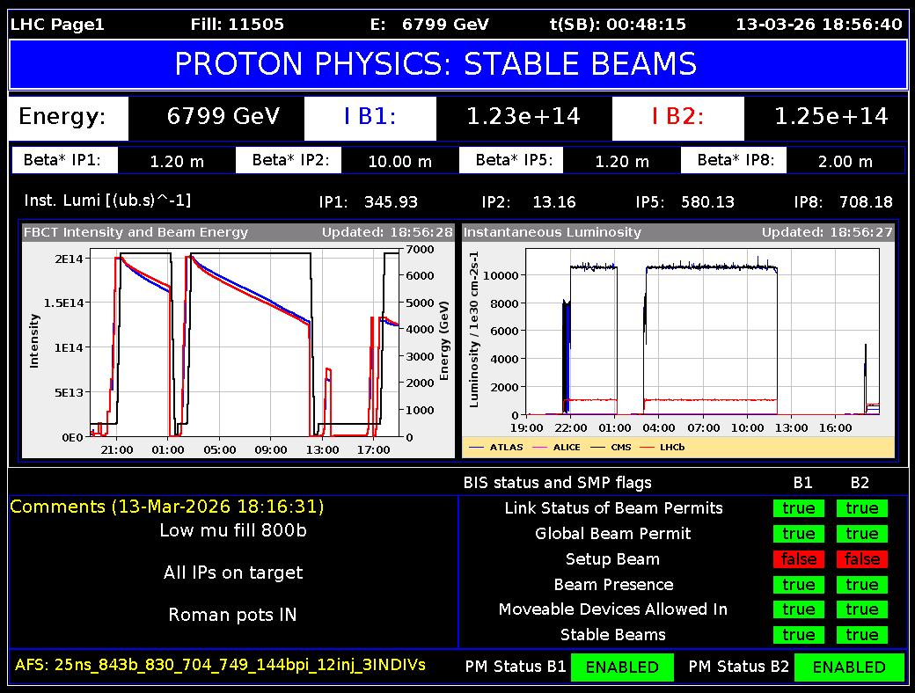
2026 LHC Commissioning
Beam commissioning completed within the foreseen time
No operation problems found (limited configuration changes were beneficial)
All systems tested and configuration validated
First STABLE BEAMS (with 4 bunches) declared on March 7th
Start of physics production with 1200 bunches on Friday March 13th, about a week ahead of schedule
Intensity ramp-up finished by March 17th
Bunch intensity back to the Run3 operational goal (1.8e11 ppb), before the low-mu run
17 April 2026

Slide 8
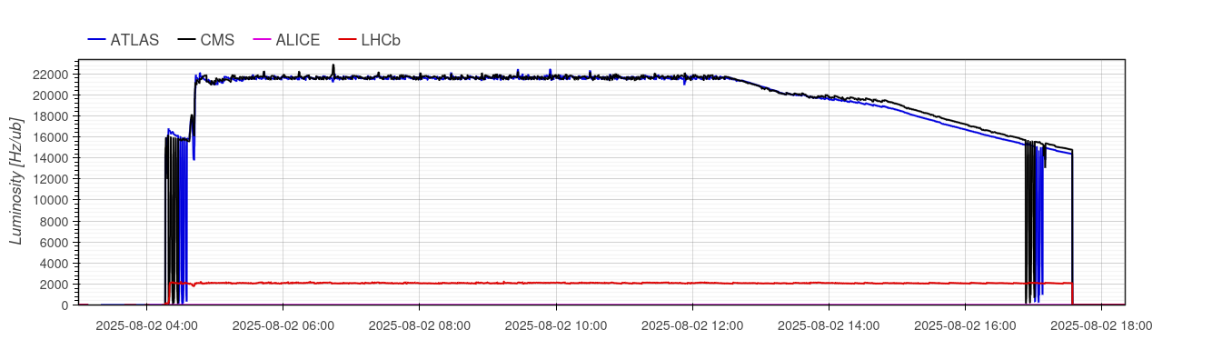
LHC configuration 2026 Changes
The baseline configuration for 2026 is (almost) unchanged:
10 minutes gain /cycle by compressing the entire b* squeeze into the ramp.
Extension of b* levelling from 60/18 cm to 50/15 cm.
The intensity per bunch will be pushed to(wards) 1.8×10¹¹ ppb – limited by the heat load to the cryogenic system (e-clouds !).
High bunch intensity
smaller β*
levelled period:
~75% of ∫L_{Fill}
18cm / 160urad & crossing angle reduction:
~12% ∫L_{Fill}
18cm / 120urad:
~13% of ∫L_{Fill}
17 April 2026

Slide 9
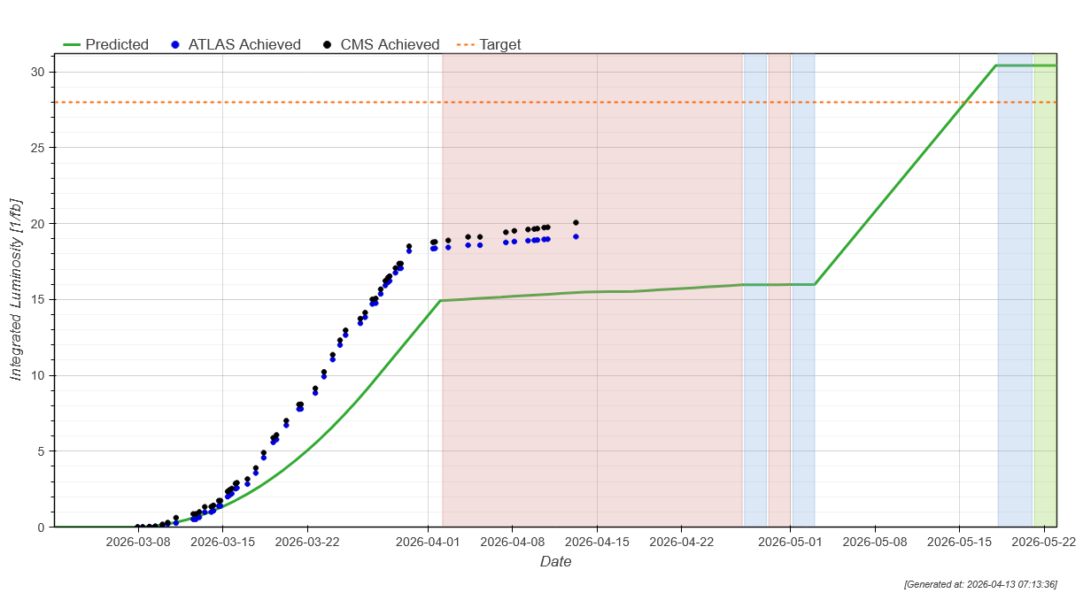
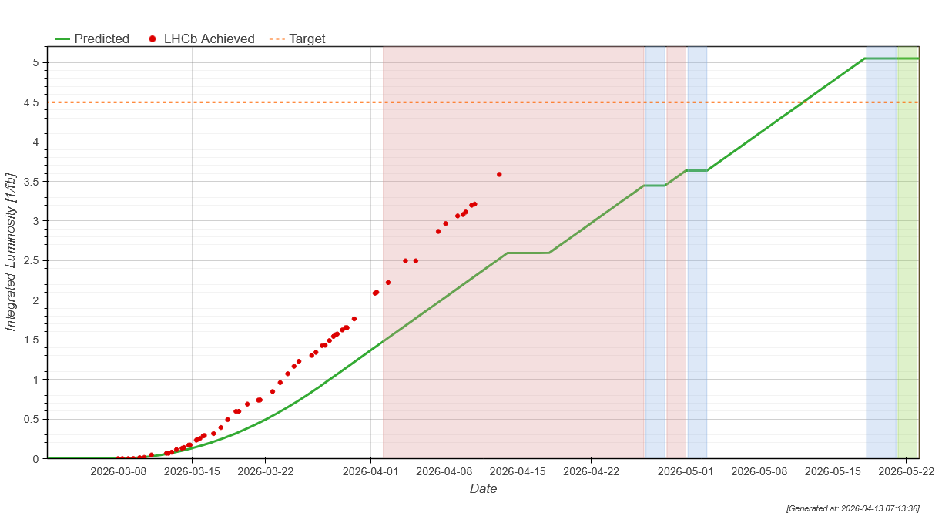
The LHC machine is running beautifully
Luminosity for CMS/ATLAS is impacted by the 3 weeks of low-pile-up run!
But very long fills are good news for LHCb
Excellent performance thanks to injector performance
Performance targets for 2026:
p-p Pb-Pb
ATLAS/CMS: 28 fb⁻¹
LHCb: 4.5 fb⁻¹
ALICE: 28 nb⁻¹
ATLAS/CMS: 8 nb⁻¹
LHCb: 0.6 nb⁻¹
ALICE: 1.3 nb⁻¹
½ way of low-mu target!
O. Brüning | Accelerator Complex Status
17 April 2026

Slide 10
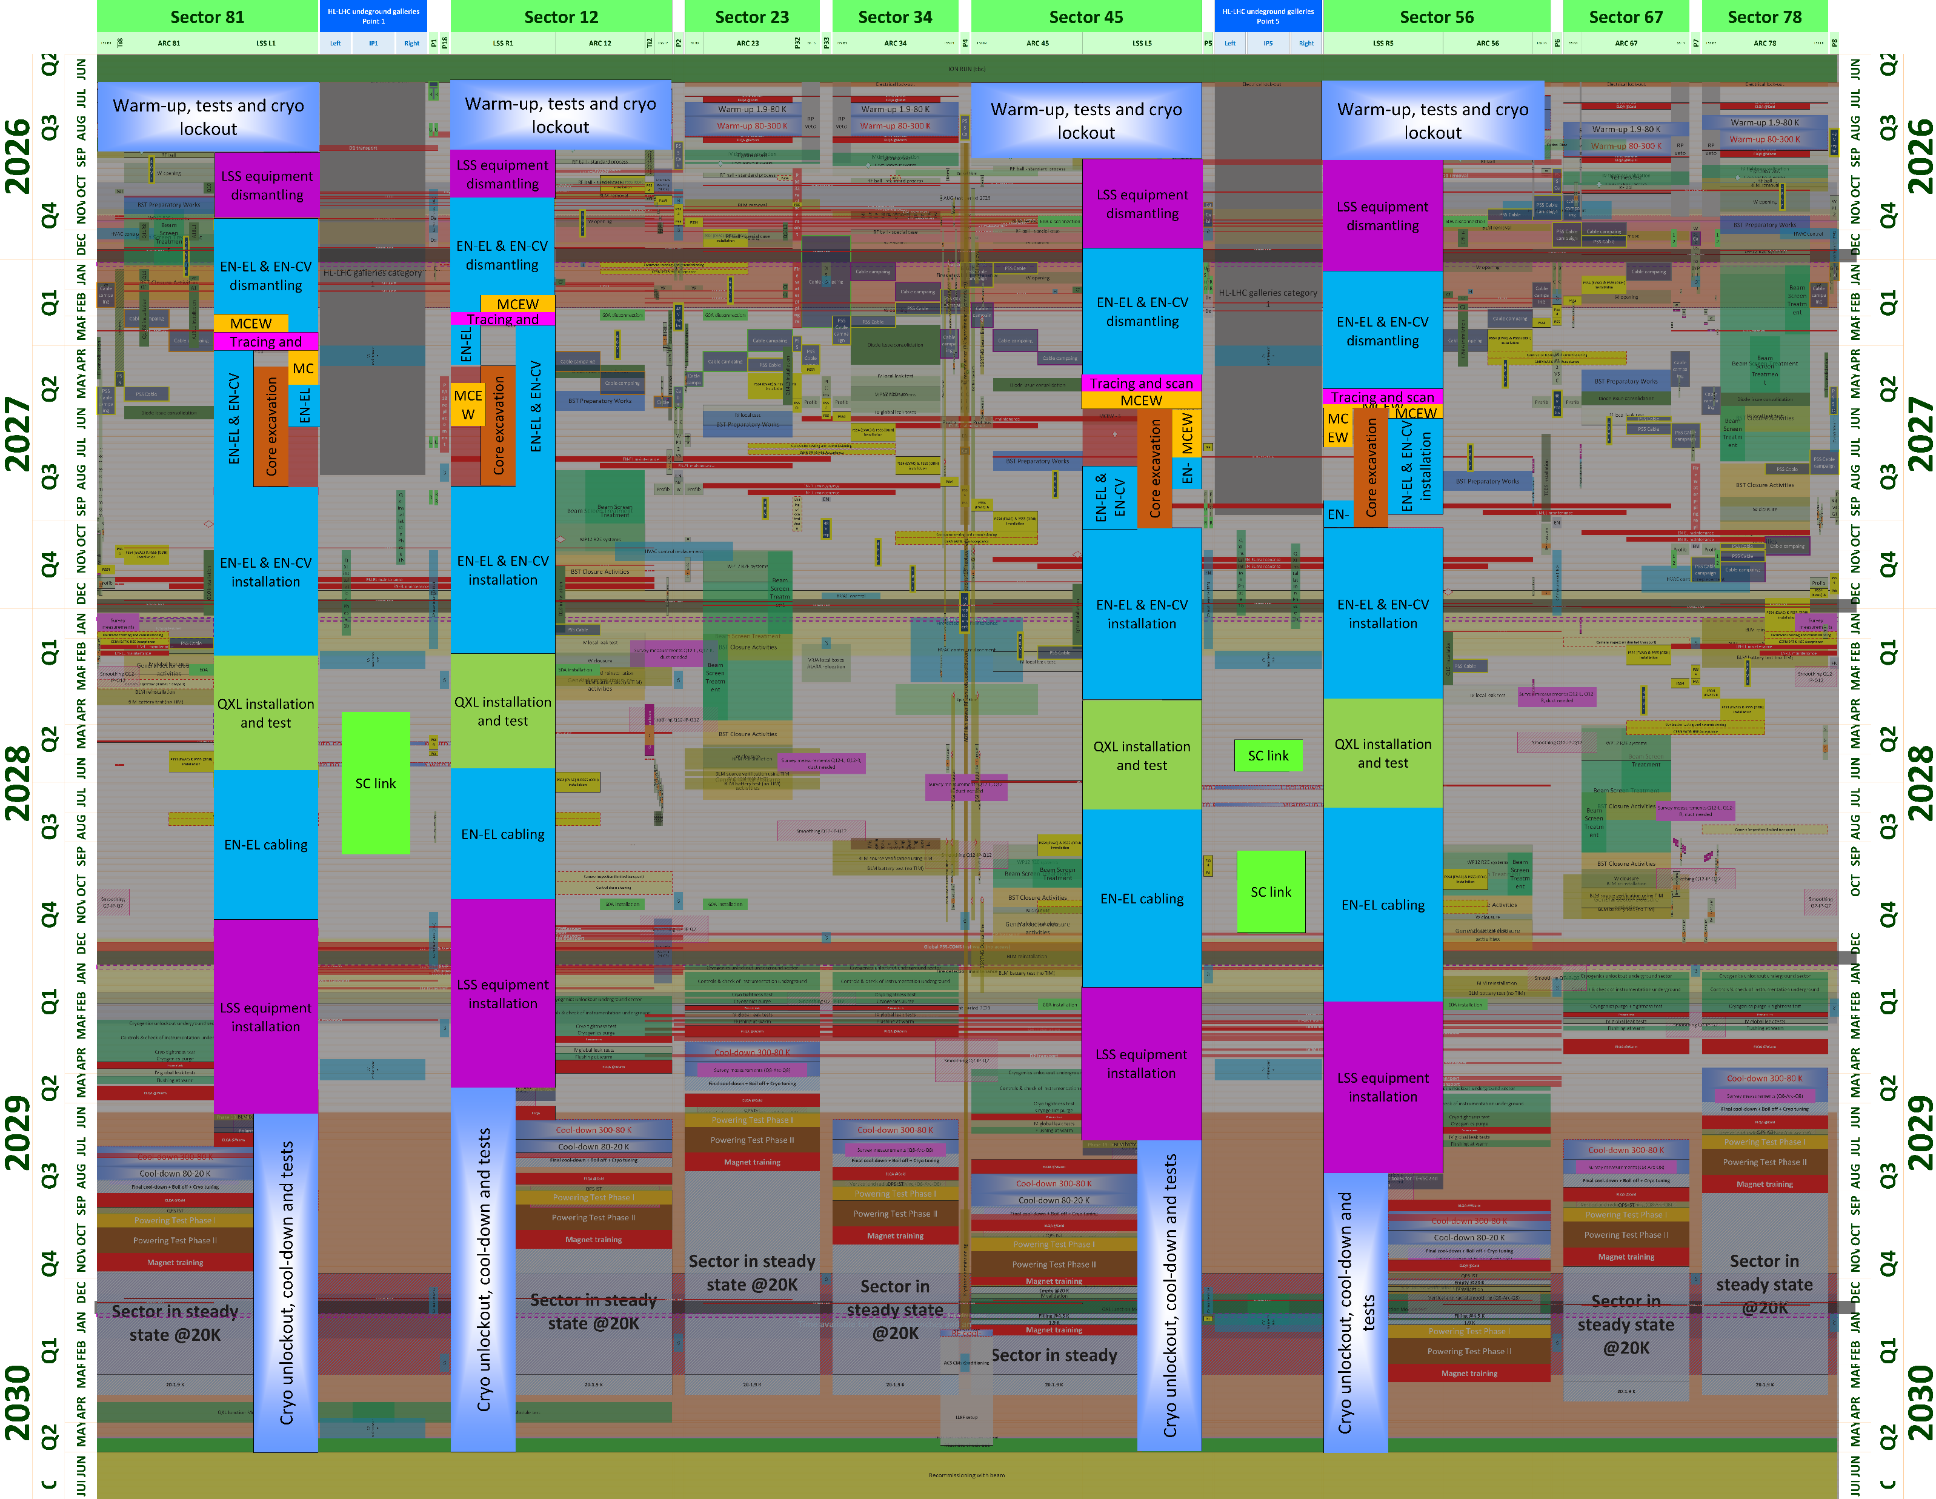
HL-LHC schedule in LSS1/5
47 months beam to beam
De-installation phase (equipment and services)
Core excavation
Minimize the time required from the LHC tunnel!!!
Installation phase & test (equipment and services)
LS3 reference schedule to be released in April 2026
May 28th & 29th LS3 readiness review
First 6 months will bring complete de-installation of present LHC Long-Straight-Sections by end of 2026
17 April 2026

Slide 11
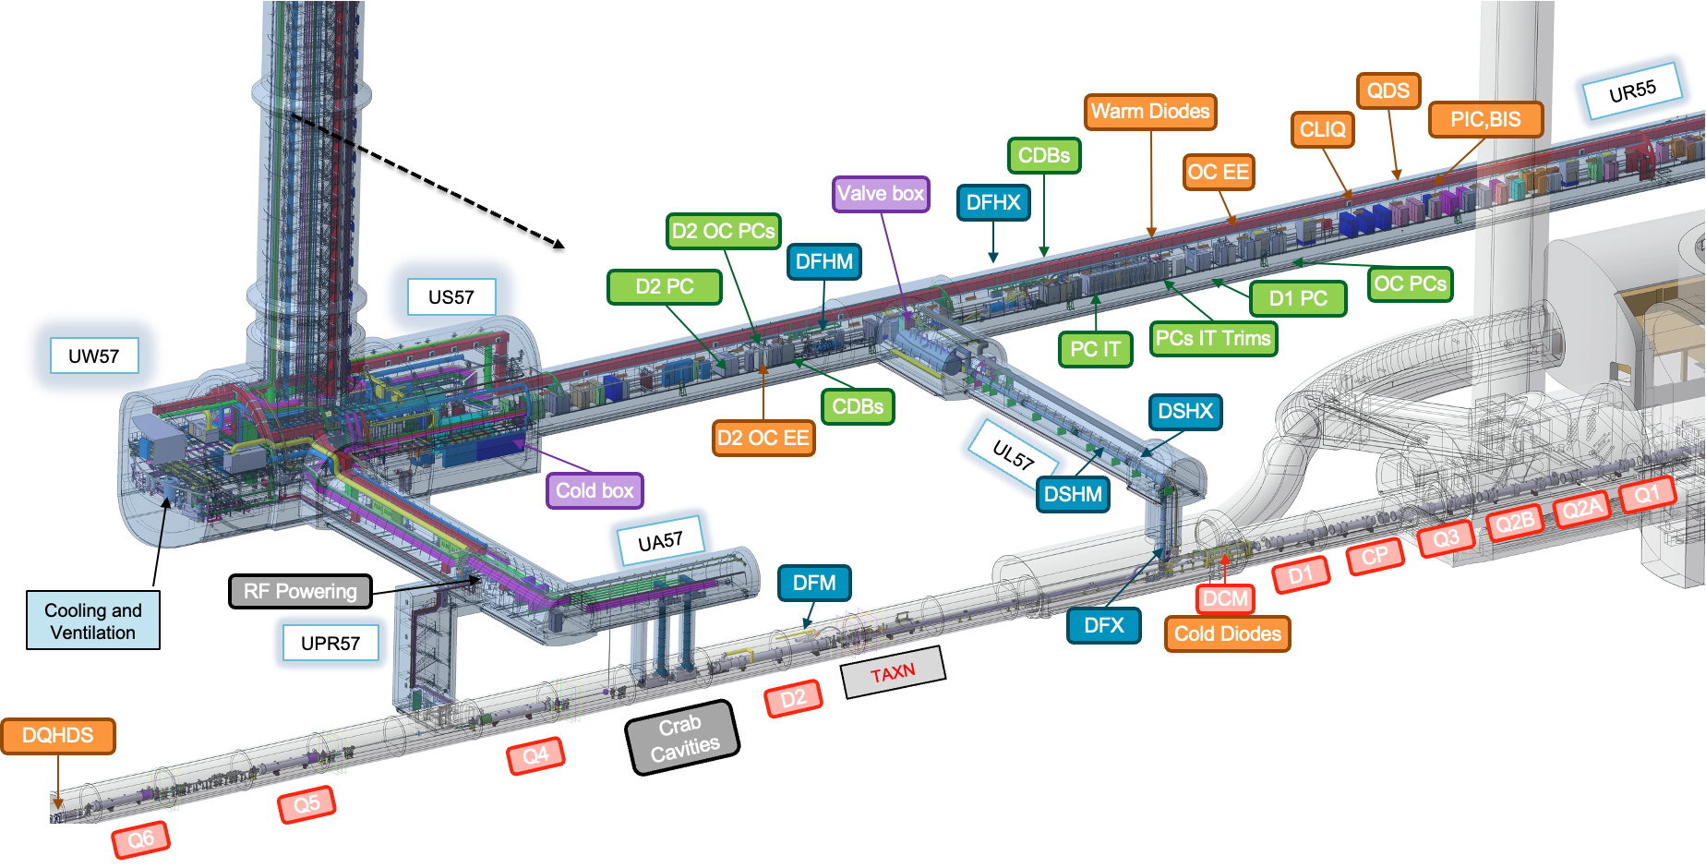
New underground galleries and surface buildings for technical infrastructure finished!
➔ Installation of services ongoing
Notes:
Highlight cores!

Slide 12
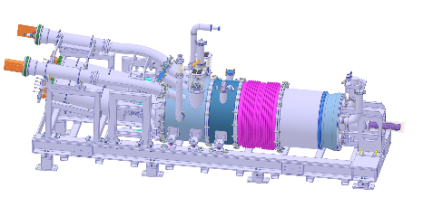
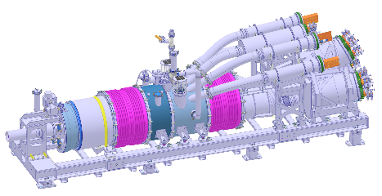
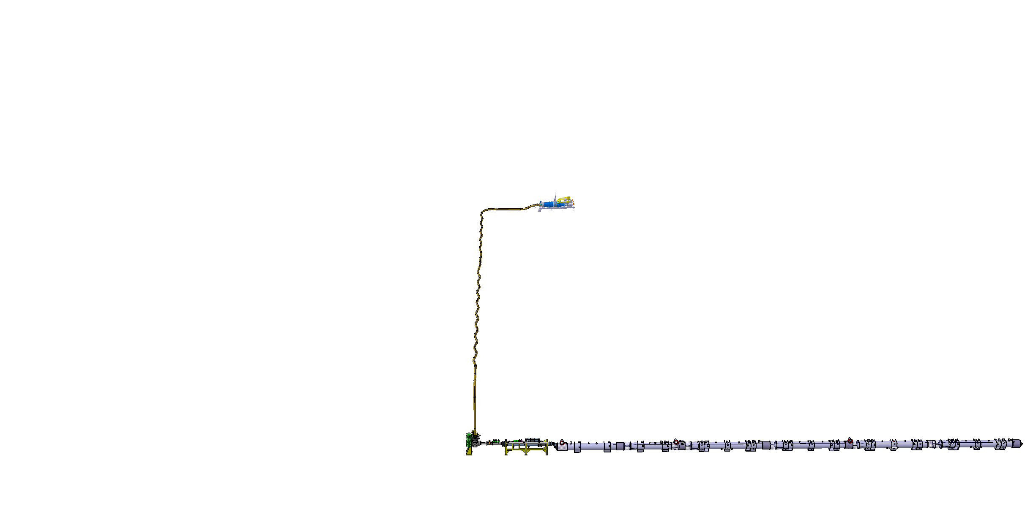
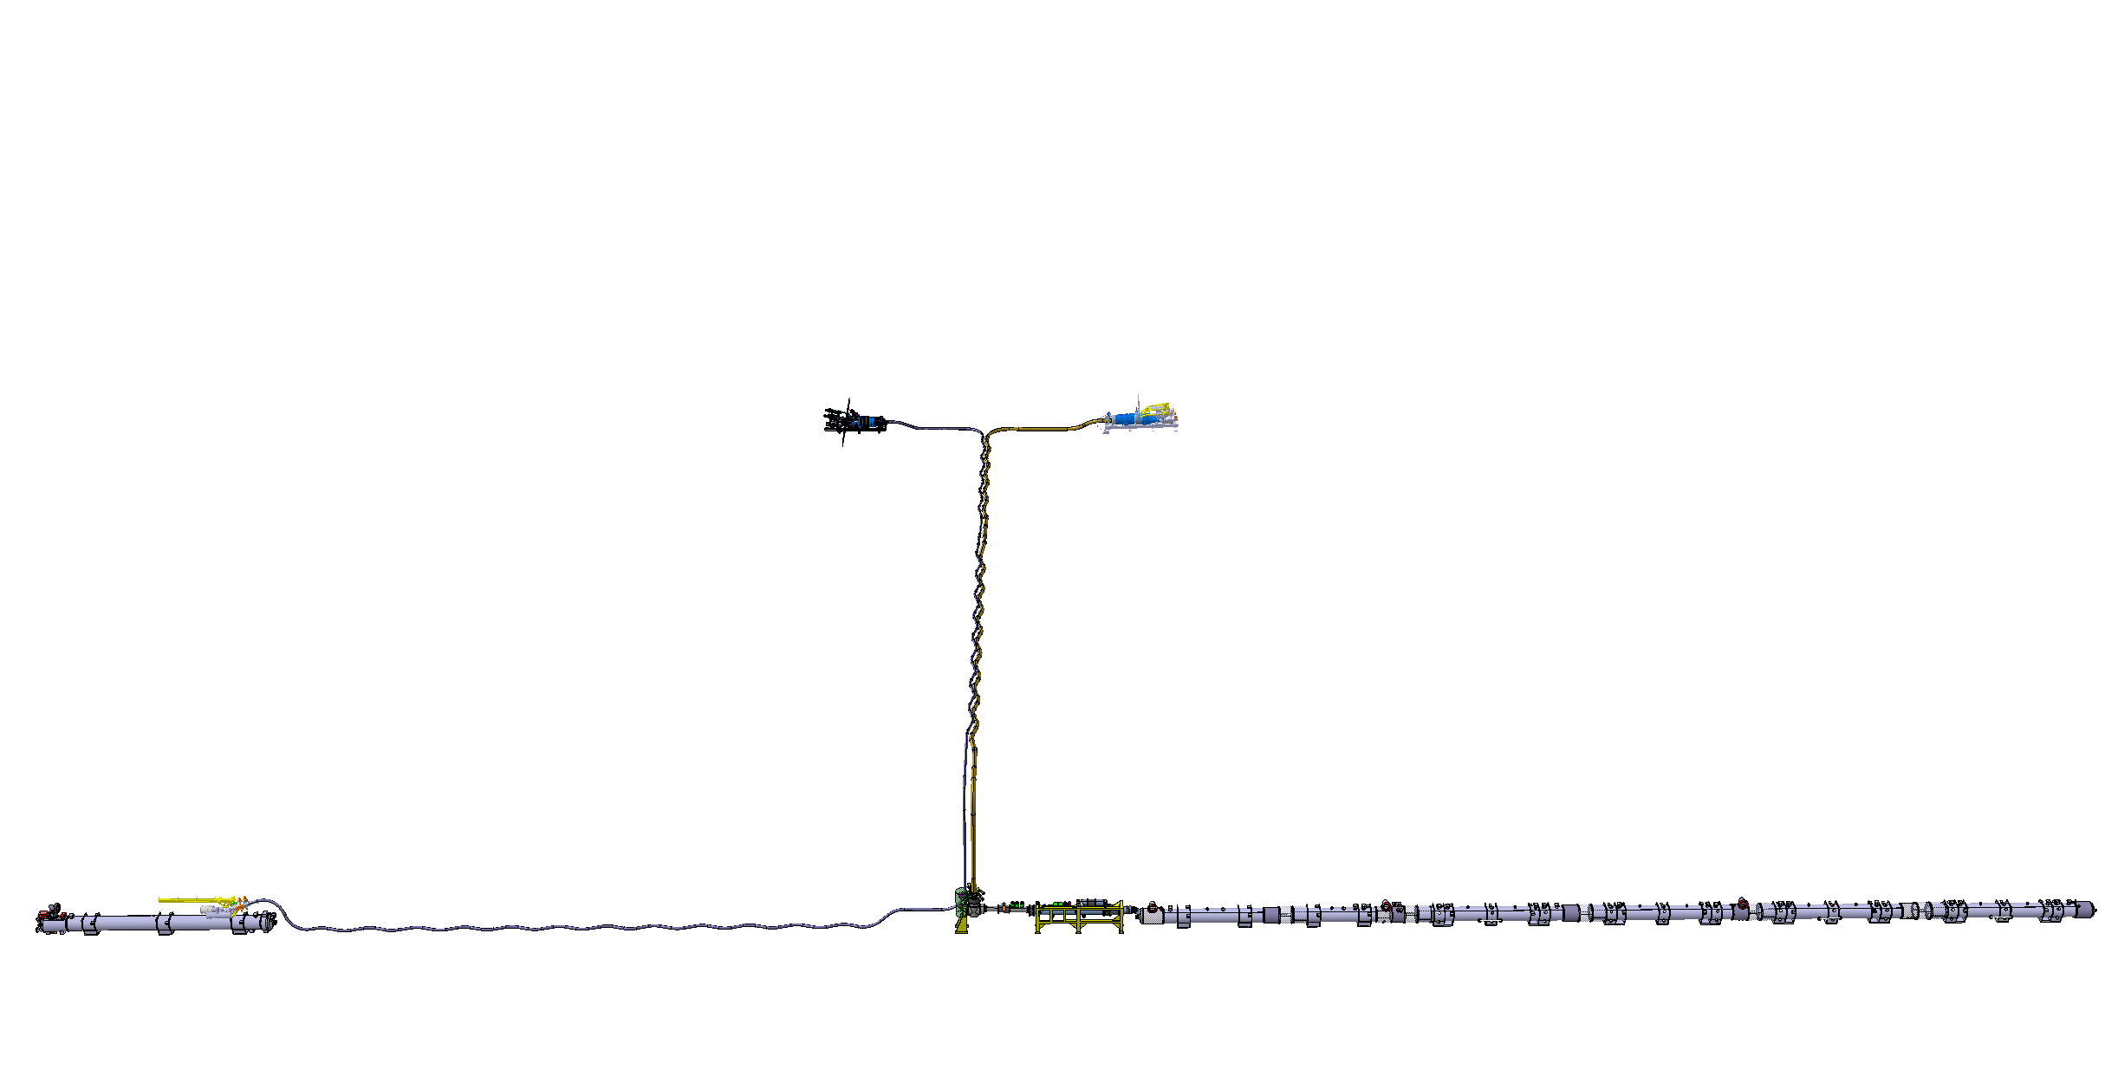
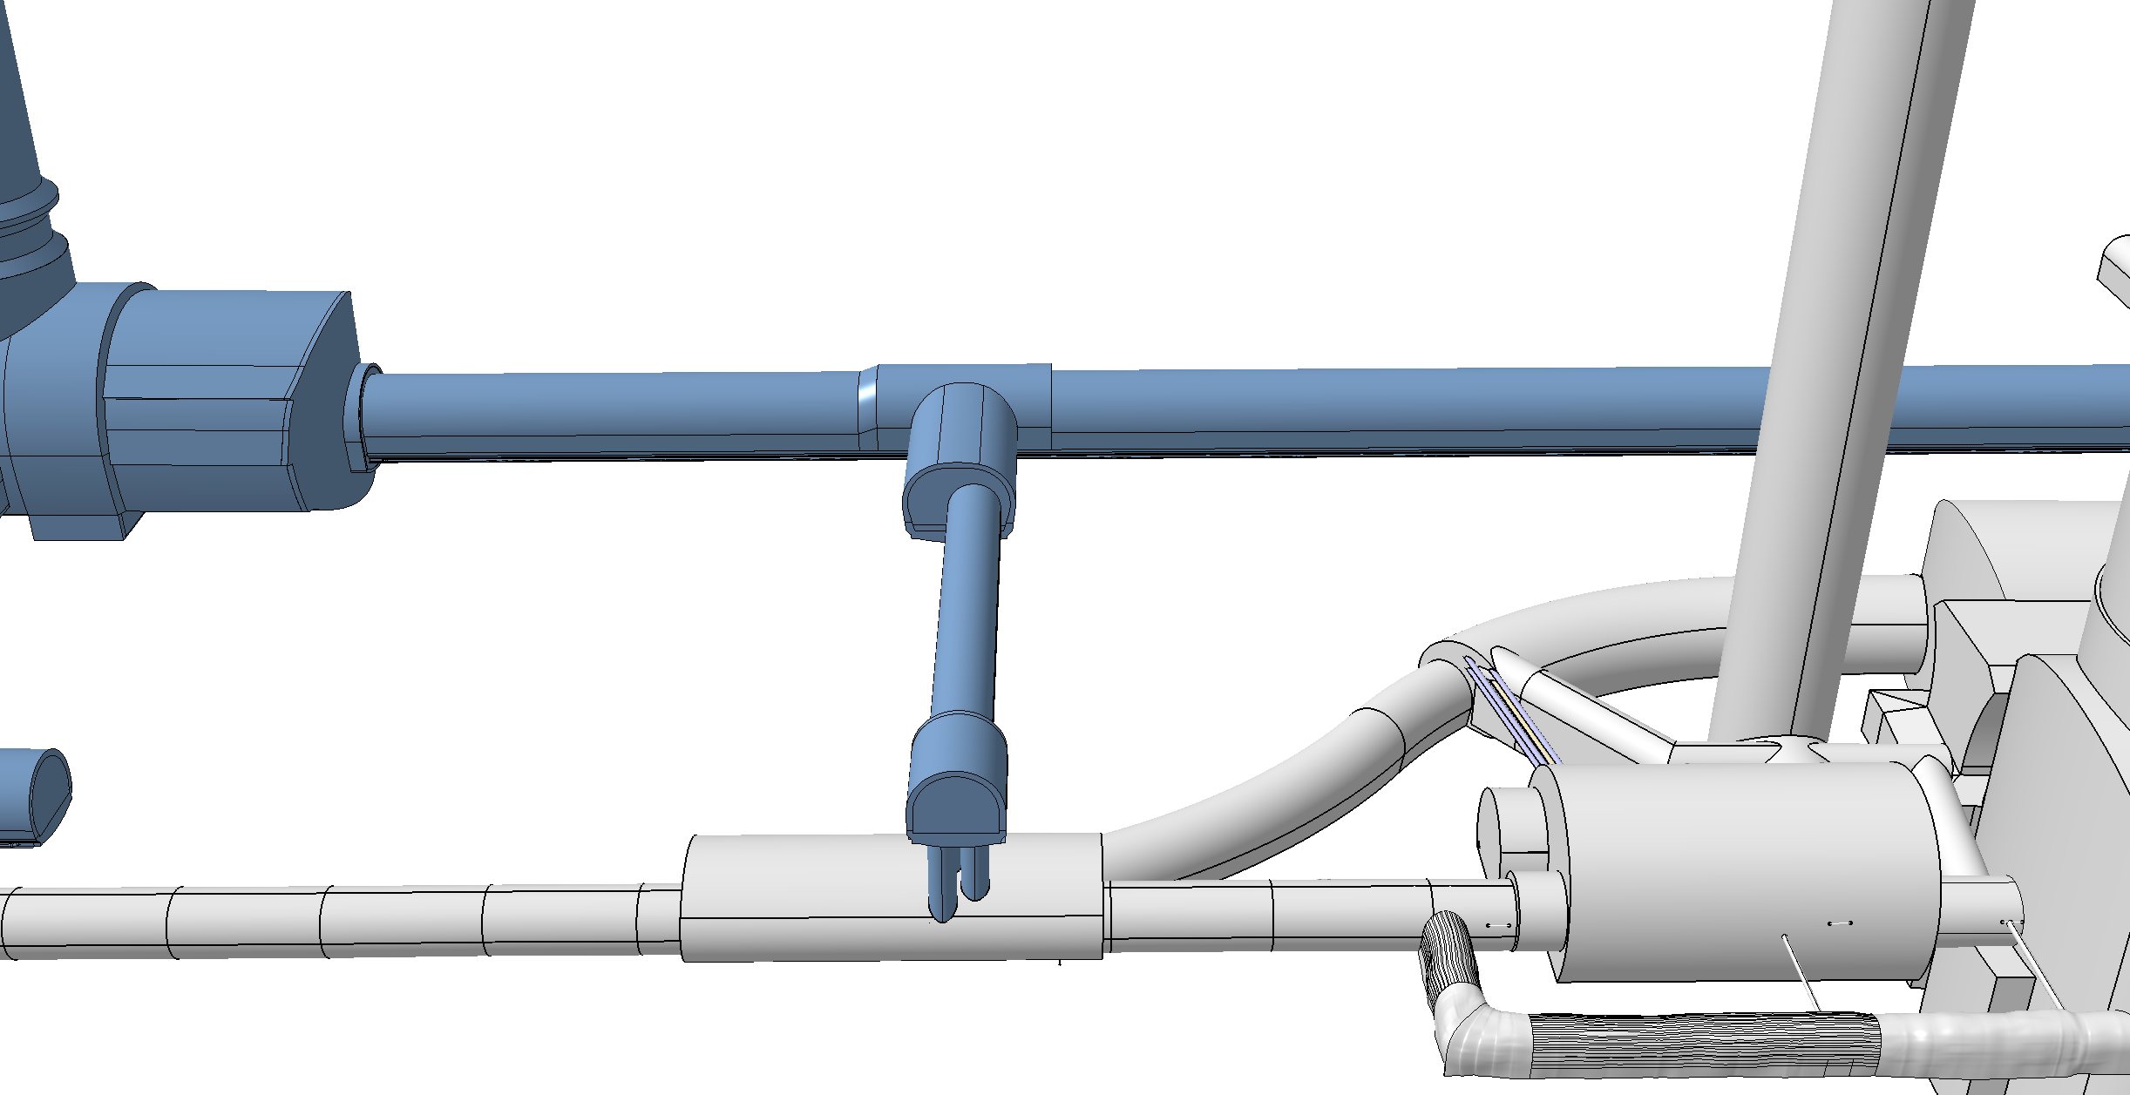
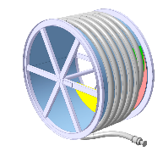
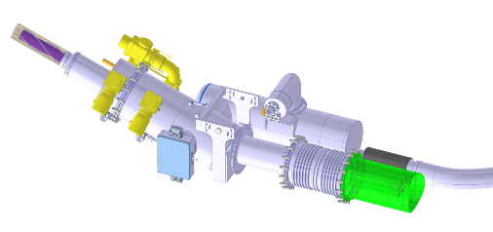
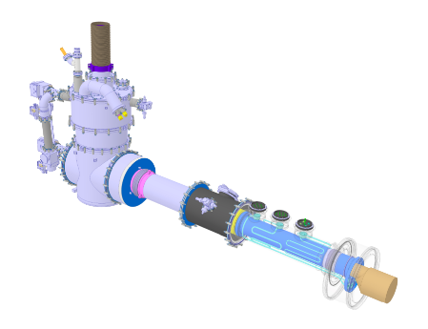
Cold Powering System
Superconducting link to minimize thermal losses when transporting over 100kA over 100m!
High Temperature Superconductor, MgB₂ operating at ca. 20K to 30K
Cooling with gaseous He from liquid He boil off
DFHM
DFHX
Power converters: (18, 0.6) kA
Power converters: (18, 7, 2) kA
DSHM
DSHX
140 m
89.5 m
Power converters: (60, 120, 200) A
D2
DCM
D1
CP
Q3
Q2B
Q2A
Q1
DFM
DFX
17 April 2026
Notes:
Complement with pictures of SC link construction and installation and celebration!

Slide 13
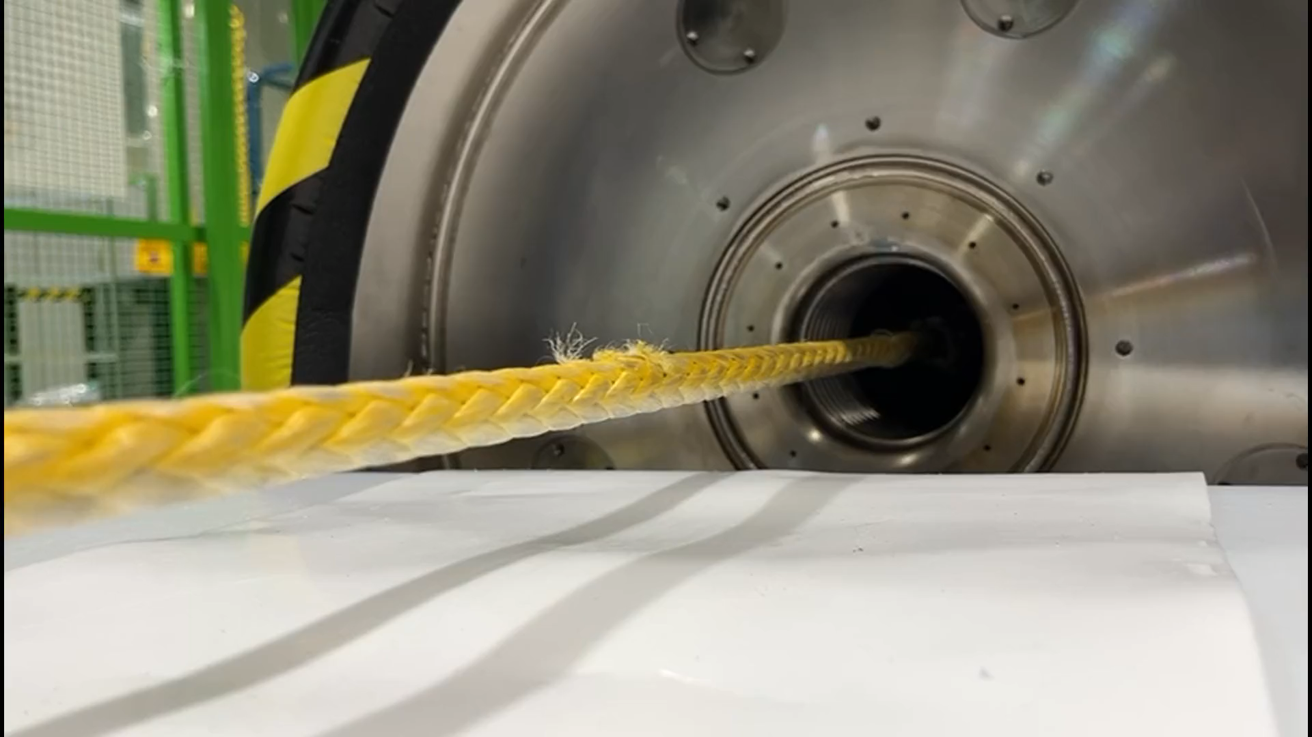
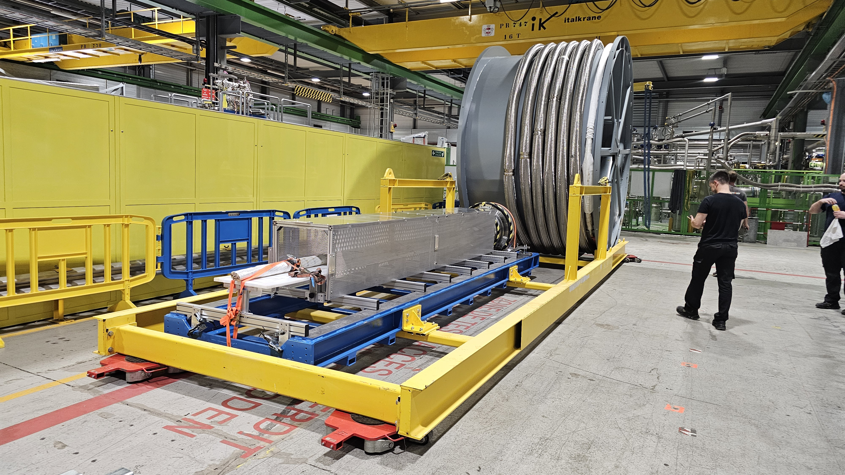
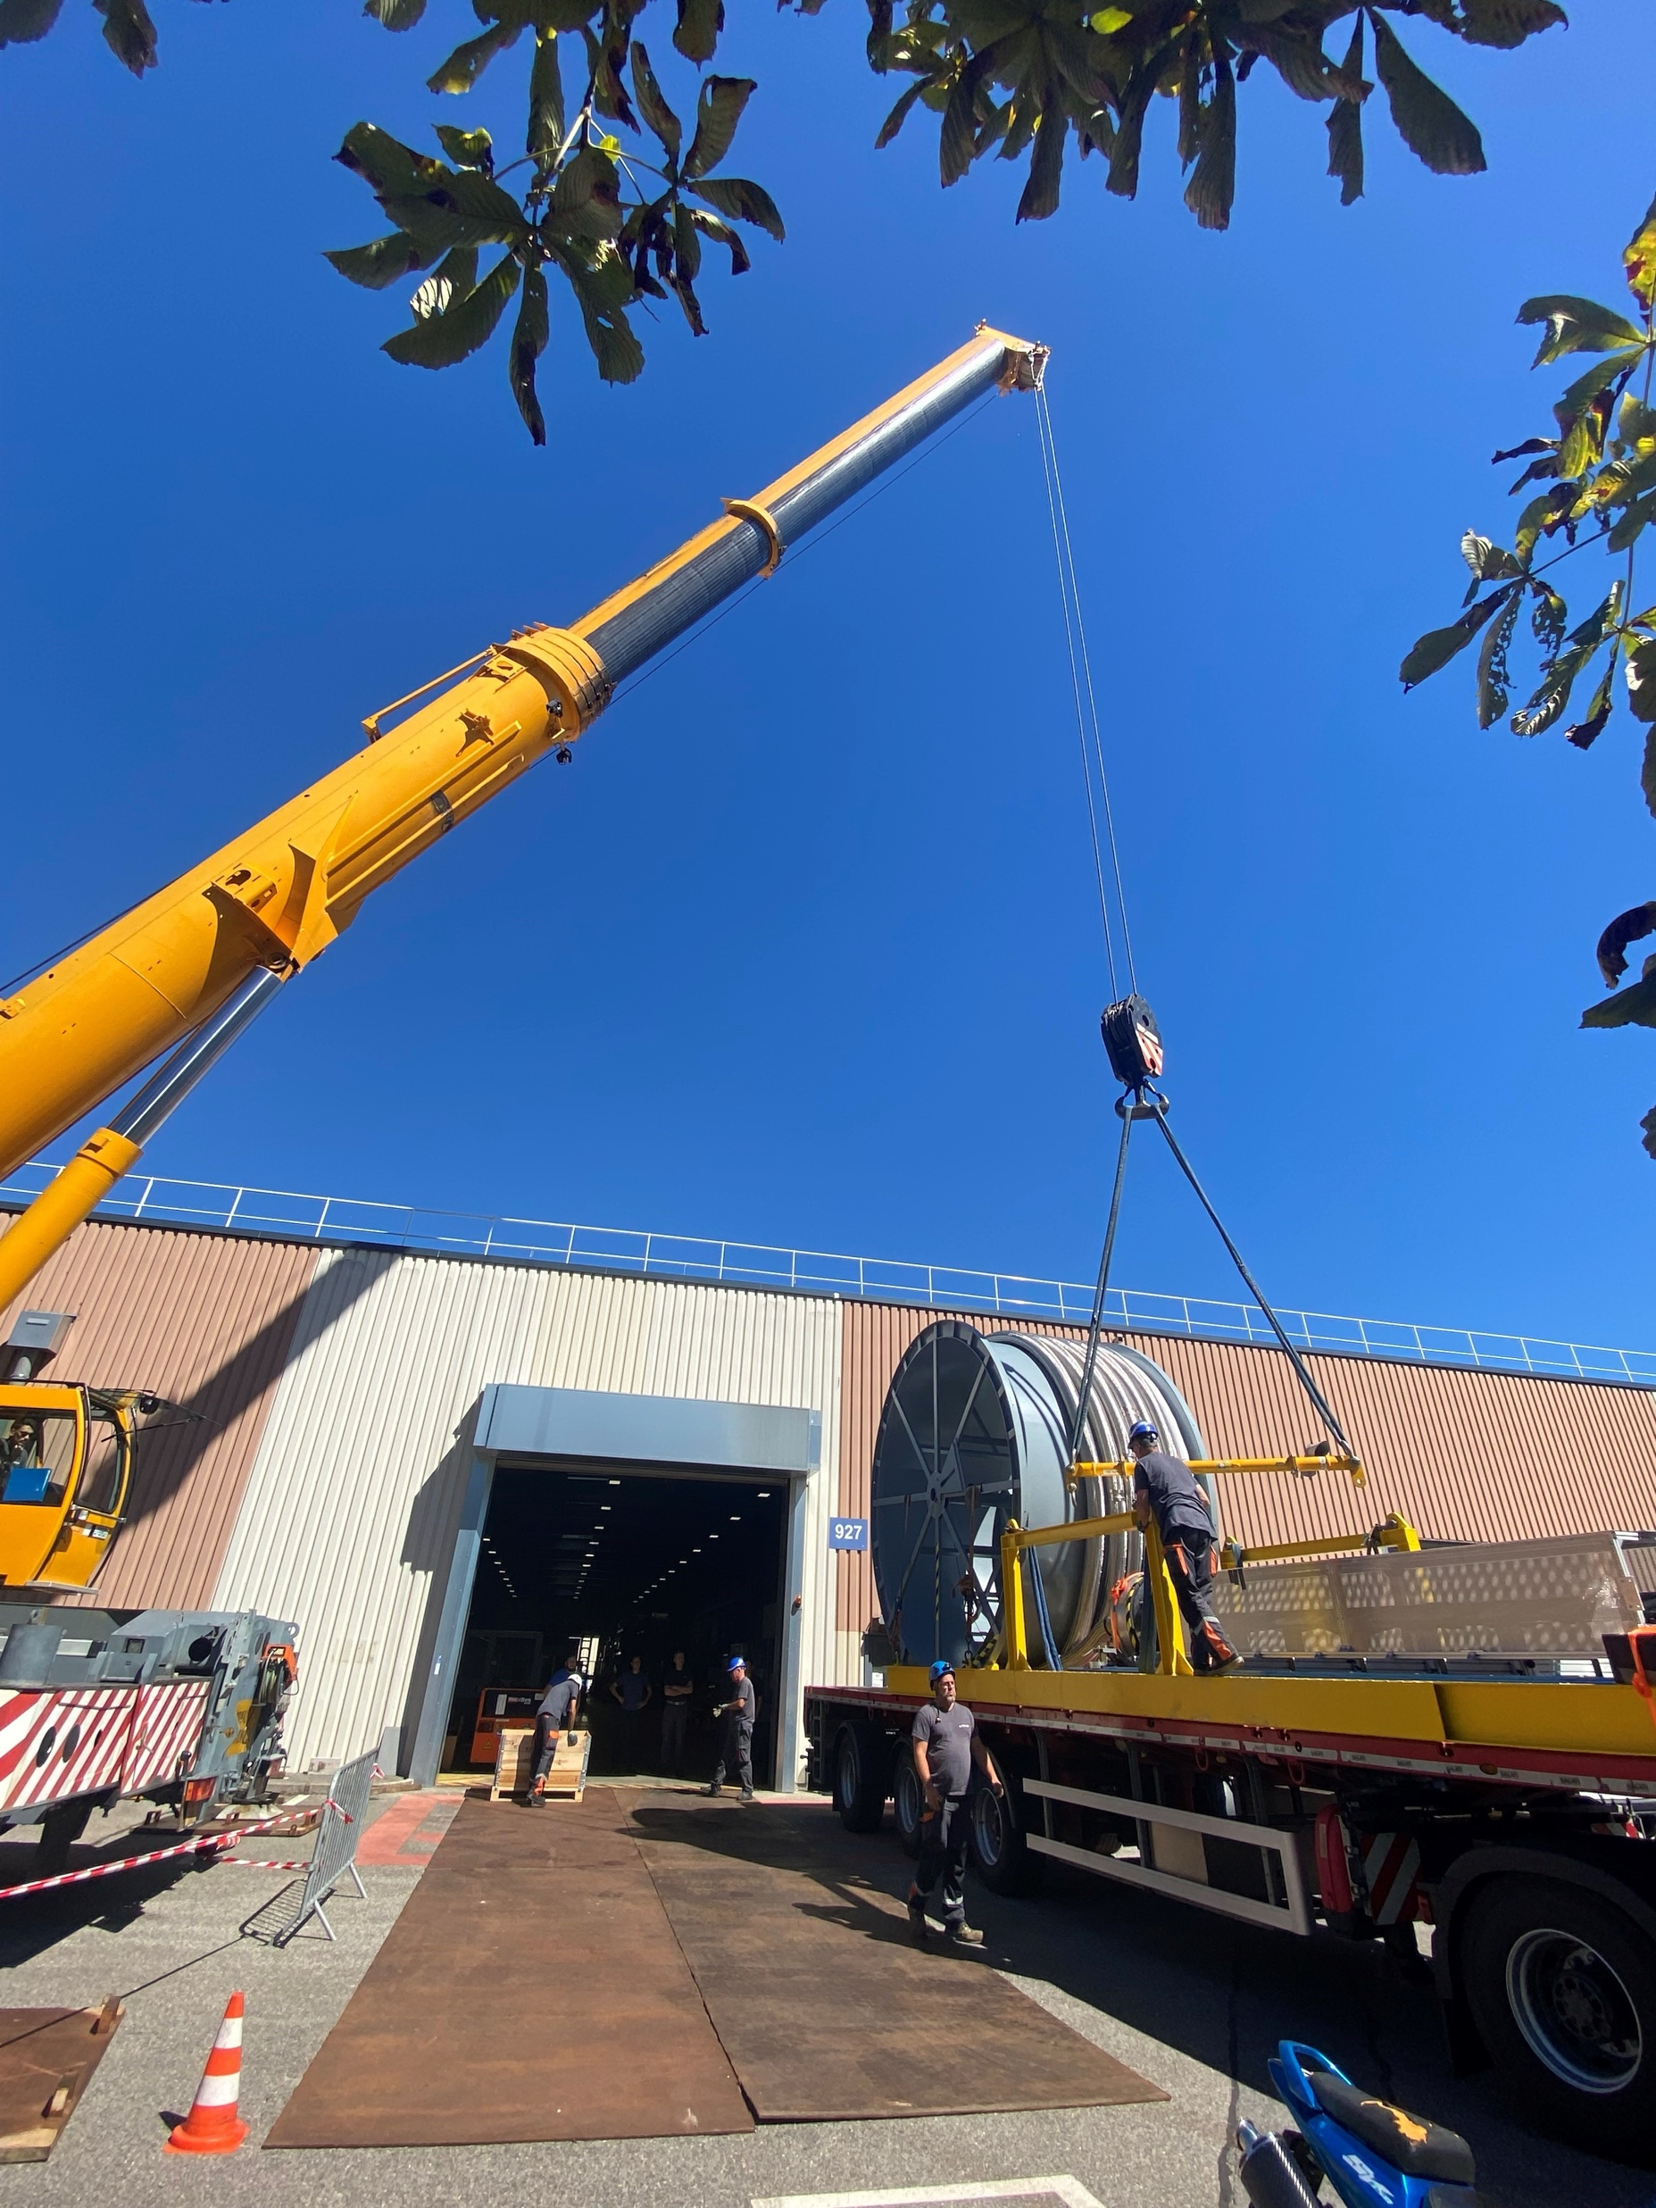
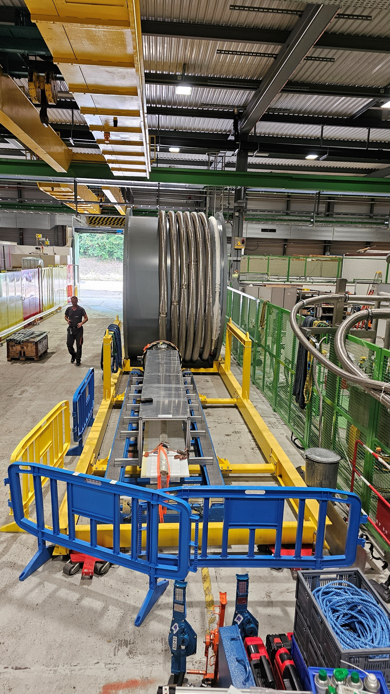
3rd Superconducting Link Assembly Finished [1 proto + 2 series]
Assembly in August 2025
Transport of 2nd series link in September 2025
2 more systems completed assembly and assembly of the first matching
section system started
17 April 2026

Slide 14
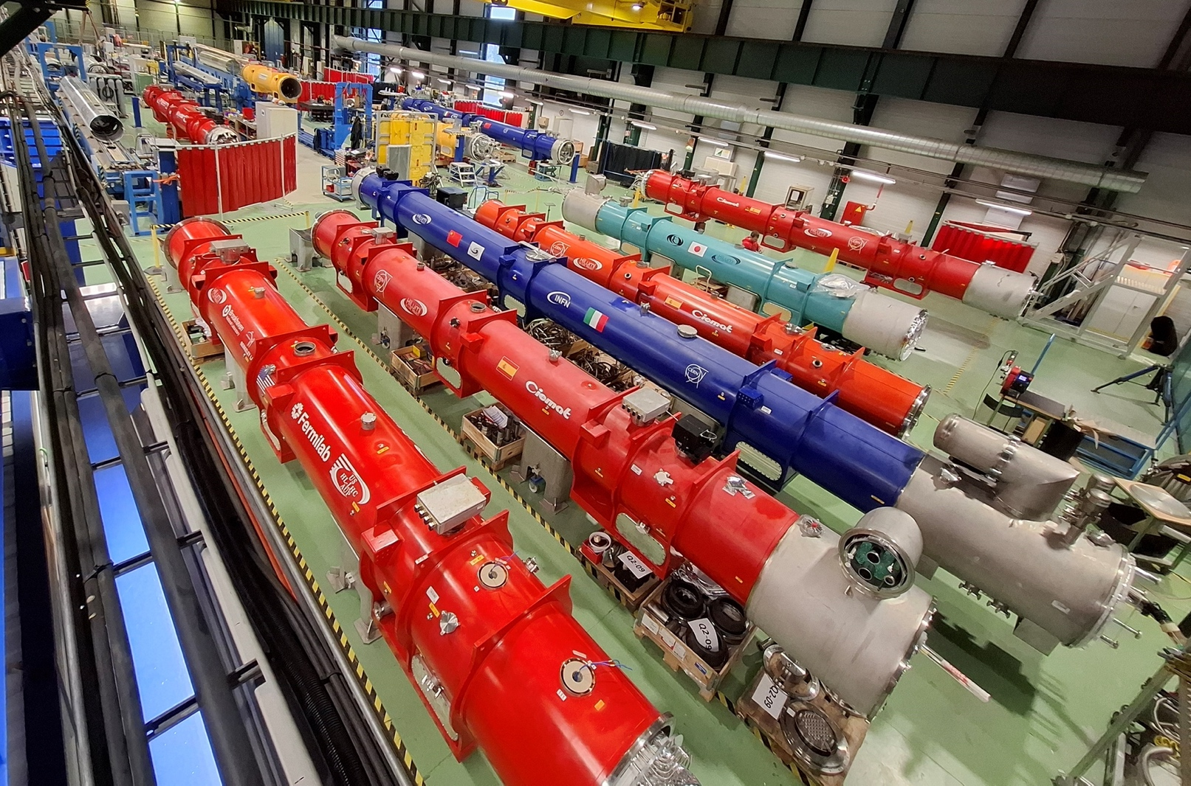
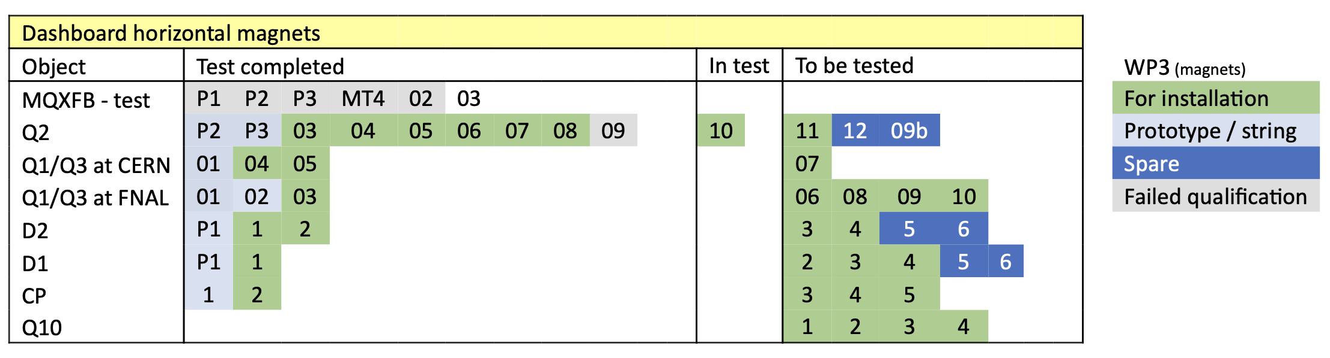
Magnet production status
Magnet production very well advanced, > 80% of magnets already qualified
40% of cryostat assembly completed to finish the units for installation in LS3
(45% when including the IT String and the spares)
2025 was a successful demonstration of required capacity of the SMI2 facility and resources
Horizontal tests marking final validation to continue throughout 2026 in SM18
17 April 2026

Slide 15
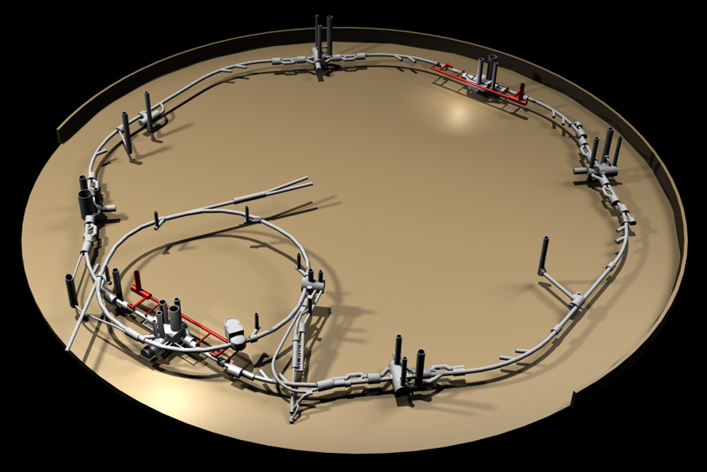
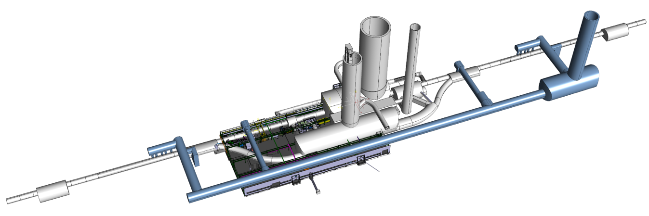
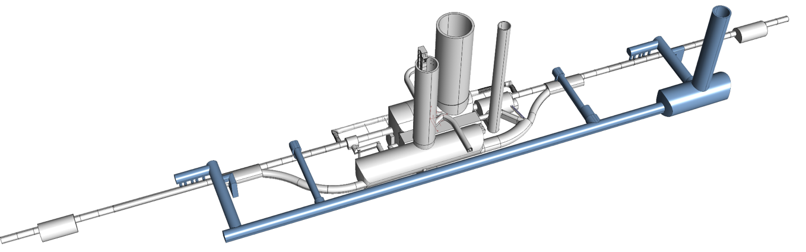

Next Milestone: HL-LHC IT STRING: P5L
P4
P5
P5
P3
P2
HL-LHC
P6
P5R
SPS
P7
P1
P5L
P8
17 April 2026

Slide 16
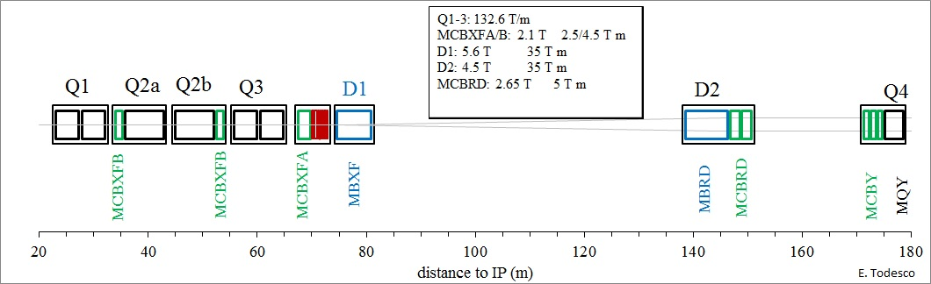
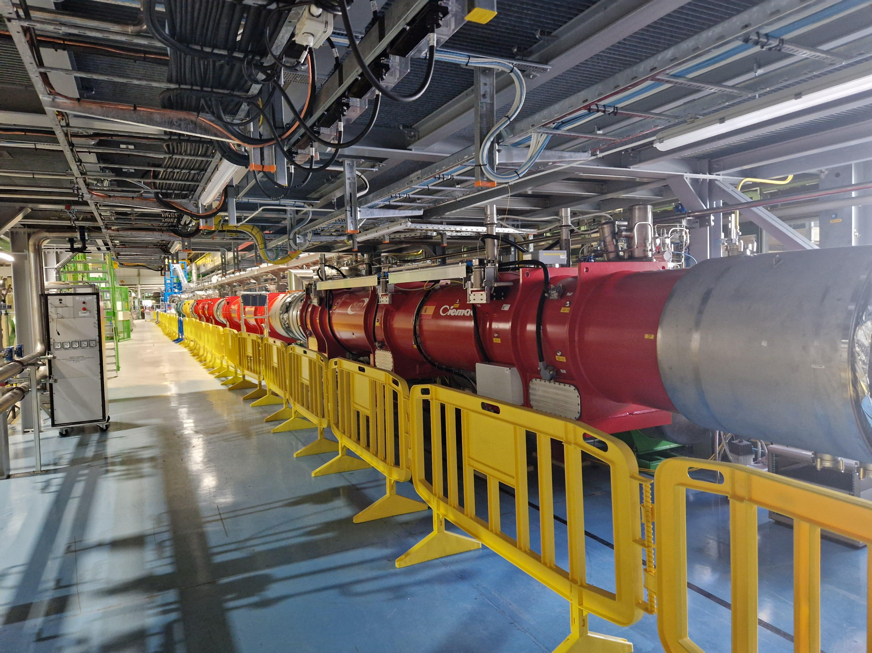
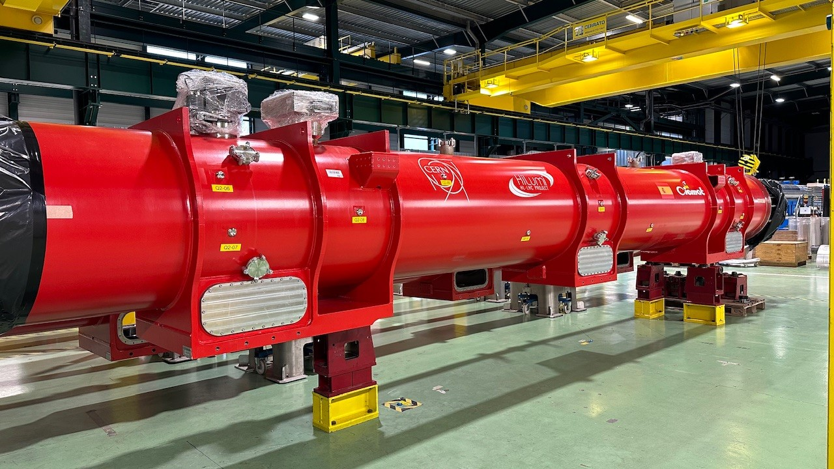
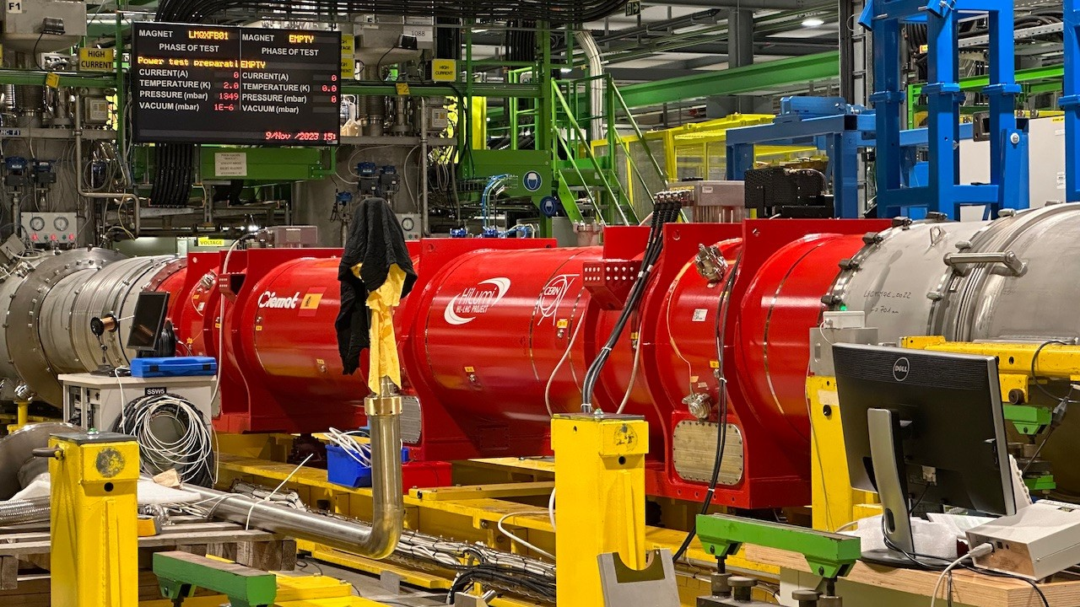
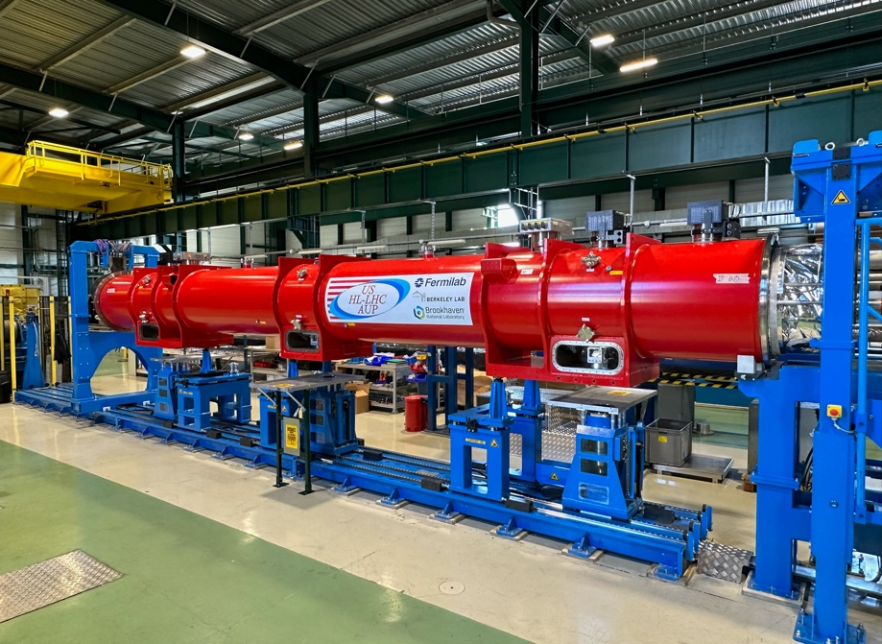
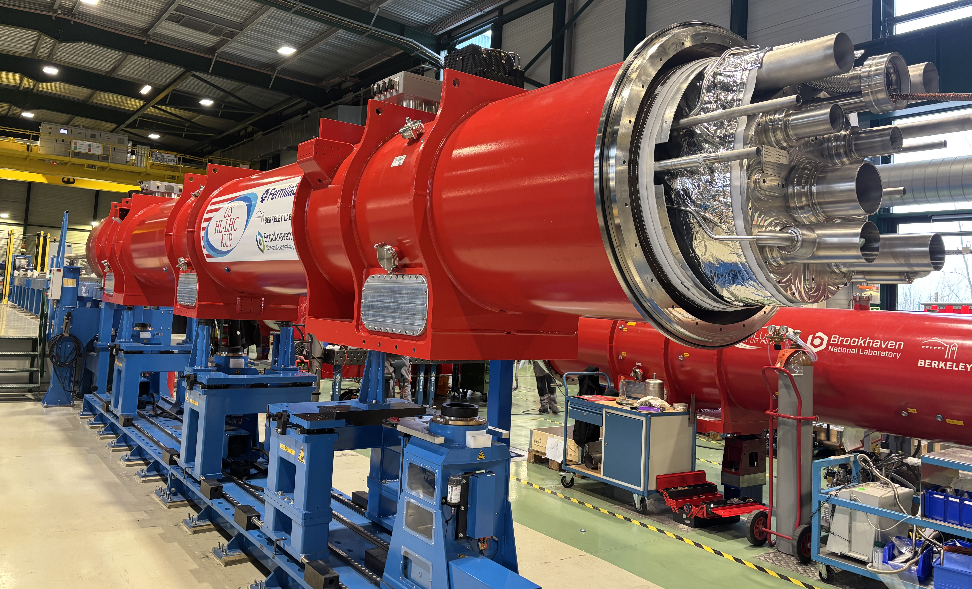
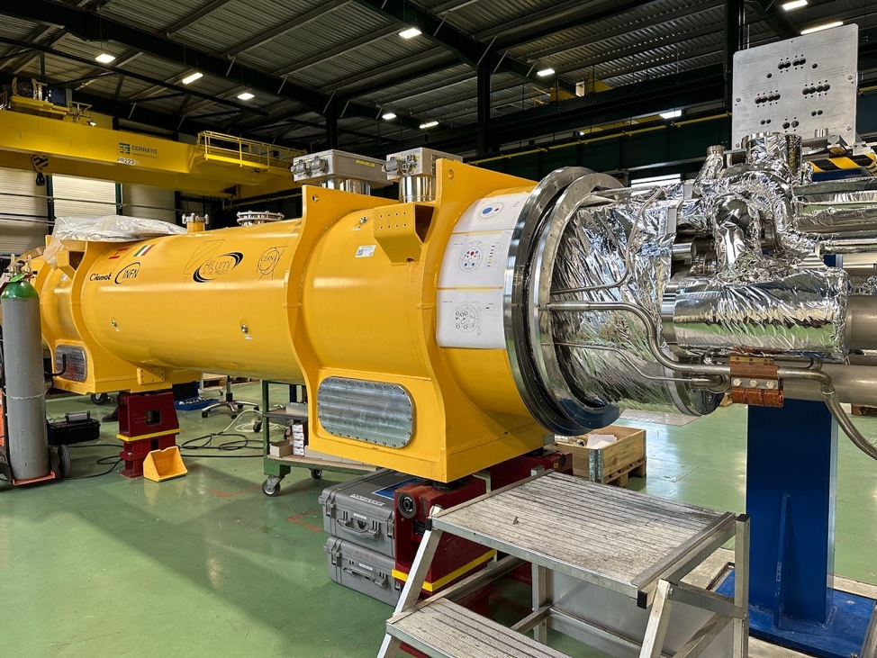
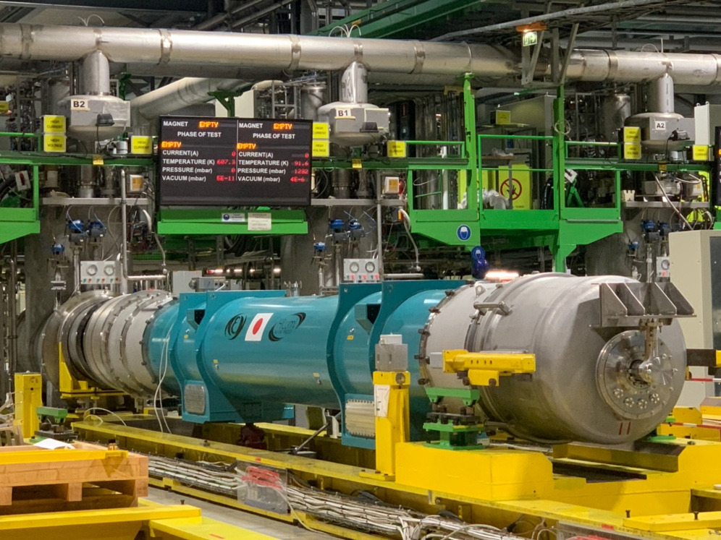
IT-String Update
O. Brüning | Accelerator Complex Status
17 April 2026

Slide 17
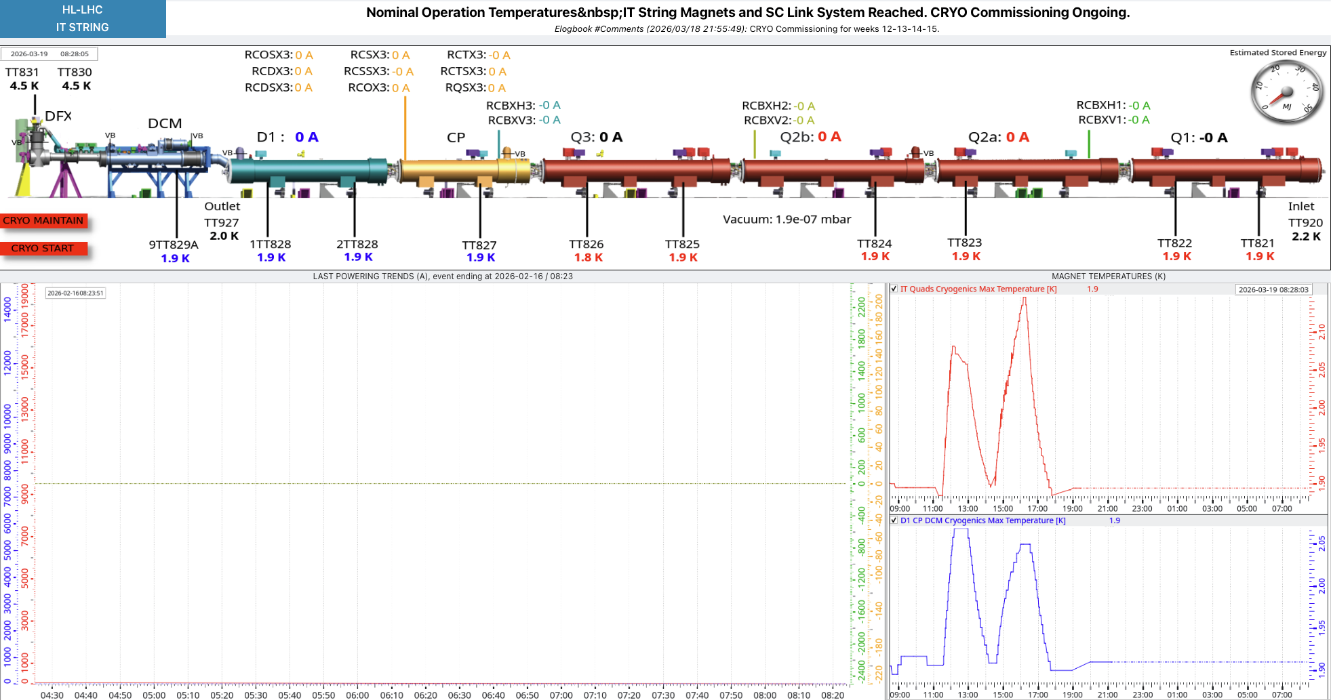
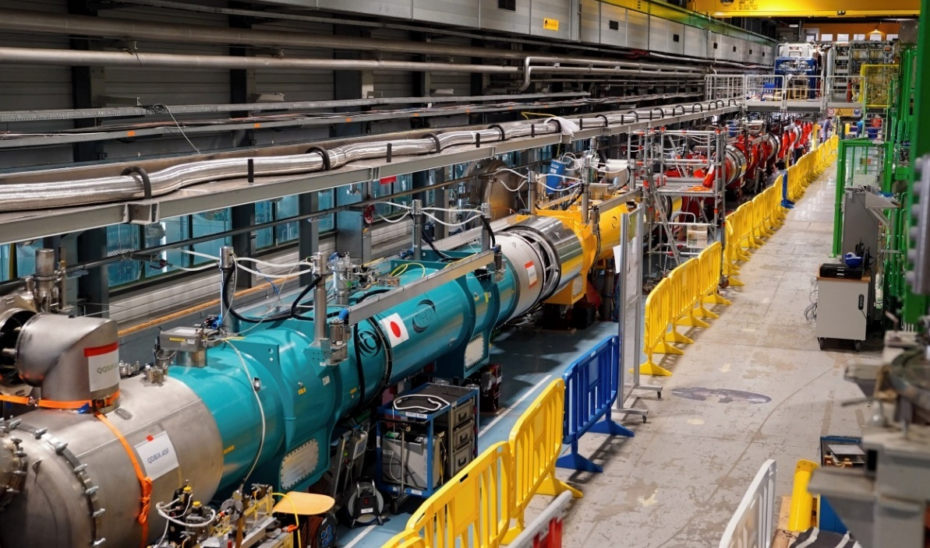
IT String cooldown: Reached 1.9K on 17th March 2026
No degradation in insulation vacuum
ELQA campaign at 80K completed
Cooldown to 1.9K and cooldown of sc link started Monday March 9th
IT-String Reached 1.9K on March 17th
Powering tests scheduled for mid April
O. Brüning | Accelerator Complex Status
17 April 2026

Slide 18
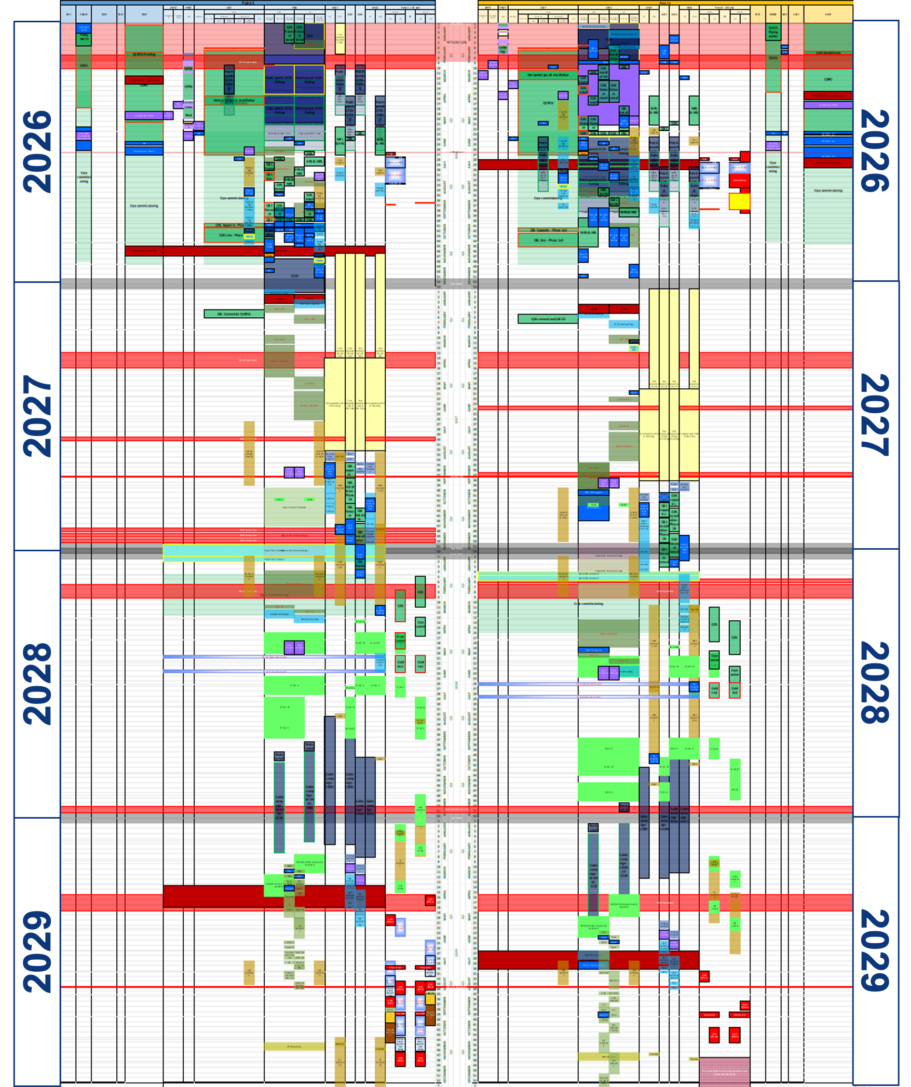
Incoming Activities in HL-LHC Galleries in 2026
Schedule of activities
  New Schedule Baseline 5.2 prepared with a focus on incoming activities in 2026
    RF: WP4 (SY-RF – Faraday cages)
    Warm Powering: WP6B (TE-EPC – Circuit Disconnector boxes, racks and infrastructure))
    Cryogenics: WP9 (TE-CRG – QXL and refrigeration)
    Integration: WP15 (Patch-Panels)
    Infrastructure: WP17 (General infrastructures)
Majority of infrastructure works to complete in 2026 (main remaining activity being vertical cores during LS3)!
17 April 2026

Slide 19
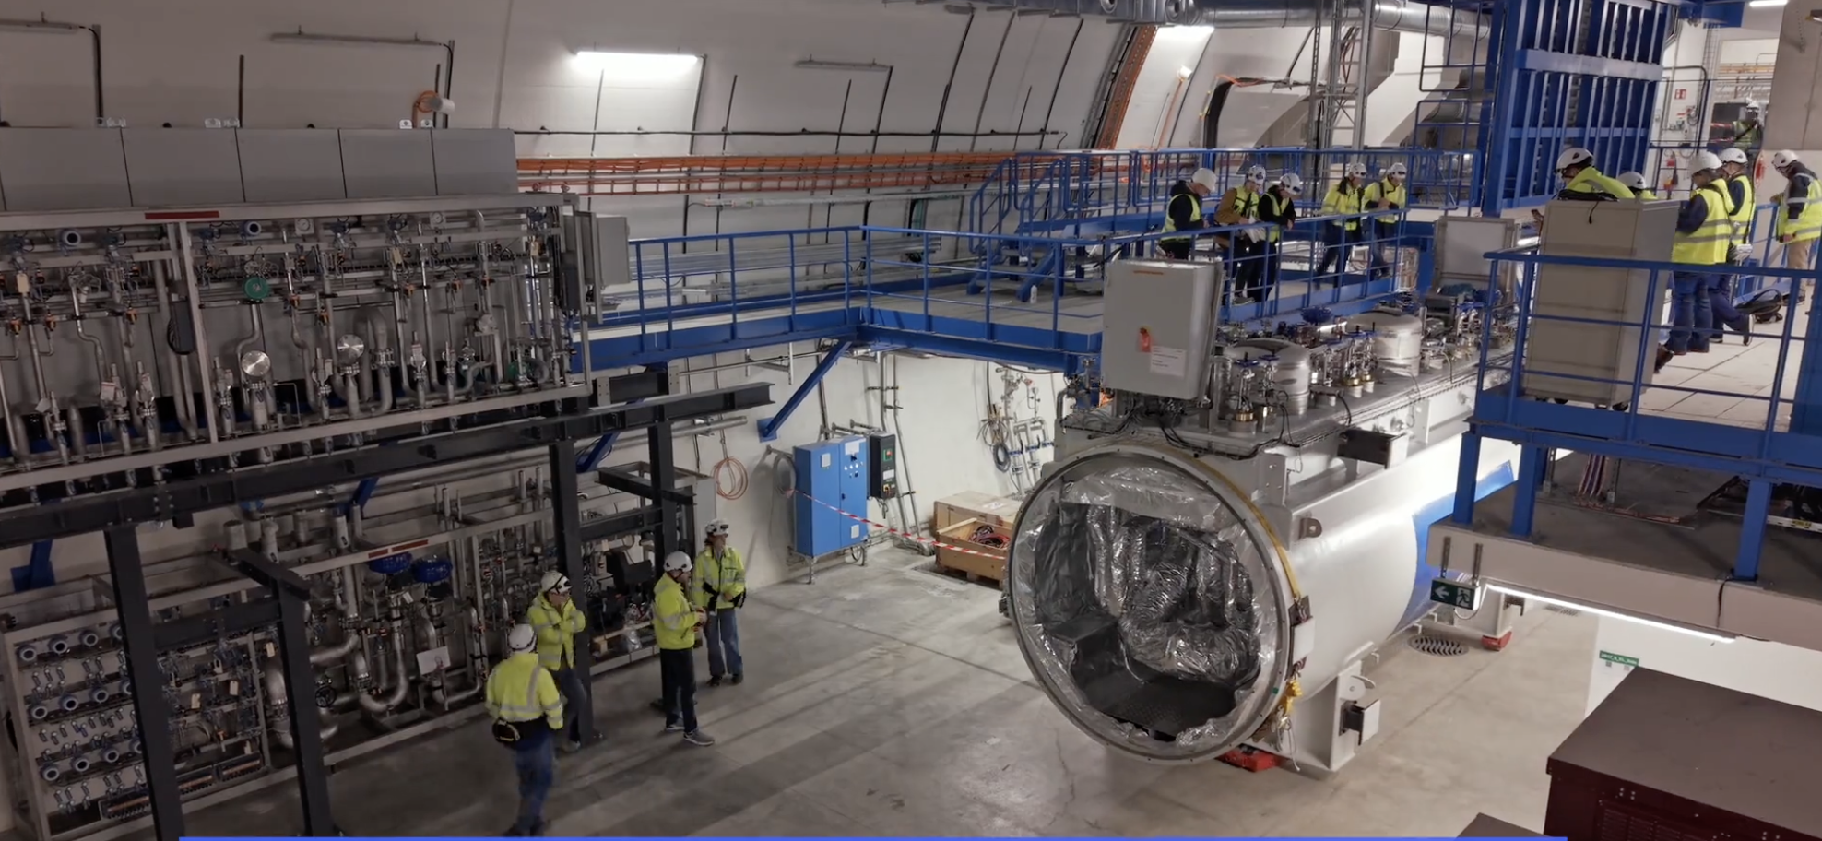
Cryogenic Cold Box Installation in Point 5
Cold Box (QURCG) Handling and Installation completed in Point 5
17 April 2026

Slide 20
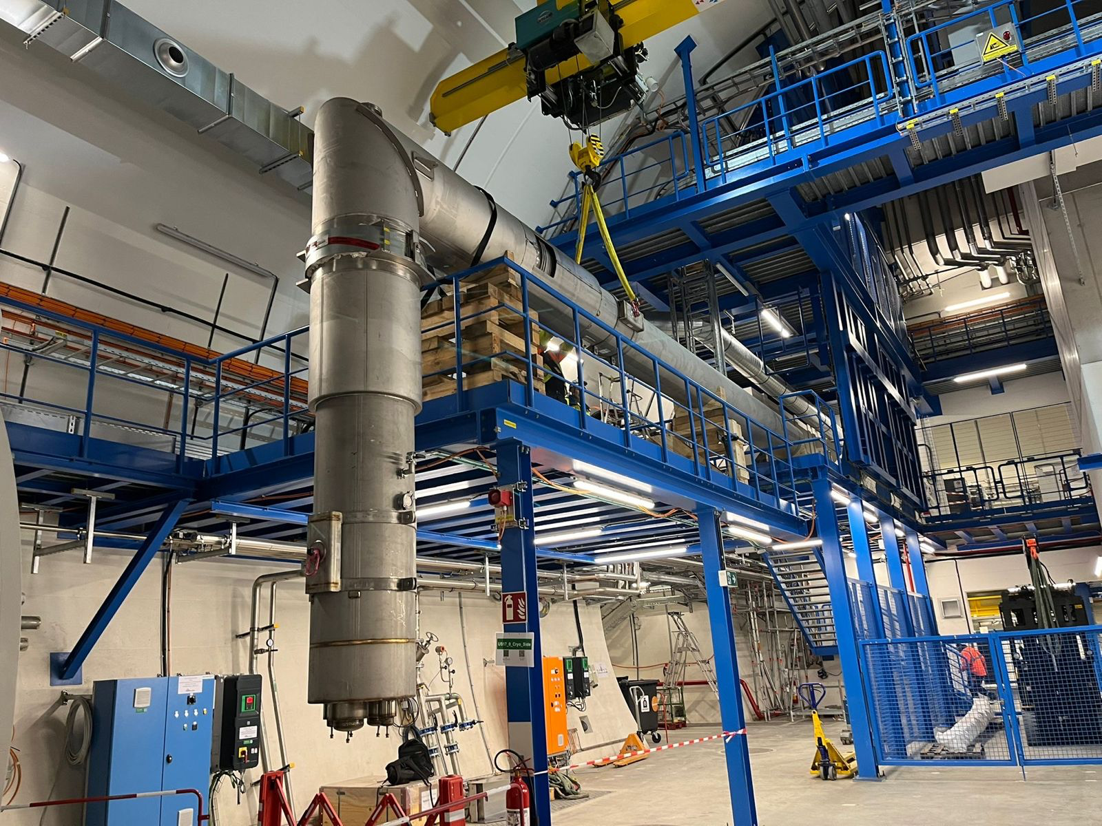
Cryogenic Distribution Line in Point 5
Lowering and temporary storage of first spools for connection to QPLG in Pt5
17 April 2026

Slide 21
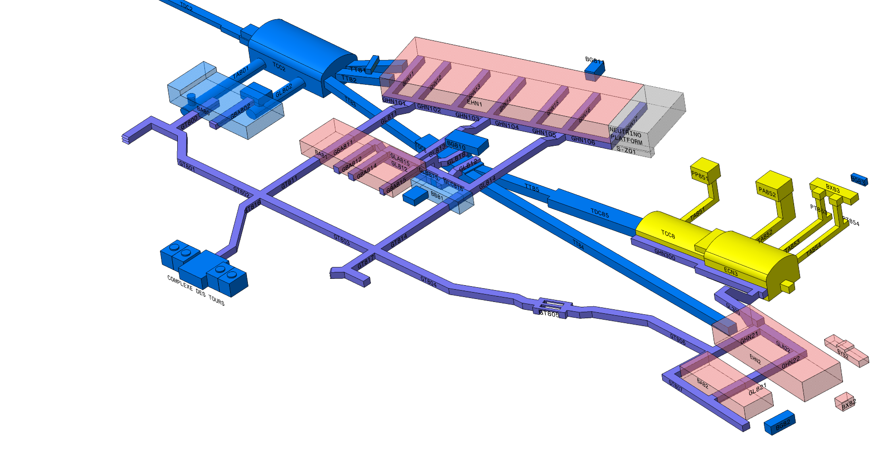

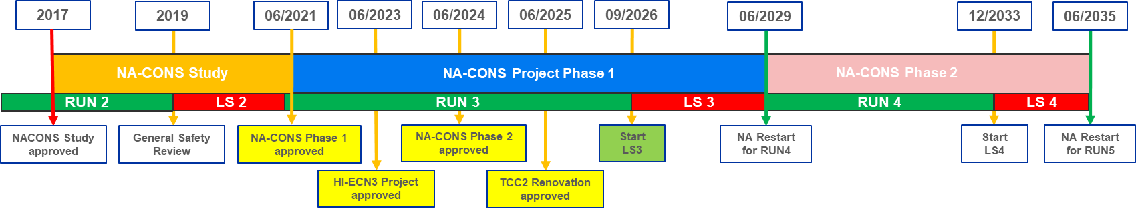
SPS North Experimental Area Consolidation
Fixed Target Experimental Area renovation after 45 years to:
Recover the availability and reliability
Improve safety and eliminate non-conformities
Prepare for new experiments and test beams
Consolidation Phase 1 (2019 – 2029):
Major work in LS3 in primary and secondary beamlines, target areas & associated service buildings
Upgrade for the SHiP Experiment
Consolidation Phase 2 (2029 – 2035):
Consolidation of the experimental halls and associated service buildings

Slide 22
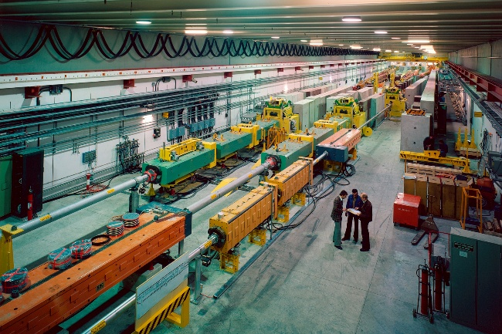
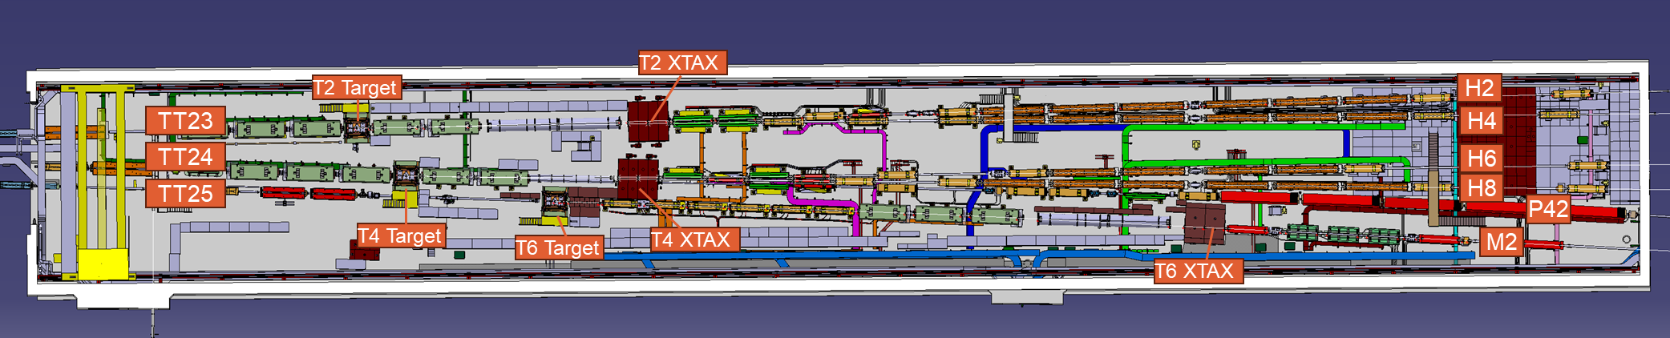
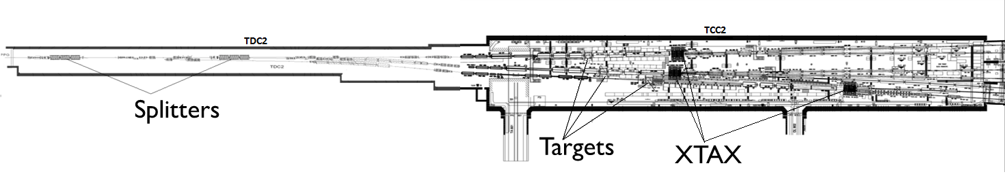
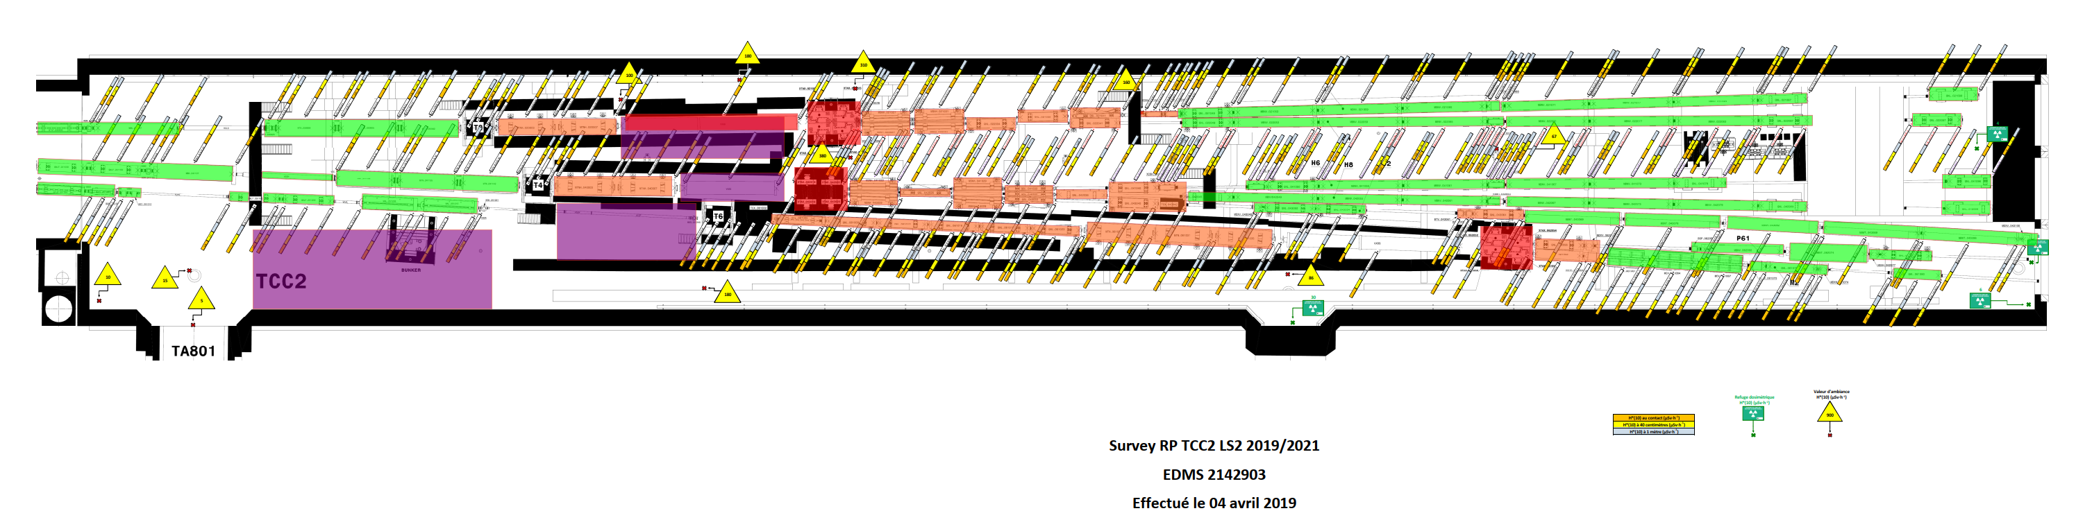
Full Renovation of the SPS North Area Target Zone
  Full removal of beamline equipment became a necessary prerequisite for the renovation of TCC2 infrastructure
  (cabling, cooling, ventilation, fire safety, survey,…) to keep dose rates within manageable limits (<300 pers.mSv)
  Significant layout and beam optics changes:
  Replacement of magnets reaching their end-of-life
  Additional equipment (beam instrumentation, magnets, dumps, beam stoppers) and upgrades for the High Intensity fixed target SHiP experiment
TCC2 during construction in the late 1970s
> 2000 uSv/h
> 2000 uSv/h
> 2000 uSv/h
> 2000 uSv/h
New TCC2 layout
< 500
< 500
< 50 uSv/h
< 500
< 500
<100
<50
< 100
< 500
< 50 uSv/h
< 1000 uSv/h
< 500 uSv/h
< 100 uSv/h
< 50 uSv/h
< 1000 uSv/h
< 50 µSv/h
< 100 µSv/h
< 500 µSv/h
< 1000 µSv/h
> 2000 µSv/h
Radiation dose map of TDC2/TCC2; data from HSE-RP based on measurements from LS1/LS2

Slide 23
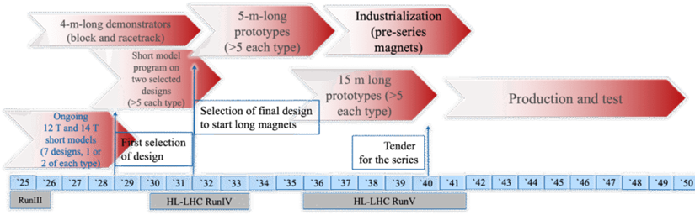

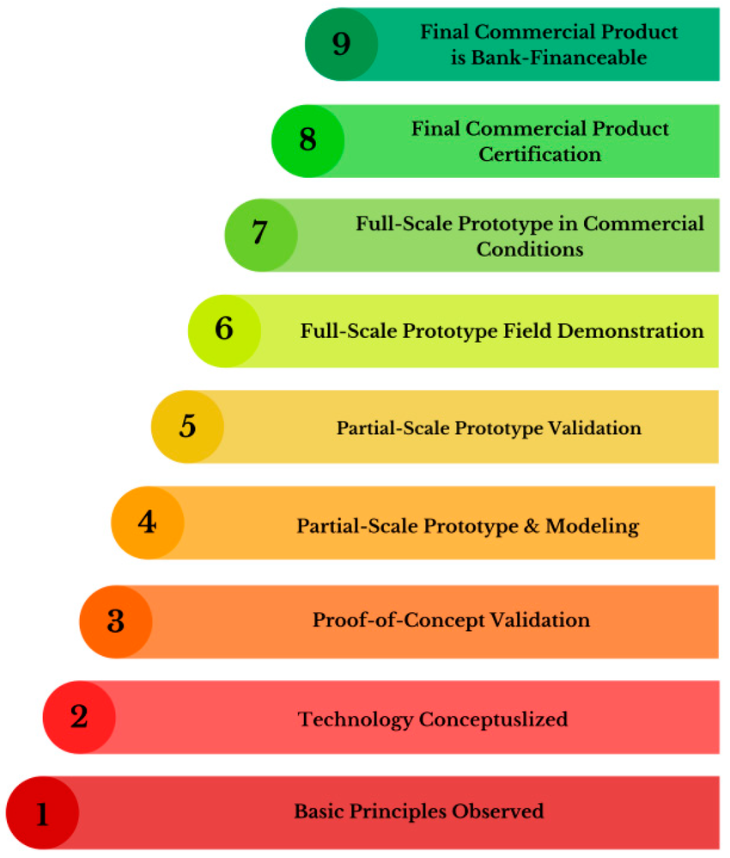
Preparing for the Future
The High Field Magnets Programme (HFM)
  An essential R&D activity that is relevant for all future accelerators
  Developing long, 14 T accelerator dipole magnets capable of being industrialized by 2040 [Nb₃Sn]
  Develop HTS magnet technology for accelerators
Targets for 2026-2030
  Bring the Technology Readiness Level for 14 T Nb₃Sn magnets from yellow towards green through short models
    Address costs by looking at hybrid options
  Bring the Technology Readiness Level for 14 T High Temperature Superconductor (HTS) magnets from red to yellow through various demonstrators
    Short model foreseen for mid 2030’s

Slide 24


Preparing for the Future – The Future Circular Collider
ESPP Strategy Group Recommendations:
    The electron–positron Future Circular Collider (FCC-ee) is recommended as the preferred option for the next flagship collider at CERN
    A descoped FCC-ee is the preferred alternative option for the next flagship collider at CERN
  Deliberated by CERN Council in March, aiming for an update of the Strategy by June
Preparing for FCC-ee is therefore a clear priority over the next years
  Building on the work already done for the feasibility study in preparation for a full TDR
    Completion of the Civil Engineering Studies
    Preparing for industrialisation
    FCC-ee prototyping of critical technologies
  Strengthen the links between the FCC project and external partners

Slide 25
Thank you

Slide 26
Video Highlights
HL-LHC Highlights for 2025: https://www.youtube.com/watch?v=SuEl9zSIp3Y
Cold Box installation in Point 5:
Lowering: https://videos.cern.ch/record/3020996
Timelapse underground: https://videos.cern.ch/record/3020998
Underground camera: https://videos.cern.ch/record/3020997
17 April 2026

Slide 27



RF Dipole, MD #1
Despite the non-ideal situation with temperature and vibrations, MD #1 for crab cavity setup with beam was successfully carried out at 1 MV /cavity in 2025
Horizontal crabbing with protons – for the first time !
17 April 2026

Slide 28

Core Phase 1: 80% execution from HL-LHC Galleries
Objective:
Maximise execution from HL-LHC to reduce intervention in LHC that is on the critical path of LS3
17 April 2026

Slide 29



UA17 Test: Concrete invert removal
17 April 2026

Slide 30



UA17 Test: Concrete drilling
17 April 2026

Slide 31

UA17 Test: outcome
Summary
Site test was vital input to confirm the success oriented LS3 schedule
Outcome: overall very successful, with a very proactive contractor responding quickly to issues and proposing constructive solutions.
A report will be prepared analysing the performance and advancement rates of the field test.
Key takeaways:
Validated contractor’s methodology
Improved understanding of required logistics with CERN groups
Validation of LS3 optimization plan
17 April 2026

Slide 32







Surface buildings: Status of installation
  Cryogenics activities
        SDx7 buildings
    ➔ Cold box delivered and installed at Point 1 and at Point 5;
    ➔ Remains tubing and connecting activities, already ongoing.
        SHMx7 buildings
    ➔ Refrigerators delivered and installed;
    ➔ Major piping executed;
    ➔ Remains tubing and connecting activities, already ongoing.
        PMx7 shafts
    ➔ Cryo transfer line installed at P5;
    ➔ Cryo transfer line will be installed soon at P1.
SD17
SHM57
Tanks delivery (6-24)
Compressor skid delivery (Autumn 25)
QURG delivery (02-26)
O. Brüning | Accelerator Complex Status
17 April 2026
Notes:
SD” Head Building over shaft; SH Cryogenics bilding;

Slide 33












Pictures from production and installation of the QXL Phase 1
Assembly of the pipe elements at Kriosystem
Assembly of the pipe elements at Kriosystem
Production of compensators
IC compensators ready for leak tests
Delivery of QXLMA PE - Jul 25
Welding test in UR15 in August 2025
Interconnection work Nov 2025
BE-GM checking of alignment in P1 - Jul 25
Transport of Pipe element from surface to final destination- Sep 25
QXL phase 1a1 in UR15
Installation phase 1A-a completed in UR15, ongoing in UR55
O. Brüning | Accelerator Complex Status
17 April 2026

Slide 34


Edge welded bellows in collimators
Vacuum Leaks
  A critical lifetime issue appeared during Run 3 affecting edge-welded-bellows used in moveable devices.
  Lifetime in number of cycles much smaller than expected.
  In 2025, new strategies were implemented to avoid unnecessary bellow movement.
  Collimator settings revised to reduce the stroke during operation.
  In 2025 bellow vacuum leaks appeared on 2 collimators. Those collimators could be blocked in open position, the leaks were sealed with varnish - operation could proceed – we were lucky !
2026 Startup
  February 11th – A vacuum leak was identified on a bellow of a tertiary collimator upstream of ALICE.
  The collimator is critical for operation and required replacement.
  Impact: Startup with beam delayed by ~5 days.
  This bellow problem will be present during Run 4.
17 April 2026

Slide 35

P18 warm compressor Degradation
Exchange requires 1 day intervention
Following the Run3 extension in 2026, all warm screw compressors are exceeding the 40'000 hours of runtime - the manufacturer runtime limit for the major overhaul performed at each LS.
From mid-February, one compressor at P18 started to show early signs of degradation: increase of vibration levels, probably due to a bearing degradation.
Compressor is equipped with an online vibration monitoring system.
Experts estimate that the compressor can run until May 26 but not more and there is a risk that vibration degradations evolve faster than expected.
Spare compressor already transported to SMH18 in case of anticipated intervention needed
Compressor exchange mandatory (heavy operation)
17 April 2026

Slide 36


Schedule implication
Resulting in 6 days lost for physics
No impact on HW commissioning and machine check-out
  Loss of operation days split between experiments and machine:
    0.5d from MD
    5.5d from physics (2d low-µ pp, 2.5d high-µ pp)
    1d from PbPb
17 April 2026

Slide 37



SPS Machine Status
Commissioning
LHC beams delivered according to schedule – BCMS beams prepared at 4 x 36 bunches at 1.7e11 ppb
HL-LHC parameters re-established after ~1 week of scrubbing
Fixed Target physics started on schedule
Multiple Studies
    First high-power, high-energy proton beam test on a gaseous He cooled refractory target
    (for newly approved SHiP experiment)
    Decommissioned hysteresis cycle with 200 GeV/c ramp – replaced by a flat 26 GeV/c padding cycle ➔ potential energy savings
17 April 2026

Slide 38
Injector Complex Machine Status
Linac4 and PSB:
Commissioning completed successfully, delivering beam according to plan and within the requested specifications [Linac4 H⁻ source 40mA @ 0.8Hz; PSB delivered all LHC beam variants]
PS Machine:
First beam on January 24th ; 3 days ahead of schedule only 47 days after beam stop in 2025!
Successful testing of prototype solid-state amplifier for main accelerating cavities during the beam commissioning phase - Crucial to validate planned LS3 upgrades
AD / ELENA Machines:
Beam commissioning started as planned on February 13th
Physics started on Friday 27th with beam performances already close to end of last year
  Six users taking beam on the first day of physics
SPS Machine:
LHC beams delivered according to schedule – BCMS beams with 4 x 36 bunches at 1.7e11 ppb
HL-LHC parameters re-established after ~1 week of scrubbing
Fixed Target physics started on schedule
Decommissioned hysteresis cycle [200GeV/c –> 26GeV/c -> energy savings – 300kCHF / year] and beam on He cooled target [preparation for newly approved SHiP experiment]
17 April 2026

