Slide 1
SIS100 Magnet Measurement Tools
P. Spiller, C. Roux. A. Szwangruber,
M. Buzo, S. Russenschuck

Slide 2
Outline
Motivation
Scope of work
Resources
Status of collaboration contract

Slide 3
Motivation
The new collaboration is a continuation of common developments in the area of
magnetic field measurements systems which were formalized in addendum #2 and #9.
Magnetic field measurement systems for the SIS100 superconducting dipoles | Annex to #2 #9, KR2984/TE | 2014 2016

Slide 4
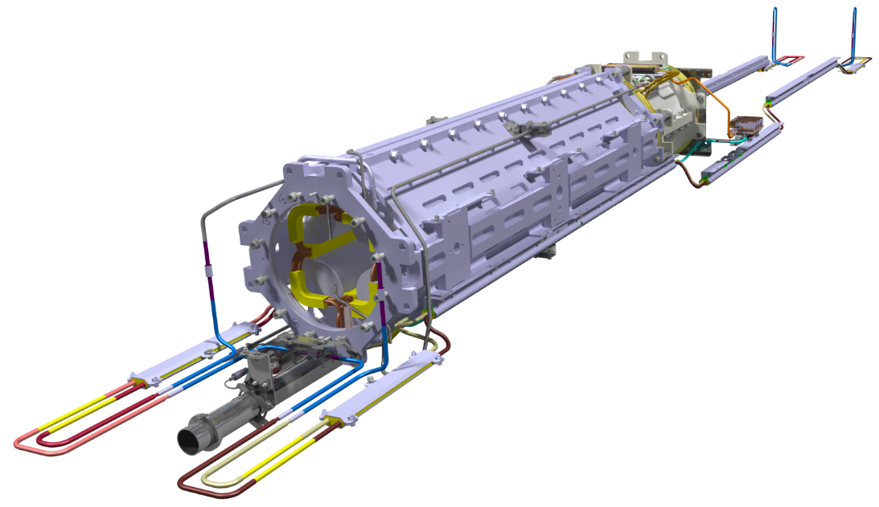
Motivation
Series production and cold testing of the superconducting quadrupole units (QU) for SIS100 is ongoing at JINR, Russia: 1. High risk, 2. Critical path for SIS100
Risk minimization by series production of QU in European industry.
Cold testing of 36 industry units at GSI STF is required and to be enabled.
Cold testing contains qualification by magnetic field measurements on series QUs
The “new” GSI-CERN collaboration will focus on development and manufacturing of measurement systems for high precision magnetic field measurements on superconducting magnets
rotating coil probes
stretched wire system
control and data acquisition systems
QP unit for SIS100: main quadrupole and corrector magnet

Slide 5
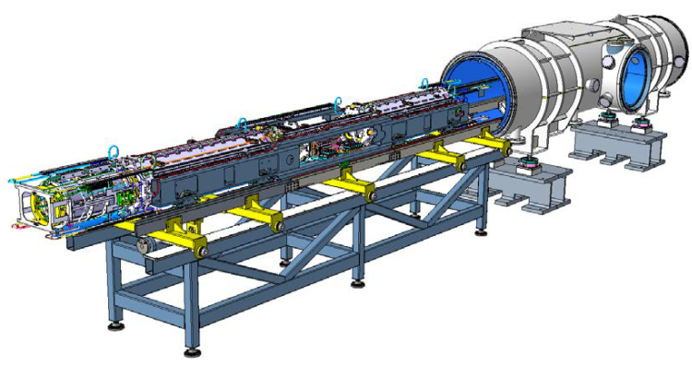
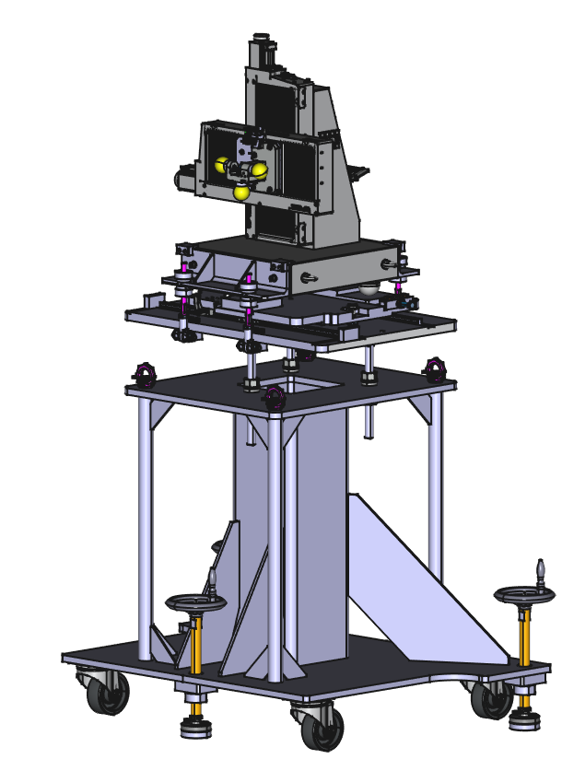
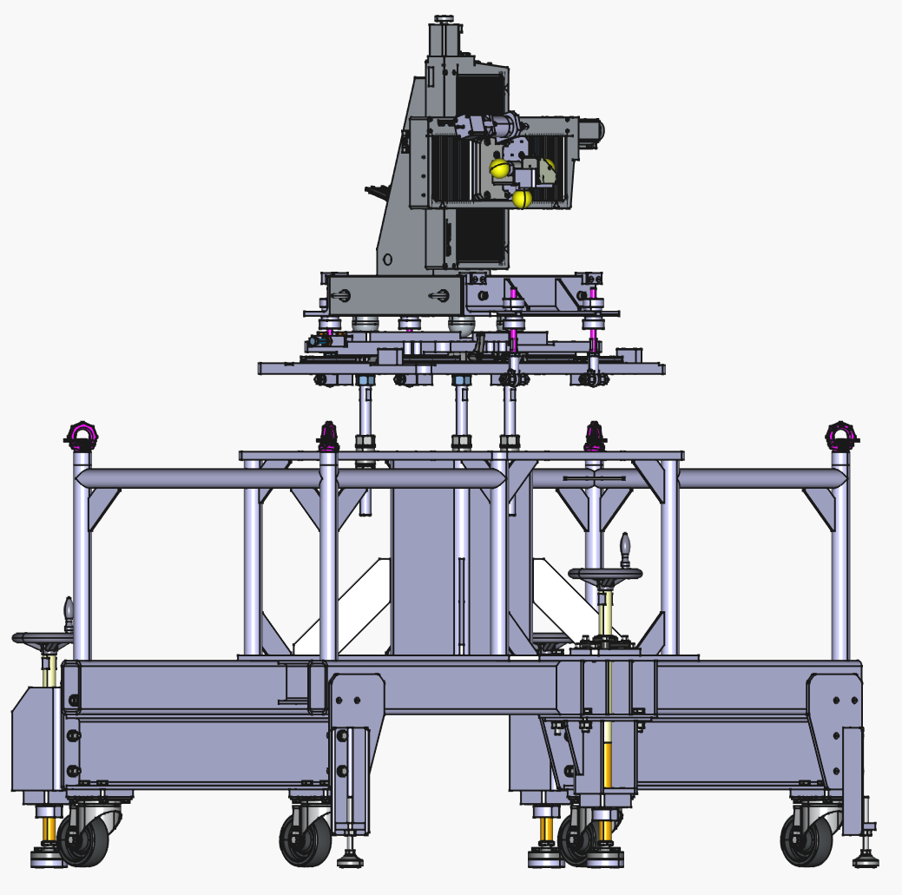
Motivation
Required infrastructure for cold testing of QU at STF:
test cryostats for QD-units
bench and tooling for a fast mounting of the cold mass into the test cryostat (preparation towards series testing)
systems for magnetic field measurements
anticryostat for magnetic field measurements
optimisation of the existing infrastructure
~ 9 m
Test cryostat and mounting bench with QD units installed on a testing girder. Design and production Fantini Sud (IT). Courtesy Fantini Sud.
Procurement strategy:
Test cryostats and installation benches - design and production
(awarded to Fantini Sud close to completion)
Systems for magnetic field measurements - design and production within GSI-CERN collaboration
Anticryostat – design and production (awarded to ILK)
Components for the infrastructure upgrade – GSI (SCM, CRY)
Model of the GSI stretched wire system, magnetic axis measurements FAIR SIS100 QD units.
Courtesy P.Doll GSI-ENG

Slide 6
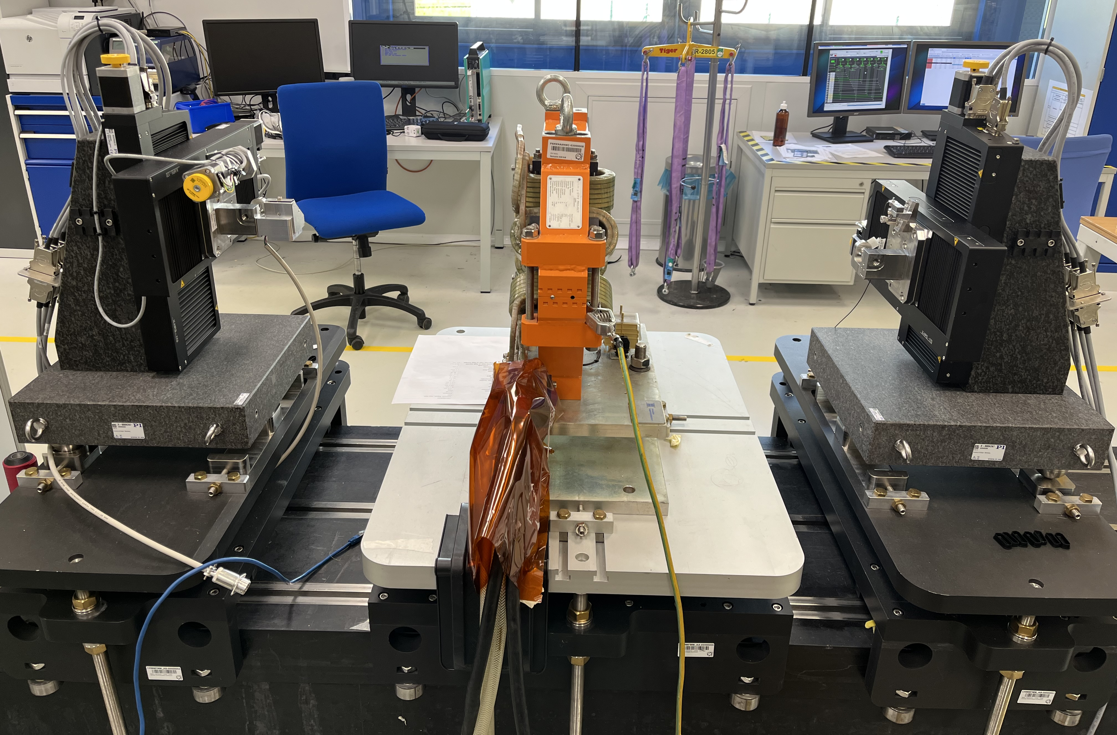
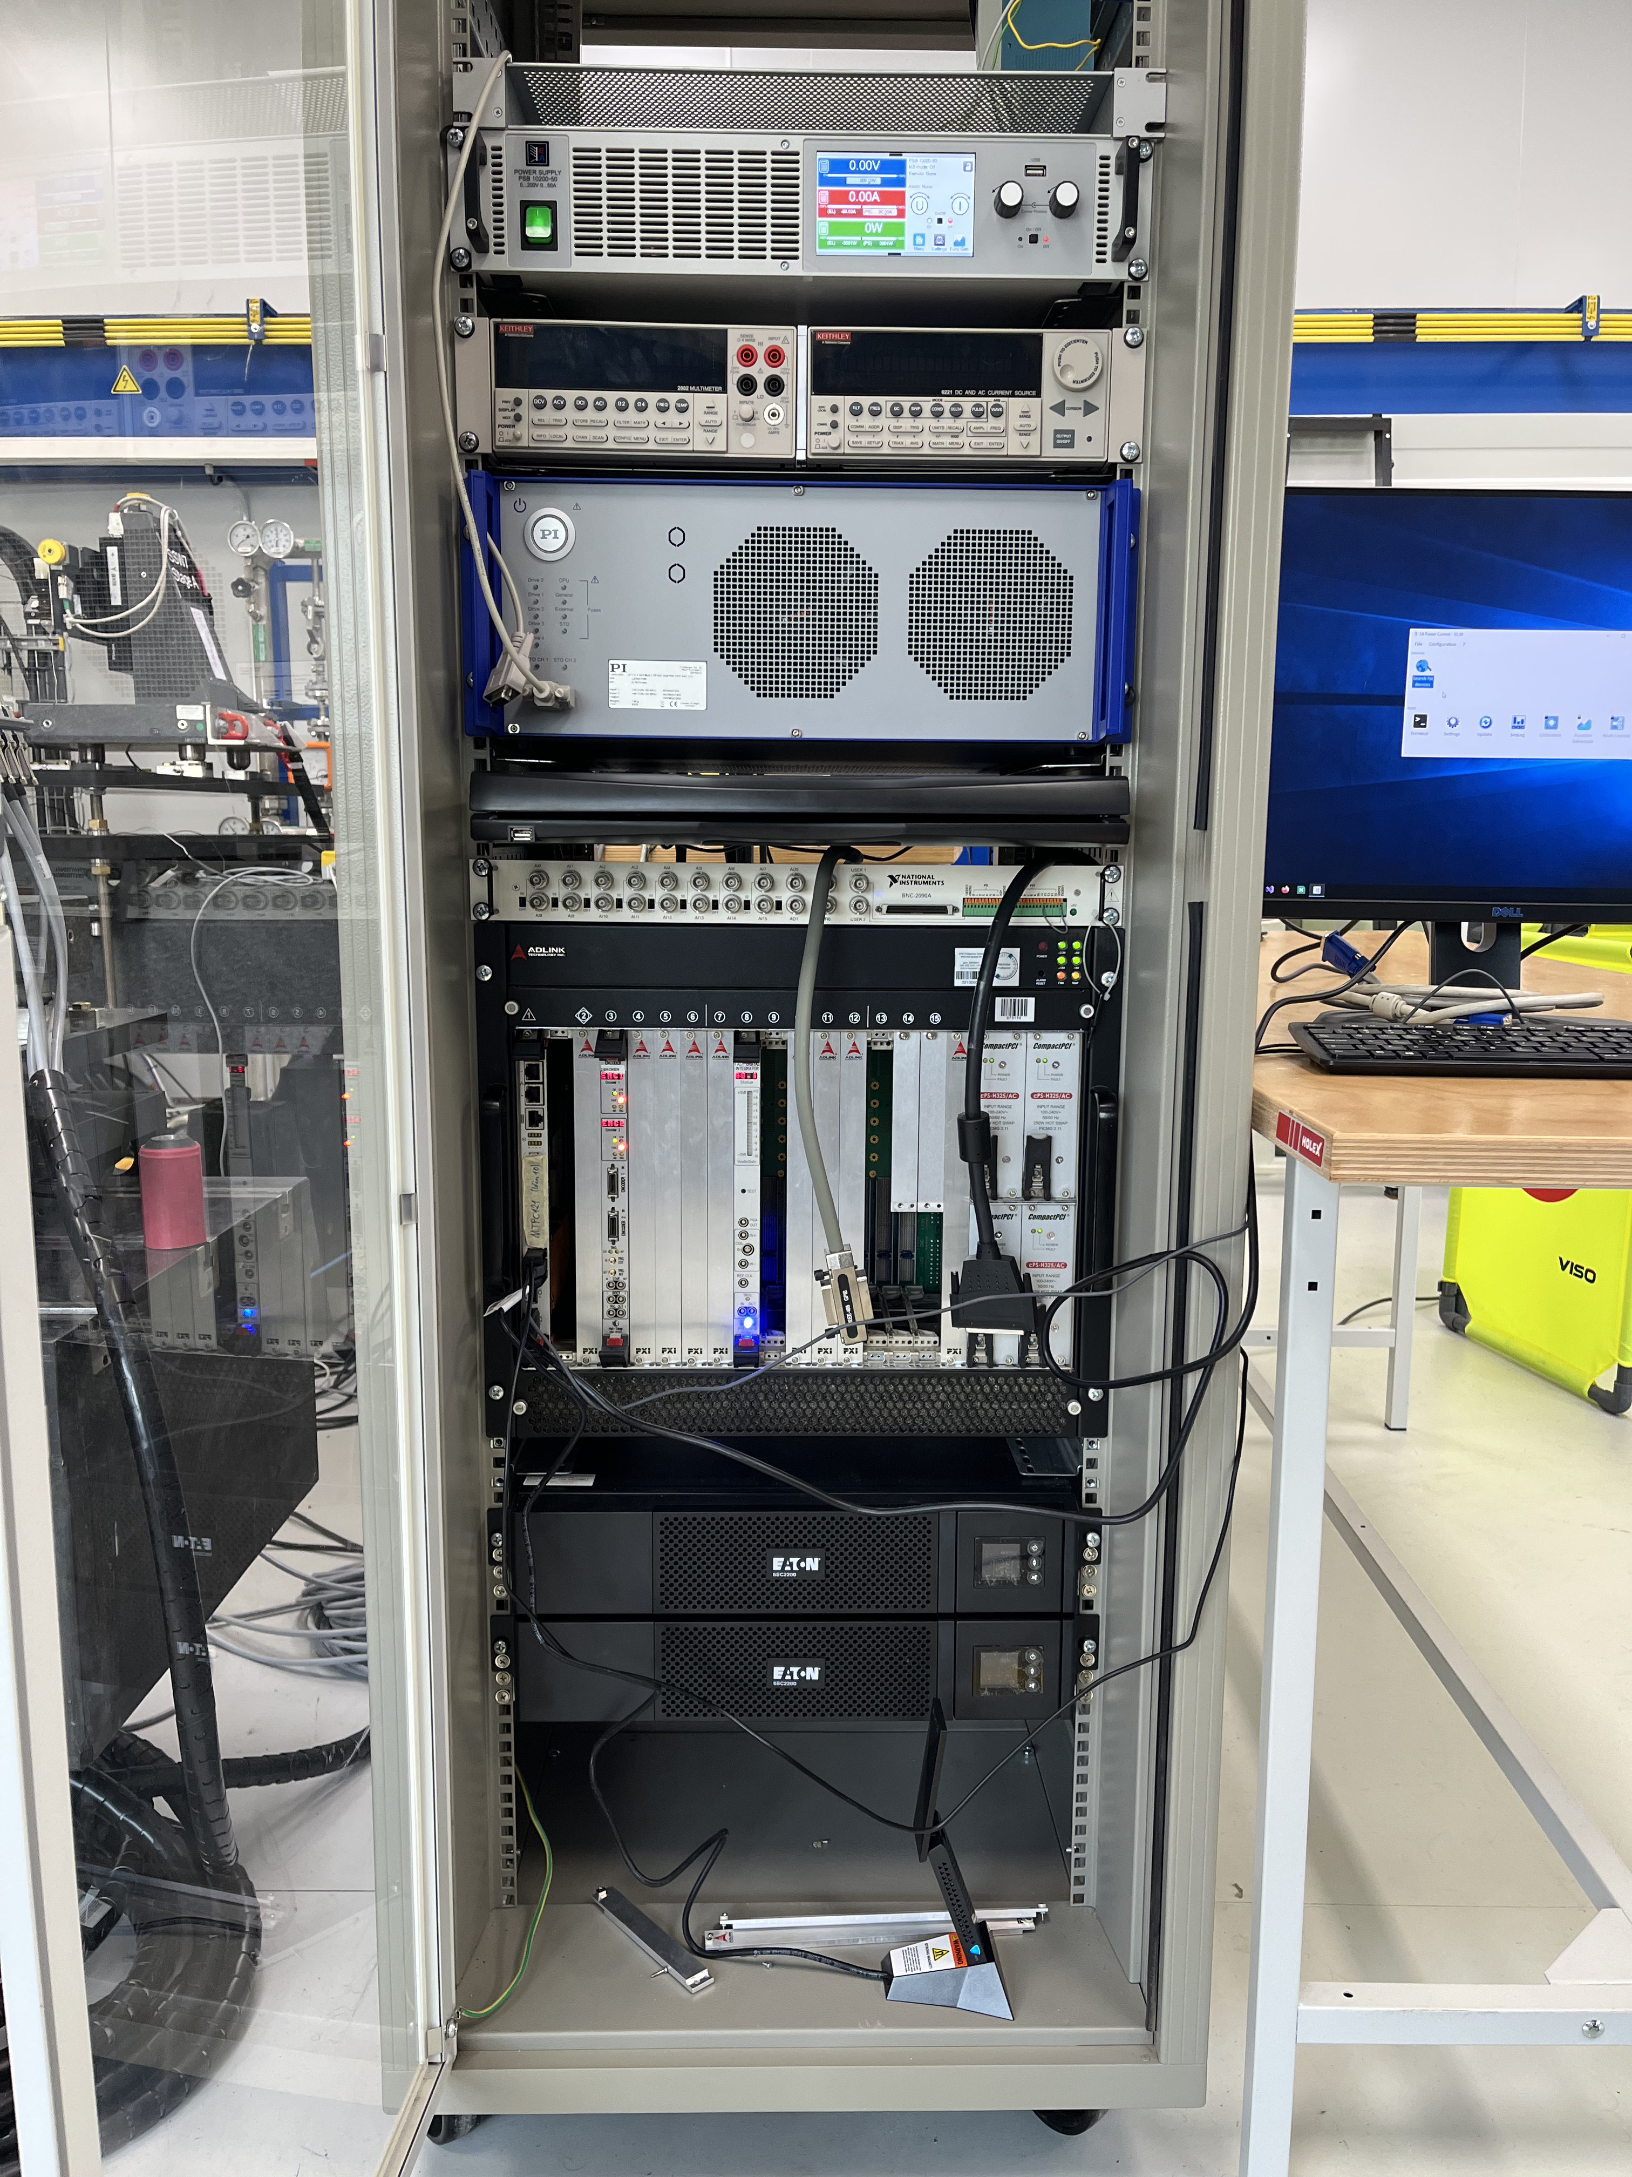
Development of new magnetic field measurement systems for GSI an CERN
Wire measurement system:
Position of the magnetic axis
Integral field gradient
Applicable for SIS100 units /doublets
GSI Stretched wire system for magnetic axis measurements on SIS100 sc Quadrupoles.
Collaboration scope and contributions:
GSI | CERN
System development based on the CERN-SSW5 design
Hardware procurement | Training of GSI personnel
Final assembly and commissioning of the system
1.5 FTE | 0.2 FTE
~ 170.000 €
a
b
a. Linear stages at calibration bench, b. control rac. System under assembly at B311 CERN. Courtesy D. Teo GSI-SCM
Current development status
Linear stages and a motion controller procured at PI Germany
Support frames under procurement at GSI
System under assembly and software integration at CERN
Expected readiness for QU testing – Q2 2026

Slide 7
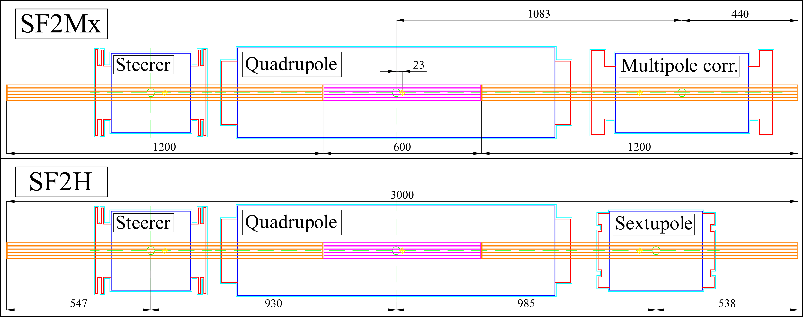
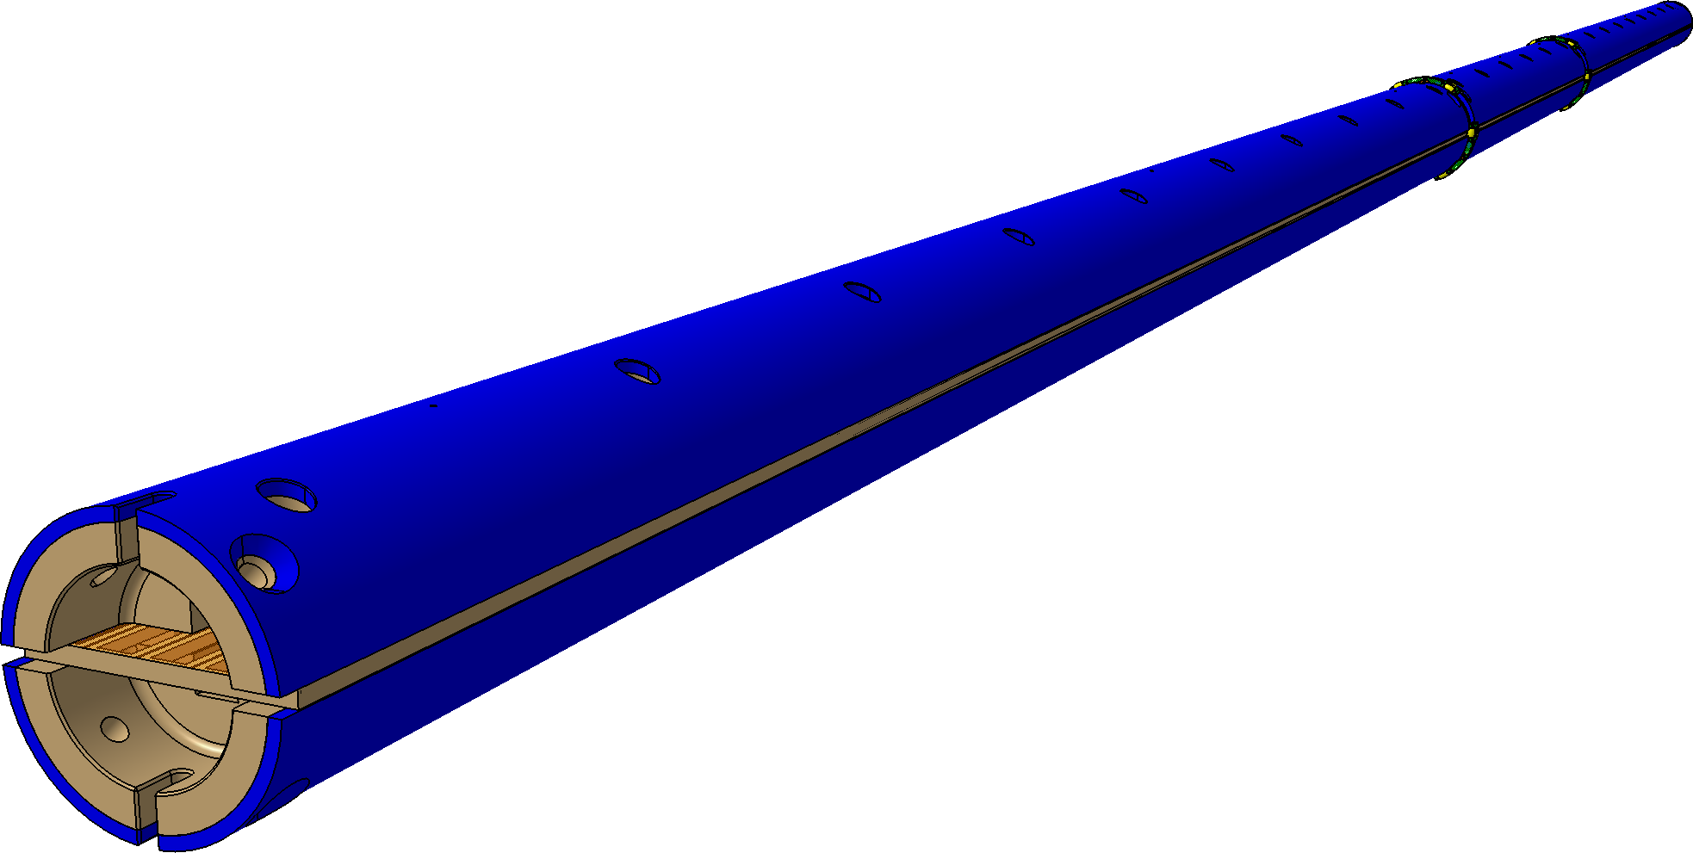
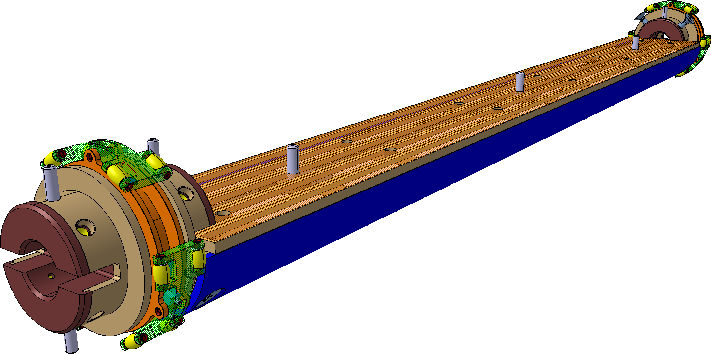
Development of new magnetic field measurement systems for GSI and CERN
Rotating coil system:
Field homogeneity
Integral field gradient for main quadrupole
Integral field strength for corrector magnets
Applicable for SIS100 quadrupole units
Rotating coil shaft for measurements within an anticryostat
a.
Collaboration scope and contributions:
GSI | CERN
Development of the measuring head based on PCB coils
Mechanical design and electrical layout for the PCB | PCB manufacturing and calibration
Procurement of components for measuring heads (no need to procure new motor unit – old one will be used) | Assembly and calibration of the measuring heads
Assembly of motor units
Adjustment of the control and data acquisition software for operation at GSI
2.5 FTE | 0.2 FTE
~ 150.000 €
~ 3100 mm
b.
c.
a. Requirements on longitudinal segmentation of the shaft,
b. 3D model under finalisation,
c. central segment of the shaft, view on intersegment connections and PCB.
Courtesy V. Marusov GSI-SCM
Readiness for QU testing in Q4 2026 is challenging
Tentative magnetometer design. Courtesy V. Marusov

Slide 8
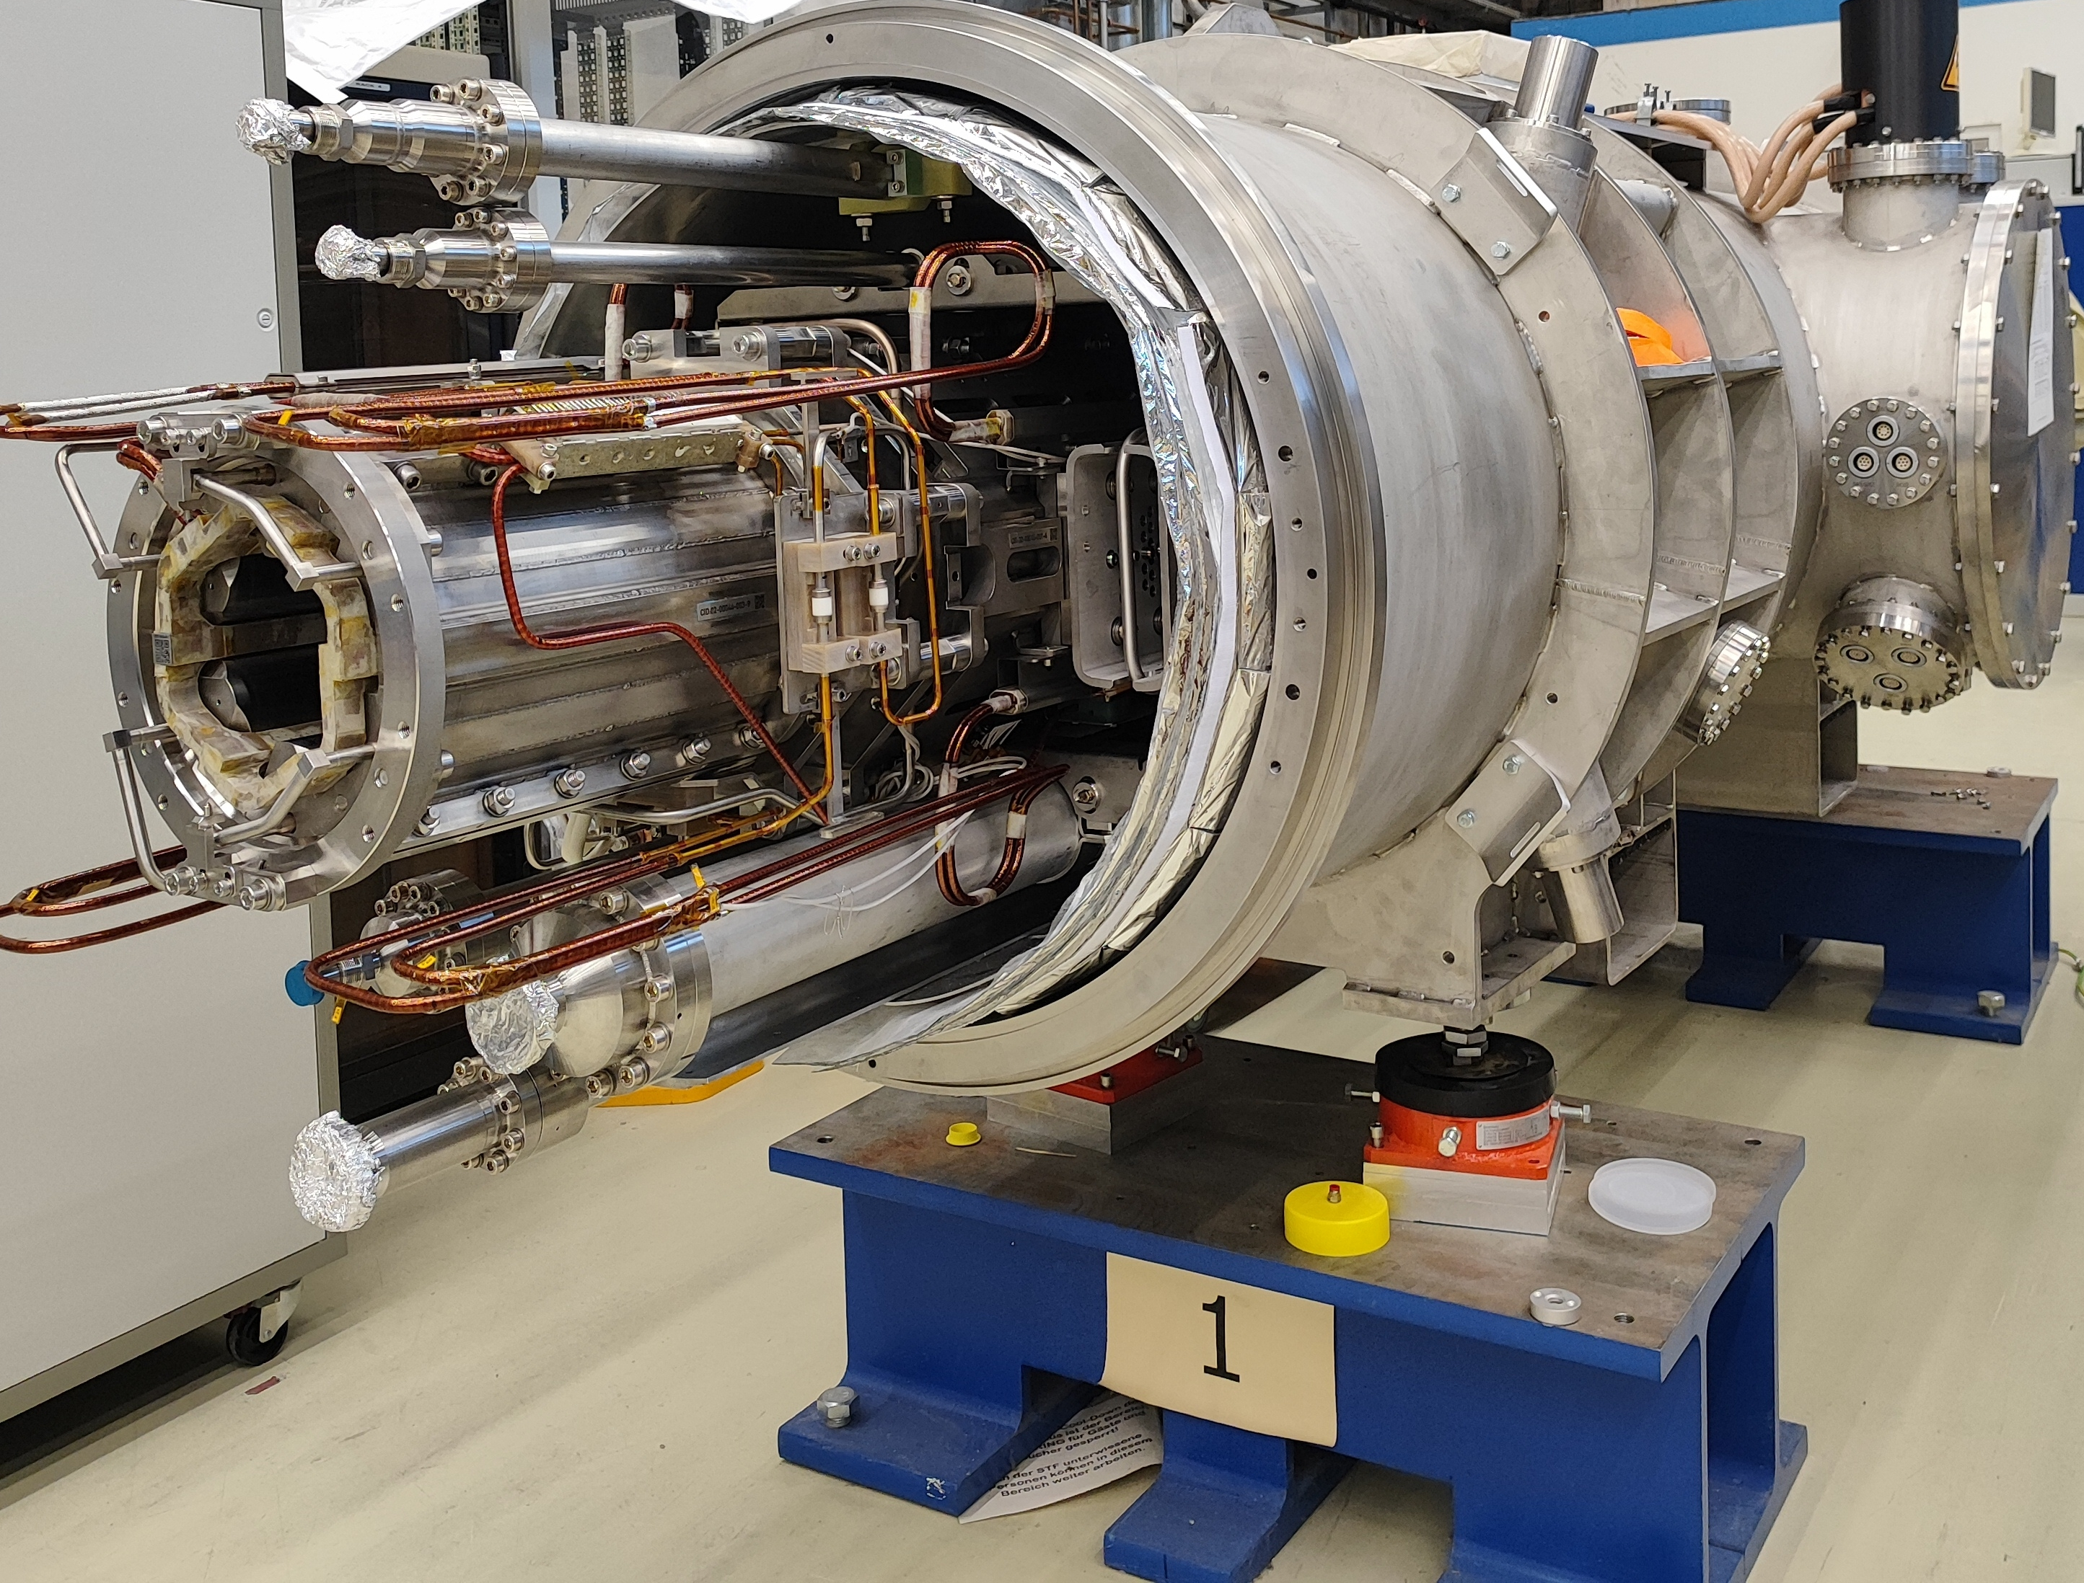
New: Realisation of Magnetic field measurements at 300K using CERN LDM D2 rotating coil system
Goal: Magnetic field qualification of prototype industry quadrupole units
First validation of the magnetic field properties (B₆)
Comparison integral magnetic field on Units from JINR and BNET production
Temporary provision by CERN for testing at GSI
Adaptation of the GSI control cabinet for operation with LDM D2 rotating coil shaft for warm measurements of prototype units (CERN, GSI contribution)
Training of GSI personnel, supervision of the measurement campaign at GSI
Prototype quadrupole Units under testing at SFT
Expected readiness for measurements on the Quadrupole prototypes – May 2026

Slide 9
Benefit for CERN
Qualification of new suppliers of precision stages (PI continuous serving the needed technology).
Development of new controller software for these new stages. in progress
Training of new CERN and GSI personnel. in progress
Development of data acquisition systems based on more commercially available components. open
Replacement of the CERN FDI (Digital integrators) for which electronic components are no longer available. open
Qualification of new suppliers for measurement shafts (G11 composite) and PCB plates.
(market research started > KVB GmbH; Krüger & Sohn GmbH)
CERN benefits from technological advancements, new suppliers and software updates

Slide 10
Description of work
GSI’s contribution:
Rotating coil system:
Mechanical design for a coil shaft based on CERN developments. ongoing
Layout of the PCB (printed circuit boards) for single measuring segments of the coil shafts. ongoing
Mechanical assembly and wiring of the segments for two rotating-coil shafts. open
2. Single stretched wire (SSW) system (DC and AC mode):
Modification of the mechanical design of the support platforms for movable stages of the existing SSW. done
3. Provision of one qualified expert (1 FE) for two 2 years for work within CERN’s Technology Department to enable the realization of the collaboration within the timeline defined. done: position is filled, a GSI employee is deployed to CERN in 12.2025 for 2 years - work place CERN

Slide 11
Description of work
CERN’s contribution:
Provision of a 3D model and drawings for the existing SSW. done
Provision of access to the mechanical model and drawings of CERN's rotating coil shaft including anti-cryostat. done
Provision of access to the layout of the PCB Gerber files for the rotating coil shaft. done
Provide the GSI Expert access to the laboratories where mechanical assembly and intersegment wiring of the coil shaft can be executed. Support the GSI Expert's activity in developing software and hardware. done
Testing and calibrating the two SSW systems at CERN. in progress
Calibration of single segments required for two rotating coil shafts and the final calibration of the shafts. open

Slide 12
Description of work
Joint contributions:
Procurement of mechanical parts, purchased items and assembly of coil heads. open
Procurement of mechanical parts single stretched wire system. done for GSI system
Update of the control and acquisition cards for the stretched wire system, which will be assembled according to the layout provided by CERN. in progress
Adaptation of control and data acquisition (DAQ) software for communicating with new hardware based on the flexible framework for magnetic measurements (FFMM) in C++ language. Software must be adapted based on the FFMM toolkit for the specific common CERN and GSI applications. in progress
Definition of acceptance criteria for the deliverables to fulfil the quality and safety aspects of both laboratories. open
GSI and CERN procure their respective hardware independently and separately, with no shared responsibility or obligation for the other Party's procurement activities

Slide 13
Resources
Resources | Provided by CERN | Provides by GSI
Senior Scientist | 0.5 FTE (110 kEUR) | 1.5 FTE
Technician | 0.3 FTE (42 kEUR) | 1 FTE
GRAD |  | 1 FTE
Material | 250 kEUR (for CERN equip.) | 340 kEUR
Infrastructure | 20 kEUR (for both)
Travel and accommodation | 10 kEUR (for both) | 50 kEUR
Die Kostenschätzung für Travel und Accomodation beinhaltet Travel vom CERN Personal zur GSI Zwecks Inbetriebnahmen der Messysteme SSW, Rotierende Spule. Warme Magnetfeldmesssystem (Hardware Ausleihe und Personalkosten wurden zum Zeitpunkt des Vertragsentstehung /Unterschrift nicht enthalten, da nicht vorgesehen) Die Ausleihekosten wurden mir nicht benannt. Alle Transporte (GSI Equipment von GSI zur CERN und von CERN zur GSI werden durch GSI bezahlt – so Art.6 der Kollaborationsagreement.

Slide 14
Summary
Set-up of streched wire system according to plan.
Set-up of rotating coil system delayed.
Development and production of testing cryostat and preparation banks with good progress but delayed.
Development and production of anticryostat in progress but delayed.
Completion of the magnet field measurement equipment meeting the delivery of first industry series units will be challenging by end of 2026.

