Slide 1
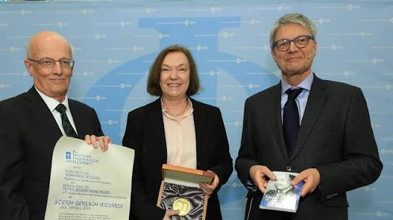
A Tribute to Peter Braun-Munzinger a surprise(?), some physics, and some memories
TK Hemmick

Slide 2
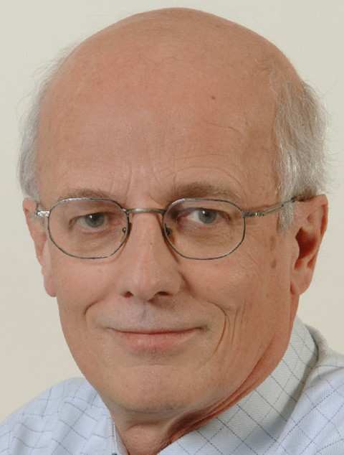
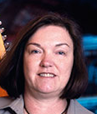

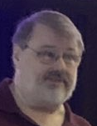
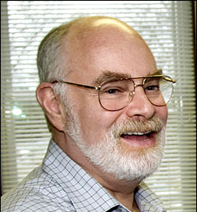
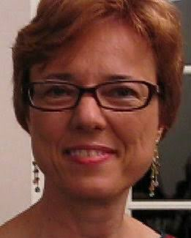
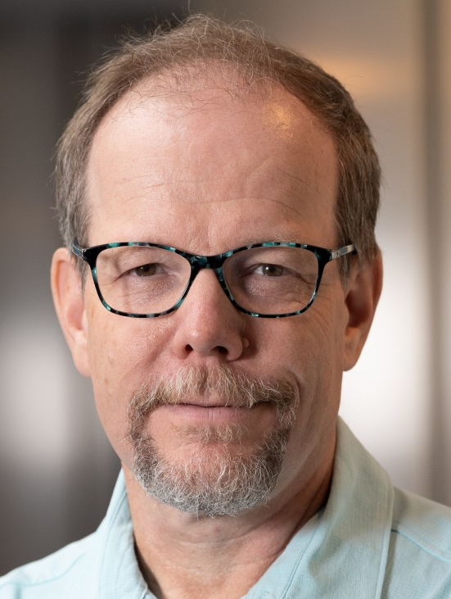
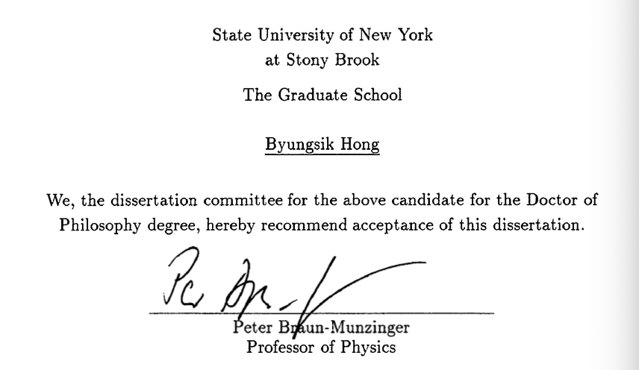

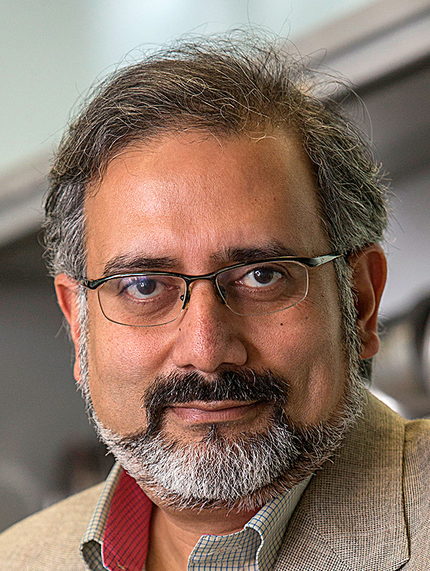
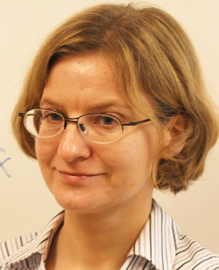
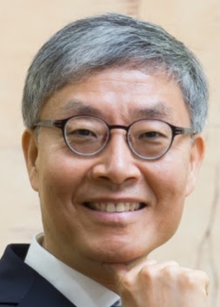
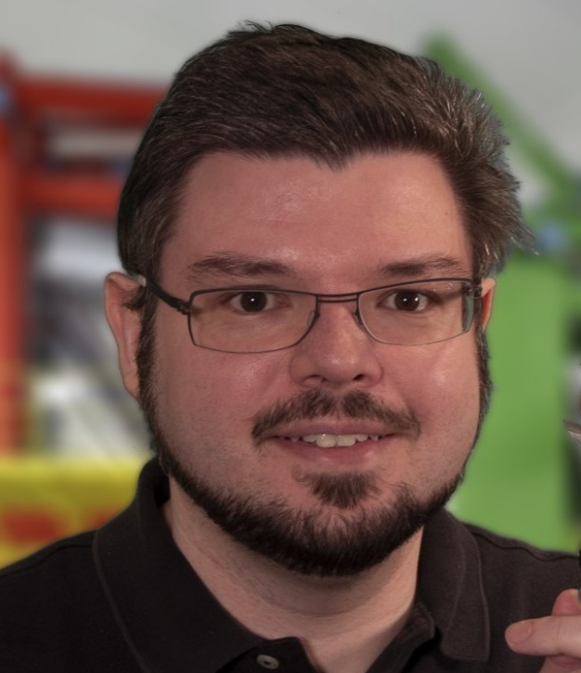
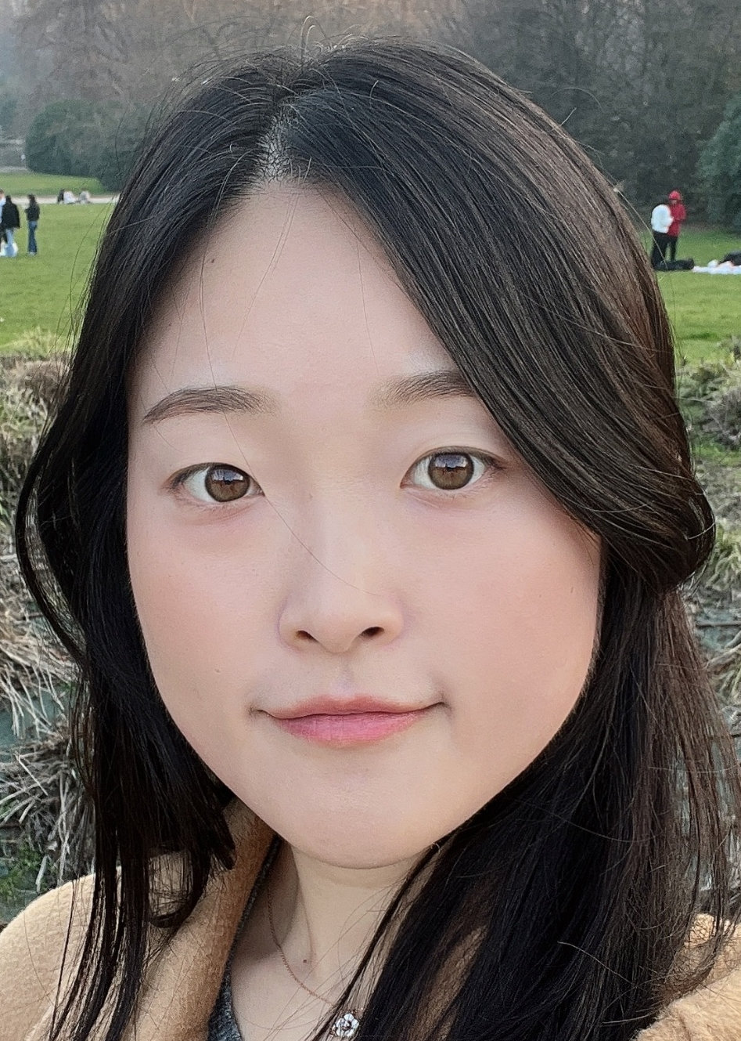
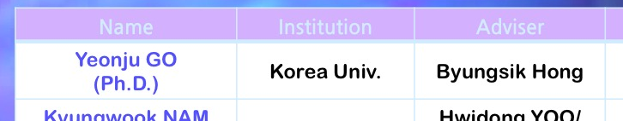
A Timeline of the SBU RHIG
PBM and JS → Germany 1995
Michael Marx → Heaven 2011
Barbara Jacak → Berkeley 2015
Founders
2017
Hemmick
Marx
Jacak
Drees
Recipient of Genesis Grant
Deshpande
Recipient of Three Genesis Grants !!
Kiryluk
Bernauer
Stony Brook University just hired
Peter’s Intellectual Granddaughter!
Go

Slide 3
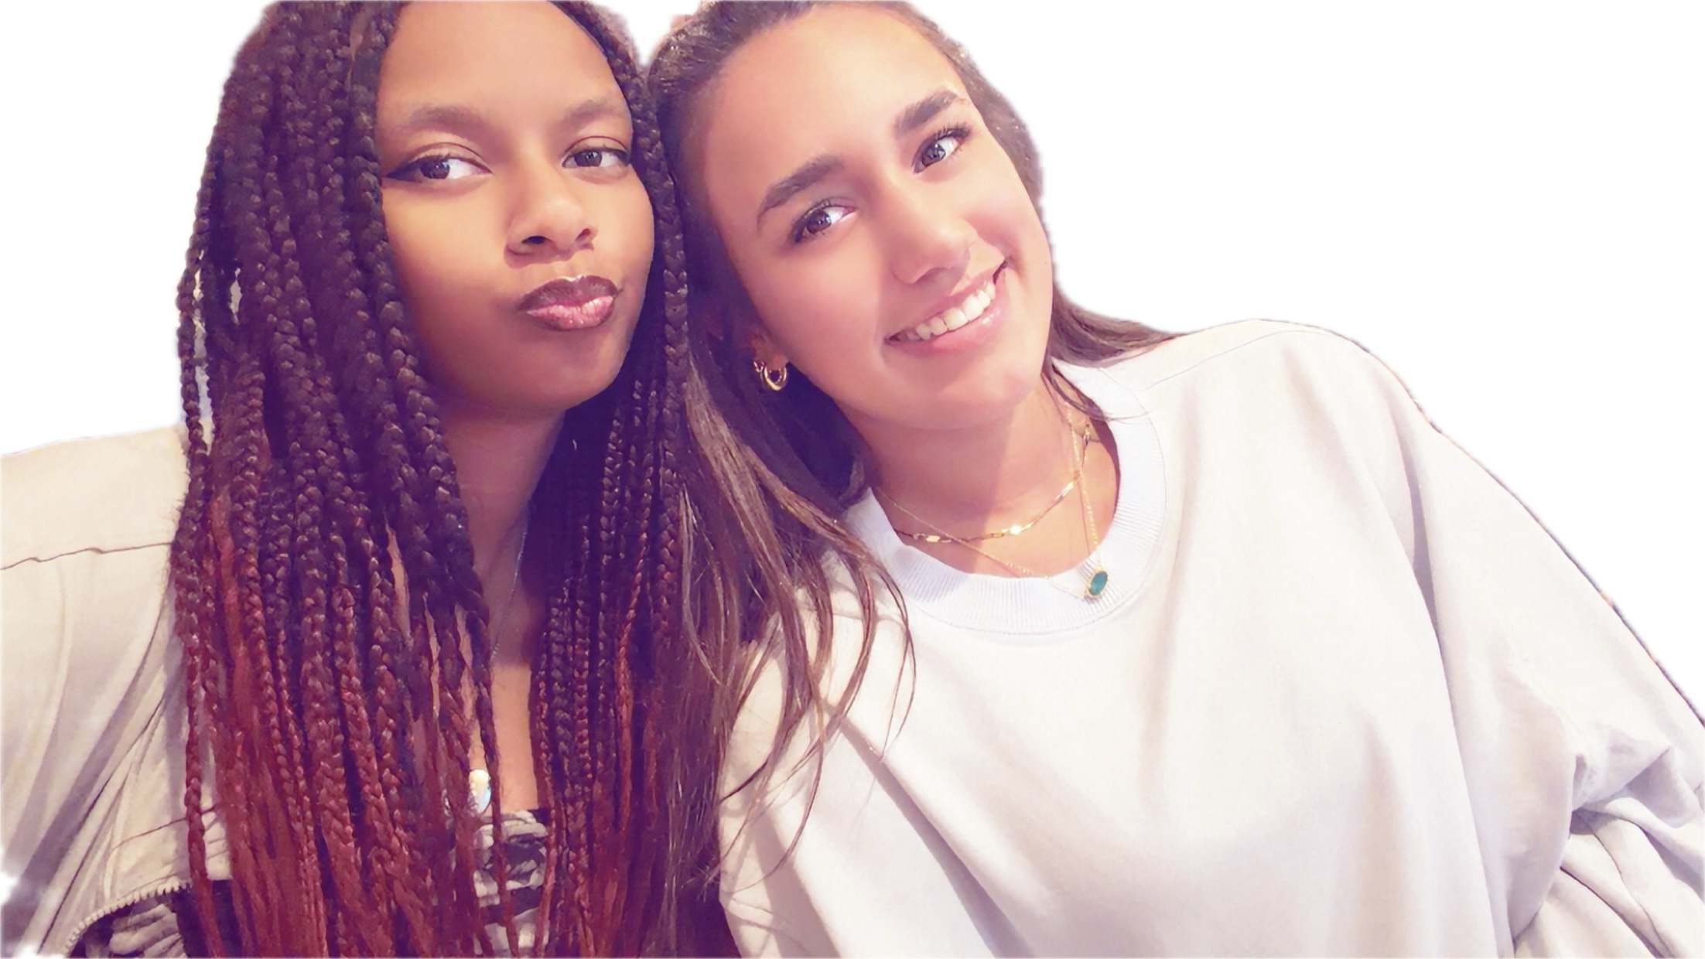
What do grandfathers do?
Emery Reed, 17
Sofia Hemmick, 13
Show photos of the grandkids!

Slide 4
Yeonju Go
High energy nuclear physics; studying Quantum Chromodynamics at extreme conditions using high energy heavy ion collisions
Ph.D. in Korea University; CMS at LHC, CERN
Postdoc at University of Colorado Boulder; ATLAS at LHC & sPHENIX at RHIC, BNL
Goldhaber Fellow at Brookhaven National Laboratory; sPHENIX at RHIC,
AI in Physics
Joined Stony Brook two weeks ago!

Slide 5
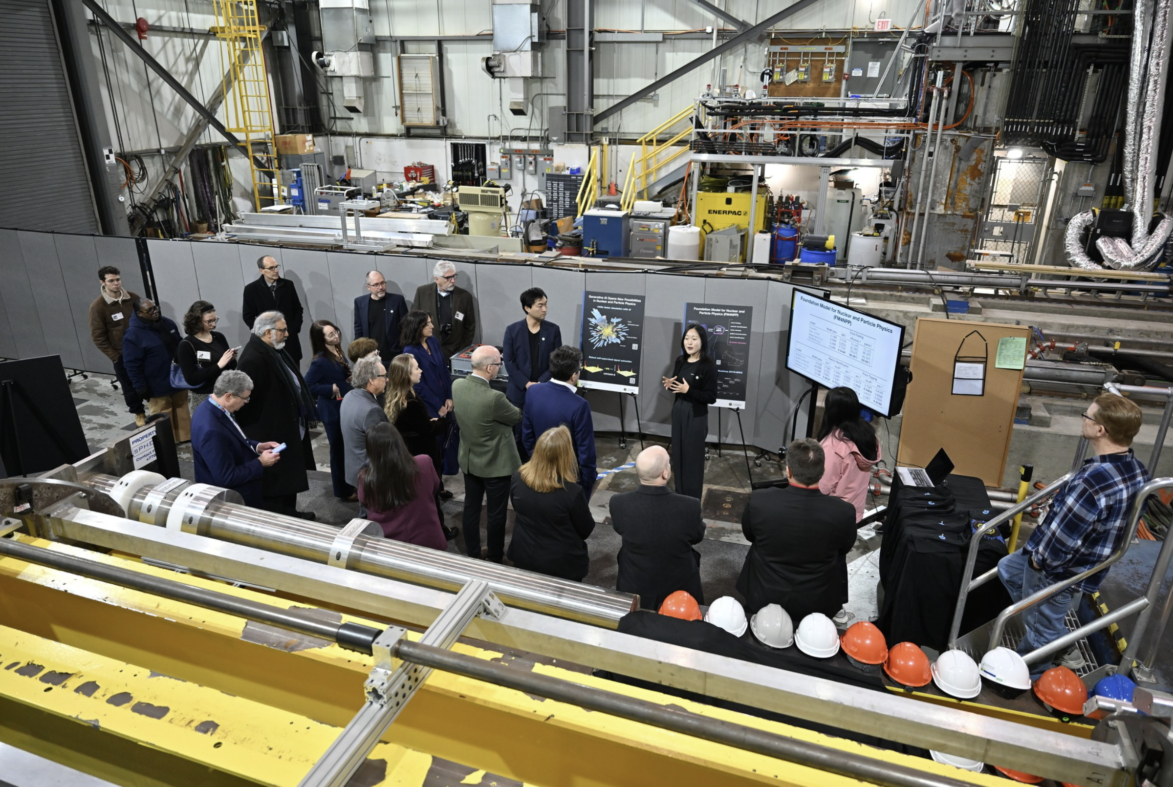



FM4NPP: Foundation Model for Nuclear and Particle Physics
FM4NPP drew strong interest from Darío Gil, with high praise for its impact and scaling behavior
Strong alignment with the DOE Genesis Mission
SBU President
Andrea Goldsmith
DoE Under Secretary for Science
Darío Gil
2026 Feb. 7th

Slide 6
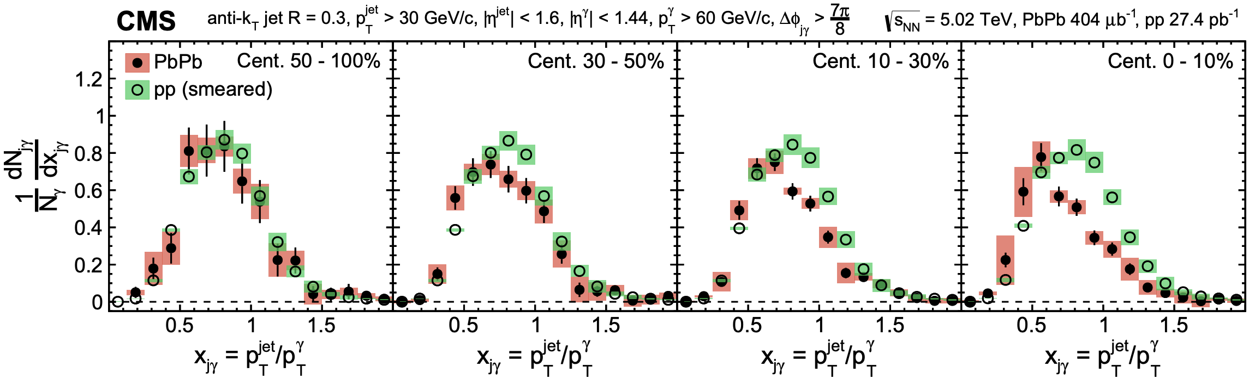



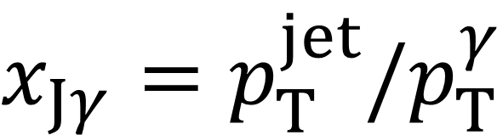
Estimate Jet Energy Loss using Photon-jet
Photons do NOT strongly interact with QGP
  access to the initial energy of jet
Y. Go, CMS PLB 785 (2018) 14
PbPb
pp
$$γ$$
$$x_{Jγ}=p_{T}^{jet}/p_{T}^{γ}$$
Parton (Jet) energy loss found w.r.t photon reference!
Jet

Slide 7
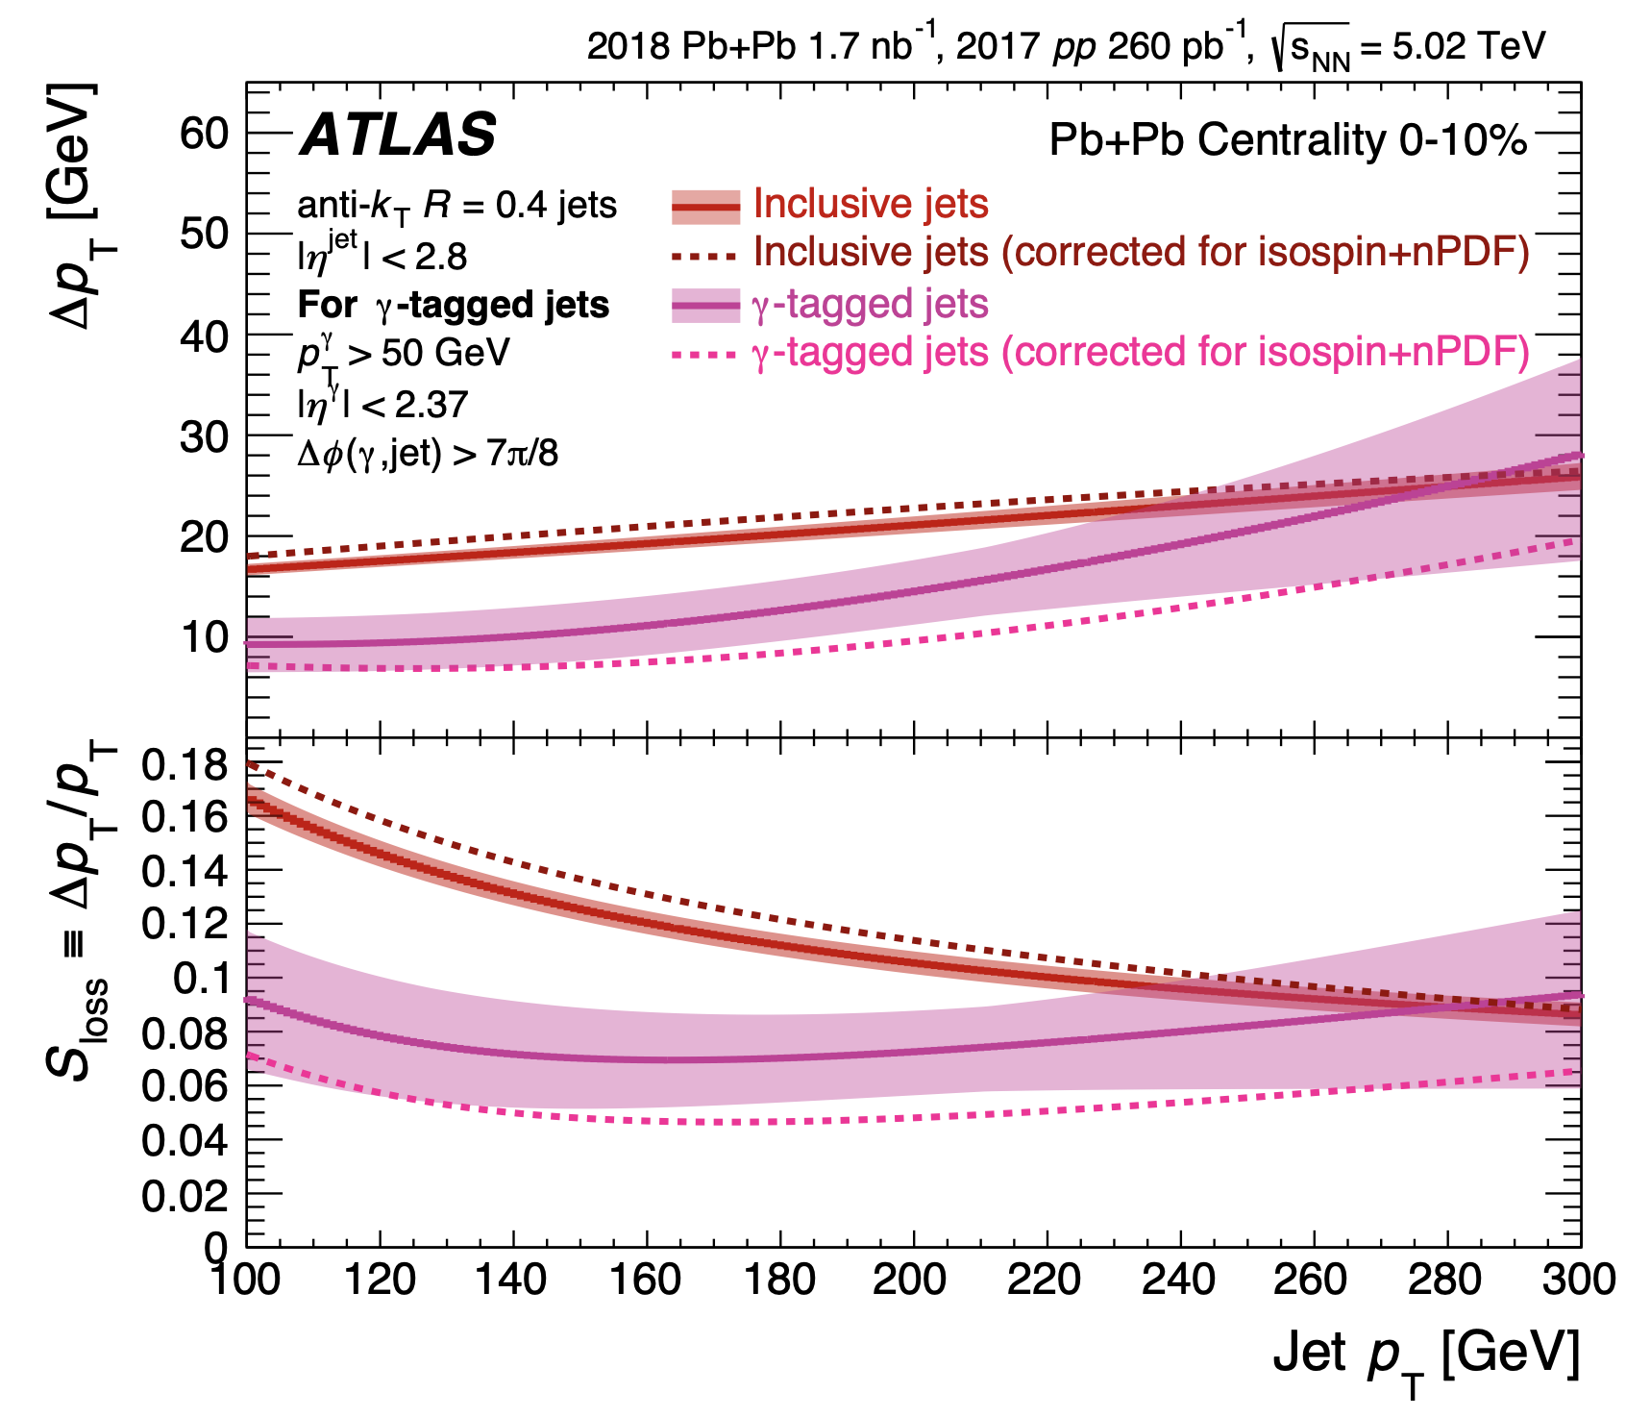

Quark vs Gluon Energy Loss in QGP
Y. Go, ATLAS PLB 846 (2023) 138154
quarks and gluons
energy loss
parton-to-QGP interaction → jet energy loss
$ΔE_{gluon}$ $>$ $ΔE_{quark}$
?
Inclusive jets (gluon dominant)
Gluons lose more energy than quarks?
fractional energy loss
  First experimental evidence that quarks lose less energy
  than gluons in QGP !
Photon-tagged jets (quark dominant)

Slide 8
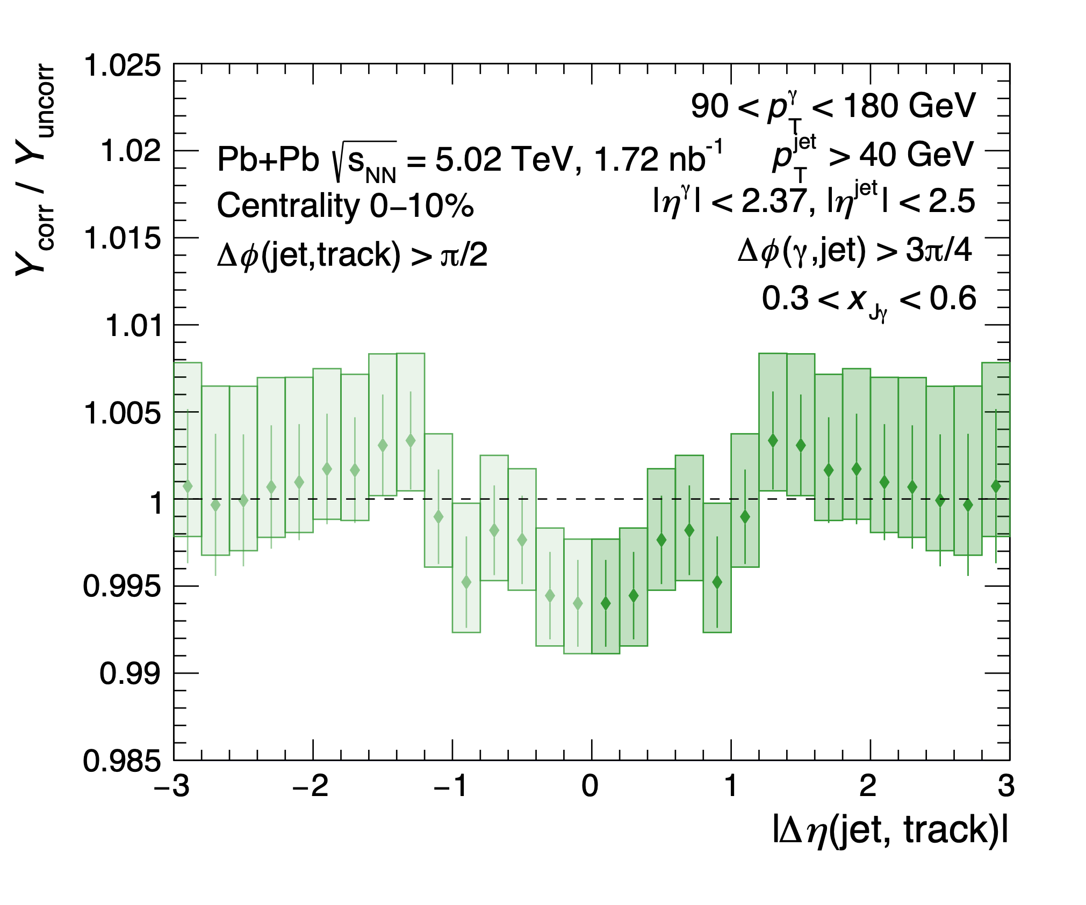
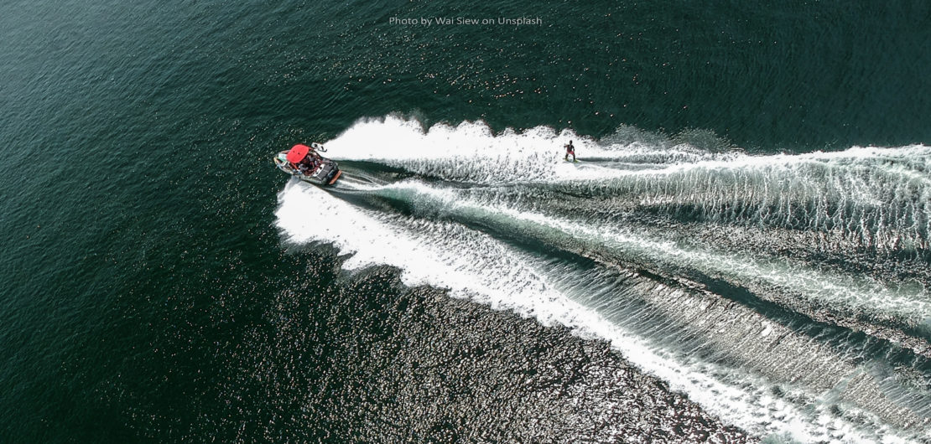



Diffusion Wake induced by Jets
Y. Go, ATLAS PRC 111 (2025) 044909
Water (QGP)
Boat (jet)
Enhancement (wake)
Relative Medium Modification
Depletion
(diffusion wake)
reflected points
First direct experimental measurement of diffusion wake
The dip indicates diffusion wake

Slide 9
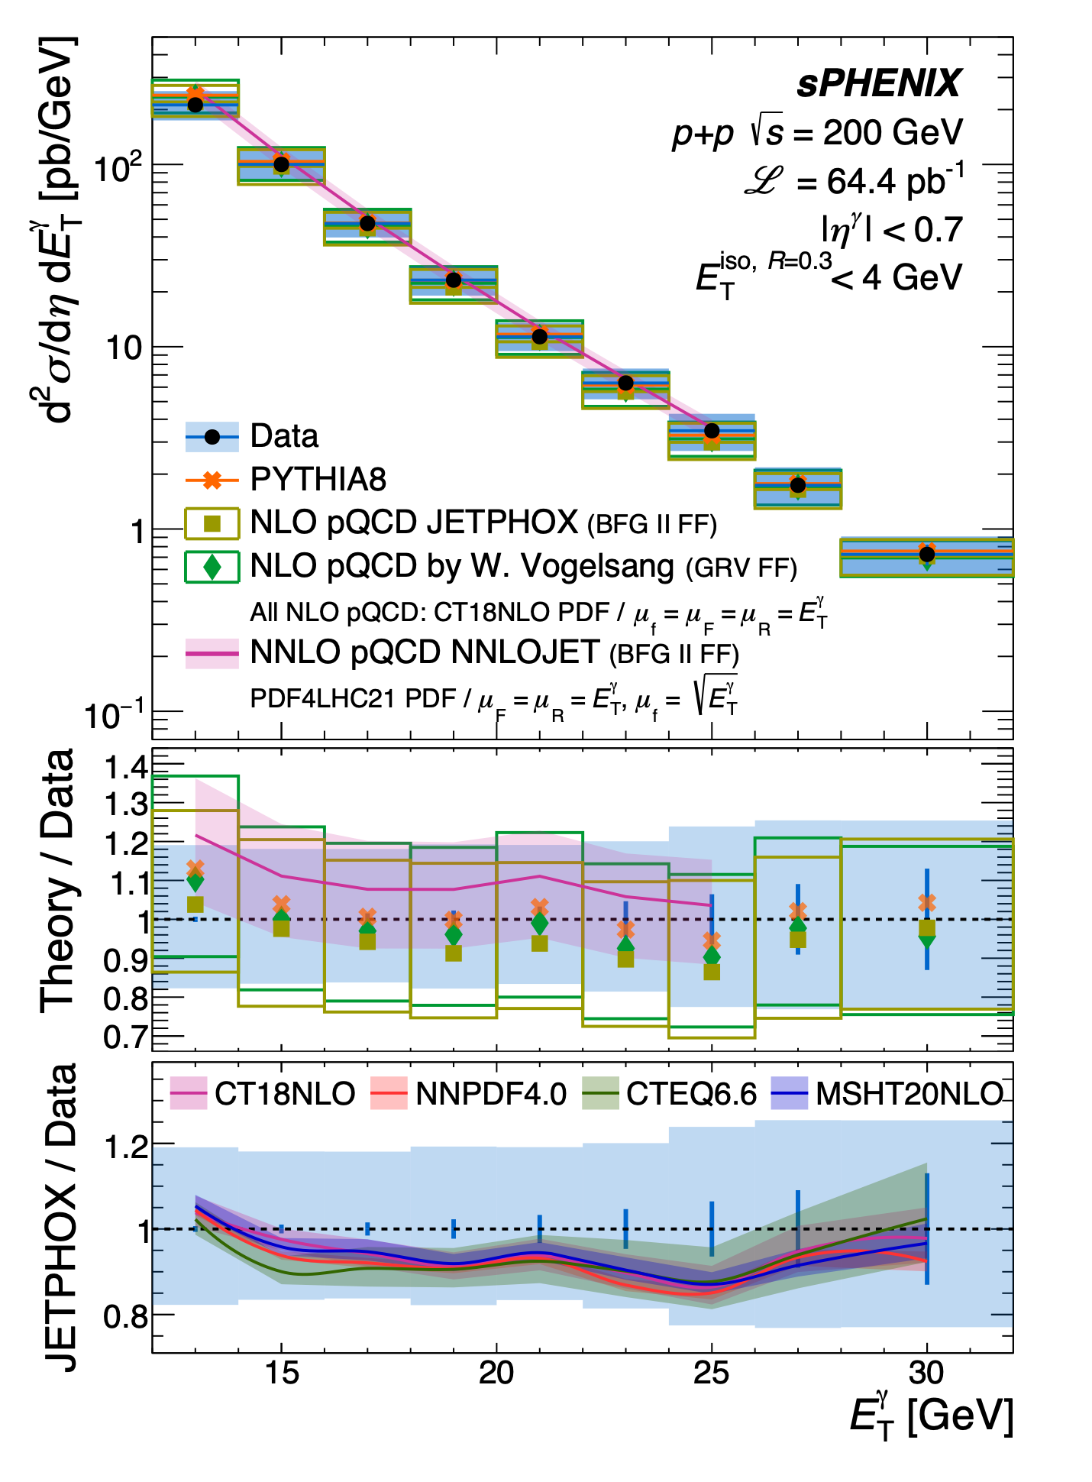

Isolated Prompt Photons in p+p collisions
arXiv:2607.03892
$$γ$$
sPH-JET-2026-02
One of the very first sPHENIX measurements !
Isolated prompt photons in p+p test pQCD calculations and provide sensitivity to the gluon PDF
Establish photon reconstruction in sPHENIX and pp reference for future measurements in heavy ion collisions

Slide 10
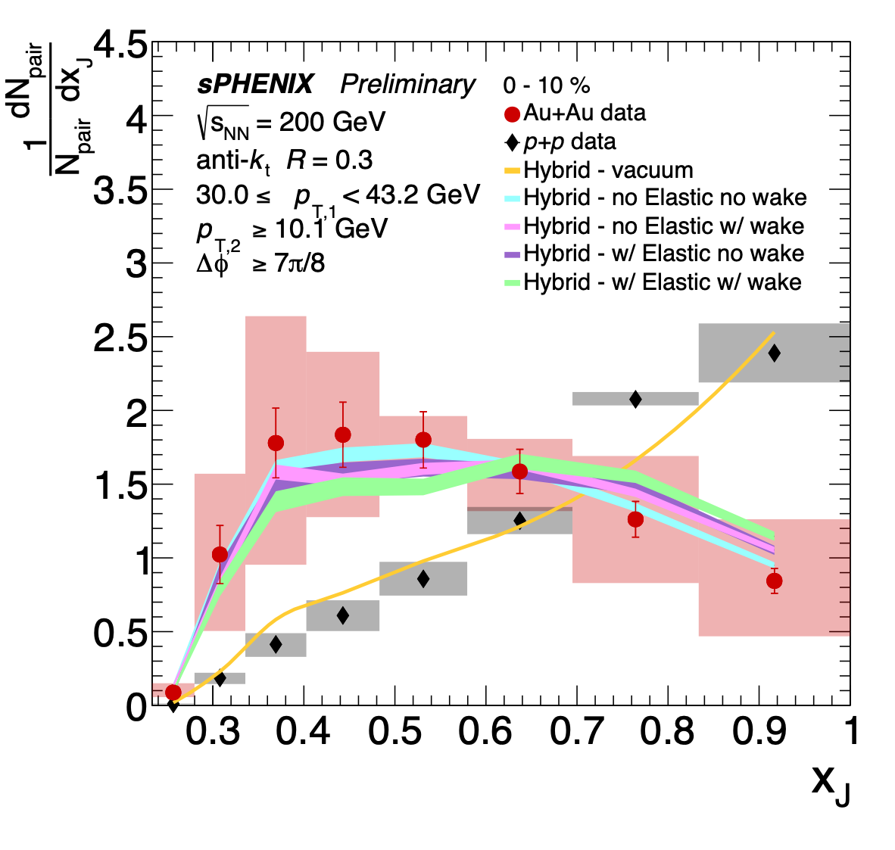
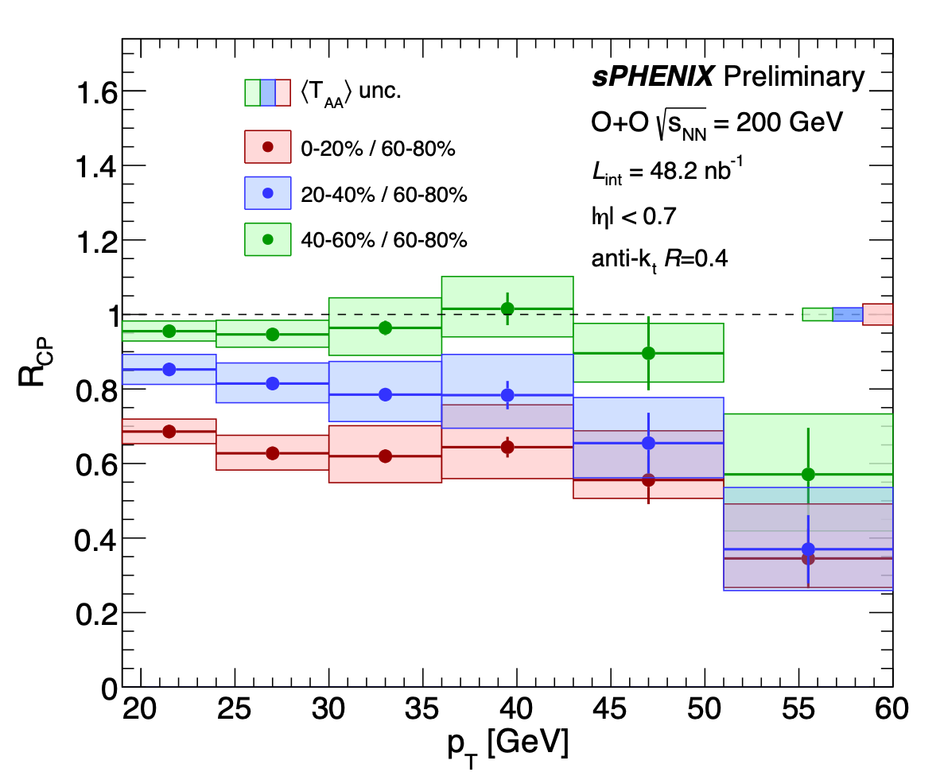
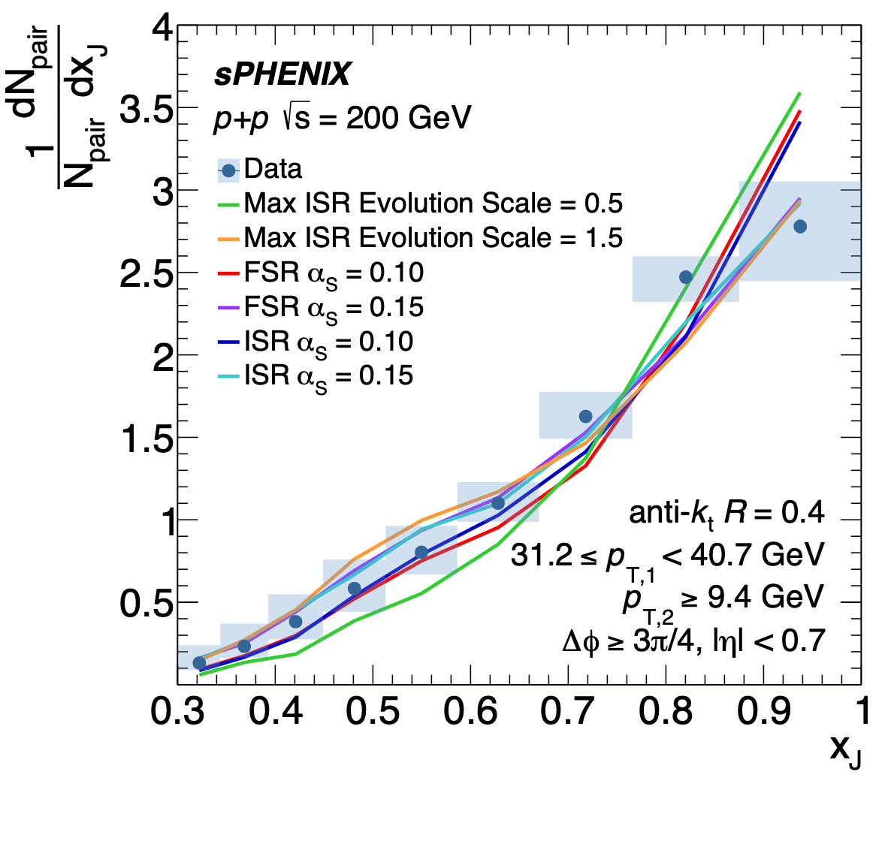
Jets in sPHENIX
Serving as Jet Topical Group co-convener at sPHENIX since Aug. 2025
coordinating various jet and photon measurements in pp, O+O, Au+Au collisions
p+p
Au+Au
O+O

Slide 11
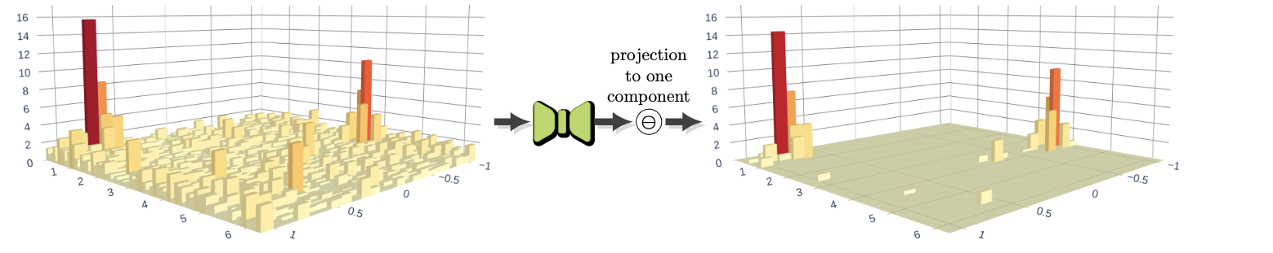




Jet Background Subtraction using UVCGAN-S
Translate jet+background calorimeter image to jet signal-only calorimeter image
Energy [GeV]
$$φ$$
$$η$$
$$φ$$
$$η$$
UVCGAN-S
  preserves the full dimensional information
  can use experimental data (w/o label) for training; mitigate physics modeling-dependence
Significant improvement in performance
  x2 better momentum resolution
  ~ 40% improvement in position resolution
  efficiency 74% → 92%, fake rate 80% → 6%
Unsupervised learning, unpaired image-to-image translation
arXiv:2510.23717
accepted by Nature Scientific Reports

Slide 12
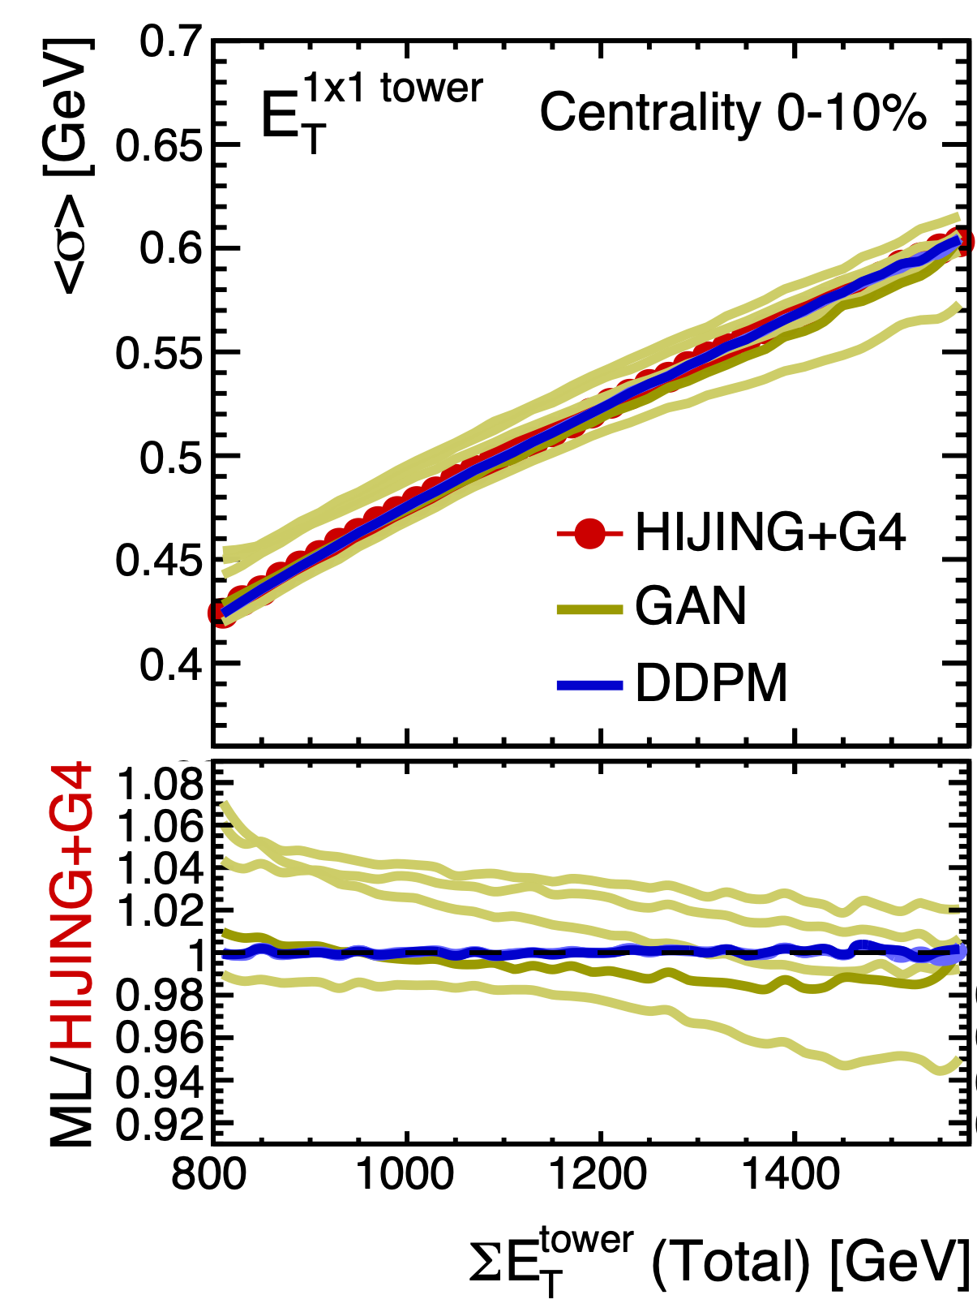
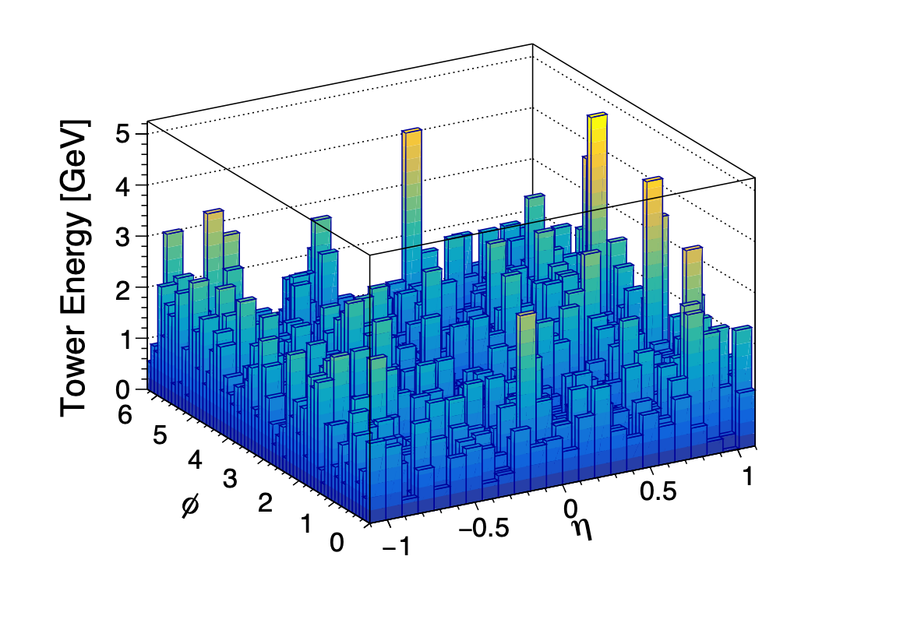
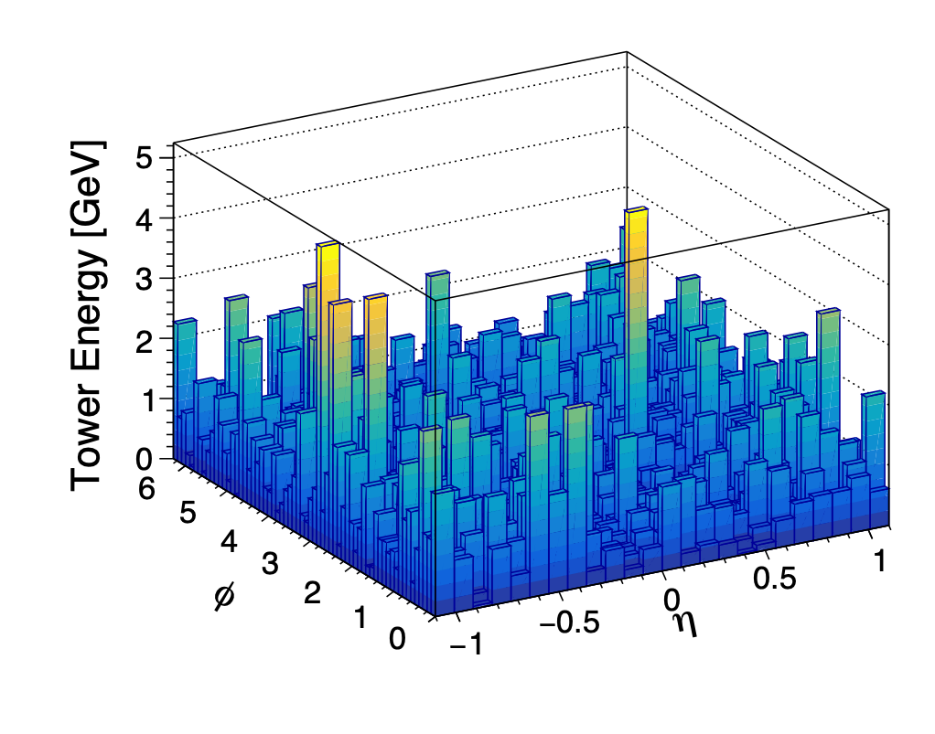

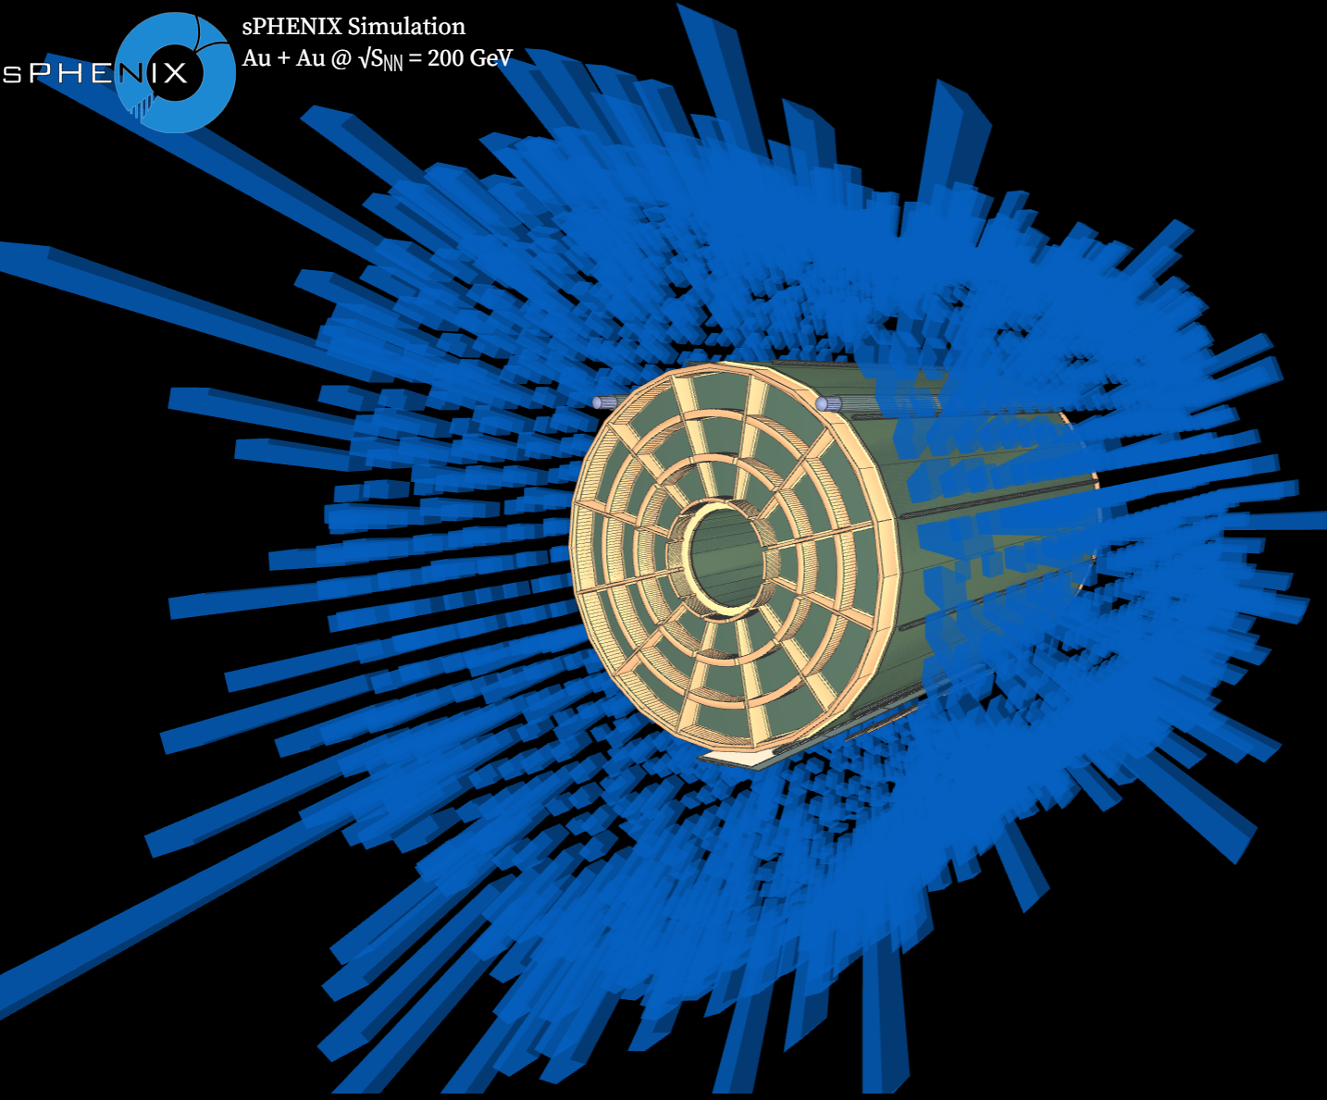
Fast Simulation: Full Calorimeter Detector
Generate high fidelity “particle production + full detector simulation” data in central heavy ion collisions using
Denoising Diffusion Probabilistic Model (DDPM)
PRC 110 (2024) 034912
Training sample
(HIJING+GEANT4)
Generated (DDPM)
0-10% central event display
40 minutes per event
1.34 seconds per event
on CPU
on GPU
DDPM provide a speedup of 1800 times! (on GPU)
  at least 100 times faster, considering a 32-core CPU equivalent to a GPU
Great stability and accuracy of DDPM within sub-percent level

Slide 13
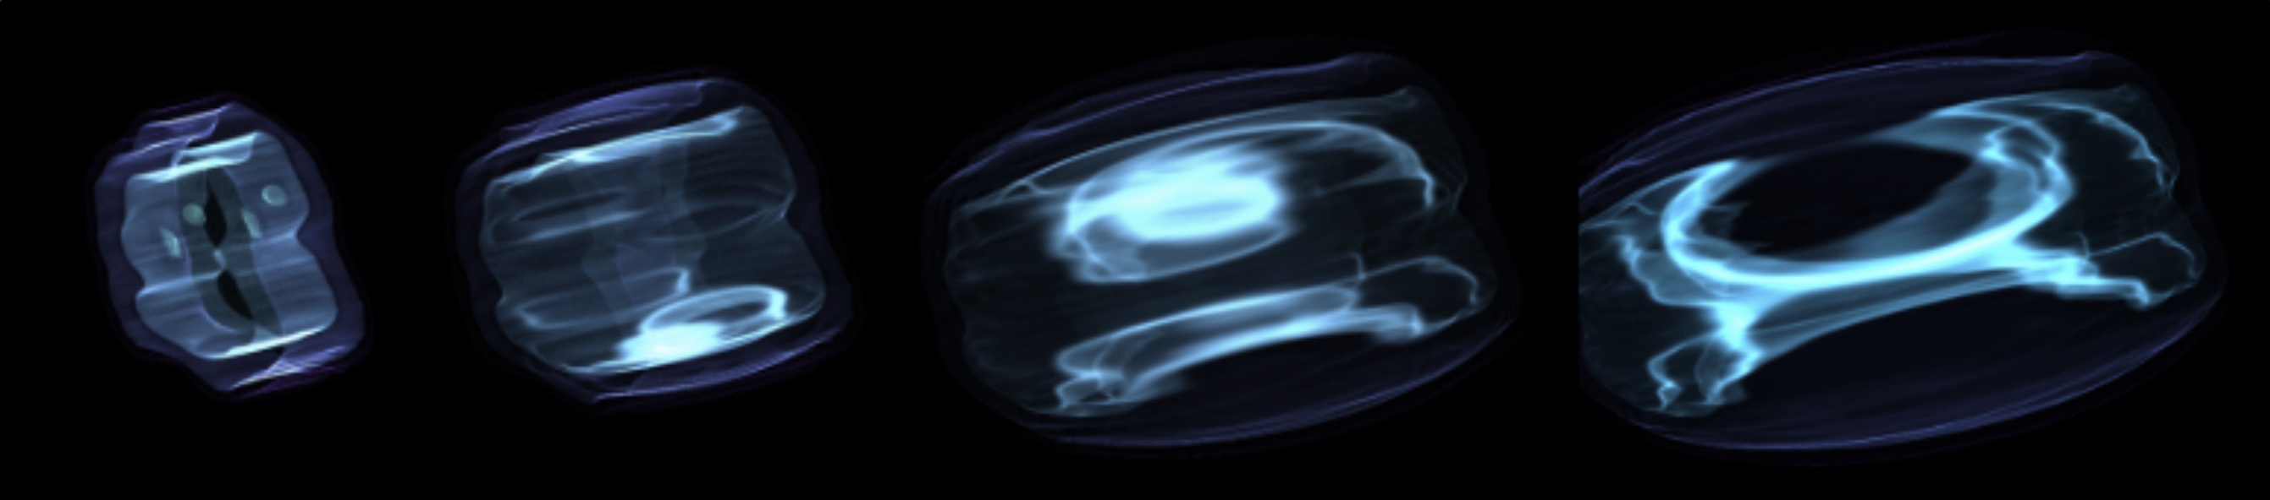
Fast Simulation: Hydrodynamic Evolution
Full spatiotemporal hydrodynamic medium (Quark Gluon Plasma) evolution simulations are computationally very demanding
QGP 3+1D Energy Density Evolution
time
Fourier Neural Operator (FNO)-based model developed: TC-QGP to predict the full time evolution of 3D QGP fields from the initial time 3D fields.
  O(100,000) speedup with a few percent accuracy
 | 2+1D | 3+1D
Simulation time per event with 1 CPU | ~10 minutes | ~20 hours
TC-QGP | 0.03 seconds | 0.2 seconds

Slide 14
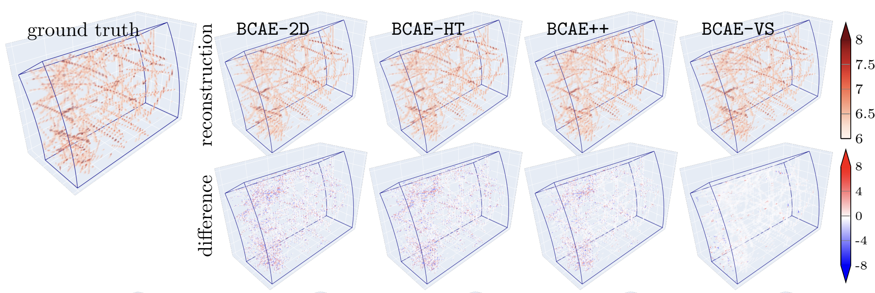
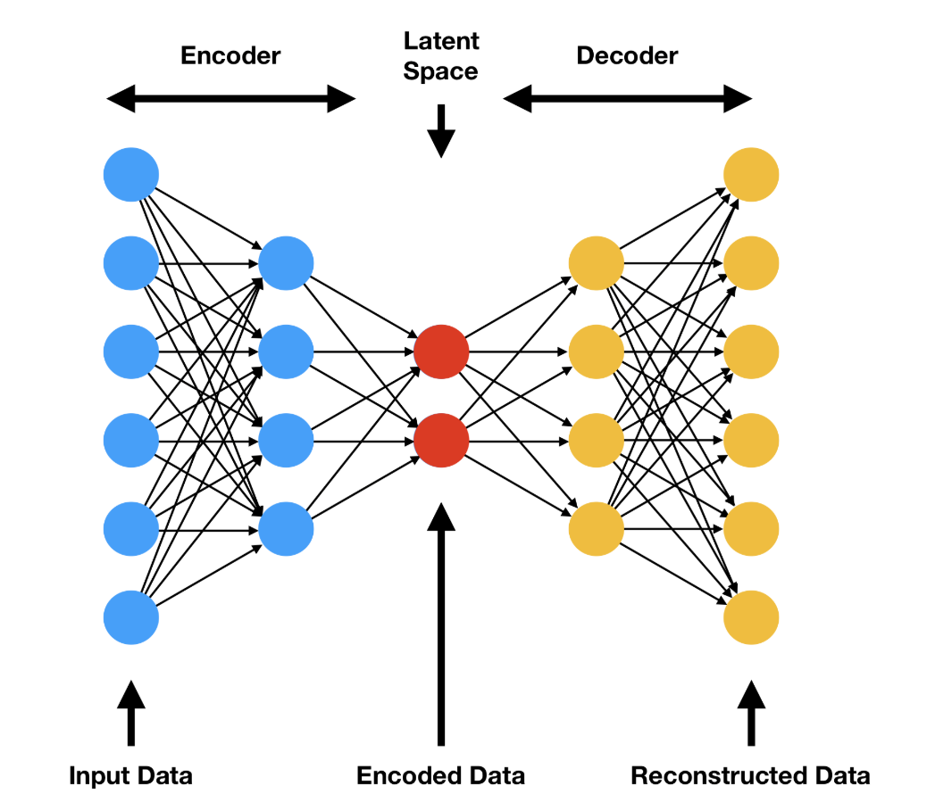
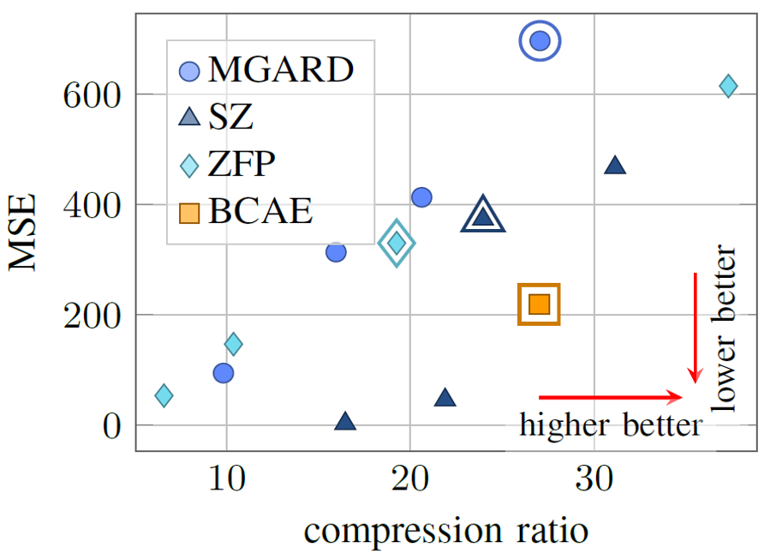




Data Distillation / Compression
Data Compression
  Record compact encoded data during data taking, store them permanently, and decode them offline for reconstruction
BCAE (Bicephalous Convolutional Autoencoder) model
Reconstructed value
Patterns, 2026, 101452
arXiv:2411.11942
Encoder
Decoder
Reconstruction - Truth
BCAE
Encoded data
- BCAE outperforms other
off-the-shelf lossy compression algorithms
- Great prospect for Electron-Ion Collider
Input data
Output data

Slide 15

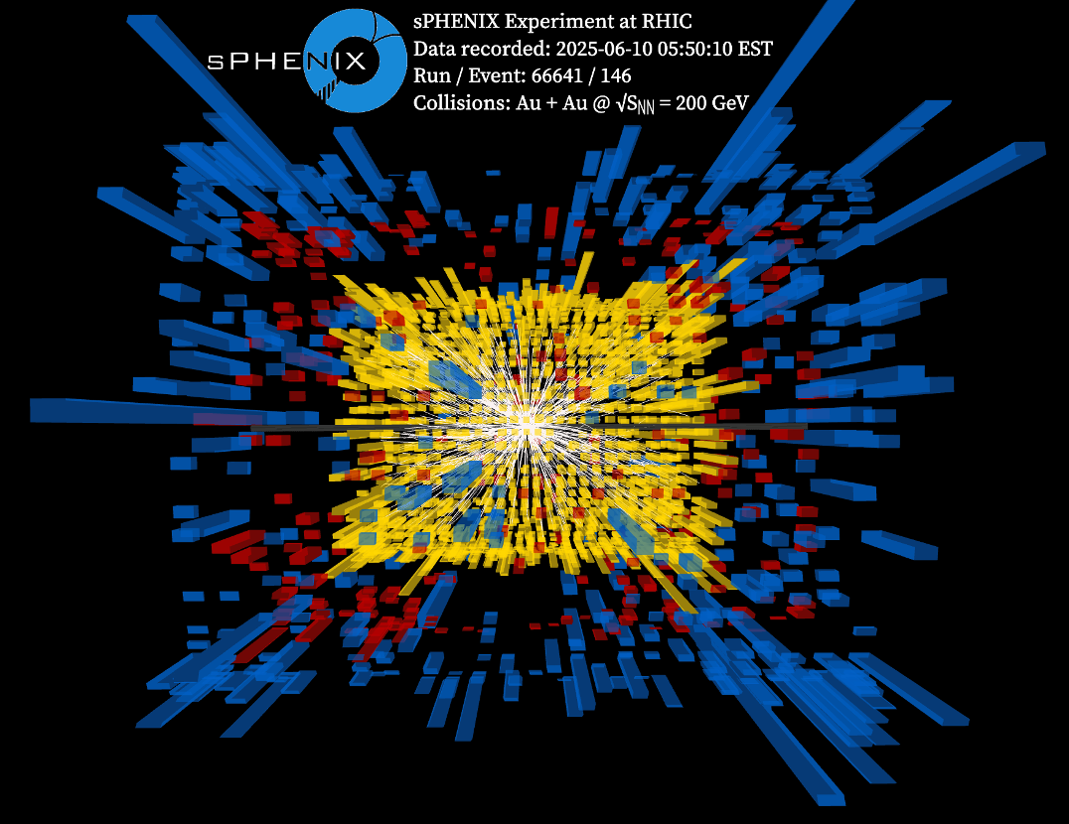

Foundation Model for Nuclear and Particle Physics
Foundation models learn broad features and patterns from massive datasets (pre-train)
Foundation Model for Nuclear and Particle Physics (FM4NPP): a self-supervised learning with inputs on unlabeled sparse detector-level data
  low-level spacepoint (E, x, y, z) in time projection chamber
Various Downstream Tasks
track finding
particle identification
noise removal
global reconstruction
jet tagging
event classification
anomaly detection
.
.
.
AI-driven discovery
lightweight Adapter for multiple downstream tasks
minimal
training
Pre-training

Slide 16

Mariia Mitrankova

Slide 17
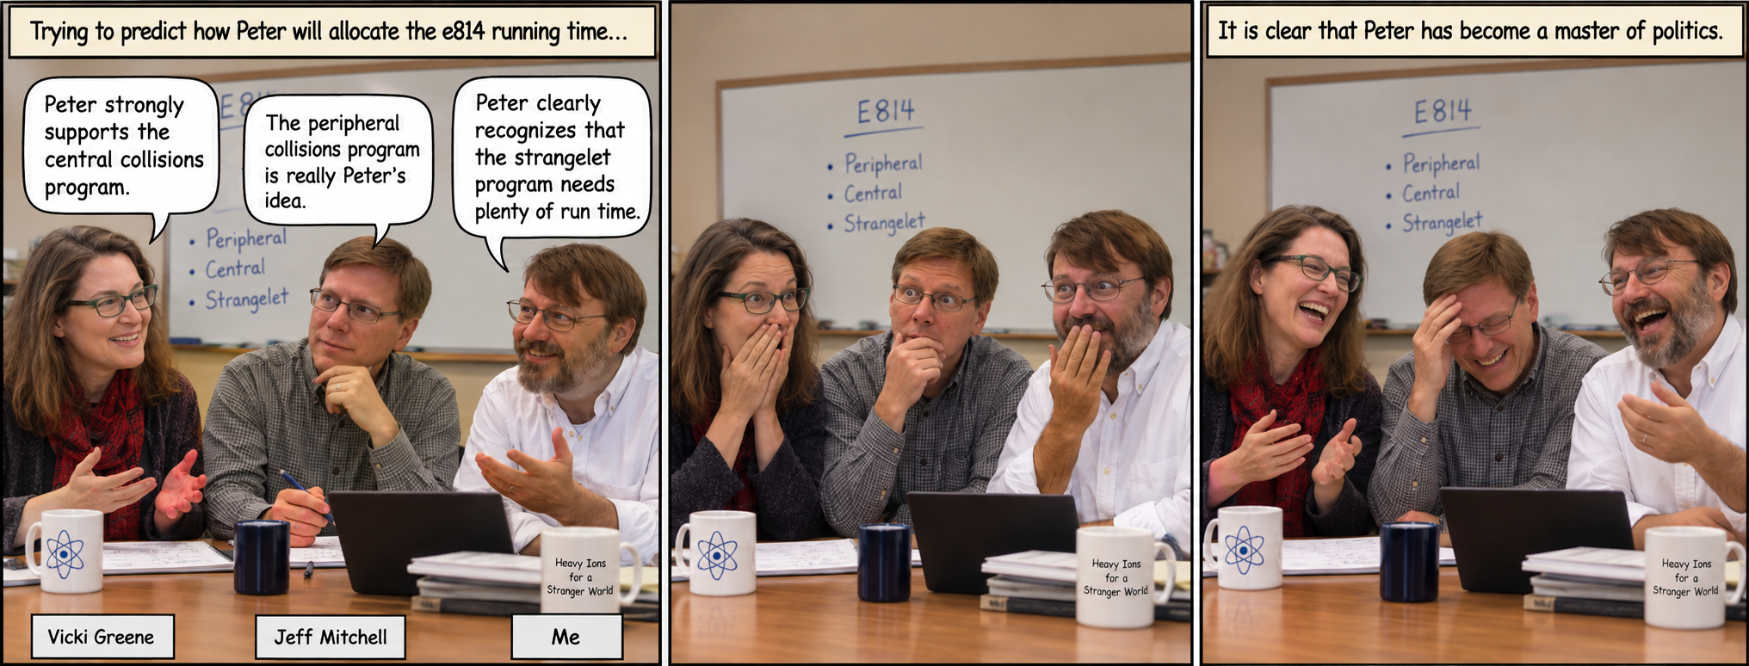
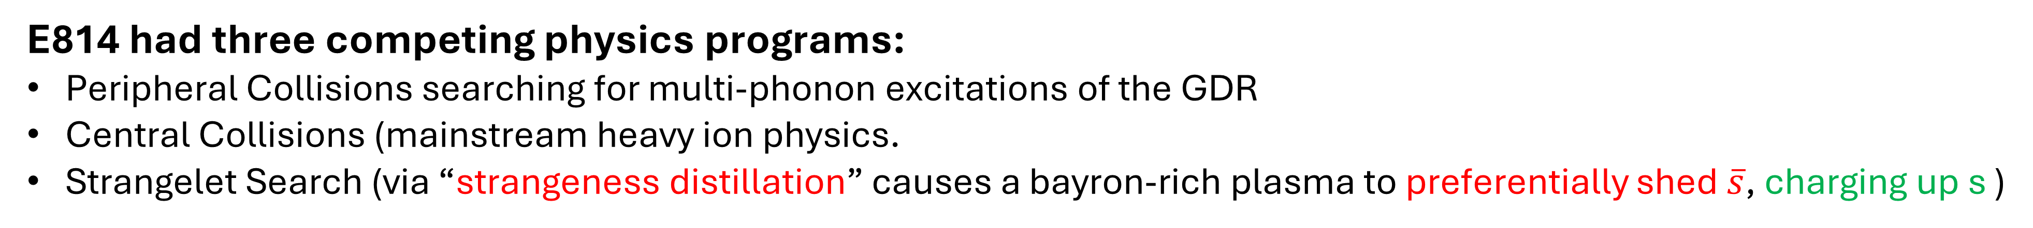
How do you allocate a two-week run?
E814 had three competing physics programs:
Peripheral Collisions searching for multi-phonon excitations of the GDR
Central Collisions (mainstream heavy ion physics.
Strangelet Search (via “strangeness distillation” causes a bayron-rich plasma to preferentially shed $\overline{s}$, charging up s )

Slide 18
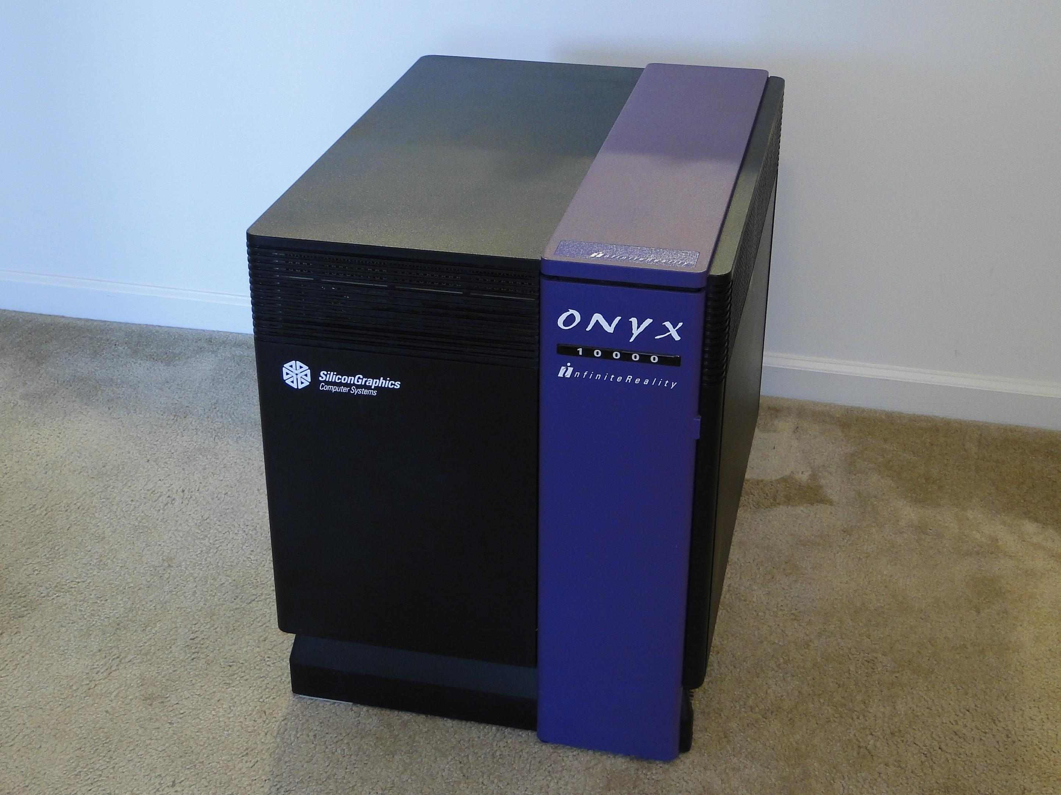
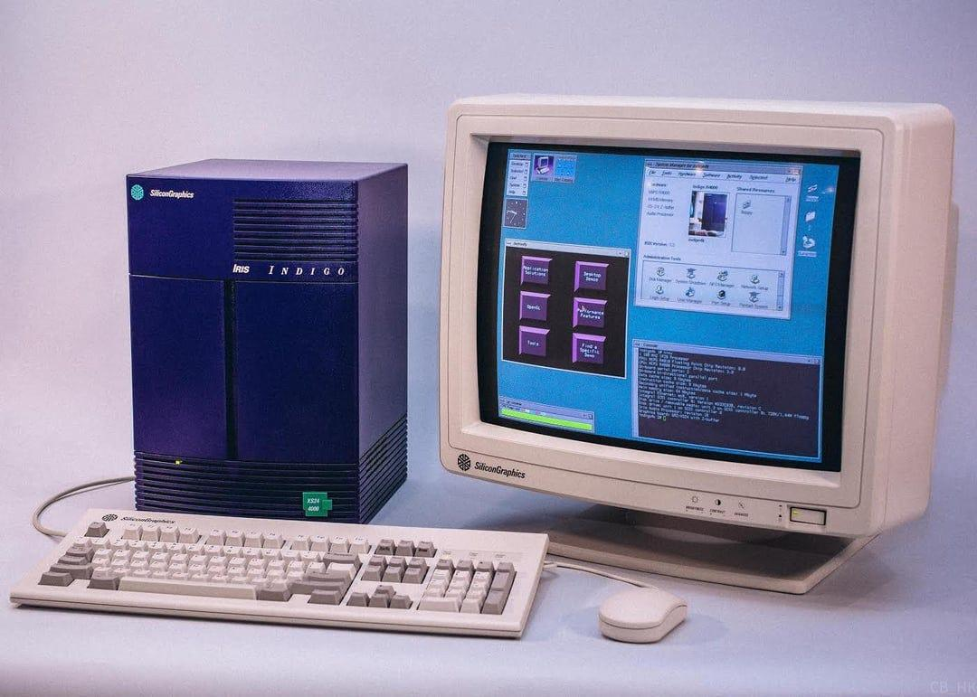

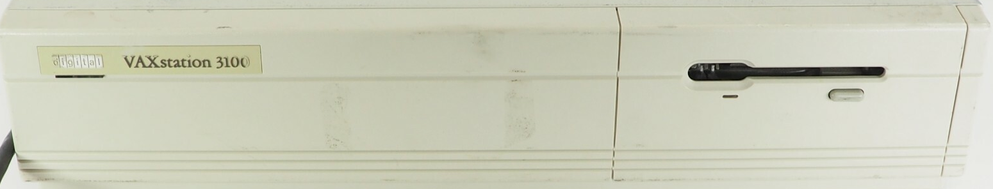
What Shall we Name our Unix Computers?
Skipper (mainframe)
Gilligan (workstation)
Skipper
Gilligan
SB814A
If you read the slides from Dariusz, you saw that Peter later accepted the names.
SB814B
SB814C
SB814D

Slide 19
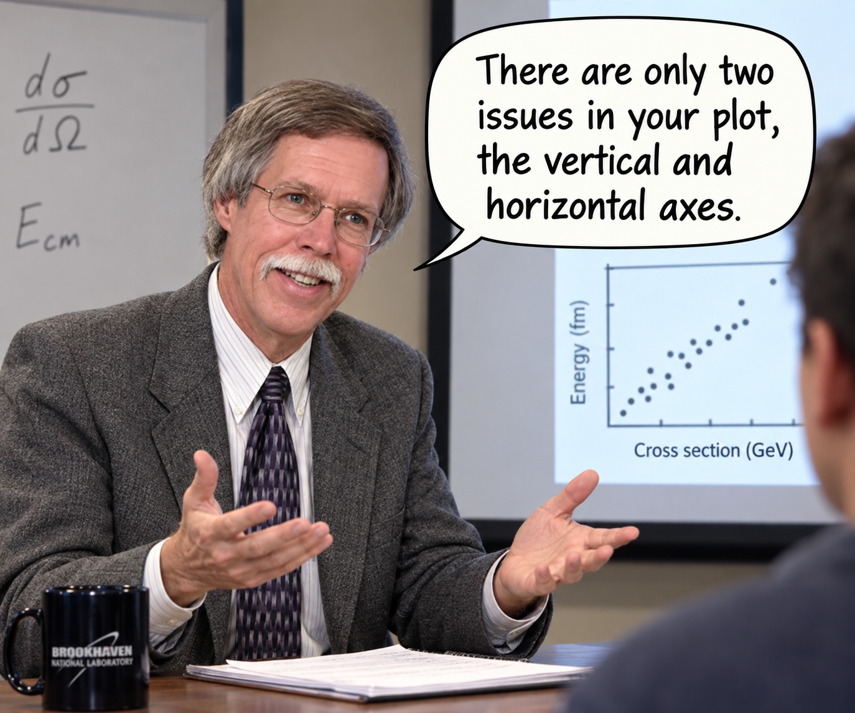
PBM and the Two-week Long Thesis Defense

Slide 20


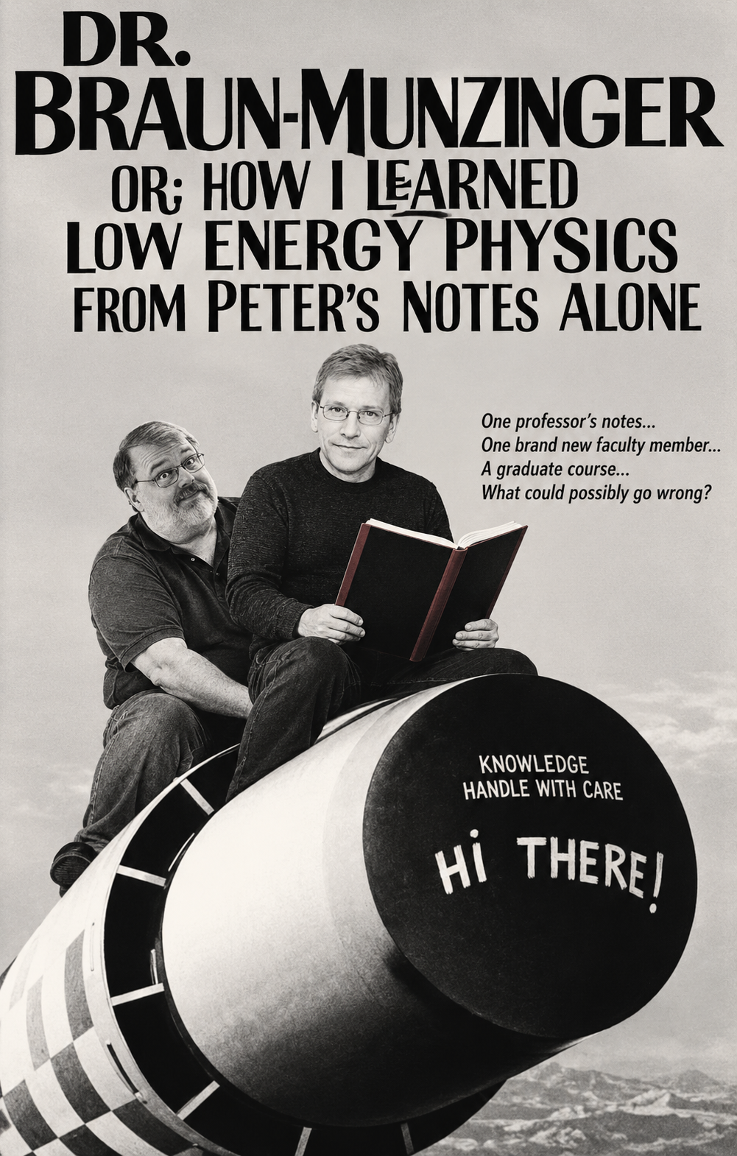
Peter’s Notes and my First Class Ever!

Slide 21
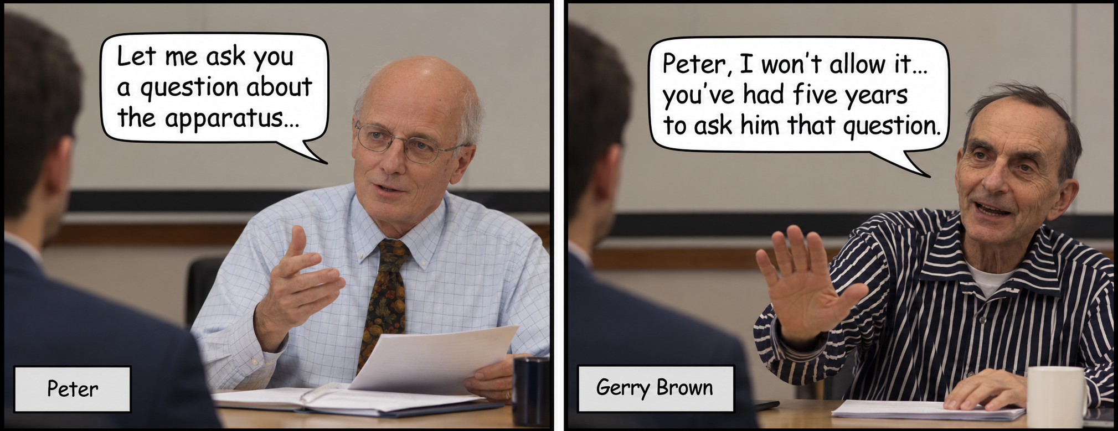
Peter vs. the Irrepressible Gerry Brown

Slide 22
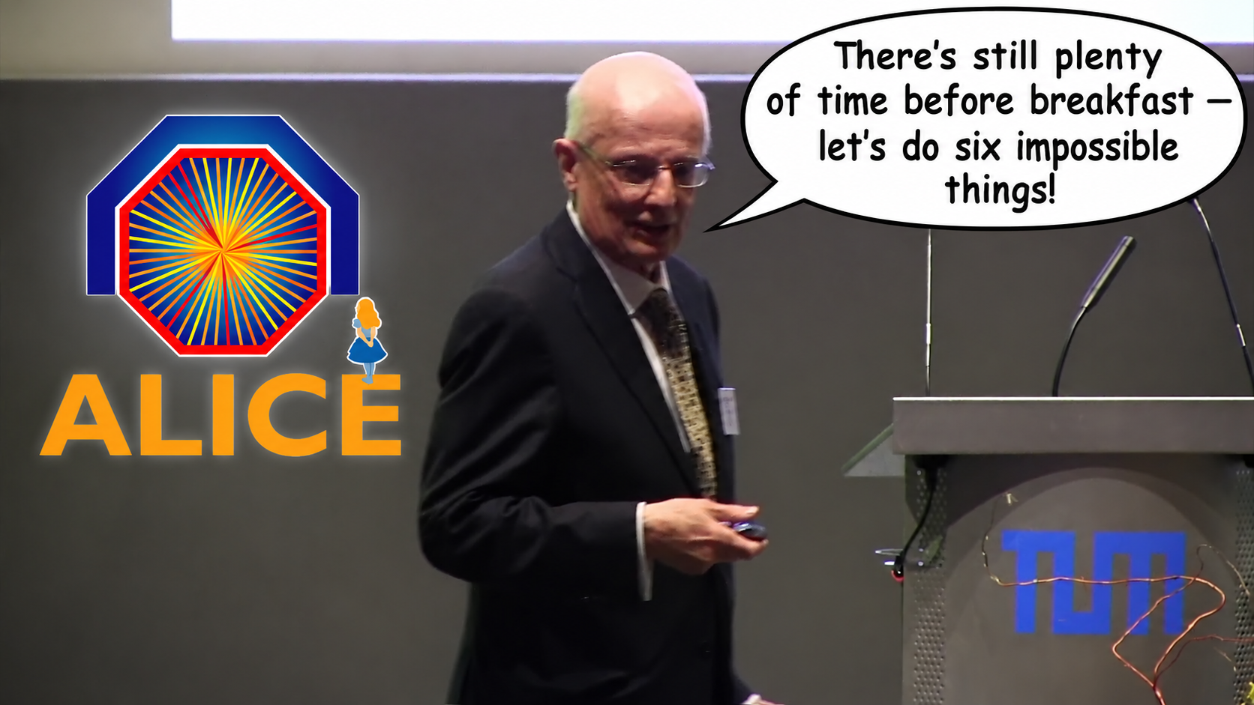
To Dream and Do Impossible Things
Kai Schweda:
Power of persuasion
Making us do things we would never do voluntarily — and making us enjoy it
Scientific compass
Always pushing us towards questions that matter
PBM (to Bill Llope on WHAT to analyze):
“…otherwise, you’re just measuring Brooklyn phone numbers!”

Slide 23
