Slide 1
Alarm System GUI
Sven Düfer

Slide 2
agenda
requests
system coverage
example
outlook

Slide 3
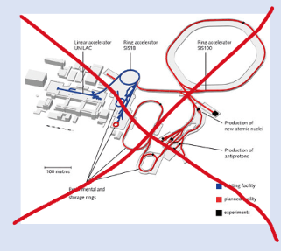

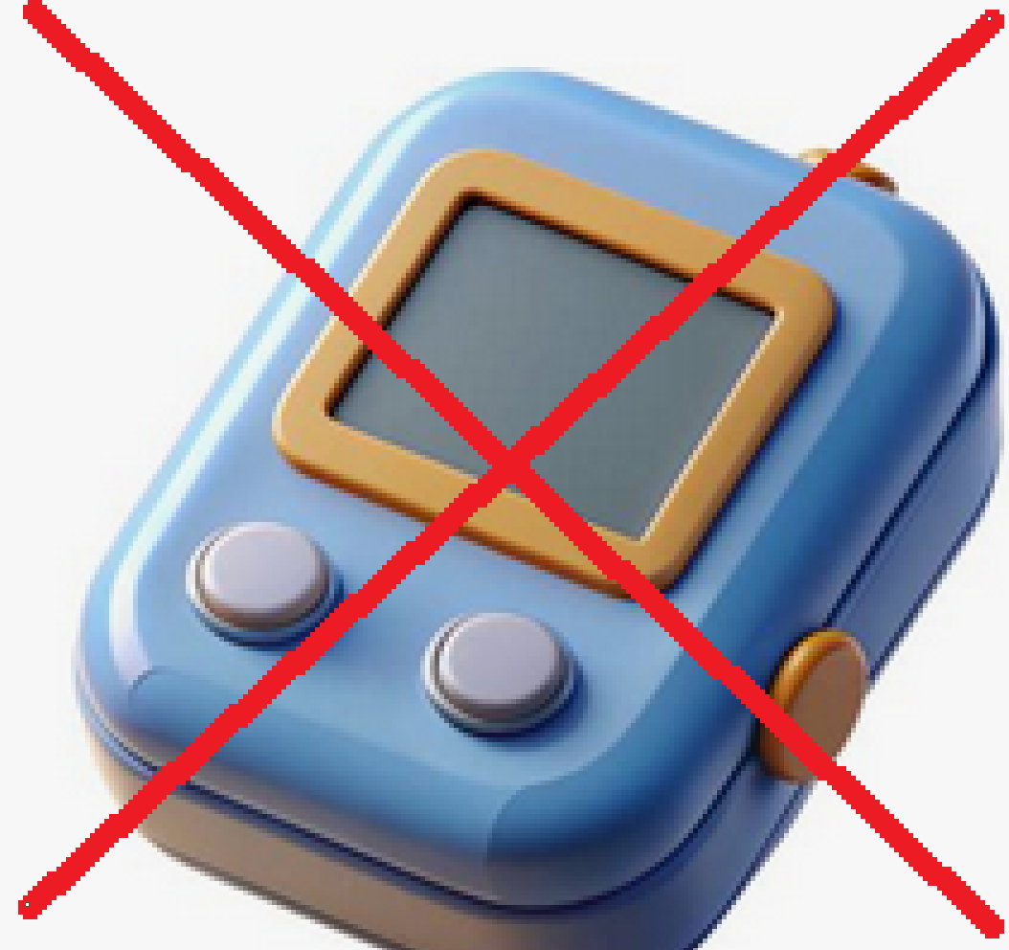



requests
- no threat map
- no automatic on-call alerts / pager triggers
- acknowledge alarm
- mute/ unmute button
- searching/ filtering (device, level, time)
- logging alerts for preventive maintenance

Slide 4
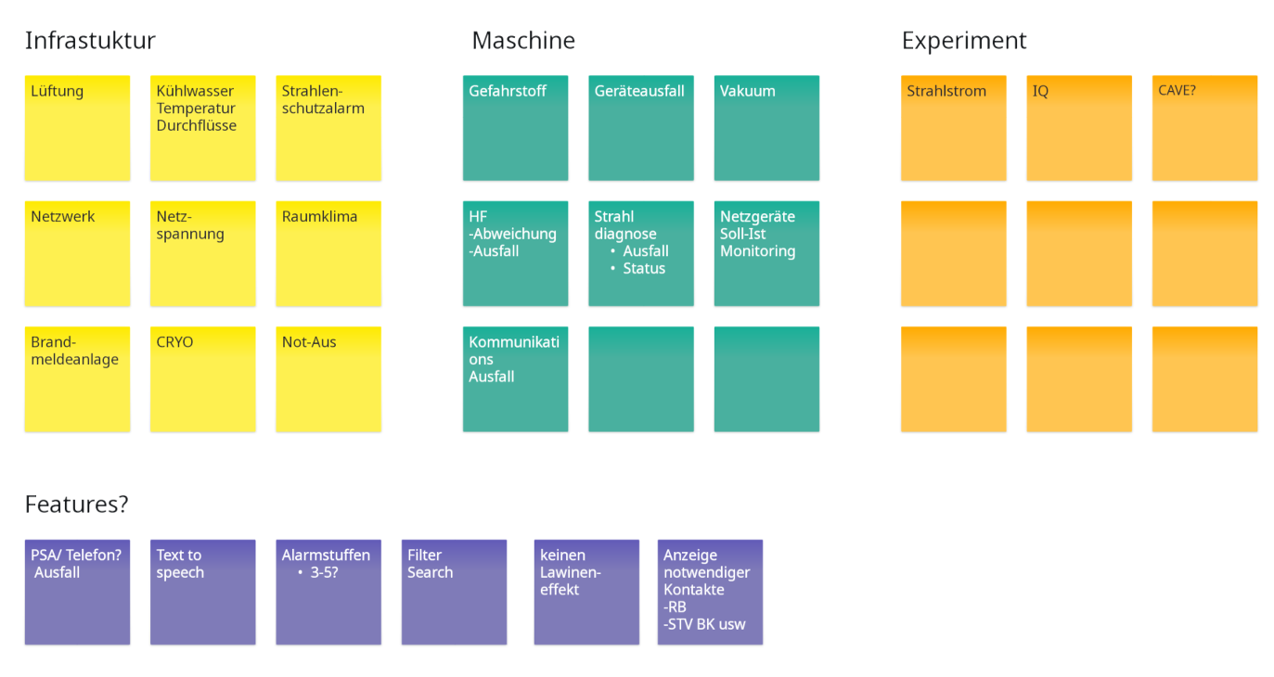
system coverage
Which services & features should the system cover?

Slide 5
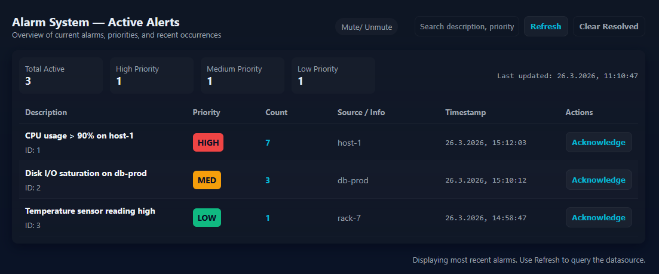
example

Slide 6
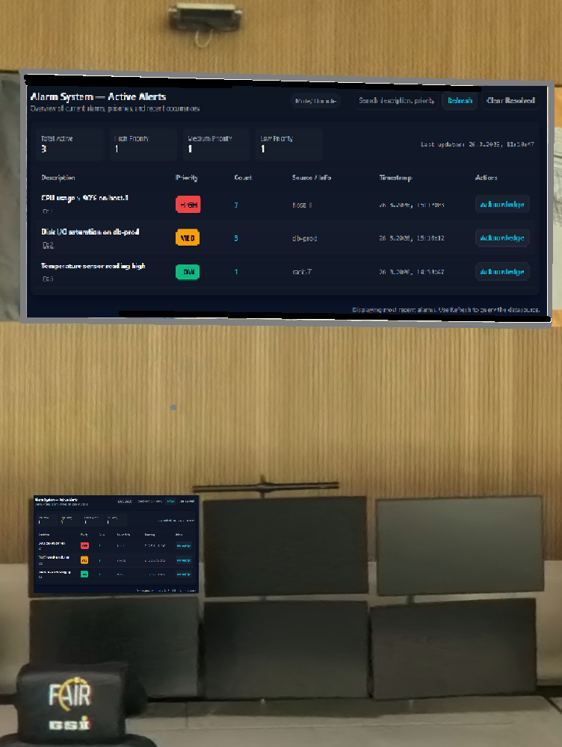
outlook
- upcoming meeting with ACO
- prototyping
- testing

