Slide 1
Testing Quantum Electrodynamics at critical background electromagnetic fields
Antonino Di Piazza
International Conference on Science and Technology for FAIR in Europe 2014
Worms, October 15th, 2014
TexPoint fonts used in EMF.
Read the TexPoint manual before you delete this box.:

Slide 2
Outline
Introduction to the electromagnetic interaction
Strong-field Quantum Electrodynamics (QED) in strong atomic and laser fields
Electron-positron photoproduction in combined atomic and laser fields
Conclusions
For more information on strong-field QED see the review:
A. Di Piazza et al., Extremely high-intensity laser interactions with fundamental quantum systems, Rev. Mod. Phys. 84, 1177 (2012)

Slide 3
Electromagnetic interaction
The electromagnetic interaction is one of the four “fundamental” interactions in Nature. It is the interaction among electric charged particles (e.g., electrons and positrons) and it is mediated by the electromagnetic ¯eld (photons, in the “quantum” language)
The relativistic quantum theory describing this interaction is known as Quantum Electrodynamics (QED) and the Lagrangian/Hamiltonian of QED depends on two parameters:
Electron mass m=9.1£10^{{28} g
Electron charge e, with jej=4.8£10^{{10} esu
The typical scales of QED are determined by the parameters m and e, and by the two fundamental constants: the speed of light c and the (reduced) Planck constant }

Slide 4
Typical scales of QED
Strength: ®=e²/}c=7.3£10^{{3} (Fine-structure constant) | Energy: mc²=0.511 MeV (Electron rest energy)
Length: ¸_{C}=}/mc=3.9£10^{{11} cm (Compton wavelength) | Electromagnetic field: E_{cr}=m²c³/}jej=1.3£10¹⁶ V/cm B_{cr}=m²c³/}jej=4.4£10¹³ G (Critical fields of QED)
QED in vacuum is the most successful physical theory we have:
where a_{e}=(g { 2)/2 is half the anomalous magnetic moment of the electron (Aoyama et al. 2012). Equivalent to measure the distance Earth-Moon with an accuracy of the order of the width of a single human hair!
Proton-radius puzzle (Pohl et al. 2013)!

Slide 5
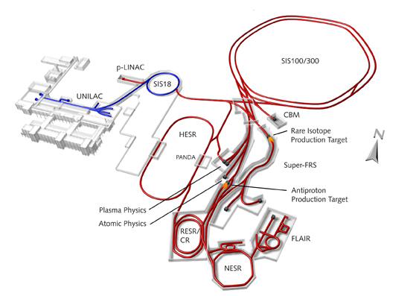
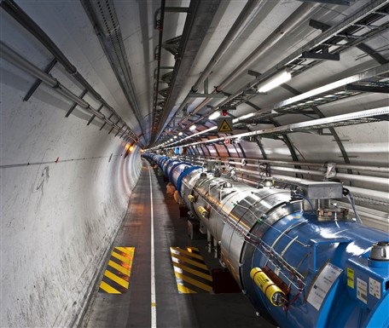
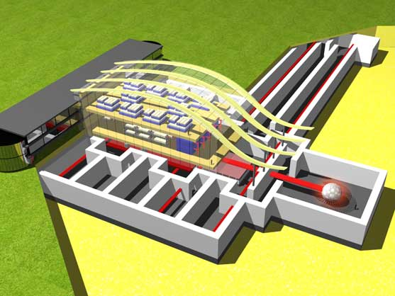
Experimental tests of QED in the presence of strong electromagnetic fields are not comparably numerous and accurate
The reasons are:
on the experimental side, the critical electromagnetic field of QED is very “large”
on the theoretical side, exact calculations are feasible only for a few background electromagnetic fields: constant and uniform electric/magnetic field, Coulomb field, plane-wave field
}!/mc²
Strong-field QED:
highly-charged ions,
high-intensity lasers
10
High-Energy QED:
accelerator physics
1
0.1
0.1
1
10
E/E_{cr}

Slide 6
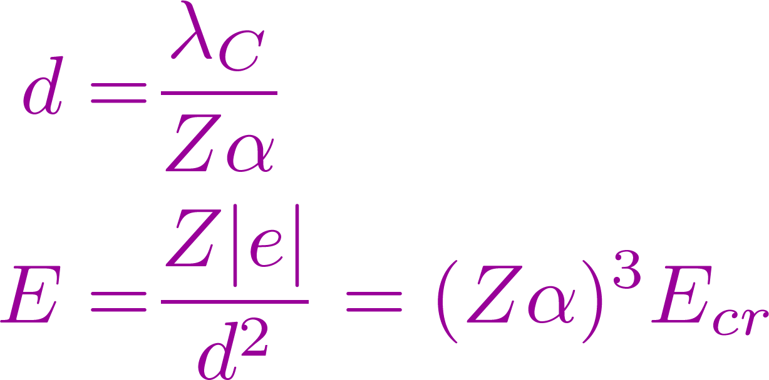
Strong-field QED in a strong atomic ¯eld
Highly-charged ions are sources of very strong ¯elds and strong-¯eld QED in the presence of strong atomic ¯elds has been investigated since a long time (Bethe and Heitler 1934, Bethe and Maximon 1954). A bare nucleus with velocity v collides with a particle (e{, e⁺ or °) with energy ² for an electron or a positron (}! for a photon)
High-order QED effects (Coulomb corrections) only depend on the Lorentz- and gauge-invariant parameter Z®
Zjej
v
²(}!)
All the properties of the energies of a hydrogen-like atom depend only on Z® (Beresteskii et al., 1982)
n=1
Zjej
For Uranium 91⁺ it is Z®¼0.66

Slide 7
Strong-field QED in intense laser pulses
A typical experimental setup in strong-field QED in intense laser pulses
E (}!)
E_{L}, !_{L}
Lorentz- and gauge-invariant parameters (Di Piazza et al. 2012)
Name | Mathematical definition | It controls… | SF-QED regime
Classical nonlinearity parameter |  | Relativistic and multiphoton effects | » & 1
Quantum nonlinearity parameter |  | Quantum effects (pair production etc…) | Â & 1
Numerical values (with an e{ beam of E=2 GeV (Wang et el. 2013))
Laser facility | Energy (J) | Pulse duration (fs) | Spot radius (¹m) | Intensity (W/cm²)
Phelix (GSI, Darmstadt) | 120 | 500 | 10 (1) | 10²⁰ (10²²) | »=11, Â=0.08 (»=110, Â=0.8)
Polaris (IOQ, Jena) | 150 | 150 | 5 (1) | 10²¹ (3£10²²) | »=18, Â=0.14 (»=180, Â=1.4)

Slide 8
Strong-field QED in strong atomic and laser fields
Units with }=c=1
There exist many calculations of QED processes in atomic and laser ¯elds but the atomic ¯eld is taken into account at the leading order (Born approximation) (Yakovlev 1965, Mueller et al. 2003, Loetstedt et al. 2009, Di Piazza et al. 2009)
We have calculated the electron propagator in the leading-order quasi-classical approximation by including exactly both the atomic and the laser ¯eld at and
The physical scenario is the following:
V(r)
² À m
z
A(t+z)
Since the particle is assumed to be ultra-relativistic, it is convenient to use light-cone coordinates Á=t{z, T=(t+z)/2 and ½=(x, y). We approximate V(r)¼V(½, T) and A(t+z)=A(2T) and the coordinate Á will play here the role of time.

Slide 9
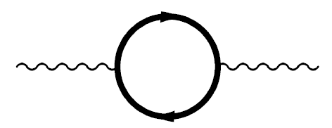
By employing the optical theorem, we calculated the total cross-section of photo-production in combined strong atomic and laser ¯eld and at photon energies
We are interested in the influence of the laser ¯eld on the Bethe-Heitler cross section, then we subtracted the contribution coming only from the photon and the laser ¯eld (Reiss 1962, Nikishov and Ritus 1964)
Whereas pair production from the laser field and the atomic field is negligible as
The cross section in the total-screening regime (!/m²Àr_{c} =1/®mZ^{1/3}, with r_{c} being the screening radius) has the form
where the function include the Coulomb corrections and the functions and the e®ects of the laser ¯eld

Slide 10
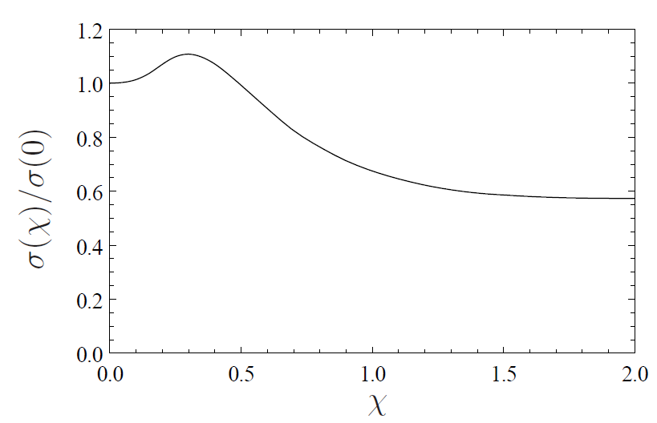
At (Bismuth) we observed a suppression of the cross section of 40 % at which corresponds to a laser intensity of at an incoming photon energy of
The suppression of the cross section is caused by the deviation in the transverse direction due to the laser field, which reduces the formation length of the process. In this sense, it is the analogous in the laser field of the Landau-Pomeranchuk-Migdal (LPM) effect, where the reduction of the formation length is induced by the multiple scattering of the charged particle in matter
The LPM e®ect for the Bethe-Heitler process in matter has never been observed experimentally, as photon energies of the order of 1 TeV are required (Baier and Katkov 2005)
A. Di Piazza and A. I. Milstein, Phys. Lett. B 717, 224 (2012);
A. Di Piazza and A. I. Milstein, Phys. Rev. A 89, 062114 (2014)

Slide 11
Conclusions
Quantum Electrodynamics (QED) is the physical theory that has been succesfully tested with the highest accuracy
There are areas of QED that still deserve theoretical and experimental investigation, as the strong-field sector
We have studied the e®ect of a strong laser ¯eld on the Bethe-Heitler cross section and we have found a suppression of the cross section, analogous to the LPM e®ect in matter
The LPM for the Bethe-Heitler process in laser can be in principle observable already with available technology

