Slide 1
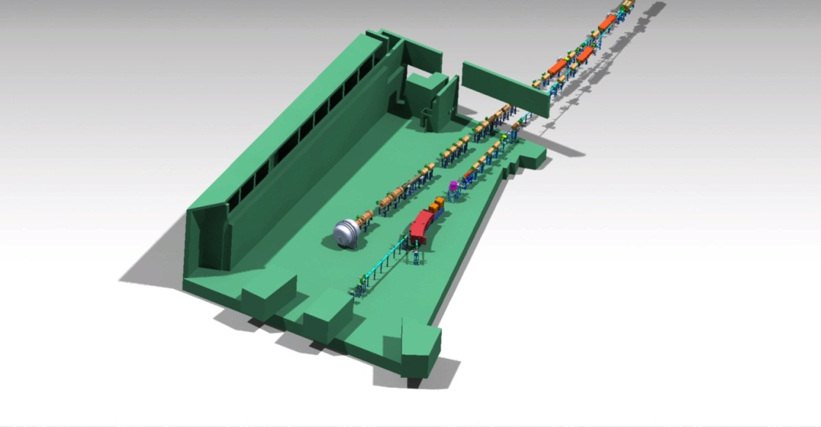




Instrumentation for Plasma Physics
APPA Cave
W D M
Vincent Bagnoud, GSI and Helmholtz Institute Jena
for the WDM and HEDgeHOB Collaborations

Slide 2
we prepare the instrumentation necessary for day-one experiments
Summary
In the modular start version of FAIR, the plasma physic collaborations will deliver a fully functional experimental area including target chamber and focusing magnets.
For the start period of FAIR, a scientific program has been prepared that enables a significant contribution to Plasma Physics research:
  use of proton microscopy with outstanding properties already with day-one FAIR parameters, and
  the generation of warm dense matter for a limited number of materials and accessible parameters
Only the full FAIR parameters AND a petawatt high-energy laser will enable realizing the full HEDgeHOB and WDM programs.

Slide 3
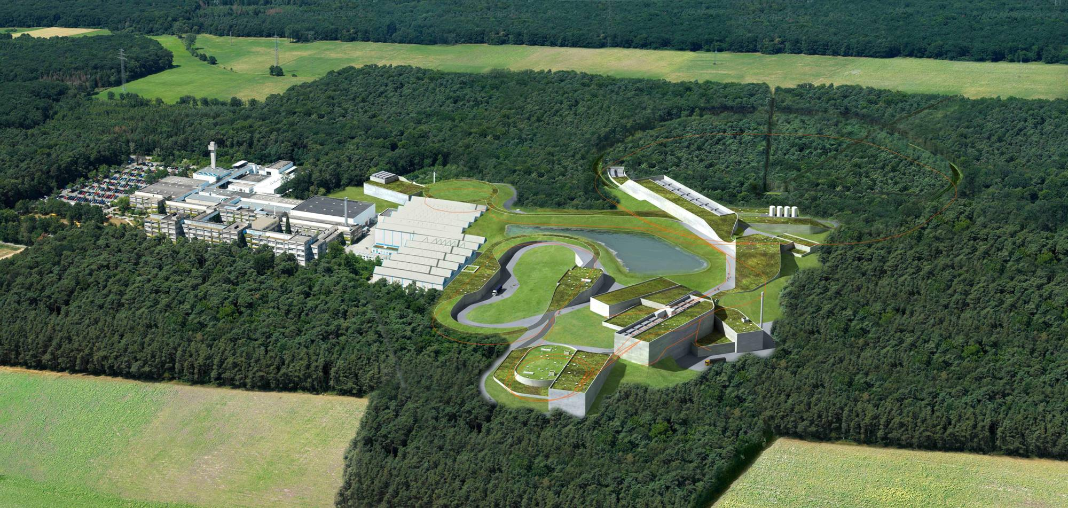
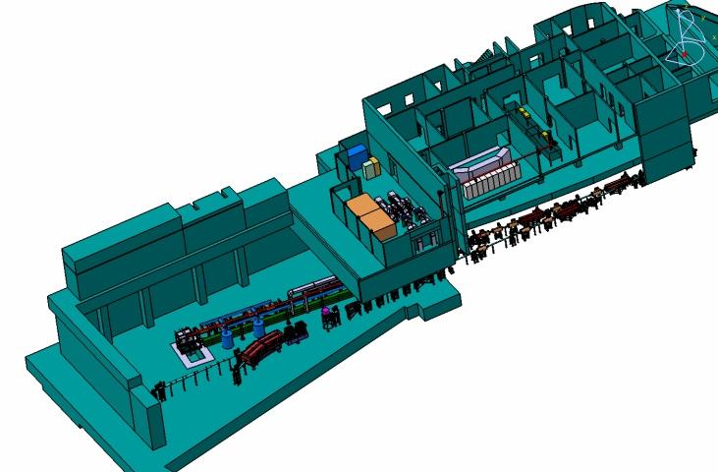
Status of the APPA cave
APPA
Notes:
first FAIR View, then APPA Cave and Zoom on the beamline

Slide 4



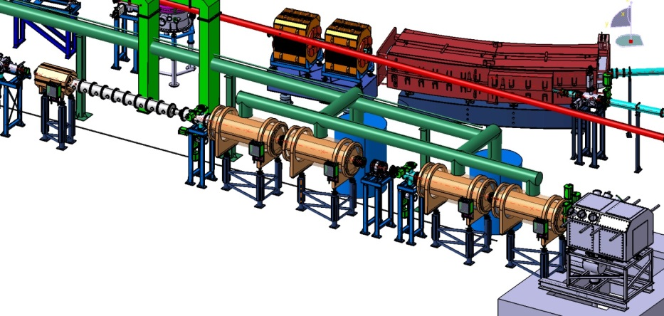

The plasma physics beam line is located in the APPA cave
Main components of the plasma physics beam line:
  target chamber
  wobbler
  specific focusing magnets
ITEP
Notes:
first FAIR View, then APPA Cave and Zoom on the beamline
put logos ITEP, IHEP
50% from Invest

Slide 5
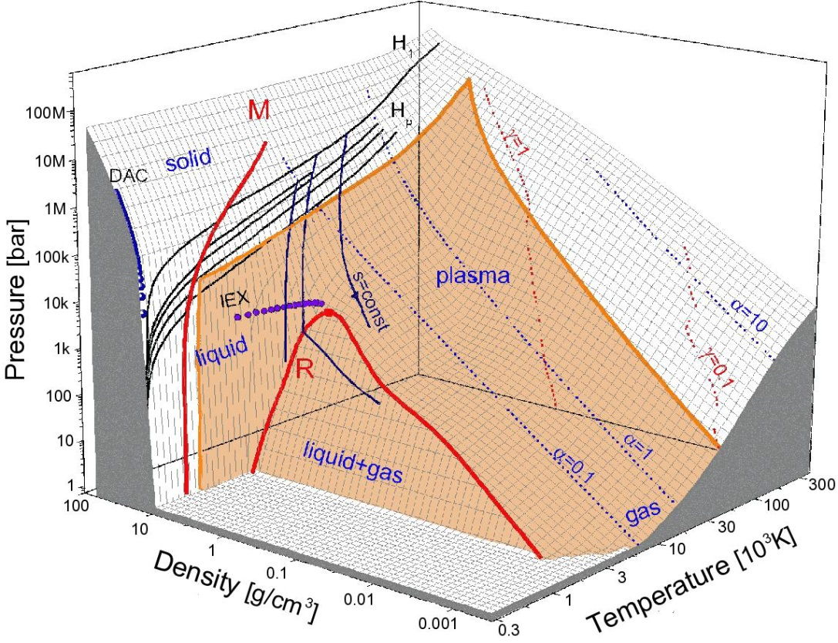
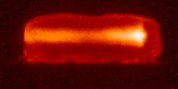
To explore states of matter, a precise suite of instruments are necessary
To generate warm dense states of matter, FAIR is the ideal tool
To characterize warm dense matter, one needs a precise measurement of a set of three parameters (e. g. ρ, P, T)
In a very limited number of configurations (like the ones proposed by WDM) the measurement of two parameters is sufficient.
heating with ion beams
P, T, ρ ?
65 mm
Ne¹⁰⁺ 300 MeV/u; Kr crystal
large sample volume (mm³)
uniform physical conditions
any target material
long evolution time scales (50 ns)
EOS of lead showing the accessible area with FAIR parameters

Slide 6
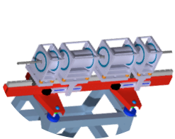
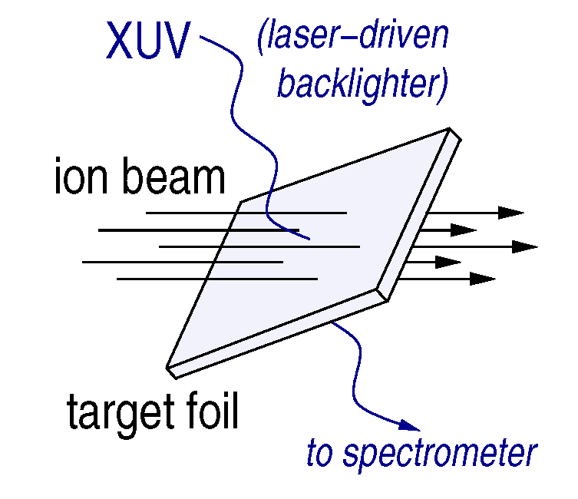
FAIR allows to begin our experimental program already in the start phase
We are preparing a world-wide unique proton microscope (PRIOR)
  with SIS 18: 5 × 10¹⁰ protons, 4.5 GeV, δt = 100 ns
  with SIS 100: 2 × 10¹³ protons, 3 - 10 GeV, δt = 50 ns
Early ion beams allow addressing fundamental atomic and thermophysical properties of WDM in special target configurations
For more information about day one plasma physics,
see talk from Paul Neumayer (Wednesday, 17:15)

Slide 7
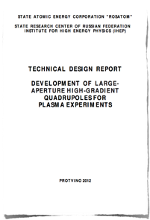
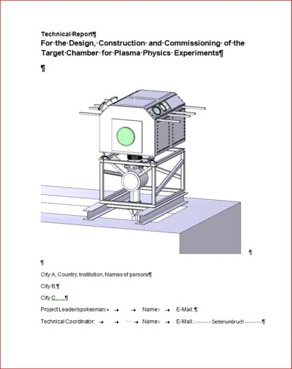
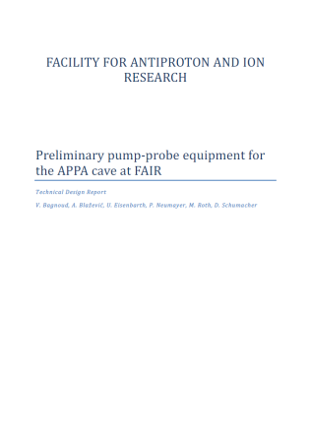
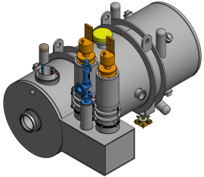
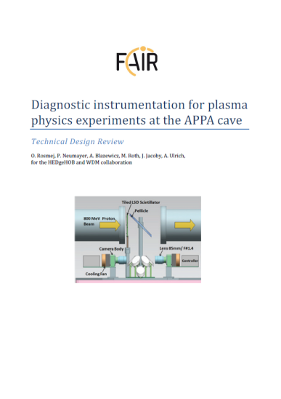
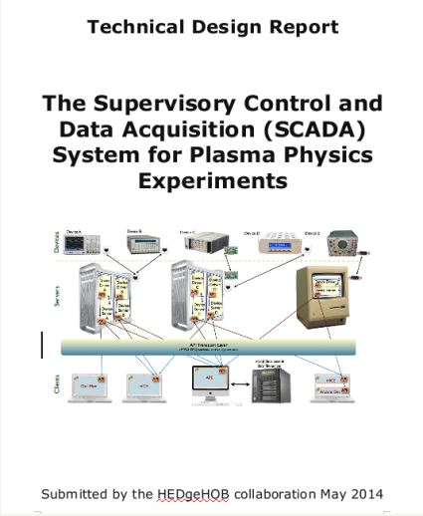
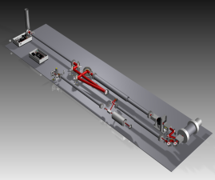
Status of the TDRs
Super conducting quadrupoles for final focusing
Experimental target chamber
Diagnostic laser
Detectors and diagnostic instrumentation
 ☑
Data Acquisition
TDRs in preparation:
Ion beam line - matching section
RF beam rotator- wobbler
Cryogenic targets for LAPLAS
Emission spectroscopy

Slide 8
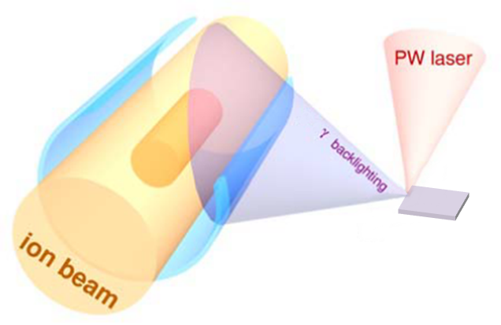
At FAIR only advanced diagnostics will be suited to perform our studies
In previous experiments (GSI/HHT) diagnostics monitoring the surface (pyrometry (T) and VISAR (P)) have been used
At FAIR, in depth measurement of P,T, ρ is necessary as the FAIR targets will be complicated
All these measurements require a probe
At FAIR both an advanced pump and probe are necessary

Slide 9
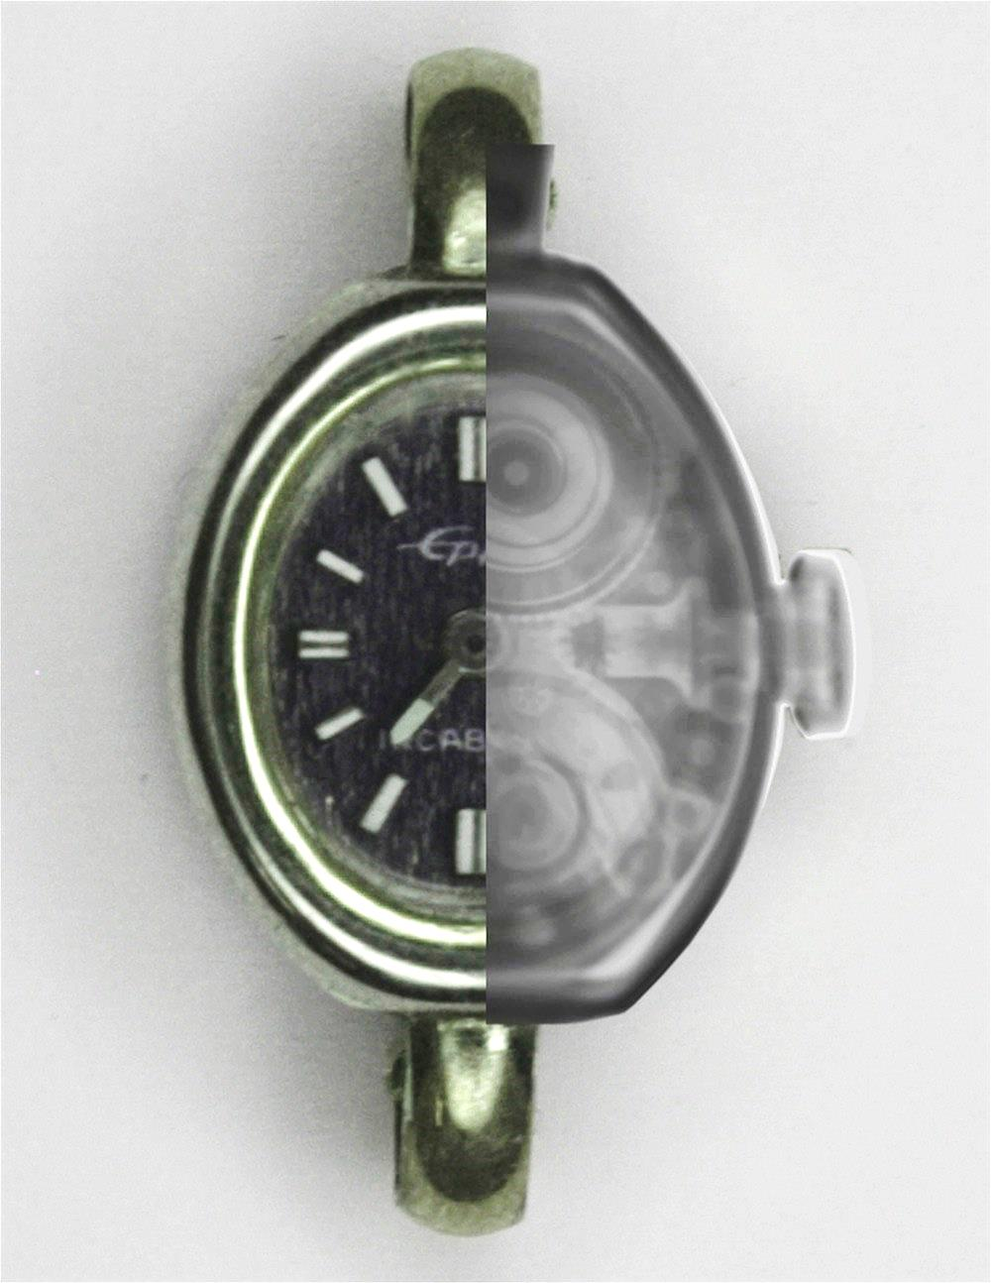
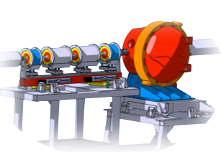
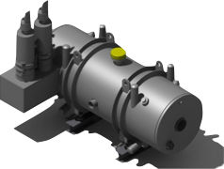
FAIR will drive a worldwide unique high-energy proton-radiography facility
available with early SIS-100 or SIS-18 proton beams:
3 – 10 GeV, moderate (>10¹⁰) to high (10¹³) intensity
enables study of materials at extreme dynamic environments with high spatial resolution (HEDP, plasma physics and materials research)
PaNTERA (Proton therapy and radiography) project (jointly with BIOMAT)
GSI, 2014
High-resolution (10 µm) magnifier with PMQ or electromagnets
Superconducting imager with high-gradient quadrupoles

Slide 10
For the start period of FAIR, a lot can be done using a 100 J laser
A laser is the tool of choice in many plasma physics experiments
  as probe, a laser can be used directly (VISAR) or as driver for x-rays, electrons, protons and neutrons
  as a driver, a laser can efficiently generate shocks for compression experiments
The ideal laser is a petawatt high-energy laser (Helmholtz beamline)
For the start phase, we can work with reduced laser parameters (only as shock driver and X-UV source)
Parameter | Pulse energy | Pulse duration |  | Pulse shape | Repetition rate |  | Wavelength
value | 100 J | 100 ps | 20 ns | programmable | 1/10 min | 1/1 min | 500 nm
tolerance | min | min | max |  | min | max | +/-50 nm
at 100 J, the maximum fluence of a 12 cm top-hat beam is 1.5 J/cm² – x2 below the damage threshold
For longer pulses (1 ns), the beam line should accept up to 300 J

Slide 11
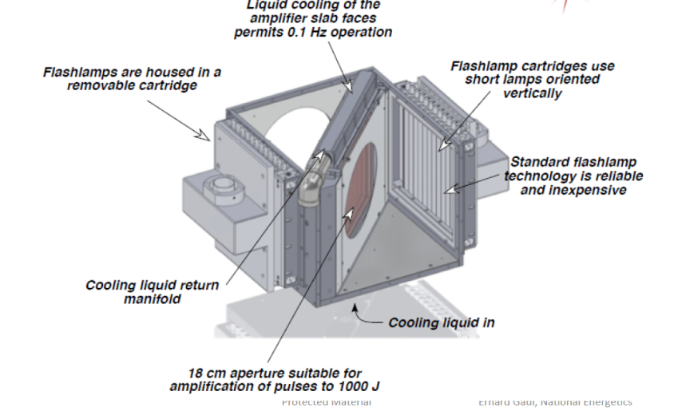

We proposed a compact and cost effective laser architecture
The laser leverages a lot of the proved PHELIX technology (in green)
Power amplifier
programmable source (Fiber)
Regenerative amplifier + Preamplifier
Frequency Doubling
E_{out} = 20J
12 cm
32 cm

Slide 12
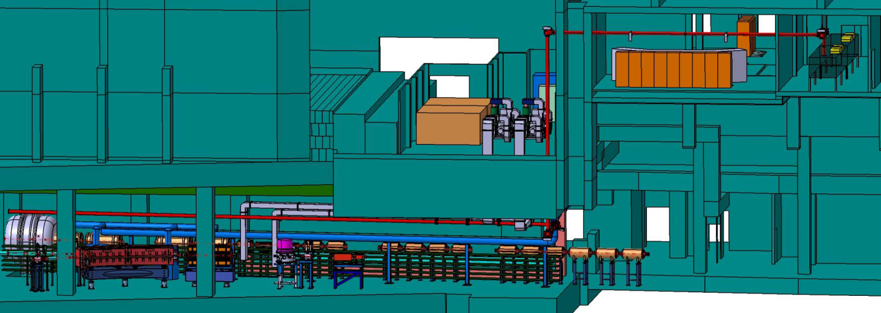
The laser is located in the APPA building
Power amplifier
programmable source (Fiber)
Regenerative amplifier + Preamplifier
Frequency Doubling
Beam Transport
control room
laser room
laser room
control room
laser beamline
target chamber
ion beamline
proposed implementation for a diagnostic laser at FAIR

Slide 13
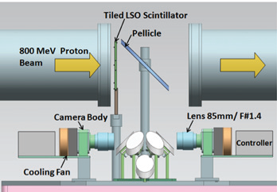
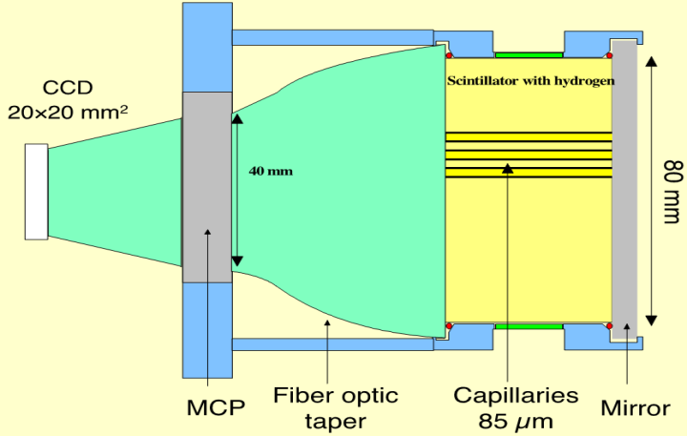
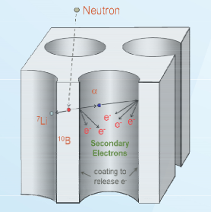

Particle detectors for protons/neutrons
Example: gated proton imager
Example: gated neutron imager
fast n: scintillating fibers
slow n: doped MCP
Needed for:
PRIOR, PW-laser generated protons
Needed for:
PW-laser generated neutrons

Slide 14
we prepare the instrumentation necessary for day-one experiments
Summary
In the modular start version of FAIR, the plasma physic collaborations will deliver a fully functional experimental area including target chamber and focusing magnets.
For the start period of FAIR, a scientific program has been prepared that enables a significant contribution to Plasma Physics research:
  use of proton microscopy with outstanding properties already with day-one FAIR parameters, and
  the generation of warm dense matter for a limited number of materials and accessible parameters
Only the full FAIR parameters AND a petawatt high-energy laser will enable realizing the full HEDgeHOB and WDM programs.

