Slide 1
Injector Upgrade for FAIR
W. Barth
W. Barth, Injector Upgrade for FAIR, ICST, Worms/Germany
15.10.14

Slide 2
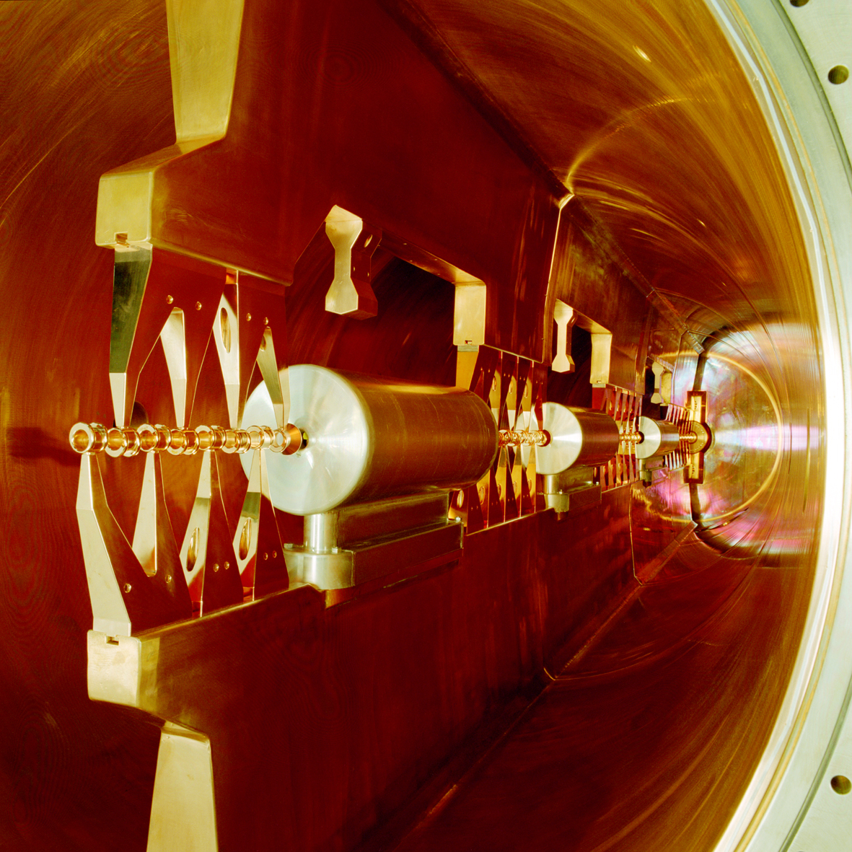
Injector Upgrade for FAIR
W. Barth, GSI - Darmstadt
Introduction
FAIR-requirements
Status of the Unilac High Current Performance
Further Investigations
  ion source emittance
  RFQ-Matching
  superlens performance
  pulsed gas stripper
High Energy LINAC
  rf-amplifiers
  beam dynamics studies
  accelerator cavity studies
FAIR proton LINAC&UNILAC proton performance
cw-LINAC
Summary&Outlook
W. Barth, Injector Upgrade for FAIR, ICST, Worms/Germany
15.10.14

Slide 3
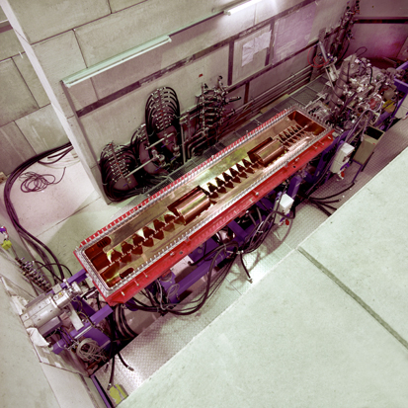
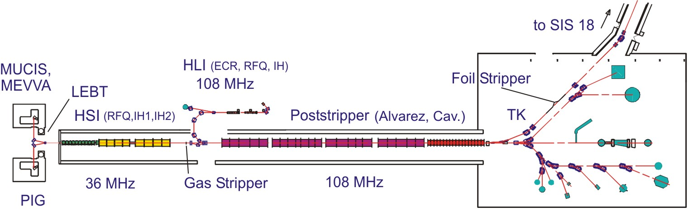
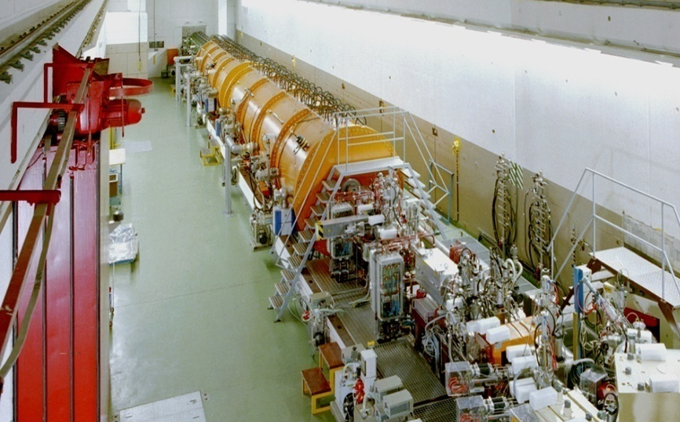
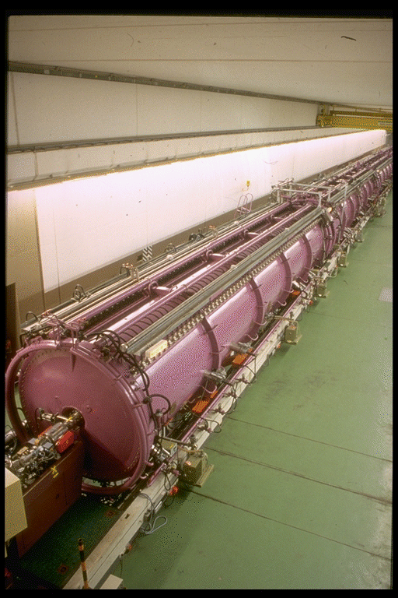
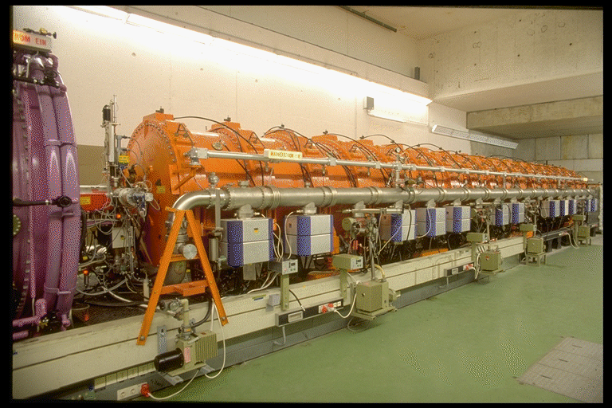
The GSI UNIversal Linear ACcelerator
High Charge State Injector (1991)
High Current Injector (1999)
Alvarez (1975)
Single Gap Resonators (1975)
W. Barth, Injector Upgrade for FAIR, ICST, Worms/Germany
15.10.14

Slide 4
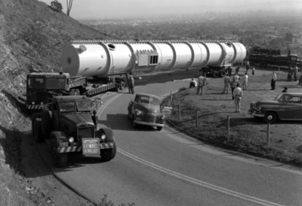
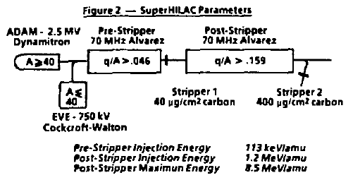
Development of compact, high efficient, (high intensity) heavy ion linac cavities
²³⁸U³⁷⁺
How to shorten the lenghs of a heavy ion accelerator?
Delivery of Post-Stripper HILAC (heavy ion linear accelerator) tank on Cyclotron Road (at the horseshoe curve), April 16, 1956.
Mar 1983; Particle accelerator conference; Santa Fe, NM (USA):
Very complex ion sources
Ion sources to be optimized for high intensity high charge state beams
Low charge/mass ratio → High field gradient/long accelerating structure
Stripping losses → intensity requirements
Highest linac energy → stripping to the highest possible charge state for max. final beam energy
W. Barth, Injector Upgrade for FAIR, ICST, Worms/Germany
15.10.14

Slide 5
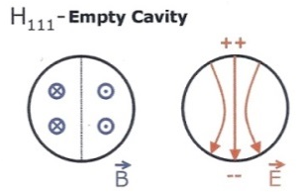
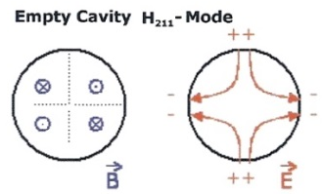

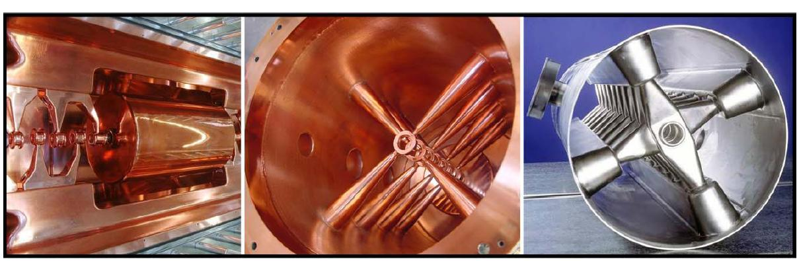
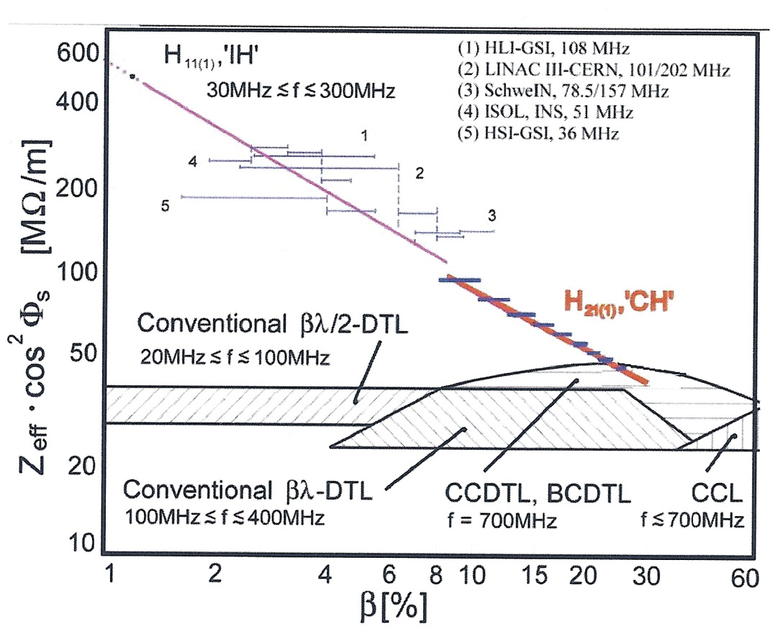
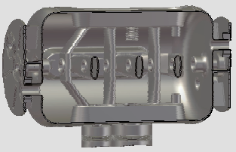
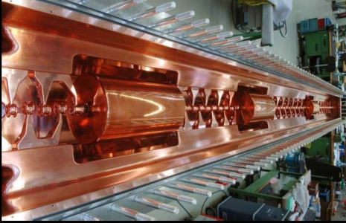
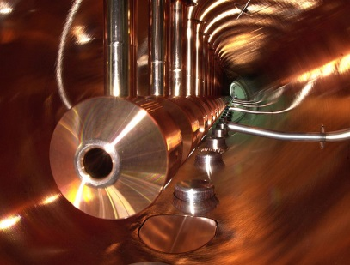
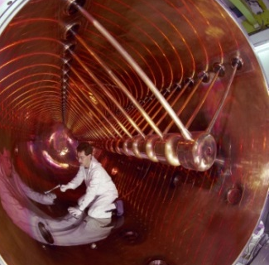
rf-cavity development -> preparation for the injector linacs
HSI 36 MHz@gsi
sc-prototype, 360 MHz
HLI 108 MHz@gsi
nc-CH-cavity
sc-325 MHz
UNILAC-booster cavity
IH 216 MHz@HIT/Heidelberg
nc-325 MHz
Wideröe
Alvarez
W. Barth, Injector Upgrade for FAIR, ICST, Worms/Germany
15.10.14
5

Slide 6
FAIR-Requirements
W. Barth, Injector Upgrade for FAIR, ICST, Worms/Germany
15.10.14

Slide 7
UNILAC-Upgrade for FAIR
Front End Upgrade
W. Barth, Injector Upgrade for FAIR, ICST, Worms/Germany
15.10.14

Slide 8
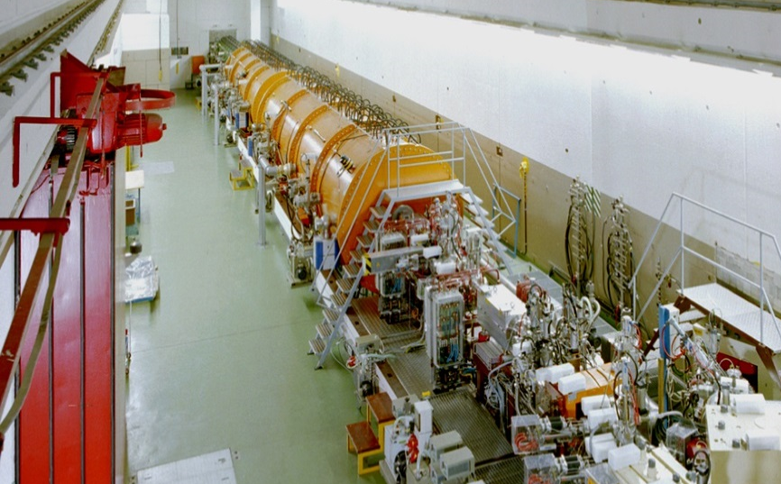
Recommendation UNILAC-Review
Increase of U⁴⁺
beam intensity:
Terminal West&
Compact LEBT
Short
gas-stripper section
High Current Injector
Alvarez
Single Gap resonators
- strong periodic focussing -> (ALVAREZ type DTL prefered)
- no performance limitations (vs. costs, length, ...)
- RFQ-Upgrade (rf-sparking)
- KONUS beam dynamics vs. strong periodic focusing -> beam brilliance!
- UNILAC as FAIR injector only !!!
Strong performance issues
overall injector strategy?
W. Barth, Injector Upgrade for FAIR, ICST, Worms/Germany
15.10.14

Slide 9
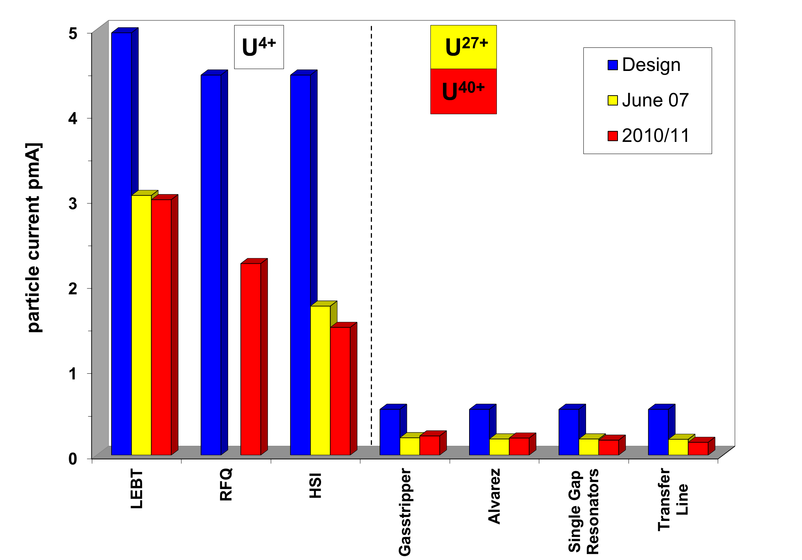
Status of the Unilac High Current Performance
U²⁸⁺
Talk of O. Boine-Frankenheim, GSI
source+LEBT performance
Injector per-formance???
38% of the design intensity
(25% of the performance w.r.t. beam brilliance)
W. Barth, Injector Upgrade for FAIR, ICST, Worms/Germany
15.10.14

Slide 10
Status Quo
W. Barth, Injector Upgrade for FAIR, ICST, Worms/Germany
15.10.14

Slide 11
Terminal West
Dedicated Terminal exclusively for uranium beam
General layout exists
Integrated service area
All power supplies integrated in the Faraday room
No extension within the basement
Talk of R. Hollinger, GSI
W. Barth, Injector Upgrade for FAIR, ICST, Worms/Germany
15.10.14

Slide 12
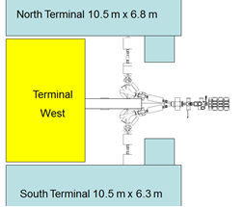
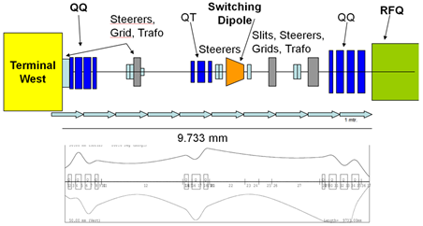
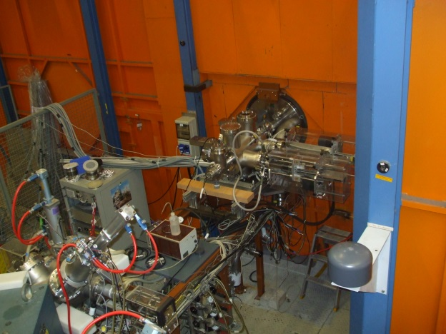
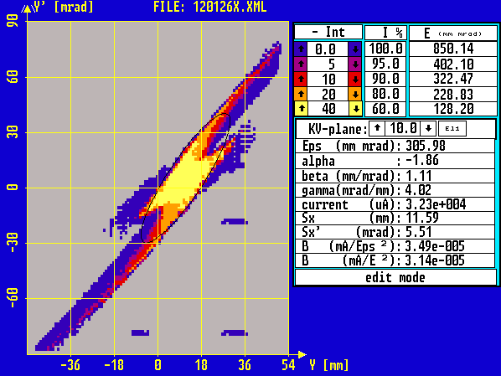
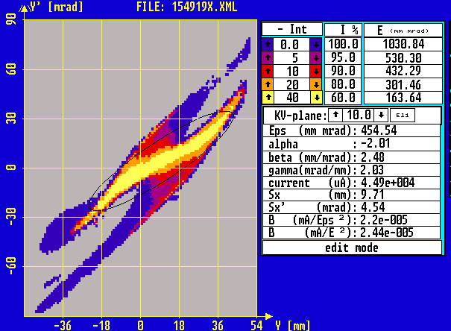
Design of LEBT
9733mm
Measurements of uranium beam emittance@North TerminalEmittance for high current uranium beam (55 mA) , Oct. 2013
→ Latest solution: Use existing quartet before RFQ, and a new quartet behind source
W. Barth, Injector Upgrade for FAIR, ICST, Worms/Germany
15.10.14

Slide 13
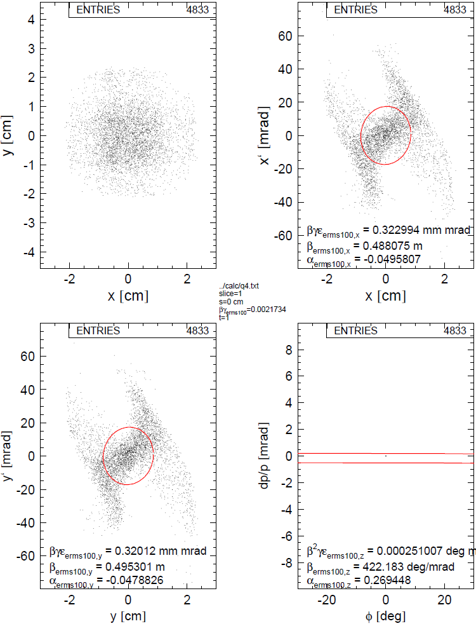
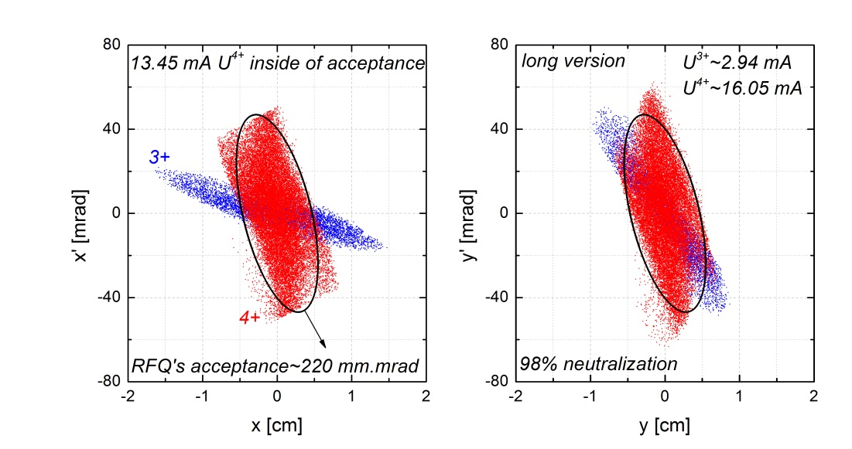
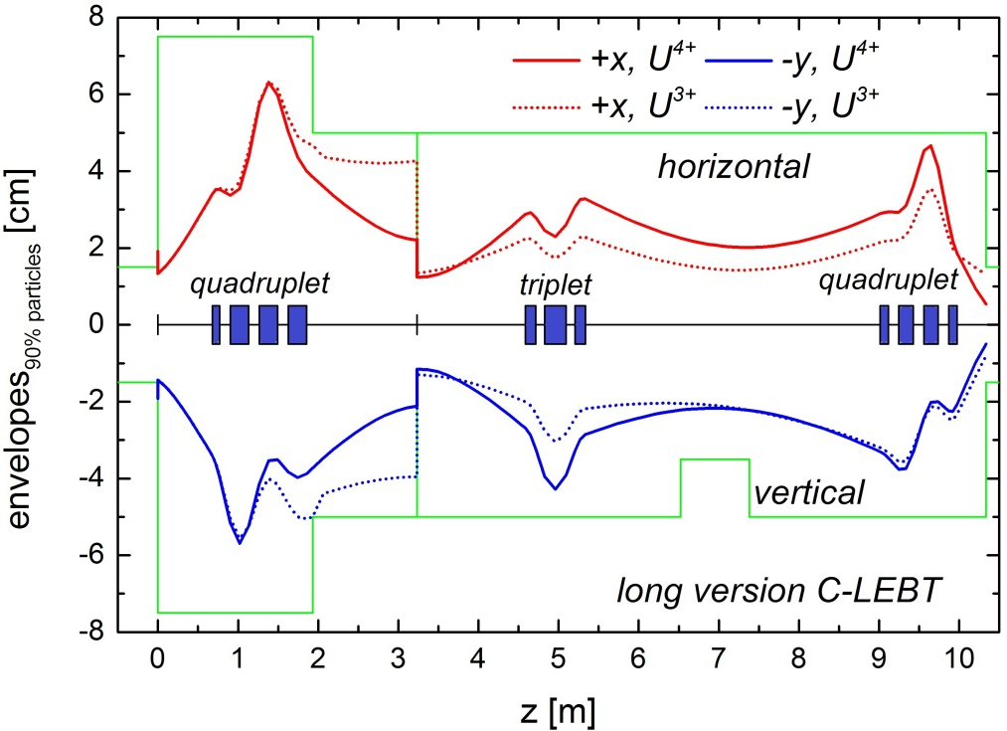
Design of a Dedicated Uranium LEBT
(long version, allows for three sources feeding the HSI)
initial
U³⁺ ~ 20 mA
U⁴⁺ ~ 36 mA
final
iris (U³⁺ suppression)
14 mA U⁴⁺ inside
220 mm*mrad
13.45 mA U⁴⁺ inside ellipse
98% space charge compensation
magnet field maps used
two charge states
cutting of off-acceptance ions
220 mm*mrad
C. Xiao
W. Barth, Injector Upgrade for FAIR, ICST, Worms/Germany
15.10.14

Slide 14
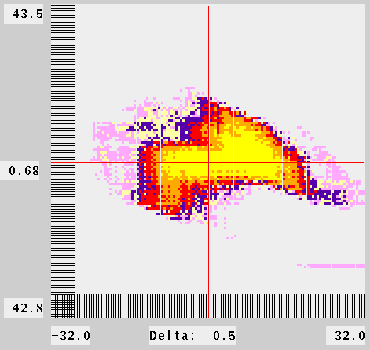
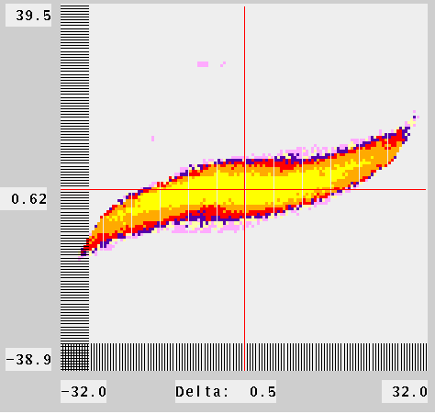
RFQ Matching
Data for required advanced beam dynamics simulations (further optimization, upgrade, redesign and development of machine) were collected -> Measurements are complete and self-consistent.
A gain in particle transmission with new QQ settings was confirmed with Ta ⁴⁺ (RFQ transmission of 75±2% instead of 51±4%; 4 mA)
Additional tuning of the LEBT, based on dedicated beam dynamics simulations with recently measured beam emittance behind ion source terminal potentially could lead to increased particle transmission for the entire HSI
Further optimization of the whole HSI for high current beam applying new QQ setting is proposed by means of medium ions.
W. Barth, Injector Upgrade for FAIR, ICST, Worms/Germany
15.10.14

Slide 15
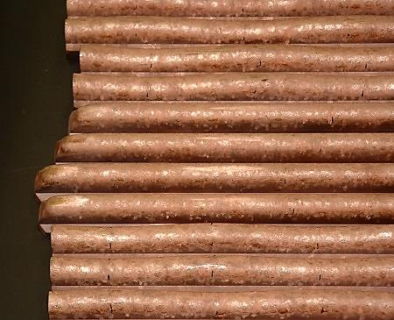
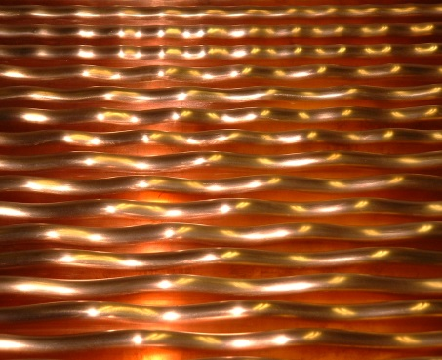
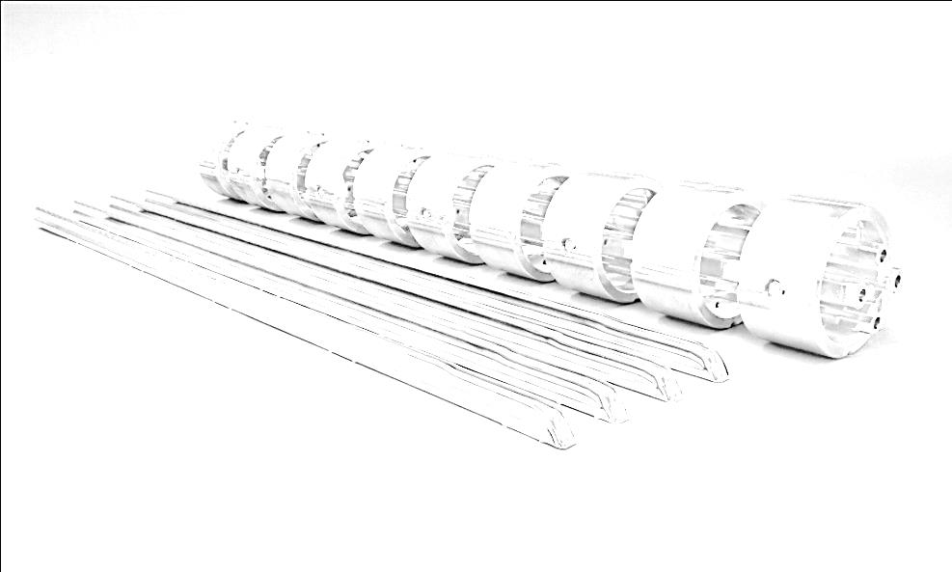
RFQ-Upgrade
5 years of operation
New RFQ-rods
Talk of S. Yaramyshev, GSI
RFQ-Upgrade 2004 (RFQ-Matching, surface quality)
RFQ-Upgrade 2009 (surface quality as well, increase of acceptance, increased field gradient
extensive mixed operation (high duty factor operation m/q=25 (⁵⁰Ti²⁺ + short pulse heavy ion beams (m/q=59.5; ²³⁸U⁴⁺) -> Reduced performance (10% less field gradient): reduced transmission, increased beam emittance
2014: no mixed operation until now -> 96,4% of the design gradient reached.
High probality of ireversible damages of the electrode surface (field emission stimulated by thermal stress, high voltage breakdowns caused by strong particle losses)
tank voltage [a.u.]
Design
tank voltage [a.u.]
W. Barth, Injector Upgrade for FAIR, ICST, Worms/Germany
15.10.14

Slide 16
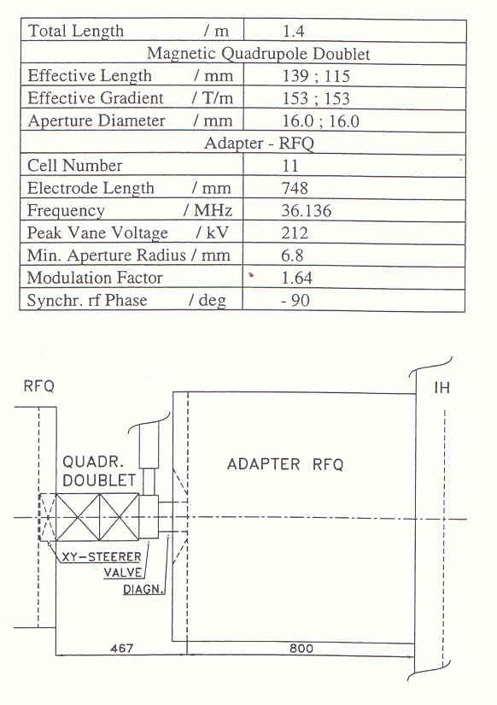
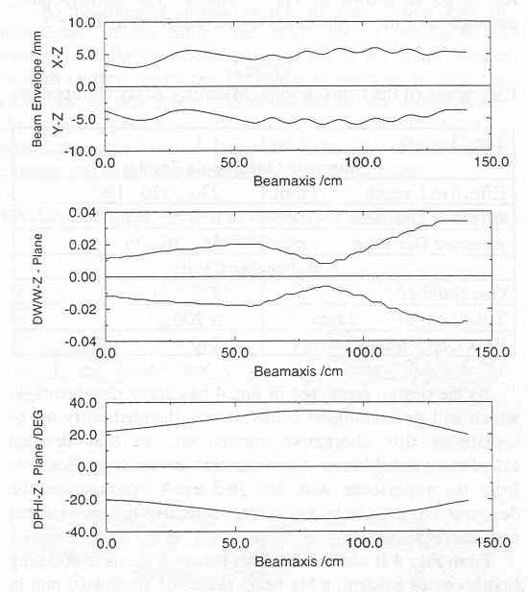
Further Investigations III – MEBT performance
Beamload for a 6.5 mA Uranium beam was appr. 25 kW ( beamload with 2 mA Krypton beam 7.5 kW)
With improved setting for Krypton beam, the measured beamload was reduced to appr. 4 kW.
Beamload caused by a mismatch of the RF-power -> reduced shunt impedance of the resonator (beam is hitting the surfaces).
⁸⁶Kr²⁺: 10% higher superlens rf-amplitude & 15% higher quadrupole field strength -> MEBT-transmission increased 75% -> 93%
Recommendation: new quad doublet with increased field strength, trapezoidal shaped superlens electrodes!
(Redesign of the MEBT in discussion)
W. Barth, Injector Upgrade for FAIR, ICST, Worms/Germany
15.10.14

Slide 17
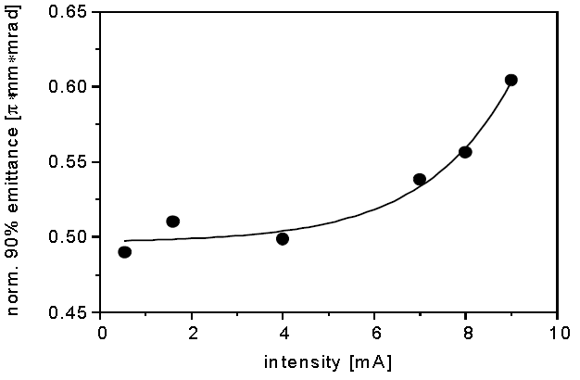
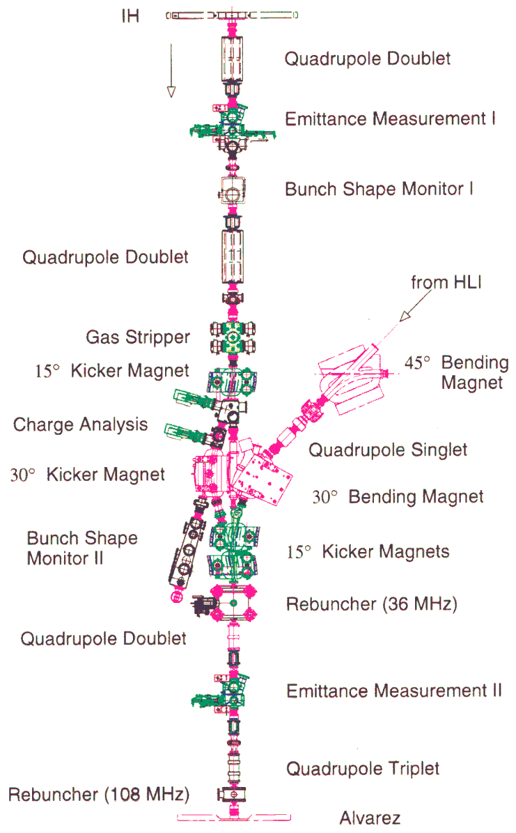
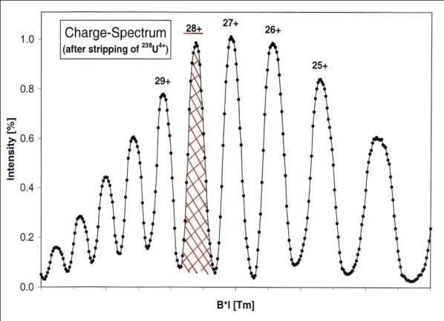
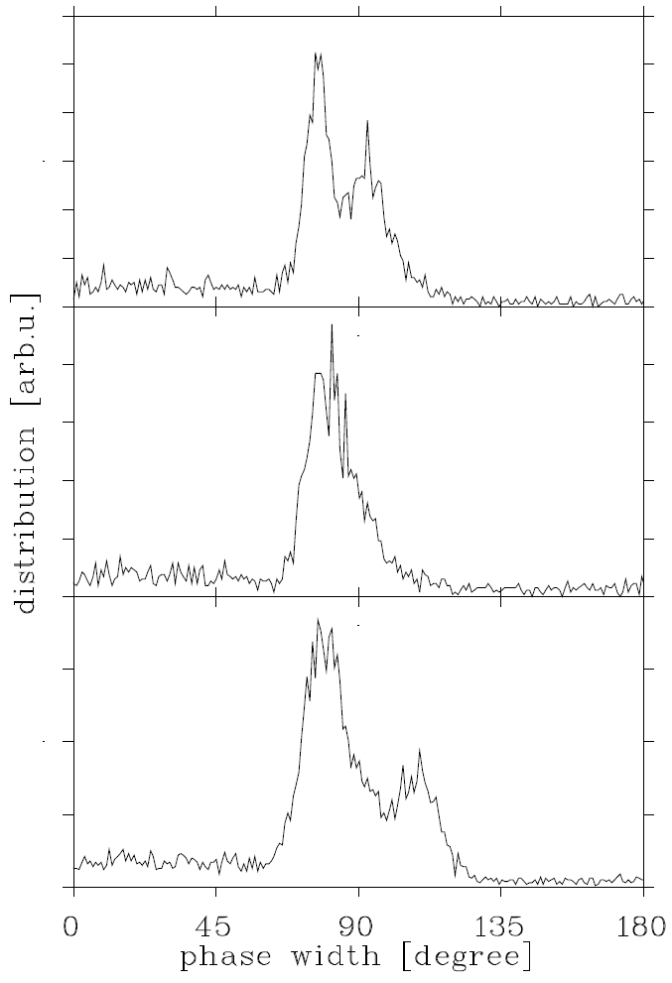
Optimization of gas stripper area (1.4 MeV/u)
enlarged apertures
high stripper target density
high current operation (extremely high space charge forces)
full transmission
separation of Uranium charge states
optimum stripping efficiency
less long./transv. emittance growth
FAIR
⁴⁰Ar¹⁰⁺
^{high current}
max.
^{high current}
^{(HSI)}
^{low current}
W. Barth, Injector Upgrade for FAIR, ICST, Worms/Germany
15.10.14

Slide 18
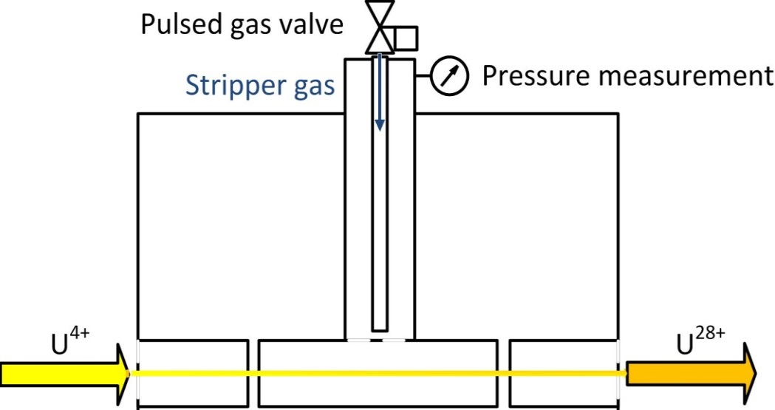
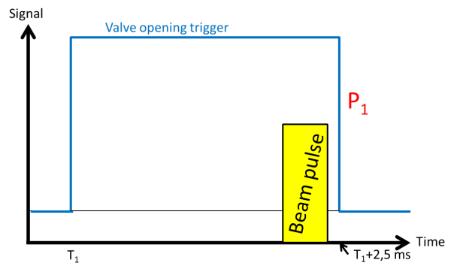
Further Investigations – fast switching gas stripper
P. Scharrer, et.al.
U⁴⁺ + He; 4 ms
25+
How does the gas
distribution looks like?
gas cell
27+
reduced average gas pressure
increased target density
pulse to pulse variation
lower gas consumption
→ dense noble gas target available
He -> lower (equilibrium) charge state, increased yield
U⁴⁺ + N₂; 2,5 ms
V.P. Shevelko
W. Barth, Injector Upgrade for FAIR, ICST, Worms/Germany
15.10.14

Slide 19
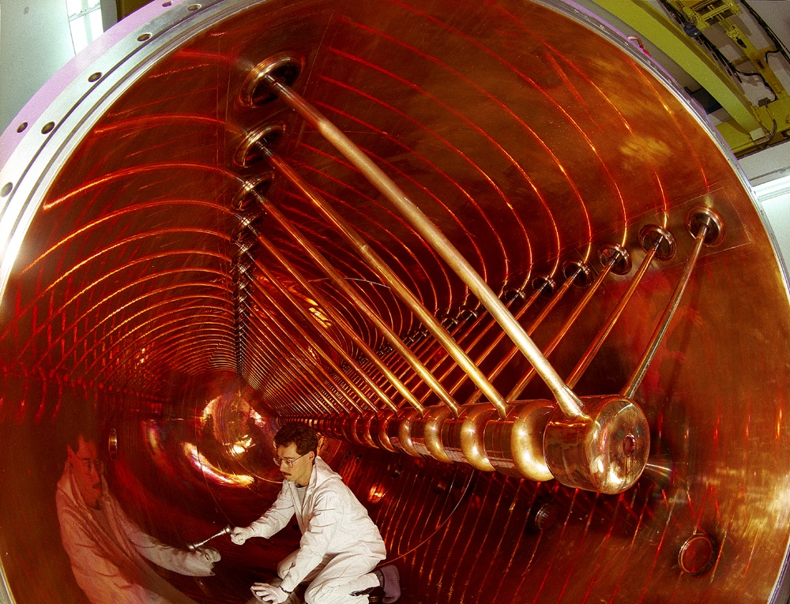
High Energy LINAC
W. Barth, Injector Upgrade for FAIR, ICST, Worms/Germany
15.10.14

Slide 20
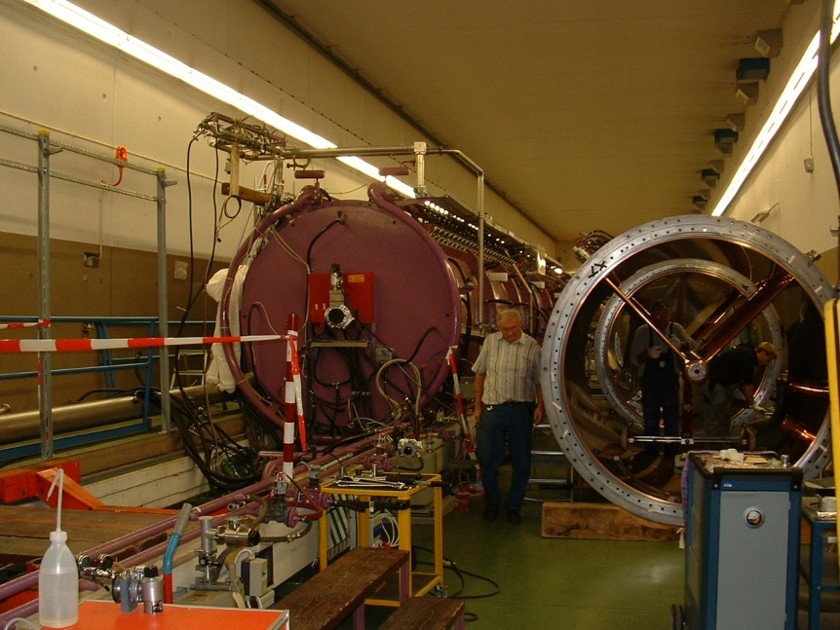
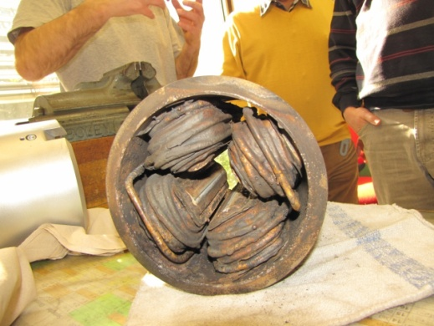
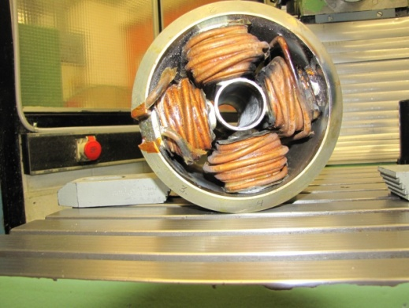
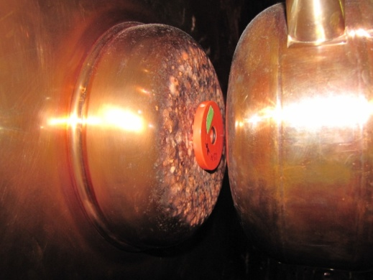
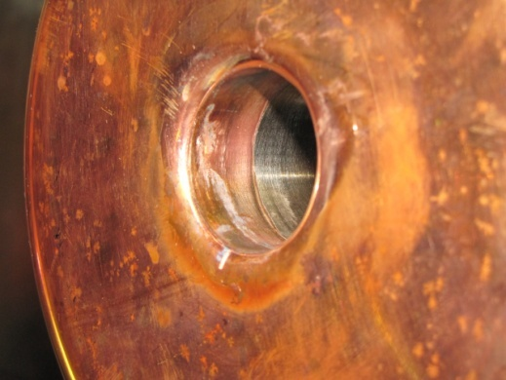
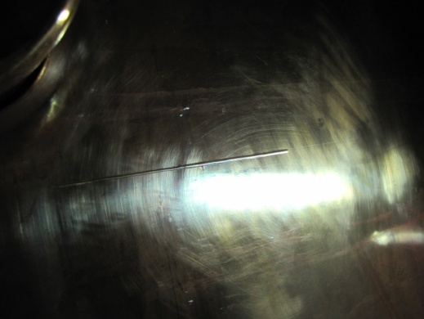
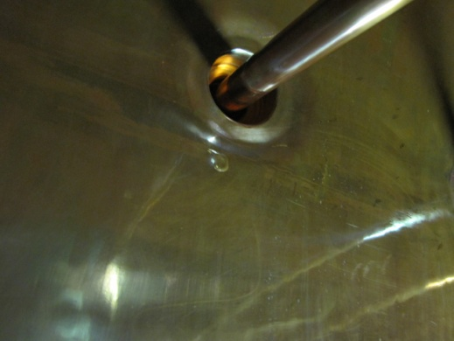
Active defects
178 tank-quadrupoles
(leak tightness/water/pre-vakuum, el. properties, ground faults), drift tubes + supports (water& vakuum leaks)
Leak tightness of all tanks
Reduced availibility of the focussing system → limited beam intensity and quality, (no) multi beam operation !
Regular and substantial repairing program for all tanks!
Drift tubes
massive sparkovers beam induced surface defects
Copper surface quality
... inner tank blanket at different positions
High probality of long term-break downs, significant limitations during operation (reduced duty factor, limited rf-voltage, ...)
W. Barth, Injector Upgrade for FAIR, ICST, Worms/Germany
15.10.14

Slide 21
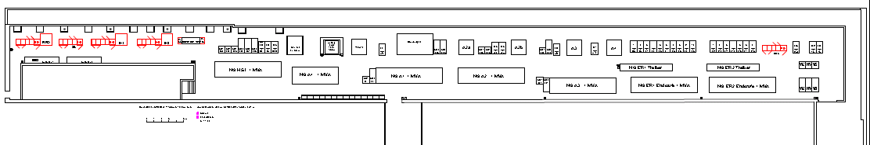
High Energy LINAC - rf-amplifiers (2015-2017)
UNILAC rf-amplifier gallery (since 1975)
≈120m
Modularized Upgrade strategy
Exchange of supply and control units
Exchange LLRF, Measurement, interlock
Independent exchange of driver amplifier system (Solid state amplifiers)
Independent exchange of high power amplifiers
  Prototype (THALES) ordered
  Dedicated test area allocated
  Milestone: Successful test operation
  Procurement of series: 2017
  Step by step mounting in shutdowns
Potentially finalized until 2020!
W. Barth, Injector Upgrade for FAIR, ICST, Worms/Germany
15.10.14

Slide 22
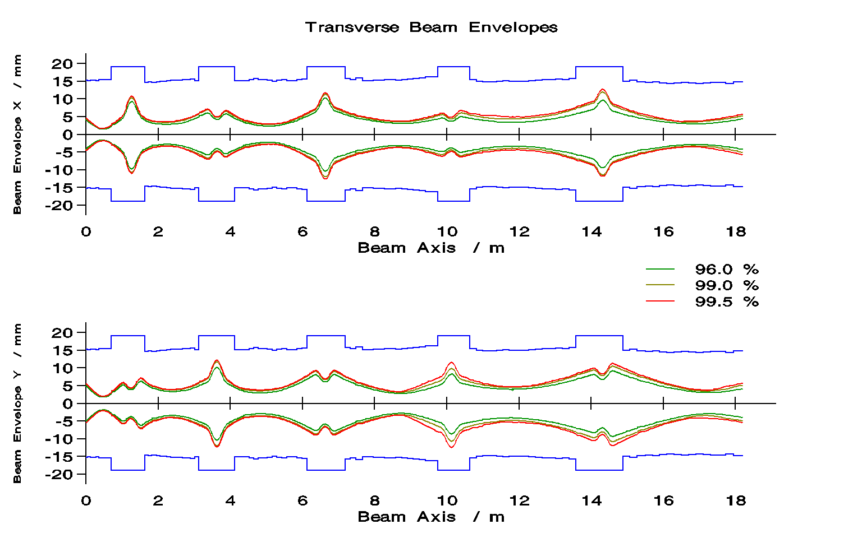
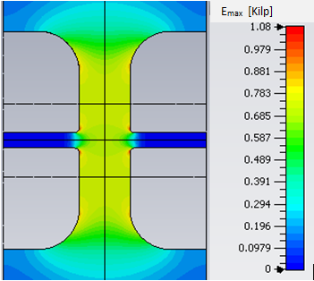

Rf-Simulations on Drift Tube Design for
HE-Linac Alvarez-DTL with strong periodic Focusing
Rf-Simulations on Drift Tube Design for
HE-Linac Alvarez-DTL with strong periodic Focusing
Interdigital H-Mode cavity: Emittance Growth Reduction for KONUS Beam Dynamics
KONUS beam dynamics features high effective R_{s}
the price to pay is reduced focusing & periodicity in transv. & long. planes
108 MHz, example: L_{cell} = 200 mm ≙ 2.45 MeV/u
present
modified (current status)
new design (2014)
R_{s} = 53 MΩ/m
R_{s} = 60 MΩ/m
new: old: UNILAC*:
Transmission: 92% 88% 100%
Emittance growth: ~ 35% ~ 50% 20-40%
*measured
X. Du
W. Barth, Injector Upgrade for FAIR, ICST, Worms/Germany
15.10.14

Slide 23




The FAIR Proton Injector
Beam Energy Beam Current (design/oper.) Beam Pulse Repetition Rate Frequency Norm. Emittance at output Momentum Spread Beam Loading (peak) RF Power (peak) Klystron (3 MW Peak Power) Solid State Amplifier (50 kW) Total Length (RFQ + CH) | 70 MeV 70 / 35 mA 36 µs 4 Hz 325.224 MHz 2.1 / 4.2 µm ≤ ± 10⁻³ 4.9 MW 2.5 MW 7 3 ≈ 27 m
≥2019
RFQ
CH-DTL
Klystron

Slide 24
UNILAC proton performance
April 14 (H3→p)
W. Barth, Injector Upgrade for FAIR, ICST, Worms/Germany
15.10.14

Slide 25




High intensity proton beam@UNILAC
clean ion source&stripper-spectrum
high brilliance beam
parallel operation -> carbon beam operation!
Further development goal: 3emA, improved ion source performance, careful UNILAC-optimization w.r.t. beam transmission
W. Barth, Injector Upgrade for FAIR, ICST, Worms/Germany
15.10.14

Slide 26
UNILAC proton performance
SiS-acceptance (norm.) [pi*mm*mrad] | 1.1
SIS-p-design current | 1,76
SIS-Uranium-design current | 15,0
W. Barth, Injector Upgrade for FAIR, ICST, Worms/Germany
15.10.14

Slide 27


High Intensity protons@FAIR
S. Appel, GSI
FAIR
p-LINAC
GSI-UNILAC
3emA
2.1e11 (measured)
W. Barth, Injector Upgrade for FAIR, ICST, Worms/Germany
15.10.14

Slide 28





Post acceleration of UNILAC p-beam
Beam Diagnostic Test Bench (since 2008)
FAIR-p-LINAC-Prototype (to be tested 2015)
Dump
W. Barth, Injector Upgrade for FAIR, ICST, Worms/Germany
15.10.14
28

Slide 29




Post acceleration of UNILAC p-beam
Beam Diagnostic Test Bench (since 2008)
FAIR-p-LINAC-Prototype (to be tested 2015)
Dump
rebuncher
24.3 MeV, p
W. Barth, Injector Upgrade for FAIR, ICST, Worms/Germany
15.10.14
29

Slide 30

Superconducting cw-linac layout
Super Heavy community → High duty factor, 7.5 MeV/u, variable beam energy, heavy ion linac
GSI/HIM-SHE-progr.
Small number of rf cavities and short cavity lengths (1 m)
acc. gradient of 5 MV/m → compact linac design
Several cavities, solenoids per cryostat
Very small transverse cavity dimension
High charge state injector@GSI
W. Barth, Injector Upgrade for FAIR, ICST, Worms/Germany
15.10.14
30

Slide 31




Pushing the limits: cw-heavy ion beams@coulomb barrier
Advanced Demonstrator
Step 1 (2016)
High Charge State Injector
Power Supplies, rf-amplifiers and controls
He-reservoir
W_{kin} = 4.6 MeV/u (heavy ions)
W_{kin} ≈ 5.8 MeV/u (medium ions)
Step 2 (2019)
7773 mm
W. Barth, Injector Upgrade for FAIR, ICST, Worms/Germany
15.10.14

Slide 32
Summary&Outlook (Update!!!)
UNILAC-Upgrade measures:
  Terminal West, Compact LEBT – increased primary beam intensity
  RFQ&MEBT-upgrade and careful beam matching for entire HSI
  No change for stripper section incl. charge separation system → pulsed gas stripper
  Optionally re-design of matching line (depending on DTL solution)
Two to be considered HE-LINAC options: ALVAREZ type DTL (strong periodic focusing) or IH-type DTL: short tanks, triplet focusing scheme
  Design and layout, testing of the major HE-LINAC key components
  Reconstruction of rf-amplifier gallery → preparation for HE-LINAC
FAIR commissioning with upgraded HSI, but existing UNILAC DTL (improved reliability)
Avoiding long duty operation (in particular mixed operation with short pulse heavy ion beams) -> applying UNILAC as injector for FAIR only → cw-LINAC project
UNILAC usefull as a (medium) high current proton injector for the first time → FAIR p-LINAC (longterm option)
W. Barth, Injector Upgrade for FAIR, ICST, Worms/Germany
15.10.14

Slide 33
Backup
W. Barth, Injector Upgrade for FAIR, ICST, Worms/Germany
15.10.14

Slide 34




28 GHz-ECR ion source
GOAL:
Higher Charge State → higher energy gain
Higher Charge State → higher beam intensity without stripping
Higher heavy ion beam intensity → cw-/ pulse-mode operation
Compact accelerator → lower cost
low consumption rate -> operation with rare isotope
ECR-projects/developments for heavy ion application:
VENUS (LBNL)
SERSE (INFN)
SUSI (NSCL/MSU) -> FRIB (U33+/34+)
MS-ECRIS@RIKEN (U35+)
SECRAL (IMP-HIRFL) (U41+)
Increase pulse intensities for medium and heavy ions by a factor of 10-15!
Uranium-Charge state distribution from the RIKEN 28 GHz SC-ECRIS
RF injection side
Beam extraction side
W. Barth, Injector Upgrade for FAIR, ICST, Worms/Germany
15.10.14

Slide 35

Status of the Unilac High Current Performance
U²⁸⁺
March 14: 2.35 emA, U²⁸⁺@Transfer Line -> Injector performance dropped down (2012)!
W. Barth, Injector Upgrade for FAIR, ICST, Worms/Germany
15.10.14

Slide 36


Beam Diagnostics Test Bench
beam transformator
(ion current)
beam-dump
phase probe
(beam position)
h/v-steerer
(enlarged)
quadrupole duplett
profile grid
hor./vert. slit
High resolution x/y-profile grid
(emittance meas.)
ion current
beam profile
position (correction)
beam emittance
bunch structure (non destructive)
beam energy
W. Barth, Injector Upgrade for FAIR, ICST, Worms/Germany
15.10.14
36

Slide 37
Compact-LEBT – Status
Design of the LEBT in progress, optimum solution proposed, other solutions under investigation.
Optimum solution: Length appr. 9.7 m , two focusing magnets up to switching magnet (quadrupole/solenoid not yet decided): Appropriate for various alternative scenarios of RFQ (unchanged or redesigned), adjustable for various beam emittances from ion source.
Measurements at North terminal with Uranium und Tantalum June-October 2013, used for simulations for proposed LEBT-design!
W. Barth, Injector Upgrade for FAIR, ICST, Worms/Germany
15.10.14

