Slide 1
Medical physics appications of CMOS detectors
@GSI Biophysics
Daria Boscolo
1st Pixel Platform Workshop (Mar 23, 2026)

Slide 2
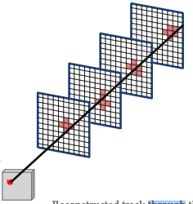
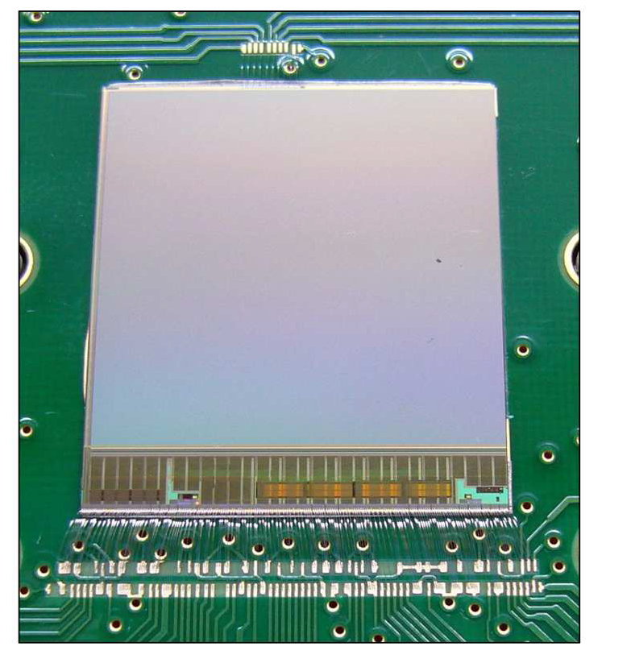
MIMOSA-28 sensor
Measurements of charged particle trajectories
CMOS technology
Active area: ~ 2 × 2 cm2
Pixel size: 20.7 μm
Epitaxial layer: 14 μm
Readout time: 186.5 μs
Spatial resolution: σ < 10 μm
Binary output with high resolution
Developed by PICSEL group,
IPHC Strasbourg
PhD Thesis of Claire Anne Reidel
Reconstructed track through the
different clusters and vertex

Slide 3
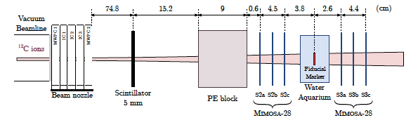
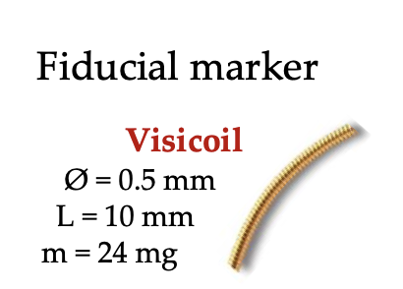
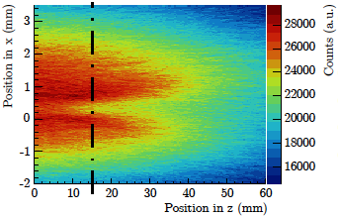
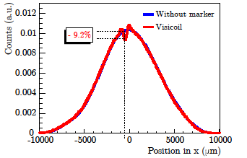
CMOS experience @ Biophysics
Fluence perturbations due to fiducial markers in ion-beam therapy
Three-dimensional fluence distribution from all reconstructed tracks
Quantification of the fluence perturbation due to fiducial markers for particle therapy
Reidel, C. A. et al PMB 2020.

Slide 4
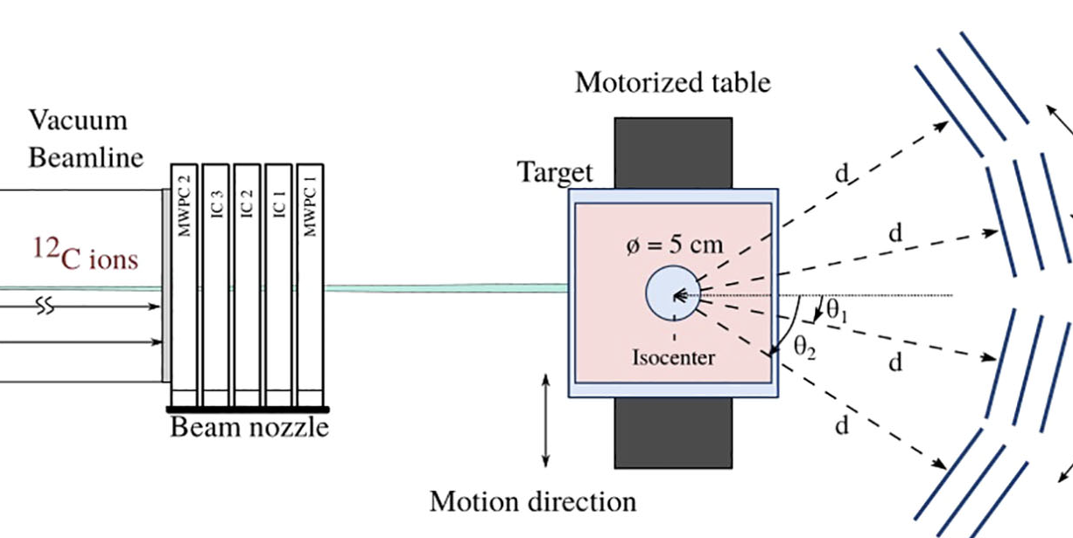
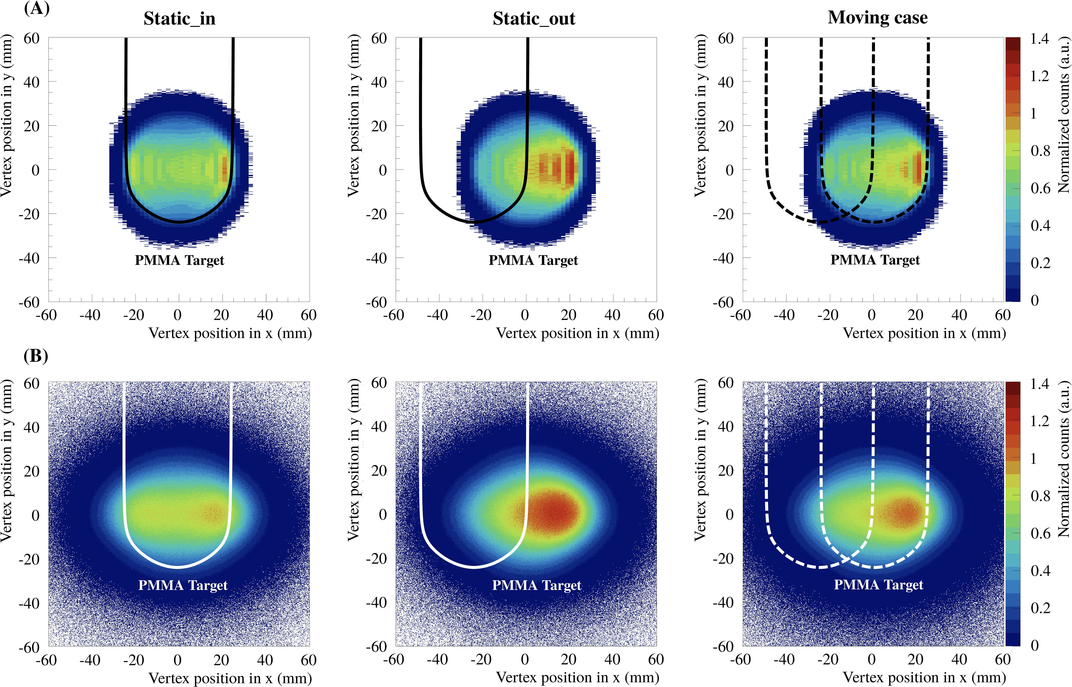
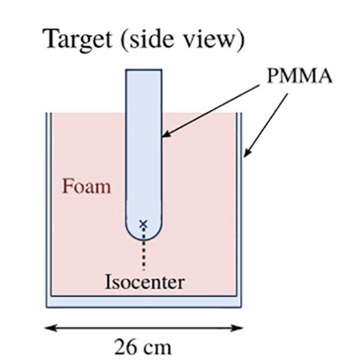
CMOS experience @ Biophysics
4D-online monitoring of density gradients
CMOS particle trackers that are used to reconstruct the fragment vertices and to verify a treatment delivery
Reidel, C. A. et al Front. Oncol. 2025

Slide 5
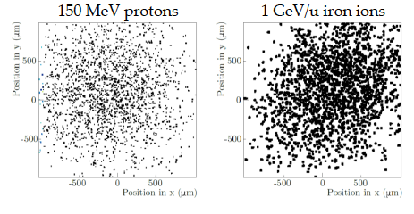
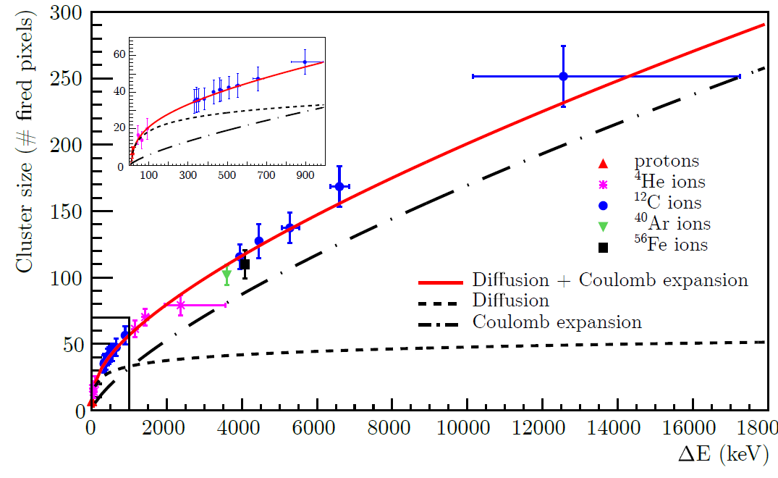
CMOS experience @ Biophysics
Cluster size distributions to different particles and energies
Dependence on the energy loss
Dependence on particle species?
C.-A. Reidel et al., NIMA, 2021

Slide 6
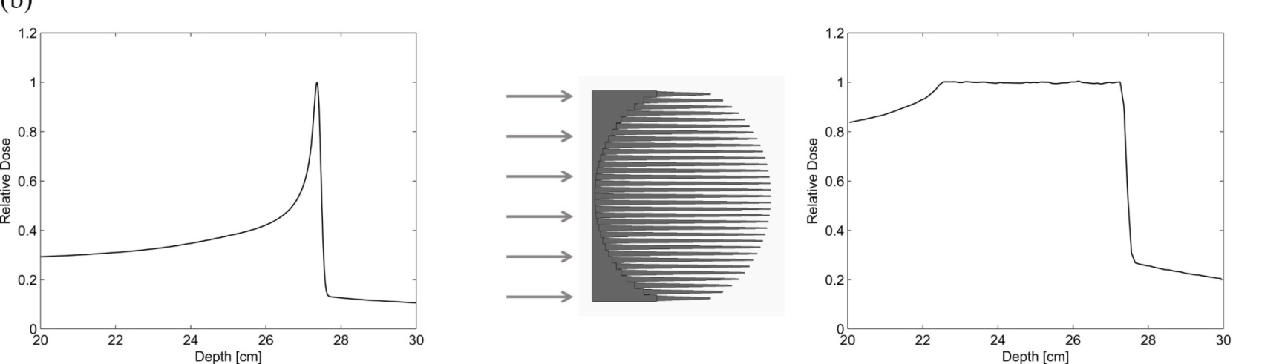
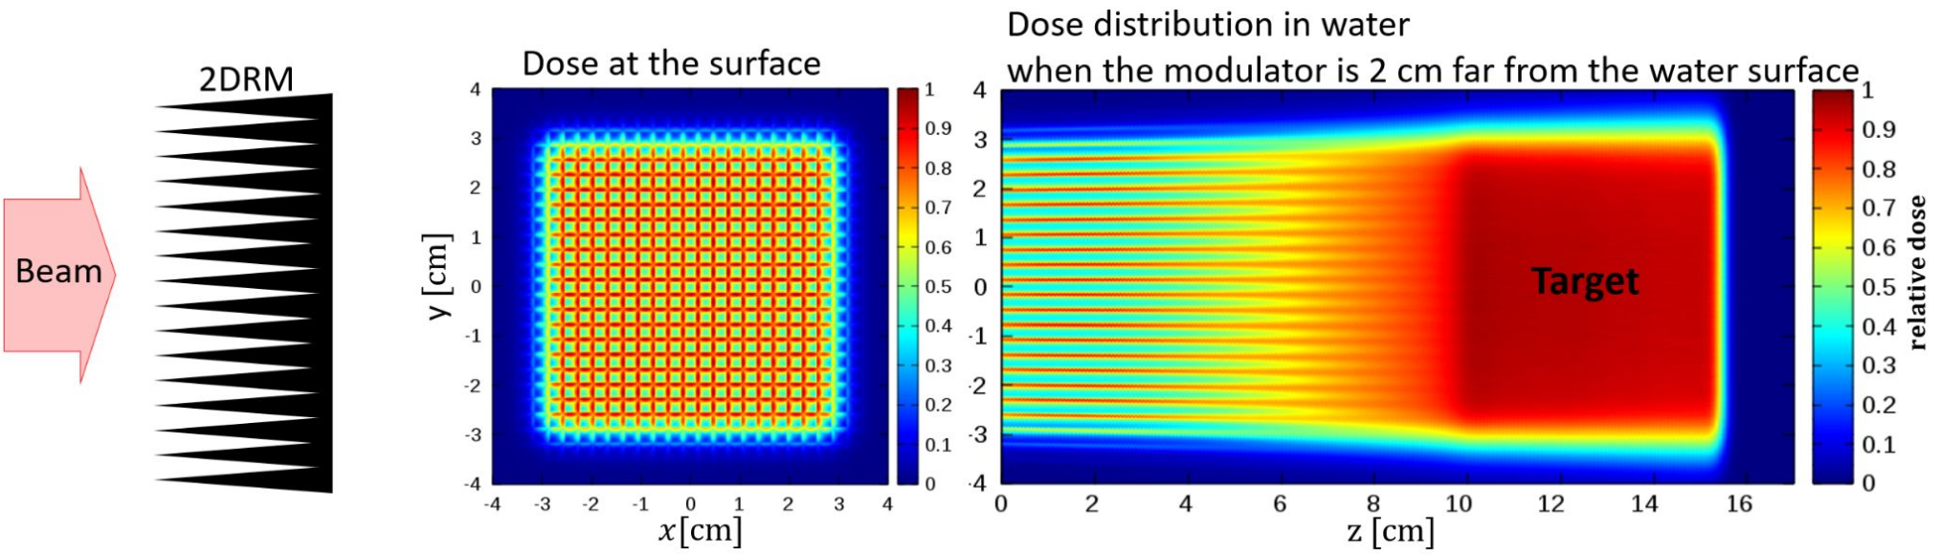
Characterization of complex scattered fields:
Near-field of 3D-Range-Modulators for in FLASH beam application:
Simeonov et al, PMB, 2017.

Slide 7
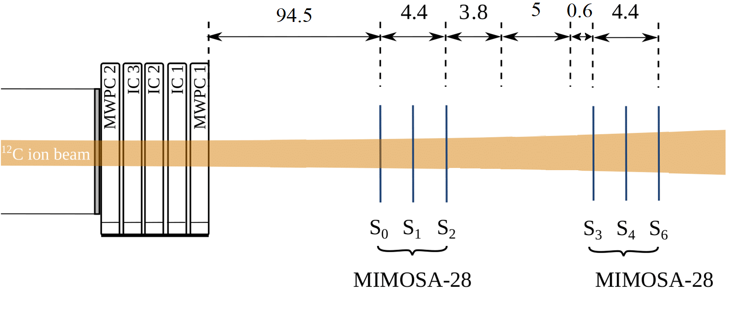
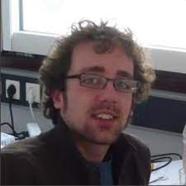
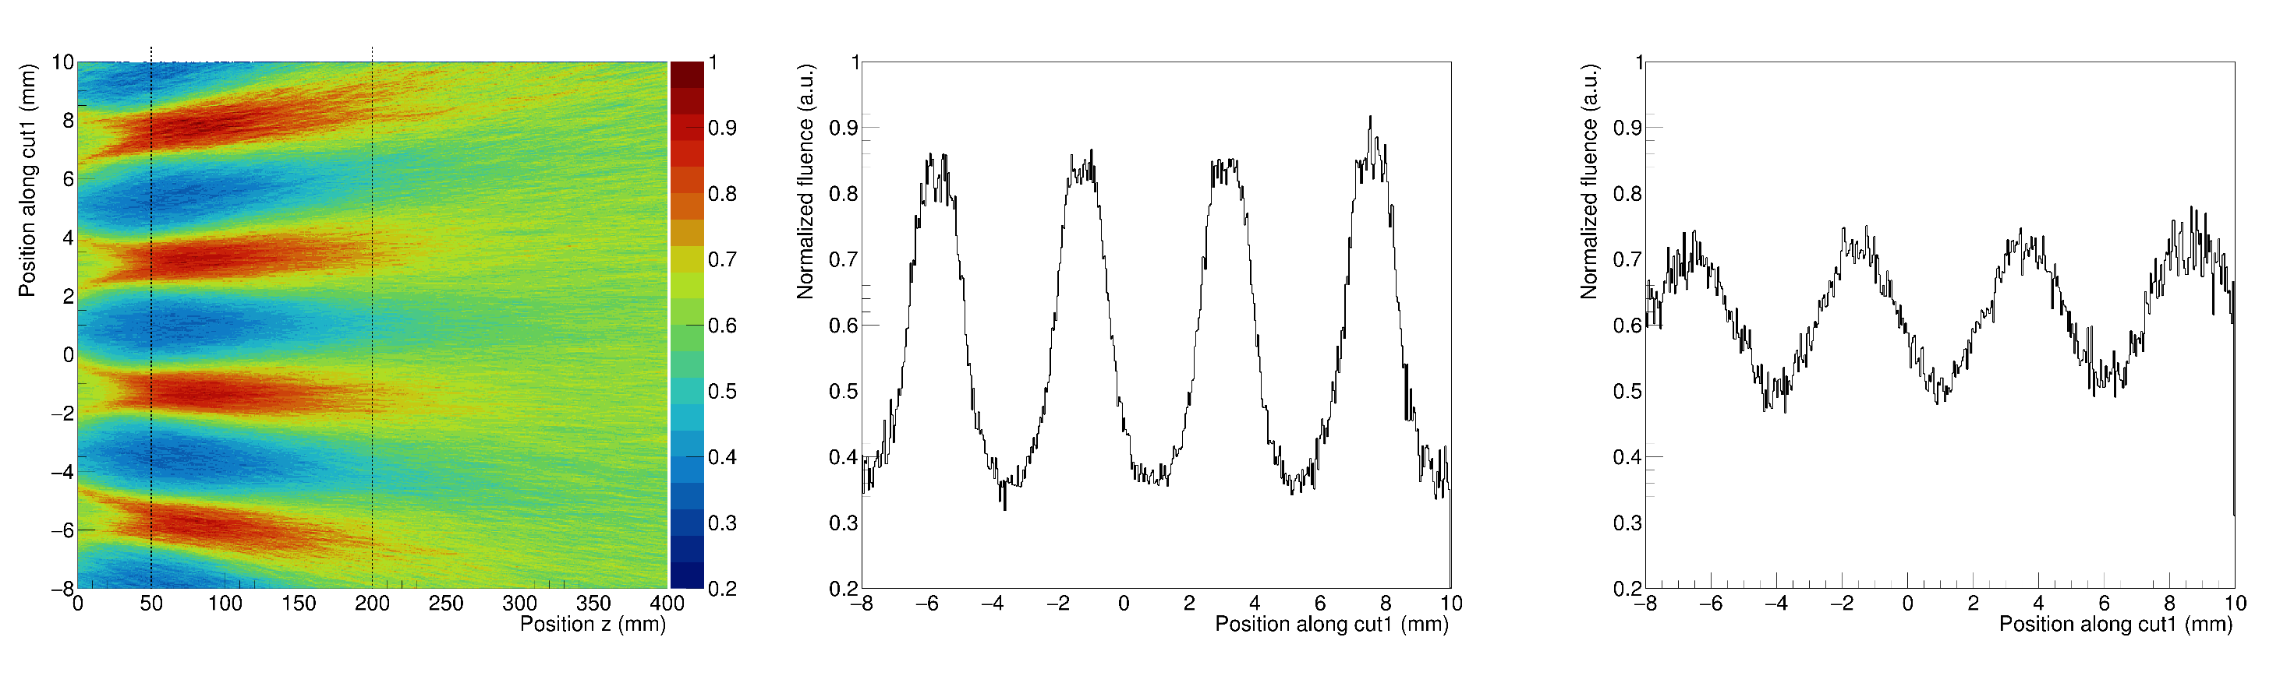
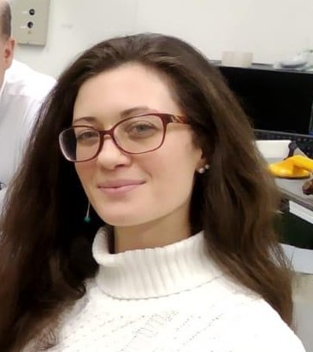
Characterization of complex scattered fields:
Near-field of 3D-Range-Modulators for in FLASH beam application:
Experiment conducted by Claire-Anne Reidel and Christoph Schuy
50 mm
200 mm

Slide 8
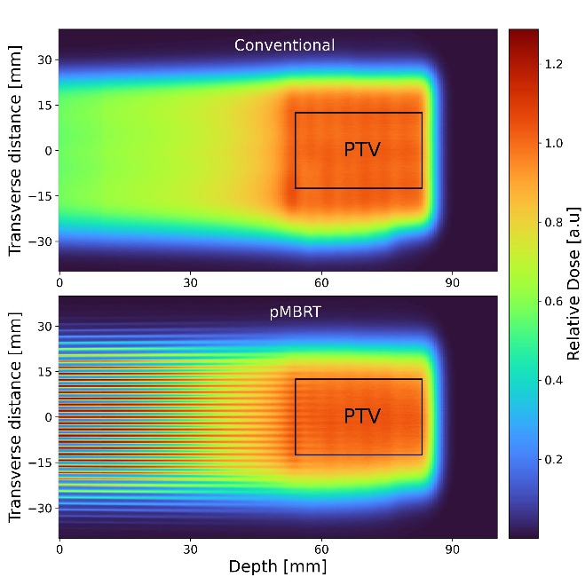
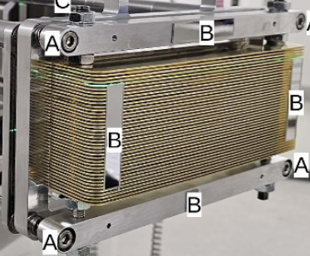
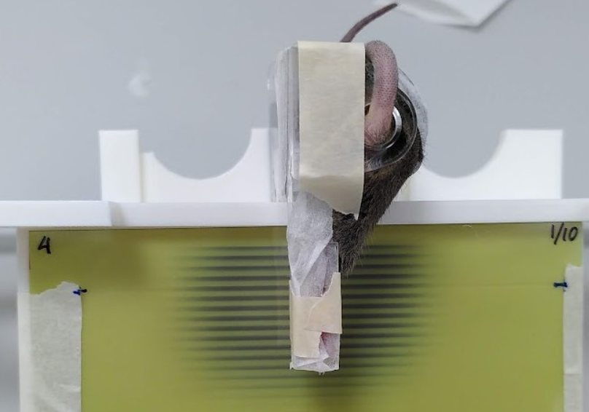
Characterization of complex scattered fields:
Mini Beam

Slide 9
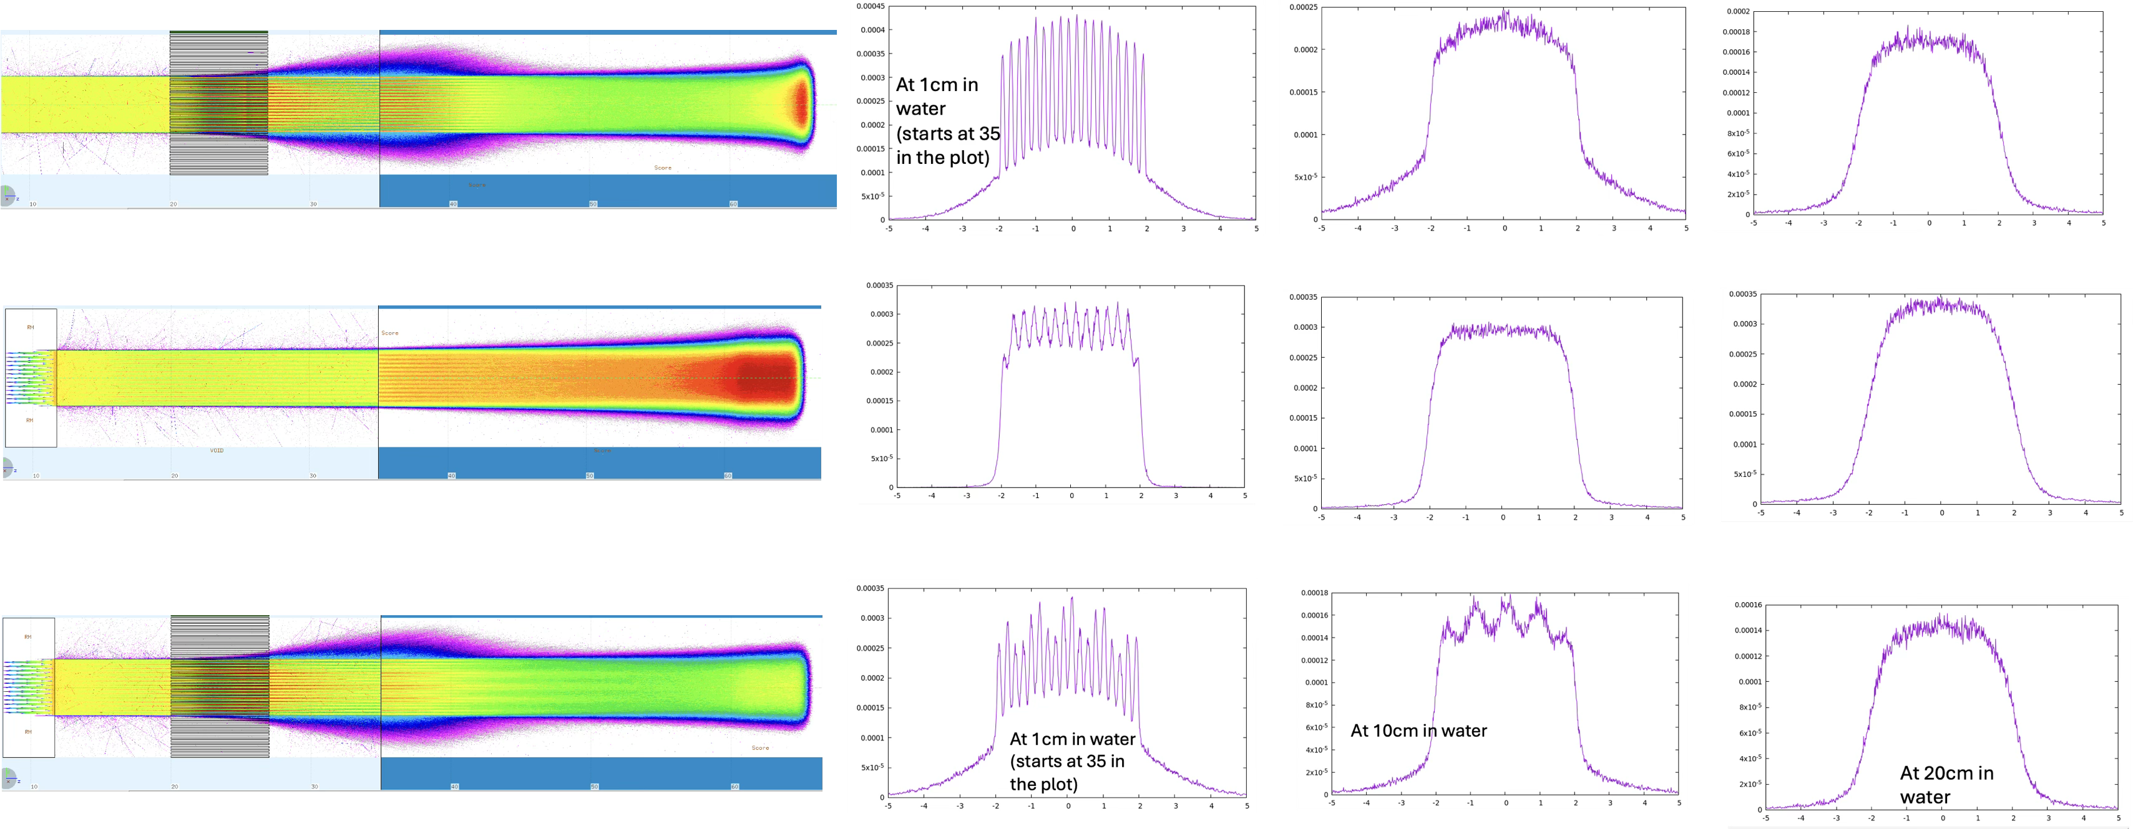
Characterization of complex scattered fields:
Or even combining them… PRESTO (EU Pianoforte project)
Mini Beam
Modulator
Modulator + Mini Beam

Slide 10
Wish list for pixel detectors for medical physics applications
Ideal applications:
Beam QA for particle therapy
Trackers for monitoring in beam: looking at the phase space
Possibly able to measure dE/dx
Ideal characteristics:
Large area
Operational at high intensities (10^5-10^6 particle per spill)
Compact and transportable
Simple to operate (evtl some routines for clustering, alignment etc..)

Slide 11
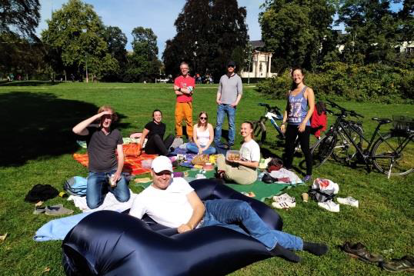
Aknowledgments
Claire Anne Reidel
Uli Weber
Christoph Schuy
Andreas Bückner
Marco Durante
Thank you for the attention!

