Slide 1
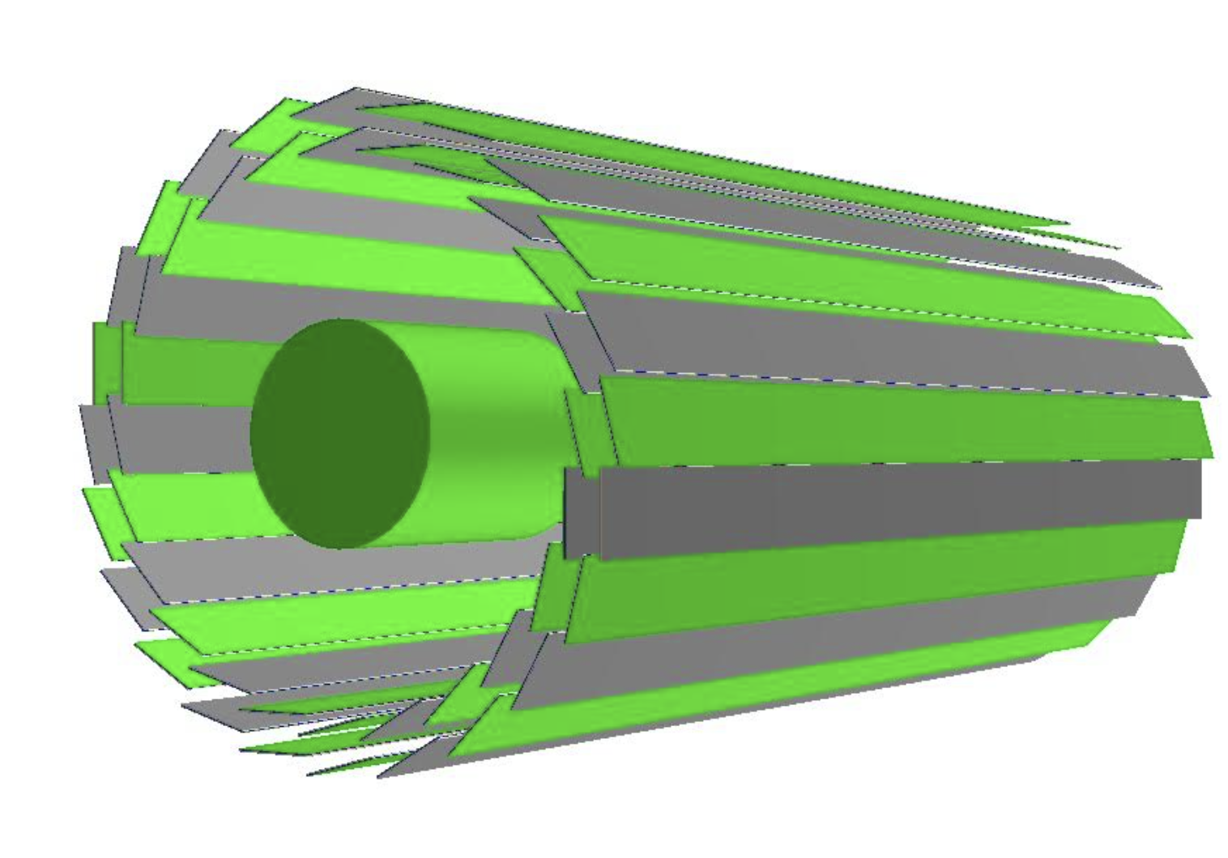
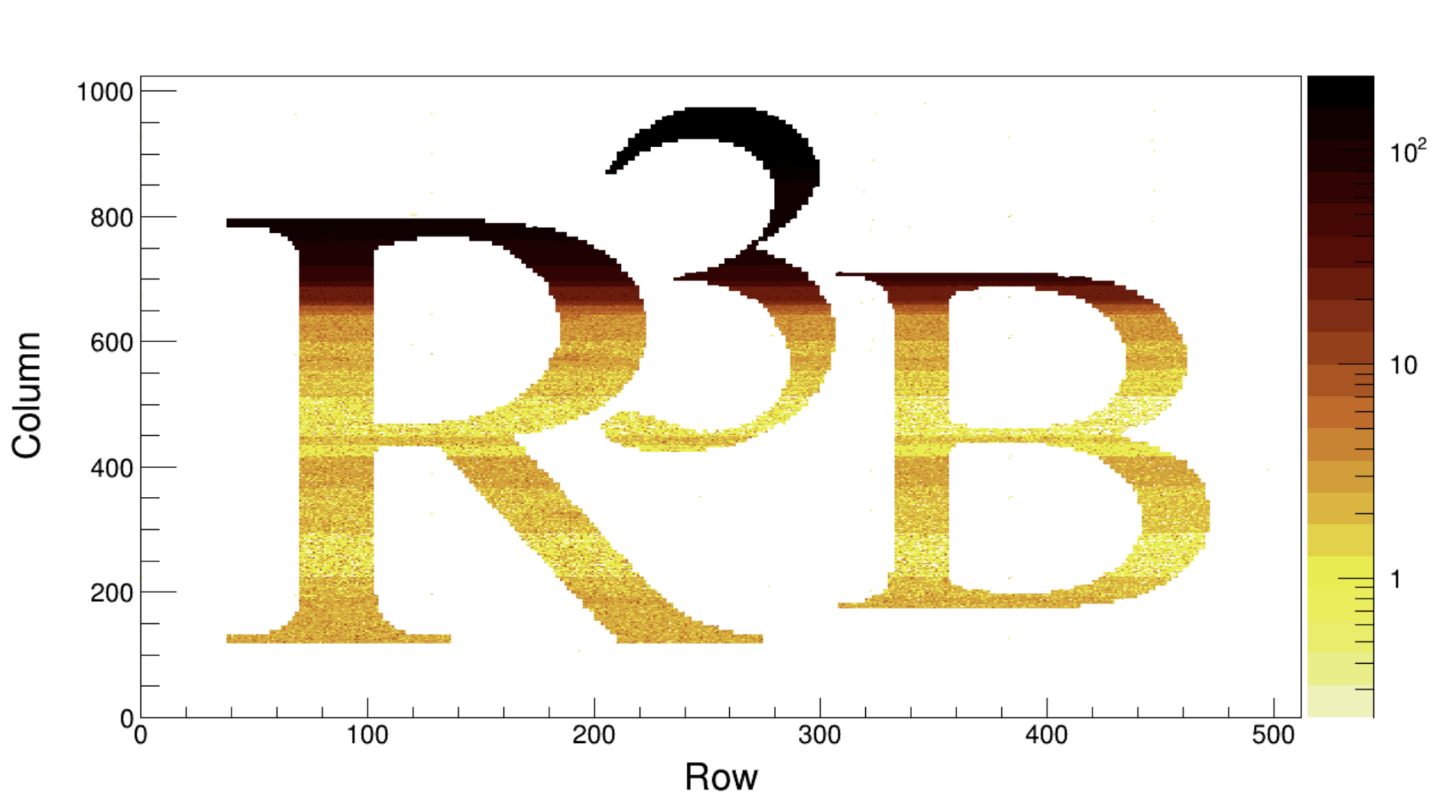
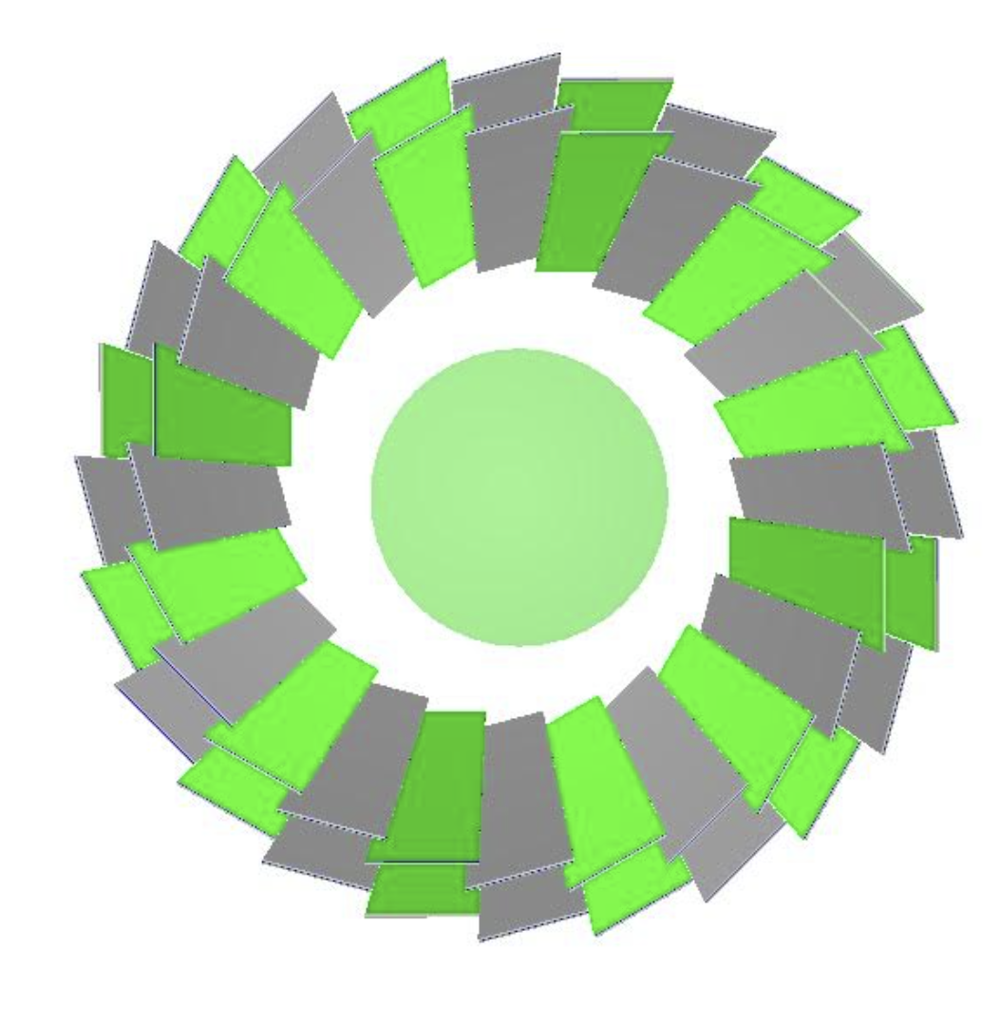
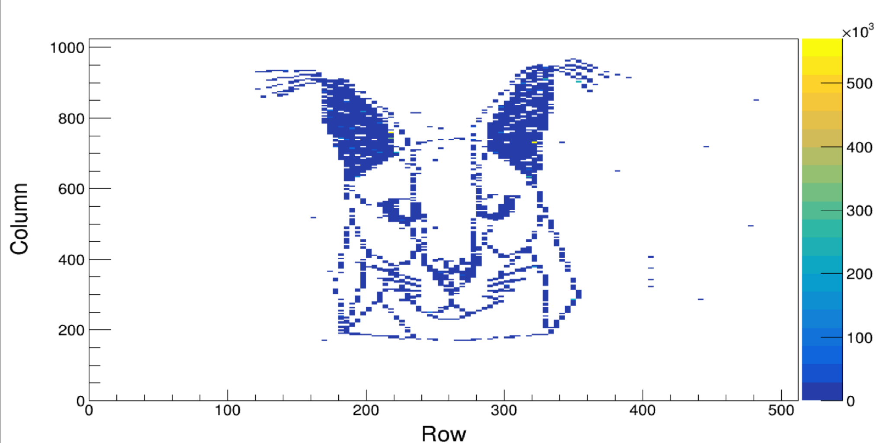



Pixels in NUSTAR
By:Luke Rose
Date:23/03/2026

Slide 2
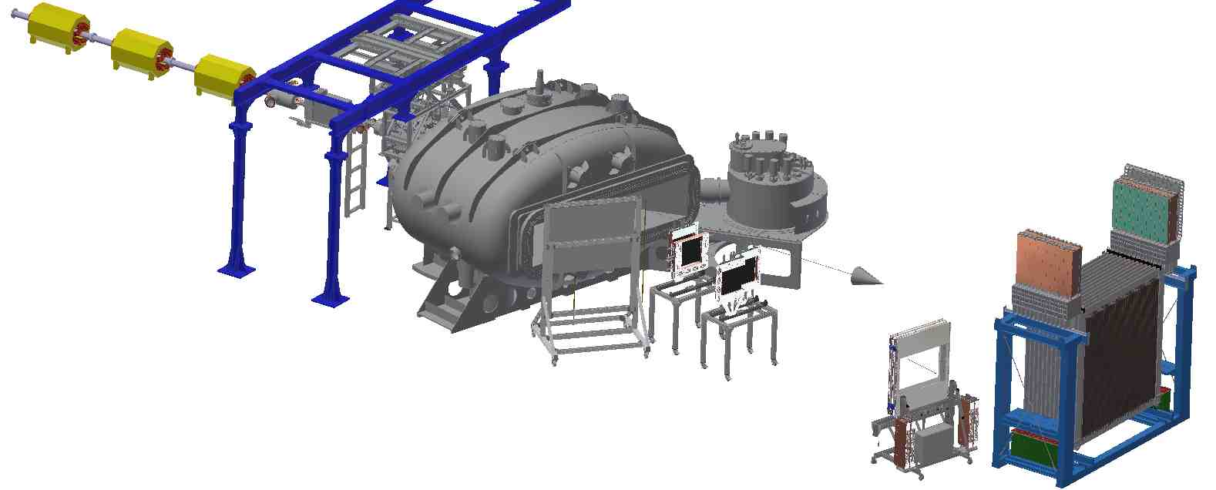

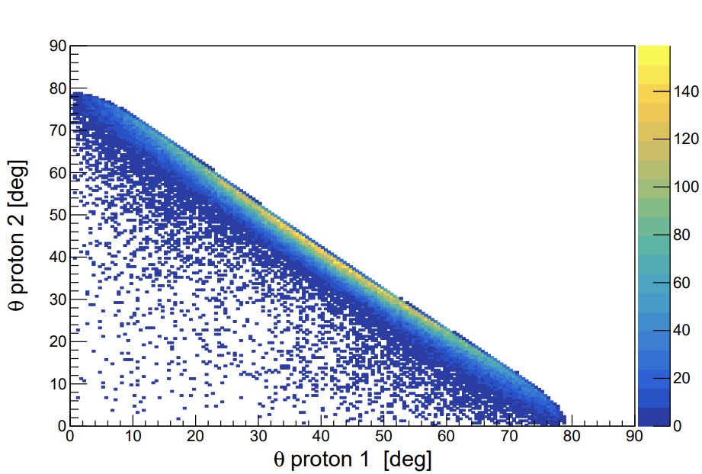
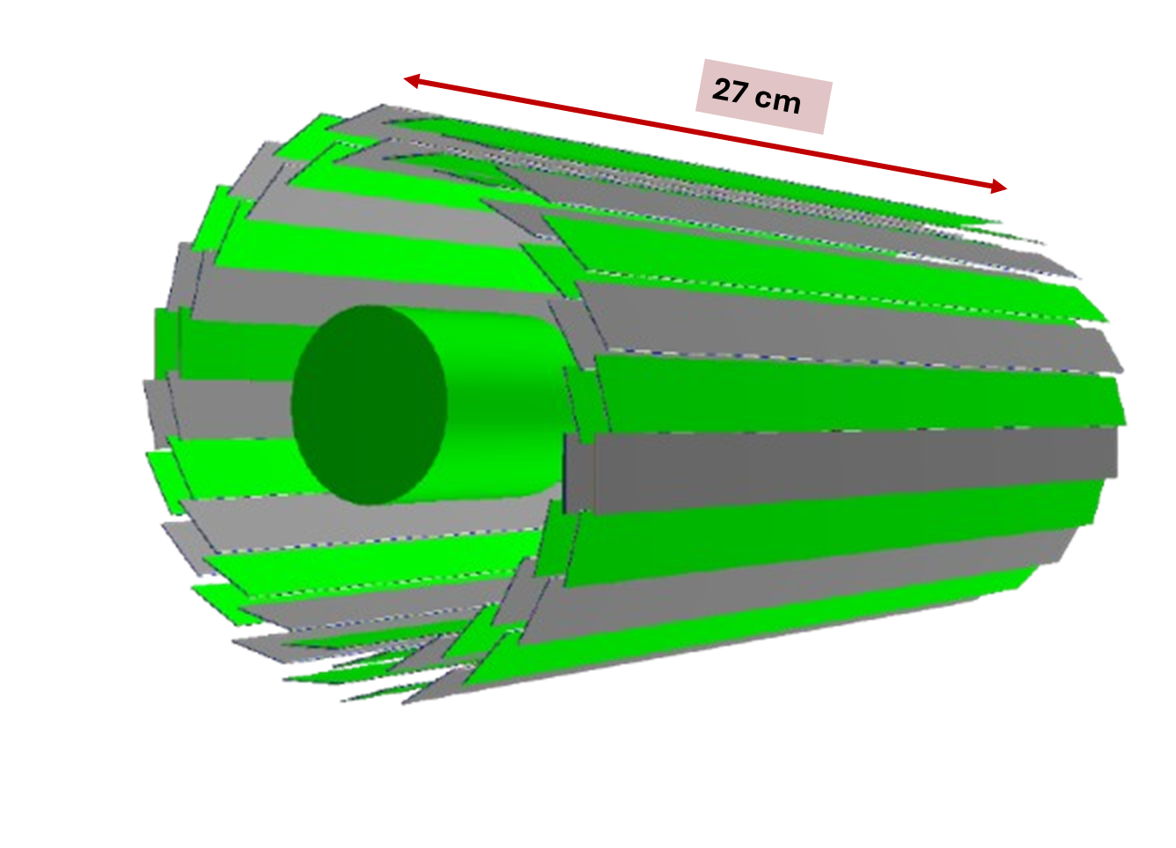
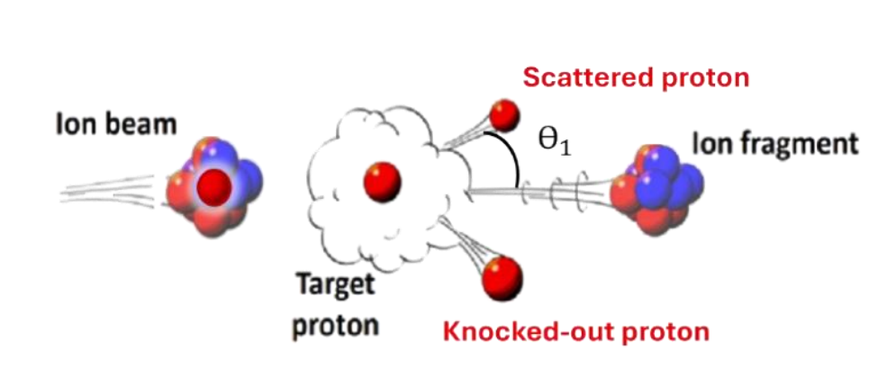
R3B-QFS Physics case
GLAD
Physics programs
Study nuclear structure using QFS as a reaction probe.
  ^{A}X(p,2p)Y^{A-1}
Want to study the scattered and knocked out proton to find the vertex of the reaction.
Target area

Slide 3
R3B-TRT
TRT Requirements:
Two proton detection efficiency of >=65%.
Spatial resolution of ≈10 um.
2𝜋 azimuthal coverage.
Forward polar direction ≈ 10 − 90◦.
Low material budget.
Vertex resolution < 1 mm.
Radiation length = 0.23%.
DAQ capable of ≈50 kHz.
GLAD
Target area

Slide 4
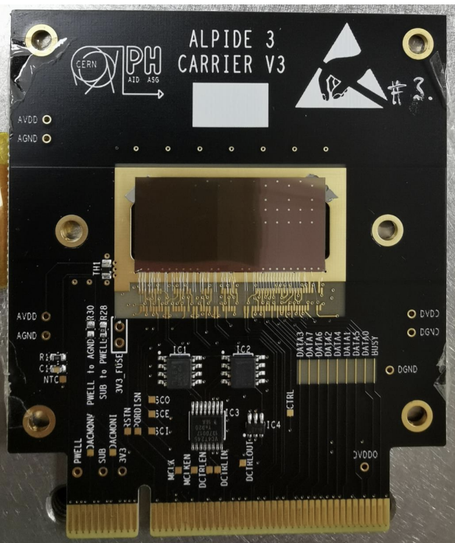
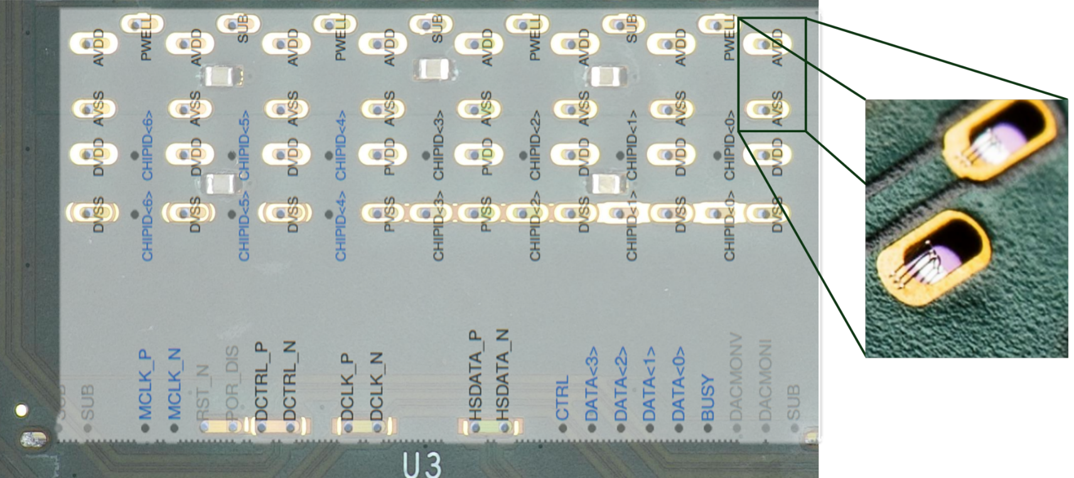
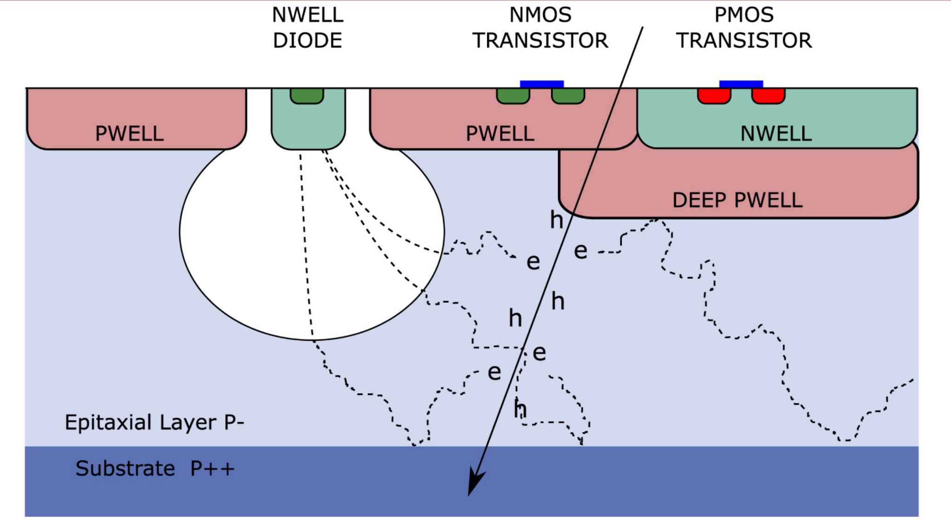
ALPIDE
3x1.5 cm² active area, 50 𝜇m bulk thickness, 25 𝜇m active thickness, 25 𝜇m non active.
Bonding pads used to configure different modes (Inner Barrel).
Back bias can be applied to create a larger depletion region reducing the diffusion time and reducing background noise.
  Current settings VBB=0V,-3V and for “gold chips” -6V.

Slide 5
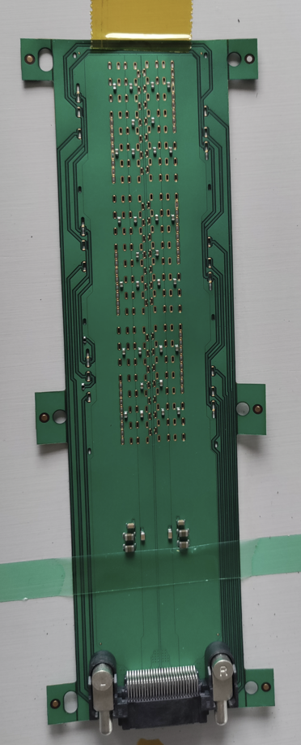
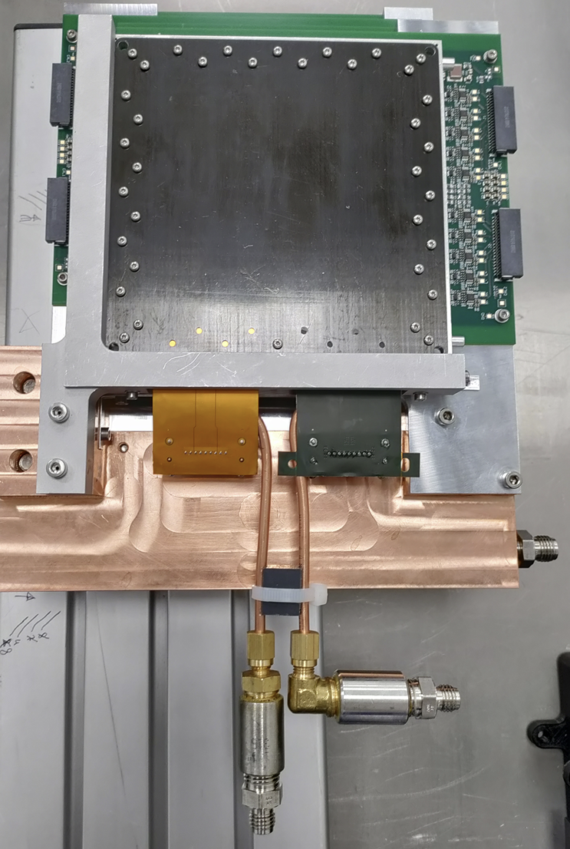
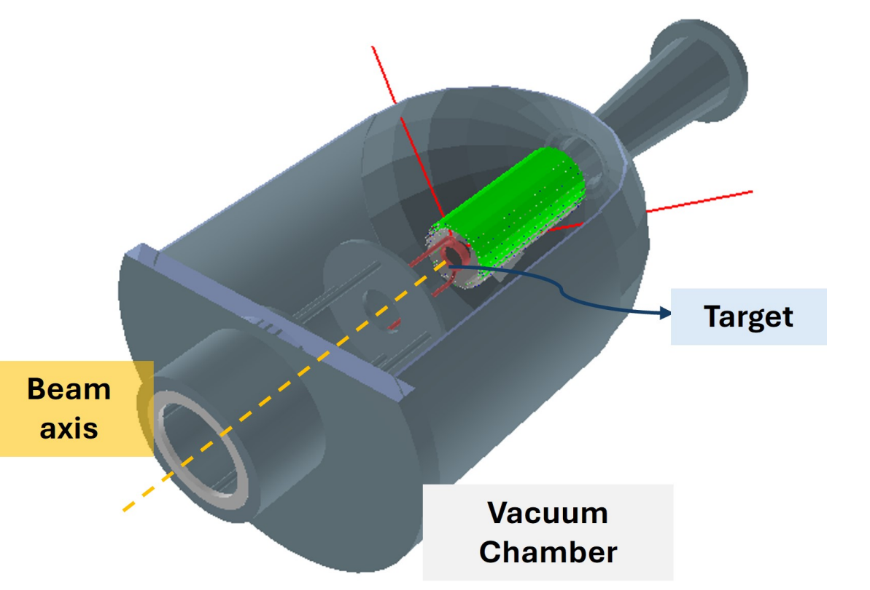
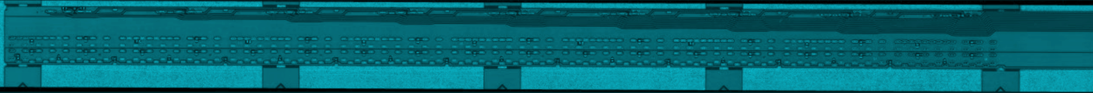
ALPIDE detector Form factors
SCC:
Single Carrier Card.
Test platz board.
Stage1:
3x2 array of chips.
3 modules gives a plane.
Active area≈9x9 cm²
Stage2:
1x9 array of chips.
Placed in barrel geometry.

Slide 6
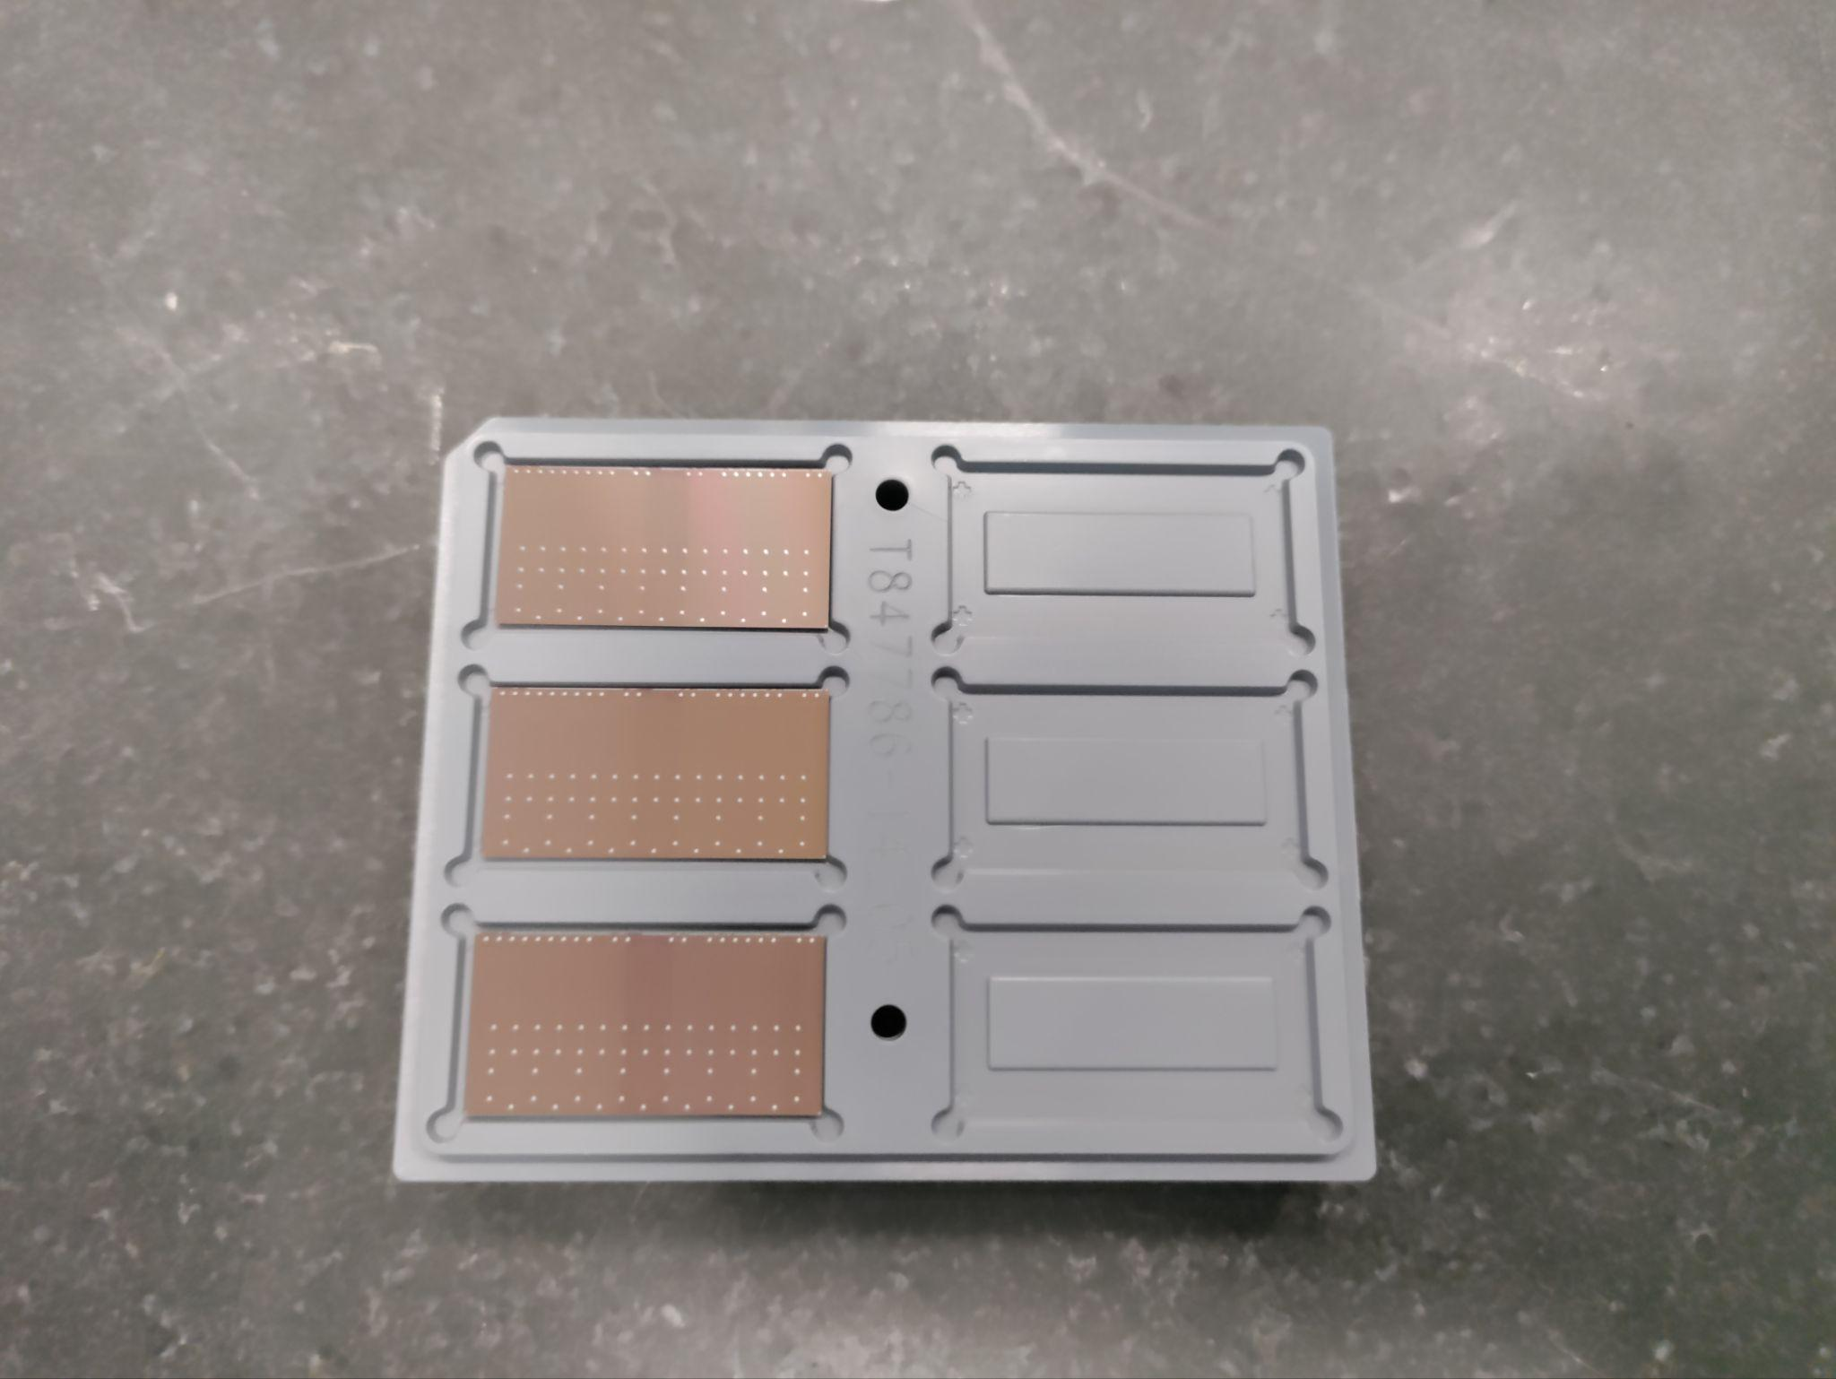
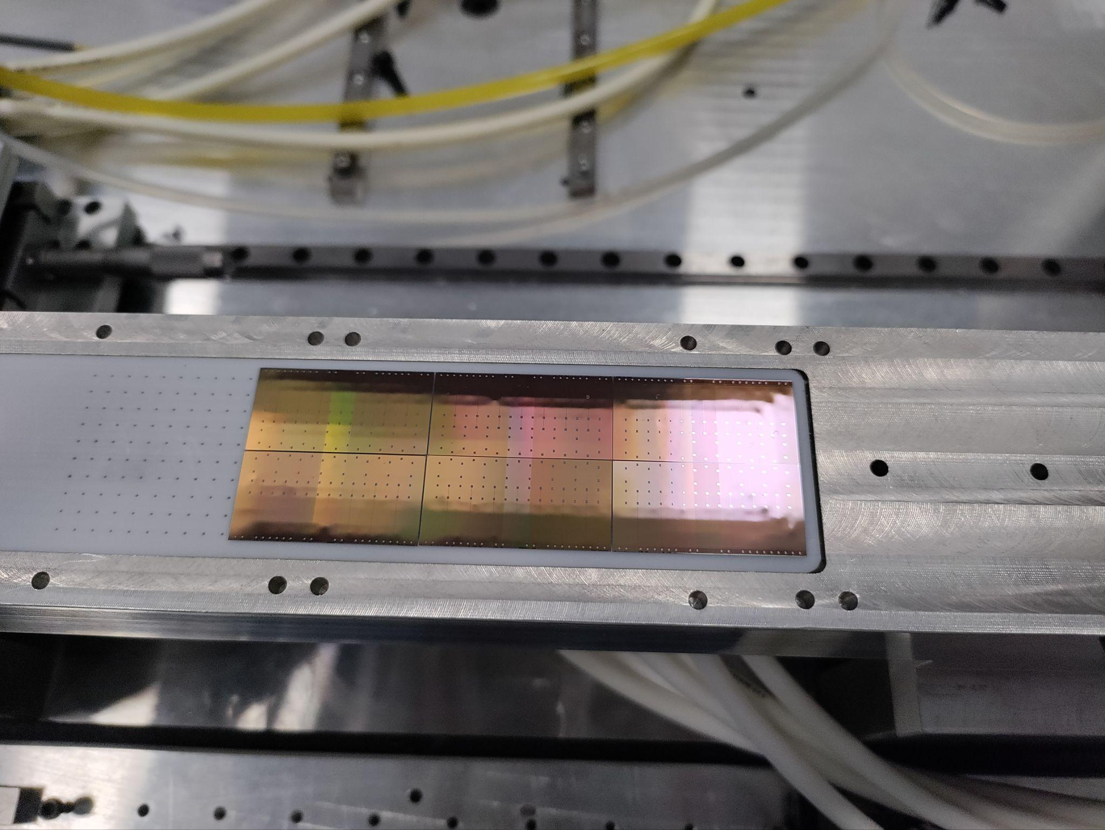
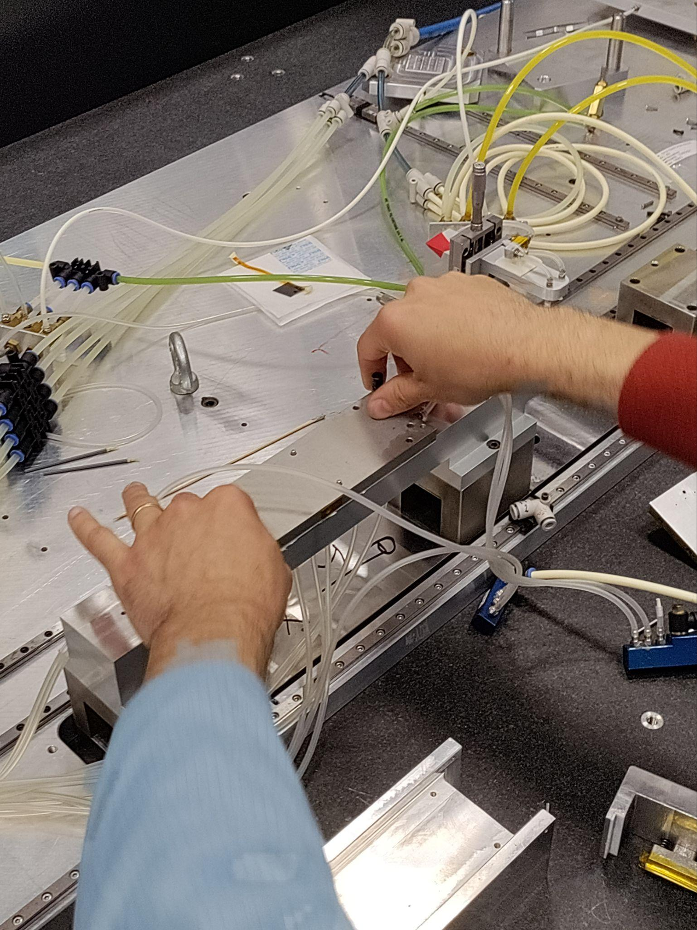
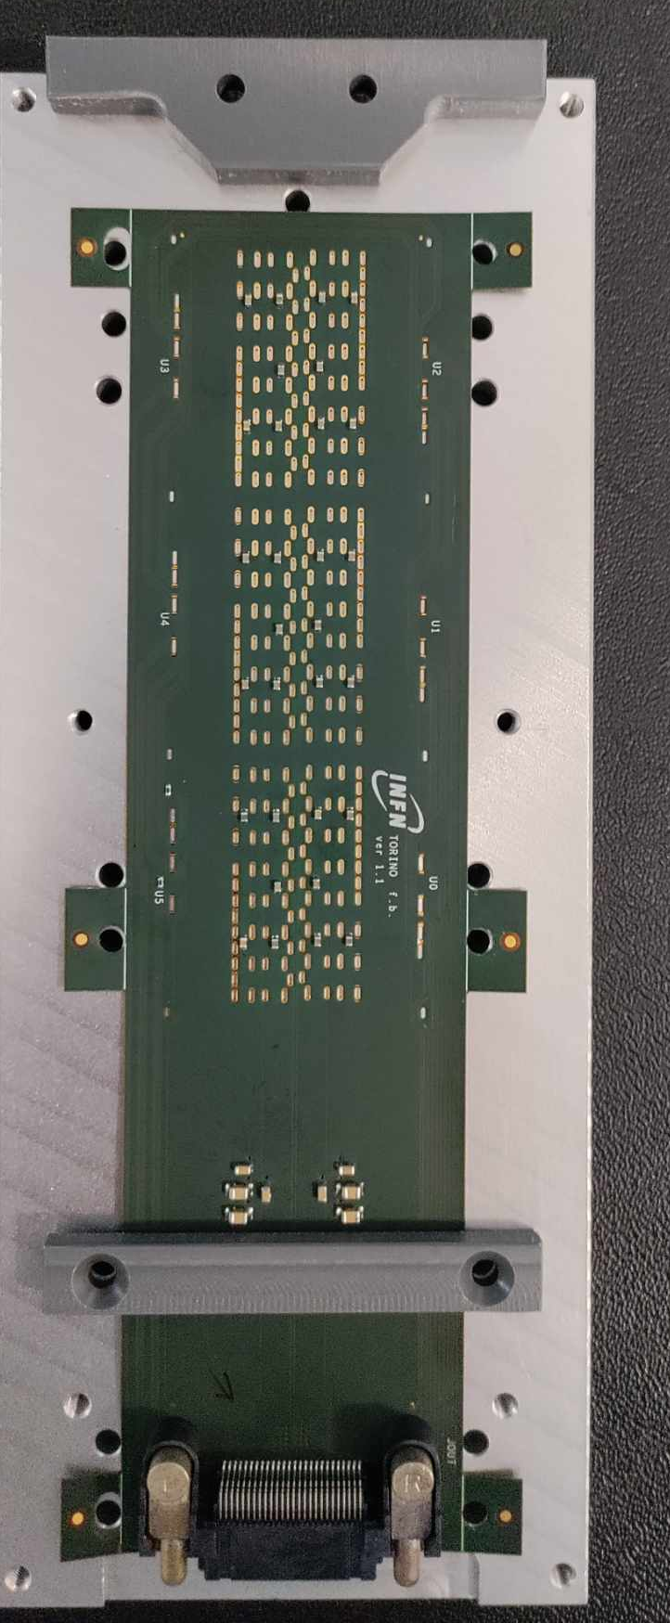
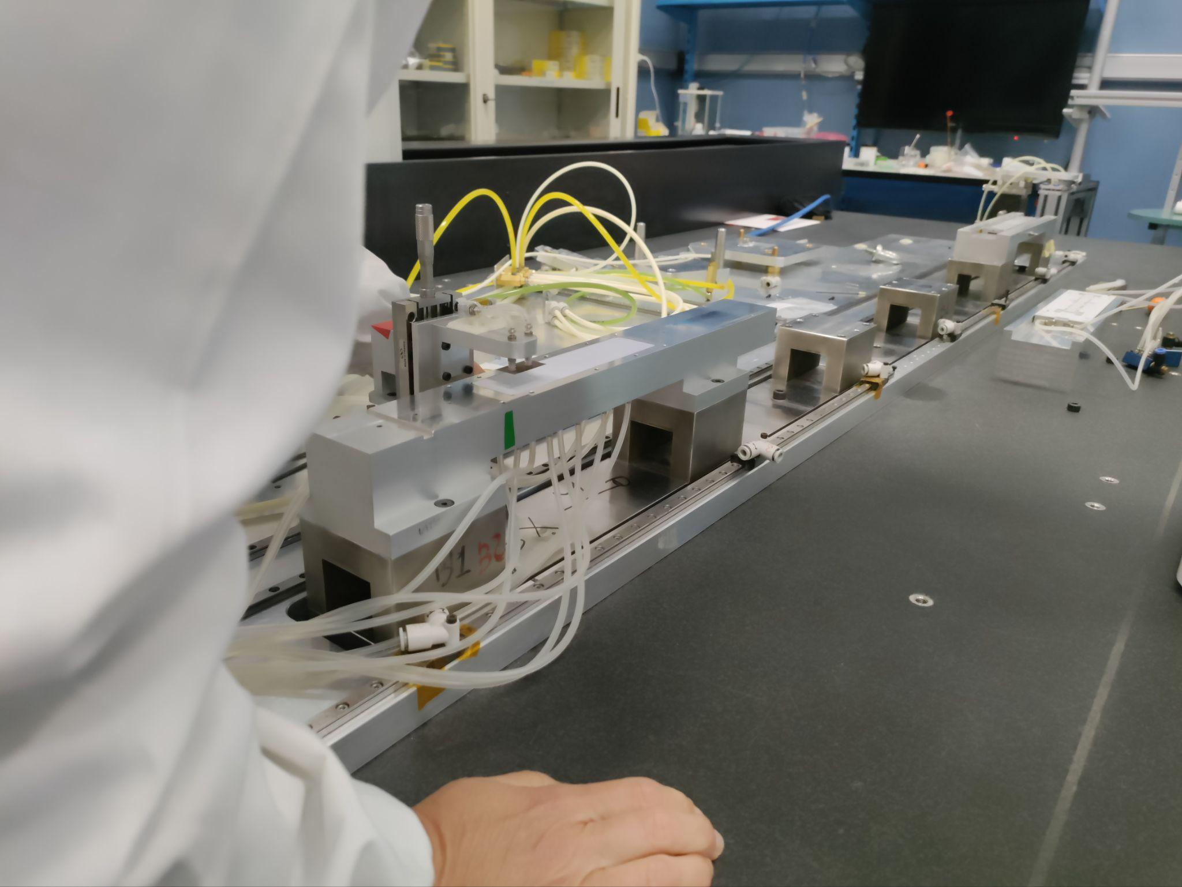
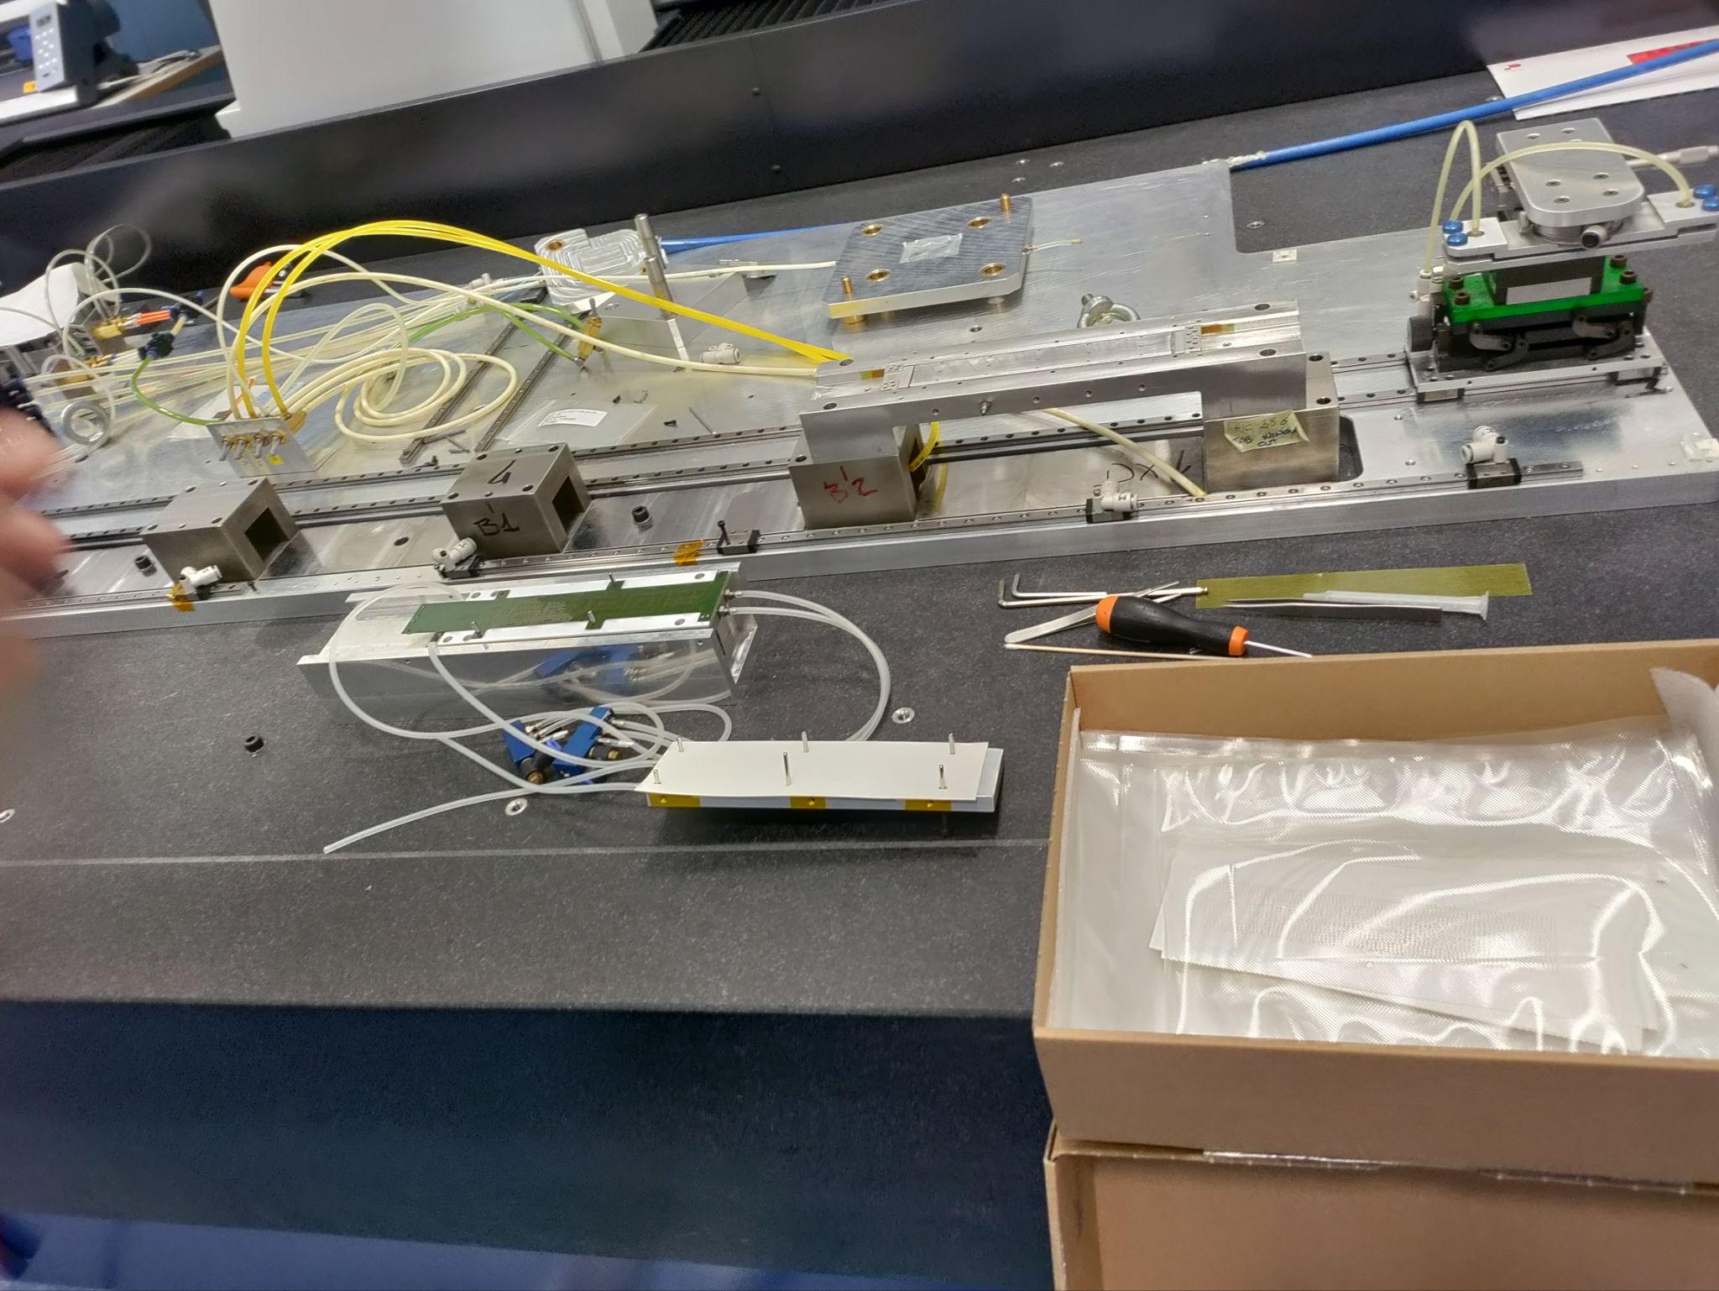
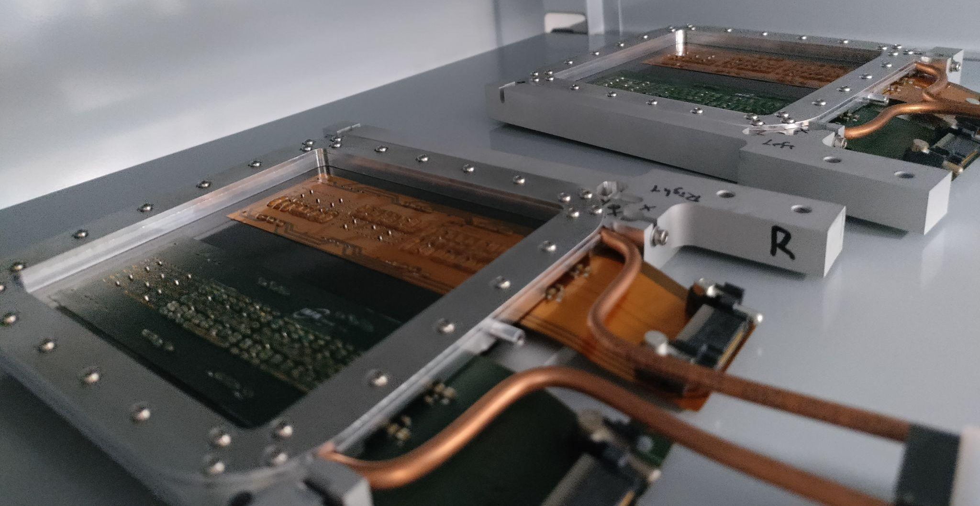
Module production - Stage 1
Chips taken from wafer tray.
Placed using CMM and micrometer jig on vacuum bed.
Position measured for all chips and recorded.
Glue mask placed on FPC and dots are produced on the FPC.
FPC+Glue placed on-top of chips.
1.
3.
5.
6.
2.
4.
6. FPC removed from jig ready for characterization and testing.
7. Selected fully working FPC glued to carbon foil to form a plane.
7.
CMM = Coordinate Measuring Machine.

Slide 7
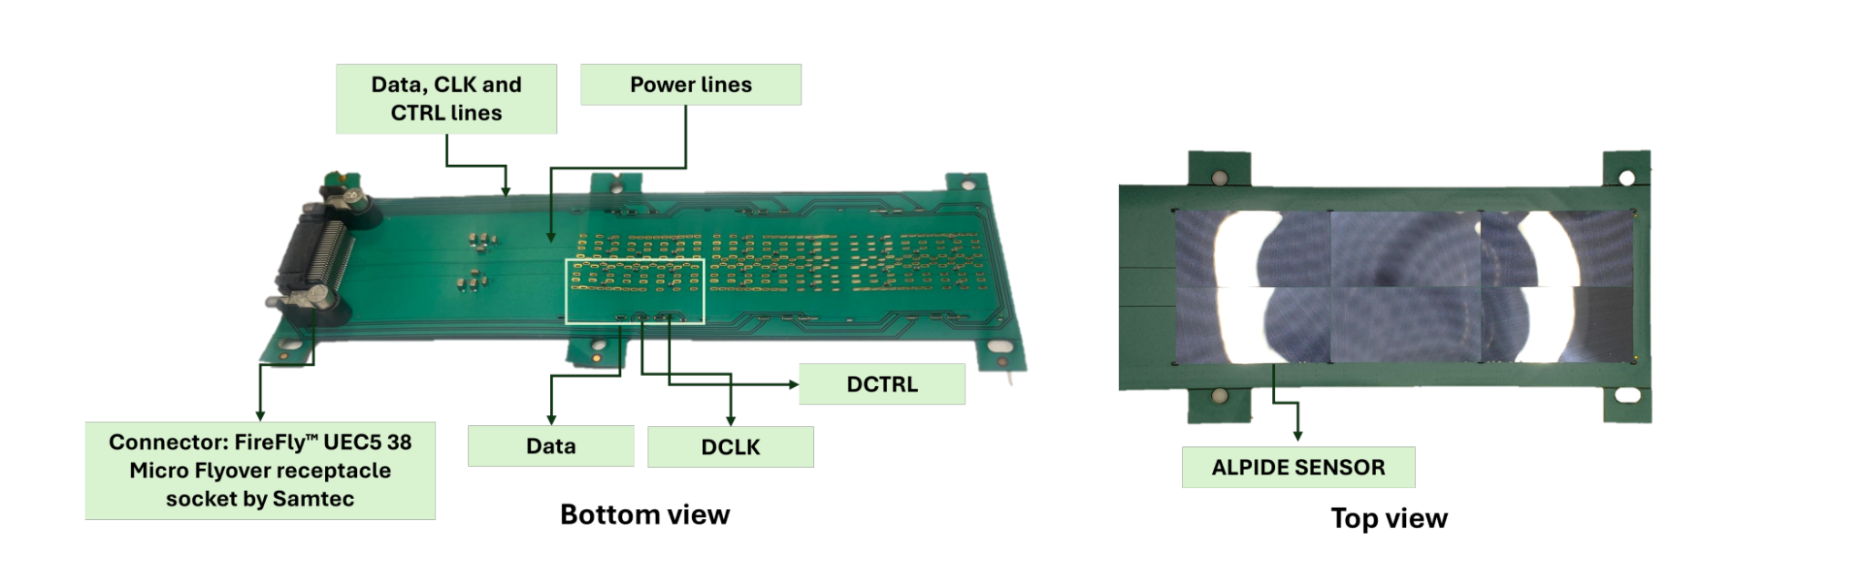
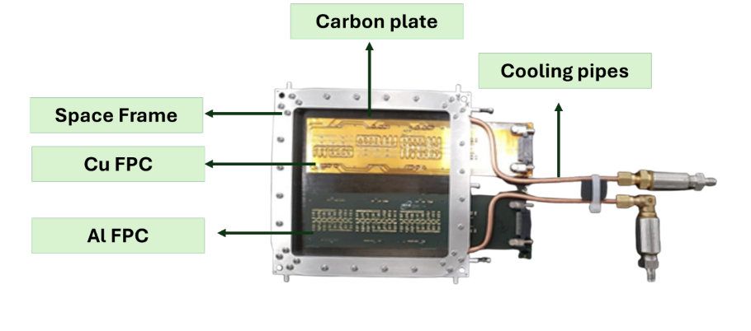
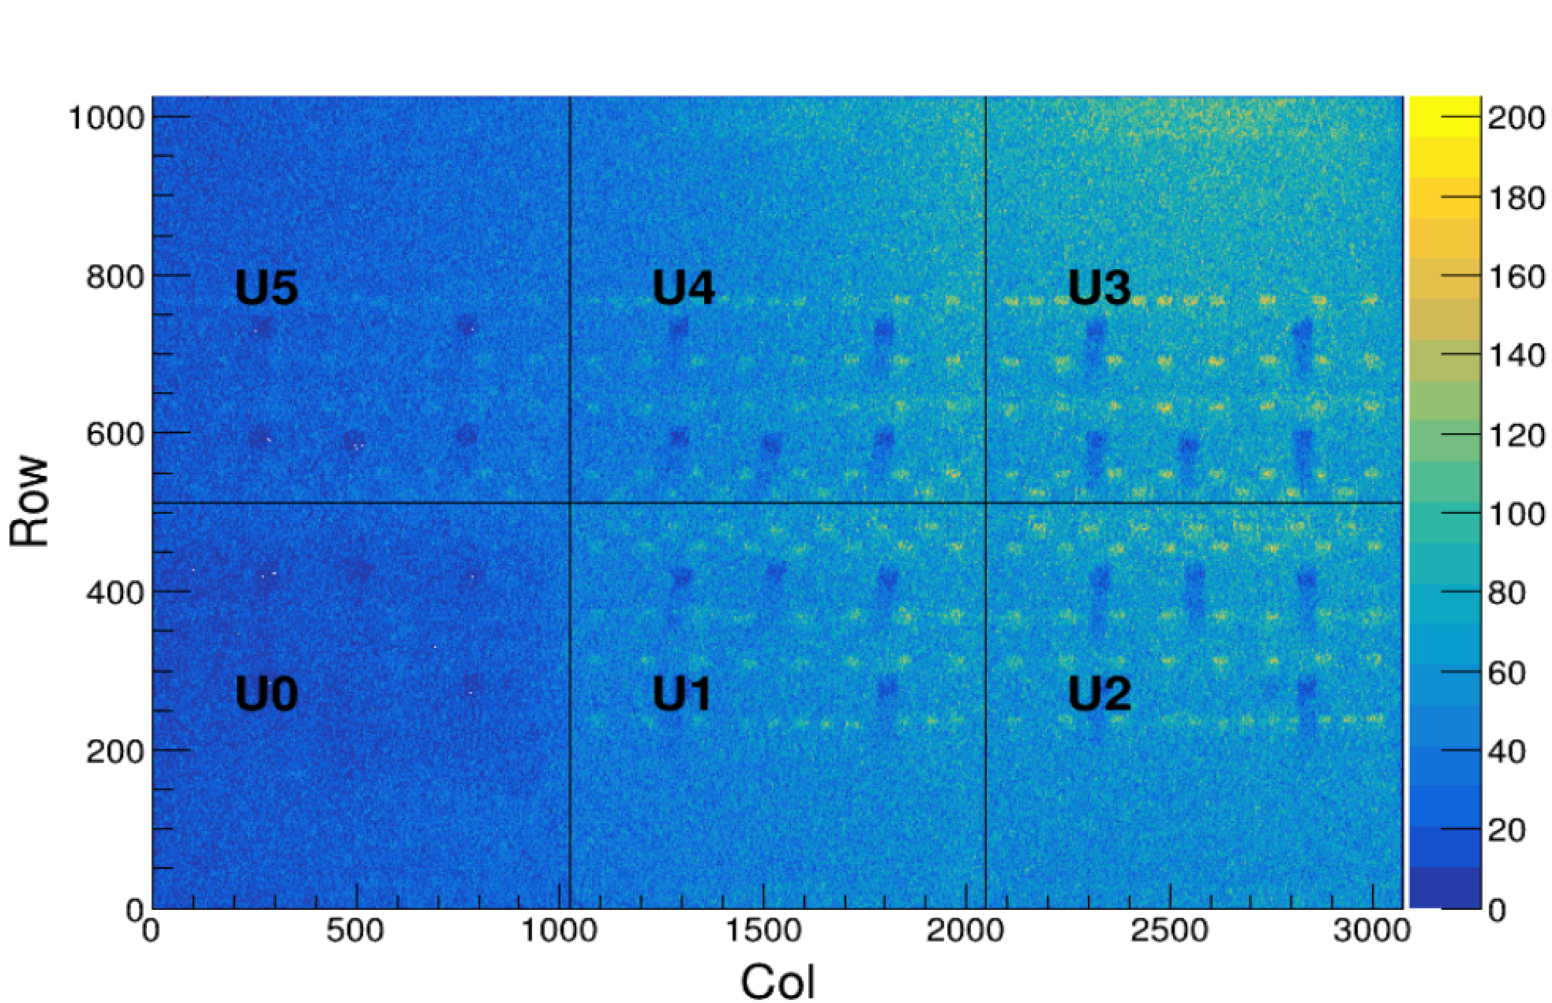
Stage 1 Module
Source scan data stage 1

Slide 8
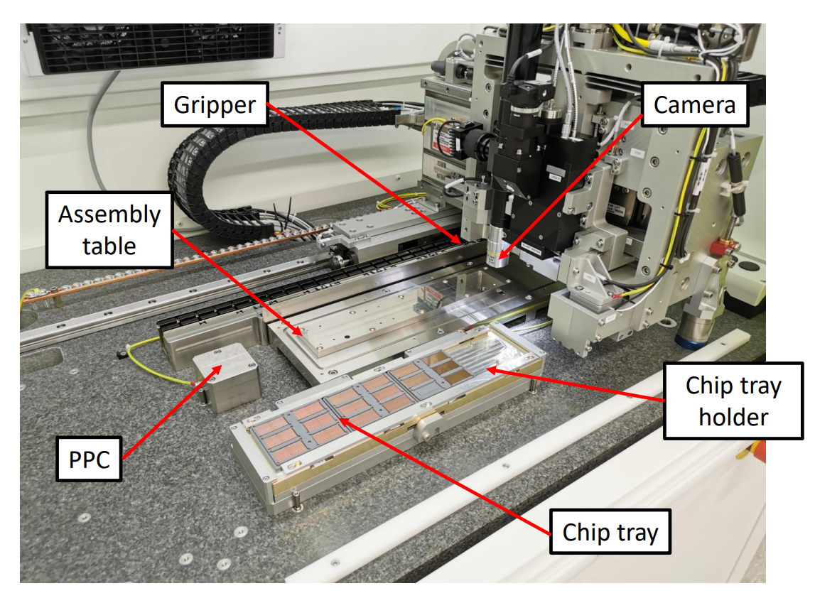
Module production - Stage 2
Chips taken from wafer tray.
Placed using ALICIA and held by vacuum jig.
Position measured for all chips and recorded.
Glue mask placed on FPC and dots are produced on the FPC.
FPC+Glue placed on-top of chips.
6. FPC removed from jig ready for characterization and testing.
7. Selected fully working FPC glued to carbon foil to form a plane.
ALICIA = ALICE Integrated Circuit Inspection and Assembly machine

Slide 9
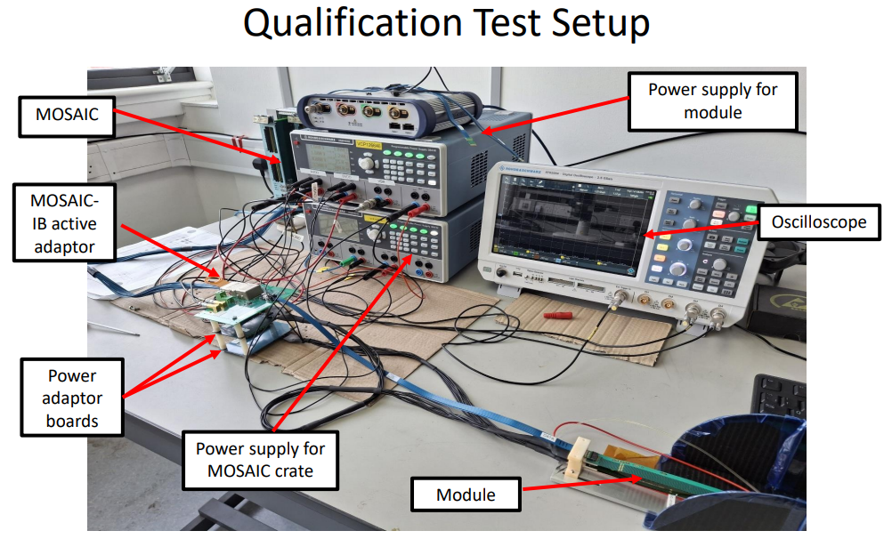
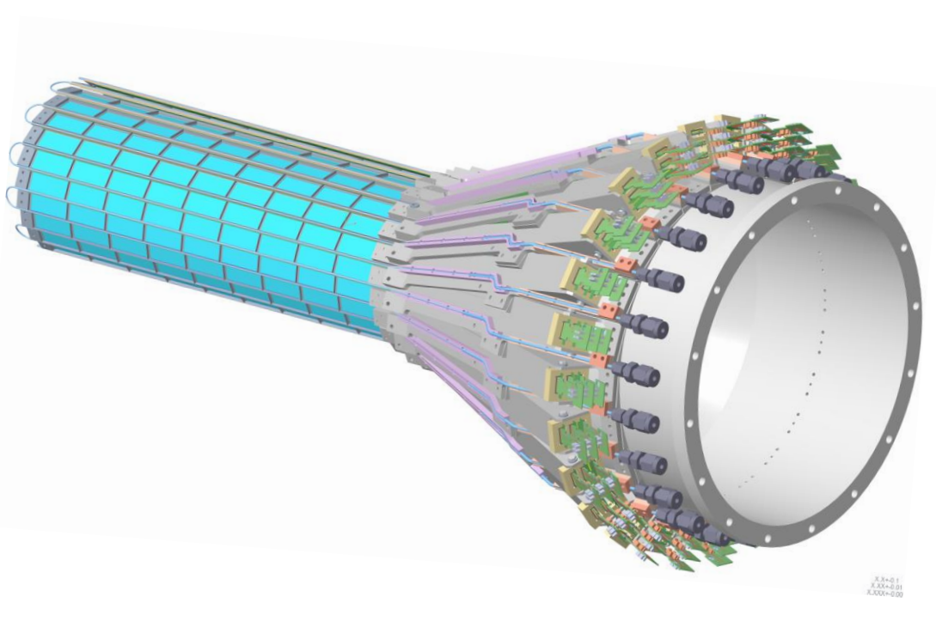
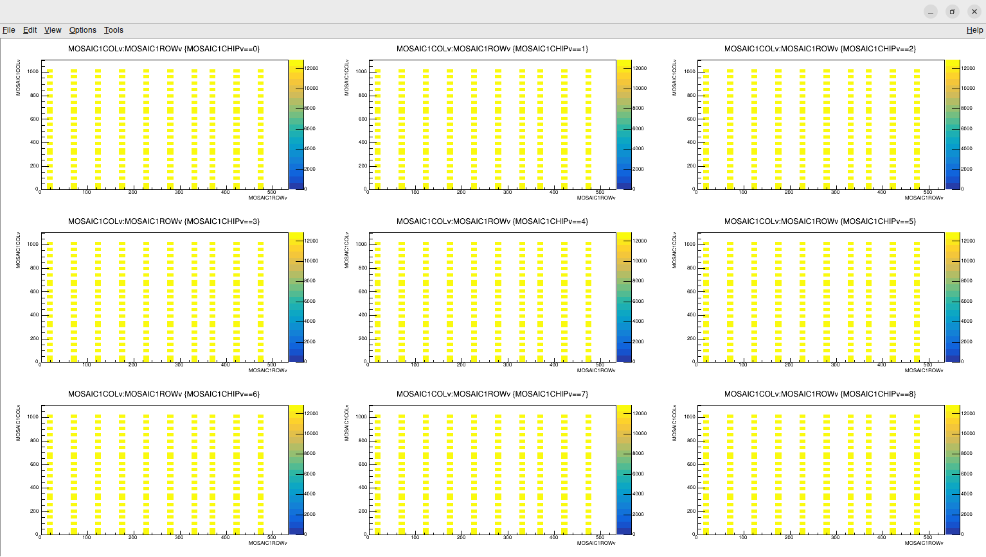
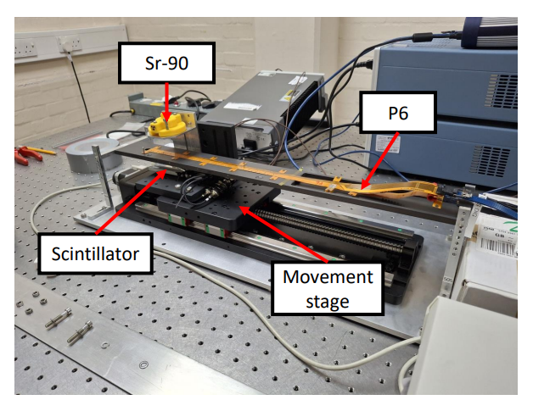
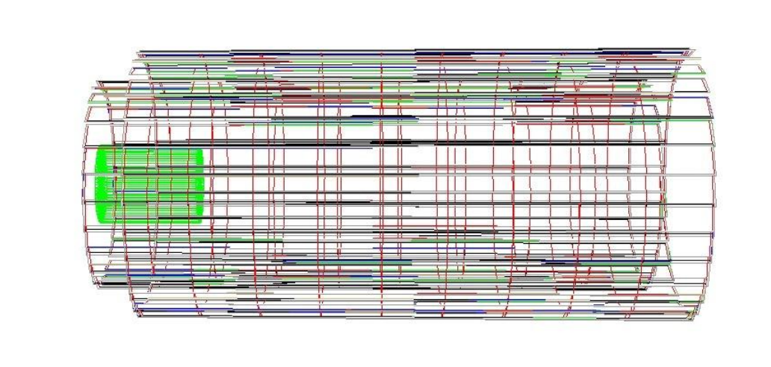
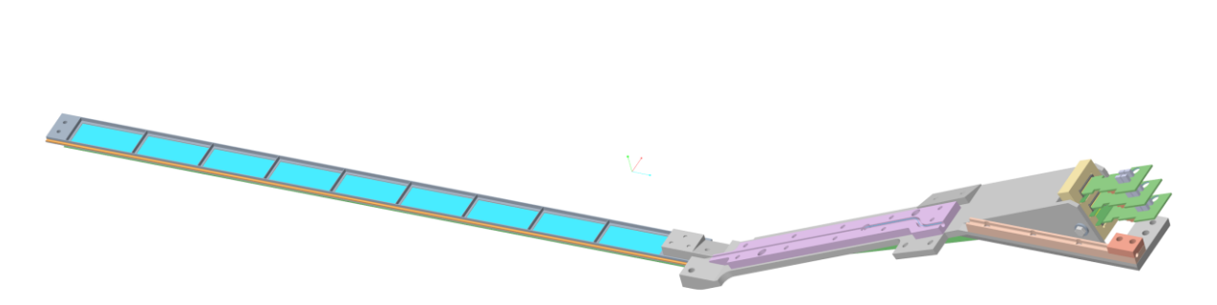
Stage 2 Module
Digital scan of all 9 chips in module
First prototypes produced and wire bonded.
Source scan station constructed.
Full module production to start soon.
Full DAQ testing is underway.

Slide 10
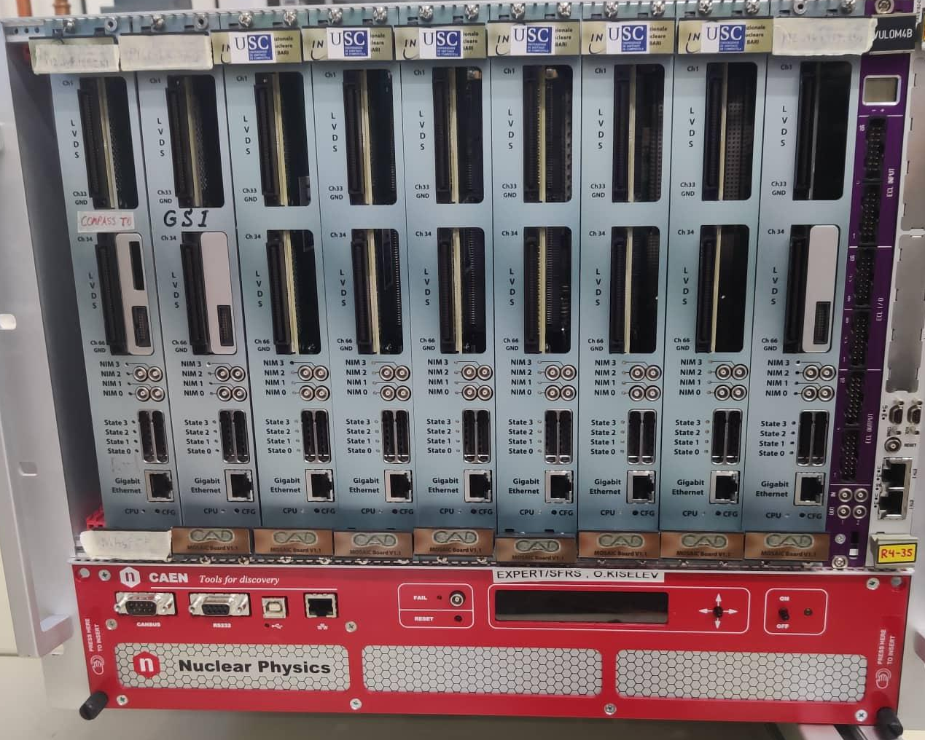
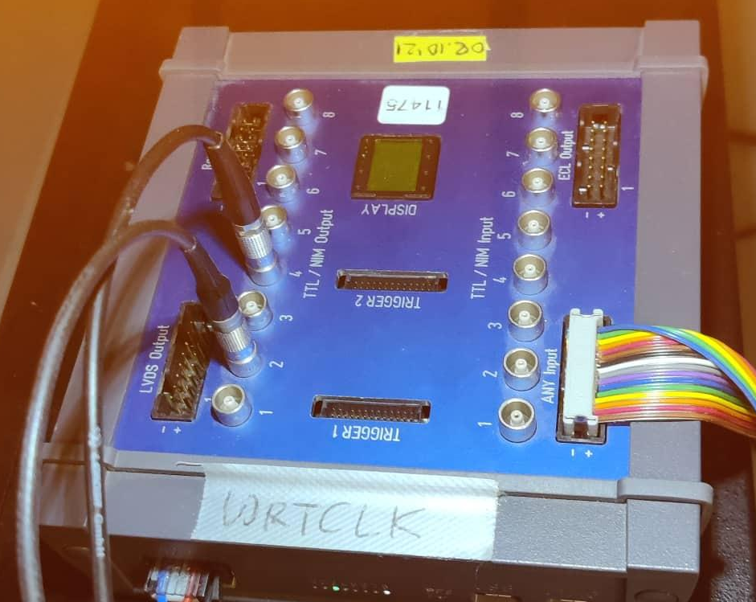
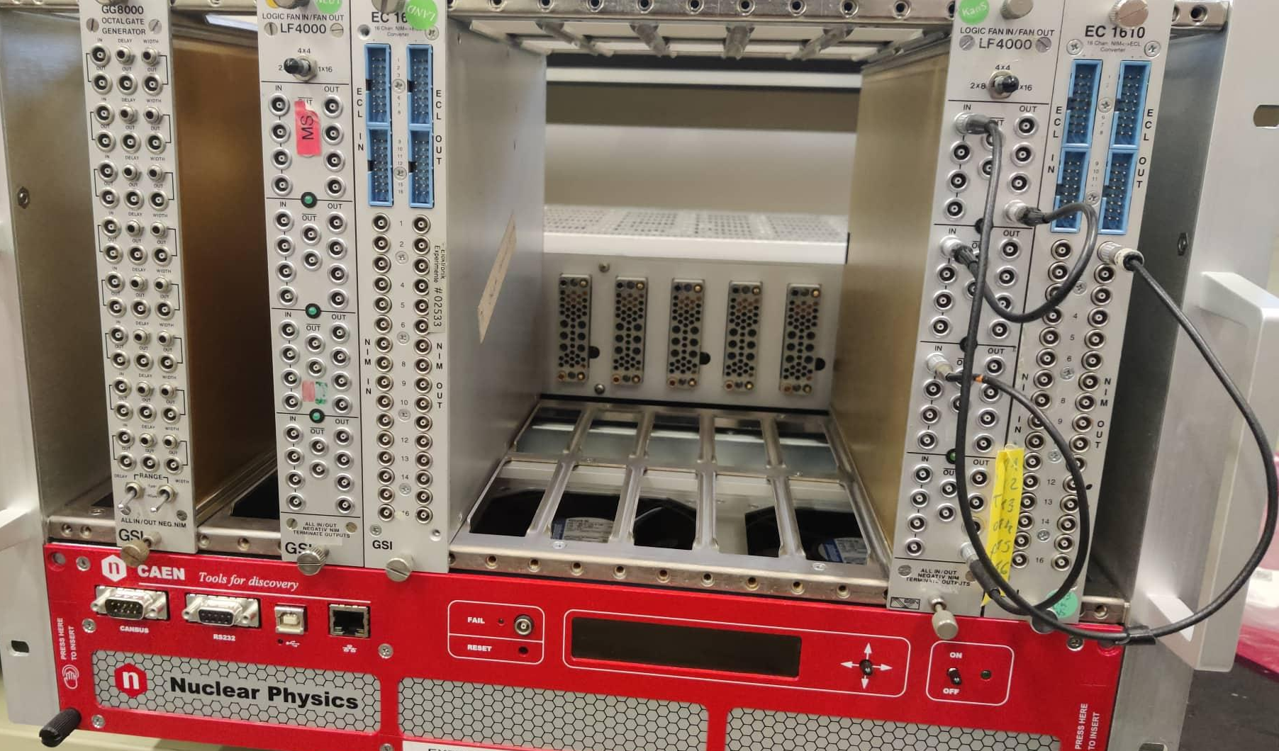
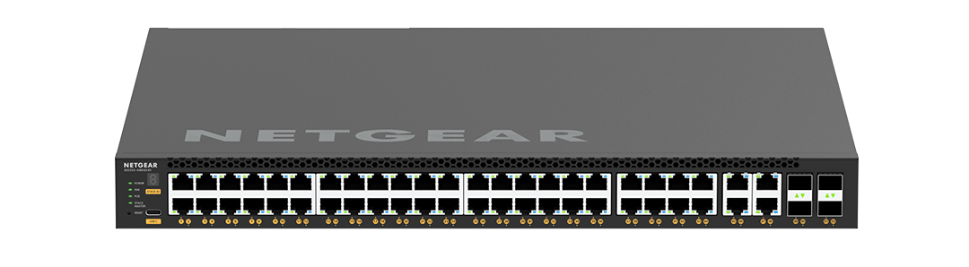

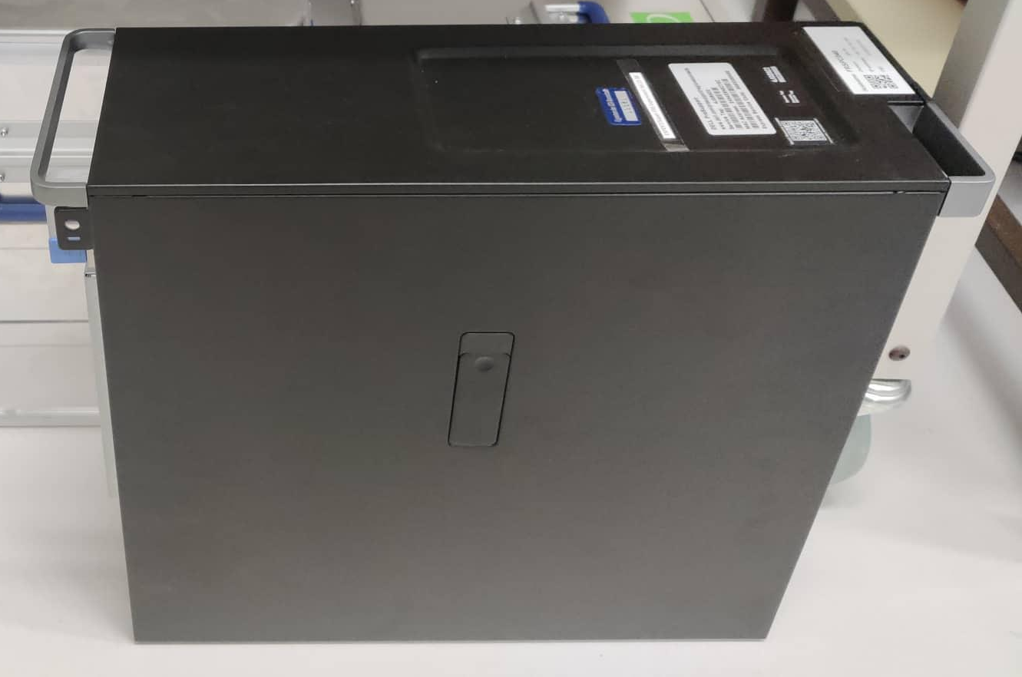
DAQ-Pictorial
Logic FIFO->Clock+Trigger
EXPLODER3-Rata Clock 6.25 MHz
In T1 +T3
Rest of the world
(main to)
TRT:Each 9 chip module needs a MOSAIC
https://web-docs.gsi.de/~bloeher/wrtclk/docs/#overview

Slide 11
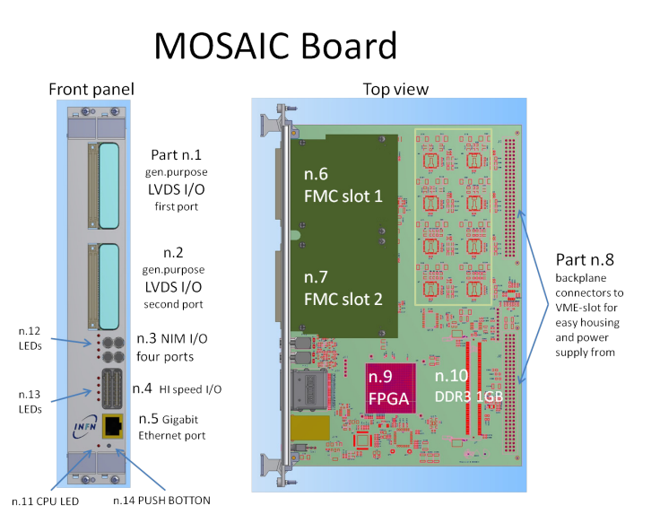
DAQ-MOSAIC vme readout board
Two slot VME6U module.
12 LVDS cables connect 10 Data, clock and control.
1.2 Gbps line rate.
1 GB DDR3 memory module working at 400 MHz performing a nominal throughput of 6.4 GB/s
1 Gbps ethernet cable out.
4 Lemo cables with configurable jumpers.
  L0:RATA_CLOCK_IN
  L1:TRIGGER_1_IN
  L2:BUSY_OUT
  L3:TRIGGER_3_IN
MOSAIC = MOdular System for Acquisition Interface and Control.
https://cds.cern.ch/record/2314957/files/epjconf_mpgd2018_07002.pdf

Slide 12
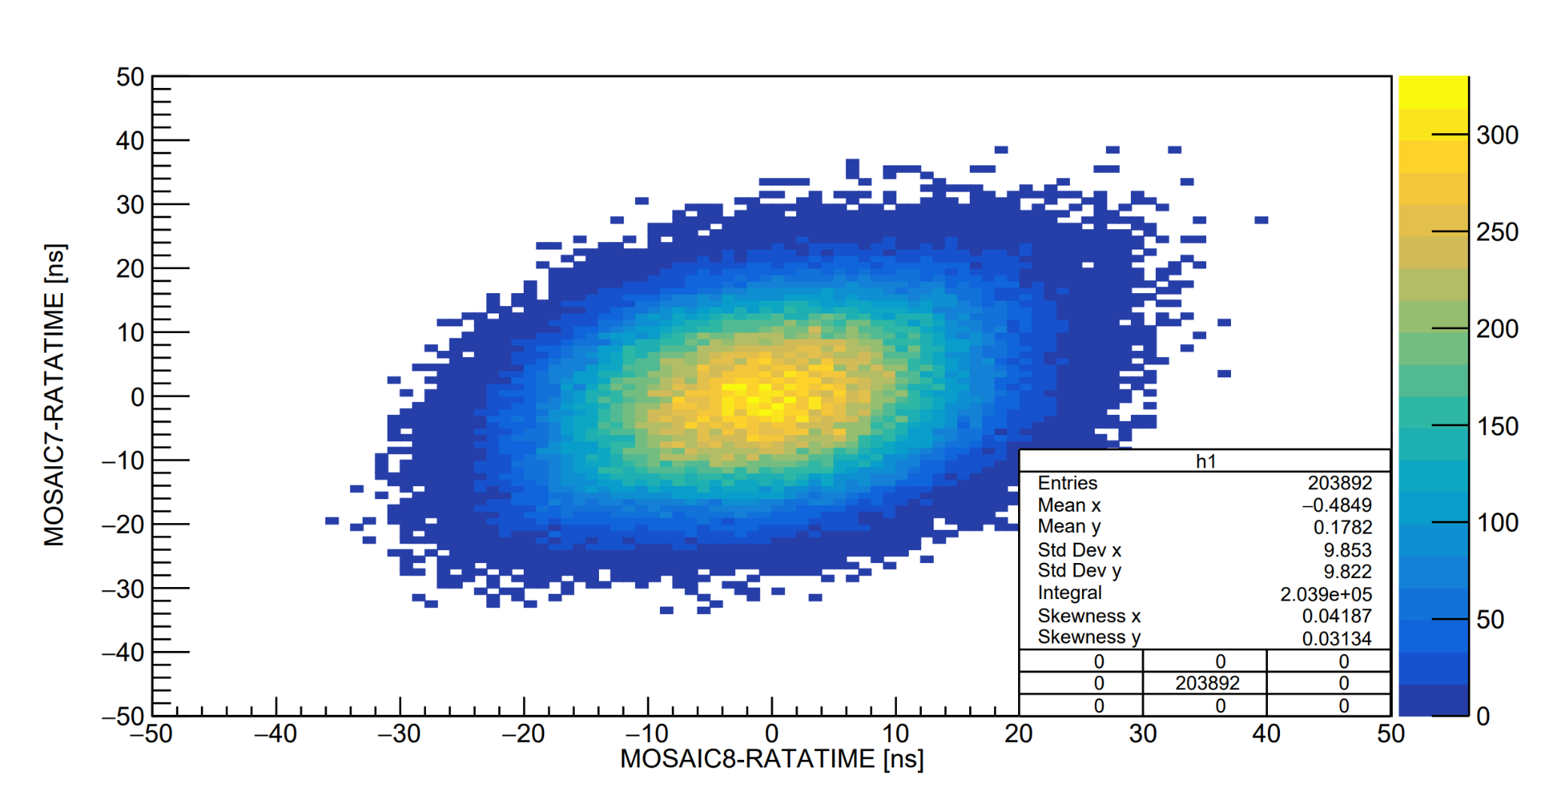
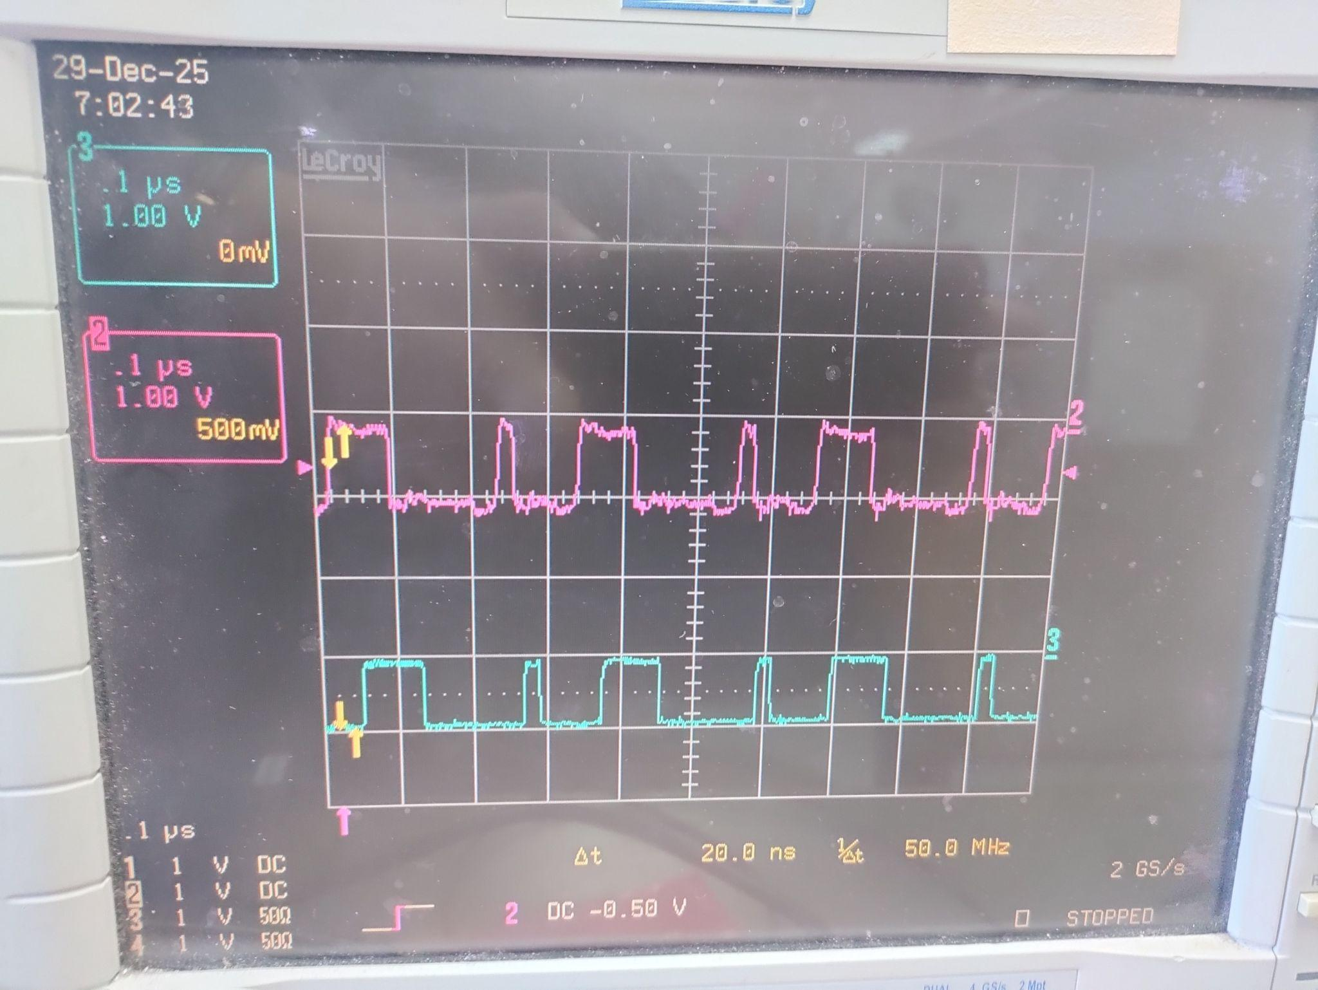
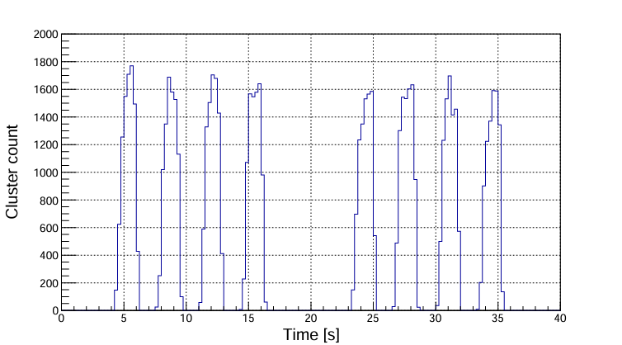
DAQ-Rata clock timing resolution
Rata clock timing protocol* used.
6.25 MHz, full timestamp encoded ever 10 us.
Resolution with respect to main DAQ of 10 ns.
* https://fy.chalmers.se/~f96hajo/rataser/

Slide 13
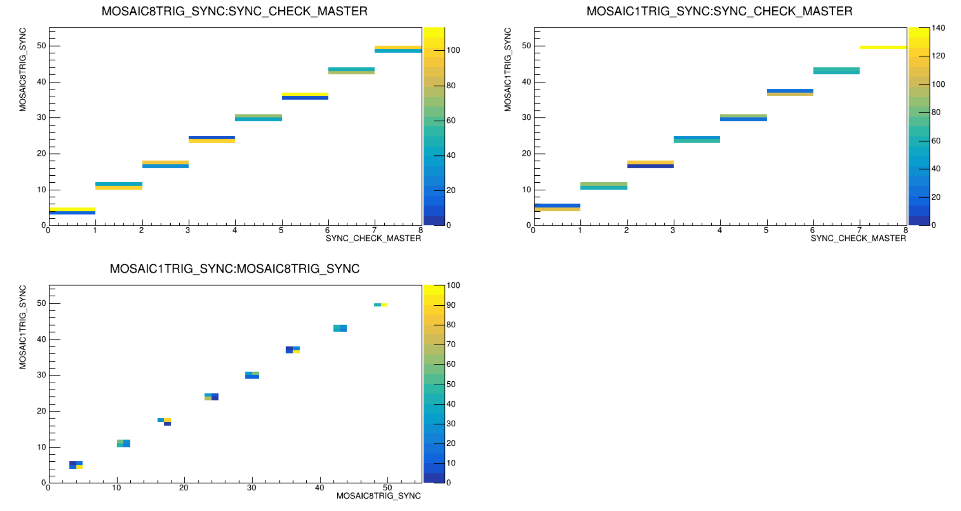
DAQ-Triggered module
Main trigger length is modulated/randomized.
This can be measured by the mosaic and then correlated to show system is in step with main DAQ.

Slide 14
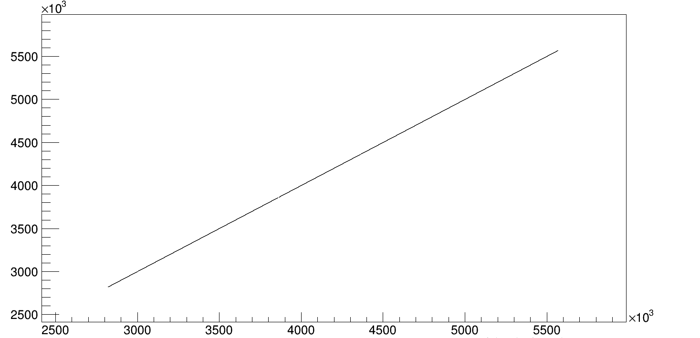
DAQ-Trigger number comparison
MOSAIC 2 chip 1 trigger num
MOSAIC trigger counter can be compared to chip trigger counter.
Correlation between values shows that device and R/O module are in step and no mismatch in data.
MOSAIC 3 chip 0 trigger num

Slide 15
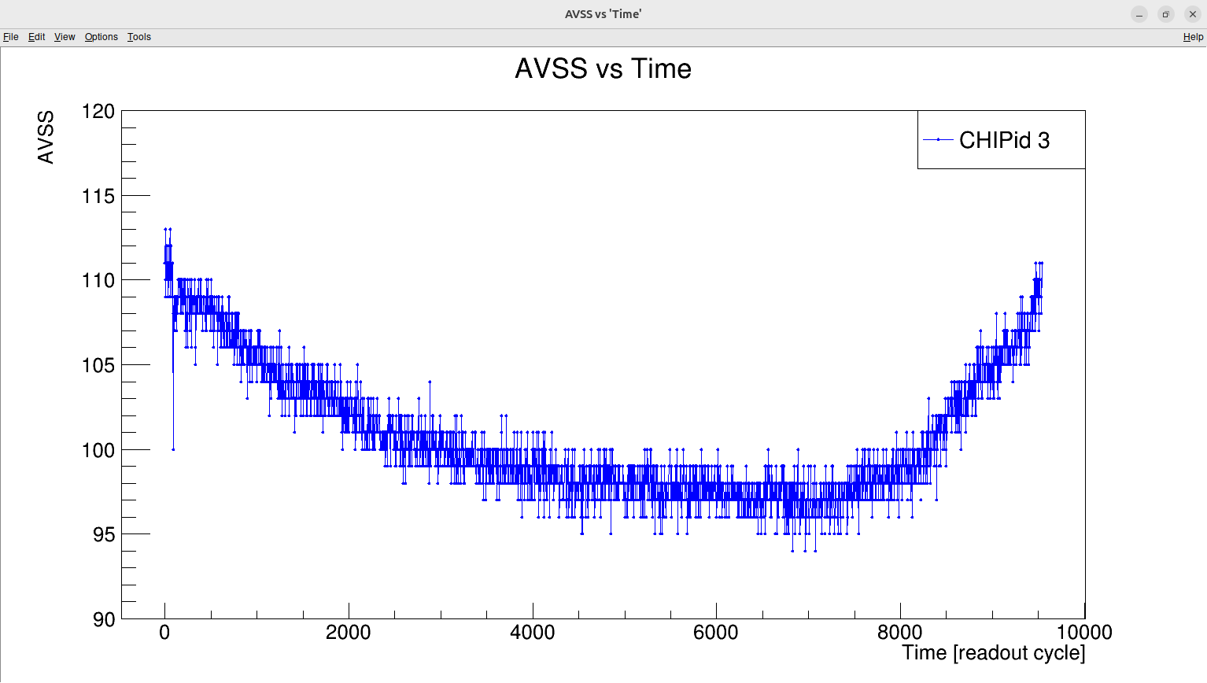
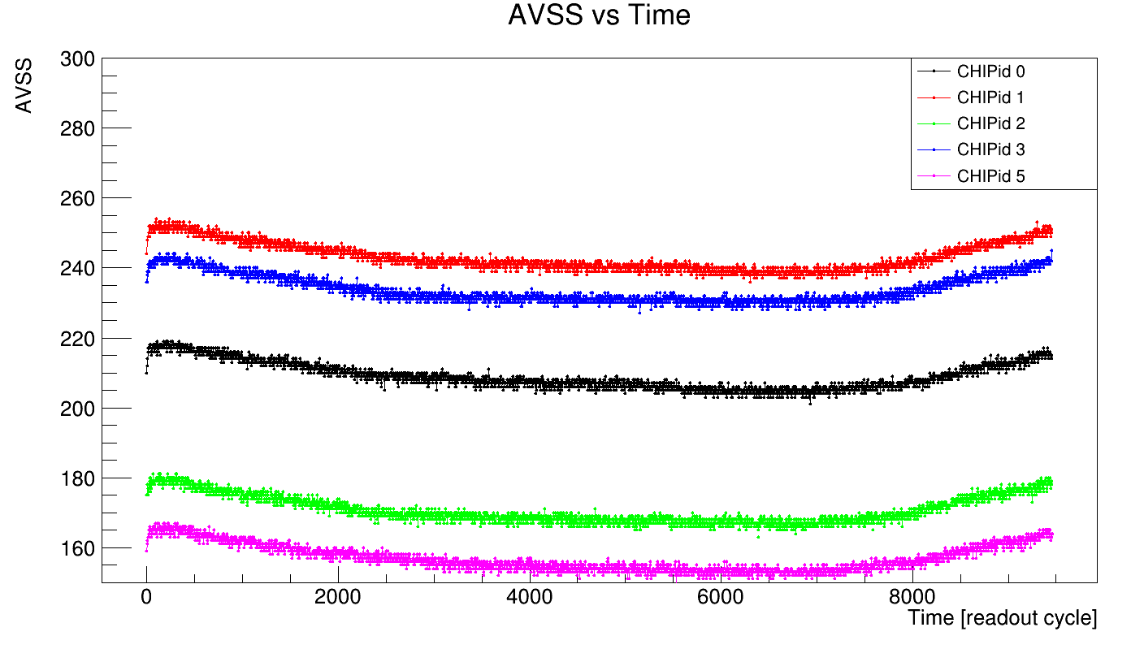
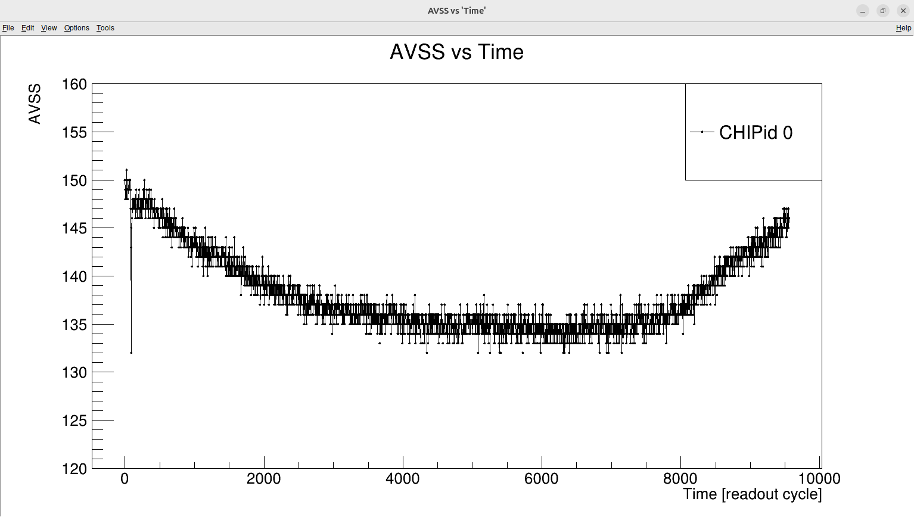
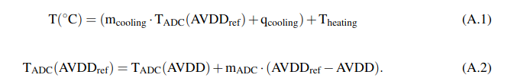
Slow control - “Temperature” readout
AVSS register can be readout off-spill to keep track of chip temperature.
Plot shows overnight test in which temperature dropped along with AVSS.
With chiller and full calibration of chips this can give temperature estimate for monitoring.*
*https://cds.cern.ch/record/2948748/files/2510.27592.pdf

Slide 16
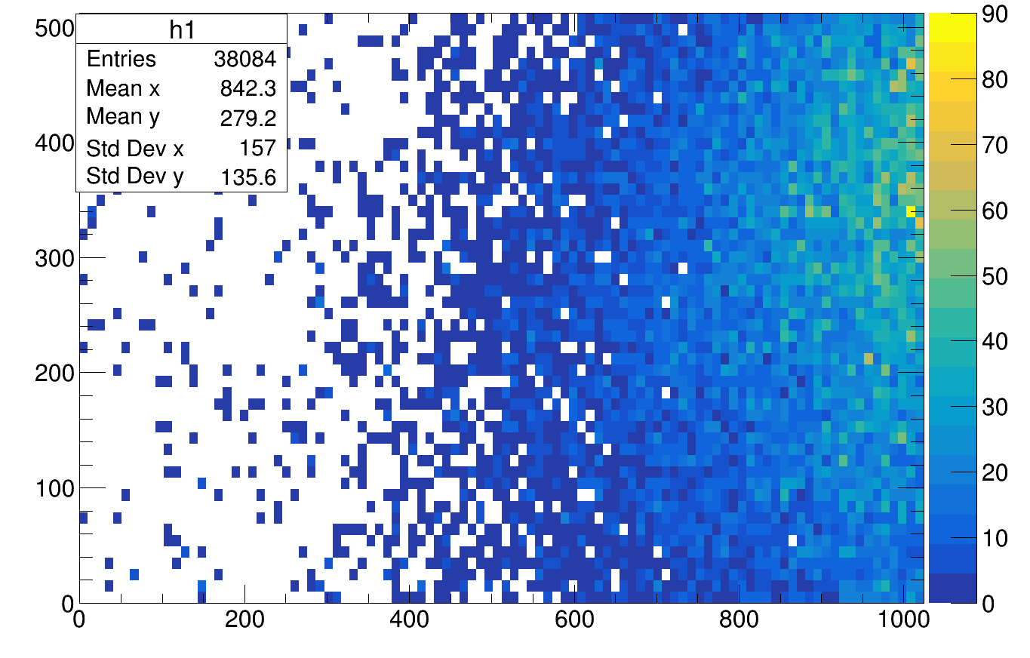
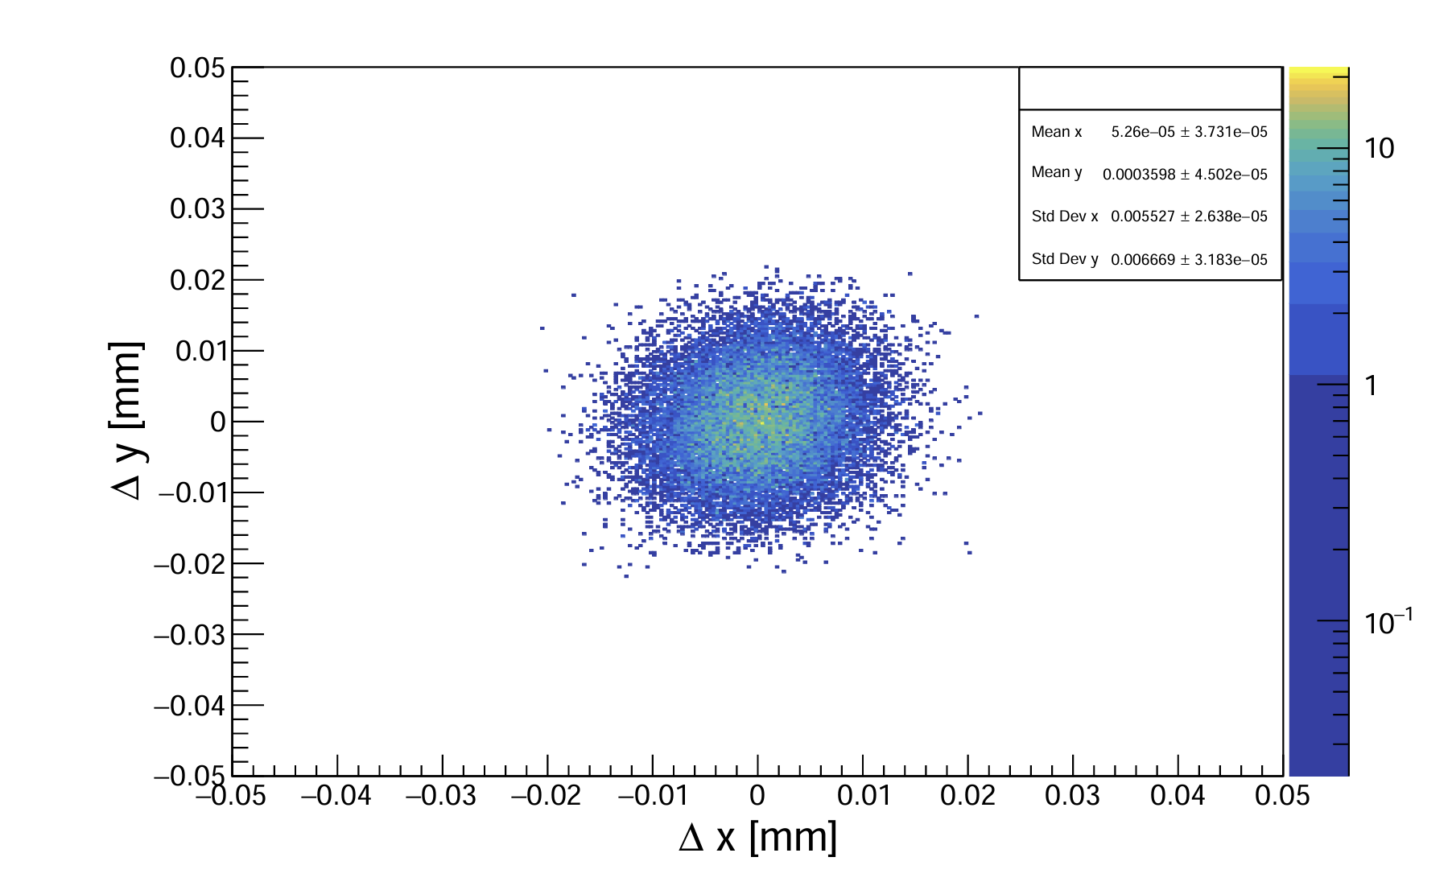
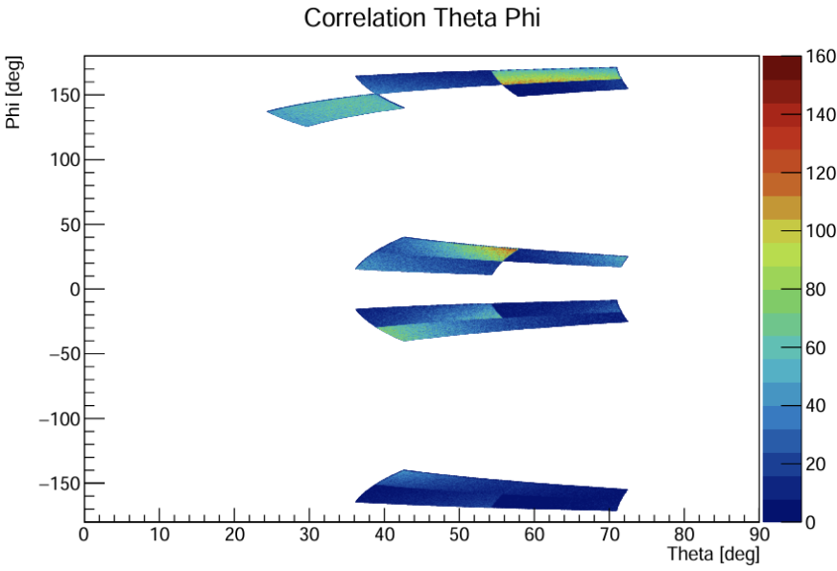

Experiments timeline & achievements
2021
CERN Test beam @ AMBER 4 SCC
First hit maps produced no synchronization.
2022
CERN Test beam @ AMBER 6 SCC
Full tracking between cards and position resolution calculated.
2023 - 2024 start
Partially working stage 1 used in NUSTAR experiments s091.
Beyond….
2024 - 2024 end
First fully working stage 1 module produced (source scan).
2025-present
Stage 1 modules in beam used with plastic detector to see clusterer evolution.

Slide 17







Experiments-g249 (in beam stage 1)
During experiment large number of small clusters seen with good correlation.
Triton contamination, could be tracked to the target.
Counts
Counts
Los Z
Los Z

Slide 18







Analysis-MEB oversampling, Non binary clustering
MEB allows for 2nd and 3rd sample per trigger-> Can be used to study the evolution of cluster size.
Here is an events with settings 1st=2us ,2nd=5us and 3rd=8us.
Concept from: https://agenda.infn.it/event/35597/contributions/211597/attachments/111617/159309/Vertex2023_Triolo_v3.pdf

Slide 19



Analysis-simulations: ¹²C(p,2p)¹¹B @ 500 MeV/u
The inner barrel consists of 24 modules like. The outer barrel consists of 30 modules. Each tilted by 15°
Simulations performed to check geometrical efficiency and missing mass resolution

Slide 20




Analysis-simulations - 𝛿 electrons
Beam settings: ²³⁸U at 500 MeV/u and with a threshold on the electrons of 100 keV.
Check multiplicity 𝛿 in each FPC.
Worse case scenario->8 electrons per FPC in inner barrel-> around 30-50 pixels which is within tolerance for the DAQ.

Slide 21
Conclusions and summary
First working stage 1 modules constructed and working deployed successfully in R³B experiments.
Stage 2 is in pre-production phase and several modules with all functional chips are currently being wire bonded.
Analysis of multi strobe triggered mode is being developed
DAQ work underway to improve clocking and triggering in preparation for test beams.
Commissioning of TRT expected 2027-2028.

Slide 22



Thank you for your attention.
Thanks to colleagues from Daresbury the TRT WG and NUSTAR community.
Any questions?
*R³B collaboration - g249
*R³B collaboration - s118
*R³B collaboration - s515
* example of pixel masking
*position resolution measured 2022
*Sr⁹⁰ source with first fully working STG1

Slide 23
Backup slides

Slide 24

from: https://agenda.infn.it/event/35597/contributions/211597/attachments/111617/159309/Vertex2023_Triolo_v3.pdf

Slide 25

from: https://agenda.infn.it/event/35597/contributions/211597/attachments/111617/159309/Vertex2023_Triolo_v3.pdf

Slide 26

Stage 2 all 9 chips AVSS reg read-short run

