Slide 1

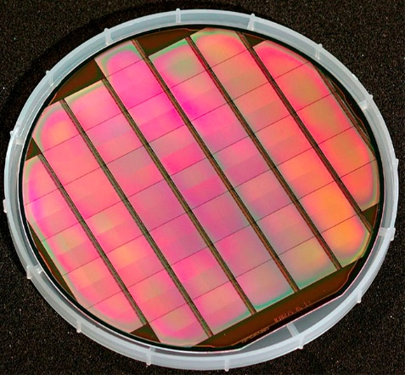
CMOS Monolithic Active Pixel Sensors
M. Deveaux, GSI
Wafer with MIMOSA-5 sensors

Slide 2

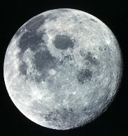

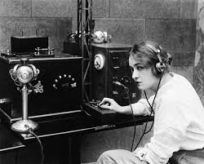

Outline today
What are MAPS and why does a hammer may put them to value.
Hot to improve the time resolution of MAPS without hitting the moon.
Radiation tolerance of MAPS: Why smaller is tougher.
Why telegraphs may cause trouble.
MAPS knocked out: What you should know about Single Event Effects.
Oh oh...
1+1=3

Slide 3
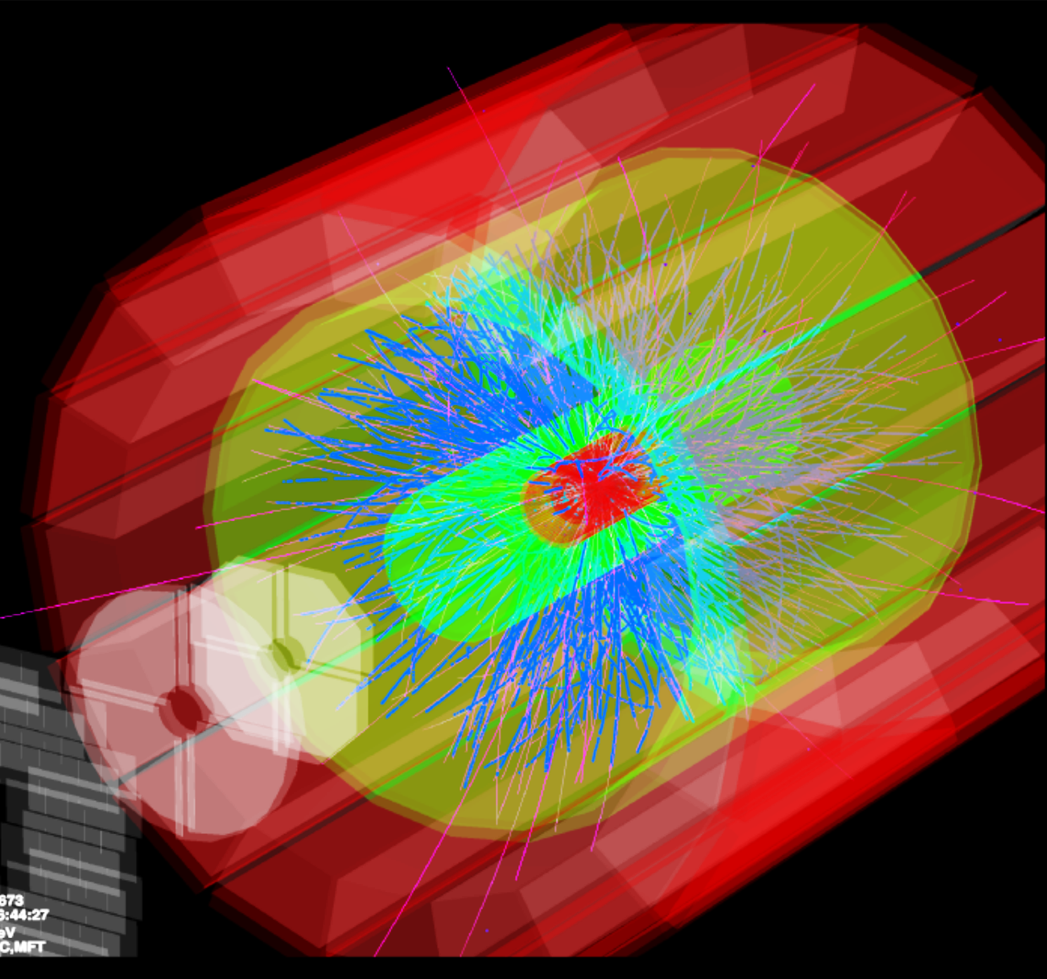
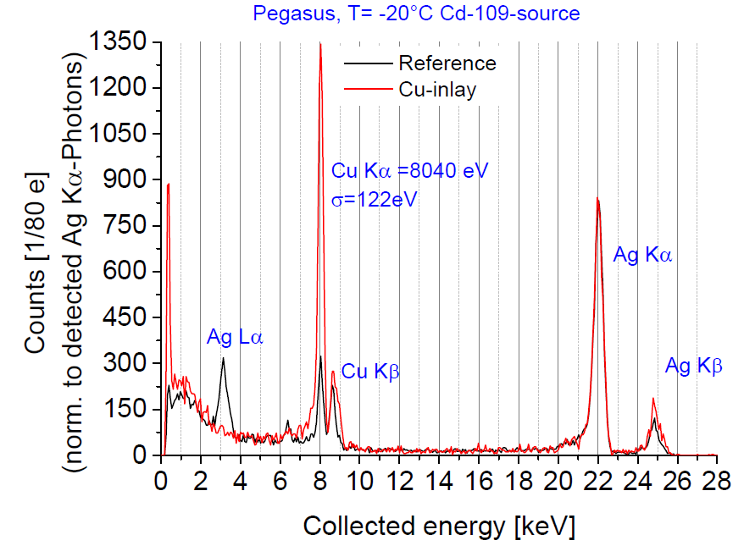
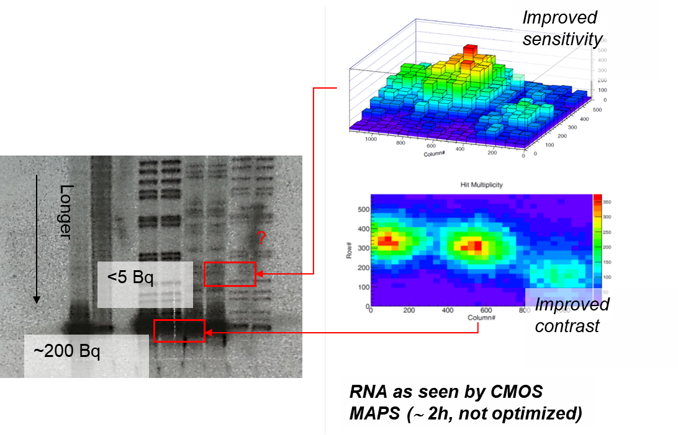
What do those pictures have in common?
Soft X-ray spectroscopy (GU Frankfurt)
ALICE ITS-2
J. Cabello, 2007, doi: 10.1109/NSSMIC.2007.4436936.
RNA – sequencing (GU Frankfurt)
Tritium autoradiography

Slide 4
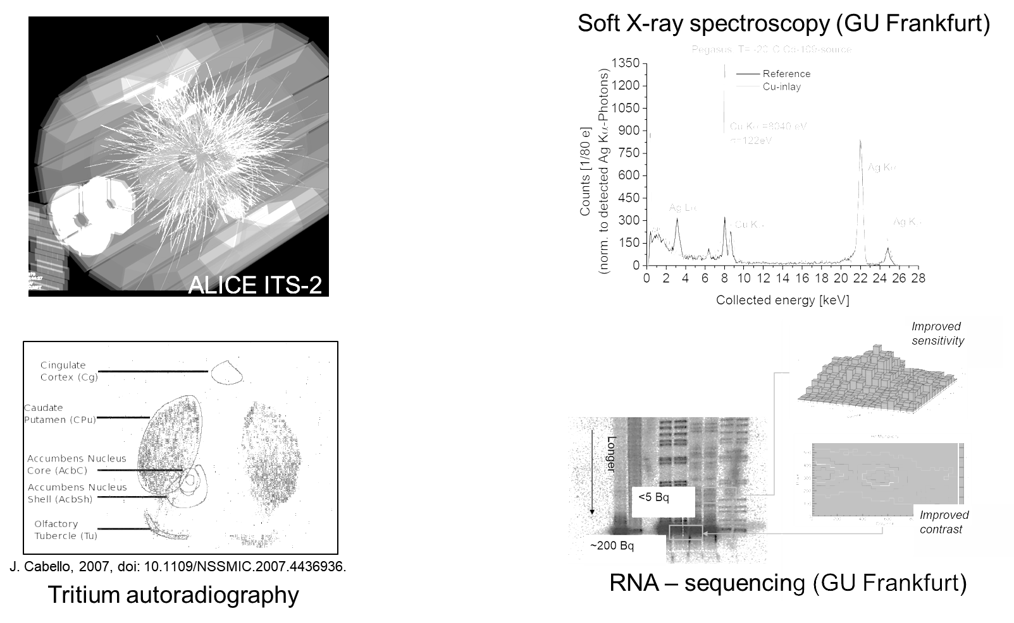
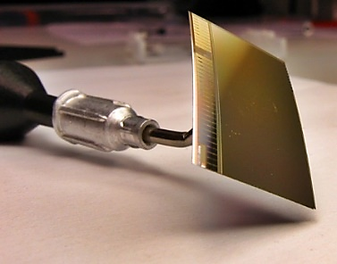
What do those picture have in common?
CMOS Monolithic Active Pixel Sensor
(MIMOSA-26 by IPHC Strasbourg)

Slide 5
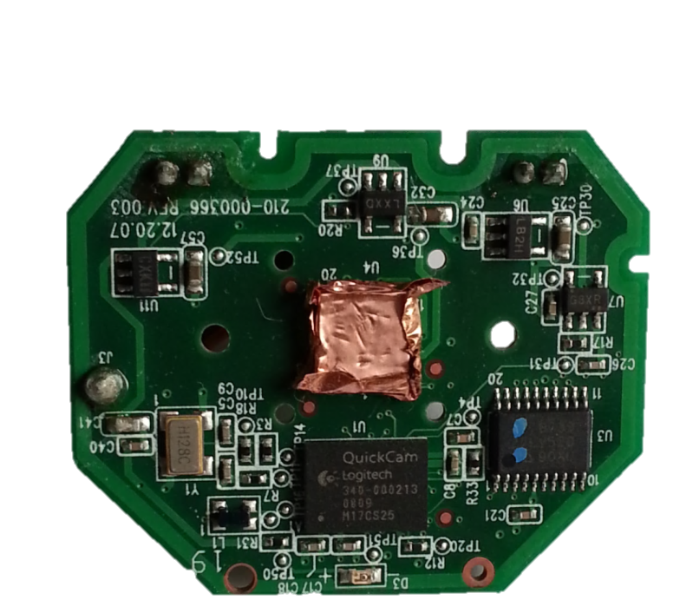
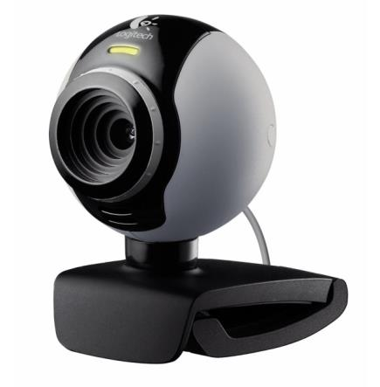

CMOS Monolithic Active Pixel Sensors
What is required to get a MAPS detector?
Mostly a hammer…
…Metal tape…
… a Webcam…
…and some radiation.

Slide 6

Radioaktivity as seen by a webcam

Slide 7
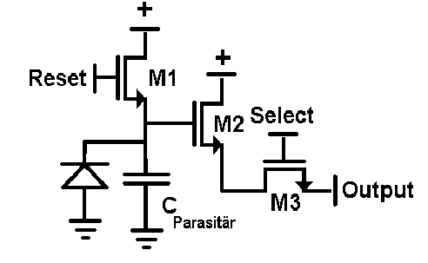
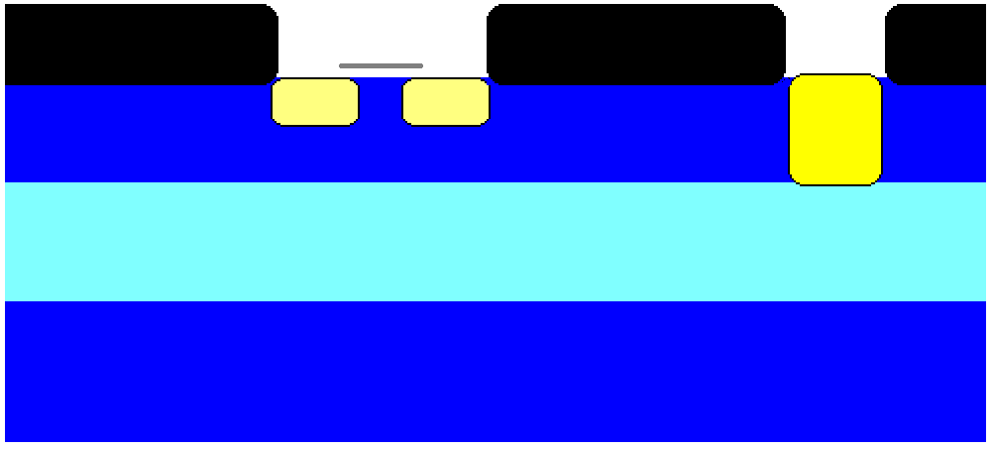
The operation principle of MAPS
+3.3V
Reset
+3.3V
Output
SiO₂
SiO₂
SiO₂
N++
N++
N+
P+
P-
P+
Digital camera: ~1000 photons produce one electron each.
Particle detector: One particle produces ~1000 electrons.

Slide 8
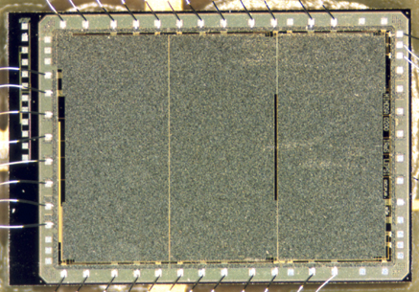
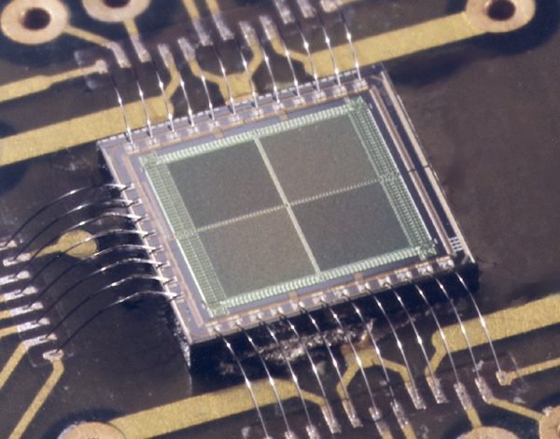
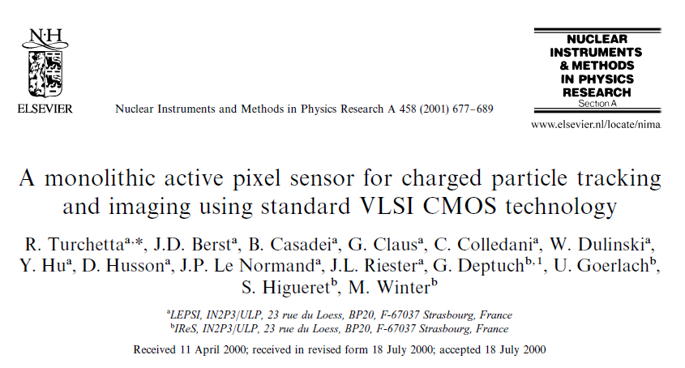
MAPS – the beginning
MIMOSA 1 paper
MIMOSA – 1 (1999)
MIMOSA – 1 (2000)
 | Mi - 1
Pixel size [µm²] | 20 x 20
Pixel number | N x 64 x 64
Readout | Analog
Frame time [µs] | ~10⁴
Dead time | > 50%

Slide 9
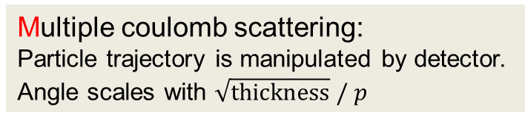
MAPS vs. Hybrid pixels
CMS @ LHC – Hybrid Pixel
MAPS:
~0.05 µm
Si equivalent
Readout - chip
Hybrid:
0.5mm Si
equivalent
~100 µm
Pixel
Pixel
Pixel
~120 µm
Multiple coulomb scattering:
Particle trajectory is manipulated by detector.
Angle scales with $\sqrt{thickness} / p$

Slide 10
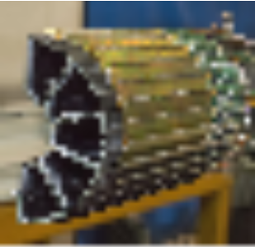
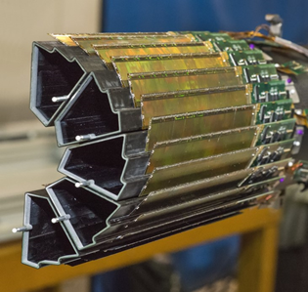
MAPS – the hope and limitations
More sensitivity
 | Hybrid pixels (2001) | MAPS (2001)
Single point resolution | ~ 30 µm | ~2 µm
Material budget | ~ 500 µm Si | ~ 50 µm Si
Time resolution | 25 ns | ~10 ms
Radiation hardness | ~10¹⁵ n_{eq}/cm² | 10¹² n_{eq}/cm²
MAPS Hybrid
Hybrid pixels (LHC / CMS)
Massive improvement required.

Slide 11
Performance of MAPS today (25µm vs. 50µm thick sensors)
p-stop 50µm
p-stop 25 µm
+ 0.5 µm for longer
pixel dimension
std 25 µm
p-stop 25 µm
Pitch/5
p-stop 50 µm
std 25 µm
Dark rate typically <10¹⁰/pixel (2 Hz/cm²)
driven by individual hot pixels.
Optimal number of fired pixels/particle (about 2.5)
State-of-the-art sensors show spat resolution $σ≈pitch/5$ with <30µm pitch (ALPIDE/MIMOSIS).
May be $σ≈pitch/10$ if charge information is used.
46th CBM collaboration Meeting, Oct. 20-25 2025, Lanzhou, China

Slide 12
MAPS – the hope and limitations
We need both
More sensitivity
More statistics
 | Hybrid pixels (2001) | MAPS (2001)
Single point resolution | ~ 30 µm | ~2 µm
Material budget | ~ 500 µm Si | ~ 50 µm Si
Time resolution | 25 ns | ~10 ms
Radiation hardness | ~10¹⁵ n_{eq}/cm² | 10¹² n_{eq}/cm²
MAPS Hybrid
Hybrid pixels (LHC / CMS)
Massive improvement required.

Slide 13
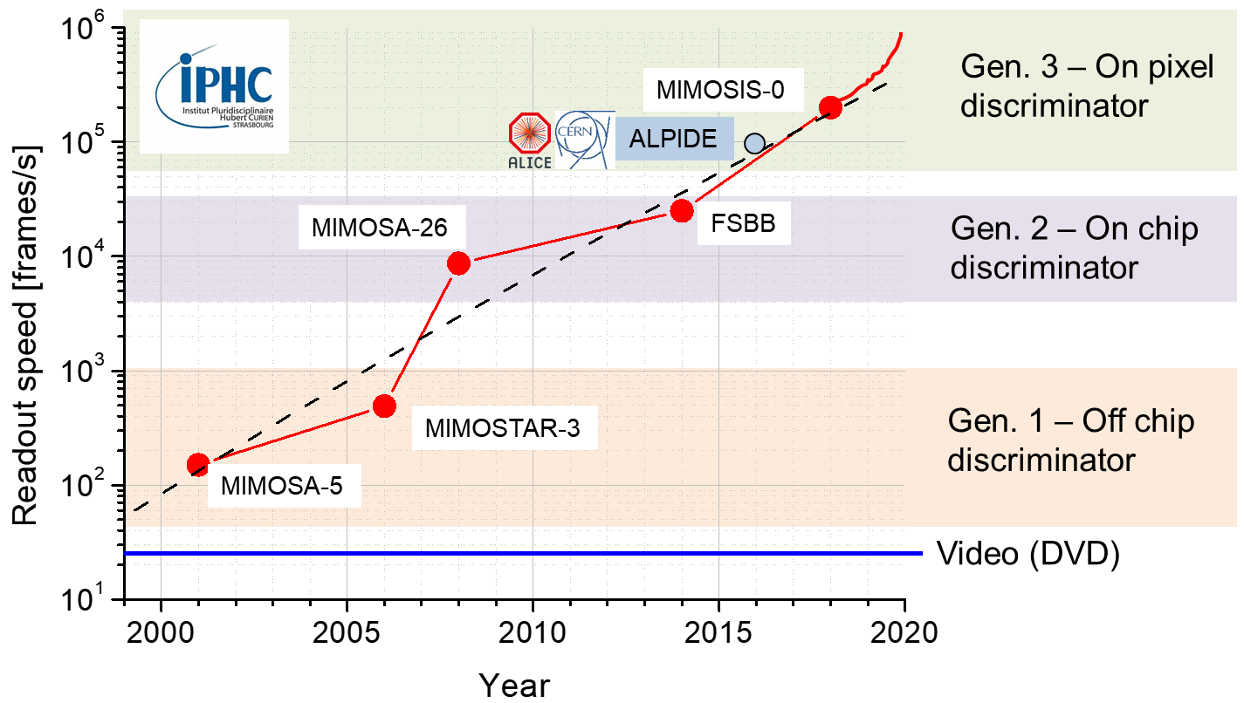
The need for speed
Time resolution?
Particle rate?
Data bandwidth?

Slide 14
Speed of MAPS: Limiting factors
+3.3V
Reset
+3.3V
Output
SiO₂
SiO₂
SiO₂
N++
N++
N+
P+
P-
 | Optimized | Traditional
Charge collection time | 1 ns | 100 ns
Signal formation time | few ns | 500 ns
Time resolution |  | 10 000 000 ns
P+
Why the gap?

Slide 15
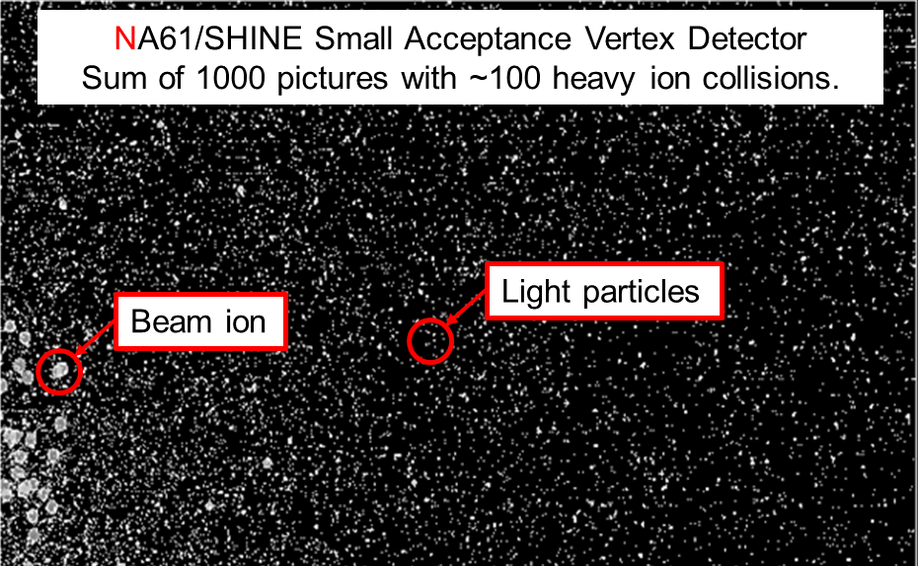
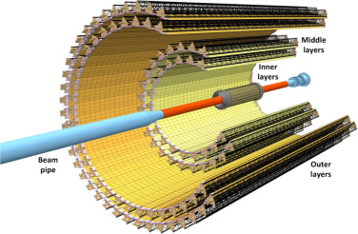
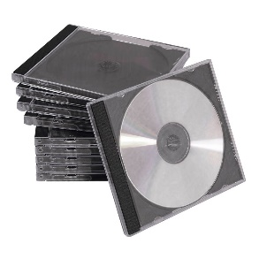



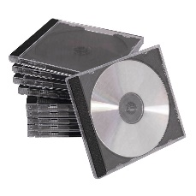

Block diagram of MAPS
Sensor
Externer ADC
Disclaimer:
Numbers indicative only.
How much data does a 10m² Detector generate?
200'000 fps
=> 1.2 Tbit/s
500k Pixel, 5cm²
About
~3 PB/s.
Should we better start a new pile each hour?
?
600m/s
3PB/s = 30000m/s
3.5h to the Moon.
8000m/s
What about data compression?

Slide 16
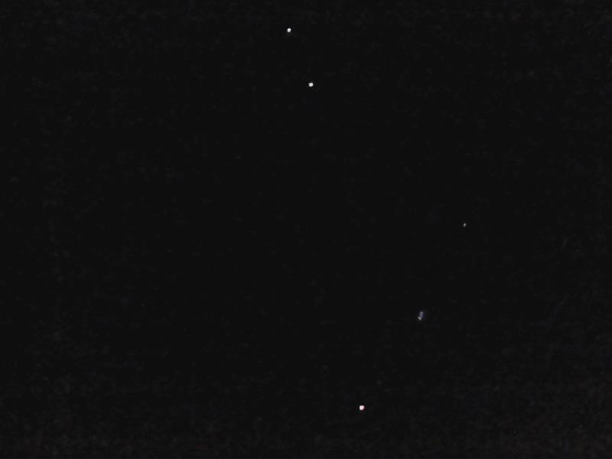
Data compression
Most pixels (>99.5%) are black.
Only few are white.
Idea: Ignore all black pixels.

Slide 17
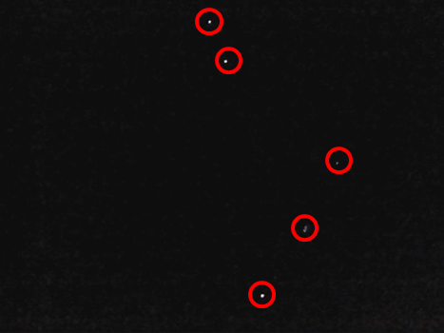
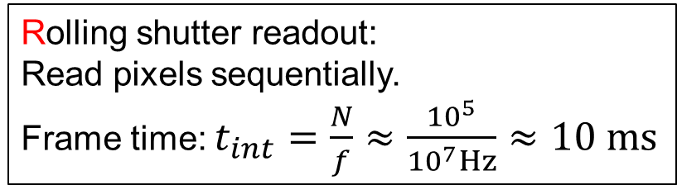
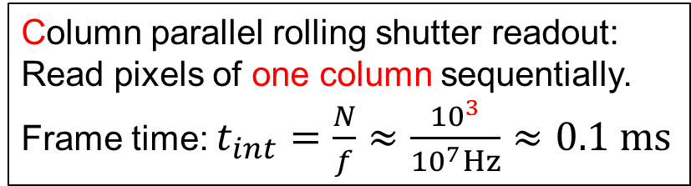
How to readout the pixels?
Pixel array
Chip
Pixel array
ADC
FPGA - card
1000 x discriminator
Zero suppression
Hit
finder
Compress by ignoring dark pixels:
5000 Mbps => 200 Mbps (x25 reduction)
CPU
Output
Outside world
Rolling shutter readout:
Read pixels sequentially.
Frame time: $t_{int}=\frac{N}{f}≈\frac{{10}^{5}}{{10}^{7}Hz}≈10 ms$
Column parallel rolling shutter readout:
Read pixels of one column sequentially.
Frame time: $t_{int}=\frac{N}{f}≈\frac{{10}^{3}}{{10}^{7}Hz}≈0.1 ms$
Still – Each pixel is addressed once per frame.

Slide 18
Why no in-pixel discriminator in 2008-2015?
+3.3V
Reset
+3.3V
Output
PMOS Transistor
SiO₂
SiO₂
SiO₂
N+
N++
P
N++
P
N+
P+
50µm
15µm
P-
P+
In standard CMOS sensors, no PMOS transistors are possible in pixel
=> No high level functions like discriminators … => “slow”

Slide 19
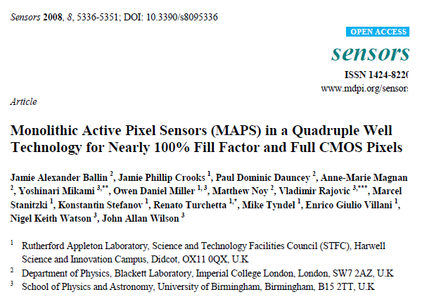
Quad – Well process (from 2008)
+3.3V
Reset
+3.3V
Output
SiO₂
SiO₂
SiO₂
N+
N++
P
N++
P
N+
P+
deep P-well
50µm
15µm
P-
P+
Progress was reached with Quad-well CMOS as provided
by the manufacturer TowerJazz (180 nm, today 65nm).

Slide 20


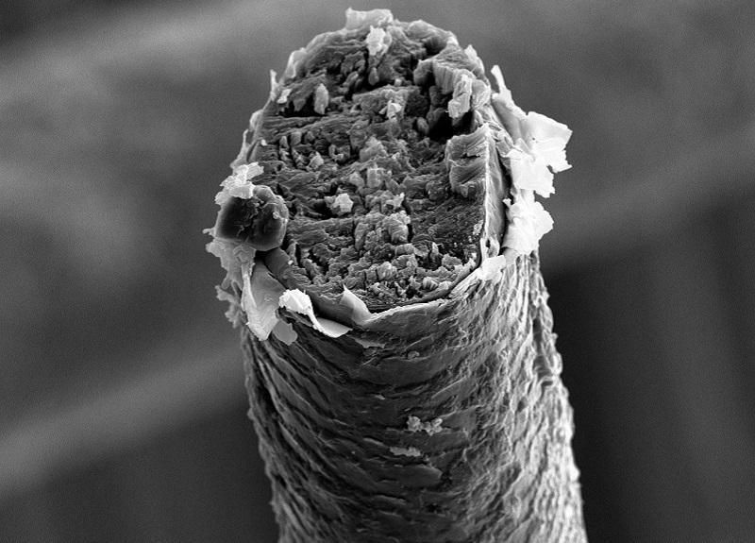
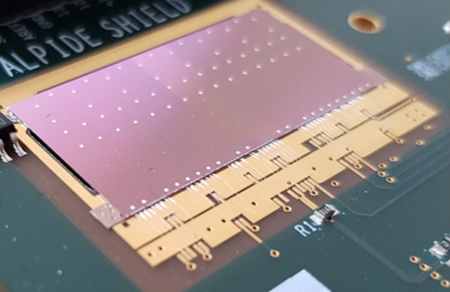
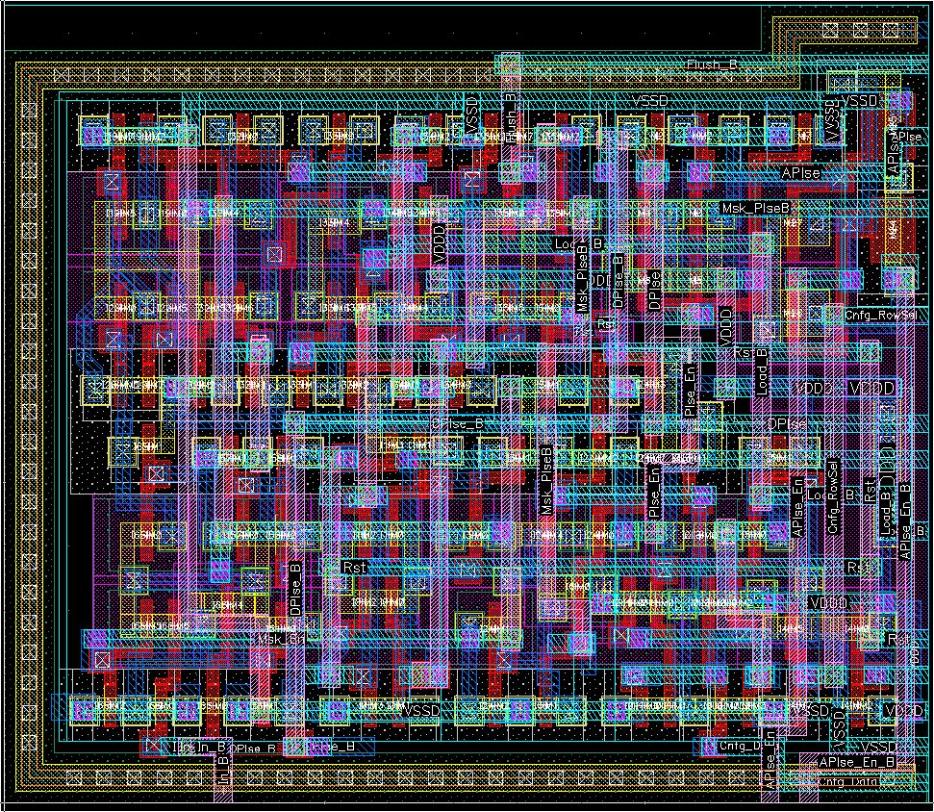



Beyond column paralle readout.
~30µm
~30µm
Priority encoder
Human hair (to scale)
14.5µm
ALPIDE Sensor.
~ 50 mW/cm²
01001010010
01001010110
Mimosis Pixel Logic Layout (106 Transistors)
01001011000
Data-Buffer
On-chip
Off-chip

Slide 21

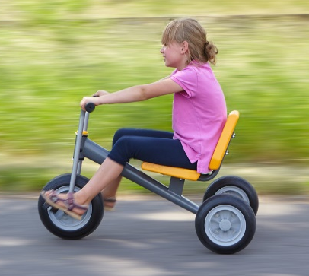
Data compression: Efficiency
No compression
How much data is generated by a 10m² detector?
Disclaimer:
Numbers indicative only.
?
600m/s
3PB/s = 30000m/s
3.5h to Moon.
8000m/s
With compression
~30GB/s = 0.5 m/s

Slide 22

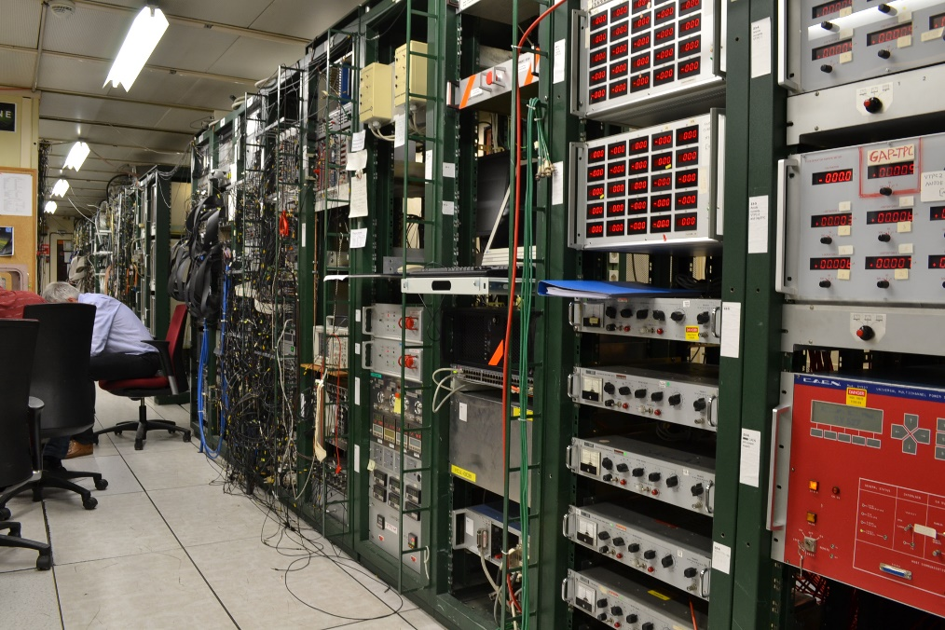

Side band contains:
Data buffers.
Voltage regulators, trim DACs.
Slow control interface.
Temperature sensors.
…
$$≈$$
0.3 x 2 cm²
CMOS technology integrates:
Sensors.
Analog electronics.
Digital data processing.

Slide 23
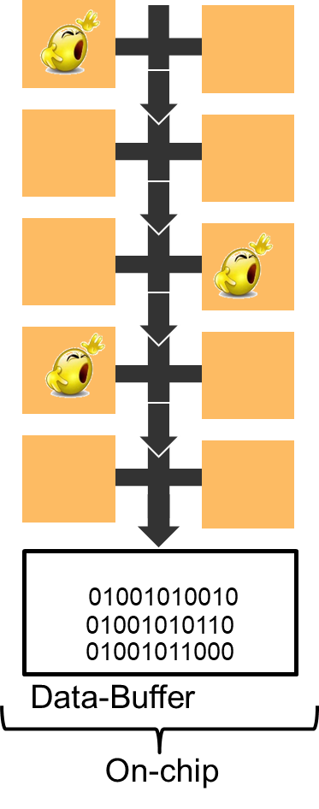
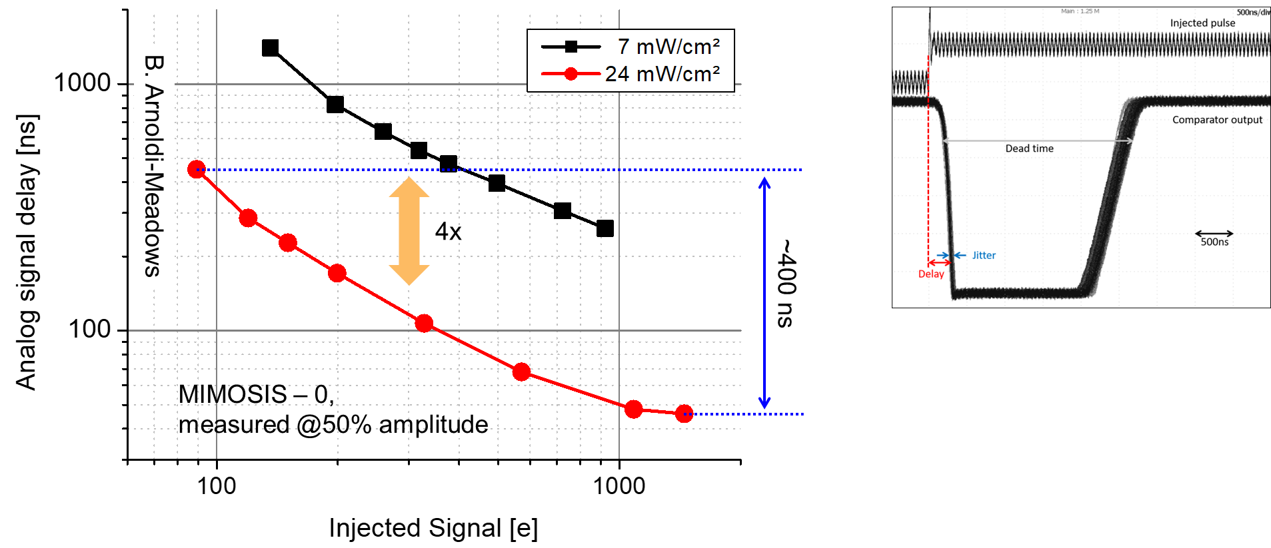
Toward MAPS Gen. 4
So far “frame readout”:
Pixels measure for given “frame time”, typically 1-10 µs.
Results are copied into pixel output buffer.
Output buffers are read-out by column logic.
+ : No data collisions on column data bus.
- : Time stamping determined by frame time, no matter the pixel performance.
A look to real pixel performance:
Slew (Signal delay) [ns]
Time stamping may be improved by >10x if frame readout
is replaced by “first come, first serve” readout.
Still: Would need a lot of energy for ~10 ns time resolution.

Slide 24
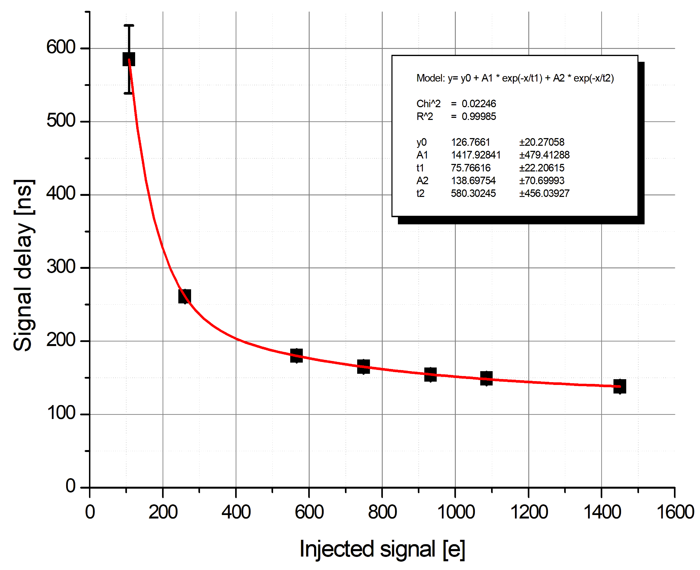
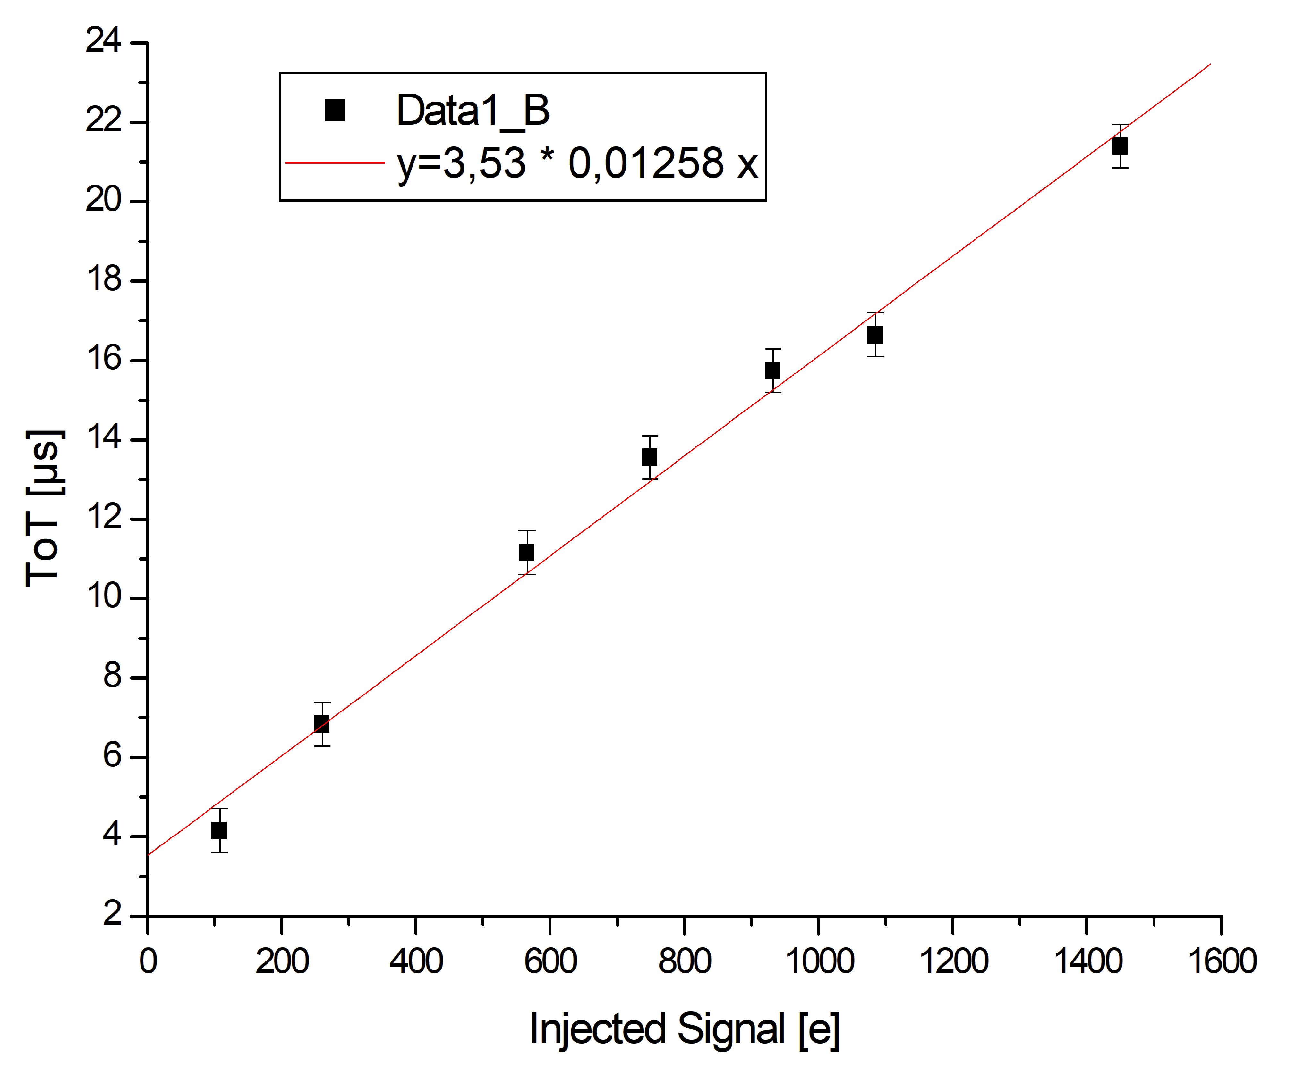
Still not good enough. What about time walk correction?
Time walk correction:
Measure signal amplitude – correct for average delay.
Signal measurement by ADC impossible, what about Time-over-Threshold (ToT)?
Inspired by G.A.Rinella et al.,
NIM-A Vol. 1056 (2023) p. 168589
B. Arnoldi-Meadows
ToT at proprtional seetings: Resolution 42 e
ToT may
be switched
on and of.
Minimum ToT @ high speed settings: ~3µs
Different setting than previous slide
Time walk correction may improve sensor performance dramatically.

Slide 25
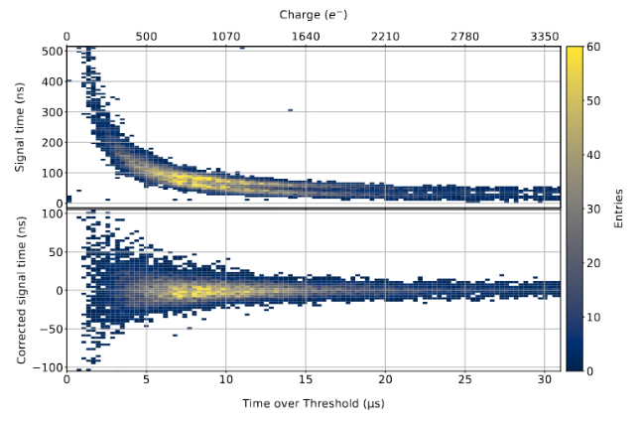
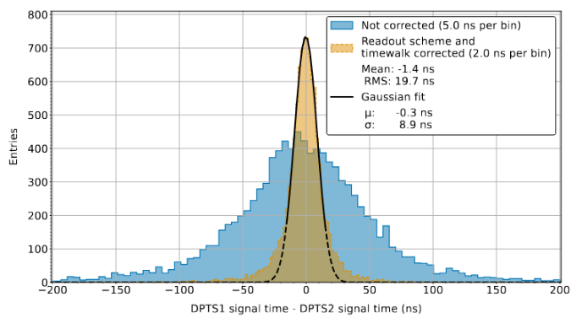
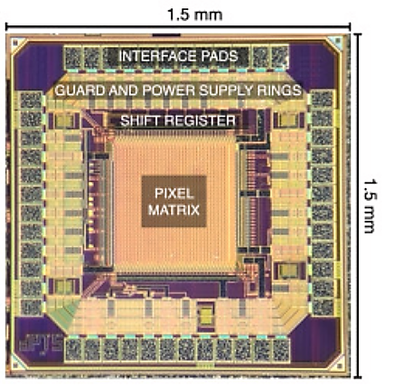

Time walk correction
Start with the DPTS prototype (by ALICE)
G. A. Rinella et al., arXiv:2212.08621v4
G. A. Rinella et al., arXiv:2212.08621v4
Time walk correction
2 sensor residual.
~6.3ns single sensor resolution
DPTS
As demonstrated in beam (by the ALICE-ITS3 team):
MAPS can reach a time precision of ~6ns (analogue front-end included) with time walk correction.
Speedup almost 1000x w.r.t MIMOSIS.
Time-Over-Threshold may provide excellent analogue time stamping with limited energy.
DPG conference Erlangen – 16 March 2026

Slide 26
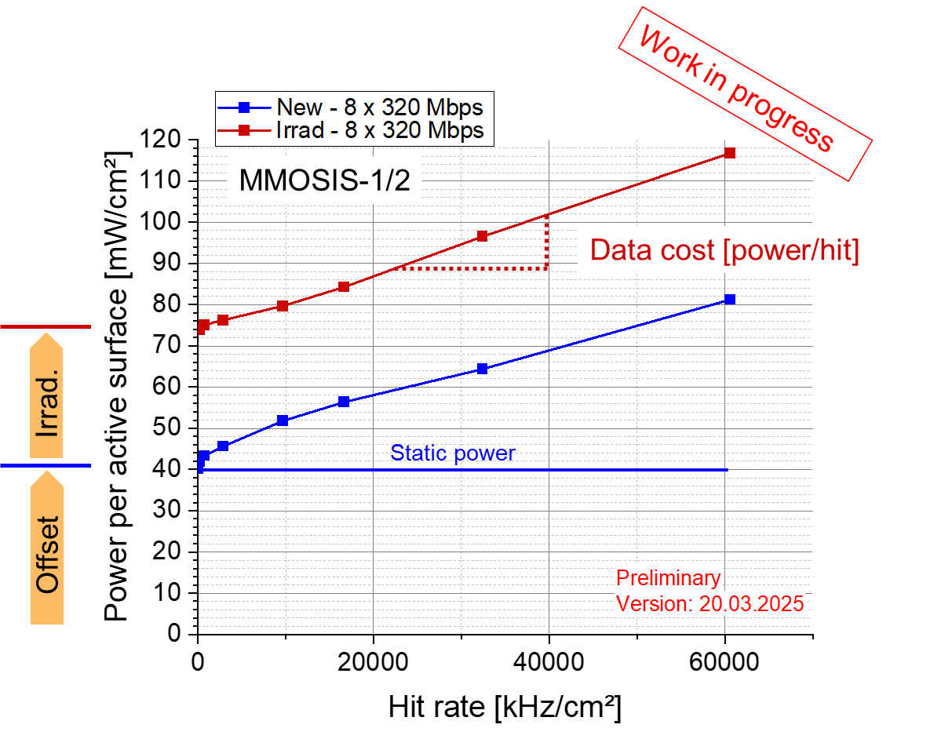
Going toward faster MAPS – Power consumption
CBM
Data transport cost is non-negligible – needs reduction for lowest power applications.

Slide 27
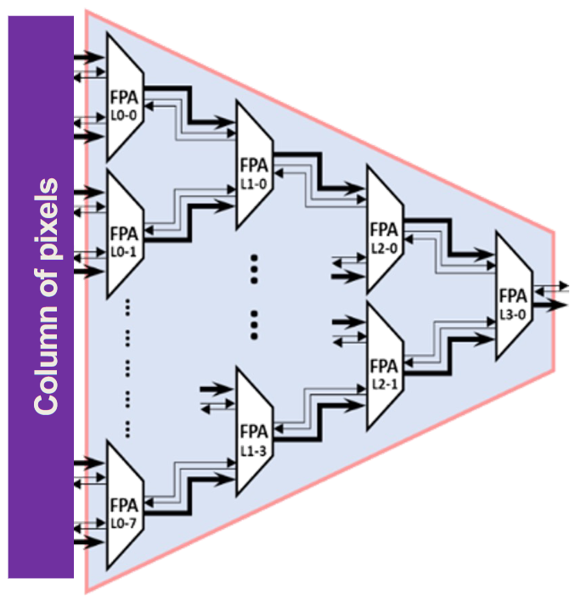

Novel sensor concepts (my simplistic understanding)
Pixel col.
More on APA:
https://doi.org/10.1016/j.nima.2024.169663
First come, first serve.
If collision: Highest spatial priority first.
TDC
Downstream logic
Position
+ ~10 ns time
Asynchronous Priority Arbiter (APA)
Concept of OCTOPUS:
Connect ~20x20µm² pixels individually with readout.
Submit data on raising edge and falling edge each.
Compute Time-Over-Threshold, do time walk correction outside sensor.
=> ~5-10ns time resolution & ~3 µm spatial resolution
DPG conference Erlangen – 16 March 2026

Slide 28

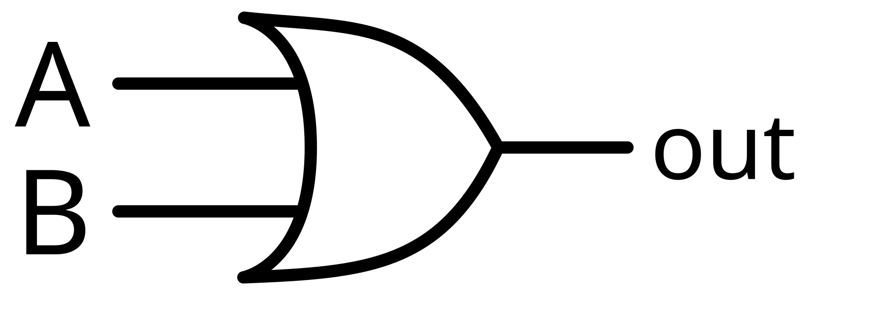
Novel sensor concepts (my simplistic understanding)
Pixel col.
Pixel structure, APA and much more…: Synergies with OCTOPUS
More on APA:
https://doi.org/10.1016/j.nima.2024.169663
Coarse TDC
Pixel OR
Position
+ ~10 ns time
Asynchronous Priority Arbiter (APA)
Fast TDC, e.g. vernier delay line/ring oscillator by
SLAC, IP2I/CPPM
<1ns time
Downstream logic
Enable
Enable
Concept: Use PixelOR for additional time resolution => Needs additional space => 40 µm pixels with four diodes each. Time resolution 1-10ns, spatial resolution 5-10 µm.
Versatile: Aim to tune power vs. performance by slow control.
DPG conference Erlangen – 16 March 2026

Slide 29
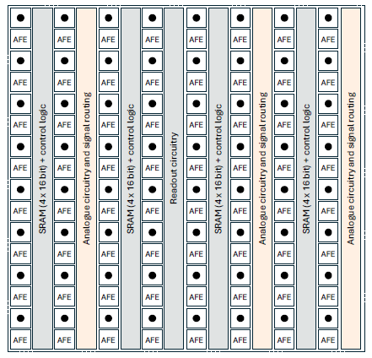
Novel sensor concepts (my simplistic understanding)
Disclaimer: My limited personal understanding.
Data (serialized)
ALMIRA
Trigger
Data (serialized)
Data Receiver
Trigger
TDC
Data (serialized)
Trigger
8x8 pixel
Concept:
Build pixel macros with 8x8 or 4x4 tiny pixels (10 or 20µm pitch) => 3µm spatial resolution.
Get time information from “MacroOR”.
Read data in a serialized way.
Best optimized for small pixels and low energy consumption (no ToT by default).
Time resolution <100ns (ALICE3 R&D goal)

Slide 30
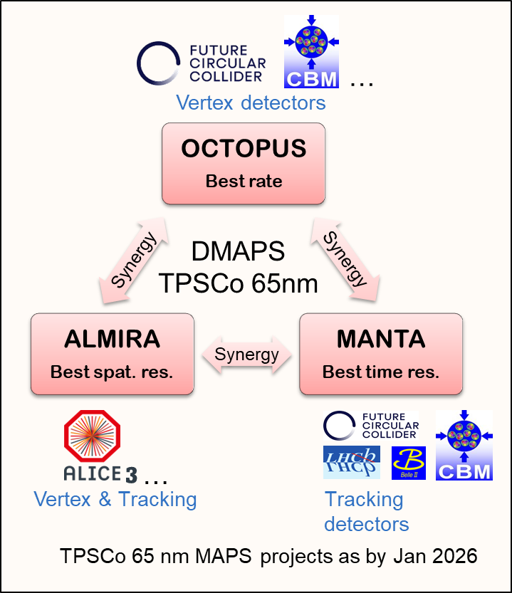
Finding the best solution: A collapetition…
“People agreed on a common technology. They use it in a
slightly different way.”
OCTOPUS, MANTA and ALMIRA will presumably
Rely on the legacy of ALPIDE/MIMOSIS and ALICE-ITS3/MOSAIX
Differ in column readout in response to complementary optimization.
Share numerous building blocks (e.g. RAM, drivers, …).
Share integration technologies.
Expect substantial synergies in R&D.
GSI is at present involved in all three projects
Coordinated R&D will exploit synergies and to obtain best technologies.

Slide 31
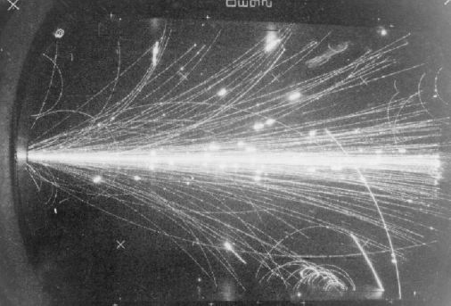

Radiation tolerance
Will this create signals or damage?
=

Slide 32
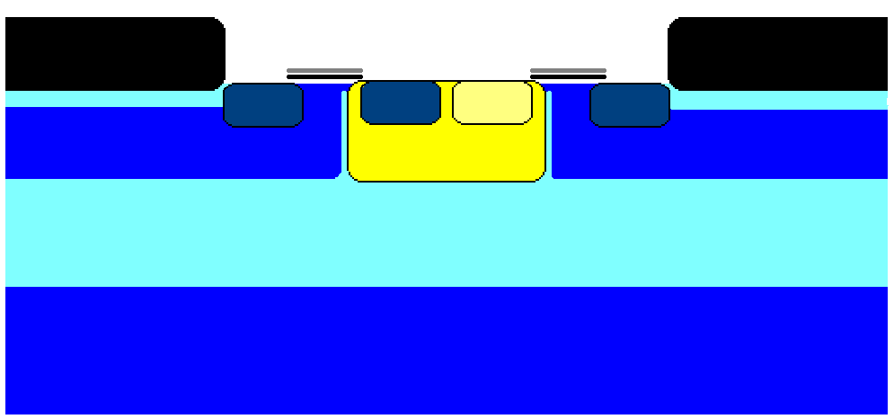

Radiation tolerance
+3.3V
Output
+3.3V
GND
SiO₂
SiO₂
GND
SiO₂
N+
SiO₂
P++
P++
N++
P++
Bulk damage
(Crystal damaged)
$$t_{e/h} \sim \frac{1}{Φ}$$
Radiation dose
Inititially: Charge collection by diffusion=> slow => Radiation tolerance: 10¹² n_{eq}/cm²
Idea: Apply electric fields => Speed up

Slide 33


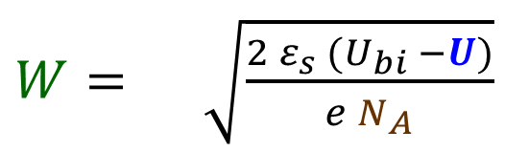
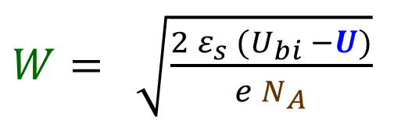
Radiation tolerance: D-MAPS
Max. 1.8V
Flat diodes:
Max. 1.8V
$W= \sqrt{\frac{2 ε_{s} (U_{bi} −U)}{e N_{A}}}$
$$2$$
SiO₂
Point diodes:
N+
N+
P+
$W= \sqrt{\frac{2 ε_{s} (U_{bi} −U)}{e N_{A}}}$
$6$^{(?)}
P-
P+
V_{BackBias}
Improvements
Reduce doping, add back bias, e.g. ALPIDE (hard for >6V).
Extend diodes (H. Pernegger et al., 2017 JINST 12 P06008)
Add AC-Pixel (MIMOSIS-1, see H. Darwish HK 4.5)

Slide 34


Radiation tolerance: D-MAPS
$$U ≥20V$$
Max. 1.8V
Flat diodes:
Max. 1.8V
Max. 1.8V
$W= \sqrt{\frac{2 ε_{s} (U_{bi} −U)}{e N_{A}}}$
$$2$$
SiO₂
SiO₂
Point diodes:
N+
P+
$W= \sqrt{\frac{2 ε_{s} (U_{bi} −U)}{e N_{A}}}$
$6$^{(?)}
P-
P+
V_{BackBias}
Improvements
Reduce doping, add back bias, e.g. ALPIDE (hard for >6V).
Extend diodes (H. Pernegger et al., 2017 JINST 12 P06008)
Add AC-Pixel (MIMOSIS-1, pioneered by IPHC, GU, GSI)
MIMOSIS-1

Slide 35

Going beyond the power wall: Radiation tolerance vs. pitch
DPTS
MIMOSIS
TOWER–0.18µm, p-stop (MIMOSIS-1)
TPSCo 65 nm (DPTS)
DPTS: G. A. Rinella et al., arXiv:2212.08621v4
MIMOSIS-1: H. Darwish et al, proceedings of 20thTrento workshop (2025), under preparation
Others: M. Deveaux, 2019 JINST 14 R11001

Slide 36


Random Telegraph Signal (RTS)
0.35 µm AMS
0.18 µm TowerJazz

Slide 37


Random Telegraph Signal
Vdd
Gate
Load
I
My charge is neutral
A particle…
My charge is positive
[1] P. Marthin-Gonthier et al., ICECS 2009, Hammamet, Tunisia, 13-16 December 2009. Piscataway NJ : IEEE, 2010, pp. 928-931. ISBN 978-1-4244-5090-9
[2] D. Doering et al., 2014 JINST 9 C05051
I
Threshold
Symbolic picture:
Measured on photo diode
t
RTS in diodes: Observed in MAPS since 2004, known radiation damage.
P. Marthin-Gonthier et al. [1], "RTS in small MOSFETs create noise in MAPS"
Check: Noise decreases for bigger MOSFETS in our 0.18µm MAPS [2].

Slide 38



The 180nm noise puzzle
Good practice: Transistor as small as possible…
Symbolic picture
Symbolic picture
$$RMS≈ 8e$$
$$RMS≈5e+RTS$$
Gate length: 0.35µm
Gate length: 0.18µm
0.35 µm AMS
0.18 µm TJazz

Slide 39



Effect of heavy ion hits on electronics
Heavy ions show high dE/dx or LET:
Scales with z² of the projectile => Au = 6200 M.I.P
Bethe Bloch: "Slow" ions create higher LET than relativistic ions.
Latch-up: Vulnerable structure
Unwanted current
Minority charge carriers excited by ions may:
Break transistor gates => Gate rupture
Switch digital electronics => Bit flip
Open unwanted conduction paths => Latch-up
(like short cut, extinguish by power cycle)
Macroscopic damage by individual ion: Single Event Effect.
Irreversible destruction
Malfunction if ignored
Thermal destruction if ignored
Ways to spot SEE:
Gate rupture: Search for permanent failure (not observed).
Bit flip: Write register with known date, read back, compare.
Latch-up: Detect increase of current consumption.

Slide 40





Test at GSI - M3 beam line
 | M3 @ GSI UNILAC
Energy / ion type | 3.2 A MeV Ca
Beam spot | 1.5 x 1.5 cm² mostly uniform
Beam time structure | 5 Hz pulses of 5 ms
Beam intensity (mean) | ~ 10⁷ Hz/cm²
Beam intensity (pulse) | 400 MHz/cm²
Dosimetry | Dedicated installation
Substrate
Not fully to scale
Low beam energy: Sufficient to reach vulnerable structures?
OK
500
3.3 AMeV Ca
on Si (SRIM)
LET [eV/Å]
ROI
0
New strategy:
Use masks to isolate building blocks (most sensitive and representative as chosen by the designers)

Slide 41



Beam test UNILAC – heavy ions and SEE
MIMOSIS-1:
MIMOSIS-2:
1s
1+1=3
Current [a.u.]
10 s
MIMOSIS-1
ROI = DAC
Current [a.u.]
No beam
Pulses: Few 10⁶/cm²
Hits in DAC steering registers confuse sensor.
1-bit flip automatic recovery does not work.
Need power cycle to restart.
No latch-up observed (for LET = 20 MeV cm²/mg).
Sensor withstands 400 MHz/cm² HI (beam impact scenario) w/o damage.
Hits in DAC steering registers tolerated.
1-bit flip automatic recovery does work.
May be overwhelmed (2 sync bitflips).
Observed at fluences ~10² above specs.
Recovered by reprogramming (most of the time).
Single bit flip recovery circuits now working.
=> Major improvement in robustness (as hoped).

Slide 42



MIMOSIS prototypes – Tolerance to heavy ion impacts
UNILAC ions as seen by MIMOSIS
As results of intense studies: MIMOSIS is considered robust to SEE.
GSI is equipped to do such work for the different communities.
46th CBM collaboration Meeting, Oct. 20-25 2025, Lanzhou, China

Slide 43
Summary and conclusion
MAPS are initially derived from digital cameras.
Major advantages: Light material budget and tiny pixels.
Technology being prepared for charged particle tracking since 1999.
Excellent spatial resolution worked out of the box.
Improvement was needed on time stamping and radiation tolerance.
Faster time stamping.
Limited by reading out the pixels and data rates.
Modern concepts aim for data reduction on pixel level.
Power may buy time stamping but needs to be provided/cooled.
Aim: Reach up to ~10 ns and rates up to 100 MHz/cm².
Radiation tolerance:
Smaller pixels are more tolerant to radiation.
Single Event Effects are of worry (and GSI is particularly competent to measure them).
Aim: Reach >10¹⁵n_{eq}/cm².
Reducing Random Telegraph Signal and tolerance to SEE remains a continuous task.

