Slide 1

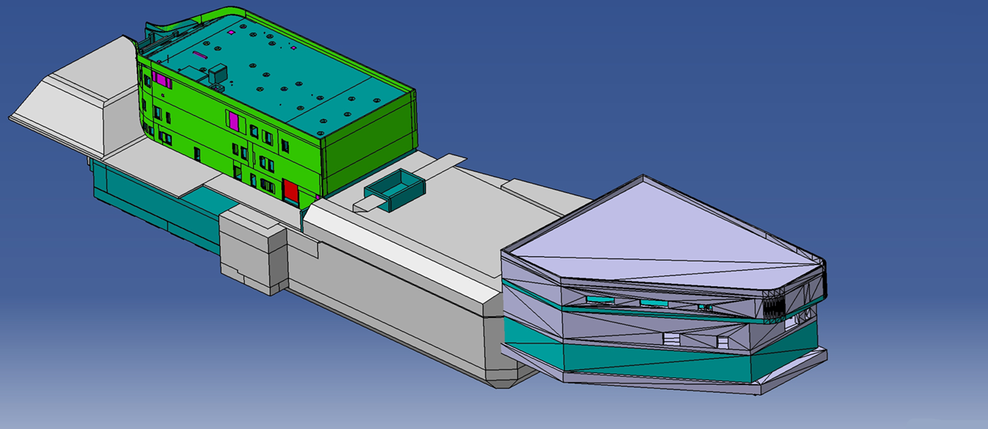
Laser setup for fusion science
V. Bagnoud
GSI & TU Darmstadt
APPA Cave Workshop
GSI, July 6th & 7th 2026

Slide 2
GSI proposes SIRIUS: an academic IFE research facility for standalone and combined laser-ion experiments
The facility will be located near the APPA cave, for which a conceptual design report exists. Compared to PHELIX at SIS18/HHT, it provides:
  × 100 higher ion beam intensities
  × 30 more laser energy
The facility fulfills both the requirement of the HED@FAIR community for experiments exploiting the combination of heavy-ion beams and lasers, and the German roadmap for laser-riven inertial fusion energy
The facility will play an essential role as training ground and for fundamental IFE-related research and could be a corner stone of a “Fusion hub” in Hesse.

Slide 3
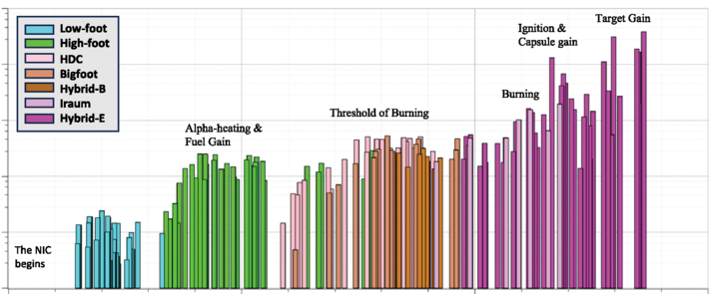
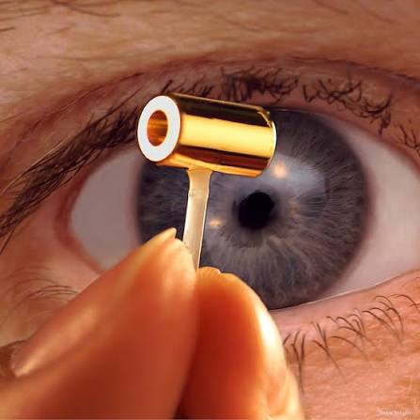
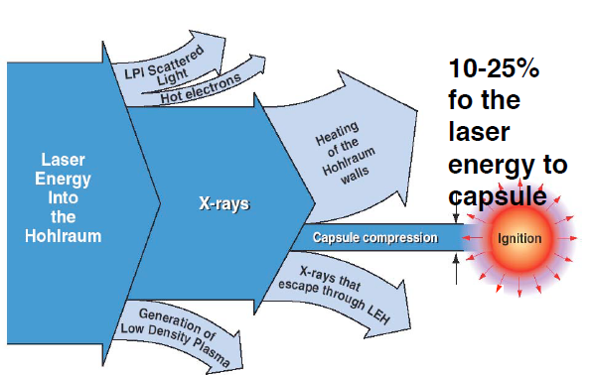
NIF fusion experiments: a major milestone on the inertial fusion energy (IFE) roadmap
Motivation
Yield of fusion experiments at LLNL
10⁴
laser energy
10³
x-ray energy
10²
implosion energy
Yield (kJ)
10¹
Hohlraum energetics
10⁰
10⁻¹
2010
2015
year
2020
2025
The energy balance behind ignition:
  Fuel gain: 400
  Target gain: 4
  Wall-plug-efficiency: 0.04

Slide 4
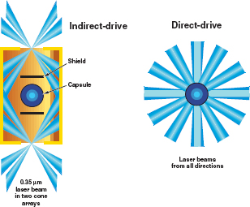
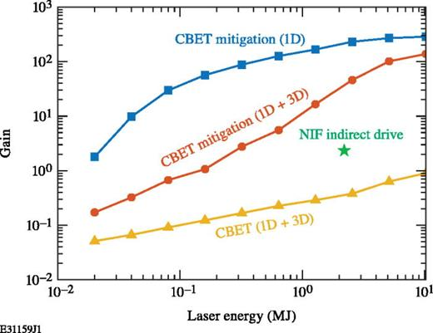
Next step in IFE research: gain ~1 demonstrator
Direct drive vs. Indirect drive
Prediction of fusion gain
vs. driver energy in direct drive*
shield
capsule
Laser beam in
2 cone arrays
NIF
OMEGA 60
NIF
Scaled OMEGA experiments in the 0.1 – 1 MJ range show:
  Direct drive is less efficient than indirect drive
  Mitigation of LPI makes direct-drive x 10 more efficient
Modern laser technology with laser diodes is x10 more efficient
* D. Froula et al, PPCF 32, 5 (2025)

Slide 5

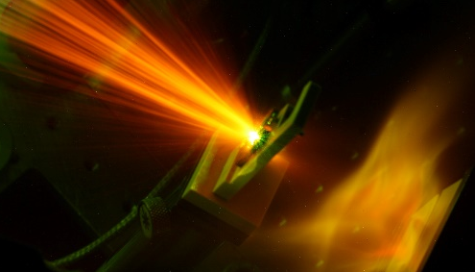
FAIR and SIRIUS can make a significant impact on target physics for IFE
Laser-plasma and hydrodynamic instabilities
  broadband laser interaction – LPI mitigation and competition
Energy loss measurement in plasma
  relevant to IFE burn with laser-ion and/or laser-laser experiments
Fast ignition studies leveraging GSI’s expertise in short pulse lasers (temp. contrast, high energy)
IFE diagnostics developments
Equation of state of warm dense matter generated by ion beams
  Warm dense matter (1-10 eV) typically found during compression phase
  Advantage: local thermodynamical equilibrium – uniformity – large samples
IFE-relevant materials research
  Exploitation of the LAPLAS setup (> 1 Mbar) – low strain rates
  Emulation of pulsed neutron fluxes for first wall studies
HED@FAIR diagnostics developments

Slide 6
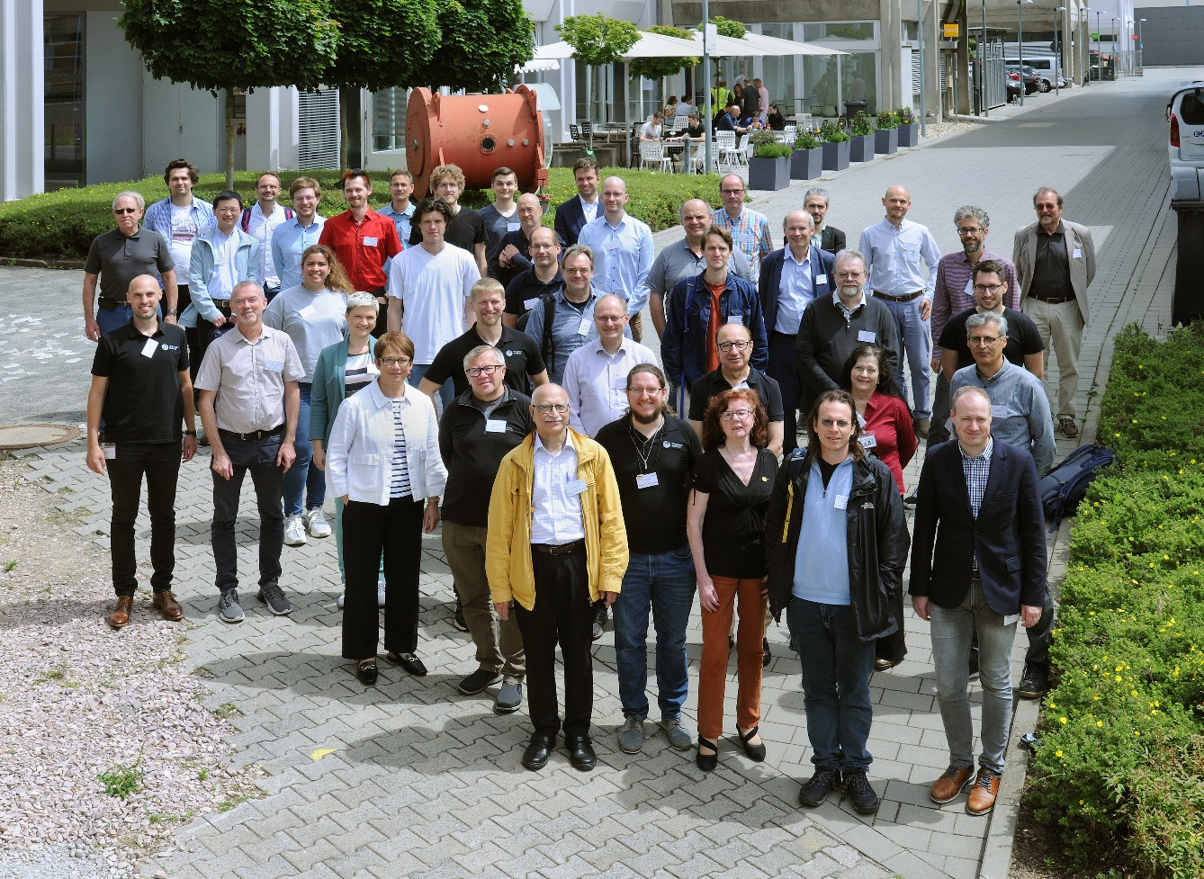
GSI Meeting on IFE R&D – June 20th & 21st 2024
Goal of the meeting: to prepare a science case for IFE research at GSI/FAIR
Define the near- and long term vision for the facility
  How can we answer the most immediate needs with existing facilities (0-5 years)?
    Training, diagnostics and methods, basic ICF and materials research
  How can we propose a facility that will have an impact on IFE research (5-10 years)?
    Training, specific IFE questions (LPI, Energy loss, EOS, diagnostics)
  How does the new facility fit in the long term development plans of the HED research capabilities at FAIR (> 10-20 years)?

Slide 7
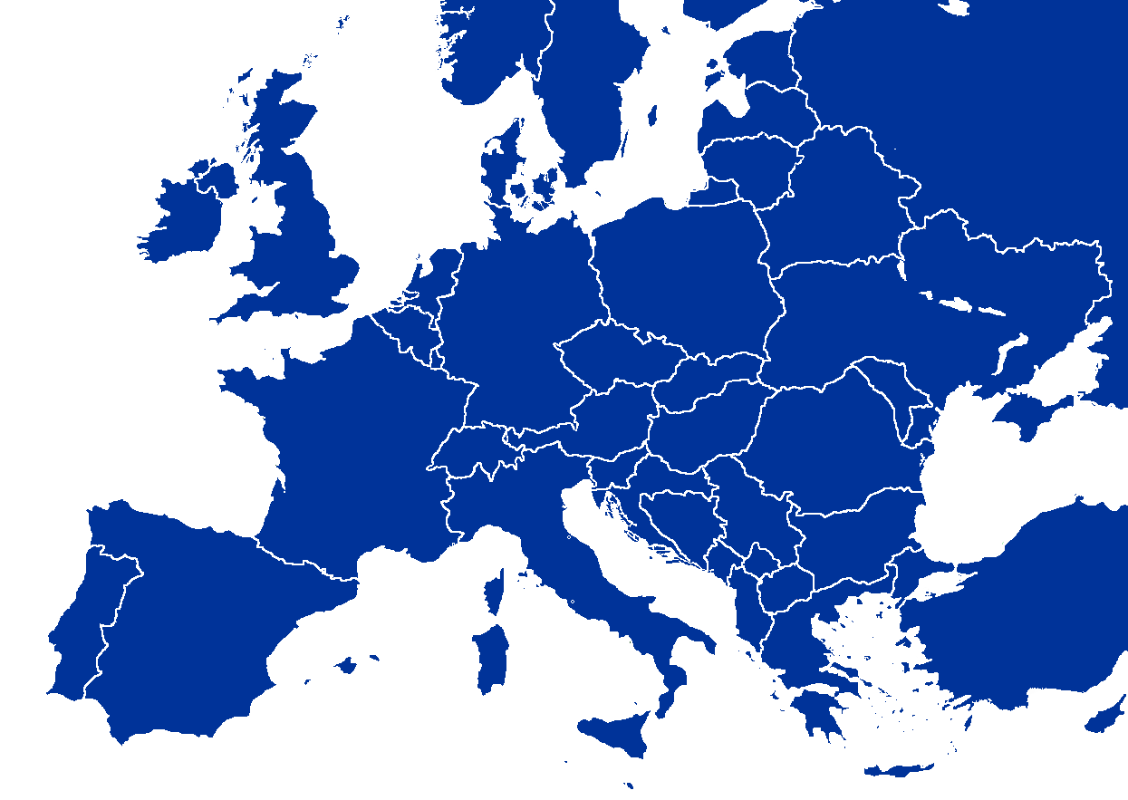
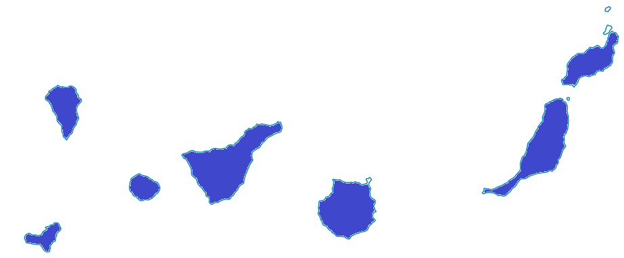
Embracing inertial fusion as application significantly increases FAIR visibility
HIPER +
German Universities
Partners with in-kind (LOI)
Spanish fusion network
HED@FAIR (only European labs)
SIRIUS draws a strong interest from European countries via fusion thematic networks (e.g. HIPER+)
  HED@FAIR in Europe: 18 institutes
  With SIRIUS: 40 institutes

Slide 8

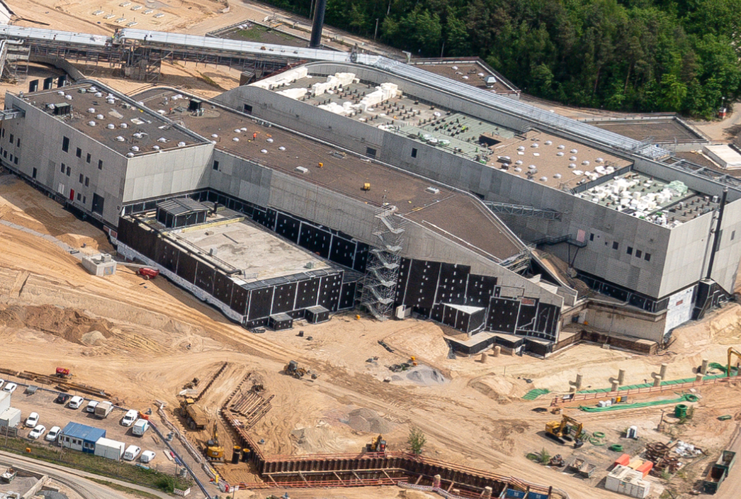
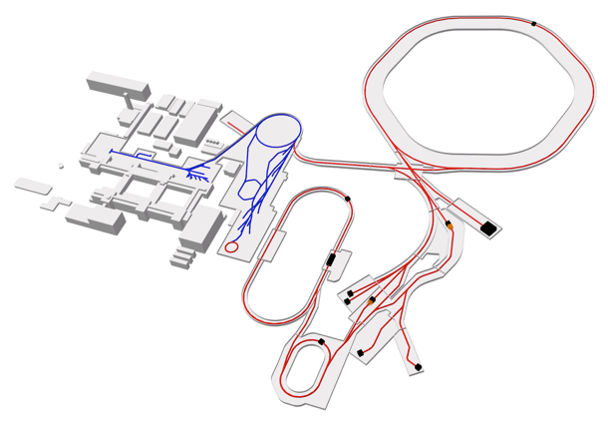
Site proposal for SIRIUS on the FAIR campus
2023: space reserved
2025: feasibility study
Ring Accelerators
SIS100
APPA
Linear Accelerator
UNILAC
SIS18
D. Fehrenz, GSI/FAIR
1500 m²
100 m
SIRIUS
APPA
cave
Existing facilities
FAIR beamlines
materials research
HED experimental areas

Slide 9
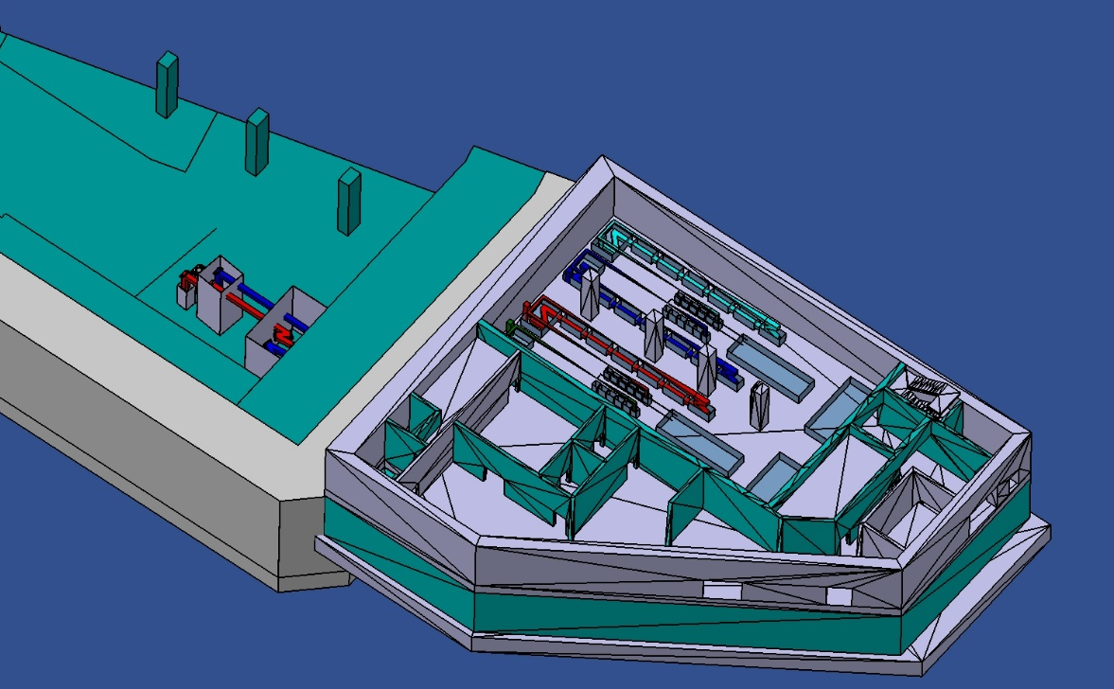
Proposed IFE research facility at the heavy-ion accelerator FAIR near Darmstadt: SIRIUS
Main characteristics:
    4 multi-kilojoule laser beamlines with flexibility in the pulse length (nanosecond down to femtosecond) and spectral bandwidth (up to 10%)
    2 target areas: one in APPA cave, one as stand-alone
Operation as user facility, operational in 7 years (preliminary studies under way)
Cost: 119 Mio€
APPA cave
SIRIUS

Slide 10
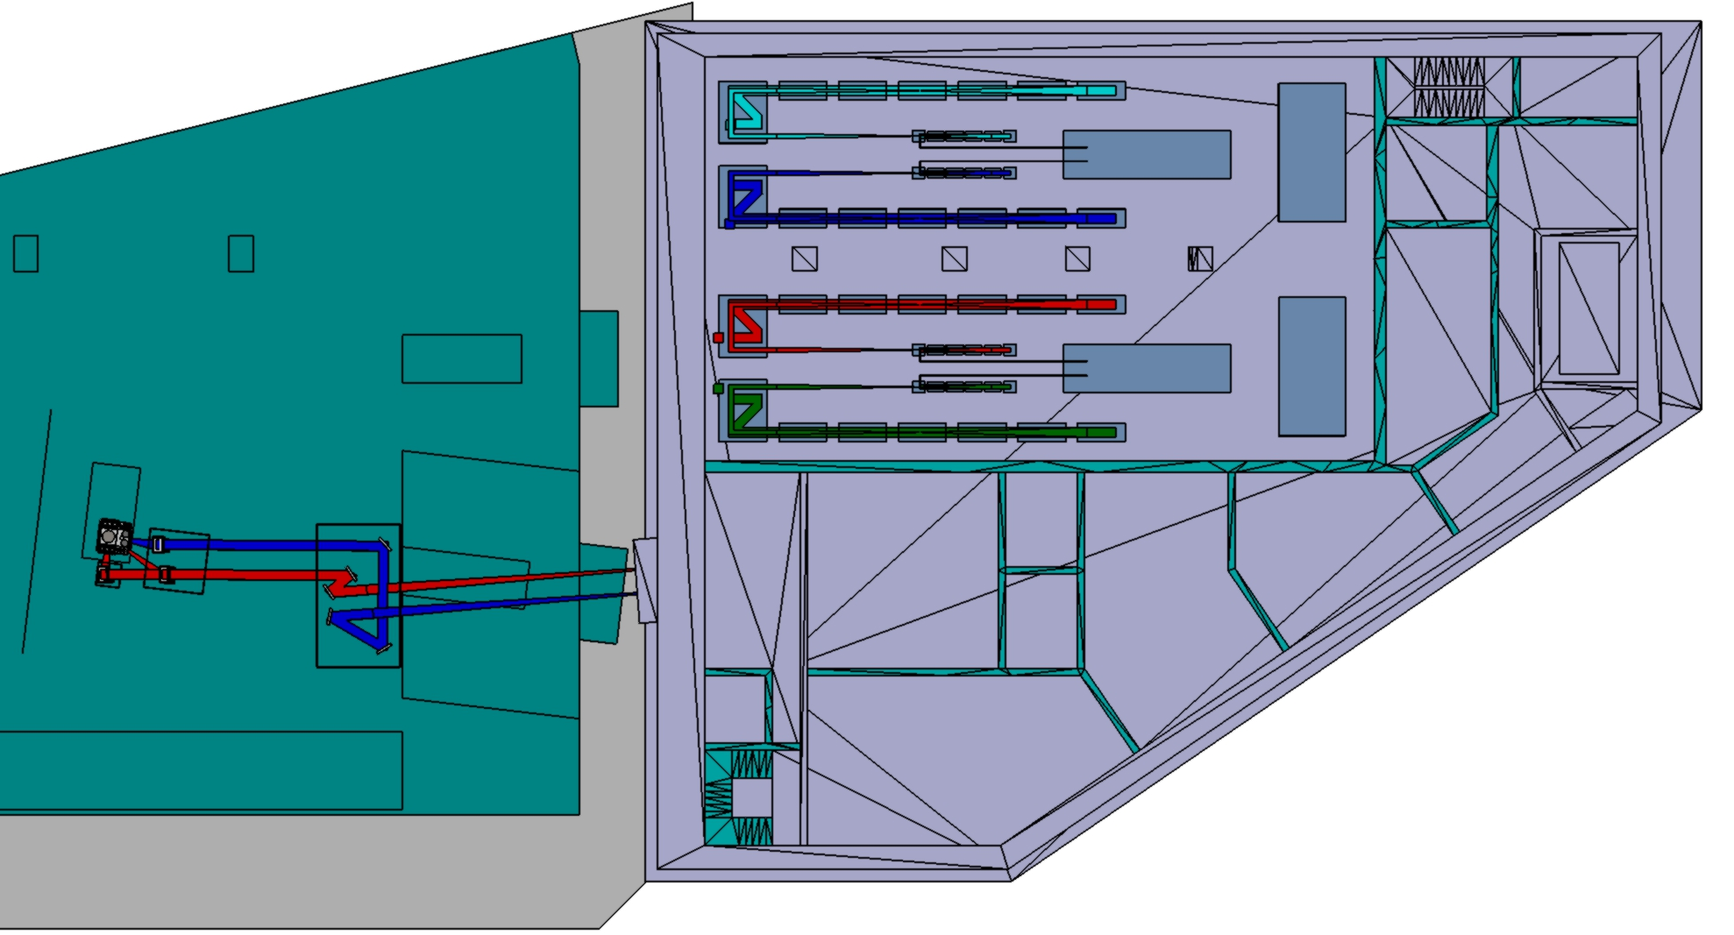
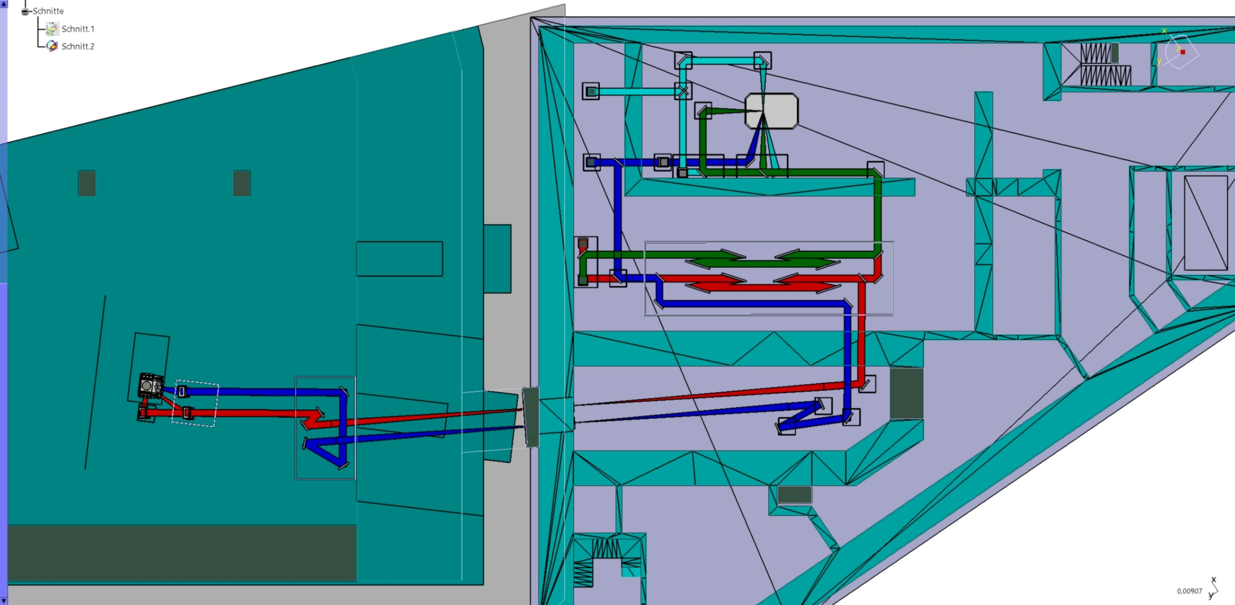
Conceptual design of the facility is on-going
Underground
SIRIUS
Target chamber
compressor
telescope tunnel
(beam transport)
HED@FAIR
Target chamber
2 target areas
  APPA cave + laser building (200 m²)
  4 laser beams
  Radiation shielding with 2-m walls

Slide 11
Conceptual design of the facility is on-going
Ground level
Laser 4
preamplifier
Laser 3
Laser bay
Laser 2
preamplifier
Laser 1
Clean room
HED@FAIR
Target chamber
Assembly
room
4 Laser beams – up to 10 kJ
  2 ns beams
  2 ns/ps beams
  40 x 40 cm² clear aperture
Clean room

Slide 12
GSI proposes SIRIUS: an academic IFE research facility for standalone and combined laser-ion experiments
The facility will be located near the APPA cave, for which a conceptual design report exists. Compared to PHELIX at SIS18/HHT, it provides:
  × 100 higher ion beam intensities
  × 30 more laser energy
The facility fulfills both the requirement of the HED@FAIR community for experiments exploiting the combination of heavy-ion beams and lasers, and the German roadmap for laser-riven inertial fusion energy
The facility will play an essential role as training ground and for fundamental IFE-related research and could be a corner stone of a “Fusion hub” in Hesse.

Slide 13
Thank you

