Slide 1

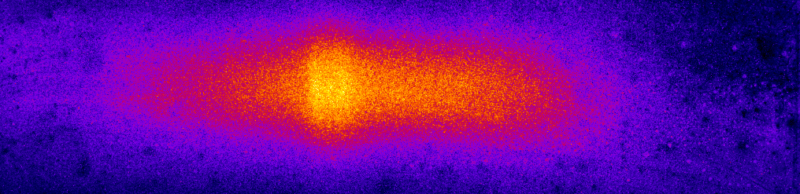

Warm Dense Matter Experiments
D. Riley
Centre for Light-Matter Interaction
Queen’s University Belfast, Antrim, United Kingdom

Slide 2
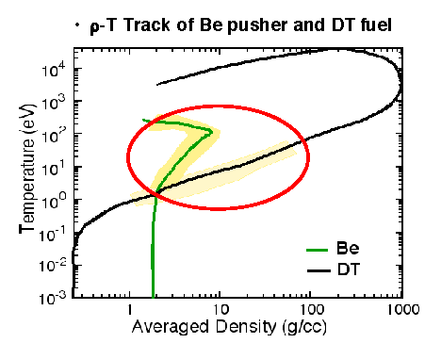
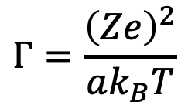
Context of WDM
Theoretical challenge of strong coupling, partial degeneracy, partial ionisation.
Occurs in laser-fusion, astrophysics and planetary sciences
Typically, energy density > 10¹¹ J/m³
$$Γ=\frac{{\left(Ze\right)}^{2}}{ak_{B}T}$$
See RW Lee et al Laser Part. Beams 20 p527 2002
a = ion-sphere radius

Slide 3
There are different approaches to WDM production
Shock/ramp compression
  Laser driven shocks >1000 GPa¹
  Z-pinches >500 GPa²
  Explosives³ (>100 GPa) and gas guns >500 GPa⁴
Volumetric heating
  Radiation from laser plasmas⁵
  Particle beams (e.g. laser-plasma protons)⁶
  X-ray and XUV lasers⁷
¹L. Veeser and J. Solem, PRL 40, 1390 ⁵SH Glenzer et al, PRL 90 175002.
² e.g. M. R. Martin et al, Phys. Plasmas 19, 056310 ⁶P.K. Patel, et al., Phys. Rev. Lett. 91 125004.
³VE Fortov and VB Mintsev, PPCF 47 A65–A72 ⁷B Nagler et al Nat. Phys. 5 693, 2009
⁴ e.g. JM Brown et al J. Appl. Phys. 88 5496

Slide 4
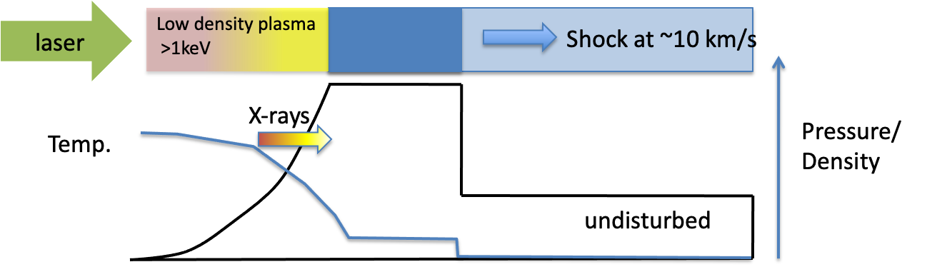


Example: Driving intense shocks
laser
sample
Low Z ablator
1 KJ in 1 ns over ~ 1mm² gives ~10¹⁴ Wcm⁻² and a pressure of in excess of 1 TPa.
$$P\left(GPa\right)=800I_{14}^{3/4}λ^{−1/2}$$
¹PC Thompson et al, J. Phys. D 14, 1215, 1981
Rankine-Hugoniot equations.

Slide 5
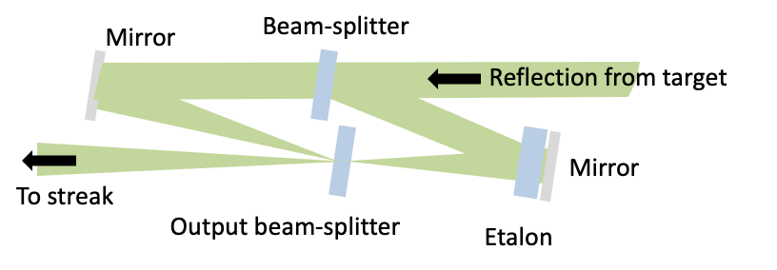
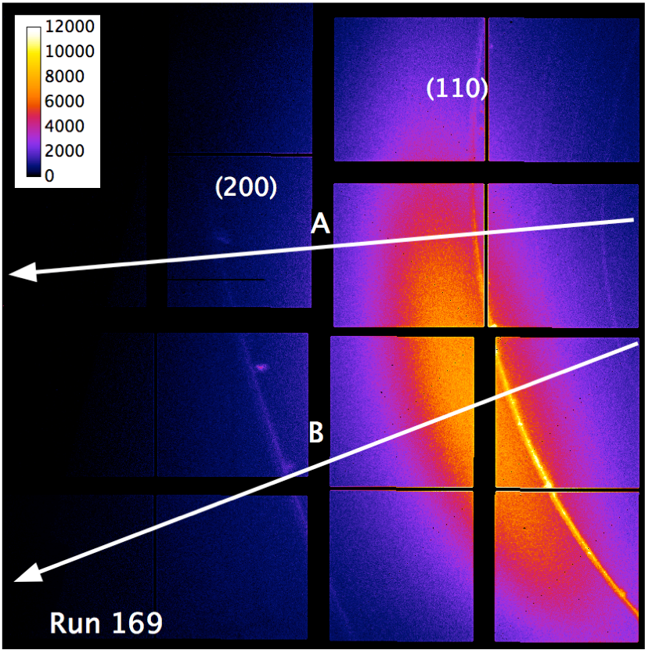
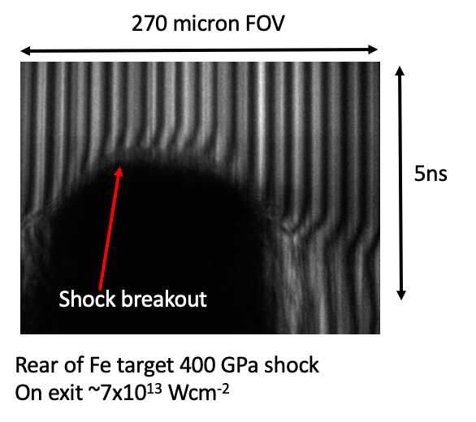
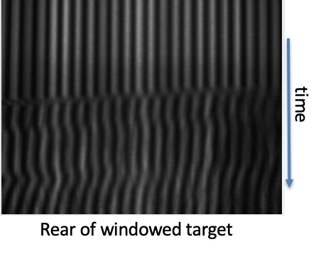
Shock diagnostics include:
XRD
VISAR
Pre-breakout
Post-breakout
Celliers et al RSI 75, 4916, 2004
Density and Temperature
Shock speed and particle speed

Slide 6
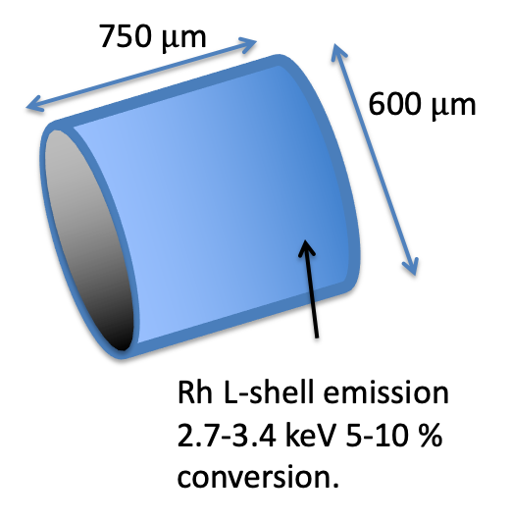
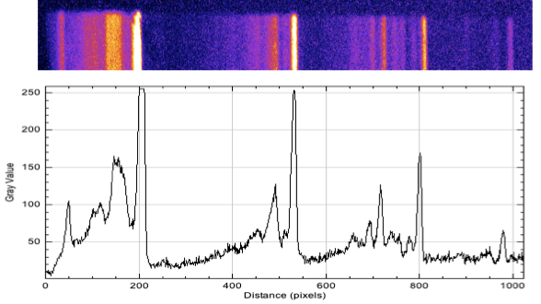
Example: Radiative heating with X-rays
0.6 mm diameter Be, coated by 1 μm Rh(Z=45)
L-shell photons have 100s μm mfp in Be
Omega laser 351nm 15KJ
30 beams.
Uniform heating to ~50 eV at ~ 1.2 gcm⁻³ density. P~ 2.8 TPa: Timescale ~ 10 ns with ~ 1ns duration x-rays. Possible due to low opacity of Be to x-rays.
Glenzer et al PRL 90 175002 2003

Slide 7
The diagnostic was XRTS
Glenzer, S. H. et al. Phys. Rev. Lett. 98, 065002 (2007)
Thomson
Cross-section
Electron-ion
correlation
Bound-free
electrons
Ion-ion
structure factor
Free electron
structure factor
Ionic form factor
¹J. Chihara J. Phys F 17 p295, 1987
²E Nardi, Phys. Rev. A 43 p1977, 1991
see Glenzer and Redmer RMP, 81, 1625, 2009

Slide 8
Proton heating approach
The laser generates fast protons by mechanisms such as TNSA (Snavely et al PRL 85 2945, 2000, Clark et al PRL 84 670, 2000. Energies can be in a spectrum ranging from MeV to 100 MeV with a conversion efficiency up to 10%.
A Macchi, M Borghesi, and M Passoni, Rev. Mod. Phys. 85 751-793, 2013

Slide 9
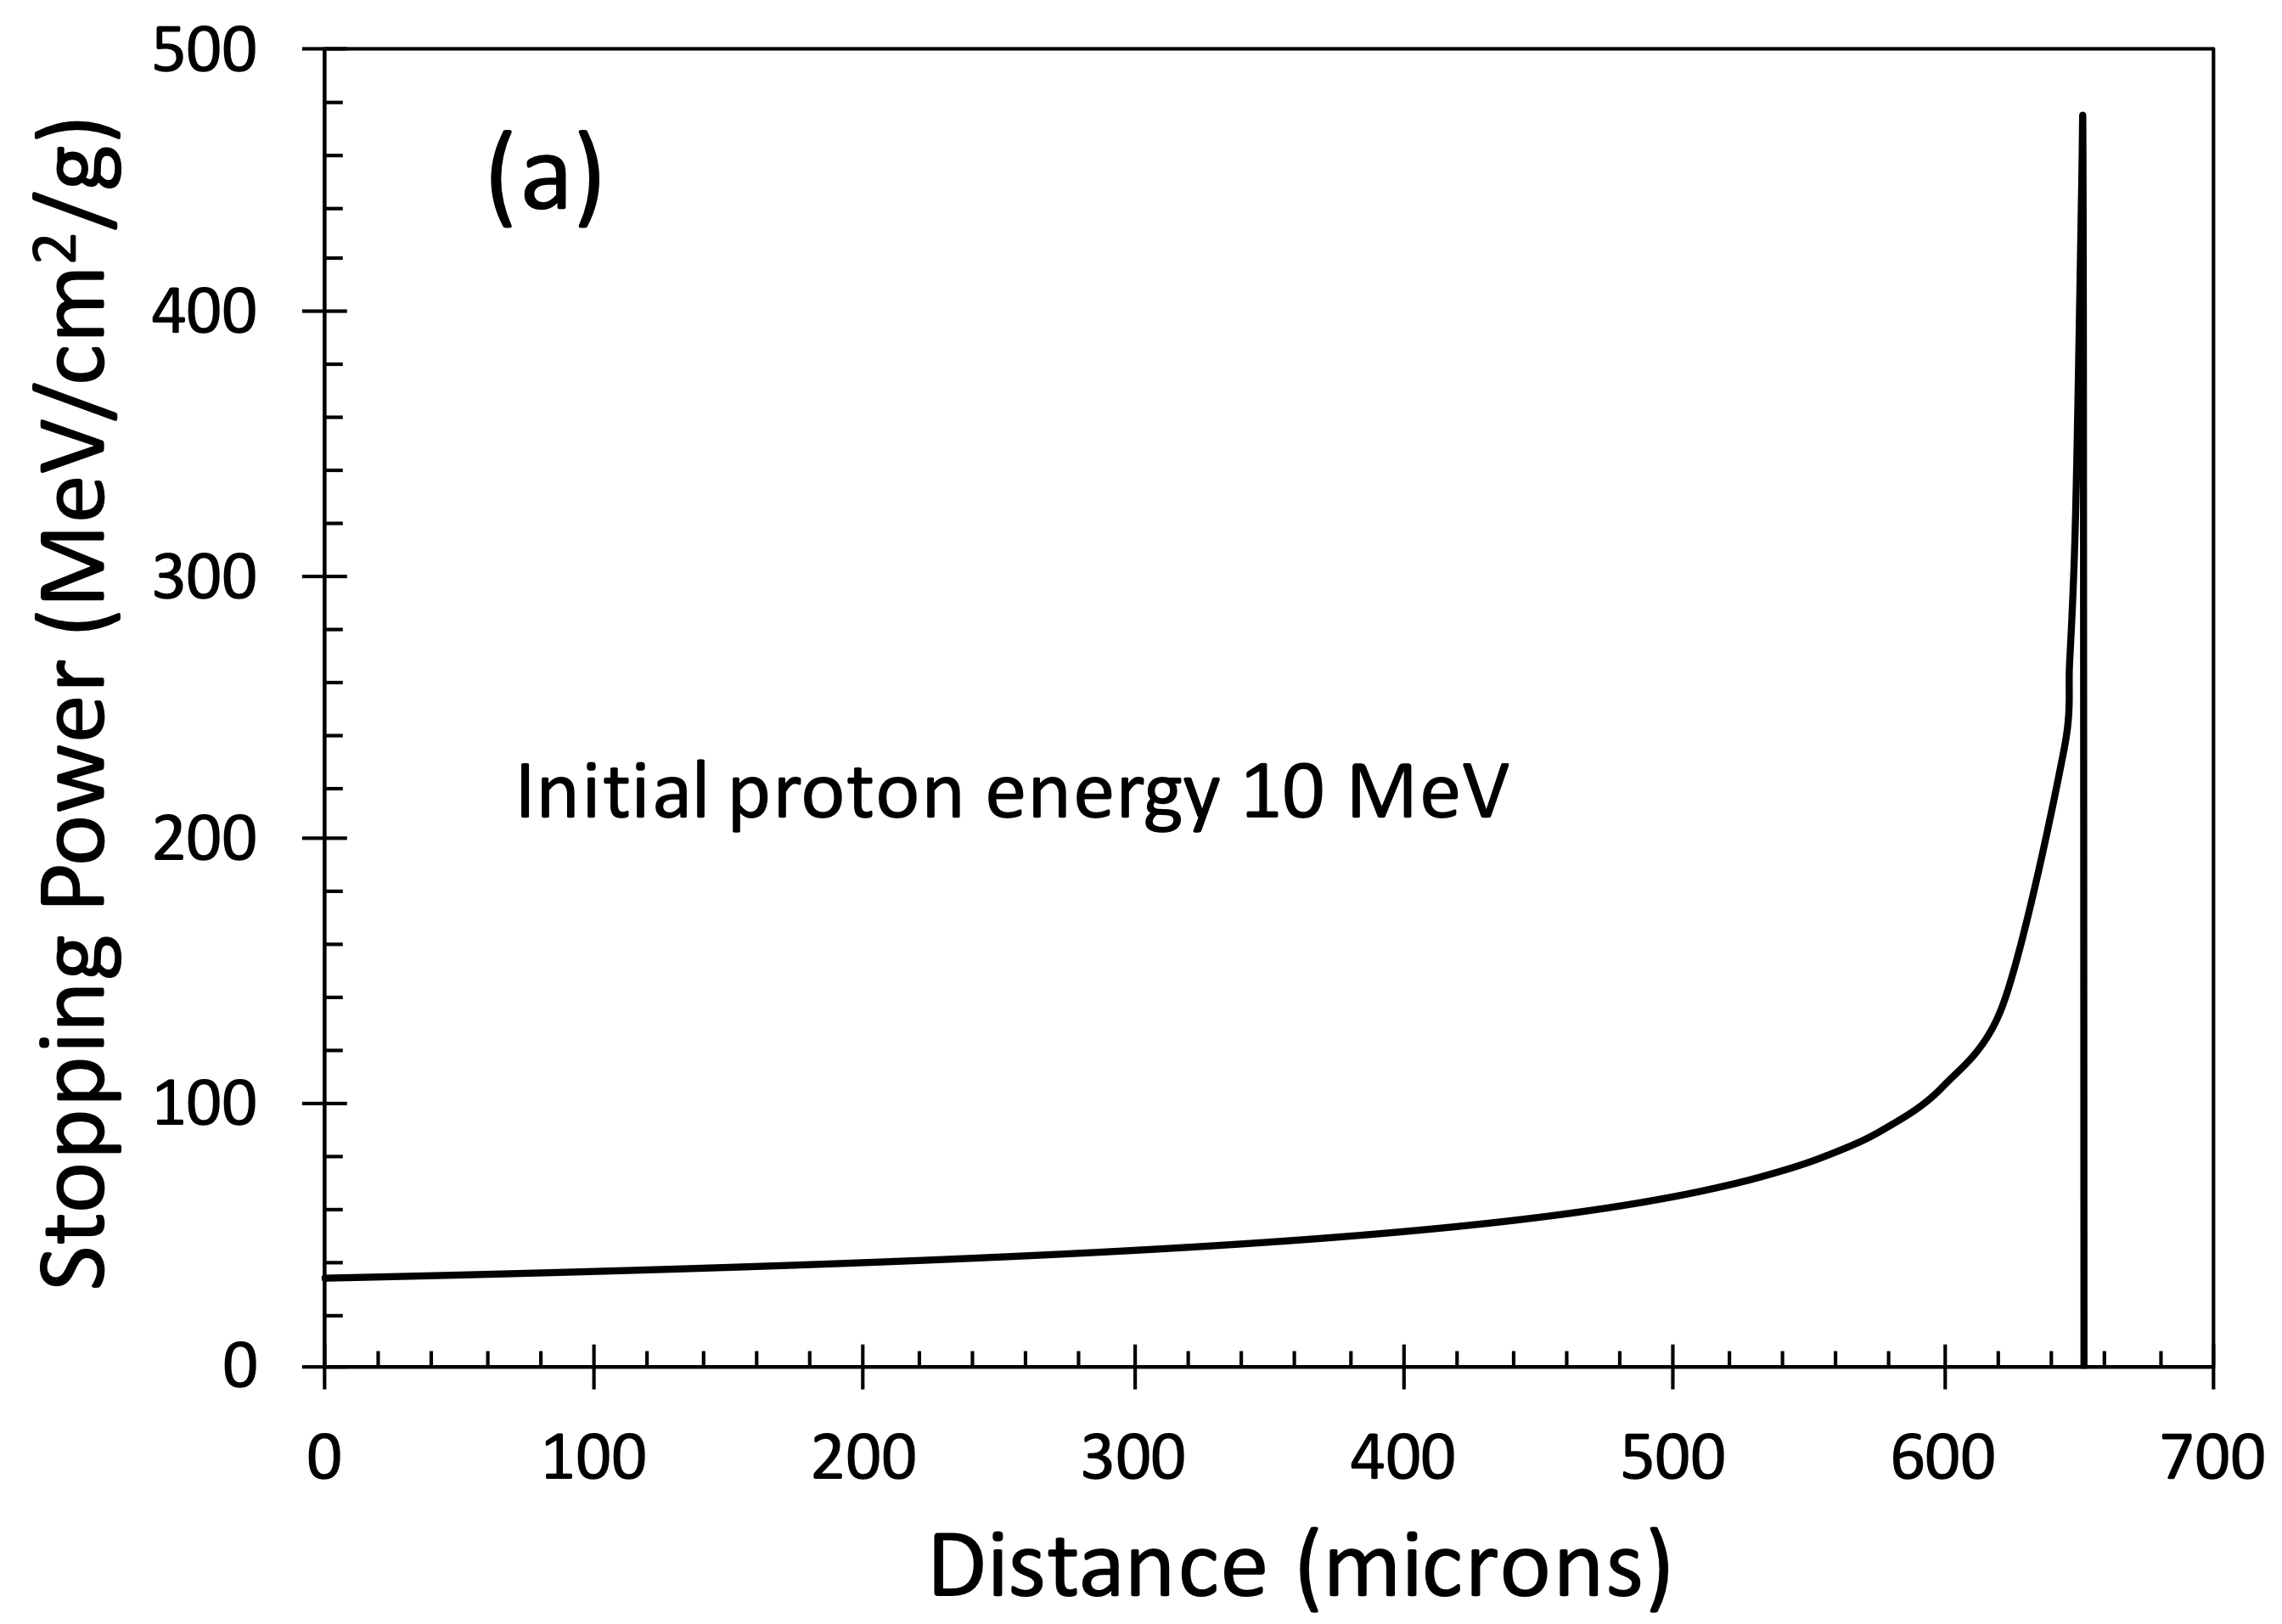
Proton heated WDM has been created
The protons stop with a Bragg peak depending on energy and material
Stopping in Al
Optical emission from target
T~ 20 eV for focussed, 4 eV unfocussed
Patel et al, PRL 91 125004, 2003
Streaked Optical Pyrometry. (SOP)

Slide 10
Probing is not trivial but possible
X-ray Absorption Near Edge Spectroscopy
XANES diagnostic, solid densities and a
few eV in WDM regime
Lévy et al, PPCF 51 124021, 2009
see also
L Lecherbourg et al, Phil. Trans. R. Soc. A 381: 20220214 (2023)
F. Dorchies et al Struct. Dyn. 10, 054301 (2023)
A. McKelvey et al Scientific reports 7, 7015 (2017)

Slide 11
Challenges- some specific issues for laser-plasmas
Fast protons use TNSA and this means fast electrons with hard-x-ray bremsstrahlung. Highly divergent proton beams (~0.5 radians).
Laser-driven shocks can involve x-ray pre-heating.
X-ray heating OK for lower Z but higher Z can be an issue for heating and probing.
Timescale for evolution may make time-averaging effects significant.
Access to sample for probing can be an issue- see Lévy experiment.

Slide 12
Some examples of where FAIR can be competitive
Creation of a large volume WDM sample with low temporal and spatial gradients and using higher Z.
Shock or high-pressure compression without x-ray preheat.
Timescale for heating is ~ 100ns but decompression times can also be large.
Ion source separated from sample for easier probing.

Slide 13
SIS-100 beams can produce WDM
From Tzifas et al Phys. Rev. Res 8 023054 (2026)
V E Fortov, D H H Hoffmann, B Yu Sharkov
Physics Uspekhi 51 (2) 109 -131 (2008)
1 GeV/u U⁺²⁸ ions loss rate of about 10 keV/nm in Steel (Fe). Range ~ 10 g/cm² which is about 13 mm in Fe. Over a mm dimension sample, we would have uniform heating to 2x10⁷ J/kg with 10¹¹ ions in a ~ 1mm area focal spot. This should lead to ~ 3eV.

Slide 14
Ion beam shocks have been proposed
Absorber material
Test material
See: PA Ni et al LPB 26 583 (2008)
For experiments on W.
Grinenko et al LPB 27 595 (2009) for conceptual study of Ramp Wave Loading
Energy deposition
>10⁵ J/g
Shock/compression
driven by pressure profile
Dewald et al IEEE Tran. Plasma Sci. 31 221 (2003) had
200MeV/u U beams depositing 1.5 kJ/g in Pb, 0.2 eV and 15 kbar shocks
‘elliptical’ ion beam
For >Mbar pressures we do not have to create
A keV plasma with ion beams. Unlike laser driven shocks
10⁵ J/g for Pb is ~10¹²Jm⁻³ ~ 10Mbar

Slide 15
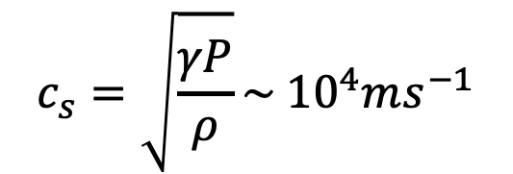

Hydrodynamic evolution vs size
If we imagine a sample at a pressure of ~ 100 GPa with density ~ 1gcm⁻³, which is typical of WDM then we can estimate a sound speed given by
$$c_{s}=\sqrt{\frac{γP}{ρ}}\sim {10}^{4}ms^{−1}$$
Estimate a hydrodynamic decompression time, based on sample size, d
$${t=d/c}_{s}$$
For a mm-sized target this gives 100 ns. For laser-plasma drive x-ray probes we can get typically 1ns with quite good conversion. Thus, volumetric heating over a large volume has some key advantage. For the Lévy experiment the thickness was of order 1 micron and sound speed estimated at 5 km/s. So, timescale ~200ps compared to heating time of ~ 10ps.

Slide 16
Experimental issues remain e.g. probing higher Z
For 2x10⁷ J/kg for Fe the pressure should be about 160 GPa.
This means a sound speed at solid density of about 5 km/s.
For XANES 1-1.5 mfp for the K-edge region is about 3-5 μm. Decompression time is then ~ 1ns.
For probing with XRTS etc we may wish to restrict the thickness to about 20 μm, as this is a mean-free path for ~ 6-7 keV photons just below edge. The decompression time would then be ~ 4 ns. Maybe tamped targets needed.
Ion beam
tamp
tamp
Fe

Slide 17
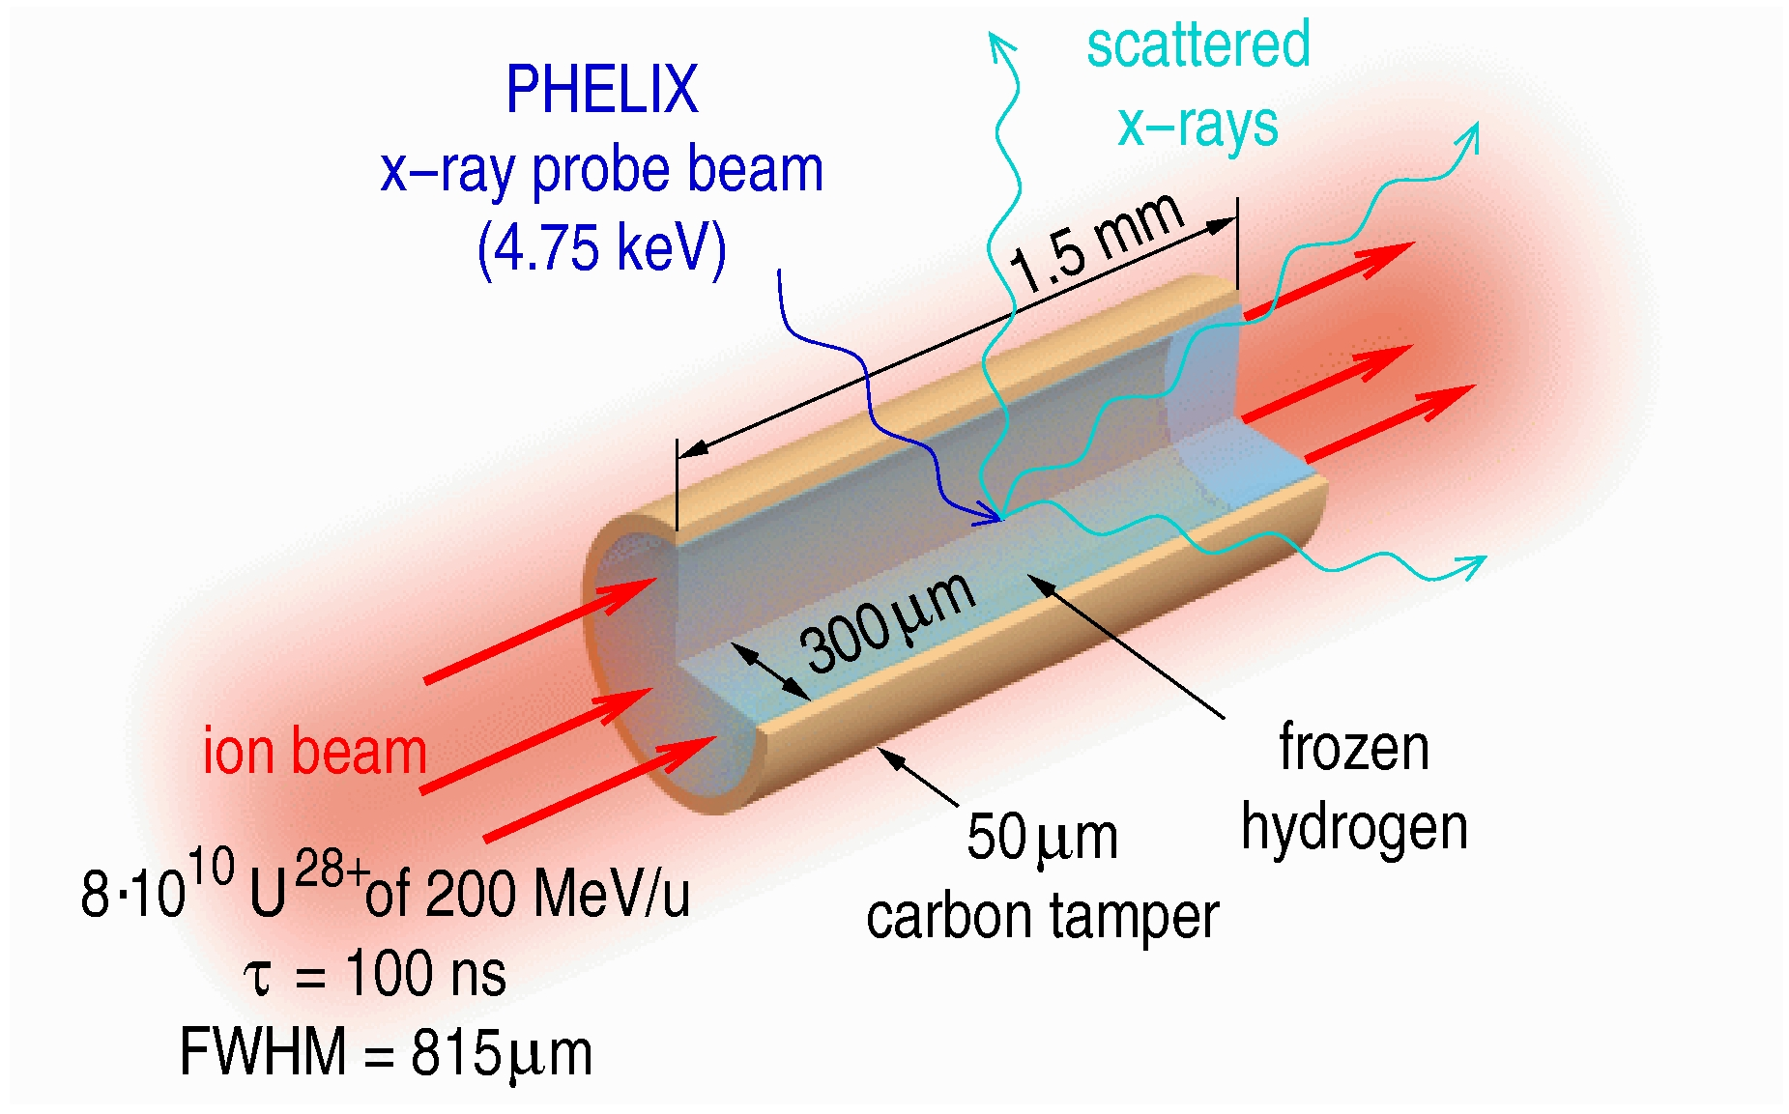
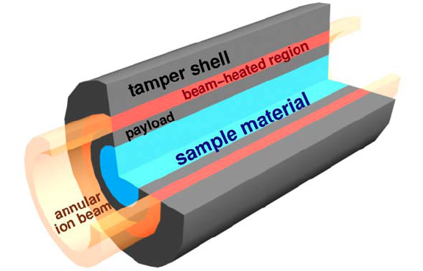
Tamping proposed previously
H
H
C
C
H
H
Kozyreva, et al PRE 68, 056406 (2003
C
C
ρ g/cc
T (eV)
Tauschwitz et al HEDP 3 371 (2007)
8 x 10¹⁰ U⁺²⁸ ions : 200 MeV/u
815 μm FWHM beam : 100 ns pulse
Weinwurm et al Phys. Plasma. 20, 092701 (2013)

Slide 18
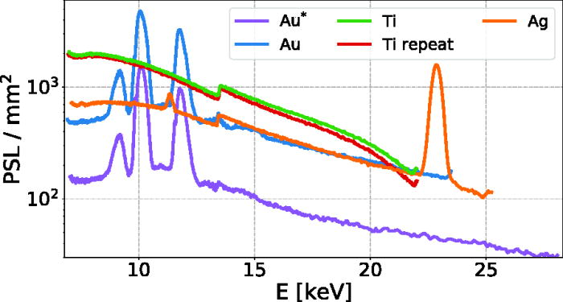
Experimental issues remain e.g. probing higher Z
2ns pulses 351 nm
Krygier et al Appl. Phys. Lett. 117, 251106 (2020)
Irradiate solid targets directly.
Betatron radiation
Albert et al, PRL 118, 134801 (2017)
Complex set-up

Slide 19
Noise issues due to fast electrons
Energy transfer of ions mainly to electrons in the target.
Simple consideration of momentum suggests transfer of energy is given by mass ratio m_{e}/m_{ion}. For uranium-238 mass ratio is ~ 4.4x10⁵.
For 200 MeV/u this means ~ 100 keV electrons. These can generate bremsstrahlung radiation that causes background noise and damage in instruments.

Slide 20
Summary
FAIR/SIS-100 can compete well in several key areas:
Volumetric heating possible for wide range of sample materials
Ion heating can be far more controlled and flexible than laser drive proton source experiments.
There are still experimental challenges e.g. trade off between hydrodynamic decompression times and having samples that can be probed.
Fast electrons still can be an issue due to collisional transfer from ions.

Slide 21
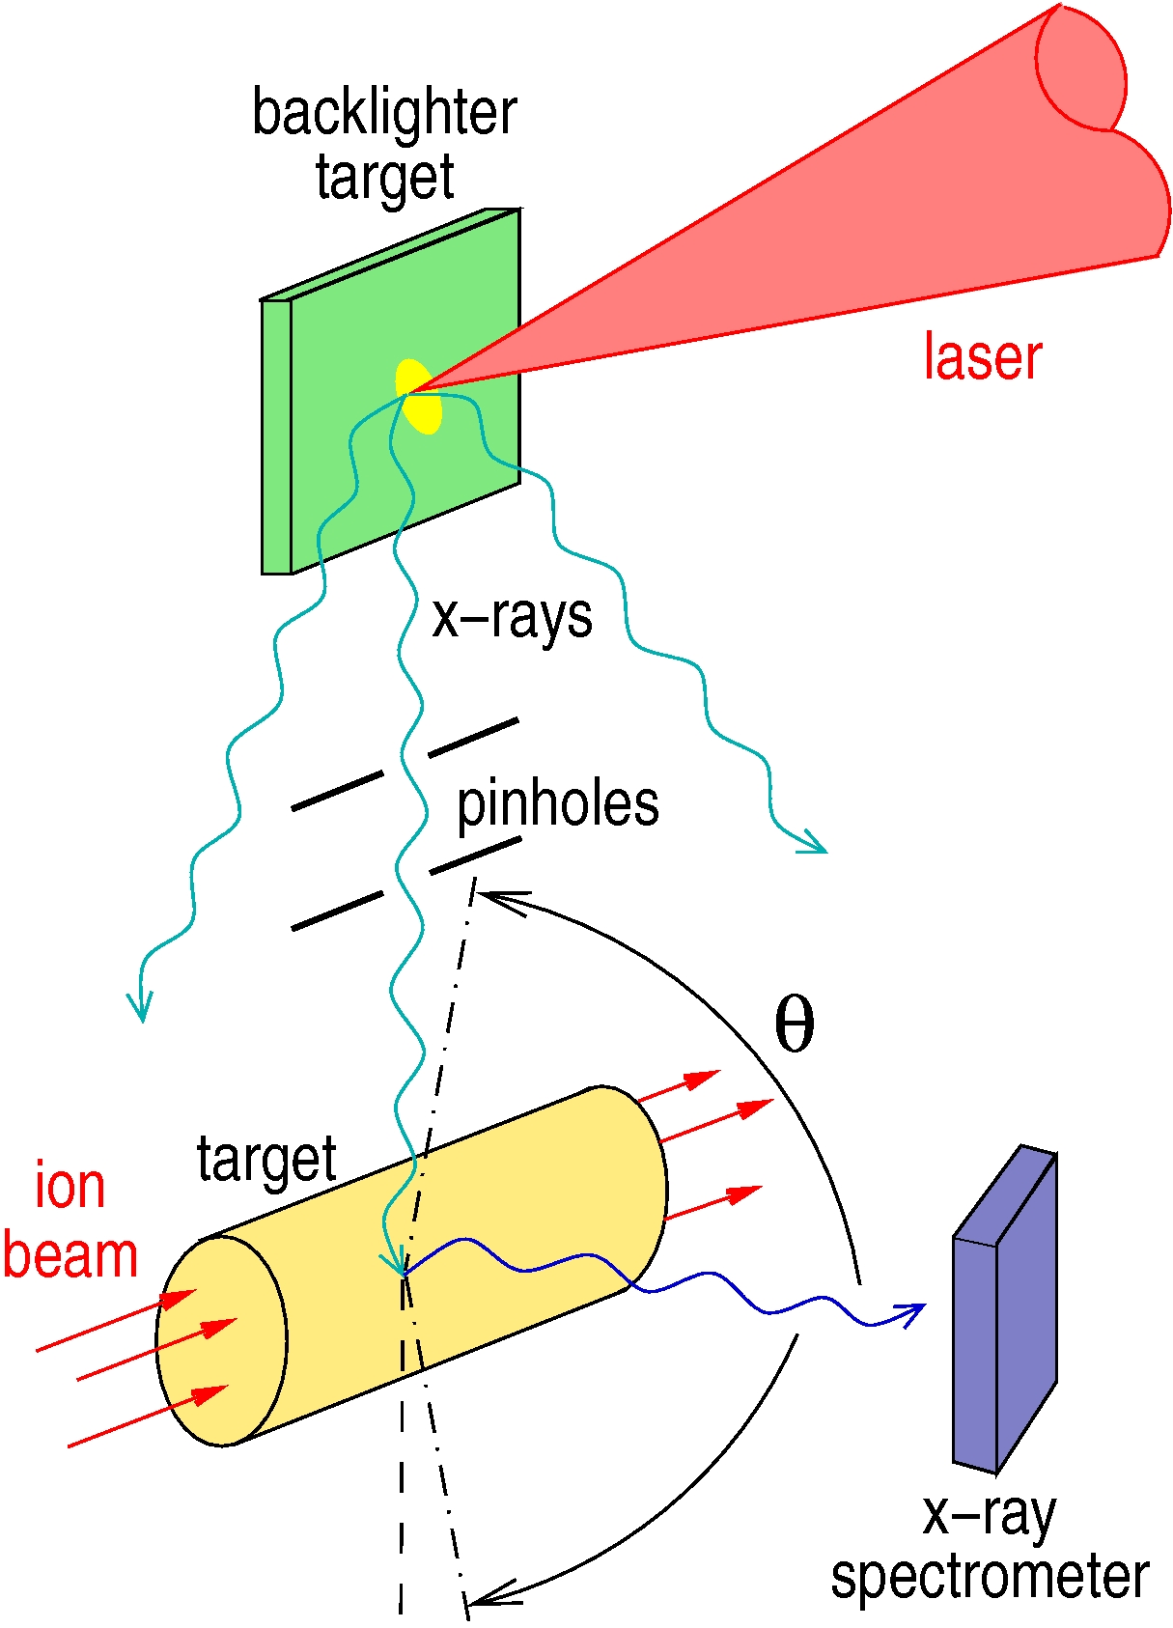
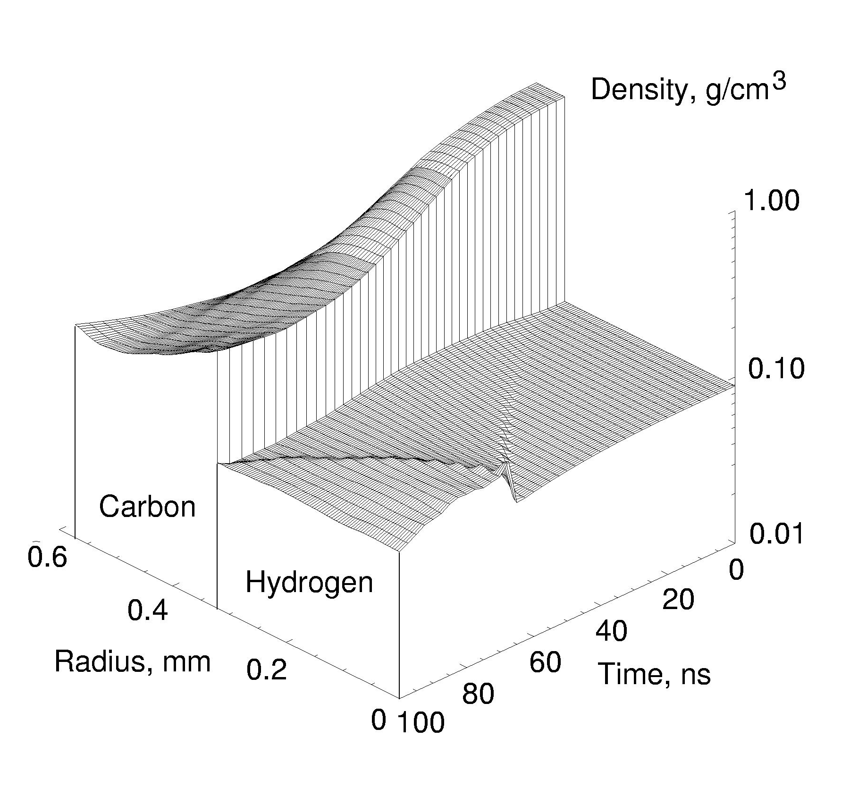
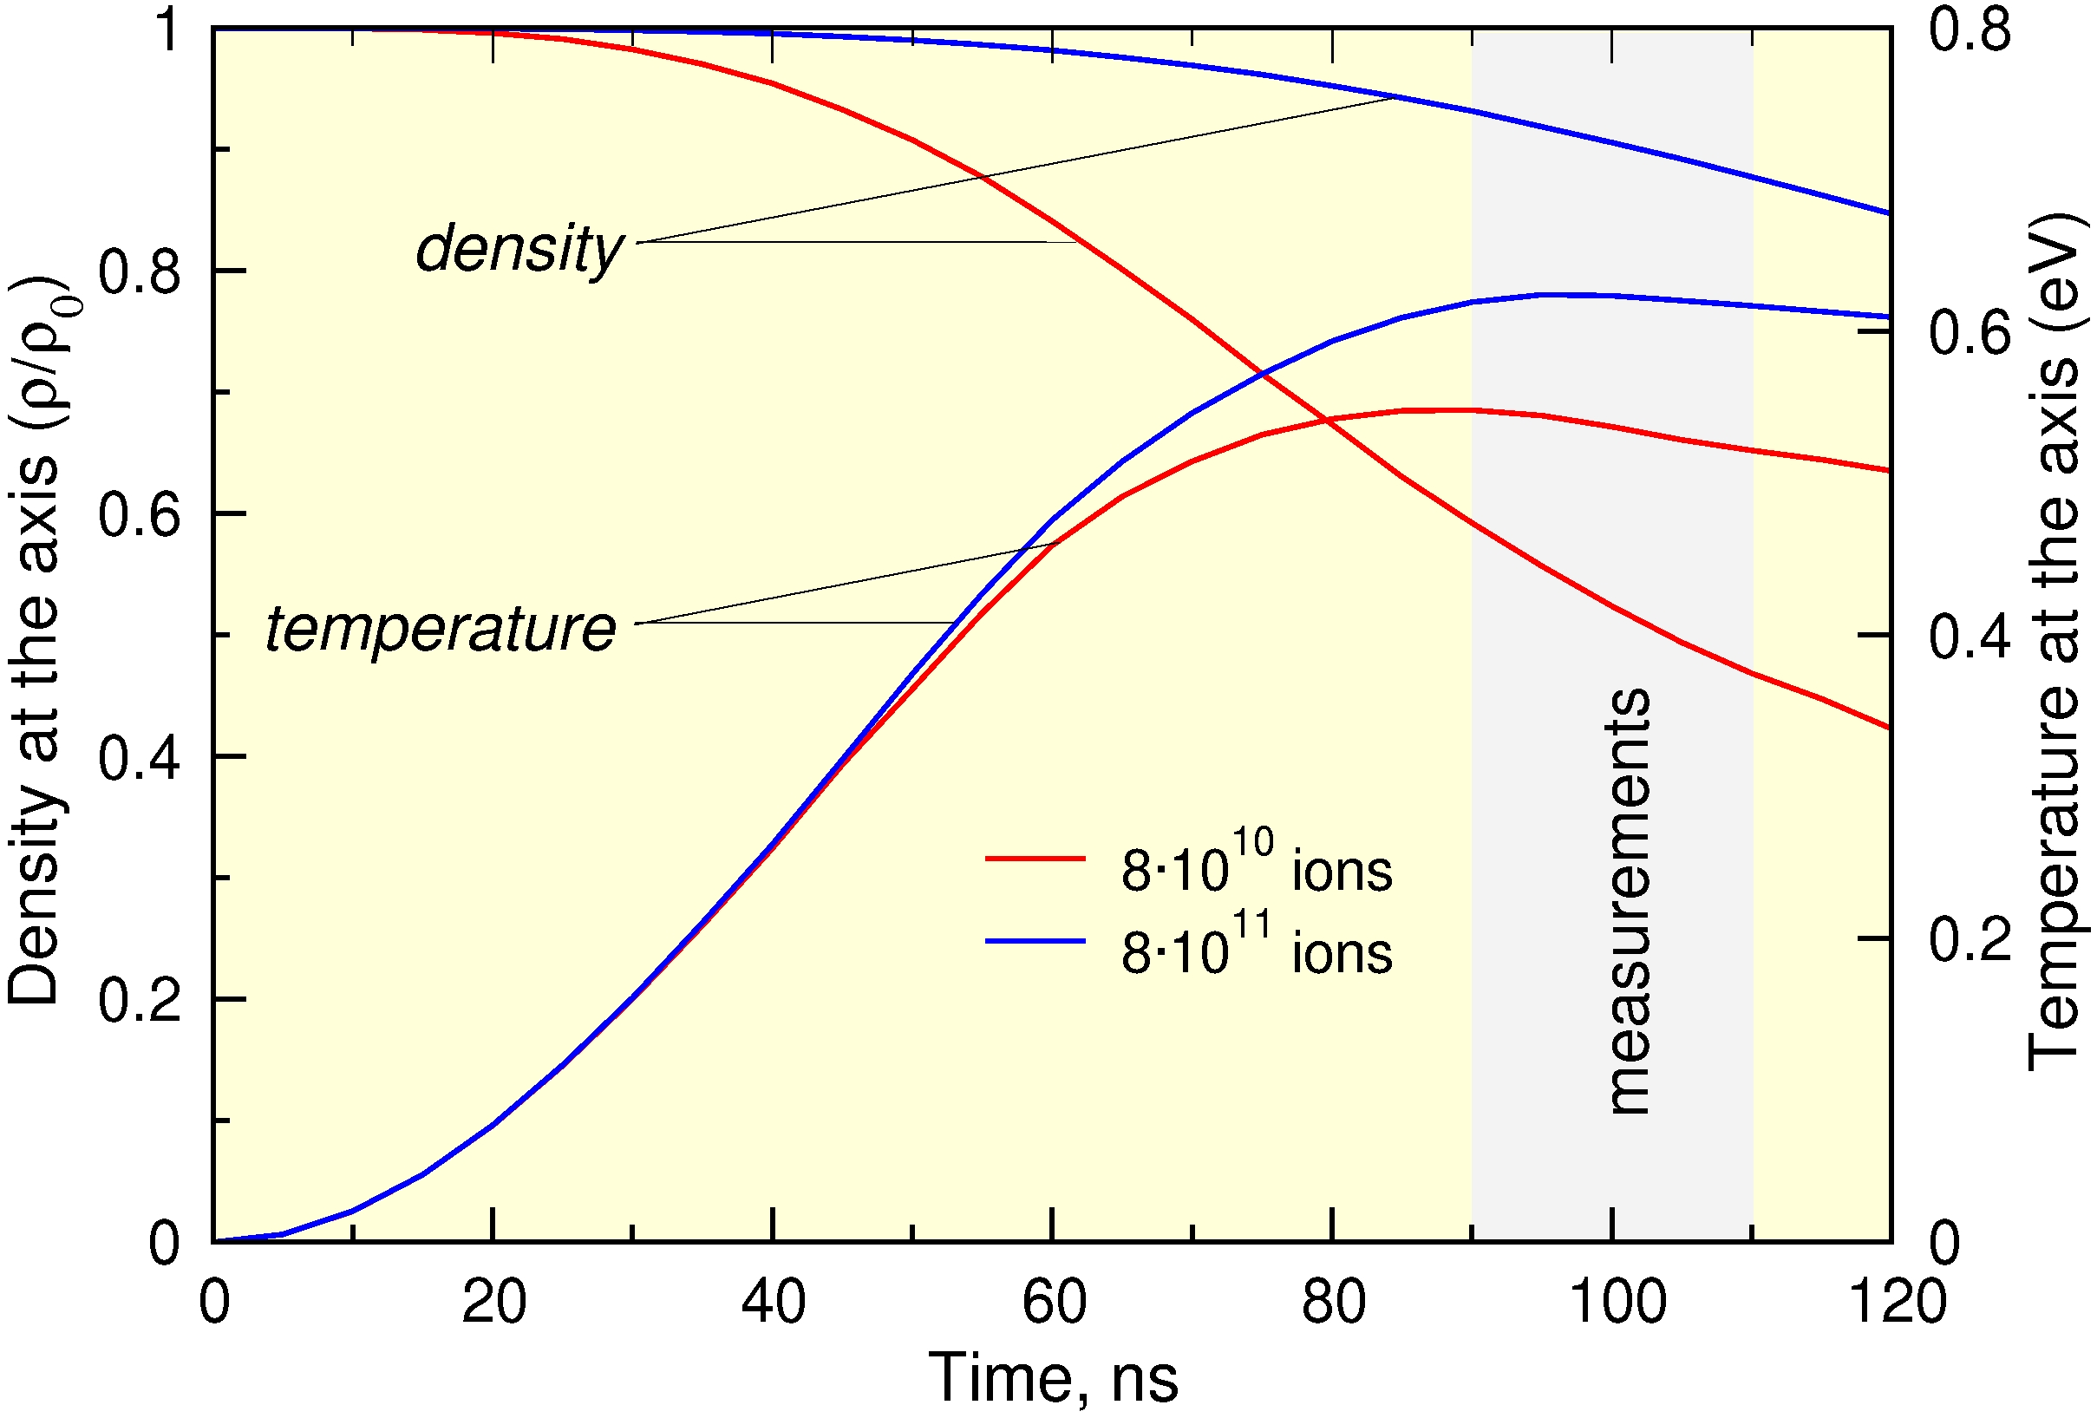
Tamping has been discussed previously
No hot outer high Z plasma. X-ray probe
Kozyreva, et al PRE 68, 056406 (2003
Rosmej et al, Journal of Physics: Conference Series 72 (2007) 012007
Weinwurm et al Phys. Plasma. 20, 092701 (2013)

Slide 22
Diagnostics- a variety are available
Emission spectroscopy: Requires low opacity to be effective? WDM is low temperature and high density. Probes surface? SOP can give shock temperature.
Absorption spectroscopy: Smooth background spectra useful for EXAFS/XANES. Opacity of higher Z targets may require thin targets (decompression time short) or higher energy photons.
X-ray diffraction: Can give microscopic structure of ions. Interpret in terms of density and temperature.
X-ray Thomson scattering: Dynamic structure factor- temperature and electron density/average ionization.
For x-rays we probe the bulk of a sample, but opacity can be an issue.

Slide 23
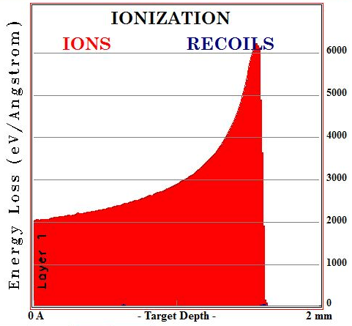
Ion beams can have advantages
~1mm
Uniform heating depends location of Bragg peak of ions. Major benefit is ability to heat higher Z materials
ion beam e.g. 2x10¹¹ ions, U²⁸⁺ from SIS-18 in 100ns at 200MeV/u
High/Low Z cylinder
For SIS-100 2x10¹² ions. Range of 1 GeV/u U ions in Pb is ~15mm.
2mm Pb target 200MeV/u U ions

Slide 24
Ion beams can do this well
For Pb ions at 200 MeV/u (e.g. SIS-18) we have range of about 1 gcm⁻². This is >3 mm in Al. For SIS-100 with 1 GeV/u we would get > 3cm.
Can heat high Z but probing needs higher Z source?

Slide 25
Challenges
Samples should be as uniform as possible
Spatial scale-length ideally long enough to be probed with spatial resolution.
Timescale for evolution affects physics- equilibration within and between species may be affected.
Timescale for evolution may make time-averaging effects significant.
Access to sample for probing is important.

Slide 26
Facilities for WDM production
Large Laser-Facilities: Shocks are a key method, but also fast electrons, X-ray volumetric heating and proton beam heating.
Z-pinches: Flyer plate driver as well as X-rays, pinch compression.
Gas Guns: Shocks principally.
X-FEL facilities: Volumetric X-ray heating.
Ion Beam Facilities: Principally volumetric ion beam heating.

Slide 27
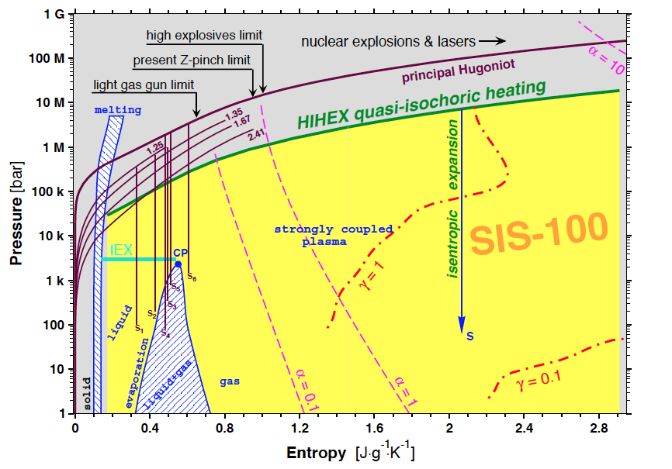
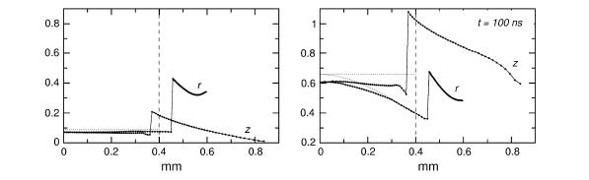
SIS-100 accesses WDM states of H to Pb
T(eV)
Density (g/cc)
Pb accessible regime from HEDgeHOB report
2005.
Dynamically confined H- Tauschwitz et al HEDP 3 371 (2007)

Slide 28
Example (b) : Compare to Z-pinch
Be liner
Frozen H/D core
Shaped current rise over several 100ns leads to quasi-isentropic compression.
HEDgeHOB LAPLAS collaboration.
Weinwurm et al Phys. Plasma. 20, 092701 (2013)

Slide 29
Ion beams at FAIR can have advantages
No hot outer high Z plasma. X-ray probe
A. Kozyreva, M. Basko, F. Rosmej, T. Schlegel, A. Tauschwitz, D. Hofffmann, PRE 68, 056406 (2003)

