Slide 1
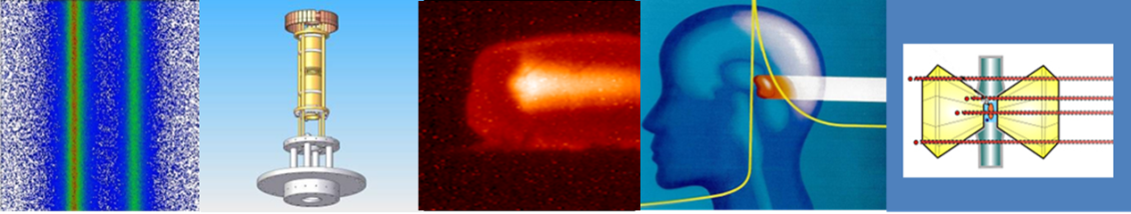



MATerials Research at FAIR
Eugenia Toimil-Molares
GSI Darmstadt
On behalf of the MAT collaboration

Slide 2

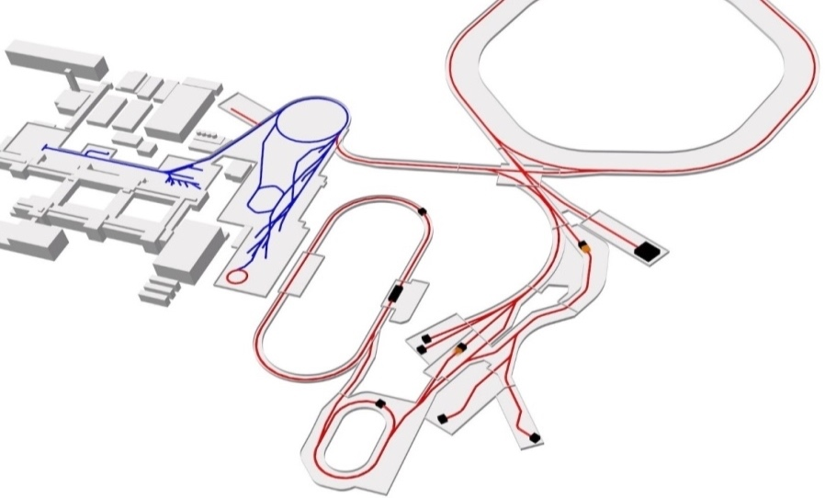
Materials Research at GSI and FAIR
Ion-track nanotechnology, irradiation effects, materials under extreme conditions
~ 200 MAT collaboration members from 27 countries
~ 40 groups served per beamtime
~ highly interdisciplinary (materials science, chemistry, geology, biology, nanosciences, …)
Operation of the MAT facilities:
flexible beam conditions
various ion species, energies, fluxes….
6 beamlines (→ 7)
> 10 target stations (→ 12)
online and in-situ analysis
Highest ion energy loss
Large ion penetration range
Highest intensities
Higher energies
Highly charged ions
at low kinetic energies

Slide 3
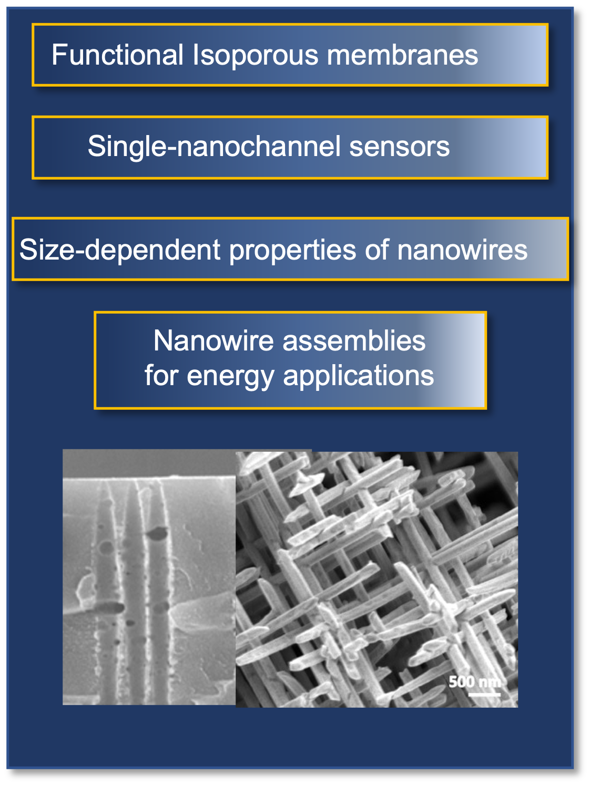
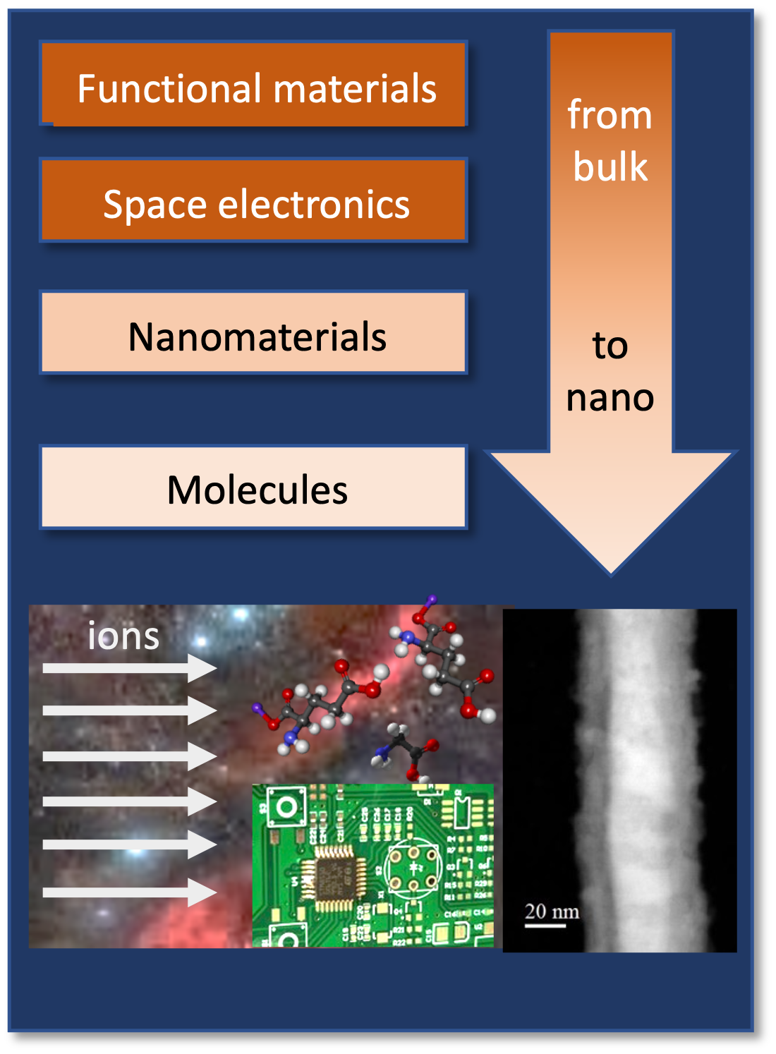
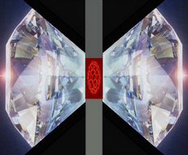
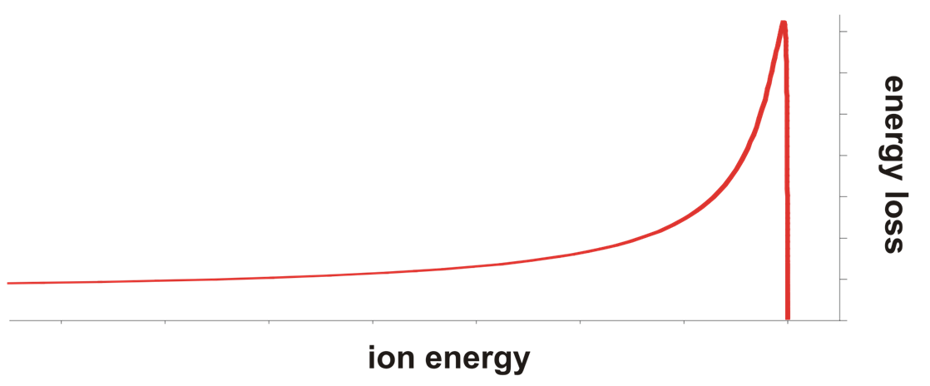
Materials Research at GSI and FAIR
Ion-track nanotechnology
Heavy ion-induced modifications
Materials under multiple extremes
Fabrication, characterization and application of novel nanostructures
From bulk to nanoscale
Simulation of cosmic radiation
Combining high pressure, radiation and temperature
High-pressure irradiation
Radiation hardness of functional materials
ion
beam
energy loss
50 GeV
200 MeV/u
ion penetration range
3 - 11 MeV/u
3 - 11 MeV/u
Cave A → APPA Cave

Slide 4

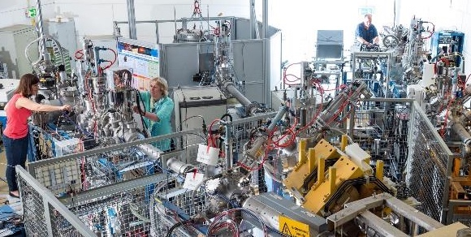
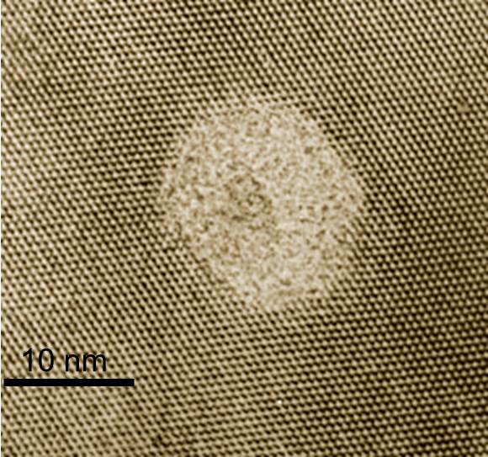
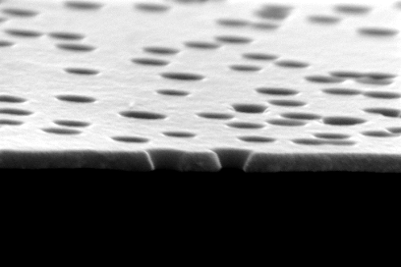
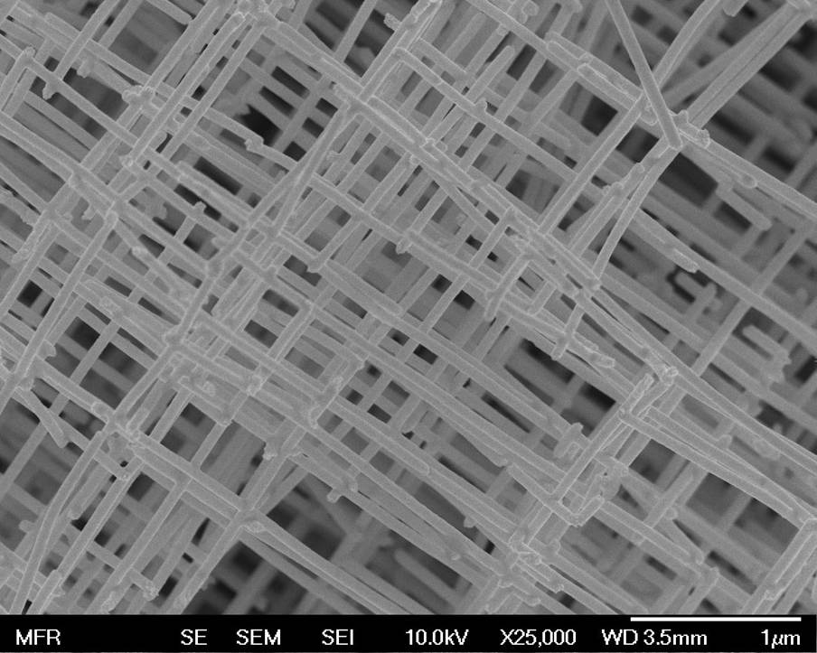
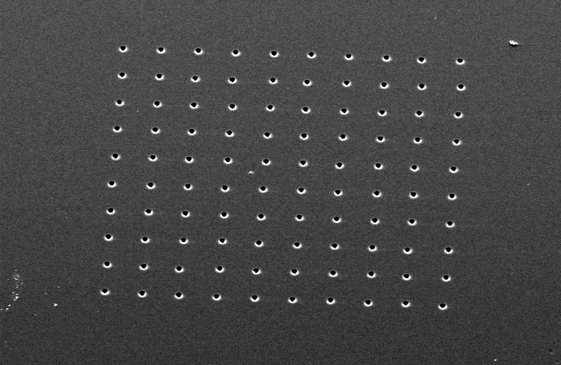

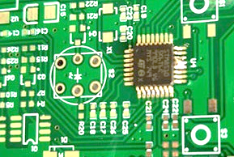
MAT science at existing facilities
Highest ion energy loss and in-situ and online analysis
SIS18
UNILAC
UNILAC (3-11.4 MeV/u)
Ion range up to 100 µm
ion-track nanotechnology
ion-induced materials modifications: from bulk to nano
radiation hardness functional materials (including fusion and accelerator materials)
heavy ion microprobe for sub-µm targeting with single ions (space electronics and detectors)
astrochemistry
ions

Slide 5

MAT facilities in 2030-31 (3 - 11.4 MeV/u)
SIS 18
28GHz
ECR
18GHz
ECR
cw-beam HELIAC
North
HSI
HSI
UNILAC (10 Hz, 1 ms)
X0 & M-branch
HSI
South
HELIAC: cw beams suitable for most of MAT activities (tunable intensity and energy), more efficient and stable irradiations (transfer technology)
UNILAC: pulsed beams allow only ~35% of program; unique for testing performance limits of materials in e.g. inertial confinement fusion and accelerators
Dual-beam experiments become possible → new research possibilities

Slide 6
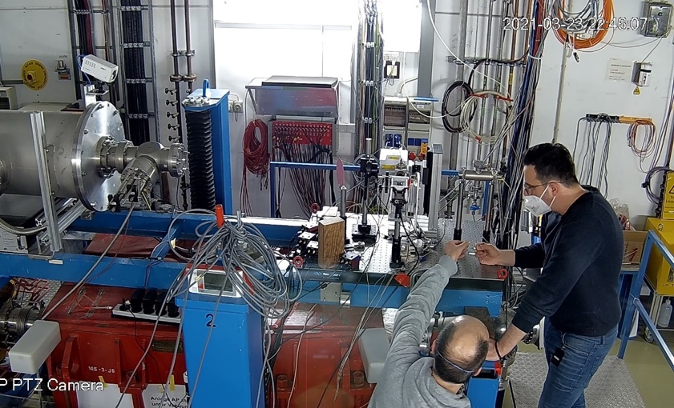
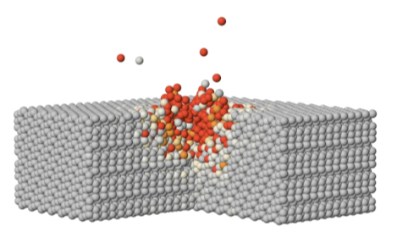
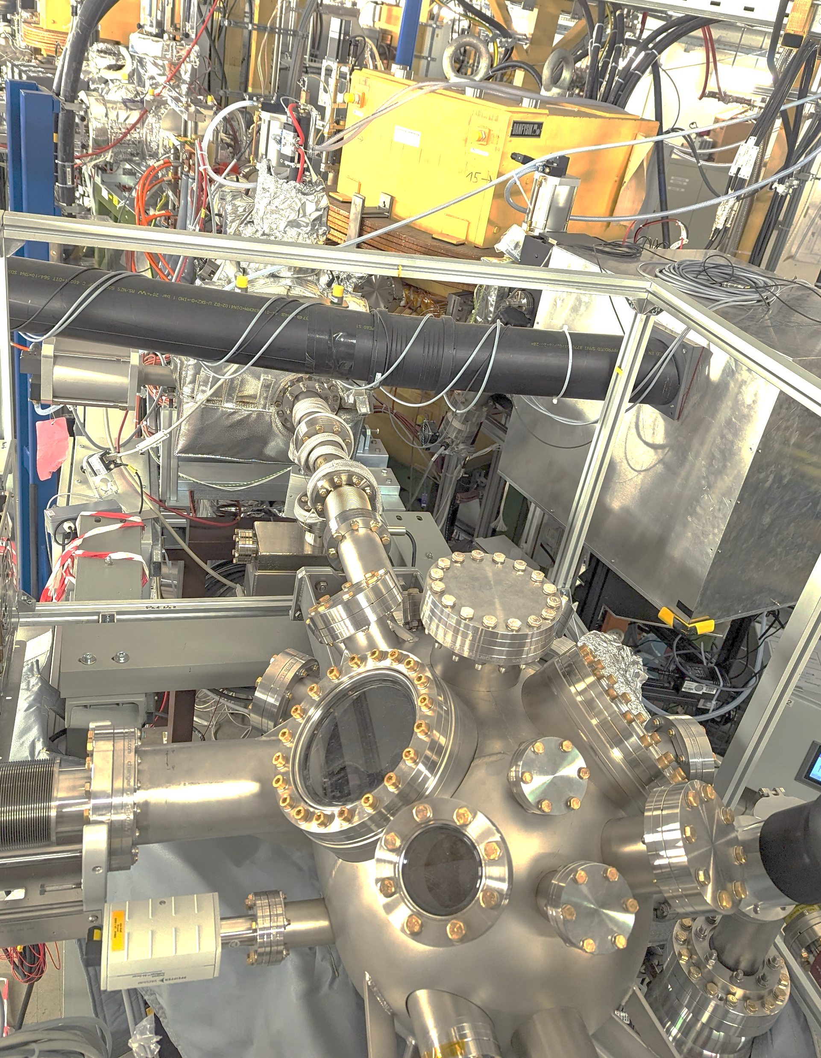

MAT science at existing facilities
Highest ion energy loss and in-situ and online analysis
High energy / ion range
SIS18
UNILAC
SIS18 (80-1000 Mev/u)
Ion range ~mm-cm
UNILAC (3-11.4 MeV/u)
Ion range up to 100 µm
CRYRING MAT-station
Highest ion charge states
at various kinetic energies
irradiation of thick bulk samples
irradiations at high-pressures
radiation hardness of materials
ions

Slide 7

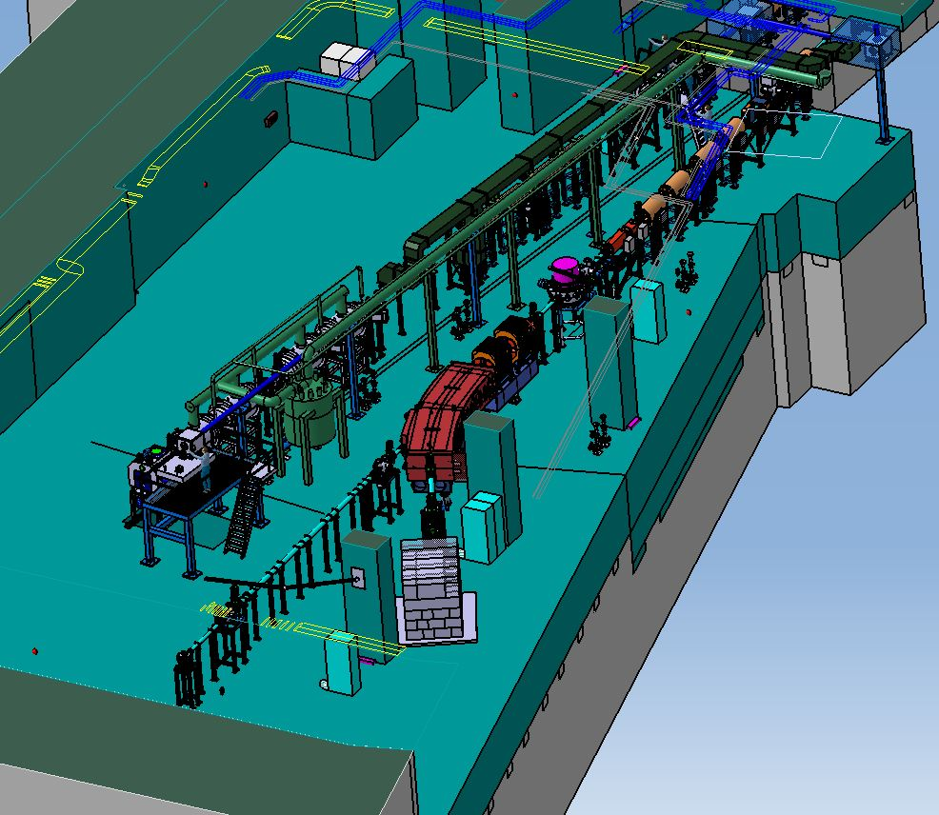
MAT science at APPA cave
Materials under extreme conditions
Cave A to APPA cave:
High pressure
Ion Irradiation
Energy up to 10 GeV/u
Higher beam intensity
Cave suitable for experiments with more intense beams
Beam diagnostics for fast and slow extraction
APPA cave
Temperature
APPA cave
High-pressure irradiation platform
HED@FAIR
SPARC
Multipurpose-target station with in-situ and online analytics
BIOMAT beamline
MAT stations

Slide 8
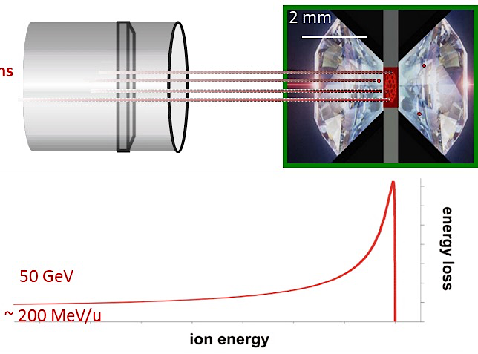
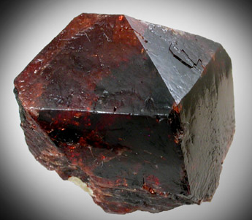
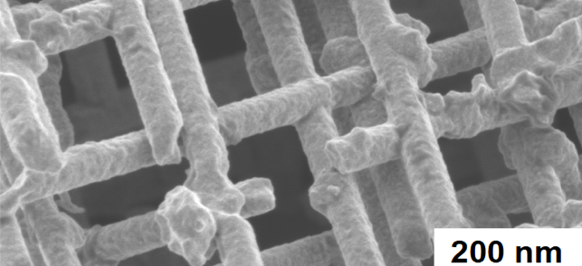
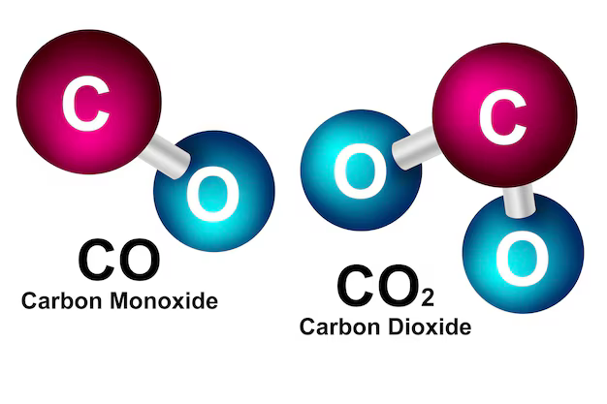
Coupling extreme conditions
High pressure
Ion Irradiation
High energy
Au, Pb, U ions
Zircon
Temperature
Ion Irradiation
Energy density ~ eV/atom
Nanowires
Pressures of up to ~100 GPa
Ion fluence up to 10¹³ i/cm²
Enormous amount of energy in very localized volumes and in very short times
Molecular compounds
Penetration depth (mm)
Study of phases in Earth’s & rocky planet’s interiors
Formation and stabilization of high-pressure phases - new properties!
New thermodynamic paths for phase-transitions of bulk materials and nanomaterials

Slide 9

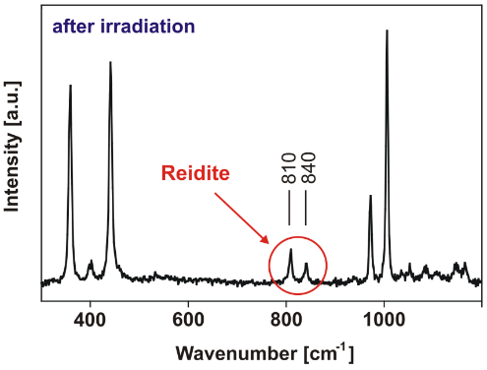





Formation /stabilization of high-pressure phases
After irradiation and decompression
Ion Irradiation
ZrSiO₄
14 GPa
+
reidite
Pressures of up to ~100 GPa
Ion fluence up to 10¹³ i/cm²
Penetration depth (mm)
High-pressure phase reidite:
  forms below critical transition pressure
  is stable upon pressure release
  nanocrystal formation at very low ion fluences
Phys. Rev. Lett. 96 (2006) 19570
Nature Materials 8 (2009) 793

Slide 10
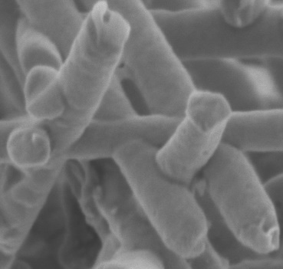
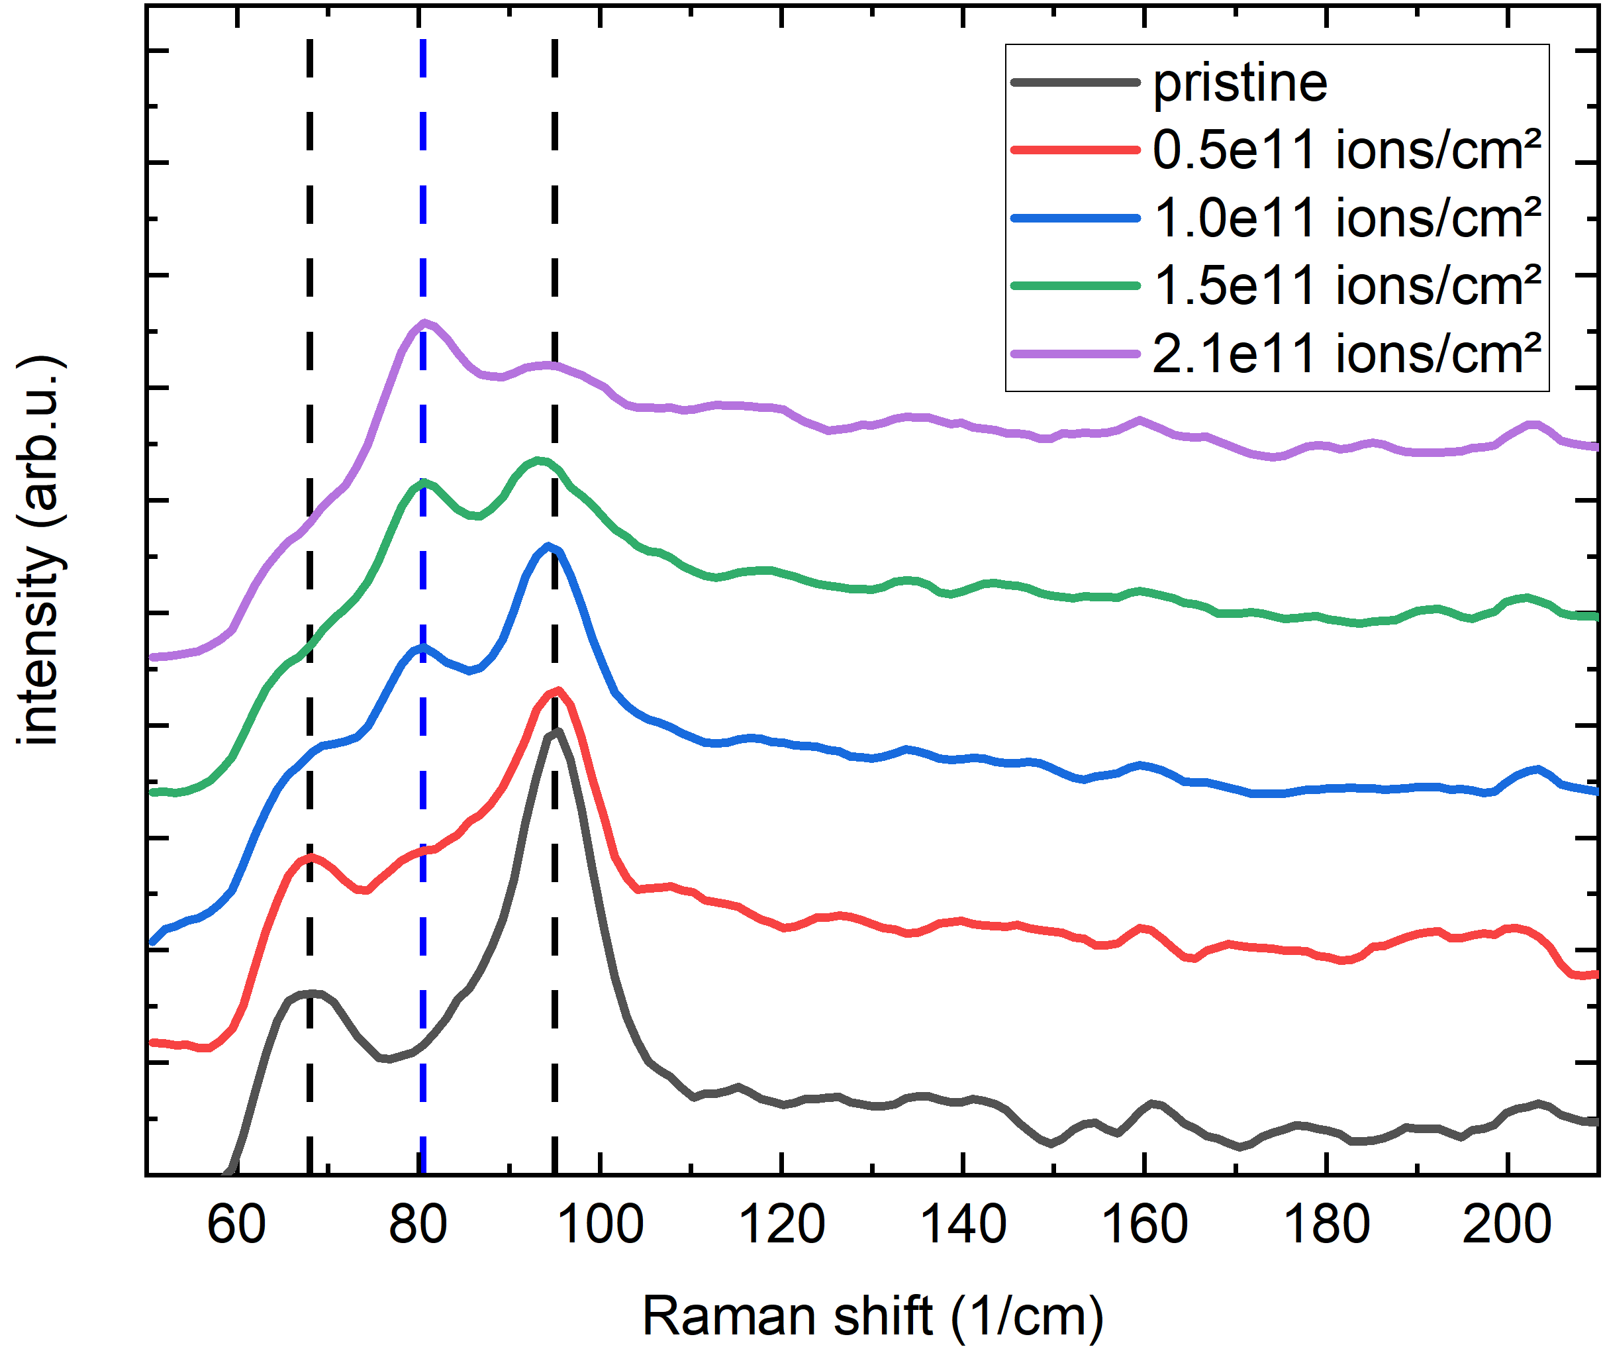
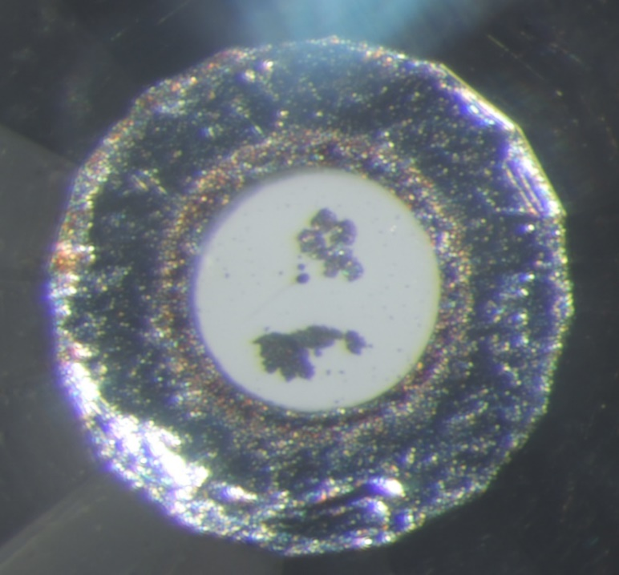
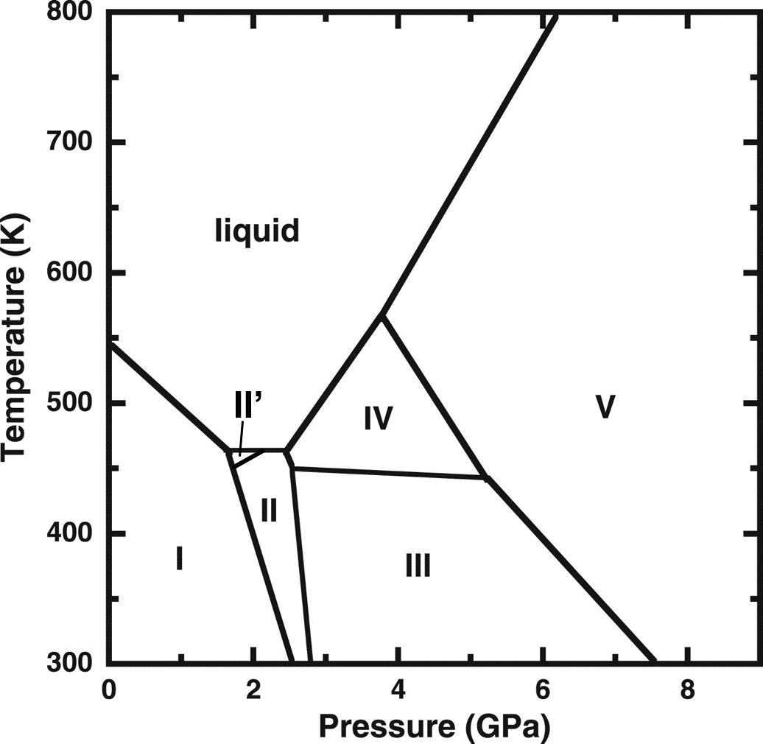
Formation /stabilization of high-pressure phases
In-situ Raman – Bi NWNW (35 nm)
Bi-NWNW (35 nm)
Bi-I
Bi-II
Bi-I
²³⁸U
2.4 GPa
²³⁸U @245 MeV/u
~30 MeV/u @ sample position
Schroeck et al. Phys. Rev B 112 (2025) 014111

Slide 11
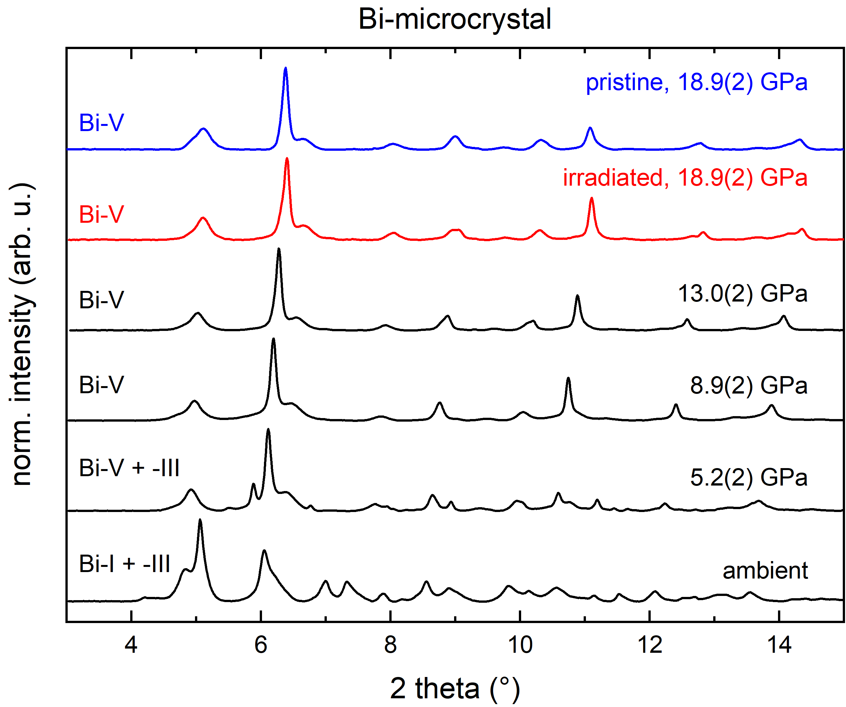
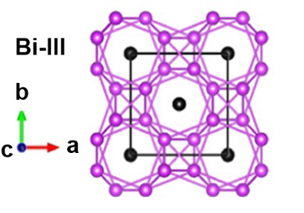
Formation /stabilization of high-pressure phases
Bi microcrystal
f = 3e13 i/cm²
quenching
18.9 GPa
²³⁸U @325 MeV/u
f = 3e13 i/cm²
Bi-III phase is
superconducting
with T_{c} ~6-8 K
J. Phys. Chem. C 124 (2020) 6659

Slide 12

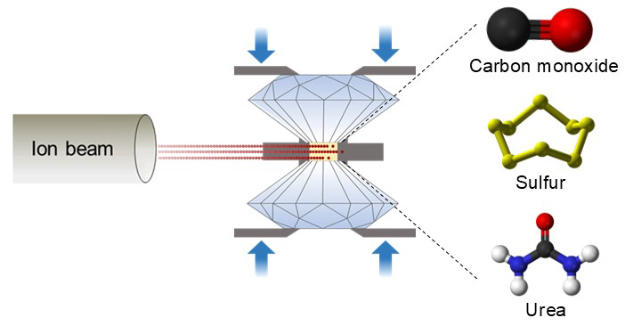
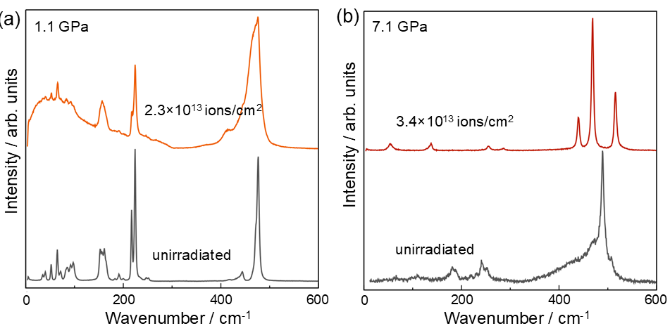
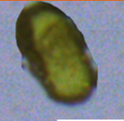
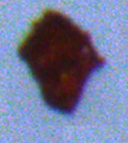
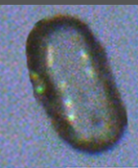
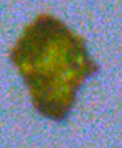
Ion-induced phase transitions in molecular solids
Efficient breakage of sulfur S₈ rings drive system toward more ordered polymeric state, expected to exhibit superior thermal, electrical and chemical properties
1.1 GPa
7.1 GPa
p-S
SII
SHI irradiation under high pressure induces chemical reactions in molecular solids, evidenced by the polymerization of CO and sulfur, and urea decomposition
α-S²⁵
S₈
Liang, Tzifas, Winkler et al. PCCP (2026)
Tzifas et al, Phys. Rev. Res. 8 (2026) 023054

Slide 13

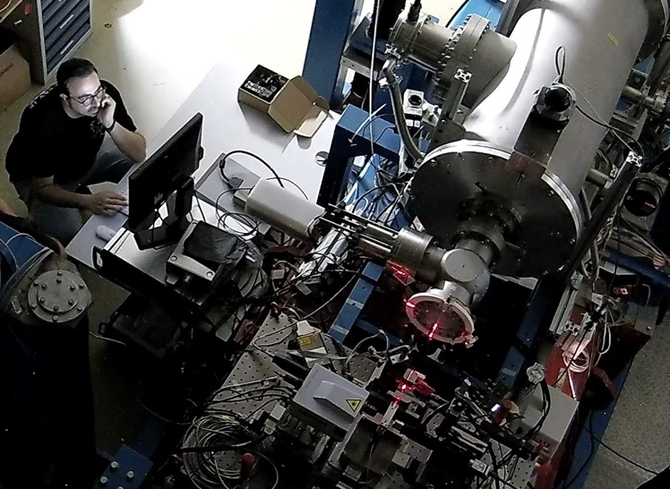
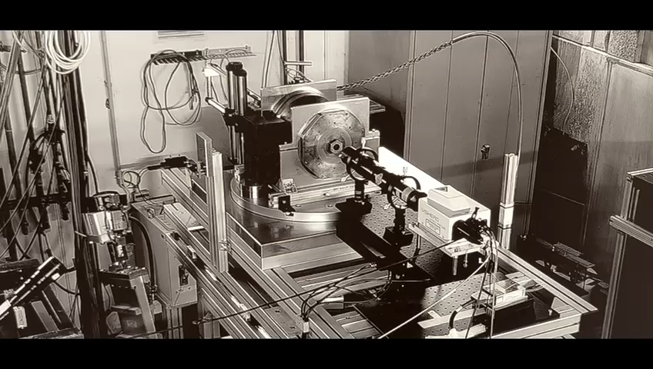



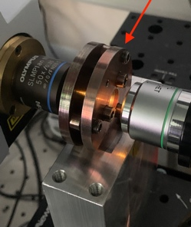





Operational platforms in cave A
Diamond anvil cells (DAC)
Paris-Edinburgh cell (PEC)
sample size ~ 10-50 µm
pressure up to ~100 Gpa
room temperature
sample size ~ mm
pressure up to ~12 Gpa
T_{max} ~ 600 °C

Slide 14
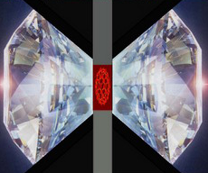

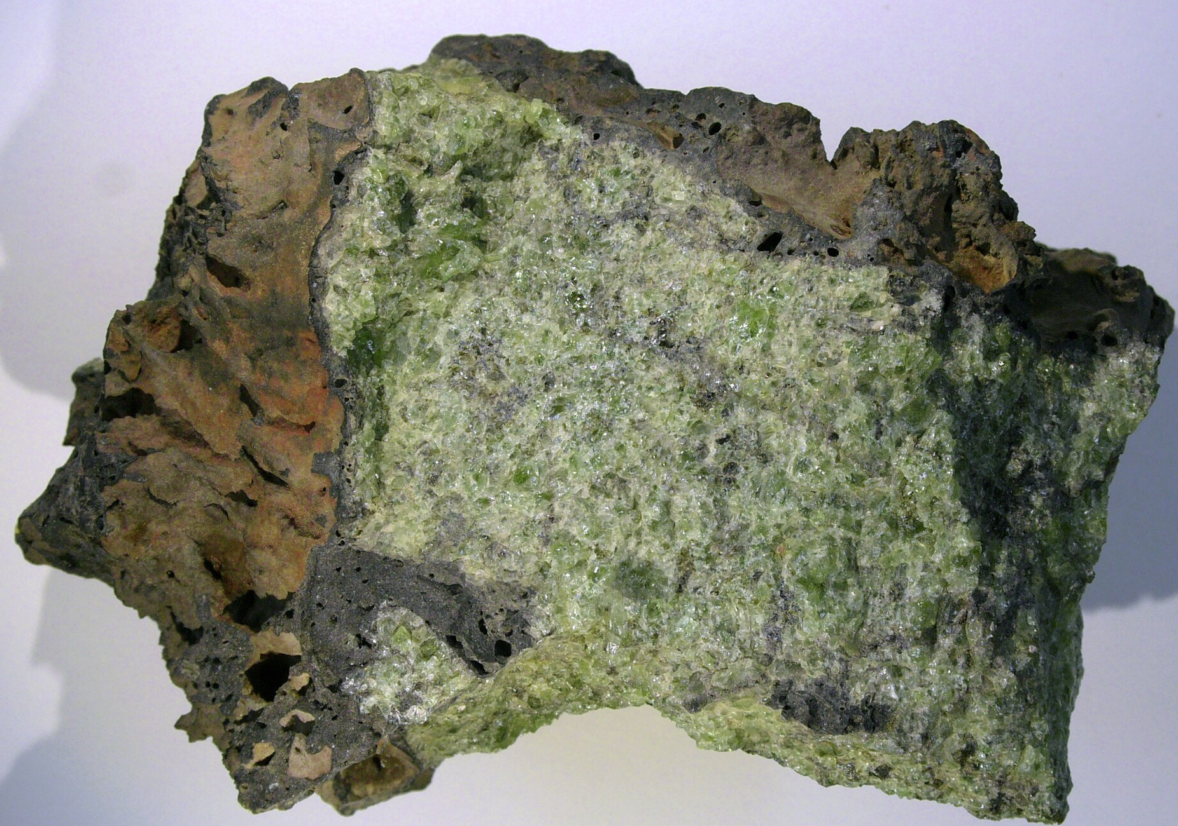


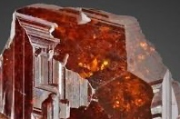
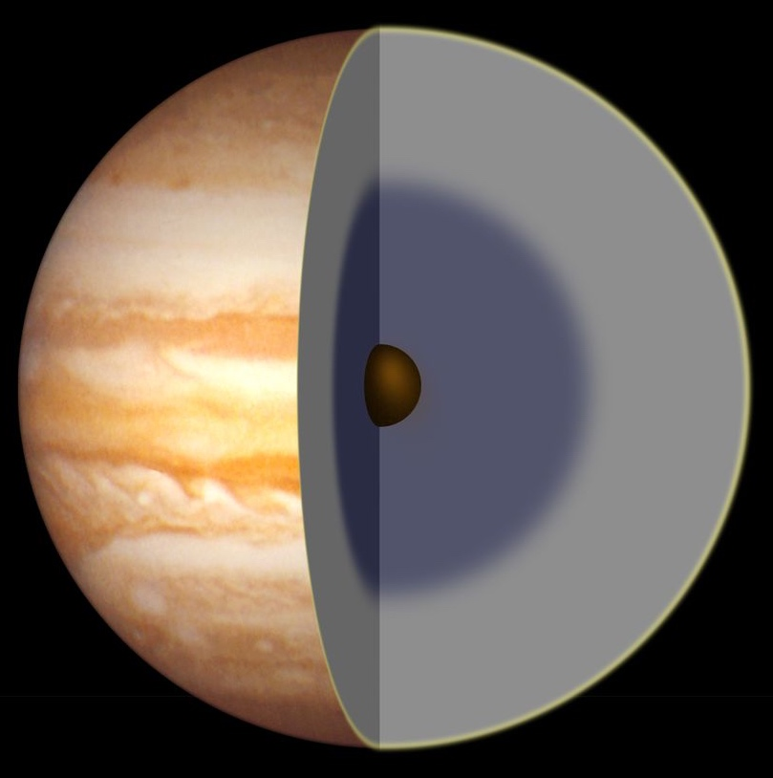
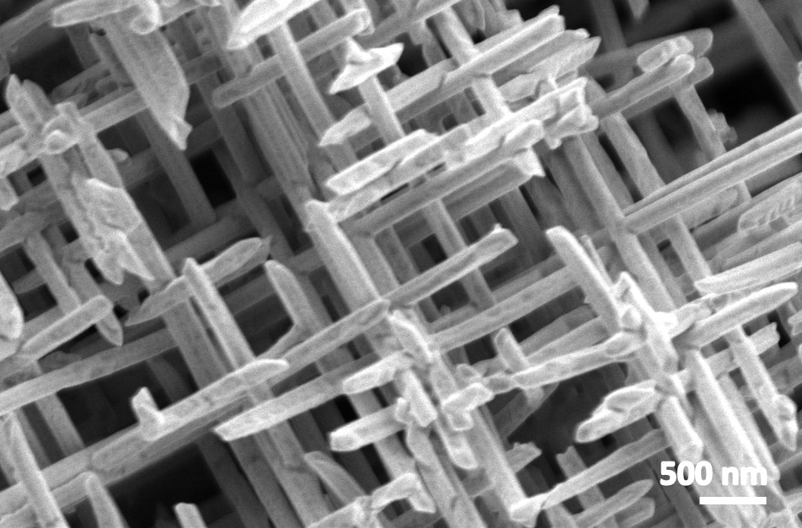
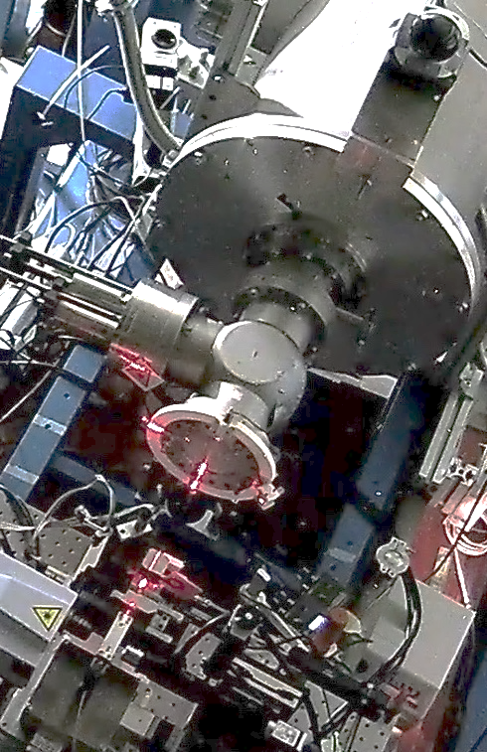
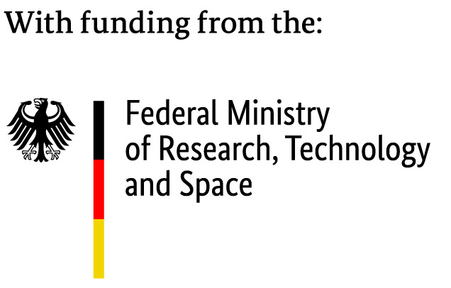
Extension to low- and high-temperatures
pressure
Extension of high-pressure research to low and high-temperatures
Materials of interest: ices, minerals, nanomaterials and molecular compounds
P
Research goals
Irradiation of space ices under pressure at cryogenic temperatures to understand physicochemical processes
Study response of rocky planet materials under irradiation, pressure and high temperatures and explore how extreme conditions affect structural and chemical changes
Conduct temperature-dependent in-situ electrical measurements to correlate structural and electrical properties of novel material phases
Elucidating the role of temperature and temperature/pressure rates in ion-induced phase transformations under high-pressure
ices
High T
minerals
Low T
gas giants
nanomaterials
Ions
Platform upgrade funded by BMFTR ErUM-Pro (2025-2028) (B. Winkler, Goethe University Frankfurt)

Slide 15
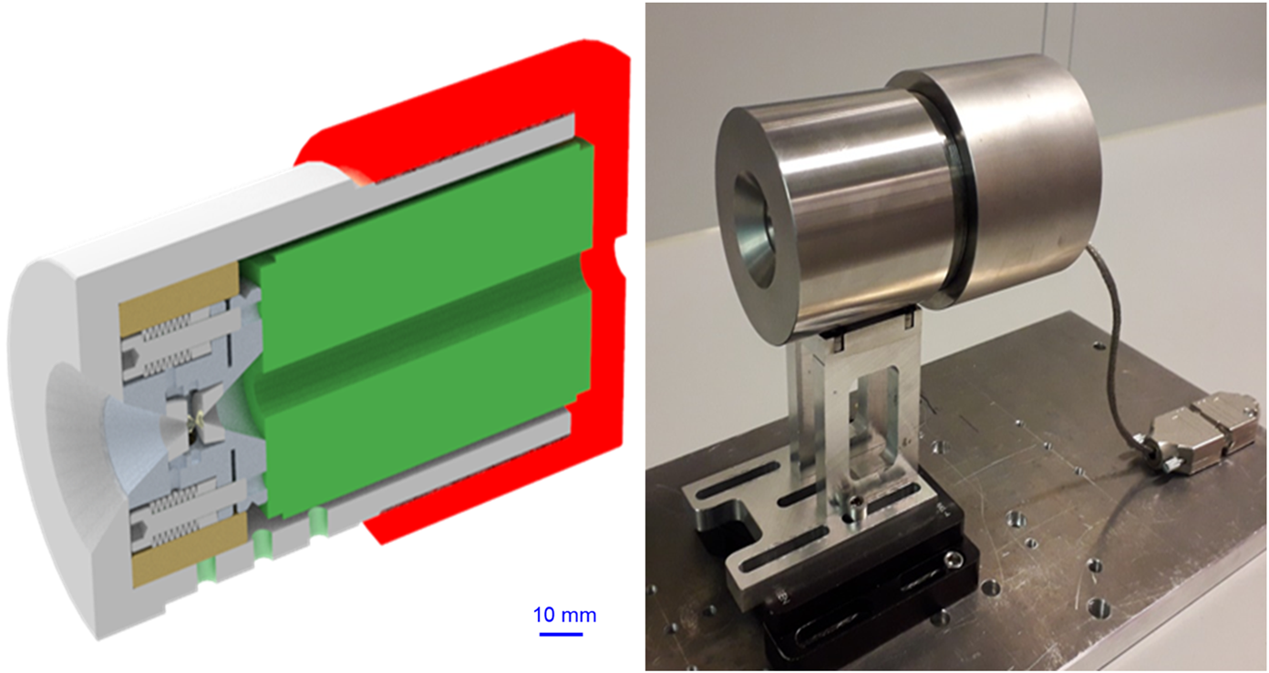
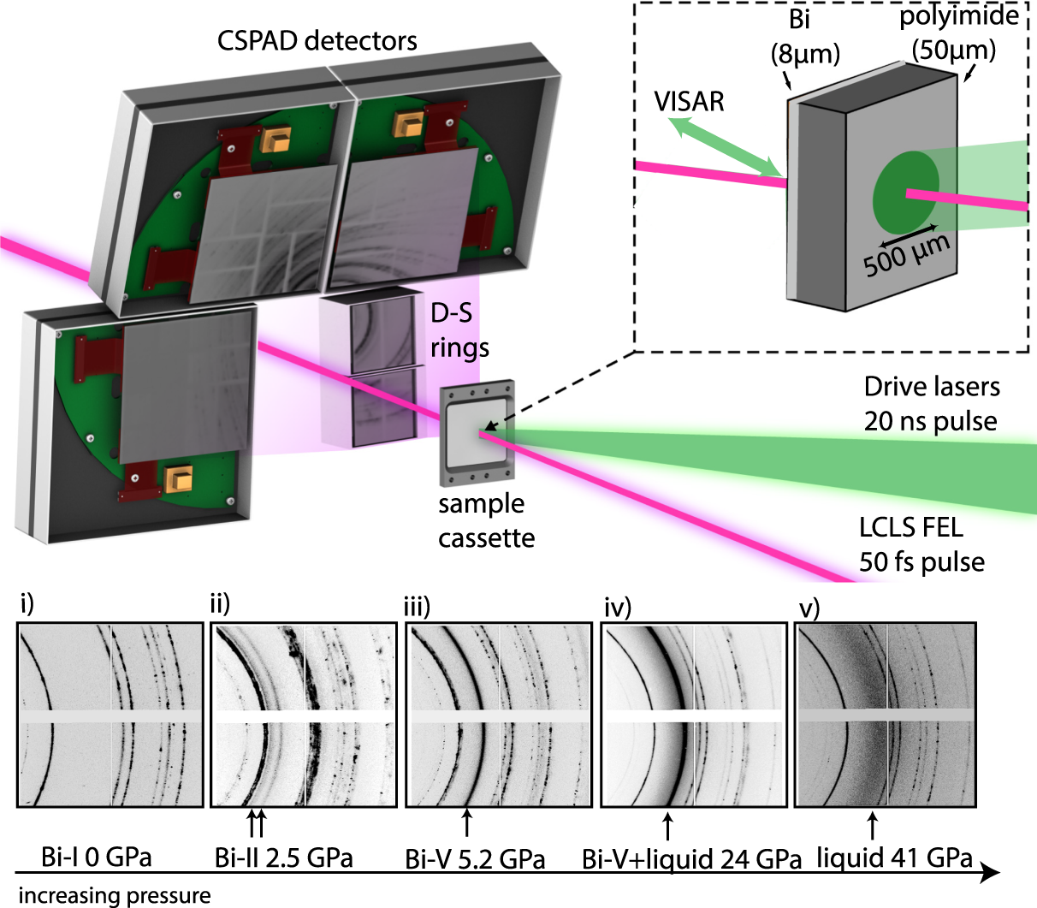
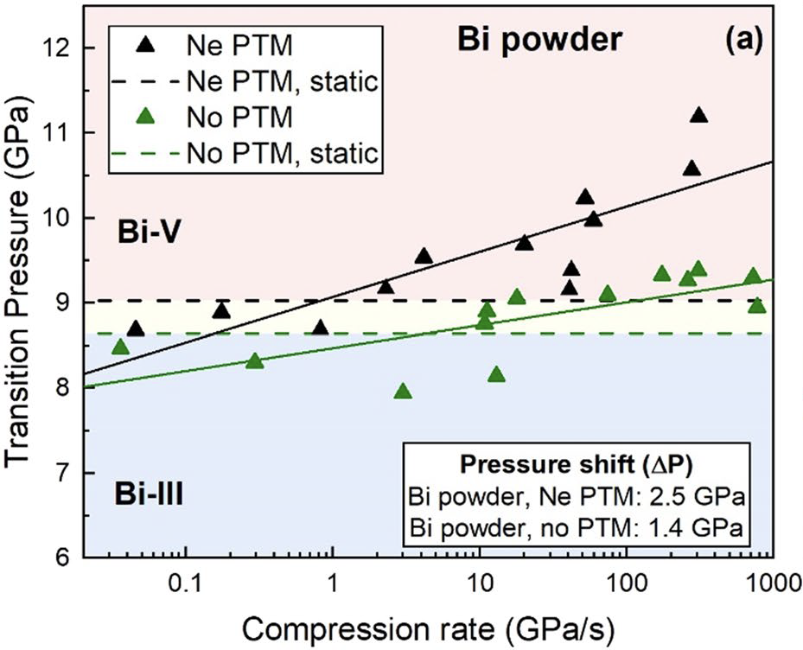





Static vs. dynamic compression (Bi)
Static → Dynamic-DAC (10⁰–10² s⁻¹) → FdC → Laser-driven shock (10⁵–10⁸ s⁻¹)
Range 0.01–780 GPa/s
Time-resolved XRD
at DESY P02.2
4 KHz
$$Cmce$$
Cubic
$$Im\overline{3}m$$
$$C2/m$$
h$: I4/mcm$
g: $I4/mmm$
Investigation of influence of compression rate on bismuth phase transitions and
elucidate bismuth transformations at intermediate compression rates (µs)
$$R\overline{3}m$$
Gorman et al., Sci. Rep. 8 (2018) 16927
Husband et al., Sci. Rep. 11 (2021) 14859
Bi-III absent
Bi-V starts at lower pressures with unidentified phase Bi-M
Schröck et al. Phys. Rev B 112 (2025) 014111
Bi-III→Bi-V shifts to higher P at higher compression rates
Bi-I→ Bi-II → Bi-III → Bi-V

Slide 16

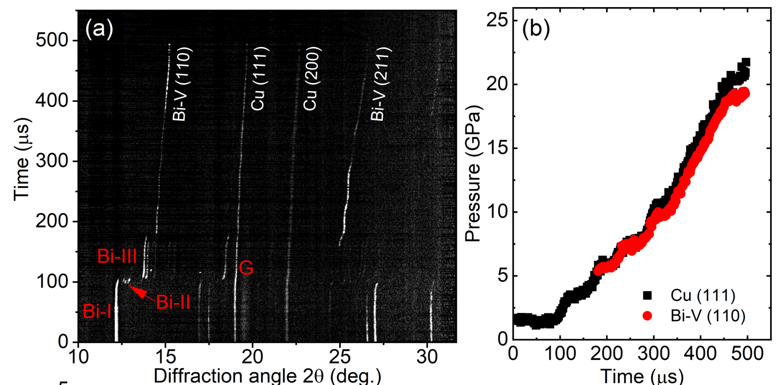


Dynamic compression of Bi at µs-timescales
Static → Dynamic-DAC (10⁰–10³ s⁻¹) → FdA→ Laser-driven shock (10⁵–10⁸ s⁻¹)
Eu-XFEL
Time (µs)
Difraction angle 2θ (deg.)
Time (µs)
Compression rates up to ~60 TPa/s (≈60× faster than previous dDACs)
Strain rates ~10² – 10³ s⁻¹
MHz-XRD enabled by EuXFEL pulse train → µs structural tracking
Accessing a strain‑rate regime between classical dDAC and shock
O’Bannon, Appel, Schröck, Tzifas, Toimil-Molares, Pepin et al. Nature Communications Materials (2026)

Slide 17
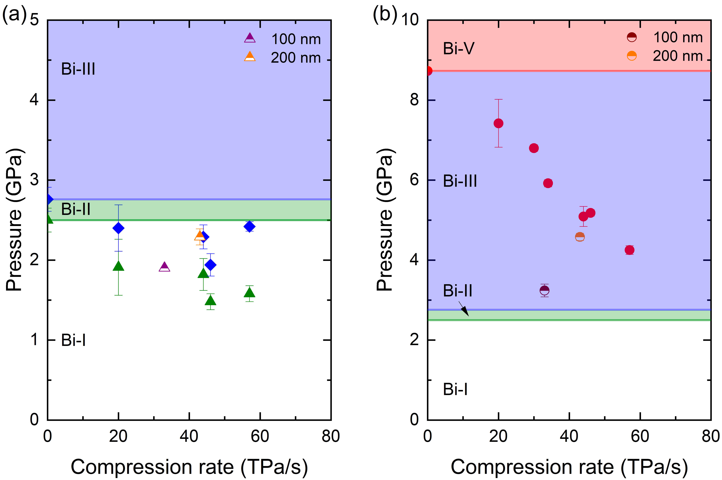
Microsecond compression reveals kinetic suppression of Bi‑III
Eu-XFEL
Time (µs)
Difraction angle 2θ (deg.)
Time (µs)
Static sequence preserved: Bi‑I → Bi‑II → Bi‑III → Bi‑V
Bi‑V nucleates 2 - 4 GPa lower than in static DAC
Bi‑III stability field shrinks with increasing rate → complex host-guest arrangement kinetically hindered
Transition onset depends on compression rate
At sufficiently fast loading, Bi‑III may be bypassed entirely → shock‑compression observations
O’Bannon, Appel, Schröck, Tzifas, Toimil-Molares, Pepin et al. Nature Communications Materials (2026)

Slide 18
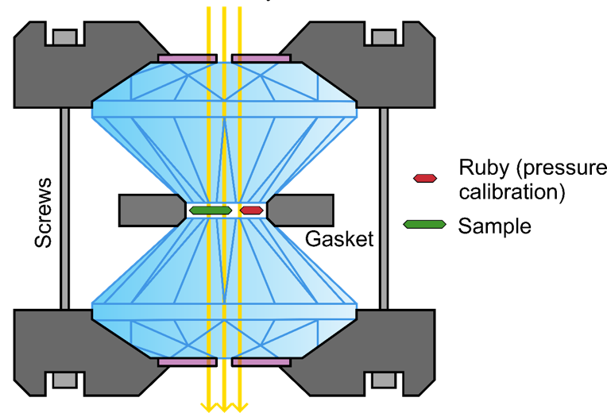
High pressure
Ion Irradiation
Coupling extreme conditions
Temperature
High energy
Au, Pb, U ions
High pressures
Ion Irradiation
Energy density ~ eV/atom
GeV heavy ions deposit enormous amount of energy in very localized volumes and in very short times
Pressures of up to ~100 GPa
Ion fluence up to 10¹³ i/cm²
Penetration depth (mm)
Diamond anvil cells
Notes:
High-static pressures are achieved by inserting the materials of interest (x, y, z) in diamond anvil cells, where pressures of upto 100 Gpa can be reached
The heavy ion beams, as we have seen, deposit enormous amount of energy in very localized volumes and in very short times.
So, at GSI, Materials will be pressurized between the two diamonds of a diamond anvil cell to tens of GPa, and subsequently exposed to the ion beams.
A special characteristic of swift heavy ions is that they deposit the maximal energy at the end of the trajectory. So the high energy ions of the synchrotron accelerator can penetrate the cell (either though the diamonds or though the gasket and deposit the maximal amount of energy on the pressurized material.

Slide 19
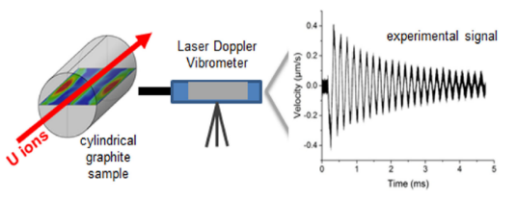







Functional materials response to radiation
Monitoring of ion-pulse induced stress waves
Applications:
High-power accelerators:
(targets, collimators and beam dumps)
High temperature reactors
Space materials
Shock and Vibration (2021) 8884447
APPA cave:
Fast extraction of high-intensity pulsed beams (higher intensities up to 10¹¹ pps)
High energy – larger volumes of radiation damaged and thermally excited material
New facility to study dynamic response of beam-facing materials on site
Degradation of thermal conductivity
Pretreated copper targets for ion-beam desorption experiments
Acta Materialia 184 (2020) 187
Vacuum 194 (2021) 110608

Slide 20










Astrochemistry at APPA cave
How are complex molecules created in space?
Galactic Cosmic Rays
Ion beam
GSI
FAIR
APPA cave:
Extension of available ion energies for determination of molecules formation and destruction yields
Irradiation of molecules inside bulk materials simulating space conditions
Chemical processes, sputtering, temperature effects,…
Multipurpose chamber with in-situ and online analysis techniques
Astronomy & Astrophysics A&A 623, A134 (2019)
Astronomy and Astrophysics, 599, A130 (2017)
NIMB 365 (2015) 477–481
µm thick cryogenic film
on IR transparent window
ion beam

Slide 21


Summary
APPA cave
New experimental opportunities for Materials Research at CRYRING and in APPA cave with FAIR beam parameters and diagnostics
High-pressure irradiation platforms being extended and ready for Day 1
Chambers for radiation hardness tests and astrochemistry being planed
Platforms are mobile and can be used at various locations
HED
SPARC
BIOMAT stations
GSI-MAT
MAT-collaboration meeting
Thank you for your attention!

Slide 23
International competitiveness
worldwide only very few large-scale high-energy heavy-ion accelerators with dedicated beamlines for material science
Facility | Capabilities / limitations | Rating
GSI/FAIR | Most comprehensive facility: full ion/energy/flux range, ex-situ, in-situ & online analysis, onsite expertise. | Excellent
GANIL/CIMAP | Several in-situ techniques; focus 0.5–4 MeV/u, max E ~29 MeV/u for Pb. | Limited
IMP/CAS | Dedicated materials beamlines; limited ion flux. | Limited
HIAF/CAS | Materials research beamlines not yet available — expected in future. | No current activities
JINR & Univ. of Jyväskylä | Beams up to UNILAC energies; no in-situ analysis. | Limited
CERN | HiRadMat beamline for pulsed beams — only protons. | No current activities
NICA & RAON | Plan activities; limited experience with heavy ions so far. | No current activities
Riken, MSU, BNL | Very few activities; no material-science user facility. | No current activities

Slide 24
EXTRAS

Slide 25




MAT science at CRYRING
Physics topics
ion solid interaction at highest charge states and low kinetic energies
surface and sputtering processes
defect enginnering in 2D materials
CRYRING (0.3 – 14 MeV/u)
MAT station @ CRYRING
2021: comissioning of UHV-irradiation chamber with ¹⁰⁷Ag⁴⁷⁺ @ 5.9 MeV/u
2025: installation and commissioning of in-situ Raman spectrometry and first experiments
Highest ion charge states

