Slide 1
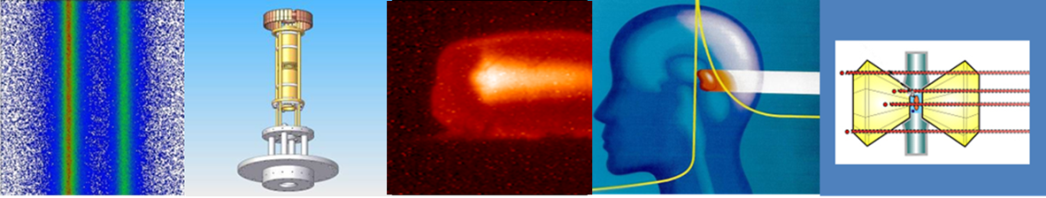


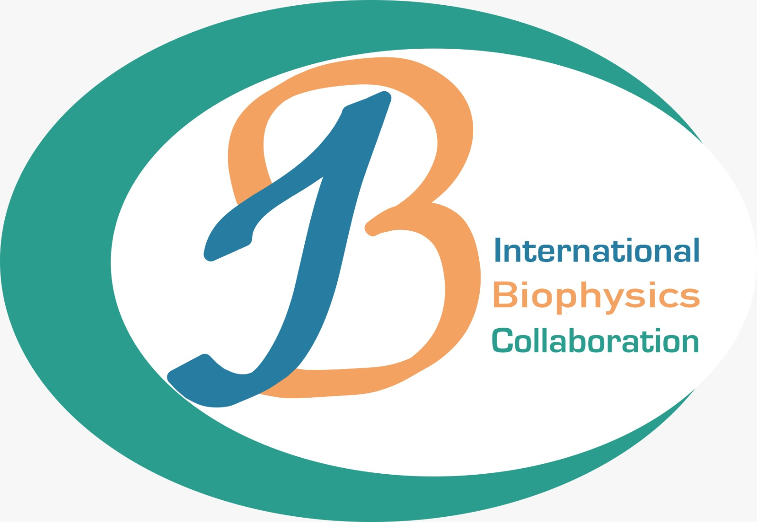
The International Biophysics Collaboration Program in the APPA cave
Marco Durante
Head of Biophysics Department, GSI

Slide 2
Biophysics at GSI – science with existing facilities
Space radiation protection
Particle therapy
1998 2022
First European center to treat patients with high energy ¹²C-ions (440 patients treated on site)
Now extensive research program in particle therapy covering from nuclear physics to molecular biology
Work supported by BMBF, EU (INSPIRE, HITRI, ERC AdG), NIH
Target station: Cave M (SIS18)
ESA reference facility for ground-based space radiation protection studies
Current ESA-supported programs ongoing: IBER/IRES/ROSSINI/GCRsim
ESA/FAIR Summer School in Darmstadt
EU programs: RADNEXT-HEARTS
Target station: Cave A (SIS18)

Slide 3


Added science with additional facilities - FAIR
Patera et al., Front. Phys. 2020

Slide 4
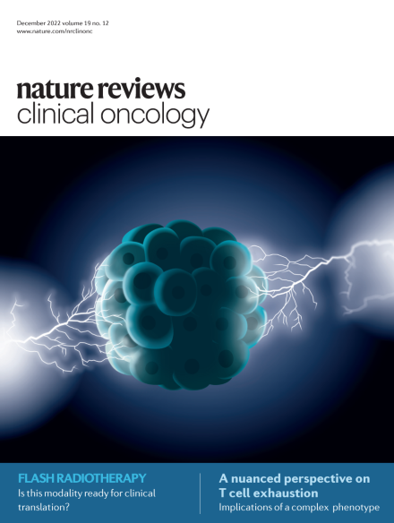
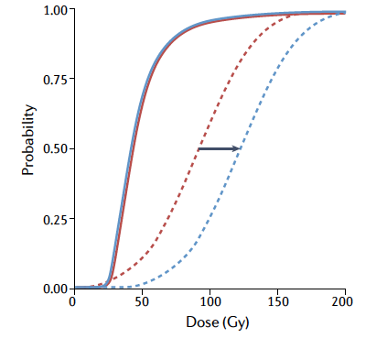
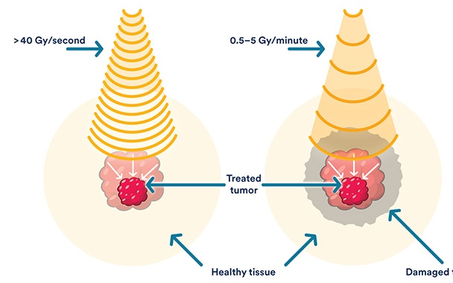
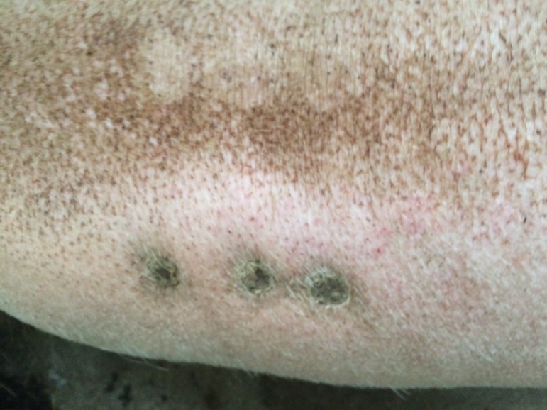
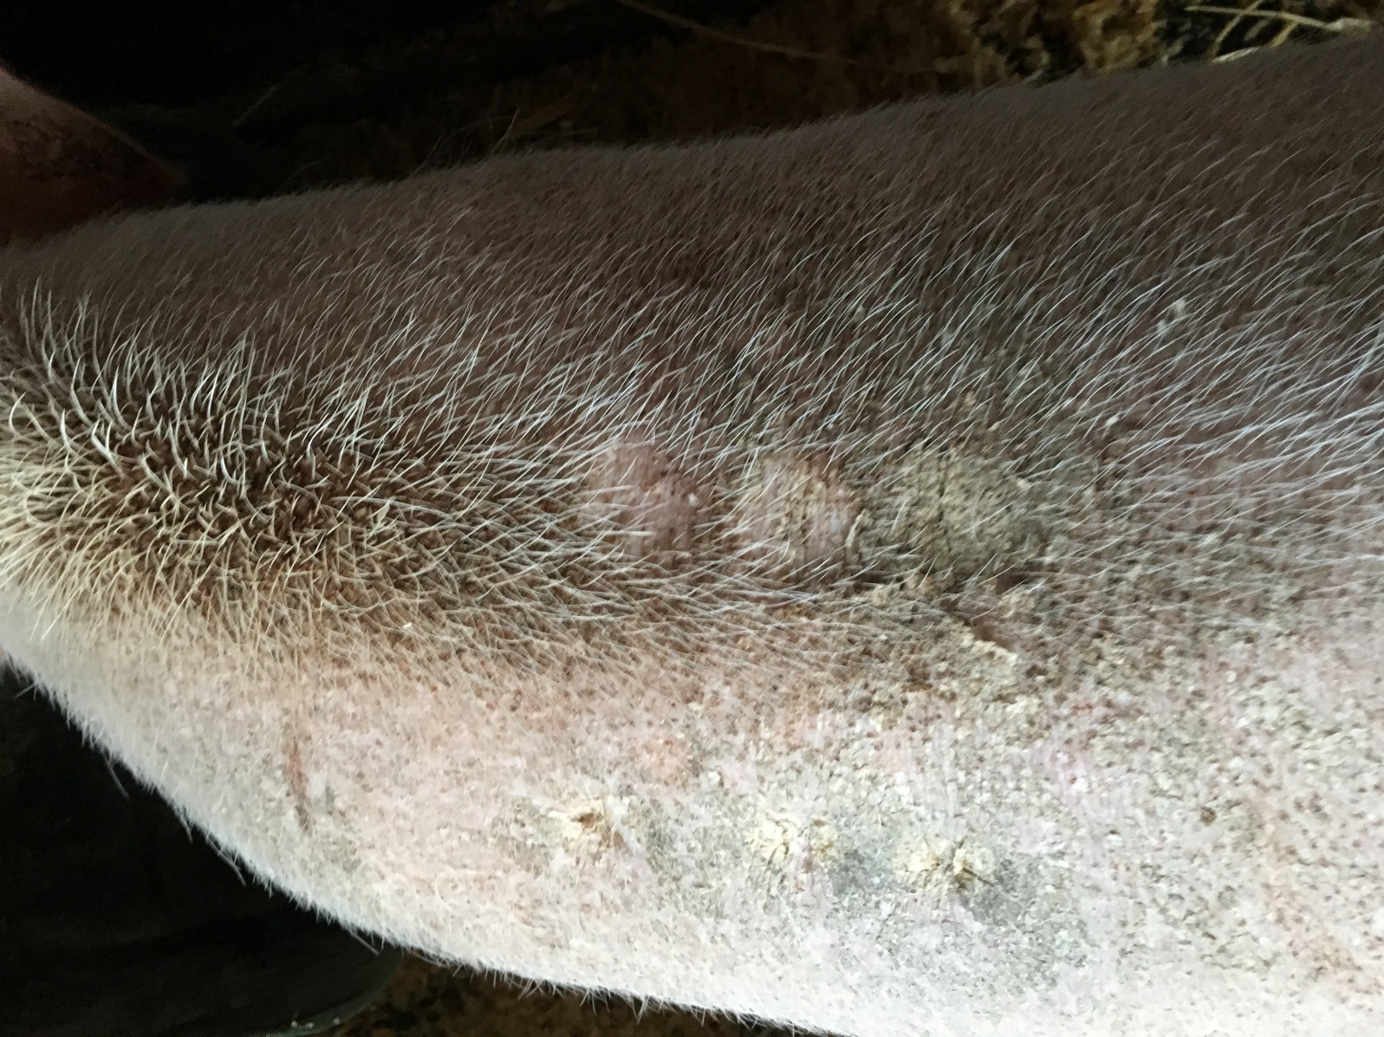
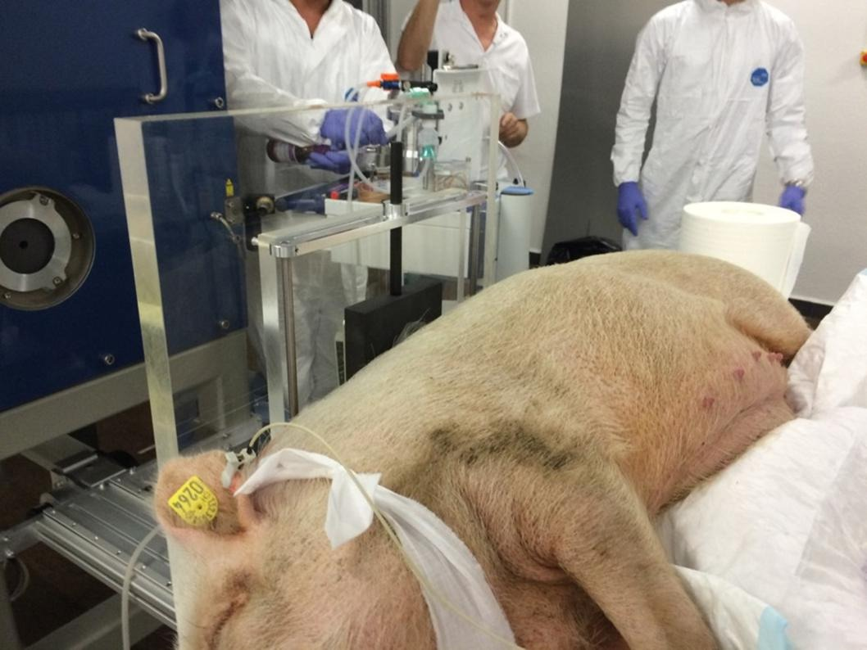
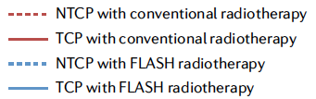
Ultra-high intensity: FLASH radiotherapy
FLASH
RT
CONV RT
> 40 Gy/s
0.5–5 Gy/min
9 mo post-RT
3 years post-RT
CONV
FLASH
Vozenin, Bourhis & Durante, Nat. Rev. Clin. Oncol. 2022
34Gy 31Gy 28Gy
34Gy 31Gy 28Gy

Slide 5
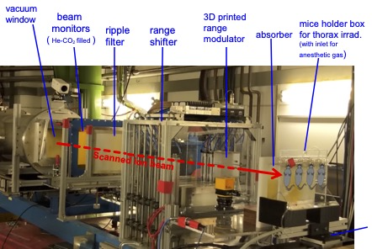
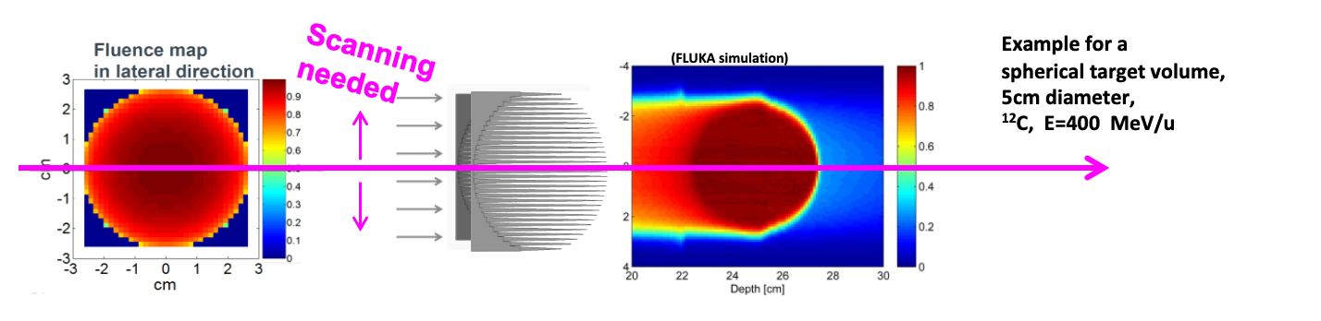
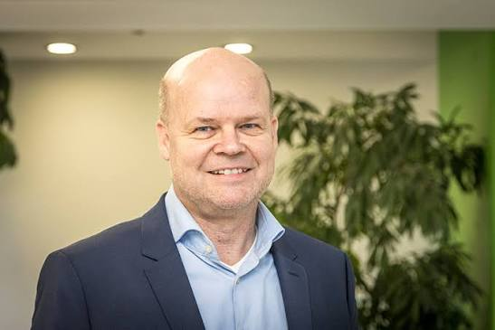
1. Test of the current mechanistic models at high-LET;
U. Weber, E. Scifoni, M. Durante, FLASH radiotherapy with carbon ion beams. Med. Phys. 49, 1974–1992 (2022).
2. Clinical implementation in C-ion therapy;
M. Durante, J. Debus, J. S. Loeffler, Physics and biomedical challenges of cancer therapy with accelerated heavy ions. Nat. Rev. Phys. 3, 777–790 (2021).
3. If the sparing effect survives at high-LET, possibility of using very heavy ions (such as ²⁰Ne or ⁴⁰Ar) in therapy, and idea originally pursued by Cornelius Tobias at the Lawrence Berkeley Laboratory.
J.Jansen, O.Sokol, Y. Prezado, M.Durante, Back with Weight: Revisiting Very Heavy Ions for Precision Radiotherapy. Radiat. Res. 205, 113-1283 (2026).
Why should we test FLASH with heavy ions?
Uli Weber

Slide 6
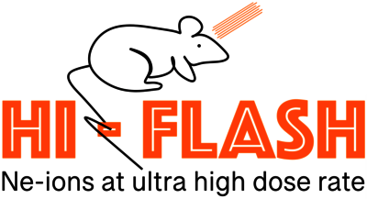
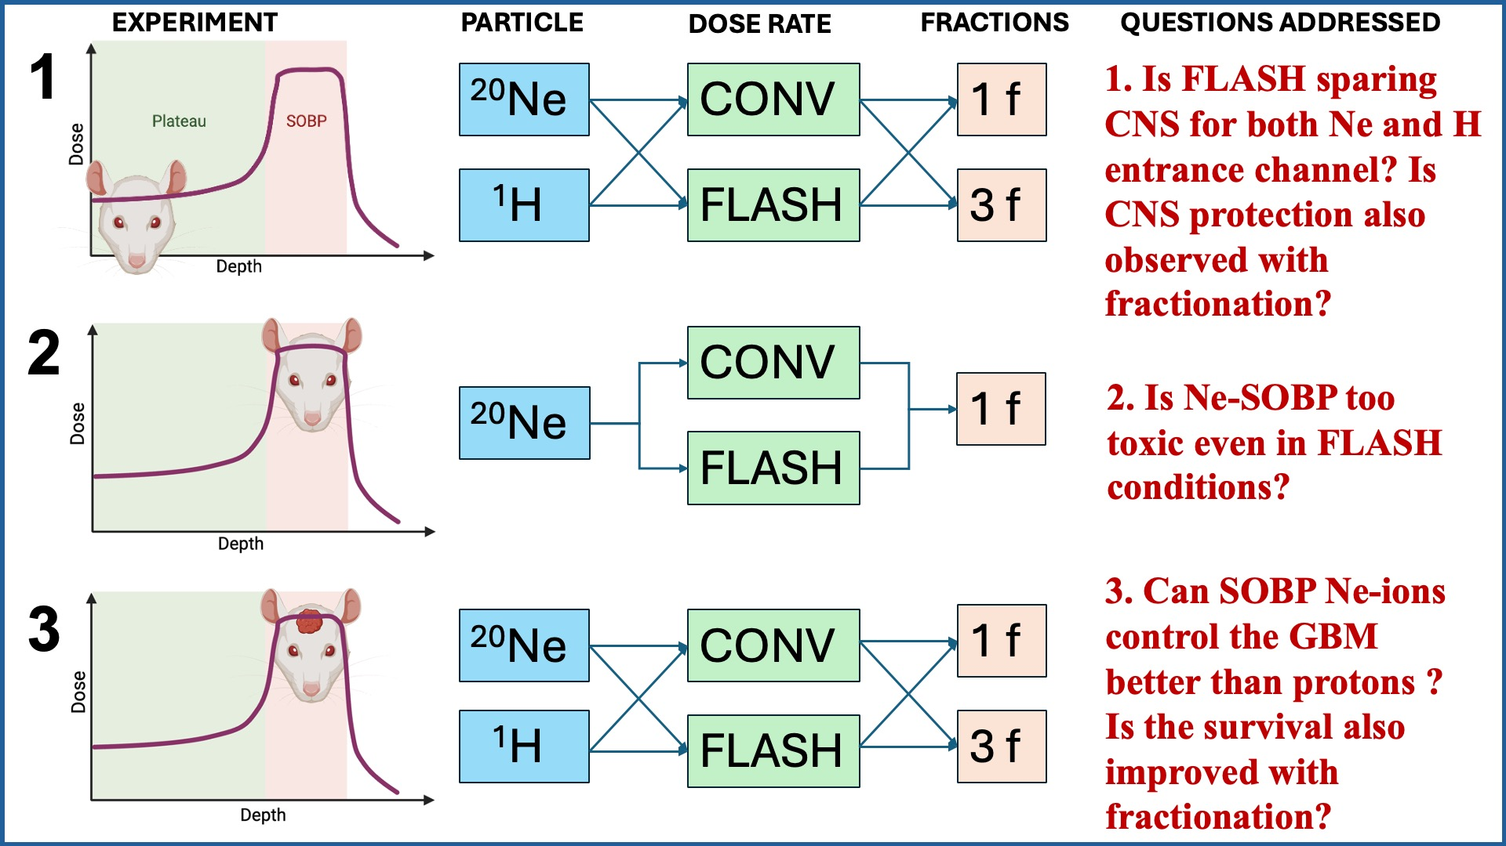

Superheavy FLASH
F98 rat GBM model

Slide 7
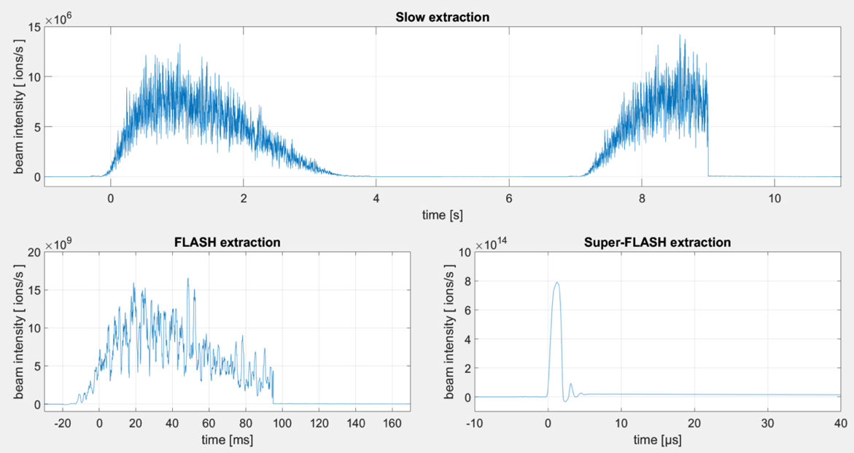
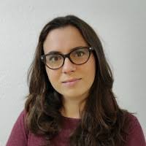

Superfast FLASH
Daria Boscolo
∼ 10² Gy/s
∼ 10⁷ Gy/s

Slide 8
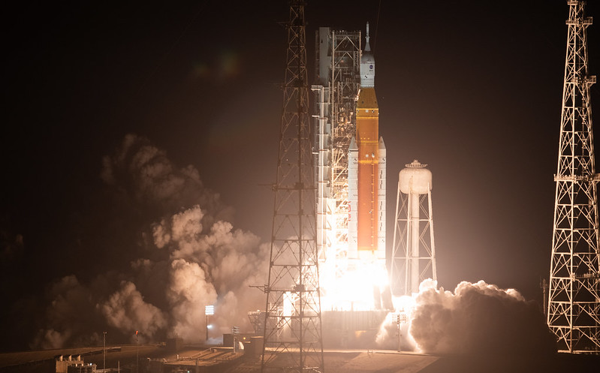
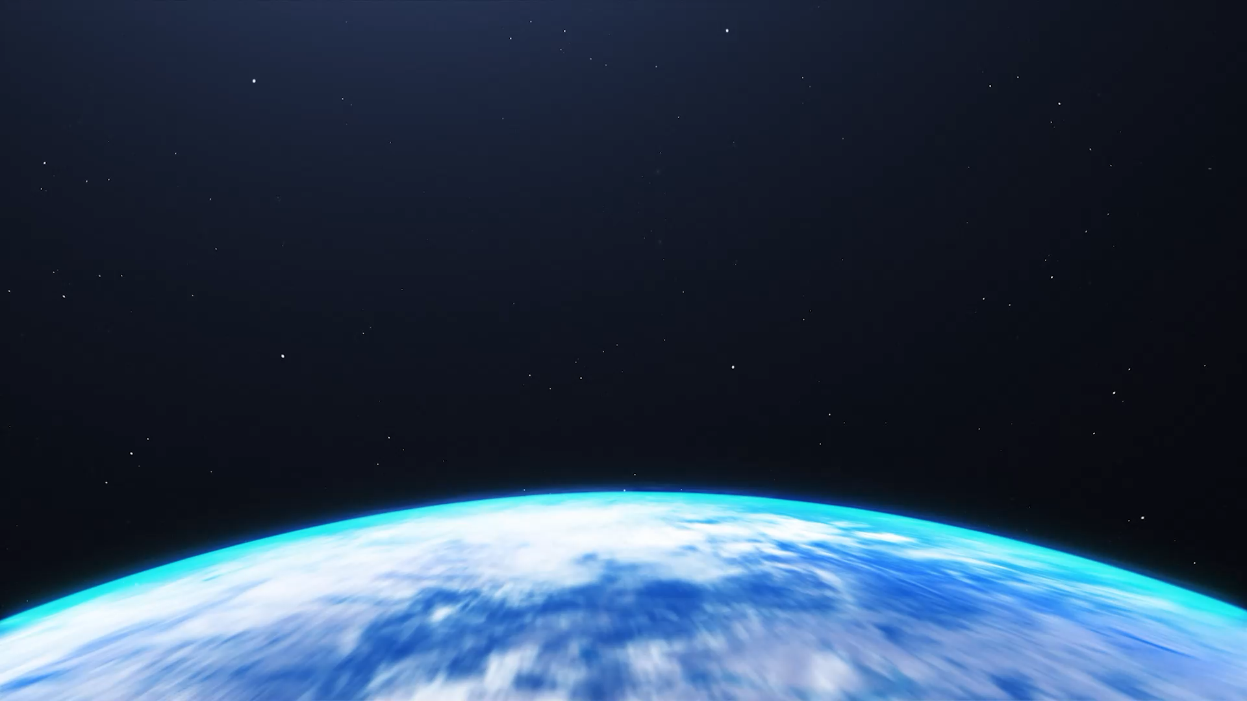
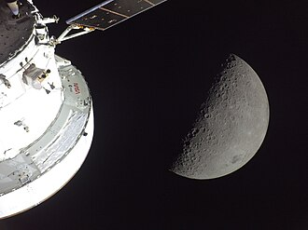





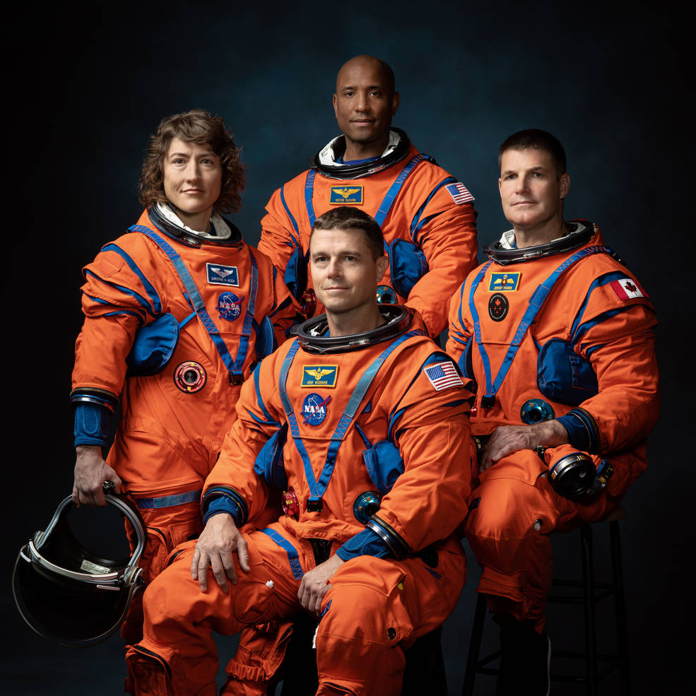
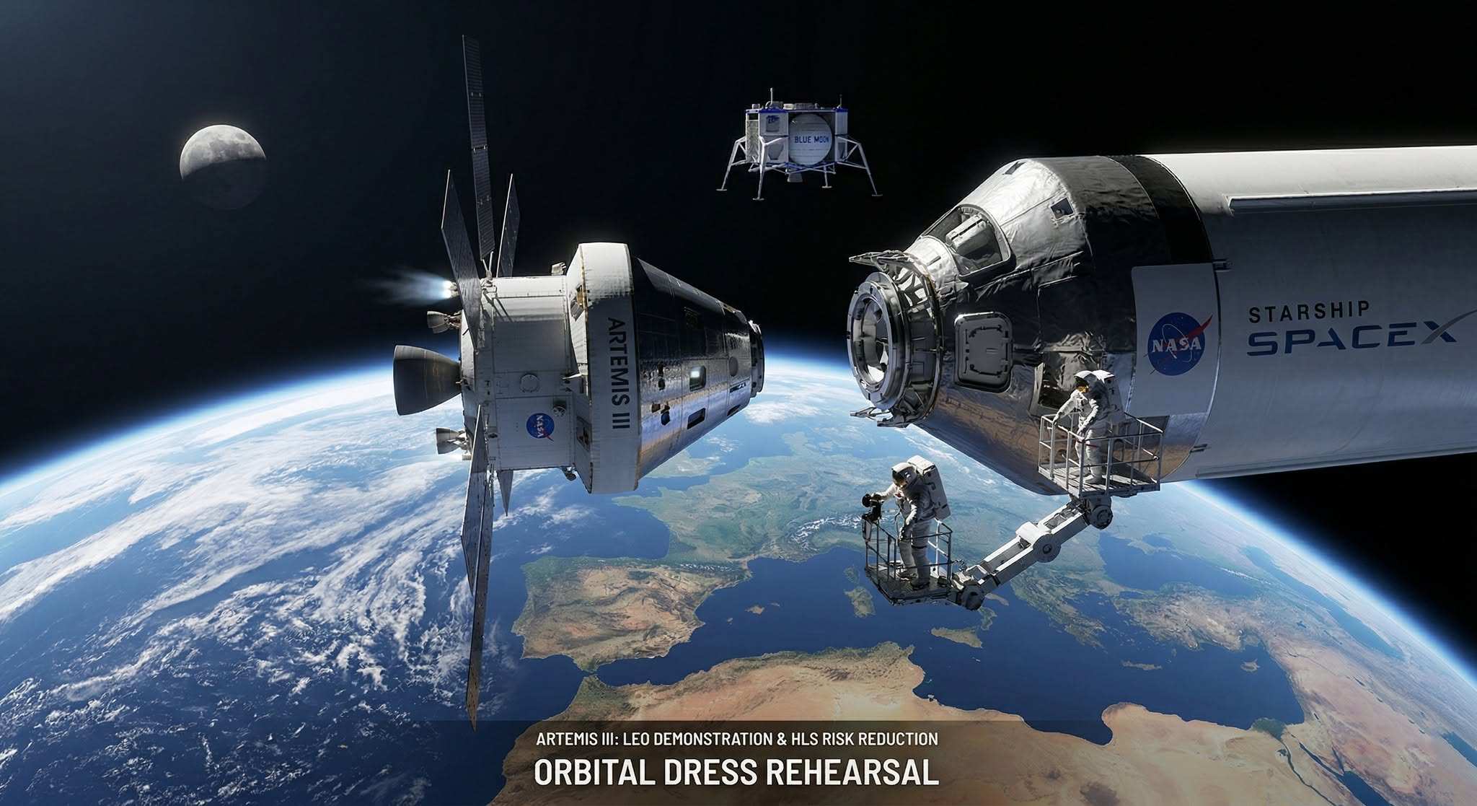
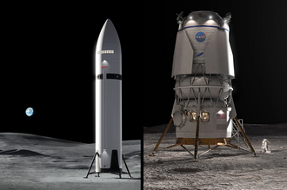

Artemis - Lunar exploration program
European service module
Artemis I
16.11-15.12.2022
Artemis II: April 1-11, 2026
Artemis III (LEO test of the Human Landing System): 2027
Artemis IV and V: 2028

Slide 9

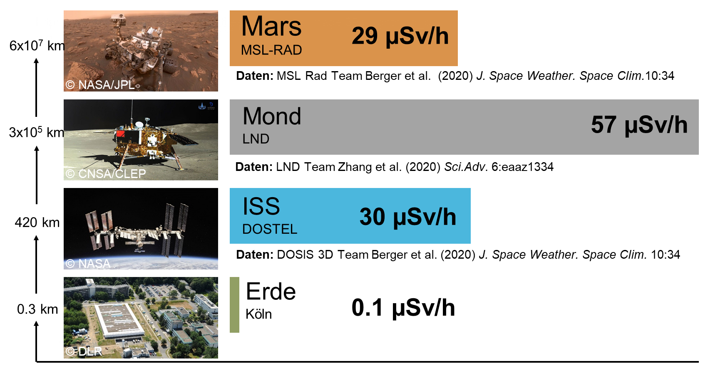
ISS / Moon / Mars: Dose equivalent rate (µSv/h)
Moon
Earth
Mars has a thin (1/100 Earth) CO₂ atmosphere, moon has no atmosphere

Slide 10
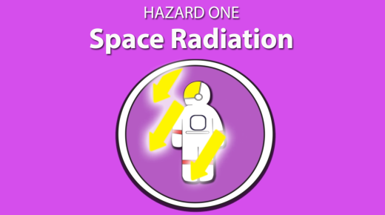
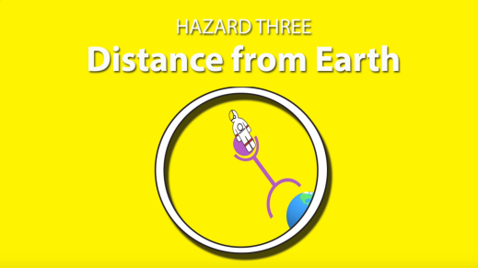
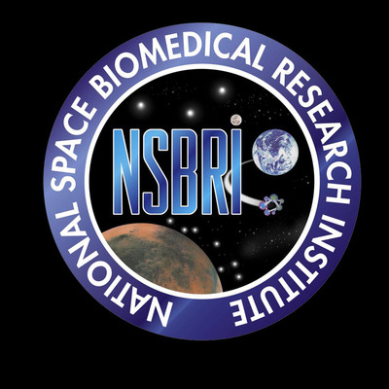

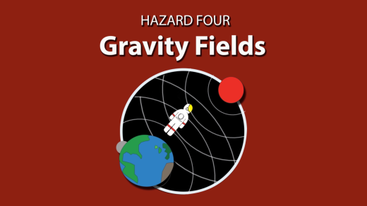
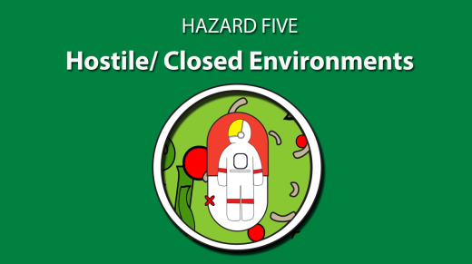
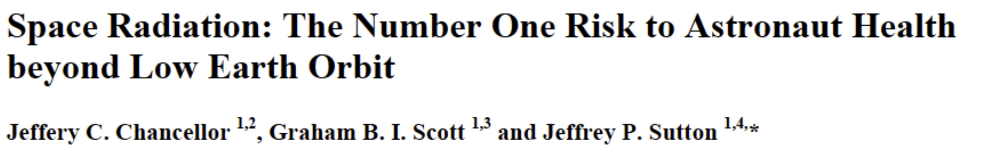
Health risk in deep space
High uncertainty on the risk
Lack of countermeasures

Slide 11
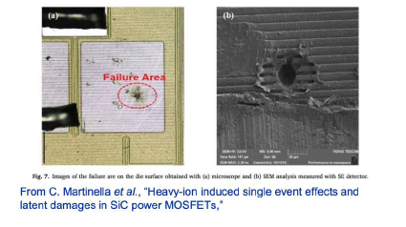
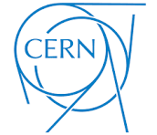
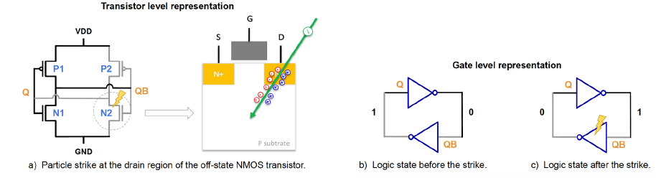

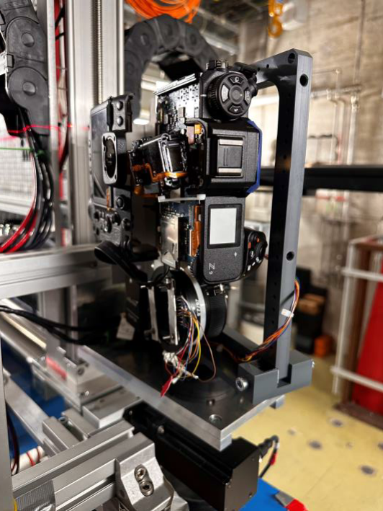
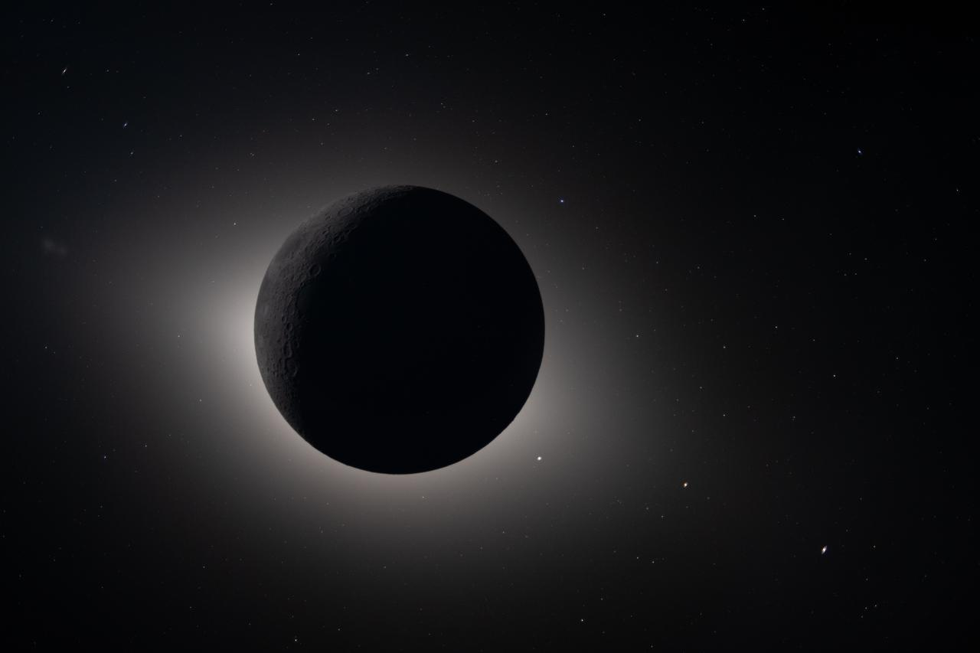

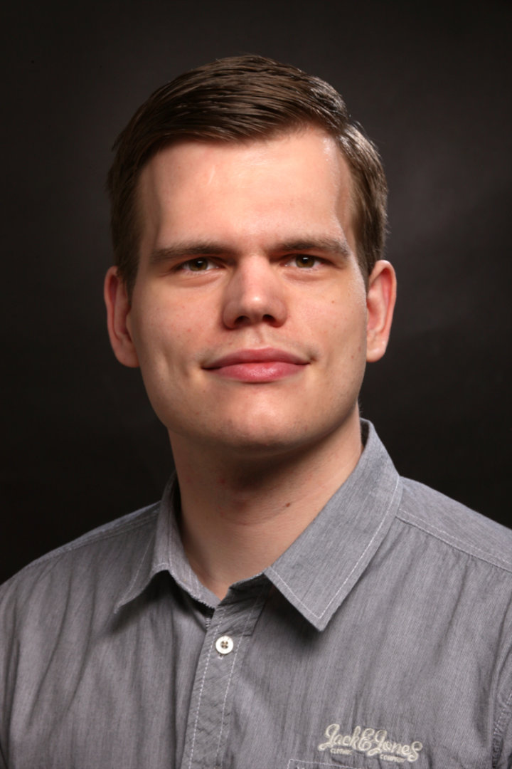

Heavy ions at accelerators: not only for human health risk
High-Z and –E (HZE) ions are needed for COTS
The HULC - - Handheld Universal Lunar Camera test at GSI - Cave A with 1 GeV/n ²³⁸U-beams in 2025
Artemis II in eclipse – April 6, 2026, photo taken by HULC (Nikon Z9), courtesy of NASA
Tim Wagner

Slide 12
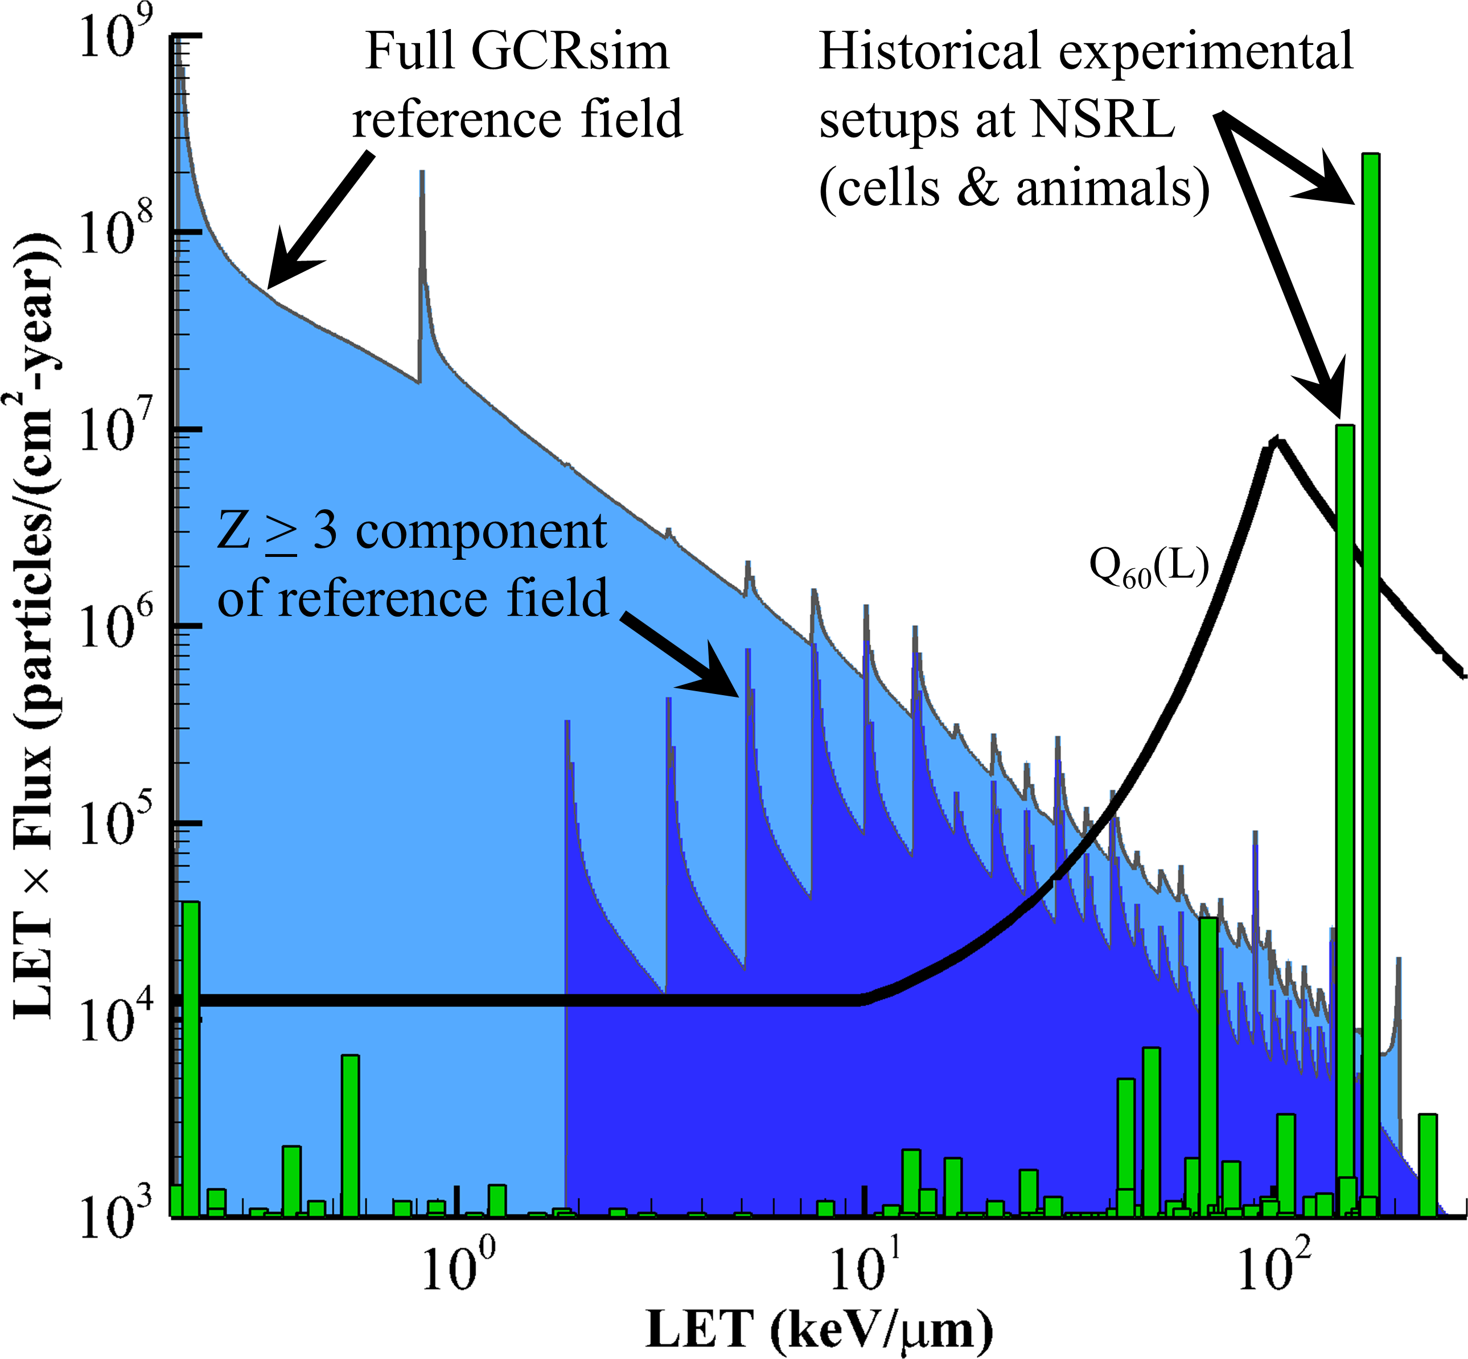
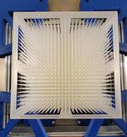


From single heavy ions to the full spectrum in the lab: the galactic cosmic ray simulators at BNL and GSI
Simonsen et al., PLoS Biol. 2020

Slide 14
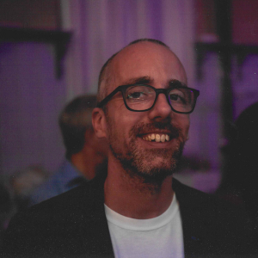
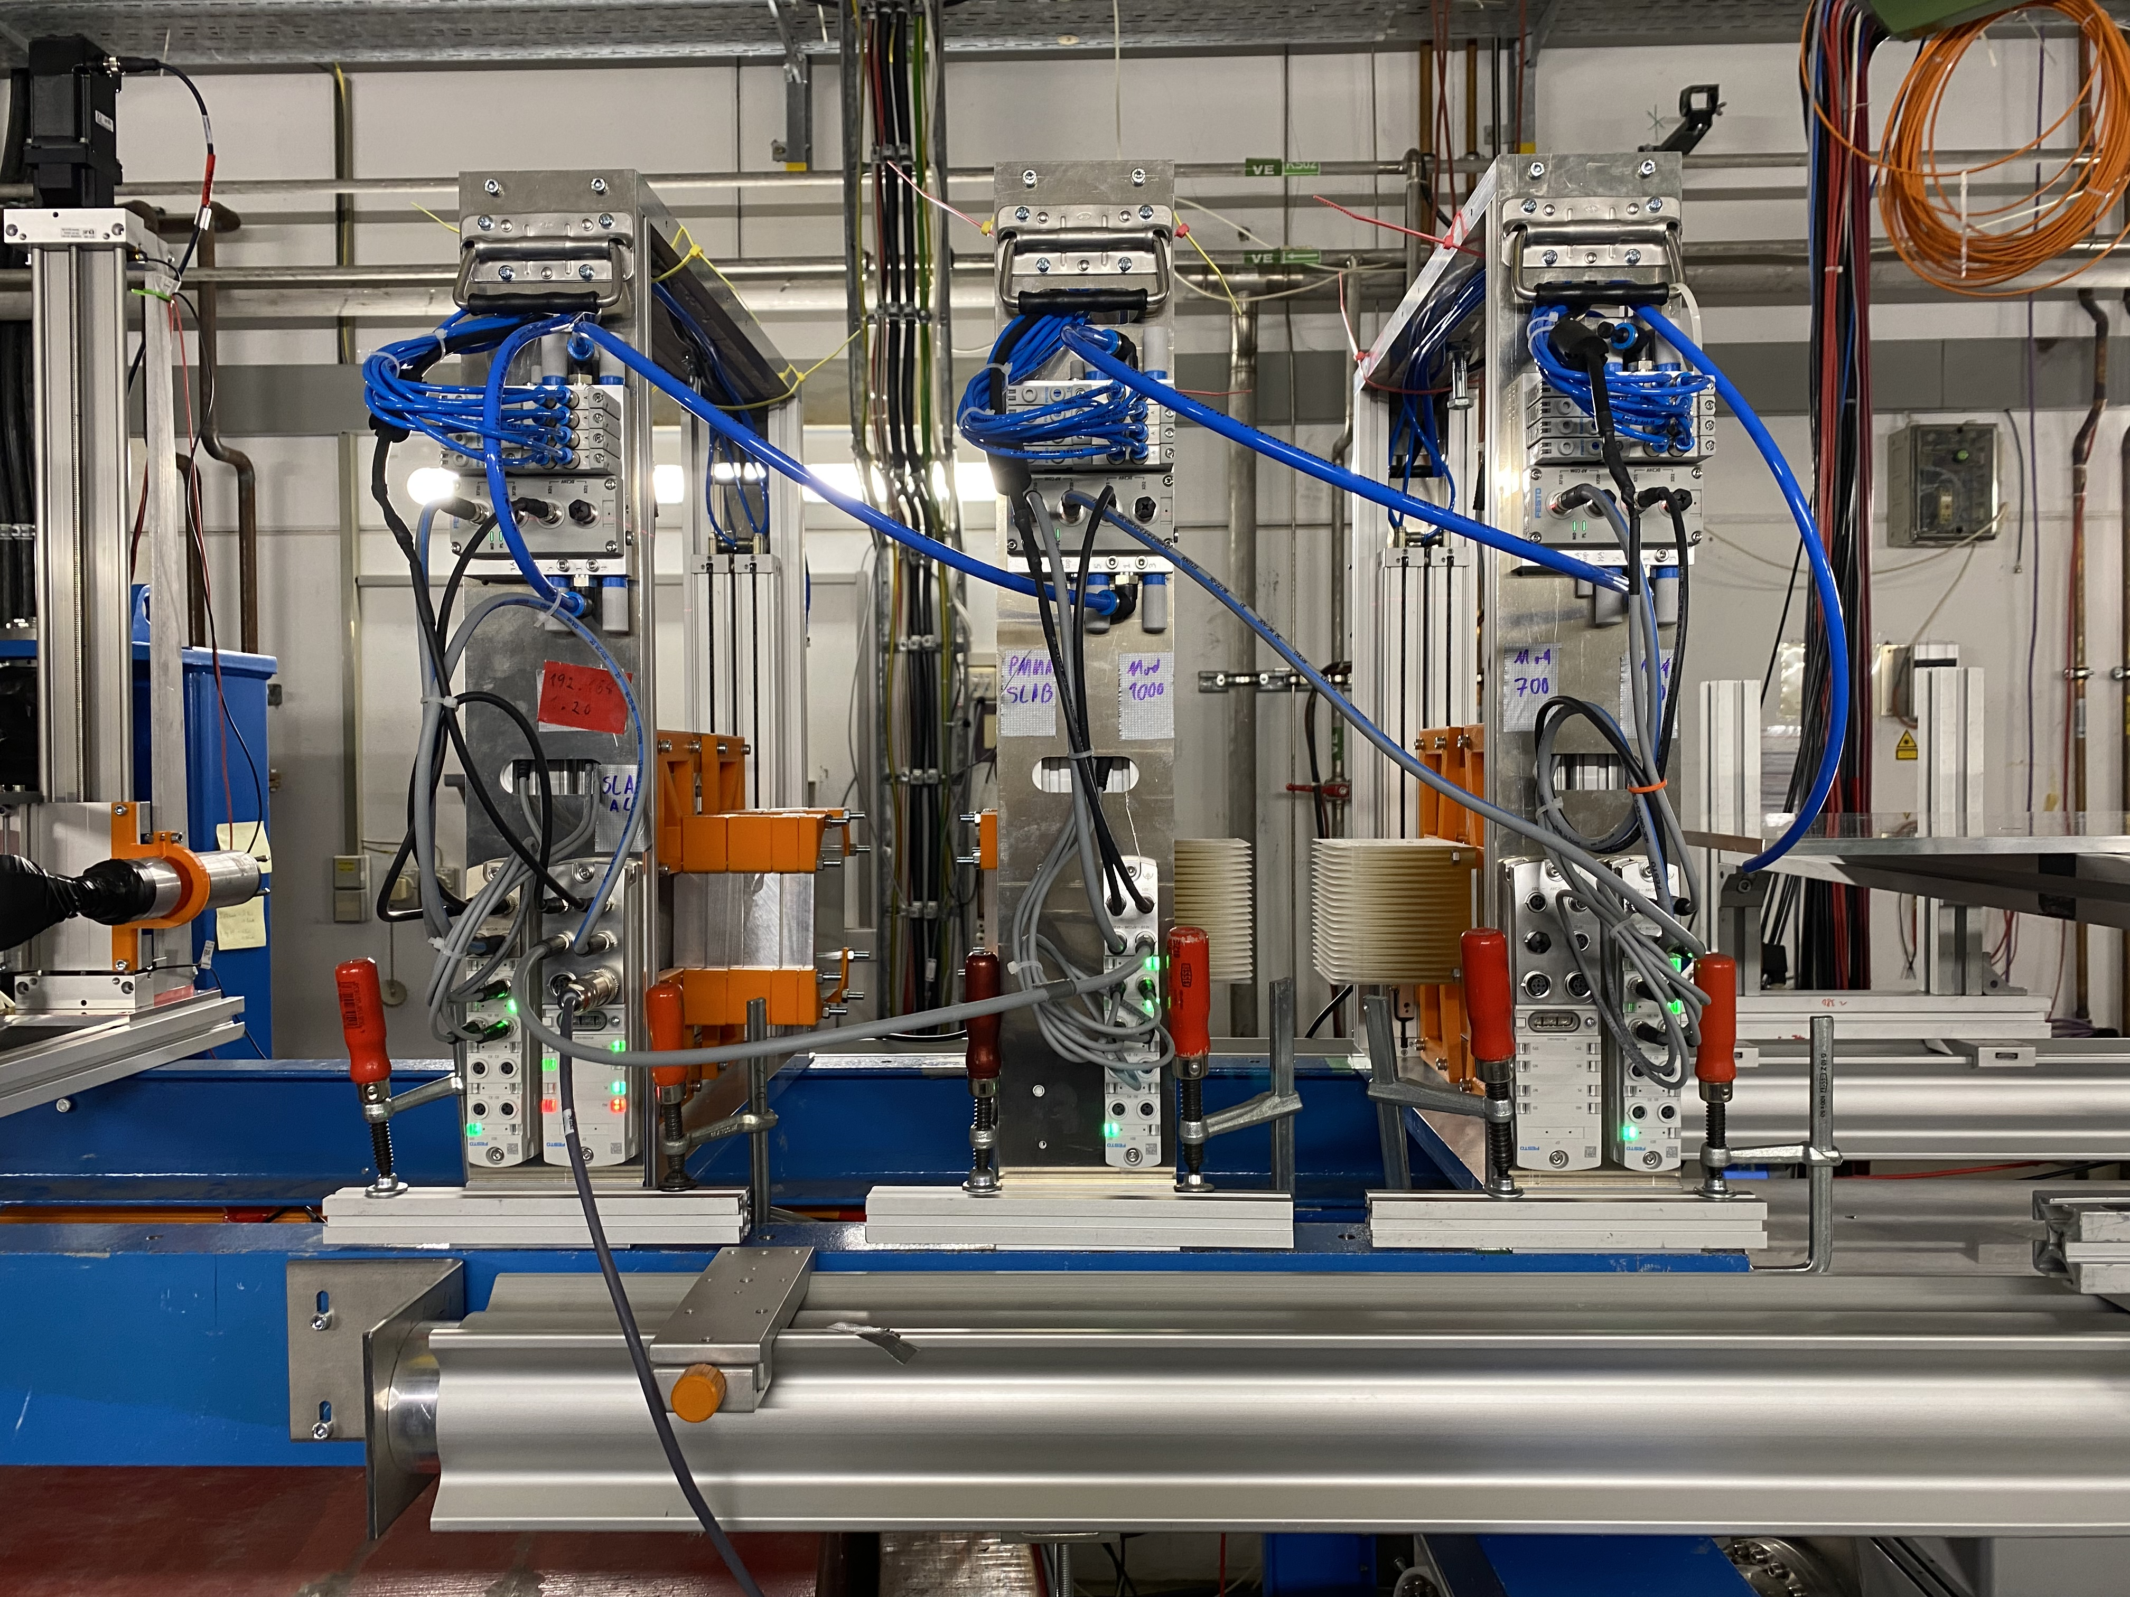
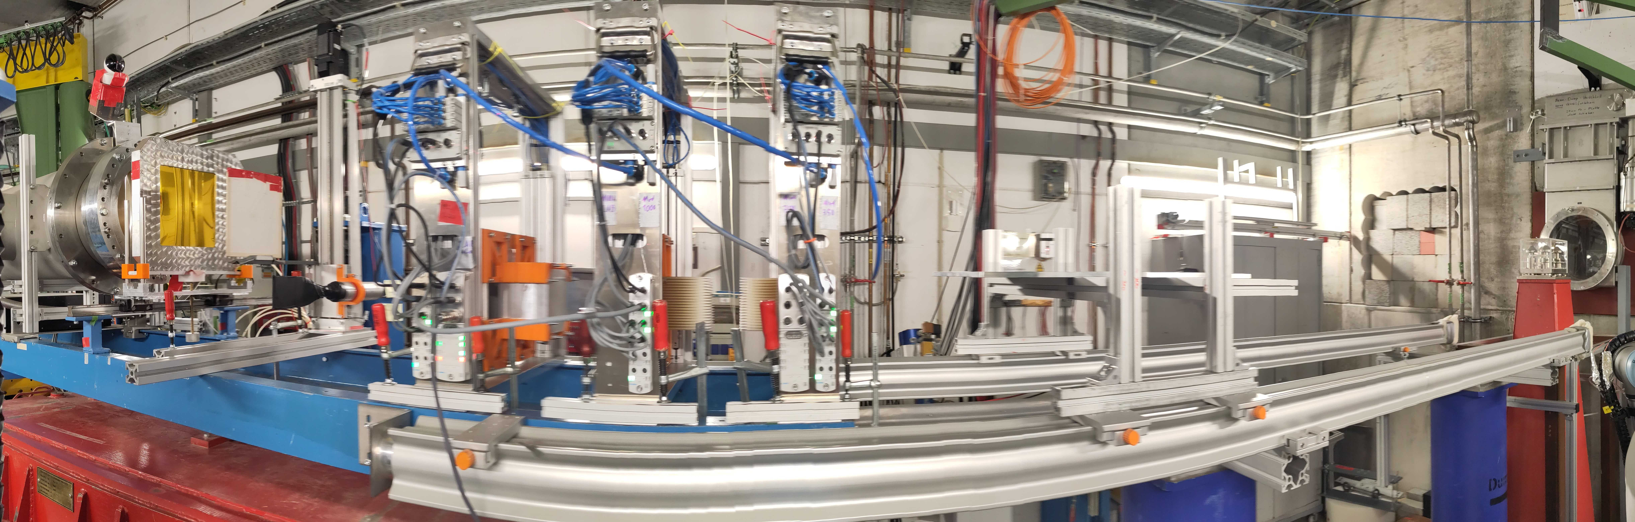
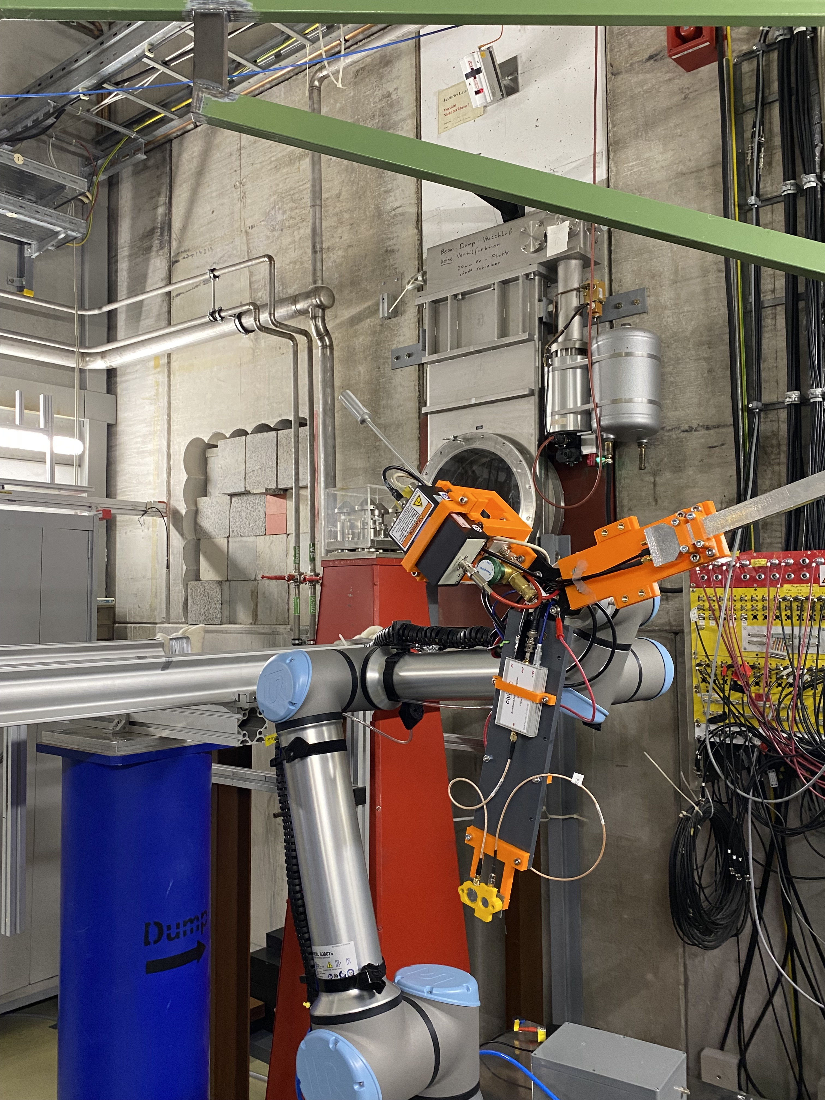
Galactic cosmic ray simulator at GSI-Darmstadt
Christoph Schuy
1
2
700 MeV/n ⁵⁶Fe
+
Modulator
3
4
5
6
1 GeV/n ⁵⁶Fe
+
Modulator
350 MeV/n ⁵⁶Fe
+
Modulator
1 GeV/n ⁵⁶Fe
+
“Spiky” Slab Target
1 GeV/n ⁵⁶Fe
+
“Spiky” Slab Target
350 MeV/n ⁵⁶Fe
+
Slab Target
Lunati et al., Life Sci. Space Res. 2026; Pierobon et al., Life Sci. Space Res. 2026

Slide 15
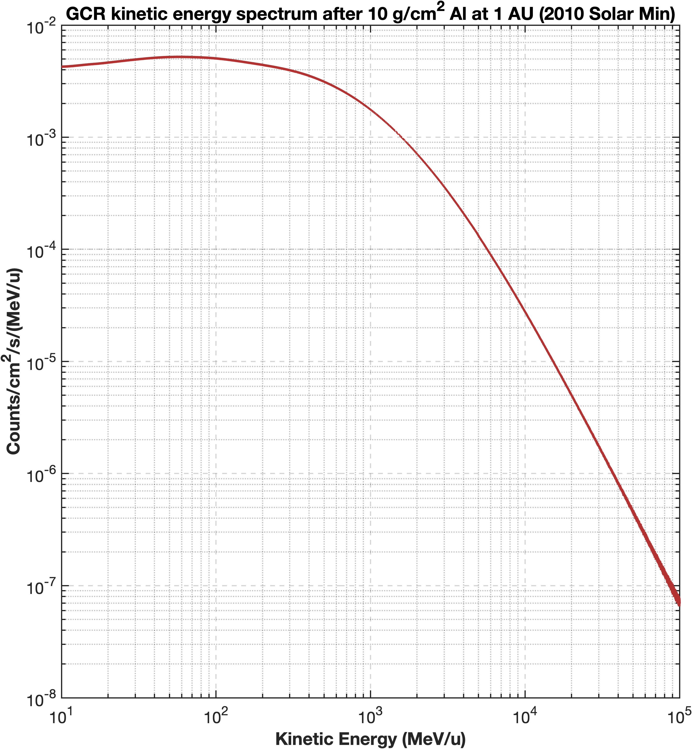
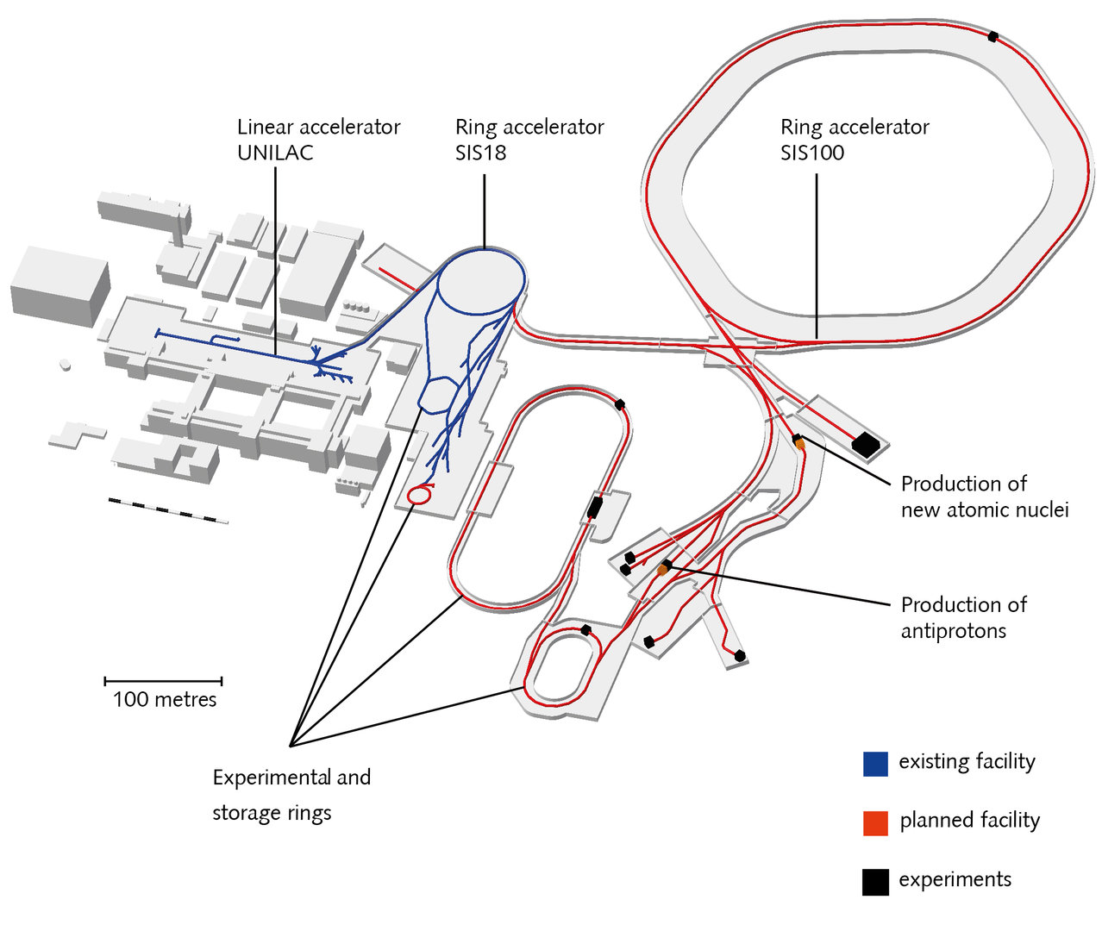
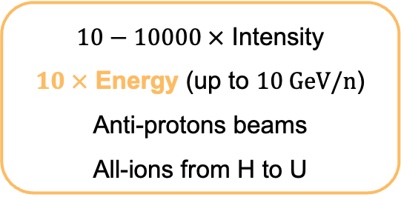
Next Steps GCR Simulator @FAIR
FAIR gain factors (rel. to GSI)
$10−10000 ×$ Intensity
$10 ×$ Energy (up to $10 \text{GeV}\text{/}\text{n}$)
Anti-protons beams
All-ions from H to U
CBM
Full GCR spectrum
can be simulated
SIS-18
SIS-100

Slide 16
International competitiveness
Accelerators with biomedical applications programs able to accelerate Z>1
Europe
USA
Asia
Research
Clinical
Under construction
GANIL (F)
PARTREC (NL)
LNS (IT)
CERN (CH)
BNL/NSRL (USA)
HIT (D)
CNAO (IT)
HIMAC (JP)
Gunma (JP)
SPHIC (China)
NICA (Ru)
SEEIST (South-eastern Europe)
RAON (Korea)
MSAM (China)
Mayo Clinics (USA)

Slide 17
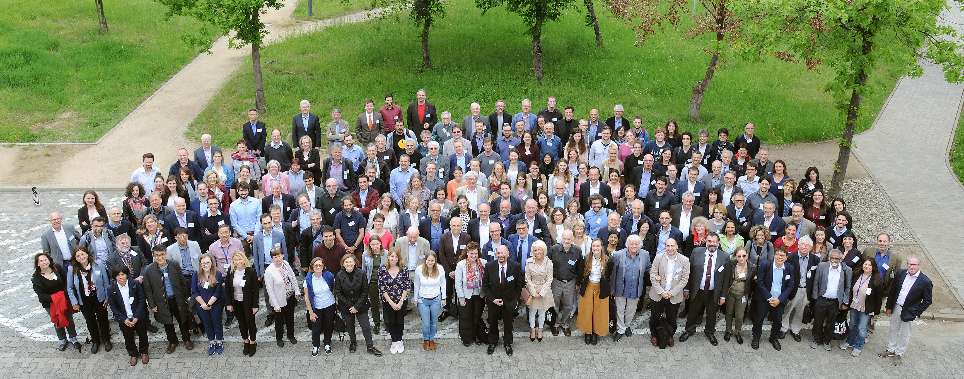
Thank you very much!
www.gsi.de/bio-coll

