Slide 1
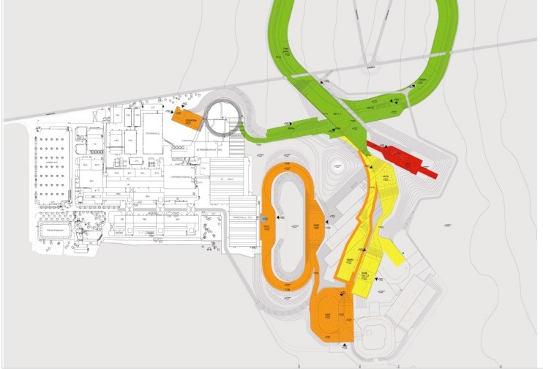
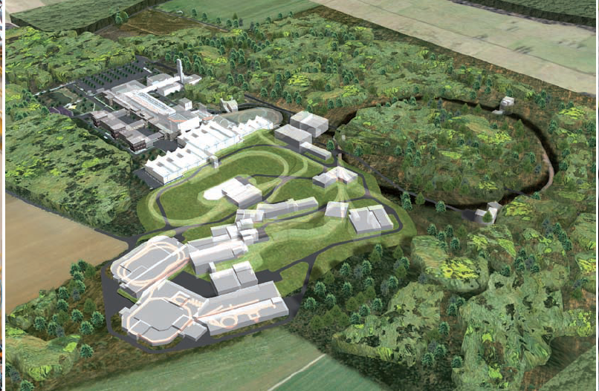
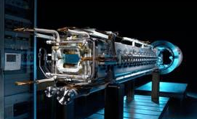

Status and plans of the HED@FAIR collaboration
An Update
APPA Cave Workshop 2026
Kurt Schoenberg
Spokesperson HED@FAIR

Slide 2
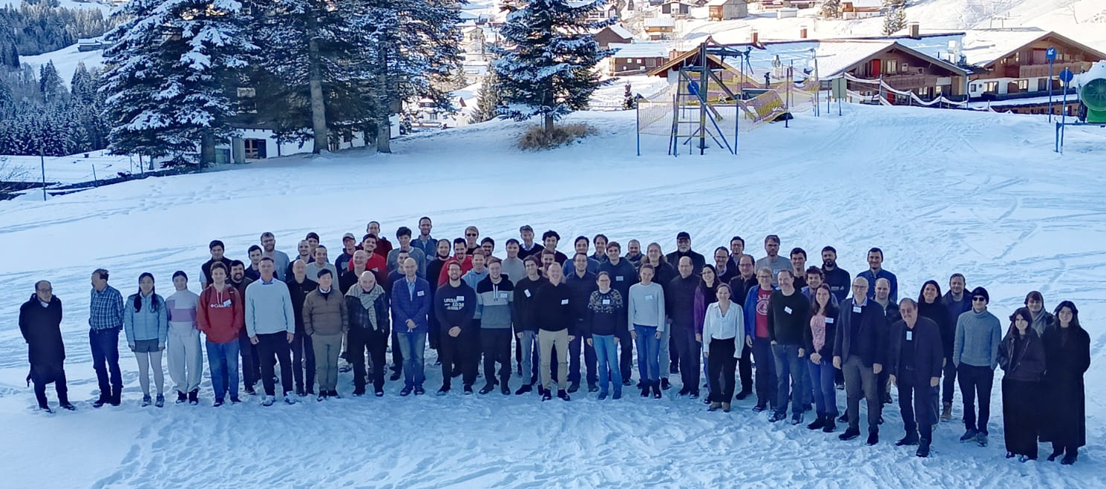
HED@FAIR - High Energy Density Science at FAIR
HED@FAIR Collaboration
  114 members from 11 countries
  (69 members from Russian institutes currently suspended)
German members
  43 members from Germany
  (25 from university groups, 18 from HGF)
HEDP Workshop 2026

Slide 3
Experimental facilities used by HED@FAIR
Research topics
Warm dense matter generated
with heavy ion beams
Proton microscopy
Nuclear photonics &
fusion research
Experimental facilities at GSI
Ion and laser beamlines at UNILAC (Z6)
and SIS-18 (HHT)
PHELIX
Experimental facilities at FAIR
APPA Cave connected to SIS-100 (FS++)
Possibility for a high-power laser next to the
APPA cave (SIRIUS project)
Area for
laser building

Slide 4
The APPA cave will offer unique possibilities for warm dense matter experiments

Slide 5
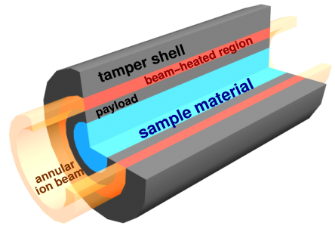
FAIR will provide a clean, volumetric, ion-beam-driven platform for measuring warm dense matter EOS and transport properties in the 1 to 10’s of eV regime

Slide 6
Proton microscopy has already proven itself as a versatile diagnostic for measuring material evolution in slow to fast dynamic systems

Slide 7
The facilities at GSI have played a key role in preparing for FS++
Experimental and diagnostic technique/prototype development

Slide 8
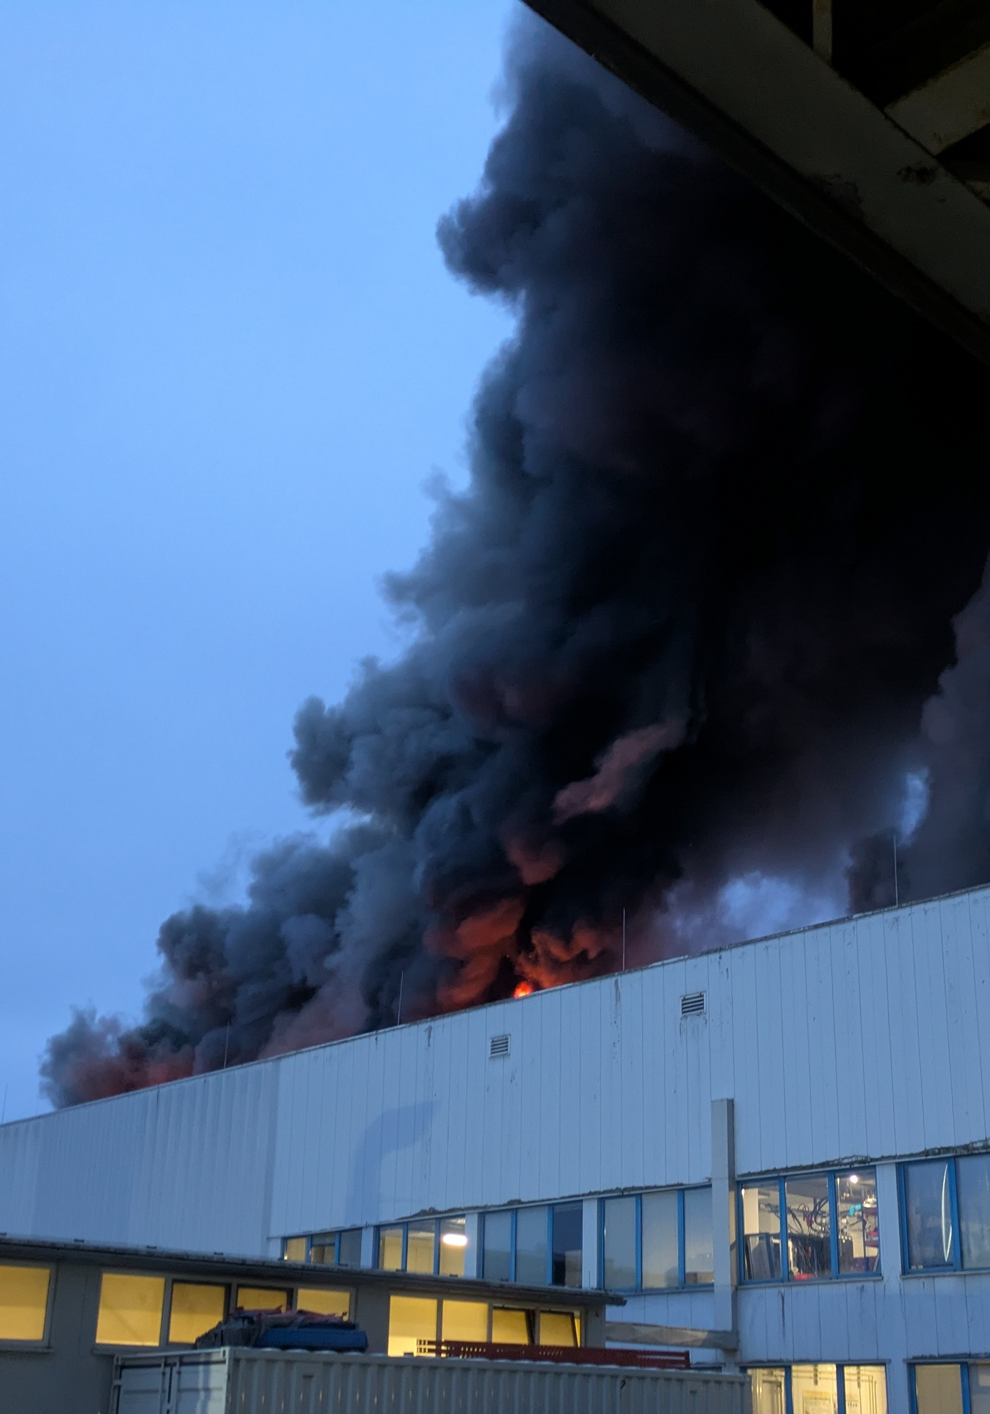
The fire at the UNILAC on February 5th significantly impacted our plans
On the positive side: Most of the experimental installations of HED@FAIR were minimally affected by the fire
  PHELIX laser
    The laser installation and the laser building were not damaged by the fire.
    Laser-only experiments were restarted once the campus infrastructure (power, etc.) was operating normally.
  HHT experimental area at SIS-18
    The HHT area was not adversely affected by the fire.
  Z6 experimental area at UNILAC
    No direct fire or water damage, but some contamination with soot.
The main impact of the fire is the loss of SIS-18 beamtime and high Z ion flux
  Until 2030, only limited beams from PARTIH and InterLAC will be available
  Normal operations with UNILAC beams are expected to restart in 2030
  Until UNILAC – no significant HiHex experiments
  Possibility of PRIOR experiments with InterLAC

Slide 9
Post fire beam planning

Slide 10
Impact of the recent fire on HED experiments
 | Only PHELIX laser (HHT, Z6) | With interim ion source (HHT, Z6) | With UNILAC (HHT, Z6) | FS++ (APPA cave)
PRIOR (proton microscopy) | Not feasible | Research program can start with InterLAC | Can be operated with good performance | Full performance
HIHEX (isochoric heating) | Not feasible | Not feasible | Study of phase transitions, no warm dense matter experiments | Full performance
LAPLAS (isentropic compression) | Not feasible | Not feasible | Not feasible | Full performance
Laser-only experiments | Full performance | Full performance | Full performance | Requires high-power lasers next to the APPA cave
Stage
Experiment

Slide 11
Next proton microscope experiments will depend on the available beams
Current status
  The proton microscope and the blast chamber for shock experiments have been commissioned.
  A high-explosive driver for shock experiments is in development in collaboration with the Fraunhofer Institute for Chemical Technology.
The PRIOR program can continue with the interim sources
  First R&D experiments with the explosive drivers are planned for 2027
  First science experiments with beams from Interlac and explosive drivers are planned for 2028
For more details, see the presentation
by M. Schanz
Basic “proof of concept” campaign
¹H - ¹²C, from 10⁷ particles/bunch and 500 MeV/u Medical imaging Small animal imaging Dose dependent image quality analysis of samples
Alternative research program
¹H - ¹²C, from 5･10⁸ particles/bunch and 1 GeV/u Static imaging and slow dynamics Melting & crystallization of alloys & geological samples Post-shock evaluation of geological samples
Planned and scheduled experiments
¹H, from 5･10⁹ particles/bunch and 3.5 GeV Ultra-fast dynamic processes in dense matter High explosives driven shock-wave experiments for dynamic equation of state measurements

Slide 12
Heavy ion heating experiments require beams from the UNILAC
Current status
  Coupled experiments with PHELIX and SIS-18 beams have been carried out successfully at HHT.
  The day-1 target chamber and various diagnostics have been constructed and commissioned (funded by BMFTR VF).
  First isochoric heating experiments have been carried out successfully.
HIHEX experiments require the heavy ion beam intensity from the UNILAC
Neither PARTIH nor InterLAC can provide the heavy ion beams needed for our heating experiments
  HIHEX is paused until 2030
Testing and commissioning of diagnostics at HHT
U⁷³⁺, from 5･10⁸ particles/bunch and 150 MeV/u Further development of detectors Laser driven x-ray diagnostics (microscopic structure) Optical probes (macroscopic parameters)
Isochoric heating experiments at HHT
U⁷³⁺, from 2･10⁹ particles/bunch and 250 MeV/u Study of phase transitions Superheating of iron and silicon Graphitization of diamond
HIHEX and LAPLAS experiments in the APPA cave
U²⁸⁺, up to 5･10¹¹ particles/bunch and 2.7 GeV/u Generation of warm dense matter Isochoric heating (HIHEX) Isentropic compression (LAPLAS)

Slide 13
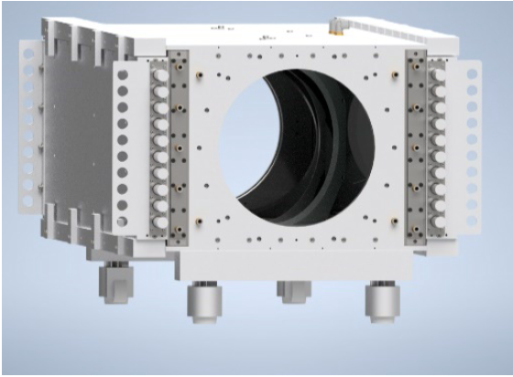
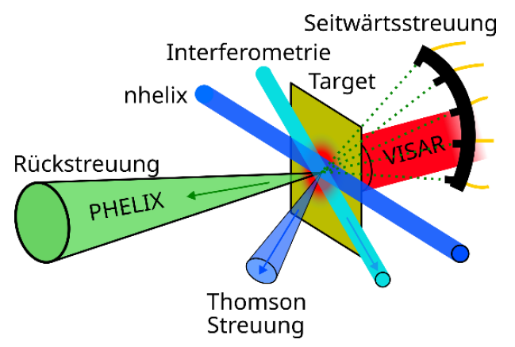
A PHELIX upgrade will enhance the possibilities for the study of
laser plasma instabilities (LPI)
ULEP (“Upgrade des LPI-Experimentierplatzes an PHELIX”)
  Proposal has been submitted to fusion science call
  Selected in first round, detailed application to be submitted
  Joint application from GSI, TU Darmstadt, Focused Energy,
  HI Jena, TH Bingen
Planned upgrades
  Creation and amplification of programmable broadband nanosecond laser pulses
  Increasing the PHELIX shot rate from 1/90min to 1/15 min with improved cooling setup
  Upgrade of the Z6 target area, including adaptive optics and new Thomson scattering diagnostics
For more details, see the presentation by V. Bagnoud
▲Cooling setup for main laser amplifiers
Side scattering
Interferometry
Backscatter
▲Experimental setup for LPI experiments at Z6

Slide 14
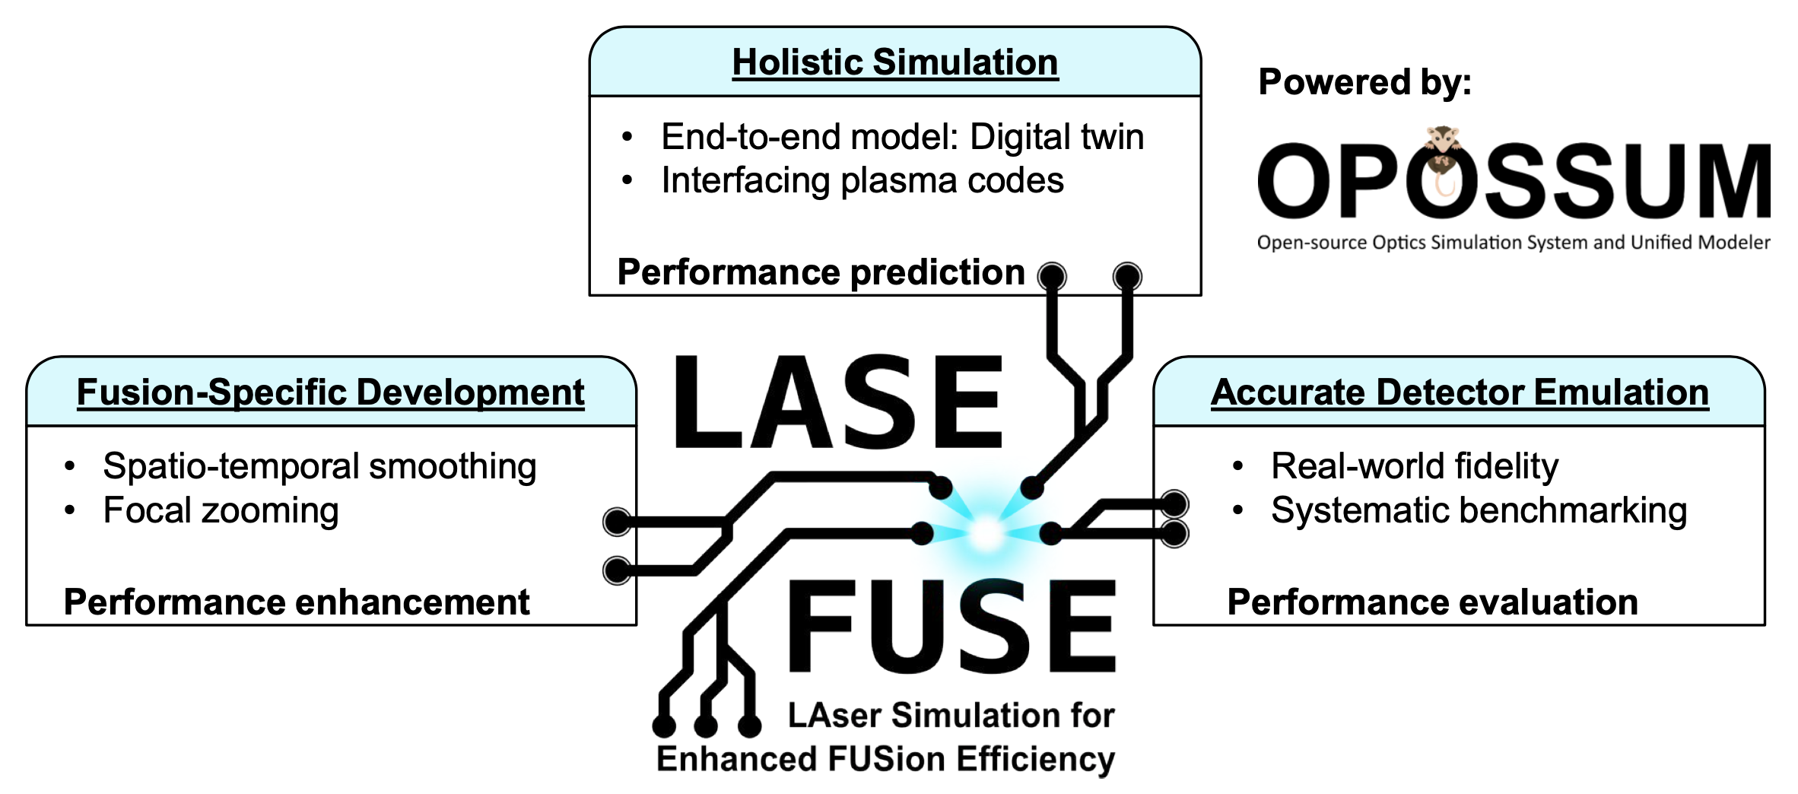


Two Young Investigator Groups at GSI have been funded recently that support work on PHELIX and future laser systems
Group led by Jonus Ohland
Group led by Yannik Zobus
Challenge: Inertial Fusion Energy (IFE) requires 100s of high-energy lasers at high repetition rates
Beam control too unstable for reliable ignition … active beam control is required!
Goal: Develop next-gen laser beam control for IFE!
Funding for 2 postdocs, 3 PhD students and 1 technician for 5 years
Goal: Develop digital twin technology for planning
large-scale laser facilities and provide a holistic laser
simulation framework
Funding for 1 postdoc and 3 PhD students for 5 years

Slide 15
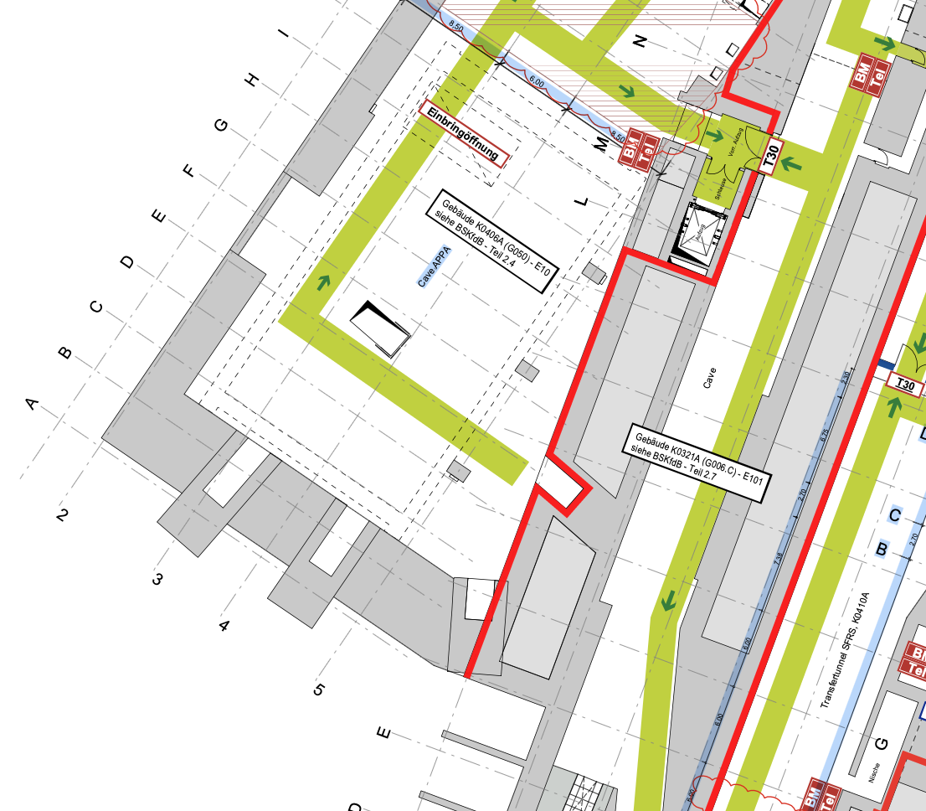
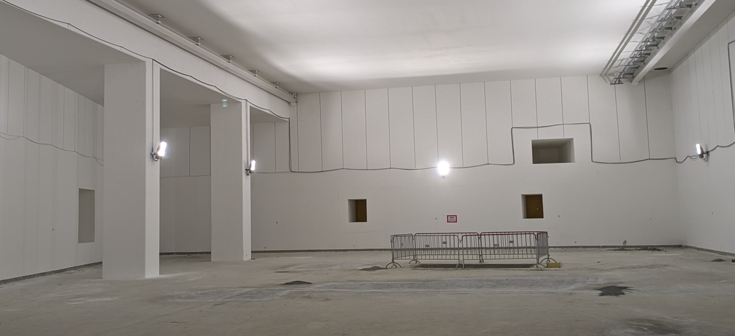
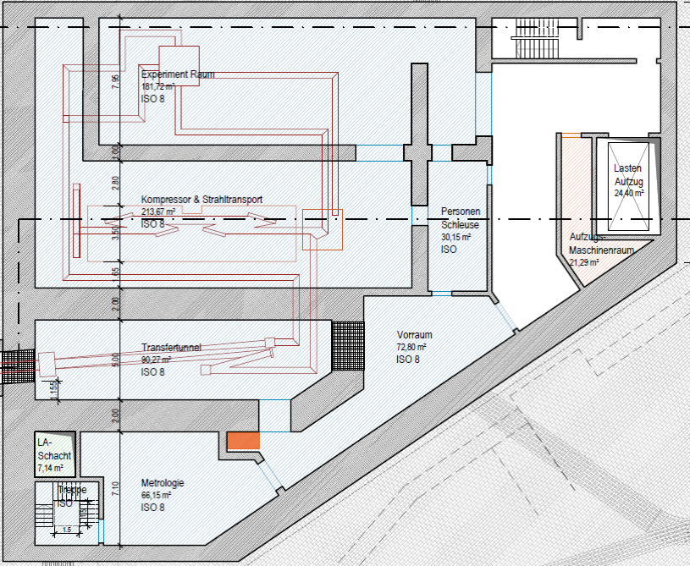
SIRIUS - A future laser facility for APPA cave HED Experiments
SIRIUS (formerly named FLARE)
  4 beamlines (kJ, ns, 2ω) with large bandwidth for fusion science experiments
  Beamlines can also be operated in a short-pulse
  (ps, 1ω) mode
  The coupling of HIHEX isochoric WDM generation with a ns/ps laser drive at FAIR will provide a time-resolved platform for investigation of WDM physics of high relevance, for example, to IFE. (ablation pressure, shock dynamics, radiation transport, and mix physics in the initial WDM regime that seeds inertial fusion implosions.)
APPA Cave
p-bar tunnel
Target chamber
for laser-only
experiments
APPA Cave
Laser
building
Beamlines into
the APPA cave
Opening for laser beamlines
Compressor
Beam dump
BioMat
Beam dump
HED
For more details, see the presentations by V. Bagnoud
and P. Neumayer
15

Slide 16
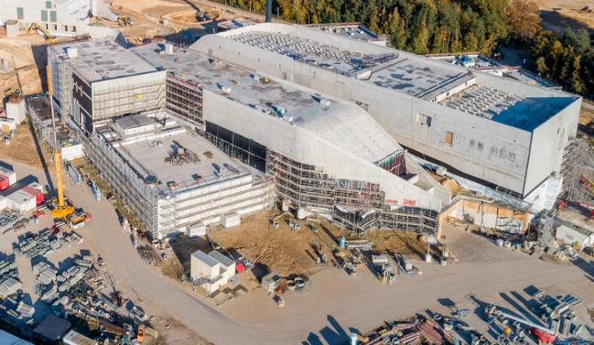

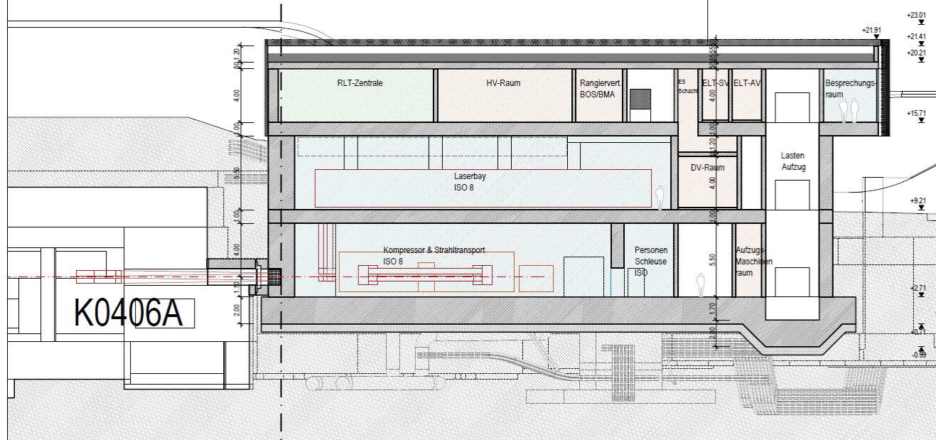
Current status of the SIRIUS project
As part of the European THRILL project, we are preparing the conceptual design of a high-power laser next to the APPA cave
  A feasibility study for the laser building has been completed.
  The conceptual design report for the laser will be finished in 2026.
Next steps for the SIRIUS project
  An application to include SIRIUS in the roadmap of German research infrastructures is in preparation and will be submitted this summer.
  In the next step, a funding application for the SIRIUS project in the framework of the German fusion science initiative will be prepared.
APPA
1500 m²
Photo: M. Konradt

Slide 17
Conclusions
We are looking forward to the approval of FS++
  The experiments in the APPA cave will enable unique warm dense matter experiments with heavy ion beams from SIS-100
  Phase 0 experiments have played an essential role in the preparations of these experiments.
  Hopefully, PRIOR experiments can continue, HIHEX will require the UNILAC
Fusion science research offers new opportunities for the HED@FAIR collaboration
  We are working on further improving the capabilities of the PHELIX laser with the ULEP project and Young Investigator Groups.
  The SIRIUS project would provide along with heavy ion beams, a unique, time-resolved platform for investigation of WDM physics of high relevance to IFE
  Stand-alone laser experiments are also helping the HED Collaboration to "bridge the gap" until the UNILAC is again operational and until the realization of APPA.

