Slide 1
Hadron-Quark Mixed Phase with Geometrical Structure and Equation of State
Toshiki Maruyama (JAEA)
Nobutoshi Yasutake (Chiba Inst. of Tech.)
Minoru Okamoto (Univ. of Tsukuba & JAEA)
Toshitaka Tatsumi (Kyoto Univ.)

Slide 2
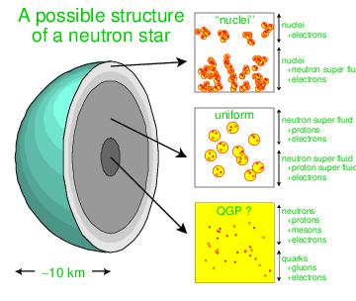
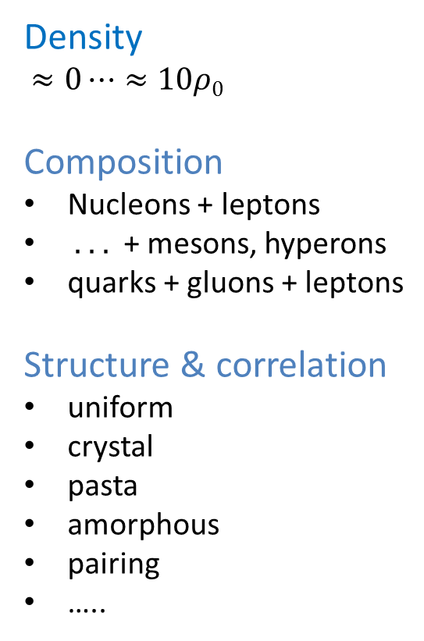
Matter of neutron stars
Density
$≈0⋯≈10ρ0$
Composition
Nucleons + leptons
. . . + mesons, hyperons
quarks + gluons + leptons
Structure & correlation
uniform
crystal
pasta
amorphous
pairing
…..

Slide 3
Relation between physical properties
Liquid-gas
Meson condensation
Hadron-quark
…………..
Density
Phase transitions
Chemical composition
Structure
Interaction
Pressure

Slide 4
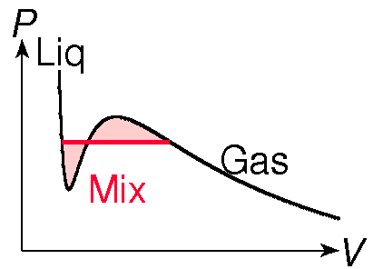
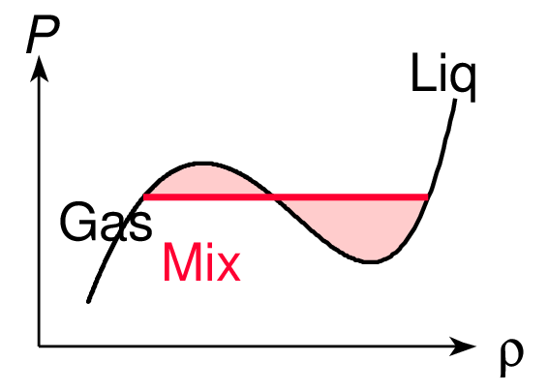
First-order phase transition and EOS
Single component congruent
(e.g. water)
Maxwell construction satisfies the
Gibbs cond. T^{I}=T^{II}, P^{I}=P^{II}, μ^{I}=μ^{II}.
Many components non-congruent
(e.g. water+ethanol)
Gibbs cond.T^{I}=T^{II}, P_{i}^{I}=P_{i}^{II}, μ_{i}^{I}=μ_{i}^{II}.
No Maxwell construction !
Many charged components
(nuclear matter)
Gibbs cond. T^{I}=T^{II}, μ_{i}^{I}=μ_{i}^{II}.
No Maxwell construction !
No constant pressure !
This is the case for nuclear matter !

Slide 5
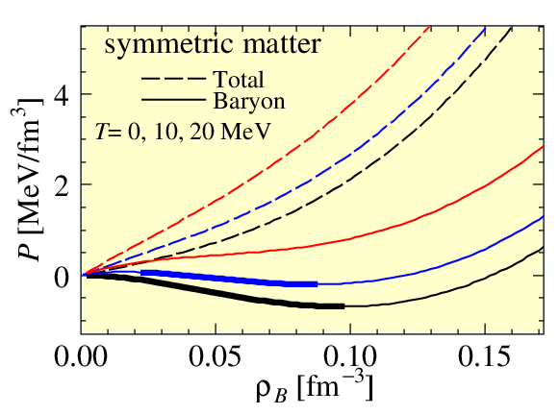
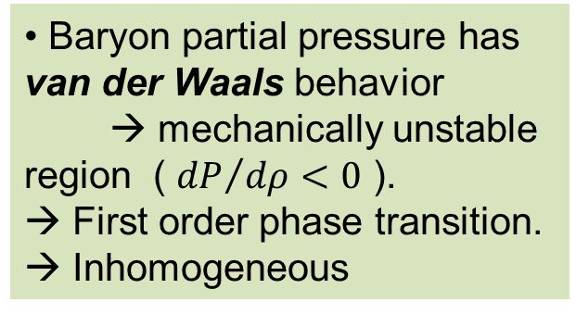
(1) Low-density nuclear matter
[Phys.Rev. C72 (2005) 015802]
Pressure vs density
Total pressure is positive. Monotonically increases with density and temperature.
Baryon partial pressure has van der Waals behavior
→ mechanically unstable region ( ${dP}/{dρ}<0$ ).
→ First order phase transition. → Inhomogeneous
5
Notes:
5
5

Slide 6
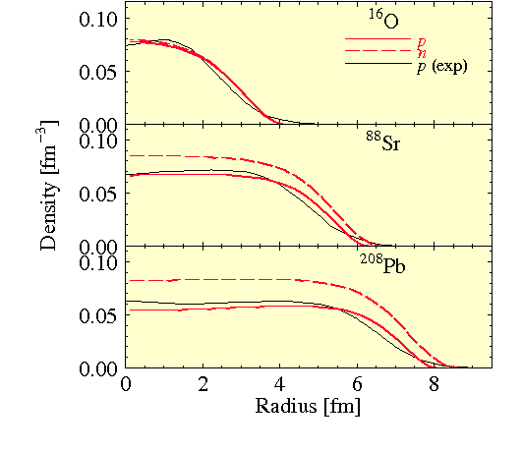
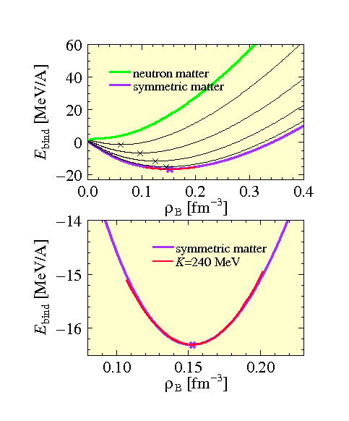
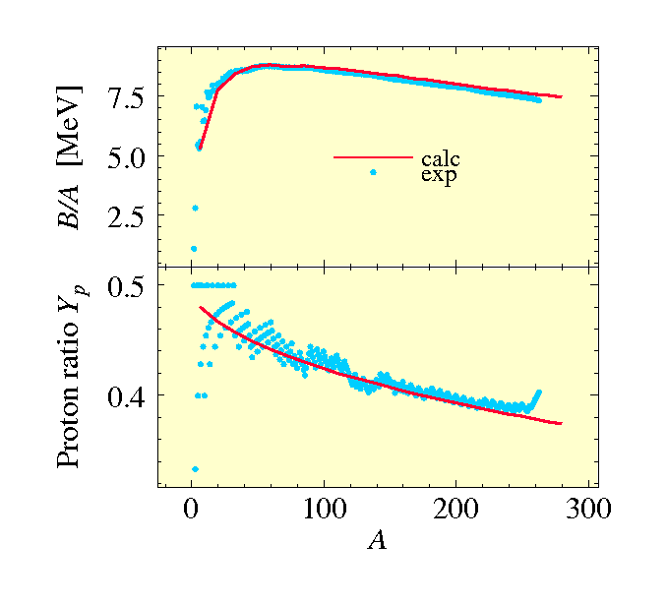
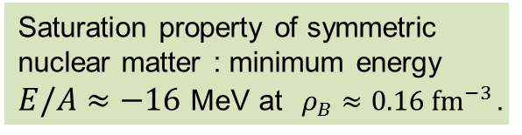
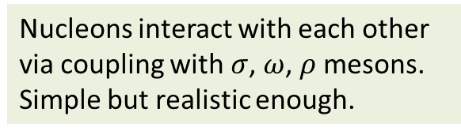
RMF + Thomas-Fermi model
Nucleons interact with each other via coupling with $σ$, $ω$, $ρ$ mesons.
Simple but realistic enough.
Binding energies, proton fractions, and density profiles of nuclei are well reproduced.
Saturation property of symmetric nuclear matter : minimum energy
$E/A≈−16$ MeV at $ρ_{B}≈0.16 {\text{fm}}^{−3}$.

Slide 7
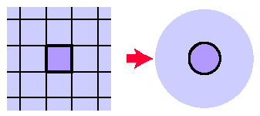
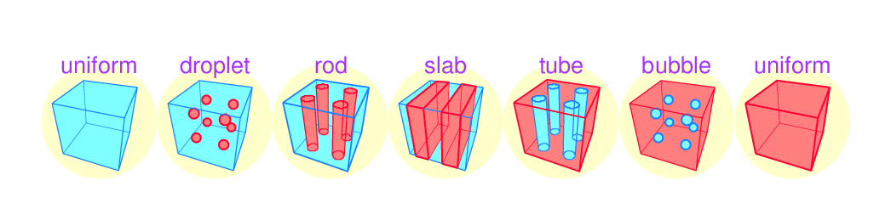
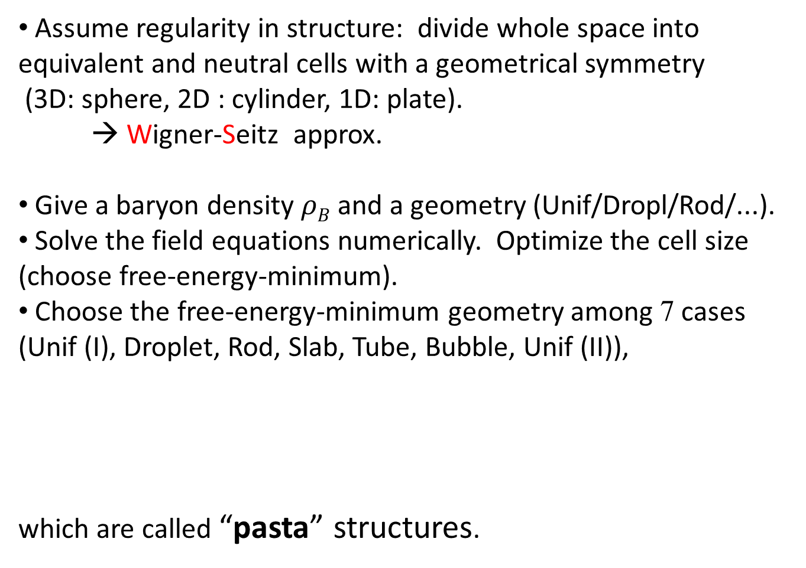
Numerical calculation of mixed-phase structure
Assume regularity in structure: divide whole space into equivalent and neutral cells with a geometrical symmetry
(3D: sphere, 2D : cylinder, 1D: plate).
→ Wigner-Seitz approx.
Give a baryon density $ρB$ and a geometry (Unif/Dropl/Rod/...).
Solve the field equations numerically. Optimize the cell size (choose free-energy-minimum).
Choose the free-energy-minimum geometry among 7 cases
(Unif (I), Droplet, Rod, Slab, Tube, Bubble, Unif (II)),
which are called “pasta” structures.
WS-cell
7
Notes:
7
7
7
7

Slide 8
Nuclear “pasta” structures
Baym, Bethe, Pethick, 1971
  “Nuclei inside-out”
uniform
Ravenhall et al 1983 & Hashimoto et al 1984
  Concept of “pasta” structures.
  Minimizing free-energy of the inhomogeneous structure,
  i.e., achieving the balance between surface tension and the Coulomb repulsion
  → nuclear pasta
uniform
Figure from K. Oyamatsu, NPA561, 431 (1993)

Slide 9
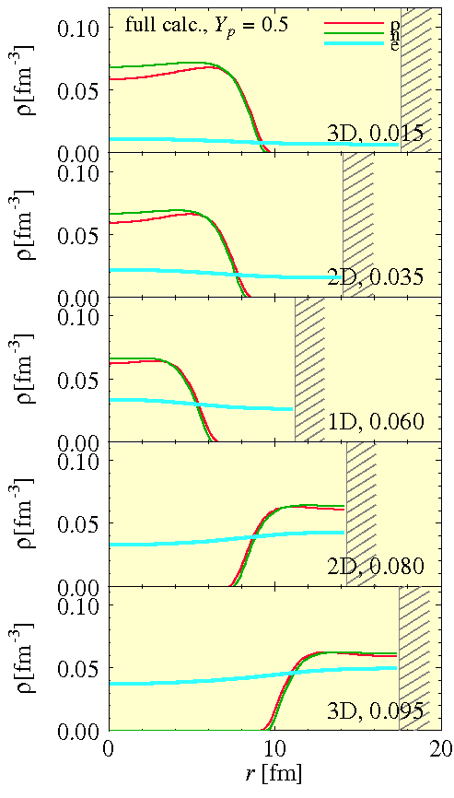
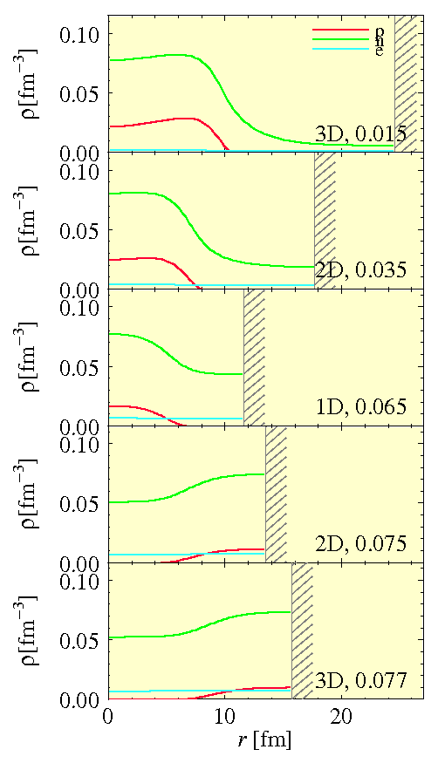
Density profiles in WS cells
Y_{p}=0.5
Y_{p}=0.1
T=0
T=0

Slide 10
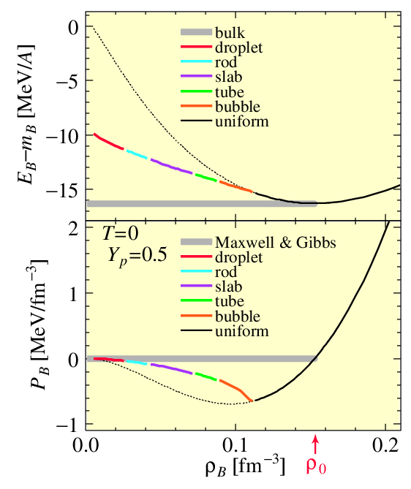
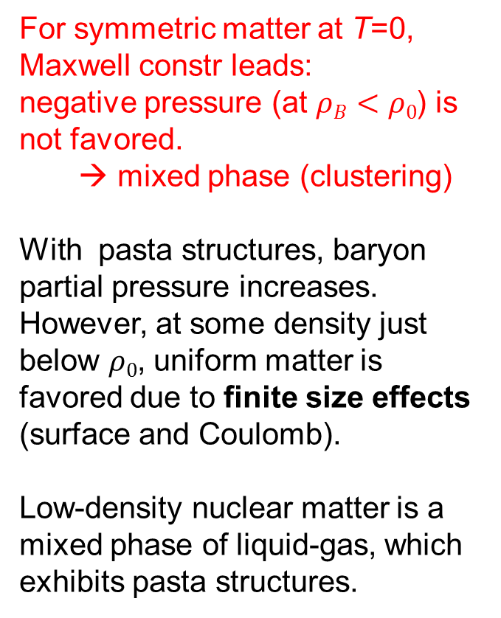
EOS of nuclear matter
Before and after clusterization
For symmetric matter at T=0, Maxwell constr leads:
negative pressure (at $ρB<ρ0$) is not favored.
→ mixed phase (clustering)
With pasta structures, baryon partial pressure increases.
However, at some density just below $ρ0$, uniform matter is favored due to finite size effects (surface and Coulomb).
Low-density nuclear matter is a mixed phase of liquid-gas, which exhibits pasta structures.
10
Notes:
10
10
10
10

Slide 11
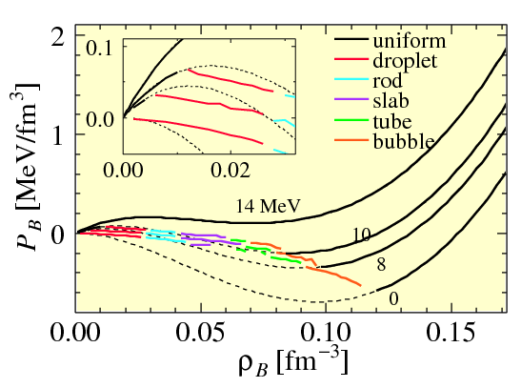
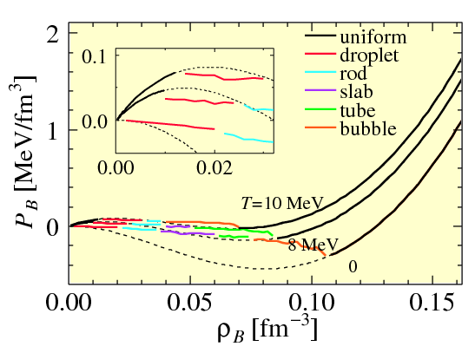
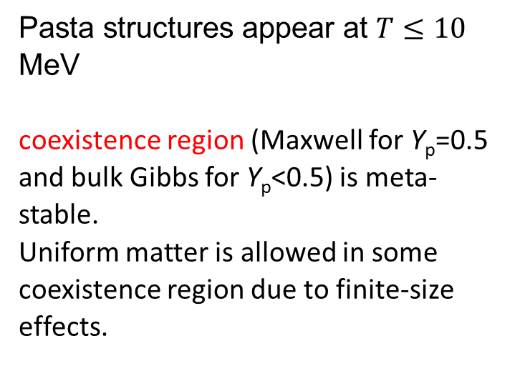
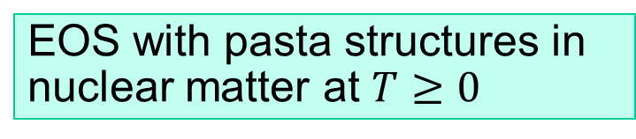
EOS with pasta structures in nuclear matter at $T≥0$
Symmetric matter Y_{p}=0.5
Pasta structures appear at $T≤10$ MeV
coexistence region (Maxwell for Y_{p}=0.5 and bulk Gibbs for Y_{p}<0.5) is meta-stable.
Uniform matter is allowed in some coexistence region due to finite-size effects.
Asymmetric matter Y_{p}=0.3
11
Notes:
11
11

Slide 12
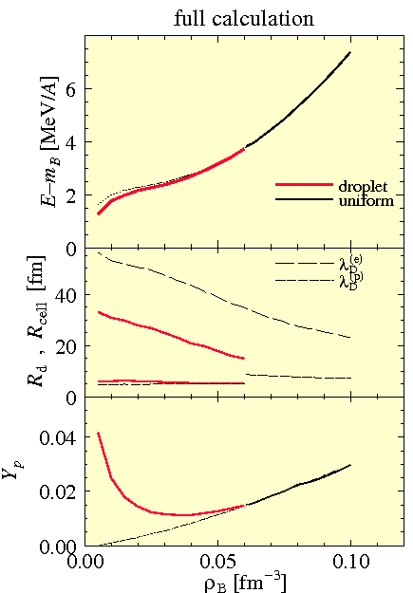
Beta-equilibrium case
T=0
Beta equil.
Only “droplet” structure appears.
The change of EOS due to the non-uniform structure is small.

Slide 13




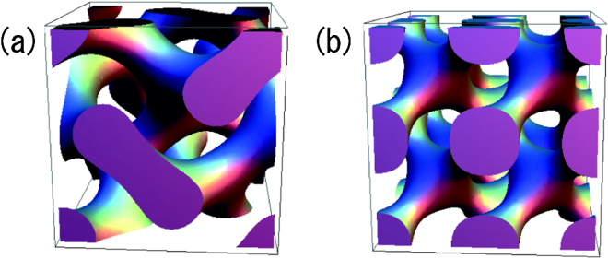
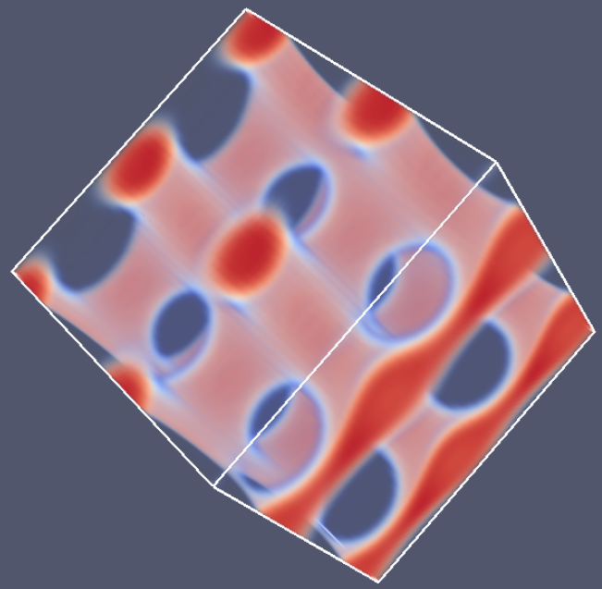
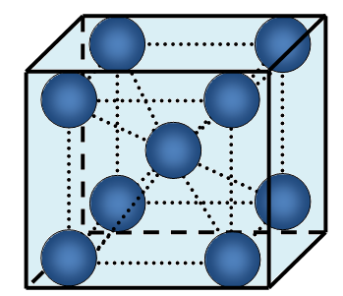
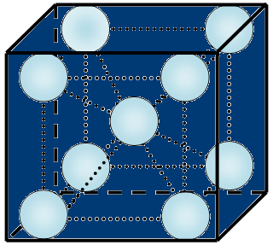
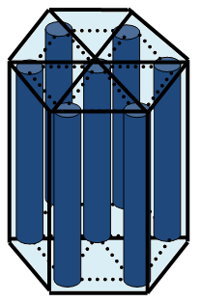
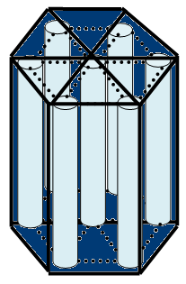
Fully 3 dimensional (3D) calculation
3D
Use of the Wigner-Seitz cell
2D
1D
→ Limitation of emerging structures.
Complex structures were missing
dumbbell
Gyroid
double-
diamond
network
Crystalline structures could not be discussed.
“droplet”
“bubble”
“rod”
“tube”
bcc lattice
Honeycomb

Slide 14
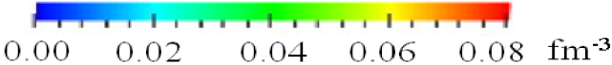
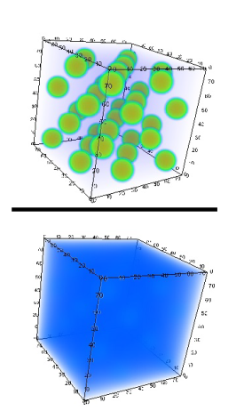
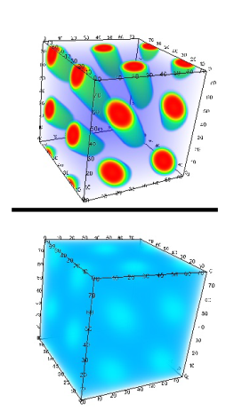
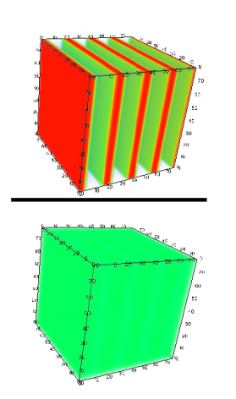
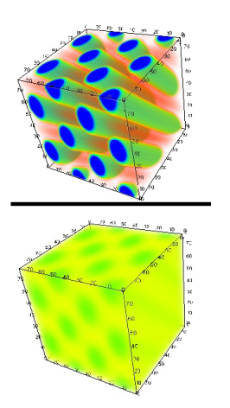
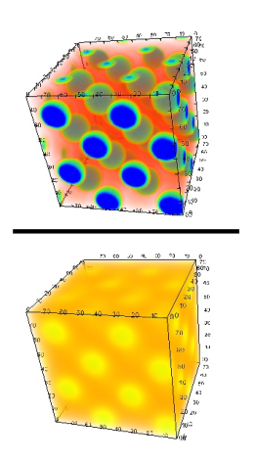
Fully 3D RMF calculations
[Phys.Lett. B713 (2012) 284]
Y_{p} = Z/A = 0.5
proton
electron
“droplet”
[fcc]
ρ_{B} = 0.012 fm⁻³
“rod”
[honeycomb]
0.024 fm⁻³
“slab”
0.05 fm⁻³
“tube” [honeycomb]
0.08 fm⁻³
“bubble”
[fcc]
0.094 fm⁻³

Slide 15
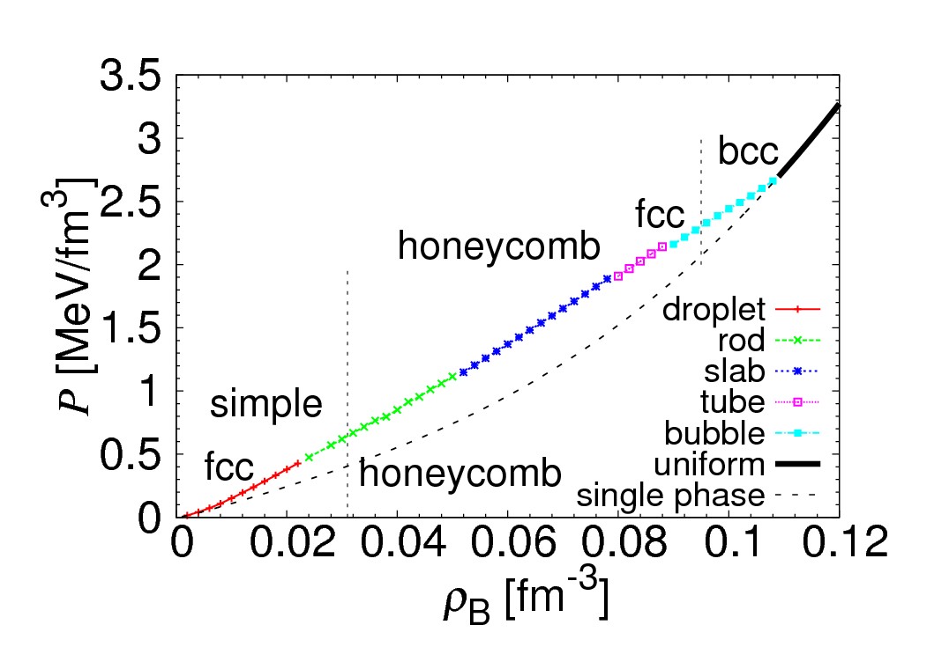
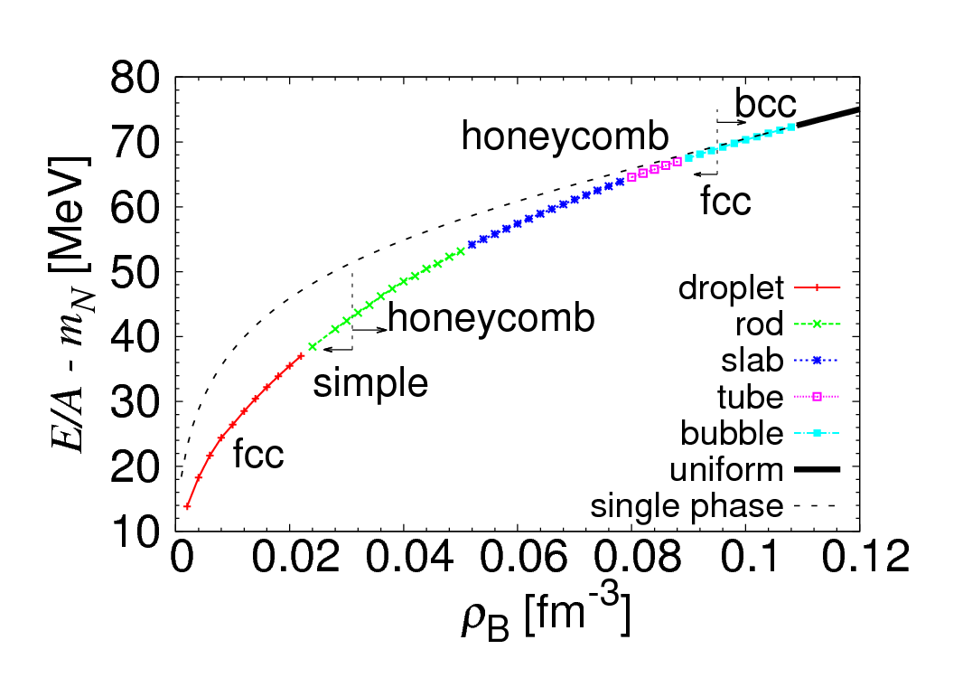
Y_{p} = Z/A = 0.5
EOS has a similar behavior to that of the conventional studies.
Novelty:
fcc lattice of droplets can be the ground state at some density.
← Not the Coulomb interaction among “point particles” but the change of the droplet size is relevant.

Slide 16
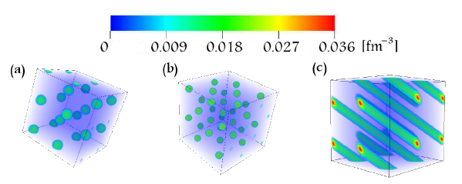
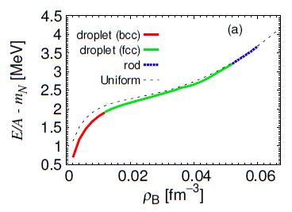
[Phys. Rev. C 88, 025801]
Beta equilibrium case
Slightly different result from
the WS approx.
Crystalline structures bcc & fcc.
Rod phase appears.

Slide 17
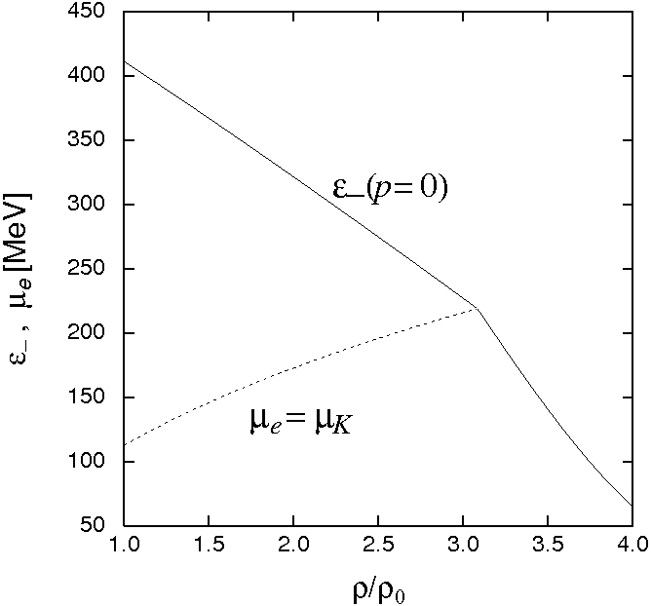
(2) Kaon condensation
[Phys. Rev. C 73, 035802]
K single particle energy (model-independent form)
From a Lagrangian with chiral symmetry
Threshold condition of condensation

Slide 18
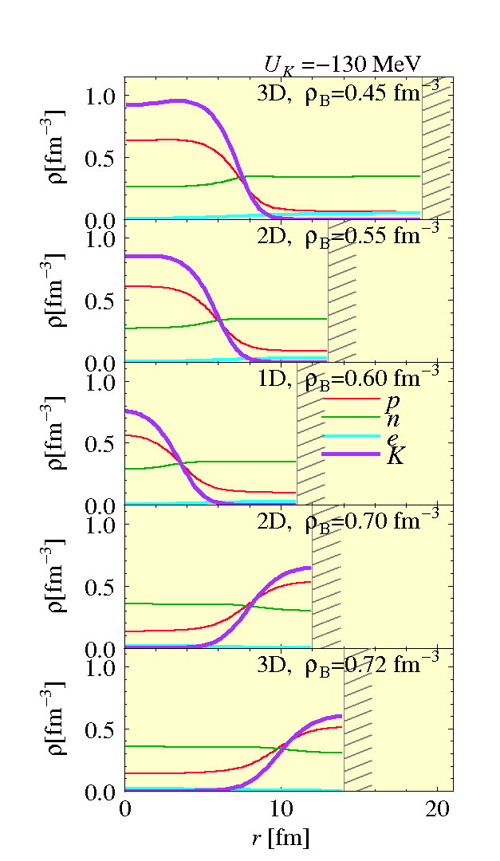
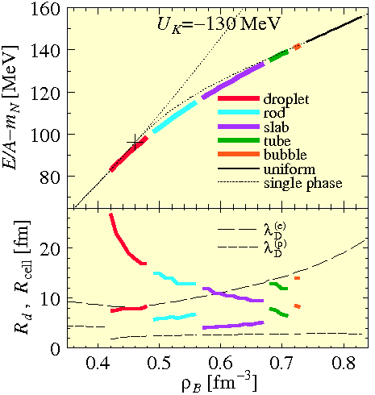
Kaonic pasta structure

Slide 19
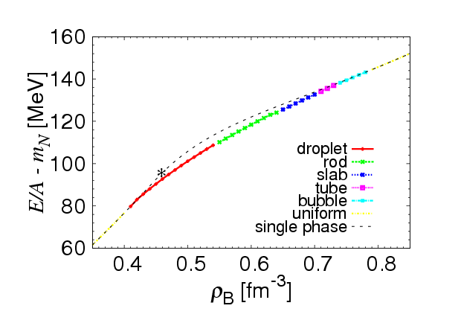
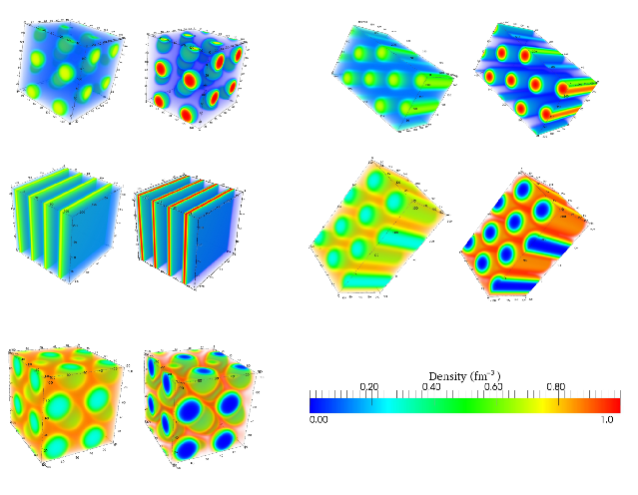





[unpublished yet]
Fully 3D calculation
p
K⁻
p
K⁻
0.45$ρ0$
0.60$ρ0$
0.70$ρ0$
0.72$ρ0$
0.75$ρ0$

Slide 20
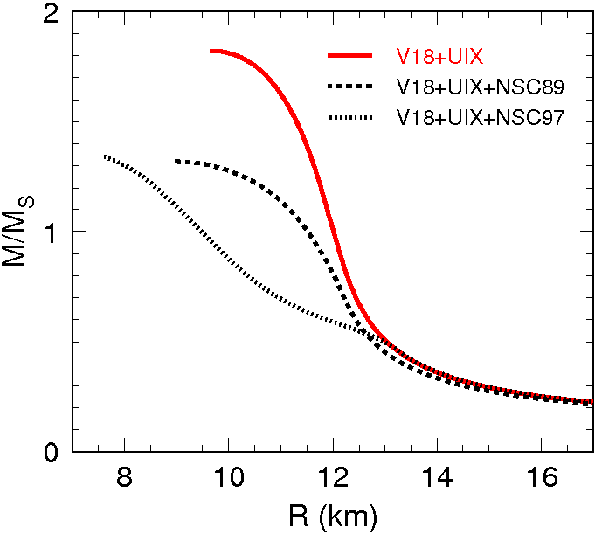
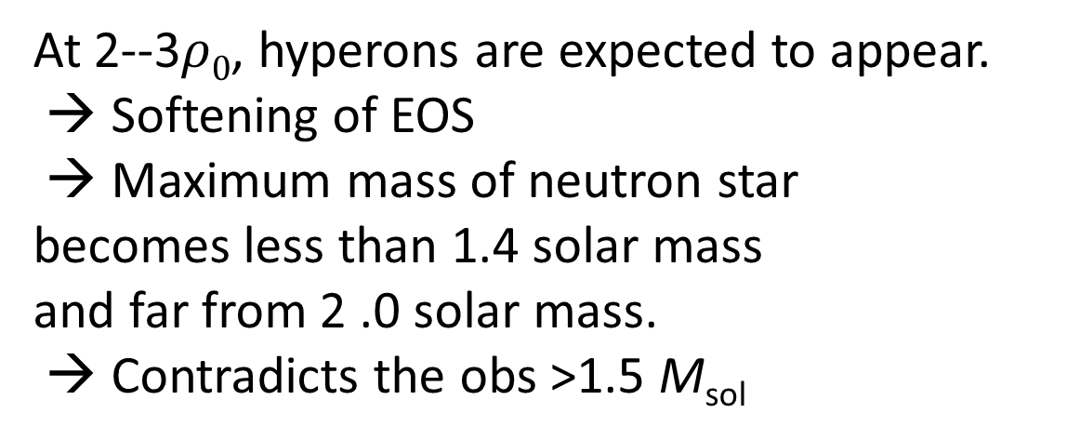
(3) Hadron-quark phase transition
[Phys. Rev. D 76, 123015]
At 2--3$ρ0$, hyperons are expected to appear.
→ Softening of EOS
→ Maximum mass of neutron star
becomes less than 1.4 solar mass
and far from 2 .0 solar mass.
→ Contradicts the obs >1.5 M_{sol}
Schulze et al, PRC73 (2006) 058801

Slide 21
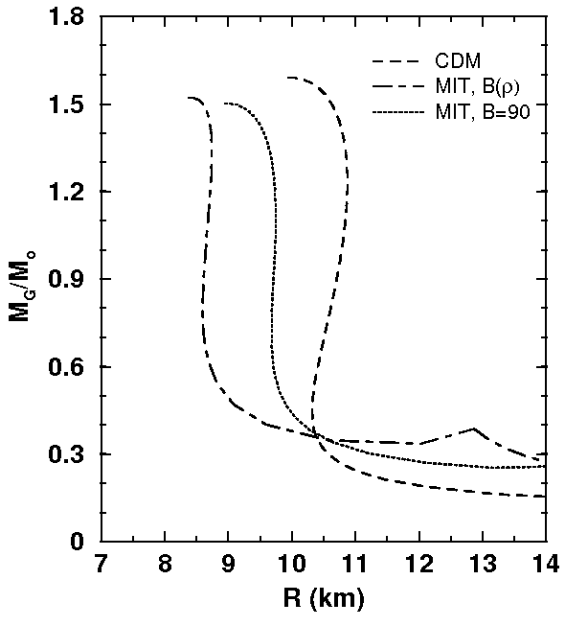
Phase transition to quark matter may solve this problem. [Maieron et al, PRD70 (2004) 043010 etc].
But the existence of mixed phase may soften the EOS again!
Bulk Gibbs calculation yields wide range of mixed phase and large softening [Glendenning, PRD46,1274].
Maxwell construction
Full calculation is important !

Slide 22

Hadron-Quark mixed-phase structure and EOS (T=0)
Assume regularity in structure: divide whole space into equivalent and neutral cells with a geometrical symmetry
(3D: sphere, 2D : cylinder, 1D: plate).
→ Wigner-Seitz cell approx.
Divide a cell into hadron phase and quark phases.
Give a geometry (Unif/Dropl/Rod/...) and a baryon density ρ_{B}.
Solve the field equations numerically. Optimize the cell size and H-Q boundary position (choose the energy-minimum).
Choose an energy-minimum geometry among 7 cases
(Unif H, droplet, rod, slab, tube, bubble, Unif Q).
WS-cell
22
Notes:
22
22
22
22

Slide 23
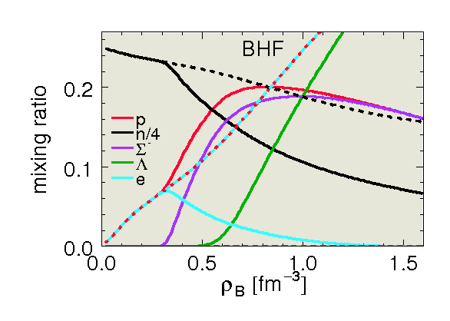
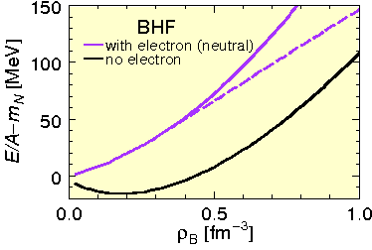
Hadron phase
Brueckner Hartree Fock model
YN scatt data, L-nuclear levels,
and nuclear saturation are fitted.

Slide 24
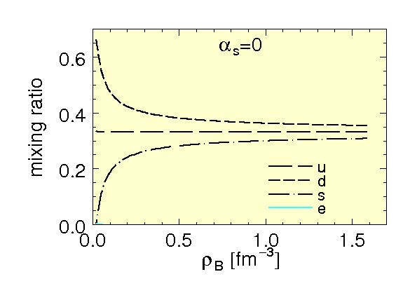
Quark phase
MIT bag model
Electron fraction is very small in quark matter.

Slide 25
Coupled equations
to get density profile, energy, pressure, etc of the system

Slide 26

EOS of matter
Full calculation is between the Maxwell construction (local charge neutral) and the bulk Gibbs calculation (neglects the surface and Coulomb).
Closer to the Maxwell.

Slide 27




Structure of compact stars
TOV equation
Pressure (input of TOV eq.)‏
Density at position $r$
mass inside the position $r$
total mass and radius.
Density profile of a compact star ($M=1.4 M⨀$)‏
Bulk Gbbs
Full calc τ_{surf}=40 MeV/fm²
Maxwell const.
27
Notes:
27

Slide 28

Hyperon suppression
Neutral matter
Without charge-neutrality condition in each phase, hyperons are suppressed.
Neutral matter
→ ρ_{th}=0.34 fm⁻³
Non neutral matter
→ ρ_{th}=1.15 fm⁻³
Charged matter
Mixed phase consists of negative-charged quark phase and positive-charged hadron phase!

Slide 29


Mass-radius relation of a cold neutron star
Full calculation with pasta structures yields similar result to the Maxwell construction.
Maximum masses are almost the same for 3 cases.
We need to improve largely the quark EOS or hadron EOS to get $\sim 2M⨀$
τ_{surf}=40
29
Notes:
29

Slide 30

Another model for quark phase:
Schwinger-Dyson eq.
[ arXiv:1309.1954 ]
[Yasutake, etal, arXiv1309:1954]

Slide 31


EOS of matter with trapped neutrinos.
Y_{l}=0.3

Slide 32

Summary
You should take into account the existence of mixed phases.
Low-density matter:
  Mixed phase from the beginning (from low density).
  Does not affect the structure and mass of neutron stars.
  But important for neutrino emission and crust properties.
Kaon condensation:
  crucial for the structure and mass of neutron stars.
  Depends on the kaons potential.
Hadron-quark mixed phase:
  crucial for the structure and mass of neutron stars.
  Surface tension is unknown.
  strong surface tension → larger size
    → charge neutrality → closer to Maxwell
  weak surface tension → smaller size
    → Coulomb ineffective → closer to bulk Gibbs

