Slide 1

Masses of “black widow” systems:
why high values
should not be a surprise
J.E. Horvath,
IAG – USP
São Paulo, Brazil
with O. Benvenuto & M.A. De Vito (La Plata)

Slide 2
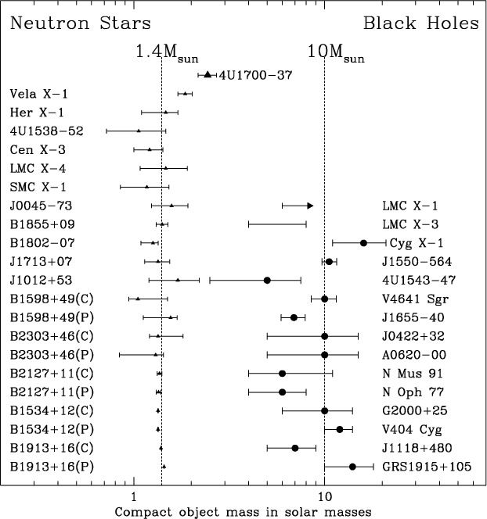
Once upon a time the idea of a single mass scale was
firmly rooted in the community
Figure from
Clark et al.
A&A 392, 909 (2002)
Consistent with 1.4 M

Slide 3
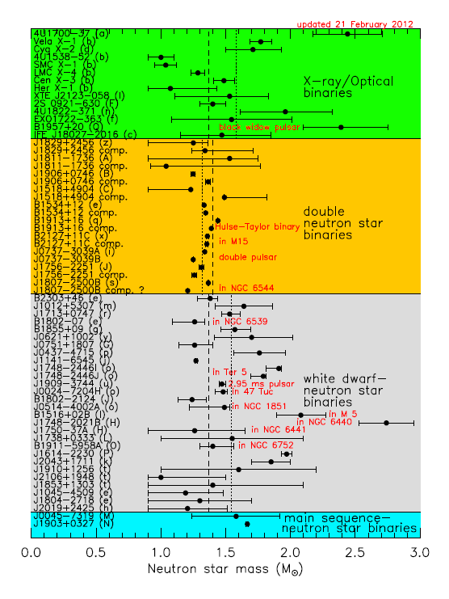
However, the newest
evidence points towards
a much wider range
of masses
Sample compiled by
Lattimer et al 2012,
available at
http://www.stellarcollapse.org/nsmasses

Slide 4
Bayesian analysis (Valentim, Rangel & Horvath, MNRAS 414,
1427, 2011) points out that one mass scale is unlikely, the
distribution is more complex. Within a double gaussian scenario,
two masses are present : 1.37 and 1.73 M (by the way, exactly what
Woosley & collab. predicted long time ago...)
Other works finding the same pattern:
Zhang et al. A&A 527, A83, 2011
Özel et al., ApJ 757, 55, 2012 (1.33 and 1.48 M)
Kiziltan, Kottas & Thorsett, 2013 (1.35 and 1.55 M)
Is the high value related to the size of the Fe core? (jump @ 18 M)
Are some of them born as such, massive ?
Accretion role dominating the high-mass sample? Stay tuned...

Slide 5
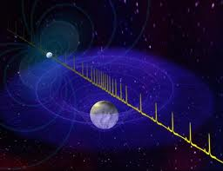
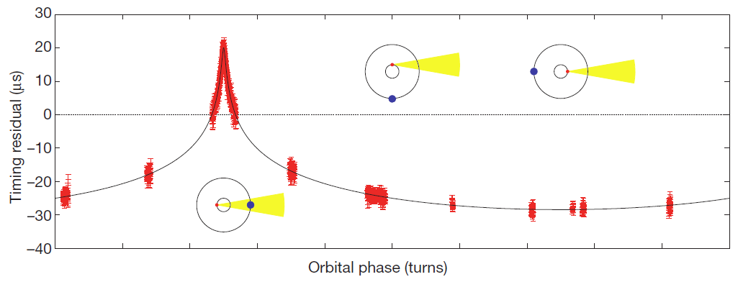
Demorest et al 2010: a NS with M~ 2 M measuring the Shapiro delay
“clean” measurement
widely accepted

Slide 6

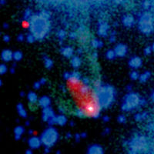
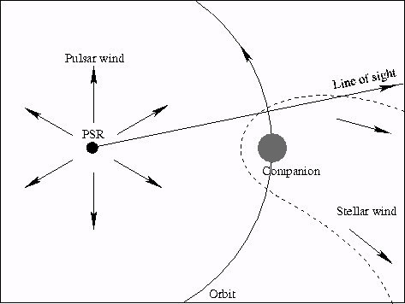
1982: Backer et al. discovered the first member of the ms
pulsar class RECYCLED BY ACCRETION?
1988: Fruchter, Stinebring & Taylor (Nature 333, 237, 1988) found an eclipsing pulsar with a very low mass companion, the hypothesis of ablation wind quickly follows
Original sketch of the PSR 1957+20 system
Composite Image from Chandra (2012)

Slide 7
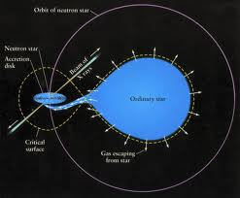
“Black widow” pulsars
Relatives of the accreting X-ray binaries…
LMXRB
and others
Many ms
pulsars in
binaries

Slide 8
M. Roberts, arXiv:1210.6903

Slide 9
Last members of the zoo (~ 30 detected members):
PSR J1719-1438 (Bailes et al., Science 333, 1717, 2011)
Extremely low mass companion, yet high mean density
ρ > 23 g cm⁻³ for it
PSR J1311-3430 (Romani et al. , ApJ 760, L36, 2012)
similar system, but with extremely low hydrogen
abundance for the donor n_{H} < 10⁻⁵

Slide 10



How are these ultra-compact systems formed and evolve?
(Benvenuto, De Vito & Horvath ApJL 753, L33, 2012)
primary (NS) ; secondary (donor)
Onset of Roche Lobe Overflow (RLOF) of the donor , Paczynski
Accreted by the NS,
always<

Slide 11

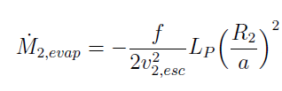


In general, β < 1 and angular momentum is lost
from the system. The exact value of β is not critical for
evolution (but keep an eye on it !!!)
1st ingredient
(Ritter, A&A 202, 93, 1988)
Evaporating wind
2nd ingredient
(Stevens et al., MNRAS 254, 19, 1992 )
with
Irradiation feedback
3rd ingredient
(Bunning & Ritter, A&A 423, 281, 2004
Hameury)

Slide 12
Later: ablation by
the wind
Initial accreting
phase (close binary)

Slide 13




All three effects incorporated into an adaptative Henyey
code, solving simultaneously structure and orbital evolution
(Benvenuto & De Vito, 2003 ; De Vito & Benvenuto, 2012)
must be in the “right” range to explain the
observed systems
If is too short (< 0.5 d), the mass transfer would start at ZAMS
If is too long (> 0.9 d), the orbit widens when donor is ~0.3 M
not the observed “black widow” state !
If is too small, mass transfer would be > age universe
If is too high, mass transfer is unstable (Podsiadlowski et al)
Started calculations right after the NS formation
CAVEAT !!!, just an hypothesis

Slide 14
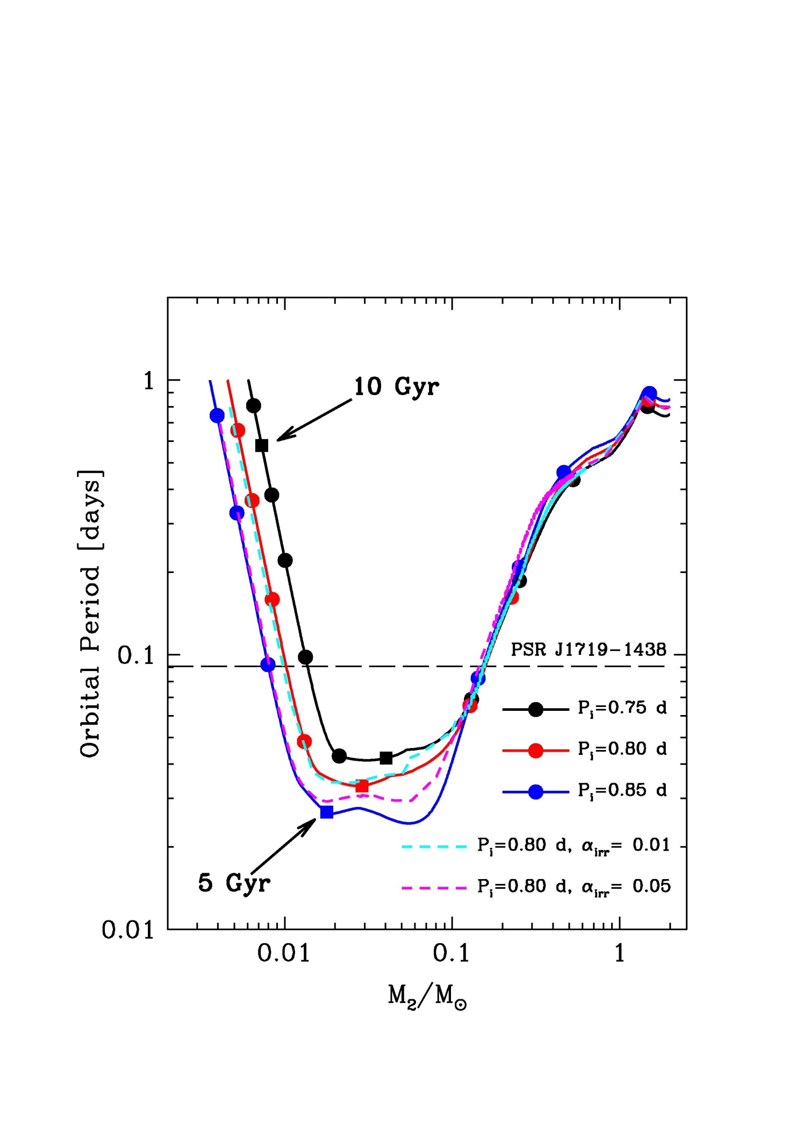
At slightly larger initial
periods, the secondary
detaches at high mass
and do not produce
“black widow” systems
PSR J1719-1438
Low –inclination
solutions apply
Accretion
dominant
Donor becomes degenerate

Slide 15
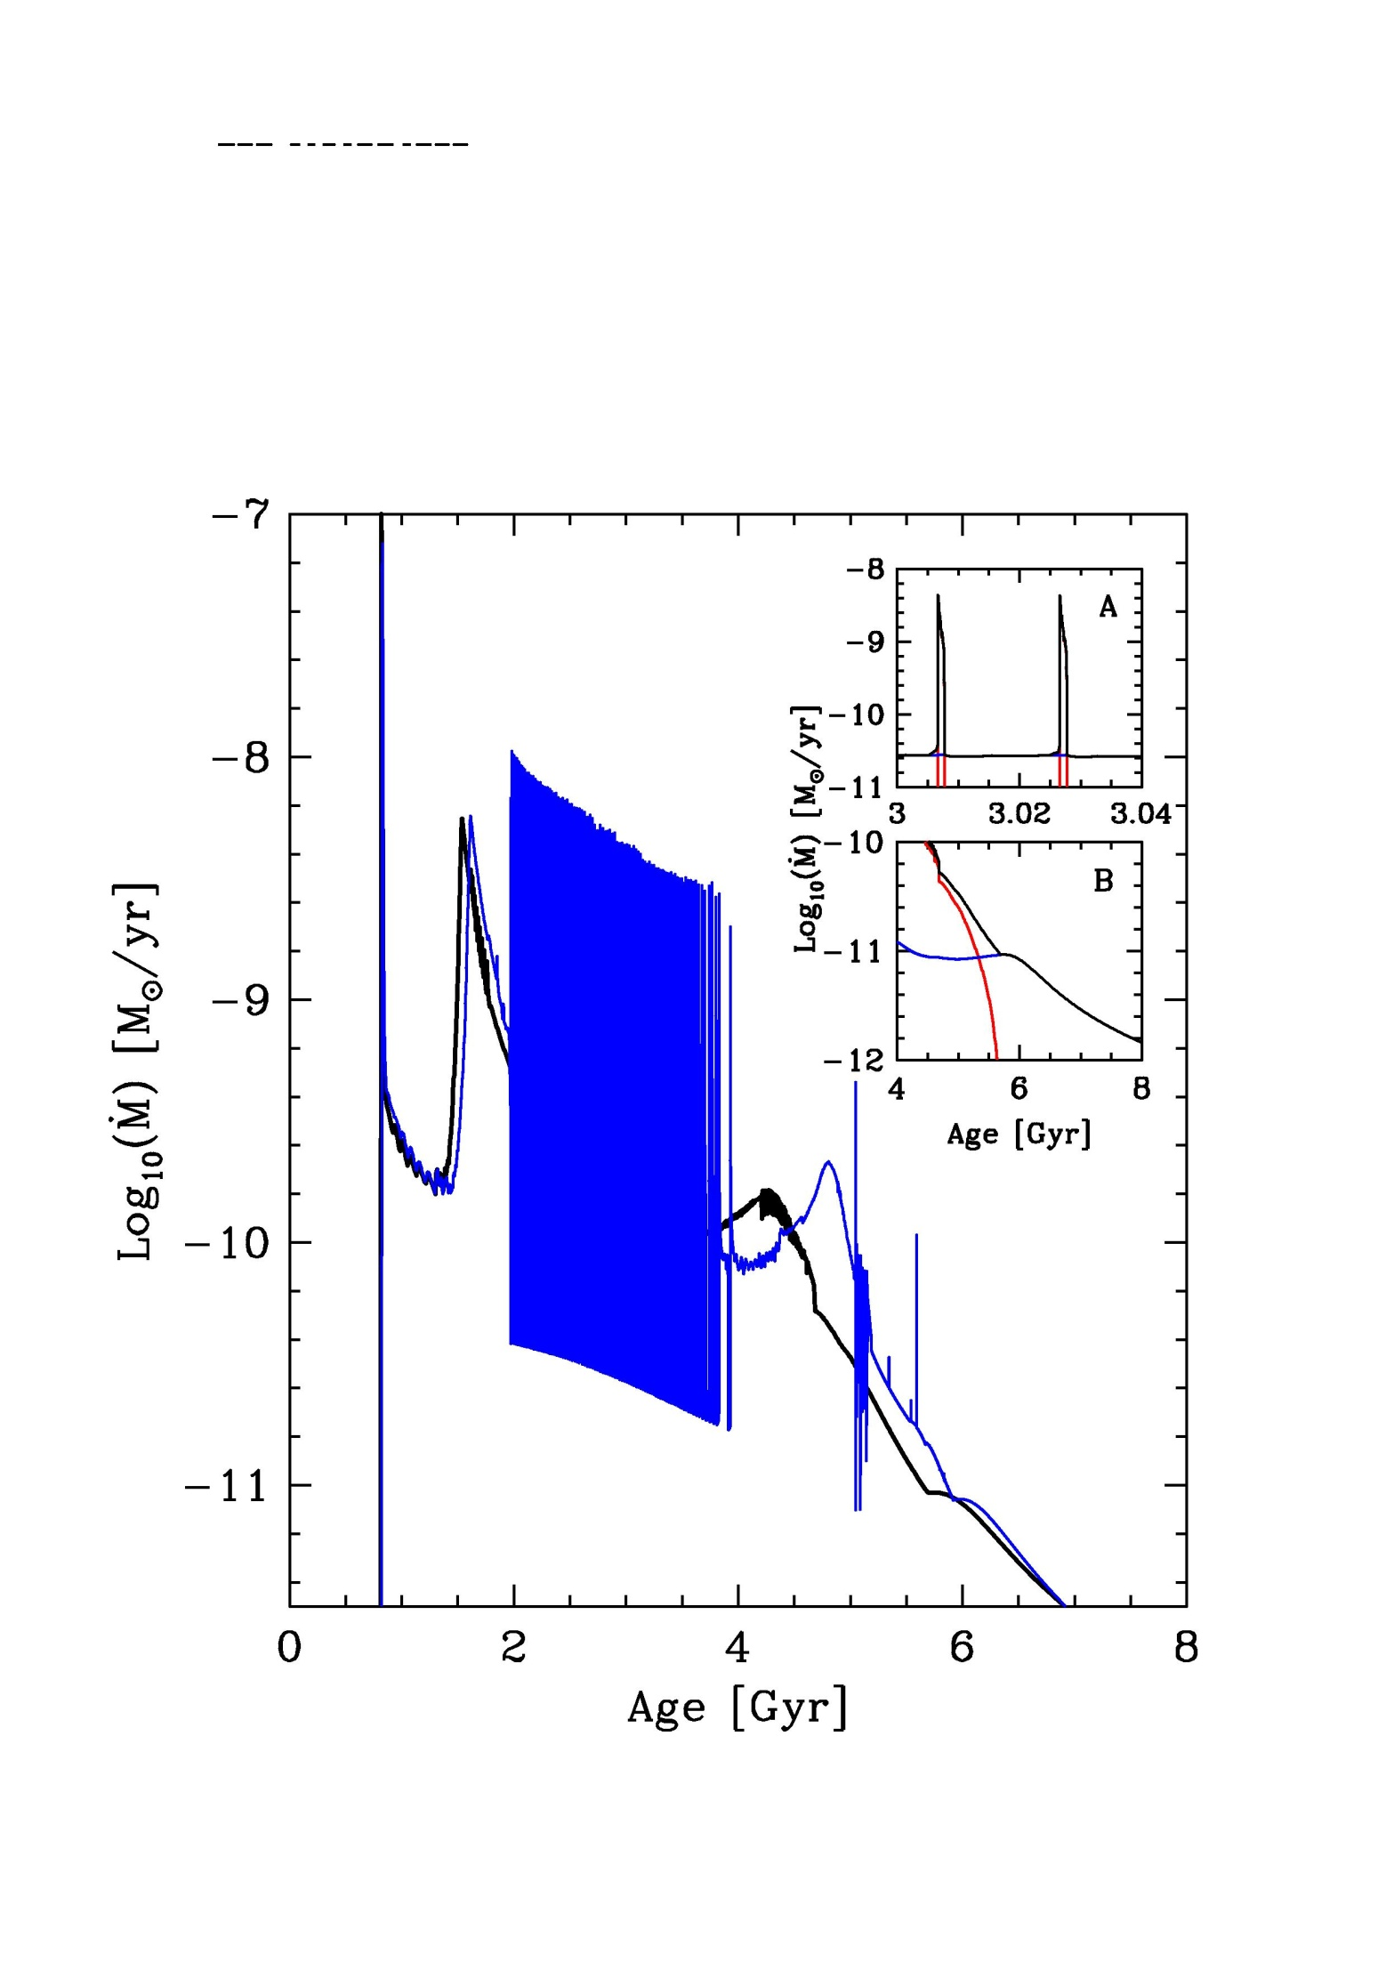
PSR J1719-1438
The system goes
back and forth
from accretion to
isolation at
intermediate mass
(redback stage !)
Not a numerical
instability

Slide 16
The original “black widow” PSR 1957+20: new results
(van Kerkwijk, Breton & Kulkarni, ApJ 728, 95, 2011)
Mpsr/M₂ ~ 70 (through spectral lines, radial velocity)
M_{psr} = 2.4 ± 0.12 M
(M_{psr} > 1.66 M very firm)
Romani et al. (ApJ 760, L36, 2012) found three high values
for the neutron star in PSR J1311-3430, depending on the
interpretation M_{psr}> 2.1 M up to ~ 3 M
(similar to the Antoniadis et al. technique)

Slide 17
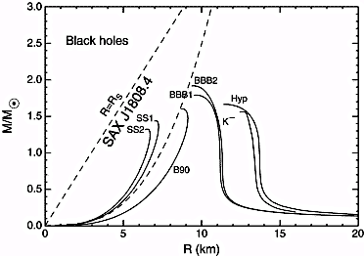

Slide 19
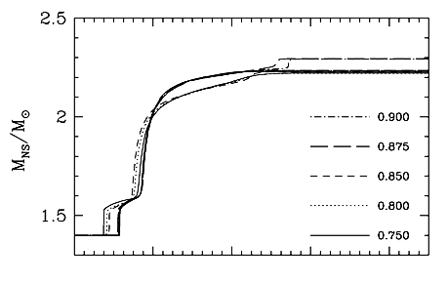
Self-consistent calculations of the PSR J1311-3430 system
require such high values to reach the observed state
Calculations for several values of the initial period,
and fixed accretion efficiency β of 50%

Slide 20
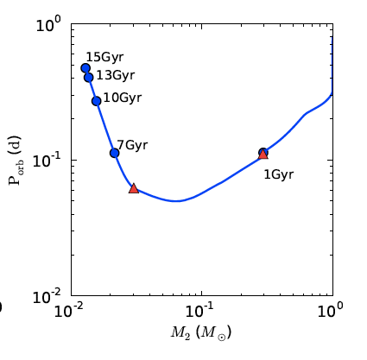
Conclusions
* Ultra-compact “black widow” pulsar systems result
from a bifurcation in parameter space, in this
sense they follow a new evolutionary path.
*
* The role of winds+irradiation is crucial : RLOF alone
would not produce anything like PSR J1719-1438 or
PSR J1311-3430 The full parameter space needs exploration,
but we can state that PSR masses emerging are consistently
very large because this is required to locate them where
they are currently observed
Evolution supports high masses
Important for the final
pulsar mass, but high
*
*
Chen, Chen, Tauris & Han 2013

Slide 21
Danken !

