Slide 1


Slide 2
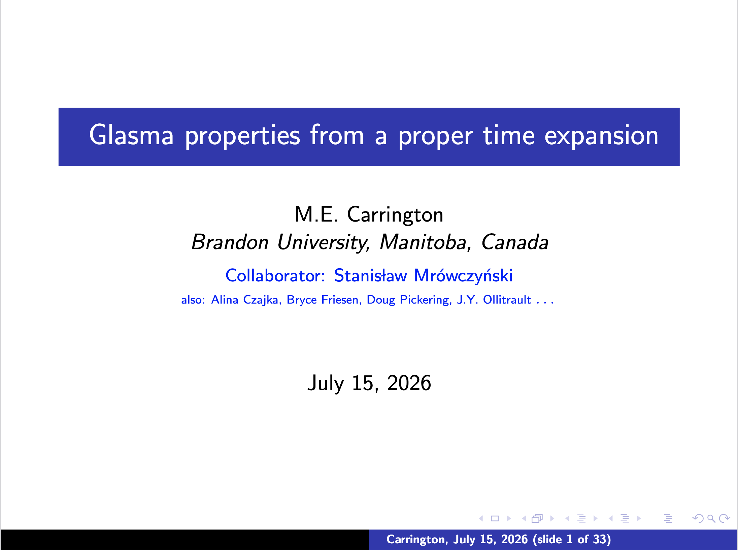
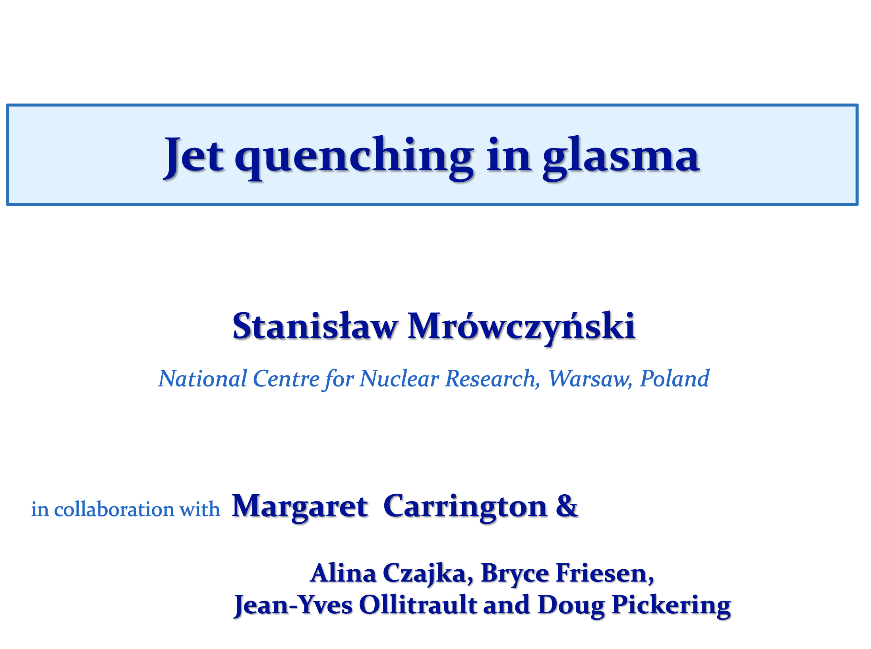


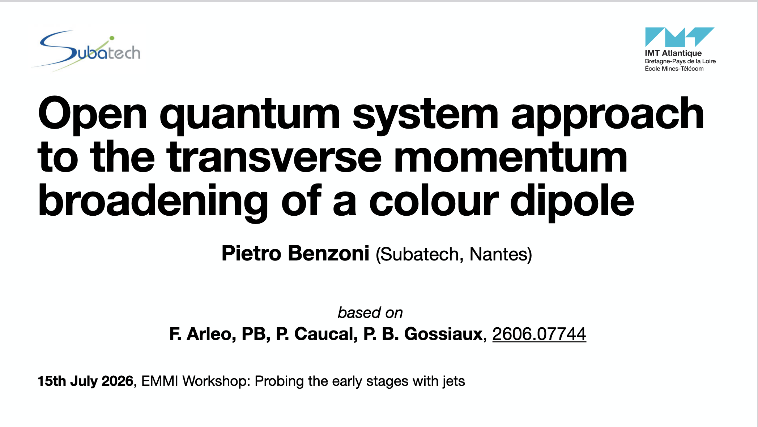

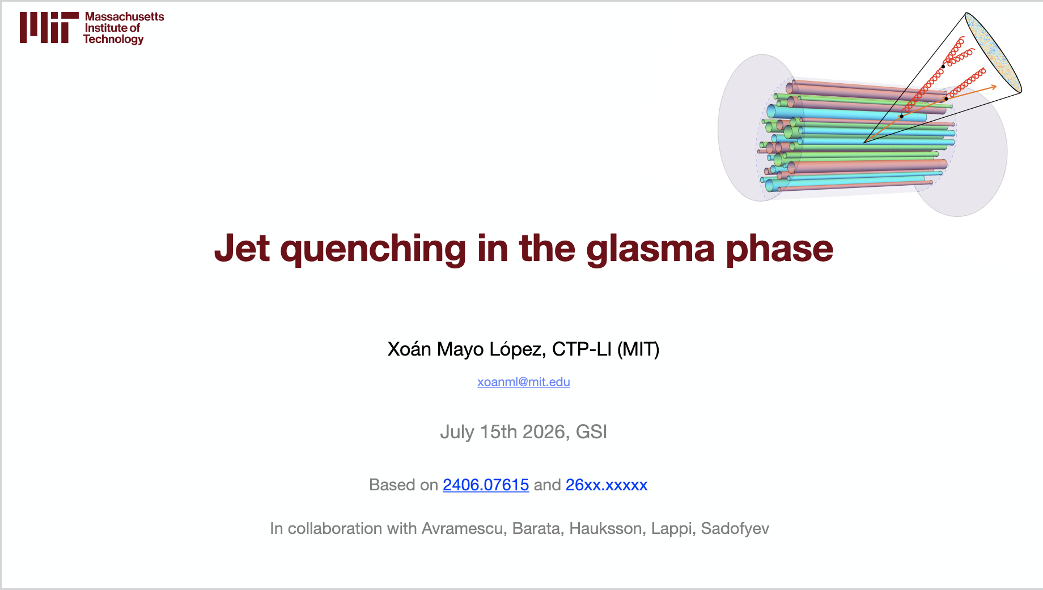


Slide 3
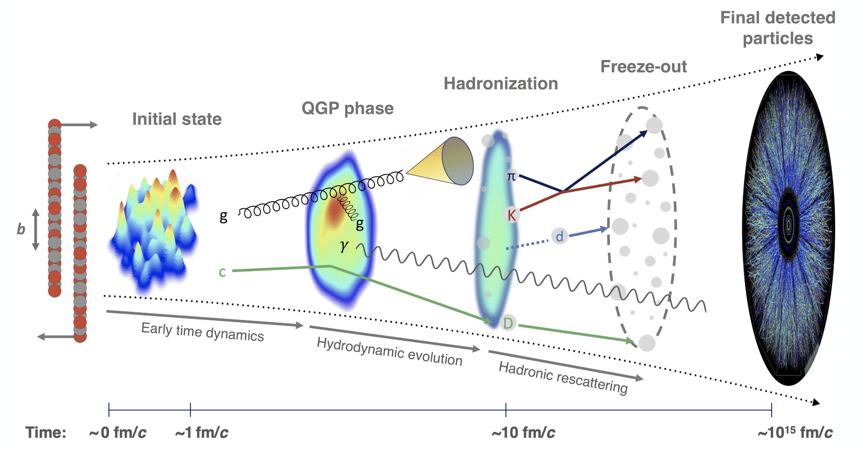
What do we understand by now about the energy loss during the very first moments after HIC and beyond?
How can we access that in experiment? What suggestions do we have on the two sides?
What is the most pressing missing element in our description of the matter in HIC?

