Slide 1
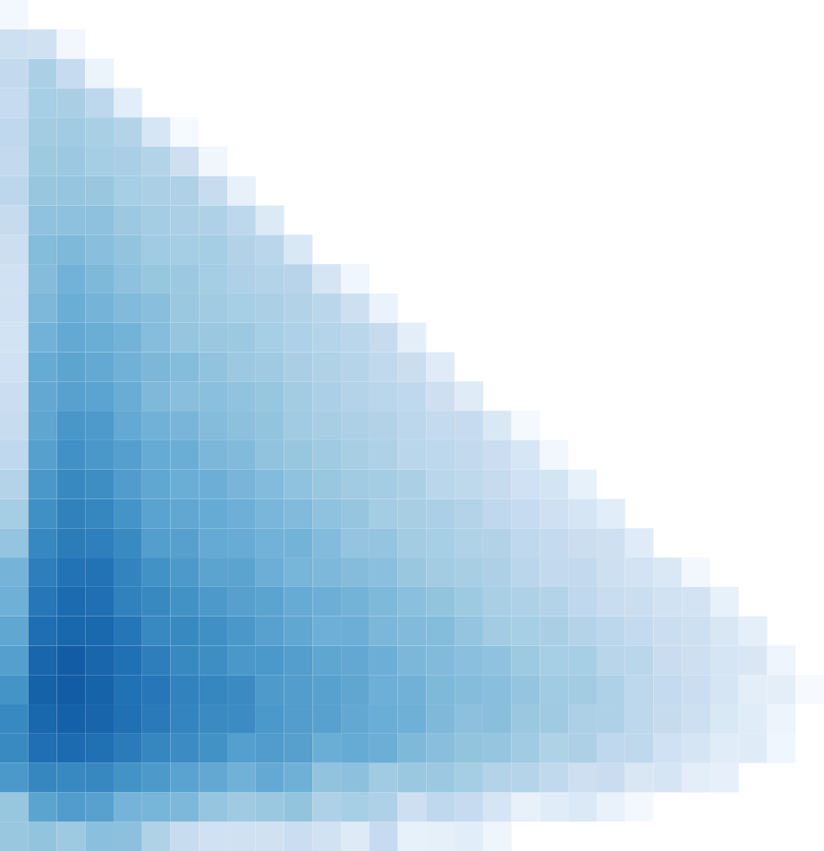

Deriving a parton shower for jet thermalization in QCD plasmas
[I. Soudi, AT 2510.25837, 2607.xxxx]
Adam Takacs
CERN TH,
University of Bergen
EMMI Workshop: Probing the early stages with jet quenching (July 13-17), Darmstadt 2026

Slide 2
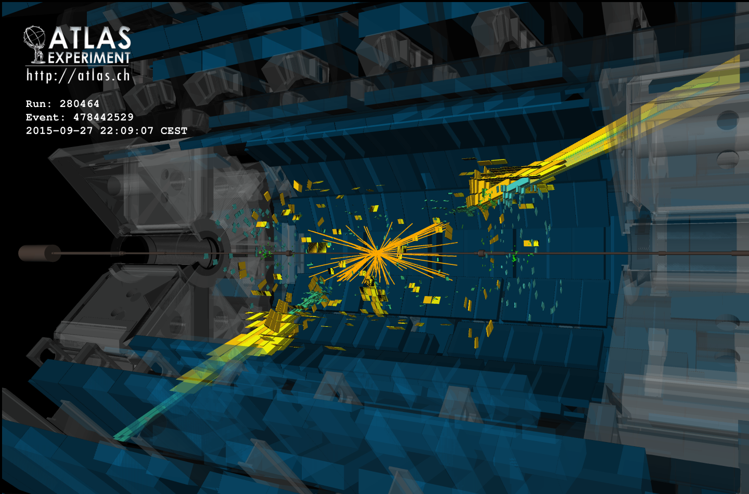
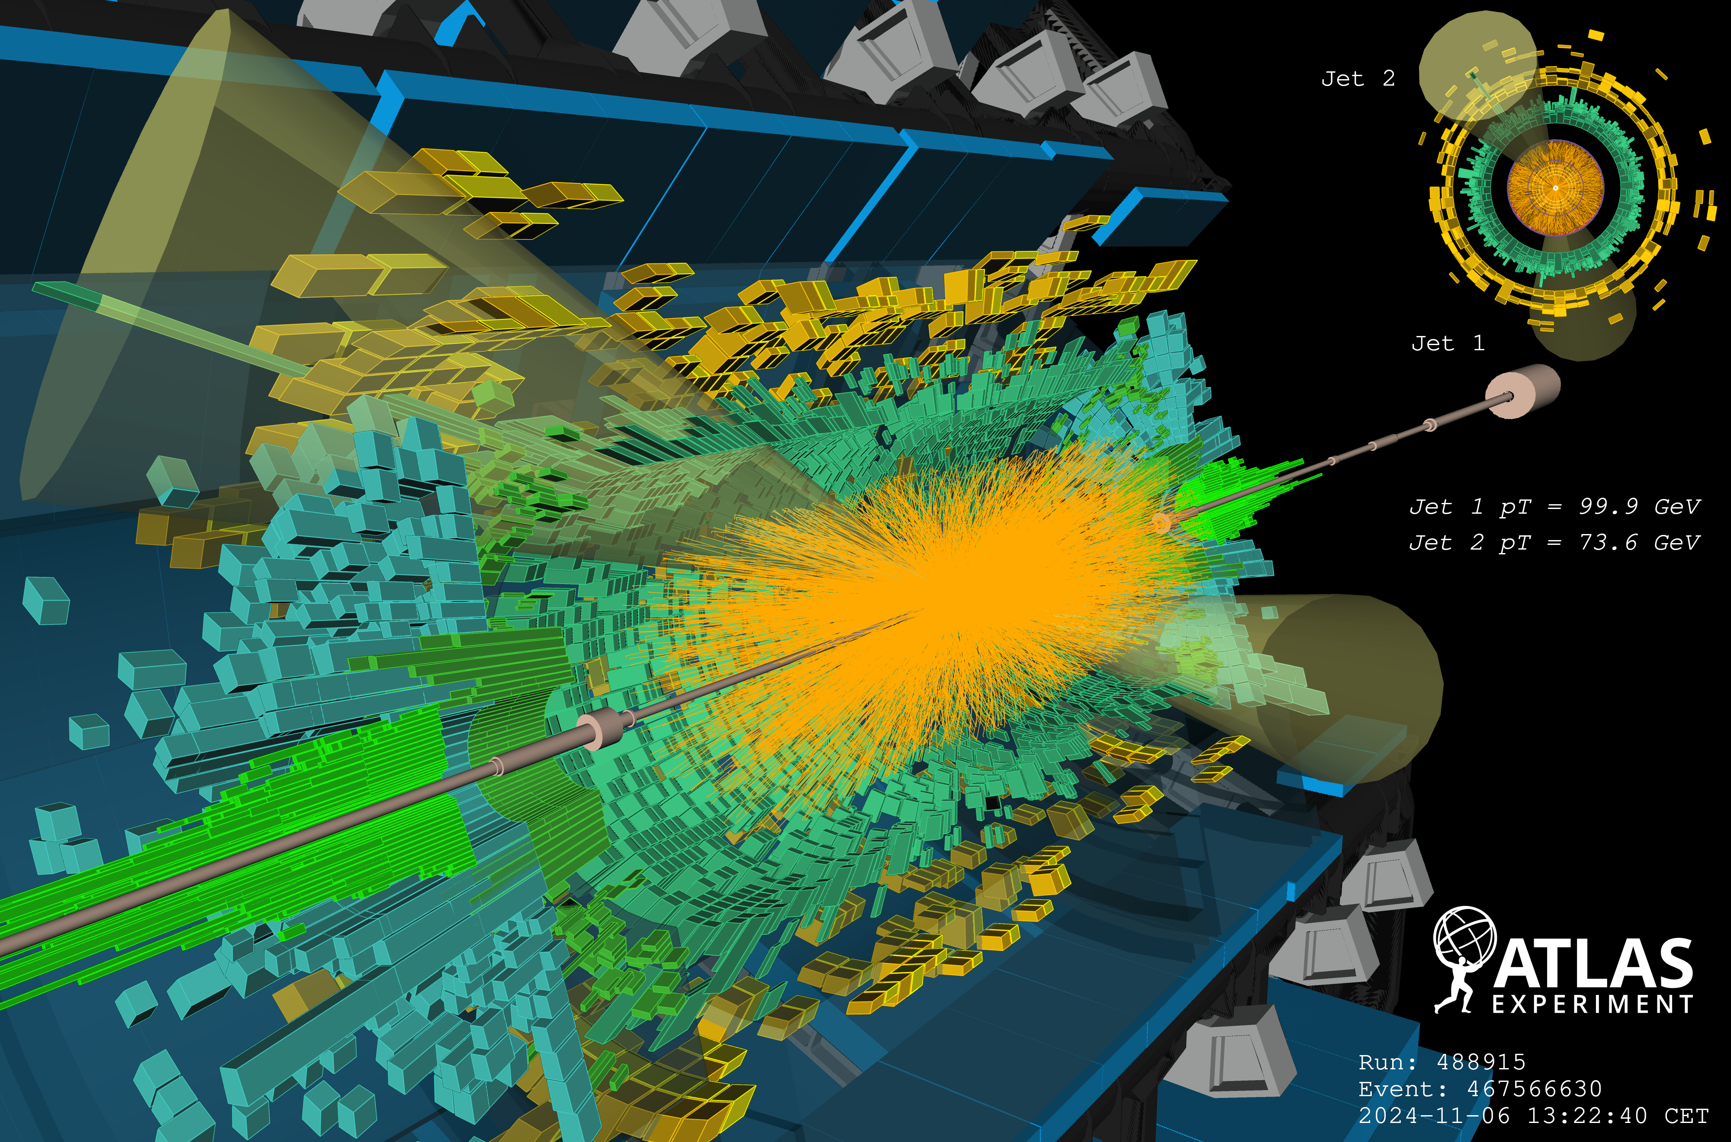
1. Jets in heavy-ion collisions
Adam Takacs (CERN-TH) Early stages 2026, Darmstadt

Slide 3
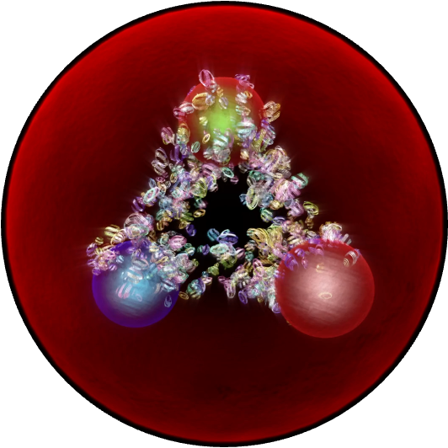
jet₁
1. Jets in heavy-ion collisions
jet₂
Adam Takacs (CERN-TH) Early stages 2026, Darmstadt

Slide 4

Scattering amplitudes in the QGP
Separate fields to hard and bkg. ($q=q_{h}+q_{0}$, $A=A_{h}+A_{0}$)
$ℒ_{QCD}\left(q,A\right)=ℒ\left(q_{h},A_{h}\right)+ℒ\left(q_{0},A_{0}\right)+ℒ_{int}\left(q_{h},A_{h},q_{0},A_{0}\right)$
$≈ℒ\left(q_{h},A_{h}\right)+g{\overline{q}}_{h}\hat{𝒥}q_{h}+gA_{h}\hat{𝒥}A_{h}$
Dressed propagators (and vertices):
Models for the background $\left\langle \hat{𝒥}\left(x^{μ}\right){\hat{𝒥}}^{+}\left(y^{μ}\right)\right\rangle$:
        High-temperature plasma ($T≫Λ_{QCD}$)
        Color charge distribution
        Non-perturbative “kernel”
⇽ integrating out soft
degrees of freedom
=
+
+
+ …
effective,
in-medium
Feynman rules
$$⊗$$
$$⊗$$
$$⊗$$
=
+
+
+ …
$$⊗$$
$$⊗$$
$$⊗$$
Adam Takacs (CERN-TH) Early stages 2026, Darmstadt

Slide 5


Scattering amplitudes in the QGP
Separate fields to hard and bkg. ($q=q_{h}+q_{0}$, $A=A_{h}+A_{0}$)
$ℒ_{QCD}\left(q,A\right)=ℒ\left(q_{h},A_{h}\right)+ℒ\left(q_{0},A_{0}\right)+ℒ_{int}\left(q_{h},A_{h},q_{0},A_{0}\right)$
$≈ℒ\left(q_{h},A_{h}\right)+g{\overline{q}}_{h}\hat{𝒥}q_{h}+gA_{h}\hat{𝒥}A_{h}$
Dressed propagators (and vertices):
Models for the background $\left\langle \hat{𝒥}\left(x^{μ}\right){\hat{𝒥}}^{+}\left(y^{μ}\right)\right\rangle$:
        High-temperature plasma ($T≫Λ_{QCD}$)
        Color charge distribution
        Non-perturbative “kernel”
Goal: $\left\langle 1,2…n|AA\right\rangle$
⇽ integrating out soft
degrees of freedom
A
1
=
+
+
2
+ …
effective,
in-medium
Feynman rules
$$⊗$$
$$⊗$$
$$⊗$$
=
+
+
+ …
…
$$⊗$$
$$⊗$$
$$⊗$$
A
n
Adam Takacs (CERN-TH) Early stages 2026, Darmstadt

Slide 6
Scattering amplitudes in the QGP
Separate fields to hard and bkg. ($q=q_{h}+q_{0}$, $A=A_{h}+A_{0}$)
$ℒ_{QCD}\left(q,A\right)=ℒ\left(q_{h},A_{h}\right)+ℒ\left(q_{0},A_{0}\right)+ℒ_{int}\left(q_{h},A_{h},q_{0},A_{0}\right)$
$≈ℒ\left(q_{h},A_{h}\right)+g{\overline{q}}_{h}\hat{𝒥}q_{h}+gA_{h}\hat{𝒥}A_{h}$
Dressed propagators (and vertices):
Models for the background $\left\langle \hat{𝒥}\left(x^{μ}\right){\hat{𝒥}}^{+}\left(y^{μ}\right)\right\rangle$:
        High-temperature plasma ($T≫Λ_{QCD}$)
        Color charge distribution
        Non-perturbative “kernel”
⇽ integrating out soft
degrees of freedom
=
+
+
+ …
effective,
in-medium
Feynman rules
$$⊗$$
$$⊗$$
$$⊗$$
=
+
+
+ …
$$⊗$$
$$⊗$$
$$⊗$$
Adam Takacs (CERN-TH) Early stages 2026, Darmstadt

Slide 7
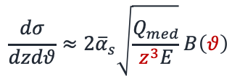


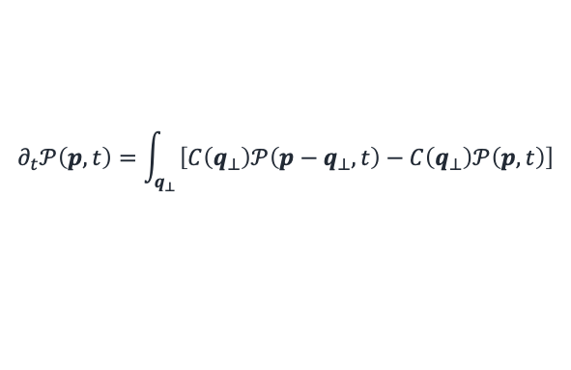





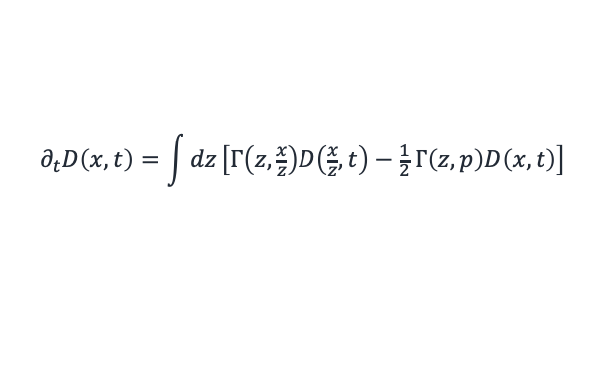
Example: jets in large medium
[Blaizot, Dominguez, Iancu, Mehtar-Tani]
[Casalderrey-Solana, Mehtar-Tani, Tywoniuk, Salgado]
[Caucal, Iancu, Mueller, Soyez]
Broadening: (in vacuum straight line $δ_{ij}δ\left(p−p′\right)$)
Evolution equation for mom. distr:
Radiation: medium-induced (+ vacuum)
Wide-angle medium-induced cascade:
Cascade evolution:
2
2
$$\frac{dσ}{dzdθ}≈{2\overline{α}}_{s}\sqrt{\frac{Q_{med}}{z^{3}E}}B\left(θ\right)$$
$$≈ 𝒢_{ij}\left(p^{′},p,L\right)$$
$$⟹$$
$$⊗$$
$$⊗$$
$$⊗$$
$$⊗$$
changing color
and momentum
$$⊗$$
$$⊗$$
$$⊗$$
Medium ($k_{t} \sim Q_{med}$, $z≪Q_{med}/E$):
soft & collin. pole
$$∂_{t}𝒫\left(p,t\right)=\int_{q_{⊥}}{\left[C\left(q_{⊥}\right)𝒫\left(p−q_{⊥},t\right)−C\left(q_{⊥}\right)𝒫\left(p,t\right)\right]}$$
2
2
(+ mixing with
jet evolution!)
$$⟹$$
+
+ ...
“time”
mom. distribution
scattering rate
virtual term
$$⊗$$
$$⊗$$
$$⊗$$
$$⊗$$
$$⊗$$
$$⊗$$
$$⊗$$
$$⊗$$
$$≈\hat{q} ∂_{p}^{2}𝒫\left(p,t\right)$$
$$∂_{t}D\left(x,t\right)=\int{dz}\left[Γ\left(z,\frac{x}{z}\right)D\left(\frac{x}{z},t\right)−\frac{1}{2} Γ\left(z,p\right)D\left(x,t\right)\right]$$
diffusion approx.
$$q≪p$$
“time”
BDMPS-Z
splitting rate
FF
virtual term
Adam Takacs (CERN-TH) Early stages 2026, Darmstadt

Slide 8
Example: jets in large medium
[Blaizot, Dominguez, Iancu, Mehtar-Tani]
[Casalderrey-Solana, Mehtar-Tani, Tywoniuk, Salgado]
[Caucal, Iancu, Mueller, Soyez]
Broadening: (in vacuum straight line $δ_{ij}δ\left(p−p′\right)$)
Evolution equation for mom. distr:
Radiation: medium-induced (+ vacuum)
Wide-angle medium-induced cascade:
Cascade evolution:
2
2
$$\frac{dσ}{dzdθ}≈{2\overline{α}}_{s}\sqrt{\frac{Q_{med}}{z^{3}E}}B\left(θ\right)$$
$$≈ 𝒢_{ij}\left(p^{′},p,L\right)$$
$$⟹$$
$$⊗$$
$$⊗$$
$$⊗$$
$$⊗$$
changing color
and momentum
$$⊗$$
$$⊗$$
$$⊗$$
Medium ($k_{t} \sim Q_{med}$, $z≪Q_{med}/E$):
soft & collin. pole
$$∂_{t}𝒫\left(p,t\right)=\int_{q_{⊥}}{\left[C\left(q_{⊥}\right)𝒫\left(p−q_{⊥},t\right)−C\left(q_{⊥}\right)𝒫\left(p,t\right)\right]}$$
2
2
(+ mixing with
jet evolution!)
$$⟹$$
+
+ ...
“time”
mom. distribution
scattering rate
virtual term
$$⊗$$
$$⊗$$
$$⊗$$
$$⊗$$
$$⊗$$
$$⊗$$
$$⊗$$
$$⊗$$
$$≈\hat{q} ∂_{p}^{2}𝒫\left(p,t\right)$$
$$∂_{t}D\left(x,t\right)=\int{dz}\left[Γ\left(z,\frac{x}{z}\right)D\left(\frac{x}{z},t\right)−\frac{1}{2} Γ\left(z,p\right)D\left(x,t\right)\right]$$
diffusion approx.
$$q≪p$$
“time”
BDMPS-Z
splitting rate
FF
virtual term
Adam Takacs (CERN-TH) Early stages 2026, Darmstadt

Slide 9
Example: jets in large medium
[Blaizot, Dominguez, Iancu, Mehtar-Tani]
[Casalderrey-Solana, Mehtar-Tani, Tywoniuk, Salgado]
[Caucal, Iancu, Mueller, Soyez]
Broadening: (in vacuum straight line $δ_{ij}δ\left(p−p′\right)$)
Evolution equation for mom. distr:
Radiation: medium-induced (+ vacuum)
Wide-angle medium-induced cascade:
Cascade evolution:
2
2
$$\frac{dσ}{dzdθ}≈{2\overline{α}}_{s}\sqrt{\frac{Q_{med}}{z^{3}E}}B\left(θ\right)$$
$$≈ 𝒢_{ij}\left(p^{′},p,L\right)$$
$$⟹$$
$$⊗$$
$$⊗$$
$$⊗$$
$$⊗$$
changing color
and momentum
$$⊗$$
$$⊗$$
$$⊗$$
Medium ($k_{t} \sim Q_{med}$, $z≪Q_{med}/E$):
soft & collin. pole
$$∂_{t}𝒫\left(p,t\right)=\int_{q_{⊥}}{\left[C\left(q_{⊥}\right)𝒫\left(p−q_{⊥},t\right)−C\left(q_{⊥}\right)𝒫\left(p,t\right)\right]}$$
2
2
(+ mixing with
jet evolution!)
$$⟹$$
+
+ ...
“time”
mom. distribution
scattering rate
virtual term
$$⊗$$
$$⊗$$
$$⊗$$
$$⊗$$
$$⊗$$
$$⊗$$
$$⊗$$
$$⊗$$
$$≈\hat{q} ∂_{p}^{2}𝒫\left(p,t\right)$$
$$∂_{t}D\left(x,t\right)=\int{dz}\left[Γ\left(z,\frac{x}{z}\right)D\left(\frac{x}{z},t\right)−\frac{1}{2} Γ\left(z,p\right)D\left(x,t\right)\right]$$
diffusion approx.
$$q≪p$$
“time”
BDMPS-Z
splitting rate
FF
virtual term
Adam Takacs (CERN-TH) Early stages 2026, Darmstadt

Slide 10
Example: jets in large medium
[Blaizot, Dominguez, Iancu, Mehtar-Tani]
[Casalderrey-Solana, Mehtar-Tani, Tywoniuk, Salgado]
[Caucal, Iancu, Mueller, Soyez]
Broadening: (in vacuum straight line $δ_{ij}δ\left(p−p′\right)$)
Evolution equation for mom. distr:
Radiation: medium-induced (+ vacuum)
Wide-angle medium-induced cascade:
Cascade evolution:
2
2
$$\frac{dσ}{dzdθ}≈{2\overline{α}}_{s}\sqrt{\frac{Q_{med}}{z^{3}E}}B\left(θ\right)$$
$$≈ 𝒢_{ij}\left(p^{′},p,L\right)$$
$$⟹$$
$$⊗$$
$$⊗$$
$$⊗$$
$$⊗$$
changing color
and momentum
$$⊗$$
$$⊗$$
$$⊗$$
Medium ($k_{t} \sim Q_{med}$, $z≪Q_{med}/E$):
soft & collin. pole
$$∂_{t}𝒫\left(p,t\right)=\int_{q_{⊥}}{\left[C\left(q_{⊥}\right)𝒫\left(p−q_{⊥},t\right)−C\left(q_{⊥}\right)𝒫\left(p,t\right)\right]}$$
2
2
(+ mixing with
jet evolution!)
$$⟹$$
+
+ ...
“time”
mom. distribution
scattering rate
virtual term
$$⊗$$
$$⊗$$
$$⊗$$
$$⊗$$
$$⊗$$
$$⊗$$
$$⊗$$
$$⊗$$
$$≈\hat{q} ∂_{p}^{2}𝒫\left(p,t\right)$$
$$∂_{t}D\left(x,t\right)=\int{dz}\left[Γ\left(z,\frac{x}{z}\right)D\left(\frac{x}{z},t\right)−\frac{1}{2} Γ\left(z,p\right)D\left(x,t\right)\right]$$
diffusion approx.
$$q≪p$$
“time”
BDMPS-Z
splitting rate
FF
virtual term
Adam Takacs (CERN-TH) Early stages 2026, Darmstadt

Slide 11
Example: jets in large medium
[Blaizot, Dominguez, Iancu, Mehtar-Tani]
[Casalderrey-Solana, Mehtar-Tani, Tywoniuk, Salgado]
[Caucal, Iancu, Mueller, Soyez]
Broadening: (in vacuum straight line $δ_{ij}δ\left(p−p′\right)$)
Evolution equation for mom. distr:
Radiation: medium-induced (+ vacuum)
Wide-angle medium-induced cascade:
Cascade evolution:
2
2
$$\frac{dσ}{dzdθ}≈{2\overline{α}}_{s}\sqrt{\frac{Q_{med}}{z^{3}E}}B\left(θ\right)$$
$$≈ 𝒢_{ij}\left(p^{′},p,L\right)$$
$$⟹$$
$$⊗$$
$$⊗$$
$$⊗$$
$$⊗$$
changing color
and momentum
$$⊗$$
$$⊗$$
$$⊗$$
Medium ($k_{t} \sim Q_{med}$, $z≪Q_{med}/E$):
soft & collin. pole
$$∂_{t}𝒫\left(p,t\right)=\int_{q_{⊥}}{\left[C\left(q_{⊥}\right)𝒫\left(p−q_{⊥},t\right)−C\left(q_{⊥}\right)𝒫\left(p,t\right)\right]}$$
2
2
(+ mixing with
jet evolution!)
$$⟹$$
+
+ ...
“time”
mom. distribution
scattering rate
virtual term
$$⊗$$
$$⊗$$
$$⊗$$
$$⊗$$
$$⊗$$
$$⊗$$
$$⊗$$
$$⊗$$
$$≈\hat{q} ∂_{p}^{2}𝒫\left(p,t\right)$$
$$∂_{t}D\left(x,t\right)=\int{dz}\left[Γ\left(z,\frac{x}{z}\right)D\left(\frac{x}{z},t\right)−\frac{1}{2} Γ\left(z,p\right)D\left(x,t\right)\right]$$
diffusion approx.
$$q≪p$$
“time”
BDMPS-Z
splitting rate
FF
virtual term
Adam Takacs (CERN-TH) Early stages 2026, Darmstadt

Slide 12
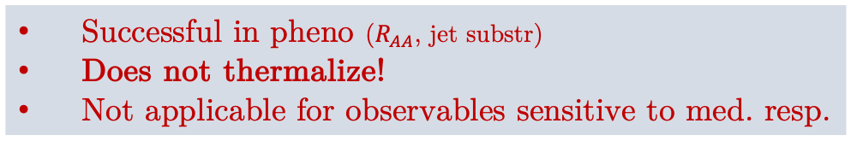
Example: jets in large medium
[Blaizot, Dominguez, Iancu, Mehtar-Tani]
[Casalderrey-Solana, Mehtar-Tani, Tywoniuk, Salgado]
[Caucal, Iancu, Mueller, Soyez]
Broadening: (in vacuum straight line $δ_{ij}δ\left(p−p′\right)$)
Evolution equation for mom. distr:
Radiation: medium-induced (+ vacuum)
Wide-angle medium-induced cascade:
Cascade evolution:
2
2
$$\frac{dσ}{dzdθ}≈{2\overline{α}}_{s}\sqrt{\frac{Q_{med}}{z^{3}E}}B\left(θ\right)$$
$$≈ 𝒢_{ij}\left(p^{′},p,L\right)$$
$$⟹$$
$$⊗$$
$$⊗$$
$$⊗$$
$$⊗$$
changing color
and momentum
$$⊗$$
$$⊗$$
$$⊗$$
Jet evolution in the QGP
Medium ($k_{t} \sim Q_{med}$, $z≪Q_{med}/E$):
soft & collin. pole
$$∂_{t}𝒫\left(p,t\right)=\int_{q_{⊥}}{\left[C\left(q_{⊥}\right)𝒫\left(p−q_{⊥},t\right)−C\left(q_{⊥}\right)𝒫\left(p,t\right)\right]}$$
2
2
(+ mixing with
jet evolution!)
$$⟹$$
+
+ ...
“time”
mom. distribution
scattering rate
virtual term
$$⊗$$
$$⊗$$
$$⊗$$
$$⊗$$
$$⊗$$
$$⊗$$
Successful in pheno ($R_{AA}$, jet substr)
Does not thermalize!
Not applicable for observables sensitive to med. resp.
$$⊗$$
$$⊗$$
$$≈\hat{q} ∂_{p}^{2}𝒫\left(p,t\right)$$
$$∂_{t}D\left(x,t\right)=\int{dz}\left[Γ\left(z,\frac{x}{z}\right)D\left(\frac{x}{z},t\right)−\frac{1}{2} Γ\left(z,p\right)D\left(x,t\right)\right]$$
diffusion approx.
$$q≪p$$
“time”
BDMPS-Z
splitting rate
FF
virtual term
Adam Takacs (CERN-TH) Early stages 2026, Darmstadt

Slide 13
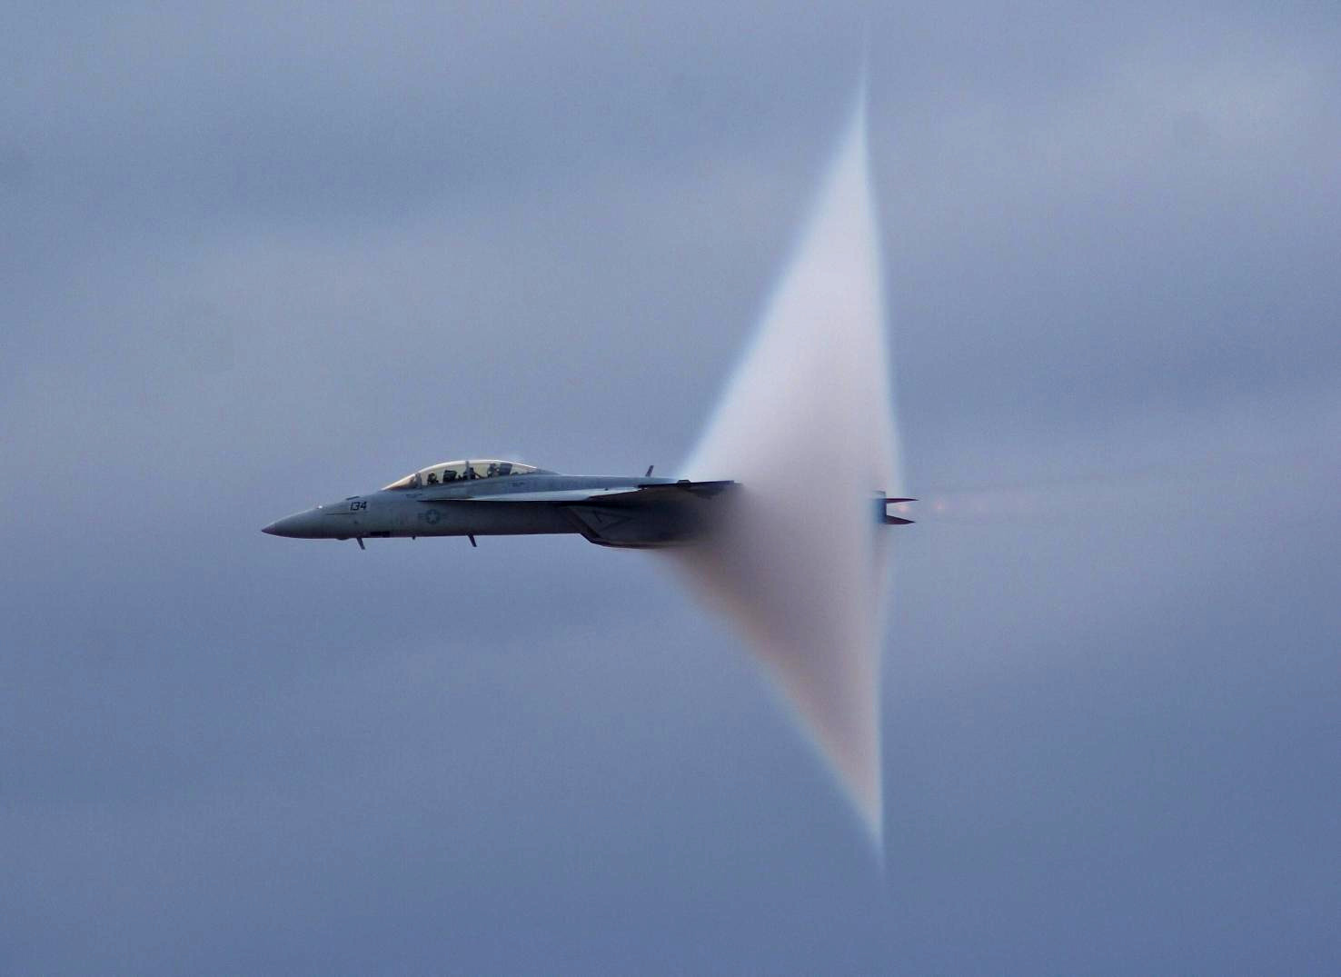
2. Jet thermalization and
Medium response
[Wikipedia]
Adam Takacs (CERN-TH) Early stages 2026, Darmstadt

Slide 14
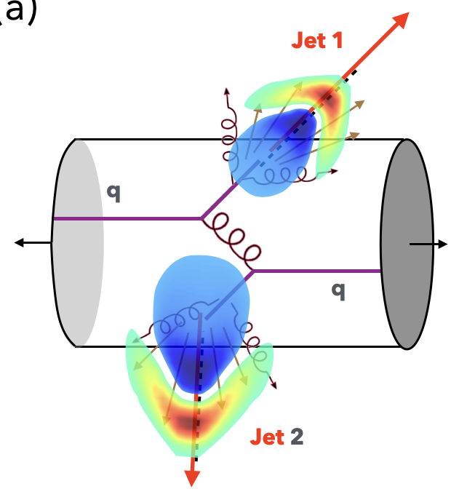

Recent experimental progression
$${\left[\frac{dN_{ch}^{asym}}{d∆η}−\frac{dN_{ch}^{sym}}{d∆η}\right]}_{AA}−{\left[\frac{dN_{ch}^{asym}}{d∆η}−\frac{dN_{ch}^{sym}}{d∆η}\right]}_{pp}$$
2602.19431
Precise measurements on medium response.
There is room for improvement.
Adam Takacs (CERN-TH) Early stages 2026, Darmstadt

Slide 15
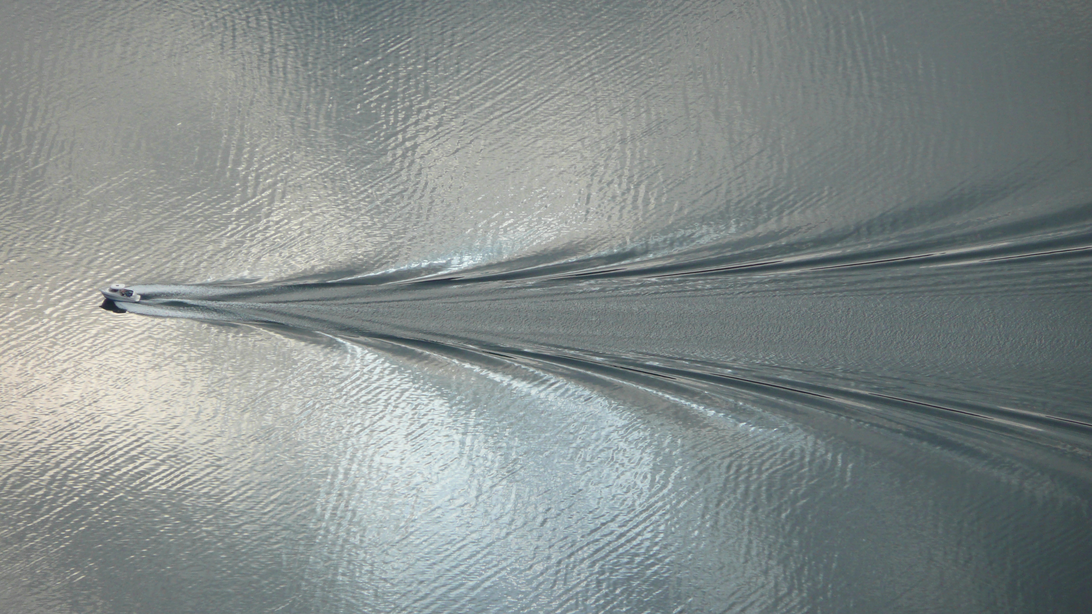
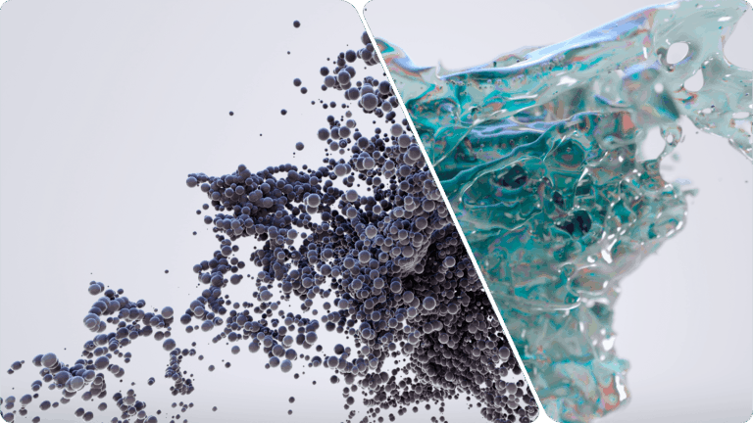


Medium response
In-medium jet evolution
Strongly coupled
Falling string + metric perturbation evolution in AdS/CFT
[Chesler, Yaffe]
In practice: instantaneous freeze-out/hydro
[Hybrid 2010.01140]
$$∂_{ν}T^{μν}=ΔJ^{μ}$$
Weakly coupled
QCD-EKT: thermalization from first principles.
[Arnold,Morre,Yaffe]
[Baier,Mueller,Schiff,Son]
$${(∂}_{t} + v{∙∇}_{x})δf\left(t,x,p\right)={δC}^{2↔2}+{δC}^{1↔2}$$
How EKT is related to jet quenching?
Minijet quenching in AMY-EKT: [Mehtar-Tani,Schlichting,Soudi]
[Brewer,Mazeliauskas,Zhou]
In practice: few scatterings + hydro.
[JEWEL, LBT, Hybrid (w Moliere)]
Adam Takacs (CERN-TH) Early stages 2026, Darmstadt

Slide 16

Medium response
In-medium jet evolution
Strongly coupled
Falling string + metric perturbation evolution in AdS/CFT
[Chesler, Yaffe]
In practice: instantaneous freeze-out/hydro
[Hybrid 2010.01140]
$$∂_{ν}T^{μν}=ΔJ^{μ}$$
Weakly coupled
QCD-EKT: thermalization from first principles.
[Arnold,Morre,Yaffe]
[Baier,Mueller,Schiff,Son]
$${(∂}_{t} + v{∙∇}_{x})δf\left(t,x,p\right)={δC}^{2↔2}+{δC}^{1↔2}$$
How EKT is related to jet quenching?
Minijet quenching in AMY-EKT: [Mehtar-Tani,Schlichting,Soudi]
[Brewer,Mazeliauskas,Zhou]
In practice: few scatterings + hydro.
[JEWEL, LBT, Hybrid (w Moliere)]
In this talk: (i) AMY-EKT ↔ jet quenching,
(ii) EKT ↔ parton showers,
(iii) EKT parton shower → med. resp
Adam Takacs (CERN-TH) Early stages 2026, Darmstadt

Slide 17

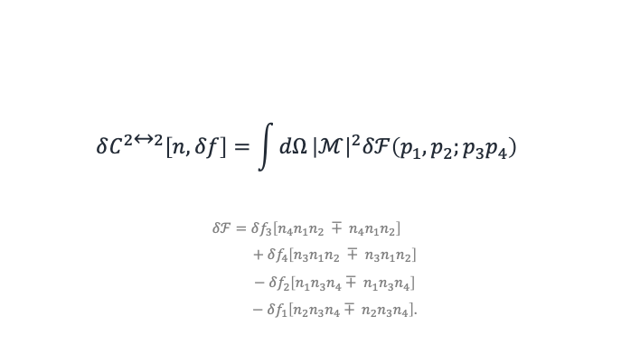

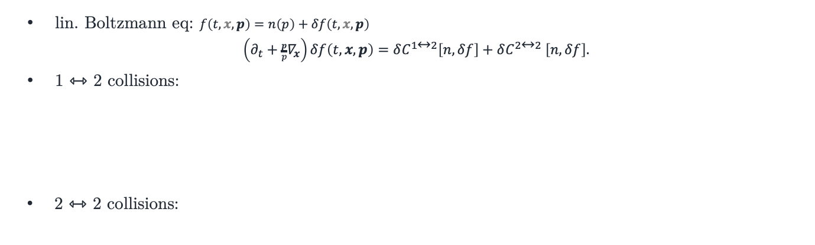

(i) Linearized kinetic theory
lin. Boltzmann eq: $f\left(t,x,p\right)=n\left(p\right)+δf\left(t,x,p\right)$
$\left(∂_{t}+\frac{p}{p}∇_{x}\right)δf\left(t,x,p\right)=δC^{1↔2}\left[n,δf\right]+δC^{2↔2}$ $\left[n,δf\right].$
1 ⇿ 2 collisions:
2 ⇿ 2 collisions:
$$δC^{1↔2}\left[n,δf\right]=\int{dz}\left[\frac{1}{z^{3}}Γ\left(z,\frac{p}{z}\right)δℱ\left(\frac{p}{z};p,\frac{\overline{z}p}{z}\right)−\frac{1}{2}Γ\left(z,p\right)δℱ\left(p;zp,\overline{z}p\right)\right]$$
$$δℱ\left(p,k,p′\right)=δf\left(p\right)\left[\left(1+n\left(k\right)\right)\left(1+n\left(p^{′}\right)\right)−n\left(k\right)n\left(p^{′}\right)\right]$$
$− δf\left(k\right)\left[n(p′) \left(1+n\left(p\right)\right)−\left(1+n\left(p^{′}\right)\right)n(p)\right]$
$− δf\left(p′\right)\left[n(k) \left(1+n\left(p\right)\right)−\left(1+n\left(k\right)\right)n(p)\right]$.
$$\frac{p}{z}$$
$$p$$
$$p$$
$$\frac{p}{z}$$
$$\frac{\overline{z}p}{z}$$
$$\frac{\overline{z}p}{z}$$
$$zp$$
$$p$$
$$p$$
$$zp$$
splitting rate
statistical factors (detailed balance)
$$\overline{z}p$$
$$p$$
$$p$$
$$\overline{z}p$$
$$\frac{p}{z}$$
$$\frac{\overline{z}p}{z}$$
$$\frac{\overline{z}p}{z}$$
$$\frac{p}{z}$$
$$p$$
$$\frac{p}{z}$$
$$\frac{p}{z}$$
$$p$$
Two type of splitting
Merging (holes)
$$\frac{\overline{z}p}{z}$$
$$\frac{\overline{z}p}{z}$$
$$zp$$
$$p$$
$$p$$
$$zp$$
$$δC^{2↔2}\left[n,δf\right]=\int{dΩ}{\left|ℳ\right|}^{2}δℱ\left(p_{1},p_{2};p_{3}p_{4}\right)$$
$$δℱ=δf_{3}\left[n_{4}{\overline{n}}_{1}{\overline{n}}_{2} ∓ {\overline{n}}_{4}n_{1}n_{2}\right]$$
$+ δf_{4}\left[n_{3}{\overline{n}}_{1}{\overline{n}}_{2} ∓ {\overline{n}}_{3}n_{1}n_{2}\right]$
$− δf_{2}\left[n_{1}{\overline{n}}_{3}{\overline{n}}_{4}∓ {\overline{n}}_{1}n_{3}n_{4}\right]$
$− δf_{1}\left[n_{2}{\overline{n}}_{3}{\overline{n}}_{4}∓ {\overline{n}}_{2}n_{3}n_{4}\right].$
$$\overline{z}p$$
$$\overline{z}p$$
scattering mx
statistical factors (detailed balance)
Single type of scatt.
Recoils, holes.
$$3$$
$$1$$
$$3$$
$$1$$
$$4$$
$$2$$
$$4$$
$$2$$
$$3$$
$$1$$
$$3$$
$$1$$
$$4$$
$$2$$
$$4$$
$$2$$
Adam Takacs (CERN-TH) Early stages 2026, Darmstadt

Slide 18
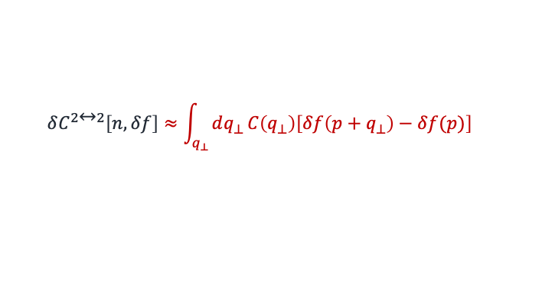

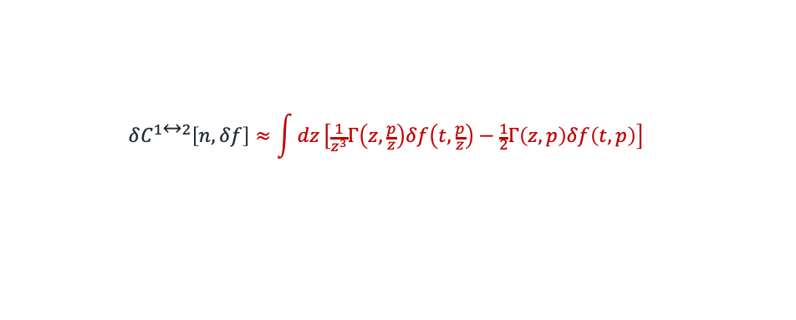
(i) Linearized kinetic theory (high-energy limit $p≫T$)
lin. Boltzmann eq:
$\left(∂_{t}+\frac{p}{p}∇_{x}\right)δf\left(t,x,p\right)≈δC^{1↔2}\left[n,δf\right]+δC^{2↔2}$ $\left[n,δf\right].$
1 ⇿ 2 collisions: (high energy limit of $Γ$ = BDMPS-Z in the HO limit)
Agrees with the BDMPS-Z medium-induced cascade!
2 ⇿ 2 collisions: (high-energy + small angle limit of $C\left(q_{⊥}\right)$ = BDMPS-Z in the HO limit)
Agrees with the BDMPS-Z broadening evolution!
(i) AMY-EKT ↔ jet quenching!
$$δC^{1↔2}\left[n,δf\right]≈\int{dz}\left[\frac{1}{z^{3}}Γ\left(z,\frac{p}{z}\right)δf\left(t,\frac{p}{z}\right)−\frac{1}{2}Γ\left(z,p\right)δf\left(t,p\right)\right]$$
$$\frac{p}{z}$$
$$p$$
$$p$$
$$\frac{p}{z}$$
$$\frac{\overline{z}p}{z}$$
$$\frac{\overline{z}p}{z}$$
$$zp$$
$$p$$
$$p$$
$$zp$$
$$\overline{z}p$$
$$p$$
$$p$$
$$\overline{z}p$$
$$\frac{p}{z}$$
$$\frac{\overline{z}p}{z}$$
$$\frac{\overline{z}p}{z}$$
$$\frac{p}{z}$$
$$p$$
$$\frac{p}{z}$$
$$\frac{p}{z}$$
$$p$$
Two type of splitting
Merging (holes)
$$\frac{\overline{z}p}{z}$$
$$\frac{\overline{z}p}{z}$$
$$zp$$
$$p$$
$$p$$
$$zp$$
$$δC^{2↔2}\left[n,δf\right]≈\int_{q_{⊥}}{dq_{⊥}}C\left(q_{⊥}\right)\left[δf\left(p+q_{⊥}\right)−δf(p)\right]$$
$$\overline{z}p$$
$$\overline{z}p$$
Single type of scatt.
Recoils, holes.
$$3$$
$$1$$
$$3$$
$$1$$
$$4$$
$$2$$
$$4$$
$$2$$
$$3$$
$$1$$
$$3$$
$$1$$
$$4$$
$$2$$
$$4$$
$$2$$
Adam Takacs (CERN-TH) Early stages 2026, Darmstadt

Slide 19
3. Kinetic theories as
parton showers
Adam Takacs (CERN-TH) Early stages 2026, Darmstadt

Slide 20

Linearized Boltzmann eq. as a parton shower
$\left(∂_{t}+\frac{p}{p} ∇_{x}\right)δf\left(t,x,p\right)=δC\left[n,δf\right].$
Homogeneous case:
    1. Separate “real” and “virtual” collisions: $δC=δC^{r}\left[n,δf\right]−δC^{v}\left[n\right] δf$.
    2. Integrate the Boltzmann eq: where $∆(t)=\exp\left[\int^{t}{dt^{′}}δC^{v}\left[n\right]\right]$
    $δf\left(t\right)=∆\left(t\right)δf_{0}+\int^{t}{dt′}\frac{∆\left(t\right)}{∆\left(t^{′}\right)} δC^{r}\left[n,δf\right]$.
    Iterate: $δf_{0}=δ\left(p−p_{0}\right)$.
    Histogram the particles: $δf\left(t,x,p\right)=\frac{1}{N_{ev} }\frac{dN}{dpdx}$
(ii) kinetic theories ↔ parton showers!
Inhomogeneous case is trivial: free streaming between collisions.
(iii) inhomogeneous perturbations
Initial condition:#[ID, p, x, weight]
[21 (100,0,0,100) (0,0,0,0) 1]
Output:
    [[21 (1.5,0.0,00,1.5) (0.1,0.0,00,0.1) 1],
    [21 (2.8,0.0,0.0,2.8) (2.0,0.0,00,2.0) 1],
    [21 (5.0,0.0,0.0,5.0) (9.4,0.0,0.0,9.4) 1],
    [21 (1.7,1.1,0.6,1.1) (9.7,0.0,0.0,9.7) -1],
    [21 (82.,-0.9,-0.2,82) (9.7,0.0,0.0,9.7) 1],
    [21 (1.0,0.4,0.2,0.9) (12.0,1.4,0.5,12.0) 1],
    [21 (2.2,0.0,0.0,2.2) (15.0,0.0,0.0,15.0) 1],
    [21 (3.3,0.0,0.0,3.3) (15.0,0.0,0.0,15.0) 1],
    [21 (1.5,0.7,0.2,1.3) (15.5,2.6,1.0,14.8) 1],
    [21 (2.1,0.9,0.3,1.8) (15.5,2.6,1.0,14.8) 1]]
Adam Takacs (CERN-TH) Early stages 2026, Darmstadt

Slide 21
Linearized Boltzmann eq. as a parton shower
$\left(∂_{t}+\frac{p}{p} ∇_{x}\right)δf\left(t,x,p\right)=δC\left[n,δf\right].$
Homogeneous case:
    1. Separate “real” and “virtual” collisions: $δC=δC^{r}\left[n,δf\right]−δC^{v}\left[n\right] δf$.
    2. Integrate the Boltzmann eq: where $∆(t)=\exp\left[\int^{t}{dt^{′}}δC^{v}\left[n\right]\right]$
    $δf\left(t\right)=∆\left(t\right)δf_{0}+\int^{t}{dt′}\frac{∆\left(t\right)}{∆\left(t^{′}\right)} δC^{r}\left[n,δf\right]$.
    Iterate: $δf_{0}=δ\left(p−p_{0}\right)$.
    Histogram the particles: $δf\left(t,x,p\right)=\frac{1}{N_{ev} }\frac{dN}{dpdx}$
(ii) kinetic theories ↔ parton showers!
Inhomogeneous case is trivial: free streaming between collisions.
(iii) inhomogeneous perturbations
Initial condition:#[ID, p, x, weight]
[21 (100,0,0,100) (0,0,0,0) 1]
Output:
    [[21 (1.5,0.0,00,1.5) (0.1,0.0,00,0.1) 1],
    [21 (2.8,0.0,0.0,2.8) (2.0,0.0,00,2.0) 1],
    [21 (5.0,0.0,0.0,5.0) (9.4,0.0,0.0,9.4) 1],
    [21 (1.7,1.1,0.6,1.1) (9.7,0.0,0.0,9.7) -1],
    [21 (82.,-0.9,-0.2,82) (9.7,0.0,0.0,9.7) 1],
    [21 (1.0,0.4,0.2,0.9) (12.0,1.4,0.5,12.0) 1],
    [21 (2.2,0.0,0.0,2.2) (15.0,0.0,0.0,15.0) 1],
    [21 (3.3,0.0,0.0,3.3) (15.0,0.0,0.0,15.0) 1],
    [21 (1.5,0.7,0.2,1.3) (15.5,2.6,1.0,14.8) 1],
    [21 (2.1,0.9,0.3,1.8) (15.5,2.6,1.0,14.8) 1]]
Adam Takacs (CERN-TH) Early stages 2026, Darmstadt

Slide 22
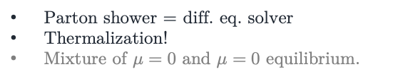

Numerical solution (gluons)
see also [Mehtar-Tani,Schlichting,Soudi]
[Brewer,Mazeliauskas,Zhou]
High-energy limit
Full EKT
High-energy limit, gluons
$$πT$$
$$πT$$
Parton shower $=$ diff. eq. solver
Cascade doesn’t thermalize!
Parton shower $=$ diff. eq. solver
Thermalization!
Mixture of $μ=0$ and $μ=0$ equilibrium.
Adam Takacs (CERN-TH) Early stages 2026, Darmstadt

Slide 23
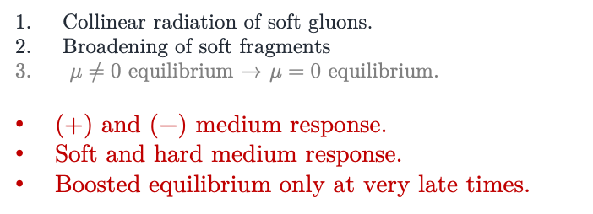
Numerical solution(gluons)
see also [Mehtar-Tani,Schlichting,Soudi]
[Brewer,Mazeliauskas,Zhou]
Collinear radiation of soft gluons.
Broadening of soft fragments
$μ≠0$ equilibrium $→$ $μ=0$ equilibrium.
(+) and (−) medium response.
Soft and hard medium response.
Boosted equilibrium only at very late times.
Adam Takacs (CERN-TH) Early stages 2026, Darmstadt

Slide 24
Outlook:
Why all the fuss?
Adam Takacs (CERN-TH) Early stages 2026, Darmstadt

Slide 25

Applications
lin. Boltzmann eq:
$\left(∂_{t}+\frac{p}{p}∇_{x}\right)δf\left(t,x,p\right)=δC\left[n,δf\right].$
New phenomenological applications of EKT!
Interface with jets, hadronization, etc.
Multi-particle correlations in EKT.
Parton-shower is an $n$-particle cross-section generator:
Unexplored topic in EKT, great relevance in EEC.
Incorporate inhomogeneities.
Previously neglected! (parton shower speedup)
Hydrodynamization: $δf\left(p,x\right)→δf_{eq}\left(p,δT\left(t,x\right),δu(t,x)\right)$
[Pythia 8.3 2203.11601]
Adam Takacs (CERN-TH) Early stages 2026, Darmstadt

Slide 26


Applications
lin. Boltzmann eq:
$\left(∂_{t}+\frac{p}{p}∇_{x}\right)δf\left(t,x,p\right)=δC\left[n,δf\right].$
New phenomenological applications of EKT!
Interface with jets, hadronization, etc.
Multi-particle correlations in EKT.
Parton-shower is an $n$-particle cross-section generator:
Unexplored topic in EKT, great relevance in EEC.
Incorporate inhomogeneities.
Previously neglected! (parton shower speedup)
Hydrodynamization: $δf\left(p,x\right)→δf_{eq}\left(p,δT\left(t,x\right),δu(t,x)\right)$
$$δf\left(p_{1},p_{2},…\right)=\frac{1}{N}\frac{dN}{dp_{1}dp_{2}…}$$
  Correlations beyond molecular chaos!
Adam Takacs (CERN-TH) Early stages 2026, Darmstadt

Slide 27

Applications
lin. Boltzmann eq:
$\left(∂_{t}+\frac{p}{p}∇_{x}\right)δf\left(t,x,p\right)=δC\left[n,δf\right].$
New phenomenological applications of EKT!
Interface with jets, hadronization, etc.
Multi-particle correlations in EKT.
Parton-shower is an $n$-particle cross-section generator:
Unexplored topic in EKT, great relevance in EEC.
Incorporate inhomogeneities.
Previously neglected! (parton shower speedup)
Hydrodynamization: $δf\left(p,x\right)→δf_{eq}\left(p,δT\left(t,x\right),δu(t,x)\right)$
$$δf\left(x\right)=\frac{1}{N}\frac{dN}{dx}$$
Adam Takacs (CERN-TH) Early stages 2026, Darmstadt

Slide 28
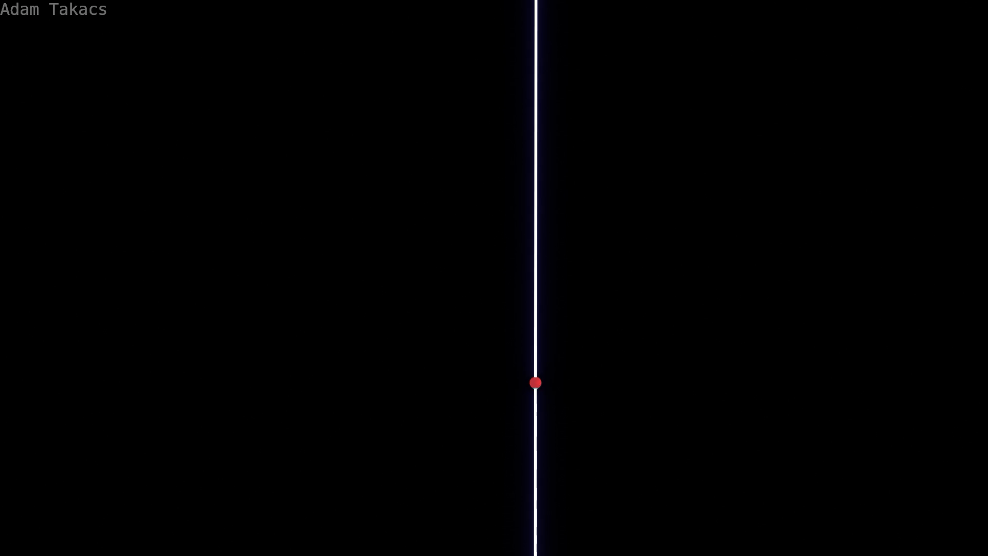
Wide-angle cascade (preliminary)
Adam Takacs (CERN, Bergen) KITP 2026

Slide 29

Jet thermalization
Adam Takacs (CERN, Bergen) KITP 2026

Slide 30
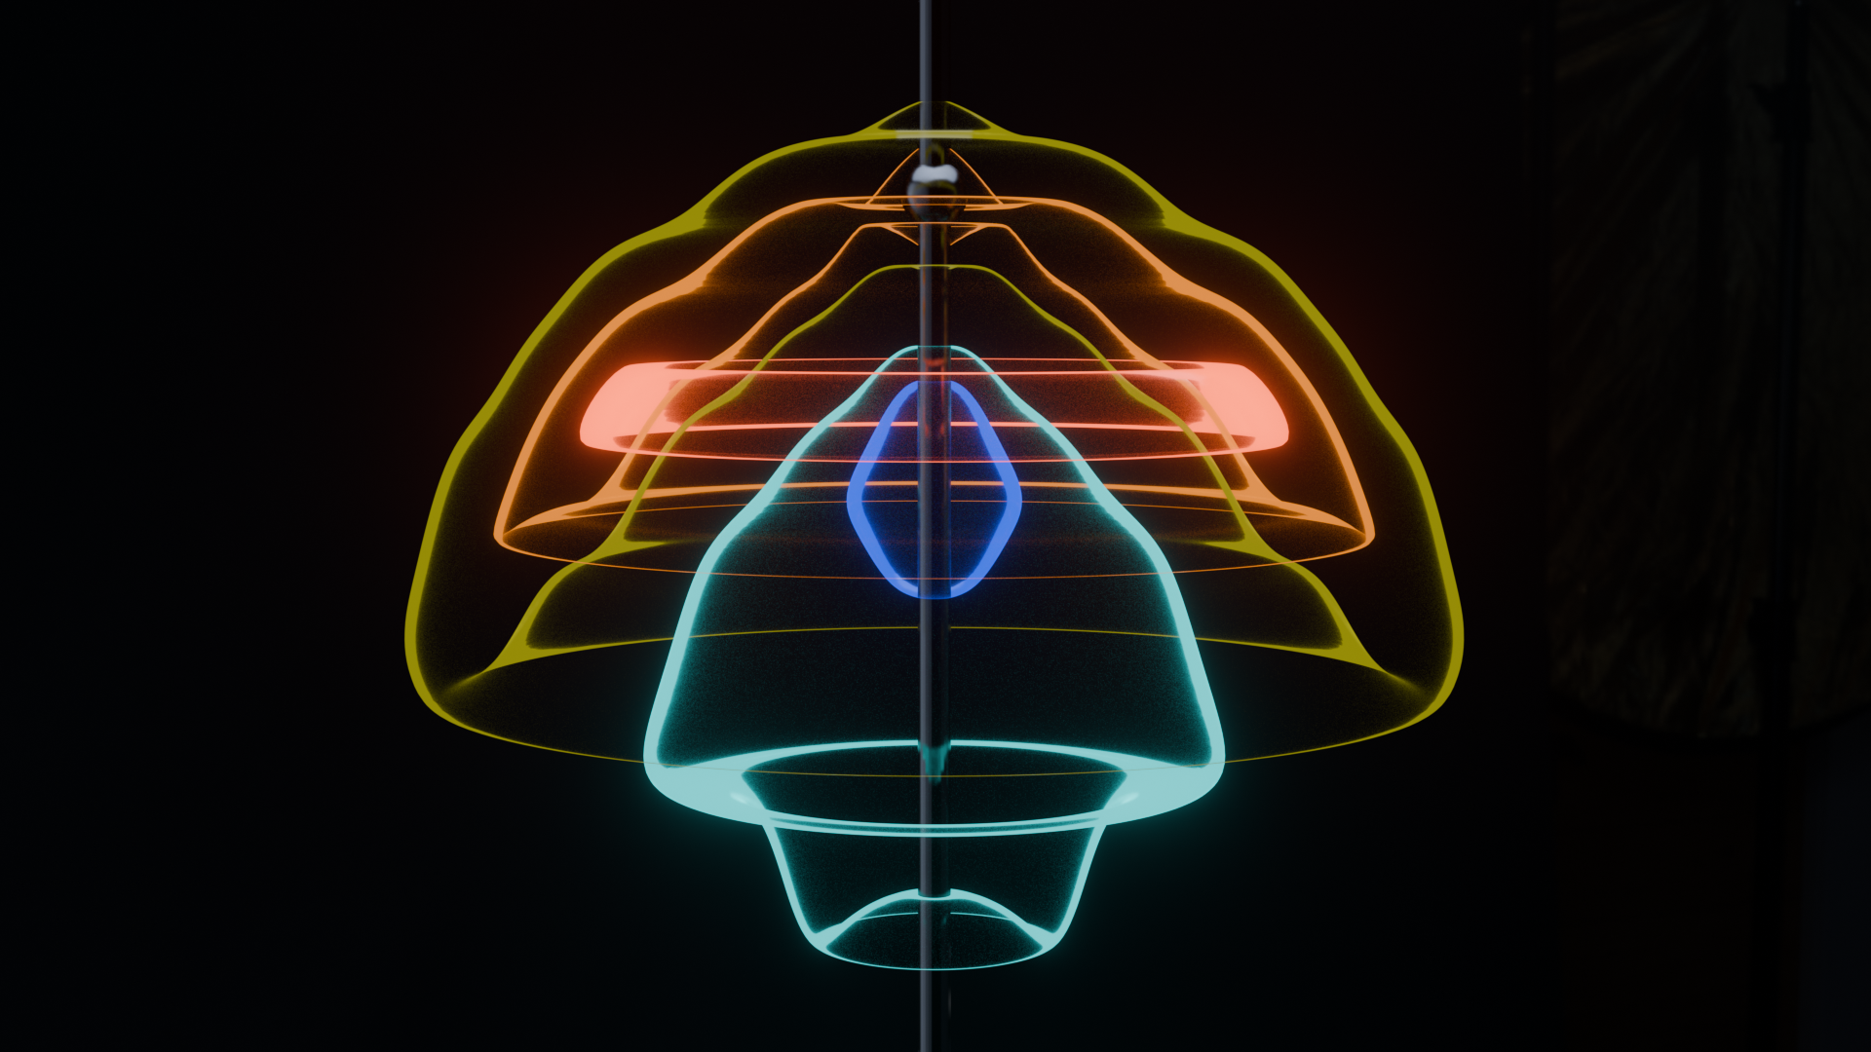
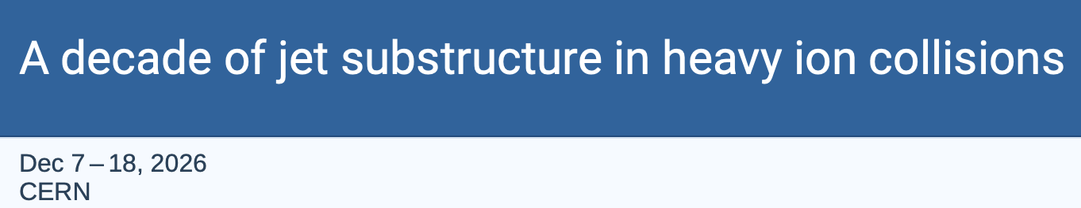

Summary:
    Perturbative grounds of jet quenching
    AMY-EKT ↔ parton energy loss and broadening
    Lin. Boltzmann eq. ↔ parton shower
    New opportunities for EKT:
      Jet thermalization,
      Multi-particle correlations, hydrodynamization, fluctuations
      Including in phenomenological workflows
[Wikipedia]
Adam Takacs (CERN-TH) Early stages 2026, Darmstadt

Slide 31
Thank you for your attention!
Adam Takacs (CERN-TH) Early stages 2026, Darmstadt

Slide 32






Jet evolution in QGP
[Casalderrey-Solana,Mehtar-Tani, Tywoniuk, Salgado]
[Caucal, Iancu, Mueller, Soyez]
virtuality
$$Qhard$$
high virtuality
vacuum jet
$$Qjet$$
$$Qmed$$
cascade
$$Λ_{QCD}$$
out of medium
vacuum jet
$$p_{T}−∆p_{T}$$
$$p_{T}$$
energy
Adam Takacs (CERN-TH) Early stages 2026, Darmstadt

Slide 33
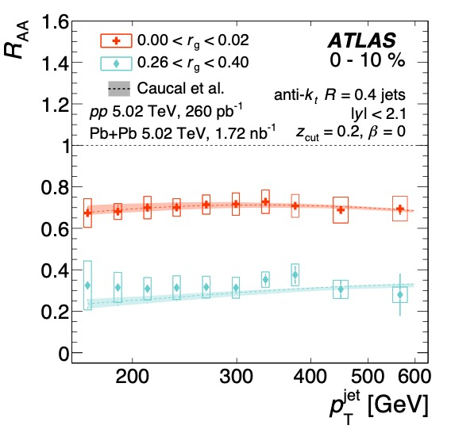
Experimental tests
[Caucal,Soto-Ontoso,AT, PRD105(2022)114046] ⇾ [ALICE PRL135(2025)031901]
[AT in PRD110(2024)014015] ⇾ [CMS 2602.09271]
Jet spectrum for different substructure
less eloss source
$$R_{AA} \sim \frac{dσ_{AA}^{jet}/dp_{T}}{dσ_{pp}^{jet}/dp_{T}}$$
more eloss source
[ATLAS PRC107(2023)054909]
Adam Takacs (CERN-TH) Early stages 2026, Darmstadt

Slide 34
Outline:
    Jet quenching ↔ QCD kinetic theory
    Kinetic theories ↔ parton showers
    New implementation for jet equilibration
Adam Takacs (CERN-TH) Early stages 2026, Darmstadt

Slide 35
1. Precision QCD
with jets
jet₁
jet₂
Adam Takacs (CERN-TH) Early stages 2026, Darmstadt

Slide 36
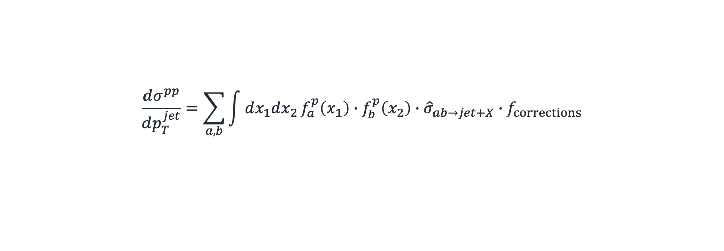
Perturbative QCD framework
Collinear factorization:
$$\frac{dσ^{pp}}{dp_{T}^{jet}}=\sum_{a,b}{\int{dx_{1}dx_{2}}f_{a}^{p}\left(x_{1}\right)∙f_{b}^{p}\left(x_{2}\right)∙{\hat{σ}}_{ab→jet+X}}∙f_{corrections}$$
parton distributions:
(find parton a in proton)
Non-perturbative
(fitted to every collision).
partonic cross-sec:
loop expansion: LO⇾NLO⇾N²LO
log expansion: LL⇾NLL⇾NNLL
improvable order-by-order.
corrections:
(hadronzation, UE, non-fact, …)
Non-perturbative
(fitted for every measurement).
Want them to be small
(jets instead of hadrons, grooming).
Adam Takacs (CERN-TH) Early stages 2026, Darmstadt

Slide 37
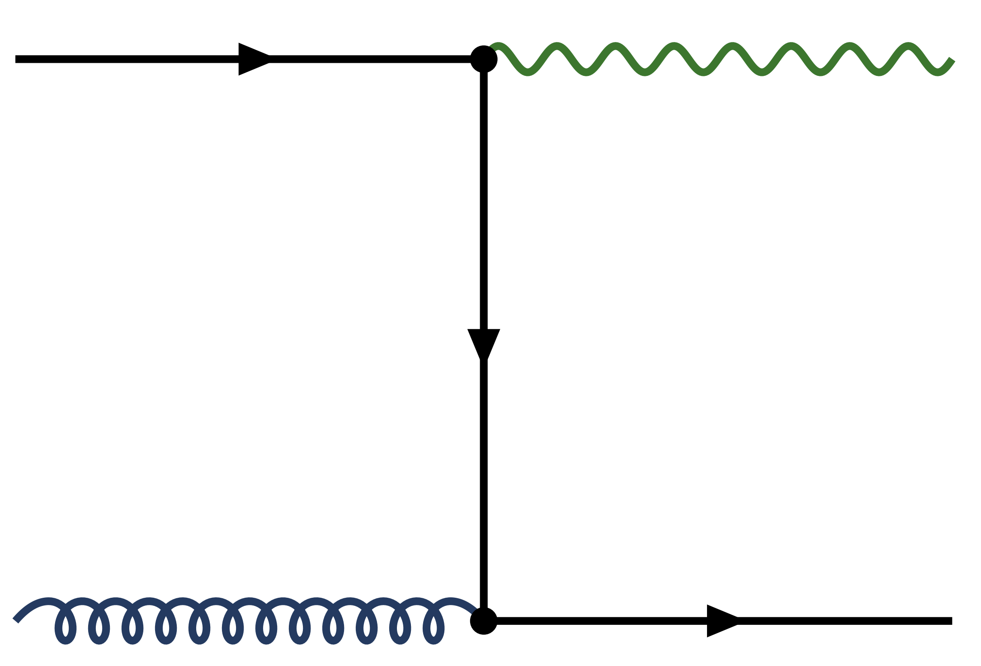
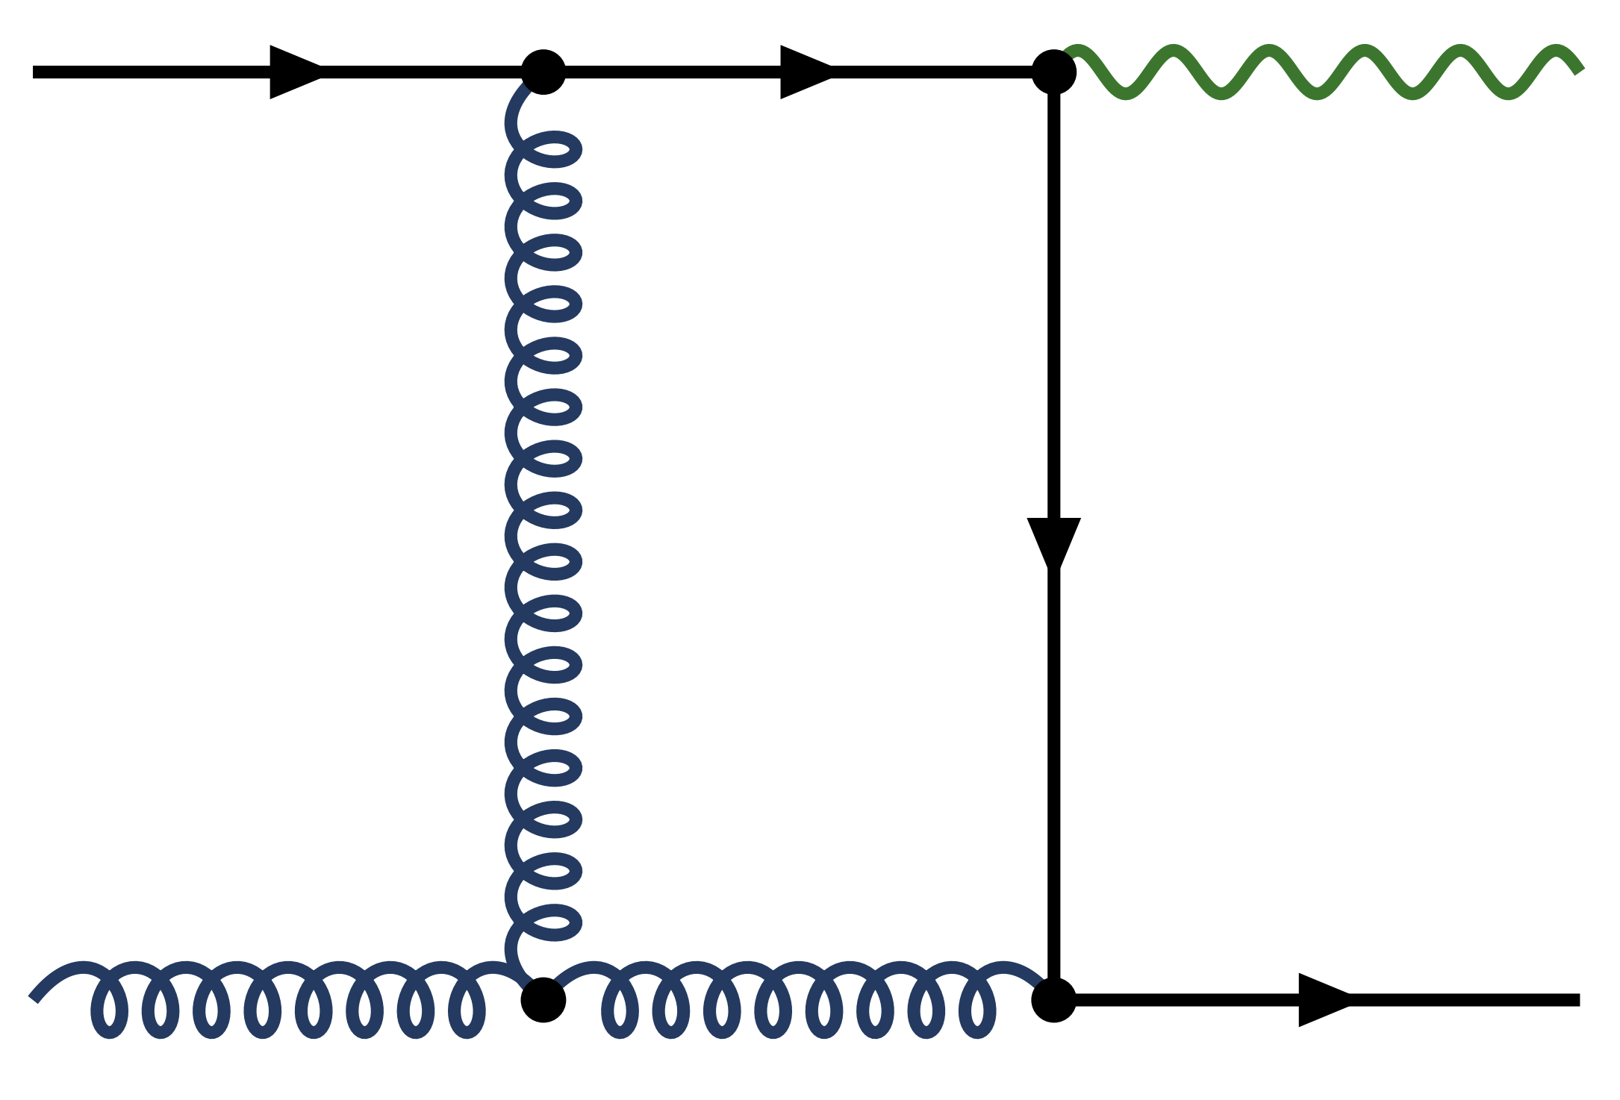
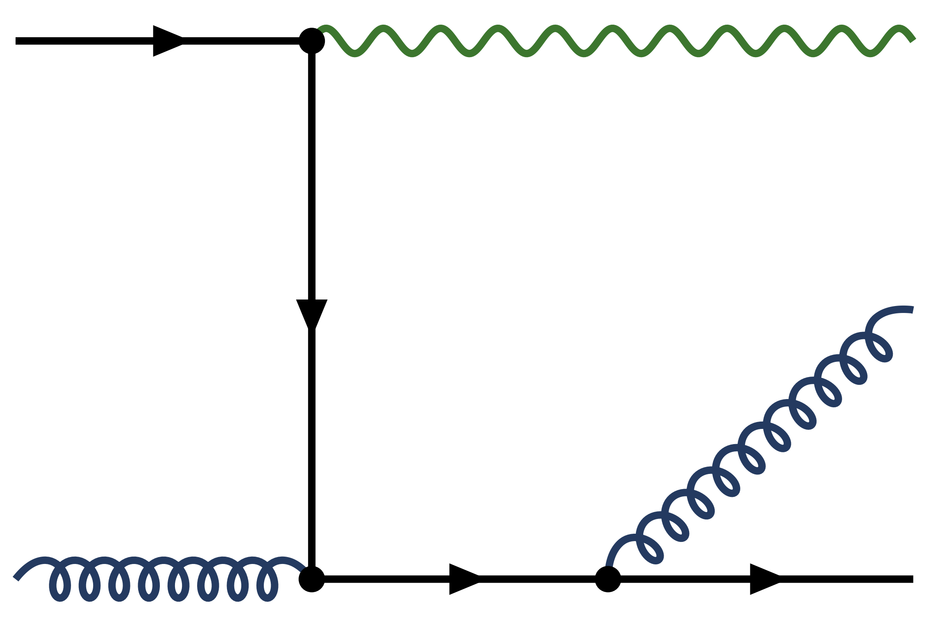
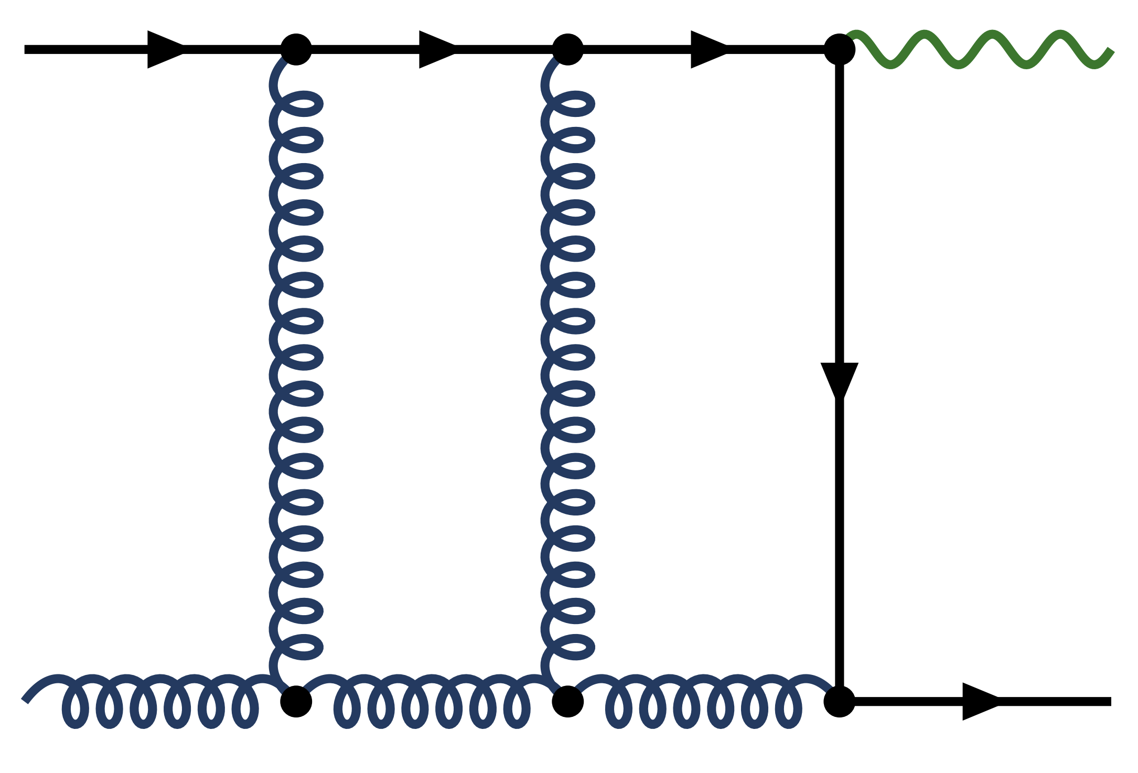
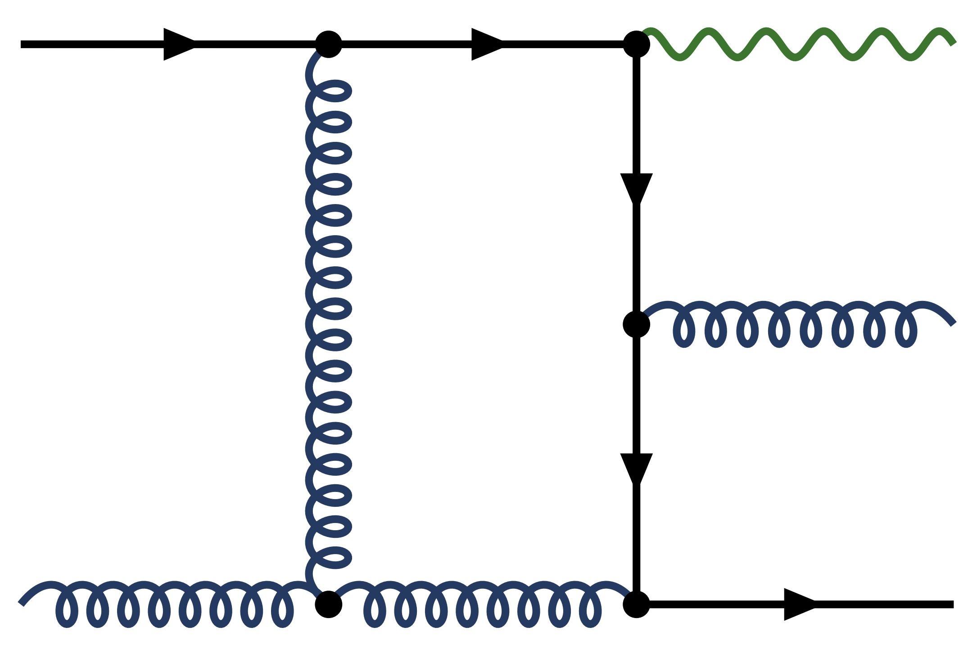
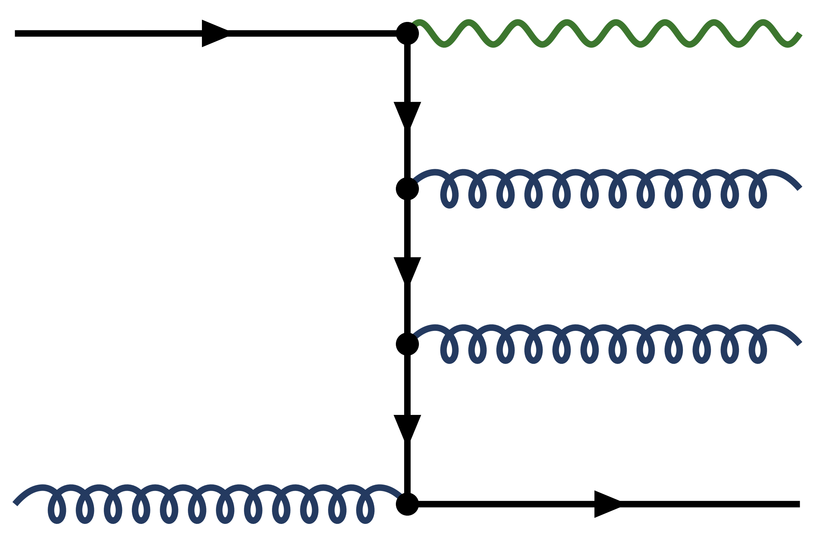
Example: photon + jet
[adapted from A.Huss]
Coupling (loop) expansion
LO
$$α_{s}α_{e}$$
D e t a i l s
NLO
$$α_{s}^{2}α_{e}$$
NNLO
$$α_{s}^{3}α_{e}$$
(+${ α}_{s}α_{e}^{2}$)
Jets are understood from first principles up to high precision!
[Chen,Ghermann,Glover,Hofer,Huss 1904.01044]
Adam Takacs (CERN-TH) Early stages 2026, Darmstadt

Slide 38



Event generators in pp
Collinear (to the beam) factorization:
Loop expansion:
Feasible only for a few outgoing legs! ☹️
  Loop & logarithmic expansion:
  Soft and collinear factorization (relative to the jet):
  Iterative process ⇾ parton shower
Theory behind MC event generators!
1
$${\hat{σ}}_{ij→n}$$
$${\hat{σ}}_{ij→n}$$
. . .
n
1
$${\hat{σ}}_{ij→n}≈{\hat{σ}}_{ij→n−1} ⨂{ \hat{σ}}_{1→2}$$
$${\hat{σ}}_{ab→cd}$$
. . .
n
Adam Takacs (CERN-TH) Early stages 2026, Darmstadt

Slide 39
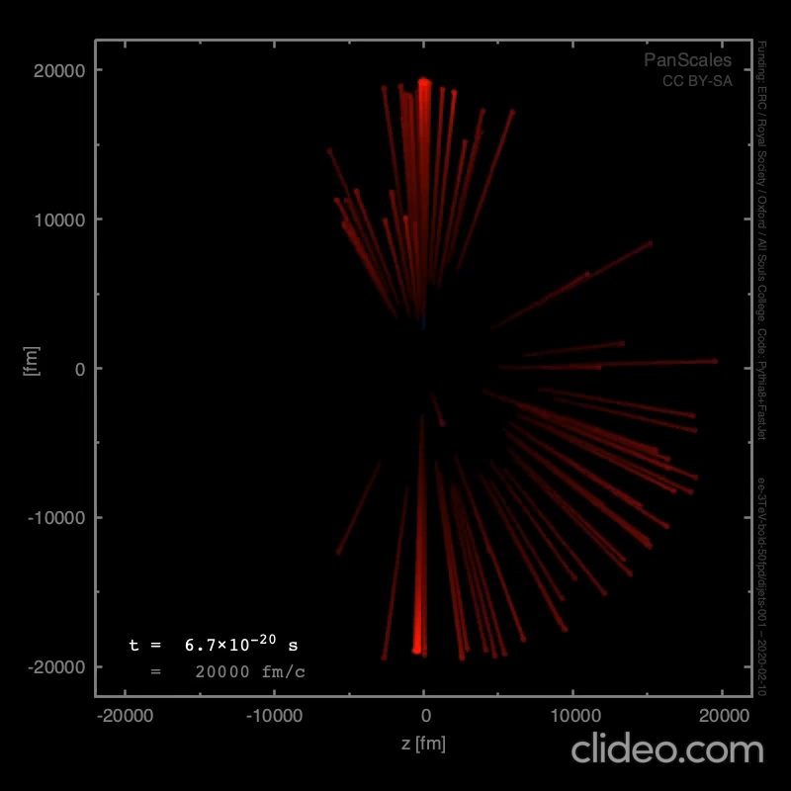
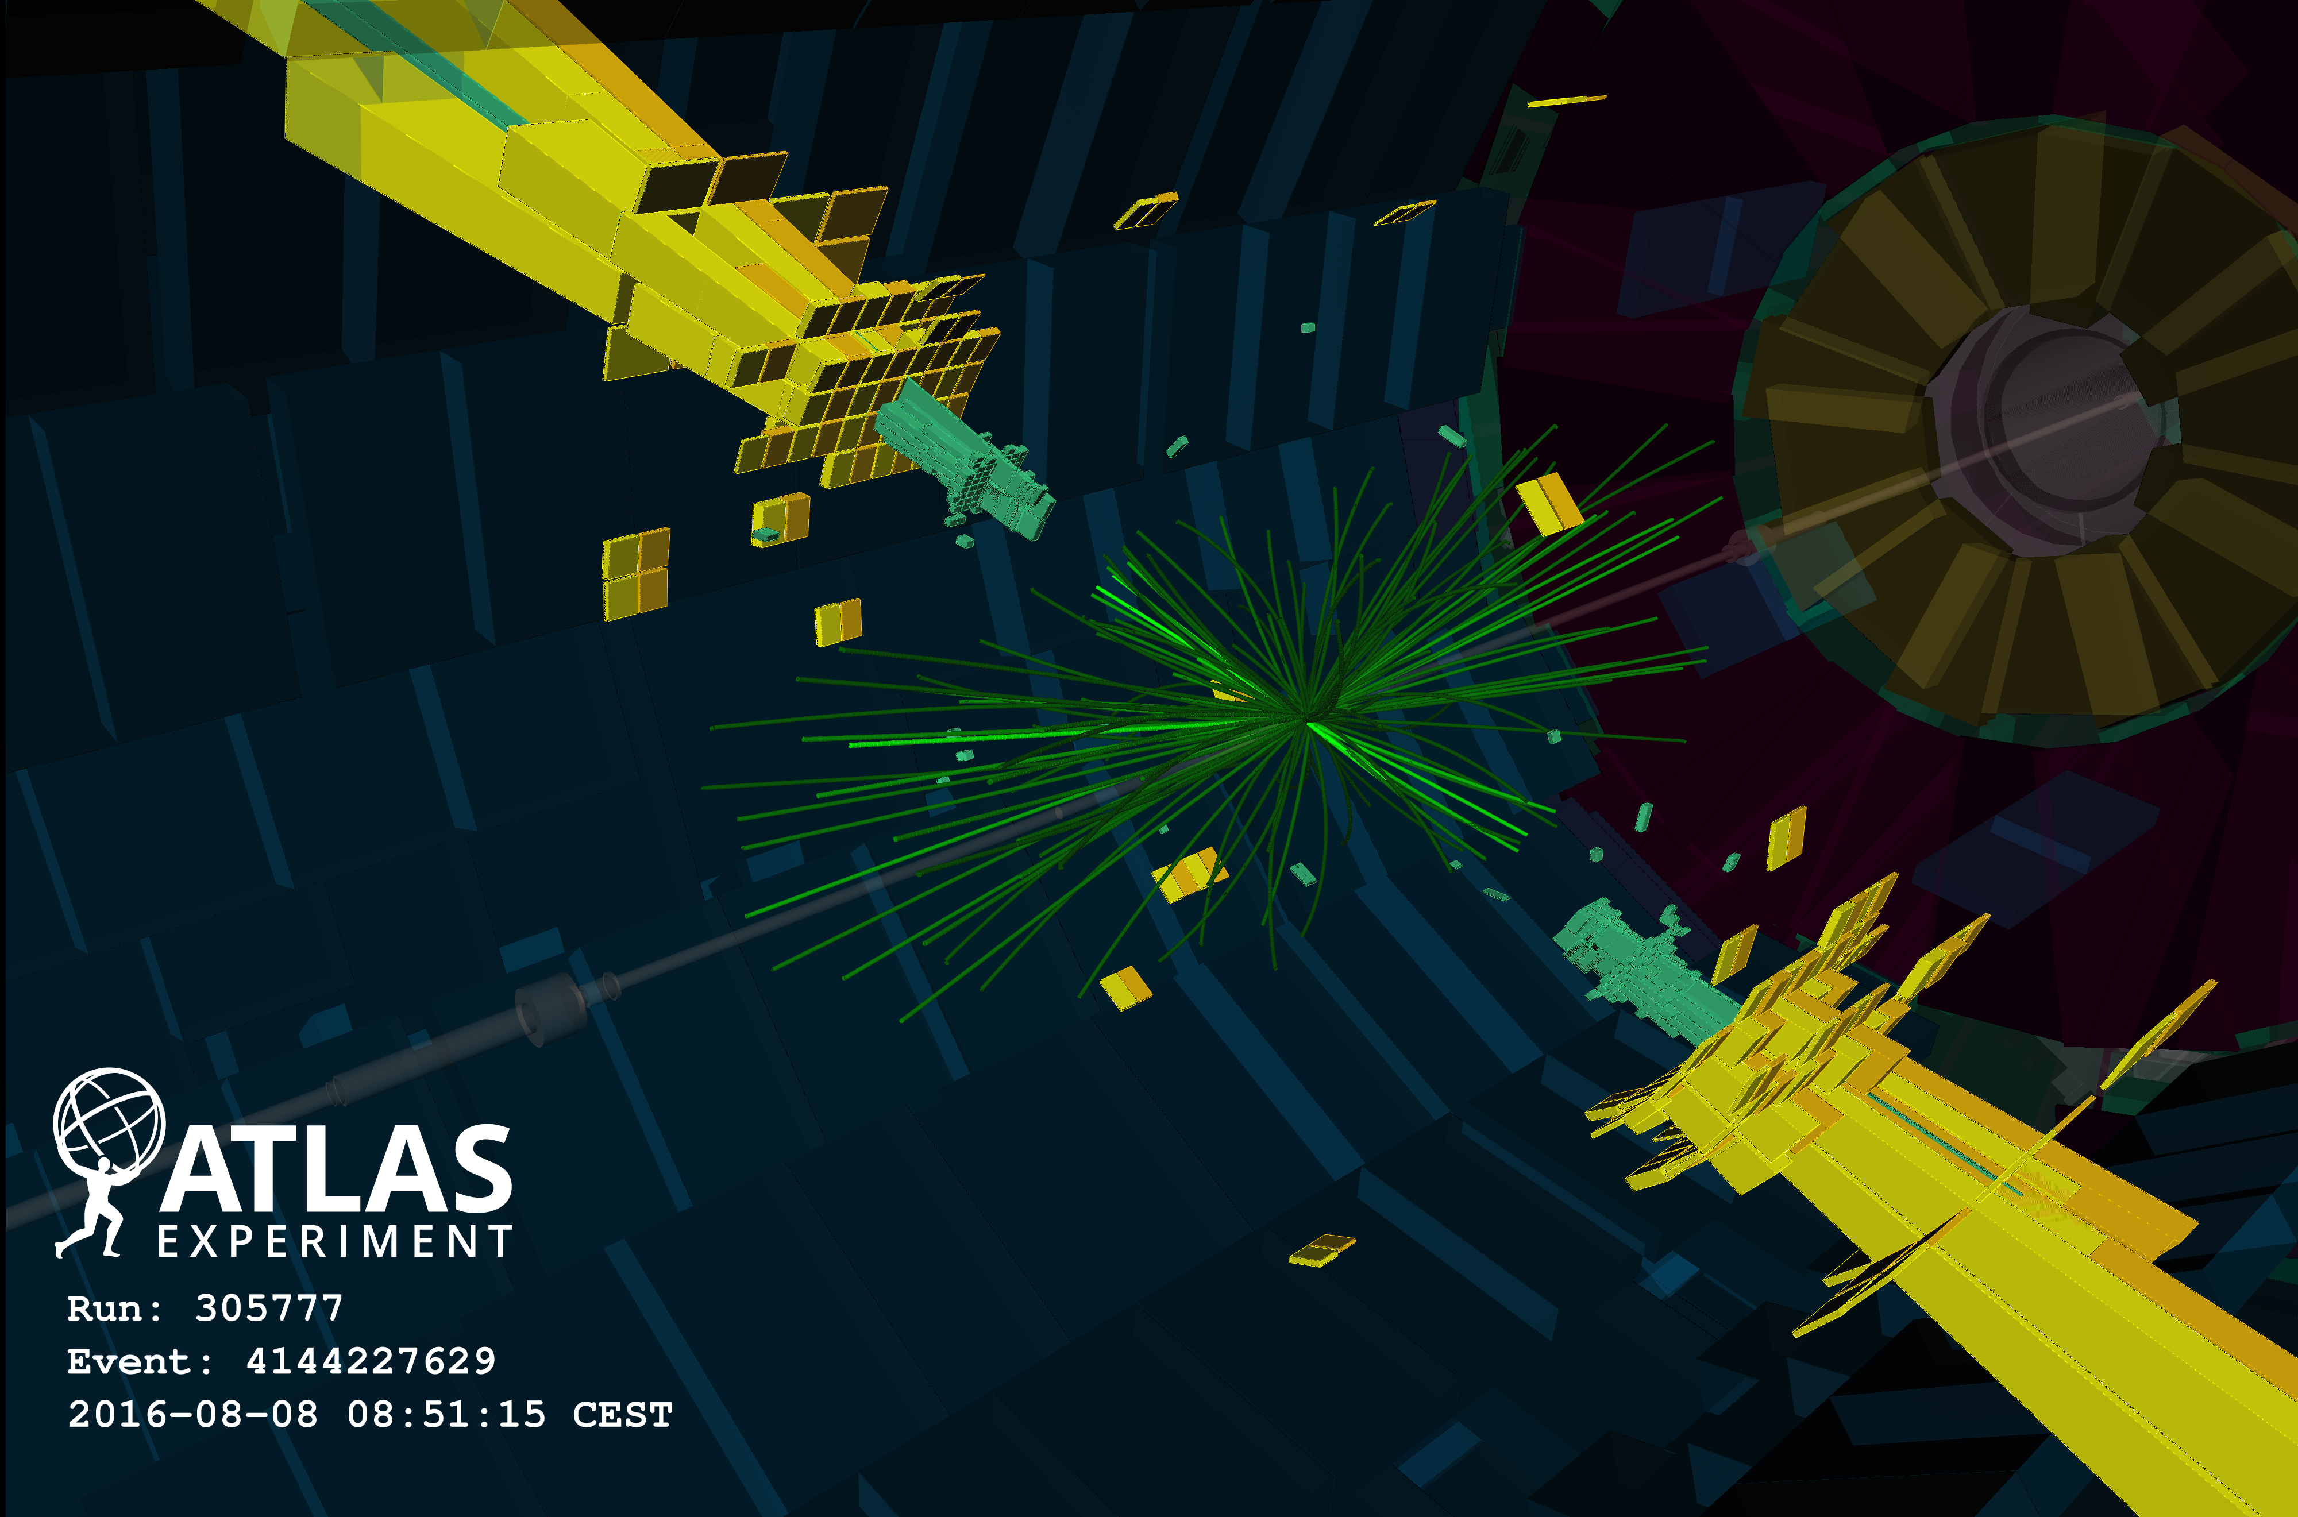
Medium-induced emissions
Event generator
Experiment
[adapted from G.Salam]
Describe multi-differential, substructure, event-wide, etc. observables.
Adam Takacs (CERN-TH) Early stages 2026, Darmstadt

Slide 40
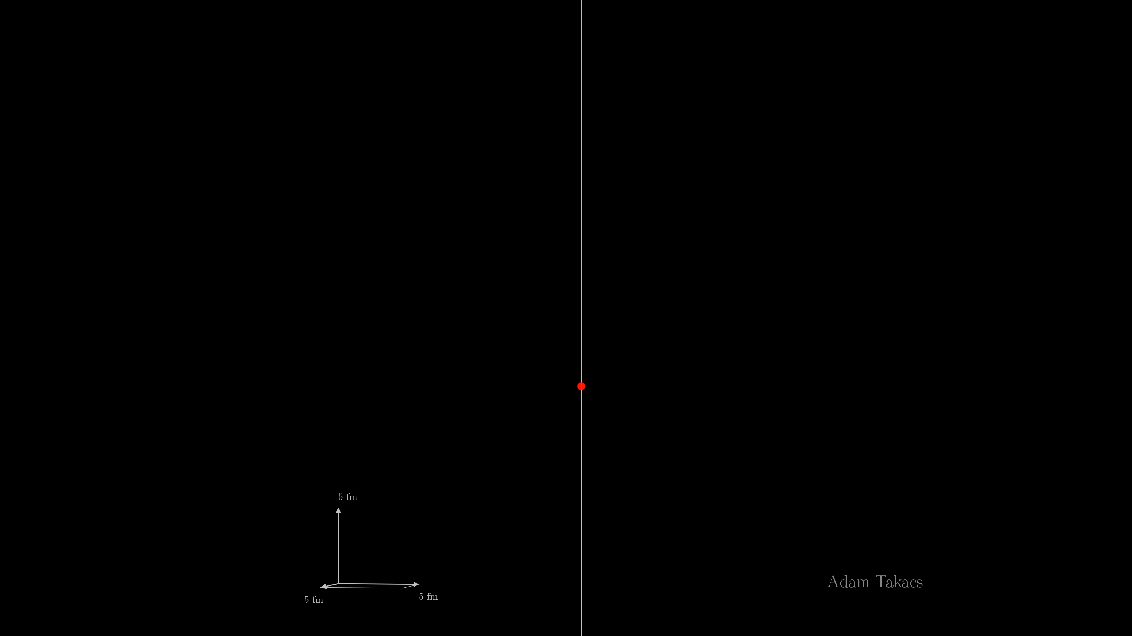
Wide-angle cascade (preliminary)
Adam Takacs (CERN, Bergen) KITP 2026

