Slide 1
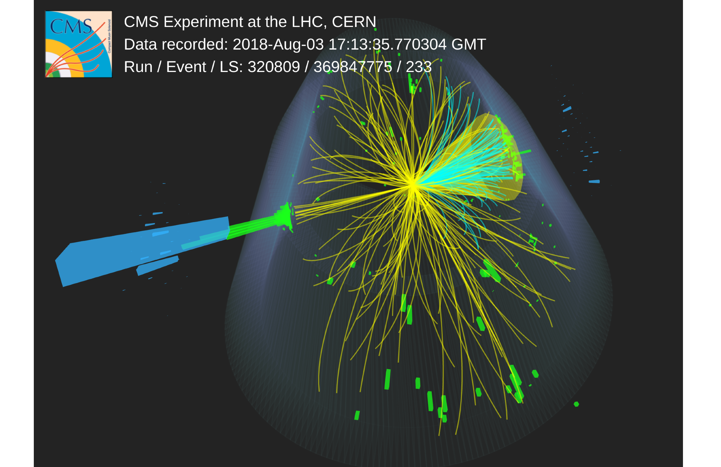

Understanding the origin of collective phenomena in jets
EMMI Workshop: Probing the early stages with jets
Xiaoyu Liu
Rice University
Based on: PRL 133 (2024) 142301, CMS-PAS-HIN-24-024, and recent model studies (to be submitted soon)

Slide 2
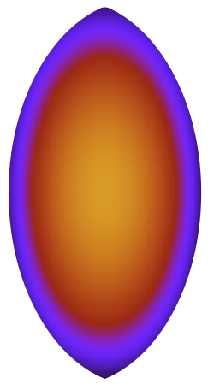



Collectivity in Heavy Ion
35-40%
Long-range, away-side
momentum conservation, di-jets...
Short-range, near-side
resonances decay, jets...

Slide 3

Collectivity in Heavy Ion
35-40%
Long-range, away-side
momentum conservation, di-jets...
Short-range, near-side
resonances decay, jets...
Long-range, near-side ridge
collective flow!
“Ridge”

Slide 4
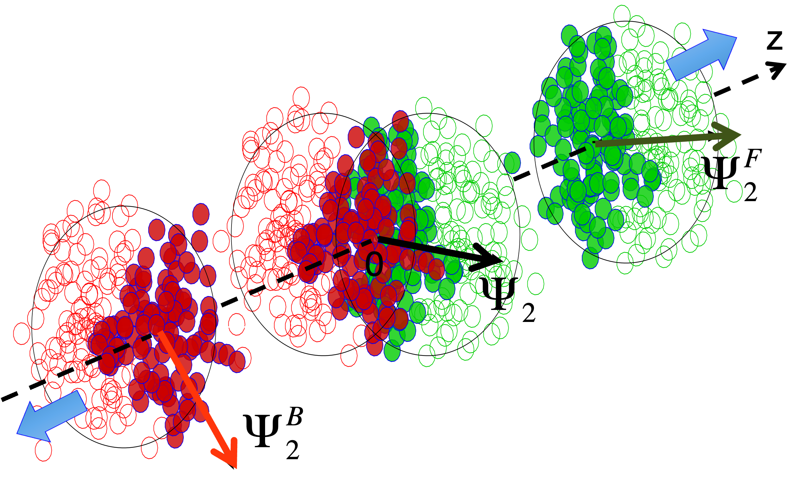
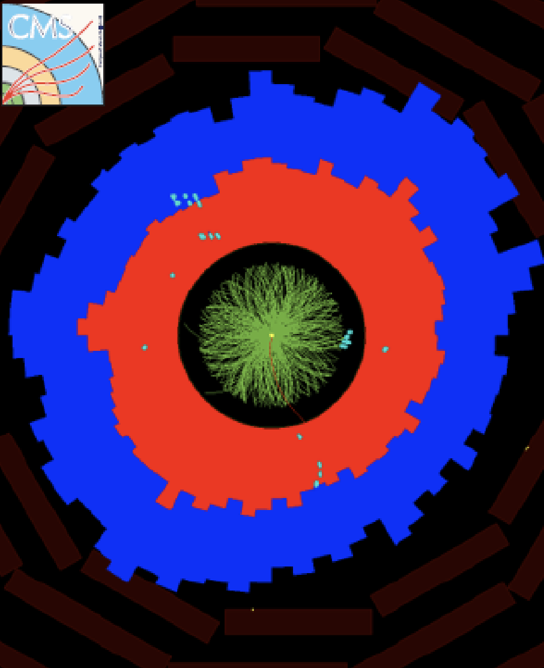
Collectivity in Heavy Ion
35-40%
Long-range, away-side
momentum conservation, di-jets...
Short-range, near-side
resonances decay, jets...
Long-range, near-side ridge
collective flow!
“Ridge”
QGP is a strongly coupled, nearly perfect fluid!
Initial State Geometry
Strong Rescattering
Final State Anisotropy

Slide 5
Collectivity in Heavy Ion
35-40%
Long-range, away-side
momentum conservation, di-jets,..
Short-range, near-side
resonances decay, jets...
collective flow...
Long-range, near-side ridge
collective flow!
“Ridge”
QGP is a strongly coupled, nearly perfect fluid!
Initial State Geometry
Strong Rescattering
Final State Anisotropy
Notes:
manifestation
emergence
Speaking of collective flow, it's worth noting that flow also contributes to the away-side ridge. As a result, we can't directly distinguish the flow component from the non-flow component.

Slide 6
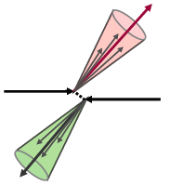
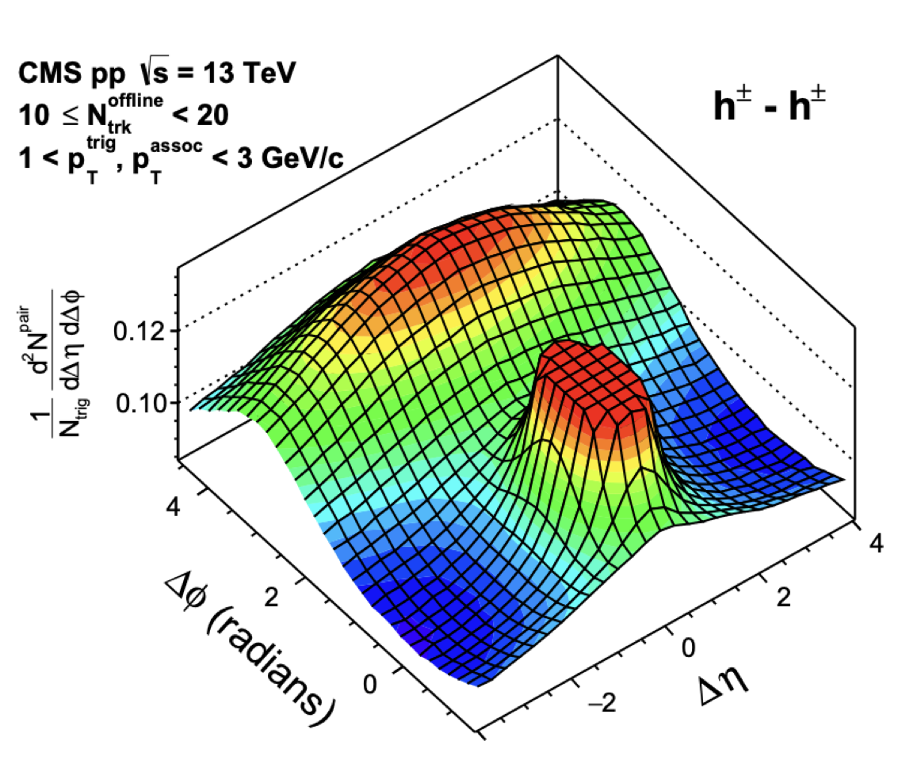
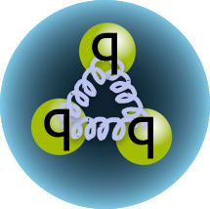
Collectivity in small systems
pp MinBias
No near-side ridge in MB pp

Slide 7
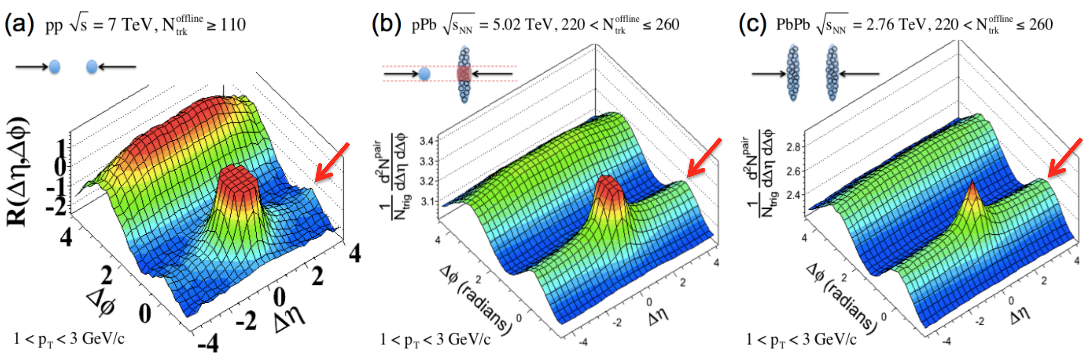
Collectivity in small systems
pp MinBias
JHEP 09 (2010) 091
No near-side ridge in MB pp
Near-side ridge in HM pp

Slide 8
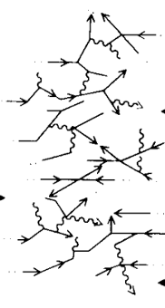
Collectivity in small systems
Also see a review: K. Dusling, WL, B. Schenke, Int.J.Mod.Phys. E25 (2016) 01, 1630002
pp MinBias
JHEP 09 (2010) 091
PLB 718 (2013) 795
No near-side ridge in MB pp
Near-side ridge in HM pp and pPb
p/A
p/A
Strong partonic re-scatterings at subfermi scales
Notes:
partonic rescattering can happen at subfermi scale

Slide 9
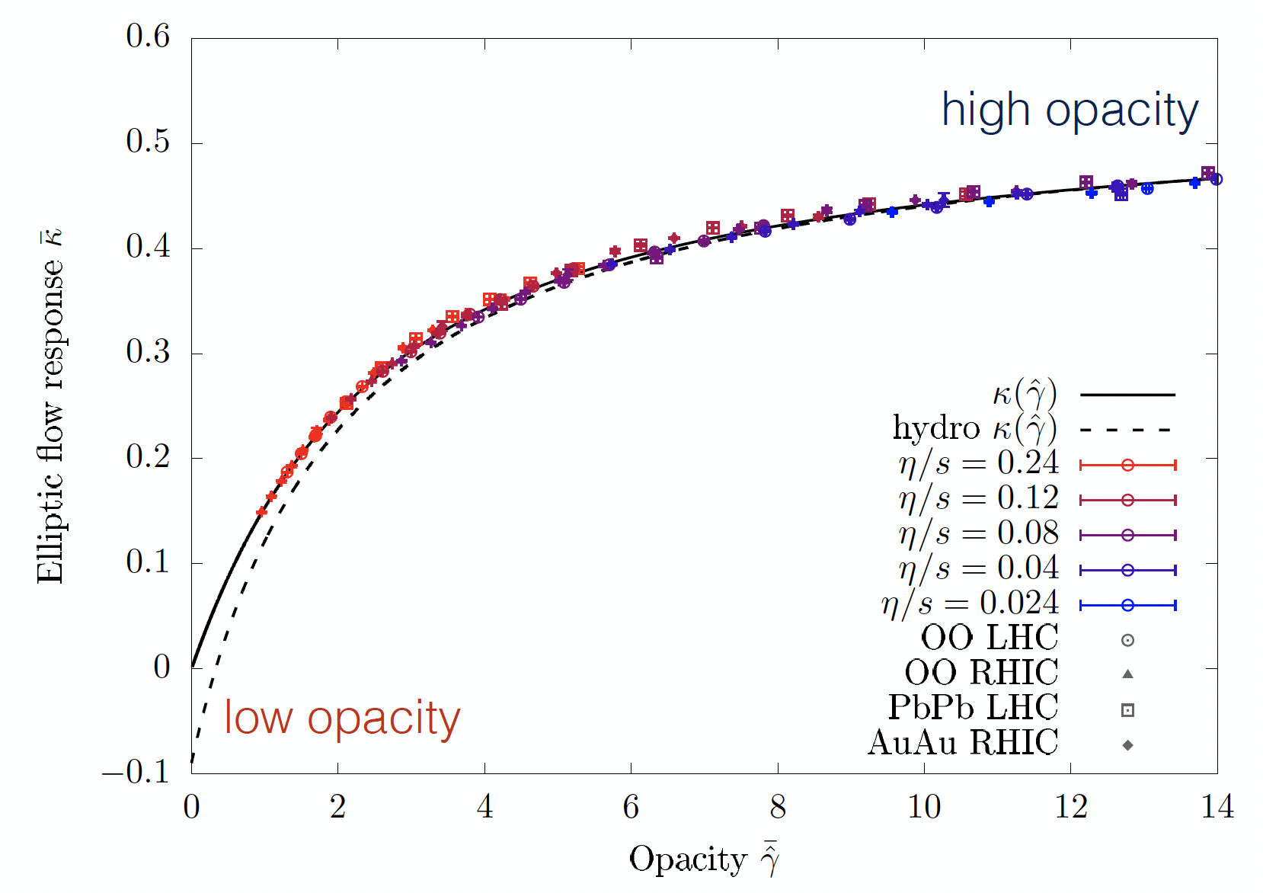

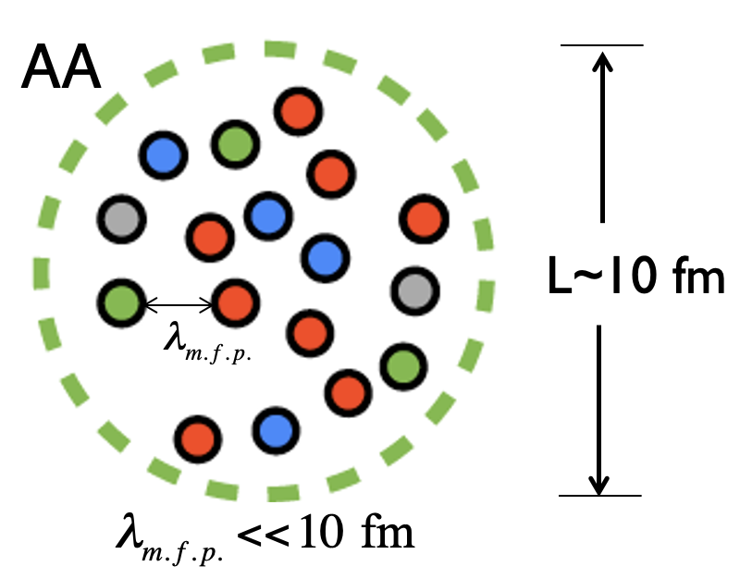

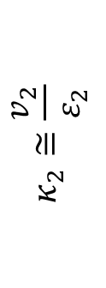
A new paradigm - Universal QGP across systems
Sören Schlichting
$$κ_{2}≅\frac{v_{2}}{ε_{2}}$$
Elliptic flow response
Opacity $\hat{γ}≡\frac{L}{ℓ_{mfp}}\sim {{(N}_{ch})}^{\frac{1}{3}}$
Notes:
A kinetic and hydrodynamic calculations predict that v₂ divided by the eccentricity depends only on the system’s opacity.

Slide 10

How small a QGP droplet can be ?
p
Pb
p
p
Pb
Pb
ultimate limit
A single quark or gluon
Can a QGP droplet be initiated by a “single parton” in the vacuum?
A. Baty, P. Gardner, WL, PRC 107 (2023) 064908
Notes:
It is now evident that QCD collectivity is not unique to heavy-ion collisions—it also emerges in much smaller systems.
This naturally leads to the question: how small can a QGP droplet be?
To push the system size to its ultimate limit, it has been postulated that a QGP droplet can be initiated by a single parton
If we keep pushing the system size to its ultimate limit, one intriguing possibility is that a QGP-like droplet could be initiated by a single quark or gluon in the vacuum.

Slide 11
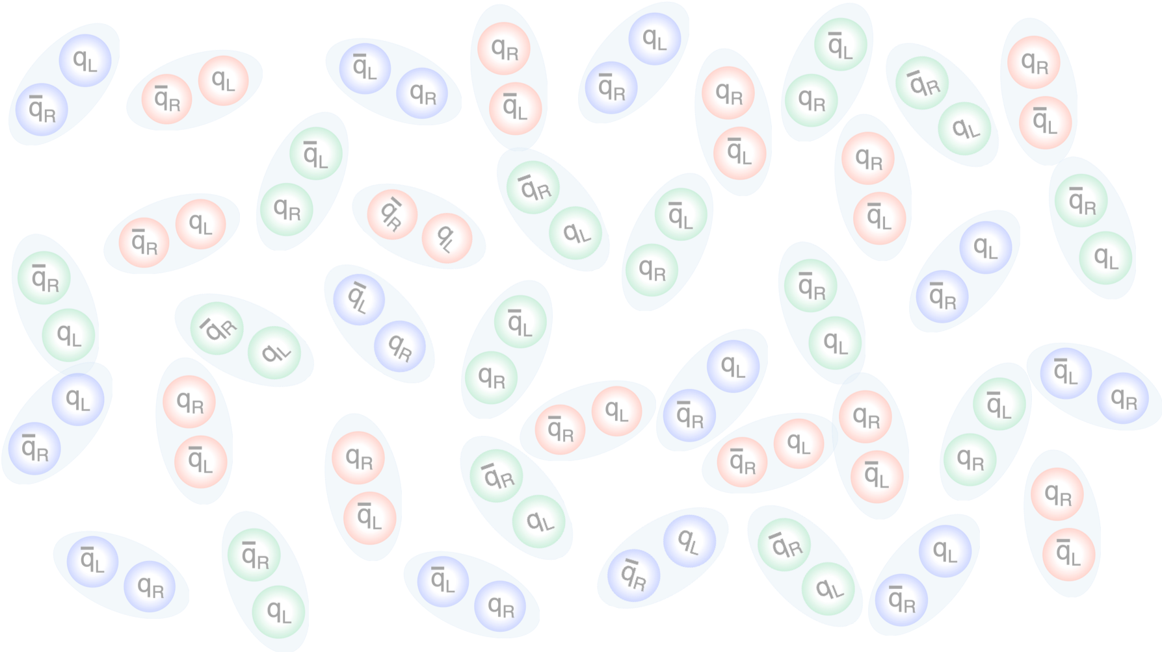
Jet: a proxy for system initiated by a parton
“Jet”
e/p
e/p
Beam axis
Notes:
Filled with virtual color charges – chiral condensates

Slide 12
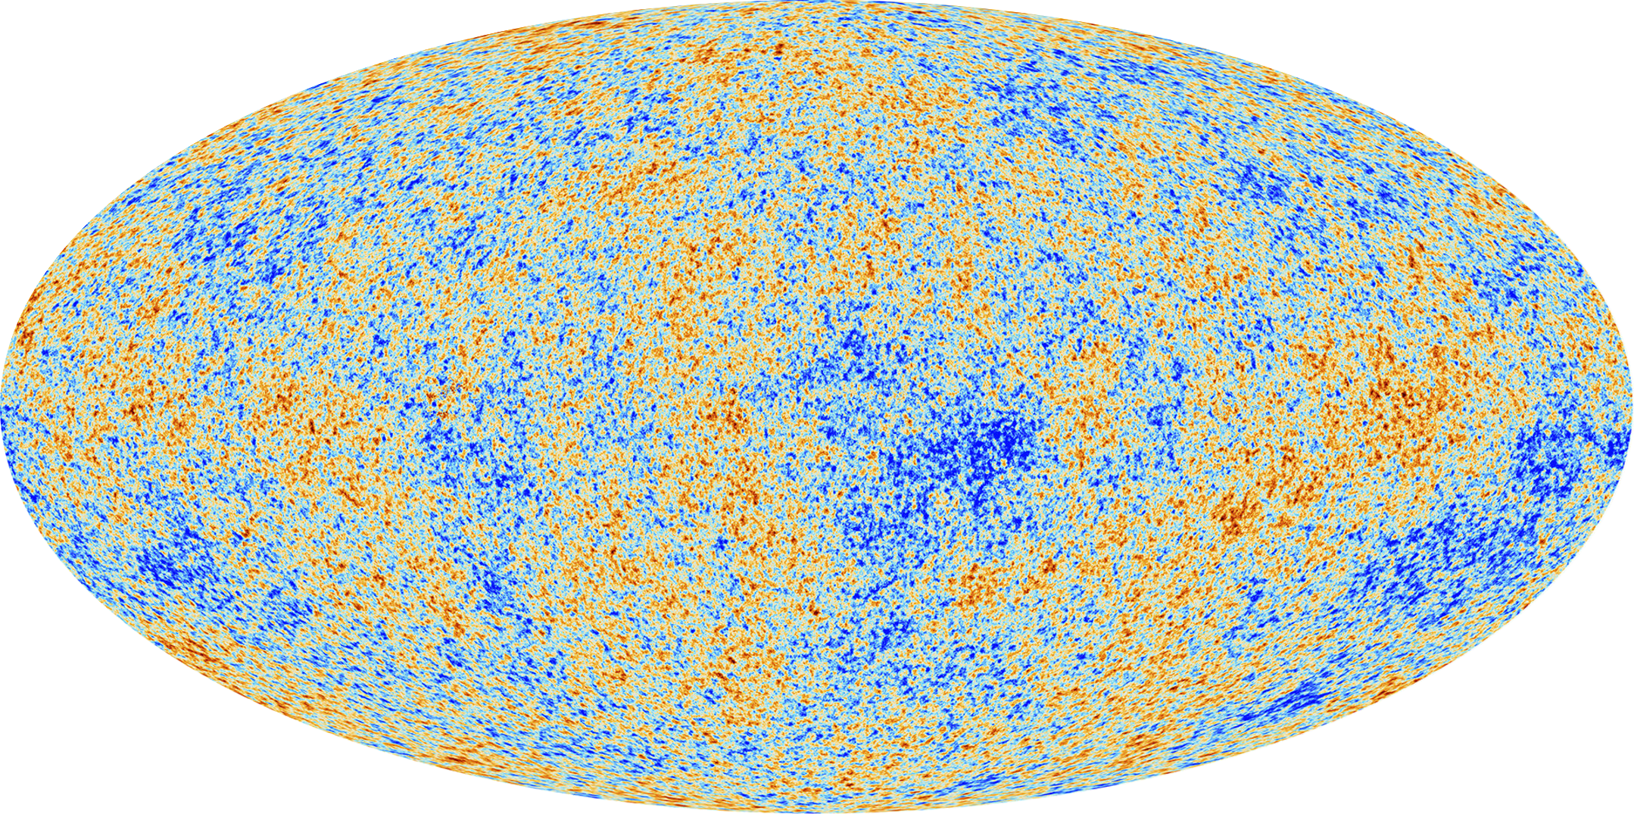



Jet: a proxy for system initiated by a parton
High-multiplicity jets
$$π$$
$$K$$
q/g
e/p
e/p
Hadronization
p
Beam axis
$$γ$$
…
Notes:
A particularly interesting case is high-multiplicity jets: systems that are small but very dense. If the energy density is high enough, they may become highly non-perturbative, perhaps even reach a regime that can be described by hydrodynamics

Slide 13
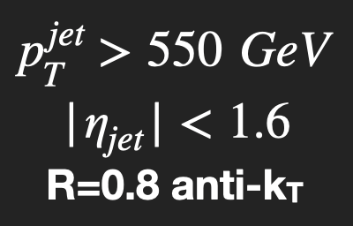

Full nominal pp data
from Run 2 (138/fb)
Full nominal pp data
from Run 2 (138/fb)
Pileups (~ 40) mitigate
Select top ~2,500 jets in $N_{ch}^{j}$out of 10⁸ jets analyzed
Analyzing only particles clustered into a jet
Notes:
These high-multiplicity jets are extremely rare, but they do exist.
With all the Run-2 data, CMS recorded about 2,500 jets with Nch > 95, enabling us to study this ultimate small system.
standard cms procedure for pileup mitigation called puppi
what is vn
transverse anisotropy
comes from initial geometry
the fact it converts initial anisotropy to the final state extremely efficient suggests it is strongly coupled and low viscosity (viscosity will smear out the fine strucure of flow )
the cartoon we have in mind

Slide 14
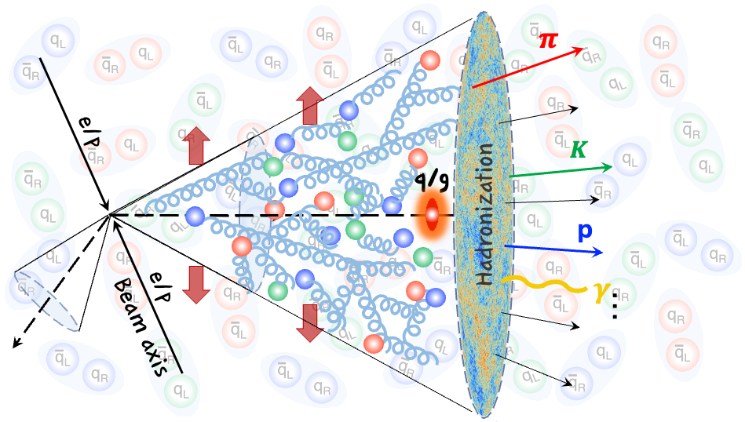
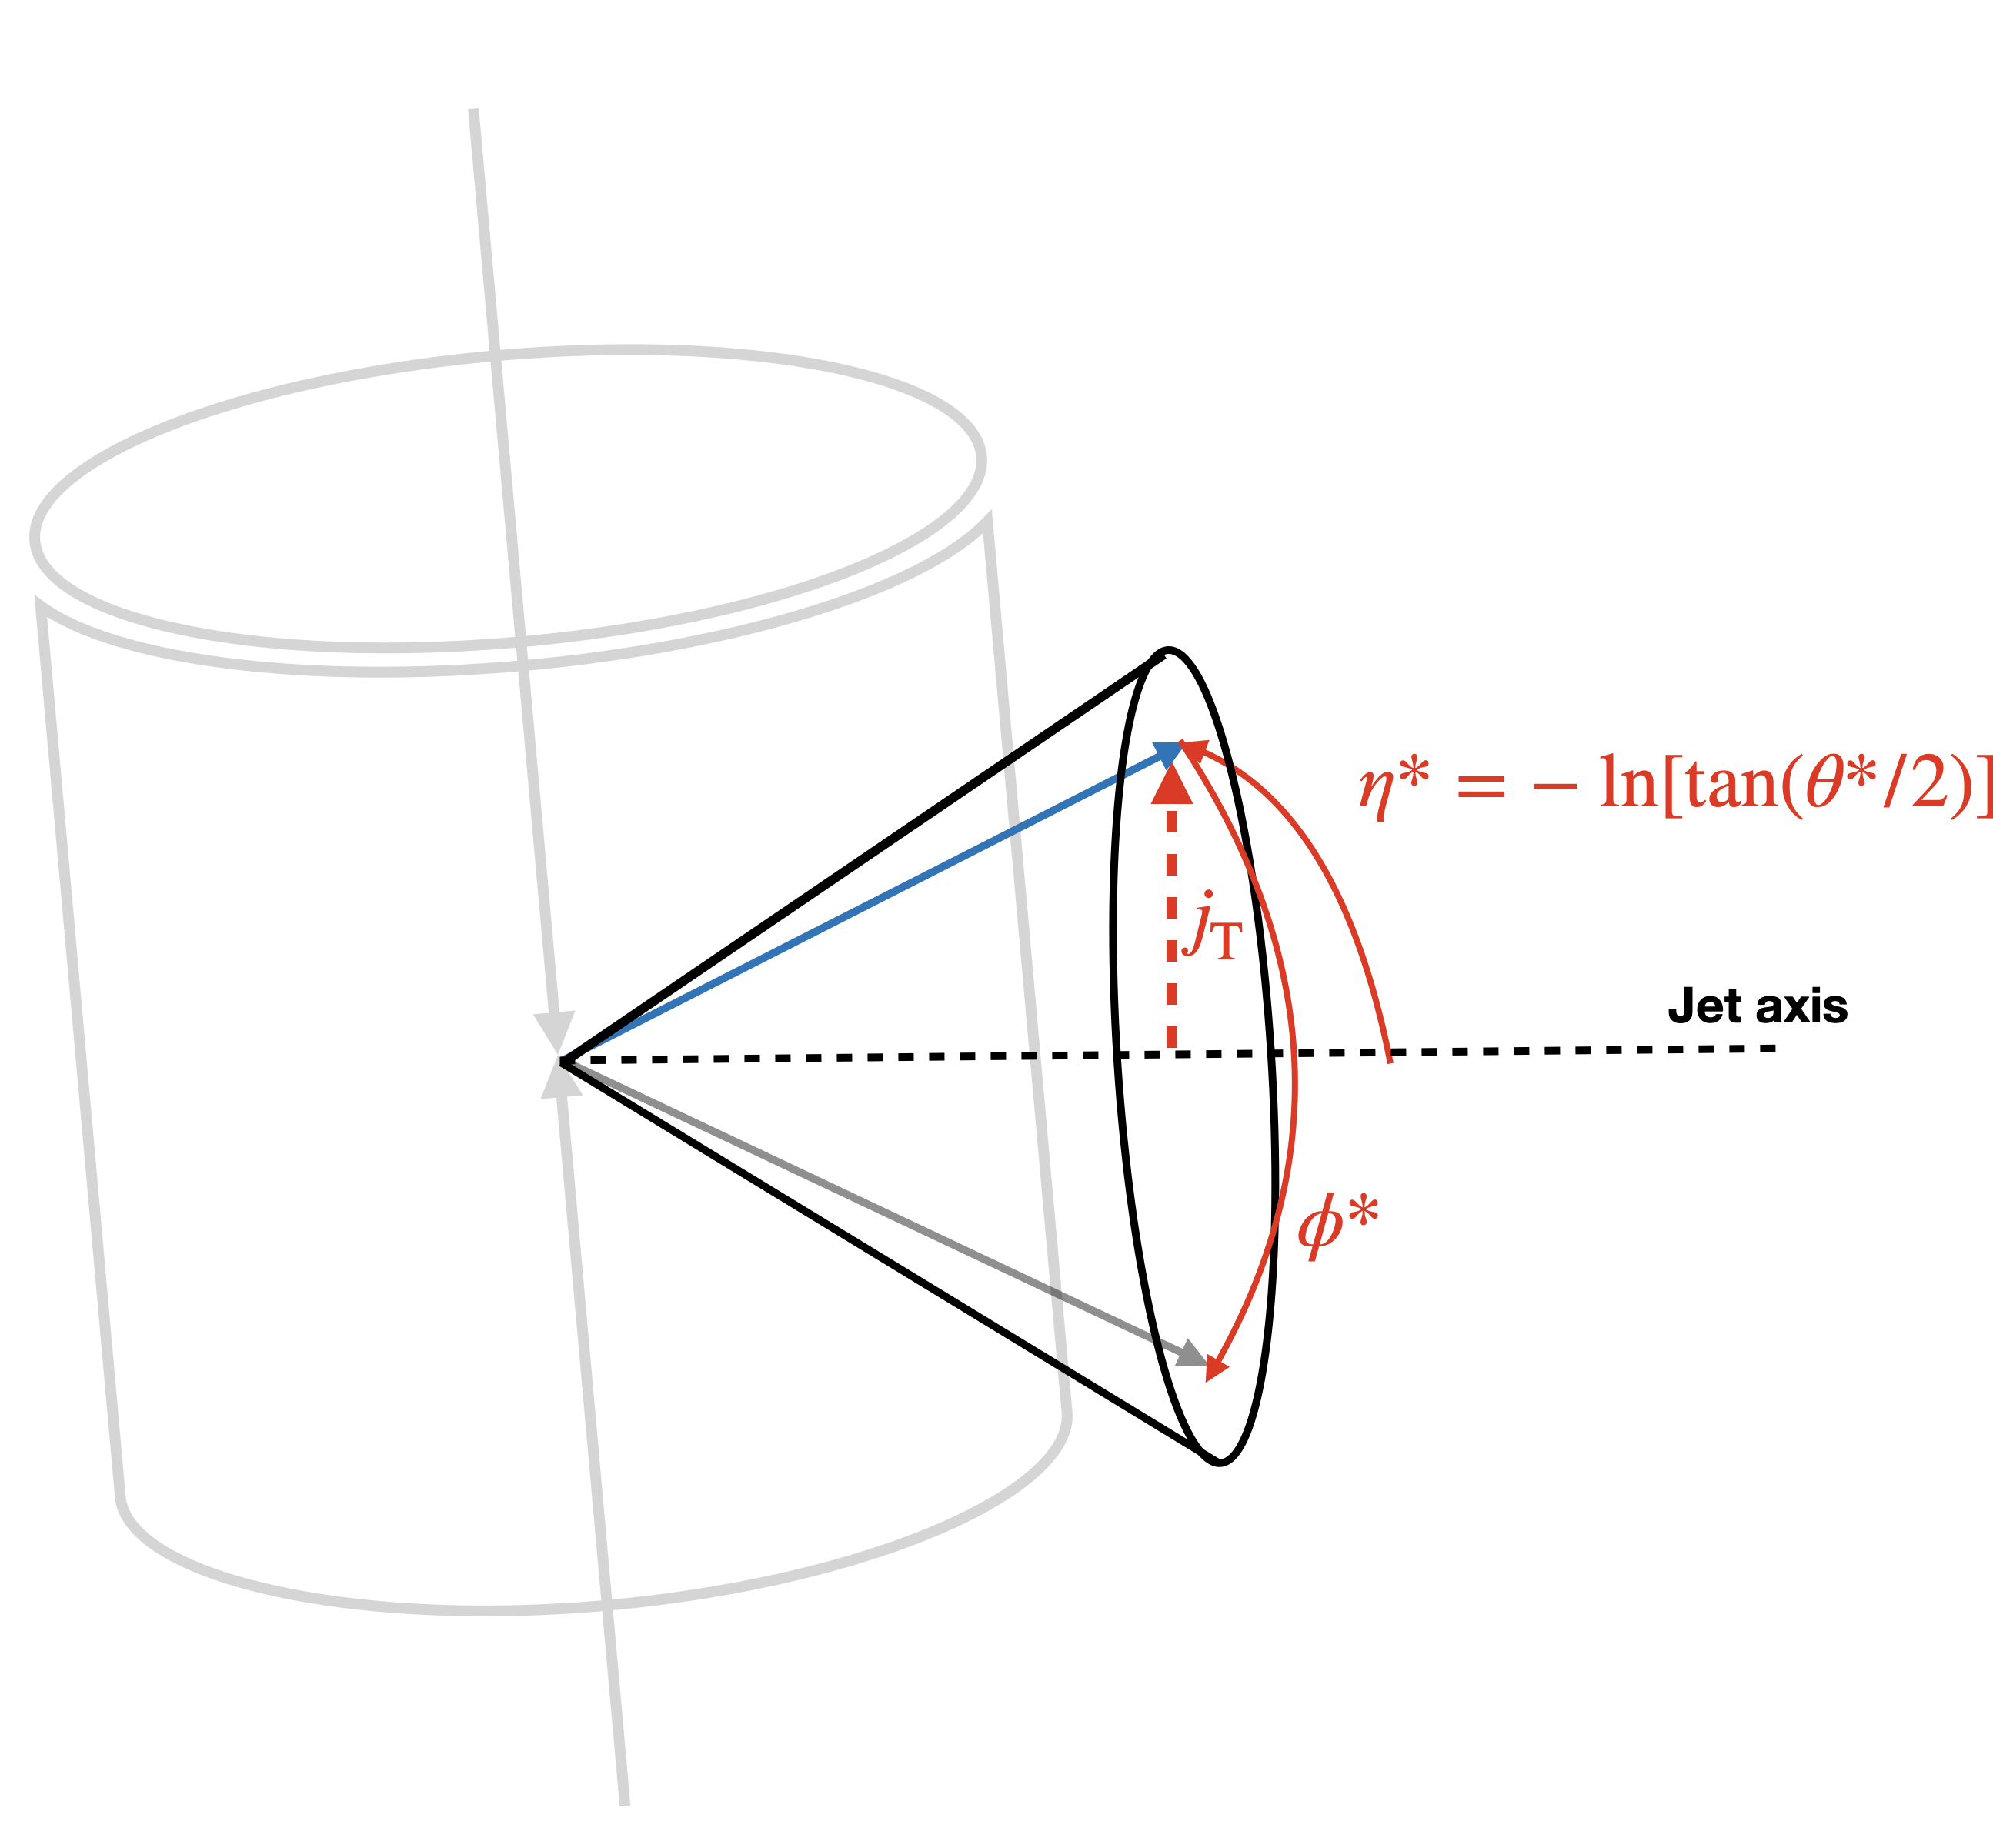
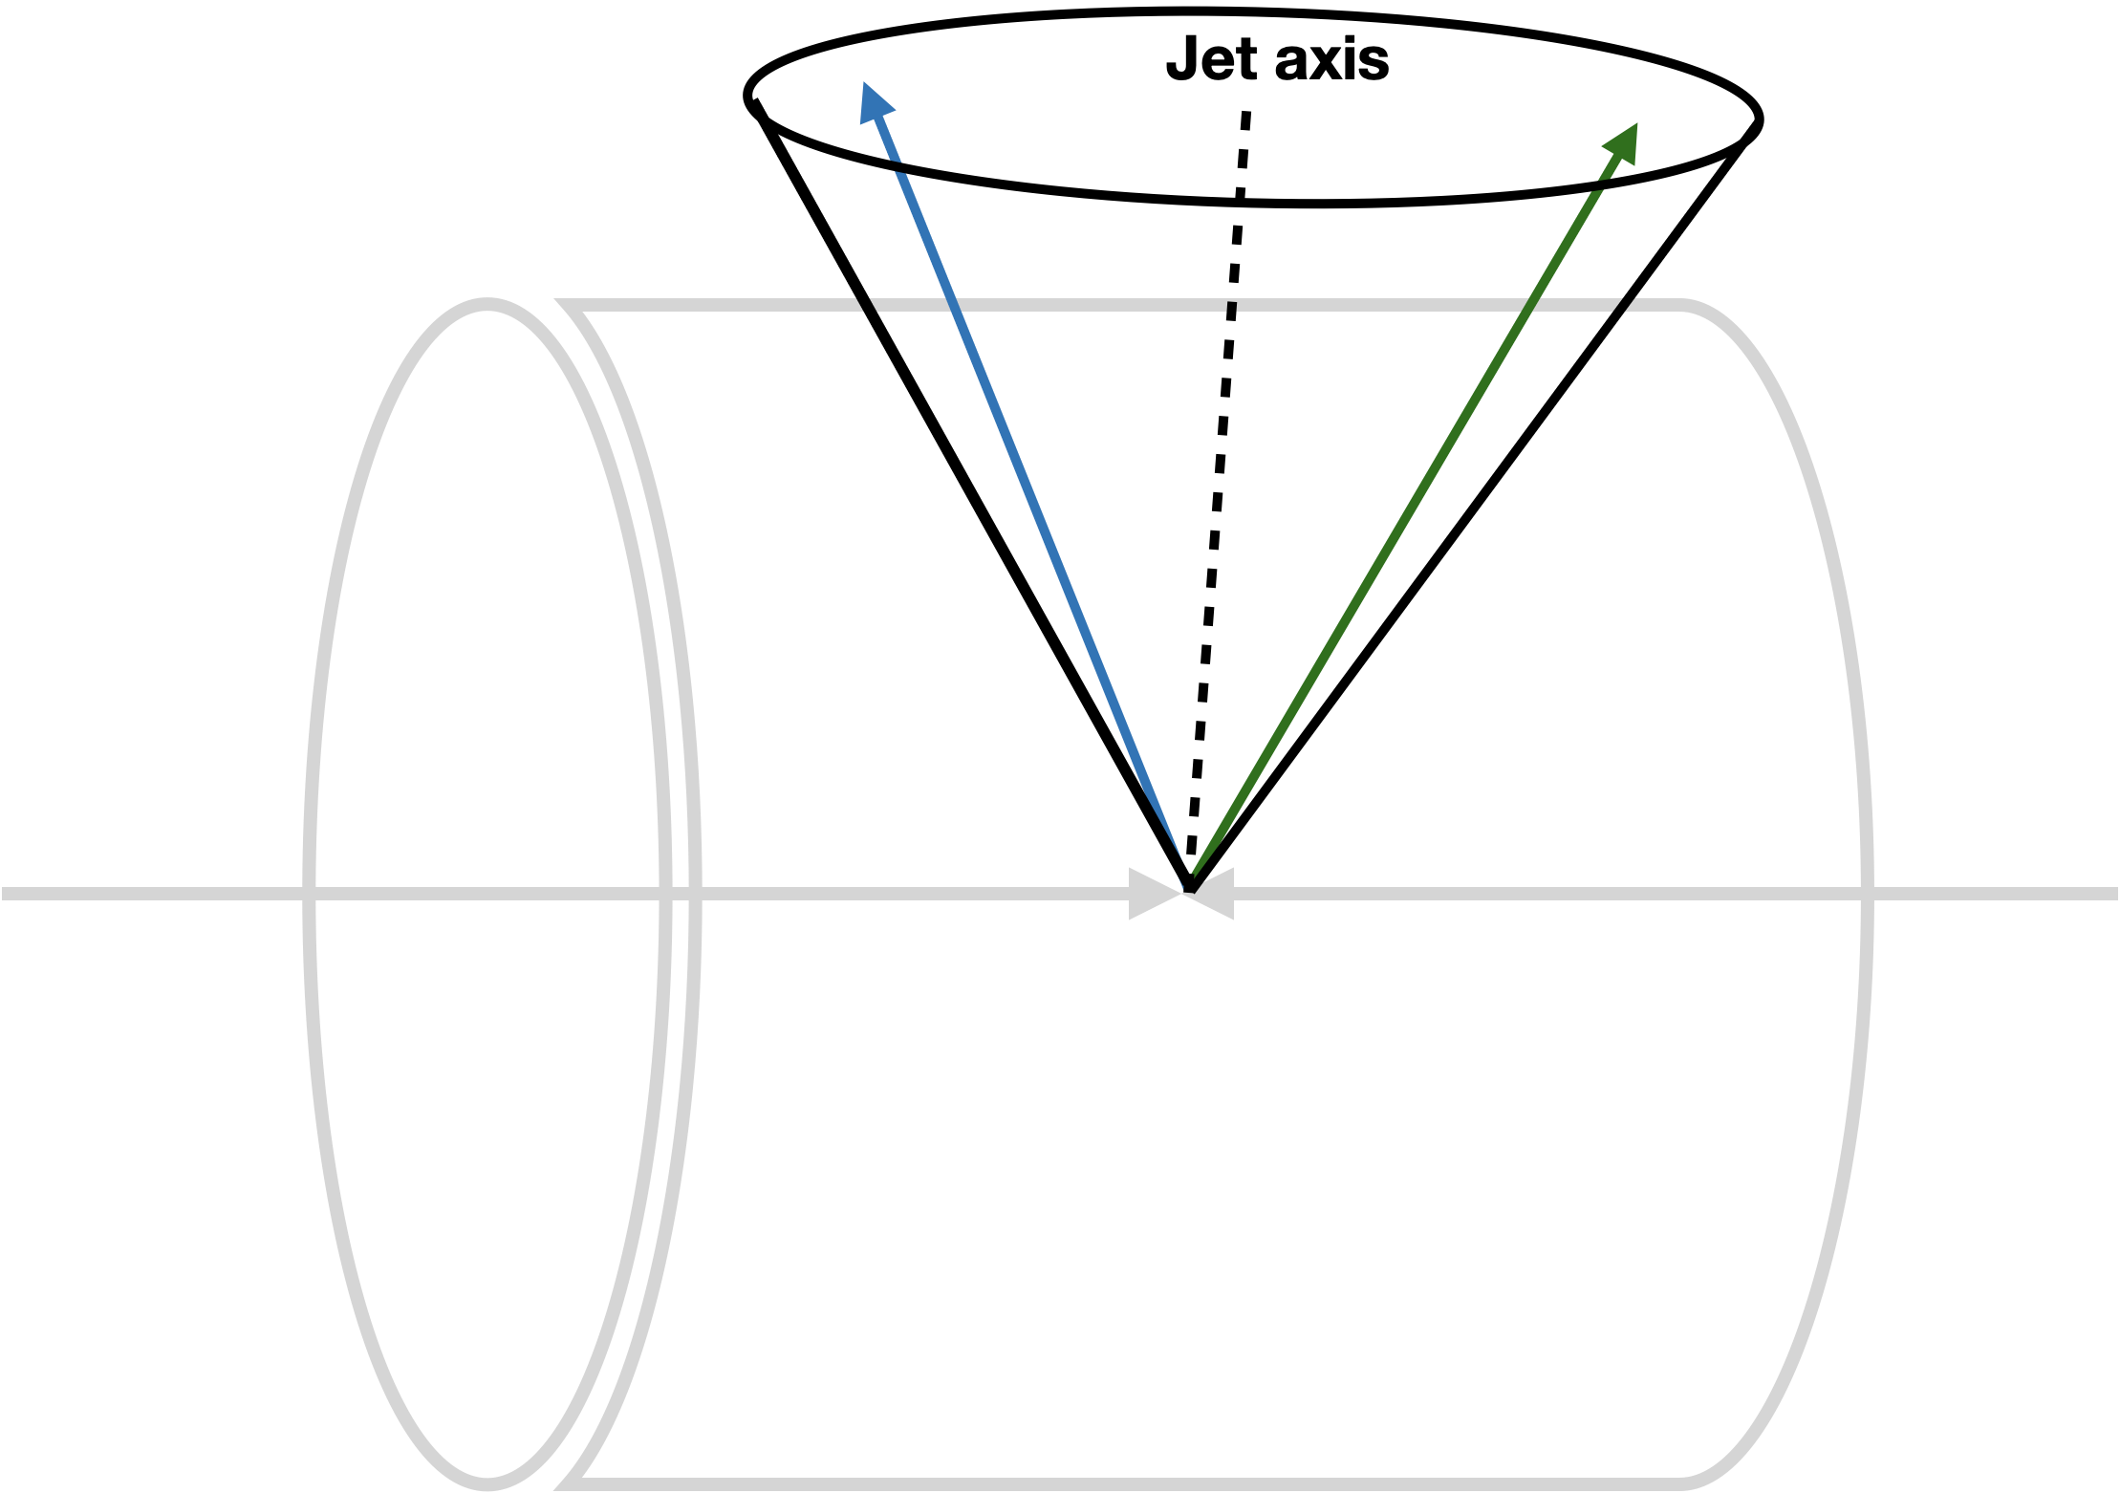


Projection to the jet axis
Jet axis
Jet axis
beam axis
$$φ^{∗}=0$$
beam axis
Lab frame
Jet frame
Projection is done for every jet individually.
$p=\left(p_{T},η, φ\right)$ ➜ $p^{∗}=\left(j_{T},η^{∗},φ^{∗}\right)$
Notes:
In order to look for any collective behavior in jets, one important aspect of the measurement is to go to the jet frame.
When a jet propagates, all transverse activity happens relative to the jet axis. Therefore, any azimuthal correlations we measure should also be defined with respect to the jet axis, not the beam axis.
phi* = 0 is perpendicular to the jet axis and defined in the plane spanned by the jet axis and the beam axis.
To look for any collective behavior inside jets, the first thing we need to do is to change our perspective and go to the jet frame.
Unlike heavy-ion collisions, where the beam axis provides a natural reference direction, all of the transverse activity in a jet develops relative to the jet axis. Therefore, any azimuthal correlations that we measure should also be defined with respect to the jet axis, not the beam axis.

Slide 15
Projection to the jet axis
70
Jet axis
$$φ^{∗}=0$$
beam axis
Jet frame
Projection is done for every jet individually.
$p=\left(p_{T},η, φ\right)$ ➜ $p^{∗}=\left(j_{T},η^{∗},φ^{∗}\right)$
Notes:
shift towards smaller eta, high Nch gluon radiation, large angle
reach peripheral Heavy ion collisions (rhic energy)

Slide 16
Two particle correlation within jets

Slide 17
Two particle correlation within jets
Similar
Notes:
Jets and collisions are kinematically equivalent up to a Lorentz boost.

Slide 18
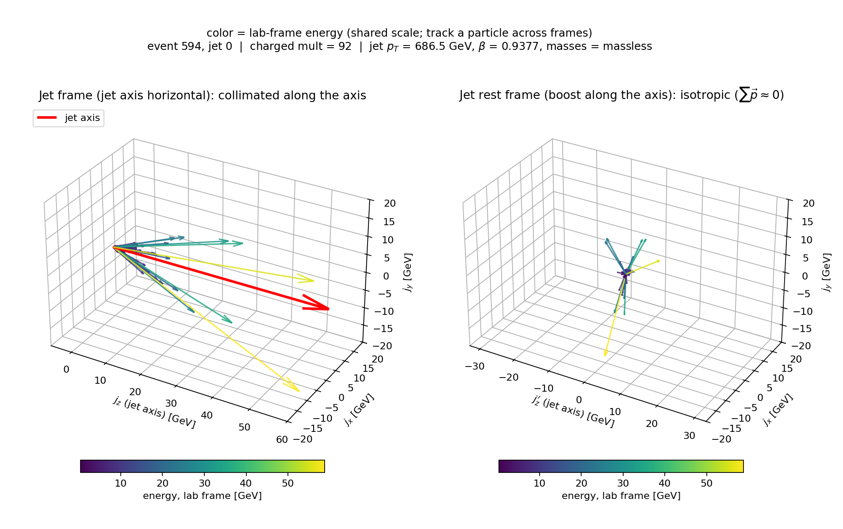

Two particle correlation within jets
Jet frame
Jet rest frame
Jets are “boosted collisions”
$∆φ^{∗}−Δη^{∗}$ is boost invariant
Notes:
conversely

Slide 19



Two particle correlation within jets
Momentum conservation
Jet frame
Jet rest frame
Collinear emission, mini-jets...
Jets are “boosted collisions”
$∆φ^{∗}−Δη^{∗}$ is boost invariant

Slide 20
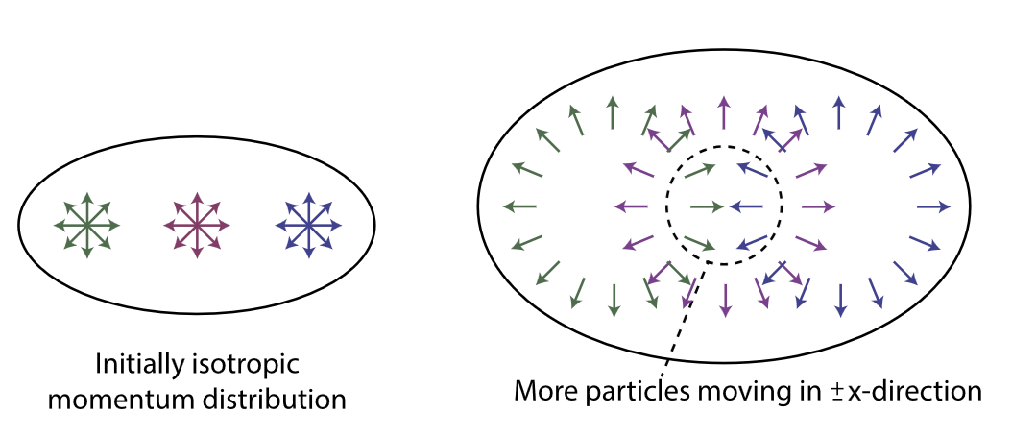
Two particle correlation within jets
Momentum conservation
What leads to a possible long-range, near-side ridge?
?
Phys.Lett.B 783 (2018)
Collinear emission, mini-jets...
“Single-hit dynamics”
Notes:
transport theory naturally accounts within the range of its validity for realistic signal sizes of the linear and non-
linear response coefficients observed in azimuthal momentum anisotropies with a large mean free path
of the order of the system size in peripheral (∼ 50% centrality) PbPb or central pPb collisions.

Slide 21
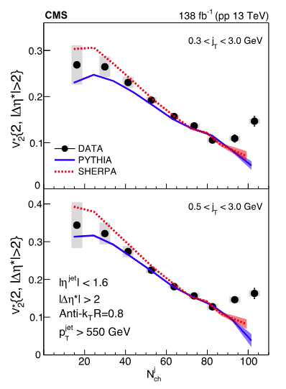

Elliptic flow $v_{2}^{∗}$
Enhanced elliptic anisotropies at high multiplicities
Onset of collectivity?
Where does it come from?
Final state interaction?
Initial-state geometry?
PRL 133 (2024) 142301
Notes:
Now let’s take a look at v₂ in the jet frame.
A surprising v₂ enhancement is observed at high Nch.
This enhancement cannot be explained by models such as Pythia8 or Sherpa.
This result is intriguing, because it may indicate the onset of collectivity within jets.

Slide 22


On the origin of long-range correlations
in high multiplicity jets – a model study
W. Zhao et. al.,arXiv:2401.13137
Hadron Interaction (UrQMD)
PYTHIA8
Parton Shower
Parton Cascade (ZPC)
Lund String Fragmentation
Tunable $σ_{p}$
On or Off
Xiao Huang (RICE), in collaboration with Wenbin Zhao, Zi-Wei Lin and Xin-Nian Wang.

Slide 23
On the origin of long-range correlations
in high multiplicity jets – a model study
W. Zhao et. al.,arXiv:2401.13137
Hadron Interaction (UrQMD)
PYTHIA8
Parton Shower
Parton Cascade (ZPC)
Lund String Fragmentation
Tunable $σ_{p}$
On or Off
Final state interaction:
partonic (pFSI)
hadronic (hFSI)
Initial anisotropy within a jet
Collective flow?
Xiao Huang (RICE), in collaboration with Wenbin Zhao, Zi-Wei Lin and Xin-Nian Wang.

Slide 24
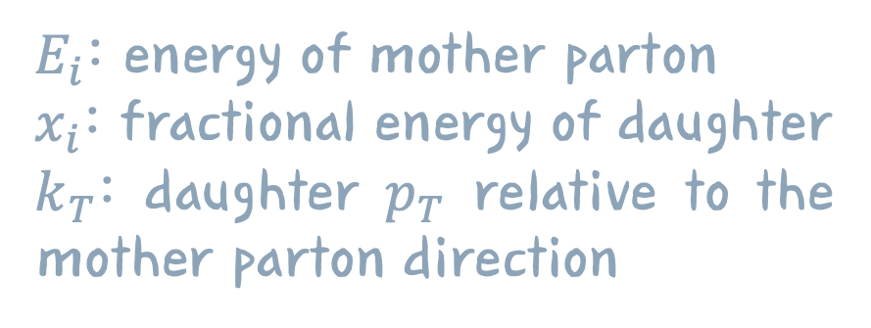
Parton shower
Formation time: accumulated from the full PYTHIA splitting history.
Formation position: accumulated from the straight-line propagation of all ancestor partons before each splitting.
$E_{i}$: energy of mother parton
$x_{i}$: fractional energy of daughter
$k_{T}$: daughter $p_{T}$ relative to the mother parton direction

Slide 25
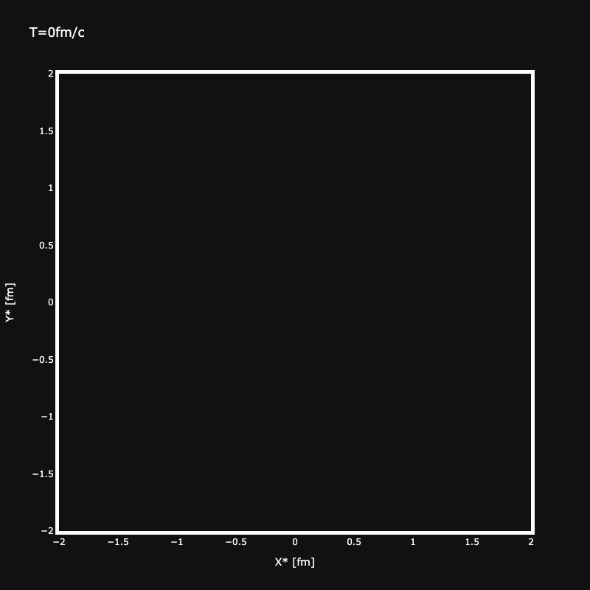
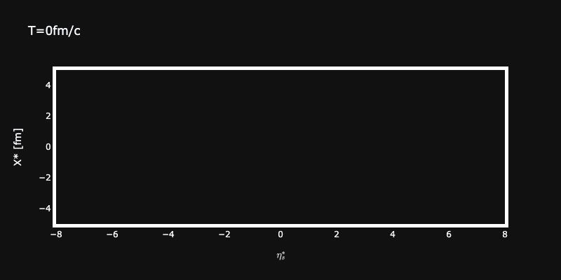




Initial stage of a jet
Space-time evolution of parton showers for a jet with $N_{ch}^{j}>100$
PYTHIA8
PYTHIA8
$$y^{∗} [fm]$$
$$x^{∗} [fm]$$
jet axis
$$η_{s}^{∗}$$
$$x^{∗} [fm]$$
Gif made by Feng Liu (SBU/BNL)
Notes:
Just to begin with a brief introduction to what we do in high-energy nuclear experiments: in general, we are interested in matter under extreme conditions.
Quantum Chromodynamics predicts the existence of a deconfined state of matter — the quark–gluon plasma, or QGP — at very high energy densities. We are able to reach such conditions through relativistic heavy-ion collisions.
In these collisions, the temperature at the center can reach trillions of degrees, hot enough to melt protons and neutrons, creating a small droplet of QGP.
As a comparison, in minimum-bias proton–proton collisions, the protons are effectively point-like, the system is too small for significant partonic rescattering, and therefore no QGP is expected to form.
QGP: Deconfined matter over large distances, interact and evolve (~10 fm/c) nonperturbatively
Both size and color are E, brighter and larger -> higher energy

Slide 26
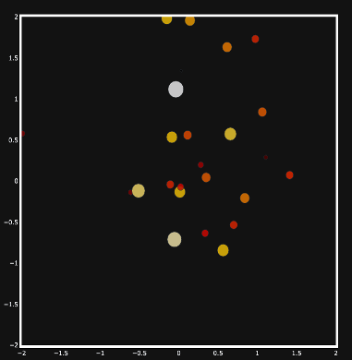
Initial transverse geometry
PYTHIA8
T=2fm/c
PYTHIA8
$$y^{∗} [fm]$$
$$y^{∗} [fm]$$
$$x^{∗} [fm]$$
$$x^{∗} [fm]$$
Notes:
Just to begin with a brief introduction to what we do in high-energy nuclear experiments: in general, we are interested in matter under extreme conditions.
Quantum Chromodynamics predicts the existence of a deconfined state of matter — the quark–gluon plasma, or QGP — at very high energy densities. We are able to reach such conditions through relativistic heavy-ion collisions.
In these collisions, the temperature at the center can reach trillions of degrees, hot enough to melt protons and neutrons, creating a small droplet of QGP.
As a comparison, in minimum-bias proton–proton collisions, the protons are effectively point-like, the system is too small for significant partonic rescattering, and therefore no QGP is expected to form.
QGP: Deconfined matter over large distances, interact and evolve (~10 fm/c) nonperturbatively
Both size and color are E, brighter and larger -> higher energy

Slide 27
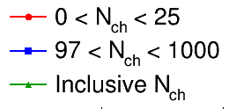
Initial transverse geometry
Sizable initial-state eccentricity
PYTHIA8
T=2fm/c
PYTHIA8
$$y^{∗} [fm]$$
$$y^{∗} [fm]$$
$$x^{∗} [fm]$$
$$x^{∗} [fm]$$
Notes:
Just to begin with a brief introduction to what we do in high-energy nuclear experiments: in general, we are interested in matter under extreme conditions.
Quantum Chromodynamics predicts the existence of a deconfined state of matter — the quark–gluon plasma, or QGP — at very high energy densities. We are able to reach such conditions through relativistic heavy-ion collisions.
In these collisions, the temperature at the center can reach trillions of degrees, hot enough to melt protons and neutrons, creating a small droplet of QGP.
As a comparison, in minimum-bias proton–proton collisions, the protons are effectively point-like, the system is too small for significant partonic rescattering, and therefore no QGP is expected to form.
QGP: Deconfined matter over large distances, interact and evolve (~10 fm/c) nonperturbatively
Both size and color are E, brighter and larger -> higher energy

Slide 28
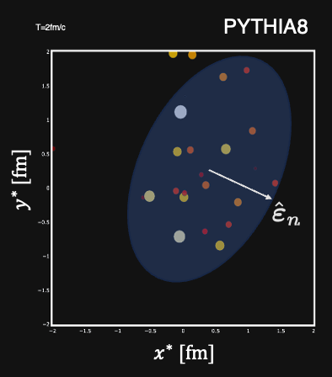
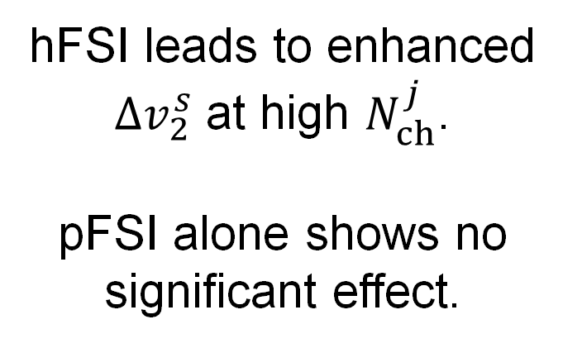
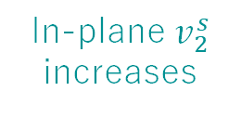
Elliptic flow w.r.t “participant plane”
No FSI
Only pFSI
Only hFSI
pFSI + hFSI
In-plane $v_{2}^{s}$ increases
hFSI leads to enhanced ${∆v}_{2}^{s}$ at high $N_{ch}^{j}$.
pFSI alone shows no significant effect.
Notes:
v_{n}^{s}\equiv\frac{\langle \mathbf{Q}_{n} \boldsymbol{\varepsilon}_n^{*}\rangle}{\sqrt{\langle \boldsymbol{\varepsilon}_{n}\boldsymbol{\varepsilon}_{n}^{*} \rangle}}
\mathbf{Q}_n
\equiv
Q_n e^{i n \Psi_n}
=
\frac{1}{N}\sum_{j=1}^{N} e^{i n \phi_j^*}

Slide 29
Why is pFSI effect small?
Small partonic opacity?
Forward rescattering angles in ZPC?
More studies underway:
  increase partonic opacity
  isotropic rescattering angles
Notes:
v_{n}^{s}\equiv\frac{\langle \mathbf{Q}_{n} \boldsymbol{\varepsilon}_n^{*}\rangle}{\sqrt{\langle \boldsymbol{\varepsilon}_{n}\boldsymbol{\varepsilon}_{n}^{*} \rangle}}
\mathbf{Q}_n
\equiv
Q_n e^{i n \Psi_n}
=
\frac{1}{N}\sum_{j=1}^{N} e^{i n \phi_j^*}

Slide 30
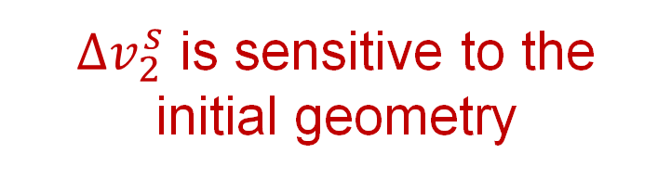
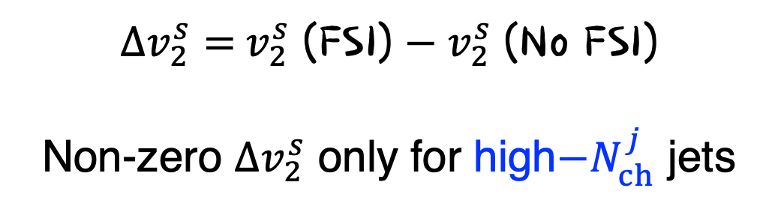
Flow response to initial geometry
$Δv_{2}^{s}=$ $v_{2}^{s}$ (FSI) $−{ v}_{2}^{s}$ (No FSI)
Non-zero $Δv_{2}^{s}$ only for high$−N_{ch}^{j}$ jets
${∆v}_{2}^{s}$ is sensitive to the initial geometry

Slide 31
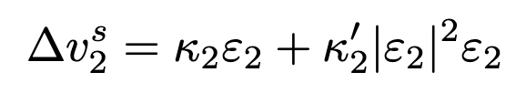
Flow response to initial geometry
${∆v}_{2}^{s}$ is sensitive to the initial geometry
Flow response increases with opacity

Slide 32
Two-particle correlation
Final state interactions lead to $v_{2}^{∗}$ enhancement at high $N_{ch}^{j}$.

Slide 33
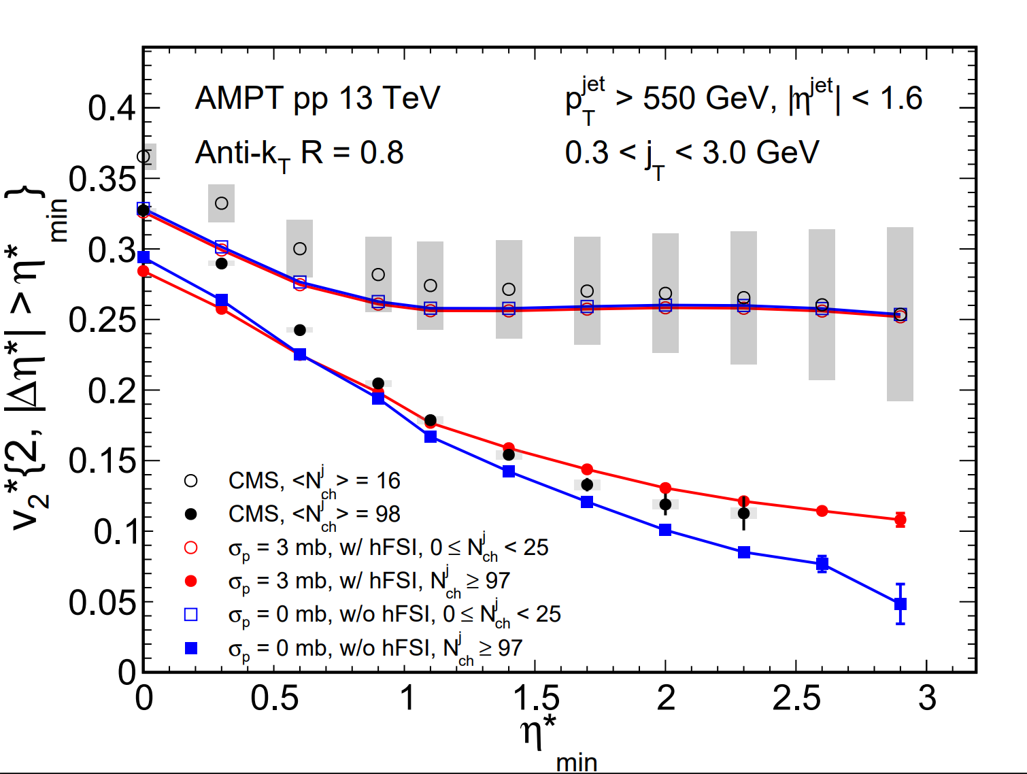



Pseudorapidity gap dependent $v_{2}^{∗}$
FSI ON
FSI OFF
$${Δη}_{min}^{∗}$$
$${Δη}_{min}^{∗}$$

Slide 34
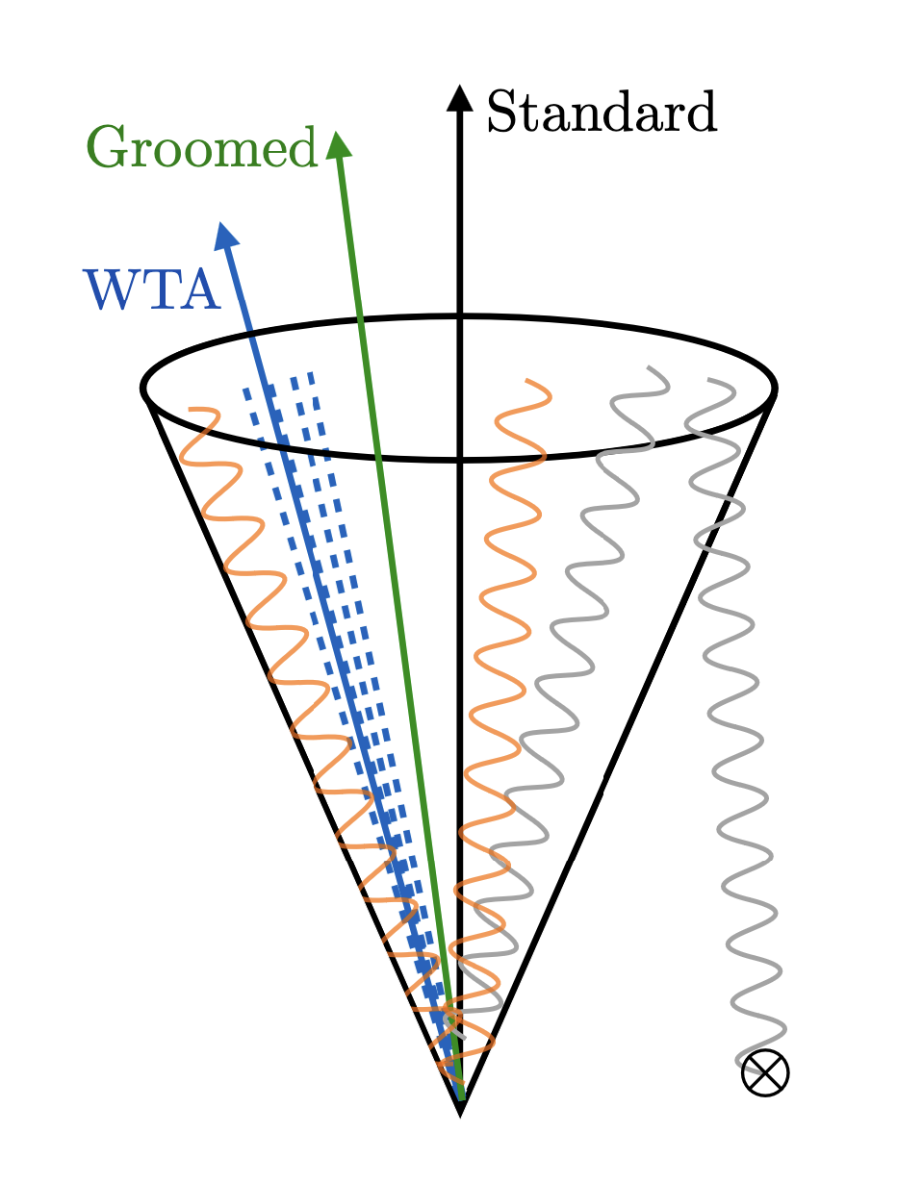
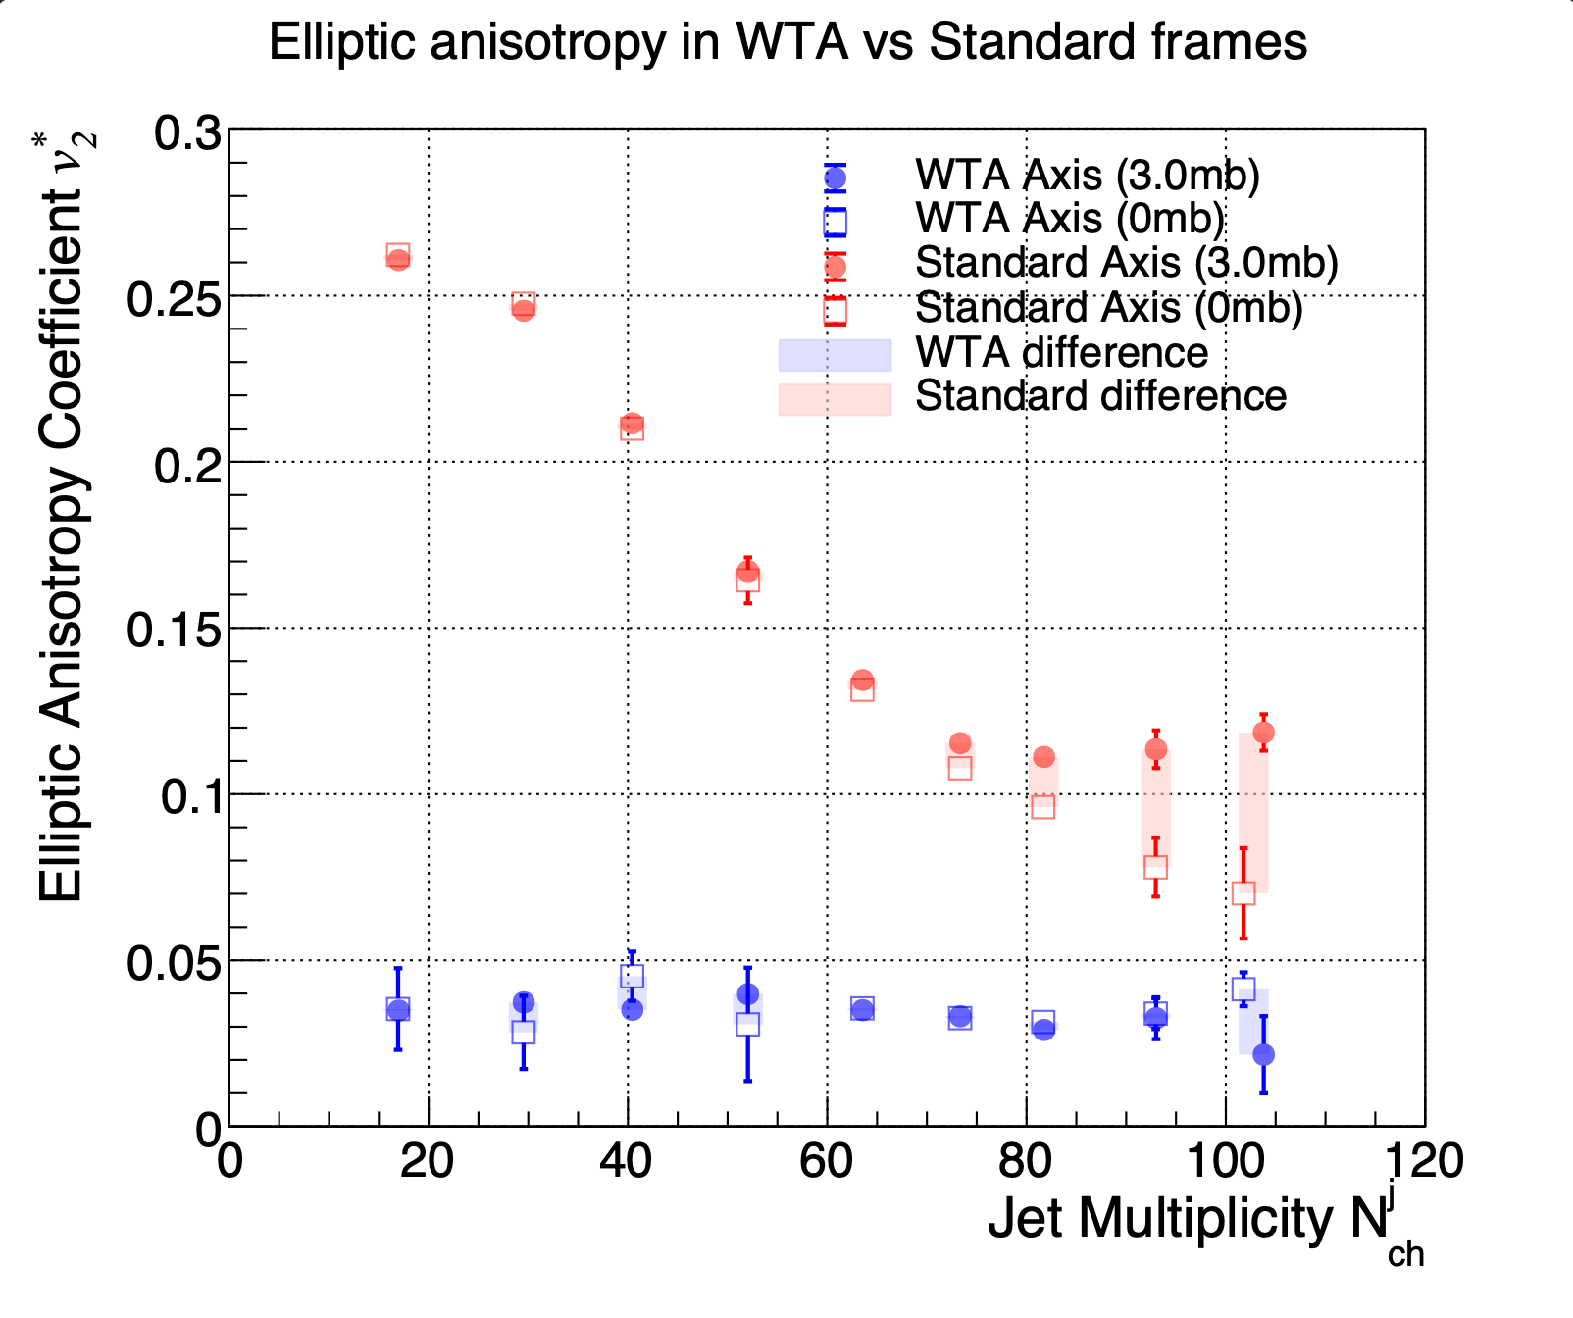
Winner-take-all (WTA) axis
Model study done by Rohan Jagadeesa (RICE)
(E-scheme)
WTA (w/ FSI)
WTA (w/o FSI)
E-scheme (w/ FSI)
E-scheme (w/o FSI)
WTA difference
E-scheme difference
JHEP04(2020)211
WTA mitigates nonflow from the momentum conservation effect but also suppresses the signal of interest.

Slide 35
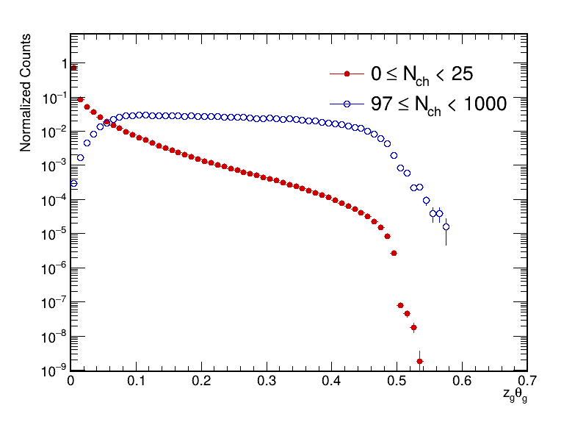
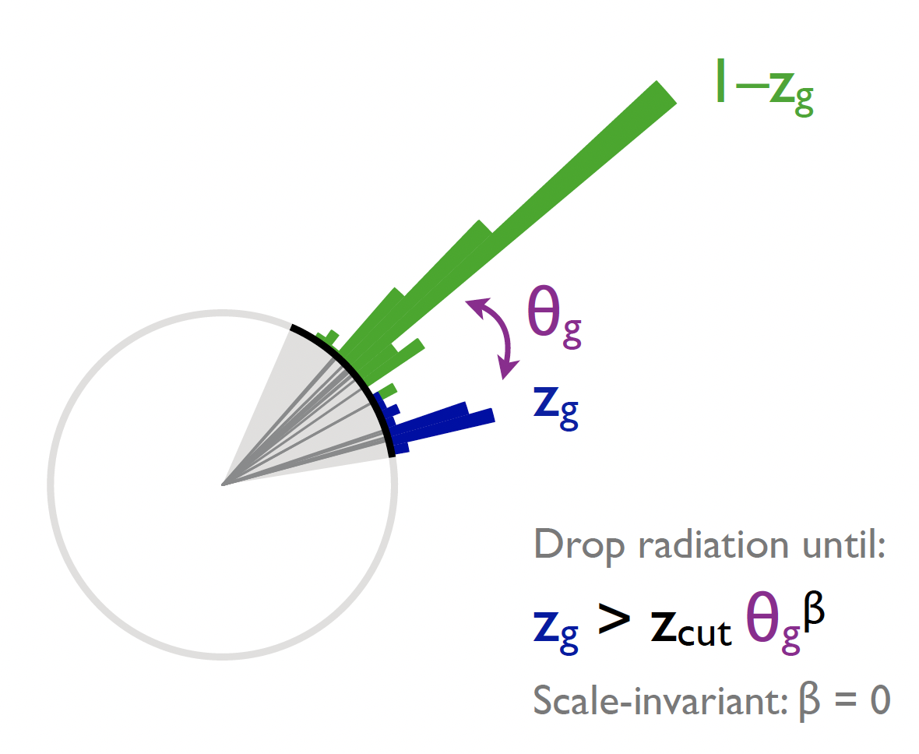
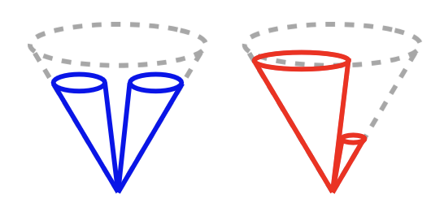

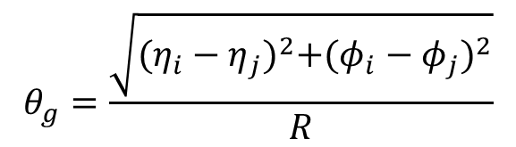
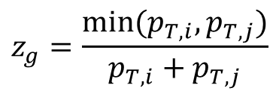
Effect of initial geometry – jet shape engineering
$$z_{g}=\frac{min⁡(p_{T,i},p_{T,j})}{p_{T,i}+p_{T,j}}$$
PYTHIA 8 pp 13 TeV
$$θ_{g}=\frac{\sqrt{{(η_{i}−η_{j})}^{2}+{(φ_{i}−φ_{j})}^{2}}}{R}$$
z_{cut}=0.1 $β$=1
Increasing
initial anisotropy?
J. Thaler

Slide 36
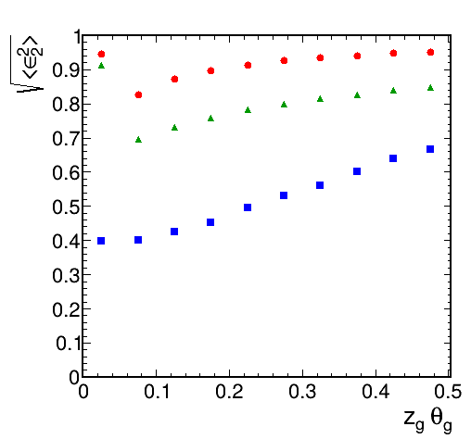
Jet substructure vs. eccentricity
Engineering the substructure does vary the “initial jet geometry”.

Slide 37
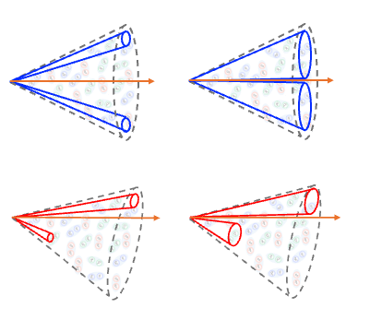

Jet substructure classified $v_{2}^{∗}(N_{ch}^{j})$
Enhancement of $v_{2}^{∗}$ relative to MC mainly for two-prone jets.

Slide 38
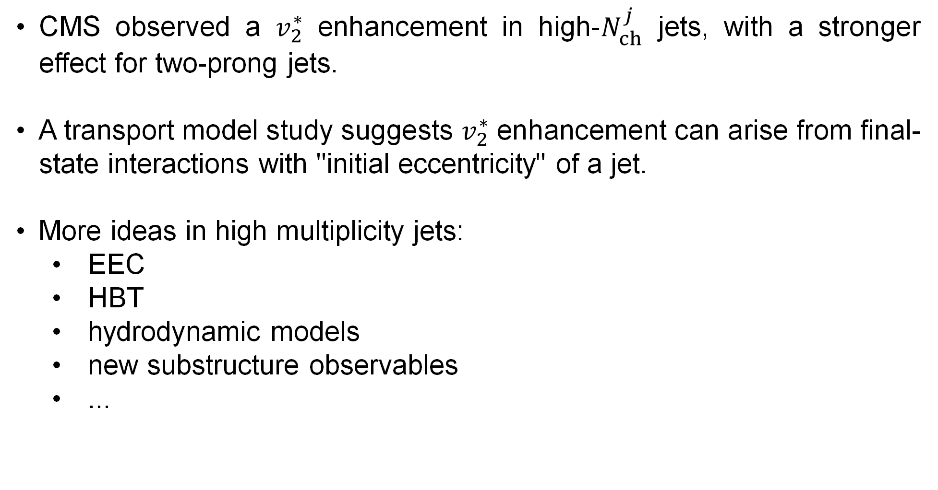
Summary and outlook
CMS observed a $v_{2}^{∗}$ enhancement in high-$N_{ch}^{j}$ jets, with a stronger effect for two-prong jets.
A transport model study suggests $v_{2}^{∗}$ enhancement can arise from final-state interactions with "initial eccentricity" of a jet.
More ideas in high multiplicity jets:
  EEC
  HBT
  hydrodynamic models
  new substructure observables
  ...
Notes:
just beginning, future plan

Slide 39
backup

Slide 40
Initial stage of a jet
Space-time evolution of parton showers for a jet with $N_{ch}^{j}>100$
PYTHIA8
PYTHIA8
$$y^{∗} [fm]$$
$$x^{∗} [fm]$$
jet axis
$$η_{s}^{∗}$$
$$x^{∗} [fm]$$
Gif made by Feng Liu (SBU/BNL)
Notes:
Just to begin with a brief introduction to what we do in high-energy nuclear experiments: in general, we are interested in matter under extreme conditions.
Quantum Chromodynamics predicts the existence of a deconfined state of matter — the quark–gluon plasma, or QGP — at very high energy densities. We are able to reach such conditions through relativistic heavy-ion collisions.
In these collisions, the temperature at the center can reach trillions of degrees, hot enough to melt protons and neutrons, creating a small droplet of QGP.
As a comparison, in minimum-bias proton–proton collisions, the protons are effectively point-like, the system is too small for significant partonic rescattering, and therefore no QGP is expected to form.
QGP: Deconfined matter over large distances, interact and evolve (~10 fm/c) nonperturbatively
Both size and color are E, brighter and larger -> higher energy

Slide 41
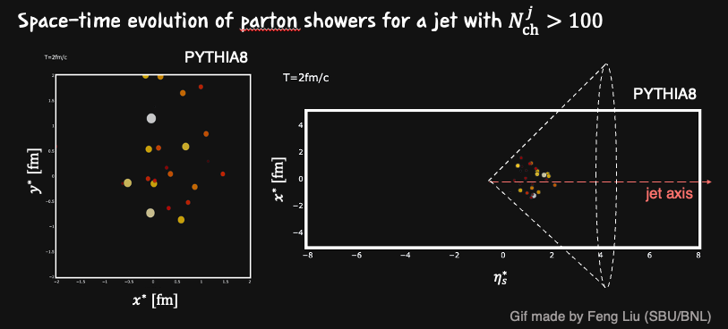
Initial stage of a jet
Gif made by Feng Liu (SBU/BNL)
Notes:
Just to begin with a brief introduction to what we do in high-energy nuclear experiments: in general, we are interested in matter under extreme conditions.
Quantum Chromodynamics predicts the existence of a deconfined state of matter — the quark–gluon plasma, or QGP — at very high energy densities. We are able to reach such conditions through relativistic heavy-ion collisions.
In these collisions, the temperature at the center can reach trillions of degrees, hot enough to melt protons and neutrons, creating a small droplet of QGP.
As a comparison, in minimum-bias proton–proton collisions, the protons are effectively point-like, the system is too small for significant partonic rescattering, and therefore no QGP is expected to form.
QGP: Deconfined matter over large distances, interact and evolve (~10 fm/c) nonperturbatively
Both size and color are E, brighter and larger -> higher energy

Slide 42
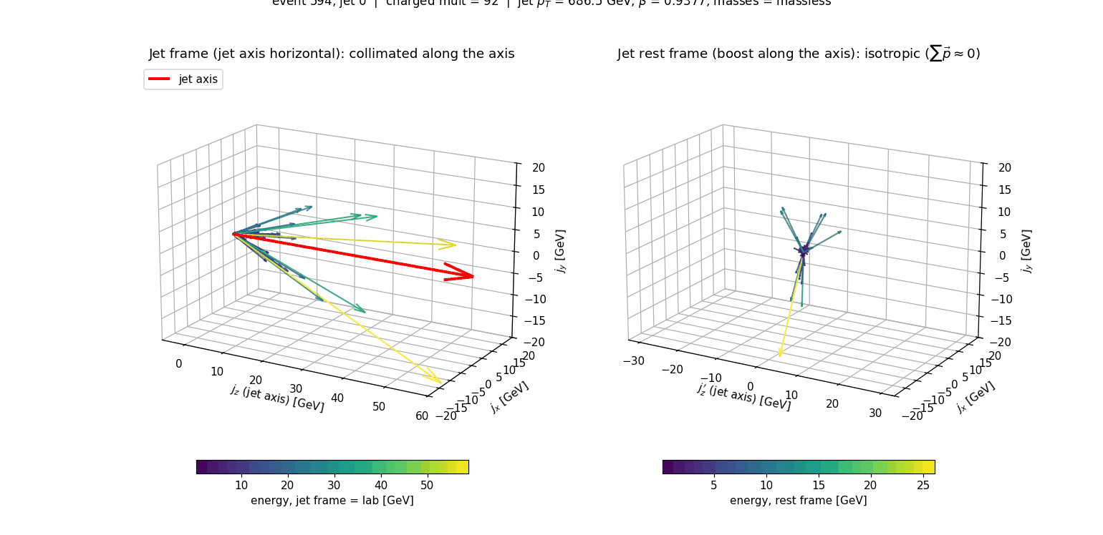
Jet frame vs. jet rest frame

Slide 43
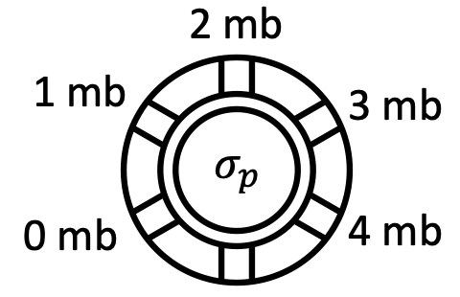
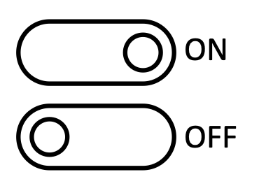



Jet charged multiplicity
Hadronic rescatterings broaden the $N_{ch}^{j}$ distribution.
w/ hadronic FSI
w/o hadronic FSI

Slide 44


Initial transverse geometry
$$y^{∗} [fm]$$
$$x^{∗} [fm]$$
Notes:
Focusing on the transverse direction, we can quantify the initial jet geometry by the eccentricity of the partons. At a given time, we find the energy-weighted centroid of the partons, calculate the azimuthal angle in the coordinate space w.s.p to it. And eventually calculate eccentricity, \epsilon2.
The plot on the right shows the time evolution of eccentricity for low-, high-, and inclusive jets. You see that a sizable initial eccentricity exists for all of them.
energy-weighted centroid
\boldsymbol{\varepsilon}_n = \varepsilon_n e^{i n \Phi_n} \equiv \frac{\sum_j w_j e^{i n \phi^{*,\mathrm{coord}}_j}}{\sum_j w_j}, \qquad \phi^{*,\mathrm{coord}}_j = \arctan\!\left(\frac{y^*_j - \langle y^* \rangle_p}{x^*_j - \langle x^* \rangle_p}\right)

Slide 45
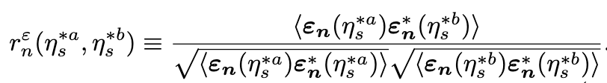

Initial longitudinal structure
Strong decorrelation across $η_{s}$

Slide 46
2D correlation within jets
Notes:
mention all charged particles are included

Slide 47
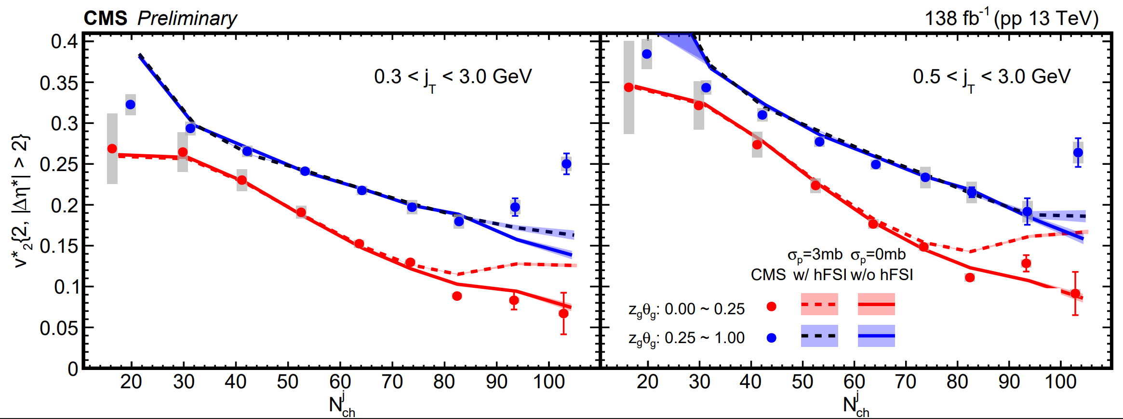
Jet substructure – model study
High-multiplicity jets
Larger $v_{2}$ enhancement for one prong jet?

Slide 48
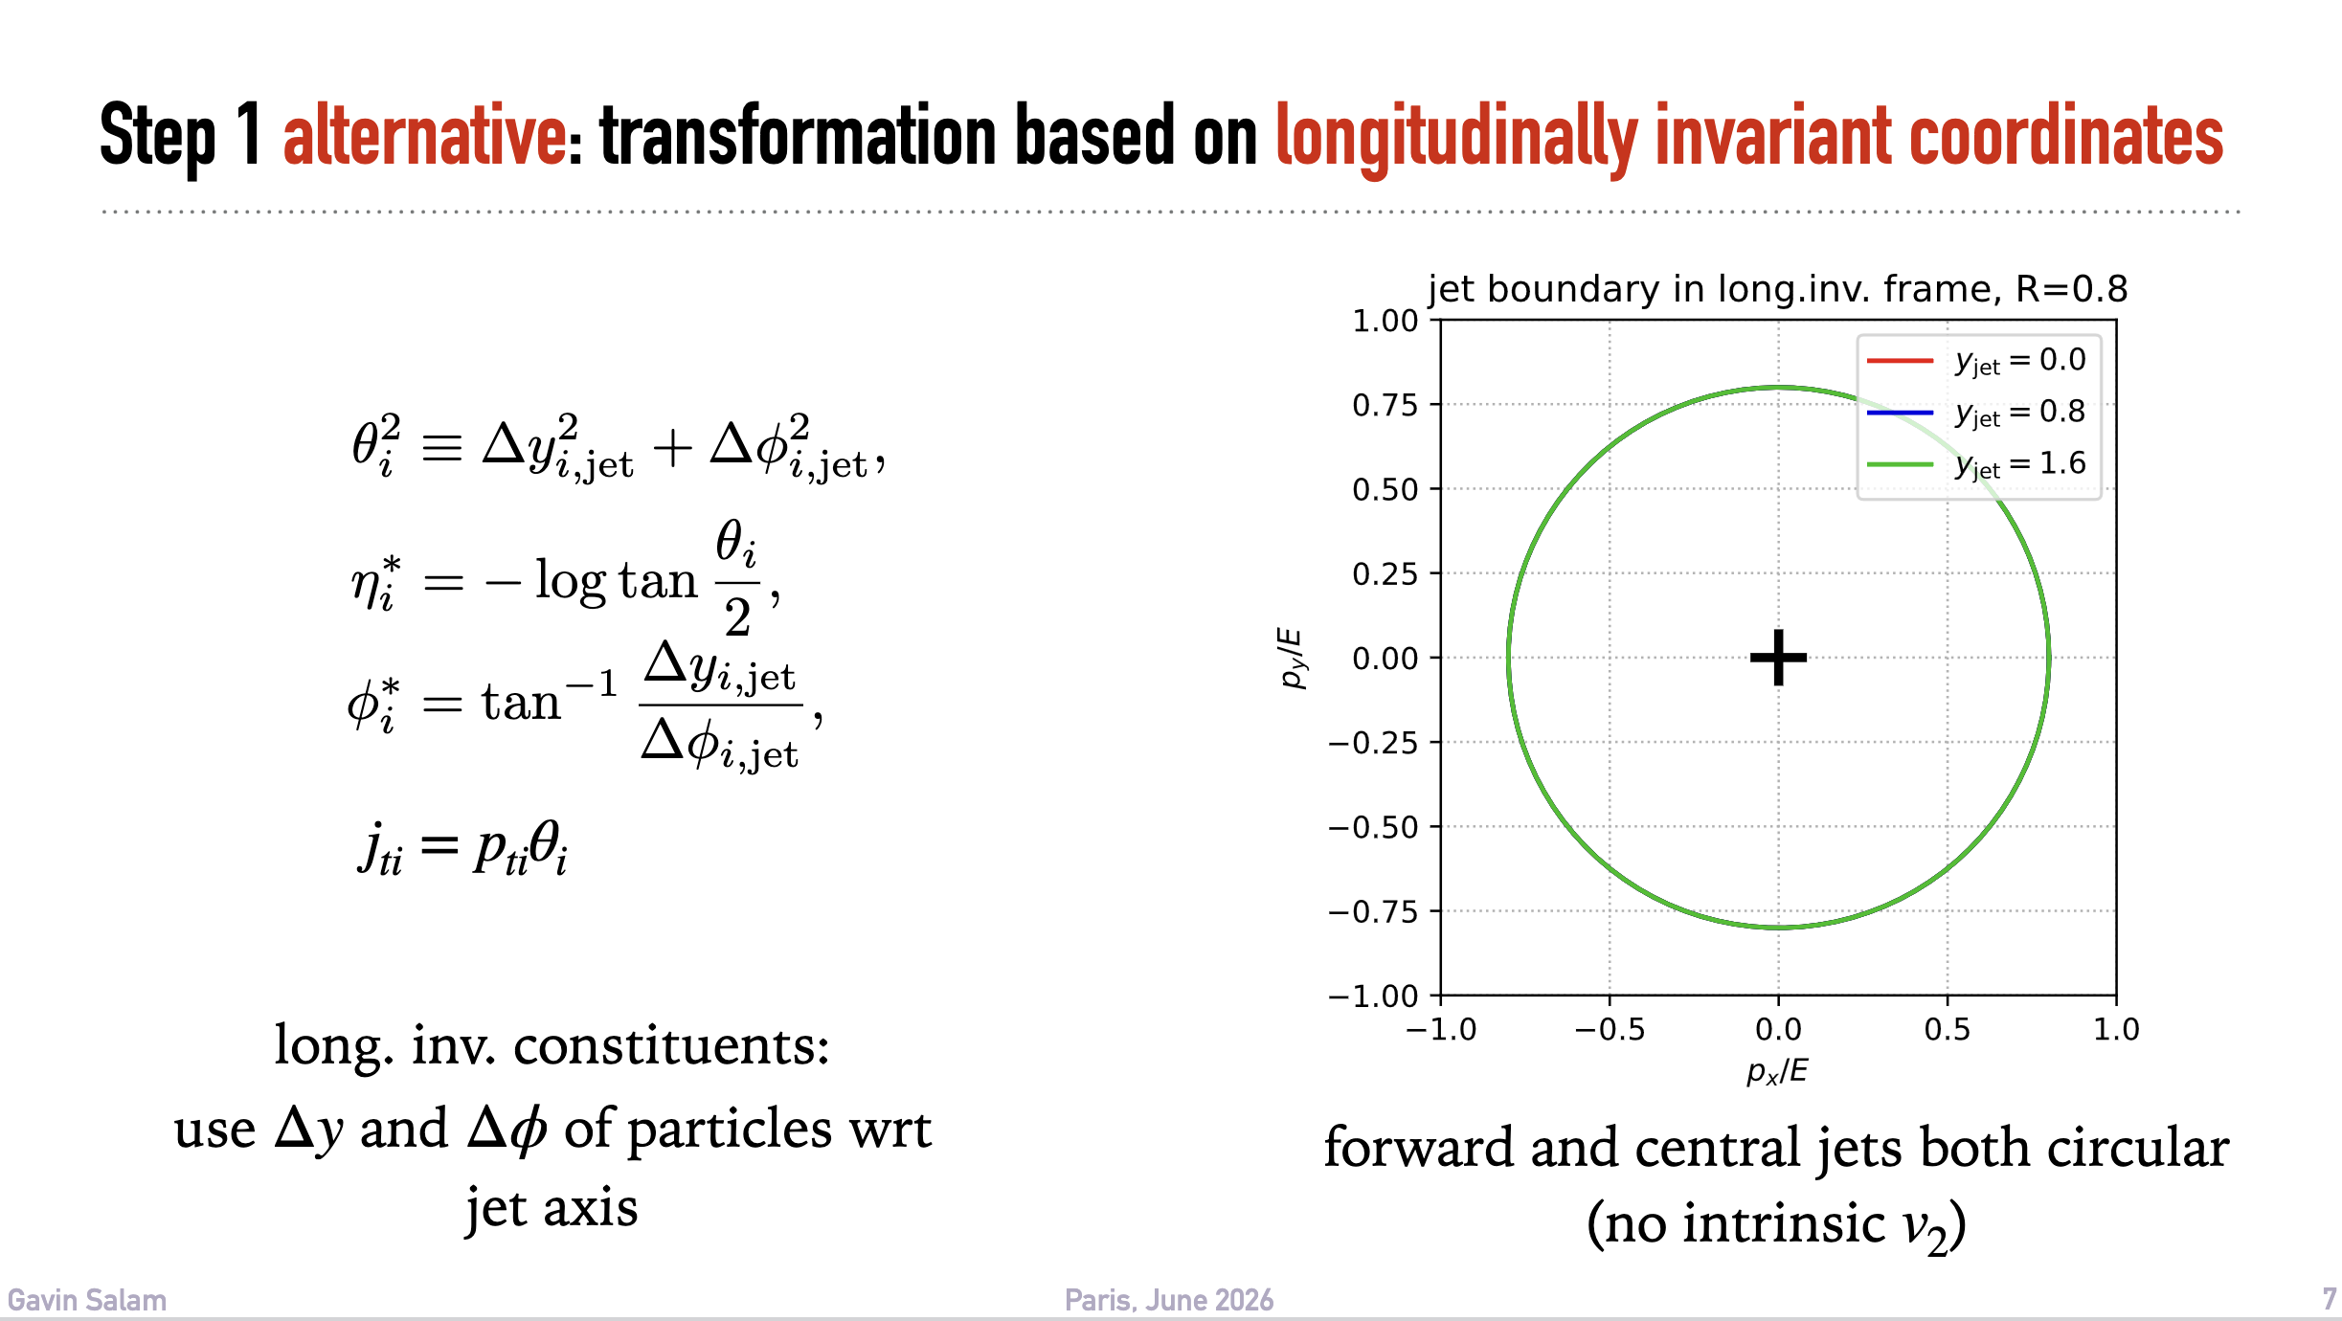
Longitudinal Invariant Coordinate
Suggested by Alba and Gavin: presentation at the small system workshop in Paris

