Slide 1



Early-Time Dynamics of Heavy-Ion Collisions
through Energy Correlators
for EMMI Workshop: Probing the early stages with jets
Andrey Sadofyev
UPV/EHU & Ikerbasque

Slide 2
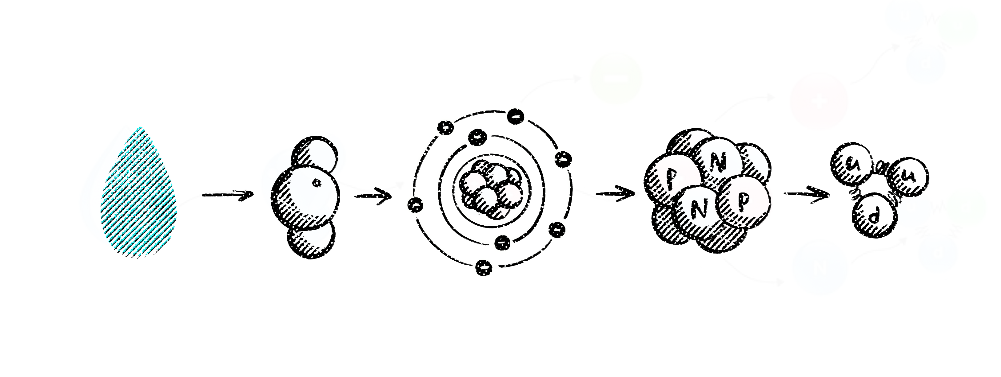
The origin of complex matter
2

Slide 3
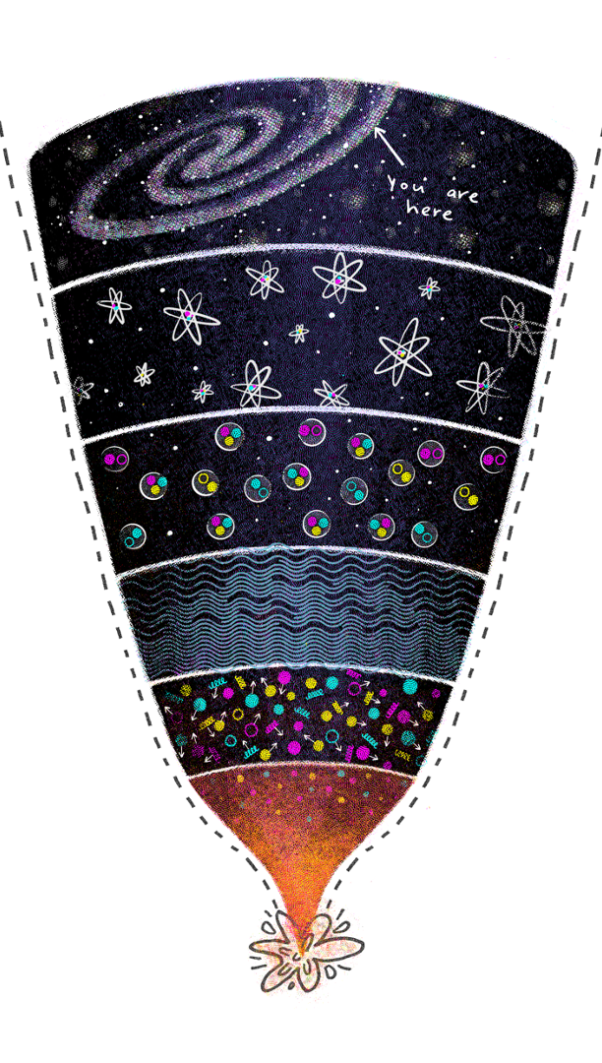
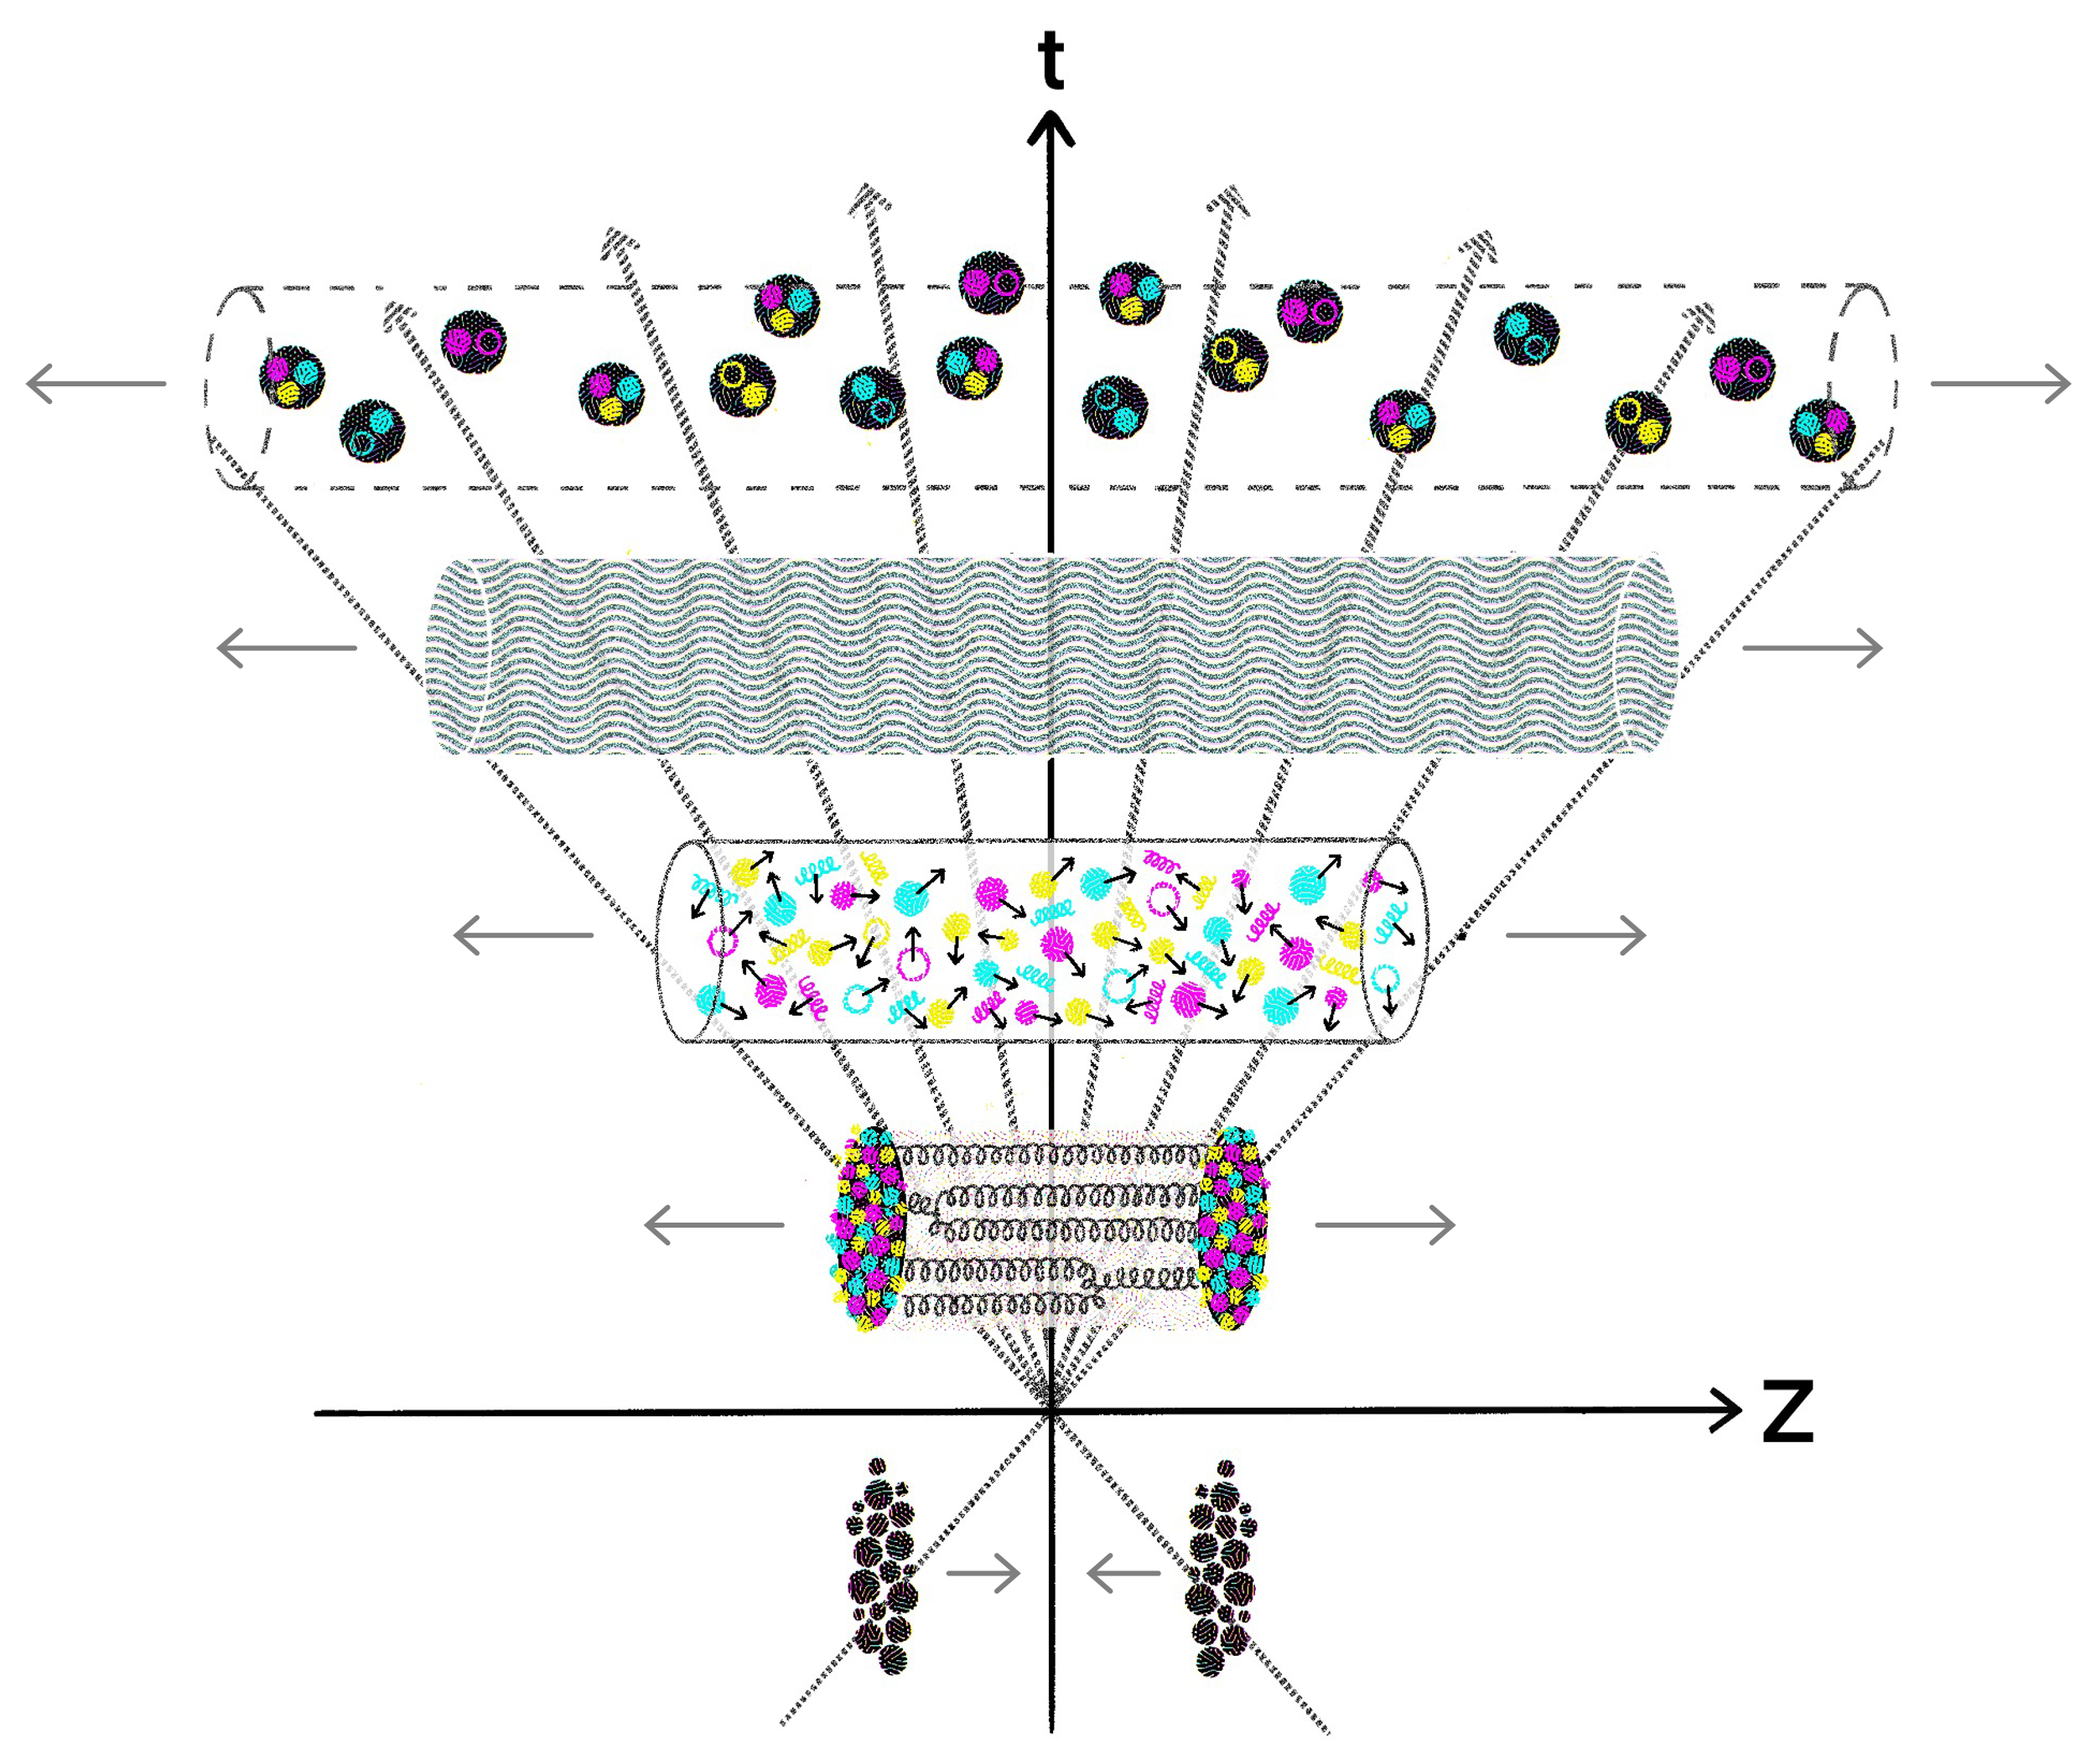
The origin of complex matter
emergence of complex matter can be probed
in heavy-ion collisions (HIC)
Big Bang
Little Bang
3

Slide 4
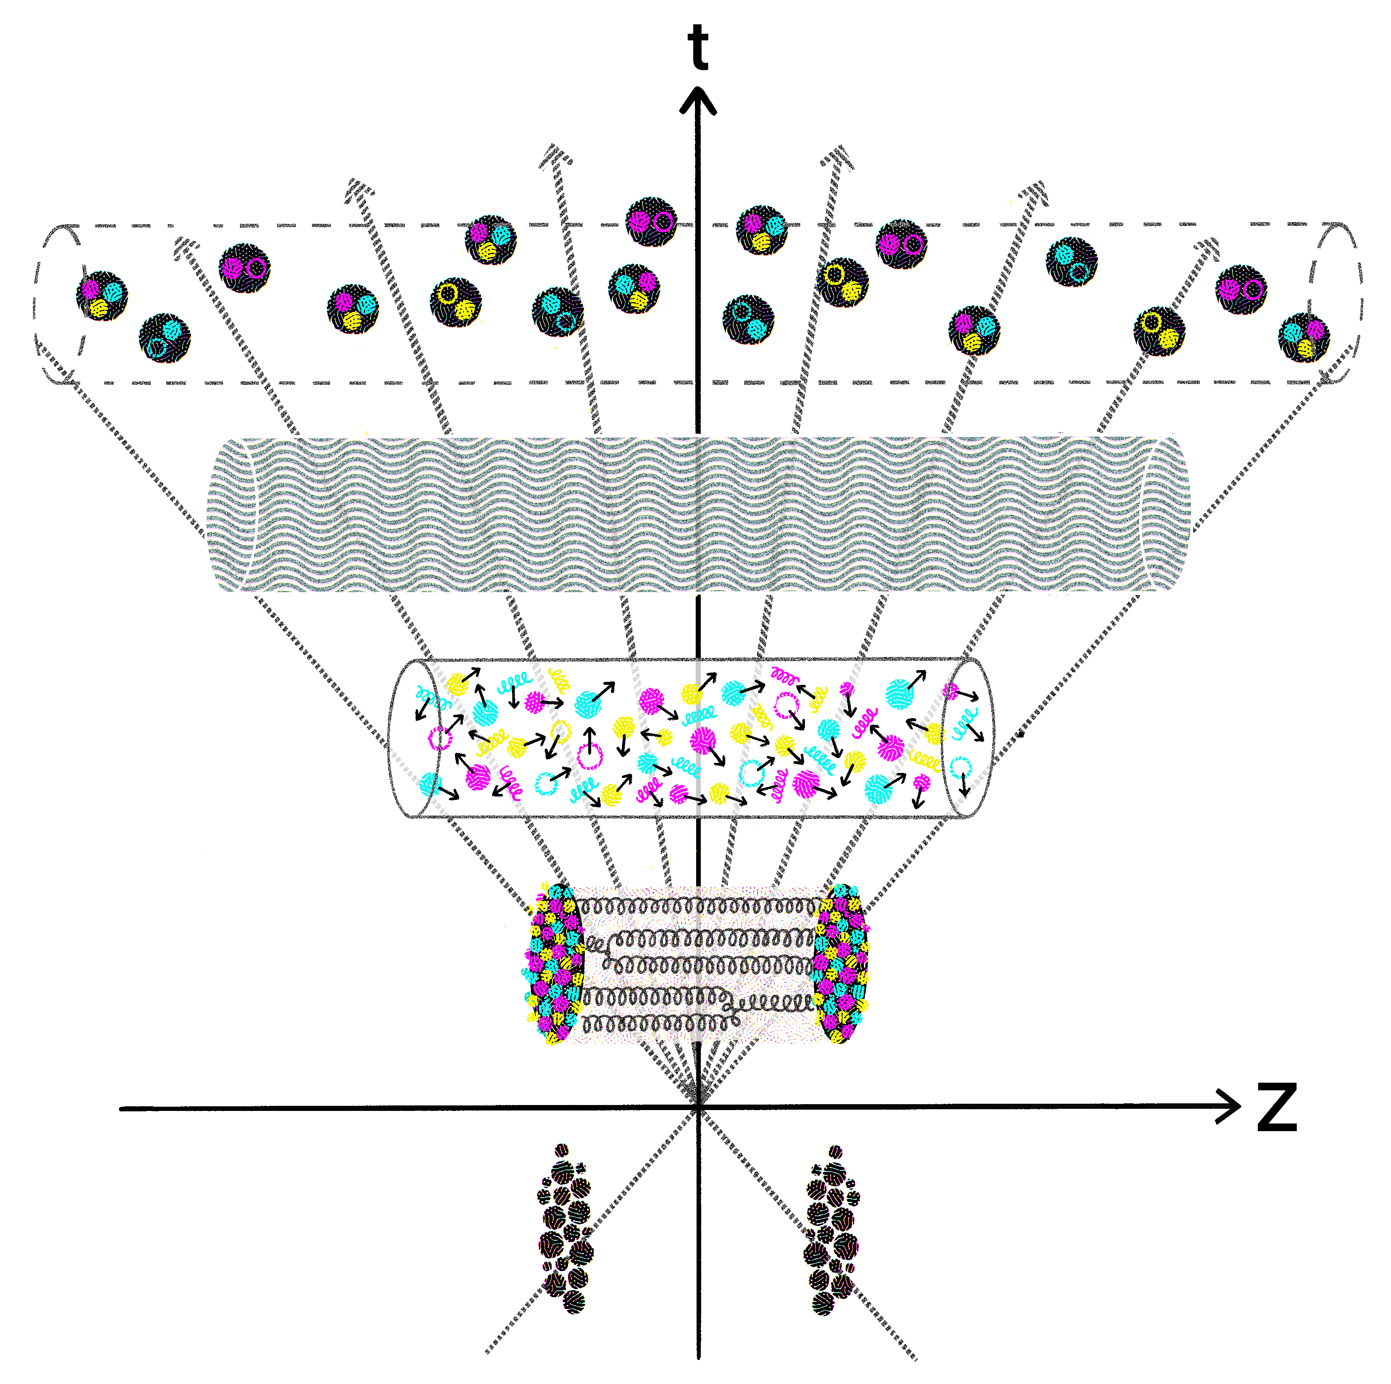
Heavy-ion collisions
Phases of QCD matter in HIC:
hadron gas
hydrodynamic Quark-Gluon Plasma (QGP)
non-equilibrium matter
glasma (strong color fields)
Matter produced in HIC undergoes
multiphase evolution
before the collision
4

Slide 5

Heavy-ion collisions
Phases of QCD matter in HIC:
hadron gas
hydrodynamic Quark-Gluon Plasma (QGP)
non-equilibrium matter
glasma (strong color fields)
Matter produced in HIC undergoes
multiphase evolution
before the collision
5

Slide 6


Heavy-ion collisions
Final state dynamics and the hydrodynamic QGP phase
accessible
6

Slide 7

Heavy-ion collisions
Final state dynamics and the hydrodynamic QGP phase
accessible
Formation of complex
nuclear matter
non-accessible
The primary goal of HIC programs worldwide
7

Slide 8
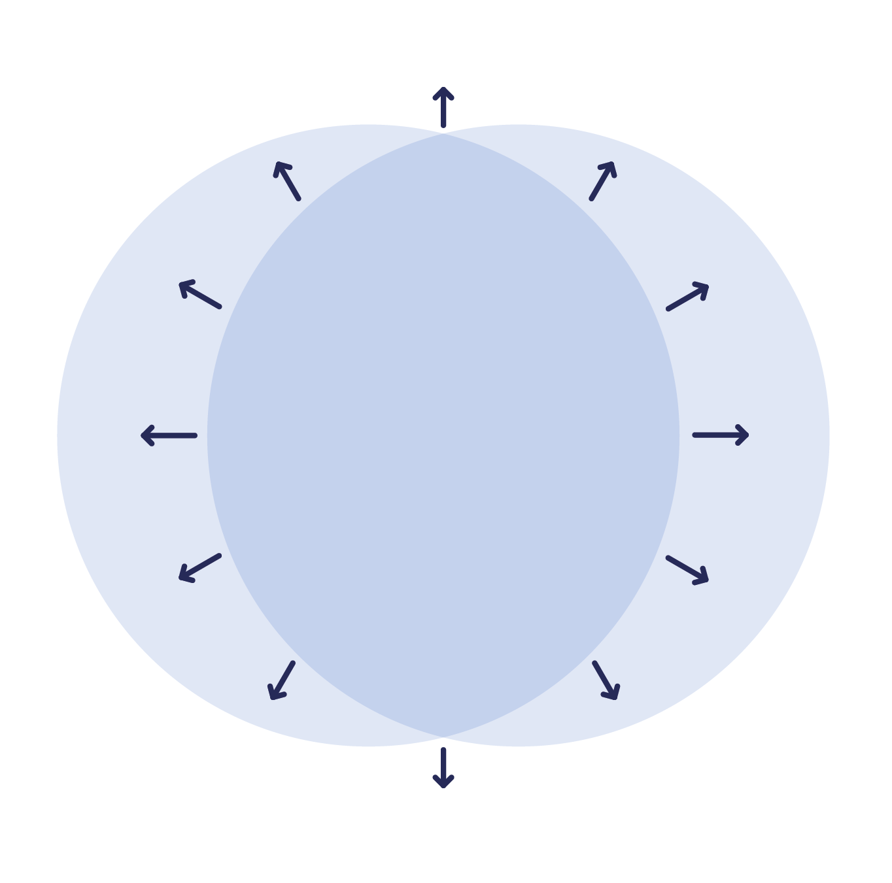

Hot QCD White Paper, arxiv: 2023.17254
Probes of matter
8

Slide 9
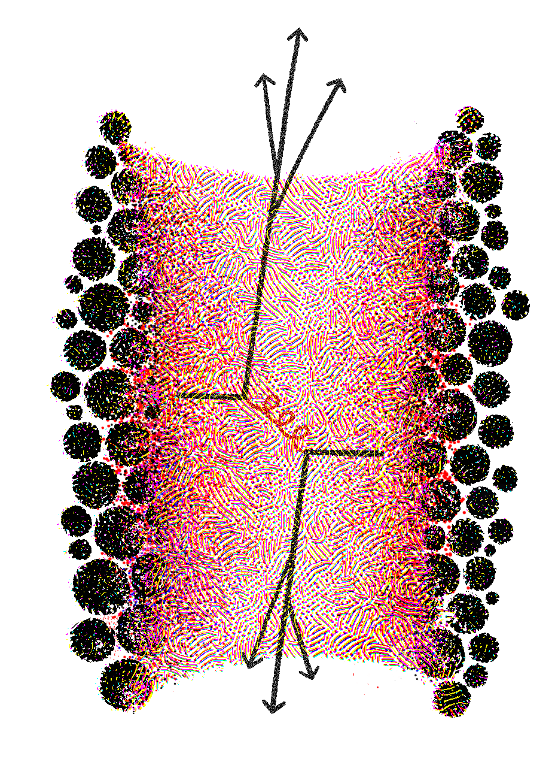
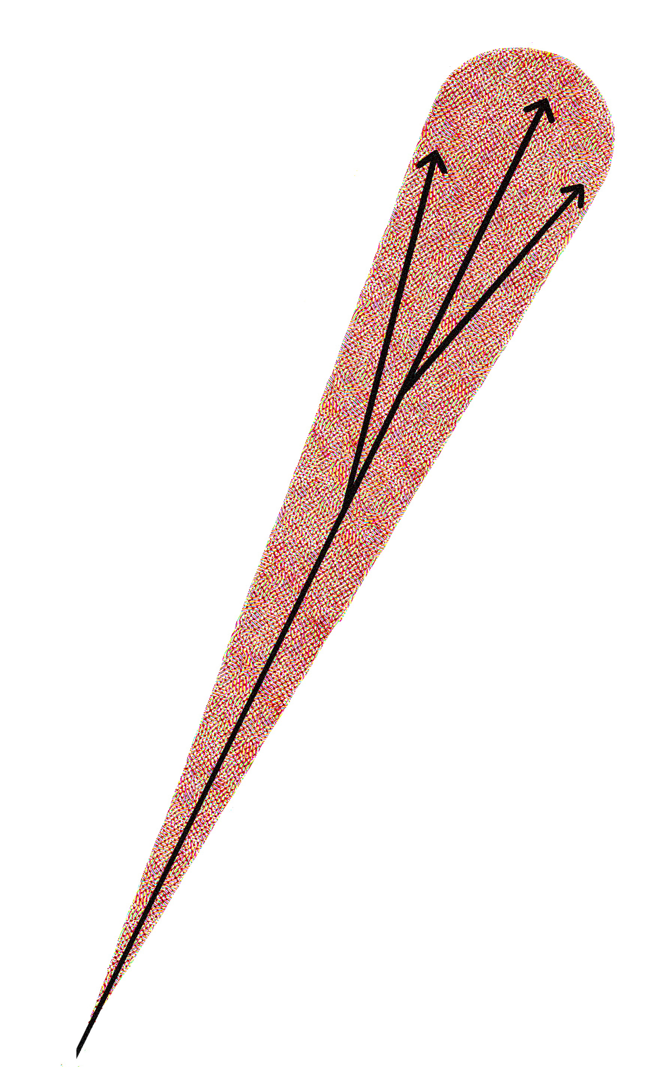
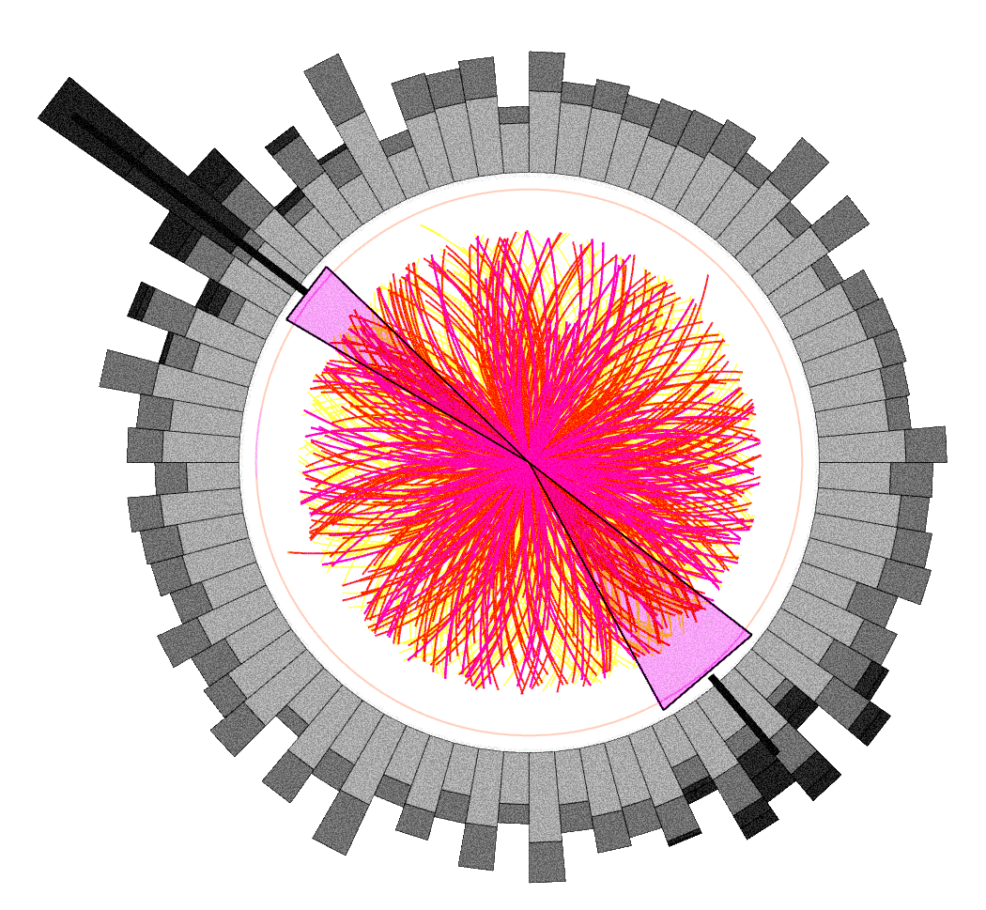

Heavy-ion collisions
jet quenching
Phases of QCD matter in HIC:
hadron gas
hydrodynamic QGP
non-equilibrium matter
glasma (strong color fields)
Jets are a tool to probe
the early evolution of matter
before the collision
jets lose energy propagating
through nuclear matter
9

Slide 10

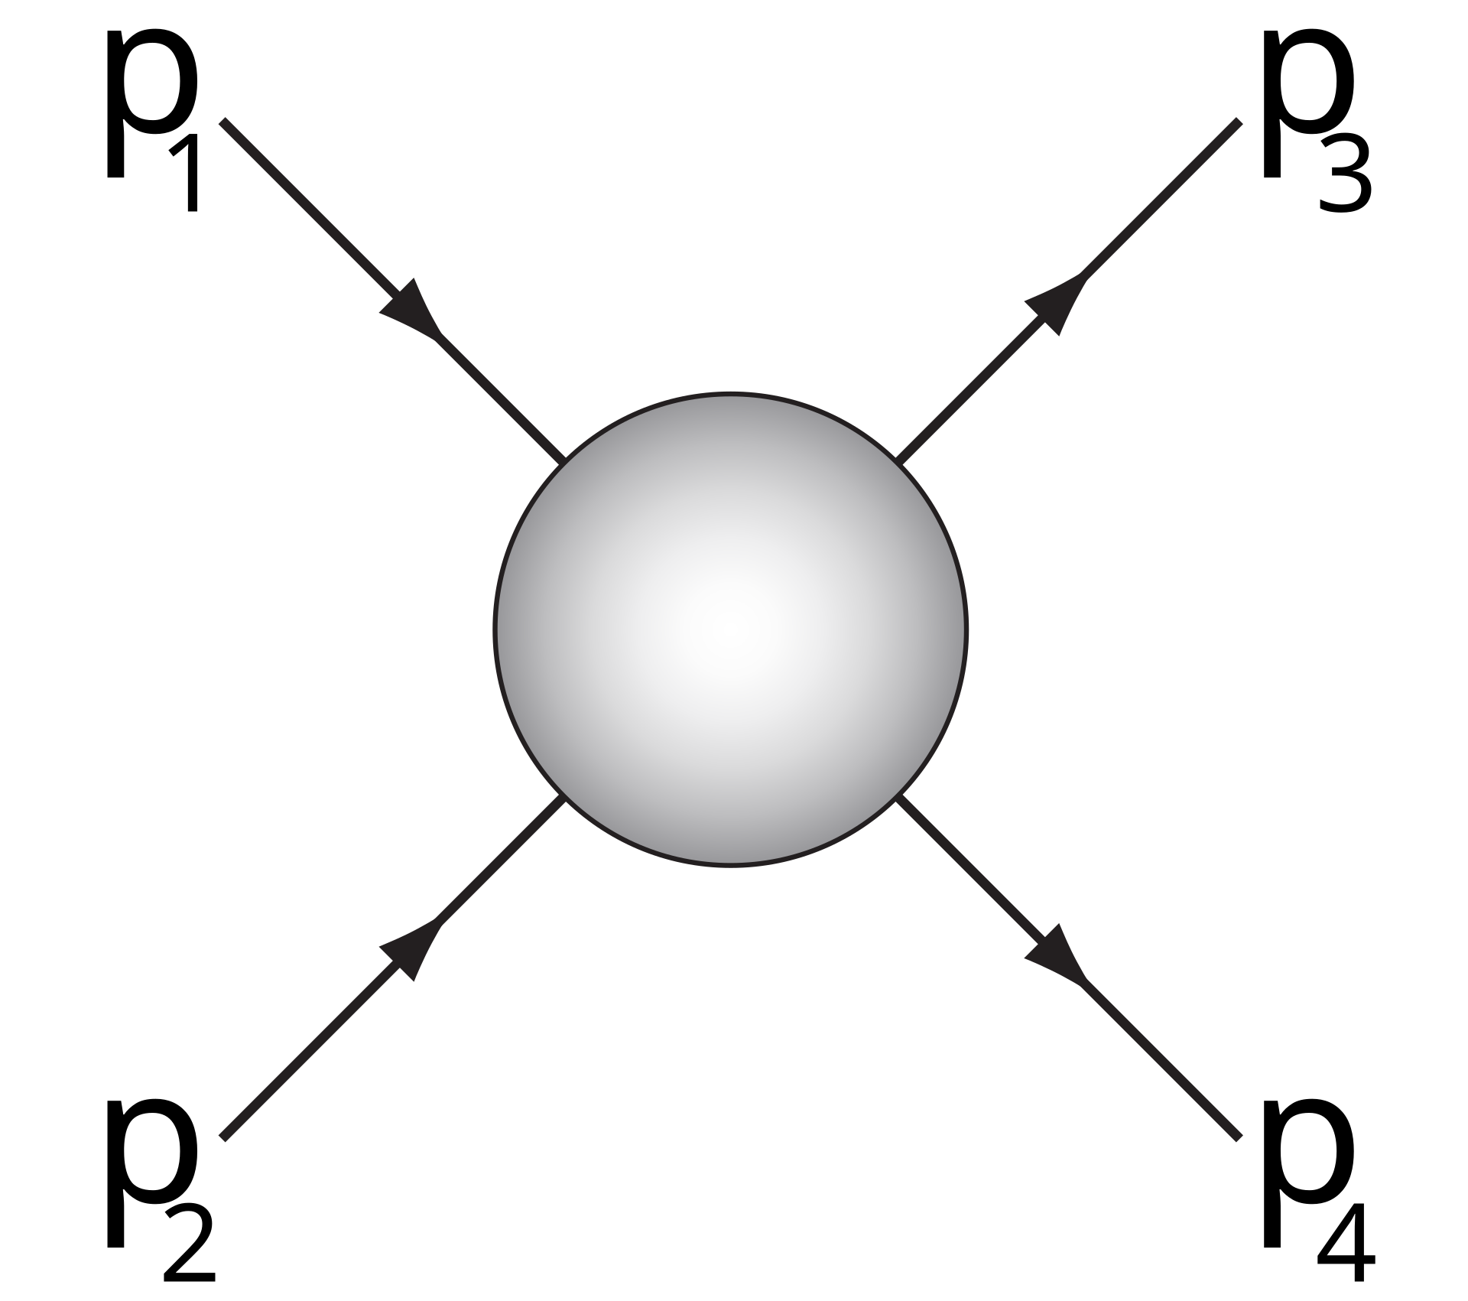
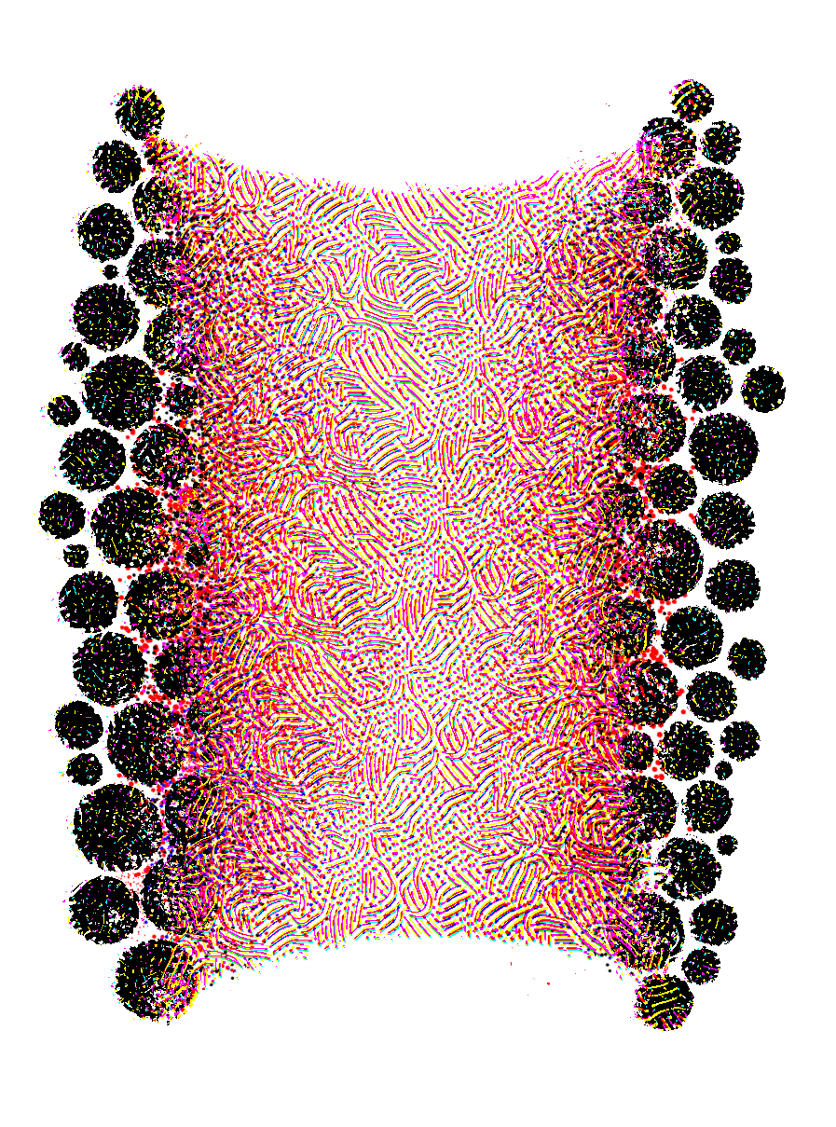
Jet quenching formalisms
10

Slide 11
R. Baier et al., NPB, 1997
B. G. Zakharov, JETP, 1997
R. Baier et al., NPB, 1998
M. Gyulassy et al., NPB, 2000
X.-F. Guo, X.-N. Wang, PRL, 2000
U. Wiedemann, NPB, 2000
M. Gyulassy et al., NPB, 2001
P. Arnold, G. Moore, L. Yaffe, JHEP, 2002
C. Salgado, U. Wiedemann, PRD, 2003
Jet quenching formalisms
11

Slide 12
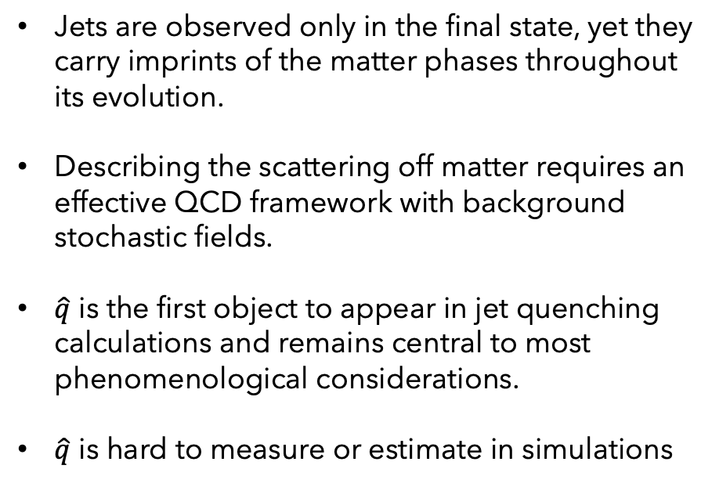
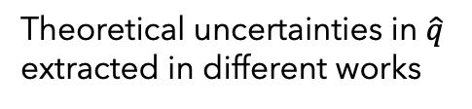
L. Apolinário, Y.-J. Lee, M. Winn, review, 2022
Jet quenching formalisms
Jets are observed only in the final state, yet they carry imprints of the matter phases throughout its evolution.
Describing the scattering off matter requires an effective QCD framework with background stochastic fields.
$\hat{q}$ is the first object to appear in jet quenching calculations and remains central to most phenomenological considerations.
$\hat{q}$ is hard to measure or estimate in simulations
Theoretical uncertainties in $\hat{q}$
extracted in different works
12

Slide 13
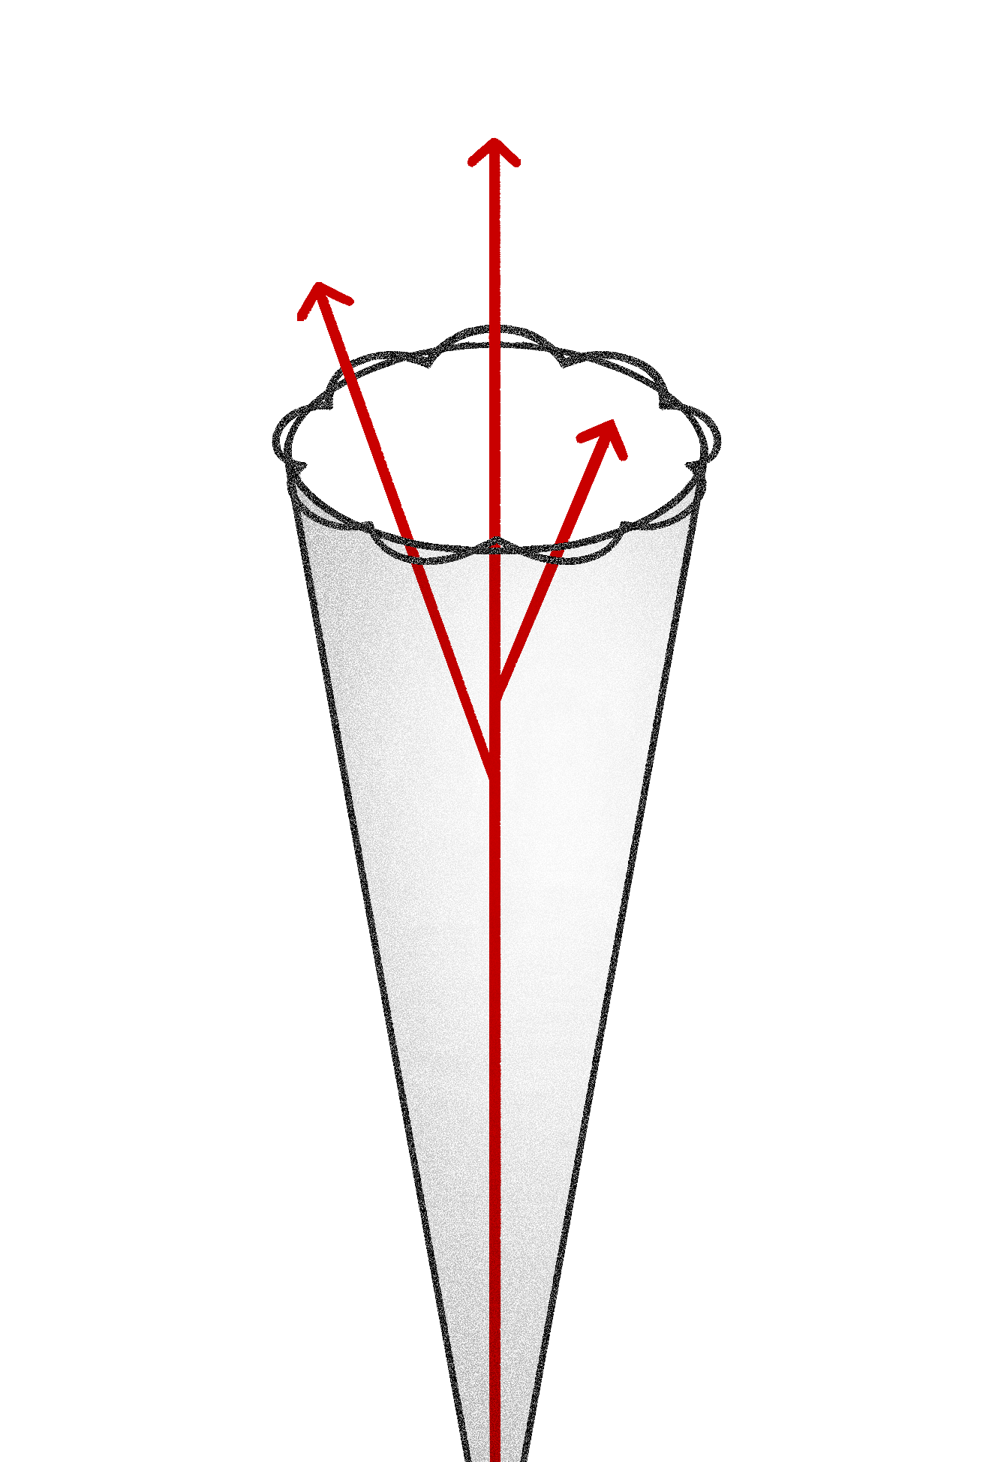
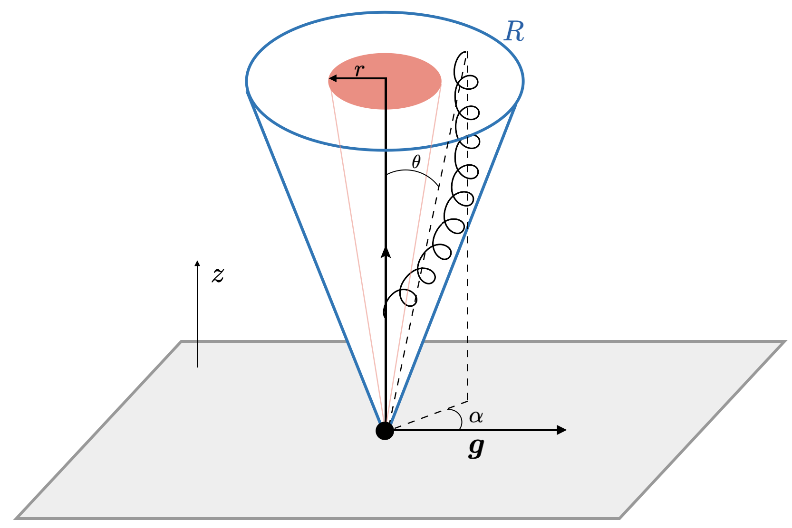
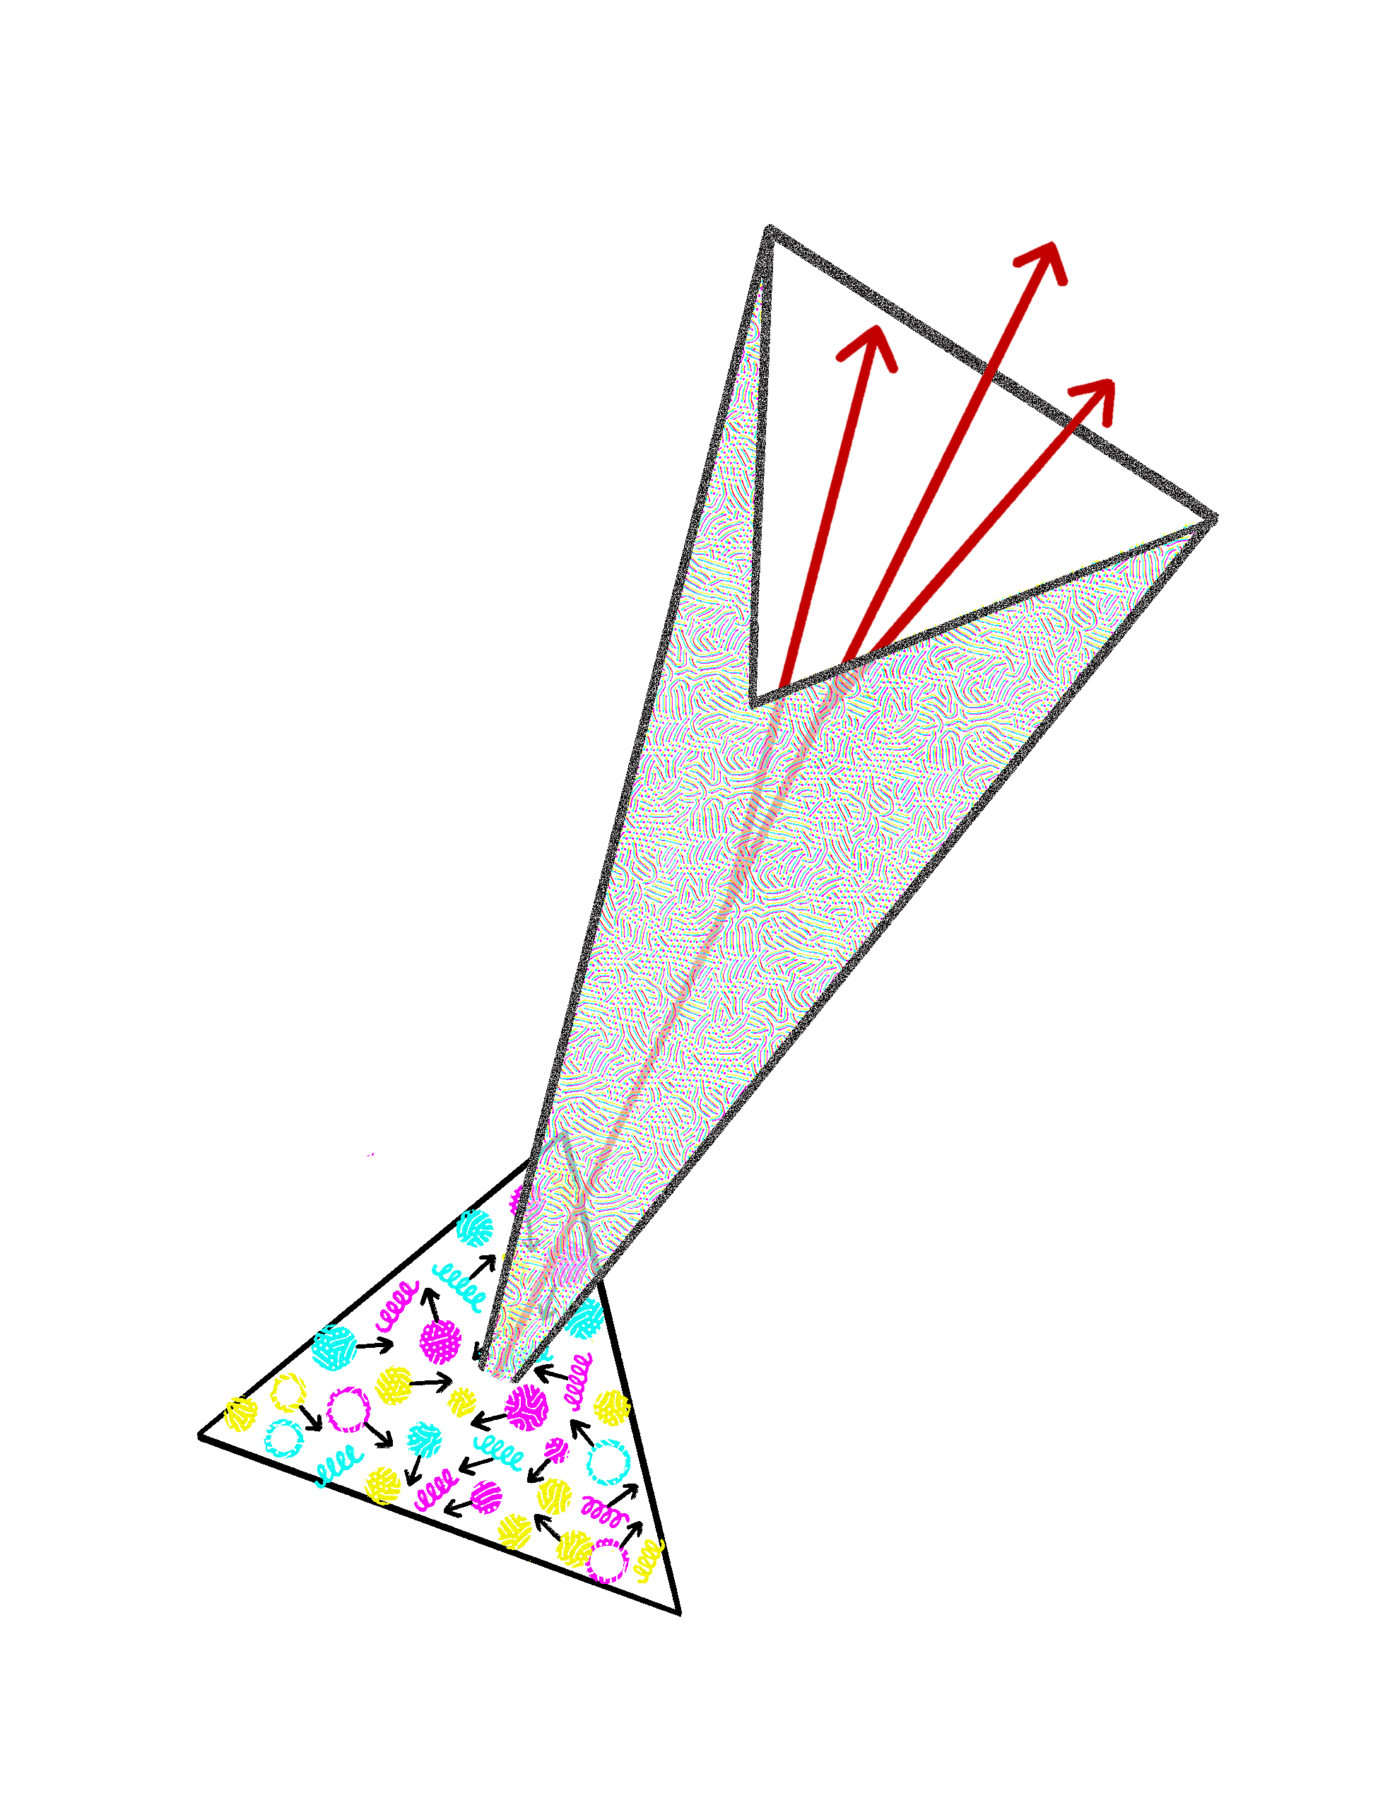
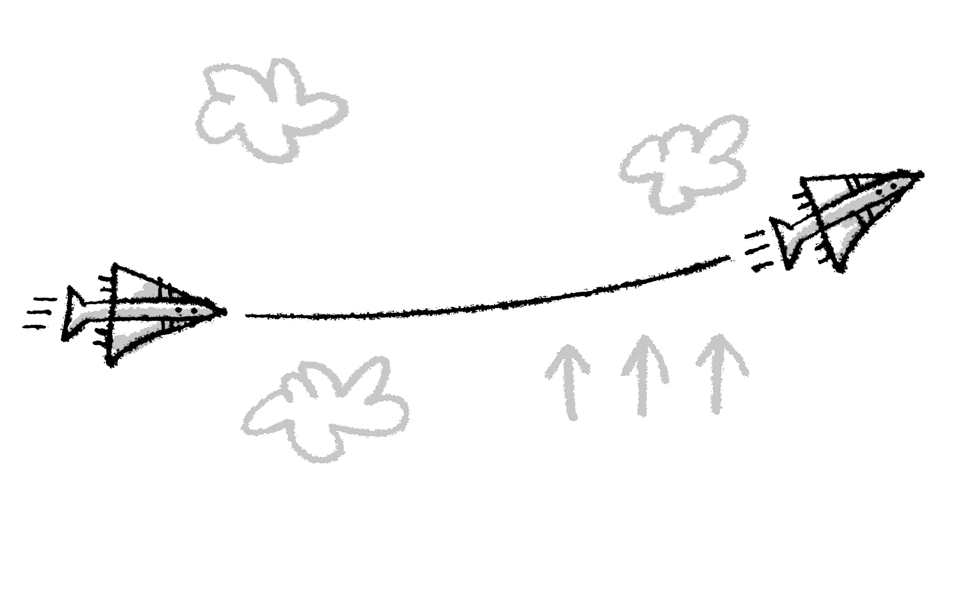
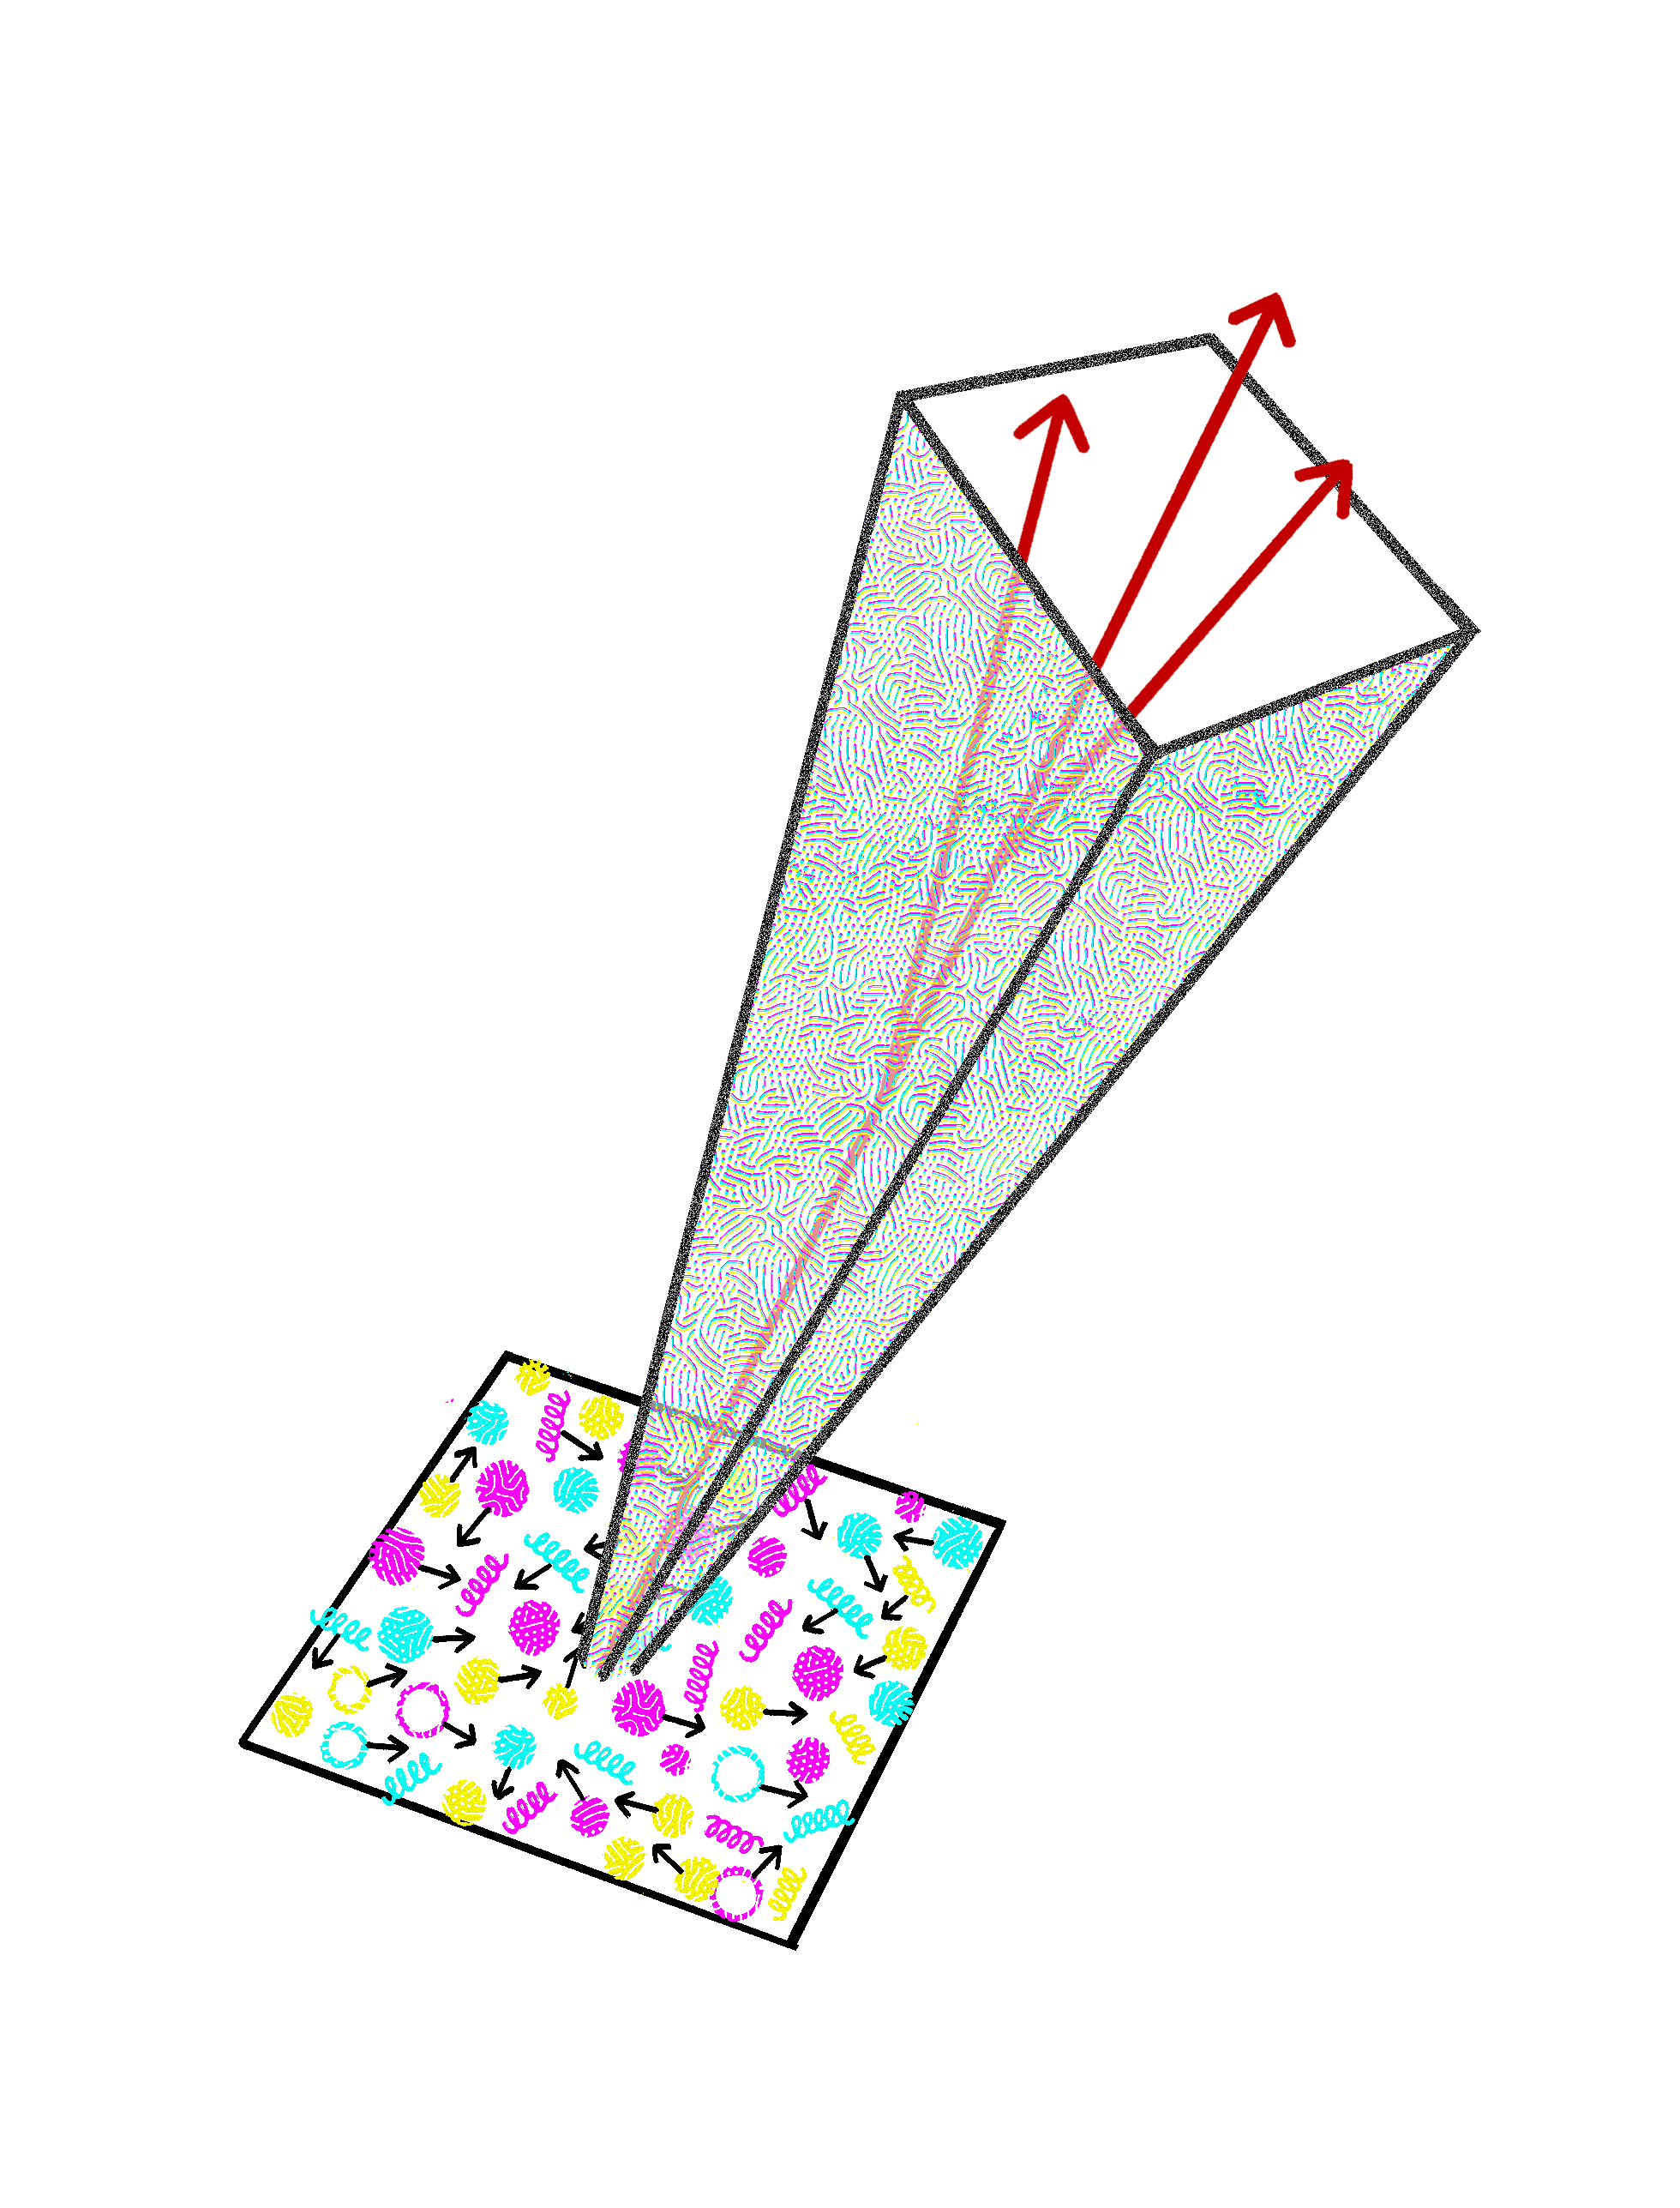
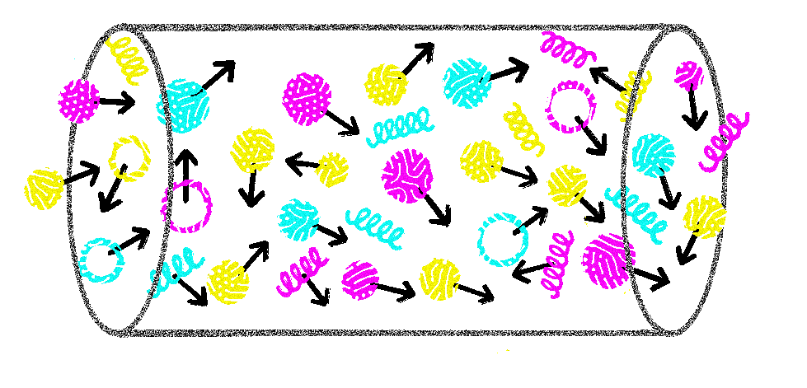
AS, M. Sievert, I. Vitev, PRD, 2021
J. Barata, X. Mayo Lopez, AS, C. Salgado, PRD, 2023
J. Barata, G. Milhano, AS, EPJC, 2024
J. Barata, C. Salgado, J. Silva, JHEP, 2024
Jets in anisotropic matter
The matter affects the softer part of the jet
It is imprinted in substructure (especially in its azimuthal part)
Only very early estimates are out there, more progress is needed
13

Slide 14
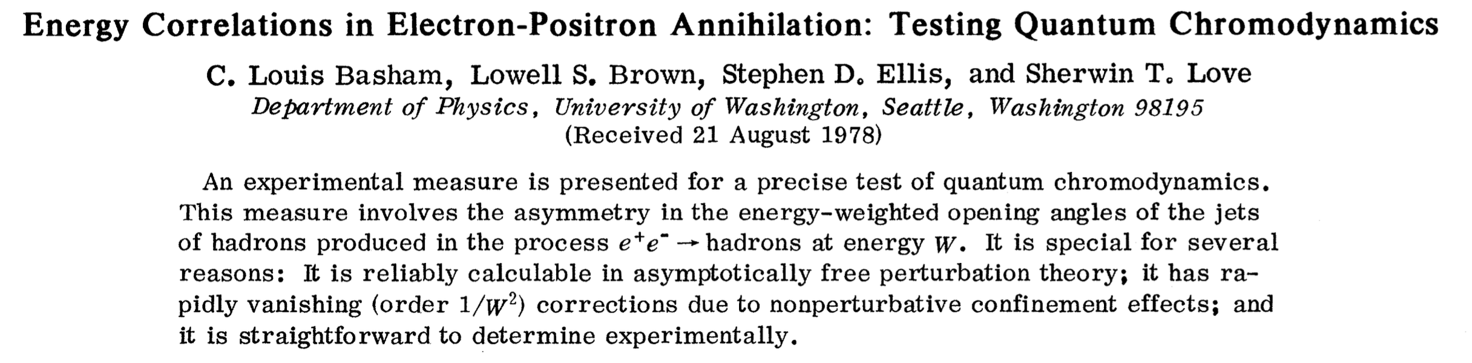
I. Moult, H. Zhu, review, 2025
Energy correlators
14

Slide 15
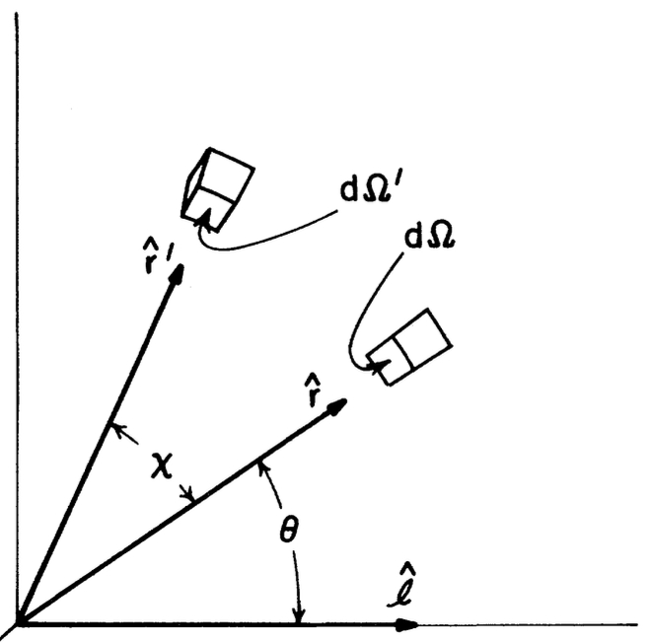
I. Moult, H. Zhu, review, 2025
Energy correlators
15

Slide 16
I. Moult, H. Zhu, review, 2025
Energy correlators
16

Slide 17
EECs in HICs
Using some semi-realistic state (extremely hard)
Focusing on a few hard particles (of the jet) with matter being a background
Medium response to the jet
Focusing on the soft particles and their correlations
…
17

Slide 18
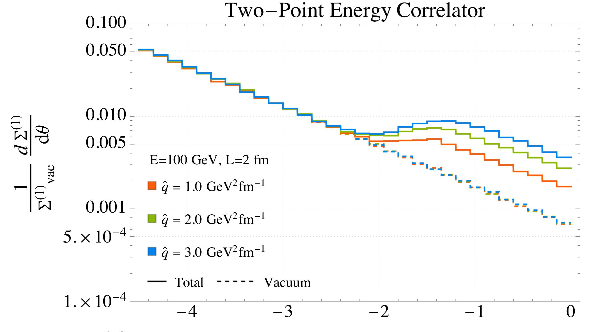
C. Andres et al., PRL, 2023
J. Barata et al., JHEP, 2024
EECs in HICs
18

Slide 19
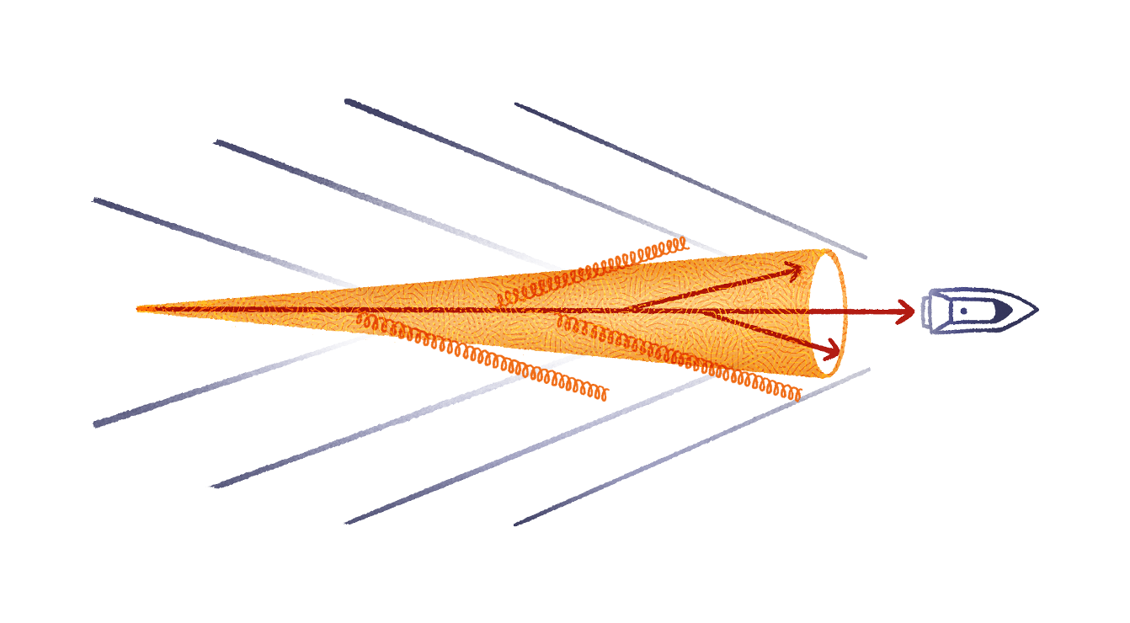
Y. He, T. Luo, X.-N. Wang, Y. Zhu, PRC, 2015
Y. Tachibana, N.-B. Chang, G.-Y. Qin, PRC, 2017
J. Casalderrey-Solana et al, JHEP, 2021
W. Chen, Z. Yang, Y. He, W. Ke, L. Pang, X.-N. Wang, PRL, 2021
Z. Yang, T. Luo, W. Chen, L.-G. Pang, X.-N. Wang, PRL, 2023
EECs in HICs
Renewed interest in the medium response: recent consideration e.g. within CoLBT, JEWEL, Hybrid model
Experimental needs, see e.g. ALICE, PRC, 2023; ATLAS, PRC, 2025; CMS, 2025
19

Slide 20
H. Bossi, A. S. Kudinoor, I. Moult, D. Pablos, A. Rai, K. Rajagopal, JHEP, 2024
Z. Yang, Y. He, I. Moult, X.-N. Wang, PRL, 2024
CMS, PLB, 2025
EECs in HICs
20

Slide 21
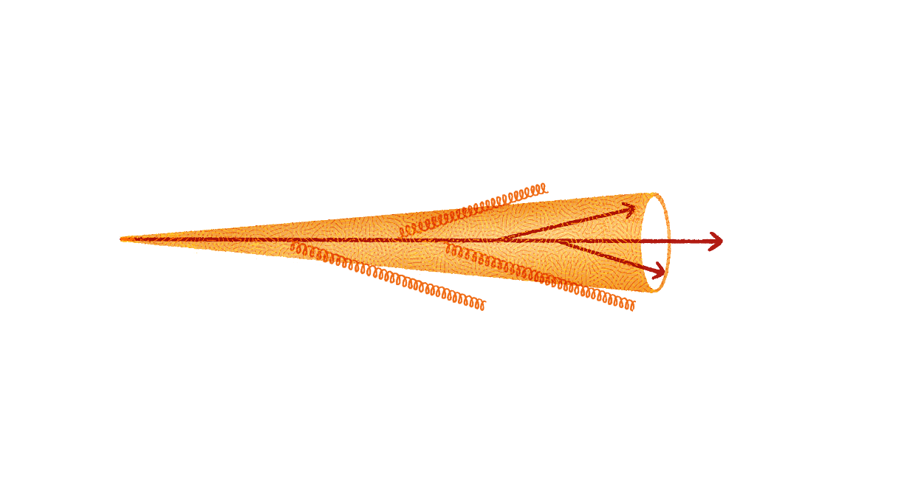
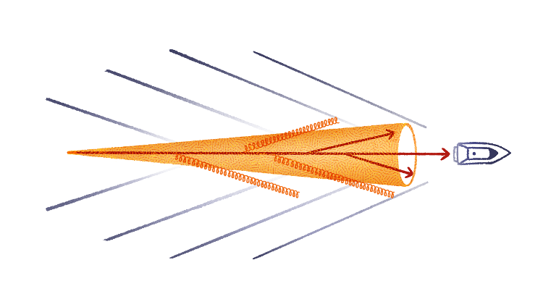

Probing the response
21

Slide 22
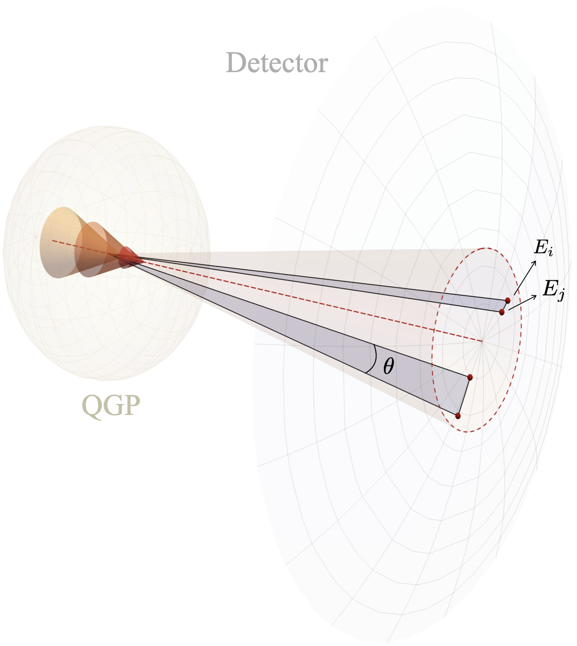
J. Barata, M. Kuzmin, G. Milhano, AS, PRD, 2025
Probing the response
The hydrodynamic description of a flowing medium is classical
So are the most of the current treatments of the medium response
But what would happen if a classical flow were plugged into the ECs?
22

Slide 23
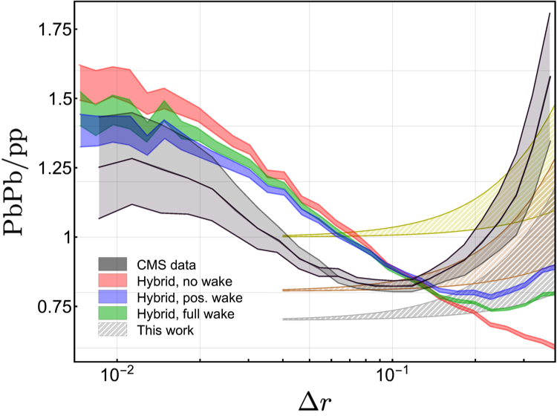
J. Barata, M. Kuzmin, G. Milhano, AS, PRD, 2025
CMS, PLB, 2025
Probing the response
23

Slide 24
Initial stages in HICs
Phases of QCD matter in HIC:
hadron gas
hydrodynamic Quark-Gluon Plasma (QGP)
non-equilibrium matter
glasma (strong color fields)
Matter produced in HIC undergoes
multiphase evolution
before the collision
24

Slide 25
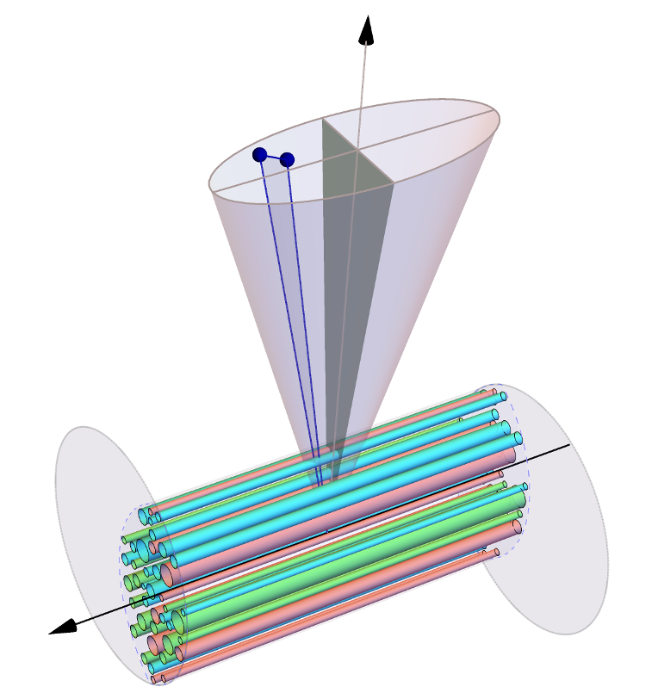
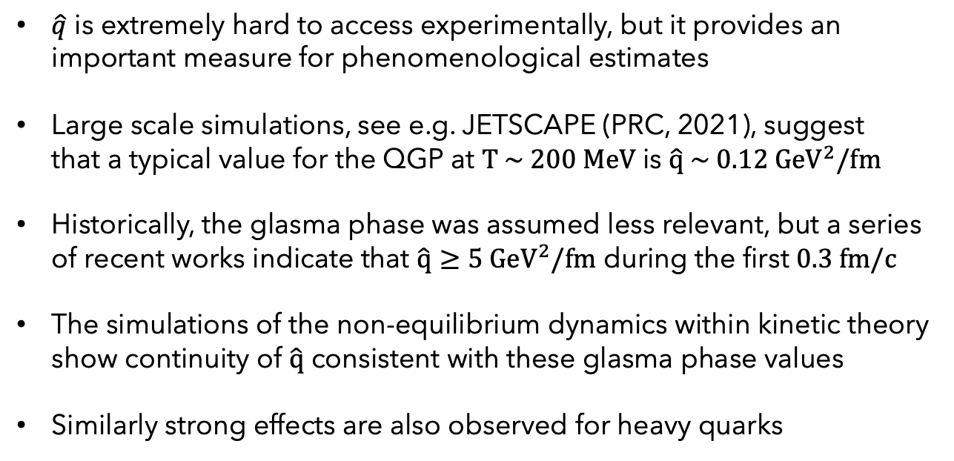
see e.g. P. Aurenche, B. G. Zakharov, PLB, 2012
A. Ipp, D. I. Müller, D. Schuh, PRD, 2020
A. Ipp, D. I. Müller, D. Schuh, PLB, 2020
M. Carrington, A. Czajka, S. Mrowczynski, PLB, 2022
M. Carrington, A. Czajka, S. Mrowczynski, PRC, 2022
D. Avramescu et al., PRD, 2023
J. Barata, S. Hauksson, X. Mayo López, AS, PRD, 2024
S. Hauksson, S. Jeon, C. Gale, PRC, 2022
K. Boguslavski et al., PRD, 2024
K. Boguslavski et al., PLB, 2024
K. Boguslavski, J. Barata, F. Lindenbauer, AS, 2025
M. Carrington, A. Czajka, S. Mrowczynski, NPA, 2020
K. Boguslavski et al., PRD, 2024
C. Gale et al., SQM2024
X. Du, PRC, 2024
D. Avramescu et al., PRD, 2025
D. Avramescu et al., PRL, 2025
Initial stages in HICs
$\hat{q}$ is extremely hard to access experimentally, but it provides an important measure for phenomenological estimates
Large scale simulations, see e.g. JETSCAPE (PRC, 2021), suggest that a typical value for the QGP at $T \sim 200 MeV$ is $\hat{q} \sim 0.12 {GeV}^{2}/fm$
Historically, the glasma phase was assumed less relevant, but a series of recent works indicate that $\hat{q}≥5 {GeV}^{2}/fm$ during the first $0.3 fm/c$
The simulations of the non-equilibrium dynamics within kinetic theory show continuity of $\hat{q}$ consistent with these glasma phase values
Similarly strong effects are also observed for heavy quarks
25

Slide 26
K. Boguslavski et al., PLB, 2024
J. Barata, G. Milhano, AS, J. Silva, 2025
Initial stages in HICs
Do the glasma and pre-equilibrium broadening patterns fit together?
26

Slide 27
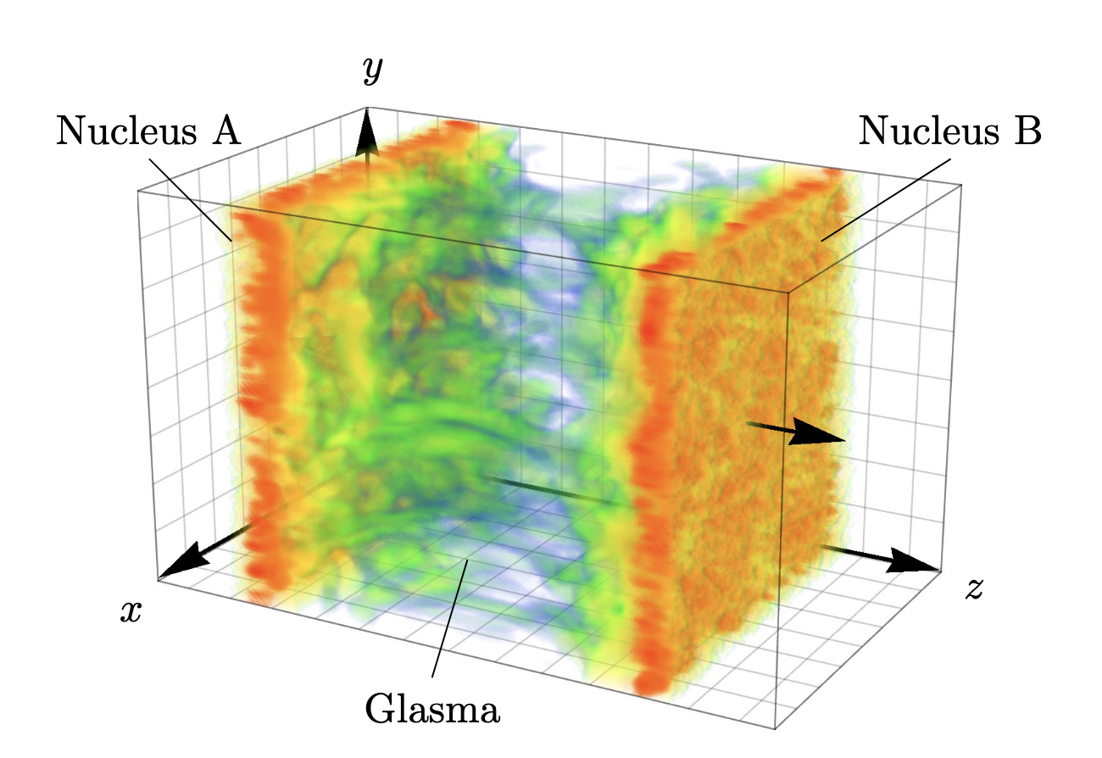
EECs in initial stages
from a paper by A. Ipp et al.
27

Slide 28
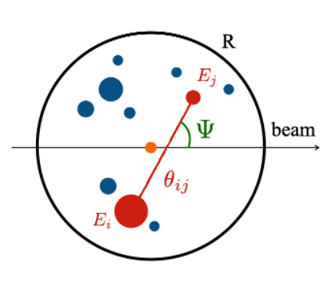
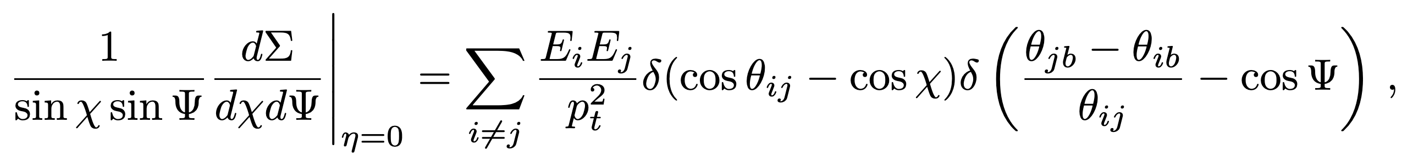
J. Barata, G. Milhano, AS, J. Silva, 2025
J. Barata, I. Moult, AS, J. Silva, 2025
EECs in initial stages
28

Slide 29
J. Barata, G. Milhano, AS, J. Silva, 2025
J. Barata, I. Moult, AS, J. Silva, 2025
see João’s talk
EECs in initial stages
vacuum
medium-induced
response
…
29

Slide 30
J. Barata, G. Milhano, AS, J. Silva, 2025
Clover EEC
30

Slide 31
EECs in initial stages
31

Slide 32
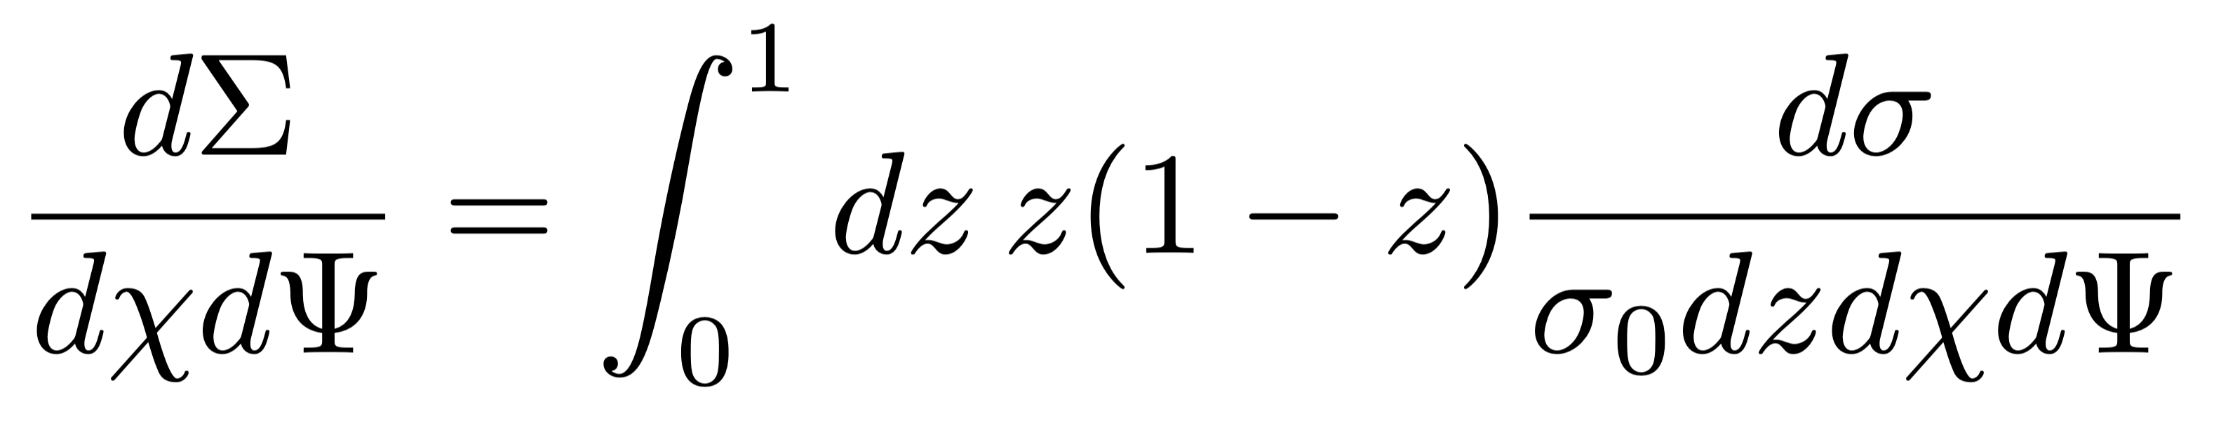
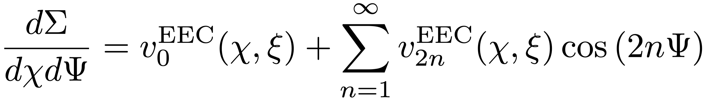
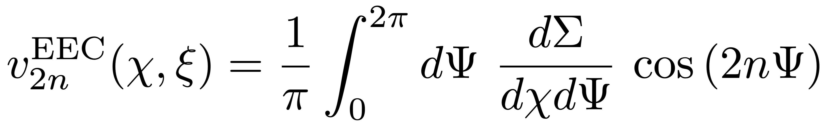
EECs in initial stages
32

Slide 33
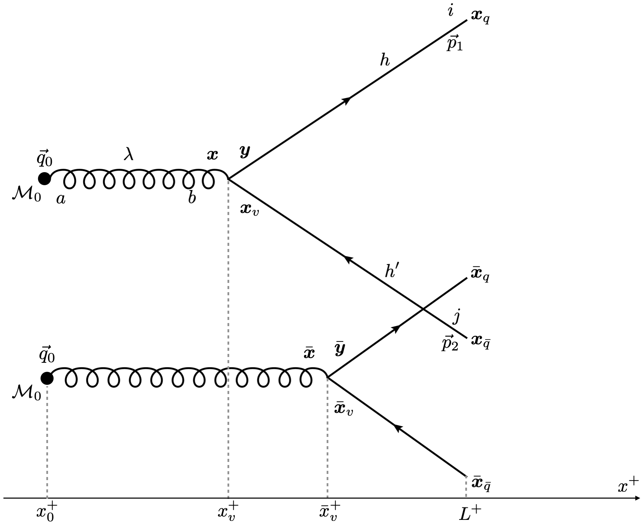
J. Barata, C. Salgado, J. M. Silva, JHEP, 2024
J. Barata, J. Brewer, K. Lee, J. M. Silva, arxiv, 2025
EECs in initial stages
33

Slide 34
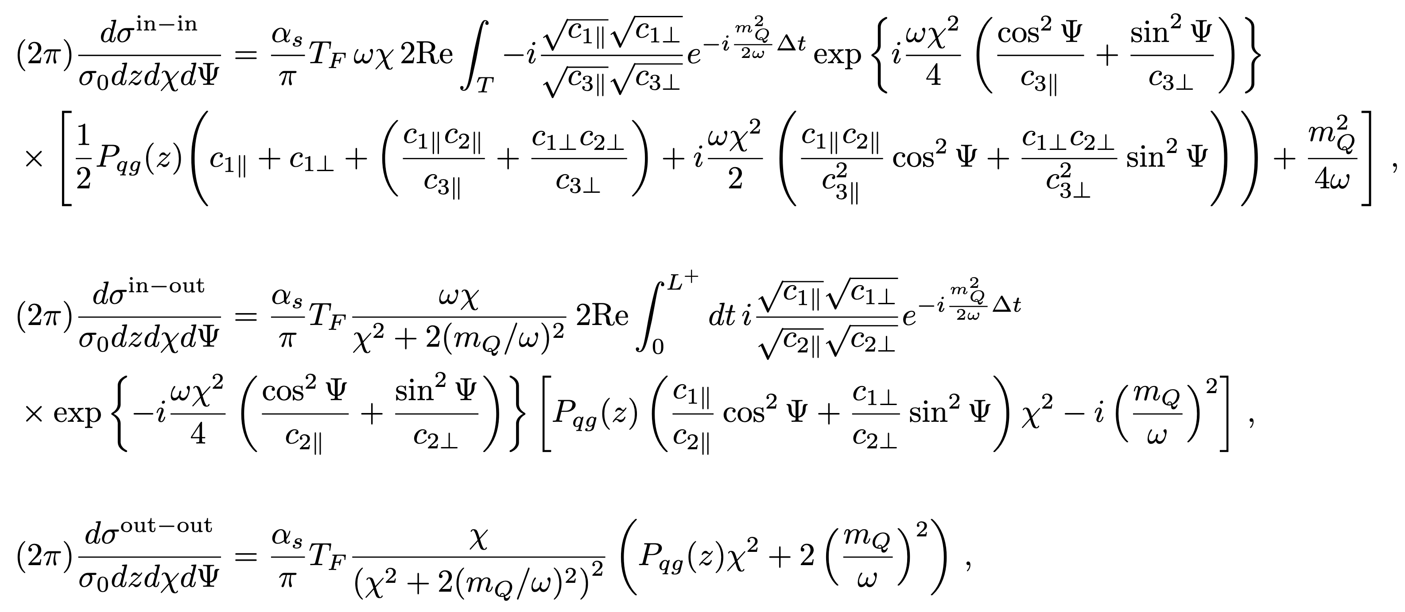
J. Barata, C. Salgado, J. M. Silva, JHEP, 2024
J. Barata, J. Brewer, K. Lee, J. M. Silva, arxiv, 2025
EECs in initial stages
34

Slide 35
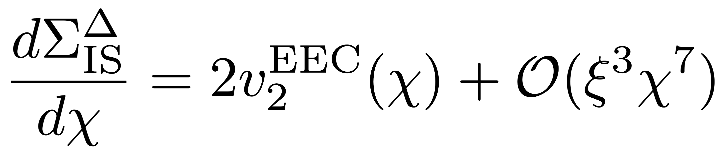
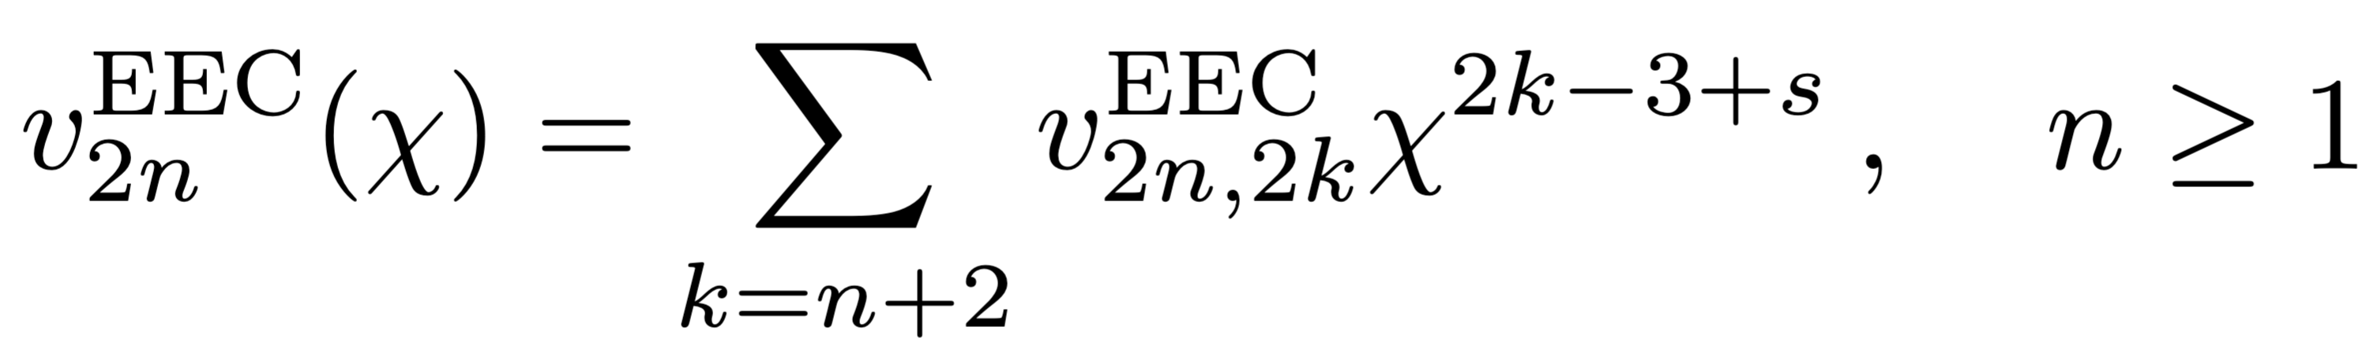
EECs in initial stages
35

Slide 36
J. Barata, G. Milhano, AS, J. Silva, 2025
Clover EEC
jet axis
(mid rapidity)
36

Slide 37
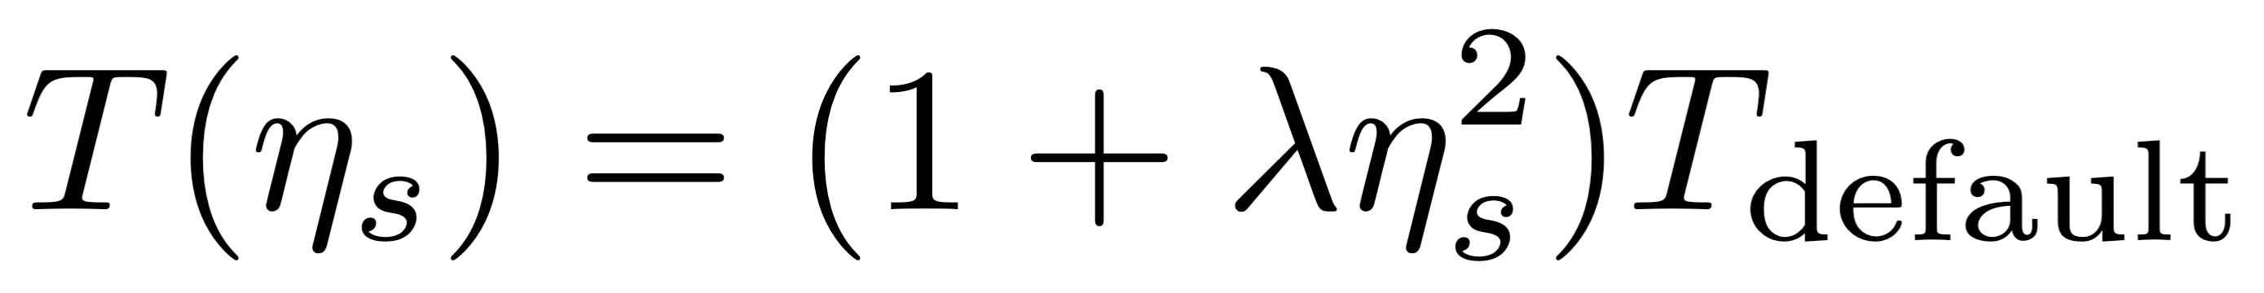
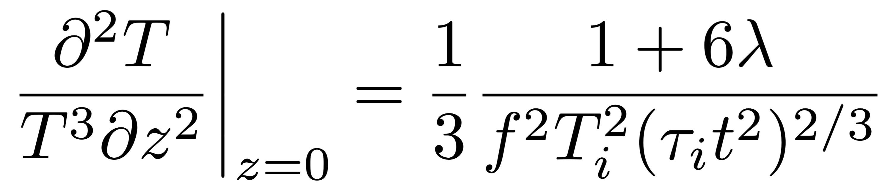

J. Barata, G. Milhano, AS, J. Silva, 2025
Clover EEC
jet axis
(mid rapidity)
for
$$λ∈\left(0,1,5,25\right) →(0.09, 0.6, 3, 13)$$
37

Slide 38
J. Barata, G. Milhano, AS, J. Silva, 2025
Clover EEC
jet axis
(mid rapidity)
38

Slide 39
Summary and outlook
Correlations of the energy fluxes have a highly universal structure, allowing us to understand their qualitative features
Only by accounting for all types of contributions can we systematically study medium properties with ECs in HIC
Initial stages and evolution effects lead to distinct directional patterns, which may help us distinguish them
ECs offer an alternative way to probe medium anisotropy
The physics becomes more complicated interesting, but that also calls for stronger cross-talk between theory and experiment
39

