Slide 1


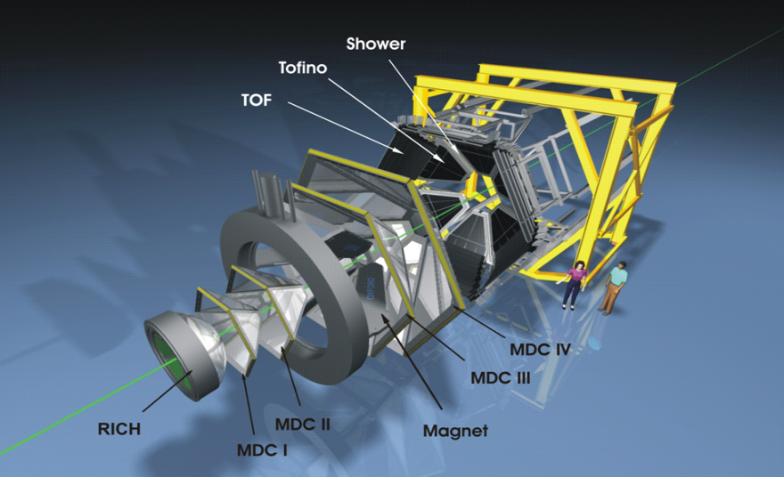
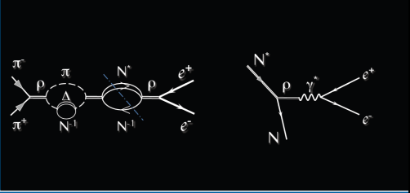
Study of electromagnetic processes
with HADES in pion induced reactions
B. Ramstein, IPN Orsay
for the HADES collaboration
RRTF symposium, GSI, 9 October 2013

Slide 2
Outline
Introduction:
General motivations of HADES experiments
  In-medium modifications of vector mesons
  Link to Time-Like electromagnetic structure of hadrons
Results from dilepton production in pp reactions with HADES
Perspectives of HADES measurements with the GSI pion beam (2014)
Conclusions

Slide 3

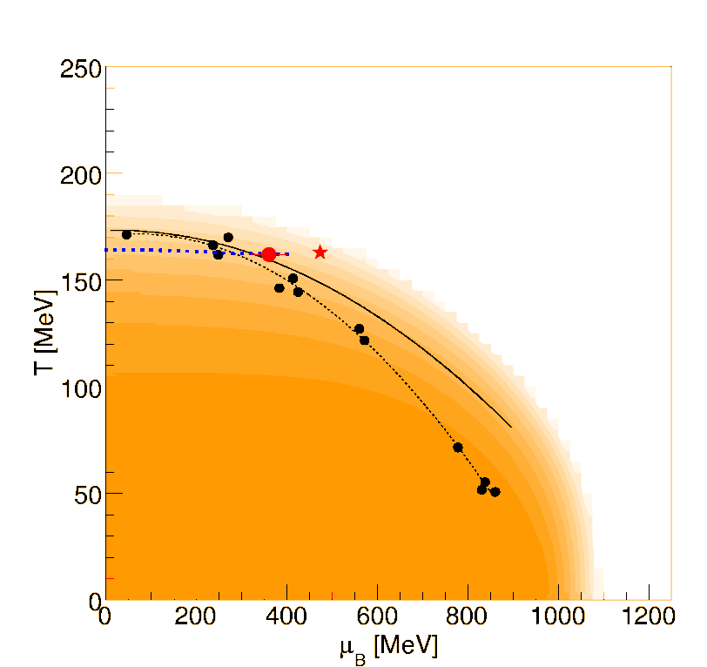
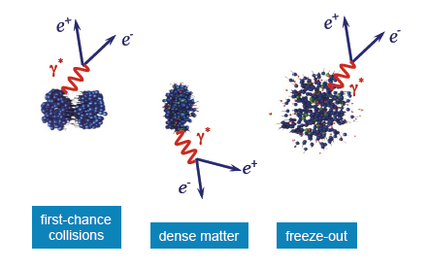
Motivations of the HADES experiment
Exploring the phase diagram of
hadronic matter…..
SIS18
E/A=1-3.5 GeV
ρ/ρ_{o} ~ 1-3,
T < 100 MeV
N_{π}/A_{part} ≈ 10%
SIS100
E/A=8 GeV
QGP
LHC
SPS
CERES
….. using dilepton emission:
rare but undistorted probe
SIS-100
SIS-300
CBM
RHIC
AGS
DLS
DLS
hadrons
SIS-18
HADES
KEK,JLAB,TAPS
G7
e+
e⁻

Slide 4
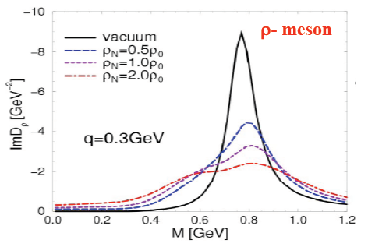
In-medium vector meson modifications:
see e.g. Leupold ,Metag,Mosel Int. J. of Mod. Phys. E19 (2010) 147 for a recent review
« in-medium broadening »
π
N
ρ
ρ
ρ
ρ
Δ
+
N⁻¹
N⁻¹
In-medium spectral function depends on ρ NN* coupling
main players: N(1520), N(1720), Δ (1910)
Rapp and Wambach EPJA 6 (1999) 415
Rapp, Chanfray and Wambach NPA 617, (1997) 472
4
Notes:
4

Slide 5
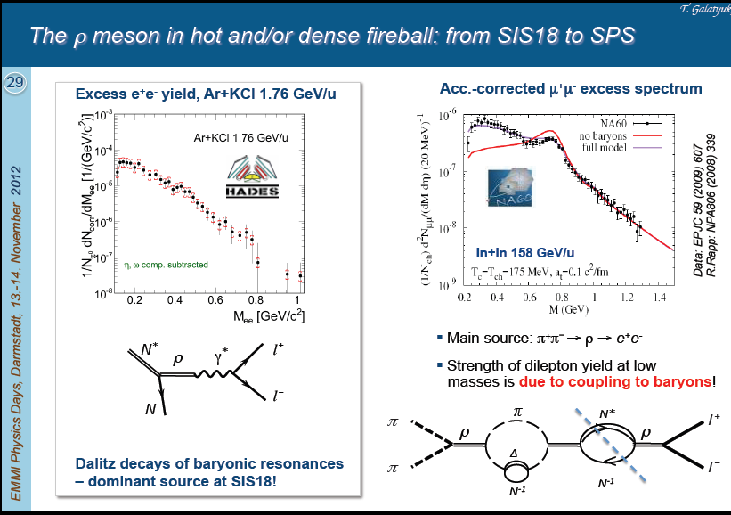
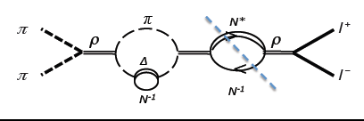
The ρ meson in hot and dense hadronic matter from SIS18 to SPS
Source of ρ mesons
Source of ρ mesons at 1-2 AGeV
NN →NR →NNρ
πN →R →Nρ
Source of ρ mesons
Source of ρ mesons at ultra relativistic energies
π⁺π⁻ →ρ
Already depends on RNρ coupling
Coupling of ρ to baryonic resonances: plays a crucial role in medium effects
can be studied in NN and πN collisions at 1-2 GeV

Slide 6
Relation to electromagnetic structure of baryons
Dalitz decay of baryonic resonances
R→Ne⁺e⁻
ρ meson production and decay
q²=M²_{inv}(e⁺e⁻)=M²_{γ*} >0
R
γ∗
γ∗
e⁺
R
ρ, ω,φ
e⁺
e⁻
e⁻
electromagnetic
elastic or transition
form factors
N
N
Vector Meson Dominance Model
Coupling constants
q² ≥ 0 : « Time like « region
electromagnetic form factors are unknown !
use models fitted to Space-Like data q² ≤0
(electroproduction of baryonic resonances)

Slide 7
Hades « strategy » : 2013 status
Study dilepton emission in dense and hot matter (cf. DLS/Berkeley)
A+A reactions in the 1-2 AGeV energy range C+C, Ar+KCl, Au+Au (2012)
cold matter at normal nuclear density p+Nb 3.5 GeV
(cf KEK, Jlab, CBELSA/TAPS)
Elementary collisions pp, dp and in future π⁻p (2014)
  reference to heavy-ion spectra
  study different dilepton sources (exclusive channels)
  dilepton emission is probing time-like electromagnetic structure of hadronic transitions!
Simultaneous measurements of hadronic channels (pp →NNπ, pp →NNππ)
Cross-checks on known channels, detailed information on baryonic resonance production
…. strangeness measurement program: K⁻ , K⁰,φ, Σ(1385), Λ(1405) to be
investigated also in π⁻p and π⁻A
HADES@FAIR (2017): pp, pA, AA E/A<8 AGeV

Slide 8
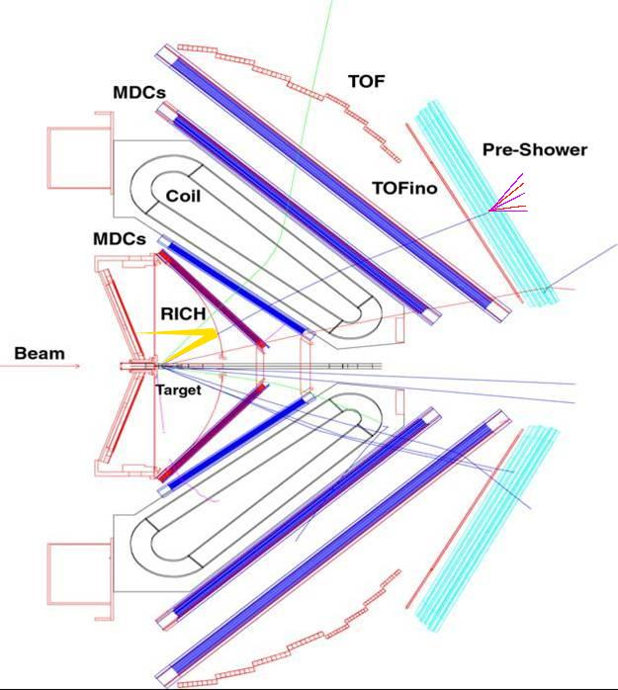
HADES
2nd generation dilepton
spectrometer
Side View
Acceptance: Full azimuth, polar angles 18º - 85º
Pair acceptance ≈ 0.35
Particle identification:
RICH, Time Of Flight, Pre-Shower (pad chambers & lead converter) ( also MDC (K±))
Trigger:
1st Level: charged particle multiplicity (~10 kHz)
2nd Level: single electron trigger (~2.5 kHz)
Momentum measurement
  Magnet: ∫Bdl = 0.1- 0.34 Tm
  MDC: 24 Mini Drift Chambers
  Leptons: Δx~ 140 μ per cell, Δp/p ~ 1-2 %
  ΔM/M ~ 2% at ω peak
Upgrade (2010)
New DAQ ~20 kHz
new MDCs for plane 1
RPC θ <45°
FW
START
θ < 7°
8
Notes:
8
Consists of 6 sectors,

Slide 9
Studies of baryonic Time-Like electromagnetic transitions in pp reactions
pp→ppe⁺e⁻ 1.25 GeV Δ resonance Dalitz decay
2.2 and 3.5 GeV higher lying resonances

Slide 10
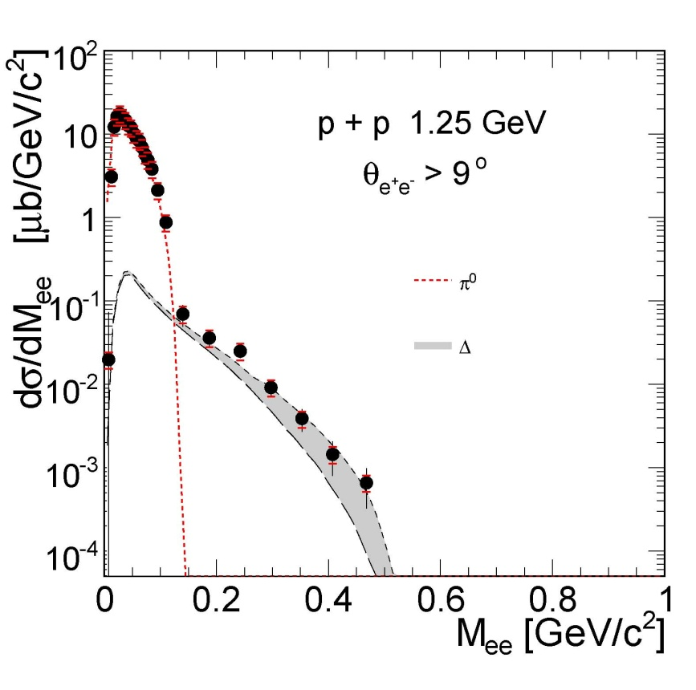
Dilepton production in pp reaction at 1.25 GeV
below η threshold: only 2 dilepton sources
HADES: Phys.Lett.B690 (2010)118
π° Dalitz decay σ_{π°} =4.5 mb
branching ratio π° → γe⁺e⁻ 1.2 %
Δ Dalitz decay :
branching ratio Δ → Ne⁺e⁻ (QED :4.2 10⁻⁵)
non resonant contribution expected to be small
Time-like N- Δ transition electromagnetic
form factors
Wan and Iachello Int. J Mod. Phys. A20 (2005) 1846
G. Ramalho and T. Pena Phys.Rev. D85 (2012) 113014
Resonance model results:
π° Dalitz
Dalitz)+ effect of Iachello FF
Notes:
10

Slide 11
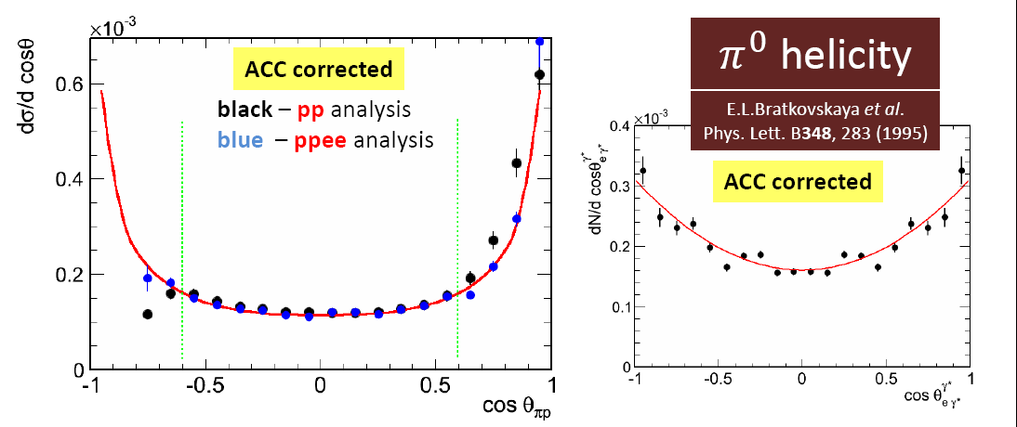
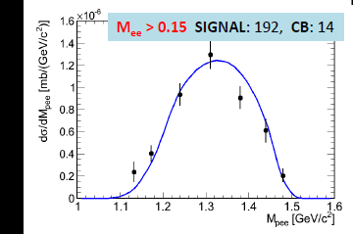
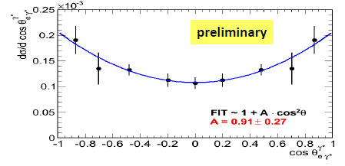
Exclusive analysis : pp→ppe⁺e⁻ at 1.25 GeV
Good agreement with
simulation of
Δ production + Dalitz decay
(cf hadronic channels)
In HADES acceptance
acceptance corrected
preliminary
preliminary
p
p
1
p₂
p
Δ⁺
e⁺
(p,e⁺,e⁻) invariant mass (GeV/c²)
cos(θ^{CM}_{pe+e-})
q²=M²_{inv}(e⁺e⁻)=M²_{γ*}
e⁻
Helicity distributions γ* → e⁺e⁻
dσ/dΩ_{e}~ 1+cos²α
α
e⁻
W. Przygoda’s analysis
Cracow
γ*
e⁺
Δ
cosα
N
First measurement !
Dalitz decay branching ratio in agreement with QED value (4.2 10 ⁻⁵)
BR= 4.42 10⁻⁵ ±20% ( syst.) ± 9% (stat)

Slide 12
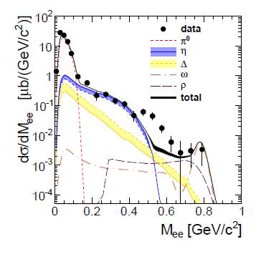
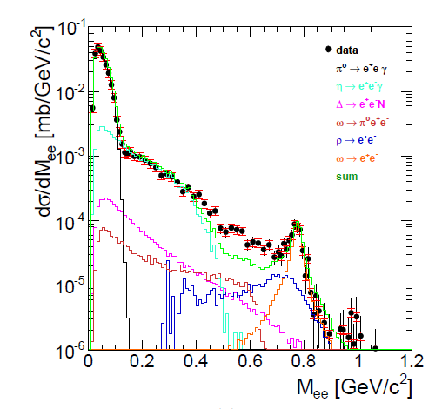
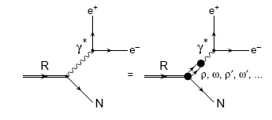
pp→e⁺e⁻X E=2.2 GeV, 3.5 GeV
Comparison to cocktail of dilepton sources
Direct production of ρ/ω
Dalitz decay of Δ resonance (point-like)
E=2.2 GeV
E=3.5 GeV
Hades data,
EPJA48 (2012) 64
Hades data,
PRC85 054005 (2012)
Effect of electromagnetic form factors / Coupling of ρ to baryonic resonances ?

Slide 13
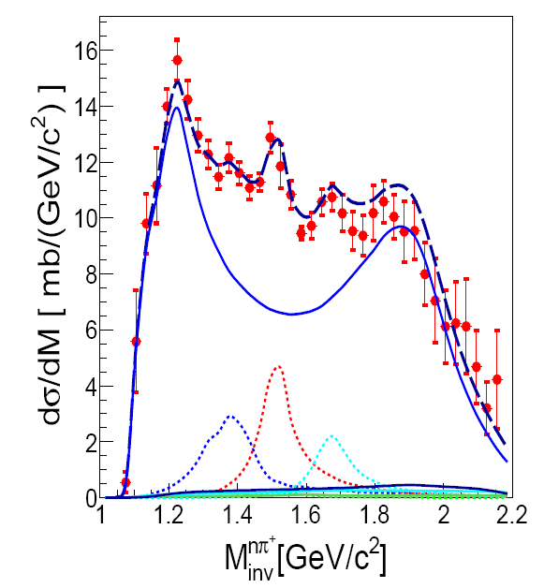
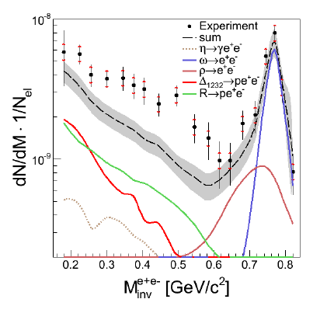
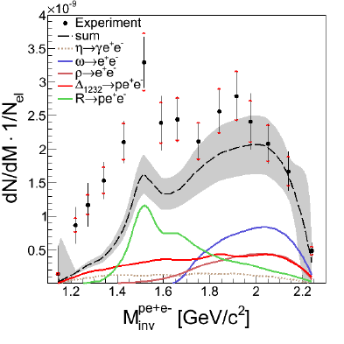
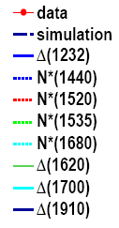
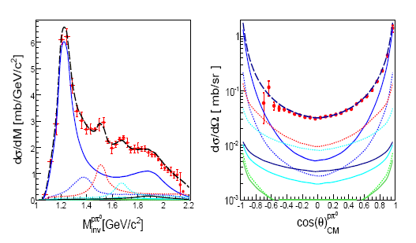
Exclusive pp→ppe⁺e⁻ channel at 3.5 GeV
Cocktail of baryonic resonances
constrained by hadronic channels
pnπ⁺
Dalitz decays of point-like baryonic resonances
+ “direct” ρ and ω
ppe+ e-
preliminary
ppe+ e-
ω
R
Δ
ω
ppπ⁰
R
ρ
Δ
Excess related to light baryonic resonances (N(1520)

Slide 14
From proton-proton to pion-nucleon experiments
dilepton emission in pp
sensitivity to the coupling of vector mesons to baryonic
resonances / Time-Like electromagnetic structure
complementary information in hadronic channels
useful constraints for medium effects
Limitations:
uncertainties due to pp interaction
many resonances contributing with broad mass distributions
small acceptance for exclusive channels
N*/Δ
ρ
ρ
N⁻¹
π⁻p→ne⁺e⁻ below ρ/ω production threshold
Advantages: interaction better known
fixed mass of the resonance in s channel
much larger acceptance for exclusive channels
electromagnetic π⁻p→ne⁺e⁻
hadronic π⁻p→ pπ⁻⁻, nπ⁺π⁻⁻, pπ⁰π⁻⁻

Slide 15
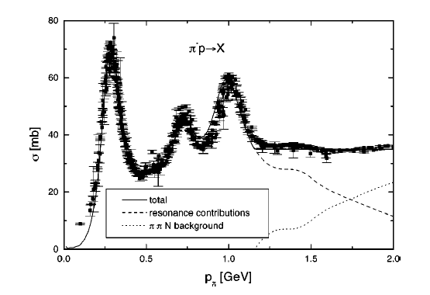
Project of pion beam experiments
with HADES
Belongs since the very beginning
to the HADES experimental program
pion momentum 0.6 < p <1.5 GeV/c
average pion flux ~ 4 10⁵/s
updated 2013 program:
Based on HADES results
Limited by constraints of beam time at GSI
Strangeness production (K⁺,K⁻,K⁰_{S},ϕ) inπ+A
π⁻p→ne⁺e⁻ below ρ/ω production threshold
  One pion, two pion, one kaon production from an energy scan in π⁻p reactions
η
ω

Slide 16
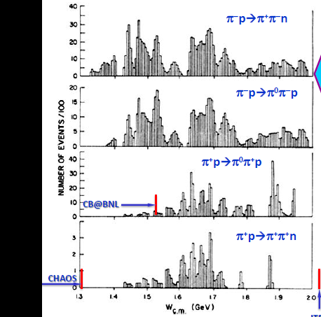
πN→ππN: present status
SAID, data base, CNS, GWU http://gwdac.phys.gwu.edu
All what we know about N* couplings to ρN, Δπ, σN is based on the analysis of 240000 events (bubble chamber < 1980)
114 kevents
72 kevents
1.4
1.6
1.8
2.
√s (GeV)
Very precise photoproduction data
Dynamical models are now available → a new combined PWA analysis of all pion and photoproduction channels will be possible.
Important for baryonic structure issues (Constituent Quark Models, Lattice QCD)
Very strong demand for new πN→ππN data !

Slide 17
Some open issues for πN→ππN and πN→πN measurements
N(1520) D₁₃
N(1720) P₁₃
Branching ratios to πΔ and (π π)_{s} N need to be checked
N(1440) P₁₁
Very large differences for BR(ρN)
between PDG and recent PWA or
coupled-channels analysis
Existence contradictory
Not seen in the latest GWU PWA analysis
BR(2π) =40 to 90 % (PDG 2012)
N(1710) P₁₁
***
N*
ρ
ρ
N⁻¹
Improve the existing data base
by a factor 200 in one week
Determine precisely the ρNN* couplings
Measurements with HADES of
π⁻p →π⁻p, π⁻p →π⁻π⁺n, π⁻p →π⁻π⁰p ,
π⁻p →π⁻ηp
in the range √s=M_{R}=1.4 to 2 GeV/c²

Slide 18
Motivations of π⁻p→ne⁺e⁻ experiments with HADES
“off-shell ρ production”
N
N(1520)
R
γ∗
ρ
ρ
e⁺
ρ, ω,φ
+ ...
e⁻
N⁻¹
Time-Like electromagnetic form factors
Space-Like electromagnetic form factors
π ⁻
R
n
e⁺
q² <0 fixed
γ*
Inverse pion electroproduction
e⁺
γ*
R
p
q² > 0
variable
e⁻
e⁻
p
π⁻
e⁻⁻
p
studied at JLab/CLAS
π⁻p→ne⁺e⁻ below ρ/ω production threshold at √s=1.52 GeV/c²
unique chance
to study the Time-Like electromagnetic structure of N*(1520)
to constrain the in-medium modifications of the ρ meson spectral function
18
Notes:
18

Slide 19
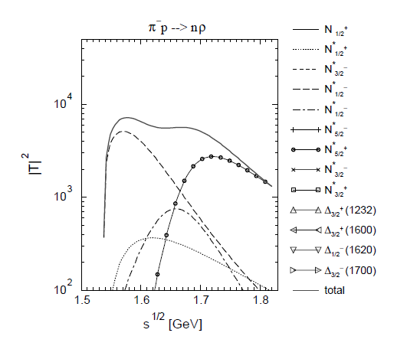
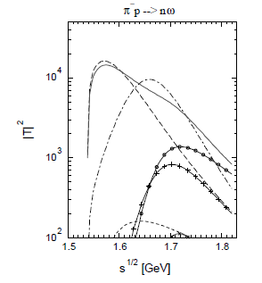
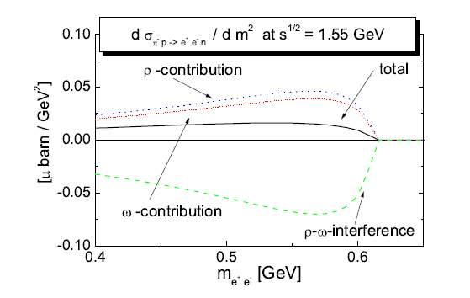
Predictions for π⁻p→ne⁺e⁻
B. Kaempfer , A Titov , R.Reznik Nucl. Phys. A721(2003)583
Titov, B.Kaempfer EPJA 12(2001)217
Coupling constants from quark models
or derived from R→Nρ/ω branching ratios
M_{ee}=0.6 GeV/c²
π⁻p→ρn
π⁻p→ωn
N(1535)
N(1535)
N(1680)
N(1440)
N(1680)
N(1440)
N(1440)
N(1675)
M.F.M. Lutz , B. Friman, M. Soyeur Nuclear Physics A 713 (2003) 97–118
Coupling constants from
hadronic coupled channel model fitted to γp→ρ/ω p and π⁻p→ρ/ω n data
overall smaller amplitudes
D₁₃(1520) has a larger contribution
Very large destructrive interference
between I=0 (ω) and I=1 (ρ) contributions

Slide 20
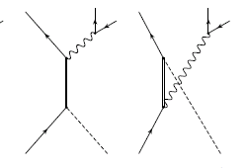
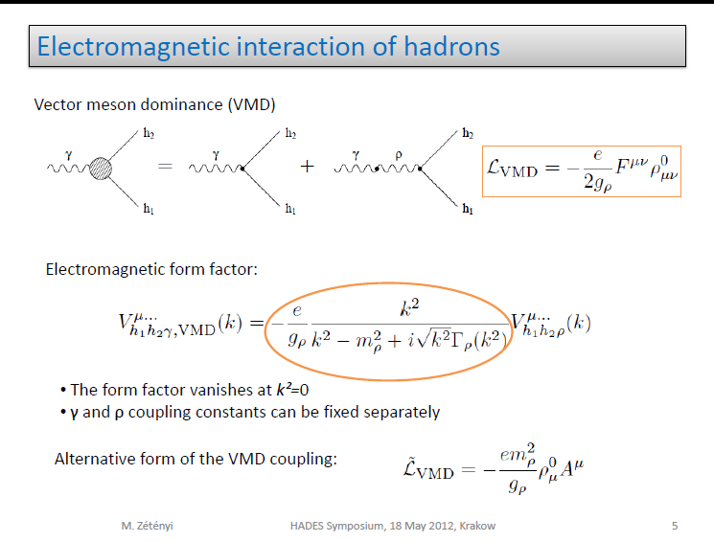
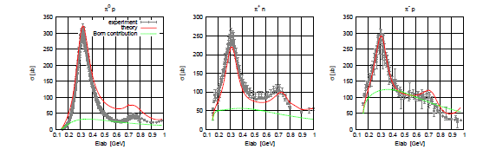
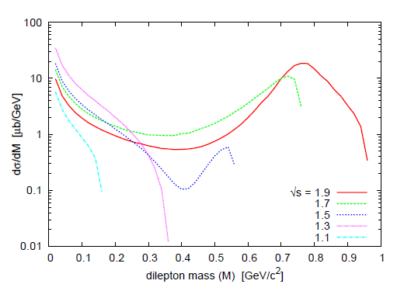
Electromagnetic form factors approach
M. Zetenyi and G. Wolf, Phys.Rev. C86 (2012) 065209
ρ production is embedded in the em form factor
R
R
s channel
u channel
+ Born term
+ ρ meson exchange
  adjustment to pion photoproduction cross sections of
  signs and strength of RNγ couplings (within the range allowed by the radiative decay widths)
γp→π⁺n
Further studies needed:
Inclusion of ω contribution
Too large cross sections for
ρ production
π⁻p→ ne⁺e⁻

Slide 21
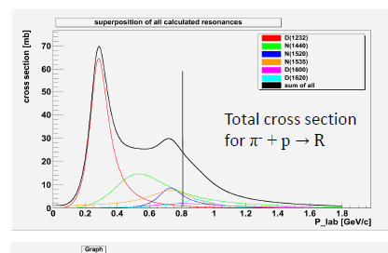
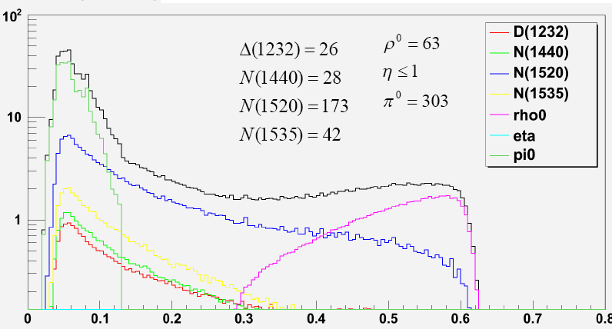
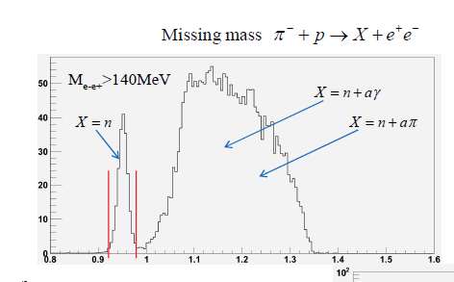
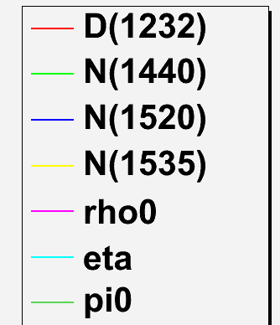
Simulations for π⁻p→ne⁺e⁻ with the resonance model
H.Kuc (Orsay/Cracow)
N
Dalitz decays
R
γ∗
e⁺
Form factors:
e⁻
« photon-point » M. Zetenyi, Gy. Wolf, nucl-th0202047
after missing mass cut
π⁻p→e⁺e⁻ n
p=0.8 GeV/c
√s=1.55 GeV/c
Missing mass selection
M_{ee} (GeV/c²)
Missing mass (GeV/c)
1900 evts in 2 weeks for M_{ee} > 140 MeV/c²
M_{ee}(GeV/c²)

Slide 22
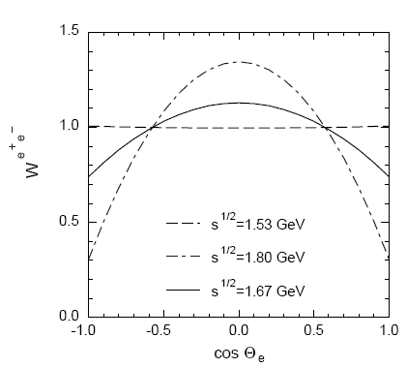
Angular distributions in π⁻p→ne⁺e⁻ :
γ* angular distributions in CM
sensitive to the different resonance
.contributions
B. Kaempfer , A Titov , R.Reznik Nucl. Phys. A721(2003)583
π⁻
N
R
e⁺
p
γ∗
e⁻
e⁺/e⁻ angular distributions
in γ* reference frame
sensitive to helicity amplitudes
(electromagnetic form factors)
e.g distributions in 1+ cos²θ in case
of purely magnetic transition Δ (1232)
measured in pp reactions
α
e⁻
γ*
e⁺
Δ
N
cosα

Slide 23
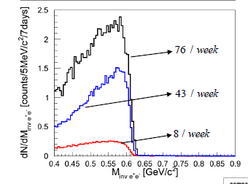
π⁻p→ ne⁺e⁻: count rate estimates
P=0.8 GeV/c √s=1.55 GeV/c
(below ω threshold)
Simulations
Resonance model
 | Resonance model | Titov et al. | M. Lutz et al.
Evts/ 2 weeks M>0.14 GeV/c² | ~ 1900 | ~6000 | ~200
incoherent sum
(M. Soyeur)
Coherent sum
(M. Soyeur)
Strategy:
fix the ρNN* couplings using
the π⁻p →π⁺π⁻N channels in the
energy scan
Measure “off-shell” ρ effects in
the dielectron production at the N*(1520)
energy
π⁻
N
π⁻
N
R
π⁺
R
γ∗
ρ
e⁺
p
ρ
p
π⁻
e⁻

Slide 24
acceptance Δp/p =8%
Momentum measurement needed
X,Y
det2
X,Y det1
Trigger on interactions
with the target, halo rejection
in beam, position sensitive detectors (δp/p<0.3%)
optimization of beam line acceptance and extension at the target

Slide 25
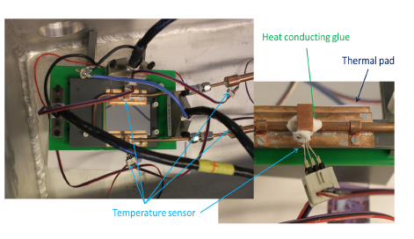
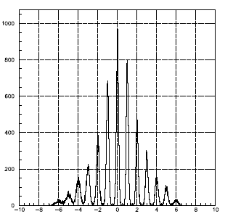

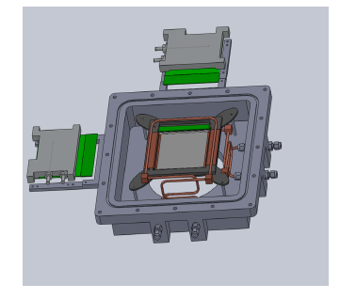
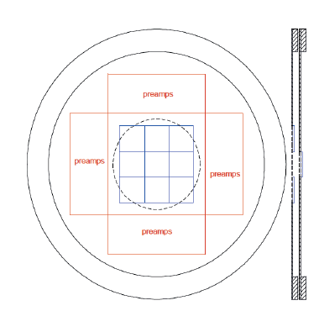
Pion Beam tracking
Beam line optimization:
Orsay
Δp/p~0,1-0.3 %
Δx<1mm
Excellence Cluster Universe, Garching
10x10 cm²
2x128 channels
300 μ Si detector
Diamond start detector GSI

Slide 26
Experiments with the GSI π⁻ beam : one possible scenario
1 week π⁻A 1.6 GeV/c 3 targets C, Cu, Pb
strangeness production (K,φ) (and a few hundreds of ρ/ω→e⁺e⁻)
1 week π⁻p energy scan π⁻p → nπ⁺π^{-,} pπ⁻π⁰
PWA.
2 weeks π⁻p → ne⁺e⁻ 0.8 GeV/c
Electromagnetic transition form factors of baryonic resonance/ off-shell ρ meson production

Slide 27
Conclusion:
perspectives of pion beam experiments with HADES ( 2014)
  Strangeness production in π⁻A at 1.7 GeV/c
  π⁻p→ne⁺e⁻ at 0.8 GeV/c
  Energy scan of π⁻p reactions : one pion, two pion and kaon production
  Urgent need of new data for Partial Wave Analysis → baryonic resonance properties
  Crucial to control the interpretation of
  medium effects (lesson from HADES dilepton experimental program )
  Unique chance to study Time-Like electromagnetic structure of higher lying resonances/coupling to ρ/ω mesons (complementary to pion electroproduction)
GSI pion beam is unique in world at present to provide these data
This should be exploited ,…. before HADES moves to FAIR
Béatrice Ramstein
27

Slide 28
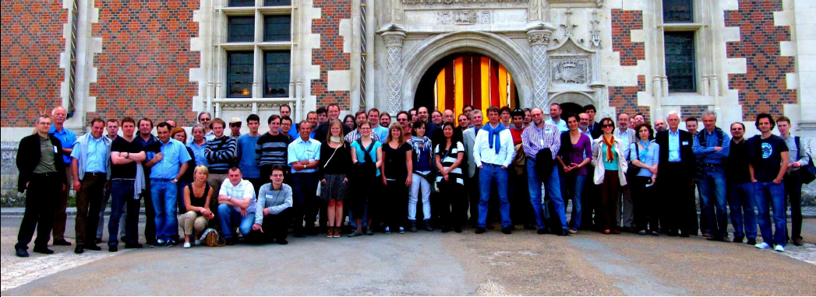
Thank you

Slide 29
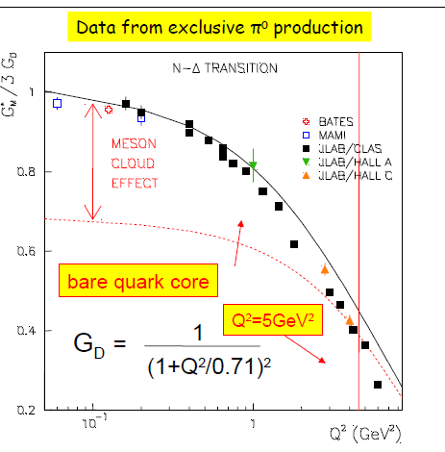
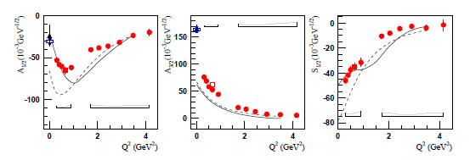
Baryonic transition electromagnetic form factors in space-Like region
Baryonic electromagnetic form factors
are measured for q²≤0
e⁺
e⁻
Δ⁺
q²=M²_{γ*} <0
γ*
Magnetic form factor for
γ*p→Δ(1232)
Data: Mainz, Jlab
I.G. Aznauryan, V.D. Burkert Prog. Part. Nucl. Phys. 67, 1 (2012)
p
Helicity amplitudes for γ*p→N(1520) D₁₃ compared to quark models
No measurement at q² > 0 → use models fitted on space like data

Slide 30
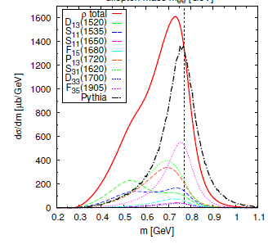
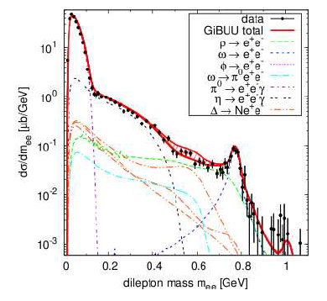
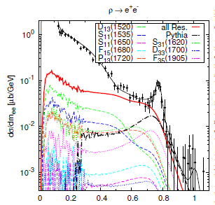
Transport model calculations for inclusive e⁺e⁻ production in pp
“ρ production approach”:
pp→Rp ; R → ρN
pp 3.5 GeV
ρ mass distribution strongly modified
in NN collisions
Same origin as in-medium effects
(coupling to baryonic resonances)
N*/Δ
ρ
ρ
ρ
N⁻¹
N(1620)
N(1520)
N(1720)
“ electromagnetic form factor approach”:
VDM
ρ → e⁺e⁻
Courtesy of Janus Weil
Hades data, Eur.Phys.J. A48 (2012) 64
N-Δ Form Factor: G.Ramalho and T. Pena
Phys. ReV. D85,113014 (2012)
J. Weil, H. van Hees and U. Mosel, EPJA 48, 111 (2012)

