Slide 1
Lattice Calculations of Hadronic Properties
Hartmut Wittig
PRISMA Cluster of Excellence, Institute for Nuclear Physics and Helmholtz Institute Mainz
EMMI RRTF Symposium
GSI Darmstadt
9 October 2013
TexPoint fonts used in EMF.
Read the TexPoint manual before you delete this box.: AAAAAAAAAAAAAAAA

Slide 2
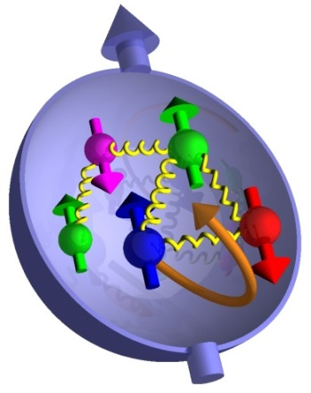
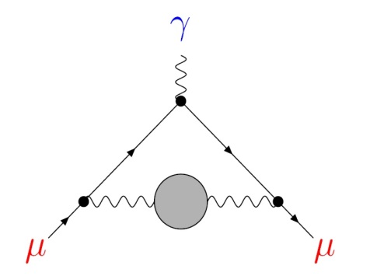
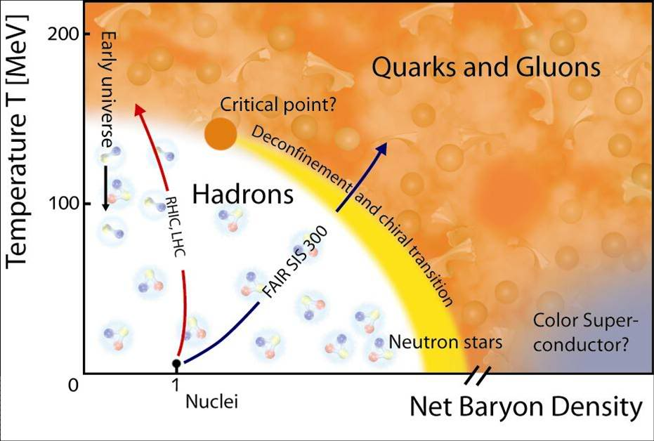
2 | Introduction
Low-Energy QCD in the LHC Era
Quantitative understanding of hadronic properties:
Hadron masses and decays
Structural properties
Determination of Standard Model parameters
Quark masses, strong coupling constant
Precision tests of the Standard Model at low energies:
QCD corrections to weak decay amplitudes
Hadronic contributions to the muon $(g−2)$
Non-perturbative input for QCD phase diagram:
Transition temperature; critical endpoint
Equation of State
Transport properties

Slide 3
3 | Introduction
Lattice QCD: non-perturbative; regularised Euclidean functional integrals
Minkowski space-time, continuum$⟶$ Euclidean space-time, discrete
lattice spacing: $a, x_{μ}=n_{μ}a, a^{−1}∼Λ_{UV}$
finite volume: $L^{3}⋅T$
Stochastic evaluation of $〈Ω〉$ via Markov process
Simulation algorithm: Hybrid Monte Carlo
[Duane et al., 1987]
Strong growth of numerical cost near physical $m_{u}, m_{d}$
Pion mass, i.e. lightest mass in the pseudoscalar channel:
$$≈500 MeV$$
(2001)
$$≈130−200 MeV$$
(2013)
$$⟶$$

Slide 4
4 | Introduction
Systematic Effects
Lattice artefacts:
$⟶$ extrapolate to continuum limit from $a≈0.05−0.12 fm$
Finite volume effects:
Observables distorted by finite box size
Empirically: $m_{π}L ≳4$ sufficient for many purposes
Unphysical quark masses:
Chiral extrapolation to physical values of $m_{u}, m_{d}$ required
Use ChPT as a guide
Inefficient sampling of SU(3) group manifold:
Simulations trapped in topological sectors as $a→0$
Use open boundary conditions in time direction
[Lüscher & Schaefer, 2012]

Slide 5
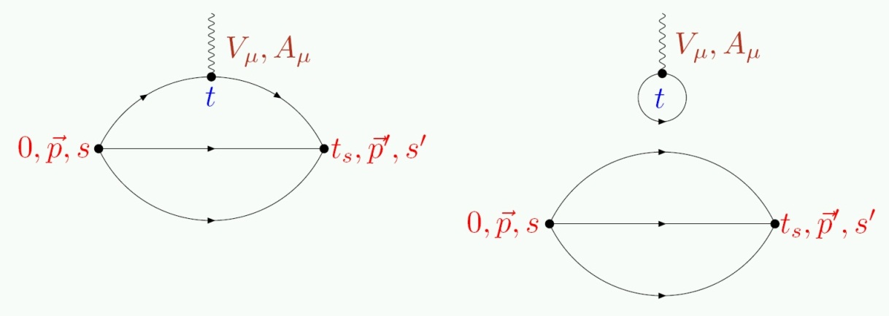
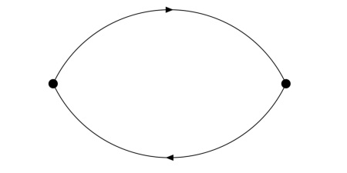
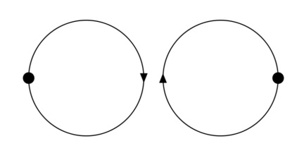
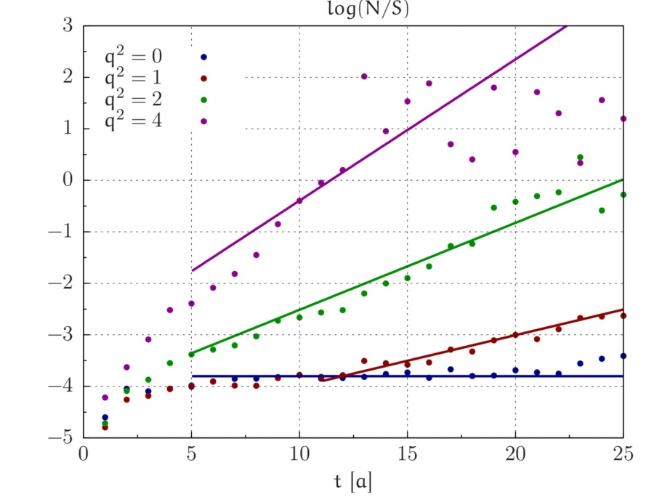
5 | Introduction
Many observables require evaluation of quark-disconnected diagrams:
Exponentially increasing noise-to-signal ratio:
Nucleon at rest: $R_{NS}\left(x_{0}\right)∼e^{\left(m_{N}− \frac{3}{2}m_{π}\right)x_{0}}$
Pion at $\vec{p}≠0$:
$$R_{NS}\left(x_{0}\right)∼e^{\left(\sqrt{m_{π}^{2}+{\vec{p}}^{2}}−m_{π}\right)x_{0}}$$
Obstacle for accurate calculations of hadron form factors and baryonic properties

Slide 6
6 | Outline
Outline
Hadron Spectroscopy
Light hadrons
Excitation spectrum; resonances
Hadron Structure
Nucleon electromagnetic form factors and axial charge
Scalar form factor of the pion
Conclusions

Slide 7
7 | Hadron Spectroscopy
Hadron Spectroscopy

Slide 8
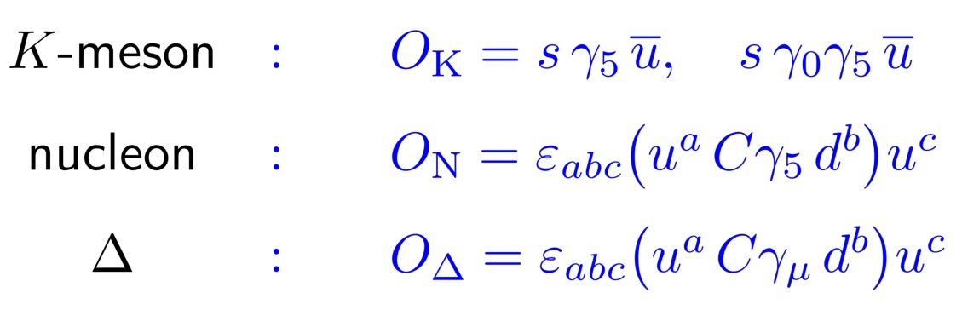
8 | Hadron Spectroscopy
Hadron Spectroscopy
Hadron masses encoded in correlation functions:
$O_{had}\left(x\right):$ interpolating operator in a given hadron channel, e.g.
$⟶$ projects on all states with the same quantum numbers
Ground state dominates at large Euclidean time separations
Excited states: sub-leading contributions

Slide 9
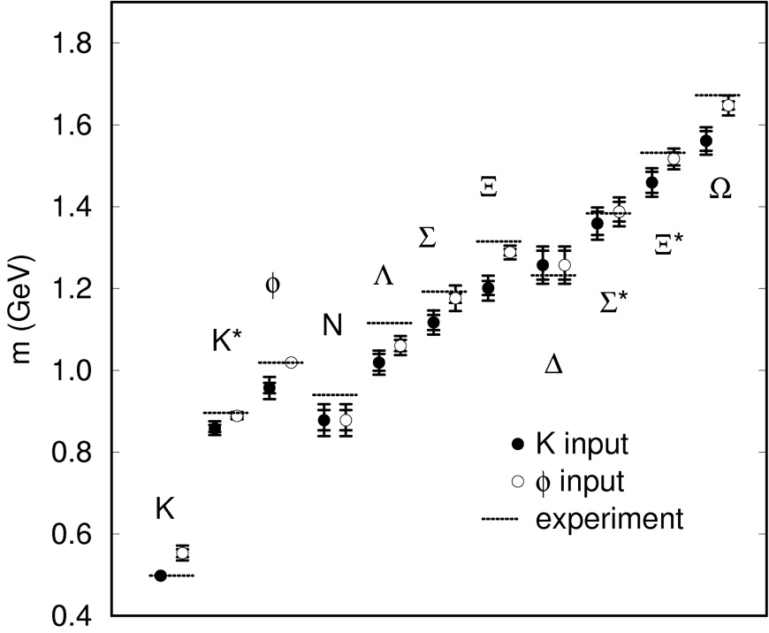
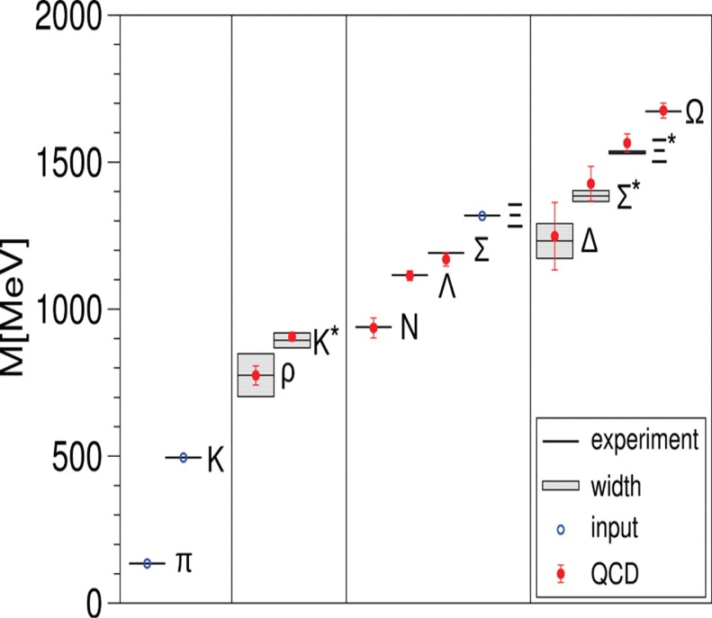
9 | Hadron Spectroscopy
Light Hadron Spectrum
Masses of the lowest-lying hadrons: Benchmark of Lattice QCD
CP-PACS Collaboration (1998):
BMW Collaboration (2008):
Dynamical $u, d, s$ quarks
Excellent agreement with experiment in continuum limit
Quenched approximation
Agreement with experiment at the level of 10 – 15%
Statistically significant deviations
Masses of the lowest-lying hadrons computable from first principles

Slide 10
10 | Hadron Spectroscopy
Challenges in lattice spectroscopy
Excitation spectrum and resonance parameters:
Isolate sub-leading contributions to correlation functions
Capture properties of states with radial and orbital excitations
Distinguish bound states and resonances from multi-hadron states
Include contributions from quark-disconnected diagrams
Complete determination of resonance parameters: energy and width
Techniques:
Variational principle – Generalised eigenvalue problem
Anisotropic lattices
“Lüscher method”: energy levels in a finite box
…

Slide 11
11 | Hadron Spectroscopy
Variational principle
Consider basis of operators $O_{i}, i=1,…,N$ in a given channel
Matrix correlator:
$$C_{ij}\left(t\right)=〈O_{i}\left(t\right) O_{j}^{†}\left(0\right)〉=\sum_{n=1}^{∞}{{\left(Z_{n}\right)}_{i} {\left(Z_{n}^{∗}\right)}_{j} e^{−E_{n}t}, {\left(Z_{n}\right)}_{i}=〈0\left|O_{i}\right|n〉}$$
Solve Generalised Eigenvalue Problem (GEVP):
$$C\left(t\right)v_{n}\left(t,t_{0}\right)=λ_{n}\left(t,t_{0}\right)C\left(t_{0}\right)v_{n}(t,t_{0})$$
$${\hat{𝒜}}_{n}≡\sum_{i=1}^{N}{{\left(v_{n}^{∗}\right)}_{i} O_{i}}$$
Define
; then
$$|n〉={\hat{𝒜}}_{n}|0〉, \hat{H}|n〉=E_{n}|n〉$$
For finite $N$ one can prove
[Lüscher & Wolff, 1990]
$$E_{n}^{eff}\left(t,t_{0}\right)=−∂_{t}\log{λ_{n}\left(t,t_{0}\right)}=E_{n}+O\left(e^{−ΔE_{n}t}\right), ΔE_{n}=\min_{n≠m}{|E_{m}−E_{n}|}$$

Slide 12
12 | Hadron Spectroscopy
Anisotropic lattices
Choose finer temporal lattice spacing: $a_{t}≪a_{s}$
For $a_{t}≪a_{s}:$slow exponential fall-off; large spatial volume preserved
Typically: $a_{s}≈0.1−0.15 fm, ξ≡{a_{s}}/{a_{t}}≈3$
$⟶$ cutoff effects in $a_{s}$ may be large

Slide 13
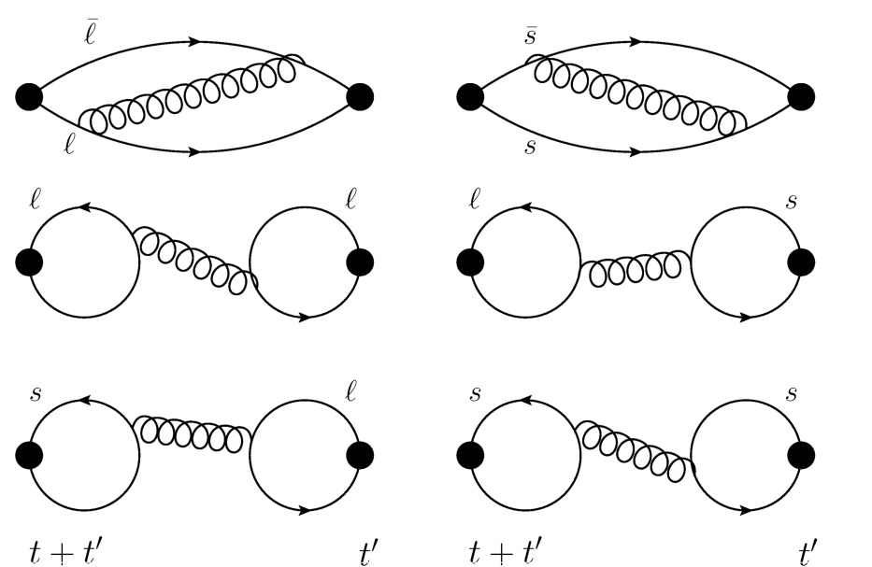
13 | Hadron Spectroscopy
Mass of the $η$ and $η^{′}$
Disconnected diagrams are crucial
Compute ground and 1st excited state for $u, d, s$ quarks
GEVP yields $(ℓ=u,d)$:
$${|n〉≡{\hat{𝒜}}_{n}|0〉, {\hat{𝒜}}_{n}=\sum_{i}{{\left(v_{n}^{∗}\right)}_{q}}, \left(Z_{n}\right)}_{q}≡〈0\left|O_{q}\right|n〉$$
for $q=ℓ, s$ and $n=η, η^{′}$
Mixing angles:
$$\tan{φ_{ℓ}=\frac{{\left(Z_{η^{′}}\right)}_{ℓ}}{{\left(Z_{η}\right)}_{ℓ}}, \tan{φ_{s}}=−\frac{{\left(Z_{η}\right)}_{s}}{{\left(Z_{η^{′}}\right)}_{s}}, \tan^{2}{φ}}=−\frac{{\left(Z_{η^{′}}\right)}_{ℓ}{\left(Z_{η}\right)}_{s}}{{\left(Z_{η}\right)}_{ℓ}{\left(Z_{η^{′}}\right)}_{s}}$$
$$(φ_{ℓ}≈φ_{s}≈φ)$$

Slide 14
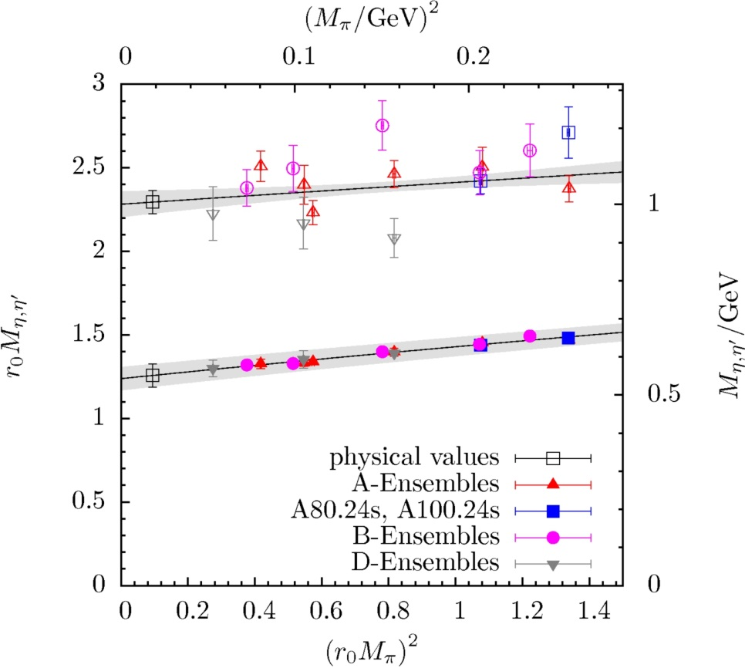
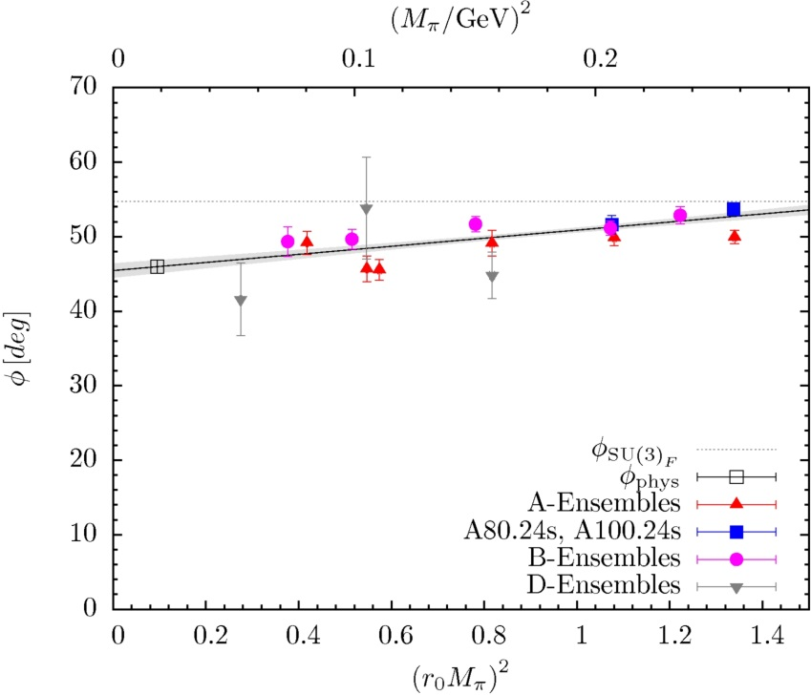
14 | Hadron Spectroscopy
ETM Collaboration (Michael, Ottnad & Urbach), arXiv:1310.1207
Twisted mass Wilson fermions + Iwasaki gauge action
Three lattice spacings: $a=0.086, 0.078, 0.061 fm$
${ m_{π}=230−510 MeV, m}_{π}^{min}L≳3.5$
$$m_{η}=551{\left(8\right)}_{stat}{\left(6\right)}_{sys} MeV$$
$$m_{η^{′}}=1006{\left(54\right)}_{stat}{(_{−38}^{+72})}_{sys} MeV$$
$$φ=46{\left(1\right)}_{stat} {{\left(3\right)}_{sys}}_{}^{o}$$

Slide 15
15 | Hadron Spectroscopy
Charmed meson spectroscopy
Open questions:
Open charm: interpretation of $D_{s0}^{∗}(2317)$ and $D_{s1}(2460)$
Charmonium: interpretation of $X, Y, Z$ states; nature of $Z_{c}(3900)$
Existence of states with “exotic” quantum numbers
Lattice issues:
Large lattice artefacts for relativistic charm quarks: $am_{c}≲1$
Spin identification:
Rotational symmetry only recovered in continuum limit: $a→0$
Map continuum spins onto Irrep’s of hypercubic group; Five irrep’s of $O_{h}$ for infinite number of spins

Slide 16
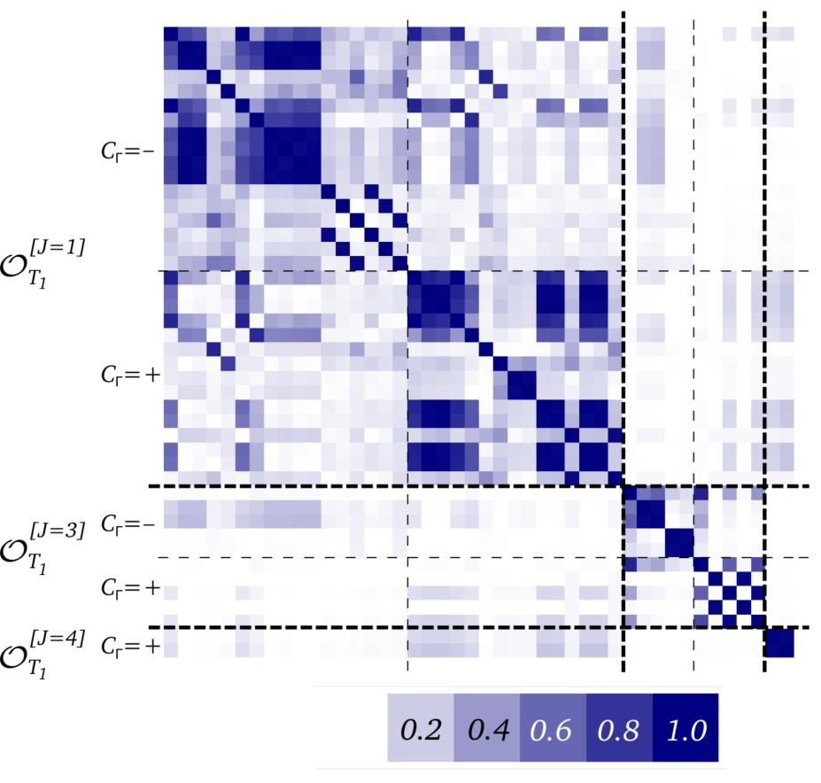
16 | Hadron Spectroscopy
HSC Collaboration (Moir et al.), JHEP 1305 (2013) 021
$O\left(a\right)$-improved Wilson fermions; anisotropic lattices
Single lattice spacing: $a_{s}=0.12 fm, {a_{s}}/{a_{t}}=3.5$
Single pion mass ${ m_{π}=391 MeV, m}_{π}^{}L=5.7$
Large variational basis; overlaps yield information on:
Composition of states
Spin identification

Slide 17
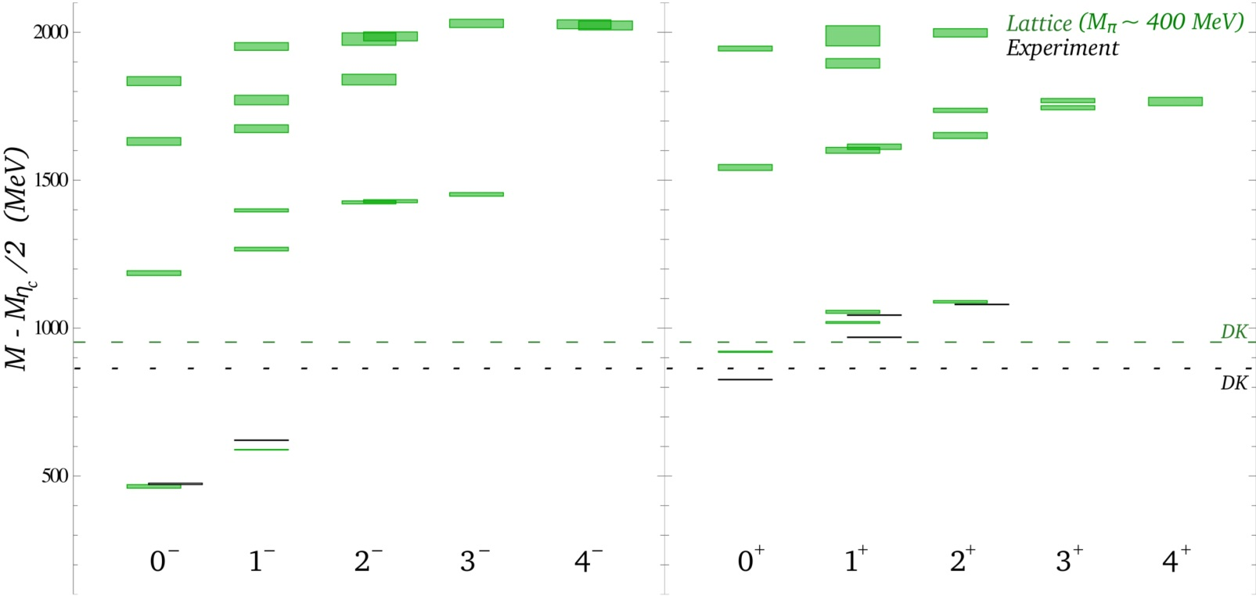
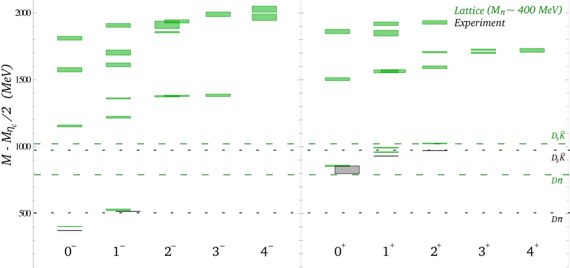
17 | Hadron Spectroscopy
HSC Collaboration (Moir et al.), JHEP 1305 (2013) 021
$O\left(a\right)$-improved Wilson fermions; anisotropic lattices
Single lattice spacing: $a_{s}=0.12 fm, {a_{s}}/{a_{t}}=3.5$
Single pion mass ${ m_{π}=391 MeV, m}_{π}^{}L=5.7$
$D$-mesons
$D_{s}$-mesons

Slide 18
18 | Hadron Spectroscopy
HSC Collaboration (Moir et al.), JHEP 1305 (2013) 021
$O\left(a\right)$-improved Wilson fermions; anisotropic lattices
Single lattice spacing: $a_{s}=0.12 fm, {a_{s}}/{a_{t}}=3.5$
Single pion mass ${ m_{π}=391 MeV, m}_{π}^{}L=5.7$
Hybrid candidates
$D$-mesons
$D_{s}$-mesons

Slide 19
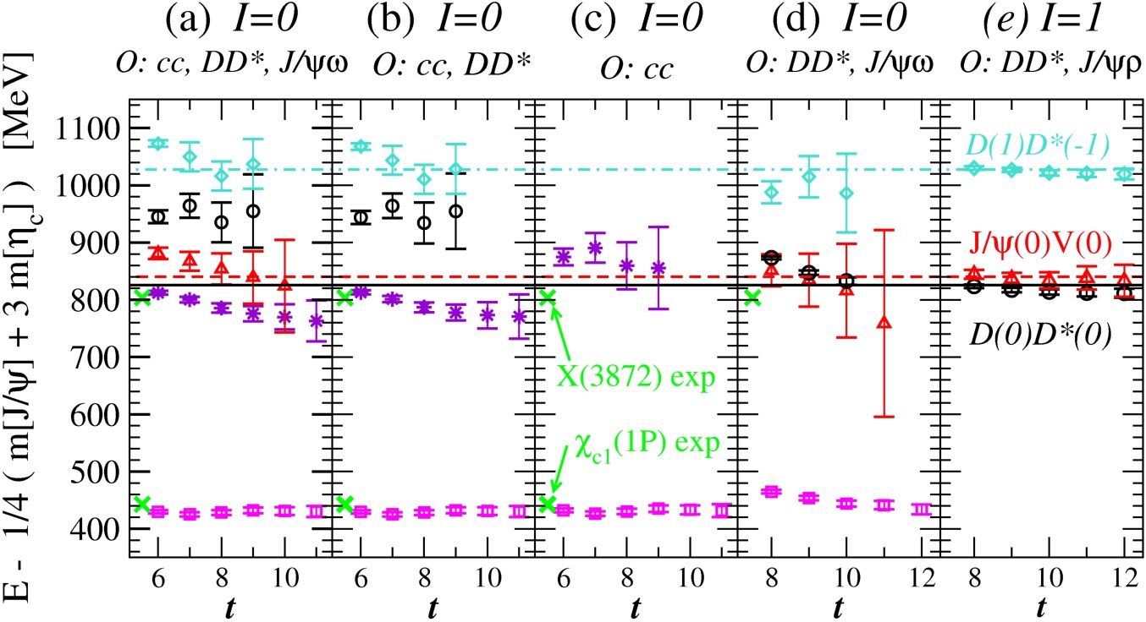
19 | Hadron Spectroscopy
Charmonium
Recent investigations of $X(3872)$ and $Z_{c}(3900)$
[Prelovsek and Leskovec, arXiv:1307.5172; arXiv:1308.2097]
$O(a)$-improved Wilson fermions, $N_{f}=2$
$m_{π}=266 MeV, a=0.124 fm, m_{π}L=2.7$

Slide 20
20 | Hadron Spectroscopy
Baryon resonances
First excited state of the nucleon – $P_{11}$ (“Roper”) – lighter than the nucleon’s parity partner – $S_{11}$
Lattice calculations inconclusive – focus on pion mass dependence
Lattice issues:
Baryons: exponentially increasing noise-to-signal ratio
Contamination from excited states
Large finite-size effects

Slide 21
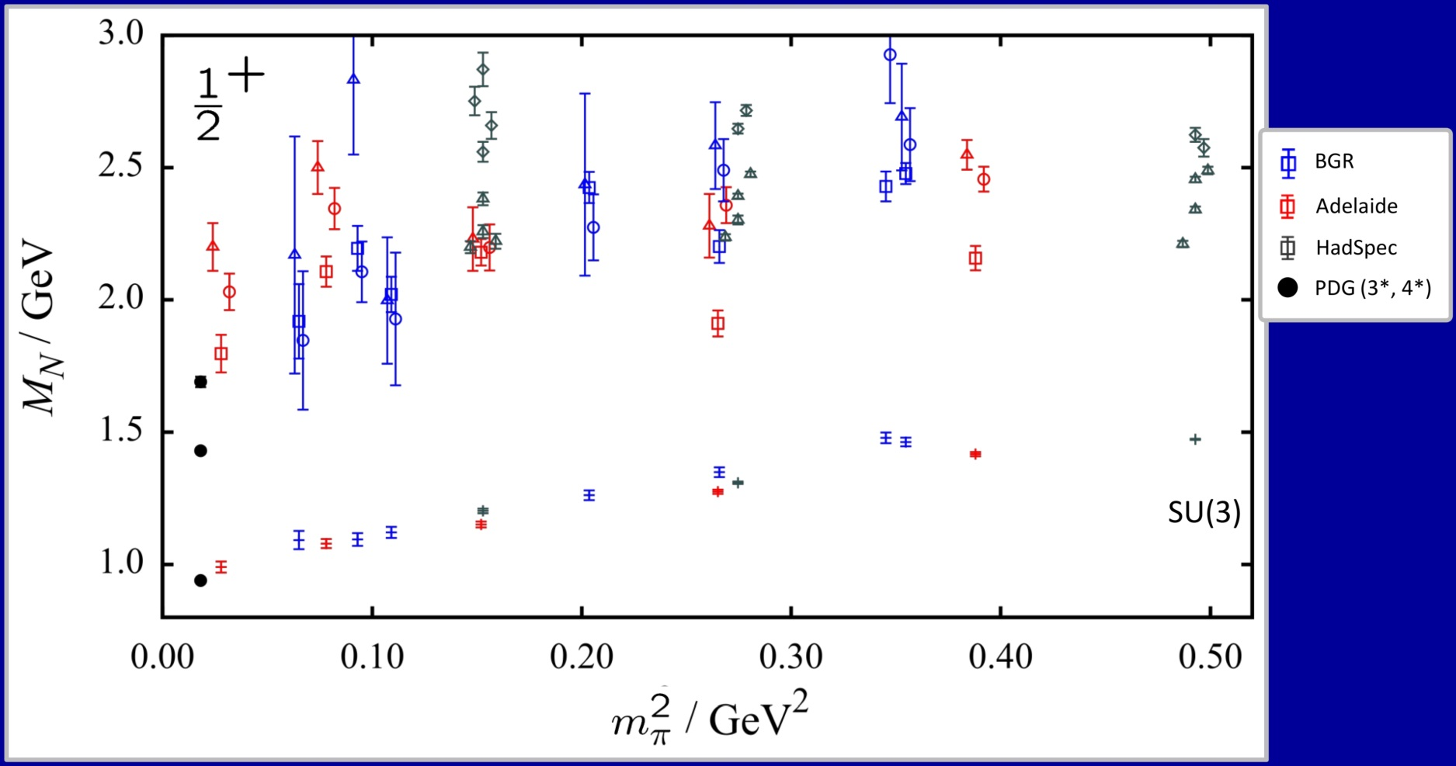
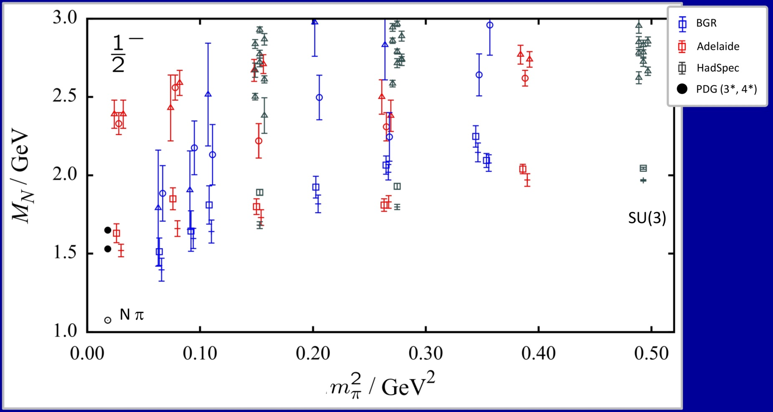
21 | Hadron Spectroscopy
Baryon resonances
Summary plot: Ch. Thomas @ Lattice 2013
Positive parity:
Negative parity:

Slide 22
22 | Hadron Spectroscopy
Summary: Hadron Spectroscopy
Ground state mesons and baryons computable with percent accuracy
Calculations of the excitation spectrum much less refined
Significant progress in mesonic sector
Baryon sector remains inconclusive
Systematic effects not well controlled
Much more statistics required
Volume study required to distinguish scattering states
Resonance widths accessible via multi-particle energy levels in a finite box
[Lüscher 1986 & 1991, Wiese 1989,…]

Slide 23
23 | Outline
23 | Hadron Structure
23 | Smearing Revisited
Hadron Structure

Slide 24
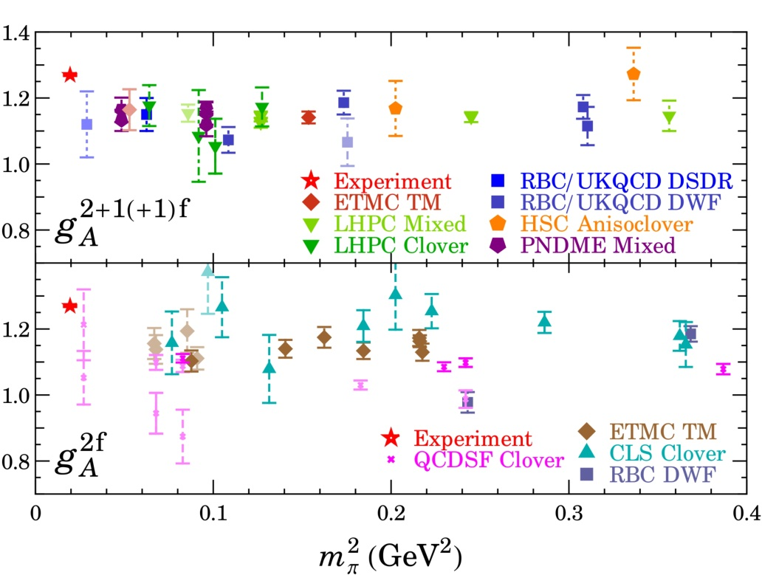
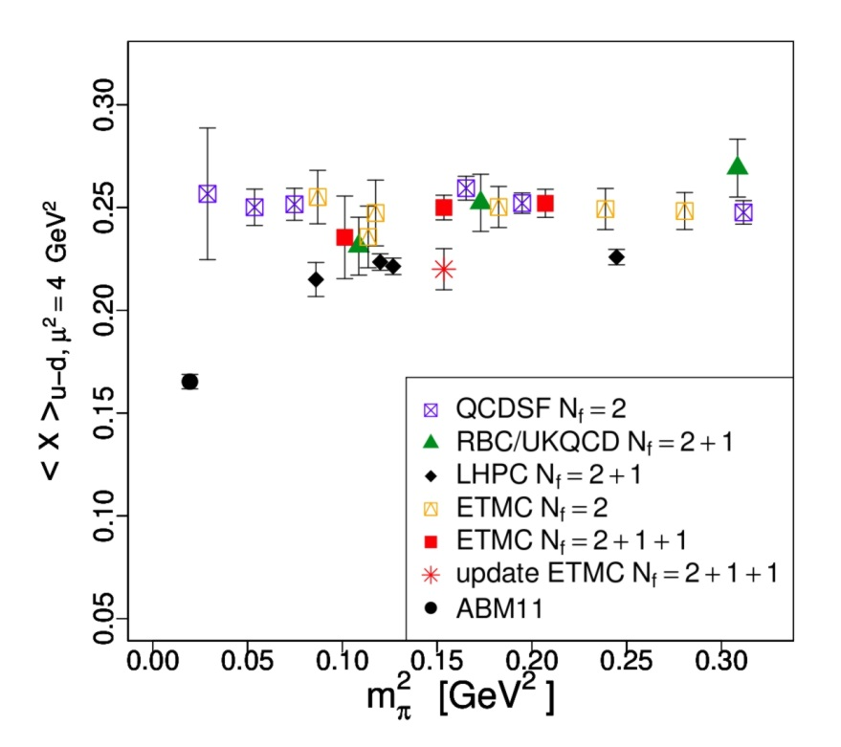
24 | Hadron Structure
Average momentum fraction
Nucleon axial charge
Current lattice simulations do not reproduce experimental results on nucleon structure
[Alekhin, Blümlein, Moch, Phys Rev D86 (2012) 054009]
[H-W Lin, PoS LATTICE2012 (2012) 013]
Systematic effects not fully controlled
Lattice artefacts
Chiral extrapolation to physical pion mass
Finite-volume effects
“Contamination” from excited states
Quark-disconnected diagrams ignored

Slide 25
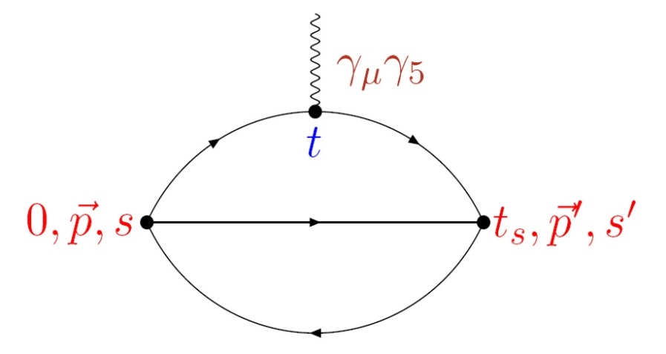
25 | Hadron Structure
Axial Charge of the Nucleon
$g_{A}:$ nucleon matrix element of the axial current:
$$〈N\left(p,s\right)|A_{μ}^{u−d} |N\left(p,s\right)〉=2g_{A} s_{μ}$$
Ideal benchmark quantity for lattice QCD:
Simple quark bilinear: $A_{μ}=\overline{q} γ_{μ}γ_{5} q$
No momentum transfer between initial and final state
No quark-disconnected diagram
Lattice calculations underestimate $g_{A}$ by $∼10\%$

Slide 26
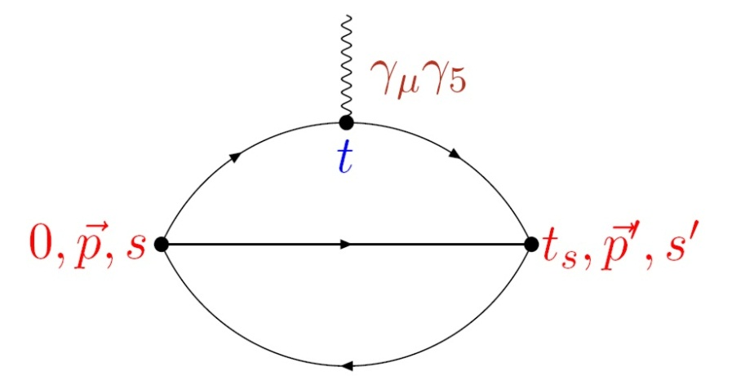
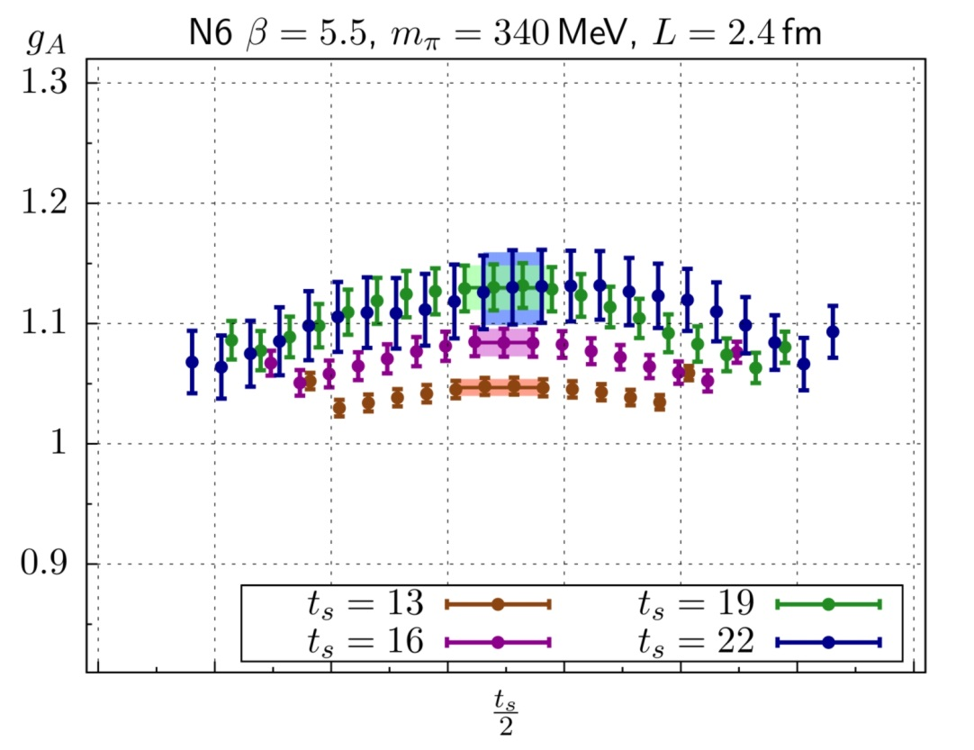
26 | Hadron Structure
Standard Method
Extract nucleon hadronic matrix elements from ratios of three- and two-point correlation functions, e.g.
Statistical fluctuations impose $t_{s}≲1.3 fm$

Slide 27
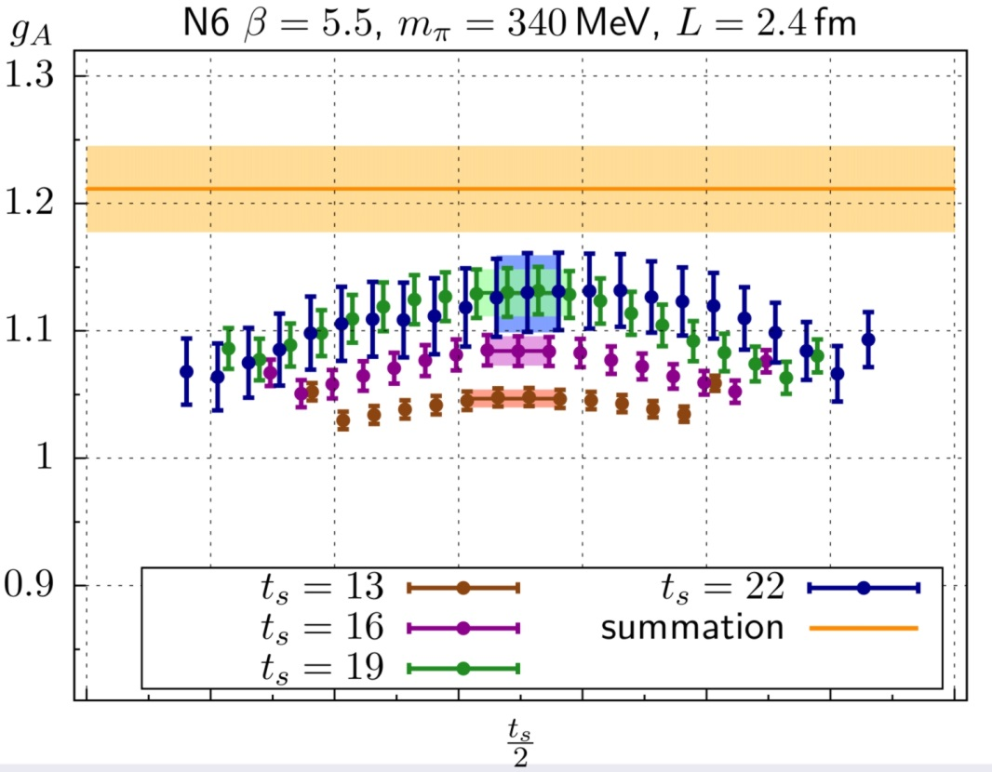
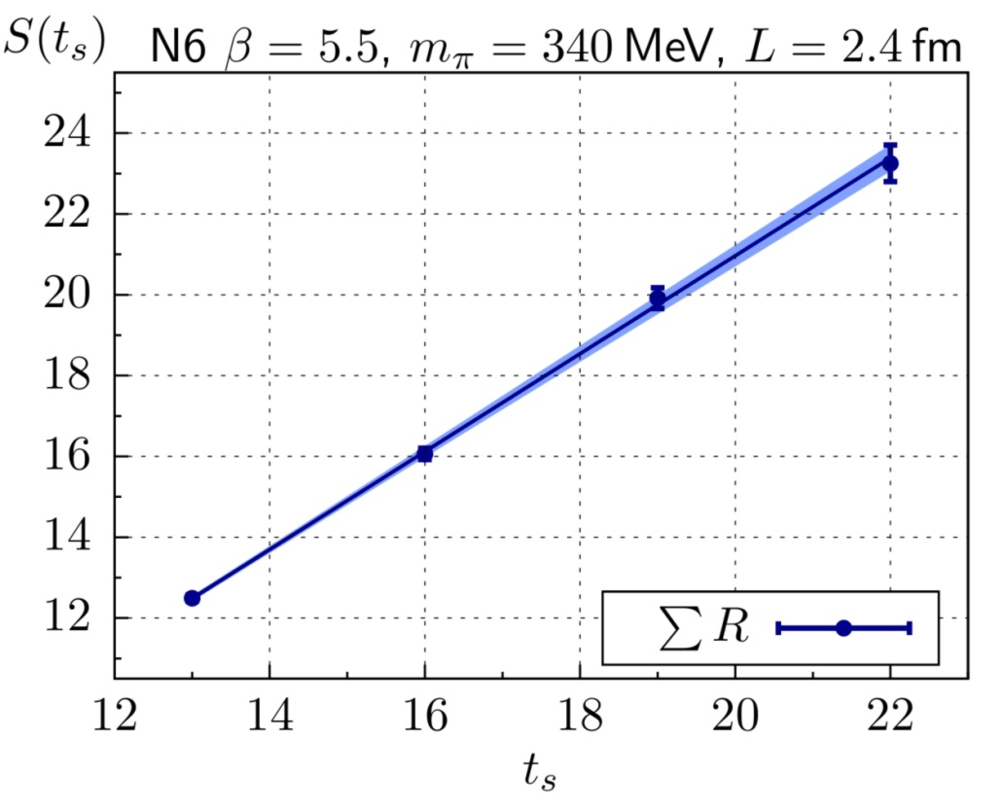
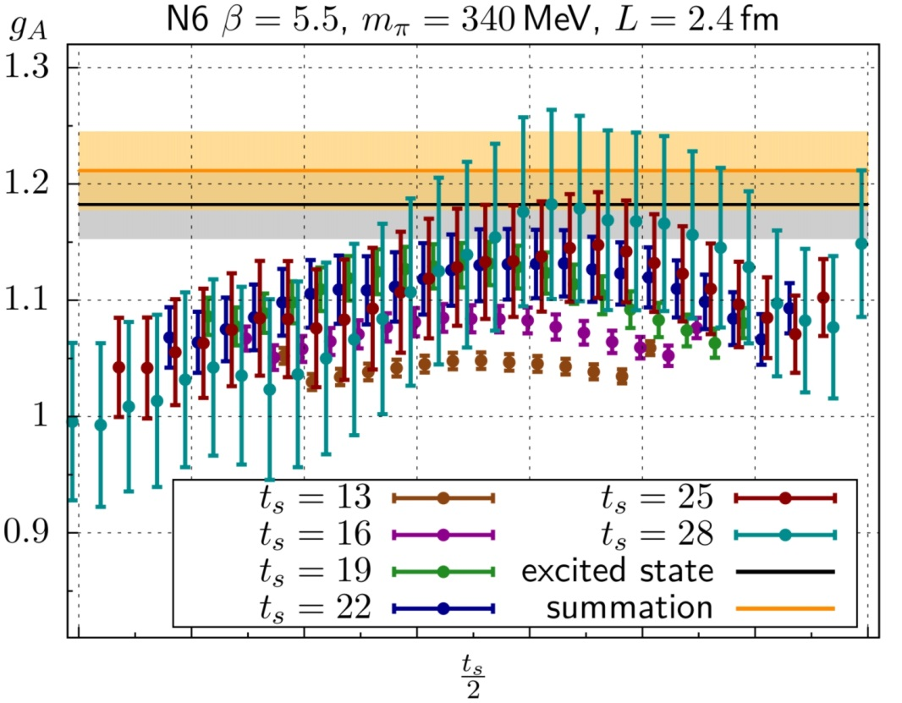
27 | Hadron Structure
Summed Insertions
[Maiani et al. 1987, Güsken et al. 1989, Bulava et al., Capitani et al.]
Standard method: $R_{Γ}\left(\vec{q},t,t_{s}\right)=ℳ_{Γ}(\vec{q})+O\left(e^{−Δt},e^{−Δ^{′}\left(t_{s}−t\right)}\right)$
Summed insertion:
$$S_{Γ}\left(t_{s}\right)≡\sum_{t=0}^{t_{s}}{R_{Γ}\left(\vec{q},t,t_{s}\right)}=K_{Γ}+t_{s}\left\{ℳ_{Γ}(\vec{q})+O\left(e^{−Δt_{s}}, e^{−Δ^{′}t_{s}}\right)\right\}$$
Excited state contributions more strongly suppressed
Determine $ℳ_{Γ}(\vec{q})$ from linear slope of summed ratio
(axial charge)
(axial charge)
(axial charge)

Slide 28
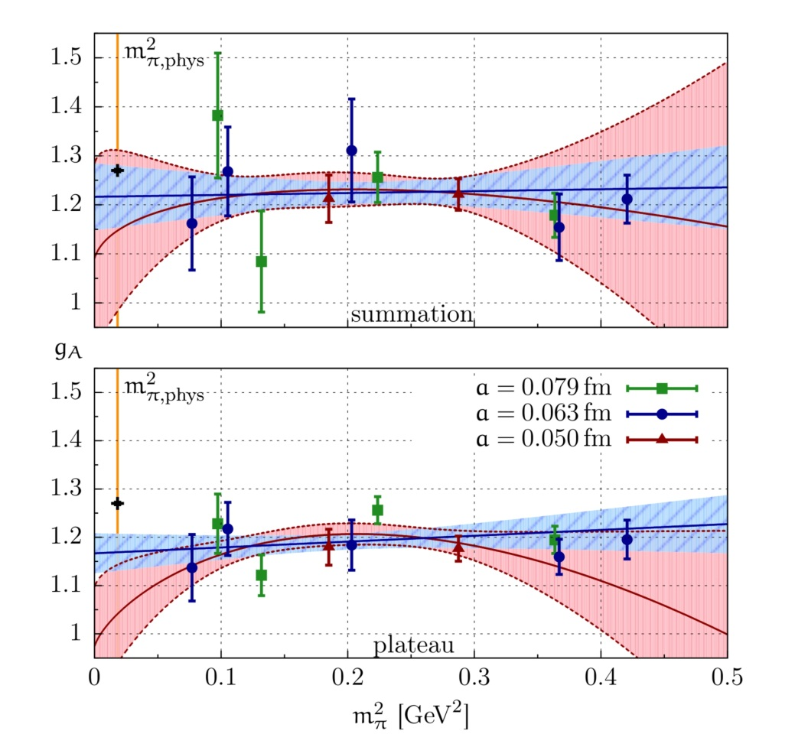
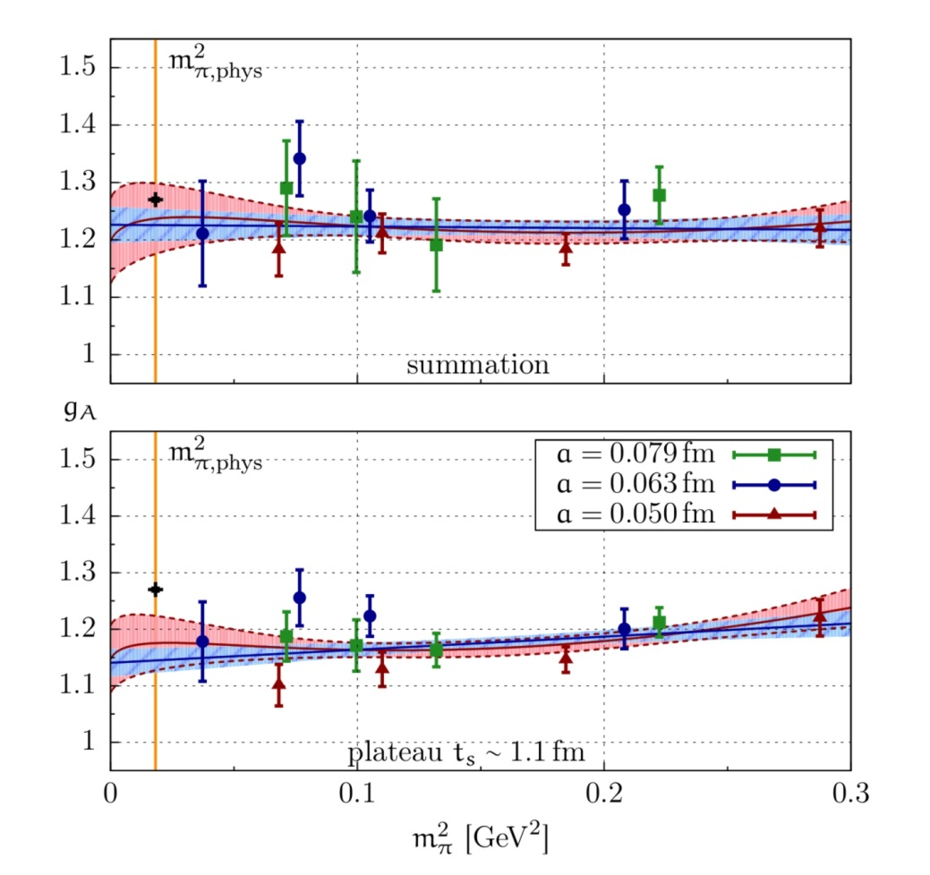
28 | Hadron Structure
Nucleon axial charge in two-flavour QCD
[Capitani, Della Morte, von Hippel, Jäger, Jüttner, Knippschild, Meyer, H.W., Phys Rev D86 (2012) 074502]
$O\left(a\right)$ improved Wilson fermions: $a=0.05, 0.063, 0.079$ fm
Pion masses: $m_{π}^{min}=$ 280 – 650 MeV, $m_{π}^{min}L≥4.0$
$$g_{A}=1.223±{0.063}_{stat}^{} (_{−0.060}^{+0.035})_{syst}$$

Slide 29
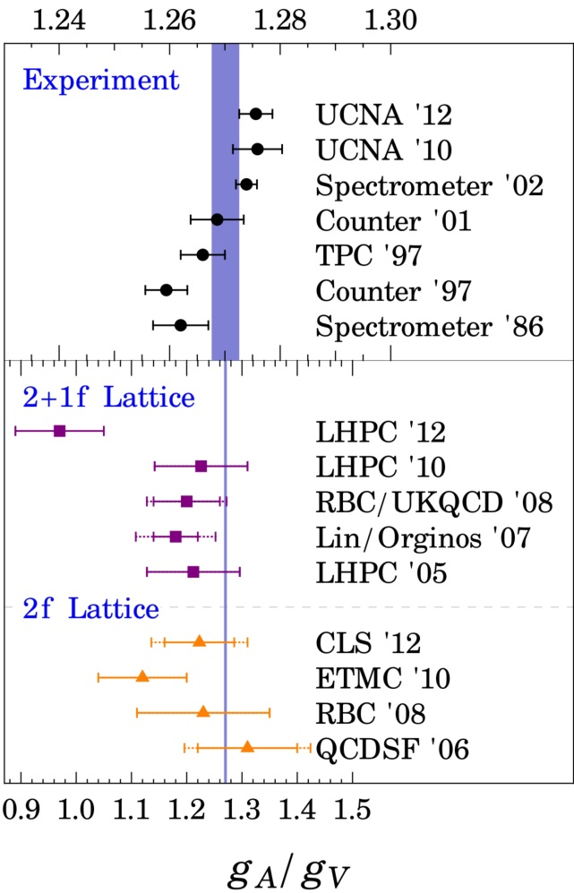
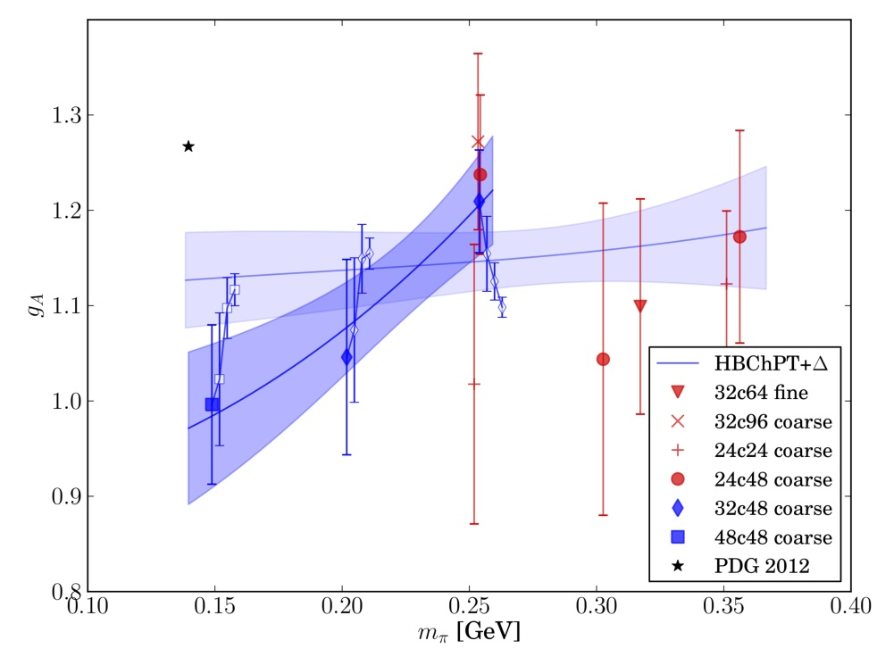
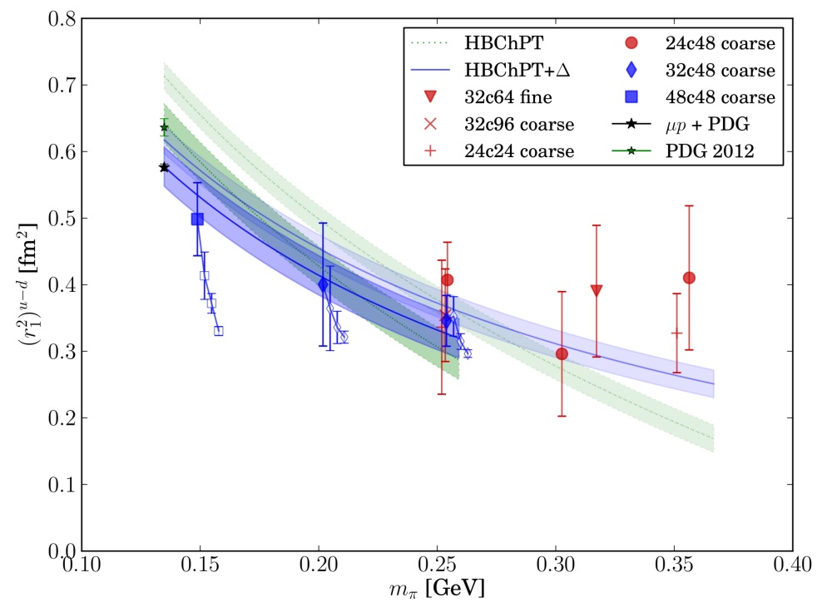
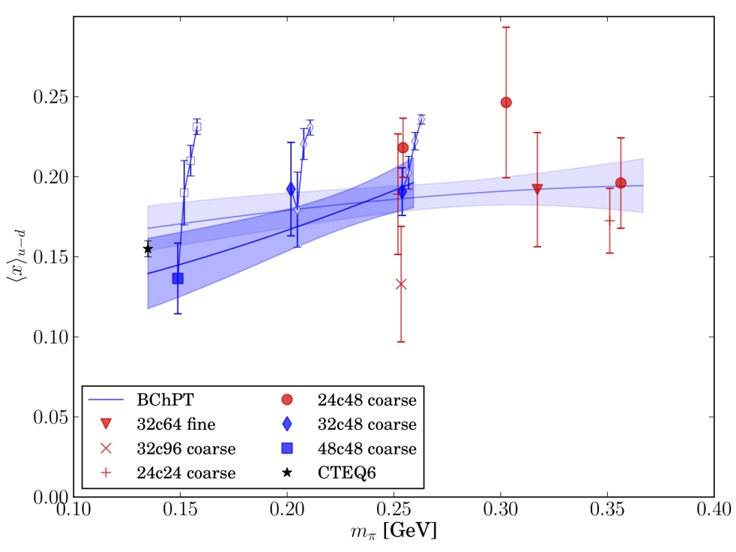
29 | Hadron Structure
Summary: Nucleon form factors and axial charge
Short source-sink separation $t_{s}$ dictated by noisy signal
Addressing excited-state contamination indispensable
LHP Collaboration
[H-W Lin, PoS LATTICE2012 (2012) 013]
[Green et al., arXiv:1209.1687]
Physical pion mass at $a=0.12 fm$
Excited-state contribution addressed

Slide 30
30 | Hadron Structure
Scalar form factor of the pion
Definition; charge radius:
$$q^{2}={\left(p_{f}−p_{i}\right)}^{2}=−Q^{2}$$
$$+$$
$$F_{s}\left(0\right)≡σ_{π}$$
(pion $σ$-term)
Chiral expansion:
$${\overline{ℓ}}_{4}=4.783±0.097⟹ {\left\langle r^{2}\right\rangle }_{s}=0.645±0.017 fm^{2}$$
Phenomenological determination from $ππ$-scattering
[Colangelo, Gasser & Leutwyler, Nucl Phys B603 (2001) 125]
$${〈r^{2}〉}_{s}=0.61±0.04 fm^{2}$$

Slide 31
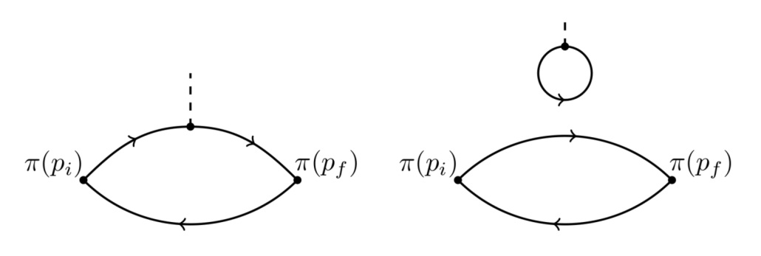
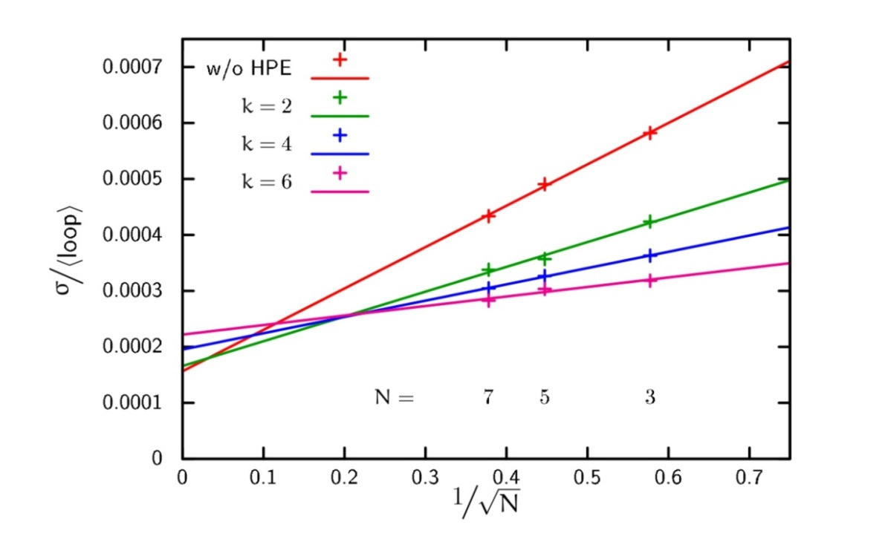
31 | Hadron Structure
Lattice calculation
[Gülpers, von Hippel, H.W., arXiv:1309.2104]
Quark-disconnected diagrams:
Stochastic evaluation of disconnected contribution: $N$ stochastic sources
“Hopping parameter expansion” of Dirac operator to order $k$
Choose $k$ and $N$ to minimise computational effort at fixed variance
$${〈loop〉= \left\langle \sum_{\vec{x}}{Tr \left\{D^{−1}\left(x,x\right)\right\}} \right\rangle }_{G}$$

Slide 32
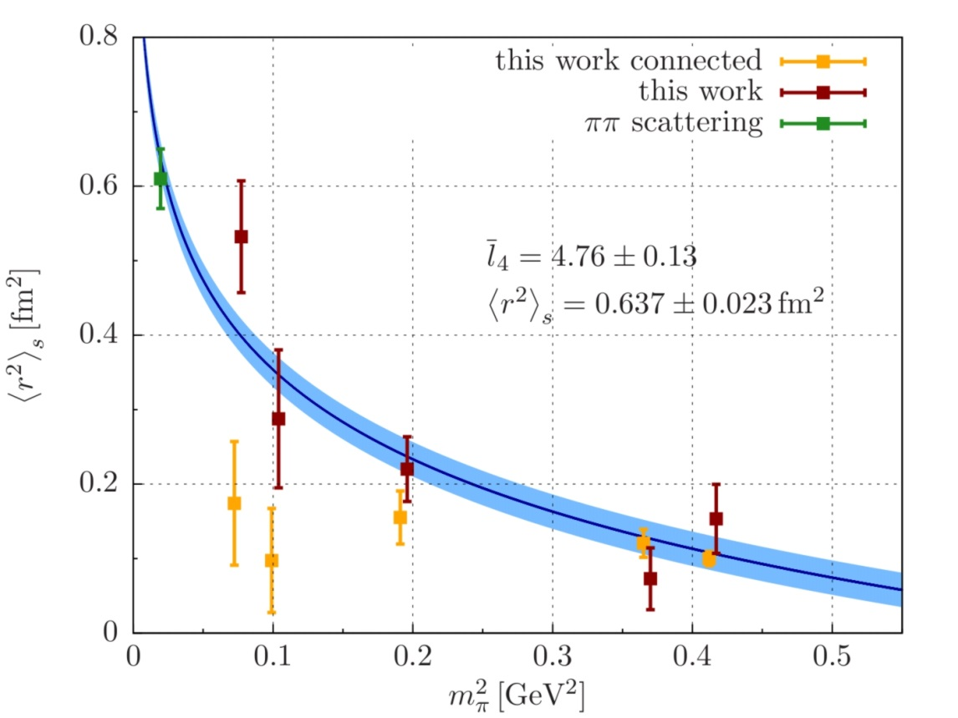
32 | Hadron Structure
Lattice calculation
[Gülpers, von Hippel, H.W., arXiv:1309.2104]
$O\left(a\right)$ – improved Wilson fermions $a=0.063 fm, m_{π}=280−650 MeV$
Fit to ChPT @ NLO: ${〈r^{2}〉}_{s}=0.637±{0.023}_{stat} fm^{2}$
Inclusion of quark-disconnected contribution crucial

Slide 33
33 | Conclusions
Conclusions:
Lattice QCD an established and mature method to study QCD at low energies
Successful “post-dictions” of many quantities – QCD works!
Clues for experiments: hadron spectroscopy, QCD phase diagram,…
Rôle of Lattice QCD in the Rapid Reaction Task Force?
Non-perturbative toolkit
Precision matters (remember $T_{c}$!) – strongly quantity-dependent
Timescales can be rather long – ensembles not generated for a special purpose
Further progess:
Increase compute power: SN-ratio, disconnected diagrams
Go beyond naïve treatment of resonances – Spectral functions
QCD Thermodynamics: sign problem
Notes:
a frontier program in electroweak physics with sensitivities to New Physics up to the multiple TeV scale
The Dark Photon project is a high-risk high-gain experiment with a fundamental discovery potential
not accessible at the high energy frontier
We moreover see exciting project in the fields of Nuclear and Hadron physics, for instance a measurement of the proton radius, the strangeness content of the nucleon Or measurements of the neutron skin of light nuclei as needed for astrophysics issues.
We believe that this is a a highly visible and complementary program in the LHC era

