Slide 1
Time-Like (TL) Electromagnetic form factors
Monday afternoon:
Which form factors do we need to describe dilepton production ?
What are the experimental constraints on baryon form factors in Space-Like and Time-Like region?
Results and plans for HADES for electromagnetic channels
Results and plans for HADES for pionic channels

Slide 2
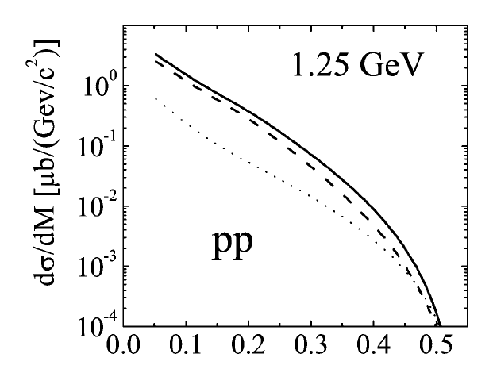
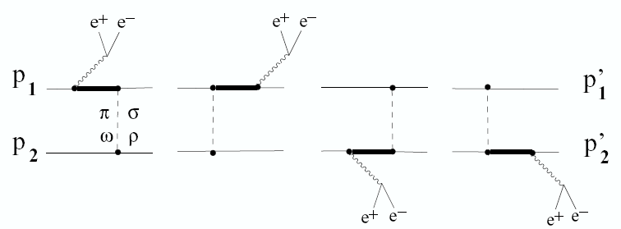
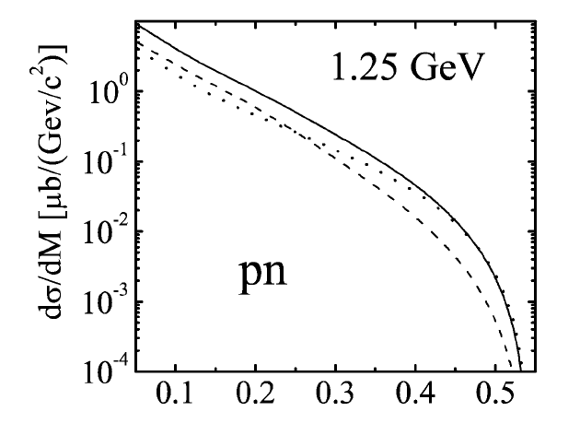
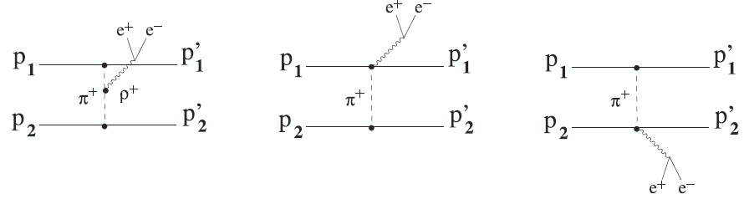
NN Bremsstrahlung and Δ Dalitz decay
NN → NNγ*→ NNe⁺e⁻
Δ → Ne⁺e⁻ (BR from QED = 4.2 10⁻⁵ not measured )
q² = M_{γ*}² > 0
N, Δ
Δ graphs
Quantum
interference
N
N
nucleon graphs
Time-Like electromagnetic form factors
Δ graphs
meson exchange currents
p
n
nucleon graphs
n
p
M_{ee}(GeV/c²)
+ ….
Pion form factor ?
⇒ pp dominated by Δ graphs
⇒ nucleon graphs (Bremsstrahlung) larger in pn than in pp collisions
Notes:
1’30

Slide 3

Non-resonant contributions in NN→NNe⁺e⁻
Pion form factor
meson exchange currents
N
p
n
N
n
p
Half-off- shell Time-Like electromagnetic nucleon form factors
+ ….
NNπ PS coupling
R. Shyam & U.Mosel, PRC67 (2003) 065202
NNπ PV coupling
Kaptari&Kämpfer, NPA 764 (2006) 338
Gauge invariance → contact terms needed
Notes:
1’30 15’

Slide 4
Nucleon form factors

Slide 5
Nucleon form factors
The nucleon internal structure is characterized by two form-factors :
Form factors can be directly compared to nucleon structure models → powerful tools for understanding non perturbative QCD
They provide constraints for GPD
Electric G_{E}(Q2)=F₁(Q2)-τF₂(Q2)
Magnetic G_{M}(Q2)=F₁(Q2)+F₂(Q2)
e+
e-
Time-Like
-
q2>0
Space-like
p
e+
-Q2=q2 < 0
γ*
G_{M}(0) = μ_{p}
G_{E}(0) = 1
p
γ*
p
p
e-
Form factors are real
Form factors are complex for q2 > 4m_{π}2

Slide 6
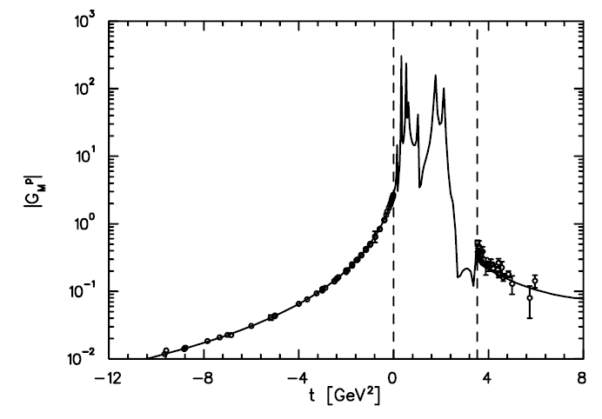
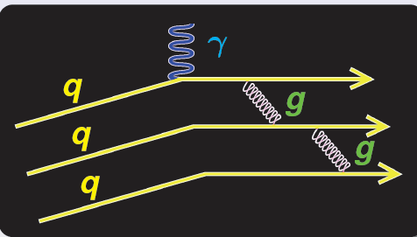
Data are needed…
From low to high energies, in Time-like and Space-Like regions
Dispersion relation prediction
Drechsel et al nucl-th/9712013
G_{M}^{p}
TL
SL
Low q2
Vector Dominance Model
?
-12 -8 -4 0 4 8
q2(GeV/c)2
High q2
Perturbative QCD
Quark counting rules
Helicity conservation
G_{M} (q2) ~ q - 4
G_{E} (q2) ~ q - 4
asymptotic behaviour:
Phragmèn-Lindelöf theorem
Phase of Time-Like FF vanishes
Notes:
The form factors are supposed to be analytical functions in the complex plane, and dispersion relations can be used to connect the values in SL and TL regions as it is shown here for the magnetic form factors.
Due to the property of analytical functions, it is also expected that the sl and tl form factor have the same values for very large q2. A direct consequence of that is that the phase of the form factors should vanish.
At high energies, the nucleon can be seen as three quarks exchanging gluons to keep together as a nucleon,
So here, the behaviour as a function of q2 can be predicted to be in 1/q-4. while at low energies, the virtual photon probes only the meson cloud and a piicture given by VDM models is expected to be more relevant.
An understanding of the structure of the nucleon therefore requires the knowledge of the form factors from low to high energies
1’
Tot 8’45

Slide 7
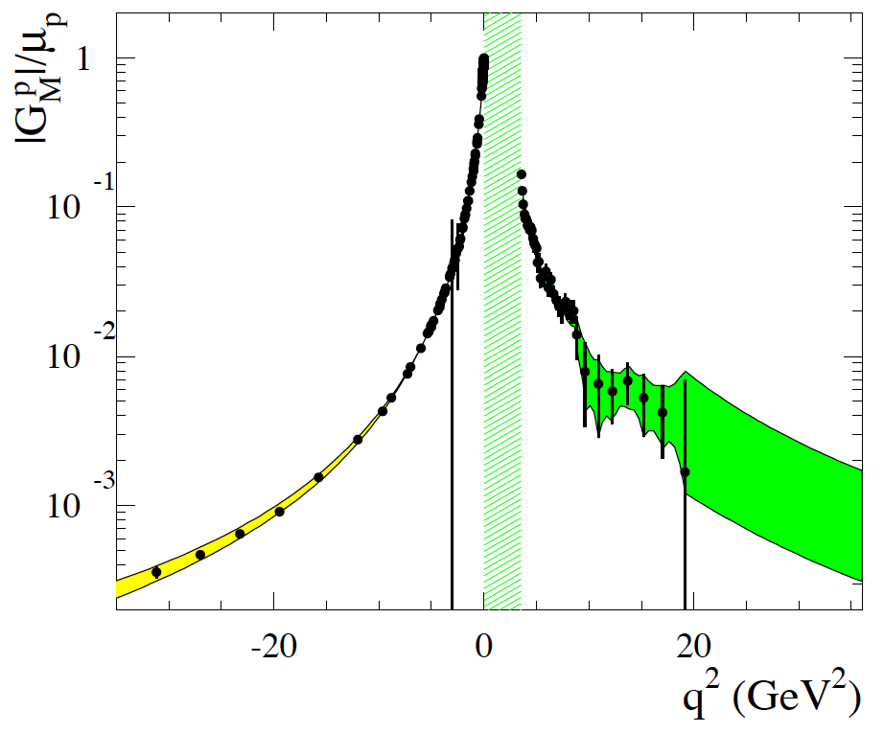
Time-Like and Space-Like electromagnetic form factors : an unified picture
electron scattering
annihilation pp↔ e⁺e⁻
From S. Pacetti, arXiv:1012.1232v1
two elctromagnetic form factors for the proton G_{E}(q²),G_{M}(q²)
complex analytical functions (real for q² < 4m_{π}²)
From S. Pacetti, arXiv:1012.1232v1
10⁰
-
Time-Like
p
e⁺
Space-like
e⁻
e⁻
10⁻¹
-Q²=q² < 0
q²>4m_{p}²
p
e⁻
p
p
|G_{M}/μ_{p|}|
e⁺
p
10⁻²
unphysical
-
e⁻
p
10⁻³
-30
-20
-10
10
30
Dispersion relations:
q² < 0
Feasibility studies for form factor in the unphysical region (q²<4m_{p}²) with PANDA
in pp→e⁺e⁻π⁰ (J. Boucher, Orsay, PhD 2011)
In pd →ne⁺e⁻ (H. Fonvieille and V.A. Karmanov EPJA42 (2009) 287-298)
-
-
Notes:
A lot of measurements in Space-Like region

Slide 8
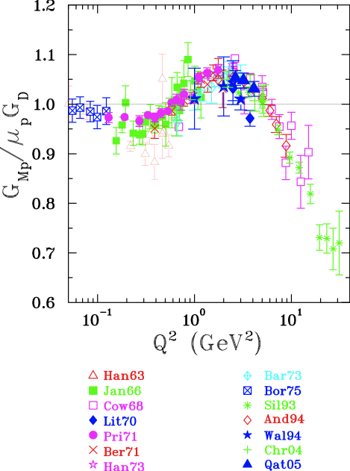
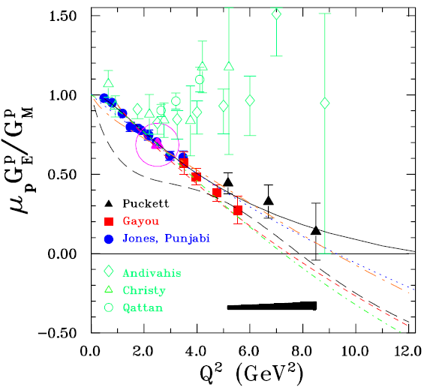
proton electromagnetic form factors in Space-Like region
Rosenbluth method: (diff. cross sections)
G_{E}(q²) ~ G_{M}(q²) ~ G_{D}(q²) = 1/(1+q²/m_{d}²) ²
m_{d}=0.71 (GeV/c²)
Rosenbluth method
GEp (I)
GEp (II)
GEp (IIII)
Perdrisat et al., progress in part. and Nucl. Physics 59 (2007) 694
Puckett et al, PRL104 (2010) 242301
Recoil proton polarization measurements
Contradictory results for G_{E}/G_{M} (2 γ contribution, radiative corrections ?)
Deviation of G_{E} from dipole, pQCD not reached
Zero-crossing of G_{E}(Q²)
Projects at JLab12 GeV
G^{p}_{E}/G^{p}_{M} up to 14.5 (GeV/c)²
G^{p}_{M} up to 18 (GeV/c)²
Notes:
Let’s look in more details at the experimental results. In the space-like region, the first results have been obtained using the Rosenbluth method, which is based on differential cross-section measurements at fixed q2 and for different electron angles and energies. In this way, the magnetic form factors could be extracted up to 35 GeV/c2 and the electric form factor up to about 6 GeV/c2. Within 30%, both form factors were consistent with a dipole form factor, which seemed to indicate that the pQCd regime was already reached. However, the more recent data from polarization transfer measurements, contradicted this picture, since much lower values were found for the electric form factors.. To explain the discrepancy between both sets of data, the role of 2photon exchange or radiative corrections is studied, but the explanation is not fully clear. Now recent new data have been measured at larger q2, which still follow this decrease, with a slightly slower slope, however. Ypu can see that these data are described by a lot of models, which are very different, some of them are based on VDM, like the Iachello model in blue, which we will in fact find again when we will speak about HADES. Also perturbative QCD models are also able to reproduce the dat, once corrections taking into account quark orbital momentum are included
1’ 15
Tot 10’

Slide 9
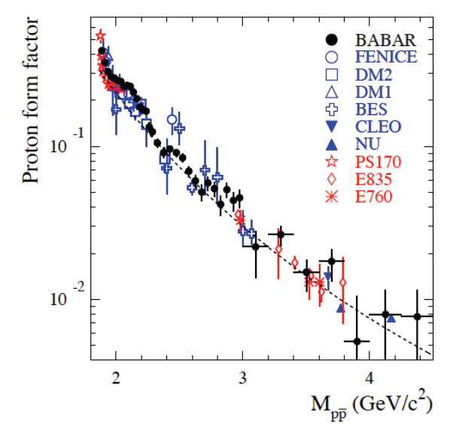
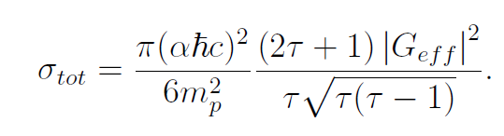
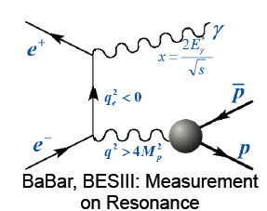
Experimental situation in Time-Like region: G_{eff}
Recent review A. Denig and M. Salme arXiv:1210.4689[hep-ex]
Most of the experiments so far have measured only cross sections
→ effective form factor
-
pp↔e⁺e⁻
-
pp↔e⁺e⁻
Effective form factor
Proton effective form factor
BABAR, BESIII Initial State Radiation technique
4
6
9
12
16
q²(GeV/c²)²
most recent results from BABAR arXiv:1302.0055
on-going analysis at BESIII : better precision than BABAR
expected for q²< 9 (GeV/c)²
BABAR √s=10.57 GeV/c
BES √s=3.773 GeV/c

Slide 10
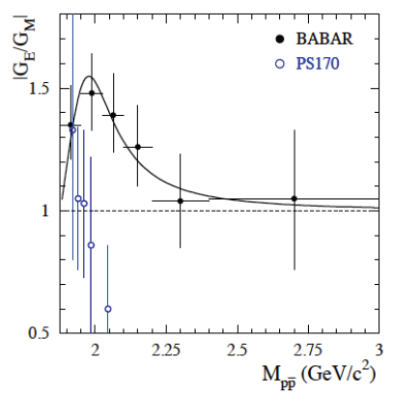
Experimental situation in Time-Like region : |G_{E}/G_{M}|
-
angular distributions: pp → e+e-
BABAR arXiv:1302.0055
PS170: Bardin et al.,NPB 411,3, (1994)
BABAR results incompatible with
old PS170/LEAR measurements
Improvements expected by from BES at q² <9 ( GeV/c)²
Need for precise measurements at large q²
4
5
6
7
8
9
q²(GeV/c²)²

Slide 11
Goal of PANDA measurements
Extract Time-Like |G_{E}| and |G_{M}| for proton up to 14 (GeV/c)²
from lepton angular distributions in pp →e⁺e⁻ reaction
and measure G_{eff} up to 30 (GeV/c)²
-
Two major challenges:
Decrease of sensitivity to G_{E}
with increasing q²
Huge hadronic background
σ (pp →π⁺π⁻) / σ (pp →e⁺e⁻) ~10⁶
-
-
-

Slide 12
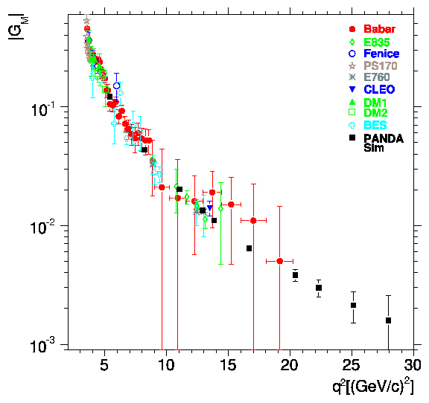
Time-Like Form Factor measurement with PANDA : precision estimates
L=2 fb⁻¹
Courtesy of S. Pacetti
Sudol et al. EPJA 44 (2010) 373
E. Tomasi-Gustafsson and M.P. Rekalo, PLB504,291
E. Tomasi-Gustafsson, arXIv:0907.4442
G_{eff}
PANDA
PANDA
BES
BES
< 1% ~10% ~23% ~50%
pQCD ?
Phragmèn-Lindelöf theorem ?
Notes:
In this publication, we also evaluate the precision on the form factor measurement that will be achieved with PANDA and compare it to the existing data. The ratio of electric to magn FF can be measured up to 14 GeV/c2 from an analysis of the angular distributions with a good precision. This will improve very much the present experimental situation. In addition, it will allow to discriminate among models which are all able to reproduce the Geff and also the space like data, but give different predictions for the ratio GE/GM. Here we see for example the Iachello model in green, which predicts a very strong electric form factor.
Cross-sections and therefore the effective form factor can be measured with good precision up to 30 GeV/c2, which is the maximum available q2 at PANDA.

Slide 13
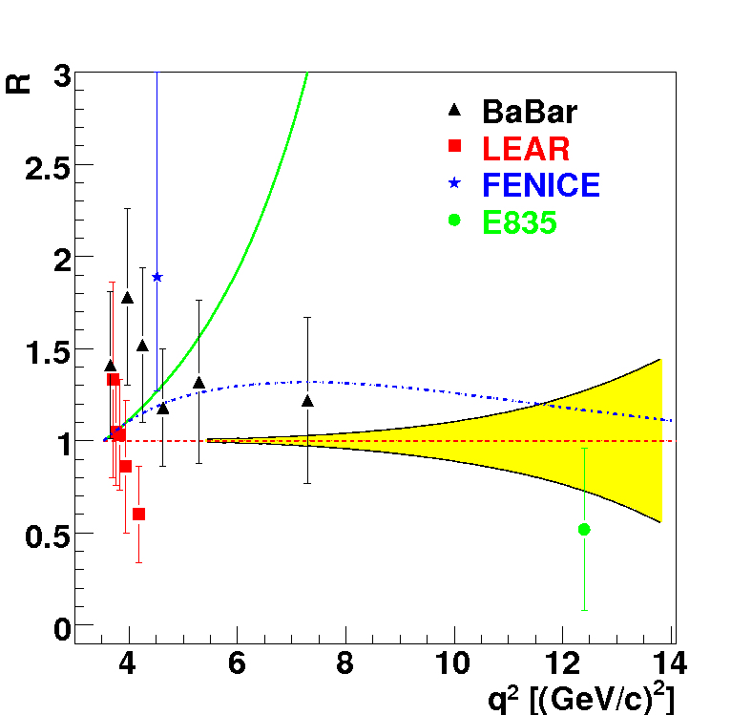
Time-Like Form Factor measurement with PANDA : precision estimates
L=2 fb⁻¹
Sudol et al. EPJA 44 (2010) 373
-VDM: F. Iachello et al., PLB43, 171 (1973)
…extended VDM, PRC66, 045501 (2002)
Egle Tomasi-Gustafsson et al., EPJA24 (2005) 419
G_{eff}
PANDA
PANDA
BES
BES
< 1% ~10% ~23% ~50%
pQCD ?
PANDA will bring
Precise determination of |G_{E}| and | G_{M} | up to 14 (GeV/c)²
G_{eff} up to 30 (GeV/c)² : transition towards perturbative QCD
Notes:
In this publication, we also evaluate the precision on the form factor measurement that will be achieved with PANDA and compare it to the existing data. The ratio of electric to magn FF can be measured up to 14 GeV/c2 from an analysis of the angular distributions with a good precision. This will improve very much the present experimental situation. In addition, it will allow to discriminate among models which are all able to reproduce the Geff and also the space like data, but give different predictions for the ratio GE/GM. Here we see for example the Iachello model in green, which predicts a very strong electric form factor.
Cross-sections and therefore the effective form factor can be measured with good precision up to 30 GeV/c2, which is the maximum available q2 at PANDA.

Slide 14


2γ contributions and radiative corrections
Rosenbluth
method
Important role of 2γ
exchange and
radiative corrections
Polarization
measurements
?
No C-odd terms
contribution
C-odd terms
contribution
-
Advantage of annihilation reactions pp ↔ e⁺e⁻
The e⁺ and e⁻ angular distributions are measured in the same experiment
PANDA measurements are sensitive to odd cos θ terms
dσ/dcosθ_{e} ~ A (1+ b cosθ_{e}sin² θ_{e} + c cos²θ_{e}+..) with b=5% or more
(M. Sudol et al EPJA 44(2010) 373).
Notes:
Mettre

Slide 15
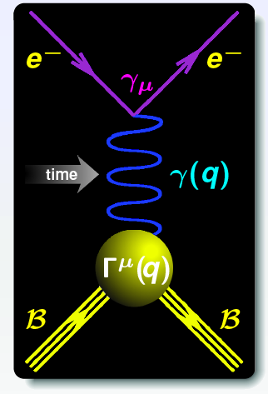
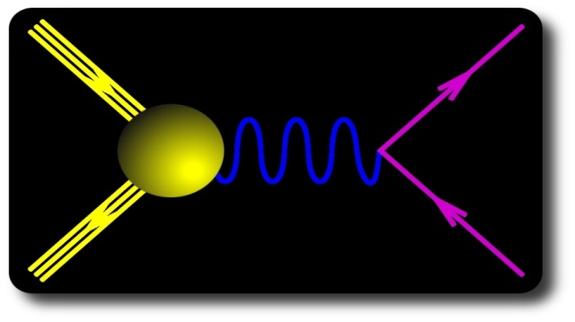


Time-Like form factors in the unphysical region (1)
Dispersion relations
q² < 0
Space Like (SL)
-
pp ↔ e⁺e⁻ annihilation
Time Like (TL)
q² < 0
p
γ(q)
e⁺
q² = s
q² > 4m_{p}²
Unphysical region
p p → e+ e- π0
p
Г^{μ}(q)
p
p
e⁻
|
FFs real
FFs complex
4m_{p}²
q²
Vector meson poles: q² = m²_{ρ}, m²_{ω}, m²_{φ}
Vector Meson Dominance (VMD)
form factor models can be tested

Slide 16
Form factors in the unphysical region (2)
Basic idea: reach q² < 4 m_{p}² by giving 4-momentum to another particle (e.g. π⁰)
M. P. Rekalo, Sov. J. Nucl. Phys., vol1, 760 (1965)
-
p
q2
e+
Crossed channel of
π⁻p→ne⁺e⁻
e-
p
‘p’
+ exch.
π°
But, contribution of Δ, of s channel terms ?
Feasibility studies for form factor in the unphysical region (q²<4m_{p}²) with PANDA
in pp→e⁺e⁻π⁰ (J. Boucher, Orsay, PhD 2011)
In pd →ne⁺e⁻ (H. Fonvieille and V.A. Karmanov EPJA42 (2009) 287-298)
-
-

Slide 17
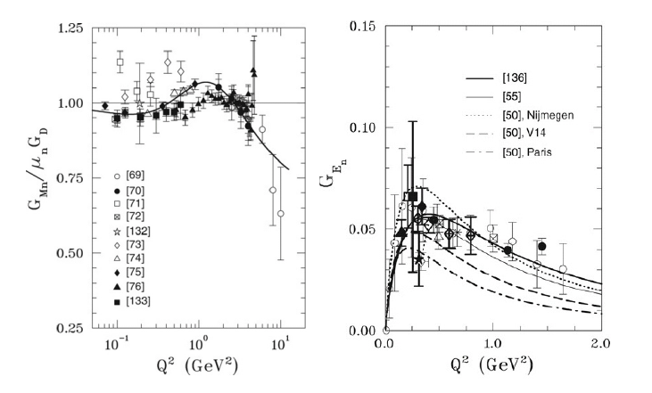
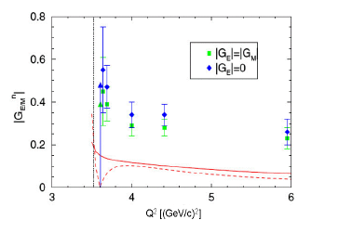
Neutron form factors
Space-Like
Time-Like
Measurements from only one experiment:
FENICE at ADONE
Projects: BES,VEP2000
Projects for neutral excited states ?

Slide 18
Baryonic transition form factors

Slide 19
Δ Dalitz decay :
Δ Dalitz decay
p
Δ⁺
γ*
e⁺
Branching ratio not measured
experimental challenge
q² = M²_{inv}(e⁺e⁻) = M_{γ*}² > 0
q²<(m_{p}+m_{Δ})²
e⁻⁻
Time Like Δ - N transition:
In the unphysical region
Complementary probes of electromagnetic
structure of N - Δ transition
Space Like N - Δ transition :
e⁻
extraction of electromagnetic
form factors
G_{E}(q²), G_{M}(q²), G_{C}(q²)
e⁻
γ*
q² = M_{γ*} = - Q² < 0
p
Δ⁺
→Nπ
Lots of data, Mainz, Jlab
Pion electro/photo-production
Notes:
1’30 tot 2’50

Slide 20
Time-like electromagnetic N-Δ transition
Space Like: q²<0
Time Like: q²>0
complex G^{TL}(q2)
Analytic continuation
real G^{SL}(q2)
Models constrained by data
Δ⁺
p
γ*
e⁺
  However, Δ decay width
  doesn’t depend on phases of form factors
  q² stays small at M_{Δ} =1232 MeV/c² , q² < 0.09 GeV/c²
e⁻
2 options:
take constant form factors (photon point value)
HSD, UrQMD, IQMD
use models for form factors G_{E}(q²),G_{M}(q²),G_{C}(q²) :
VDM,eVDM, (RQMD) two component Iachello model
Notes:
1’ tot 5’35

Slide 21
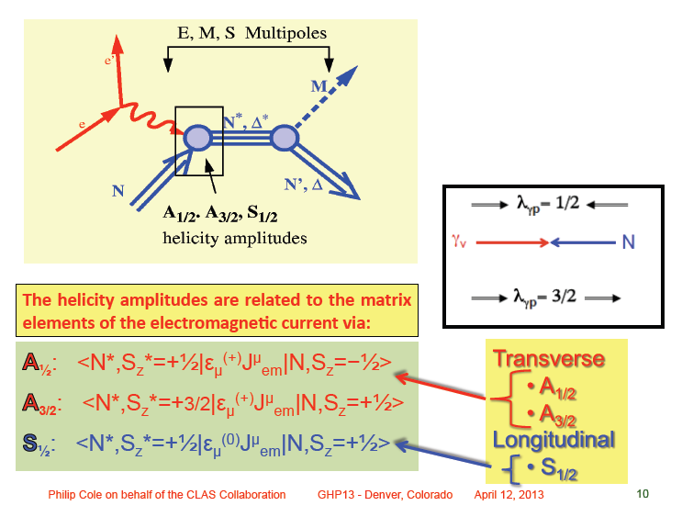

Slide 22
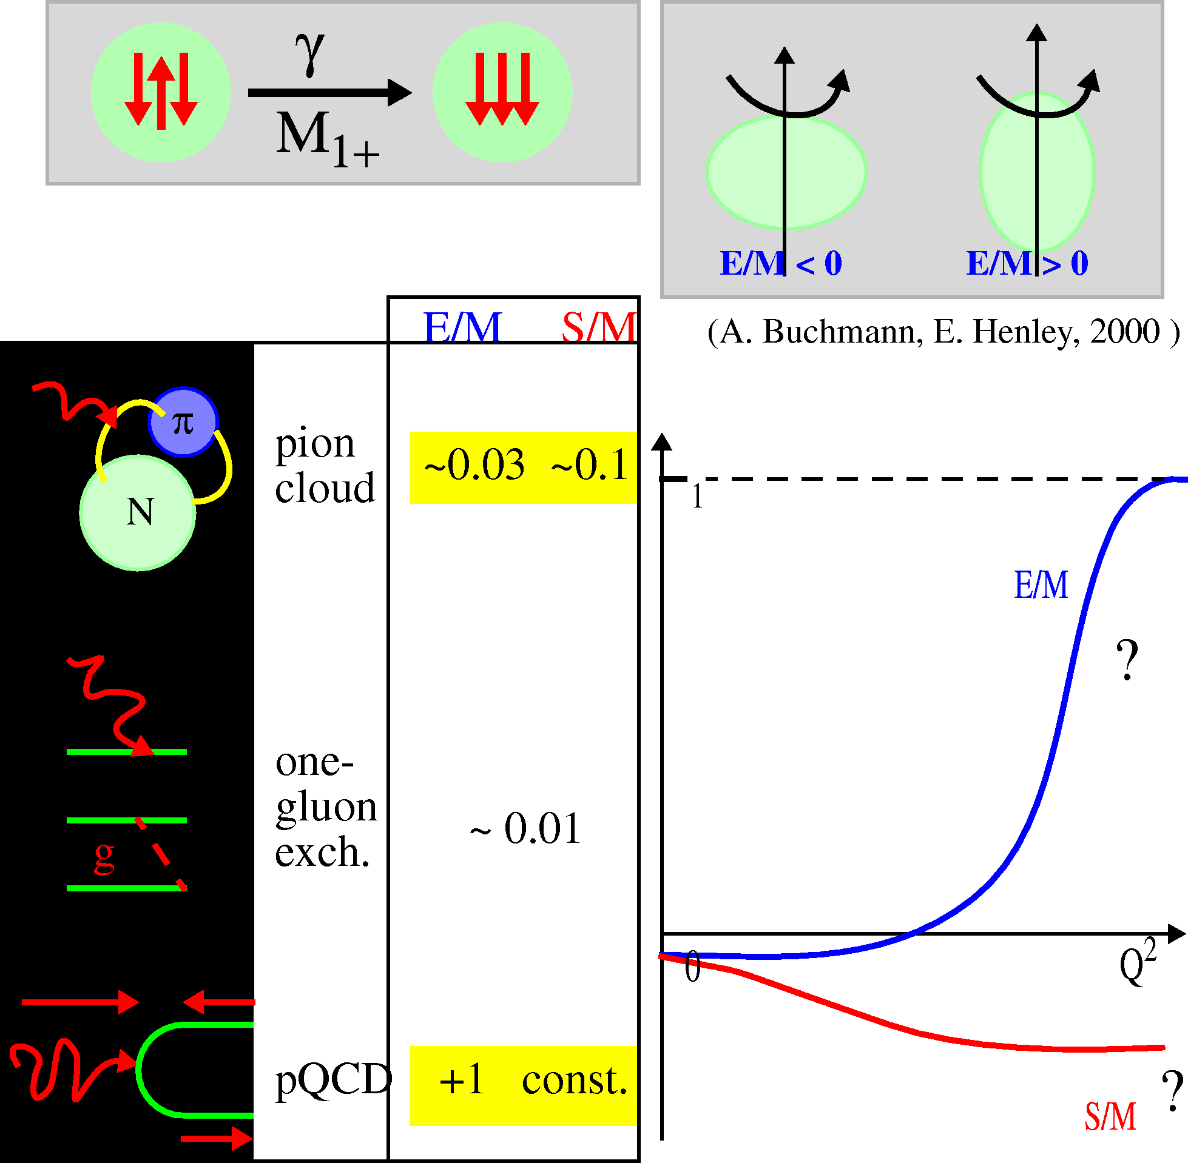
N-Δ em transition : what do we know?
at q²=0, mainly M₁₊ (magnetic) transition
N
Δ
« Photon point » : q²=0
G_{M}(0)~3, G_{E}(0)~0.04
At finite q², many recent data points from Mainz, Jlab:
multipole analysis of π° or π⁺ electroproduction
(%)
G_{M}(q²)
related to G_{E}(q² )
(%)
related to G_{C}( q² )
Notes:
1 ’ 4’35
1’ 4’35

Slide 23
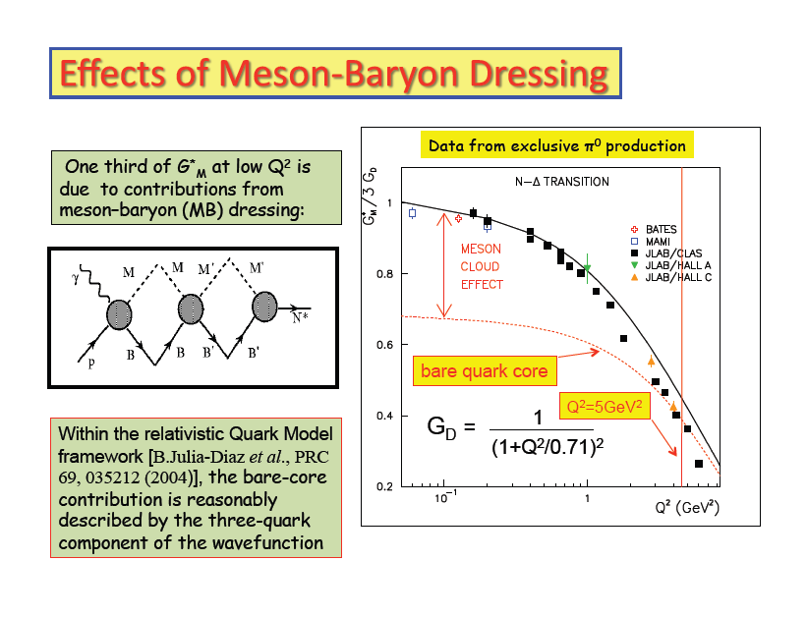
P. Cole, GHP 2013, Denver
Meson baryon dressing and quark core , what is the difference ?

Slide 24
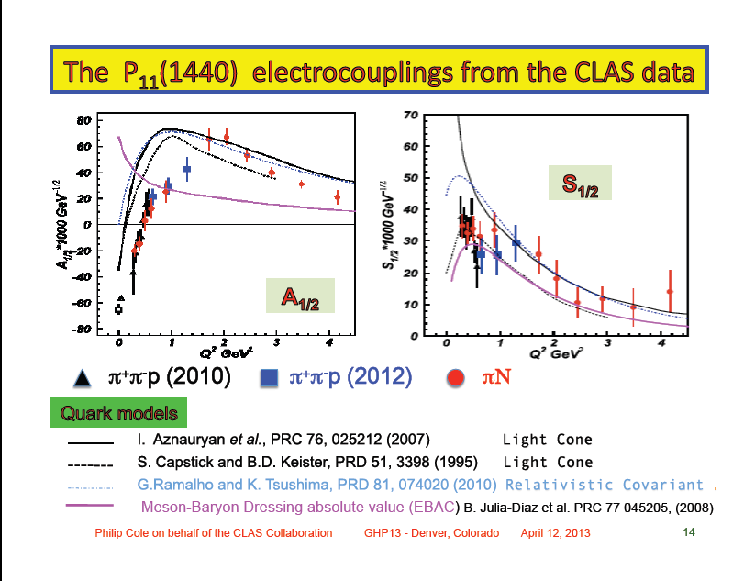
Can one easily understand why the dressing contribution (or meson cloud )
is different in the different amplitudes ?

Slide 25
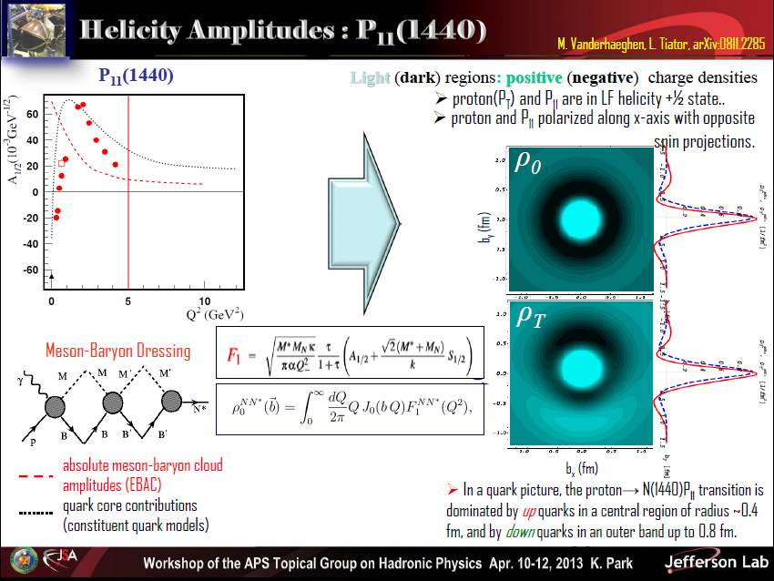

Slide 26
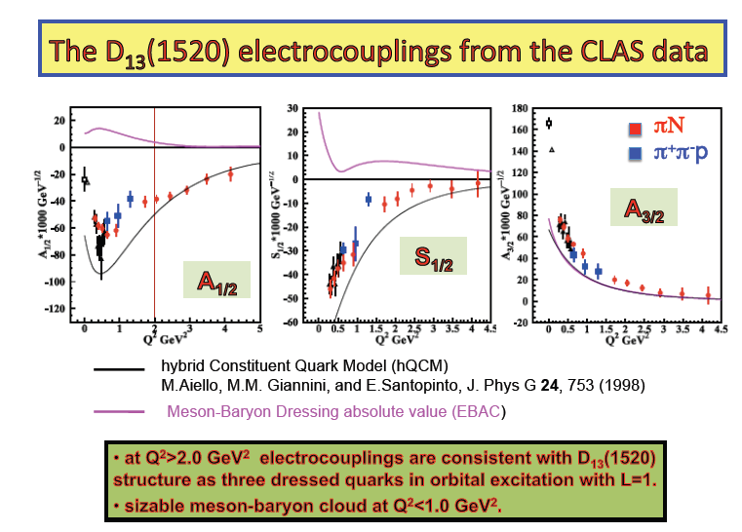
Same question here:
Can one easily understand why the dressing contribution (or meson cloud )
is different in the different amplitudes ?

Slide 27
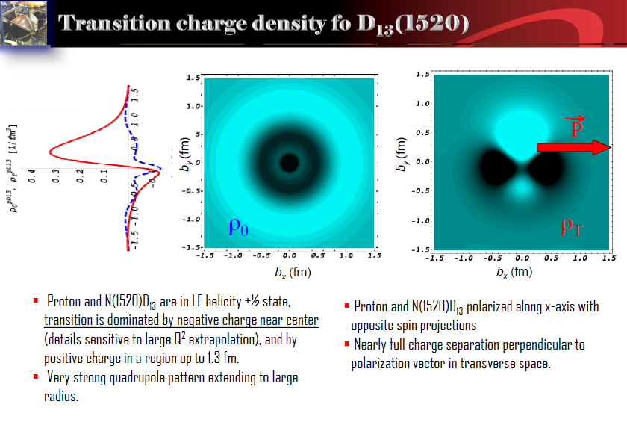

Slide 28
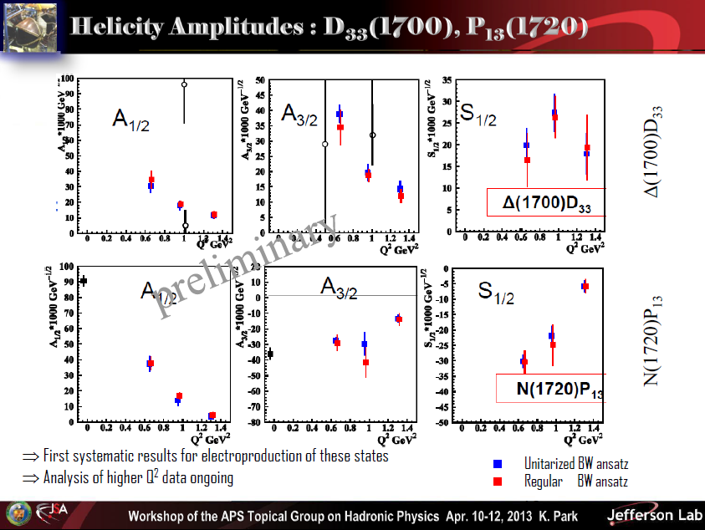
Do we have a coonsistent picture of the recent data ?

Slide 29
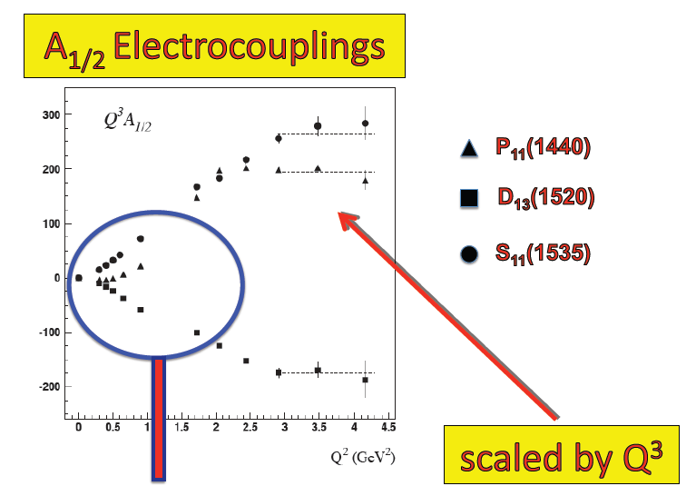
pQCD behaviour reached ?

Slide 30
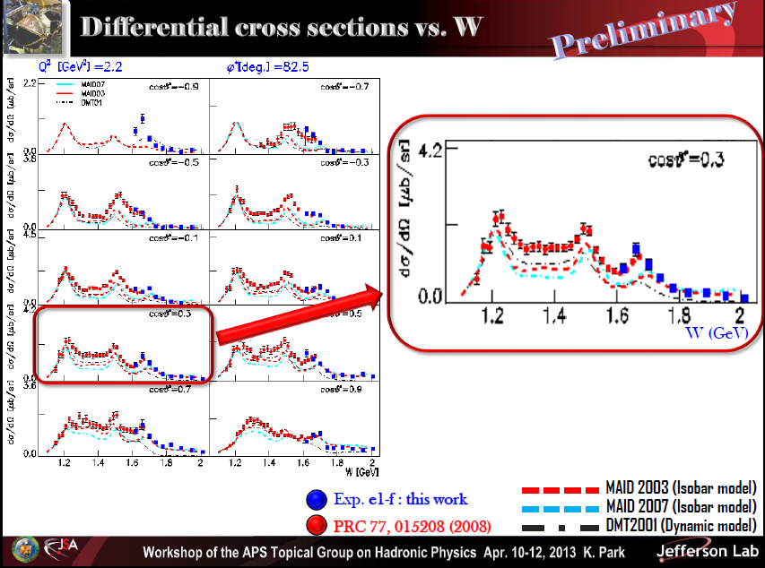

Slide 31
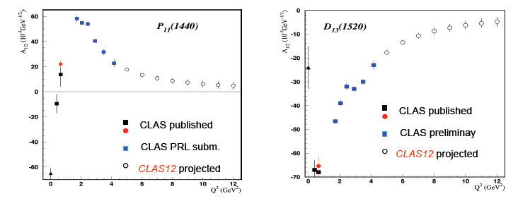
Projects for baryonic transitions in Space-Like region

Slide 32
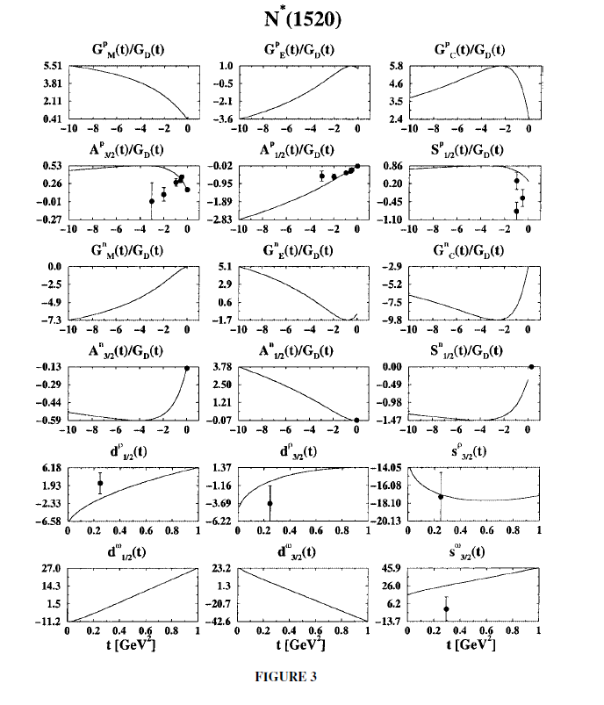
E-VDM form factors in RQMD model
B. Krivoruchenko et al.,
to be revisited ?

Slide 33
What can we measure in πp →n e⁺e⁻ reactions ?

Slide 34
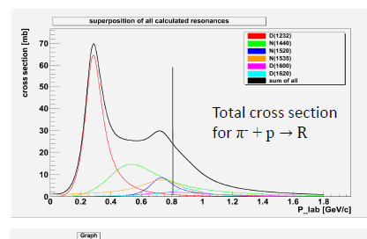
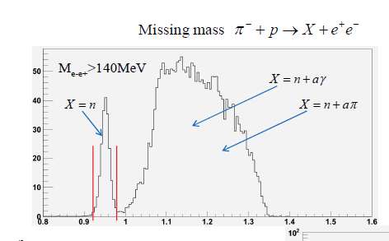
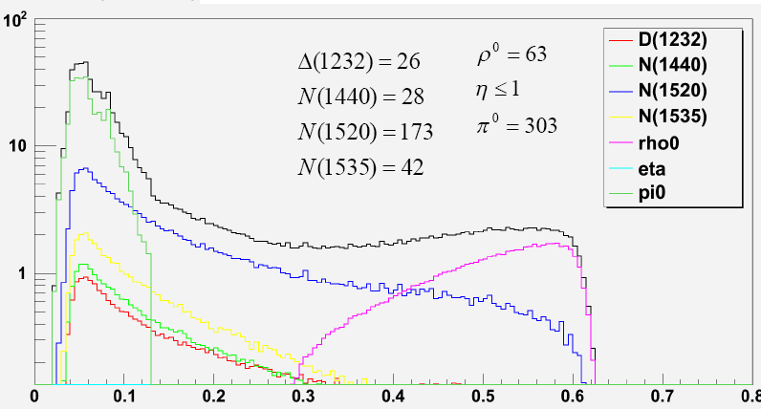
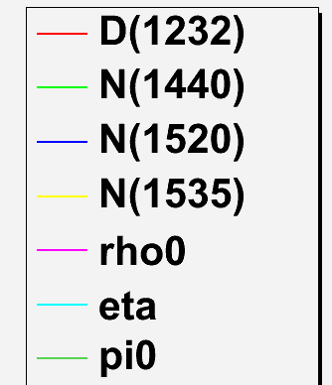
Simulations using the resonance model
H.Kuc (Orsay/Cracow)
N
R
γ∗
e⁺
Dalitz decays
e⁻
Form factors:
« photon-point » M. Zetenyi, Gy. Wolf, nucl-th0202047
Missing mass selection
p=0.8 GeV/c
√s=1.55 GeV/c
after missing mass cut
π⁻p→e⁺e⁻ n
Missing mass (GeV/c)
M_{ee}(GeV/c²)
M_{ee} (GeV/c²)

Slide 35
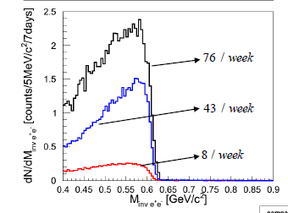
π⁻p→ ne⁺e⁻: count rate estimates
P=0.8 GeV/c (below ω threshold)
H.Kuc
 | Resonance model | Titov et al. | M. Lutz et al.
Evts/ 2 weeks M>0.14 GeV/c² | ~ 1900 | ~6000 | ~200
Resonance model
incoherent sum
(M. Soyeur)
Coherent sum
(M. Soyeur)
π⁻p→ ne⁺e⁻ with HADES
Measurement of e⁺e⁻ invariant mass spectra
and angular distributions (cf results
from pp reactions)
→ unique chance for a direct access to Time-like
electromagnetic form factors
M.F.M. Lutz , B. Friman, M. Soyeur
Nuclear Physics A 713 (2003) 97–118
N
R
γ∗
e⁺
e⁻

Slide 36
Helicity angle distributions- HADES results

Slide 37
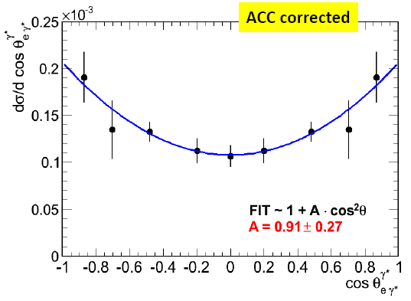
exclusive analysis pp→ppe⁺e⁻ at 1.25 GeV: helicities
Δ Dalitz decay: Δ⁺ → p γ* →pe⁺e^{-:}
only transverse γ*
(if Coulomb interaction is neglected)
helicity angle α
α
e⁻
γ*
e⁺
Helicity distributions γ* → e⁺e⁻
dσ/dΩ_{e}~ 1+cos²α
Δ
N
helicity from pe⁺e⁻ events:
γ* in Δ ref. frame
acceptance corrected
First measurement of Δ Dalitz decay!
Dalitz decay branching ratio in agreement
with QED value (4.2 10 ⁻⁵) within ~20%
Helicity consistent with 1+cos²θ
preliminary
first simulations: E.Morinière (Orsay)
data analysis: W. Przygoda
Helicity studies: T. Liu (Orsay)
B. Ramstein et al., Hadron 2009 proceedings

Slide 38
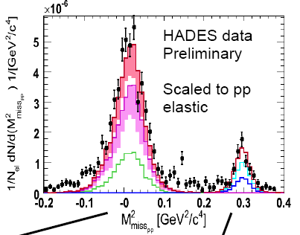
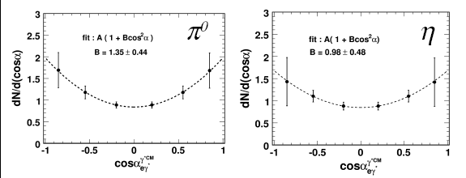
pp → pp e⁺ e⁻ γ at 2.2 GeV: an “easier case”
exclusive reconstruction π°,η → γe⁺e⁻
π
ppe⁺e⁻ detected
+ miss.mass cut
Comparison with resonance model
Teis et al, ZPA356 (97) 421
Δ1232
η
N1440
N1535
Δ1600
acceptance corrections
π/η → γ γ* → γe⁺e⁻
Helicity distributions γ* → e⁺e⁻
dσ/dΩ_{e}~ 1+cos²θ
agrees with QED predictions
and analysis check for Δ case !!
Notes:
38

Slide 39

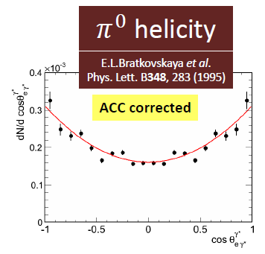
HADES data
pp at E=1.25 GeV

