Slide 1
Tracking QA
| Tobias Stockmanns on behalf of the MVD group

Slide 2
What is the Question?
How many MC tracks were found by the track finder?

Slide 3
What is the Question?
How many MC tracks were found by the track finder?
When is a track found?
Most / some hits of a track?
All hits of a track?
Hits from other tracks?

Slide 4
What is the Question?
Secondary tracks?
DPM?
Physics channels?
What is the sample?
Delayed vertices?
How many MC tracks were found by the track finder?
When is a track found?
Most / some hits of a track?
All hits of a track?
Hits from other tracks?

Slide 5
What is the Question?
How good is the track finder?
How many ghost tracks created?
How many MC tracks were found by the track finder?
How fast is it?
How good does the track fit match?

Slide 6
Classification of TrackCands
Fully Found | : | 100 % of MC Hits found AND no other hits
Partly Found | : | > 3 MC Hits found AND no other hits
Spurious | : | > 70 % of hits are from one MC track
Ghosts | : | None of the above

Slide 7
Classification of MC Tracks
 | Group 1
All tracks | : | MC Track with > 2 hits in tracking detectors
Possible tracks | : | Trackfinder specific criteria
 | Group 2
Primary | : | Primary track
Secondary | : | Secondary track
PID (opt.) | : | Specific particles
All combinations of group 1 and 2

Slide 8
Class Scheme
PndTrackingQualityTask
Data input / output
Visualization of results
PndTrackingQualityAnalysis
Combines MC Track data with TrackCand data
Classification of MC Tracks
Classification of TrackCand
PndTrackingQualityData
Analyses PndTrackCand
From which MC tracks do the hits come?
How many hits from each subdetector belong to a MC track

Slide 9
Summary Output
All Tracks: 5635
Primary Tracks wo hits: 1768
All Tracks with hits: 3867 not found: 1693
Primary Tracks with 3 hits: 943 not found: 885
Secondary Tracks with 3 hits: 596 not found: 579
Primary Tracks possible: 1593 not found: 50
Secondary Tracks possible: 735 not found: 179
FullyFound: 705 18.23% 30.28%
PartlyFound: 1397 36.12% 60.00% Spurious: 72 1.86% 3.09%
Ghosts: 380 9.83% 16.32%

Slide 10
Summary Output
All MC tracks
All Tracks: 5635

Slide 11
Summary Output
All Tracks: 5635
Primary Tracks wo hits: 1768
All Tracks with hits: 3867 not found: 1693
All primary tracks with < 3 hits in tracking detectors
All tracks with > 2 hits in tracking detectors

Slide 12
Summary Output
All Tracks: 5635
Primary Tracks wo hits: 1768
All Tracks with hits: 3867 not found: 1693
Primary Tracks with 3 hits: 943 not found: 885
Secondary Tracks with 3 hits: 596 not found: 579
Primary Tracks possible: 1593 not found: 50
Secondary Tracks possible: 735 not found: 179
All p./s. tracks with > 3 hits in tracking detectors and not possible tracks
All possible p./s. tracks

Slide 13
Summary Output
All Tracks: 5635
Primary Tracks wo hits: 1768
All Tracks with hits: 3867 not found: 1693
Primary Tracks with 3 hits: 943 not found: 885
Secondary Tracks with 3 hits: 596 not found: 579
Primary Tracks possible: 1593 not found: 50
Secondary Tracks possible: 735 not found: 179
FullyFound: 705 18.23% 30.28%
PartlyFound: 1397 36.12% 60.00% Spurious: 72 1.86% 3.09%
Ghosts: 380 9.83% 16.32%
All tracks with hits as reference
All possible tracks as reference

Slide 14
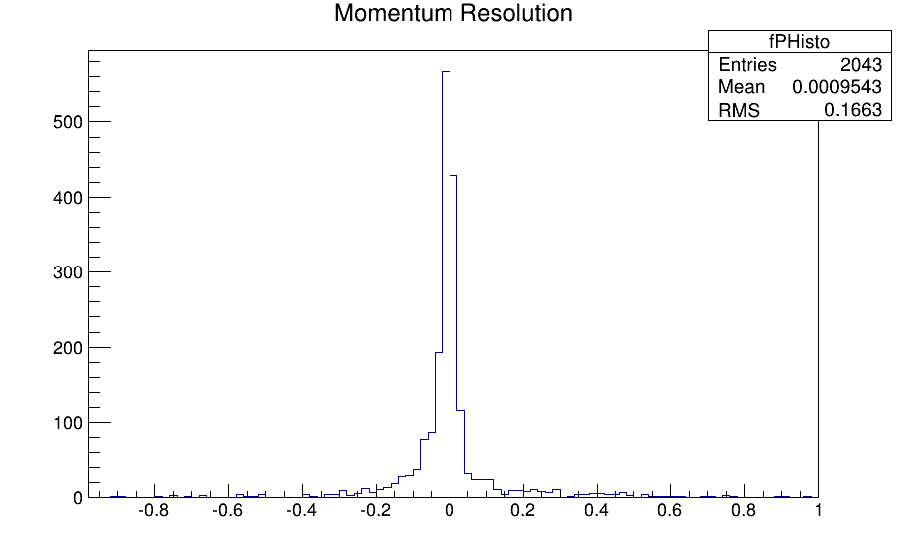
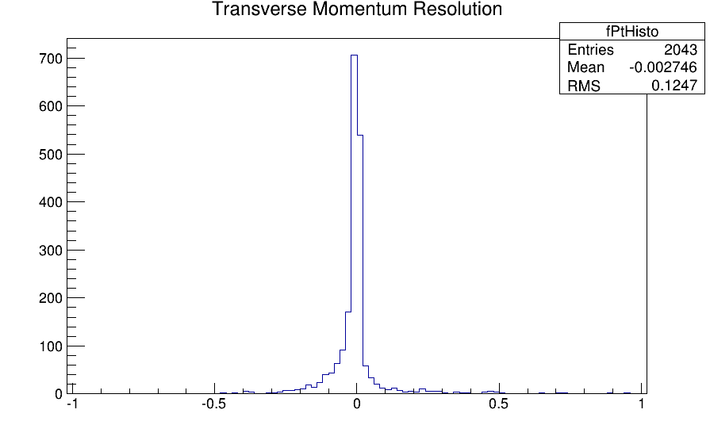
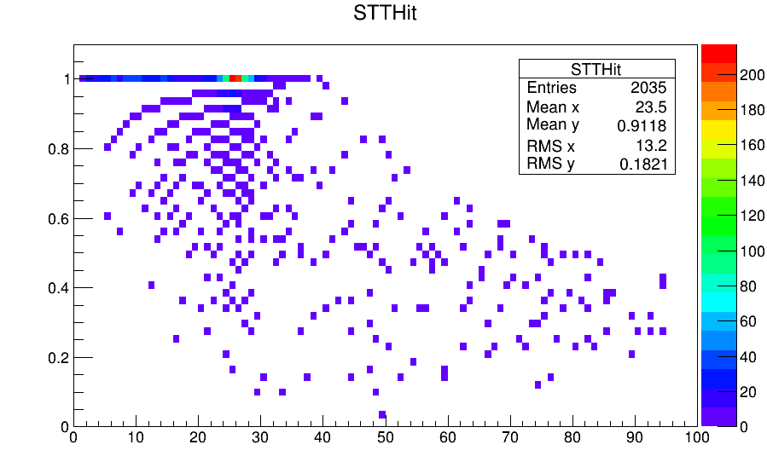
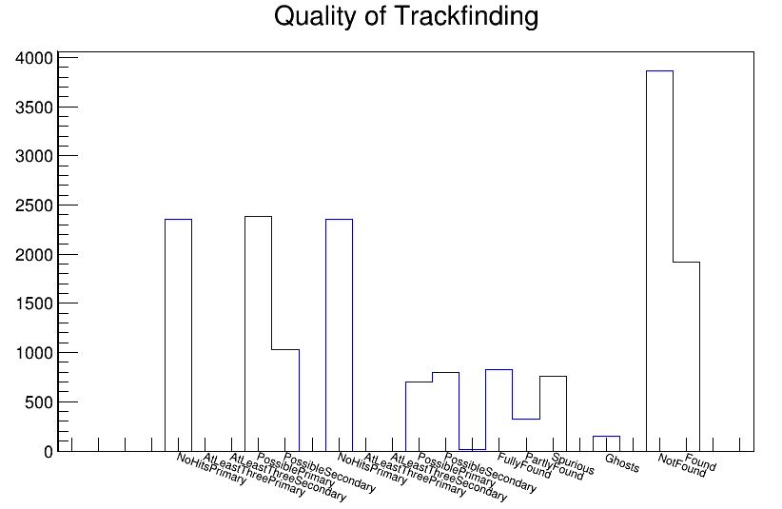
Some Results

Slide 15
Features
Runs for PndTracks and PndTrackCands
Can analyse all existing sub detectors
Easily adoptable for different track finders / fitters
class OnlySttFunctor : public PossibleTrackFunctor
{
Bool_t Call(FairMultiLinkedData* a)
{
FairRootManager* ioman = FairRootManager::Instance();
return a->GetLinksWithType(ioman→GetBranchId("STTHit")).GetNLinks() > 5;
}
void Print(){
std::cout << "OnlySttFunctor: > 5 Hits in Stt" << std::endl;
}
};

Slide 16
Questions to discuss
Classification of PndTrackCands:
What classes?
Which criteria?
Classification of MCTracks
What classes?
Which cirteria
Common data set
DPM
Physics channels?
Generic sets?
Which features are missing?

