Slide 1
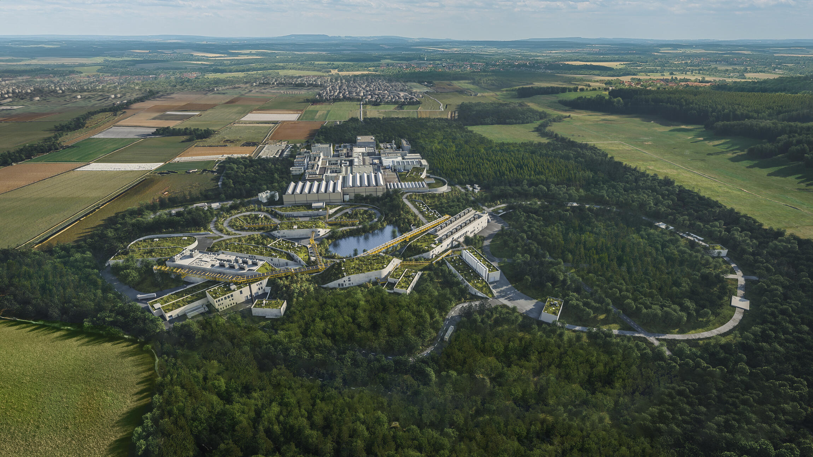
Welcome to GSI!

Slide 2
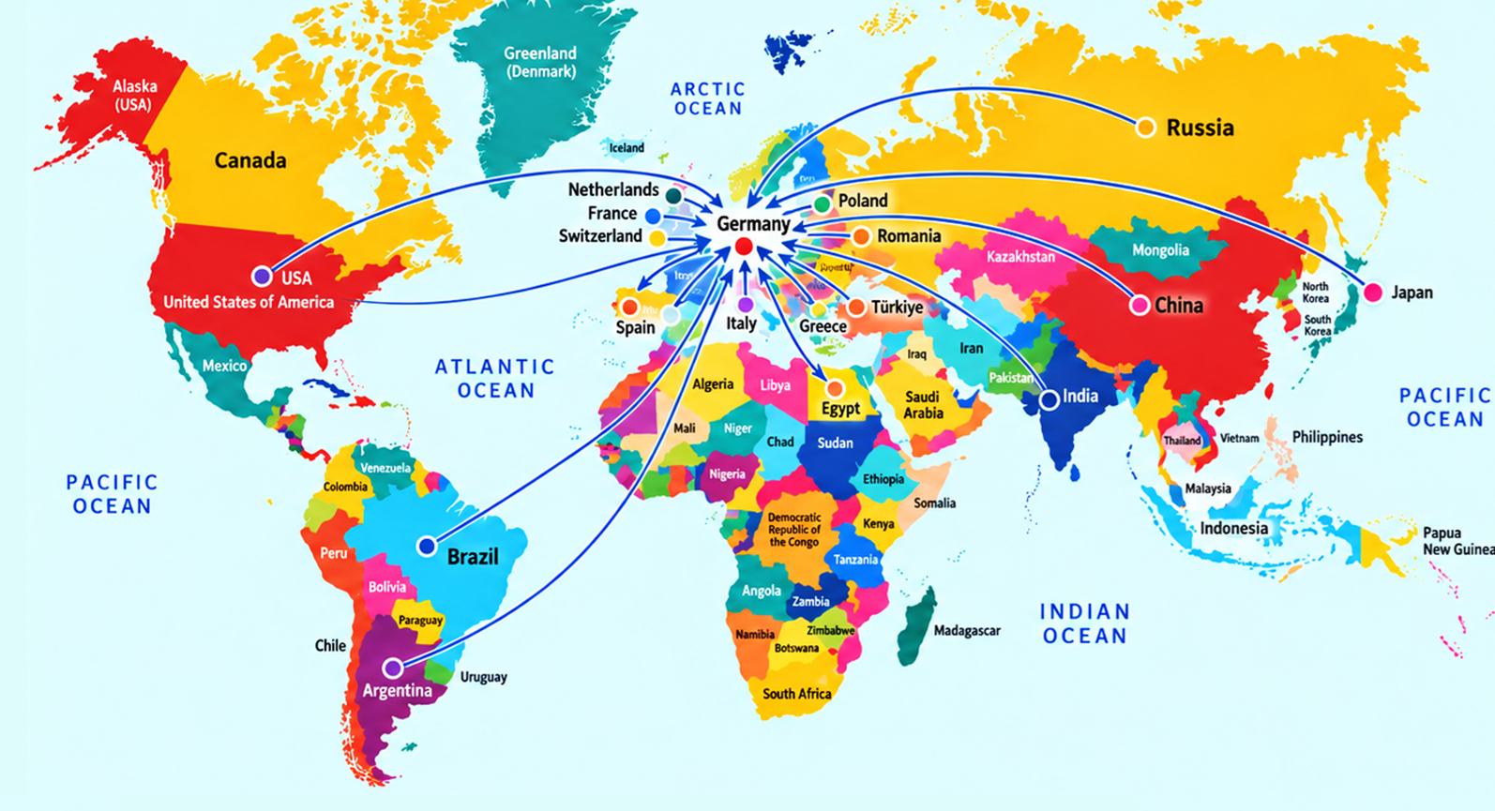
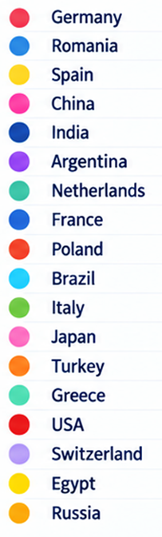
Thank you for being here
Participants from 19 countries
Our community
~ 40 user groups irradiate samples at our facilities
~ 200 collaboration members from > 30 countries including senior scientists, postdocs, and PhD students…

Slide 3

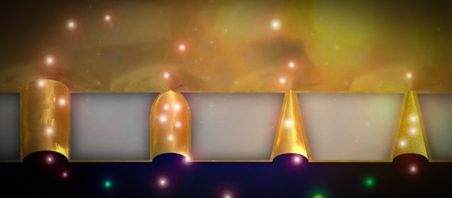







MAT users and cooperation partners
Extensive international network of collaborators from research centers, institutes and universities: GANIL, IMP Lanzhou, CERN, CONICET, ESA-ESTEC, UC Irvine, Center for Hydrogen and Fuel Cell Research, Univ. Tennessee, Univ. La Plata, …
German universities closely involved (also within BMBF- ErUM pro): Univ. Frankfurt, Univ. Heidelberg, TU Darmstadt, Univ. Jena, Univ. Mainz, Univ. Duisburg-Essen, Univ. Giessen, Univ. Applied Sciences Rhein-Main, LMU Munich, Univ. Münster, …
Within Helmholtz, projects with: DESY, HZDR, HZB, FZ Jülich, HZM, Hereon, .…
Third party funded collaborative projects from DFG, BMBF, IGF, EU-HORIZON 2020, EU HORIZON Europe, EU-MSCA, IGZ, COST, …
Transnational access via RIANA, RADNEXT, and other programs
FOR 5584 Transieves
DRAHT-KATH
BASISTECHNOLOGIEN FÜR DIE FUSION
DINERWA

Slide 4
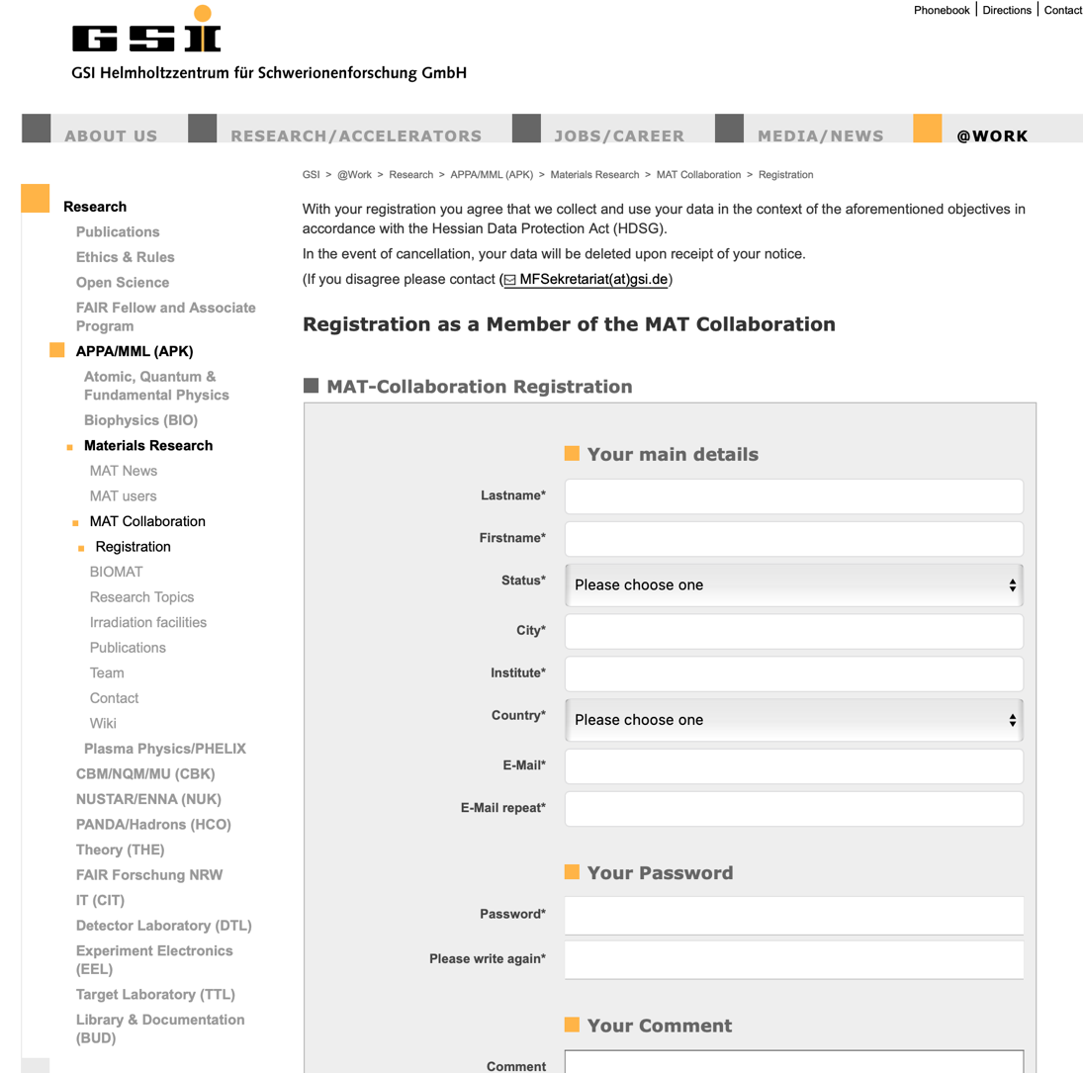
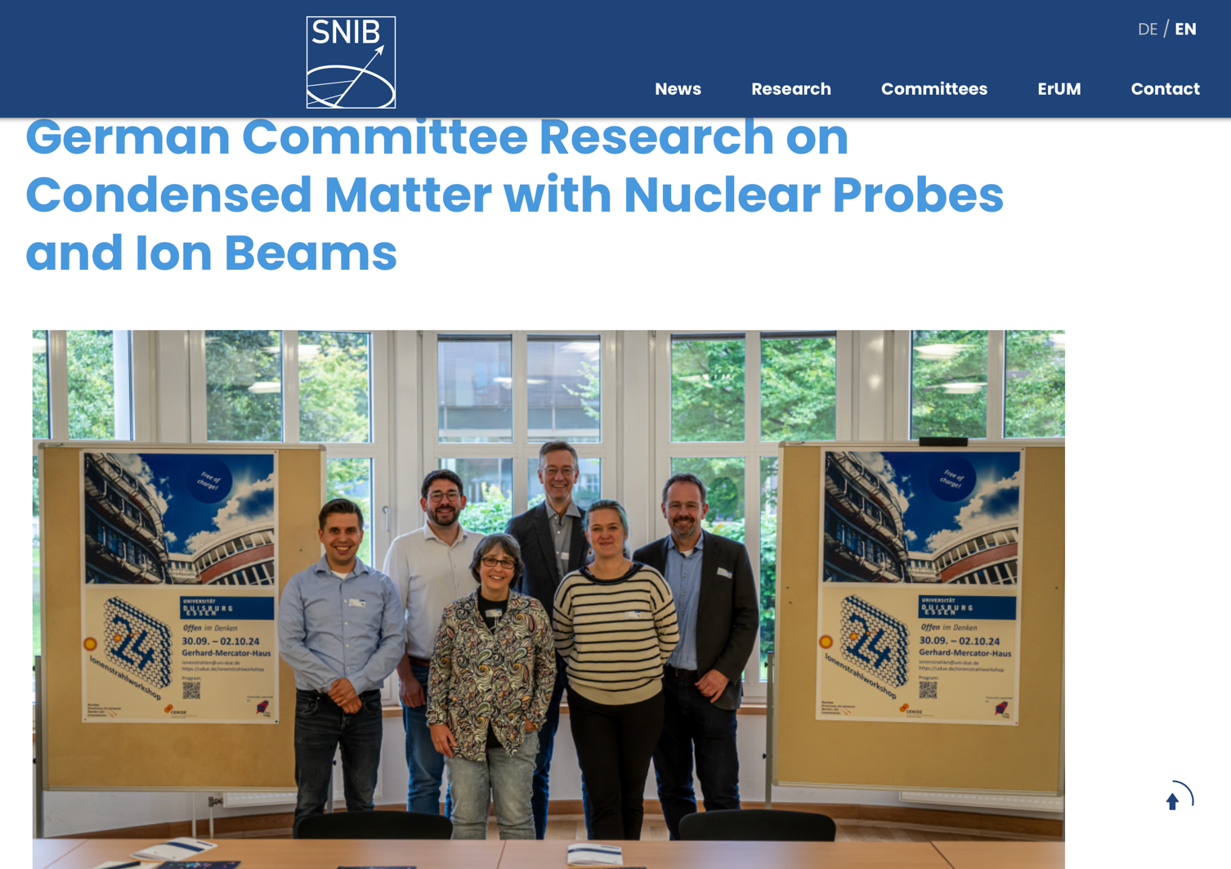
Possibilities to engage
Please, tell your new students and group members to sign in as member of the MAT-collaboration. This helps:
  keeping our statistics up to date
  reporting activities to Helmholtz, board commitees, and funding agencies
  communication
  visibility
https://www.gsi.de/en/work/research/appamml/materials_research/mat_collaboration/registration
Or just search for: GSI MAT collaboration registration
Also, you can sign in to the KFSI (German Committee Research on Condensed Matter with Nuclear Probes and Ion Beams):
  it promotes research with nuclear probes and ion beams
  represents researchers working with ion beams within the framework of the BMFTR’s "ErUM" funding program for condensed matter research
  communication and visibility
https://snib-portal.de/about-kfsi/index.php.de

Slide 5

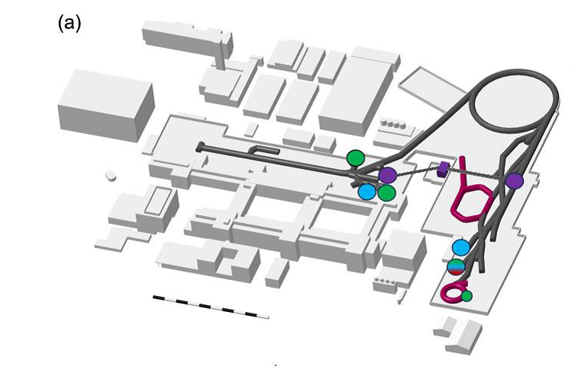
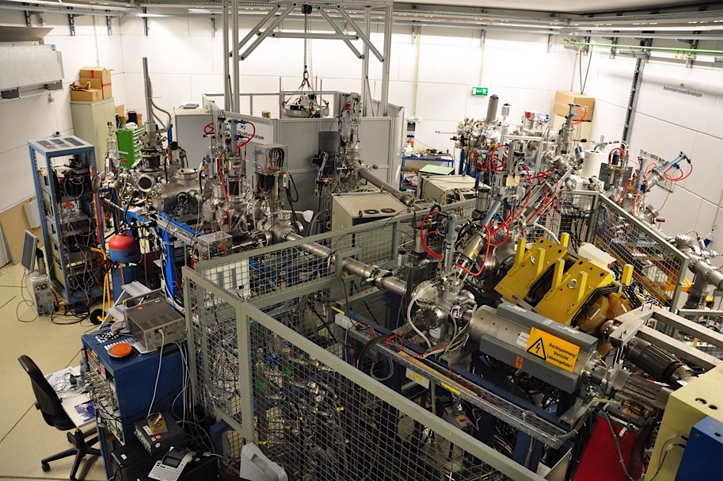
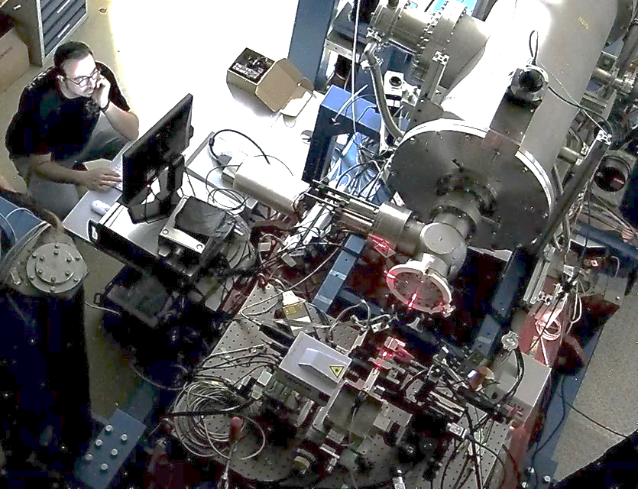
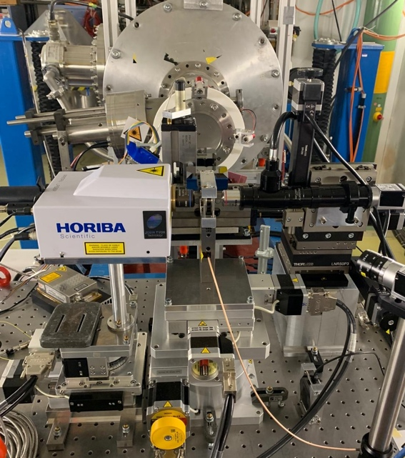

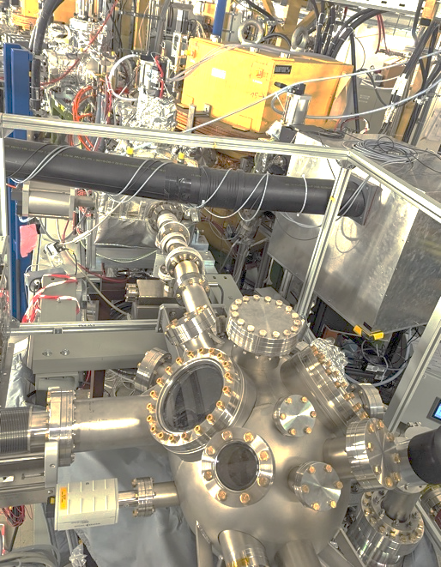
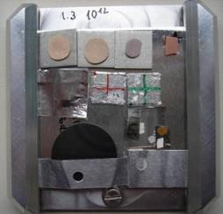
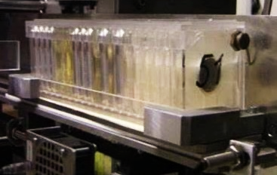



What unites us! GSI-MAT facilities
UNILAC (up to 11 MeV/u)
Highest ion energy loss
SIS-18 (up to 1 GeV/u)
Largest ion ranges mm-cm
M-branch
In–situ analysis
Cave A
High pressure platform
SIS-18
M3
M2
M1
UNILAC
X0 beamline
Sample exchange system
Heavy-ion microprobe
CRYRING MAT-station
Highest ion charge states
at various kinetic energies
GSI:
all ion species from protons to uranium
flexible ion beam parameters
mobile setups
some setups developed by uni groups (EruM-Pro program)
5 x 5 cm²

Slide 6
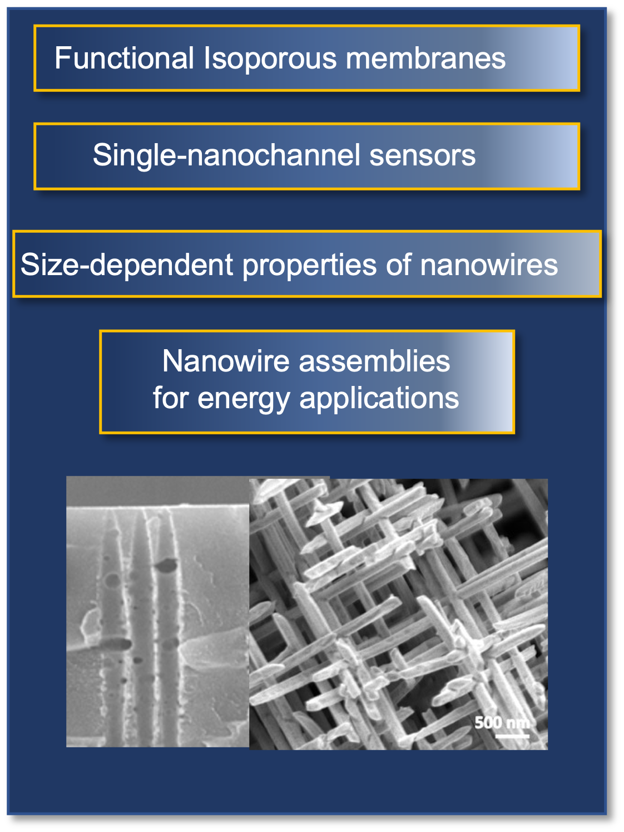
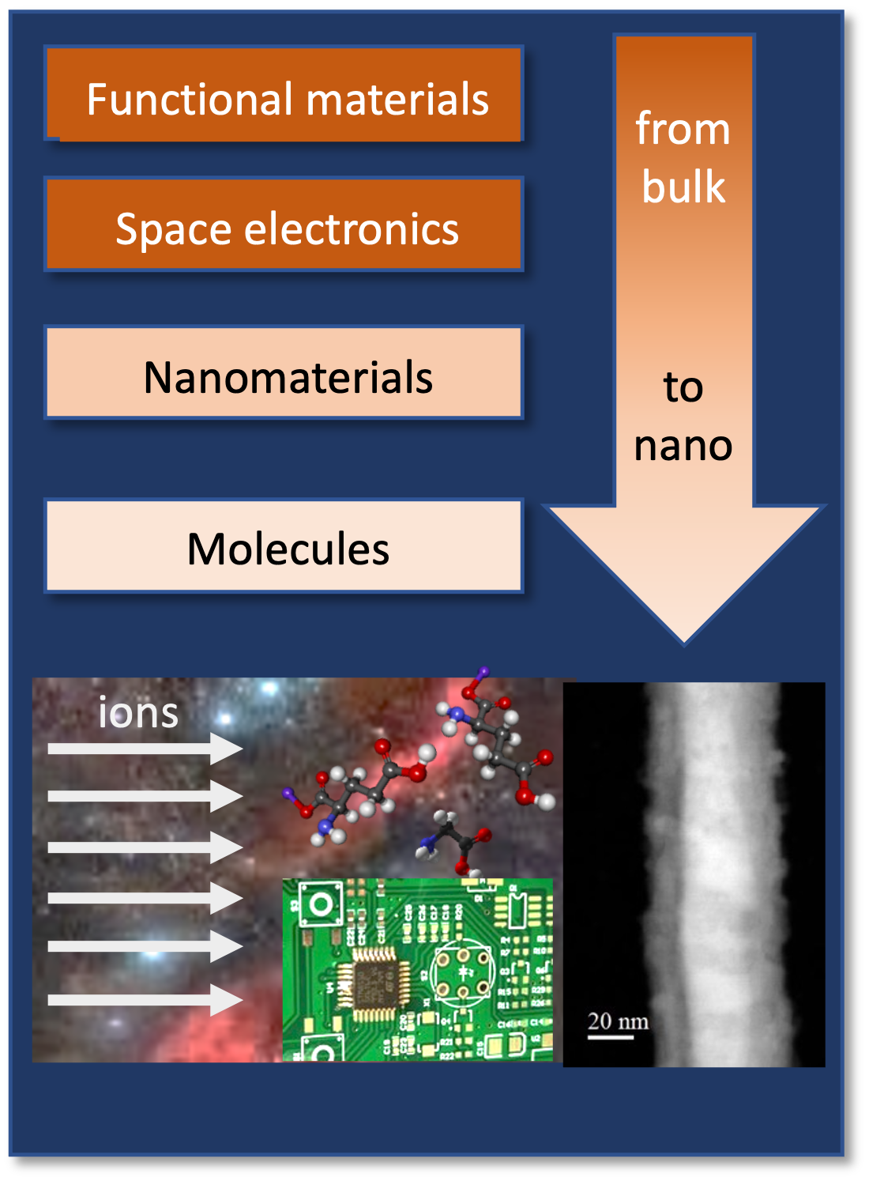

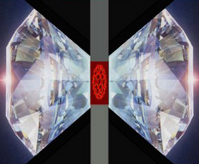
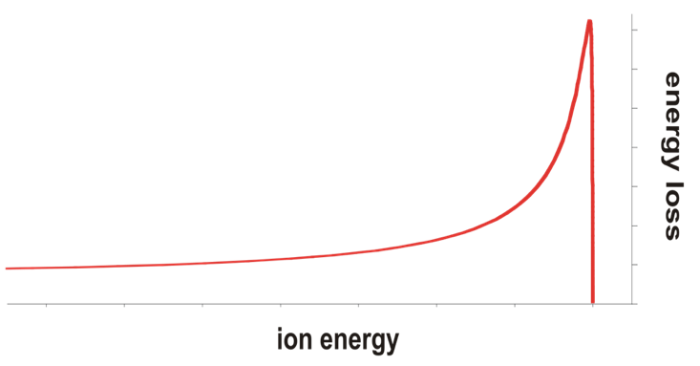
Materials Research with SHI Topics
Ion-track nanotechnology
Heavy ion-induced modifications
Materials under multiple extremes
Fabrication, characterization and application of novel nanostructures
From bulk to nanoscale
Simulation of cosmic radiation
Combining high pressure, radiation and temperature
High-pressure irradiation
morning
Radiation hardness of functional materials
afternoon
ion
beam
energy loss
50 GeV
200 MeV/u
ion penetration range
Today’s session
Thursday
Friday

Slide 7
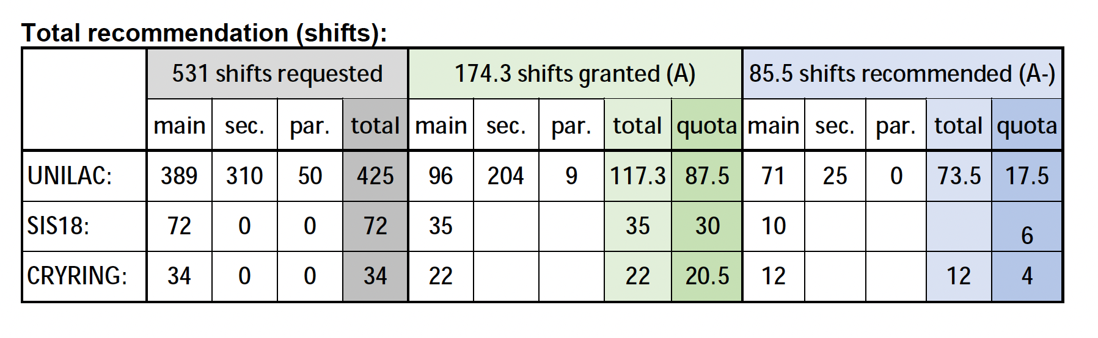
Your contribution (granted beamtime proposals for 2026/2027)
Large overbooking factors:
UNILAC: 4.8
SIS-18: 2.8
Mat-Station @ CRYRING: 1.6
Number of proposals: 39
A (granted): 33
A- (recommended): 2
B: 4
New applicants: 9

Slide 8
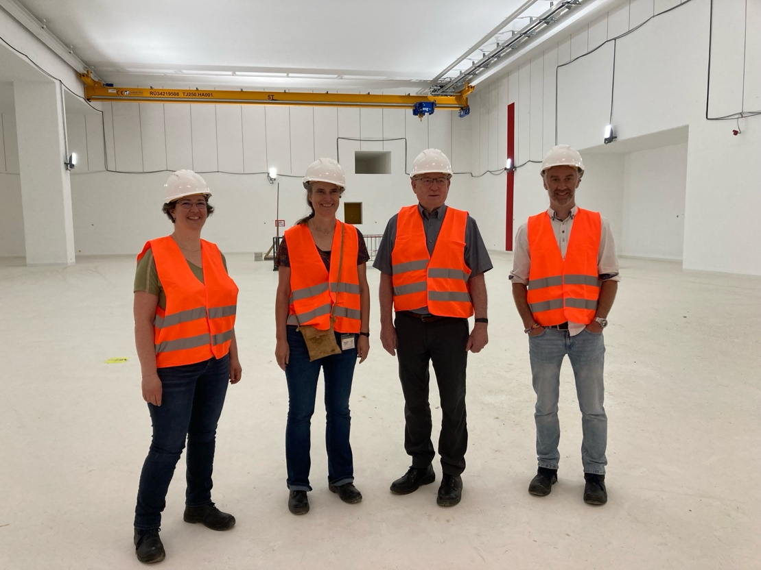
Your contribution (granted beamtime proposals for 2026/2027)
Special thank you to the members of the Program Advisory Committee for Materials Science at GSI
Aurélie Gentils
Univ. Paris-Saclay, France
Katharina Lorenz
Technical Univ. Lisbon, Portugal
Daniel Primetzhofer
Uppsala Univ., Sweden
Hermann Rothard
GANIL, France
William J. Weber (Chair)
University of Tennessee, USA
Large overbooking factors:
UNILAC: 4.8
SIS-18: 2.8
Mat-Station @ CRYRING: 1.6
Number of proposals: 39
A (granted): 33
A- (recommended): 2
B: 4
New applicants: 9

Slide 9
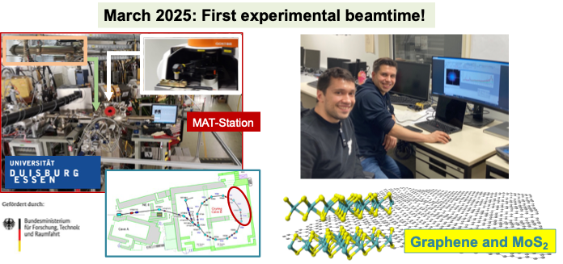
The future was bright! NEW in-situ Raman at CRYRING MAT-Station
Talk by L. Breuer
on Friday

Slide 10
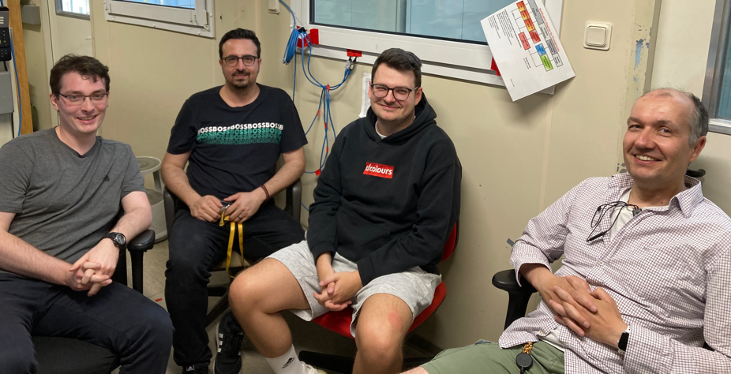
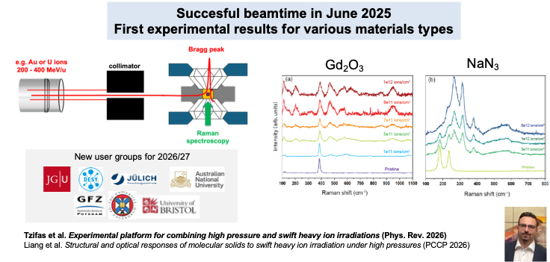
The future was bright! Upgraded High-Pressure Platform at Cave A
Talks by C. Schröck and B. Lkhamsuren
on Friday

Slide 11
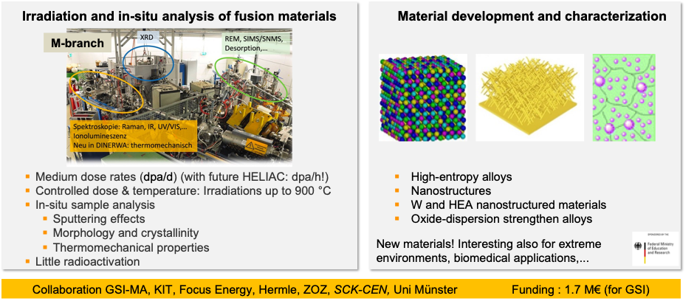
The future was bright! New substantial 3rd party funding for NEW SET UPS for
radiation hardness studies (2025-2028)
Talk by me on Friday
Funding: 2.5 M€ for GSI-MAT

Slide 12
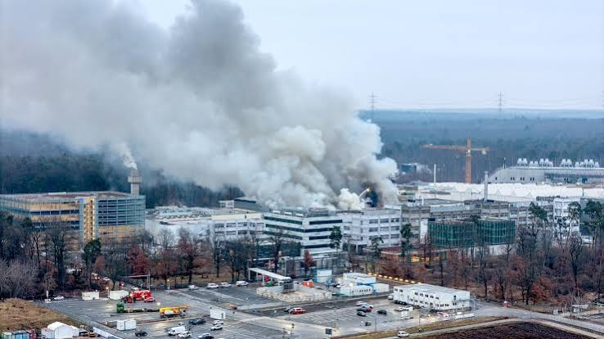
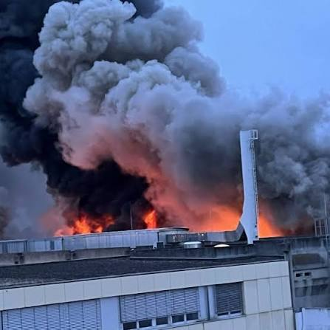
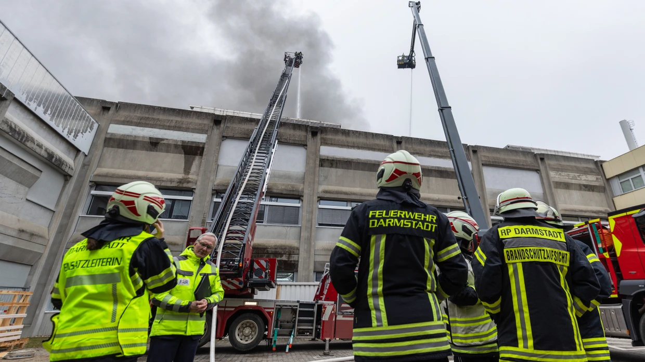
Then came February 5th, 2026
started with a shortcut within a control cabinet
all protocols were applied and worked
nobody was injured
the fire was contained in an area hosting the high-voltage power supply system for the UNILAC
the fire was put down after 20h
many areas (including X0 and M-branch) suffered from soot contamination and need to be cleaned by special companies

Slide 13
Then came February 5th, 2026
started with a shortcut within a control cabinet
all protocols were applied and worked
nobody was injured
the fire was contained in an area hosting the high-voltage power supply system for the UNILAC
the fire was put down after 20h
many areas (including X0 and M-branch) suffered from soot contamination and need to be cleaned by special companies
X0 has been cleaned already – M-branch has yet to be cleaned
special THANKS to Kay, Leon, Frieder, Arne, Pascal, and everyone who is helping ,for the HUGE effort in the last months and for what still needs to be done!! 👏 👏 👏 👏 👏 👏 👏 👏 👏 👏 👏
👏 👏 👏 👏 👏

Slide 14
Timeline (draft - being discussed now)
Preliminary
Commissioning and user beamtime / days
User beamtime / days
90
180
180
180
200
200
200
MAT-Cave A
2027
2028
2029
2030
2031
2032
2033
HITRAP I PARTIH p – min. C beams, low intensity
only @ SIS-18 caves
InterLAC p – min. Xe beams, medium intensity
protons - Xe, 1.4 MeV/u
UNILAC p – U beams, high intensity (only short pulse operation)
protons - U, 11 MeV/u
UNILAC + HELIAC full operation
UNILAC (10 Hz, 1 ms) HELIAC = cw-linac

Slide 15
Timeline (draft - being discussed now)
Preliminary
Commissioning and user beamtime / days
User beamtime / days
90
180
180
180
200
200
200
MAT-Cave A
MAT Experiments in M-branch, SIBAF, and Cave A
2027
2028
2029
2030
2031
2032
2033
HITRAP I PARTIH p – min. C beams, low intensity
only @ SIS-18 caves
InterLAC p – min. Xe beams, medium intensity
protons - Xe, 1.4 MeV/u
UNILAC p – U beams, high intensity (only short pulse operation)
protons - U, 11 MeV/u
UNILAC + HELIAC full operation
UNILAC (10 Hz, 1 ms) HELIAC = cw-linac

Slide 16
Timeline (draft - being discussed now)
Preliminary
Commissioning and user beamtime / days
User beamtime / days
90
180
180
180
200
200
200
MAT-Cave A
MAT Experiments in M-branch, SIBAF, and Cave A
MAT Experiments in all caves
2027
2028
2029
2030
2031
2032
2033
HITRAP I PARTIH p – min. C beams, low intensity
only @ SIS-18 caves
InterLAC p – min. Xe beams, medium intensity
protons - Xe, 1.4 MeV/u
UNILAC p – U beams, high intensity (only short pulse operation)
protons - U, 11 MeV/u
UNILAC + HELIAC full operation
UNILAC (10 Hz, 1 ms) HELIAC = cw-linac

Slide 17
Timeline (draft - being discussed now)
Preliminary
Commissioning and user beamtime / days
User beamtime / days
90
180
180
180
200
200
200
MAT-Cave A
MAT Experiments in M-branch, SIBAF, and Cave A
MAT Experiments in all caves
HELIAC serves MAT-facilities
2027
2028
2029
2030
2031
2032
2033
HITRAP I PARTIH p – min. C beams, low intensity
only @ SIS-18 caves
InterLAC p – min. Xe beams, medium intensity
protons - Xe, 1.4 MeV/u
UNILAC p – U beams, high intensity (only short pulse operation)
protons - U, 11 MeV/u
UNILAC + HELIAC full operation
UNILAC (10 Hz, 1 ms) HELIAC = cw-linac

Slide 18
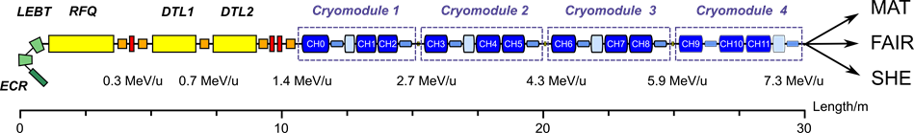
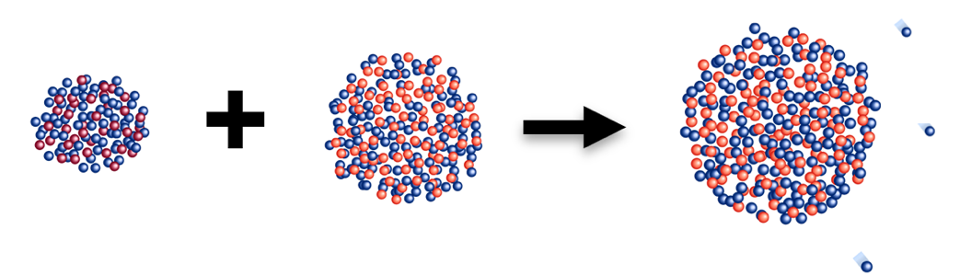
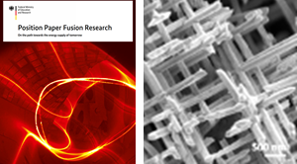
HELIAC - HElmholtz LInear ACcelarator
Variable output energy: 3.5 – 7.3 MeV/u
Beam current: ≤ 1 mA
Ion species with 1 ≤ A/q ≤ 6 in cw-mode
Ion species with 6 ≤ A/q ≤ 8.5 in pulse-mode
Planned to be installed in parallel tunnel to UNILAC
4 times more beam on target (compared to UNILAC) due to cw mode and up to 8 times due to new 18GHz-ECR Ion source
Electric power consumption is 1 MW (5 times lower compared to UNILAC)
HELIAC has been optimized for the needs of SHE & MAT programs and could be used as SIS18-injector for medium intensities
HELIAC – „discovery machine“
Maksym Miski-Oglu

Slide 19
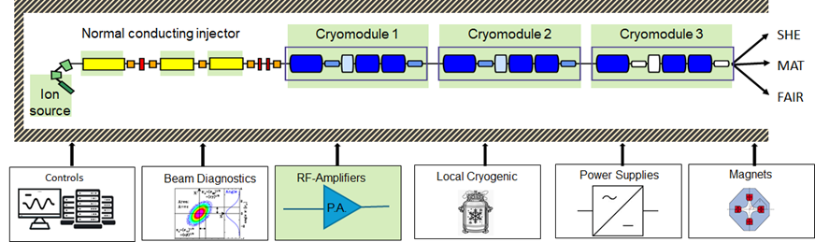
Status of Starting Version of HELIAC (CM1-CM3)
R&D successful, components available by <2030
components not yet secured
Major components for the start version of HELIAC are either in manufacturing or under development
Thanks to SIBAF, the key components of the normal-conducting HELIAC injector can be developed.
Controls, beam diagnostics, local cryogenic, power supplies and magnets are not yet funded
Maksym Miski-Oglu

Slide 20
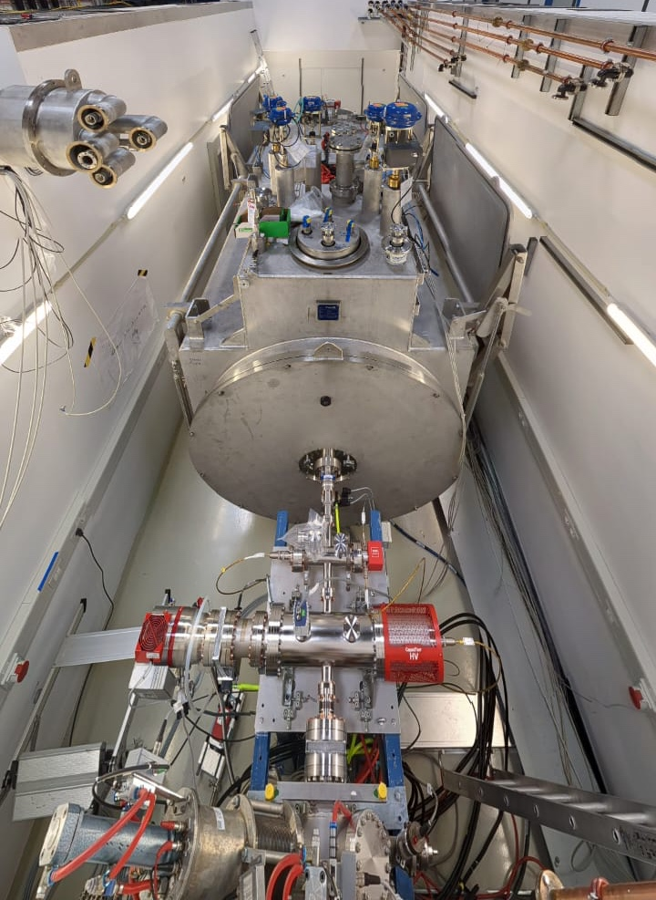

SIBAF: Supraleitende Ionenbeschleuniger als BAsistechnologie für die Fusionsforschung
(Superconducting Ion Accelerator as a BAsic Technology for Fusion Research)
WP 1. Development of the MAT Fusion Platform
WP 2. Higher Damage Rates
WP 3. Increased Penetration Depth
HELIAC Prototype (4 MeV/u)
The existing HELIAC prototype (CM1) will be upgraded to operate the dedicated irradiation chamber for fusion materials.
Extension of HELIAC Prototype
18GHz ECR ion source and beam transport system
High-power radio frequency quadrupole cavity (RFQ)
High-power RF-amplifiers for continuous-wave operation
Conceptual design of the superconducting energy booster cryomodule CM4
With CM1 and CM2-CM3 (under construction) ion beams with 10 MeV/u (i.e., ~100 µm pen. depth) will be delivered
Commissioning of the Fusion Irradiation Chamber
Irradiation and analysis
Cooling / heating of samples
Sample exchange system
Special holders for material analysis
Integrating in-situ methods
Fusion Materials: Irradiation and Analysis
Sample irradiation with max. damage rates: ~0.5–2 dpa/hour
Program for sequential irradiations (first He implantation, then irradiation with heavy ions, e.g., C, Ar, Xe, Fe, W)
Irradiation of materials under controlled atmospheres
Development of an energy modulator for homogeneous depth dose distribution
CM1 @ Test bunker
Installation site for the irradiation chamber
Use of the new fusion platform by researchers (in Germany and beyond) and companies developing materials and technologies for fusion reactors
Integration of the platform into existing consortia

Slide 21

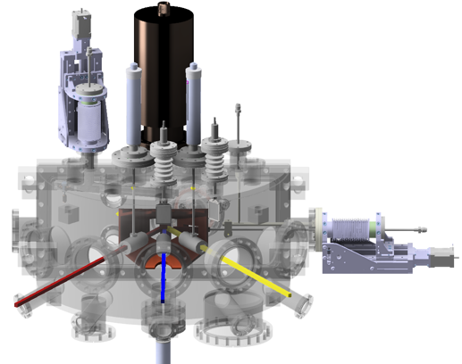
GSI-MAT facilities
2028 SIBAF
(2.7 MeV/u)
Up t Xe
UNILAC (up to 11 MeV/u)
Highest ion energy loss
SIS-18 (up to 1 GeV/u)
Largest ion ranges mm-cm
M-branch
In–situ analysis
Cave A
High pressure platform
SIS-18
M3
M2
M1
UNILAC
X0 beamline
Sample exchange system
Heavy-ion microprobe
CRYRING MAT-station
Highest ion charge states
at various kinetic energies
5 x 5 cm²

Slide 22
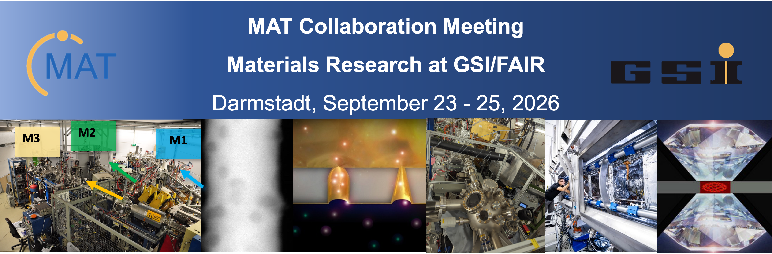
  Goal?

Slide 23
Lively discussions and exchange on:
  scientific results obtained by users at the GSI-MAT facilities
  additional exciting contributions from collaborator’s facilities
  presentation of new- and upcoming setup developments
  please share your facility-ideas, -wishes and -needs for the future with us! During your presentations and/or in the session discussions

Slide 24
Lively discussions and exchange on:
  scientific results obtained by users at the GSI-MAT facilities
  additional exciting contributions from collaborator’s facilities
  presentation of new- and upcoming setup developments
  please share your facility-ideas, -wishes and -needs for the future with us! During your presentations and/or in the session discussions

Slide 25
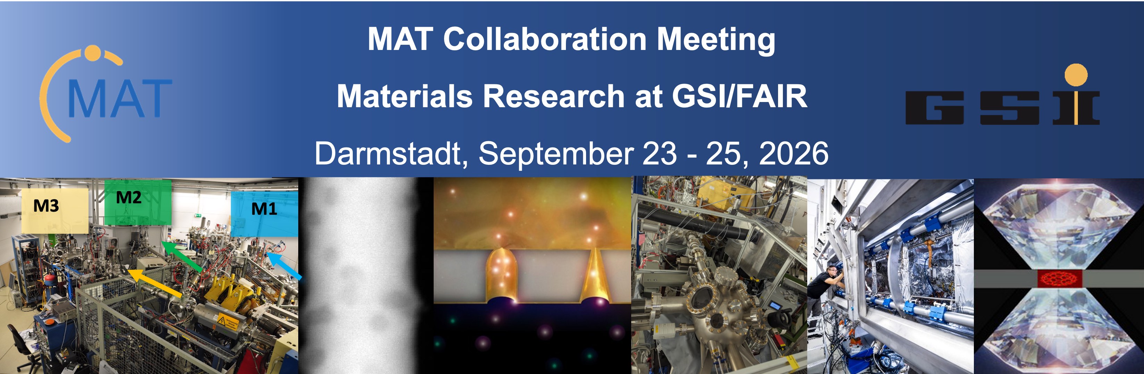
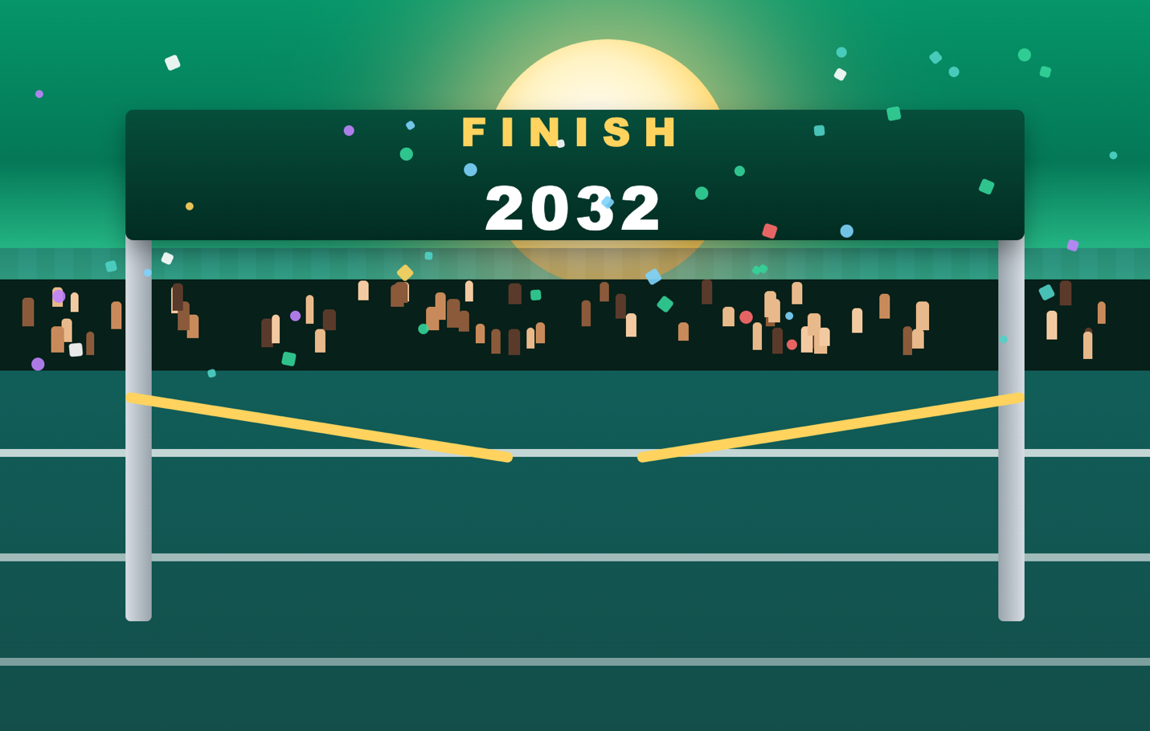
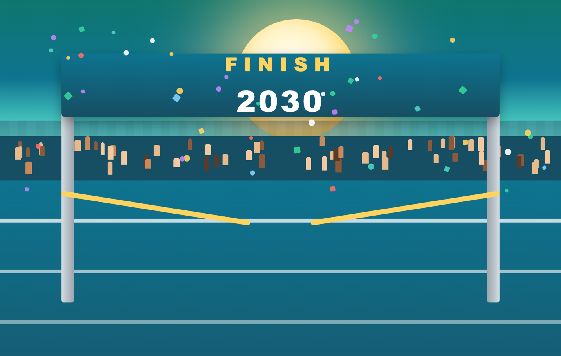

Lively discussions and exchange on:
  scientific results obtained by users at the GSI-MAT facilities
  additional exciting contributions from collaborator’s facilities
  presentation of new- and upcoming setup developments
  please share your facility-ideas, -wishes and -needs for the future with us! During your presentations or in the session discussions
The future will be even brighter!
Which facilities and set up developments do we envision for each finish-line?

Slide 26
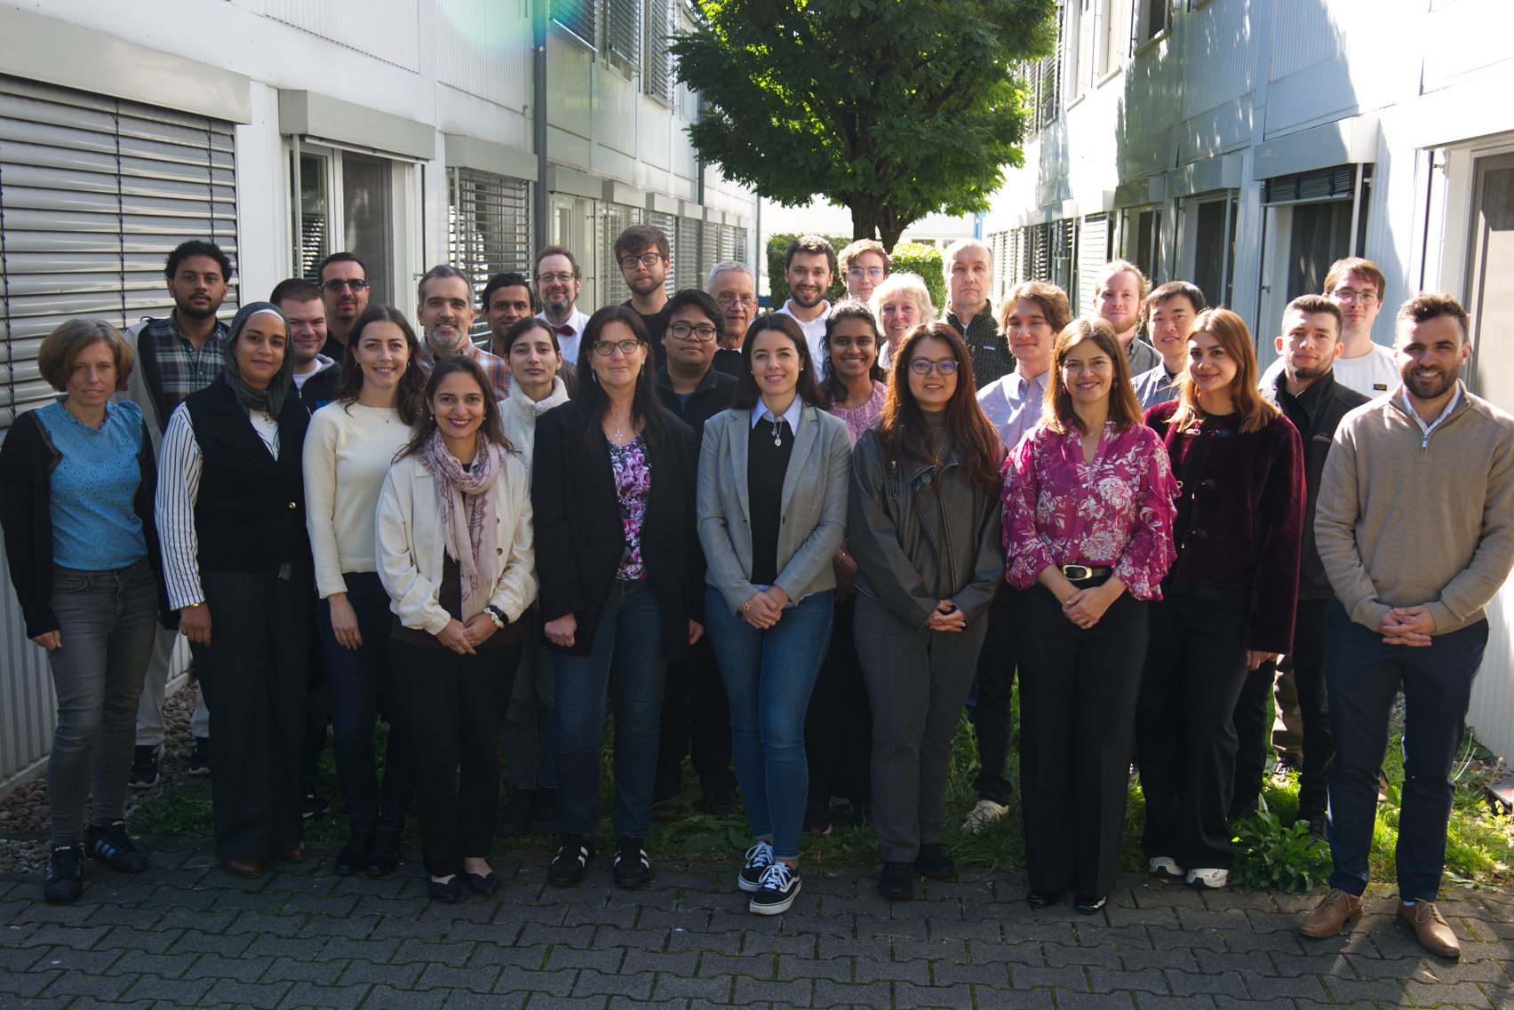
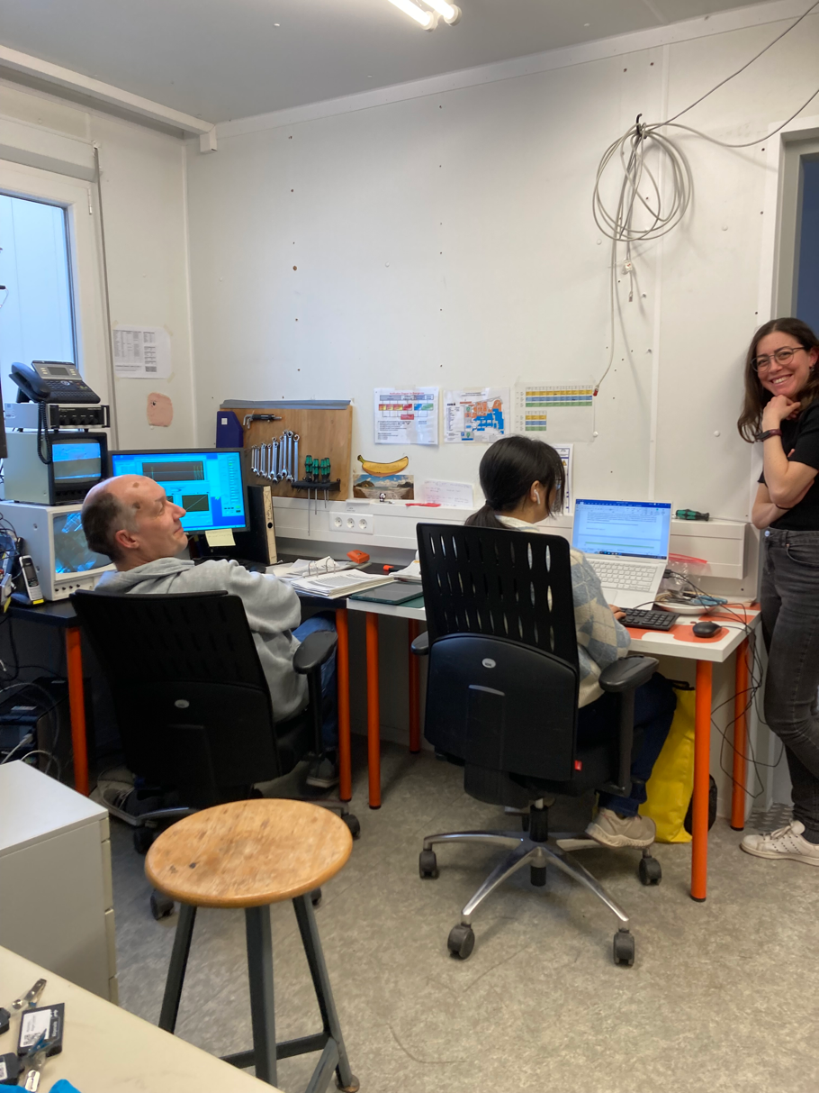
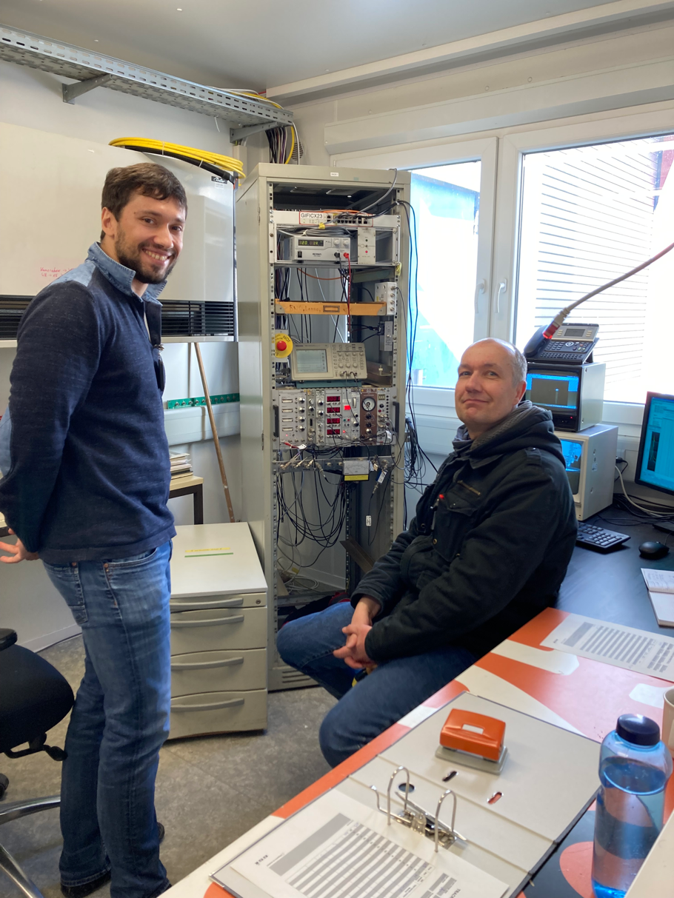
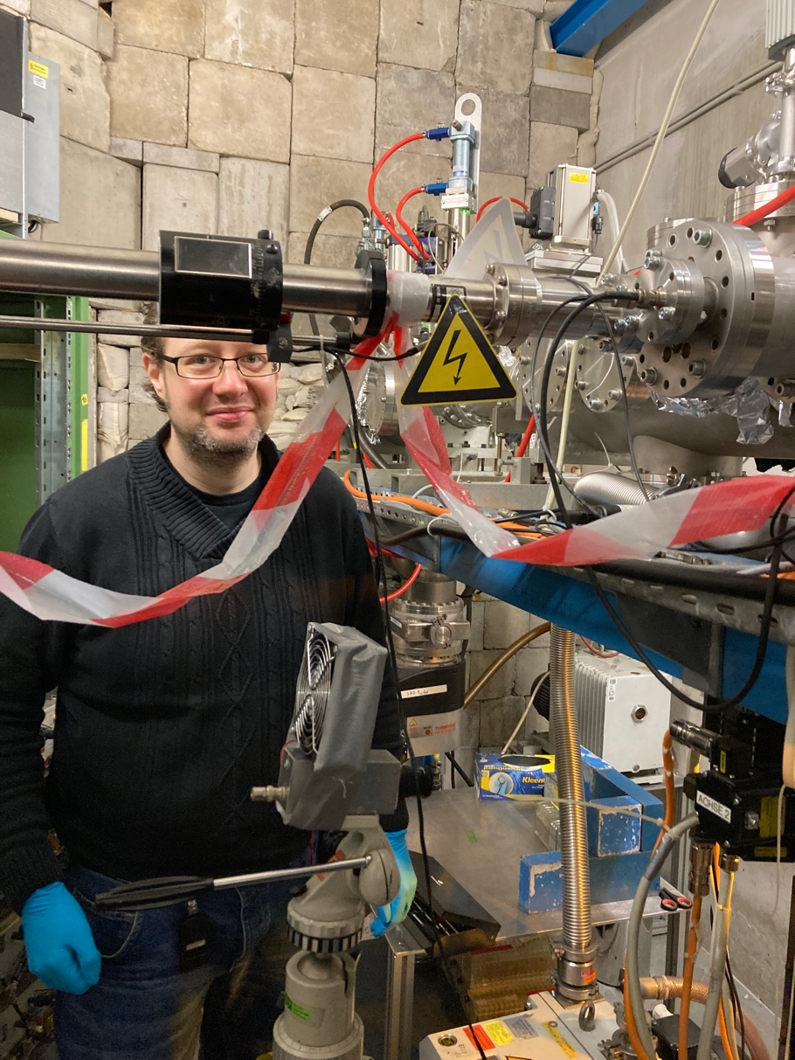
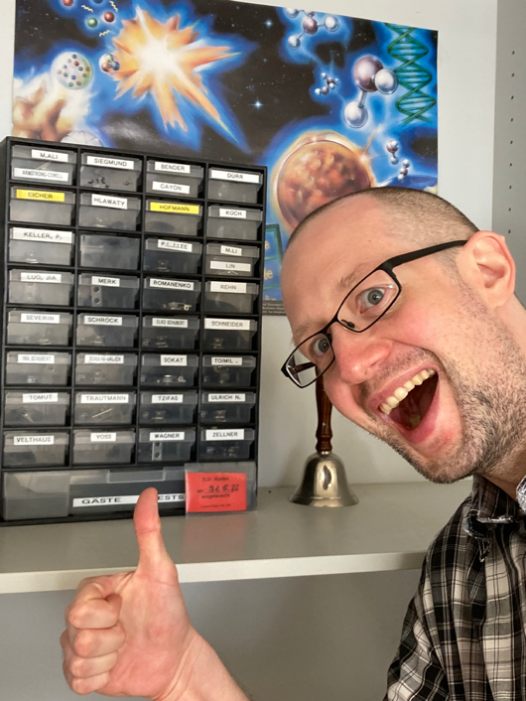
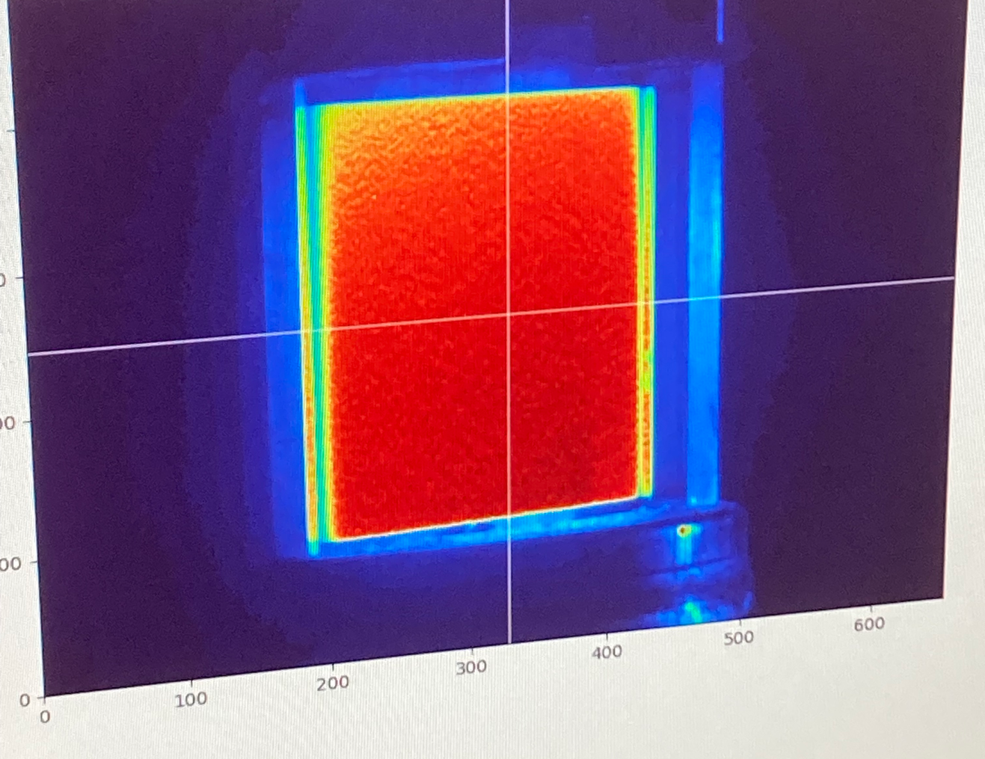
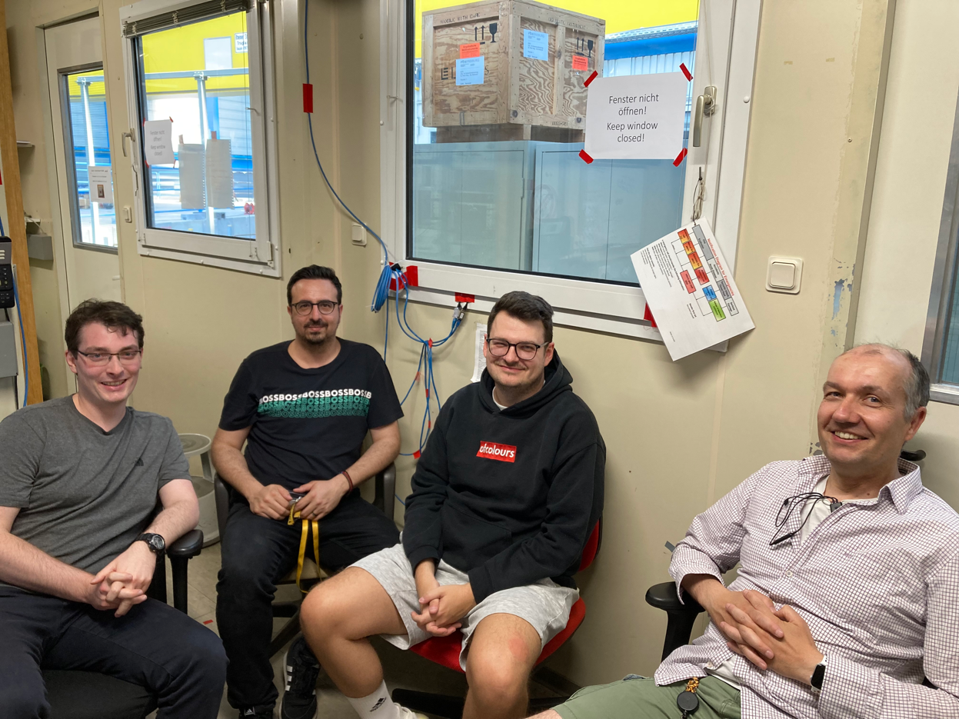
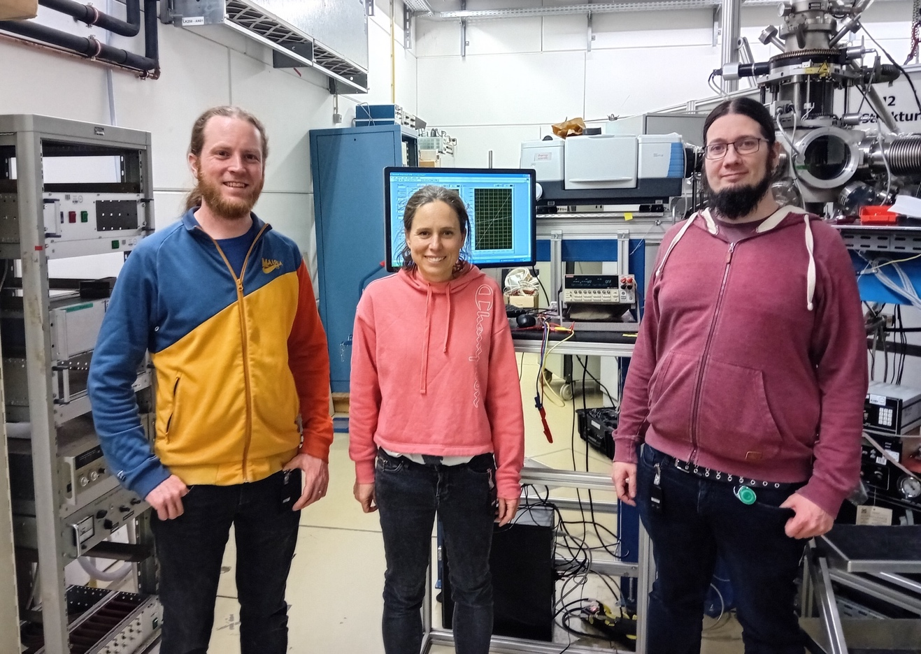
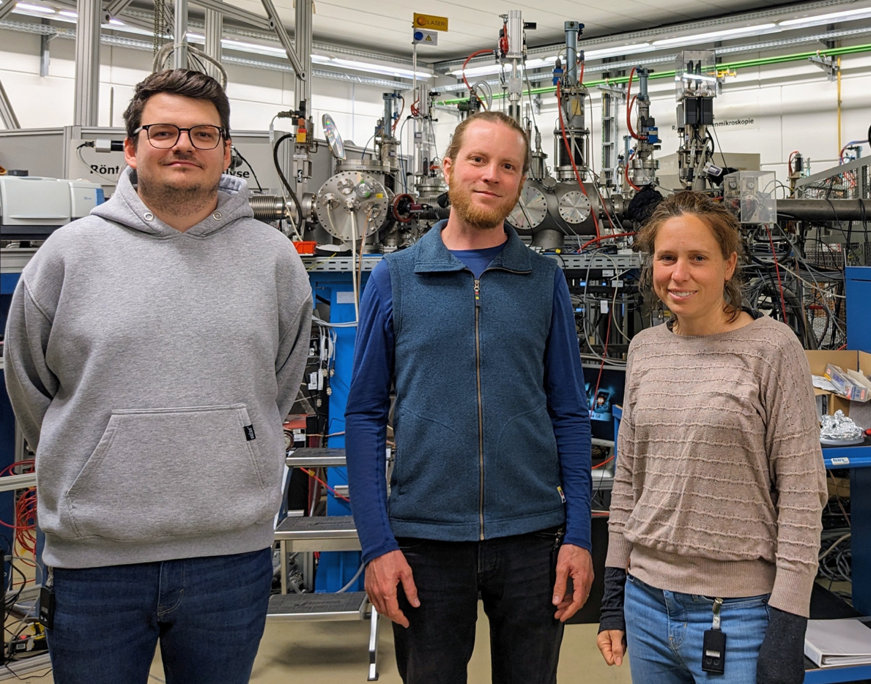
Thank you for your attention!
Questions?

Slide 27

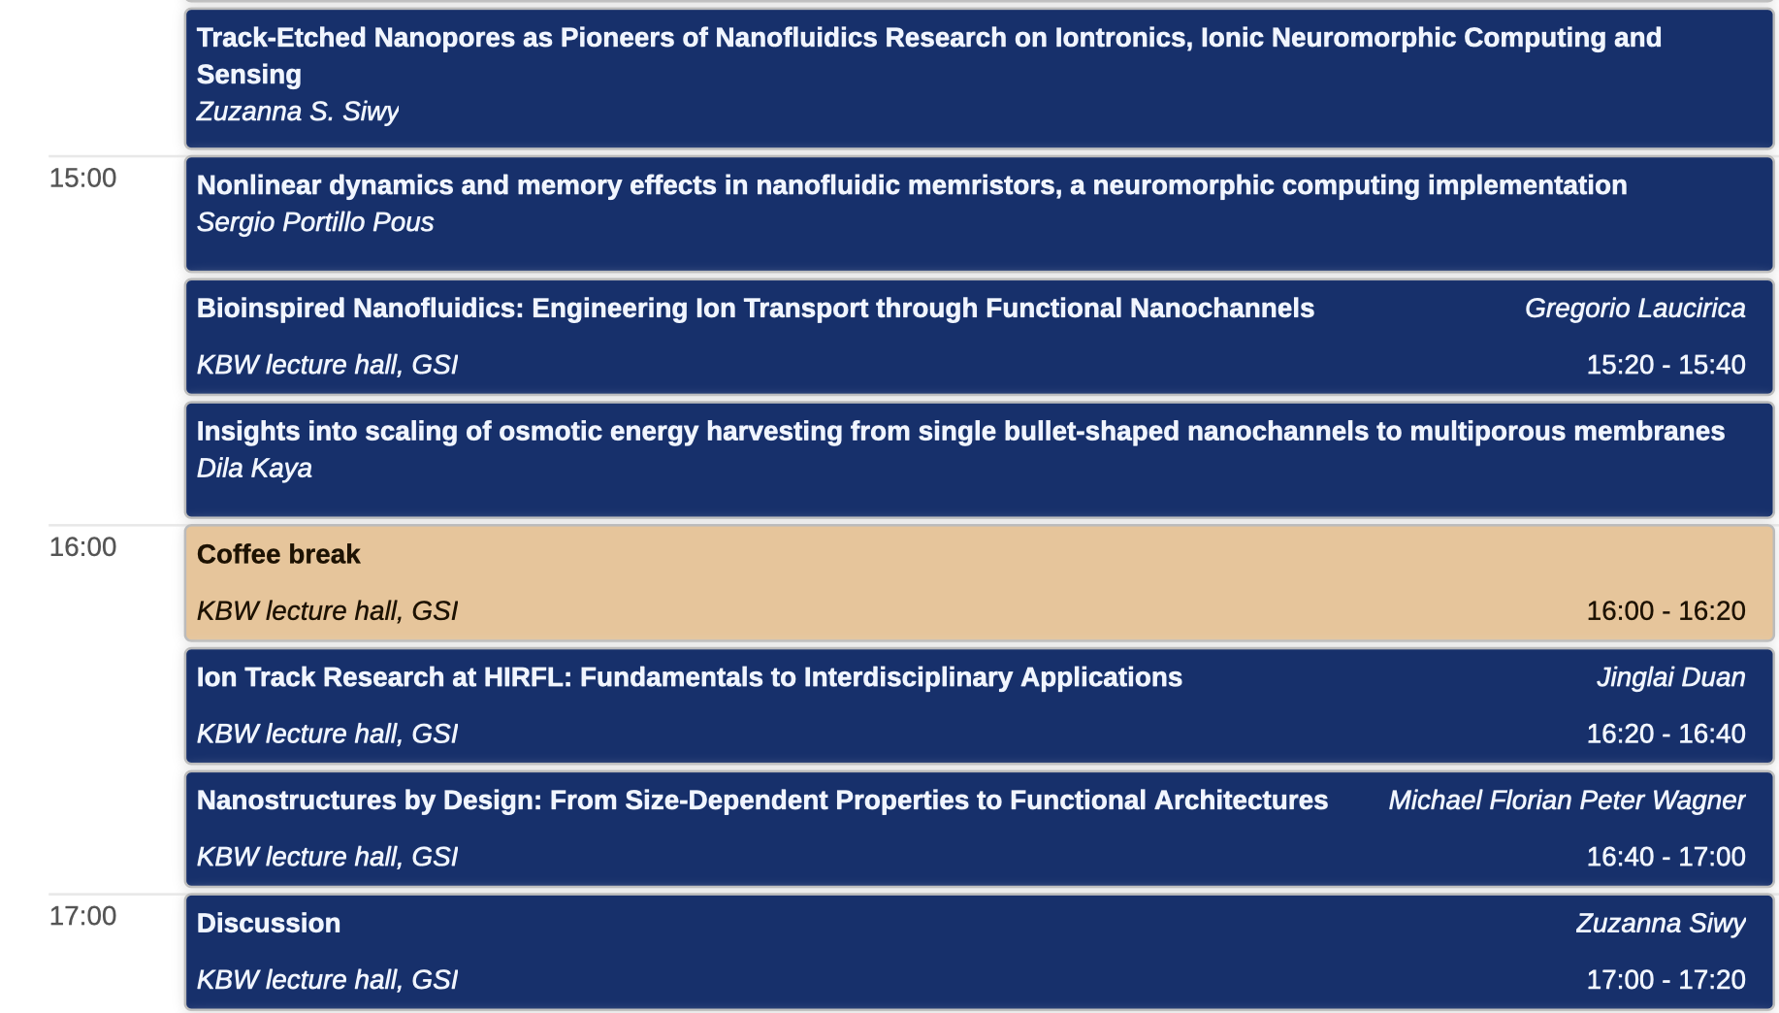
Ion-track nanotechnology
Fabrication, characterization and application of novel nanostructures
Today’s session

Slide 28
Ion-track nanotechnology
Heavy ion-induced modifications
Materials under multiple extremes
Fabrication, characterization and application of novel nanostructures
From bulk to nanoscale
Simulation of cosmic radiation
Combining high pressure, radiation and temperature
High-pressure irradiation
morning
Radiation hardness of functional materials
afternoon
ion
beam
energy loss
50 GeV
200 MeV/u
ion penetration range
Today’s session
Thursday
Friday

Slide 29
Transfer to Tour and Dinner
Deutschland ticket → no need for an extra ticket
No Deutschland ticket → Kay has group tickets for participants
Follow the locals! Bus leaves at 17:38 from bus stop BUT we need to exit through the old gate (leave your guest passes as you leave if you have one) and walk back to the bus stop (please, count with 15 min time for this)
Meeting point for tour (18:30) and for dinner (19:30) are:
  Tour: 18:30 Infopoint Mathildenhoehe at Olbrichweg 10
  (very close to the Hochzeitsturm/Wedding tower)
  Dinner: 19:30 Restaurant Shiraz, Dieburger Str. 73, 64287 Darmstadt-Ost

Slide 30

Tomorrow

Slide 31
Thank you for being here
Germany | Turkey
Japan | Japan
Germany | ?
Germany | Germany
Germany | India
Germany | greece
Germany | Germany
Germany | Argentina
Spain | Spain
Netherlands | Italy
China | China
Germany | Germany
Germany | Egypt
Netherlands
Germany | Germany
Swisserland | Germany
Germany | Germany
Germany | Brasil
Argentina | Argentina
Germany | Germany
Rumania | Rumania
Germany | Germany
Germany | China
Germany | India
Germany | Turkey
Germany | Germany
Germany | Germany
Germany | India
Germany | India
USA | Germany
Germany | Argentina
Rumania | Rumania
Germany | China
China | China
France | France
Germany | Italy
Poland | Poland
Brasil | Brasil
Australia | Australia
Spain | Spain
Germany | Russia
germany
Spain | Spain
Germany | Germany
France | Germany
Netherlands | Italy
Germany | Germany
Germany | Germany
Germany | Germany
Germany | Germany
USA | Poland
Germany | India
Rumania | Rumania
Germany | Germany
Germany | Spain
Germany | Rumania
Germany | Germany
Germany | Spain
Germany | Greece
Rumania | Rumania
Germany | Germany
Germany | Germany
China | China
Germany | Germany

